Slide 1

CIS 700: “algorithms for Big Data”
Lecture 8:
Gradient Descent
Slides at http://grigory.us/big-data-class.html
Grigory Yaroslavtsev
http://grigory.us

Slide 2
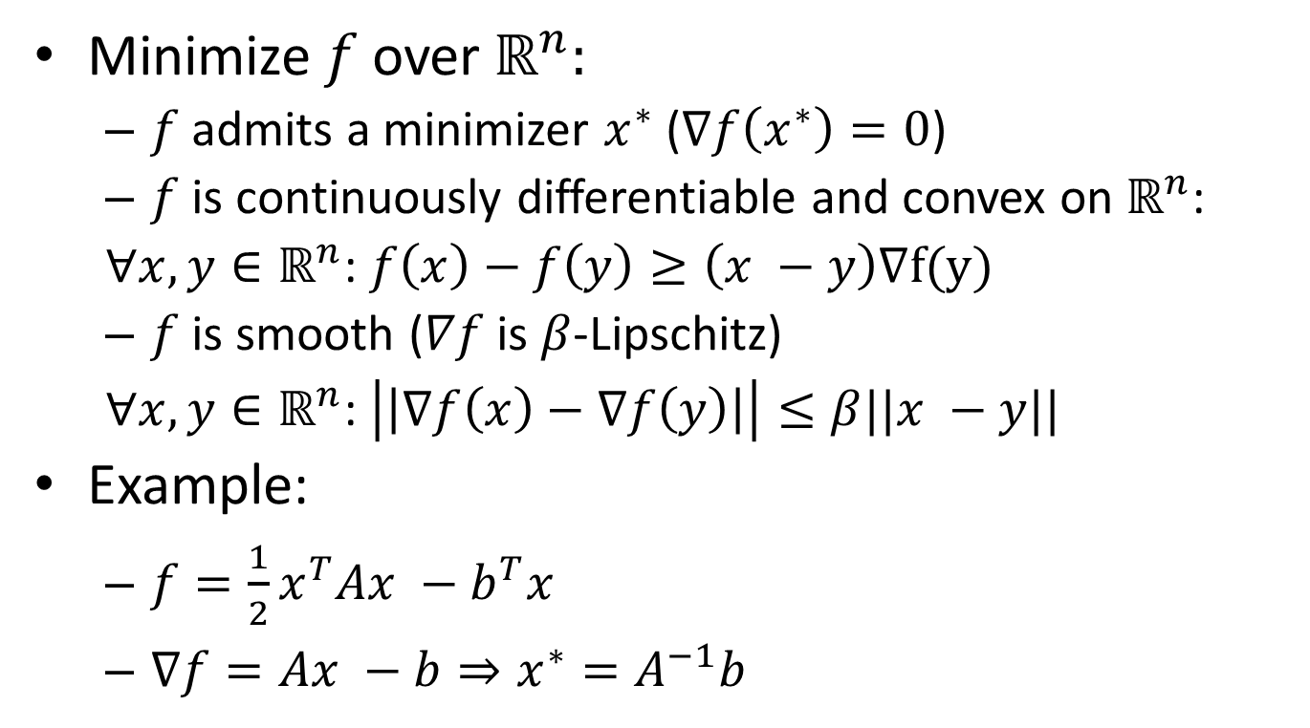
Smooth Convex Optimization
Minimize $f$ over $ℝ^{n}:$
$f$ admits a minimizer $x^{∗}$ ($∇f\left(x^{∗}\right)=0$)
$f$ is continuously differentiable and convex on $ℝ^{n}$:
$∀x,y∈ℝ^{n}$: $f\left(x\right)−f\left(y\right)≥\left(x −y\right)∇f(y)$
$f$ is smooth ($∇f$ is $β$-Lipschitz)
$∀x,y∈ℝ^{n}$: $\left|\left|∇f\left(x\right)−∇f\left(y\right)\right|\right|≤β||x −y||$
Example:
$f={\frac{1}{2}x}^{T}Ax −b^{T}x$
$∇f=Ax −b⇒x^{∗}=A^{−1}b$

Slide 3
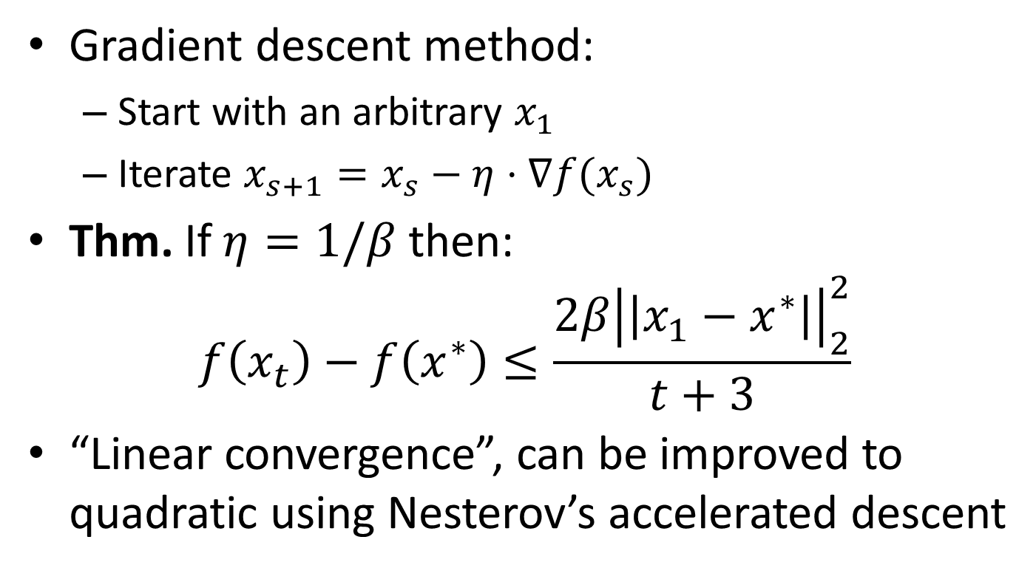
Gradient Descent Method
Gradient descent method:
Start with an arbitrary $x_{1}$
Iterate $x_{s+1}=x_{s}−η⋅∇f(x_{s})$
Thm. If $η=1/β$ then:
$$f\left(x_{t}\right)−f\left(x^{∗}\right)≤\frac{2β{\left|\left|x_{1}−x^{∗}\right|\right|}_{2}^{2}}{t+3}$$
“Linear convergence”, can be improved to quadratic using Nesterov’s accelerated descent

Slide 4
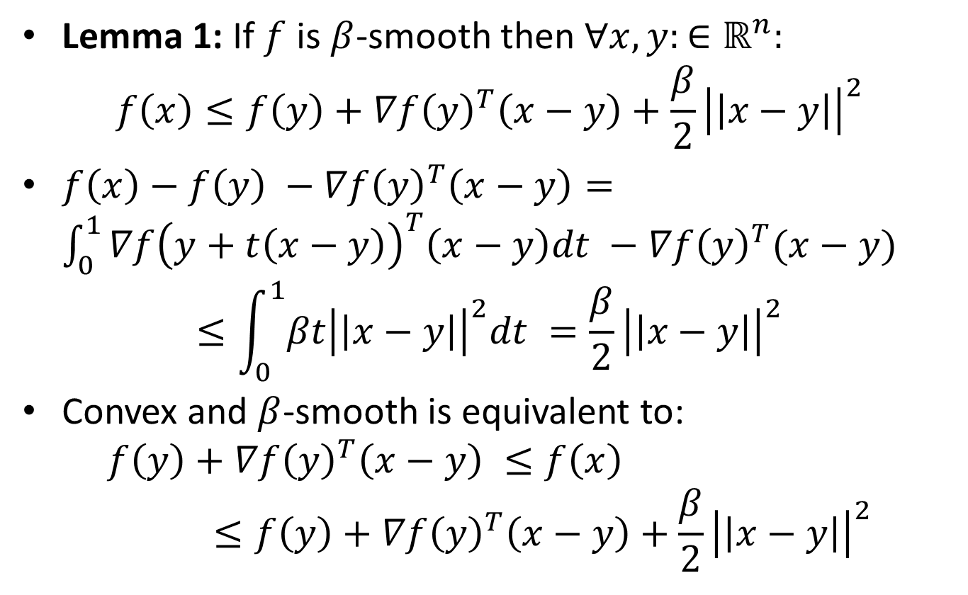
Gradient Descent: Analysis
Lemma 1: If $f$ is $β$-smooth then $∀x,y:∈ℝ^{n}:$
$$f\left(x\right)≤f\left(y\right)+∇f{\left(y\right)}^{T}\left(x−y\right)+\frac{β}{2}{\left|\left|x−y\right|\right|}^{2}$$
$f\left(x\right)−f\left(y\right) −∇f{\left(y\right)}^{T}\left(x−y\right)=\int_{0}^{1}{∇f{\left(y+t\left(x−y\right)\right)}^{T}\left(x−y\right)dt} −∇f{\left(y\right)}^{T}(x−y)$
$$≤\int_{0}^{1}{βt{\left|\left|x−y\right|\right|}^{2}dt }=\frac{β}{2}{\left|\left|x−y\right|\right|}^{2}$$
Convex and $β$-smooth is equivalent to:
$$f\left(y\right)+∇f{\left(y\right)}^{T}\left(x−y\right) ≤f\left(x\right)≤f\left(y\right)+∇f{\left(y\right)}^{T}\left(x−y\right)+\frac{β}{2}{\left|\left|x−y\right|\right|}^{2}$$

Slide 5
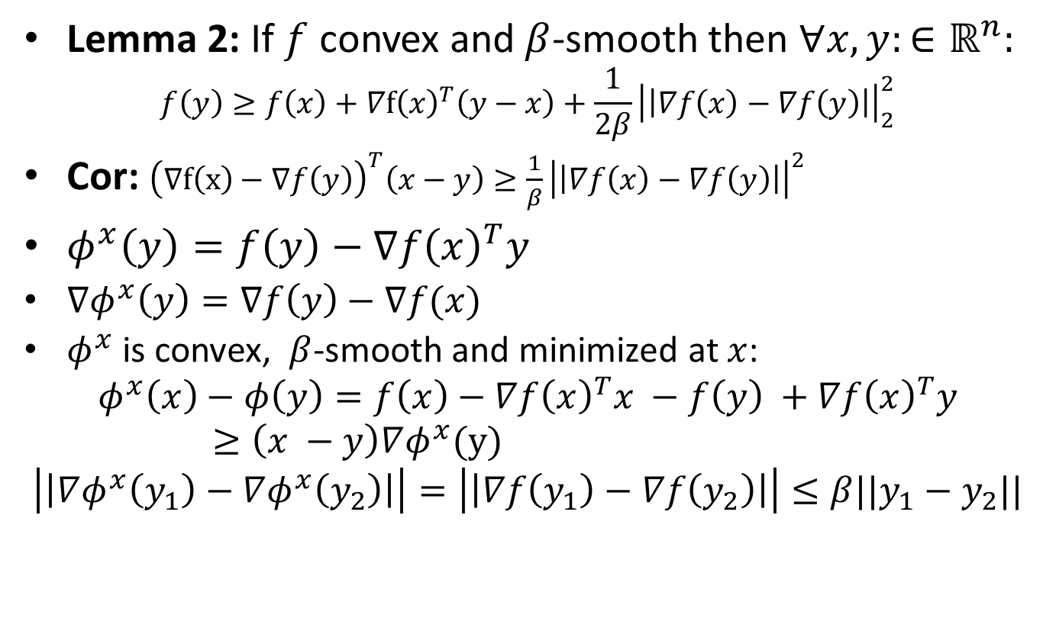
Gradient Descent: Analysis
Lemma 2: If $f$ convex and $β$-smooth then $∀x,y:∈ℝ^{n}:$
$$f\left(y\right)≥f\left(x\right)+∇f{\left(x\right)}^{T}\left(y−x\right)+\frac{1}{2β}{\left|\left|∇f\left(x\right)−∇f\left(y\right)\right|\right|}_{2}^{2}$$
Cor: ${\left(∇f\left(x\right)−∇f\left(y\right)\right)}^{T}\left(x−y\right)≥\frac{1}{β}{\left|\left|∇f\left(x\right)−∇f\left(y\right)\right|\right|}^{2}$
$φ^{x}\left(y\right)=f\left(y\right)−∇f{\left(x\right)}^{T}y$
$∇φ^{x}\left(y\right)=∇f\left(y\right)−∇f(x)$
$φ^{x}$ is convex, $β$-smooth and minimized at $x$:
$$φ^{x}\left(x\right)−φ\left(y\right)=f\left(x\right)−∇f{\left(x\right)}^{T}x −f\left(y\right) +∇f{\left(x\right)}^{T}y≥\left(x −y\right)∇φ^{x}(y)$$
$$\left|\left|∇φ^{x}\left(y_{1}\right)−∇φ^{x}\left(y_{2}\right)\right|\right|=\left|\left|∇f\left(y_{1}\right)−∇f\left(y_{2}\right)\right|\right|≤β||y_{1}−y_{2}||$$

Slide 6
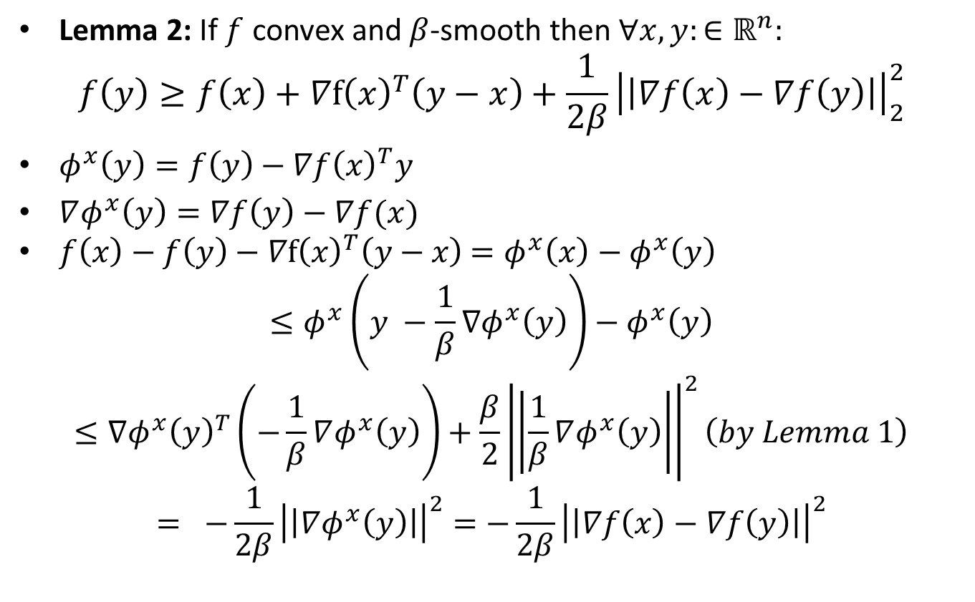
Gradient Descent: Analysis
Lemma 2: If $f$ convex and $β$-smooth then $∀x,y:∈ℝ^{n}:$
$$f\left(y\right)≥f\left(x\right)+∇f{\left(x\right)}^{T}\left(y−x\right)+\frac{1}{2β}{\left|\left|∇f\left(x\right)−∇f\left(y\right)\right|\right|}_{2}^{2}$$
$φ^{x}\left(y\right)=f\left(y\right)−∇f{\left(x\right)}^{T}y$
$∇φ^{x}\left(y\right)=∇f\left(y\right)−∇f(x)$
$f\left(x\right)−f\left(y\right)−∇f{\left(x\right)}^{T}\left(y−x\right)$ $=φ^{x}\left(x\right)−φ^{x}\left(y\right)$
$$≤φ^{x}\left(y −\frac{1}{β}∇φ^{x}\left(y\right)\right)−φ^{x}\left(y\right)$$
$$≤∇φ^{x}{\left(y\right)}^{T}\left(−\frac{1}{β}∇φ^{x}\left(y\right)\right)+\frac{β}{2}{\left|\left|\frac{1}{β}∇φ^{x}\left(y\right)\right|\right|}^{2}\left(by Lemma 1\right)$$
$$= −\frac{1}{2β}{\left|\left|∇φ^{x}\left(y\right)\right|\right|}^{2}=−\frac{1}{2β}{\left|\left|∇f\left(x\right)−∇f\left(y\right)\right|\right|}_{}^{2}$$

Slide 7
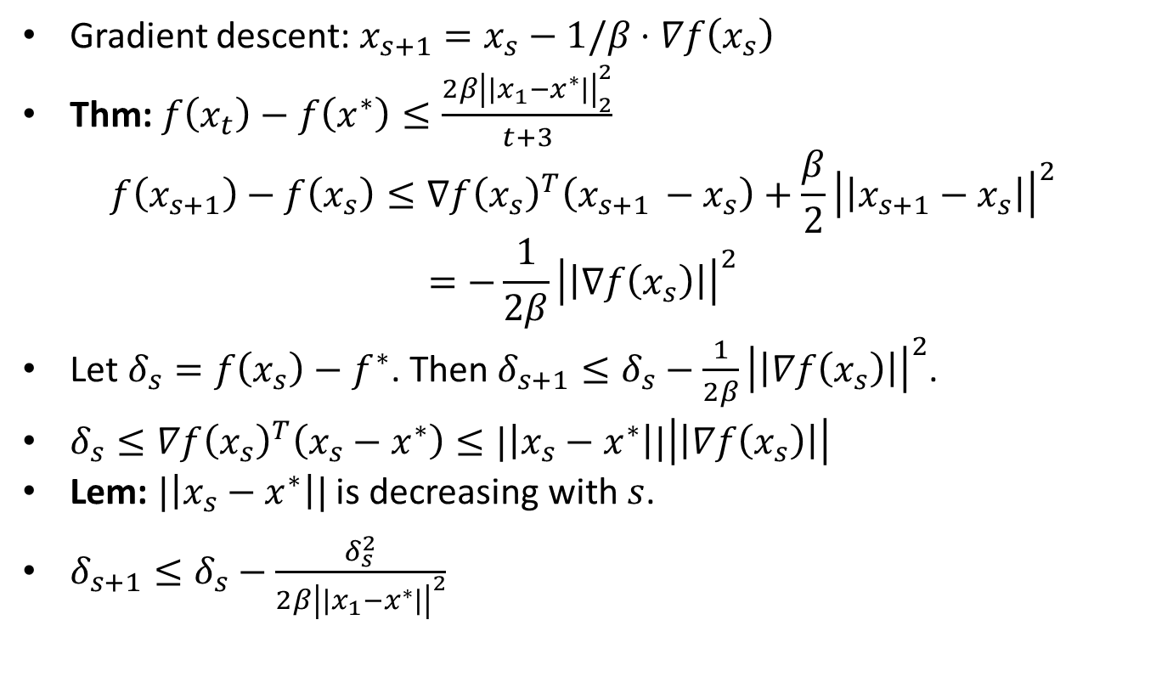
Gradient Descent: Analysis
Gradient descent: $x_{s+1}=x_{s}−1/β⋅∇f\left(x_{s}\right)$
Thm: $f\left(x_{t}\right)−f\left(x^{∗}\right)≤\frac{2β{\left|\left|x_{1}−x^{∗}\right|\right|}_{2}^{2}}{t+3}$
$$f\left(x_{s+1}\right)−f\left(x_{s}\right)≤∇f{\left(x_{s}\right)}^{T}\left(x_{s+1 }−x_{s}\right)+\frac{β}{2}{\left|\left|x_{s+1}−x_{s}\right|\right|}^{2}$$
$$=−\frac{1}{2β}{\left|\left|∇f\left(x_{s}\right)\right|\right|}^{2}$$
Let $δ_{s}=f\left(x_{s}\right)−f^{∗}$. Then $δ_{s+1}≤δ_{s}−\frac{1}{2β}{\left|\left|∇f\left(x_{s}\right)\right|\right|}^{2}$.
$δ_{s}≤∇f{\left(x_{s}\right)}^{T}\left(x_{s}−x^{∗}\right)≤|\left|x_{s}−x^{∗}\right||\left|\left|∇f\left(x_{s}\right)\right|\right|$
Lem: $|\left|x_{s}−x^{∗}\right||$ is decreasing with $s$.
$δ_{s+1}≤δ_{s}−\frac{δ_{s}^{2}}{2β{\left|\left|x_{1}−x^{∗}\right|\right|}^{2}}$

Slide 8
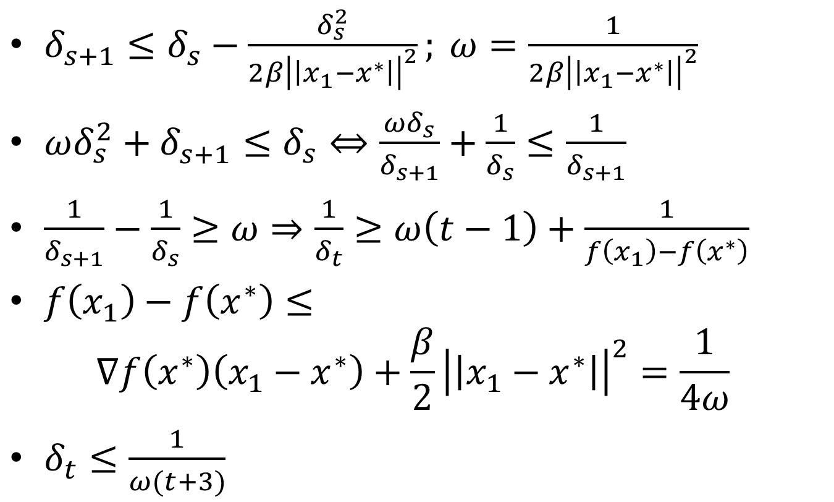
Gradient Descent: Analysis
$δ_{s+1}≤δ_{s}−\frac{δ_{s}^{2}}{2β{\left|\left|x_{1}−x^{∗}\right|\right|}^{2}}; ω=\frac{1}{2β{\left|\left|x_{1}−x^{∗}\right|\right|}^{2}}$
$ωδ_{s}^{2}+δ_{s+1}^{}≤δ_{s}⇔\frac{{ωδ}_{s}}{δ_{s+1}}+\frac{1}{δ_{s}}≤\frac{1}{δ_{s+1}}$
$\frac{1}{δ_{s+1}}−\frac{1}{δ_{s}}≥ω⇒\frac{1}{δ_{t}}≥ω\left(t−1\right)+\frac{1}{f\left(x_{1}\right)−f\left(x^{∗}\right)}$
$f\left(x_{1}\right)−f\left(x^{∗}\right)≤$
$$∇f\left(x^{∗}\right)\left(x_{1}−x^{∗}\right)+\frac{β}{2}{\left|\left|x_{1}−x^{∗}\right|\right|}^{2}=\frac{1}{4ω}$$
$δ_{t}≤\frac{1}{ω(t+3)}$

Slide 9
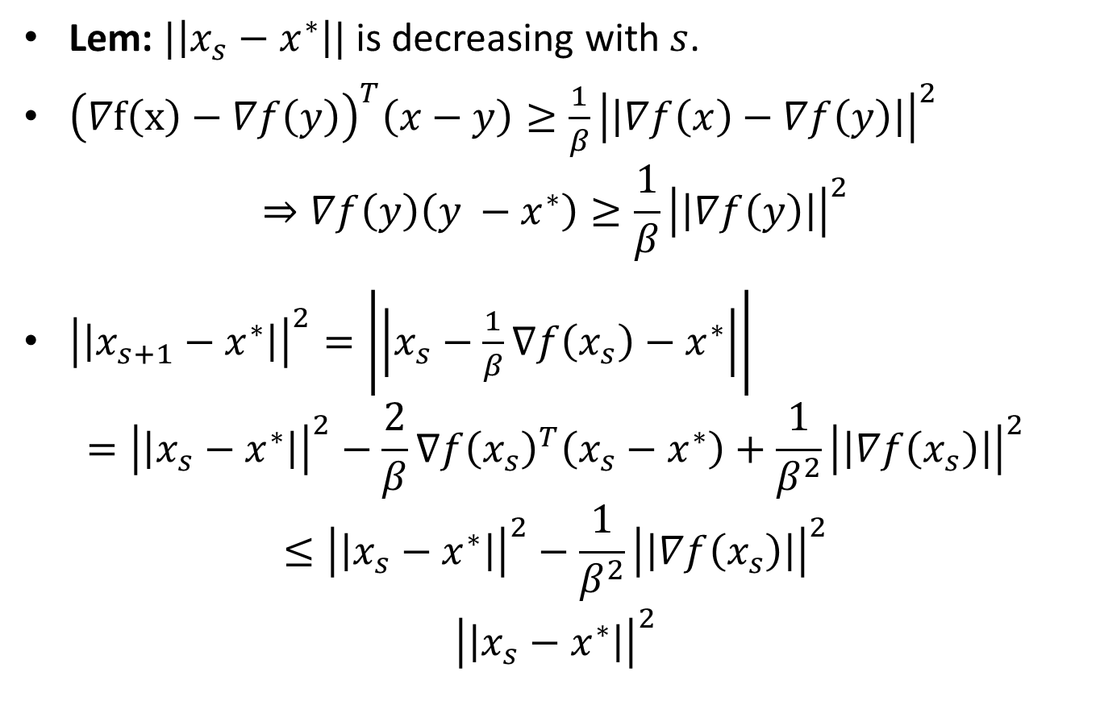
Gradient Descent: Analysis
Lem: $|\left|x_{s}−x^{∗}\right||$ is decreasing with $s$.
${\left(∇f\left(x\right)−∇f\left(y\right)\right)}^{T}\left(x−y\right)≥\frac{1}{β}{\left|\left|∇f\left(x\right)−∇f\left(y\right)\right|\right|}^{2}$
$$⇒∇f\left(y\right)\left({y −x}^{∗}\right)≥\frac{1}{β}{\left|\left|∇f\left(y\right)\right|\right|}^{2}$$
${\left|\left|x_{s+1}−x^{∗}\right|\right|}^{2}=\left|\left|x_{s}−\frac{1}{β}∇f\left(x_{s}\right)−x^{∗}\right|\right|$
$$={\left|\left|x_{s}−x^{∗}\right|\right|}^{2}−\frac{2}{β}∇f{\left(x_{s}\right)}^{T}\left(x_{s}−x^{∗}\right)+\frac{1}{β^{2}}{\left|\left|∇f\left(x_{s}\right)\right|\right|}^{2}$$
$$≤{\left|\left|x_{s}−x^{∗}\right|\right|}^{2}−\frac{1}{β^{2}}{\left|\left|∇f\left(x_{s}\right)\right|\right|}^{2}$$
$${\left|\left|x_{s}−x^{∗}\right|\right|}^{2}$$

Slide 10
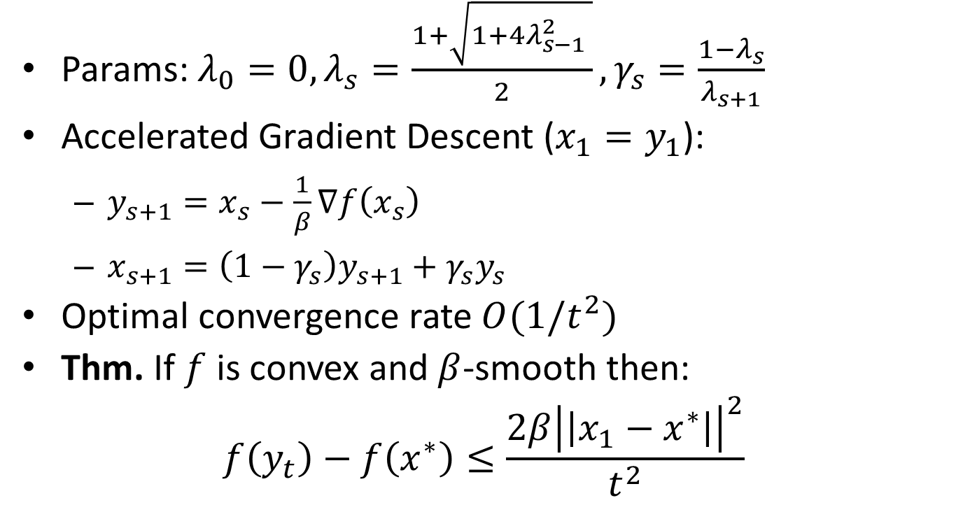
Nesterov’s Accelerated Gradient Descent
Params: $λ_{0}=0, λ_{s}=\frac{1+\sqrt{1+4λ_{s−1}^{2} }}{2}, γ_{s}=\frac{1−λ_{s}}{λ_{s+1}}$
Accelerated Gradient Descent ($x_{1}=y_{1}$):
$y_{s+1}=x_{s}−\frac{1}{β}∇f\left(x_{s}\right)$
$x_{s+1}=\left(1−γ_{s}\right)y_{s+1}+γ_{s}y_{s}$
Optimal convergence rate $O(1/t^{2})$
Thm. If $f$ is convex and $β$-smooth then:
$$f\left(y_{t}\right)−f\left(x^{∗}\right)≤\frac{2β{\left|\left|x_{1}−x^{∗}\right|\right|}^{2}}{t^{2}}$$

Slide 11
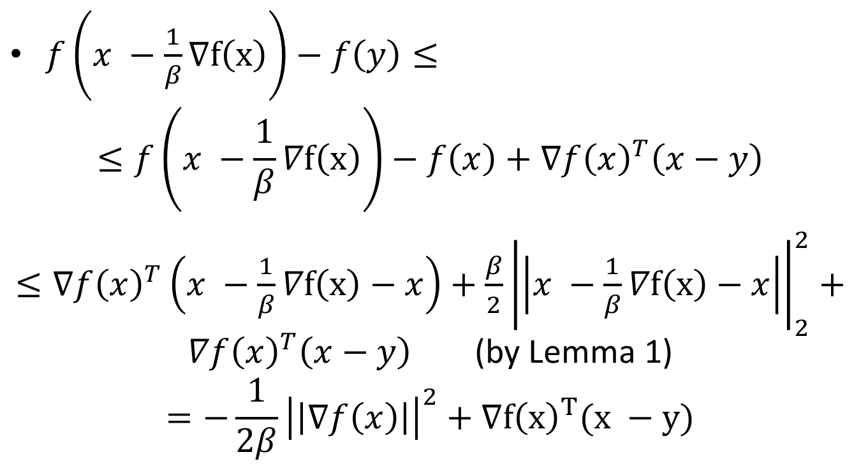
Accelerated Gradient Descent: Analysis
$f\left(x −\frac{1}{β}∇f\left(x\right)\right)−f\left(y\right)≤$
$$≤f\left(x −\frac{1}{β}∇f\left(x\right)\right)−f\left(x\right)+∇f{\left(x\right)}^{T}\left(x−y\right)$$
$≤∇{f\left(x\right)}^{T}\left(x −\frac{1}{β}∇f\left(x\right)−x\right)+\frac{β}{2}{\left|\left|x −\frac{1}{β}∇f\left(x\right)−x\right|\right|}_{2}^{2}+∇f{\left(x\right)}^{T}\left(x−y\right)$ (by Lemma 1)
$$=−\frac{1}{2β}{\left|\left|∇f\left(x\right)\right|\right|}^{2}+∇f{\left(x\right)}^{T}(x −y)$$

Slide 12
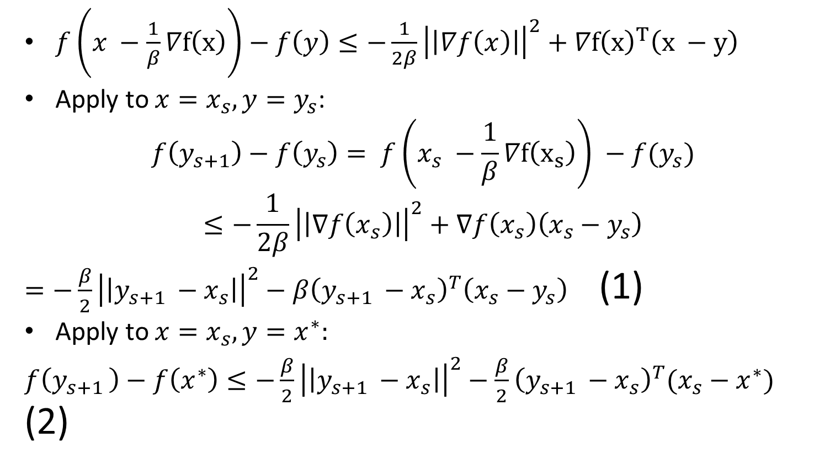
Accelerated Gradient Descent: Analysis
$f\left(x −\frac{1}{β}∇f\left(x\right)\right)−f\left(y\right)≤−\frac{1}{2β}{\left|\left|∇f\left(x\right)\right|\right|}^{2}+∇f{\left(x\right)}^{T}\left(x −y\right)$
Apply to $x=x_{s}, y=y_{s}$:
$$f\left(y_{s+1}\right)−f\left(y_{s}\right)= f\left(x_{s} −\frac{1}{β}∇f\left(x_{s}\right)\right) −f(y_{s})$$
$$≤−\frac{1}{2β}{\left|\left|∇f\left(x_{s}\right)\right|\right|}^{2}+∇f\left(x_{s}\right)\left(x_{s}−y_{s}\right)$$
$=−\frac{β}{2}{\left|\left|y_{s+1 }−x_{s}\right|\right|}_{}^{2}−β{\left(y_{s+1 }−x_{s}\right)}^{T}\left(x_{s}−y_{s}\right)$ (1)
Apply to $x=x_{s}, y=x^{∗}:$
$f\left(y_{s+1 }\right)−f\left(x^{∗}\right)≤−\frac{β}{2}{\left|\left|y_{s+1 }−x_{s}\right|\right|}^{2}−\frac{β}{2}{\left(y_{s+1 }−x_{s}\right)}^{T}(x_{s}−x^{∗})$ (2)

Slide 13
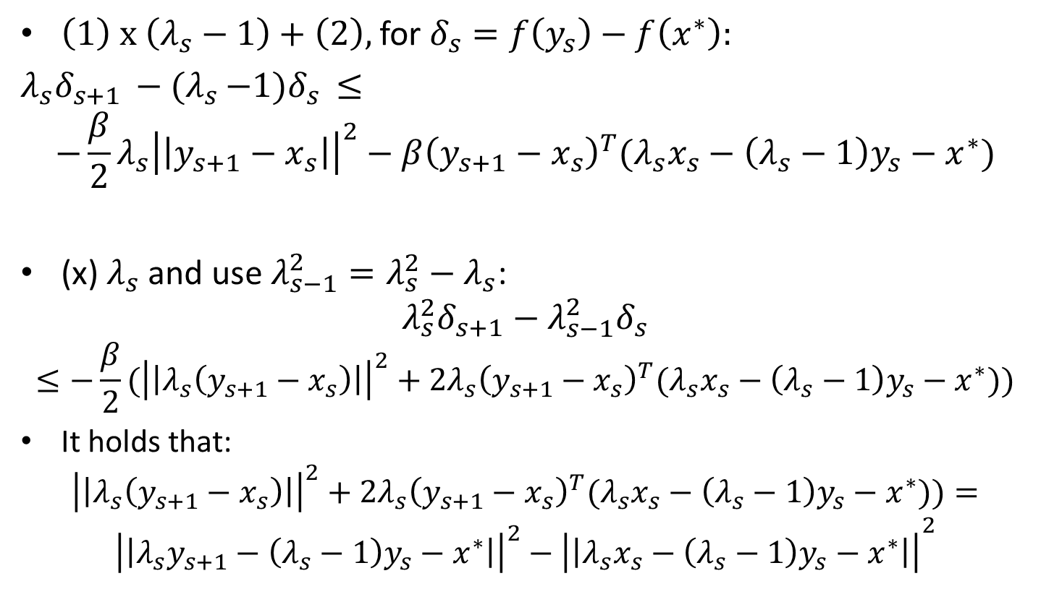
Accelerated Gradient Descent: Analysis
$\left(1\right) x \left(λ_{s}−1\right)+\left(2\right),$ for $δ_{s}=f\left(y_{s}\right)−f\left(x^{∗}\right):$
$λ_{s}δ_{s+1 }−{(λ}_{s }−1)δ_{s }≤$
$$−\frac{β}{2}λ_{s}{\left|\left|y_{s+1}−x_{s}\right|\right|}^{2}−β{\left(y_{s+1}−x_{s}\right)}^{T}(λ_{s}x_{s}−\left(λ_{s}−1\right)y_{s}−x^{∗})$$
(x) $λ_{s}$ and use $λ_{s−1}^{2}=λ_{s}^{2}−λ_{s}$:
$$λ_{s}^{2}δ_{s+1}−λ_{s−1}^{2}δ_{s}$$
$$≤−\frac{β}{2}({\left|\left|λ_{s}\left(y_{s+1}−x_{s}\right)\right|\right|}^{2}+2λ_{s}{\left(y_{s+1}−x_{s}\right)}^{T}(λ_{s}x_{s}−\left(λ_{s}−1\right)y_{s}−x^{∗}))$$
It holds that:
$${\left|\left|λ_{s}\left(y_{s+1}−x_{s}\right)\right|\right|}^{2}+2λ_{s}{\left(y_{s+1}−x_{s}\right)}^{T}(λ_{s}x_{s}−\left(λ_{s}−1\right)y_{s}−x^{∗}))=$$
$${{\left|\left|λ_{s}y_{s+1}−\left(λ_{s}−1\right)y_{s}−x^{∗}\right|\right|}^{2}−\left|\left|λ_{s}x_{s}−\left(λ_{s}−1\right)y_{s}−x^{∗}\right|\right|}^{2}$$

Slide 14
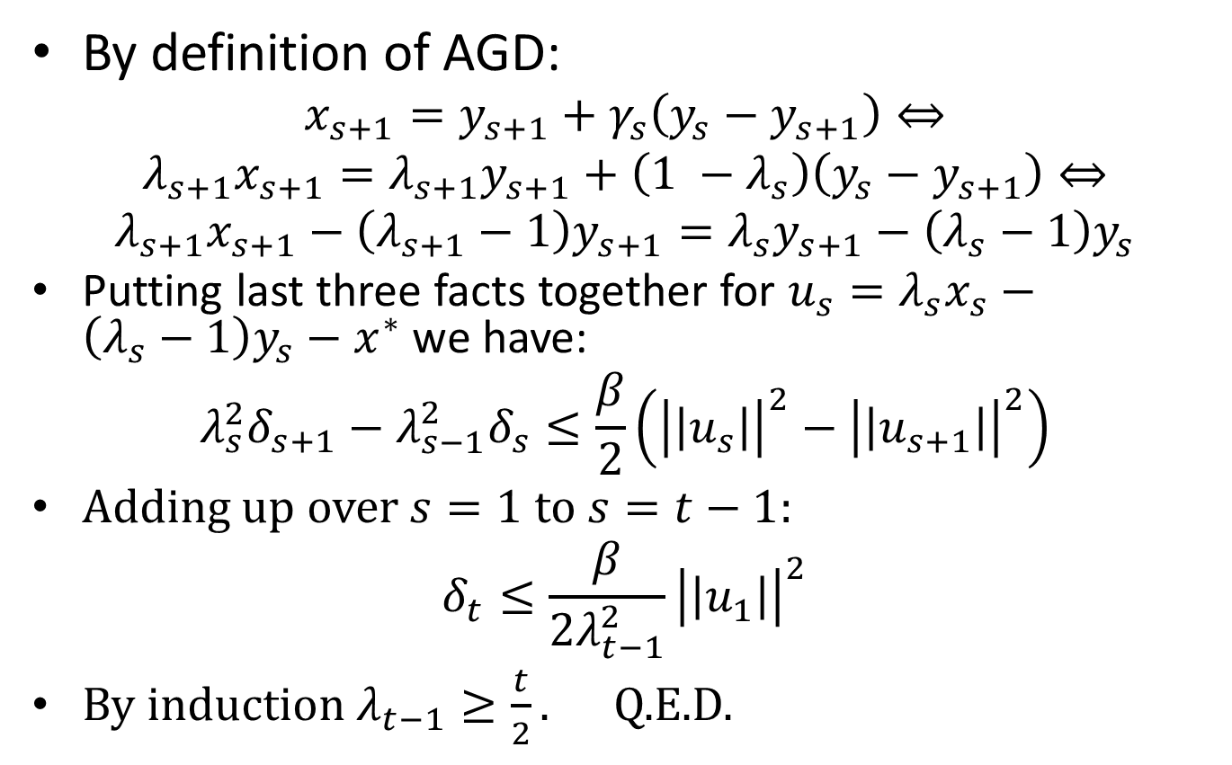
Accelerated Gradient Descent: Analysis
By definition of AGD:
$$x_{s+1}=y_{s+1}+γ_{s}\left(y_{s}−y_{s+1}\right)⇔$$
$λ_{s+1}x_{s+1}=λ_{s+1}y_{s+1}+\left(1 −λ_{s}\right)\left(y_{s}−y_{s+1}\right)⇔$
$$λ_{s+1}x_{s+1}−\left(λ_{s+1}−1\right)y_{s+1}=λ_{s}y_{s+1}−\left(λ_{s}−1\right)y_{s}$$
Putting last three facts together for $u_{s}=λ_{s}x_{s}−\left(λ_{s}−1\right)y_{s}−x^{∗}$ we have:
$$λ_{s}^{2}δ_{s+1}−λ_{s−1}^{2}δ_{s}≤\frac{β}{2}\left({\left|\left|u_{s}\right|\right|}^{2}−{\left|\left|u_{s+1}\right|\right|}^{2}\right)$$
Adding up over $s=1$ to $s=t−1$:
$$δ_{t}≤\frac{β}{2λ_{t−1}^{2}}{\left|\left|u_{1}\right|\right|}^{2}$$
By induction $λ_{t−1}≥\frac{t}{2}.$ Q.E.D.

