Slide 1

CIS 700: “algorithms for Big Data”
Lecture 11:
K-means
Slides at http://grigory.us/big-data-class.html
Grigory Yaroslavtsev
http://grigory.us

Slide 2
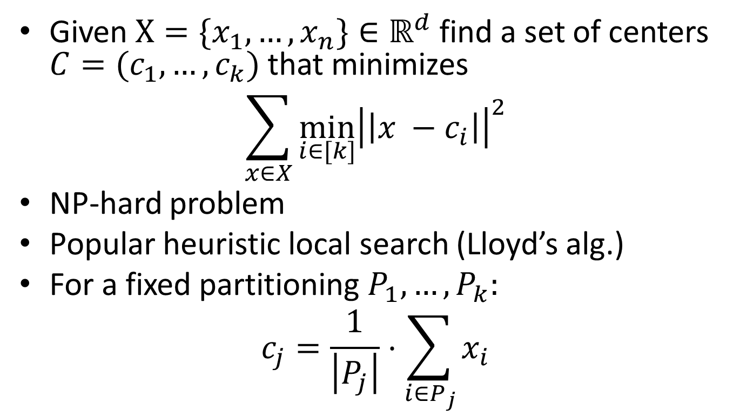
K-means Clustering
Given $X=\{x_{1},…, x_{n}\}∈ℝ^{d}$ find a set of centers $C=(c_{1},…, c_{k})$ that minimizes
$$\sum_{x∈X}{\min_{i∈[k]}{{\left|\left|x −c_{i}\right|\right|}^{2}}}$$
NP-hard problem
Popular heuristic local search (Lloyd’s alg.)
For a fixed partitioning $P_{1},…, P_{k}:$
$$c_{j}=\frac{1}{\left|P_{j}\right|}⋅\sum_{i∈P_{j}}{x_{i}}$$

Slide 3
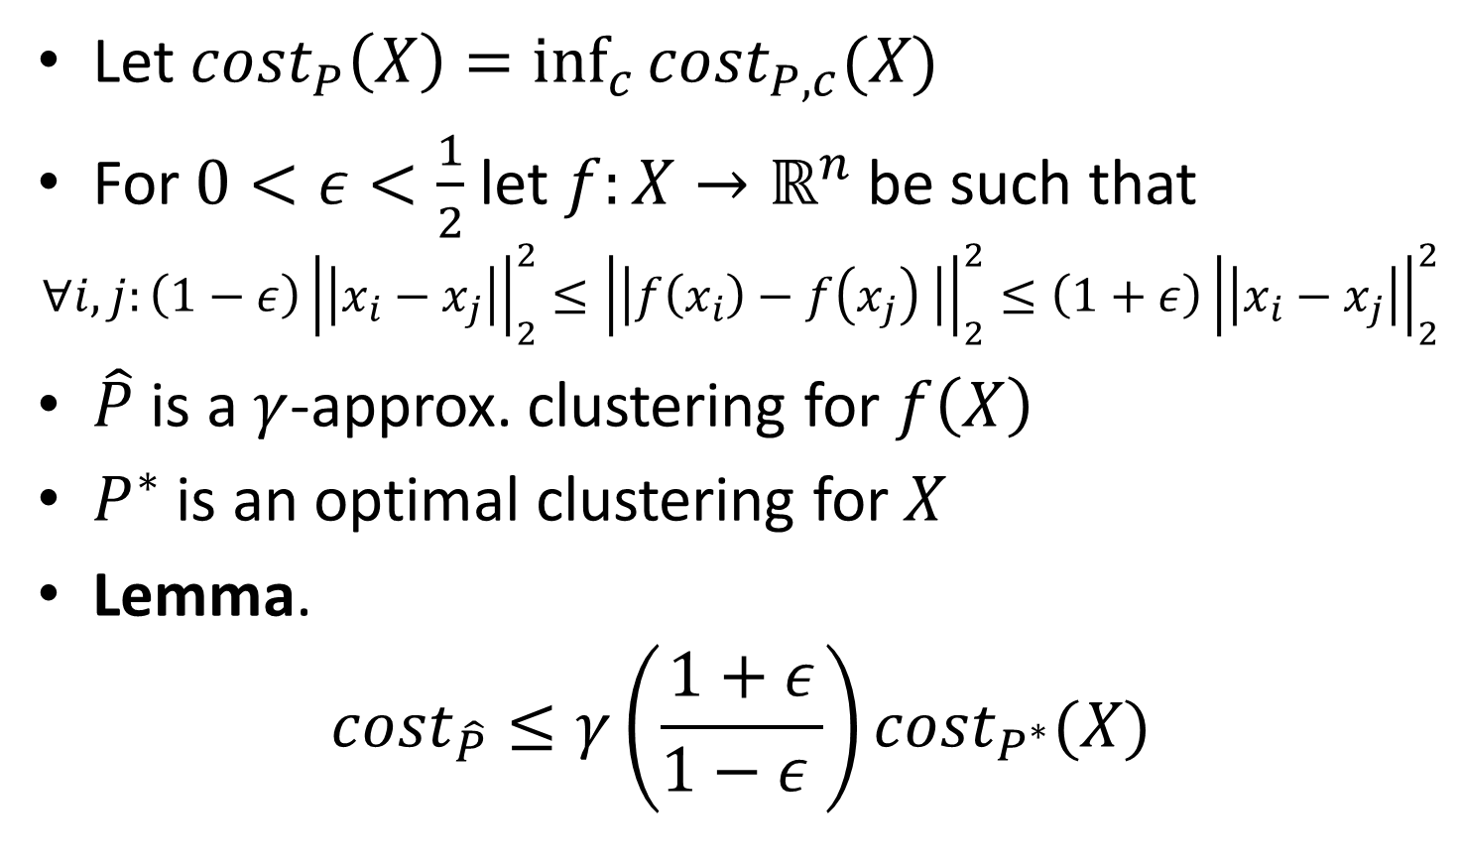
Dimension reduction for K-means
Let $cost_{P}\left(X\right)=\inf_{c}{cost_{P,c}(X)}$
For $0<ε<\frac{1}{2}$ let $f:X→ℝ^{n}$ be such that
$$∀i,j:\left(1−ε\right){\left|\left|x_{i}−x_{j}\right|\right|}_{2}^{2}≤{\left|\left|f\left(x_{i}\right)−f\left(x_{j}\right) \right|\right|}_{2}^{2}≤\left(1+ε\right){\left|\left|x_{i}−x_{j}\right|\right|}_{2}^{2}$$
$\hat{P}$ is a $γ$-approx. clustering for $f\left(X\right)$
$P^{∗}$ is an optimal clustering for $X$
Lemma.
$$cost_{\hat{P}}≤γ\left(\frac{1+ε}{1−ε }\right)cost_{P^{∗}}(X)$$

Slide 4
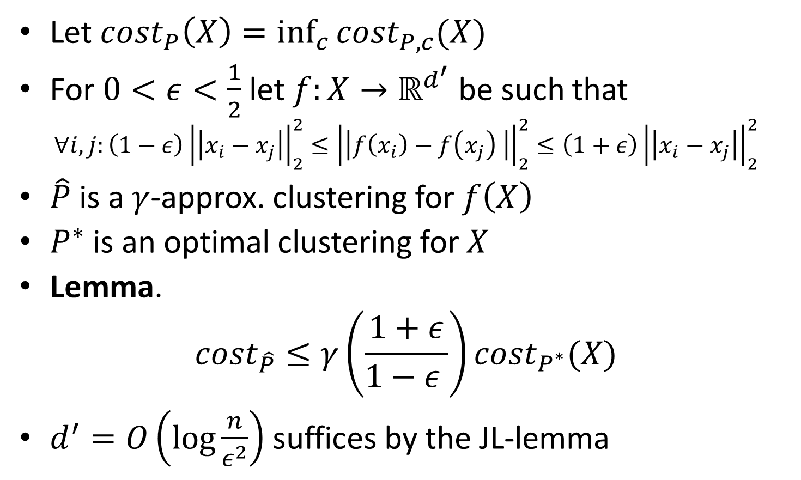
Dimension reduction for K-means
Let $cost_{P}\left(X\right)=\inf_{c}{cost_{P,c}(X)}$
For $0<ε<\frac{1}{2}$ let $f:X→ℝ^{d^{′}}$ be such that
$$∀i,j:\left(1−ε\right){\left|\left|x_{i}−x_{j}\right|\right|}_{2}^{2}≤{\left|\left|f\left(x_{i}\right)−f\left(x_{j}\right) \right|\right|}_{2}^{2}≤\left(1+ε\right){\left|\left|x_{i}−x_{j}\right|\right|}_{2}^{2}$$
$\hat{P}$ is a $γ$-approx. clustering for $f\left(X\right)$
$P^{∗}$ is an optimal clustering for $X$
Lemma.
$$cost_{\hat{P}}≤γ\left(\frac{1+ε}{1−ε }\right)cost_{P^{∗}}(X)$$
$d^{′}=O\left(log\frac{n}{ε^{2}}\right)$ suffices by the JL-lemma

Slide 5
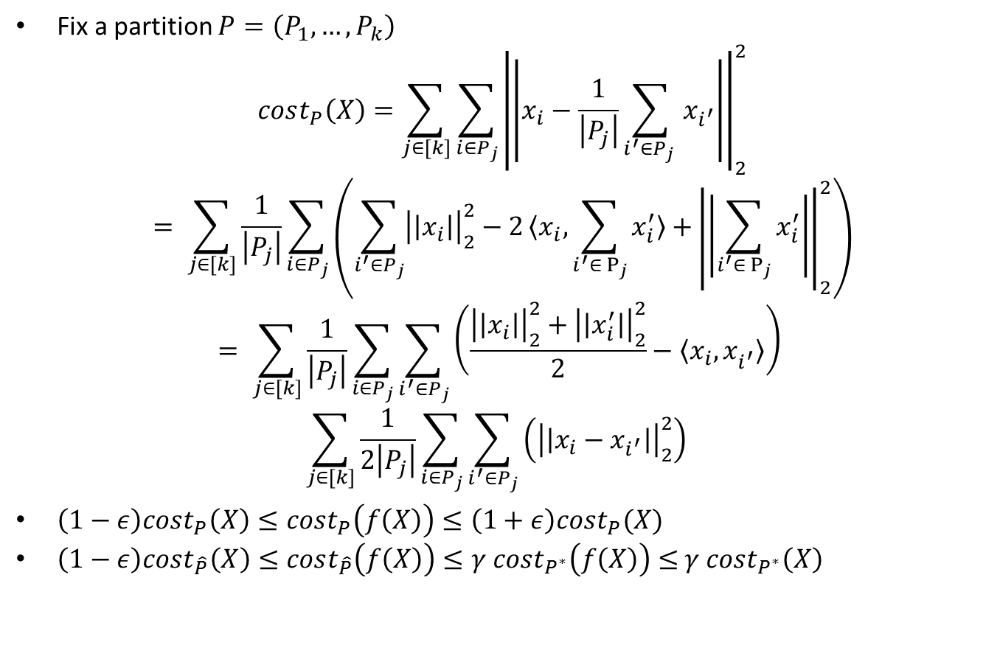
Dimension reduction for K-means
Fix a partition $P=\left(P_{1},…, P_{k}\right)$
$$cost_{P}\left(X\right)=\sum_{j∈[k]}{\sum_{i∈P_{j}}{{\left|\left|x_{i}−\frac{1}{\left|P_{j}\right|}\sum_{i^{′}∈P_{j} }{x_{i^{′}}}\right|\right|}_{2}^{2}}}$$
$$= \sum_{j∈[k]}{\frac{1}{\left|P_{j}\right|}\sum_{i∈P_{j}}{\left(\sum_{i^{′}∈P_{j}}{{\left|\left|x_{i}\right|\right|}_{2}^{2}−2〈x_{i}, \sum_{i^{′}{∈ P}_{j}}{x_{i}^{′}}〉+}{\left|\left|\sum_{i^{′}{∈ P}_{j}}{x_{i}^{′}}\right|\right|}_{2}^{2}\right)}}$$
$$= \sum_{j∈[k]}{\frac{1}{\left|P_{j}\right|}\sum_{i∈P_{j}}{\sum_{i^{′}∈P_{j}}{\left(\frac{{\left|\left|x_{i}\right|\right|}_{2}^{2}+{\left|\left|x_{i}^{′}\right|\right|}_{2}^{2}}{2}−〈x_{i},x_{i^{′}}^{}〉\right)}} }$$
$$\sum_{j∈[k]}{\frac{1}{2\left|P_{j}\right|}\sum_{i∈P_{j}}{\sum_{i^{′}∈P_{j}}{\left({\left|\left|x_{i}−x_{i^{′}}\right|\right|}_{2}^{2}\right) }} }$$
$\left(1−ε\right)cost_{P}\left(X\right)≤cost_{P}\left(f\left(X\right)\right)≤\left(1+ε\right)cost_{P}(X)$
$\left(1−ε\right)cost_{\hat{P}}\left(X\right)≤cost_{\hat{P}}\left(f\left(X\right)\right)≤γ cost_{P^{∗}}\left(f\left(X\right)\right)≤$ $γ cost_{P^{∗}}\left(X\right)$

Slide 6
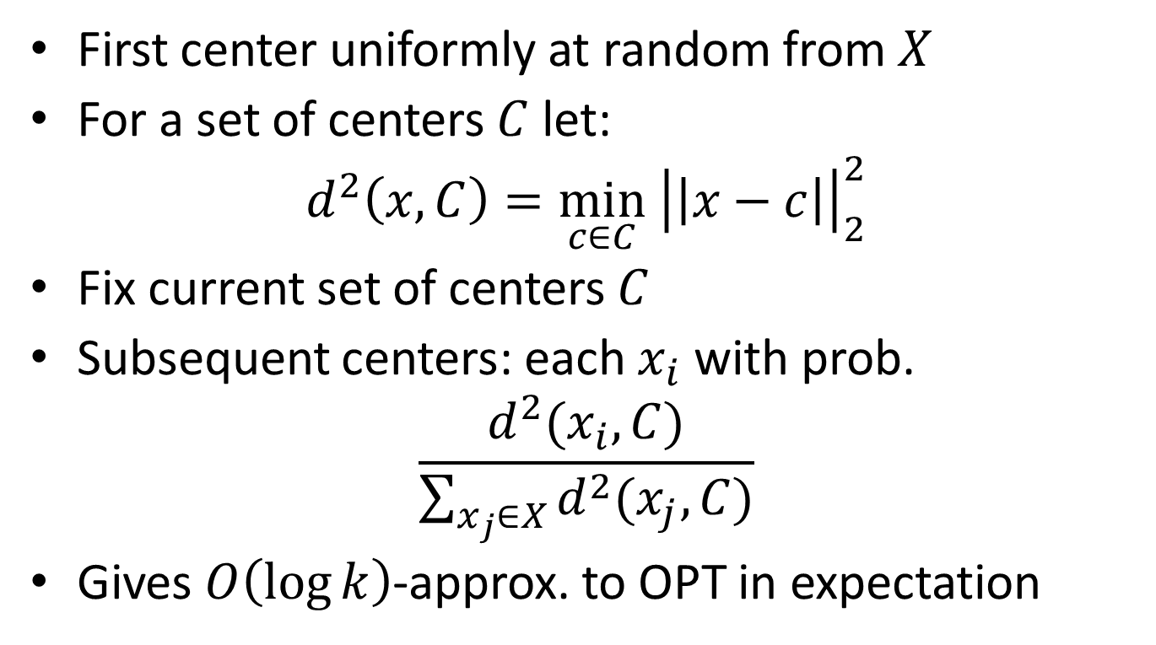
K-means++ Algorithm
First center uniformly at random from $X$
For a set of centers $C$ let:
$$d^{2}\left(x,C\right)=\min_{c∈C} {\left|\left|x−c\right|\right|}_{2}^{2}$$
Fix current set of centers $C$
Subsequent centers: each $x_{i}$ with prob.
$$\frac{d^{2}(x_{i},C)}{\sum_{x_{j}∈X}{d^{2}(x_{j}, C)}}$$
Gives $O\left(\log{k}\right)$-approx. to OPT in expectation

Slide 7
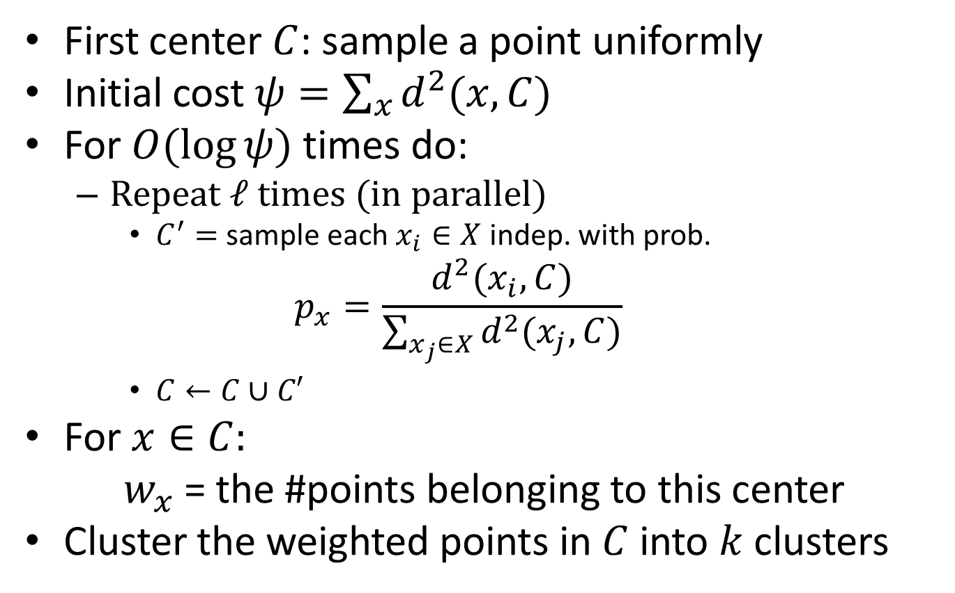

K-means$∥$ Algorithm
First center $C$: sample a point uniformly
Initial cost $ψ=\sum_{x}{d^{2}(x,C)}$
For $O(\log{ψ})$ times do:
Repeat $ℓ$ times (in parallel)
$C^{′}=$ sample each $x_{i}∈X$ indep. with prob.
$$p_{x}=\frac{d^{2}(x_{i},C)}{\sum_{x_{j}∈X}{d^{2}(x_{j}, C)}}$$
$C←C∪C′$
For $x∈C:$
$w_{x}$ = the #points belonging to this center
Cluster the weighted points in $C$ into $k$ clusters

Slide 8
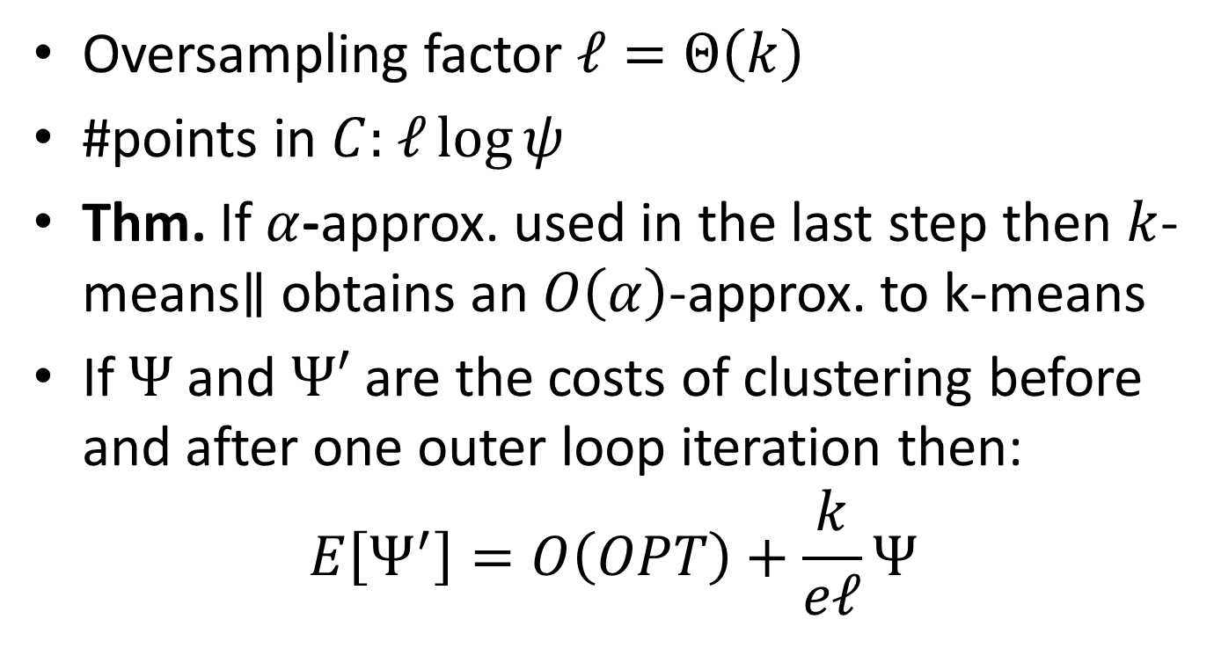
K-means$∥$ Algorithm
Oversampling factor $ℓ=Θ\left(k\right)$
#points in $C:$ $ℓ\log{ψ}$
Thm. If $α$-approx. used in the last step then $k$-means$∥$ obtains an $O\left(α\right)$-approx. to k-means
If $Ψ$ and $Ψ′$ are the costs of clustering before and after one outer loop iteration then:
$$E\left[Ψ^{′}\right]=O\left(OPT\right)+\frac{k}{eℓ}Ψ$$

Slide 9
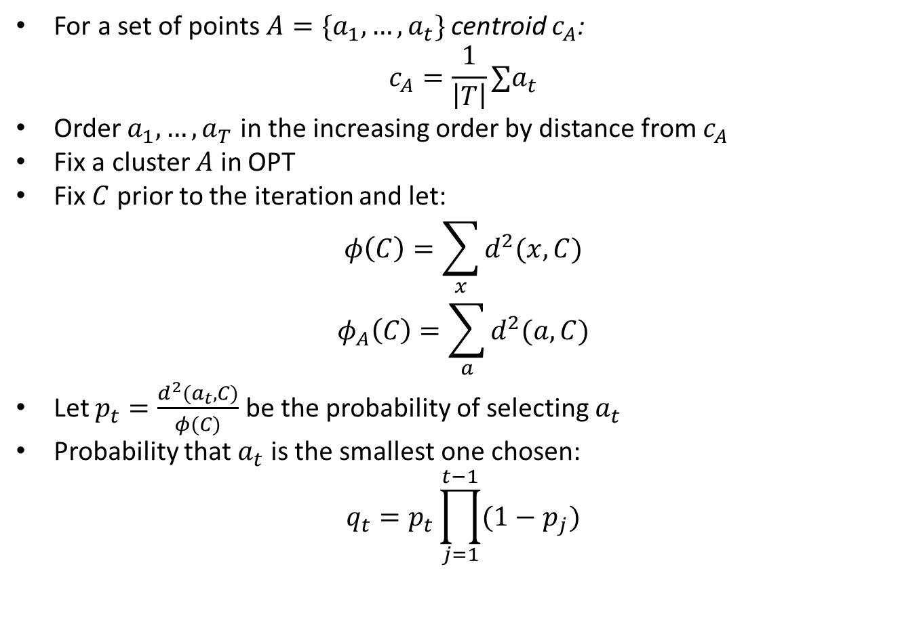

K-means$∥$ Analysis
For a set of points $A=\{a_{1},…, a_{t}\}$ centroid $c_{A}$:
$$c_{A}=\frac{1}{\left|T\right|}∑a_{t}$$
Order $a_{1}, …, a_{T}$ in the increasing order by distance from $c_{A}$
Fix a cluster $A$ in OPT
Fix $C$ prior to the iteration and let:
$$φ\left(C\right)=\sum_{x}{d^{2}(x,C)}$$
$$φ_{A}\left(C\right)=\sum_{a}{d^{2}(a, C)}$$
Let $p_{t}=\frac{d^{2}(a_{t},C)}{φ(C)}$ be the probability of selecting $a_{t}$
Probability that $a_{t}$ is the smallest one chosen:
$$q_{t}=p_{t}\prod_{j=1}^{t−1}{(1−p_{j})}$$

Slide 10
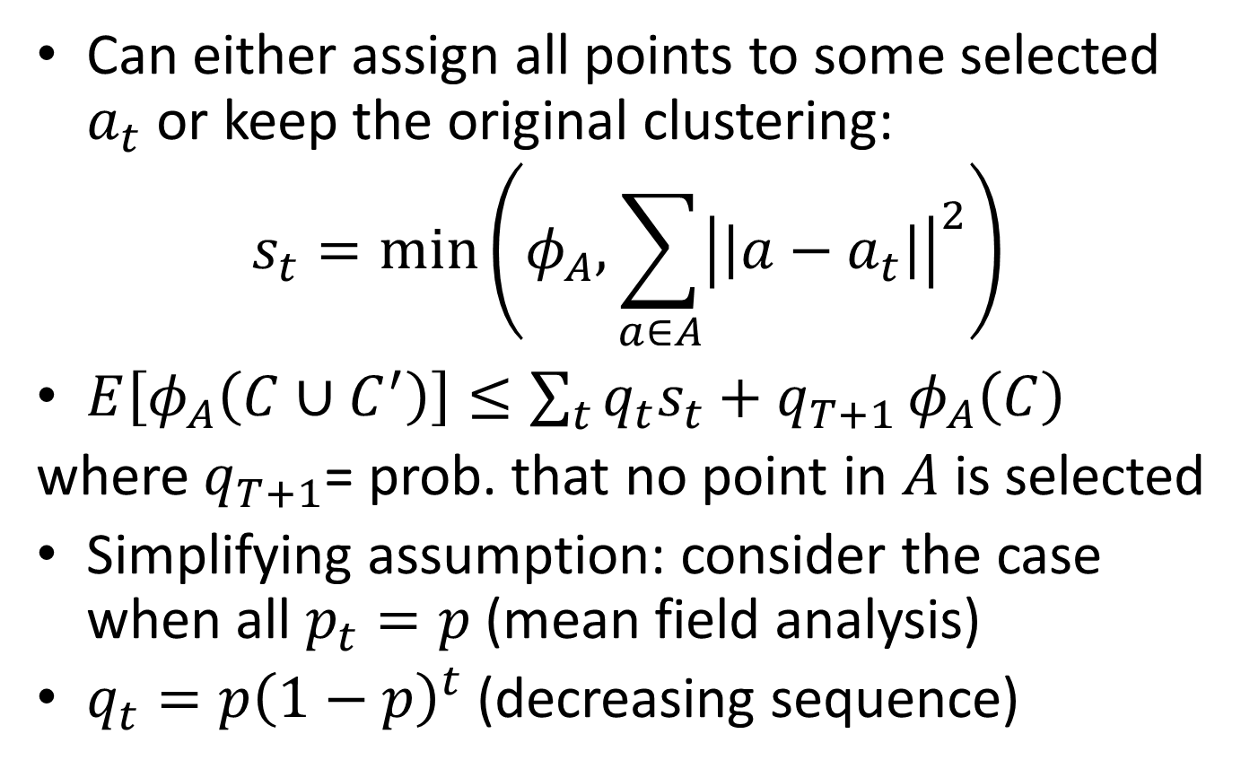
K-means$∥$ Analysis
Can either assign all points to some selected $a_{t}$ or keep the original clustering:
$$s_{t}=\min\left(φ_{A},\sum_{a∈A}{{\left|\left|a−a_{t}\right|\right|}^{2}}\right)$$
$E\left[φ_{A}\left(C∪C^{′}\right)\right]≤\sum_{t}{q_{t}s_{t}+q_{T+1}}φ_{A}\left(C\right)$
where $q_{T+1}$= prob. that no point in $A$ is selected
Simplifying assumption: consider the case when all $p_{t}=p$(mean field analysis)
$q_{t}=p{\left(1−p\right)}^{t}$ (decreasing sequence)

Slide 11
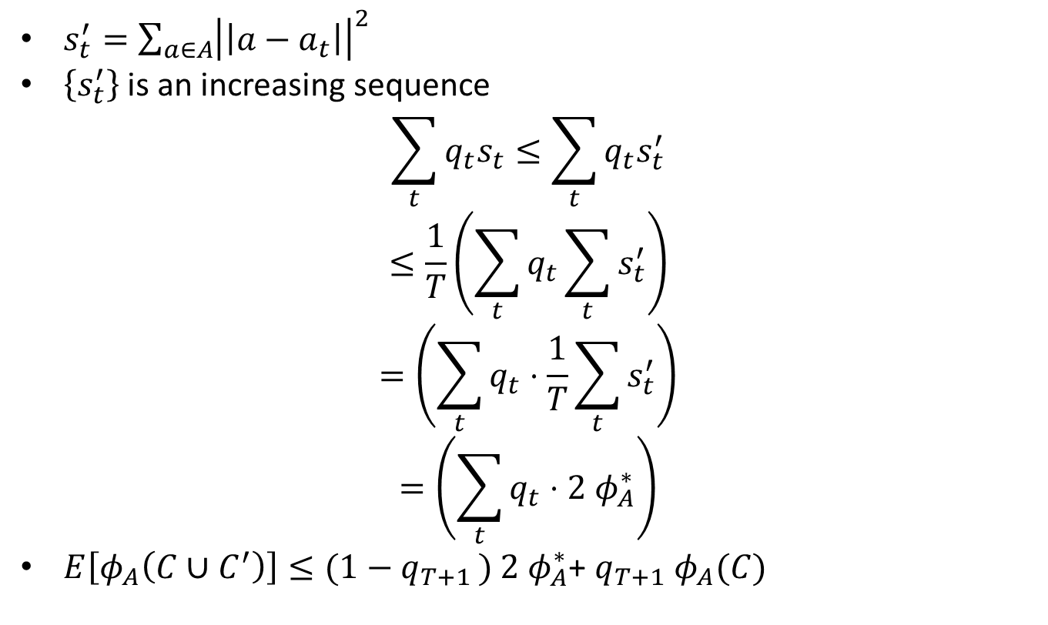
K-means$∥$ Analysis
$s_{t}^{′}=\sum_{a∈A}{{\left|\left|a−a_{t}\right|\right|}^{2}}$
$\left\{s_{t}^{′}\right\}$ is an increasing sequence
$$\sum_{t}{q_{t}s_{t}≤\sum_{t}{q_{t}s_{t}^{′}}}$$
$$≤\frac{1}{T}\left(\sum_{t}{q_{t}}\sum_{t}{s_{t}^{′}}\right)$$
$$=\left(\sum_{t}{q_{t}}⋅\frac{1}{T}\sum_{t}{s_{t}^{′}}\right)$$
$$=\left(\sum_{t}{q_{t}}⋅2 φ_{A}^{∗}\right)$$
$E\left[φ_{A}\left(C∪C^{′}\right)\right]≤(1−q_{T+1 })$ $2 φ_{A}^{∗}$+ $q_{T+1} φ_{A}(C)$

