Slide 1

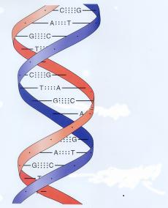
Motivation for Sublinear-Time Algorithms
Massive datasets
world-wide web
online social networks
genome project
sales logs
census data
high-resolution images
scientific measurements
Long access time
communication bottleneck (slow connection)
implicit data (an experiment per data point)

Slide 2
What Can We Hope For?
What can an algorithm compute if it
reads only a sublinear portion of the data?
runs in sublinear time?
Some problems have exact deterministic solutions
For most interesting problems algorithms must be
approximate
randomized

Slide 3
A Sublinear-Time Algorithm
B | L | A | - | B | L | A | - | B | L | A | - | B | L | A | - | B | L | A | - | B | L | A | - | B | L | A | - | B | L | A
?
B
?
L
?
L
?
A
sublinear-time algorithm
approximate answer
Quality of approximation
Resources
number of queries
running time

Slide 4
Types of Approximation
Classical approximation
need to compute a value
output should be close to the desired value
example: average
Property testing
need to answer YES or NO
Intuition: only require correct answers on two sets of instances that are very different from each other
Notes:
In cases when we need to compute some value, it is clear what we mean by "approximation". The output should be close to the desired value. This is a classical notion, and everybody has heard of approximating the average and median values by sampling.

Slide 5
Classical Approximation
A Simple Example

Slide 6
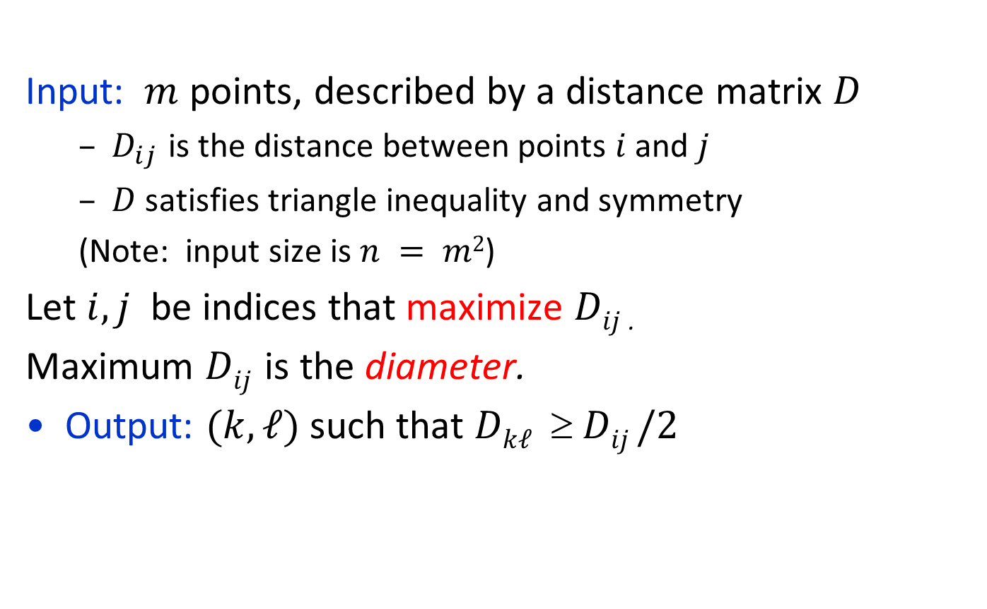
Approximate Diameter of a Point Set [Indyk]
Input: $m$ points, described by a distance matrix $D$
$D_{ij}$ is the distance between points $i$ and $j$
$D$ satisfies triangle inequality and symmetry
(Note: input size is $n = m2$)
Let $i, j$ be indices that maximize $Dij$ .
Maximum $Dij$ is the diameter.
Output: $(k, ℓ)$ such that $Dkℓ  Dij /2$

Slide 7

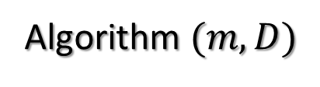




Algorithm and Analysis
$$j$$
Pick $k$ arbitrarily
Pick $ℓ$ to maximize $Dkℓ$
Output $(k,ℓ)$
Approximation guarantee
$Dij≤Dik+Dkj$ (triangle inequality)
$≤Dkℓ+Dkℓ$(choice of $ℓ$ + symmetry of $D$)
$≤2Dkℓ$
Running time: $O(m) = O(m=\sqrt{n})$
Algorithm $(m, D)$
$$ℓ$$
$$k$$
$$i$$
A rare example of a deterministic
sublinear-time algorithm

Slide 8
Property Testing

Slide 9
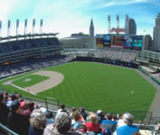
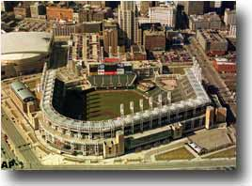
Property Testing: YES/NO Questions
Does the input satisfy some property? (YES/NO)
“in the ballpark” vs. “out of the ballpark”
Does the input satisfy the property
or is it far from satisfying it?
sometimes it is the right question (probabilistically checkable proofs (PCPs))
as good when the data is constantly changing (WWW)
fast sanity check to rule out inappropriate inputs (airport security questioning)

Slide 10
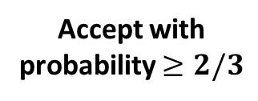

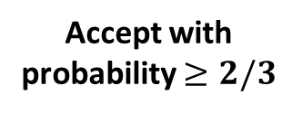
Property Tester Definition
Probabilistic Algorithm
Property Tester
YES
YES
Accept with probability $≥2/3$
Accept with probability $≥2/3$
$$ε$$
Don’t care
Close to YES
NO
Reject with probability 2/3
Far from
YES
Reject with probability 2/3
$ε$- ($≥ε$ fraction of places)
far = differs in many places
Notes:
Graph properties (eg. Testing if a graph is bipartite).
Legality of proofs.
Monotonicity of functions.
Examples of Properties.
Applications
Learning
Program testing
Advantages
Faster
Decision procedure may be infeasible, making PPT the only option..
Preprocessing

Slide 11
Randomized Sublinear Algorithms
Toy Examples

Slide 12



Property Testing: a Toy Example
0 | 0 | 0 | 1 | … | 0 | 1 | 0 | 0
Input: a string $w∈{\left\{0,1\right\}}^{n}$
Question: Is $w=00…0$?
Requires reading entire input.
Approximate version: Is $w=00…0$or
does it have $≥εn$ 1’s (“errors”)?
Sample $s=2/ε$ positions uniformly and independently at random
If 1 is found, reject; otherwise, accept
Analysis: If $w=00…0$, it is always accepted.
If $w$ is $ε$-far, Pr[error] = Pr[no 1’s in the sample]$≤{\left(1−ε\right)}^{s}≤e^{−εs}=e^{−2}<\frac{1}{3}$
If a test catches a witness with probability $≥p$,
then $s=\frac{2}{p}$ iterations of the test catch a witness with probability $≥2/3.$
Test $(n, w)$
Used: $1−x≤e^{−x}$
Witness Lemma

Slide 13

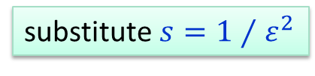
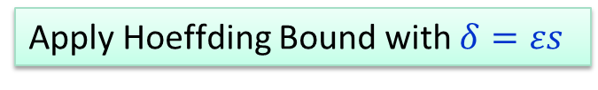
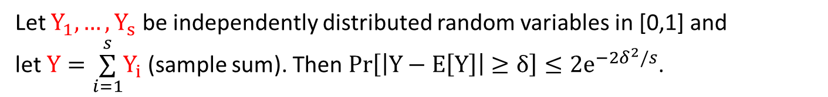
Randomized Approximation: a Toy Example
0 | 0 | 0 | 1 | … | 0 | 1 | 0 | 0
Input: a string $w∈{\left\{0,1\right\}}^{n}$
Goal: Estimate the fraction of 1’s in $w$ (like in polls)
It suffices to sample $s=1⁄ε^{2}$ positions and output the average to get the fraction of 1’s $±ε$ (i.e., additive error $ε$) with probability ¸ 2/3
$Y_{i}$ = value of sample $i$. Then E[Y] $=\underset{i=1}{\overset{s}{∑}}{E[Y}_{i}]=s⋅$ (fraction of 1’s in $w$)
$$\operatorname{Pr}\left[\left|\text{(}\text{sample} \text{average}\text{)} −\left(\text{fraction} \text{of}\text{ 1′}\text{s} \text{in} w\right)\right|≥ε\right]=Pr\left[\left|Y−E\left[Y\right]\right|≥εs\right]$$
$$≤{2e}^{−2δ^{2}/s}=2e^{−2}<1/3$$
Hoeffding Bound
Let $Y_{1}, …, Y_{s}$ be independently distributed random variables in [0,1] and
let $Y=\underset{i=1}{\overset{s}{∑}}Y_{i}$ (sample sum). Then $\operatorname{Pr}\left[\left|Y−E\left[Y\right]\right|≥δ\right]≤{2e}^{−2δ^{2}/s}$.
Apply Hoeffding Bound with $δ=εs$
substitute $s=1⁄ε^{2}$

Slide 14
Property Testing
Simple Examples

Slide 15


Testing Properties of Images

Slide 16
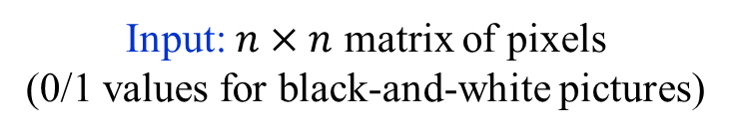
Pixel Model
Input: $n×n$ matrix of pixels
(0/1 values for black-and-white pictures)
Query: point $(i_{1}, i_{2})$
Answer: color of $(i_{1}, i_{2})$

Slide 17
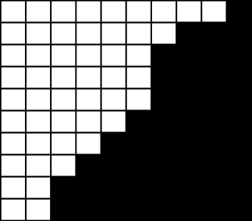
Testing if an Image is a Half-plane [R03]
A half-plane or
$ε$-far from a half-plane?
O(1/$ε)$ time

Slide 18

Half-plane Instances
A half-plane
$\frac{1}{4}$-far from a half-plane

Slide 19
Half-plane Instances
A half-plane
$\frac{1}{4}$-far from a half-plane

Slide 20
Half-plane Instances
A half-plane
$\frac{1}{4}$-far from a half-plane

Slide 21
Half-plane Instances
A half-plane
$\frac{1}{4}$-far from a half-plane

Slide 22
Half-plane Instances
A half-plane
$\frac{1}{4}$-far from a half-plane

Slide 23
Half-plane Instances
A half-plane
$\frac{1}{4}$-far from a half-plane

Slide 24
Half-plane Instances
A half-plane
$\frac{1}{4}$-far from a half-plane

Slide 25
Strategy
“Testing by implicit learning” paradigm
Learn the outline of the image by querying a few pixels.
Test if the image conforms to the outline by random sampling, and reject if something is wrong.

Slide 26
Half-plane Test
Claim. The number of sides with different corners is 0, 2, or 4.
?
?
?
?
Algorithm
Query the corners.

Slide 27
Half-plane Test: 4 Bi-colored Sides
Claim. The number of sides with different corners is 0, 2, or 4.
Analysis
If it is 4, the image cannot be a half-plane.
Algorithm
Query the corners.
If the number of sides with different corners is 4, reject.

Slide 28
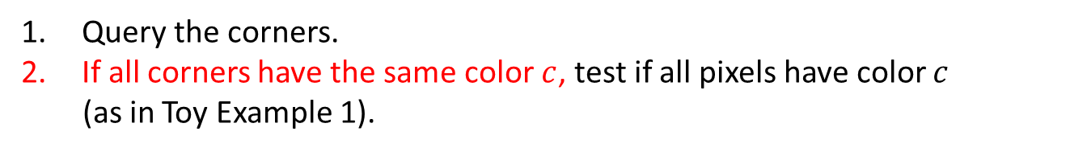
Half-plane Test: 0 Bi-colored Sides
Claim. The number of sides with different corners is 0, 2, or 4.
Analysis
?
?
If all corners have the same color, the image is a half-plane if and only if it is unicolored.
?
?
?
?
Algorithm
Query the corners.
If all corners have the same color $c$, test if all pixels have color $c$
(as in Toy Example 1).

Slide 29

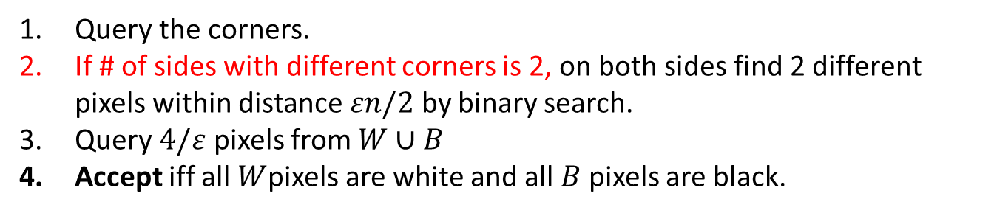


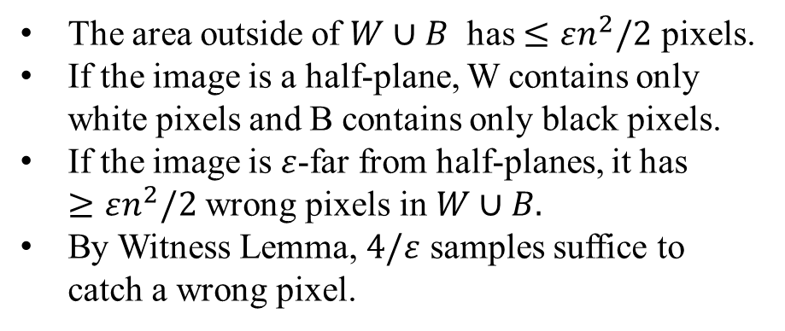
Half-plane Test: 2 Bi-colored Sides
Claim. The number of sides with different corners is 0, 2, or 4.
$$εn/2$$
?
?
Analysis
$$W$$
The area outside of $W∪B$ has $≤εn^{2}/2$ pixels.
If the image is a half-plane, W contains only white pixels and B contains only black pixels.
If the image is $ε$-far from half-planes, it has $≥εn^{2}/2$ wrong pixels in $W∪B.$
By Witness Lemma, $4/ε$ samples suffice to catch a wrong pixel.
$$B$$
?
?
$$εn/2$$
Algorithm
Query the corners.
If # of sides with different corners is 2, on both sides find 2 different pixels within distance $εn/2$ by binary search.
Query $4/ε$ pixels from $W∪B$
Accept iff all $W$pixels are white and all $B$ pixels are black.

Slide 30
Testing if an Image is a Half-plane [R03]
A half-plane or
$ε$-far from a half-plane?
O(1/$ε)$ time

Slide 31


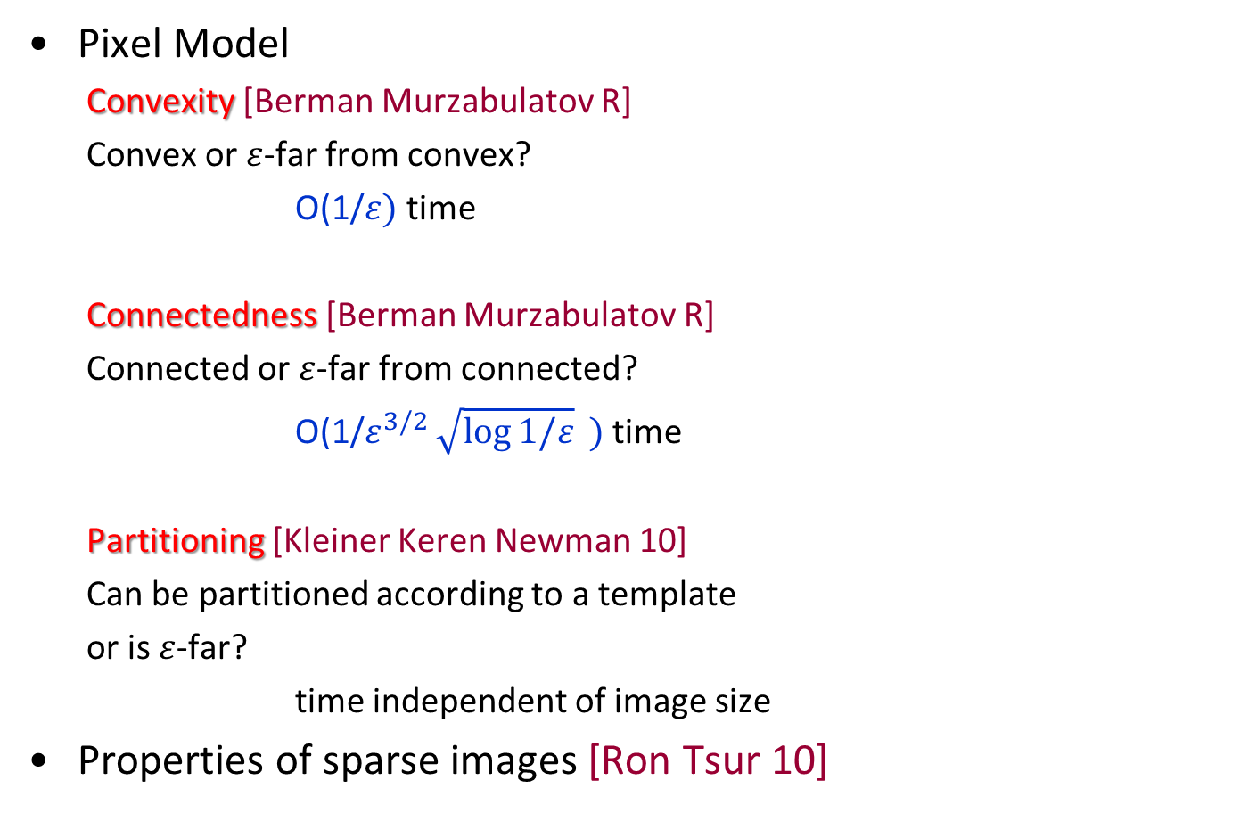
Other Results on Properties of Images
Pixel Model
Convexity [Berman Murzabulatov R]
Convex or $ε$-far from convex?
O(1/$ε)$ time
Connectedness [Berman Murzabulatov R]
Connected or $ε$-far from connected?
O(1/$ε^{3/2}\sqrt{\log{1/ε}}{ })$ time
Partitioning [Kleiner Keren Newman 10]
Can be partitioned according to a template
or is $ε$-far?
time independent of image size
Properties of sparse images [Ron Tsur 10]

Slide 32

Testing if a List is Sorted
Input: a list of n numbers x₁ , x₂ ,..., x_{n}
Question: Is the list sorted?
Requires reading entire list: Ω(n) time
Approximate version: Is the list sorted or ²-far from sorted?
(An ² fraction of x_{i} ’s have to be changed to make it sorted.)
[Ergün Kannan Kumar Rubinfeld Viswanathan 98, Fischer 01]: O((log n)/²) time
Ω(log n) queries
Attempts:
1. Test: Pick a random i and reject if x_{i} > x_{i+1} .
Fails on: 1 1 1 1 1 1 1 0 0 0 0 0 0 0 Ã 1/2-far from sorted
2. Test: Pick random i < j and reject if x_{i} > x_{j}.
Fails on: 1 0 2 1 3 2 4 3 5 4 6 5 7 6 Ã 1/2-far from sorted

Slide 33
Is a list sorted or ²-far from sorted?
Idea: Associate positions in the list with vertices of the directed line.
Construct a graph (2-spanner)
by adding a few “shortcut” edges (i, j) for i < j
where each pair of vertices is connected by a path of length at most 2
…
…
1 2 3 … n-1 n
≤ n log n edges

Slide 34
Is a list sorted or ²-far from sorted?
Test [Dodis Goldreich Lehman Raskhodnikova Ron Samorodnitsky 99]
Pick a random edge (x_{i} ,x_{j}) from the 2-spanner and reject if x_{i} > x_{j}.
1 2 5 4 3 6 7
Analysis:
Call an edge (x_{i} ,x_{j}) violated if x_{i} > x_{j} , and good otherwise.
If x_{i} is an endpoint of a violated edge, call it bad. Otherwise, call it good.
Proof: Consider any two good numbers, x_{i} and x_{j}.
They are connected by a path of (at most) two good edges (x_{i} ,x_{k}), (x_{k} ,x_{j}).
) x_{i} ≤ x_{k} and x_{k} ≤ x_{j}
) x_{i} ≤ x_{j}
5 4 3
x_{k}
x_{i} x_{j}
Claim 1. All good numbers x_{i} are sorted.

Slide 35
Is a list sorted or ²-far from sorted?
Test [Dodis Goldreich Lehman Raskhodnikova Ron Samorodnitsky 99]
Pick a random edge (x_{i} ,x_{j}) from the 2-spanner and reject if x_{i} > x_{j}.
1 2 5 4 3 6 7
Analysis:
Call an edge (x_{i} ,x_{j}) violated if x_{i} > x_{j} , and good otherwise.
If x_{i} is an endpoint of a bad edge, call it bad. Otherwise, call it good.
Proof: If a list is ²-far from sorted, it has ¸ ² n bad numbers. (Claim 1)
Each violated edge contributes 2 bad numbers.
2-spanner has ¸ ² n/2 violated edges out of · n log n.
5 4 3
x_{k}
x_{i} x_{j}
Claim 1. All good numbers x_{i} are sorted.
Claim 2. An ²-far list violates ¸ ² /(2 log n) fraction of edges in 2-spanner.

Slide 36
Is a list sorted or ²-far from sorted?
Test [Dodis Goldreich Lehman Raskhodnikova Ron Samorodnitsky 99]
Pick a random edge (x_{i} ,x_{j}) from the 2-spanner and reject if x_{i} > x_{j}.
1 2 5 4 3 6 7
Analysis:
Call an edge (x_{i} ,x_{j}) violated if x_{i} > x_{j} , and good otherwise.
By Witness Lemma, it suffices to sample (4 log n )/² edges from 2-spanner.
Sample (4 log n)/ ² edges (x_{i} ,x_{j}) from the 2-spanner and reject if x_{i} > x_{j}.
Guarantee: All sorted lists are accepted.
All lists that are ²-far from sorted are rejected with probability ¸2/3.
Time: O((log n)/²)
5 4 3
x_{k}
x_{i} x_{j}
Claim 2. An ²-far list violates ¸ ² /(2 log n) fraction of edges in 2-spanner.
Algorithm

Slide 37
Basic Properties of Functions

Slide 38


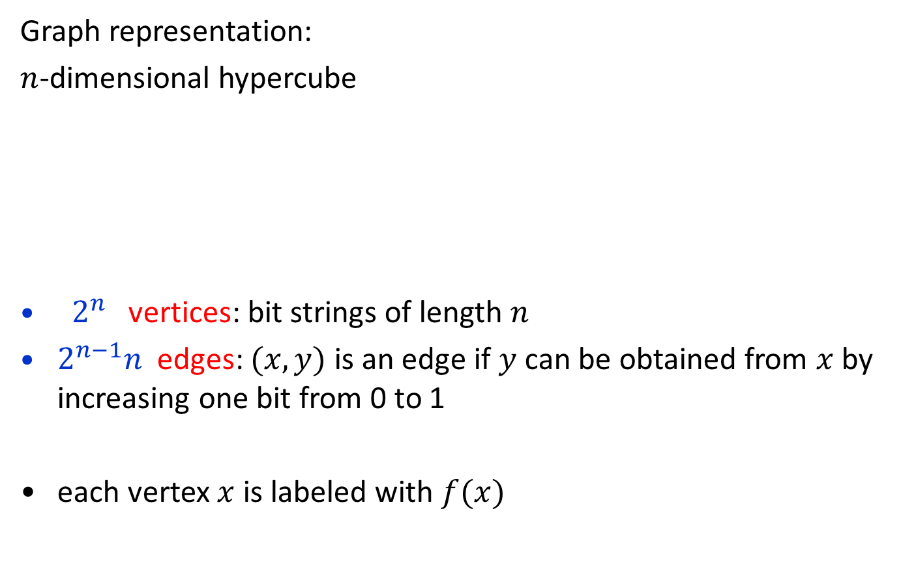
Boolean Functions $f :{\left\{0,1\right\}}^{n}→\{0,1\}$
f(011)
Graph representation:
$n$-dimensional hypercube
${ 2}^{n}$vertices: bit strings of length $n$
$2^{n−1}n$edges: $(x,y)$ is an edge if $y$ can be obtained from $x$ by increasing one bit from 0 to 1
each vertex $x$ is labeled with $f(x)$
f(111)
f(010)
f(110)
f(001)
f(101)
f(000)
f(100)
$$x$$
$$y$$
001001 011001

Slide 39
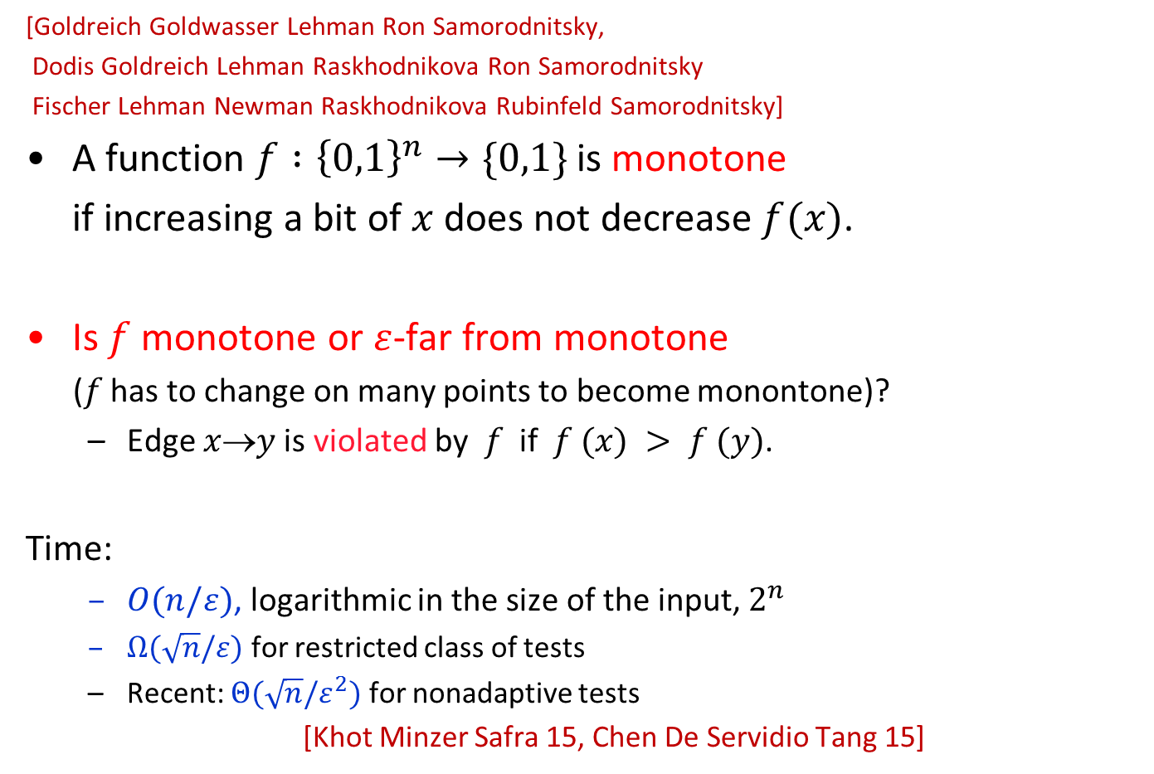

Monotonicity of Functions
1
[Goldreich Goldwasser Lehman Ron Samorodnitsky,
Dodis Goldreich Lehman Raskhodnikova Ron Samorodnitsky
Fischer Lehman Newman Raskhodnikova Rubinfeld Samorodnitsky]
A function $f :{\left\{0,1\right\}}^{n}→\{0,1\}$ is monotone
if increasing a bit of $x$ does not decrease $f(x)$.
Is $f$ monotone or $ε$-far from monotone
($f$ has to change on many points to become monontone)?
Edge $x$→$y$ is violated by $f$ if $f (x) > f (y)$.
Time:
$O(n/ε)$, logarithmic in the size of the input, $2^{n}$
$Ω(\sqrt{n}/ε)$ for restricted class of tests
Recent: $Θ(\sqrt{n}/ε^{2})$ for nonadaptive tests
[Khot Minzer Safra 15, Chen De Servidio Tang 15]
1
1
0
1
0
0
0
monotone
0
1
0
0
1
1
0
1
$\frac{1}{2}$-far from monotone

Slide 40

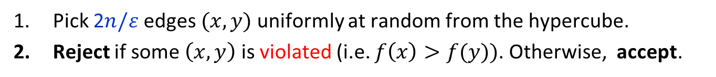
Monotonicity Test [GGLRS, DGLRRS]
Idea: Show that functions that are far from monotone violate many edges.
Analysis
If $f$ is monotone, EdgeTest always accepts.
If $f$ is $ε$-far from monotone, by Witness Lemma, it suffices to show that $≥ε/n$ fraction of edges (i.e., $\frac{ε}{n}⋅2^{n−1}n=ε2^{n−1}$ edges) are violated by $f$.
Let $V(f)$ denote the number of edges violated by $f$.
Contrapositive: If $V(f)<$ $ε{ 2}^{n−1}$, $f$ can be made monotone by changing $<ε 2^{n}$ values.
EdgeTest ($f$, ε)
Pick 2$n/ε$ edges $(x,y)$ uniformly at random from the hypercube.
Reject if some $\left(x,y\right)$ is violated (i.e. $f\left(x\right)>f(y))$. Otherwise, accept.
Repair Lemma
$f$ can be made monotone by changing $≤2⋅V(f)$ values.

Slide 41
Repair Lemma: Proof Idea
Repair Lemma
Proof idea: Transform f into a monotone function by repairing edges in one dimension at a time.
$f$ can be made monotone by changing $≤2⋅V(f)$ values.

Slide 42
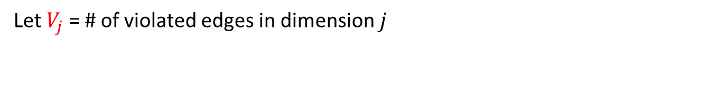
Repairing Violated Edges in One Dimension
Swap violated edges 1→0 in one dimension to 0→1.
j
0
0
0
0
i
1
0
Swapping horizontal dimension
0
1
0
1
0
1
1
0
0
1
Let $V_{j}$= # of violated edges in dimension $j$
Claim. Swapping in dimension $i$ does not increase $V_{j}$ for all dimensions $j≠i$
Enough to prove the claim for squares

Slide 43
Proof of The Claim for Squares
If no horizontal edges are violated, no action is taken.
Claim. Swapping in dimension $i$ does not increase $V_{j}$ for all dimensions $j≠i$
j
i
Swapping horizontal dimension

Slide 44
Proof of The Claim for Squares
If both horizontal edges are violated, both are swapped, so the number of vertical violated edges does not change.
Claim. Swapping in dimension $i$ does not increase $V_{j}$ for all dimensions $j≠i$
j
1
0
0
1
i
Swapping horizontal dimension
1
0
0
1

Slide 45




Proof of The Claim for Squares
Suppose one (say, top) horizontal edge is violated.
If both bottom vertices have the same label, the vertical edges get swapped.
Claim. Swapping in dimension $i$ does not increase $V_{j}$ for all dimensions $j≠i$
j
1
0
0
1
i
Swapping horizontal dimension
$$v$$
$$v$$
$$v$$
$$v$$

Slide 46
Proof of The Claim for Squares
Suppose one (say, top) horizontal edge is violated.
If both bottom vertices have the same label, the vertical edges get swapped.
Otherwise, the bottom vertices are labeled 0→1, and the vertical violation is repaired.
Claim. Swapping in dimension $i$ does not increase $V_{j}$ for all dimensions $j≠i$
j
1
0
0
1
i
Swapping horizontal dimension
0
1
0
1

Slide 47

Proof of The Claim for Squares
After we perform swaps in all dimensions:
$f$ becomes monotone
# of values changed:
$$2⋅V_{1}+ 2⋅(\# \text{violated} \text{edges} \text{in}\dim{2 \text{after} \text{swapping}\dim{1)}}$$
$$+ 2⋅(\# \text{violated} \text{edges} \text{in}\dim{3 \text{after} \text{swapping}\dim{\text{1} \text{and}\text{ 2})}}$$
$$+ …≤2⋅V_{1}+2⋅V_{2}+…2⋅V_{n}=2⋅V\left(f\right)$$
Improve the bound by a factor of 2.
Claim. Swapping in dimension $i$ does not increase $V_{j}$ for all dimensions $j≠i$
Repair Lemma
$f$ can be made monotone by changing $≤2⋅V(f)$ values.

Slide 48


Testing if a Functions $f :{\left\{0,1\right\}}^{n}→\{0,1\}$ is monotone
1
Monotone or
$ε$-far from monotone?
O(n/$ε)$ time
(logarithmic in the size
of the input)
1
1
0
1
0
0
0
monotone
0
1
0
0
1
1
0
1
$\frac{1}{2}$-far from monotone

Slide 49
Graph Properties

Slide 50
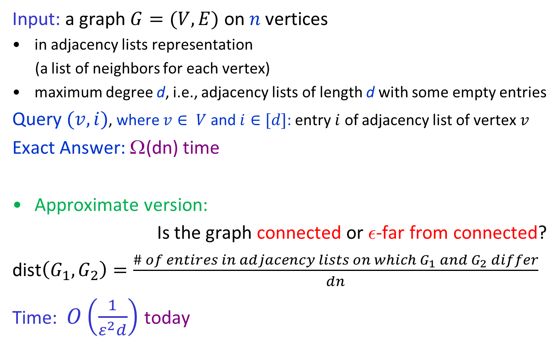
Testing if a Graph is Connected [Goldreich Ron]
Input: a graph $G=(V,E)$ on$n$vertices
in adjacency lists representation
(a list of neighbors for each vertex)
maximum degree d, i.e., adjacency lists of length d with some empty entries
Query $(v,i)$, where $v∈ V$ and $i∈[d]$: entry $i$ of adjacency list of vertex $v$
Exact Answer: Ω(dn) time
Approximate version:
Is the graph connected or ²-far from connected?
dist$\left(G_{1},G_{2}\right)=\frac{\# of entires in adjacency lists on which G_{1} and G_{2} differ}{dn}$
Time: $O\left(\frac{1}{ε^{2}d}\right)$ today
No dependence on n!

Slide 51

Testing Connectedness: Algorithm
Connectedness Tester(G, d, ε)
Repeat s=8/εd times:
pick a random vertex $u$
determine if connected component of $u$ is small:
perform BFS from $u$, stopping after at most 4/εd new nodes
Reject $if$ a small connected component was found, otherwise accept.
Run time: O($d$/ε²$d^{2}$)=O(1/ε²$d$)
Analysis:
Connected graphs are always accepted.
Remains to show:
If a graph is ²-far from connected, it is rejected with probability $≥\frac{2}{3}$

Slide 52
Testing Connectedness: Analysis
Claim 1
If Claim 2 holds, at least $\frac{\text{e}dn}{4}$ nodes are in small connected components.
By Witness lemma, it suffices to sample $\frac{2⋅4}{\text{e}dn/n}$ = $\frac{8}{\text{e}d}$nodes to detect one from a small connected component.
If G is ε-far from connected, it has $≥\frac{\text{e}dn}{2}$connected components.
Claim 2
If G is ε-far from connected, it has $≥\frac{\text{e}dn}{4}$connected components
of size at most 4/εd.

Slide 53
Testing Connectedness: Proof of Claim 1
Claim 1
We prove the contrapositive:
If G has < $\frac{\text{e}dn}{2}$connected components, one can make G connected by modifying < ε fraction of its representation, i.e., < ε$dn$ entries.
If there are no degree restrictions, k components can be connected by adding k-1 edges, each affecting 2 nodes. Here, k < $\frac{\text{e}dn}{2}$, so 2k-2 < ε$dn$ .
What if adjacency lists of all vertices in a component are full,
i.e., all vertex degrees are d?
If G is ε-far from connected, it has $≥\frac{\text{e}dn}{2}$connected components.

Slide 54
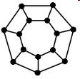
Freeing up an Adjacency List Entry
Claim 1
What if adjacency lists of all vertices in a component are full,
i.e., all vertex degrees are d?
Consider an MST of this component.
Let $v$ be a leaf of the MST.
Disconnect $v$ from a node other than its parent in the MST.
Two entries are changed while keeping the same number of components.
If G is ε-far from connected, it has $≥\frac{\text{e}dn}{2}$connected components.
$$v$$

Slide 55
Freeing up an Adjacency List Entry
Claim 1
What if adjacency lists of all vertices in a component are full,
i.e., all vertex degrees are d?
Apply this to each component that <2 free spots in adjacency lists.
Now we can connect all the components using the freed up spots while ensuring that we never change more than 2 spots per component.
Thus, k components can be connected by changing 2k spots.
Here, k < $\frac{\text{e}dn}{4}$, so 2k < ε$dn$ .
If G is ε-far from connected, it has $≥\frac{\text{e}dn}{2}$connected components.
$$v$$

Slide 56
Testing Connectedness: Proof of Claim 2
Claim 1
If Claim 1 holds, there are at least $\frac{\text{e}dn}{2}$ connected components.
Their average size $≤\frac{n}{\text{e}dn/2}$ =$\frac{2}{\text{e}d}$.
By an averaging argument (or Markov inequality), at least half of the components are of size at most twice the average.
If G is ε-far from connected, it has $≥\frac{\text{e}dn}{2}$connected components.
Claim 2
If G is ε-far from connected, it has $≥\frac{\text{e}dn}{4}$connected components
of size at most 4/εd.

Slide 57
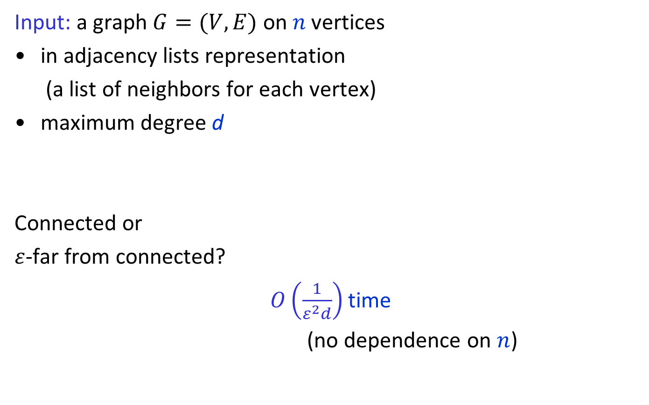
Testing if a Graph is Connected [Goldreich Ron]
Input: a graph $G=(V,E)$ on$n$vertices
in adjacency lists representation
(a list of neighbors for each vertex)
maximum degree d
Connected or
$ε$-far from connected?
$O\left(\frac{1}{ε^{2}d}\right)$ time
(no dependence on $n$)

Slide 58
Approximating # of Connected Components
[Chazelle Rubinfeld Trevisan]
Input: a graph $G=(V,E)$ on n vertices
in adjacency lists representation
(a list of neighbors for each vertex)
maximum degree d
Exact Answer: Ω(dn) time
Additive approximation: # of CC ±εn
with probability ¸ 2/3
Time:
Known: $O\left(\frac{d}{ε^{2}}\log{\frac{1}{ε}}\right)$, Ω$\left(\frac{d}{ε^{2}}\right)$
Today: $O\left(\frac{d}{ε^{3}}\right)$.
No dependence on n!
Partially based on slides by Ronitt Rubinfeld: http://stellar.mit.edu/S/course/6/fa10/6.896/courseMaterial/topics/topic3/lectureNotes/lecst11/lecst11.pdf

Slide 59
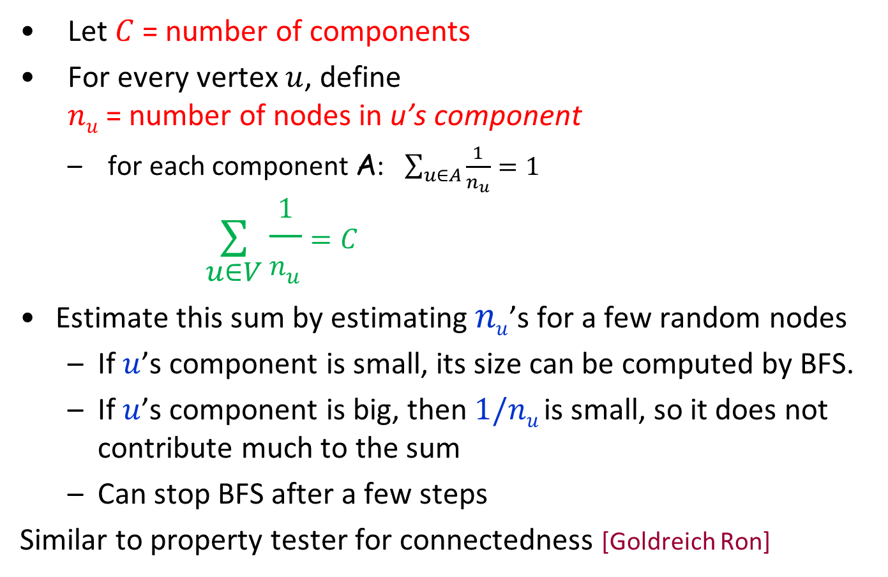
Approximating # of CCs: Main Idea
Let $C$ = number of components
For every vertex $u$, define $nu$ = number of nodes in u’s component
for each component A: $\sum_{u∈A}{\frac{1}{n_{u}}=1 }$
$$\underset{u∈V}{∑}\frac{1}{n_{u}}=C$$
Estimate this sum by estimating $nu$’s for a few random nodes
If $u$’s component is small, its size can be computed by BFS.
If $u$’s component is big, then $1/nu$ is small, so it does not contribute much to the sum
Can stop BFS after a few steps
Similar to property tester for connectedness [Goldreich Ron]
Breaks C up into
contributions
of different nodes

Slide 60

Approximating # of CCs: Algorithm
Estimating$nu$= the number of nodes in $u$’s component:
Let estimate ${\hat{n}}_{u}=\min\left\{n_{u},\frac{2}{ε}\right\}$
When $u$’s component has · 2/ε nodes , ${\hat{n}}_{u}=n_{u}$
Else ${\hat{n}}_{u}=$ 2/ε, and so $0<\frac{1}{{\hat{n}}_{u}}−\frac{1}{n_{u}}<\frac{1}{{\hat{n}}_{u}}=\frac{ε}{2}$
Corresponding estimate for C is $\hat{C}=\sum_{u∈V}{\frac{1}{{\hat{n}}_{u}}}$. It is a good estimate: $\left|\hat{C}−C\right|=\left|\sum_{u∈V}{\frac{1}{{\hat{n}}_{u}}}−\sum_{u∈V}{\frac{1}{n_{u}}}\right|≤\sum_{u∈V}{\left|\frac{1}{{\hat{n}}_{u}}−\frac{1}{n_{u}}\right|≤\frac{εn}{2}}$
Repeat s=Θ(1/ε²) times:
pick a random vertex $u$
compute ${\hat{n}}_{u}$ via BFS from $u$, stopping after at most 2/ε new nodes
Return $\tilde{C}$= (average of the values ${1/\hat{n}}_{u}$) ∙ $n$
Run time: O(d /ε³)
$$\left.\begin{aligned}a \\ b \\ c \\ \end{aligned}\right\} \left|\frac{1}{{\hat{n}}_{u}}−\frac{1}{n_{u}}\right|≤\frac{ε}{2}$$
APPROX_#_CCs (G, d, ε)

Slide 61
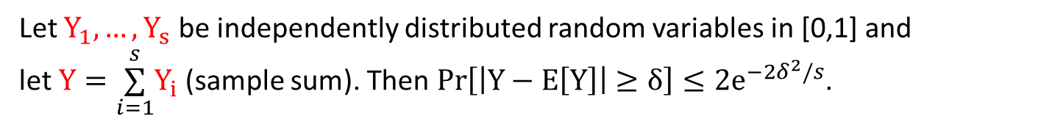
Approximating # of CCs: Analysis
Want to show: $\operatorname{Pr}\left[\left|\tilde{C}−\hat{C}\right|>\frac{εn}{2}\right]≤\frac{1}{3}$
Let $Y_{i}=1/{\hat{n}}_{u}$for the i^{th} vertex $u$ in the sample
$Y=\underset{i=1}{\overset{s}{∑}}Y_{i}=\frac{s\tilde{C}}{n}$ and $E[Y] =\underset{i=1}{\overset{s}{∑}}{E[Y}_{i}]=s⋅{E[Y}_{1}]=s$ $⋅\frac{1}{n}\sum_{u∈V}{\frac{1}{{\hat{n}}_{u}}}=\frac{s\hat{C}}{n}$
$\operatorname{Pr}\left[\left|\tilde{C}−\hat{C}\right|>\frac{εn}{2}\right]=\operatorname{Pr}\left[\left|\frac{n}{s}Y−\frac{n}{s}E\left[Y\right]\right|>\frac{εn}{2}\right]=\operatorname{Pr}\left[\left|Y−E\left[Y\right]\right|>\frac{εs}{2}\right]≤2e^{−\frac{ε^{2}s}{2}}$
Need $s=Θ\left(\frac{1}{ε^{2}}\right)$ samples to get probability $≤\frac{1}{3}$
Hoeffding Bound
Let $Y_{1}, …, Y_{s}$ be independently distributed random variables in [0,1] and
let $Y=\underset{i=1}{\overset{s}{∑}}Y_{i}$ (sample sum). Then $\operatorname{Pr}\left[\left|Y−E\left[Y\right]\right|≥δ\right]≤{2e}^{−2δ^{2}/s}$.

Slide 62
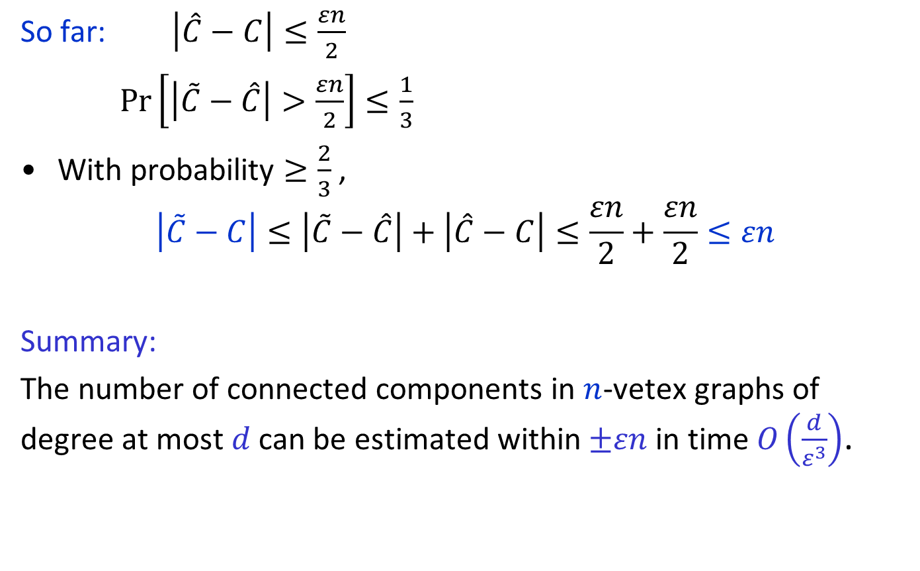
Approximating # of CCs: Analysis
So far: $\left|\hat{C}−C\right|≤\frac{εn}{2}$
$\operatorname{Pr}\left[\left|\tilde{C}−\hat{C}\right|>\frac{εn}{2}\right]≤\frac{1}{3}$
With probability $≥\frac{2}{3}$ ,
$$\left|\tilde{C}−C\right|≤\left|\tilde{C}−\hat{C}\right|+\left|\hat{C}−C\right|≤\frac{εn}{2}+\frac{εn}{2}≤εn$$
Summary:
The number of connected components in $n$-vetex graphs of degree at most $d$ can be estimated within$±εn$ in time $O\left(\frac{d}{ε^{3}}\right)$.

Slide 63
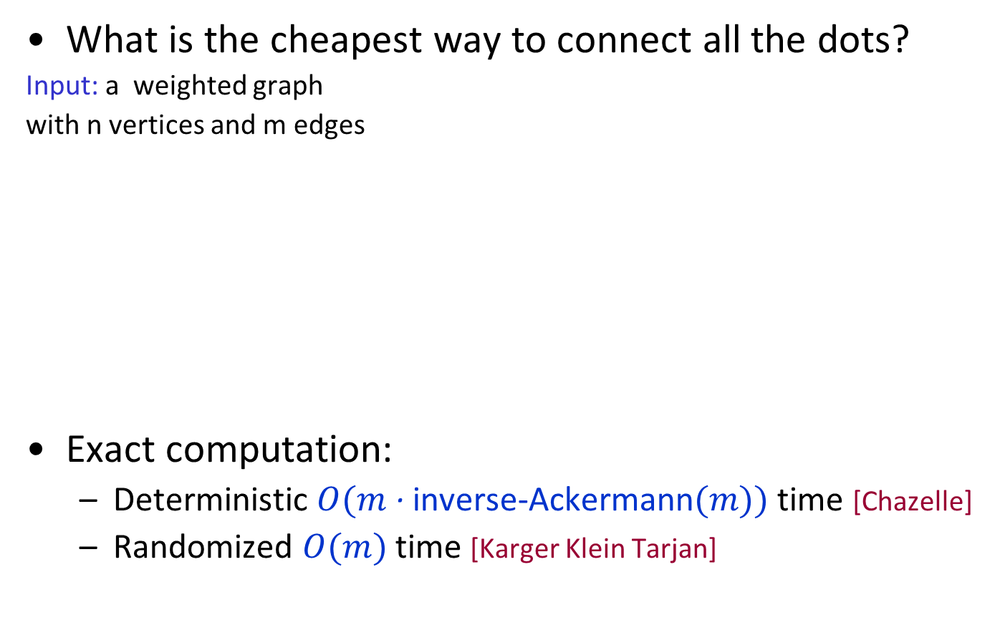
Minimum spanning tree (MST)
What is the cheapest way to connect all the dots?
Input: a weighted graph
with n vertices and m edges
Exact computation:
Deterministic $O(m$ ∙ inverse-Ackermann$(m))$time [Chazelle]
Randomized $O(m)$time [Karger Klein Tarjan]
3
4
2
7
1
5
Partially based on slides by Ronitt Rubinfeld: http://stellar.mit.edu/S/course/6/fa10/6.896/courseMaterial/topics/topic3/lectureNotes/lecst11/lecst11.pdf

Slide 64
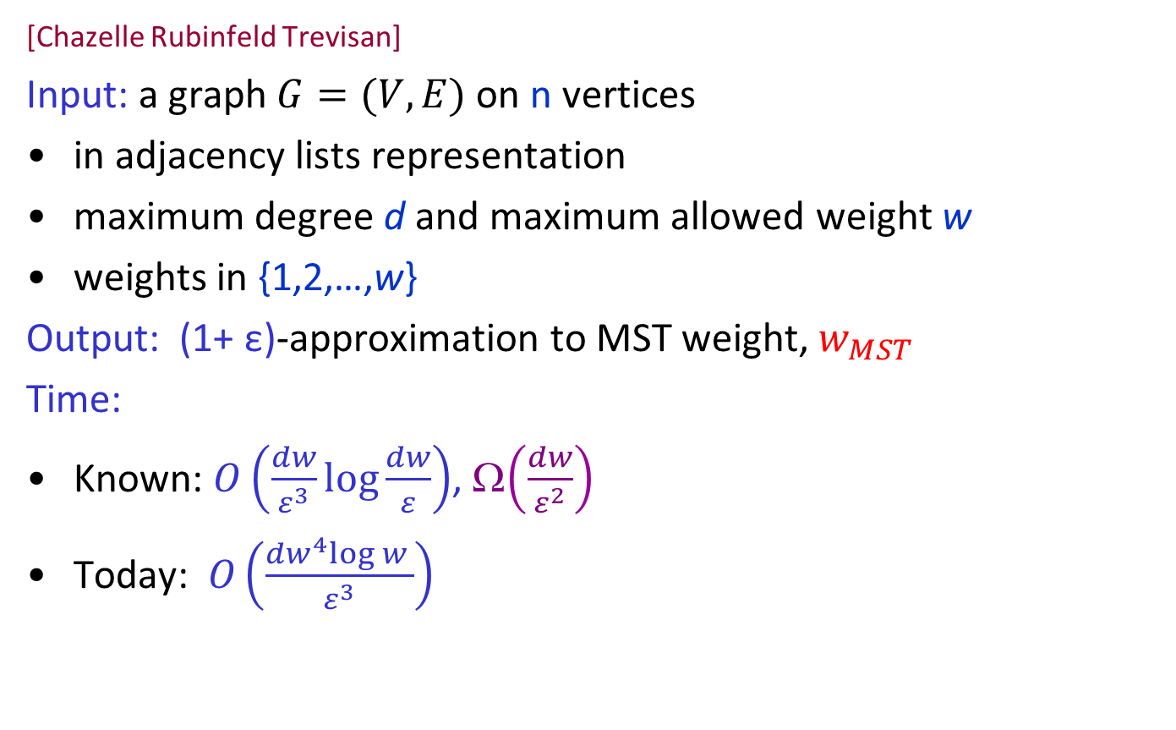
Approximating MST Weight in Sublinear Time
[Chazelle Rubinfeld Trevisan]
Input: a graph $G=(V,E)$on n vertices
in adjacency lists representation
maximum degree d and maximum allowed weight w
weights in {1,2,…,w}
Output: (1+ ε)-approximation to MST weight, $w_{MST}$
Time:
Known: $O\left(\frac{dw}{ε^{3}}\log{\frac{dw}{ε}}\right)$, Ω$\left(\frac{dw}{ε^{2}}\right)$
Today: $O\left(\frac{dw^{4}log w }{ε^{3}}\right)$
No dependence on n!

Slide 65
Idea Behind Algorithm
Characterize MST weight in terms of number of connected components in certain subgraphs of G
Already know that number of connected components can be estimated quickly

Slide 66
MST and Connected Components: Warm-up
Recall Kruskal’s algorithm for computing MST exactly.
Suppose all weights are 1 or 2. Then MST weight = (# weight-1 edges in MST) + 2 $⋅$ (# weight-2 edges in MST)
$= n – 1 +$(# of weight-2 edges in MST)
$= n – 1 +$(# of CCs induced by weight-1 edges)$−1$
MST has $n−1$ edges
By Kruskal
weight 1
weight 2
MST
connected components
induced by weight-1 edges

Slide 67
MST and Connected Components
In general: ${\text{Let} G}_{i}=\text{subgraph} \text{of} G \text{containing} \text{all} \text{edges} \text{of} \text{weight}≤i$
$$C_{i}=\text{number} \text{of} \text{connected} \text{components} \text{in}{ G}_{i}$$
Then MST has $C_{i}−1$ edges of weight $> i.$
Let $β_{i} \text{be} \text{the} \text{number} \text{of} \text{edges} \text{of} \text{weight}>i \text{in} \text{MST}$
Each MST edge contributes 1 to $w_{MST}$, each MST edge of weight >1 contributes 1 more, each MST edge of weight >2 contributes one more, …
$$w_{MST}\left(G\right)=\sum_{i=0}^{w−1}{β_{i}}=\sum_{i=0}^{w−1}{{(C}_{i}}−1)=−w+\sum_{i=0}^{w−1}{C_{i}}=n−w+\sum_{i=1}^{w−1}{C_{i}}$$
$$w_{MST}\left(G\right)=n−w+\sum_{i=1}^{w−1}{C_{i}}$$
Claim

Slide 68

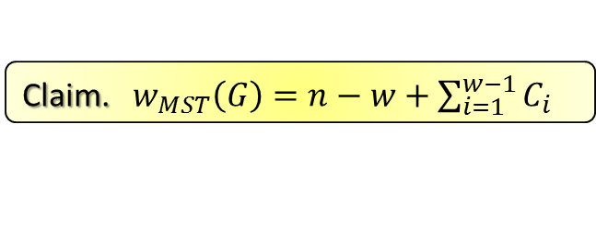
Algorithm for Approximating $w_{MST}$
APPROX_MSTweight (G, w, d, ε)
Claim. $w_{MST}\left(G\right)=n−w+\sum_{i=1}^{w−1}{C_{i}}$
For $i=1 \text{to} w−1$ do:
${\tilde{C}}_{i}←$APPROX_#CCs($G_{i} , d,ε/w$).
Return ${\tilde{w}}_{MST}=n−w+\sum_{i=1}^{w−1}{{\tilde{C}}_{i}}.$
Analysis:
Suppose all estimates of $C_{i}$’s are good: $\left|{\tilde{C}}_{i}−C_{i}\right|≤\frac{ε}{w} n.$
Then $\left|{{\tilde{w}}_{MST}−w}_{MST}\right|=|$ $\sum_{i=1}^{w−1}{{(\tilde{C}}_{i}−C_{i})|≤ }$ $\sum_{i=1}^{w−1}{{|\tilde{C}}_{i}−C_{i}|≤w⋅ }\frac{ε}{w} n=εn$
Pr[all $w−1$estimates are good]$≥{\left(2/3\right)}^{w−1}$
Not good enough! Need error probability $≤\frac{1}{3w}$ for each iteration
Then, by Union Bound, Pr[error]$≤w⋅$ $\frac{1}{3w}=\frac{1}{3}$
Can amplify success probability of any algorithm by repeating it and taking the median answer.
Can take more samples in APPROX_#CCs. What’s the resulting run time?

Slide 69
Multiplicative Approximation for $w_{MST}$
For MST cost, additive approximation $⟹$ multiplicative approximation
$w_{MST}≥n−1$ $⟹$ $w_{MST}≥n/2$ for $n≥2$
$εn$-additive approximation:
$w_{MST}−$ $εn≤{\hat{w}}_{MST}≤w_{MST}+εn$
$(1±2ε)$-multiplicative approximation:
$$w_{MST}\left(1−2ε\right)≤w_{MST}− εn≤{\hat{w}}_{MST}≤w_{MST}+εn≤w_{MST}\left(1+2ε\right)$$

