Slide 1
Big Data Reading Group
Grigory Yaroslavtsev
361 Levine
http://grigory.us
grigory@grigory.us

Slide 2
Reading group format
Weekly meetings: 3:30pm, Towne 311
Participation-driven format
  Pick a paper to discuss
  Select a volunteer to present
  Participants look at the paper before the meeting
  The volunteer explains technical details and leads the discussion
  More informal than a seminar (presentation not necessary, can use the board, the paper, notes, etc.)

Slide 3
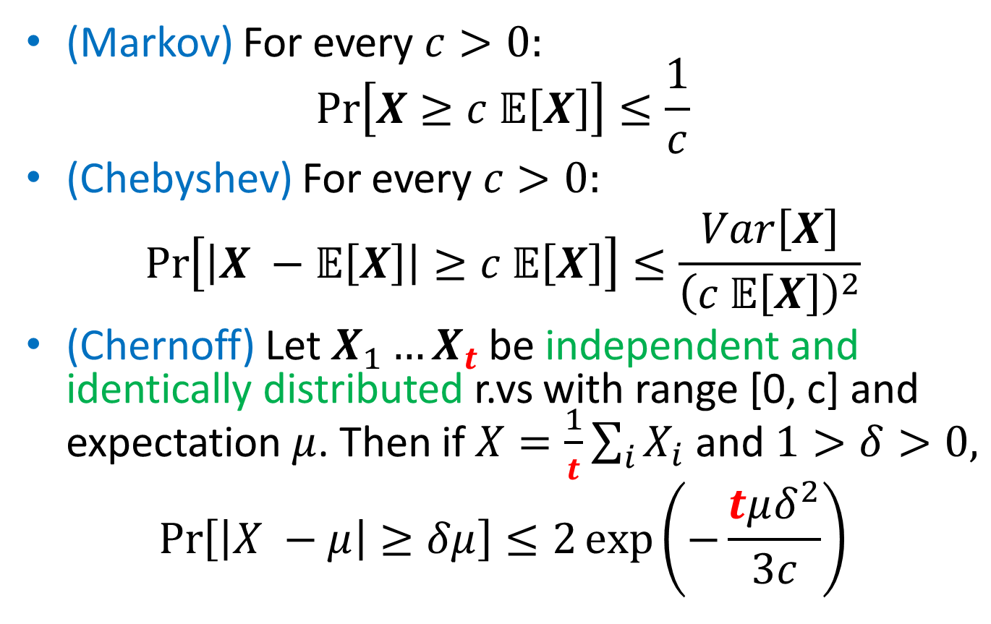
Basics
(Markov) For every $c>0:$
$$Pr\left[X≥c 𝔼\left[X\right]\right]≤\frac{1}{c}$$
(Chebyshev) For every $c>0:$
$$\operatorname{Pr}\left[\left|X −𝔼\left[X\right]\right|≥c 𝔼\left[X\right]\right]≤\frac{Var\left[X\right]}{{\left(c 𝔼\left[X\right]\right)}^{2}}$$
(Chernoff) Let $X_{1}…X_{t}$ be independent and identically distributed r.vs with range [0, c] and expectation $μ$. Then if $X=\frac{1}{t}\sum_{i}{X_{i}}$ and $1>δ>0,$
$$\operatorname{Pr}\left[\left|X −μ\right|≥δμ\right]≤2\exp\left(−\frac{tμδ^{2}}{3c}\right)$$

Slide 4
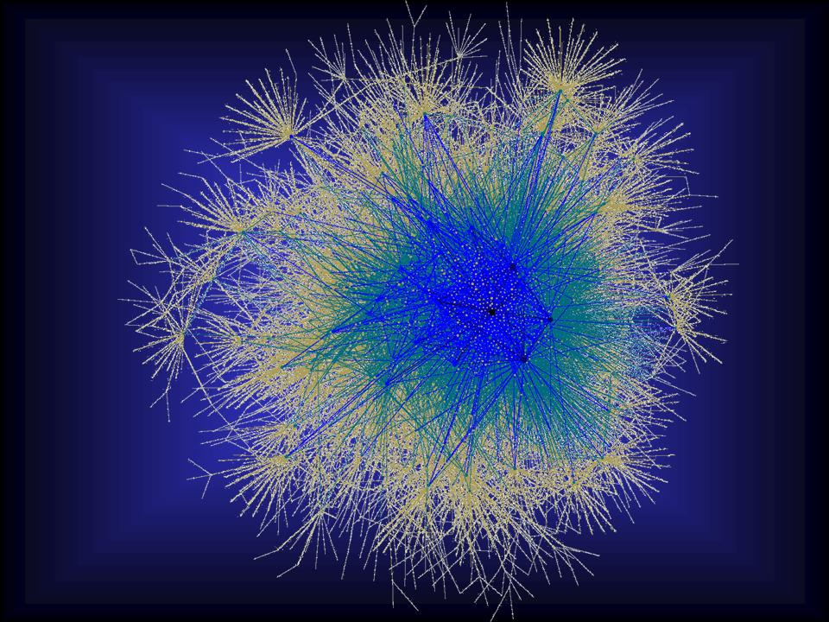
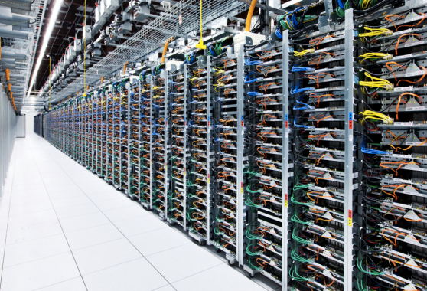
Part 1: Massive Parallel Computation
Very large data (graphs)
Enough space to store them distributedly
Not enough time to compute.
Communication is a bottleneck

Slide 5
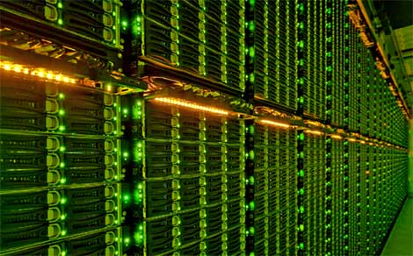
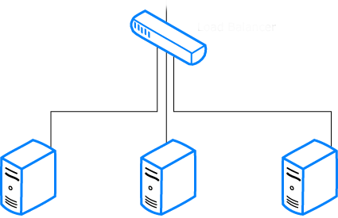

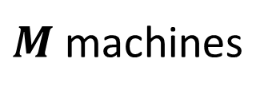
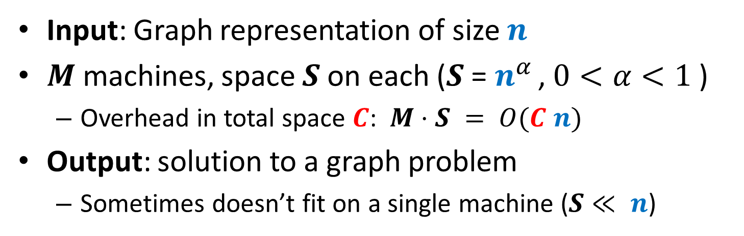



Computational Model
Input: Graph representation of size $n$
$M$ machines, space $S$ on each ($S$ = $n^{α }$, $0<α<1$ )
  Overhead in total space $C$: $M⋅S = O(C n)$
Output: solution to a graph problem
  Sometimes doesn’t fit on a single machine ($S≪ n$)
$Input:Graph$⇒
$$\text{⇒} Output$$
$M$machines
S space

Slide 6



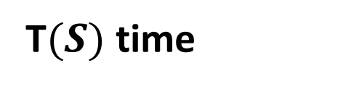
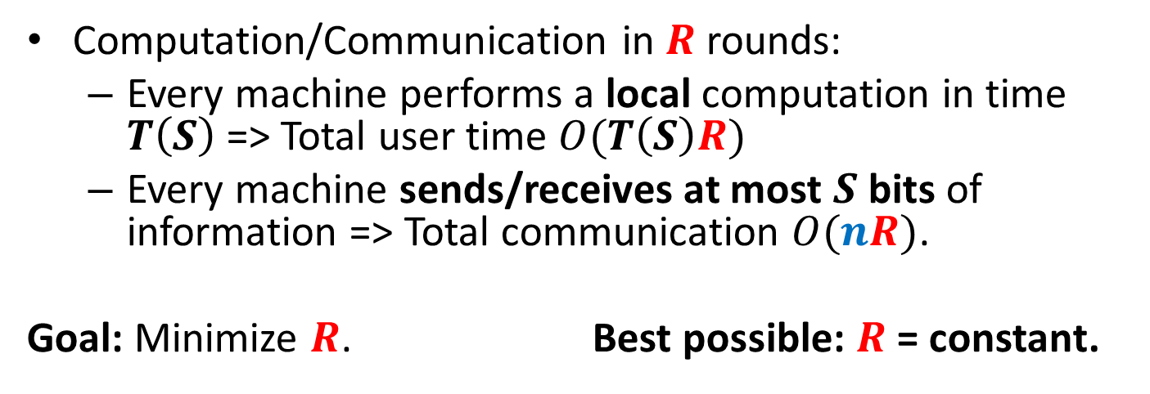
Computational Model
Computation/Communication in $R$ rounds:
  Every machine performs a local computation in time $T\left(S\right)$=> Total user time $O(T\left(S\right)R)$
  Every machine sends/receives at most $S$ bits of information => Total communication $O(nR)$.
  Goal: Minimize $R$. Best possible: $R$ = constant.
$≤S$ bits
$M$machines
S space
T$(S)$ time

Slide 7

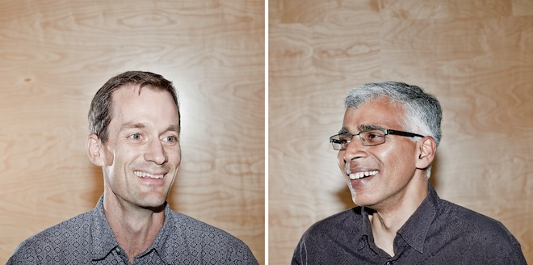


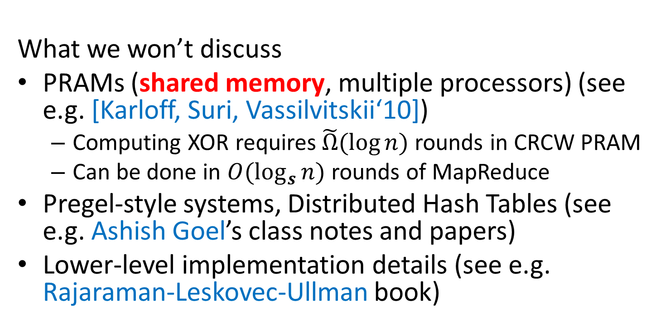
MapReduce-style computations
What we won’t discuss
PRAMs (shared memory, multiple processors) (see e.g. [Karloff, Suri, Vassilvitskii‘10])
  Computing XOR requires$\tilde{Ω}(\log{n})$ rounds in CRCW PRAM
  Can be done in $O(\log_{s}{n})$ rounds of MapReduce
Pregel-style systems, Distributed Hash Tables (see e.g. Ashish Goel’s class notes and papers)
Lower-level implementation details (see e.g. Rajaraman-Leskovec-Ullman book)

Slide 8
Models of parallel computation
  Bulk-Synchronous Parallel Model (BSP) [Valiant,90]
    Pro: Most general, generalizes all other models
    Con: Many parameters, hard to design algorithms
  Massive Parallel Computation [Feldman-Muthukrishnan-Sidiropoulos-Stein-Svitkina’07, Karloff-Suri-Vassilvitskii’10, Goodrich-Sitchinava-Zhang’11, ..., Beame, Koutris, Suciu’13, Andoni, Onak, Nikolov, Y. ‘14]
    Pros:
    Inspired by modern systems (Hadoop, MapReduce, Dryad, … )
    Few parameters, simple to design algorithms
    New algorithmic ideas, robust to the exact model specification
    # Rounds is an information-theoretic measure => can prove unconditional lower bounds
    Between linear sketching and streaming with sorting

Slide 9
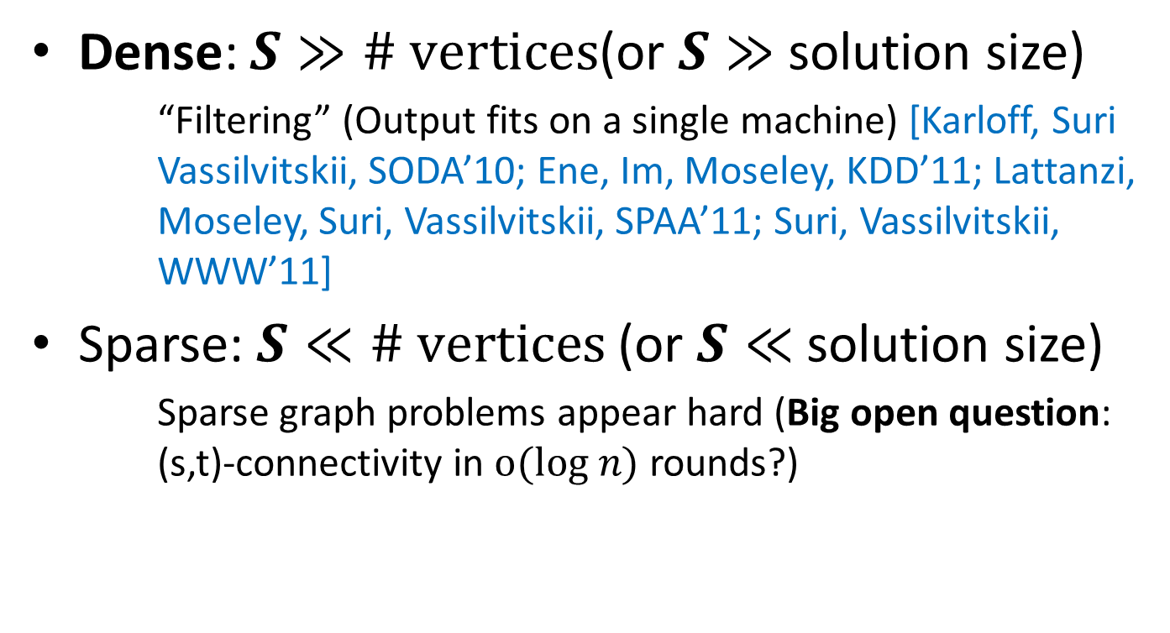
Dense graphs vs. sparse graphs
Dense: $S≫\# vertices$(or $S≫$ solution size)
    “Filtering” (Output fits on a single machine) [Karloff, Suri Vassilvitskii, SODA’10; Ene, Im, Moseley, KDD’11; Lattanzi, Moseley, Suri, Vassilvitskii, SPAA’11; Suri, Vassilvitskii, WWW’11]
Sparse: $S≪\# vertices$(or $S≪$ solution size)
    Sparse graph problems appear hard (Big open question: (s,t)-connectivity in $o(log n)$ rounds?)
VS.

Slide 10
Papers
Karloff, Suri, Vassilvitskii:
A Model of Computation for MapReduce. SODA 2010.
Feldman, Muthukrishnan, Sidiropoulos, Stein, Svitkina:
On distributing symmetric streaming computations. SODA 2008.
Lattanzi, Moseley, Suri, Vassilvitskii:
Filtering: a method for solving graph problems in MapReduce. SPAA 2011.
Bahmani, Moseley, Vattani, Kumar, Vassilvitskii:
Scalable K-Means++. VLDB 2012.
Suri, Vassilvitskii:
Counting triangles and the curse of the last reducer. WWW 2011.
Bahmani, Chakrabarti, Xin:
Fast personalized PageRank on MapReduce. SIGMOD 2011.

Slide 11

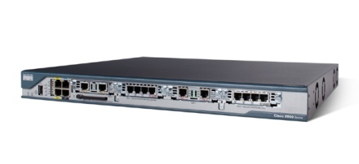
Part 2: Streaming Algorithms
Very large stream of numbers
Not enough space even to store them

Slide 12
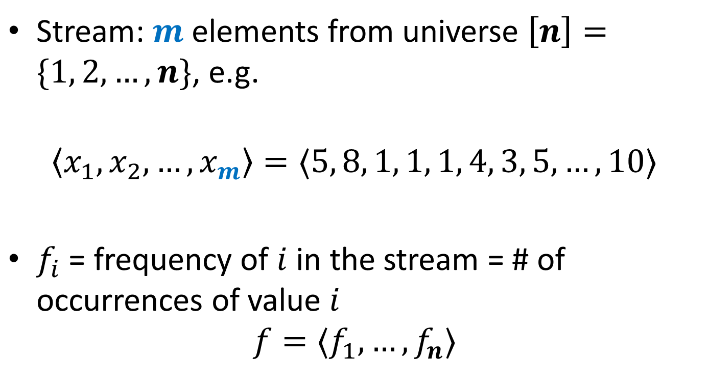
Data Streams
Stream: $m$ elements from universe $\left[n\right]=\{1, 2, …, n\}$, e.g.
$$〈x_{1},x_{2},…, x_{m}〉=〈5, 8, 1, 1, 1, 4, 3, 5, …, 10〉$$
$f_{i}$ = frequency of $i$ in the stream = # of occurrences of value $i$
$$f=〈f_{1},…, f_{n}〉$$

Slide 13
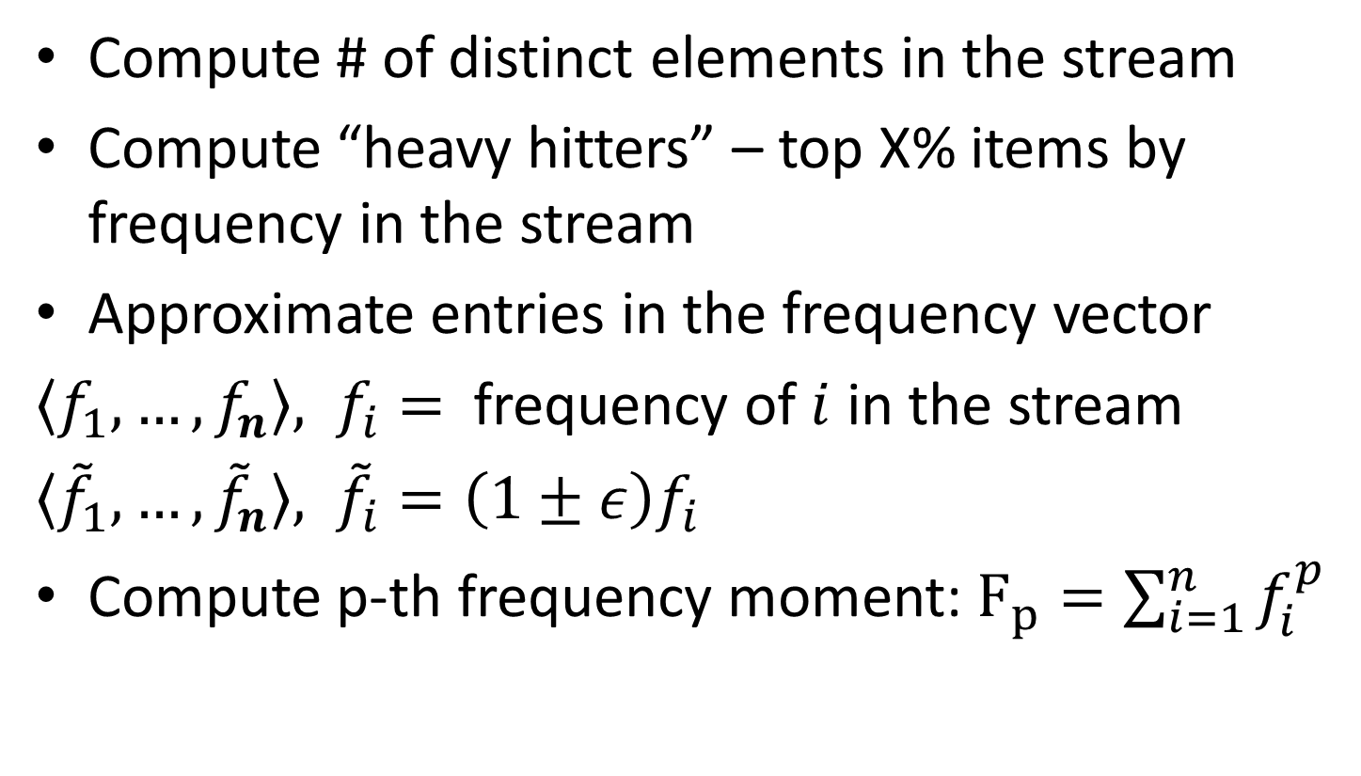
Problems on Data Streams
Compute # of distinct elements in the stream
Compute “heavy hitters” – top X% items by frequency in the stream
Approximate entries in the frequency vector
$〈f_{1},…, f_{n}〉, f_{i}=$ frequency of $i$ in the stream
$〈{\tilde{f}}_{1},…,{\tilde{f}}_{n}〉, {\tilde{f}}_{i}=\left(1±ε\right)f_{i}$
Compute p-th frequency moment: $F_{p}=\sum_{i=1}^{n}{f_{i}^{p}}$

Slide 14
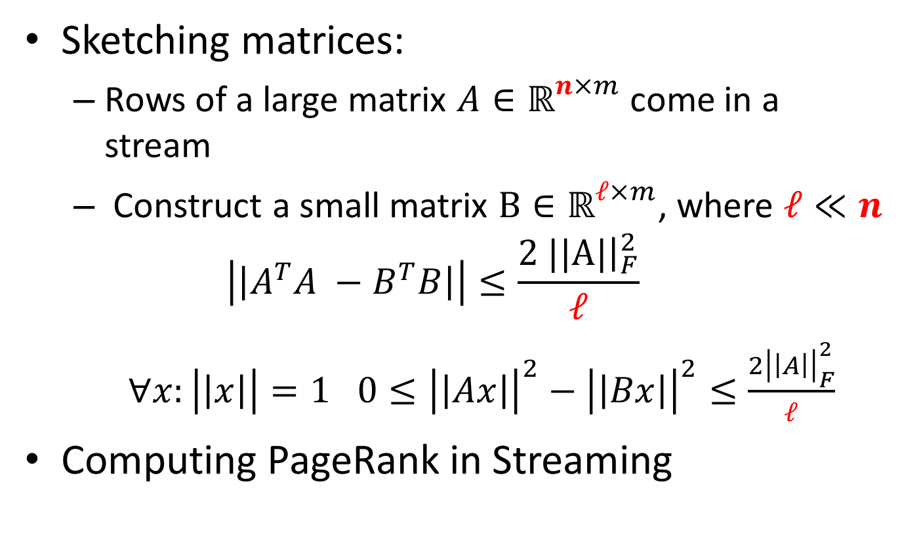
Problems on Data Streams
Sketching matrices:
  Rows of a large matrix $A∈{\text{ℝ}}^{n×m}$come in a stream
  Construct a small matrix $B∈{\text{ℝ}}^{ℓ×m}$, where $ℓ≪n$
  $$\left|\left|A^{T}A −B^{T}B\right|\right|≤\frac{2 |{\left.|​A|\right|}_{F}^{2}}{ℓ}$$
  $∀x:\left|\left|x\right|\right|=1$ $0≤{\left|\left|Ax\right|\right|}^{2}−{\left|\left|Bx\right|\right|}^{2}≤\frac{2{\left|\left|A\right|\right|}_{F}^{2}}{ℓ}$
Computing PageRank in Streaming

Slide 15
Papers
Cormode, Muthukrishnan:
An Improved Data Stream Summary: The Count-Min Sketch and Its Applications. LATIN 2004, Imre Simon Award.
Kane, Nelson, Woodruff:
An optimal algorithm for the distinct elements problem. PODS 2010, Best Paper Award.
Liberty:
Simple and deterministic matrix sketching. KDD 2013, Best Paper Award.
Jha, Seshadhri, Pinar:
A space efficient streaming algorithm for triangle counting using the birthday paradox. KDD 2013, Best Student Paper Award.
Das Sarma, Gollapudi, Panigrahy:
Estimating PageRank on graph streams. PODS 2008, Best Paper Award.

Slide 16
Thank you!
Next meeting:
Friday, September 19, 3:30pm, Towne 311
Links to all papers are available at:
http://grigory.us/big-data-reading.html

