Slide 1

Computational and Communication Complexity in Massively Parallel Computation
Grigory Yaroslavtsev
(Indiana University, Bloomington)
http://grigory.us

Slide 2
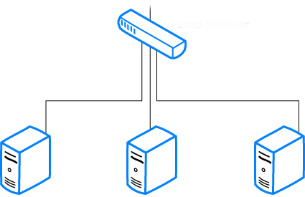

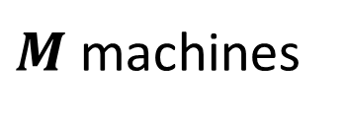
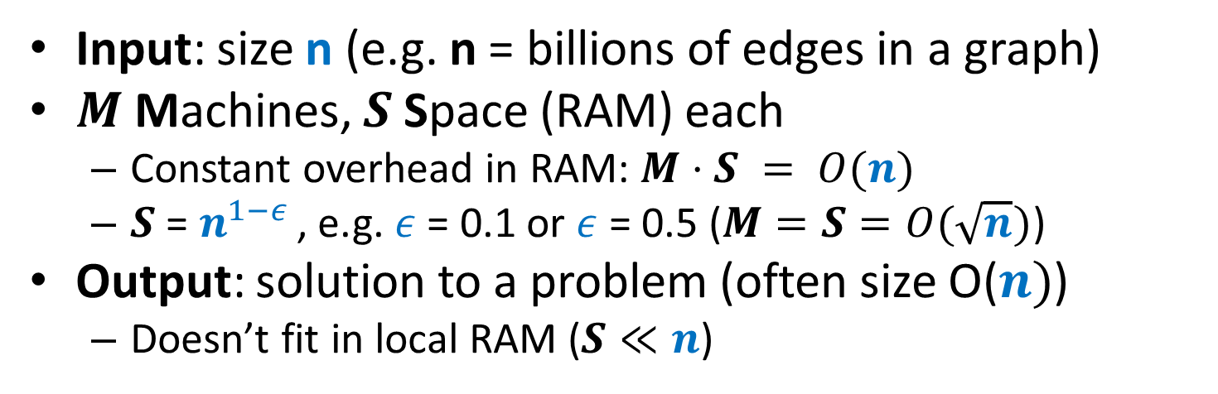

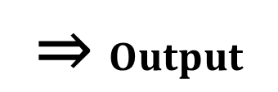
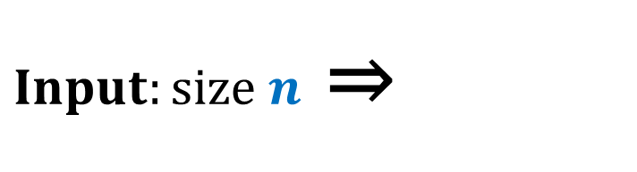
Cluster Computation (a la BSP)
Input: size n (e.g. n = billions of edges in a graph)
$M$ Machines, $S$ Space (RAM) each
Constant overhead in RAM: $M⋅S = O(n)$
$S$ = $n^{1−ε }$, e.g. $ε$ = 0.1 or $ε$ = 0.5 ($M=S=O(\sqrt{n})$)
Output: solution to a problem (often size O($n)$)
Doesn’t fit in local RAM ($S≪n$)
$Input:size n$ ⇒
$$\text{⇒} Output$$
$M$machines
S space

Slide 3



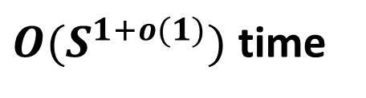
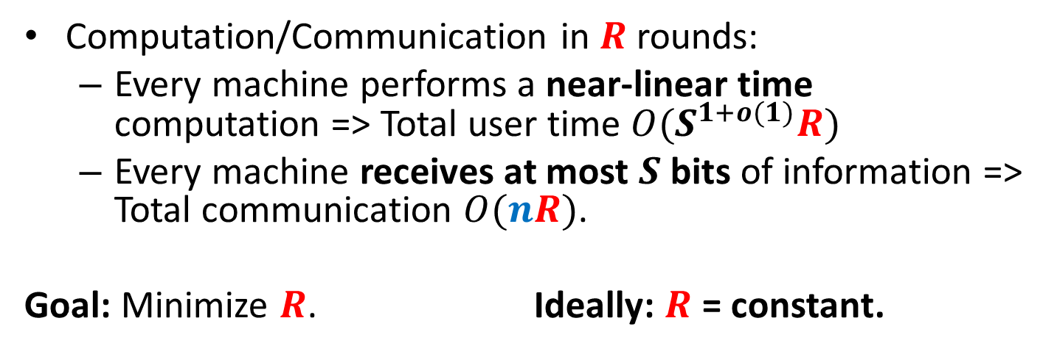
Cluster Computation (a la BSP)
Computation/Communication in $R$ rounds:
Every machine performs a near-linear time computation => Total user time $O(S^{1+o(1)}R)$
Every machine receives at most $S$ bits of information => Total communication $O(nR)$.
Goal: Minimize $R$. Ideally: $R$ = constant.
$≤S$ bits
$M$machines
S space
$O(S^{1+o(1)})$ time

Slide 4

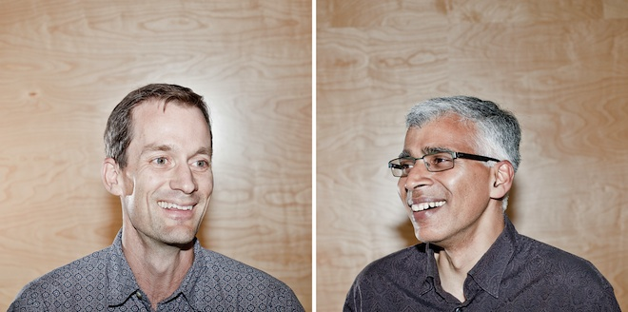



MapReduce-style computations
What I won’t discuss today
PRAMs (shared memory, multiple processors) (see e.g. [Karloff, Suri, Vassilvitskii‘10])
Computing XOR requires$\tilde{Ω}(\log{n})$ rounds in CRCW PRAM
Can be done in $O(\log_{s}{n})$ rounds of MapReduce
Pregel-style systems, Distributed Hash Tables (see e.g. Ashish Goel’s class notes and papers)
Lower-level implementation details (see e.g. Rajaraman-Leskovec-Ullman book)

Slide 5
Models of parallel computation
Bulk-Synchronous Parallel Model (BSP) [Valiant,90]
Pro: Most general, generalizes all other models
Con: Many parameters, hard to design algorithms
Massive Parallel Computation [Feldman-Muthukrishnan-Sidiropoulos-Stein-Svitkina’07, Karloff-Suri-Vassilvitskii’10, Goodrich-Sitchinava-Zhang’11, Beame, Koutris, Suciu’13, Andoni, Onak, Nikolov, Y.’14]
Pros:
Inspired by modern systems (MapReduce, Dryad, Spark, Giraph, …)
Few parameters, simple to design algorithms
New algorithmic ideas, robust to the exact model specification
# Rounds is an information-theoretic measure => can prove unconditional results
Con: sometimes not enough to model more complex behavior

Slide 6



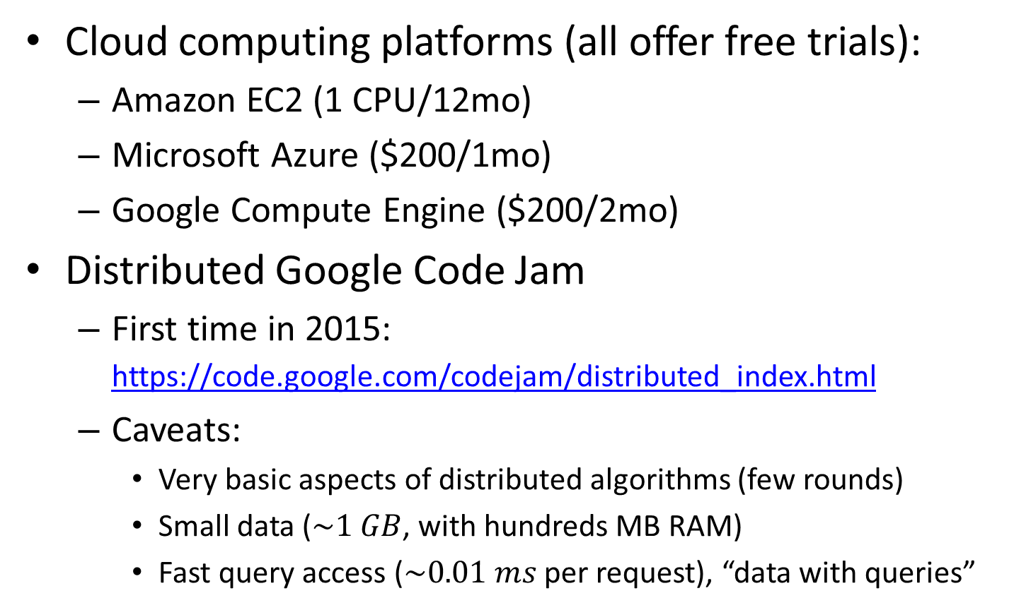
Getting hands dirty
Cloud computing platforms (all offer free trials):
Amazon EC2 (1 CPU/12mo)
Microsoft Azure ($200/1mo)
Google Compute Engine ($200/2mo)
Distributed Google Code Jam
First time in 2015: https://code.google.com/codejam/distributed_index.html
Caveats:
Very basic aspects of distributed algorithms (few rounds)
Small data ($\sim 1 GB$, with hundreds MB RAM)
Fast query access ($\sim 0.01 ms$ per request), “data with queries”

Slide 7
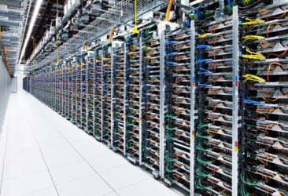
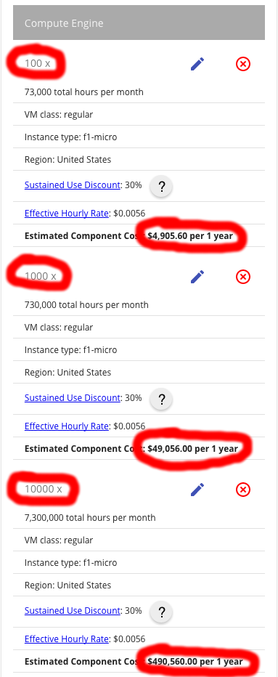
Business perspective
Pricings:
https://cloud.google.com/pricing/
https://aws.amazon.com/pricing/
$\sim L$inear with space and time usage
100 machines: 5K $/year
10000 machines: 0.5M $/year
You pay a lot more for using provided algorithms
https://aws.amazon.com/machine-learning/pricing/

Slide 8
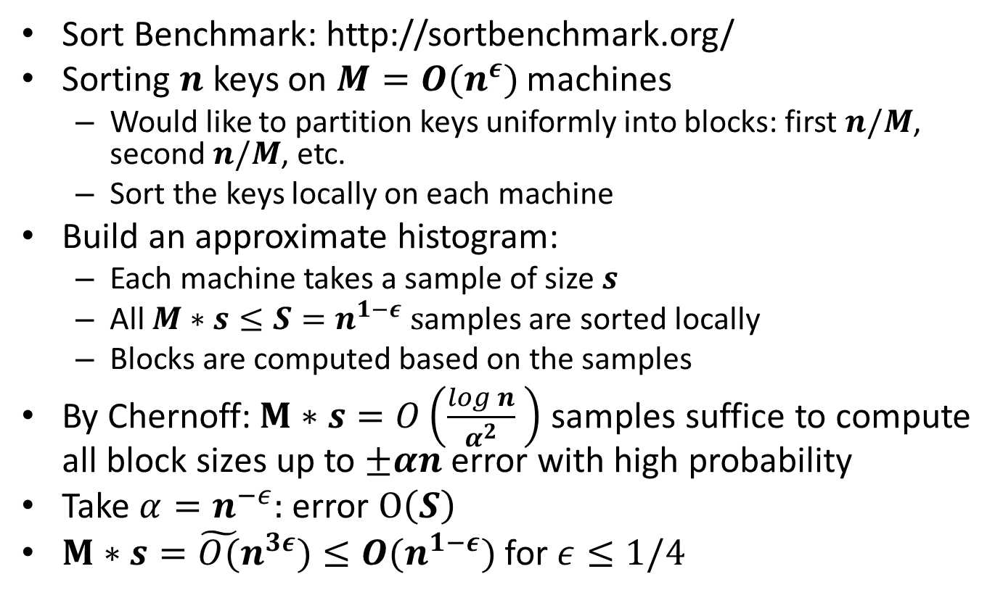
Sorting: Terasort
Sort Benchmark: http://sortbenchmark.org/
Sorting $n$ keys on $M=O(n^{ε})$ machines
Would like to partition keys uniformly into blocks: first $n/M$, second $n/M$, etc.
Sort the keys locally on each machine
Build an approximate histogram:
Each machine takes a sample of size $s$
All $M∗s≤S=n^{1−ε} s$amples are sorted locally
Blocks are computed based on the samples
By Chernoff:$M∗s=O\left(\frac{log n}{α^{2}} \right)$ samples suffice to compute all block sizes up to $±αn$ error with high probability
Take $α=n^{−ε}:$ error $O\left(S\right)$
$M∗s={\tilde{O(}n}^{3ε})≤O(n^{1−ε})$ for $ε≤1/4$

Slide 9

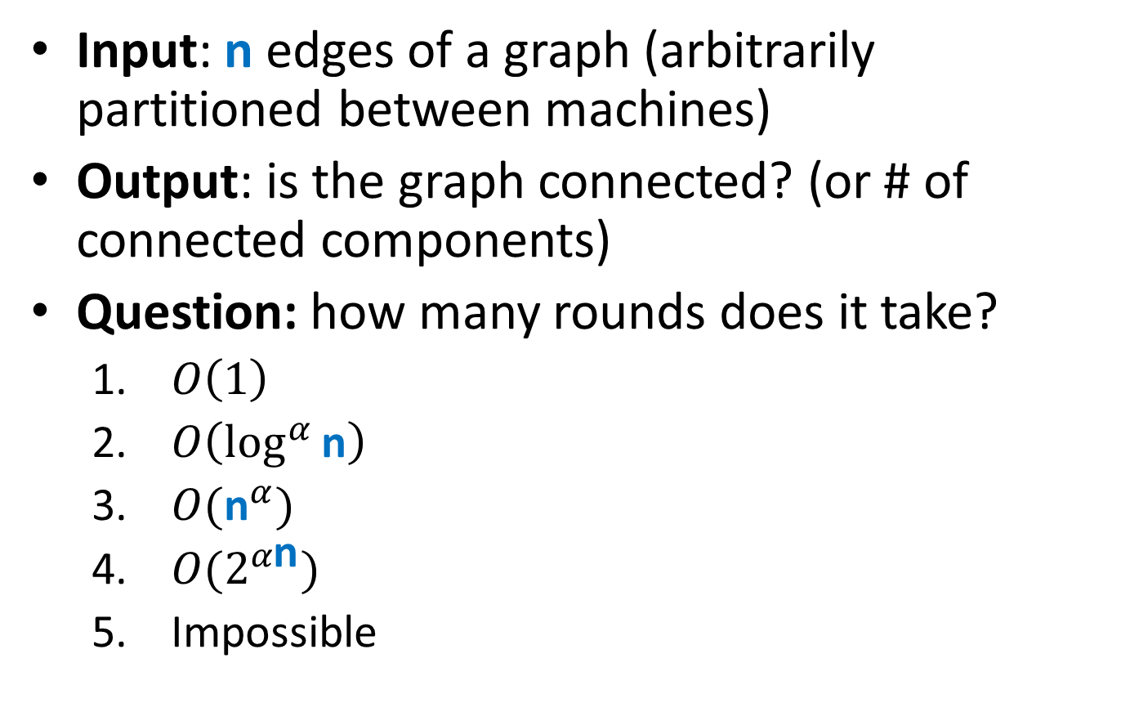
Connectivity
Input: n edges of a graph (arbitrarily partitioned between machines)
Output: is the graph connected? (or # of connected components)
Question: how many rounds does it take?
$O\left(1\right)$
$O\left(\log^{α}{\text{n}}\right)$
$O({\text{n}}^{α})$
$O(2^{α\text{n}})$
Impossible

Slide 10
Algorithms for Graphs
Dense graphs vs. sparse graphs
Dense: $S≫|V|$
Linear sketching: one round
“Filtering” (Output fits on a single machine) [Karloff, Suri Vassilvitskii, SODA’10; Ene, Im, Moseley, KDD’11; Lattanzi, Moseley, Suri, Vassilvitskii, SPAA’11; Suri, Vassilvitskii, WWW’11]
Sparse: $S≪|V|$(or $S≪$ solution size)
Sparse graph problems appear hard (Big open question: connectivity in $o(log n)$ rounds?)
VS.

Slide 11
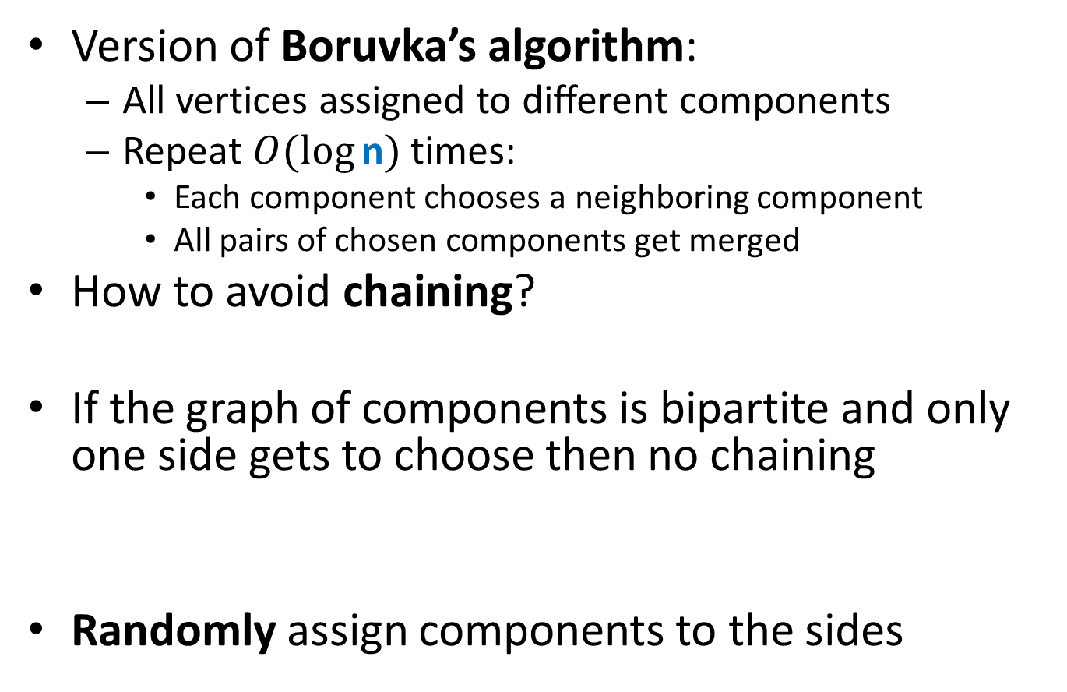
Algorithm for Connectivity
Version of Boruvka’s algorithm:
All vertices assigned to different components
Repeat $O(\log{\text{n}})$ times:
Each component chooses a neighboring component
All pairs of chosen components get merged
How to avoid chaining?
If the graph of components is bipartite and only one side gets to choose then no chaining
Randomly assign components to the sides

Slide 12
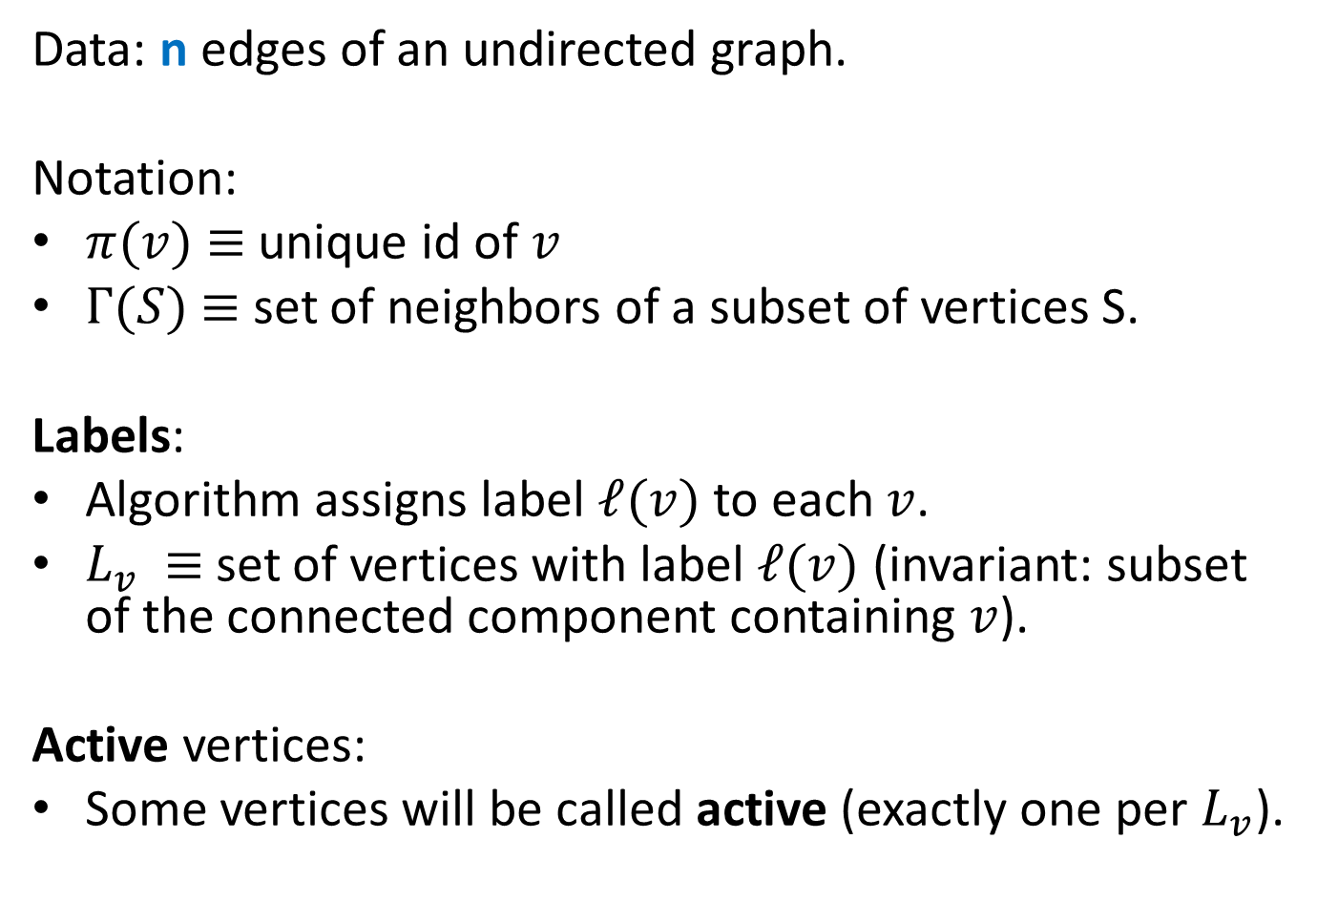
Algorithm for Connectivity: Setup
Data: $\text{n}$edges of an undirected graph.
Notation:
$π(v)$ $≡$unique id of $v$
$Γ(S)$ $≡$ set of neighbors of a subset of vertices S.
Labels:
Algorithm assigns label $ℓ(v)$ to each $v$.
$L_{v}$ $≡$set of vertices with label $ℓ(v)$ (invariant: subset of the connected component containing $v$).
Active vertices:
Some vertices will be called active (exactly one per $L_{v}$).

Slide 13
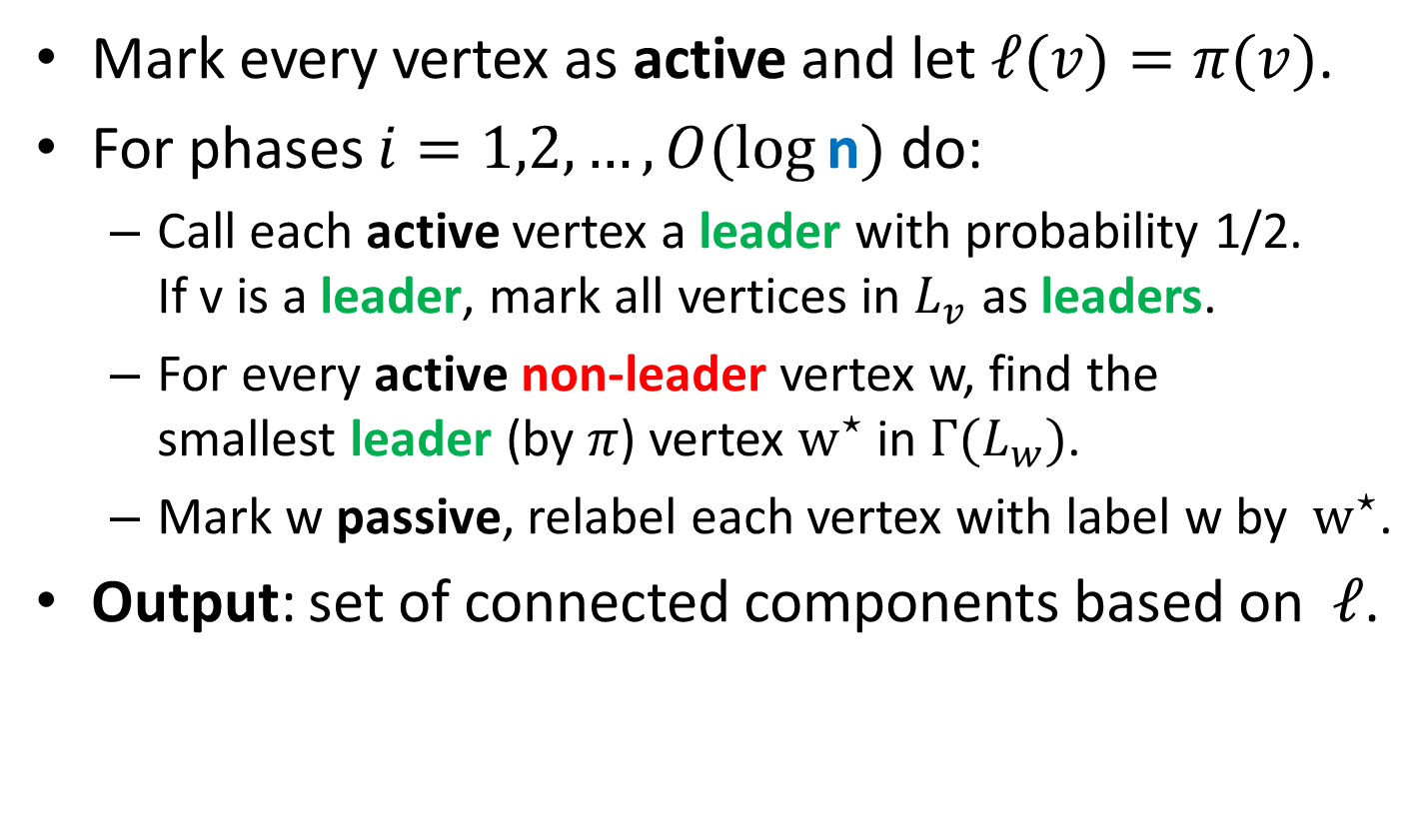
Algorithm for Connectivity
Mark every vertex as active and let $ℓ(v)=π(v)$.
For phases $i=1,2,…,O(log⁡\text{n})$ do:
Call each active vertex a leader with probability 1/2. If v is a leader, mark all vertices in $L_{v}$ as leaders.
For every active non-leader vertex w, find the smallest leader (by $π$) vertex $w^{⋆}$ in $Γ(L_{w})$.
Mark w passive, relabel each vertex with label w by $w^{⋆}$.
Output: set of connected components based on $ℓ$.

Slide 14
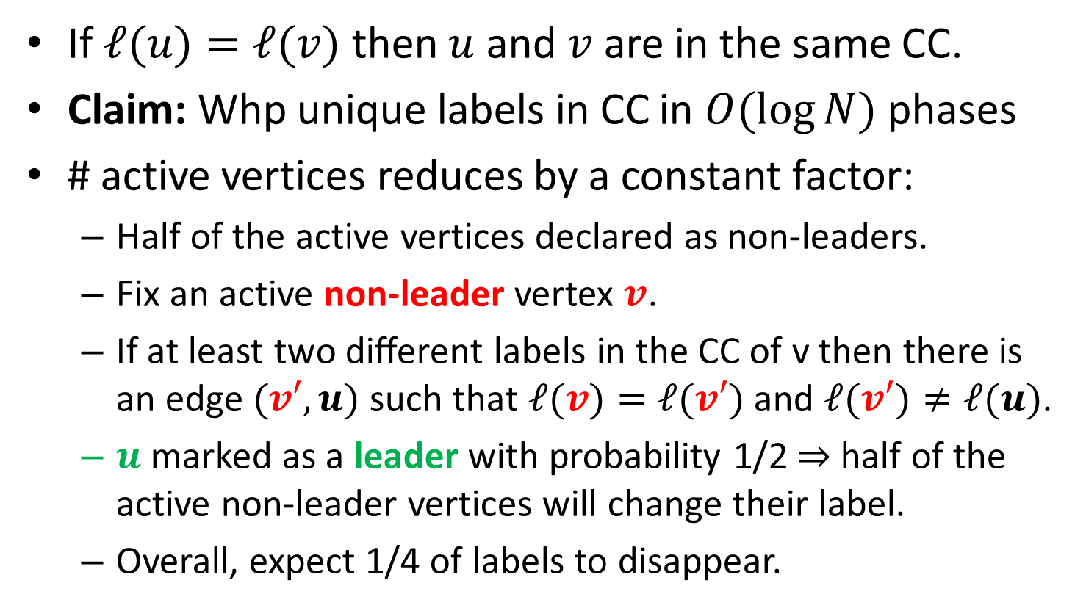
Algorithm for Connectivity: Analysis
If $ℓ(u)=ℓ(v)$ then $u$ and $v$ are in the same CC.
Claim: Whp unique labels in CC in $O(\log{N})$ phases
# active vertices reduces by a constant factor:
Half of the active vertices declared as non-leaders.
Fix an active non-leader vertex $v$.
If at least two different labels in the CC of v then there is an edge $(v′,u)$ such that $ℓ(v)=ℓ(v′)$ and $ℓ(v′)≠ℓ(u)$.
$u$ marked as a leader with probability 1/2 $⇒$half of the active non-leader vertices will change their label.
Overall, expect 1/4 of labels to disappear.

Slide 15
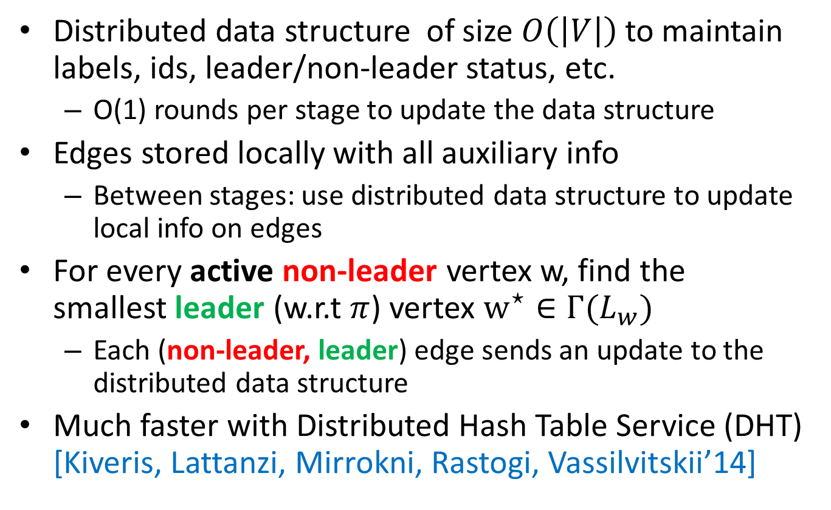
Algorithm for Connectivity: Implementation Details
Distributed data structure of size $O\left(\left|V\right|\right)$to maintain labels, ids, leader/non-leader status, etc.
O(1) rounds per stage to update the data structure
Edges stored locally with all auxiliary info
Between stages: use distributed data structure to update local info on edges
For every active non-leader vertex w, find the smallest leader (w.r.t $π$) vertex $w^{⋆}∈Γ(L_{w})$
Each (non-leader, leader) edge sends an update to the distributed data structure
Much faster with Distributed Hash Table Service (DHT) [Kiveris, Lattanzi, Mirrokni, Rastogi, Vassilvitskii’14]

Slide 16
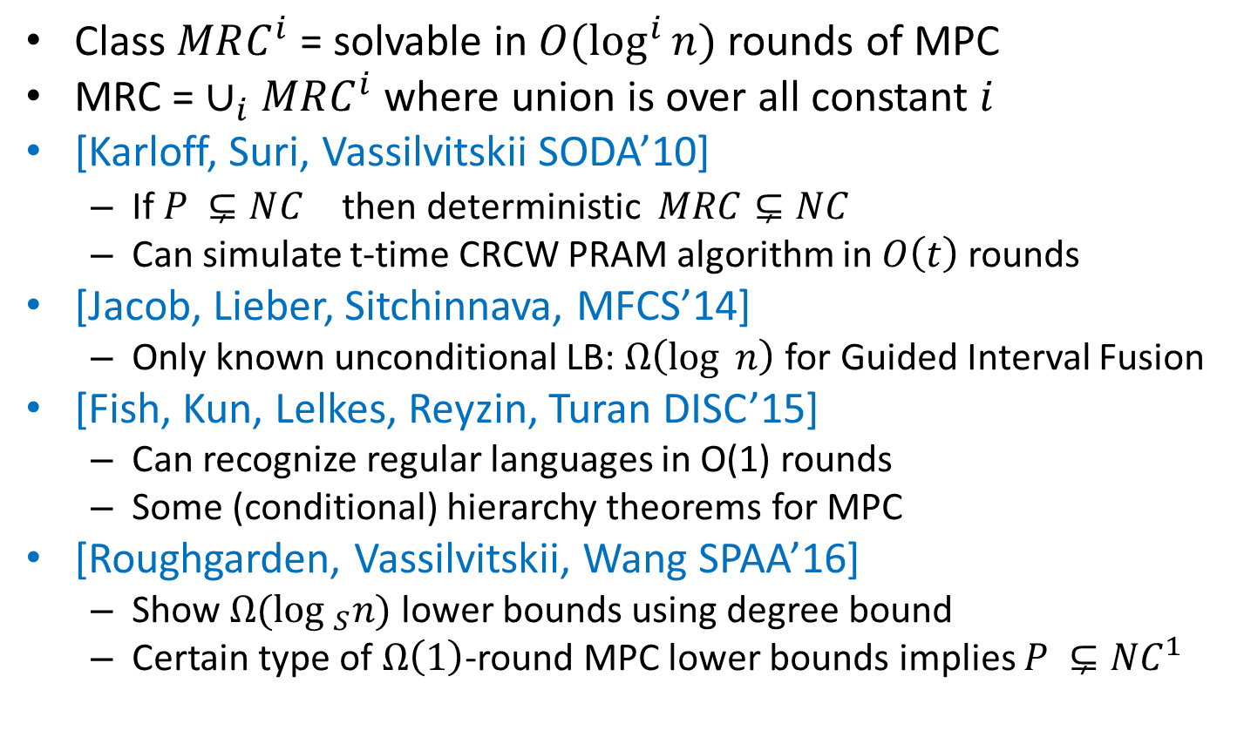
MPC and Computation Complexity
Class $MRC^{i}$ = solvable in $O(\log^{i}{n})$ rounds of MPC
MRC =$∪_{i}MRC^{i}$ where union is over all constant $i$
[Karloff, Suri, Vassilvitskii SODA’10]
If $P ⊊NC^{}$ then deterministic $MRC⊊NC$
Can simulate t-time CRCW PRAM algorithm in $O\left(t\right)$ rounds
[Jacob, Lieber, Sitchinnava, MFCS’14]
Only known unconditional LB: $Ω\left(\log{ n}\right)$ for Guided Interval Fusion
[Fish, Kun, Lelkes, Reyzin, Turan DISC’15]
Can recognize regular languages in O(1) rounds
Some (conditional) hierarchy theorems for MPC
[Roughgarden, Vassilvitskii, Wang SPAA’16]
Show $Ω(\log_{ S}n)$ lower bounds using degree bound
Certain type of $Ω\left(1\right)$-round MPC lower bounds implies $P ⊊NC^{1}$

Slide 17
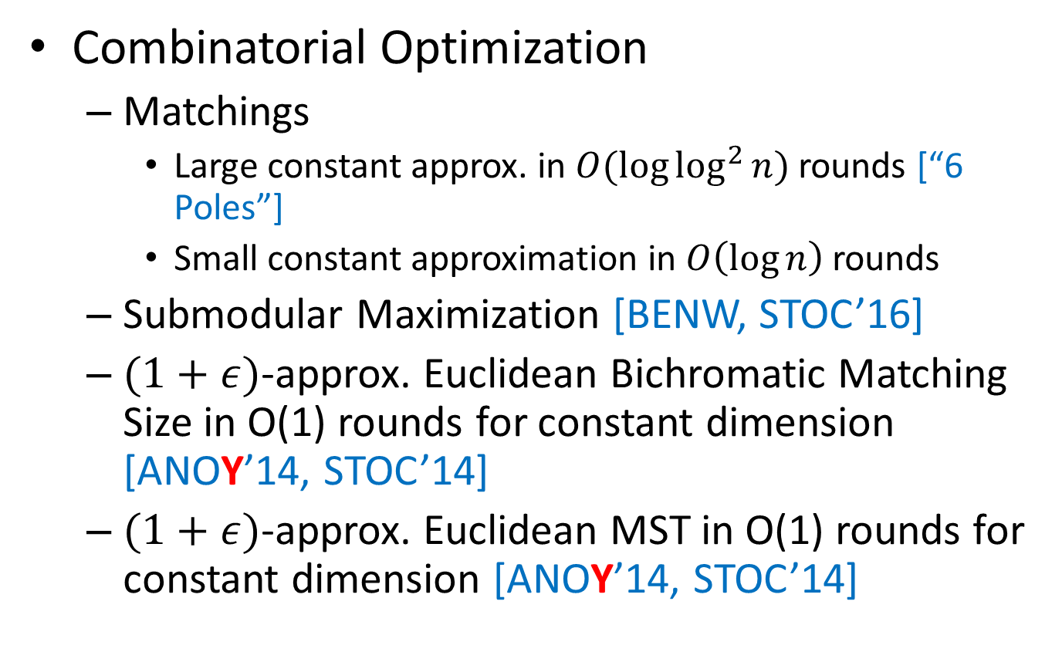
MPC for Specific Problems
Combinatorial Optimization
Matchings
Large constant approx. in $O(\log{\log^{2}{n}})$ rounds [“6 Poles”]
Small constant approximation in $O\left(\log{n}\right)$ rounds
Submodular Maximization [BENW, STOC’16]
$(1+ε)$-approx. Euclidean Bichromatic Matching Size in O(1) rounds for constant dimension [ANOY’14, STOC’14]
$(1+ε)$-approx. Euclidean MST in O(1) rounds for constant dimension [ANOY’14, STOC’14]

Slide 18
MPC for Specific Problems
Clustering
K-means: [BMVKV, VLDB’12][BEL, NIPS’13]
K-center, K-median: [EIM, KDD’11]
Correlation Clustering: [CDK, KDD’14]
Single-Linkage Clustering: [Vadapalli, Y ‘17]
See my talk at Facebook for details on clustering

Slide 19
MPC for Specific Problems
Dynamic Programming
[Im, Moseley, Sun STOC’17]:
Optimal Binary Search Tree
Weighted Interval Selection
Longest Increasing Subsequence
Active area of research right now
Other problems
Triangle Counting
…

Slide 20


Thanks! Questions?
Slides will be available on http://grigory.us
More about algorithms for massive data:
http://grigory.us/blog/
More in the classes I teach:

Slide 21
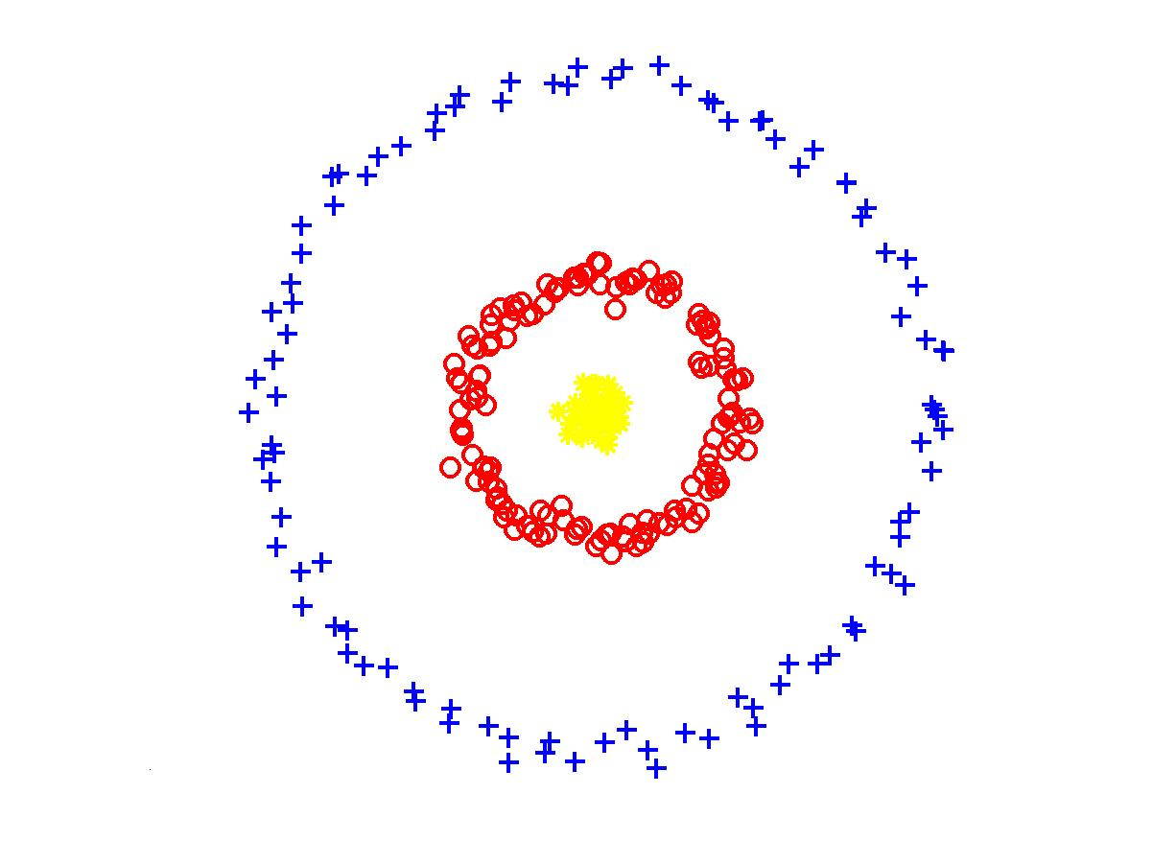
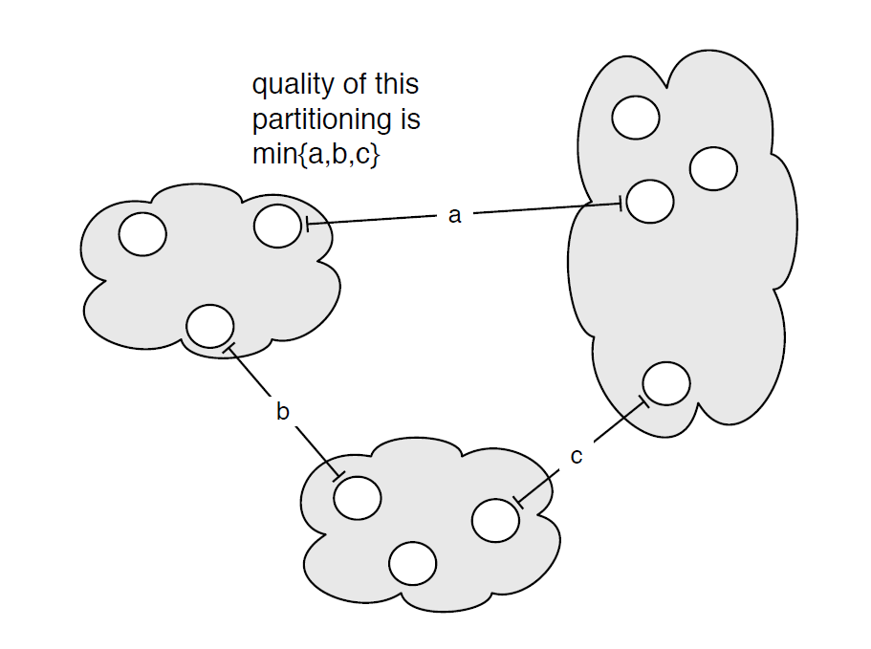

Example: Single Linkage Clustering
[Zahn’71] Clustering via Minimum Spanning Tree:
k clusters: remove $k−1$ longest edges from MST
Maximizes minimum intercluster distance
[Kleinberg, Tardos]
Notes:
“”

Slide 22

Large geometric graphs
Graph algorithms: Dense graphs vs. sparse graphs
Dense: $S≫|V|$.
Sparse: $S≪|V|$.
Our setting:
Dense graphs, sparsely represented: O(n) space
Output doesn’t fit on one machine ($S≪ n$)
Today: $(1+ε)$-approximate MST [Andoni, Onak, Nikolov, Y.]
$d=2$ (easy to generalize)
$R=\log_{S}{n}\text{= }\text{O}\text{(1) }$rounds ($S=n^{Ω(1)}$)

Slide 23
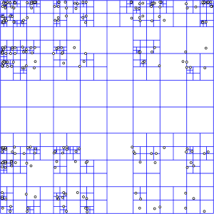
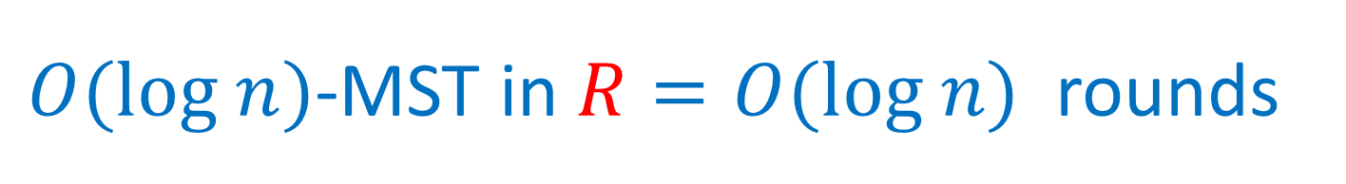

$O(log n)$-MST in $R=O(log n)$rounds
Assume points have integer coordinates $\left[0, …,Δ\right]$, where $Δ=O\left(n^{2}\right) .$
Impose an $O(log⁡n)$-depth quadtree
Bottom-up: For each cell in the quadtree
compute optimum MSTs in subcells
Use only one representative from each cell on the next level
Wrong representative:
O(1)-approximation per level

Slide 24





$εL$-nets
$εL$-net for a cell C with side length $L$:
Collection S of vertices in C, every vertex is at distance <= $εL$ from some vertex in S. (Fact: Can efficiently compute $ε$-net of size $O\left(\frac{1}{ε^{2}}\right))$
Bottom-up: For each cell in the quadtree
Compute optimum MSTs in subcells
Use $εL$-net from each cell on the next level
Idea: Pay only $O(εL$) for an edge cut by cell with side $L$
Randomly shift the quadtree: $\operatorname{Pr}\left[cut edge of length ℓ by L\right]∼ℓ/L$ – charge errors
Wrong representative:
O(1)-approximation per level
$$L$$
$$εL$$
$$L$$

Slide 25



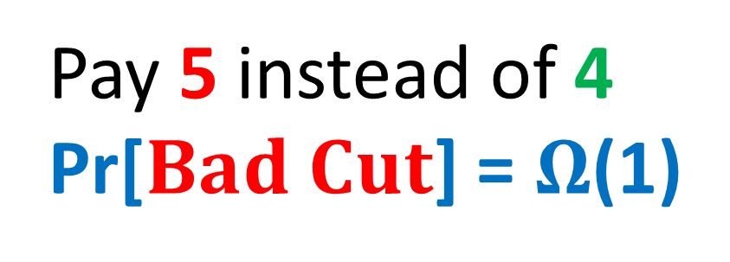
$$Randomly shifted quadtree$$
Top cell shifted by a random vector in ${\left[0,L\right]}^{2}$
Impose a randomly shifted quadtree (top cell length $2Δ$)
Bottom-up: For each cell in the quadtree
Compute optimum MSTs in subcells
Use $εL$-net from each cell on the next level
Pay 5 instead of 4
Pr[$Bad Cut$] = $Ω$(1)
2
$$Bad Cut$$
1

Slide 26

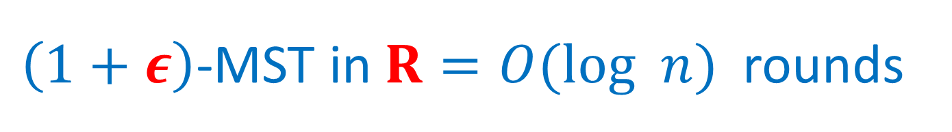
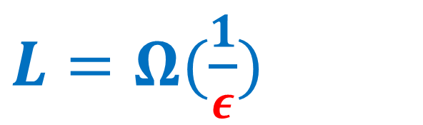
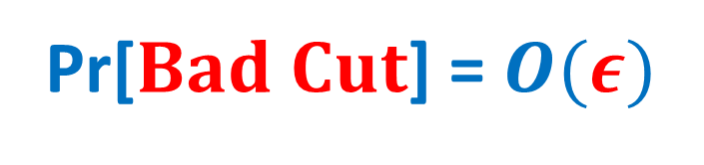
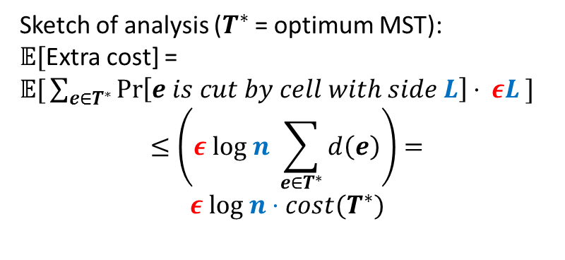
$\left(1+ε\right)$-MST in $R=O(log n)$rounds
Idea: Only use short edges inside the cells
Impose a randomly shifted quadtree (top cell length $\frac{2Δ}{ε }$ )
Bottom-up: For each node (cell) in the quadtree
compute optimum Minimum Spanning Forests in subcells, using edges of length $≤εL$
Use only $ε^{2}L$-net from each cell on the next level
Sketch of analysis ($T^{∗}$ = optimum MST):
𝔼[Extra cost] =
𝔼$\text{[}\sum_{e∈T^{∗}}{\operatorname{Pr}\left[e is cut by cell with side L\right]⋅ εL} ]$
$$≤\left(ε log n \sum_{e∈T^{∗}}{d\left(e\right)}\right)=$$
$$ε log n⋅cost(T^{∗})$$
$L=Ω(\frac{1}{ε})$
2
Pr[$Bad Cut$] = $O(ε)$
1

Slide 27

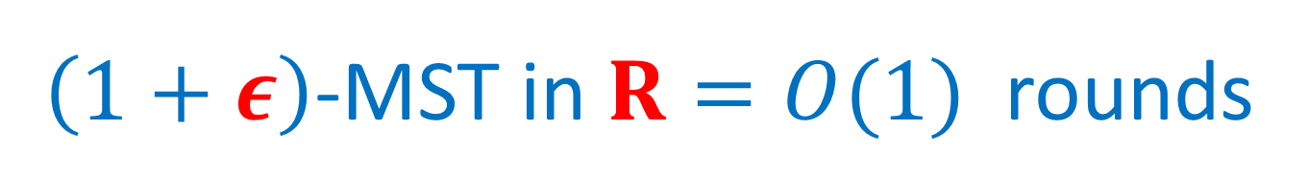


$\left(1+ε\right)$-MST in $R=O(1)$rounds
$O(log n)$ rounds => O($\log_{S}{n}$) = O(1) rounds
Flatten the tree: ($\sqrt{M}×\sqrt{M}$)-grids instead of (2x2) grids at each level.
Impose a randomly shifted ($\sqrt{M}×\sqrt{M}$)-tree
Bottom-up: For each node (cell) in the tree
compute optimum MSTs in subcells via edges of length $≤εL$
Use only $ε^{2}L$-net from each cell on the next level
$$\sqrt{M}=n^{Ω(1)}$$
⇒

Slide 28
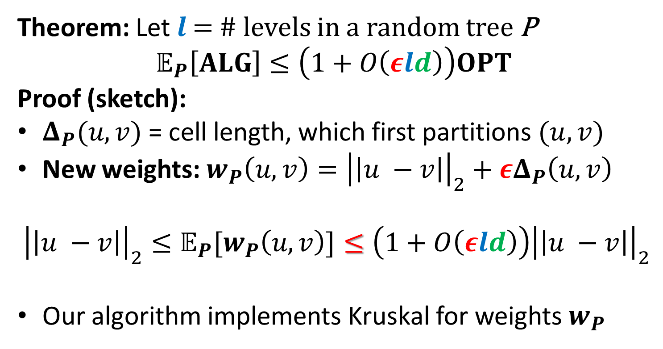



$\left(1+ε\right)$-MST in $R=O(1)$rounds
Theorem: Let $l$ = # levels in a random tree P
$$𝔼_{P}\left[ALG\right]≤\left(1+O\left(εld\right)\right)OPT$$
Proof (sketch):
$Δ_{P}(u,v)$ = cell length, which first partitions $(u, v)$
New weights: $w_{P}\left(u,v\right)={\left|\left|u −v\right|\right|}_{2}+εΔ_{P}\left(u,v\right)$
$${{\left|\left|u −v\right|\right|}_{2}≤𝔼_{P}[w}_{P}\left(u,v\right)]≤\left(1+O\left(εld\right)\right){\left|\left|u −v\right|\right|}_{2}$$
Our algorithm implements Kruskal for weights $w_{P}$
$$u$$
$$v$$
$$Δ_{P}\left(u,v\right)$$

Slide 29
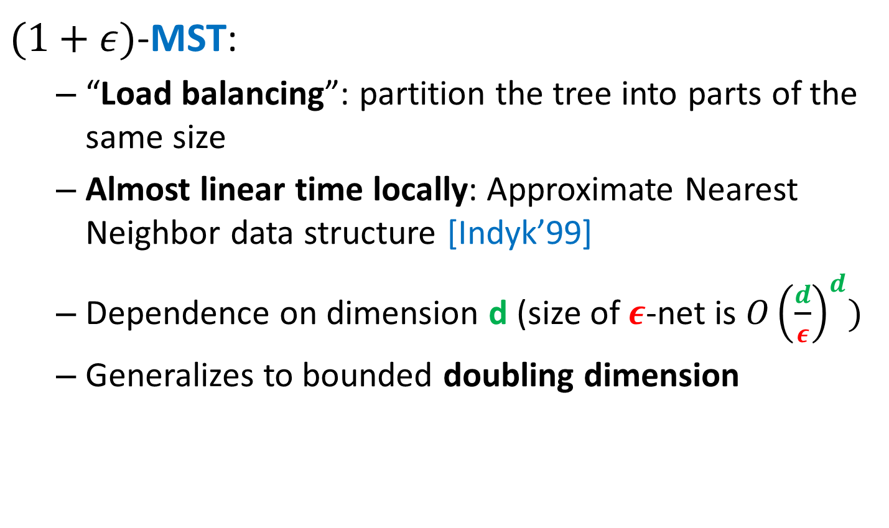
Technical Details
$(1+ε)$-MST:
“Load balancing”: partition the tree into parts of the same size
Almost linear time locally: Approximate Nearest Neighbor data structure [Indyk’99]
Dependence on dimension d (size of $ε$-net is ${O\left(\frac{d}{ε}\right)}^{d})$
Generalizes to bounded doubling dimension

Slide 30

Problem 2: Correlation Clustering
Inspired by machine learning at
Practice: [Cohen, McCallum ‘01, Cohen, Richman ’02]
Theory: [Blum, Bansal, Chawla ’04]

Slide 31
Correlation Clustering: Example
Minimize # of incorrectly classified pairs:
# Covered non-edges + # Non-covered edges
4 incorrectly classified =
1 covered non-edge +
3 non-covered edges

Slide 32
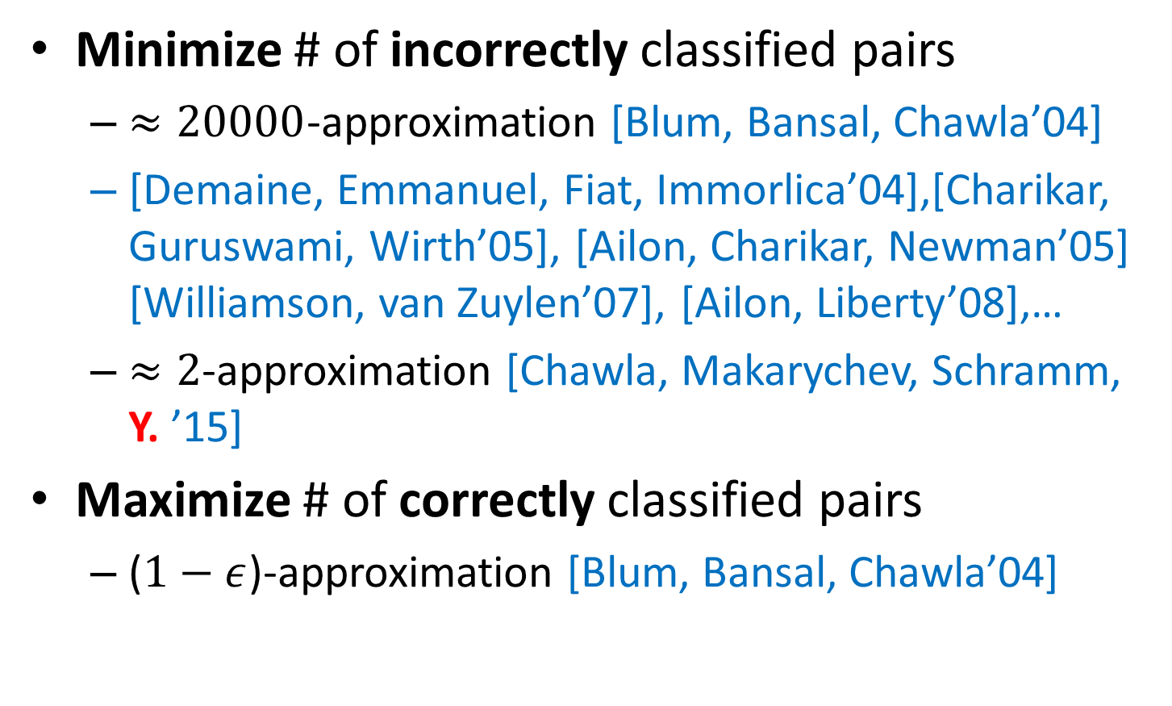
Approximating Correlation Clustering
Minimize # of incorrectly classified pairs
$≈20000$-approximation [Blum, Bansal, Chawla’04]
[Demaine, Emmanuel, Fiat, Immorlica’04],[Charikar, Guruswami, Wirth’05], [Ailon, Charikar, Newman’05] [Williamson, van Zuylen’07], [Ailon, Liberty’08],…
$≈2$-approximation [Chawla, Makarychev, Schramm, Y. ’15]
Maximize # of correctly classified pairs
($1−ε$)-approximation [Blum, Bansal, Chawla’04]

Slide 33
Correlation Clustering
One of the most successful clustering methods:
Only uses qualitative information about similarities
# of clusters unspecified (selected to best fit data)
Applications: document/image deduplication (data from crowds or black-box machine learning)
NP-hard [Bansal, Blum, Chawla ‘04], admits simple approximation algorithms with good provable guarantees

Slide 34
Correlation Clustering
More:
Survey [Wirth]
KDD’14 tutorial: “Correlation Clustering: From Theory to Practice” [Bonchi, Garcia-Soriano, Liberty] http://francescobonchi.com/CCtuto_kdd14.pdf
Wikipedia article: http://en.wikipedia.org/wiki/Correlation_clustering

Slide 35

Data-Based Randomized Pivoting
3-approximation (expected) [Ailon, Charikar, Newman]
Algorithm:
Pick a random pivot vertex $v$
Make a cluster $v∪N(v)$, where $N\left(v\right)$ is the set of neighbors of $v$
Remove the cluster from the graph and repeat

Slide 36
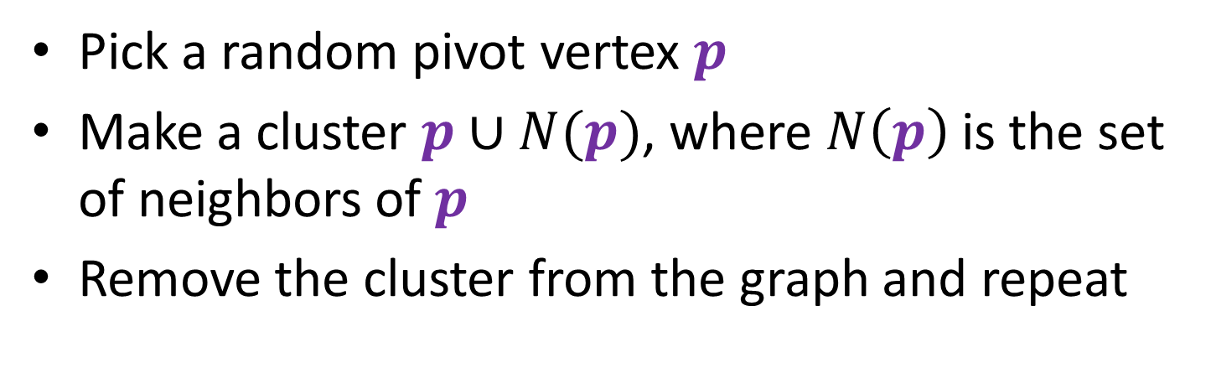
Data-Based Randomized Pivoting
Pick a random pivot vertex $p$
Make a cluster $p∪N(p)$, where $N\left(p\right)$ is the set of neighbors of $p$
Remove the cluster from the graph and repeat
8 incorrectly classified =
2 covered non-edges +
6 non-covered edges

Slide 37
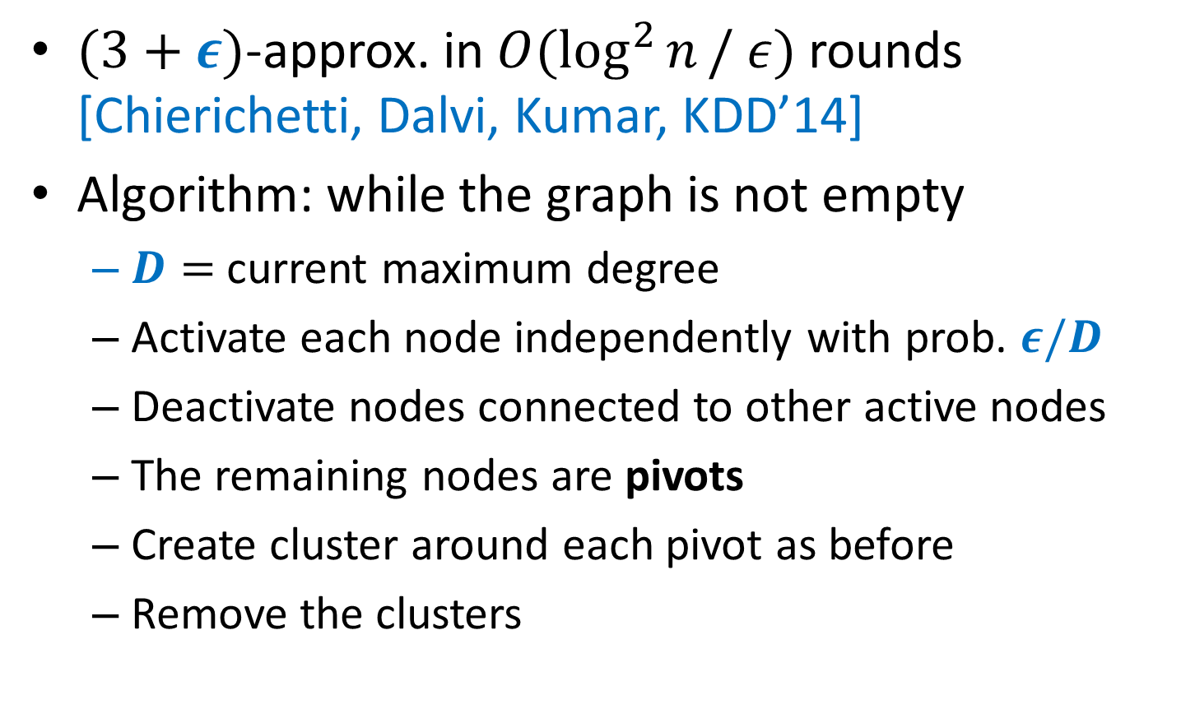
Parallel Pivot Algorithm
$(3+ε)$-approx. in $O(\log^{2}{n}/ ε)$ rounds [Chierichetti, Dalvi, Kumar, KDD’14]
Algorithm: while the graph is not empty
$D=$ current maximum degree
Activate each node independently with prob. $ε/D$
Deactivate nodes connected to other active nodes
The remaining nodes are pivots
Create cluster around each pivot as before
Remove the clusters

Slide 38
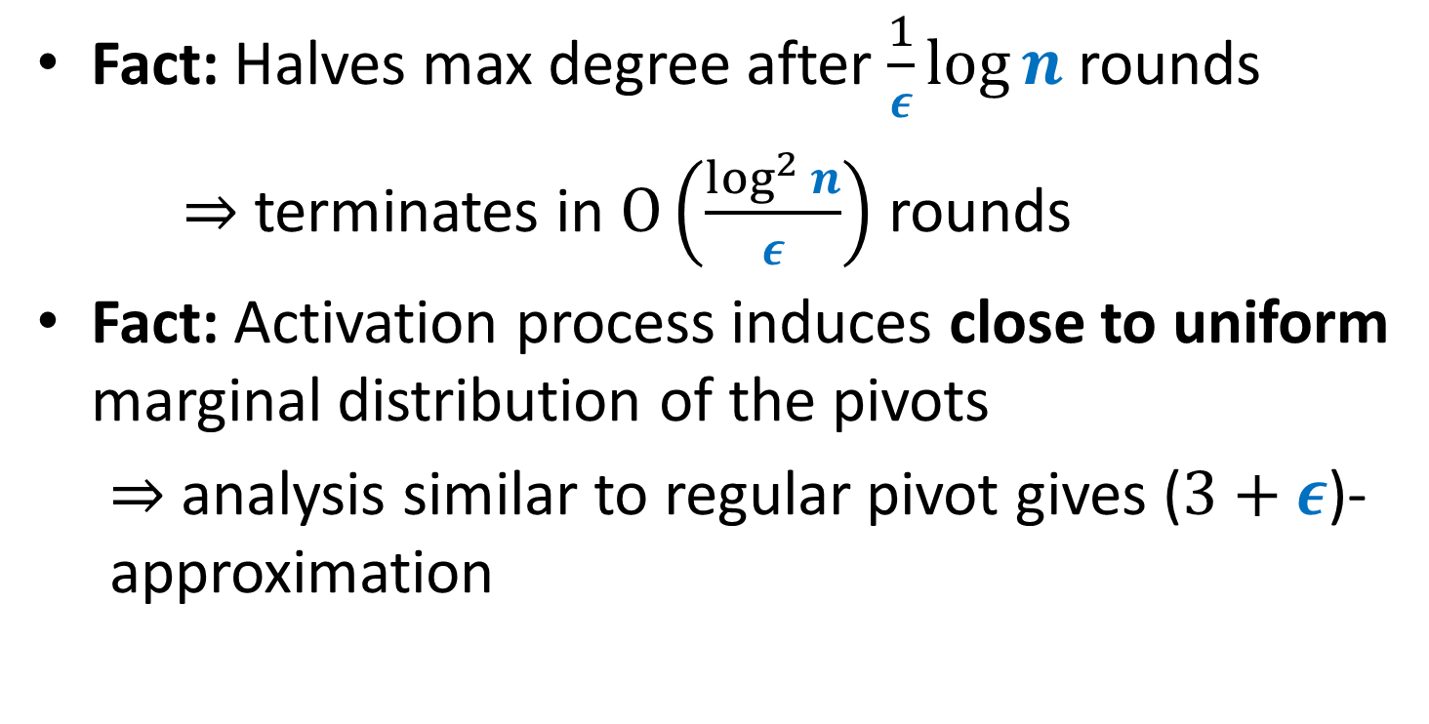
Parallel Pivot Algorithm: Analysis
Fact: Halves max degree after $\frac{1}{ε}\log{n}$ rounds
$⇒$ terminates in $O\left(\frac{\log^{2}{n}}{ε}\right)$ rounds
Fact: Activation process induces close to uniform marginal distribution of the pivots
$⇒$ analysis similar to regular pivot gives ($3+ε$)-approximation

Slide 39
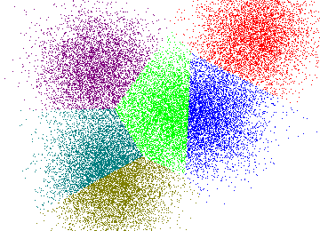

Part 2: Clustering Vectors
Input: $v_{1},…, v_{n}∈ ℝ^{d}$
Feature vectors in ML, word embedings in NLP, etc.
(Implicit) weighted graph of pairwise distances
Applications:
Same as before + Data visualization

Slide 40
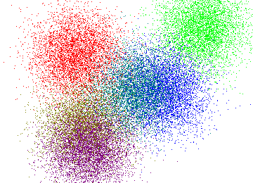

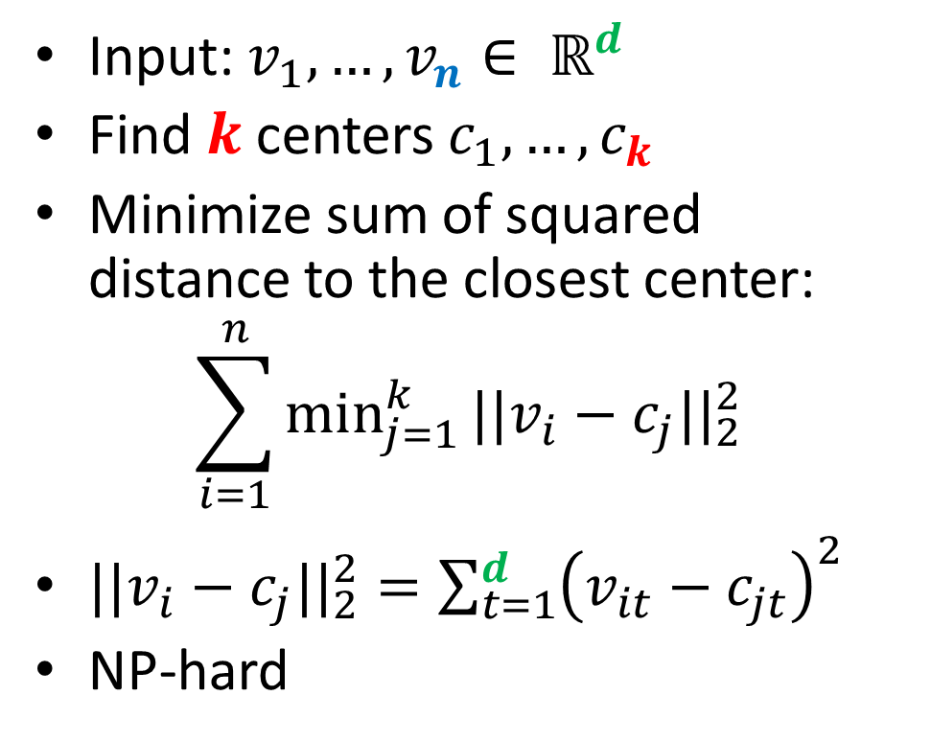
Problem 3: K-means
Input: $v_{1},…, v_{n}∈ ℝ^{d}$
Find $k$ centers $c_{1},…, c_{k}$
Minimize sum of squared distance to the closest center:
$$\sum_{i=1}^{n}{\min_{j=1}^{k}{||v_{i}−c_{j}||_{2}^{2} }}$$
$||v_{i}−c_{j}||_{2}^{2}=\sum_{t=1}^{d}{{\left(v_{it}−c_{jt}\right)}^{2}}$
NP-hard
$$⇒$$

Slide 41

K-means++ [Arthur,Vassilvitskii’07]
$C=\{c_{1},…, c_{t}\}$ (collection of centers)
$d^{2}\left(v,C\right)=\min_{j=1}^{k}{||v−c_{j}||_{2}^{2} }$
K-means++ algorithm (gives $O\left(\log{k}\right)$-approximation):
Pick $c_{1}$ uniformly at random from the data
Pick centers $c_{2}…, c_{k}$ sequentially from the distribution where point $v$ has probability
$$\frac{d^{2}\left(v,C\right)}{\sum_{i=1}^{n}{d^{2}(v_{i}, C)}}$$

Slide 42



K-means$||$ [Bahmani et al. ‘12]
Pick ${C=c}_{1}$ uniformly at random from data
Initial cost: $ψ=\sum_{i=1}^{n}{d^{2}(v_{i},c_{1})}$
Do $O(\log{ψ})$ times:
Add $O\left(k\right)$ centers from the distribution where point $v$ has probability
$$\frac{d^{2}\left(v,C\right)}{\sum_{i=1}^{n}{d^{2}(v_{i}, C)}}$$
Solve k-means for these O($k\log{ψ}$) points locally
Thm. If final step gives $α$-approximation
$⇒$ $O(α)$-approximation overall

Slide 43
Problem 4: Single Linkage Clustering
[Zahn’71] Clustering via Minimum Spanning Tree:
k clusters: remove $k−1$ longest edges from MST
Maximizes minimum intercluster distance
[Kleinberg, Tardos]
Notes:
“”

Slide 44
Large geometric graphs
Graph algorithms: Dense graphs vs. sparse graphs
Dense: $S≫|V|$.
Sparse: $S≪|V|$.
Our setting:
Dense graphs, sparsely represented: O(n) space
Output doesn’t fit on one machine ($S≪ n$)
Today: $(1+ε)$-approximate MST [Andoni, Onak, Nikolov, Y.]
$d=2$ (easy to generalize)
$R=\log_{S}{n}\text{= }\text{O}\text{(1) }$rounds ($S=n^{Ω(1)}$)

Slide 45
$O(log n)$-MST in $R=O(log n)$rounds
Assume points have integer coordinates $\left[0, …,Δ\right]$, where $Δ=O\left(n^{2}\right) .$
Impose an $O(log⁡n)$-depth quadtree
Bottom-up: For each cell in the quadtree
compute optimum MSTs in subcells
Use only one representative from each cell on the next level
Wrong representative:
O(1)-approximation per level

Slide 46
$εL$-nets
$εL$-net for a cell C with side length $L$:
Collection S of vertices in C, every vertex is at distance <= $εL$ from some vertex in S. (Fact: Can efficiently compute $ε$-net of size $O\left(\frac{1}{ε^{2}}\right))$
Bottom-up: For each cell in the quadtree
Compute optimum MSTs in subcells
Use $εL$-net from each cell on the next level
Idea: Pay only $O(εL$) for an edge cut by cell with side $L$
Randomly shift the quadtree: $\operatorname{Pr}\left[cut edge of length ℓ by L\right]∼ℓ/L$ – charge errors
Wrong representative:
O(1)-approximation per level
$$L$$
$$εL$$
$$L$$

Slide 47
$$Randomly shifted quadtree$$
Top cell shifted by a random vector in ${\left[0,L\right]}^{2}$
Impose a randomly shifted quadtree (top cell length $2Δ$)
Bottom-up: For each cell in the quadtree
Compute optimum MSTs in subcells
Use $εL$-net from each cell on the next level
Pay 5 instead of 4
Pr[$Bad Cut$] = $Ω$(1)
2
$$Bad Cut$$
1

Slide 48
$\left(1+ε\right)$-MST in $R=O(log n)$rounds
Idea: Only use short edges inside the cells
Impose a randomly shifted quadtree (top cell length $\frac{2Δ}{ε }$ )
Bottom-up: For each node (cell) in the quadtree
compute optimum Minimum Spanning Forests in subcells, using edges of length $≤εL$
Use only $ε^{2}L$-net from each cell on the next level
Sketch of analysis ($T^{∗}$ = optimum MST):
𝔼[Extra cost] =
𝔼$\text{[}\sum_{e∈T^{∗}}{\operatorname{Pr}\left[e is cut by cell with side L\right]⋅ εL} ]$
$$≤\left(ε log n \sum_{e∈T^{∗}}{d\left(e\right)}\right)=$$
$$ε log n⋅cost(T^{∗})$$
$L=Ω(\frac{1}{ε})$
2
Pr[$Bad Cut$] = $O(ε)$
1

Slide 49
$\left(1+ε\right)$-MST in $R=O(1)$rounds
$O(log n)$ rounds => O($\log_{S}{n}$) = O(1) rounds
Flatten the tree: ($\sqrt{M}×\sqrt{M}$)-grids instead of (2x2) grids at each level.
Impose a randomly shifted ($\sqrt{M}×\sqrt{M}$)-tree
Bottom-up: For each node (cell) in the tree
compute optimum MSTs in subcells via edges of length $≤εL$
Use only $ε^{2}L$-net from each cell on the next level
$$\sqrt{M}=n^{Ω(1)}$$
⇒

Slide 50
$\left(1+ε\right)$-MST in $R=O(1)$rounds
Theorem: Let $l$ = # levels in a random tree P
$$𝔼_{P}\left[ALG\right]≤\left(1+O\left(εld\right)\right)OPT$$
Proof (sketch):
$Δ_{P}(u,v)$ = cell length, which first partitions $(u, v)$
New weights: $w_{P}\left(u,v\right)={\left|\left|u −v\right|\right|}_{2}+εΔ_{P}\left(u,v\right)$
$${{\left|\left|u −v\right|\right|}_{2}≤𝔼_{P}[w}_{P}\left(u,v\right)]≤\left(1+O\left(εld\right)\right){\left|\left|u −v\right|\right|}_{2}$$
Our algorithm implements Kruskal for weights $w_{P}$
$$u$$
$$v$$
$$Δ_{P}\left(u,v\right)$$

Slide 51
Technical Details
$(1+ε)$-MST:
“Load balancing”: partition the tree into parts of the same size
Almost linear time locally: Approximate Nearest Neighbor data structure [Indyk’99]
Dependence on dimension d (size of $ε$-net is ${O\left(\frac{d}{ε}\right)}^{d})$
Generalizes to bounded doubling dimension

