Slide 1
Approximation for Directed Spanner
Grigory Yaroslavtsev
Penn State + AT&T Labs (intern)
Based on a paper at ICALP’11, joint with Berman (PSU), Bhattacharyya (MIT), Makarychev (IBM), Raskhodnikova (PSU)

Slide 2
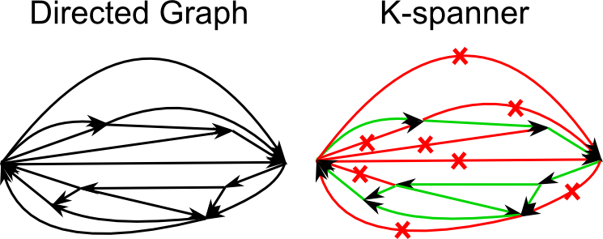
Directed Spanner Problem
K-Spanner - subset of edges, preserving distances up to a factor k > 1 (stretch k).
Problem: Find the sparsest k-spanner of a directed graph.

Slide 3
Why Spanners?
Applications
Efficient routing
Simulating synchronized protocols in unsynchronized networks
Parallel/Distributed/Streaming approximation algorithms for shortest paths
Algorithms for distance oracles

Slide 4
Why Directed Spanners?
Property testing and property reconstruction
Techniques give improvement for:
Directed Steiner Forest
Min-cost Directed Spanner (improvement for unit-length, constant k), Unit-length Directed Spanners, Client-server k-Spanner, K-diameter Spanning Subgraph, …
Practical under natural assumptions

Slide 5
Previous work
Similar problems considered in
[Dodis, Khanna, STOC 99]
[Feldman, Kortsarz, Nutov, SODA 09]
[Bhattacharyya, Grigorescu, Jung, Raskhodnikova, Woodruff, SODA 09]
[Berman, Raskhodnikova, Ruan, FSTTCS 10]
…
[Dinitz, Krauthgamer, STOC 11]

Slide 6
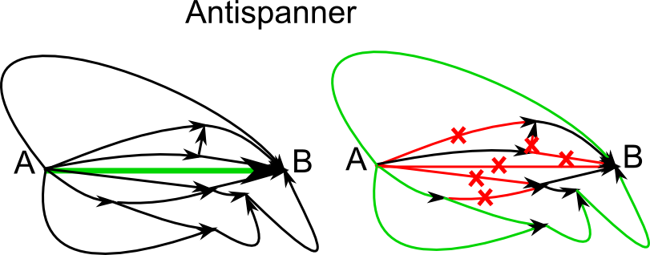
Key idea: Antispanners
Antispanner – subset of edges, which destroys all paths from A to B of stretch at most k.
We have a spanner if and only if we hit all minimal antispanners

Slide 7
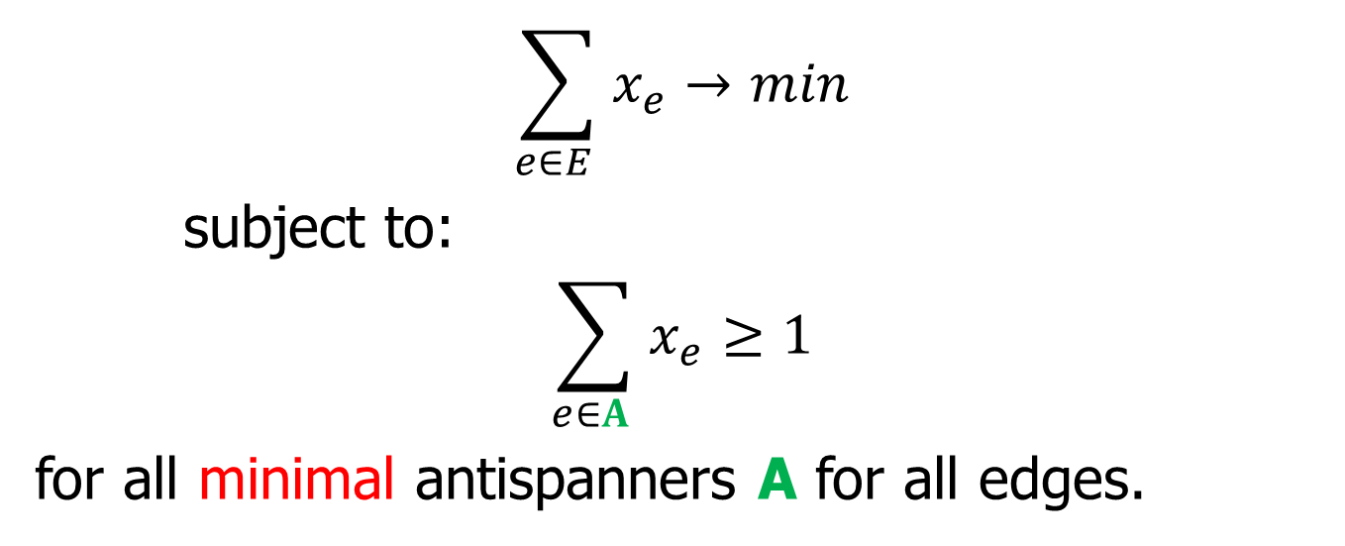
Linear programming relaxation
$$\sum_{e∈E }{x_{e}}→min$$
subject to:
$$\sum_{e∈A }{x_{e}}≥1$$
for all minimal antispanners A for all edges.
How to solve the LP?
# of antispanners is exponential in n => separation oracle.
Randomized rounding
Counting minimal antispanners (technical part)

Slide 8
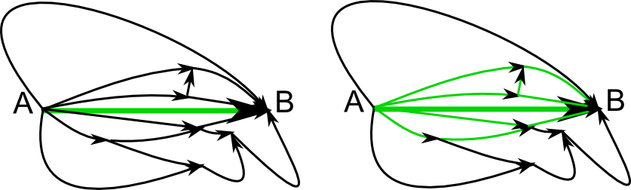
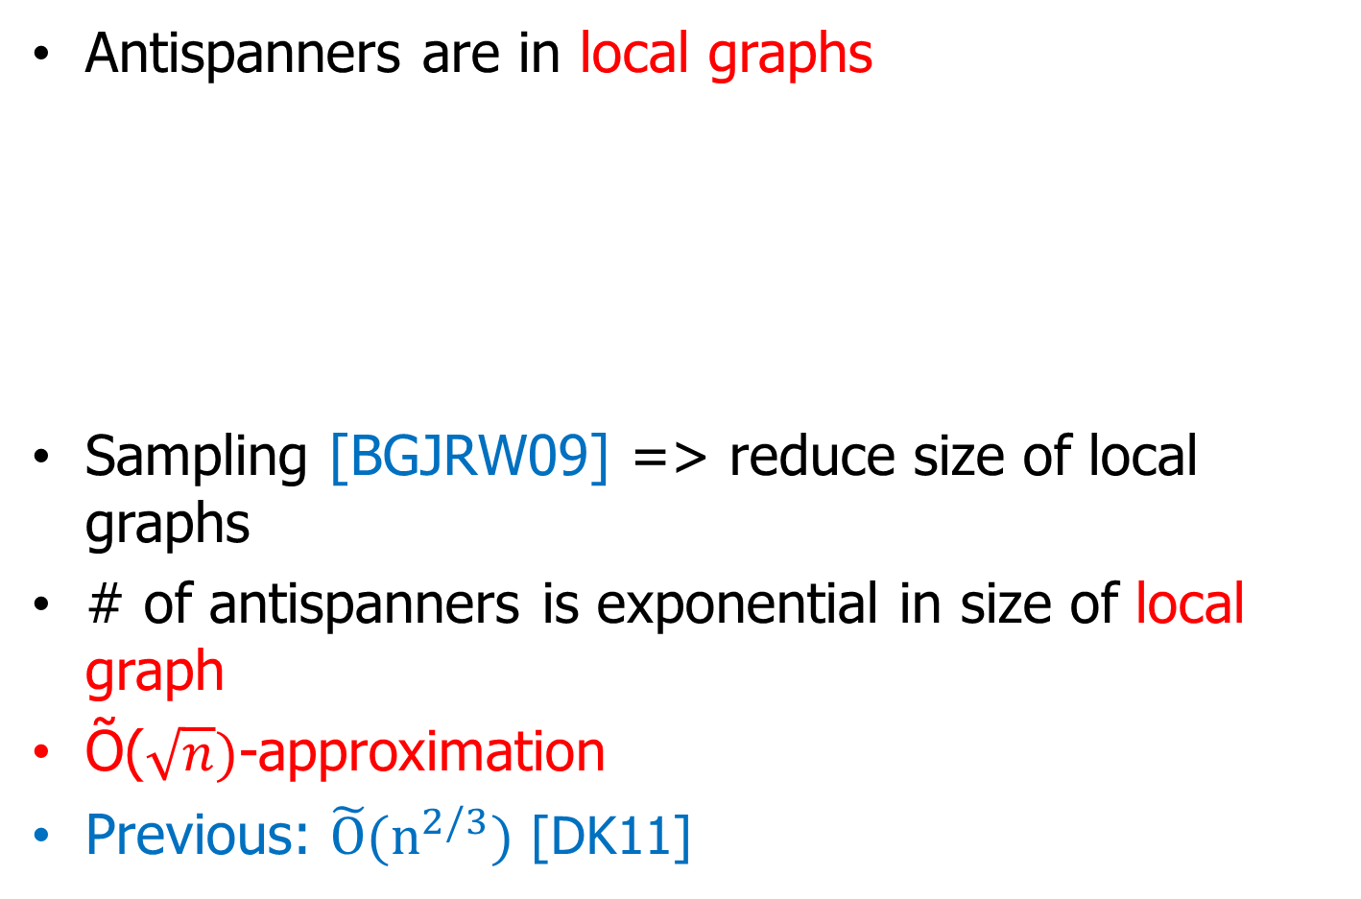
Approximation factor
Antispanners are in local graphs
Sampling [BGJRW09] => reduce size of local graphs
# of antispanners is exponential in size of local graph
Õ($\sqrt{n})$-approximation
Previous: $\tilde{O}{(n}^{2/3})$ [DK11]

Slide 9
Directed Spanner Problem (recap)
K-Spanner - subset of edges, preserving distances up to a factor k > 1 (stretch k).
Problem: Find the sparsest k-spanner of a directed graph.

Slide 10
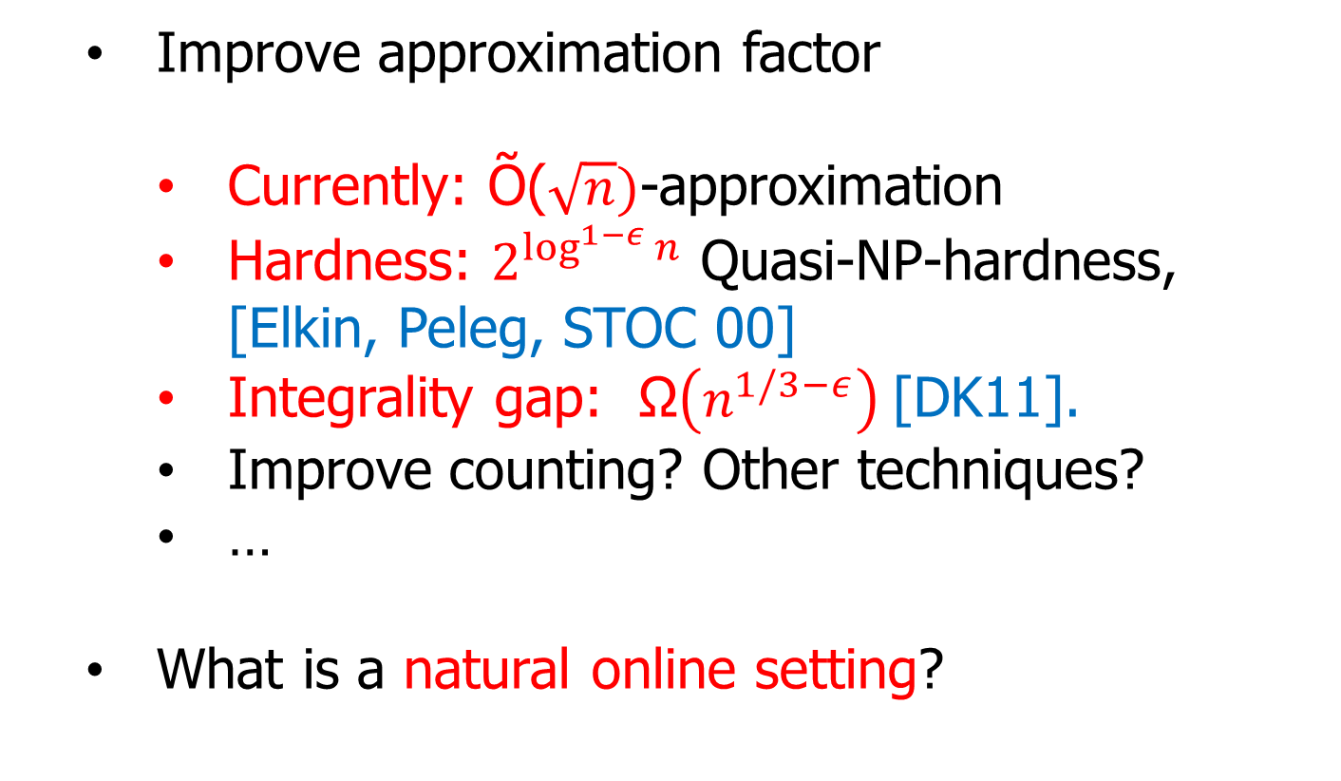
What do we think is next
Improve approximation factor
Currently: Õ($\sqrt{n})$-approximation
Hardness: $2^{\log^{1−ε }n}$ Quasi-NP-hardness, [Elkin, Peleg, STOC 00]
Integrality gap: Ω$\left(n^{1/3−ε}\right)$[DK11].
Improve counting? Other techniques?
…
What is a natural online setting?

Slide 11
What do you think?

Slide 12
Thank you!
More information: http://grigory.us

