Slide 1
Improved Approximation for the Directed Spanner Problem
Grigory Yaroslavtsev
Penn State + AT&T Labs - Research (intern)
Joint work with
Berman (PSU), Bhattacharyya (MIT), Makarychev (IBM), Raskhodnikova (PSU)
Notes:
This is “Improved approximation for the Directed Spanner Problem”.
It was initially done independently, together with Piotr Berman and Sofya Raskhodnikova and by Arnab Bhattacharyya and Konstantin Makarychev.

Slide 2
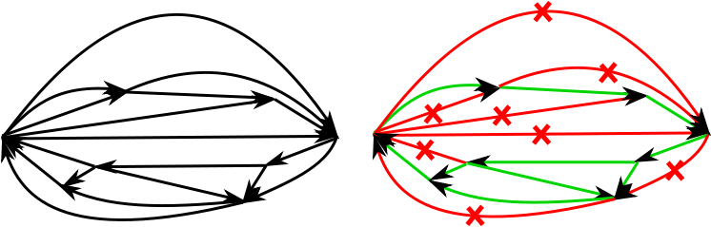
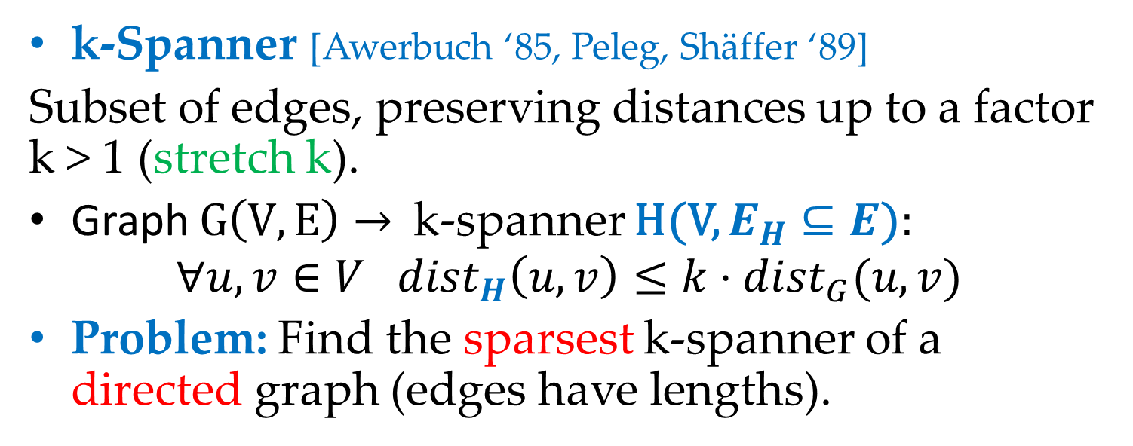
Directed Spanner Problem
k-Spanner [Awerbuch ‘85, Peleg, Shäffer ‘89]
Subset of edges, preserving distances up to a factor k > 1 (stretch k).
Graph $G\left(V,E\right)→$ k-spanner H(V, $E_{H}⊆E$):
$$∀u,v∈V {dist}_{H}\left(u,v\right)≤{k⋅dist}_{G}(u,v)$$
Problem: Find the sparsest k-spanner of a directed graph (edges have lengths).
Notes:
A k-spanner of a graph is the subset of edges of the graph, which preserves distances in the graph up to some multiplicative factor k.
We call this factor stretch, because the distances are stretched at most k times.
This was first implicitly introduced by Awerbuch and then explicitly by Peleg and Shaffer.
The computational problem we will be considering today is to find the _sparsest_ k-spanner of a graph.
We will focus on directed graphs with edges of arbitrary length.
Here is an example: Green set of edges corresponds to the sparsest spanner of the graph on the left, preserving distances up to some small factor.

Slide 3
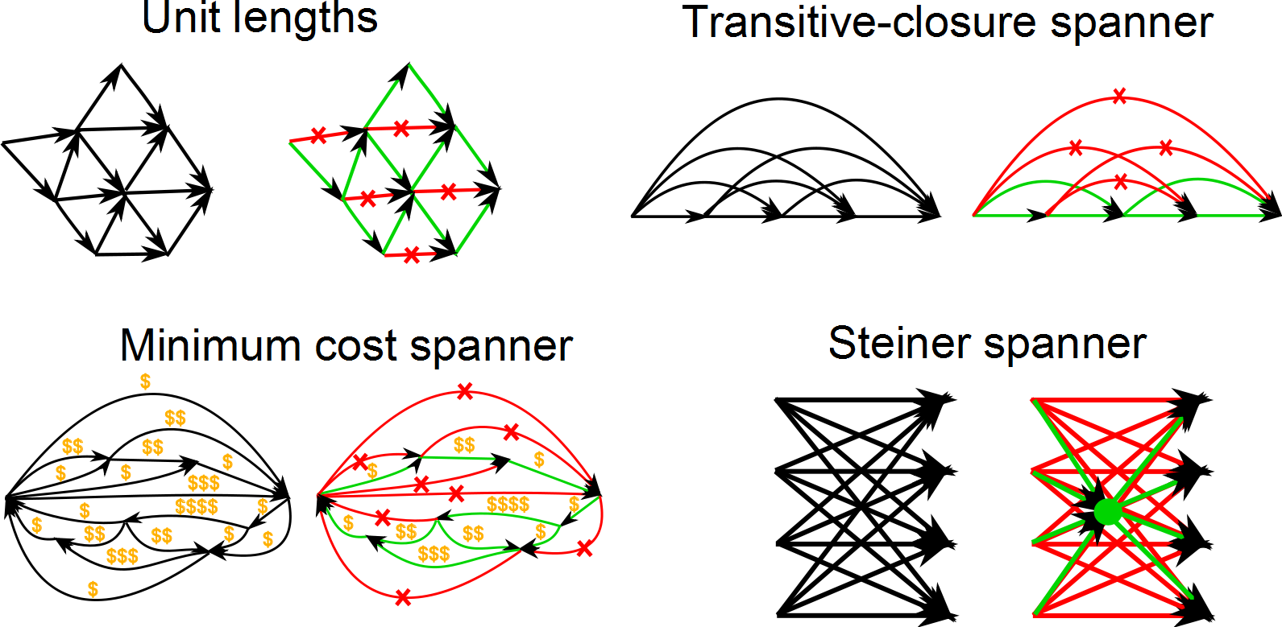
Directed Spanners and Their Friends
Notes:
There are different variations of the problem.
One important case is when all edge lengths are unit. In this case k is an integer number.
If all edges have unit lengths and the graph is transitively closed then it is a transitive-closure spanner.
A more general version we want to find not just the sparsest spanner, but the cheapest one.
Here edges have some costs, associated with them, that are independent of edge lengths.
This is called Minimum Cost spanner problem.
*If all the costs are 1 it becomes just a Directed Spanner Problem.
In some cases there are no sparse spanners. Sometimes it is useful to allow to use Steiner vertices, which are not present in the original graph and draw edges from them as well. These can help you save a lot, as shown on the picture. These are called Steiner spanners.

Slide 4
Applications of spanners
First application: simulating synchronized protocols in unsynchronized networks [Peleg, Ullman ’89]
Efficient routing [PU’89, Cowen ’01, Thorup, Zwick ’01, Roditty, Thorup, Zwick ’02 , Cowen, Wagner ’04]
Parallel/Distributed/Streaming approximation algorithms for shortest paths [Cohen ’98, Cohen ’00, Elkin’01, Feigenbaum, Kannan, McGregor, Suri, Zhang ’08]
Algorithms for approximate distance oracles [Thorup, Zwick ’01, Baswana, Sen ’06]
Notes:
The original motivation and the first application of spanners was simulating synchronized protocols in unsynchronized networks.
This was introduced by Peleg and Upfal.
Other applications include efficient routing, approximation algorithms for shortest paths in different settings (parallel, distributed and streaming) and for approximate distance oracles.
In approximate distance oracles you want not just to have a sparse subgraph, but a data structure, which uses small space and can answer shortest path queries efficiently.

Slide 5
Applications of directed spanners
Access control hierarchies
Previous work: [Atallah, Frikken, Blanton, CCCS ‘05; De Santis, Ferrara, Masucci, MFCS’07]
Solution: [Bhattacharyya, Grigorescu, Jung, Raskhodnikova, Woodruff, SODA’09]
Steiner spanners for access control: [Berman, Bhattacharyya, Grigorescu, Raskhodnikova, Woodruff, Y’ ICALP’11 (more on Friday)]
Property testing and property reconstruction [BGJRW’09; Raskhodnikova ’10 (survey)]
Notes:
In all the previous applications, if your graph is directed, then you need a directed spanner.
One new application of directed spanners is in constructing efficient access control hierarchies.
This was introduced by Atallah, Frikken and Blanton at CCCS’05 and studied by De Santis, Ferrara and Masucci at MFCS’07.
A solution, proposed by BGJRW constructs a sparse transitive closure spanner of the access control hierarchy to sparsify it.
Steiner spanners can be used for this purpose as well.
We studied this jointly with BBGRW and I will tell more about it on Friday.
Another application of unit-length transitive closure spanners is to property testing and property reconstruction.

Slide 6
Plan
Undirected vs Directed
Previous work
Framework = Sampling + LP
Sampling
LP + Randomized rounding
Directed Spanner
Unit-length 3-spanner
Directed Steiner Forest
Notes:
Here is the plan for the rest of the talk.
First we will see why are directed spanners generally harder to approximate than undirected spanners.
We will see the previous work and results.
The previous work introduced a generic framework for directed spanner and related problems.
The framework consists of two stages: sampling and linear programming.
We use the same sampling techniques as in the previous work, but give new randomized rounding schemes.
Our contribution is that we show how to use sampling together with randomized rounding of a LP.
This is the technique we are going to use today.
Today we will focus on how this technique works for be the Directed Spanner Problem.
It can also be used to improve approximation for some related problems, like Unit-length 3-spanner and Directed Spanner Forest.

Slide 7
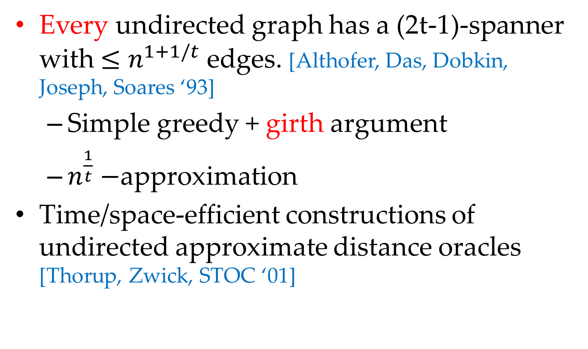
Undirected vs Directed
Every undirected graph has a (2t-1)-spanner with $≤n^{1+1/t}$ edges. [Althofer, Das, Dobkin, Joseph, Soares ‘93]
Simple greedy + girth argument
$n^{\frac{1}{t}}−$approximation
Time/space-efficient constructions of undirected approximate distance oracles [Thorup, Zwick, STOC ‘01]
Notes:
First we will see, what is the difference between undirected and directed spanners.
Let n be the number of vertices in the graph.
Then every _undirected_ graph has a (2t-1)-spanner with at most n^{1+1/t} edges,
as shown by Althofer, Das, Dobkin, Joseph and Soares back in the nineties.
This spanner can be constructed, using a simple Kruskal-like greedy algorithm.
The proof of sparsity follows from a girth argument.
This give a trivial n^{1/t}-approximation.
The fact that undirected graphs have sparse spanners allows to construct time/space-efficient undirected approximate distance oracles.
This was shown by Thorup and Zwick.

Slide 8
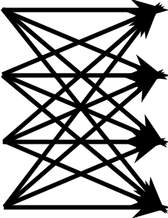
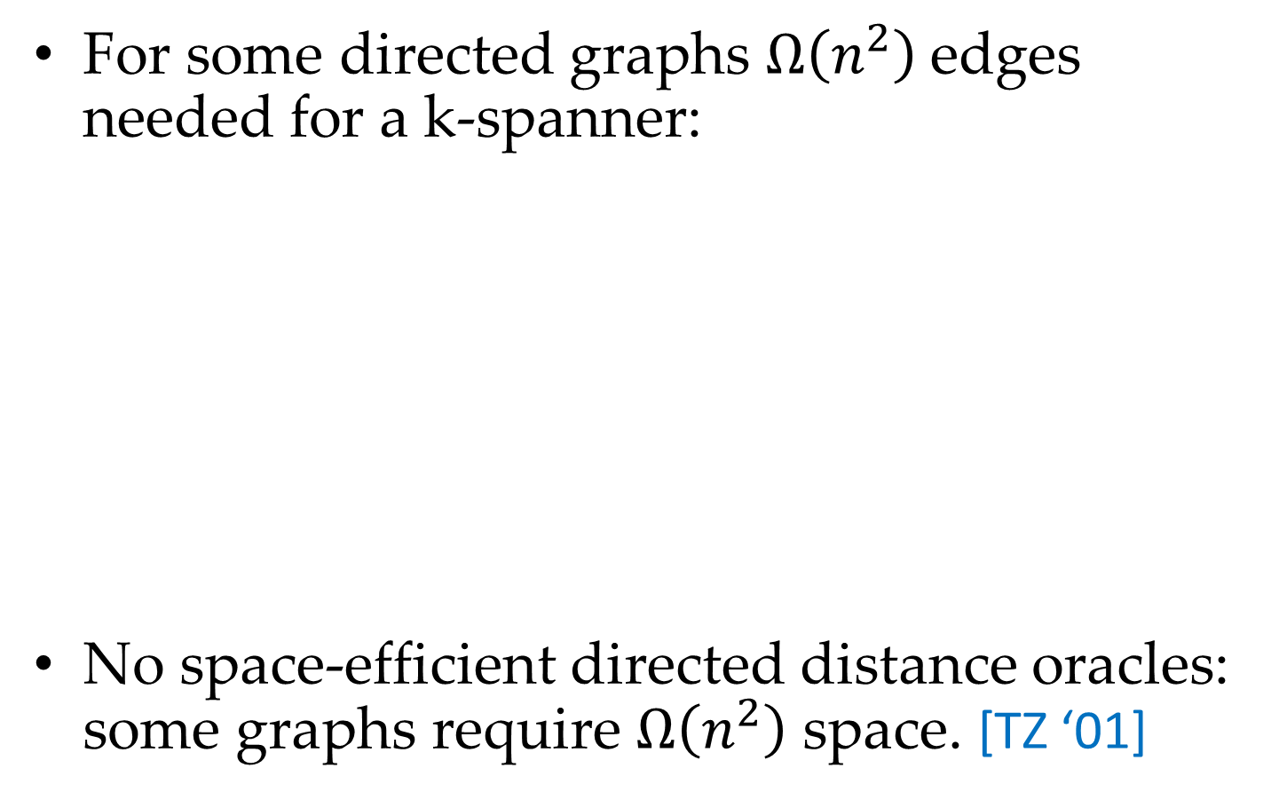
Undirected vs Directed
For some directed graphs $Ω\left(n^{2}\right)$edges needed for a k-spanner:
No space-efficient directed distance oracles: some graphs require $Ω\left(n^{2}\right)$ space. [TZ ‘01]
Notes:
In directed case there is no guarantee of sparsity for k-spanner.
This is illustrated be a directed complete bipartite graph, as shown on the picture.
Every k-spanner of this graph has to include all edges, because otherwise some pairs of vertices will be disconnected.
There are no space-efficient oracles for directed graphs.
As shown by Thorup and Zwick, some graphs really require big omega n^2 space.

Slide 9
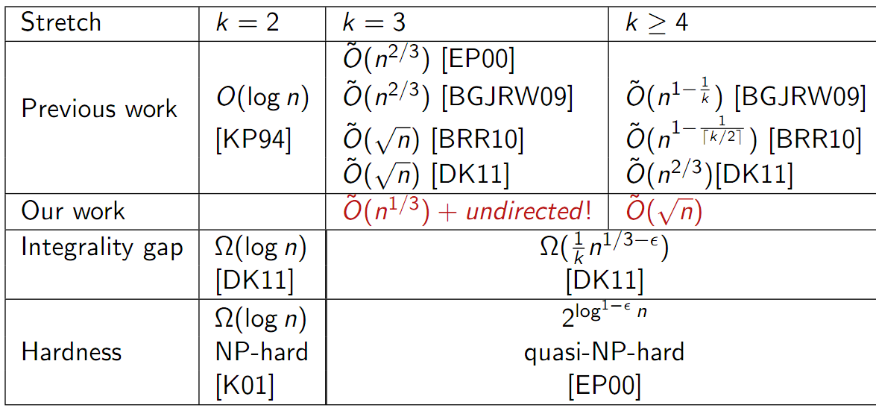
Unit-Length Directed k-Spanner
O(n)-approximation: trivial (whole graph)
Notes:
Here is the summary of previous work on approximation for the directed k-spanner in unit-length case.
*Note, that in this case we can assume k to be an integer.
The case of k=2 is completely resolved and O(log n) approximation is tight, unless P=NP.
*It admits O(log n)-approximation, as shown by Kortsarz and Peleg.
*Matching hardness results was shown by Kortsarz.
For k>=3 behavior is very different. Here tilde hides some factors polylogarithmic in n.
Note, that O(n)-approximation is trivial, because it is given by an algorithm that just outputs the whole graph.
This is because every weakly connected graph must have at least n-1 edges in the spanner.
The first non-trivial approximation algorithm was given by BGJRW’09. It was improved by BRR’10.
These algorithms are very different, but the approximation factor degrades to O(n) when k increases.
First algorithm that gives approximation factor, independent of k was given recently by Dinitz and Krauthgamer STOC’11.
We improve their approximation to \tildeO(\sqrt{n}) and this is the main result we will see today.
For k=3 we can get better approximation, than for larger values of k, using slightly different approach.
Improving the result of Dinitz and Krauthgamer, we give \tildeO(n^{1/3})-approximation in this case.
It is remarkable that this also implies the first improvement in approximation over the trivial approximation, given by girth arguments, as shown ADDJS’93.
We also note that this approximation almost matches the integrality gap, shown by Dinitz and Krauthgamer.
However, there is still a huge gap between between these approximation and hardness results.
Label-Cover hardness for directed spanner was given by Elkin and Peleg.

Slide 10
Overview of the algorithm
Paths of stretch k for all edges => paths of stretch k for all pairs of vertices
Classify edges: thick and thin
Take union of spanners for them
Thick edges: Sampling
Thin edges: LP + randomized rounding
Choose thickness parameter to balance approximation
Notes:
Now I will describe the generic framework, which is used for directed spanner.
First we observe, that it is enough to construct paths of stretch k between endpoints of each edge.
This preserves distances between all pairs of vertices.
We classify edges into two classes, which we call thick and thin.
Then we construct spanners for thick and thin edges separately and take their union.
For thick edges we use simple sampling. For thin edges we use LP + randomized rounding.
Finally, we select parameter of thickness in such way that both constructed spanners give \tildeO{\sqrt{n}}-approximation.
To explain what thick and thin edges are we will need to introduce a notion of a local graph.

Slide 11
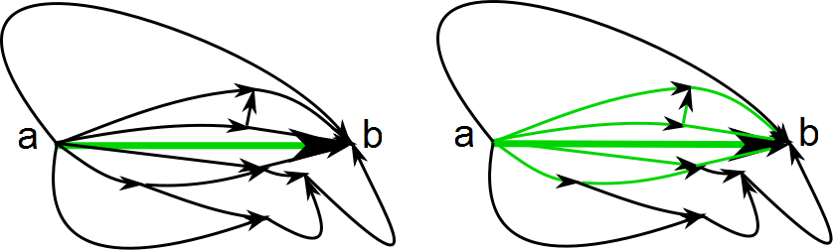

Local Graph
Local graph for an edge (a,b): Induced by vertices on paths of stretch $≤k$ from a to b
Paths of stretch k only use edges in local graphs
Thick edges: $≥\sqrt{n}$ vertices in their local graph. Otherwise thin.
Notes:
Fix an edge (a,b) in the graph and consider vertices that lie on some path of stretch at most k from a to b.
We call the subgraph induced by these vertices a “local graph” for an edge (a,b).
An example is shown on the picture and green edges show edges of the local graph for (a,b).
Clearly, every spanner only uses edges in the “local graph”.
We call an edge “thick”, if its local graph has at least \sqrt{n} vertices. Otherwise, we call the edge thin.
Thickness parameter \sqrt{n} is choosen to balance approximation, given by two stages of the algorithm.
Now I will describe the sampling technique we use for thick edges.

Slide 12
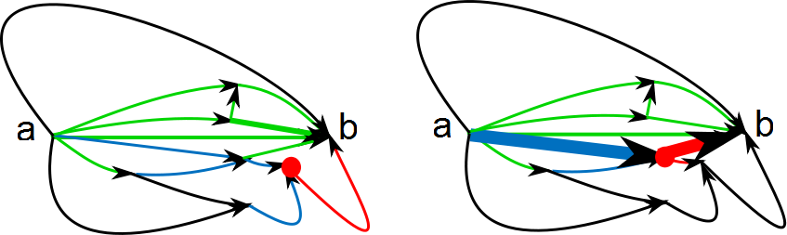
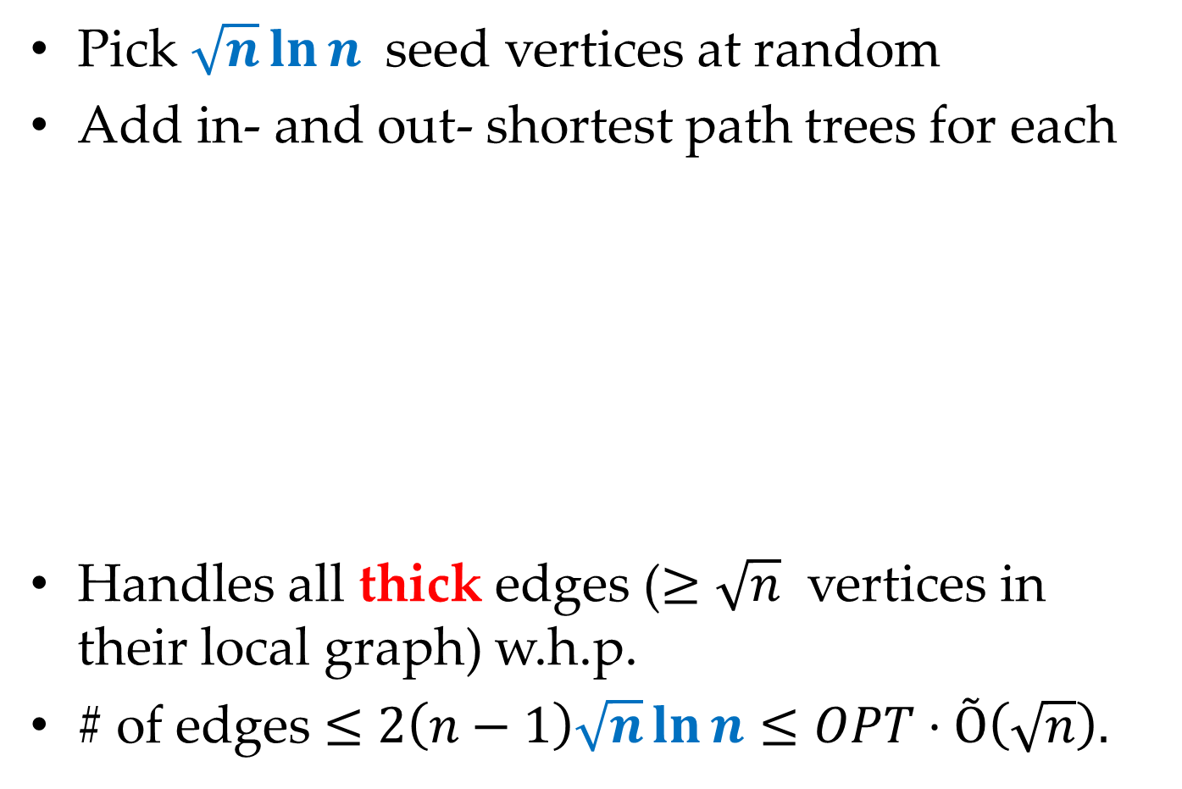
Sampling [BGJRW’09, FKN09, DK11]
Pick $\sqrt{n}\ln{n}$ seed vertices at random
Add in- and out- shortest path trees for each
Handles all thick edges ($≥\sqrt{n}$ vertices in their local graph) w.h.p.
# of edges $≤$ $2\left(n−1\right)\sqrt{n}\ln{n}≤OPT⋅Õ\left(\sqrt{n}\right).$
Notes:
The sampling technique that we use is very simple. Similar sampling techniques were used in the previous work.
To construct a spanner for thick edges we pick O{\sqrt{n}} seed vertices at random.
From each of them we construct incoming and outgoing trees of shortest paths.
One the left picture this is shown for one seed vertex, which is marked red.
The spanner for thick edges is given by taking union of the constructed trees.
Note, that if at least one seed vertex was sampled inside the local graph of an edge (a,b) then the constructed edge set has a path of stretch at most k from a to b.
It is easy to see that we will sample at least one seed vertex inside a local graph of each thick edge with high probability.
Finally, each time we sample we add at most 2(n - 1) edges to the spanner, so we have O(\sqrt{n})-approximation.

Slide 13
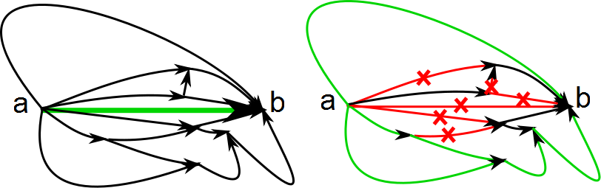
Key Idea: Antispanners
Antispanner – subset of edges, which destroys all paths from a to b of stretch at most k.
Spanner <=> hit all antispanners
Enough to hit all minimal antispanners for all thin edges
Minimal antispanners can be found efficiently
Notes:
They key concept we use for describing the linear program is an antispanner for an edge.
Given an edge (a,b) we call a subset of edges an antispanner for this edge, if its removal from the graph destroys all paths from a to b of stretch at most k.
Clearly, every spanner has to intersect with all such antispanners, because otherwise the spanner property does not hold.
So the set of the edges of the antispanner has to hit all these antispanner sets.
It is enough to hit all _minimal_ antispanners (as sets of edges), because this implies hitting all of them.
Finally, note that we can efficiently check, whether the graph is a k-spanner by running shortest paths algorithms.
So if a graph is not a spanner then we can efficiently find a minimal antispanner by taking the complement of its edge set and then minimizing it.
Now we are ready to state the linear program.

Slide 14
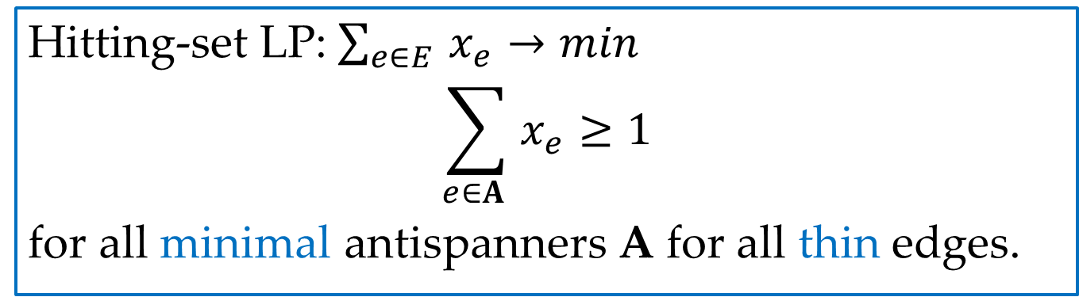
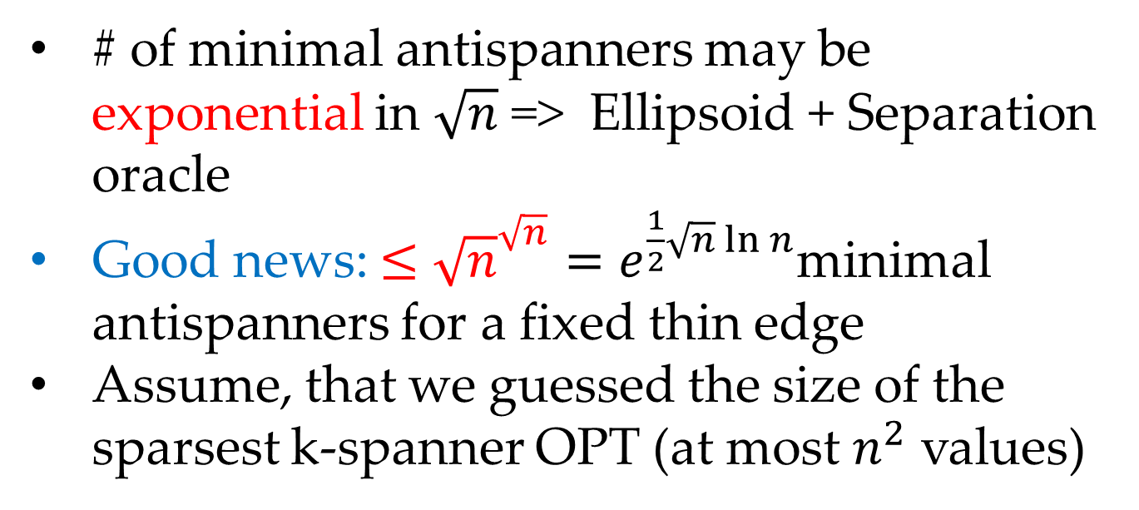
Linear Program (dual to [DK’11])
Hitting-set LP:$\sum_{e∈E }{x_{e}}→min$
$$\sum_{e∈A }{x_{e}}≥1$$
for all minimal antispanners A for all thin edges.
# of minimal antispanners may be exponential in $\sqrt{n}$ => Ellipsoid + Separation oracle
Good news: $≤{\sqrt{n}}^{\sqrt{n}}=e^{\frac{1}{2}\sqrt{n}\ln{n}}$minimal antispanners for a fixed thin edge
Assume, that we guessed the size of the sparsest k-spanner OPT (at most $n^{2}$ values)
Notes:
We use a hitting-set linear program, which is a dual of a flow-based linear program, used in DK’11.
We have variables x_e for each edge in the graph, corresponding to edge selections.
For any fixed antispanner the sum of the edge selections over its edges should be at least one.
We write these conditions for all minimal antispanners for all thin edges.
Clearly, if the edge edge selection variables are zero-one, this gives us the sparsest spanner.
We consider fractional relaxation of this LP.
A technical difficulty is that the number of minimal antispanners can be exponential in \sqrt{n}.
This is why we use an ellipsoid algorithm with a separation oracle to solve the LP.
However, the good news are that we can give an upper bound on the number of minimal antispanners for a fixed thin edge.
Our bound shows that this number can only be slightly larger than exponential in \sqrt{n}.
Now to simplify presentation assume that we’ve guessed the size of the minimal k-spanner OPT.
It can only take at most n^2 different values, so we can go iterate through all of them.

Slide 15
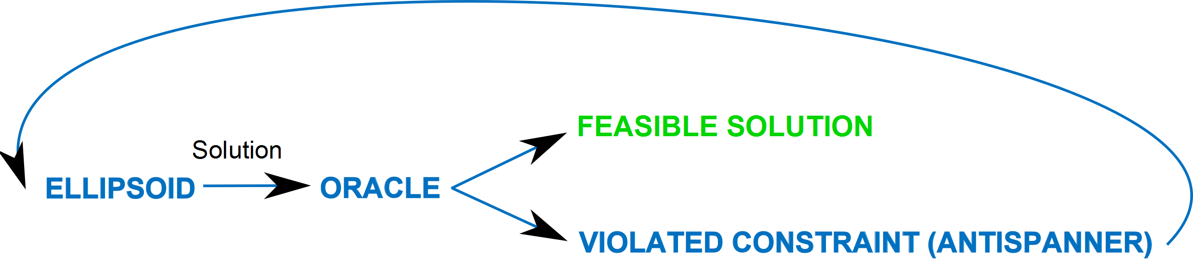
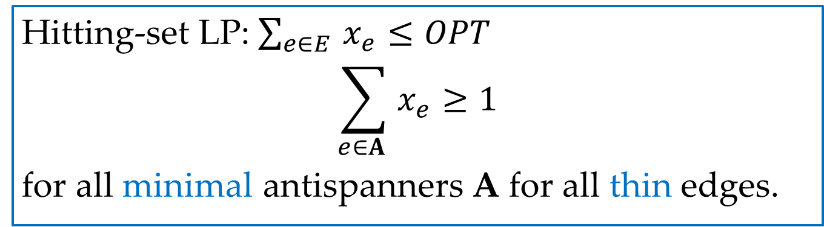
Oracle
Hitting-set LP:$\sum_{e∈E }{x_{e}}≤OPT$
$$\sum_{e∈A }{x_{e}}≥1$$
for all minimal antispanners A for all thin edges.
We use a randomized oracle => in both cases oracle can fail with some probability.
Notes:
Once we’ve guessed OPT, we replace the objective function by an inequality.
We design a separation oracle to check the feasibility of the resulting LP.
Given some solution to the LP a separation oracle needs to either accept it as a feasible or reject and provide a violated constraint.
We are going to use a _randomized_ separation oracle, so behavior in both cases can be different due to the randomness.

Slide 16
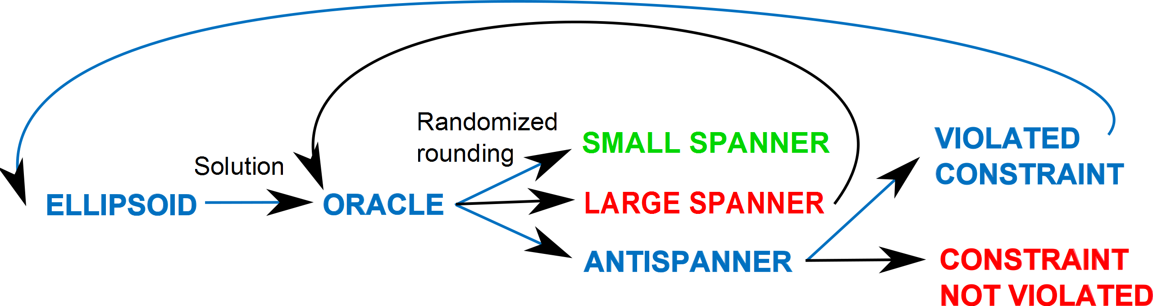
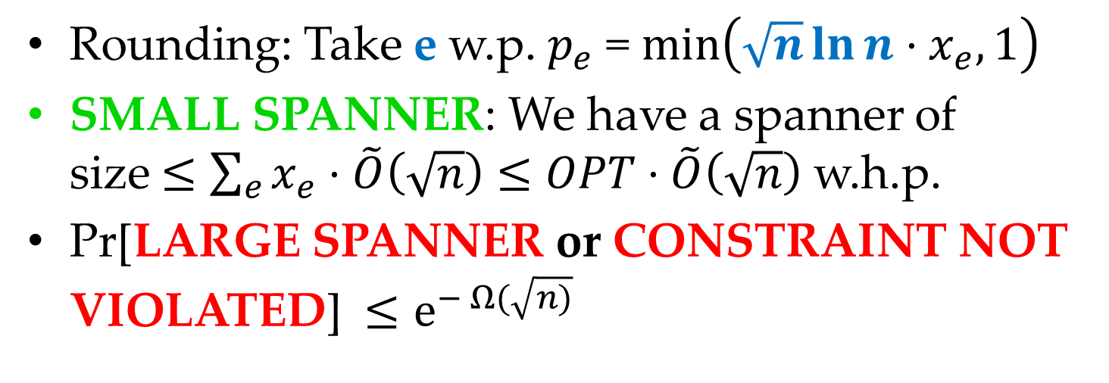
Randomized Oracle = Rounding
Rounding: Take e w.p. $p_{e}$ = $min\left(\sqrt{n}\ln{n}⋅x_{e},1\right)$
SMALL SPANNER: We have a spanner of size$≤\sum_{e}{x_{e}}⋅\tilde{O}\left(\sqrt{n}\right)≤OPT⋅\tilde{O}\left(\sqrt{n}\right)$ w.h.p.
Pr[LARGE SPANNER or CONSTRAINT NOT VIOLATED] $≤e^{− Ω(\sqrt{n)}}$
Notes:
Our randomized oracle will do randomized rounding of the current LP solution.
It will construct an edge set, by including each edge of the graph with probability, proportional to its fractional selection variable.
To get the probability we scale the fractional selection by a factor \sqrt{n}ln n and if it exceeds one select the edge deterministically.
If the current solution is feasible, then we will have spanner of size \tildeO(\sqrt{n}) * OPT w.h.p. and we succeed.
If the solution is infeasible, then we find an antispanner, which corresponds to a violated constraint.
As we do randomized rounding in both cases there is a probability of failure.
If we have a spanner, its size can be too large.
If we don’t have a spanner then the constraint corresponding to the antispanner can be not violated.
We show that any of these events happens with exponentially small probability.
This was the algorithm for directed k-spanner.

Slide 17
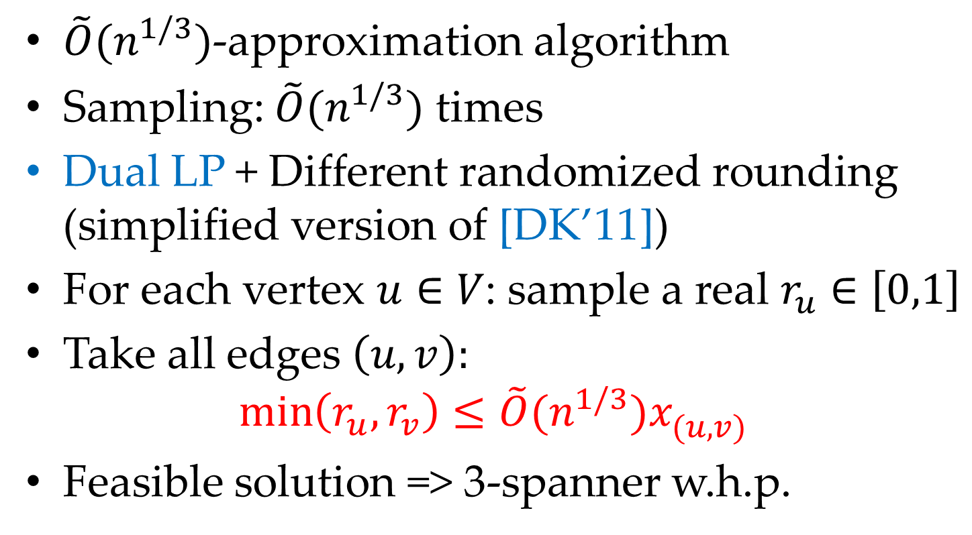
Unit-length 3-spanner
$\tilde{O}(n^{1/3})$-approximation algorithm
Sampling: $\tilde{O}(n^{1/3})$ times
Dual LP + Different randomized rounding (simplified version of [DK’11])
For each vertex $u∈V$: sample a real $r_{u}∈\left[0,1\right]$
Take all edges $\left(u,v\right):$
$$\min\left(r_{u}, r_{v}\right)≤{\tilde{O}(n^{1/3})x}_{(u,v)}^{}$$
Feasible solution => 3-spanner w.h.p.
Notes:
For unit-length 3-spanner we give a $\tilde{O}(n^{1/3})$-approximation.
First we use sampling $\tilde{O}(n^{1/3})$ times.
To achieve better approximation in the LP step we change the rounding scheme.
We use a simplified version of rounding, used by Dinitz and Krauthgamer.
For each vertex we sample a random real value uniformly distributed on the interval zero-one.
Then we include into the spanner all edges (u,v), for which the following condition is satisfied:
Minimum of the random values on endpoints of the edge is at most the fractional selection from the LP times a scaling factor.
We simiplify the analysis of a dual flow-based LP, given in DK’11, to show that given a feasible solution to the LP the rounding gives a 3-spanner with high probability.

Slide 18
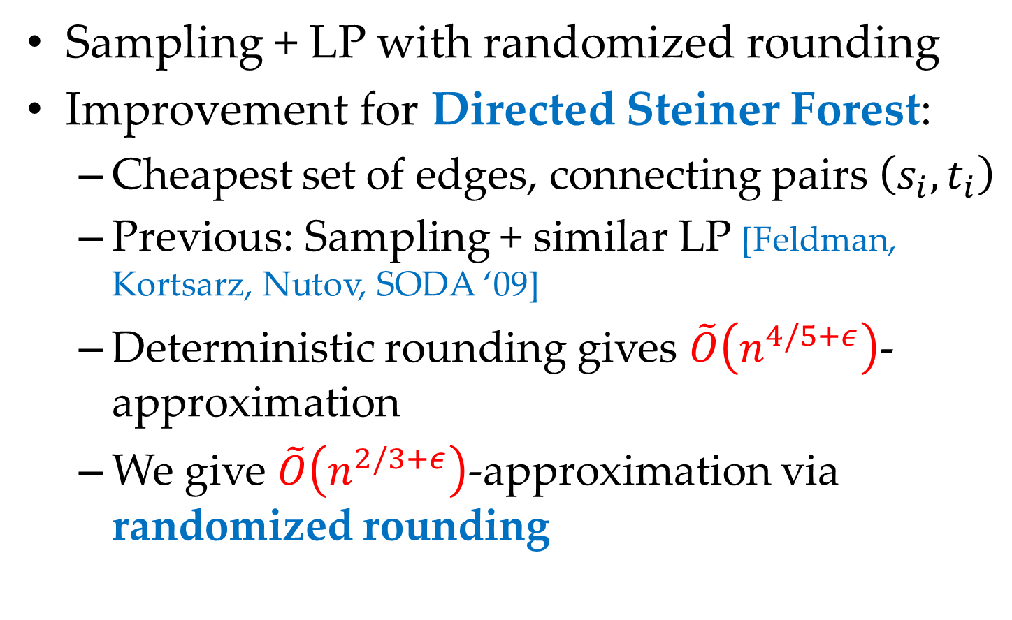
Conclusion
Sampling + LP with randomized rounding
Improvement for Directed Steiner Forest:
Cheapest set of edges, connecting pairs $\left(s_{i}, t_{i}\right)$
Previous: Sampling + similar LP [Feldman, Kortsarz, Nutov, SODA ‘09]
Deterministic rounding gives $\tilde{O}\left(n^{4/5+ε}\right)$-approximation
We give $\tilde{O}\left(n^{2/3+ε}\right)$-approximation via randomized rounding
Notes:
We have introduced the technique, which combines sampling with randomized rounding of a linear program.
This technique also gives improvement in approximation for the Directed Steiner Forest problem.
Given a graph G and a set of pairs of nodes (s_i, t_i) the problem is to find the cheapest set of edges, which connects all given pairs.
Previous best approximation for this problem was given by Feldman, Kortsarz and Nutov.
They use sampling together with a linear program similar to the Directed Spanner LP.
They do deterministic rounding of the LP and get \tildeO(n^{4/5}+\epsilon) approximation.
We do randomized rounding in a similar way that we’ve seen for Directed Spanner and get a \tildeO(n^{2/3} + \epsilon)-approximation.

Slide 19
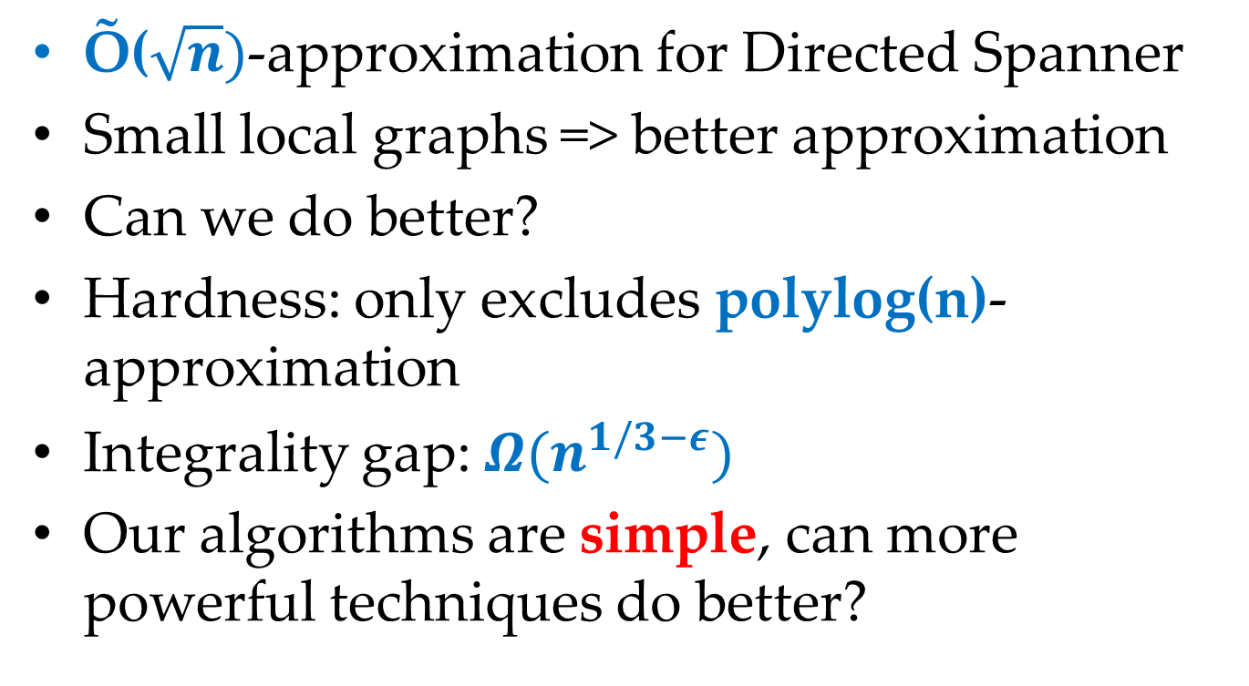
Conclusion
Õ($\sqrt{n})$-approximation for Directed Spanner
Small local graphs => better approximation
Can we do better?
Hardness: only excludes polylog(n)-approximation
Integrality gap: $Ω(n^{1/3−ε})$
Our algorithms are simple, can more powerful techniques do better?
Notes:
We have seen ~O(\sqrt n) approximation for the Directed Spanner problem.
Can we do better thani this?
The hardness result be Elkin and Peleg only excludes polylog(n)-approximation.
The integrality gap by Dinitz and Krauthgamer is \Omega(n^{1/3}-\epsilon), so there this is some space here as well.
The algorithms we use are simple. Can more powerful techniques (like LP or SDP hierarchies) do better?

Slide 20
Thank you!
Slides: http://grigory.us
Notes:
Thank you!
You can find the slides on my homepage.

