Slide 1
Steiner Transitive-Closure Spanners of Low-Dimensional Posets
Grigory Yaroslavtsev
Pennsylvania State University +
AT&T Labs – Research (intern)
Joint with P. Berman (PSU), A. Bhattacharyya (MIT), E. Grigorescu (GaTech), S. Raskhodnikova (PSU), and D. Woodruff (IBM)
Notes:
Welcome to “Steiner Transitive-Closure Spanners of Low-Dimensional Posets”.
This is joint work with Piotr Berman, Arnab Bhattacharyya, Elena Grigorescu, Sofya Raskhodnikoa and David Woodruff.
I would like to thank Arnab Bhattacharyya for his help in preparing the slides.

Slide 2
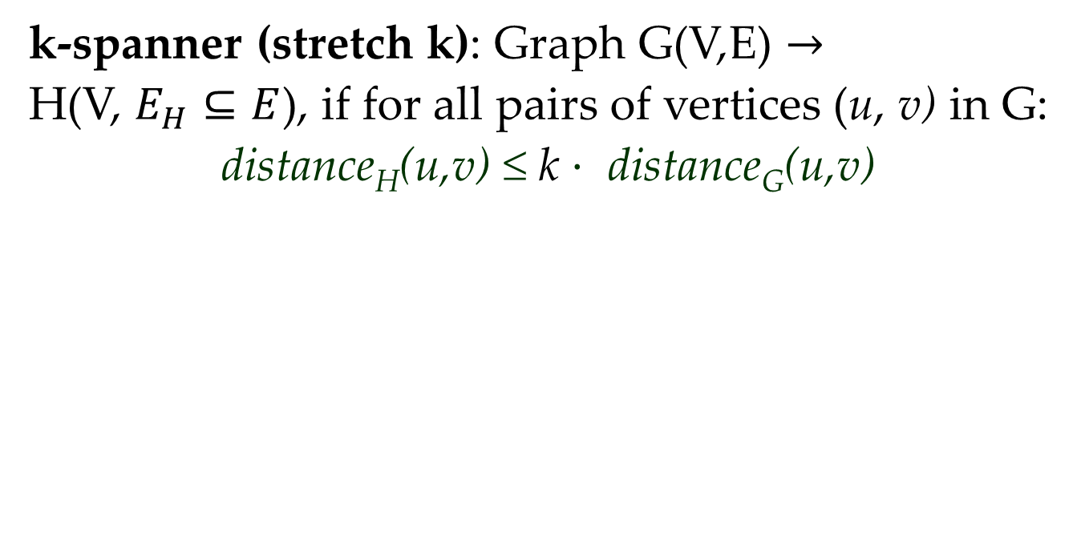
Graph Spanners
k-spanner (stretch k): Graph G(V,E) $→$
H(V, $E_{H}⊆E$), if for all pairs of vertices (u, v) in G:
distance_{H}(u,v) ≤ k $⋅$ distance_{G}(u,v)
G
H: 2-spanner of G
[Awerbuch ‘85, Peleg-Schäffer ‘89]
Notes:
We start by introducing a notion of a k-spanner.
The definition is the same as in the talk on Monday.
Given a graph, a k-spanner is a subset of edges, such that for all pairs of vertices in the graph it preserves distances up to a multiplicative factor k.
Namely, the distances in k-spanner are at most k times larger than the distances in the original graph.
Today we will be considering directed graphs, with all edges of length 1.
We will be interested in the problem of constructing such spanners with minimum number of edges for a fixed value of k.
Here is an example of a directed graph and a 2-spanner for it.

Slide 3
Transitive-Closure Spanners
Transitive closure TC(G) has an edge from u to v iff
G has a path from u to v
G
TC(G)
H is a k-TC-spanner of G if H is a subgraph of TC(G) for which distance_{H}(u,v) ≤ k iff G has a path from u to v
H is a k-TC-spanner of G if H is a k-spanner of TC(G)
Shortcut edge consistent with ordering
2-TC-spanner of G
[Bhattacharyya, Grigorescu, Jung, Raskhodnikova, Woodruff, SODA‘09],
generalizing [Yao 82; Chazelle 87; Alon, Schieber 87, …]
Notes:
Today we will be considering spanners for transitively closed graphs, because they are useful for applications.
First, recall the definition of a transitive closure, which we denote as TC(G).
There is an edge from u to v in transitive closure if and only if there is some path from u to v in the graph.
Here is an example of a transitive closure for a directed path.
We say that a subgraph H is a k-Transitive-closure spanner (or k-_TC_-spanner) of G, if H is a k-spanner for the Transitive closure of G.
This means that for every pair (u,v) there is a path of length at most k in H, iff G has a path from u to v.
Here is an example of a 2-TC-spanner of a directed path.
The notion of a k-TC-spanner was first explicitly introduced by BJGRW and implicitly used before by Yao, Chazelle, Alon, Schieber and others.

Slide 4
Applications of TC-Spanners
  Data structures for storing partial products [Yao, ’82; Chazelle ’87, Alon, Schieber, 88]
  Constructions of unbounded fan-in circuits [Chandra, Fortune, Lipton ICALP, STOC‘83]
  Property testers for monotonicity and Lipschitzness [Dodis et al. ‘99,BGJRW’09; Jha, Raskhodnikova, FOCS ‘11]
  Lower bounds for reconstructors for monotonicity and Lipshitzness [BGJJRW’10, JR’11]
  Efficient key management in access hierarchies
Follow references in [Raskhodnikova ’10 (survey)]
Notes:
Here is a summary of applications of TC-spanners.
The first applications we know are in constructing data structures for storing partial products and in constructions of unbounded fan-in circuits.
Most recent applications are in property testing and property reconstruction.
In applications to property testing and property reconstruction only _2_-TC-spanners are useful.
This is why we pay special attention today.
The last application to key management in access hierarchies we will consider in more detail.

Slide 5
Application to Access Control
Access hierarchy with low storage and low key derivation times
Sparse TC-spanner
Access class with private key k_{i}
i
j
Need k_{i} to efficiently compute k_{j} from P_{ij}
Permission edge with public key P_{ij}
To speed up key derivation time, add shortcut edges consistent with permission edges
[Attalah, Frikken, Blanton ‘05; Attalah,Blanton,Frikken ‘06, De Santis,Ferrara,Massuci ‘07, Attalah,Blanton,Fazio,Frikken ‘09]
Notes:
Access control hierarchy can be represented as a directed graph.
The vertices of this graph correspond to access classes.
The user, who has access to some class, has permission to access all descendant classes as well.
A scheme, proposed by Attalah, Blanton, Fazio and Frikken assigns a private key k_i to each of the classes.
In order to minimize the number of different keys a user has to store they propose a scheme for derivation of keys for descendant classes.
Each edge has a public key, associated with it.
As shown on the picture, given a key k_i, a key k_j for the descendant class can be efficiently computed using a public key P_ij.
If the hierarchy is deep, the derivation times become large, so shortcut edges can be added, if they are consistent with permission edges.
If we introduce shortcuts by constructing a Sparse TC-spanner for the graph of permissions, then we get low storage and low key derivation times.

Slide 6
Steiner TC-Spanners
Add extra node & reduce key storage!
Steiner
2-TC-spanner
H is a Steiner k-TC-spanner of G if
vertices(G) ⊆ vertices(H)
distance_{H}(u,v) ≤ k if G has a path from u to v
∞ otherwise
Notes:
However, in some situations TC-spanners are not sufficient, because they are still large.
Here is an example: a directed biclique. Any TC-spanner for it includes all edges, because if you remove at least one edge, there will be no path between its endpoints.
This example illustrates why introducing new vertices (which are called Steiner vertices) can be useful.
Adding a Steiner point reduces the number of edges from quadratic to linear.
Now we give a formal definition.
H is a Steiner k-TC-spanner of G, if:
The vertex set of H is a superset of the vertex set of G.
For all pairs (u,v) we have:
a)If there is a path from u to v, then the distance from u to v in H is at most k.
b)There is no path from u to v in H otherwise (This is exactly what we need for access control, because we don’t want to let users access classes they don’t have permission for).

Slide 7
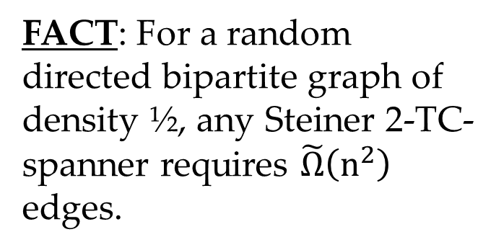
Bounds for Steiner TC-Spanners
For some graphs Steiner TC-spanners are still large:
FACT: For a random directed bipartite graph of density ½, any Steiner 2-TC-spanner requires $\tilde{Ω}\left(n^{2}\right)$ edges.
Notes:
For arbitrary graphs we can’t get get any non-trivial upper bounds, because _some_ graphs have large Steiner TC-spanners.
This is illustrated by the following example.
Take a random directed bipartite graph, constructed by including each edge of a bipartite clique independently with probability ½.
In this case it can be shown that any Steiner 2-TC-spanner requires \tilde\omega (n^2) edges.

Slide 8
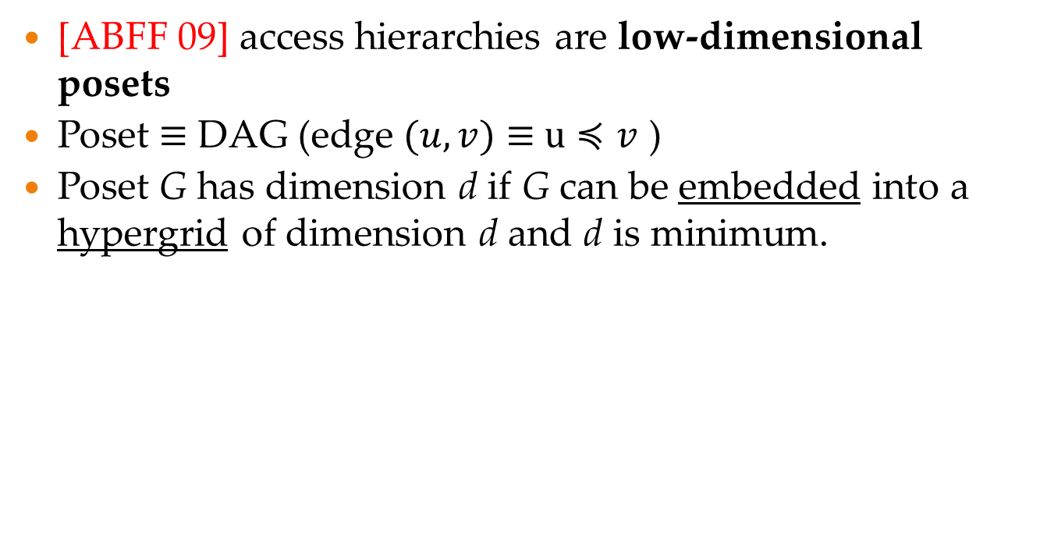
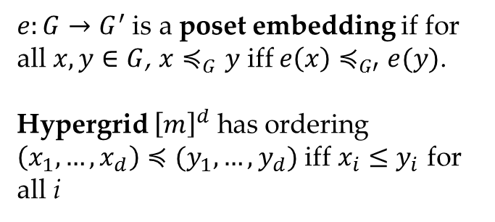
Low-Dimensional Posets
[ABFF 09] access hierarchies are low-dimensional posets
Poset $≡$ DAG (edge $(u,v)$ $≡$ $u≼v$ )
Poset G has dimension d if G can be embedded into a hypergrid of dimension d and d is minimum.
$e:G→G^{′}$ is a poset embedding if for all $x, y∈G$, $x≼_{G}y$ iff $e\left(x\right)≼_{G′}e(y)$.
Hypergrid ${\left[m\right]}^{d}$ has ordering $\left(x_{1}, …, x_{d}\right)≼(y_{1}, …, y_{d})$ iff $x_{i}≤y_{i}$ for all i
Notes:
However, ABFF argue that access control hierarchies are usually described by posets of _low dimension_.
They initiated the study of bounding the size of the spanner in terms of dimension.
Dimension d of a poset G is the smallest dimension of a hypergrid, into which the poset can be embedded.
The embedding should preserve the ordering between the elements of the poset.
This can be formally defined by specifying a mapping e from the set of elements of the poset G into another poset G’.
Namely for all pairs of elements in the poset (x,y), it should hold that
x is less than y with respect to the poset G if and only if e(x) is less than e(y) with respect to G’.
The ordering on the hypergrid [m]^d is given by the dominance order.
One point is less than another if it is nonstrictly dominated on each component.
Here is an example, where red points correspond to a poset, embedded into a hypergrid.

Slide 9
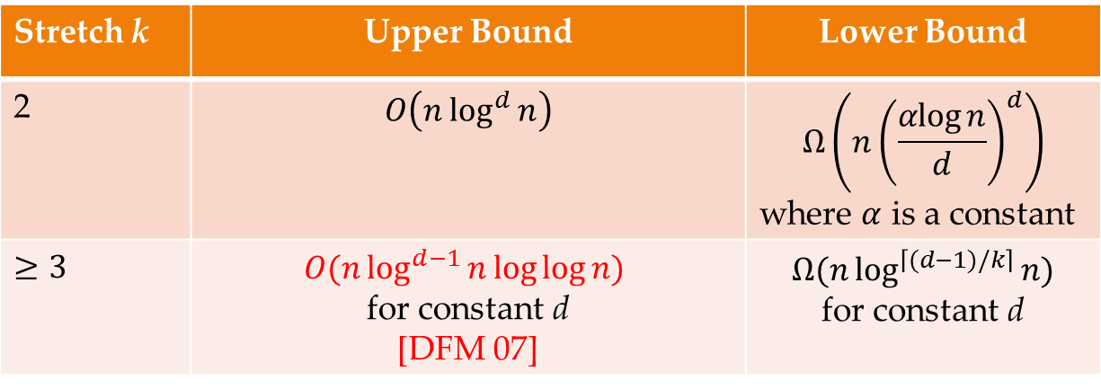
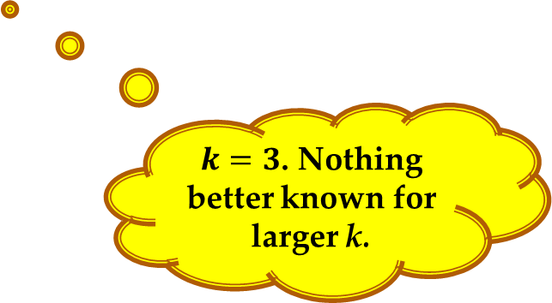
Our Main Results
Stretch k | Upper Bound | Lower Bound
2 | $$O\left(n\log^{d}{n}\right)$$ | $$Ω\left(n{\left(\frac{αlog{n}}{d}\right)}^{d}\right)$$ where $α$ is a constant
$≥3$ | $O(n\log^{d−1}{n}\log{\log{n) }}$ for constant d [DFM 07] | $$Ω(n\log^{\left\lceil (d−1)/k\right\rceil }{n)}$$ for constant d
$k=3$. Nothing better known for larger k.
d is the poset dimension
Notes:
Here is a table, summarizing the previous work and our results.
QUESTION: Really nothing known before for k=2?
For stretch k=2 we give a O(n log^d n) upper bound on the size of a Steiner TC-spanner of any poset on n vertices.
We complement it by the following lower bound (shown on the picture, where \alpha is some constant).
This lower bound should be interpreted as follows: there exists an infinite family of posets, for which it holds.
This is the main technical result that will be shown today.
For low-dimensional posets we can think of d as being a small constant.
In this case the bound is tight up to a constant factor.
For larger values of stretch a slightly better upper bound was given by De Santis Ferrar and Masucci.
We show the following lower bound for constant d.
Note, that the upper bound doesn’t get better when k>3.
QUESTION: Does an open problem, proposed by Arnab make sense? This formula gives n \log n for any k.

Slide 10
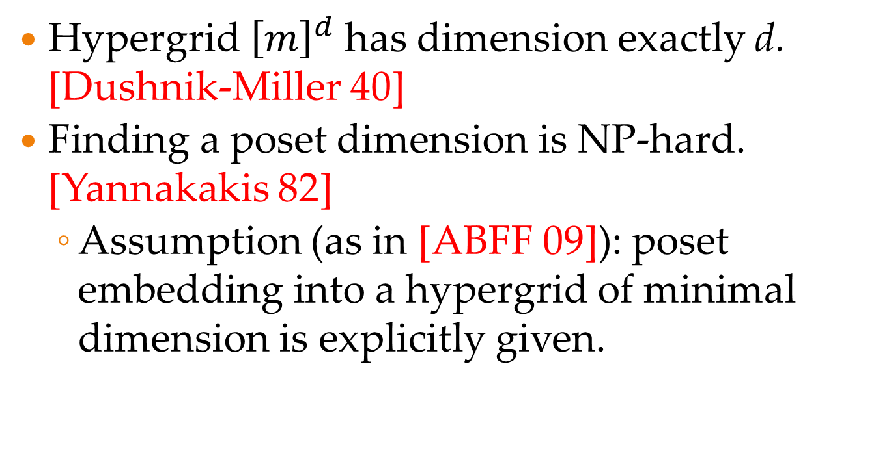
Facts about Poset Dimension
Hypergrid ${\left[m\right]}^{d}$ has dimension exactly d. [Dushnik-Miller 40]
Finding a poset dimension is NP-hard. [Yannakakis 82]
  Assumption (as in [ABFF 09]): poset embedding into a hypergrid of minimal dimension is explicitly given.
Notes:
We give some facts about about poset dimension.
You cannot embed a hypergrid into a hypergrid of lower dimension, so a hypergrid of dimension d has dimension exactly d.
As shown by Yannakakis, finding a minimal embedding into a hypergrid is NP-hard, as shown by Yannakakis.
This is why we assume, as it was done in ABFF, that the poset embedding is explicitly given.

Slide 11

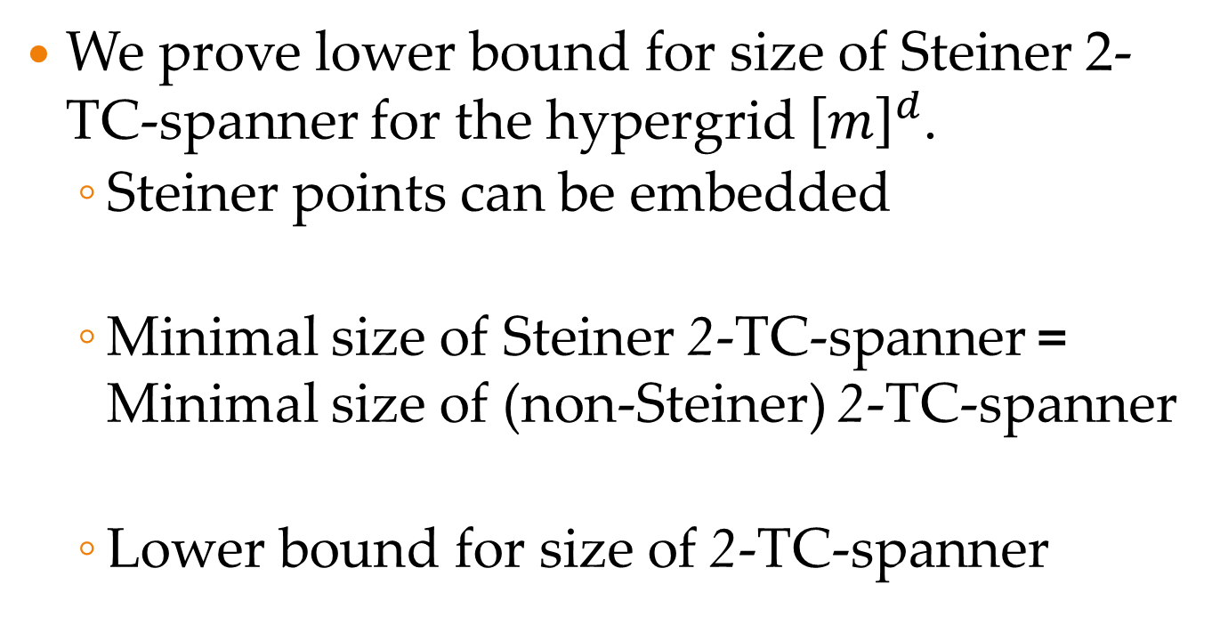
Lower Bound for $k=2$
We prove lower bound for size of Steiner 2-TC-spanner for the hypergrid ${\left[m\right]}^{d}$.
  Steiner points can be embedded
  Minimal size of Steiner 2-TC-spanner = Minimal size of (non-Steiner) 2-TC-spanner
  Lower bound for size of 2-TC-spanner
Notes:
For k=2 we prove the lower bound by considering hypergrids [m]^d for all dimensions d.
First we observe that for hypergrids the Steiner points do not help.
Namely, if we have a Steiner k-TC-spanner, then we can move all the Steiner points to some vertices of the hypergrid.
This is why the minimal sizes of Steiner and non-Steiner k-TC-spanners are equal.
So we prove a lower bound on the size of just a k-TC-spanner.

Slide 12


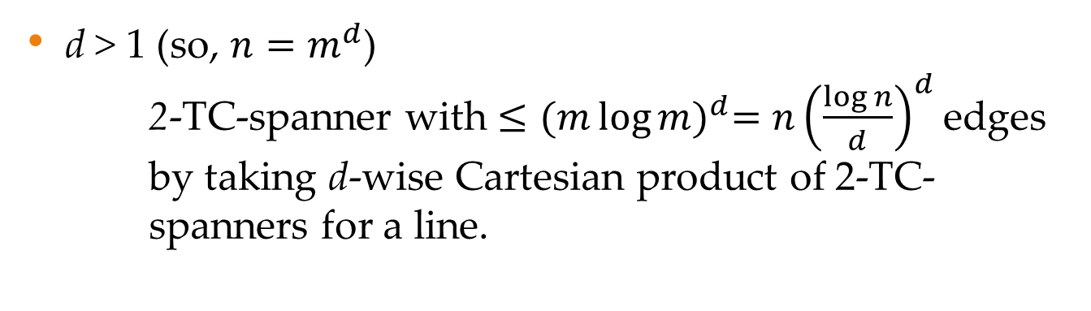
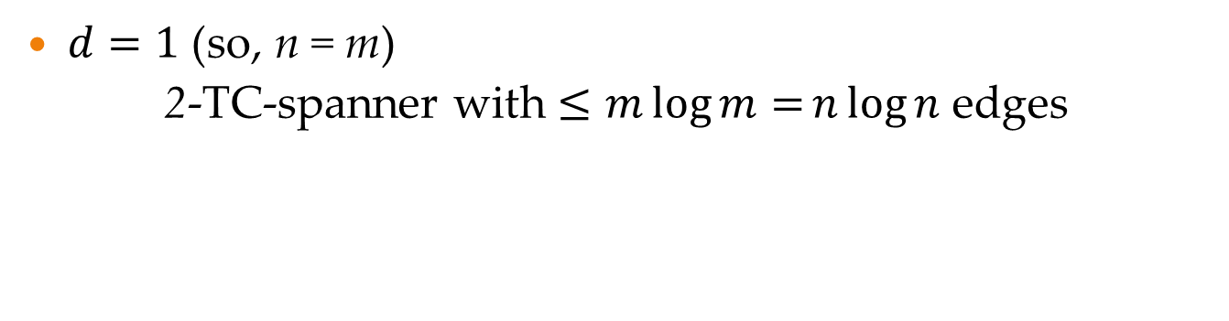
2-TC-Spanner for ${\left[m\right]}^{d}$
$d=1$ (so, n = m)
2-TC-spanner with $≤m\log{m=}n\log{n}$ edges
…
…
We show this is tight upto $α^{d}$ for a constant $α$.
d > 1 (so, $n=m^{d}$)
  2-TC-spanner with $≤{(m\log{m)}}^{d}=n{\left(\frac{\log{n}}{d}\right)}^{d}$edges by taking d-wise Cartesian product of 2-TC- spanners for a line.
Notes:
Now when we know that Steiner points don’t help for hypergrids let’s study, how do 2-TC-spanners for hypergrids can be constructed. (Slightly illogical here).
If d = 1 (so n = m) then a spanner of size n \log n can be constructed as follows (shows the animation and explains).
If d > 1 (so n = m^d) then a 2-TC-spanner can be constructed by taking d-wise Cartesian product of 2-TC-spanners on a line.
This give a spanner with n(log n/d)^d edges. We show that this is tight up to \alpha^d.

Slide 13
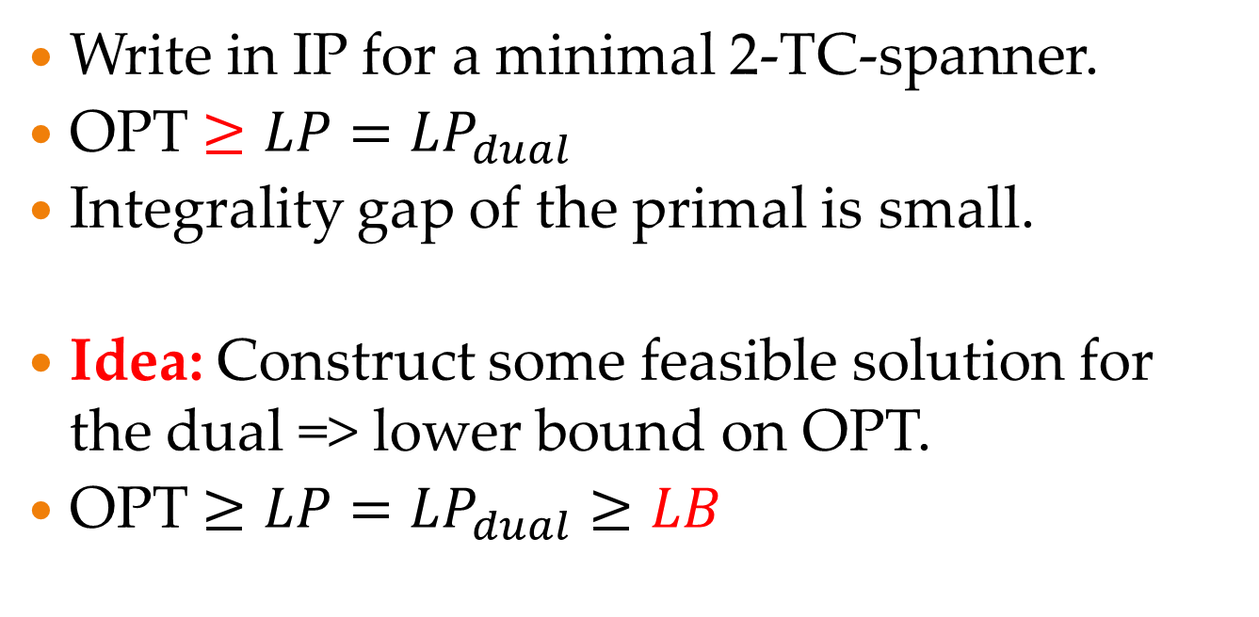
Lower Bound Strategy
Write in IP for a minimal 2-TC-spanner.
OPT $≥LP=LP_{dual}$
Integrality gap of the primal is small.
Idea: Construct some feasible solution for the dual => lower bound on OPT.
OPT $≥LP=LP_{dual}≥LB$
Notes:
Our lower bound proof strategy is as follows.
First we give an IP formulation for a minimal 2-TC-spanner problem.
Then consider an LP-relaxation. For it the value of the objective function is not larger then the integral optimum.
By duality the optimal value of the LP is equal to the optimal value of the dual maximization problem.
Now the idea is to construct some feasible solution to the dual maximization problem, which gives a lower bound on OPT.
This method is quite general, but it is crucial that the integrality gap of the LP should be small to get good lower bounds.

Slide 14
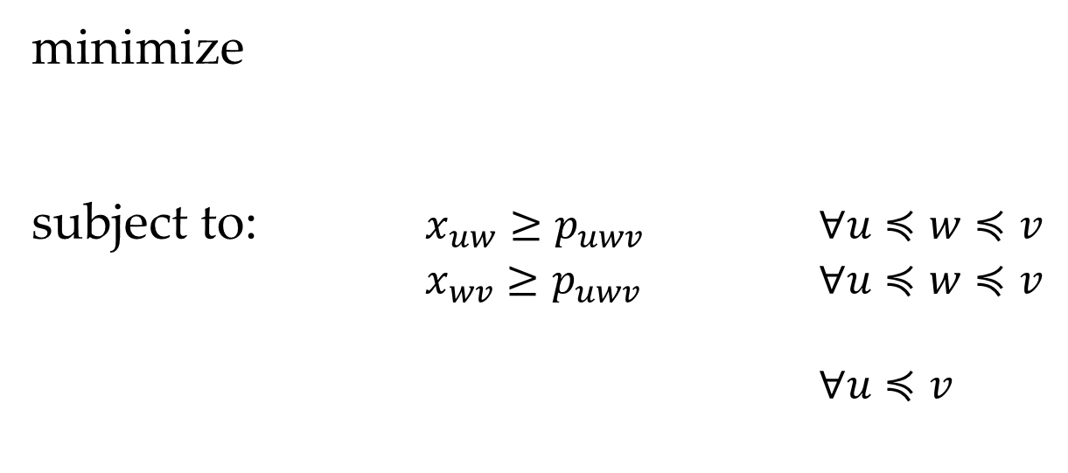
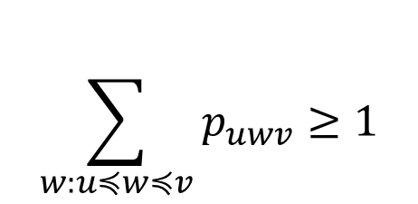
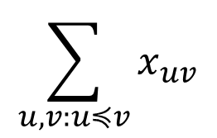
IP Formulation
{0,1}-program for Minimal 2-TC-spanner:
minimize
subject to: $x_{uw}≥p_{uwv}$ $∀u≼w≼v$
$x_{wv}≥p_{uwv}$ $∀u≼w≼v$
$∀u≼v$
$$\sum_{u,v:u≼v}{x_{uv}}$$
$$\sum_{w:u≼w≼v}{p_{uwv}≥1}$$
Notes:
Here is a {0,1} integer program for minimal 2-TC-spanner.
We have variables for edge selections x_uv and for paths of length two p_uwv.
The constraints are that the path p_uwv only if both of the edges uw and wv are selected.
There should be at least one path from u to v through some intermediate vertex w for all comparable pairs (u,v).

Slide 15
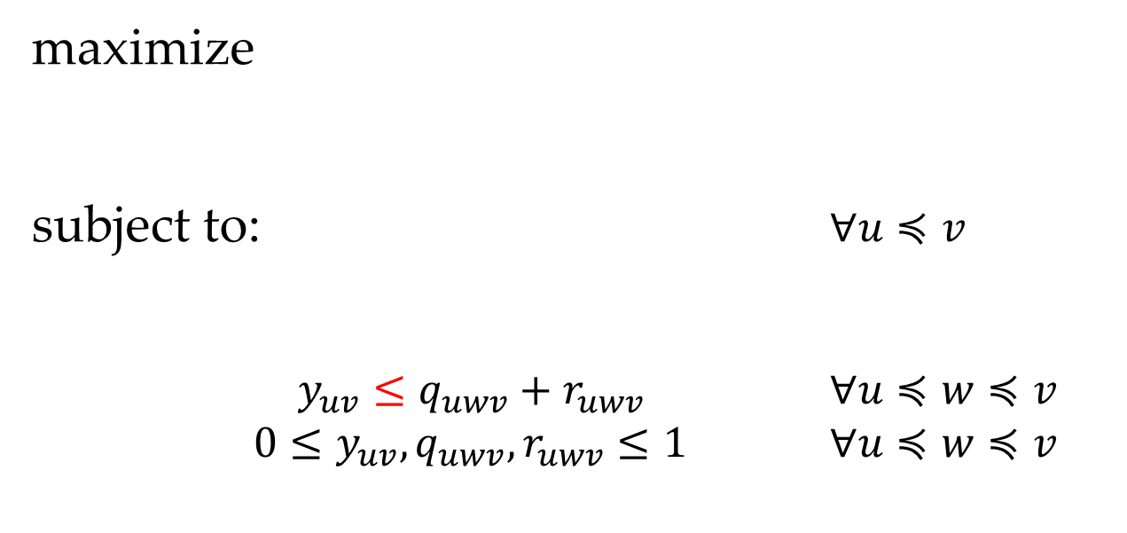
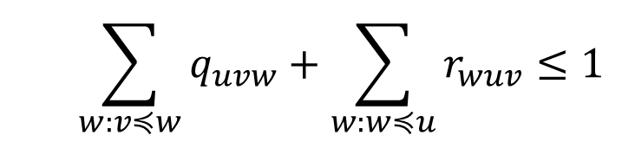
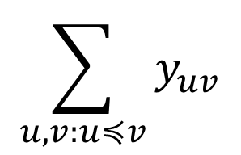
Dual LP
Take fractional relaxation of IP and look at its dual:
$$\sum_{u,v:u≼v}{y_{uv}}$$
maximize
subject to: $∀u≼v$
$y_{uv}≤q_{uwv}+r_{uwv}$ $∀u≼w≼v$
$0≤y_{uv}, q_{uwv}, r_{uwv}≤1$ $∀u≼w≼v$
  $$\sum_{w:v≼w}{q_{uvw}+\sum_{w:w≼u}{r_{wuv}≤1}}$$
Notes:
Now I will concentrate on the main idea, because the rest are calculations.
*Y_uv --- fractional cut of an edge (uv) for paths of length 2.
*Q_uvw --- fractional cut for all paths with the first hop through (u,v).
*R_wuv --- fractional cut for all paths with the second hop through (u,v).
First note that the only essential variables for this LP are y_uv’s and we have such variables for all pairs of vertices in the poset.
Then observe that we can make these inequalities tight by increasing the corresponding y_uv’s.

Slide 16
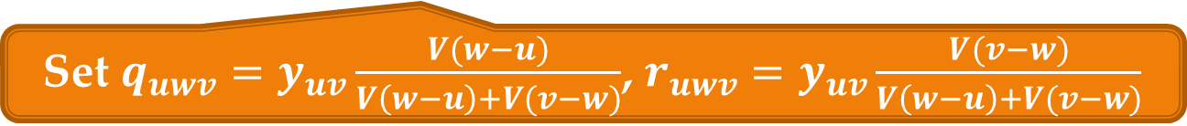
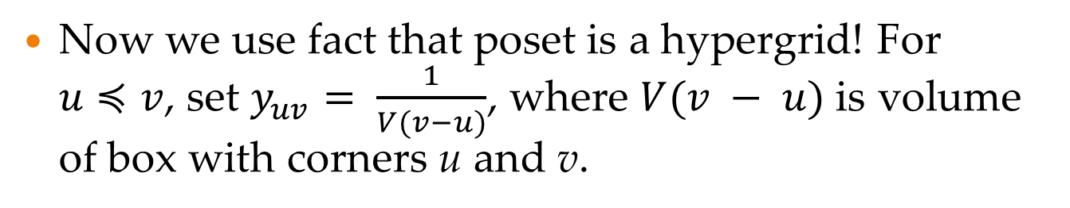
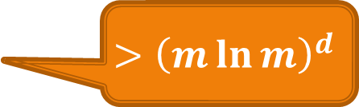
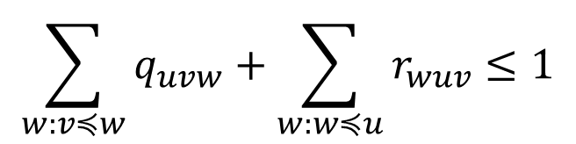
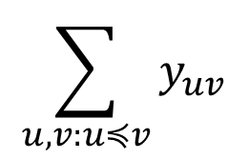
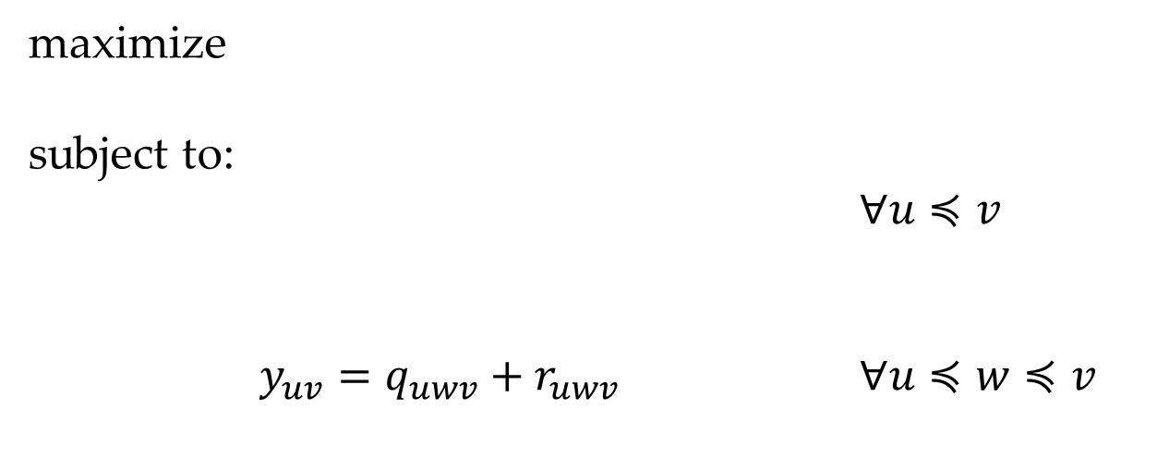
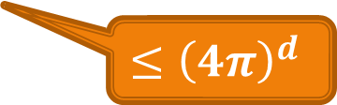
Constructing solution to dual LP
Now we use fact that poset is a hypergrid! For $u≼v$, set $y_{uv}= \frac{1}{V(v−u)}$, where $V(v − u)$ is volume of box with corners u and v.
$$\sum_{u,v:u≼v}{y_{uv}}$$
$$>{\left(m\ln{m}\right)}^{d}$$
maximize
subject to:
$∀u≼v$
$y_{uv}=q_{uwv}+r_{uwv}$ $∀u≼w≼v$
$$\sum_{w:v≼w}{q_{uvw}+\sum_{w:w≼u}{r_{wuv}≤1}}$$
$$≤{\left(4π\right)}^{d}$$
Set $q_{uwv}=y_{uv}\frac{V(w−u)}{V\left(w−u\right)+V(v−w)}$, $r_{uwv}=y_{uv}\frac{V(v−w)}{V\left(w−u\right)+V(v−w)}$
Notes:
Now we use the fact that the poset is a hypergrid.
Studying the 1-dimensional case we observe that in this case the feasible solution we are looking for we can take in the form y_uv = 1/V(v-u).

Slide 17

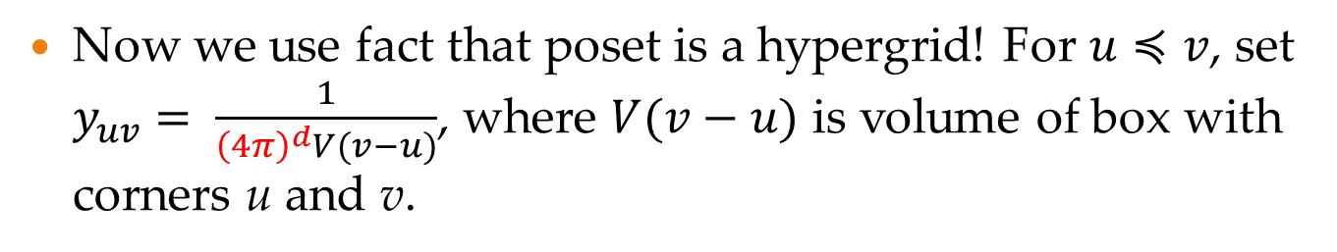
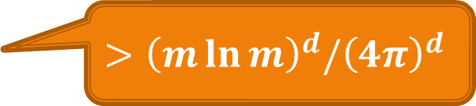
Constructing solution to dual LP
Now we use fact that poset is a hypergrid! For $u≼v$, set $y_{uv}= \frac{1}{{\left(4π\right)}^{d}V(v−u)}$, where $V(v−u)$ is volume of box with corners u and v.
$$\sum_{u,v:u≼v}{y_{uv}}$$
$$>{\left(m\ln{m}\right)}^{d}/{\left(4π\right)}^{d}$$
maximize
subject to:
$∀u≼v$
$y_{uv}=q_{uwv}+r_{uwv}$ $∀u≼w≼v$
$$\sum_{w:v≼w}{q_{uvw}+\sum_{w:w≼u}{r_{wuv}≤1}}$$
$$≤1$$
Set $q_{uwv}=y_{uv}\frac{V(w−u)}{V\left(w−u\right)+V(v−w)}$, $r_{uwv}=y_{uv}\frac{V(v−w)}{V\left(w−u\right)+V(v−w)}$

Slide 18
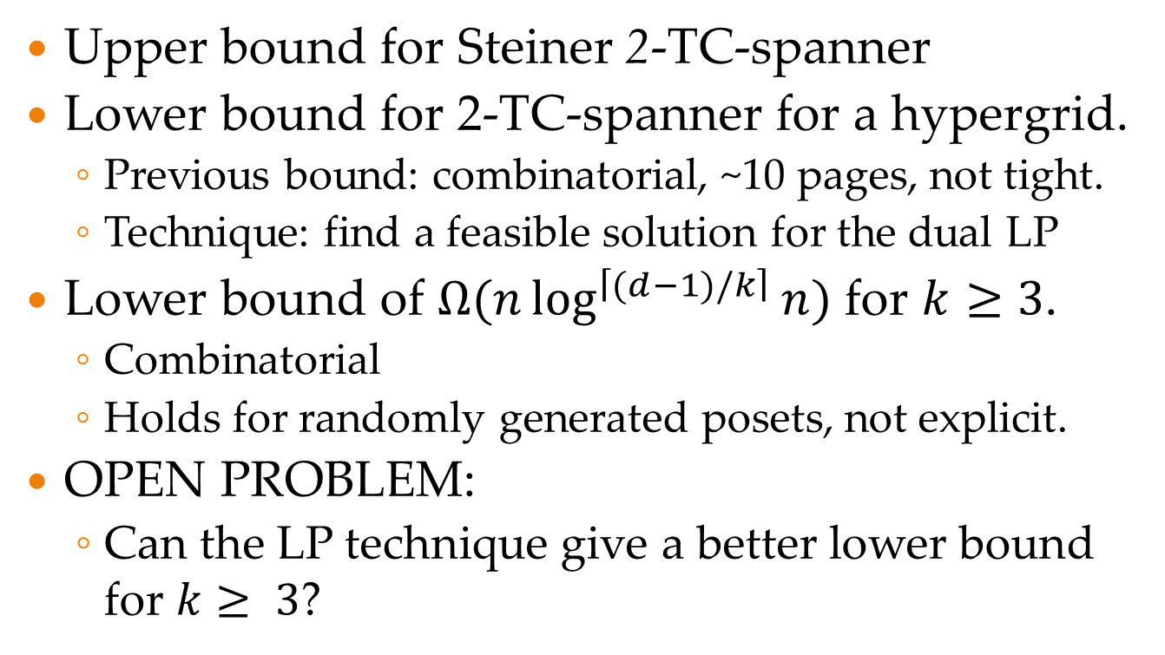
Wrap-up
Upper bound for Steiner 2-TC-spanner
Lower bound for 2-TC-spanner for a hypergrid.
  Previous bound: combinatorial, ~10 pages, not tight.
  Technique: find a feasible solution for the dual LP
Lower bound of $Ω(n\log^{\left\lceil (d−1)/k\right\rceil }{n)}$ for $k≥3$.
  Combinatorial
  Holds for randomly generated posets, not explicit.
OPEN PROBLEM:
  Can the LP technique give a better lower bound for $k≥ 3$?
Notes:
And now a brief summary.
We give an upper bound on size of Steiner 2-TC-spanner.
This is complemented by a lower bound, which is tight for constant dimension d.

Slide 19
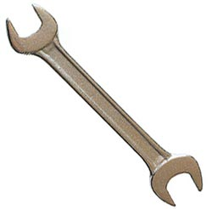
THANKS!

