Slide 1


Learning and Testing Submodular Functions with Bounded Range
Grigory Yaroslavtsev
( with Sofya Raskhodnikova, )
IBM Research, Almaden
May 29, 2012

Slide 2
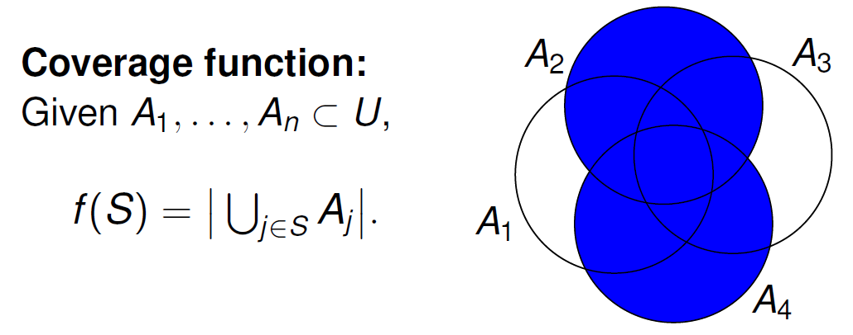
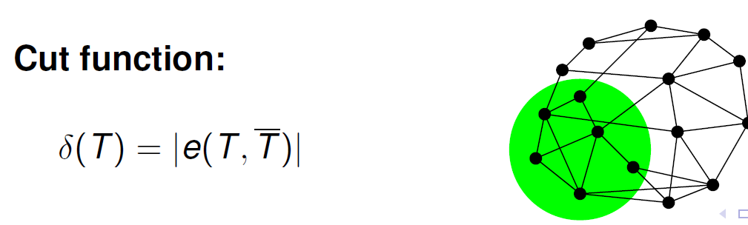
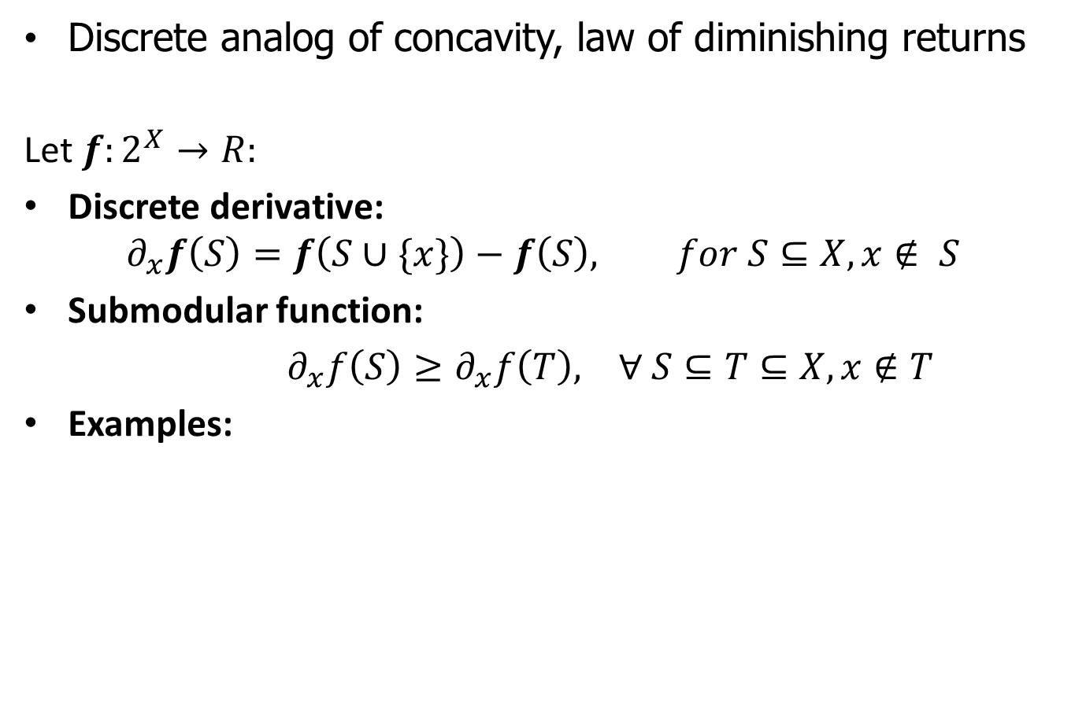
Submodularity
Discrete analog of concavity, law of diminishing returns
Let $f:2^{X}→R:$
Discrete derivative:
$$∂_{x}f\left(S\right)=f\left(S∪\{x\}\right)−f\left(S\right), for S⊆X, x∉ S$$
Submodular function:
$∂_{x}f\left(S\right)≥∂_{x}f\left(T\right), ∀ S⊆T⊆X, x∉T$
Examples:

Slide 3
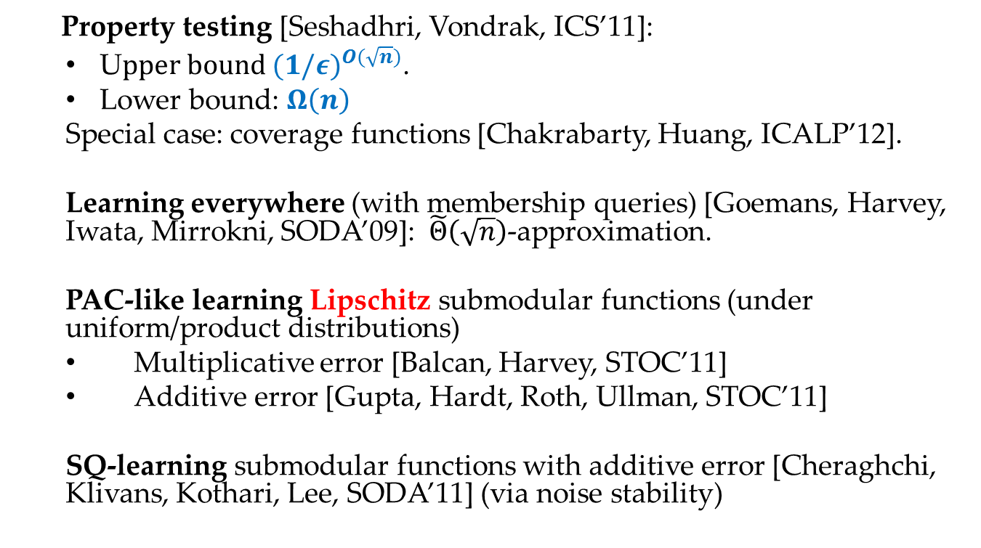
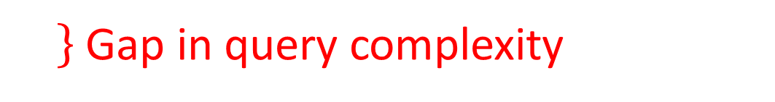
Previous work
Property testing [Seshadhri, Vondrak, ICS’11]:
U$pper bound {(1/ε)}^{O(\sqrt{n})}$.
Lower bound: $Ω\left(n\right)$
Special case: coverage functions [Chakrabarty, Huang, ICALP’12].
Learning everywhere (with membership queries) [Goemans, Harvey, Iwata, Mirrokni, SODA’09]: $\tilde{Θ}\left(\sqrt{n}\right)$-approximation.
PAC-like learning Lipschitz submodular functions (under uniform/product distributions)
Multiplicative error [Balcan, Harvey, STOC’11]
Additive error [Gupta, Hardt, Roth, Ullman, STOC’11]
SQ-learning submodular functions with additive error [Cheraghchi, Klivans, Kothari, Lee, SODA’11] (via noise stability)
Gap in query complexity

Slide 4
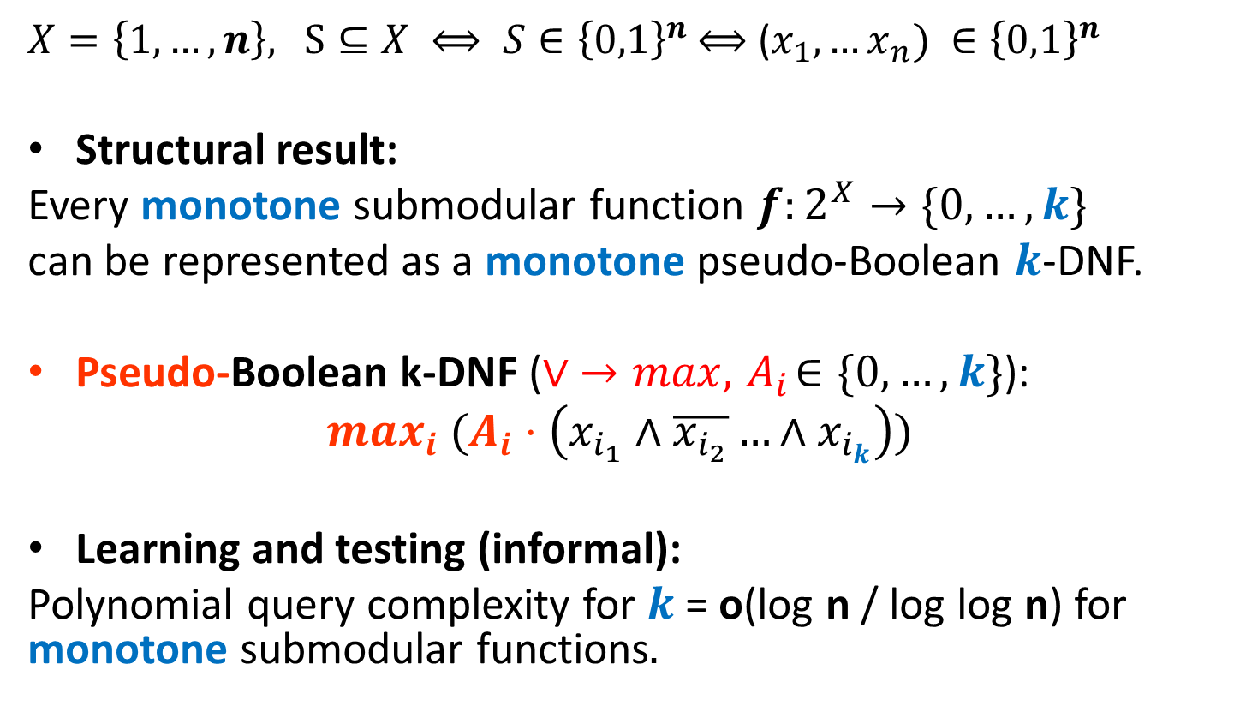
Our results
$X=\left\{1,…, n\right\},$ $S⊆X ⟺ S∈{\left\{0,1\right\}}^{n}$ $⟺$ ($x_{1}, …x_{n}) ∈{\left\{0,1\right\}}^{n}$
Structural result:
Every monotone submodular function $f:2^{X}→\{0, …, k\}$
can be represented as a monotone pseudo-Boolean $k$-DNF.
Pseudo-Boolean k-DNF ($∨ →max, { A}_{i}∈\{0, …, k\}$):
$$max_{i} (A_{i}⋅\left(x_{i_{1}}∧\overline{x_{i_{2}}}…∧x_{i_{k}}\right))$$
Learning and testing (informal):
Polynomial query complexity for $k$ = o(log n / log log n) for monotone submodular functions$.$

Slide 5




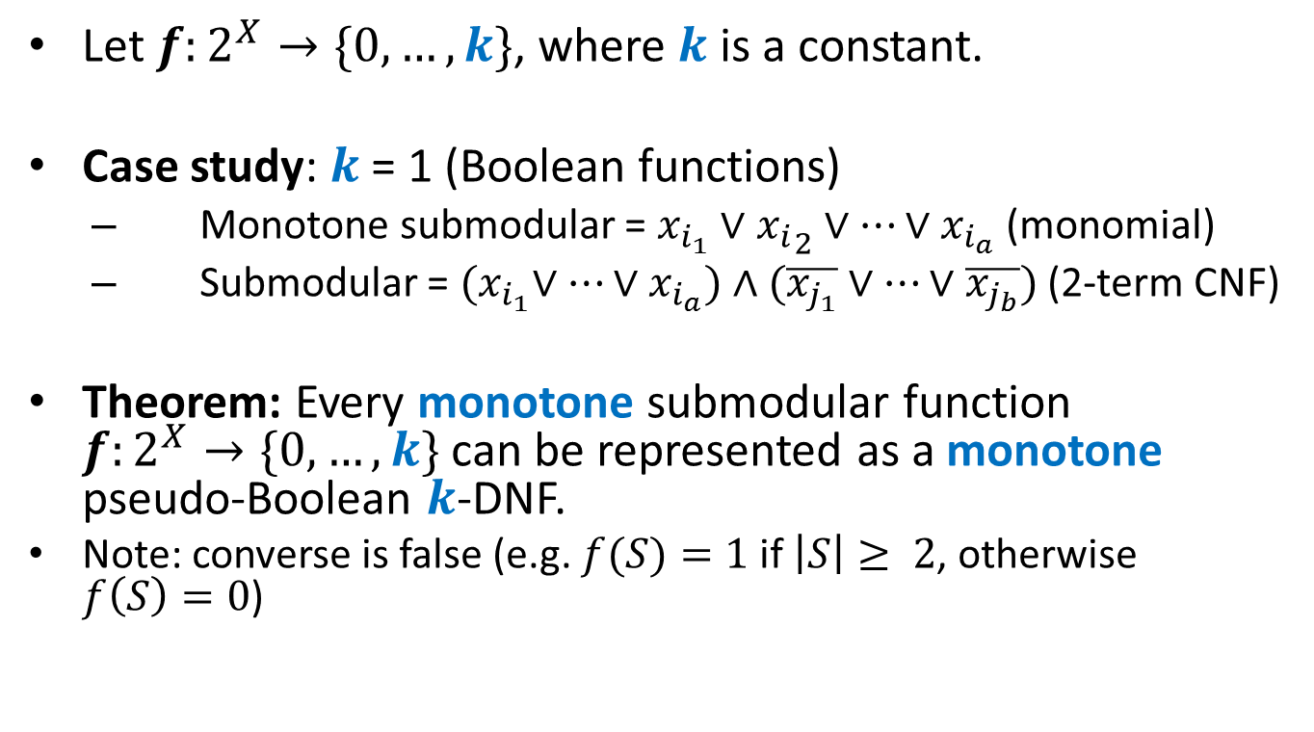

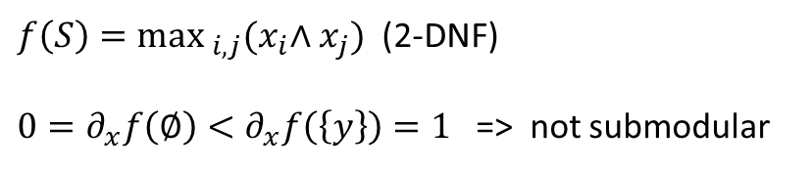

Bounded integral range
Let $f:2^{X}→\{0,…, k\}$, where $k$ is a constant.
Case study: $k$ = 1 (Boolean functions)
Monotone submodular = $x_{i_{1}}∨{x_{i}}_{2}∨…∨x_{i_{a}}$ (monomial)
Submodular = ${(x}_{i_{1}}∨…∨x_{i_{a}})∧(\overline{x_{j_{1}}}∨…∨\overline{x_{j_{b}}})$ (2-term CNF)
Theorem: Every monotone submodular function $f:2^{X}→\{0, …, k\}$can be represented as a monotone pseudo-Boolean $k$-DNF.
Note: converse is false (e.g. $f(S)=1$ if $\left|S\right|≥ 2$, otherwise $f\left(S\right)=0$)
$$X$$
$\left|S\right|≥2$
$f\left(S\right)=\max_{i,j}{{(x}_{i}∧x_{j}})$ (2-DNF)
$0=∂_{x}f\left(∅\right)<∂_{x}f\left(\left\{y\right\}\right)=1$ => not submodular
$1$
$0$
$\left|S\right|<2$
$∅$

Slide 6
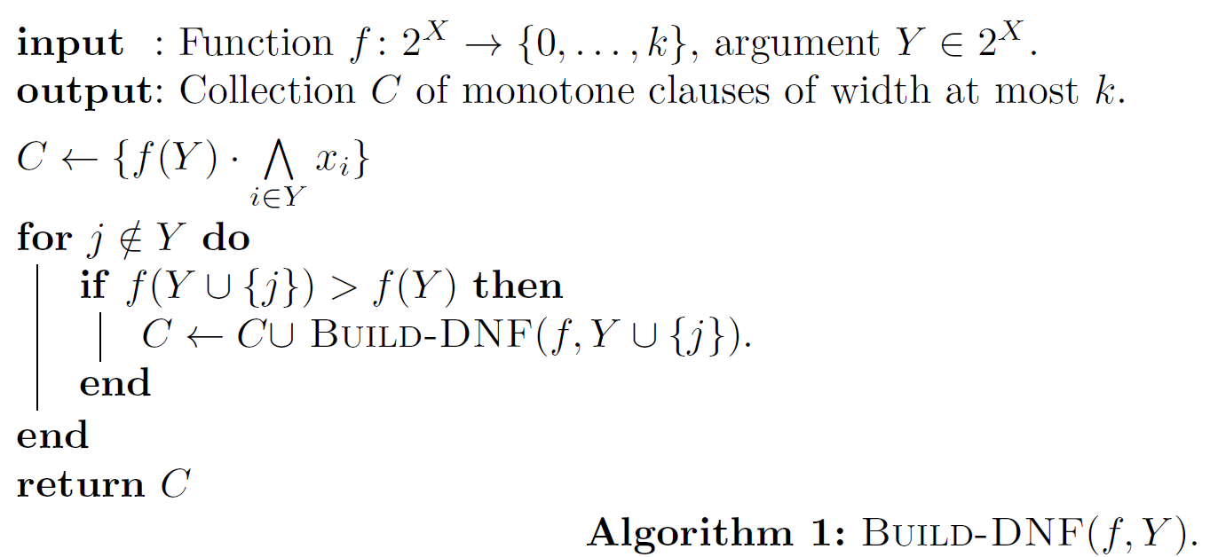

Theorem: Every monotone submodular function $f:2^{X}→\{0, …, k\}$can be represented as a monotone pseudo-Boolean $k$-DNF.
Proof: Run Build-DNF$(f,∅)$

Slide 7
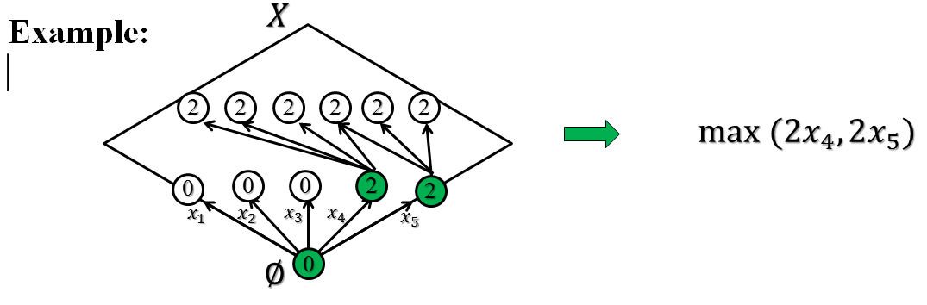
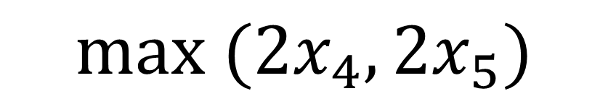
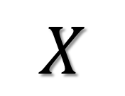
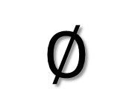
$$X$$
2
2
2
2
2
2
$$max (2x_{4},2x_{5})$$
0
0
0
2
2
$$∅$$
0

Slide 8
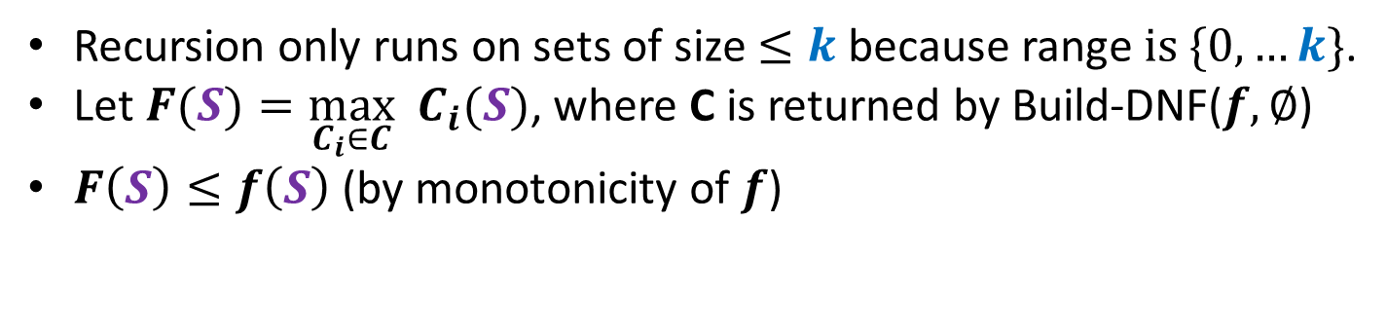
Recursion only runs on sets of size $≤k$ because range $is \{0, …k\}$.
Let $F(S)=\max_{C_{i}∈C} C_{i}(S)$, where C is returned by Build-DNF($f,∅$)
$F\left(S\right)≤f\left(S\right)$ (by monotonicity of $f$)

Slide 9



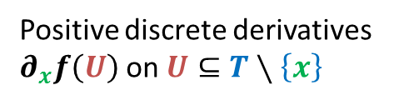

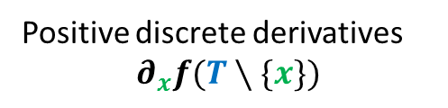


$$F\left(S\right)≥f\left(S\right)$$
Let $T⊆S$ be the smallest set, such that $f(T)=f(S)$.
By minimality of $T$ and monotonicity $∂_{x}f(T∖\{x\})>0$ $∀x∈T.$
$∂_{x}f\left(U\right)≥∂_{x}f\left(T∖\left\{x\right\}\right)>0 ∀x∈T,∀U⊆T∖\left\{x\right\}$
This is why there will be recursive calls from all $U⊆T$.
Recursive call from $T$ ensures that $F\left(S\right)≥f\left(T\right)=f\left(S\right).$
$$S$$
$$T$$
$$f(T)=f(S)$$
Positive discrete derivatives
$$∂_{x}f(T∖\{x\})$$
Positive discrete derivatives
$∂_{x}f\left(U\right)$on$U⊆T∖\left\{x\right\}$
$$U$$
$∅$

Slide 10
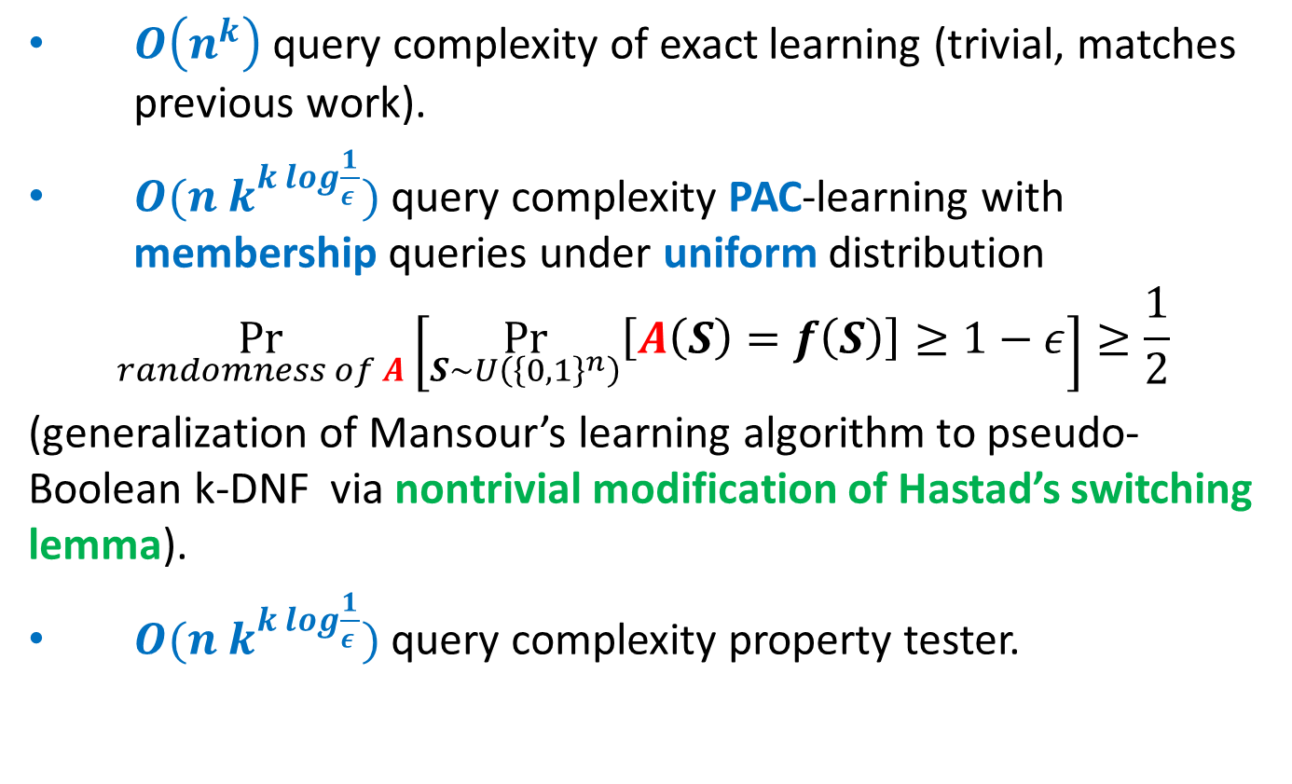

Monotone submodular functions $f:{\left\{0,1\right\}}^{n}→\{0, …,k\}$
$O\left(n^{k}\right)$ query complexity of exact learning (trivial, matches previous work).
$O(n k^{k log\frac{1}{ε }})$ query complexity PAC-learning with membership queries under uniform distribution
$$\underset{randomness of A}{Pr}\left[\underset{S∼U\left({\left\{0,1\right\}}^{n}\right)}{Pr}\left[A\left(S\right)=f\left(S\right)\right]≥1−ε\right]≥\frac{1}{2}$$
(generalization of Mansour’s learning algorithm to pseudo-Boolean k-DNF via nontrivial modification of Hastad’s switching lemma).
$O(n k^{k log\frac{1}{ε }})$ query complexity property tester.

Slide 11
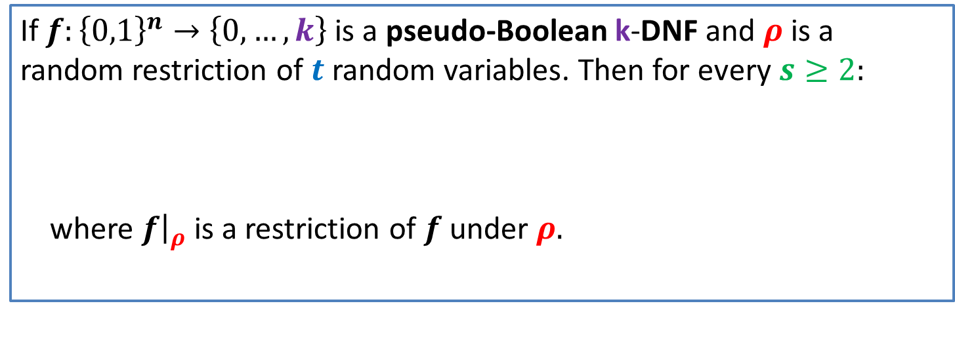
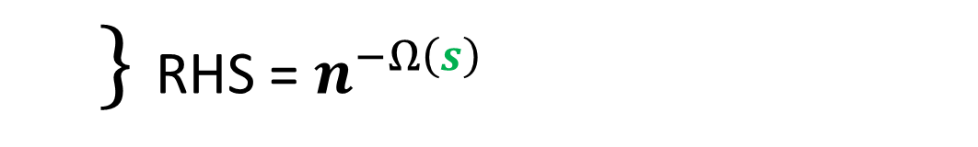
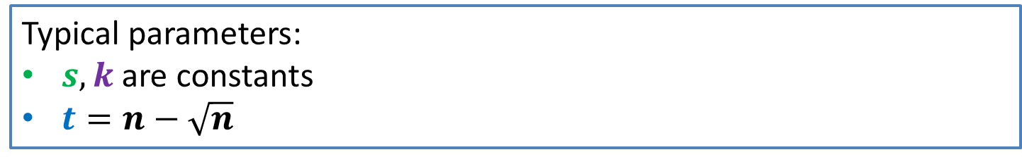
Switching lemma for pseudo-Boolean functions
If $f:{\left\{0,1\right\}}^{n}→\left\{0, …, k\right\}$ is a pseudo-Boolean k-DNF and $ρ$ is a random restriction of $t$ random variables. Then for every $s≥2:$
where $f{\left.​\right|}_{ρ}$ is a restriction of $f$ under $ρ.$
$$Pr \left[f{\left.​\right|}_{ρ}is not expressible by a pB s−CNF\right]≤{\left(\frac{ \left(n−t\right)k^{10}}{n}\right)}^{s/2}$$
Typical parameters:
$s,k$ are constants
$t=n−\sqrt{n}$
RHS = $n^{−Ω\left(s\right)}$

Slide 12
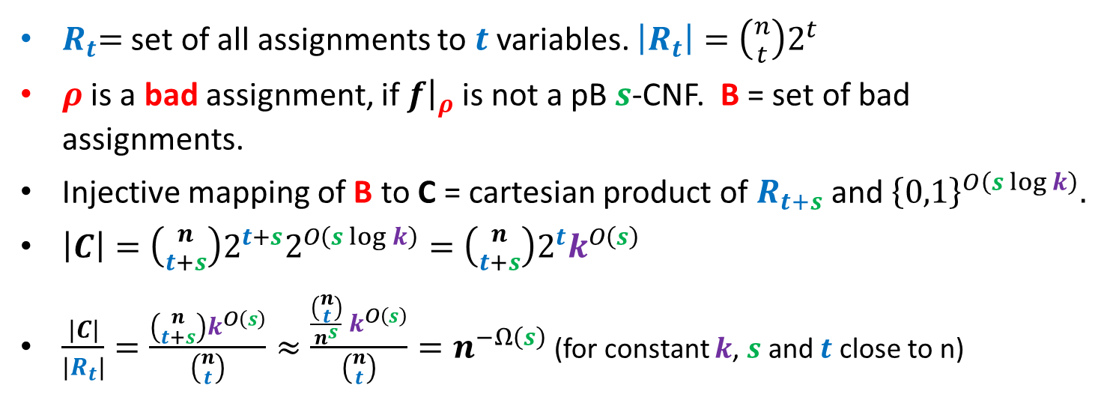
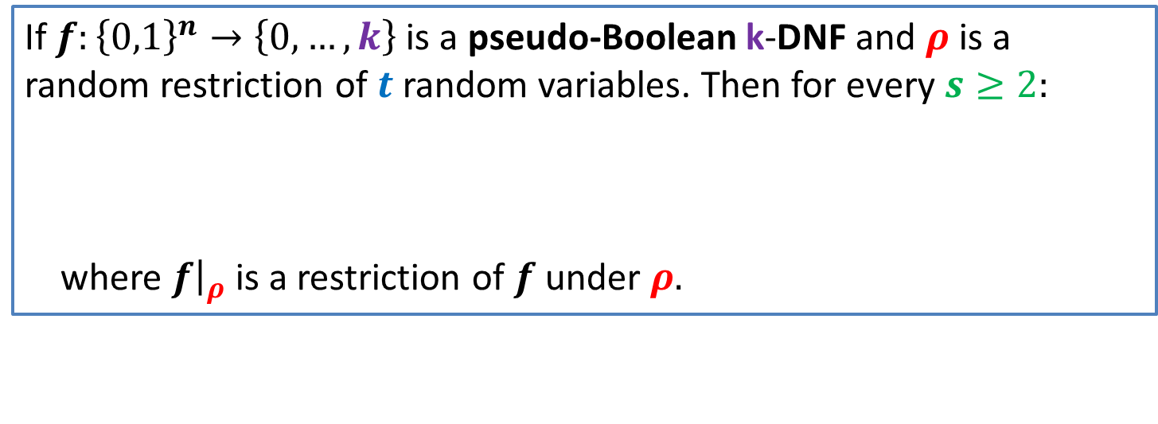
If $f:{\left\{0,1\right\}}^{n}→\left\{0, …, k\right\}$ is a pseudo-Boolean k-DNF and $ρ$ is a random restriction of $t$ random variables. Then for every $s≥2:$
where $f{\left.​\right|}_{ρ}$ is a restriction of $f$ under $ρ.$
$$Pr \left[f{\left.​\right|}_{ρ}is not expressible by a pB s−CNF\right]≤{\left(\frac{ \left(n−t\right)k^{10}}{n}\right)}^{s/2}$$
$R_{t}$= set of all assignments to $t$ variables. $\left|R_{t}\right|=\left({n \atop t}\right)2^{t}$
$ρ$ is a bad assignment, if $f{\left.​\right|}_{ρ}$ is not a pB $s$-CNF. B = set of bad assignments.
Injective mapping of B to C = cartesian product of $R_{t+s}$ and ${\left\{0,1\right\}}^{O\left(s\log{k}\right)}.$
$\left|C\right|=\left({n \atop t+s}\right)2^{t+s}2^{O\left(s\log{k}\right)}=\left({n \atop t+s}\right)2^{t}k^{O\left(s\right)}$
$\frac{\left|C\right|}{\left|R_{t}\right|}=\frac{\left({n \atop t+s}\right)k^{O\left(s\right)}}{\left({n \atop t}\right)}≈\frac{\frac{\left({n \atop t}\right)}{n^{s}} k^{O\left(s\right)}}{\left({n \atop t}\right)}=n^{−Ω\left(s\right)}$ (for constant $k$, $s$ and $t$ close to n)

Slide 13
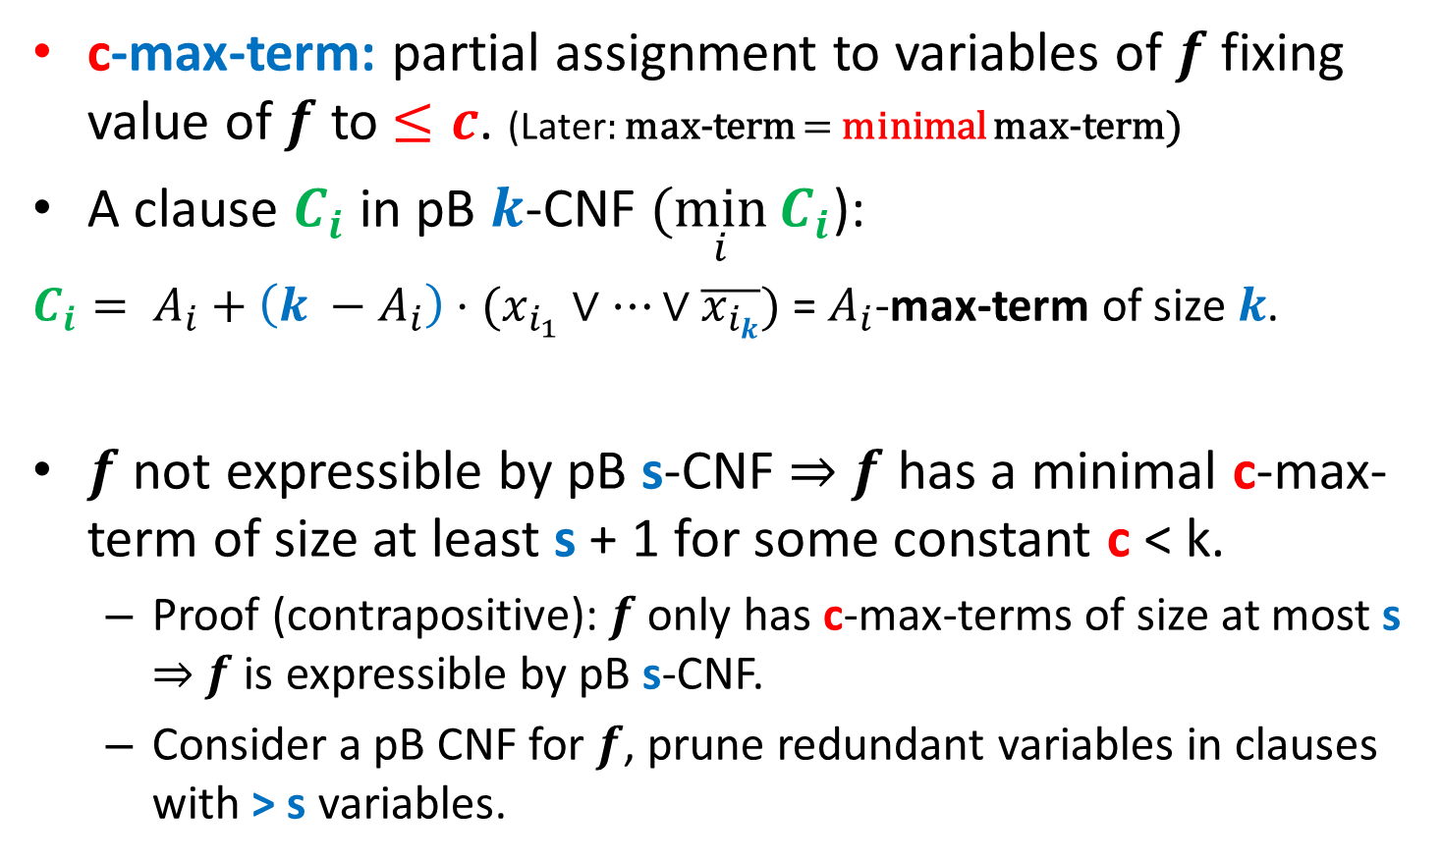
Pseudo-Boolean Max-Terms
c-max-term: partial assignment to variables of $f$ fixing value of $f$ to $≤c$. (Later: max-term = minimal max-term)
A clause $C_{i}$ in pB $k$-CNF $(\min_{i}{C_{i}}$):
${C_{i}= A}_{i}+\left(k −A_{i}\right)⋅(x_{i_{1}}∨…∨\overline{x_{i_{k}}})$ = $A_{i}$-max-term of size $k$.
$f$ not expressible by pB s-CNF $⇒$ $f$ has a minimal c-max-term of size at least s + 1 for some constant c < k.
Proof (contrapositive): $f$ only has c-max-terms of size at most s $⇒$ $f$ is expressible by pB s-CNF.
Consider a pB CNF for $f$, prune redundant variables in clauses with > s variables.

Slide 14
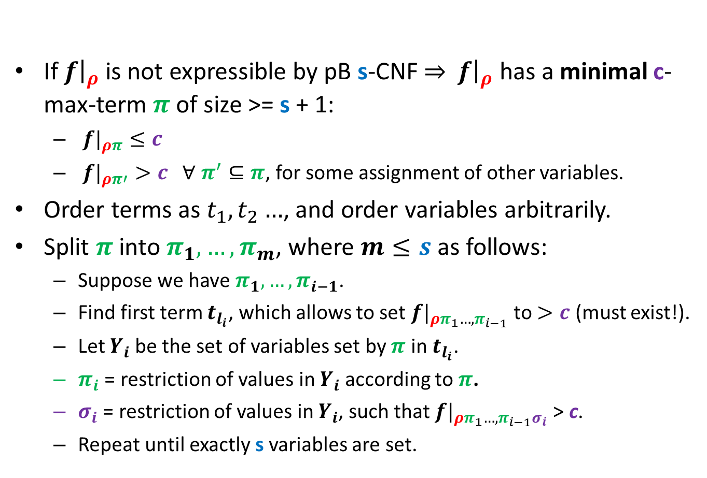
Proof by mapping [Razborov]
If $f{\left.​\right|}_{ρ}$ is not expressible by pB s-CNF $⇒$ $f{\left.​\right|}_{ρ}$ has a minimal c-max-term $π$ of size >= s + 1:
${f|}_{ρπ}≤c$
${f|}_{ρπ′}>c ∀ π^{′}⊆π$, for some assignment of other variables.
Order terms as $t_{1},t_{2}…$, and order variables arbitrarily.
Split $π$ into $π_{1}, …, π_{m}$, where $m≤s$ as follows:
Suppose we have $π_{1}, …, π_{i−1}$.
Find first term $t_{l_{i}}$, which allows to set ${f|}_{ρπ_{1}…, π_{i−1}}$to $>c$ (must exist!).
Let $Y_{i}$ be the set of variables set by $π$ in $t_{l_{i}}$.
$π_{i}$ = restriction of values in $Y_{i}$ according to $π$.
$σ_{i}$ = restriction of values in $Y_{i}$, such that ${f|}_{ρπ_{1}…, π_{i−1}σ_{i}}$> c.
Repeat until exactly s variables are set.

Slide 15
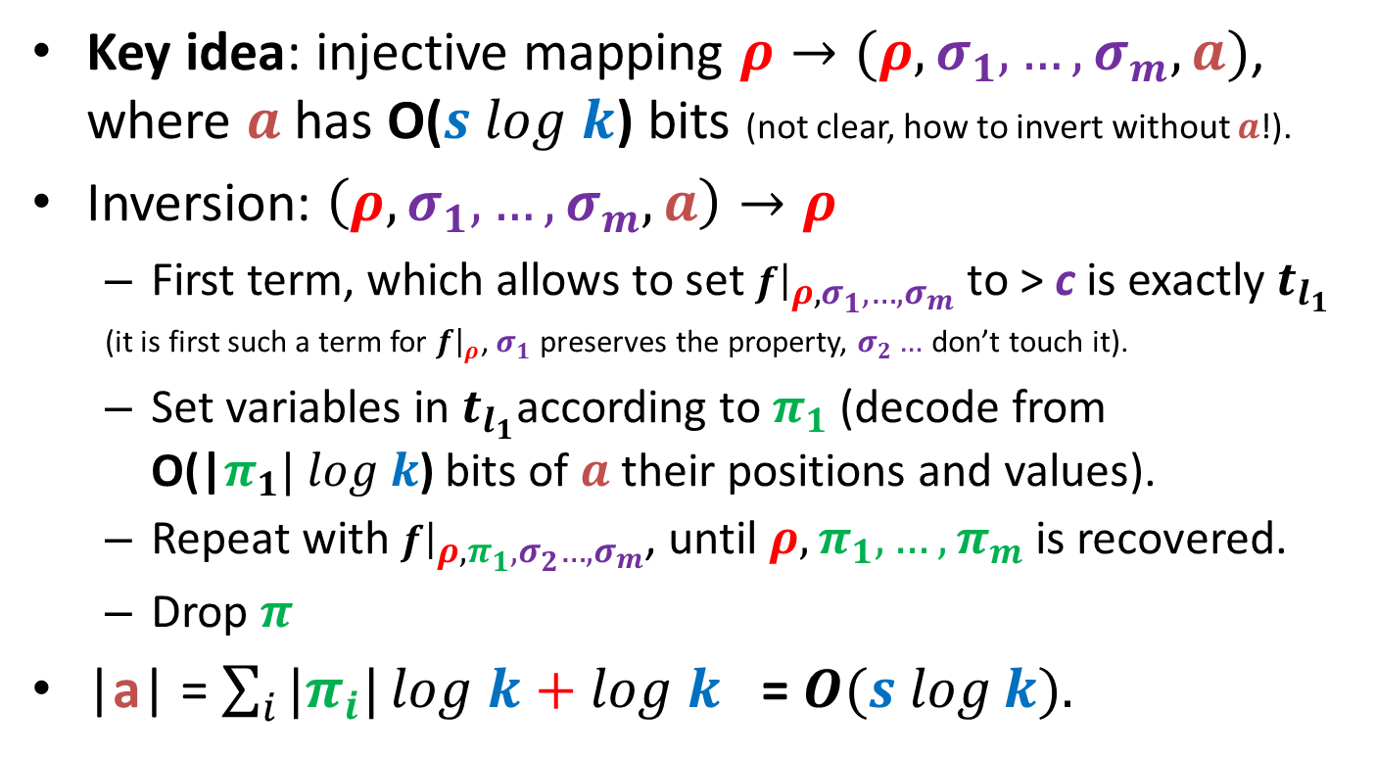

Proof by mapping [Razborov]
Key idea: injective mapping $ρ→(ρ,σ_{1},…,σ_{m}, a)$, where $a$ has O($s log k$) bits (not clear, how to invert without $a$!).
Inversion: $\left(ρ,σ_{1},…,σ_{m}, a\right)→ρ$
First term, which allows to set $f{\left.​\right|}_{ρ,σ_{1},…,σ_{m}}$ to > c is exactly $t_{l_{1}}$
(it is first such a term for $f{\left.​\right|}_{ρ}$, $σ_{1}$ preserves the property, $σ_{2}…$ don’t touch it).
Set variables in $t_{l_{1}}$according to $π_{1}$ (decode from O(|$π_{1}| log k$) bits of $a$ their positions and values).
Repeat with $f{\left.​\right|}_{ρ,π_{1},σ_{2}…,σ_{m}}$, until $ρ,π_{1}, …,π_{m}$ is recovered.
Drop $π$
|a| = $\sum_{i}{|π_{i}|}log k+log k$ = $O(s log⁡k).$
Encoding of $c!$

Slide 16
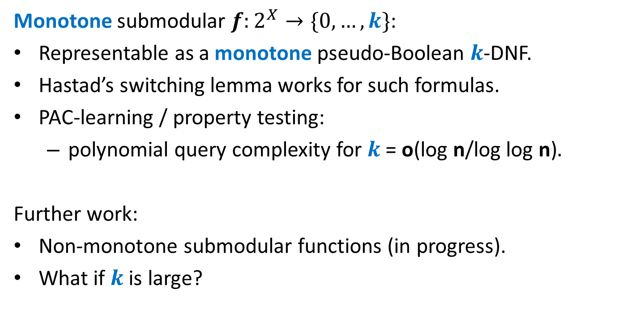
Conclusion
Monotone submodular $f:2^{X}→\{0,…, k\}$:
Representable as a monotone pseudo-Boolean $k$-DNF.
Hastad’s switching lemma works for such formulas.
PAC-learning / property testing:
polynomial query complexity for $k$ = o(log n/log log n)$.$
Further work:
Non-monotone submodular functions (in progress).
What if $k$ is large?

