Slide 1

Learning and Testing Submodular Functions
Grigory Yaroslavtsev
With Sofya Raskhodnikova (SODA’13)
+ Work in progress with Rocco Servedio
Columbia University
October 26, 2012

Slide 2
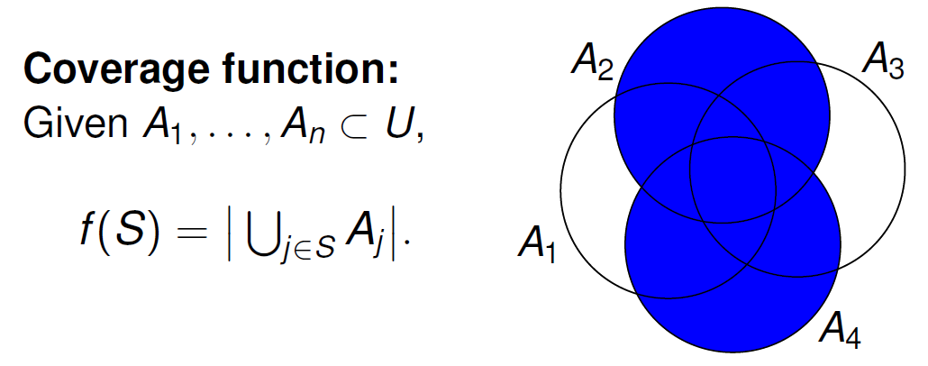
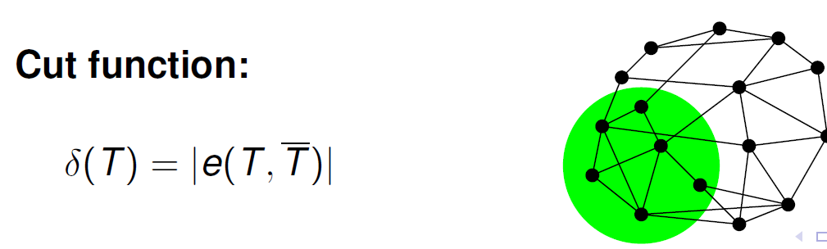
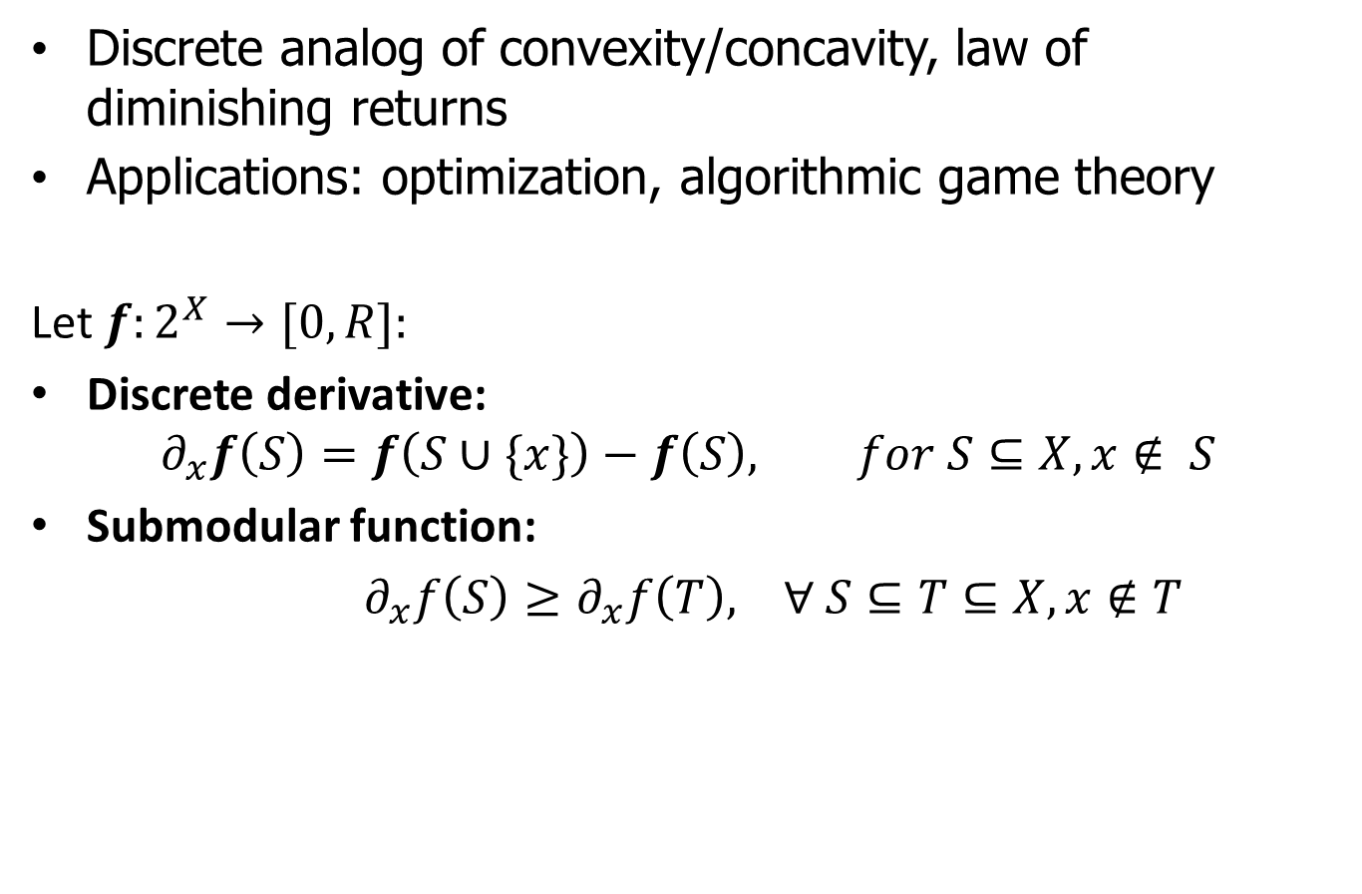
Submodularity
Discrete analog of convexity/concavity, law of diminishing returns
Applications: optimization, algorithmic game theory
Let $f:2^{X}→[0,R]:$
Discrete derivative:
$$∂_{x}f\left(S\right)=f\left(S∪\{x\}\right)−f\left(S\right), for S⊆X, x∉ S$$
Submodular function:
$∂_{x}f\left(S\right)≥∂_{x}f\left(T\right), ∀ S⊆T⊆X, x∉T$

Slide 3
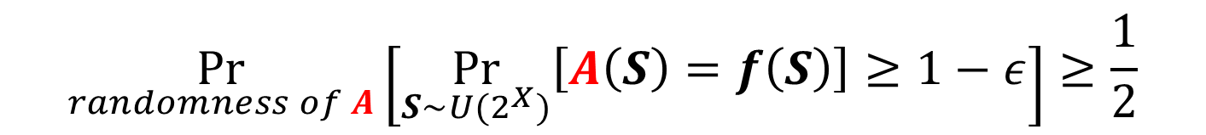
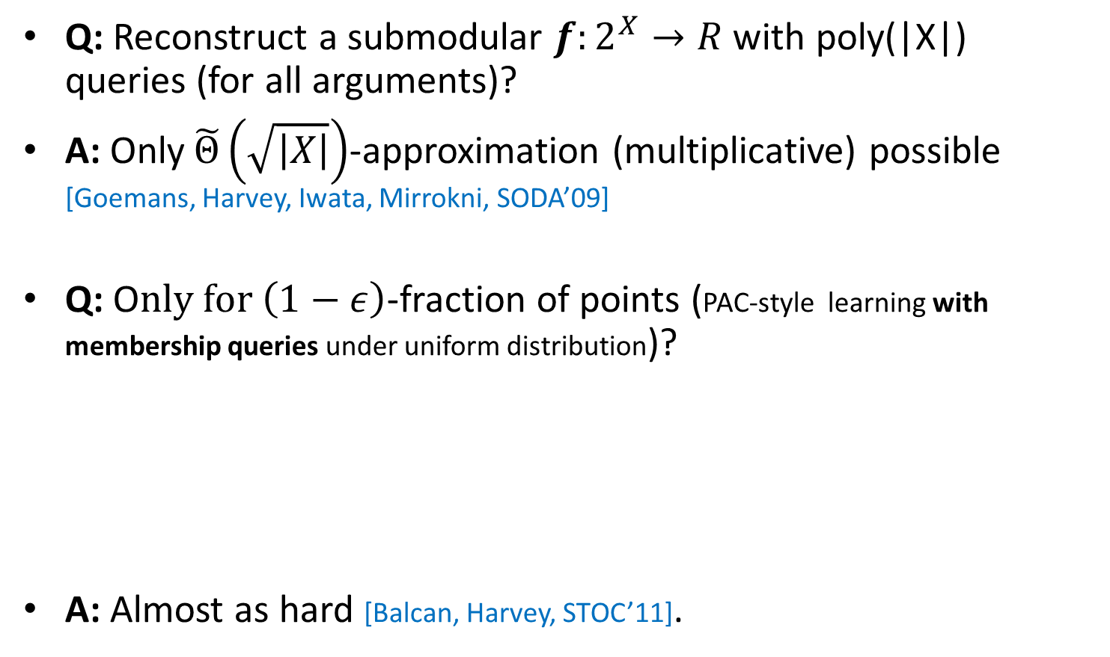
Exact learning
Q: Reconstruct a submodular $f:2^{X}→R$ with poly(|X|) queries (for all arguments)?
A: Only$\tilde{Θ}\left(\sqrt{\left|X\right|}\right)$-approximation (multiplicative) possible [Goemans, Harvey, Iwata, Mirrokni, SODA’09]
Q: O$nly for \left(1−ε\right)$-fraction of points (PAC-style learning with membership queries under uniform distribution)?
A: Almost as hard [Balcan, Harvey, STOC’11].
$$\underset{randomness of A}{Pr}\left[\underset{S∼U(2^{X})}{Pr}\left[A\left(S\right)=f\left(S\right)\right]≥1−ε\right]≥\frac{1}{2}$$

Slide 4
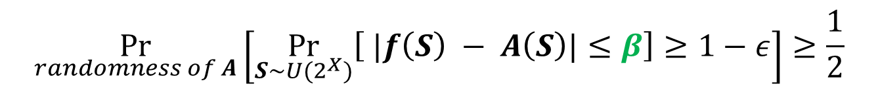
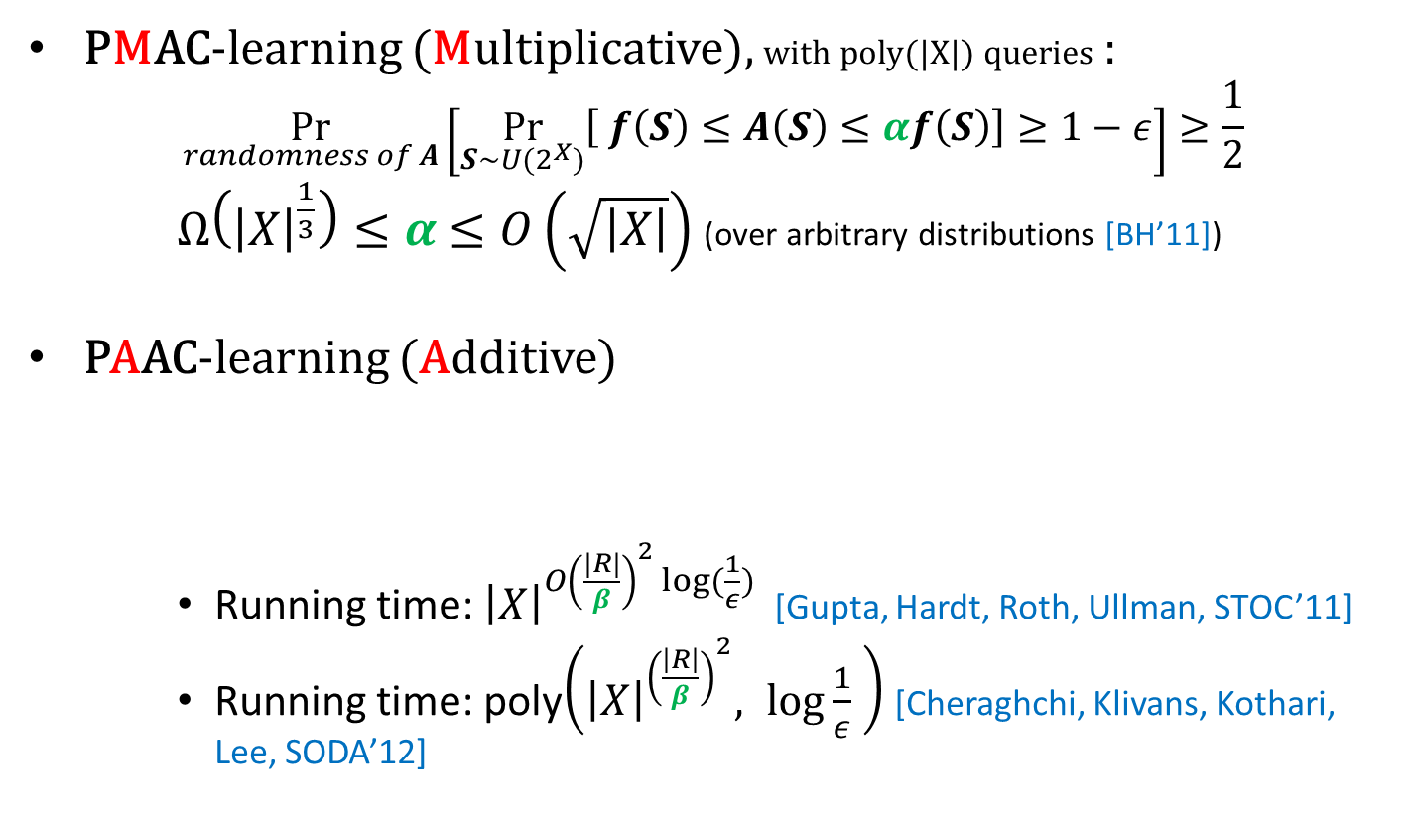
Approximate learning
PMAC-learning (Multiplicative), with poly(|X|) queries :
$$\underset{randomness of A}{Pr}\left[\underset{S∼U(2^{X})}{Pr}\left[ f\left(S\right)≤A\left(S\right)≤αf\left(S\right)\right]≥1−ε\right]≥\frac{1}{2}$$
$Ω\left({\left|X\right|}^{\frac{1}{3}}\right)≤α$ $≤O\left(\sqrt{\left|X\right|}\right)$ (over arbitrary distributions [BH’11])
PAAC-learning (Additive)
Running time: ${\left|X\right|}^{O{\left(\frac{|R|}{β}\right)}^{2} log⁡(\frac{1}{ε}) }$ [Gupta, Hardt, Roth, Ullman, STOC’11]
Running time: poly$\left({\left|X\right|}^{{\left(\frac{\left|R\right|}{β}\right)}^{2}}, log\frac{1}{ε} \right)$ [Cheraghchi, Klivans, Kothari, Lee, SODA’12]
$$\underset{randomness of A}{Pr}\left[\underset{S∼U(2^{X})}{Pr}\left[ |f\left(S\right) − A\left(S\right)|≤β\right]≥1−ε\right]≥\frac{1}{2}$$

Slide 5
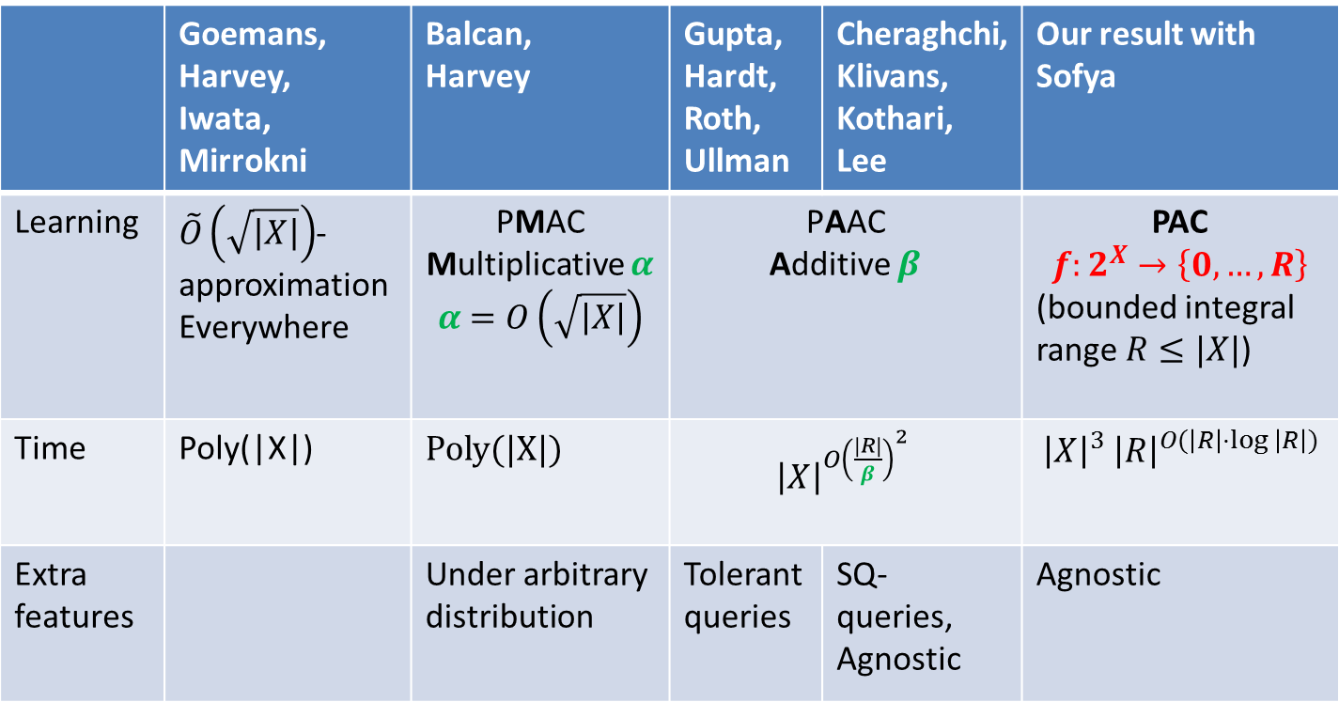

Learning $f:2^{X}→[0,R]$
For all algorithms $ε=const.$
 | Goemans, Harvey, Iwata, Mirrokni | Balcan, Harvey | Gupta, Hardt, Roth, Ullman | Cheraghchi, Klivans, Kothari, Lee | Our result with Sofya
Learning | $\tilde{O}\left(\sqrt{\left|X\right|}\right)$-approximation Everywhere | PMAC Multiplicative $α$ $α$ $=O\left(\sqrt{\left|X\right|}\right)$ | PAAC Additive $β$ |  | PAC $$f:2^{X}→\left\{0,…,R\right\}$$ (bounded integral range $R≤|X|$)
Time | Poly(|X|) | Poly(|X|) | ${\left|X\right|}^{{O\left(\frac{|R|}{β}\right)}^{2} }$ |  | $${\left|X\right|}^{3} {\left|R\right|}^{O(\left|R\right|⋅log \left|R\right|)}$$
Extra features |  | Under arbitrary distribution | Tolerant queries | SQ- queries, Agnostic | Agnostic

Slide 6







Learning: Bigger picture
Subadditive
[Badanidiyuru, Dobzinski, Fu, Kleinberg, Nisan, Roughgarden,SODA’12]
$⊆$
XOS = Fractionally subadditive
$⊆$
Submodular
Other positive results:
Learning valuation functions [Balcan, Constantin, Iwata, Wang, COLT’12]
PMAC-learning (sketching) valuation functions [BDFKNR’12]
PMAC learning Lipschitz submodular functions [BH’10] (concentration around average via Talagrand)
$⊆$
Gross substitutes
$⊆$
OXS
$⊆$
$⊆$
Additive (linear)
Value demand

Slide 7

Discrete convexity
Monotone convex $f:\{1,…, n\}→\left\{0, …, R\right\}$
Convex $f:\{1, …,n\}→\left\{0, …, R\right\}$

Slide 8



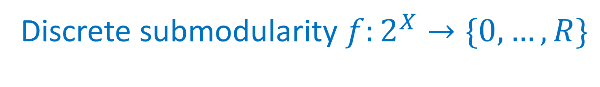





Discrete submodularity $f:2^{X}→\{0,…,R\}$
Case study: $R$ = 1 (Boolean submodular functions $f:{\left\{0,1\right\}}^{n}→ \{0,1\}$)
Monotone submodular = $x_{i_{1}}∨{x_{i}}_{2}∨…∨x_{i_{a}}$ (monomial)
Submodular = ${(x}_{i_{1}}∨…∨x_{i_{a}})∧(\overline{x_{j_{1}}}∨…∨\overline{x_{j_{b}}})$ (2-term CNF)
Monotone submodular
Submodular
$$X$$
$$X$$
$$\left|S\right|≥\left|X\right|−R$$
$$\left|S\right|≤R$$
$$\left|S\right|≤R$$
$$∅$$
$$∅$$

Slide 9


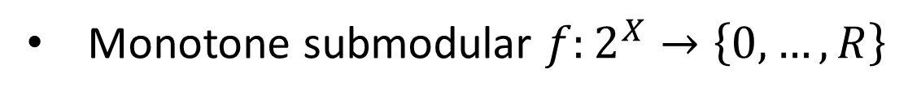

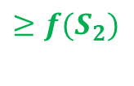

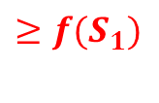
Discrete monotone submodularity
Monotone submodular $f:2^{X}→\left\{0, …, R\right\}$
$$≥max(f\left(S_{1}\right), f(S_{2}))$$
$$≥f(S_{1})$$
$$≥f(S_{2})$$
$$\left|S\right|≤R$$
$$f(S_{1})$$
$$f(S_{2})$$

Slide 10




Discrete monotone submodularity
Theorem: for monotone submodular $f:2^{X}→\left\{0, …, R\right\}$ f$or all T: f\left(T\right)=\max_{S⊆T, \left|S\right|≤R} f(S)$
$f\left(T\right)≥\max_{S⊆T, \left|S\right|≤R} f(S)$ (by monotonicity)
$$T$$
$$S⊆T,$$
$$\left|S\right|≤R$$
$$\left|S\right|≤R$$

Slide 11





Discrete monotone submodularity
$f\left(T\right)≤\max_{S⊆T, \left|S\right|≤R} f\left(S\right)$
S$’=$ smallest subset of $T$ such that $f\left(T\right)=f\left(S’\right)$
$∀x∈S^{′}$we have $∂_{x}\left(S^{′}∖\left\{x\right\}\right)>0$ =>
Restriction of $f$on$2^{S^{′}}$ is monotone increasing =>$|S’|≤ R$
$$T$$
$$S′$$
$$S′$$
$$\left|S\right|≤R$$

Slide 12
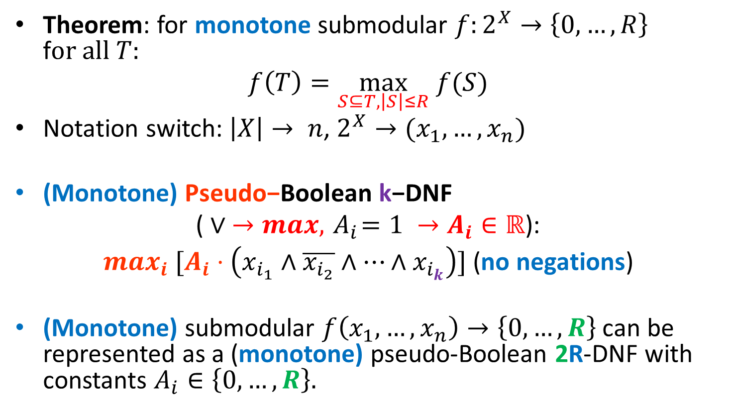
Representation by a formula
Theorem: for monotone submodular $f:2^{X}→\left\{0, …, R\right\}$ f$or all T:$
$$f\left(T\right)=\max_{S⊆T, \left|S\right|≤R} f(S)$$
Notation switch: $\left|X\right|→ n$, $2^{X}→(x_{1},…, x_{n})$
(Monotone) $\text{Pseudo}\text{−}\text{Boolean} \text{k}\text{−}\text{DNF}$
$$\text{(}∨ →max, { A}_{i}=1 →A_{i}∈ℝ\text{): }$$
$max_{i} [A_{i}⋅\left(x_{i_{1}}∧\overline{x_{i_{2}}}∧…∧x_{i_{k}}\right)]$(no negations)
(Monotone) submodular $f\left(x_{1}, …, x_{n}\right)→\left\{0, …,R\right\}$ can be represented as a (monotone) pseudo-Boolean 2R-DNF with constants $A_{i}∈\left\{0, …, R\right\}.$

Slide 13
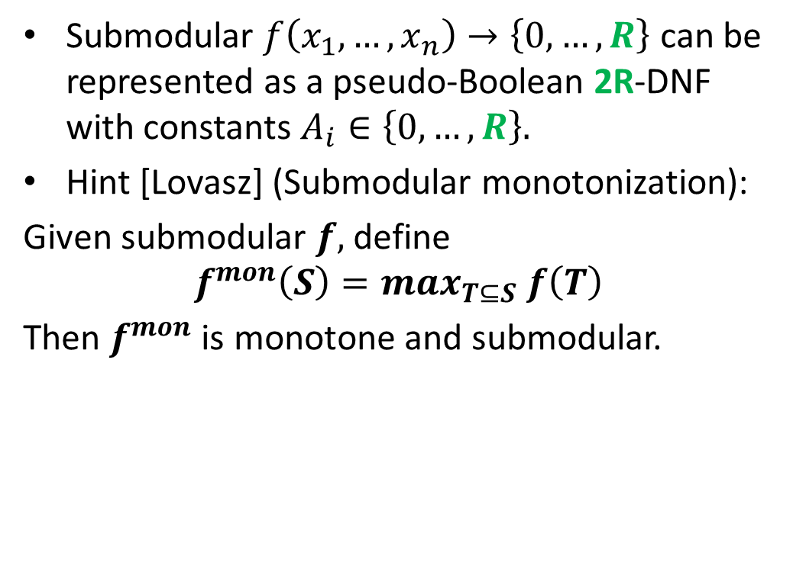
Discrete submodularity
Submodular $f\left(x_{1}, …, x_{n}\right)→\left\{0, …,R\right\}$ can be represented as a pseudo-Boolean 2R-DNF with constants $A_{i}∈\left\{0, …, R\right\}.$
Hint [Lovasz] (Submodular monotonization):
Given submodular $f,$ define
$$f^{mon}\left(S\right)=max_{T⊆S} f\left(T\right)$$
Then $f^{mon}$ is monotone and submodular.
$$X$$
$$\left|S\right|≥\left|X\right|−R$$
$$\left|S\right|≤R$$
$$∅$$

Slide 14
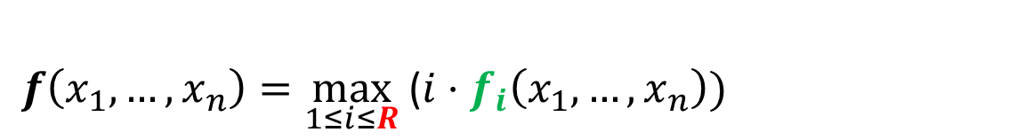

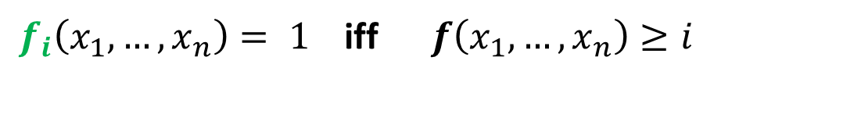
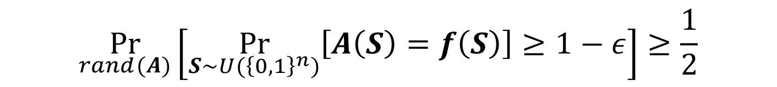
Learning pB-formulas and k-DNF
$DNF^{k,R}$ = class of pB-DNF of width $k$ with $A_{i}∈\{0, …, R\}$
i-slice $f_{i}\left(x_{1}, …, x_{n}\right)→ \{0,1\}$ defined as
If $f∈ DNF^{k,R}$ its i-slices $f_{i}$ are $k$-DNF and:
PAC-learning
$f_{i}\left(x_{1}, …, x_{n}\right)= 1$ iff $f\left(x_{1}, …, x_{n}\right)≥i$
$f\left(x_{1}, …, x_{n}\right)=\max_{1≤i≤R}$ ($i⋅f_{i}\left(x_{1},…, x_{n}\right))$
$$\underset{rand(A)}{Pr}\left[\underset{S∼U({\left\{0,1\right\}}^{n})}{Pr}\left[A\left(S\right)=f\left(S\right)\right]≥1−ε\right]≥\frac{1}{2}$$

Slide 15
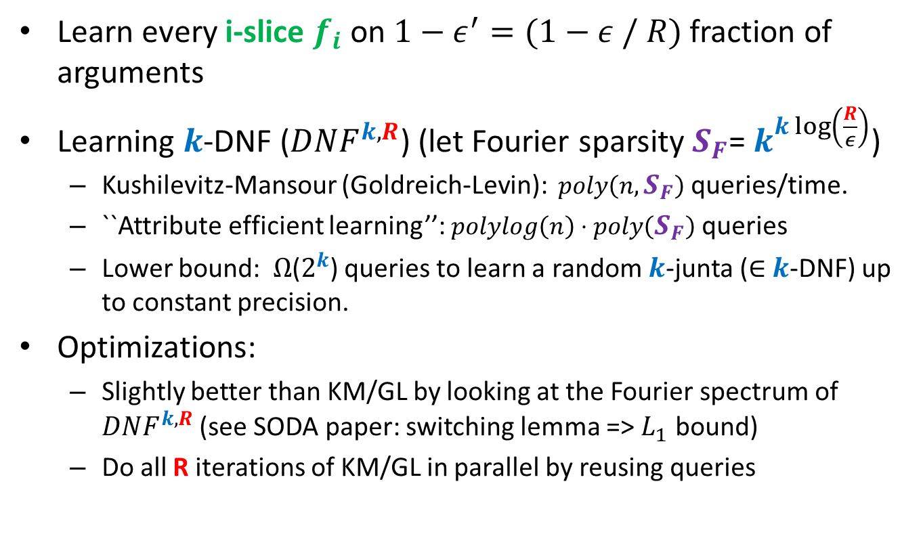
Learning pB-formulas and k-DNF
Learn every i-slice $f_{i}$ on ${1−ε}^{′}=(1−ε / R)$fraction of arguments
Learning $k$-DNF ($DNF^{k,R}$) (let Fourier sparsity $S_{F}$= $k^{k\log\left(\frac{R}{ε}\right)}$)
Kushilevitz-Mansour (Goldreich-Levin): $poly\left(n,S_{F}\right)$ queries/time.
``Attribute efficient learning’’: $polylog\left(n\right)⋅poly\left(S_{F}\right)$ queries
Lower bound: $Ω$($2^{k}$) queries to learn a random $k$-junta ($∈$ $k$-DNF) up to constant precision.
Optimizations:
Slightly better than KM/GL by looking at the Fourier spectrum of $DNF^{k,R}$(see SODA paper: switching lemma => $L_{1}$ bound)
Do all R iterations of KM/GL in parallel by reusing queries

Slide 16
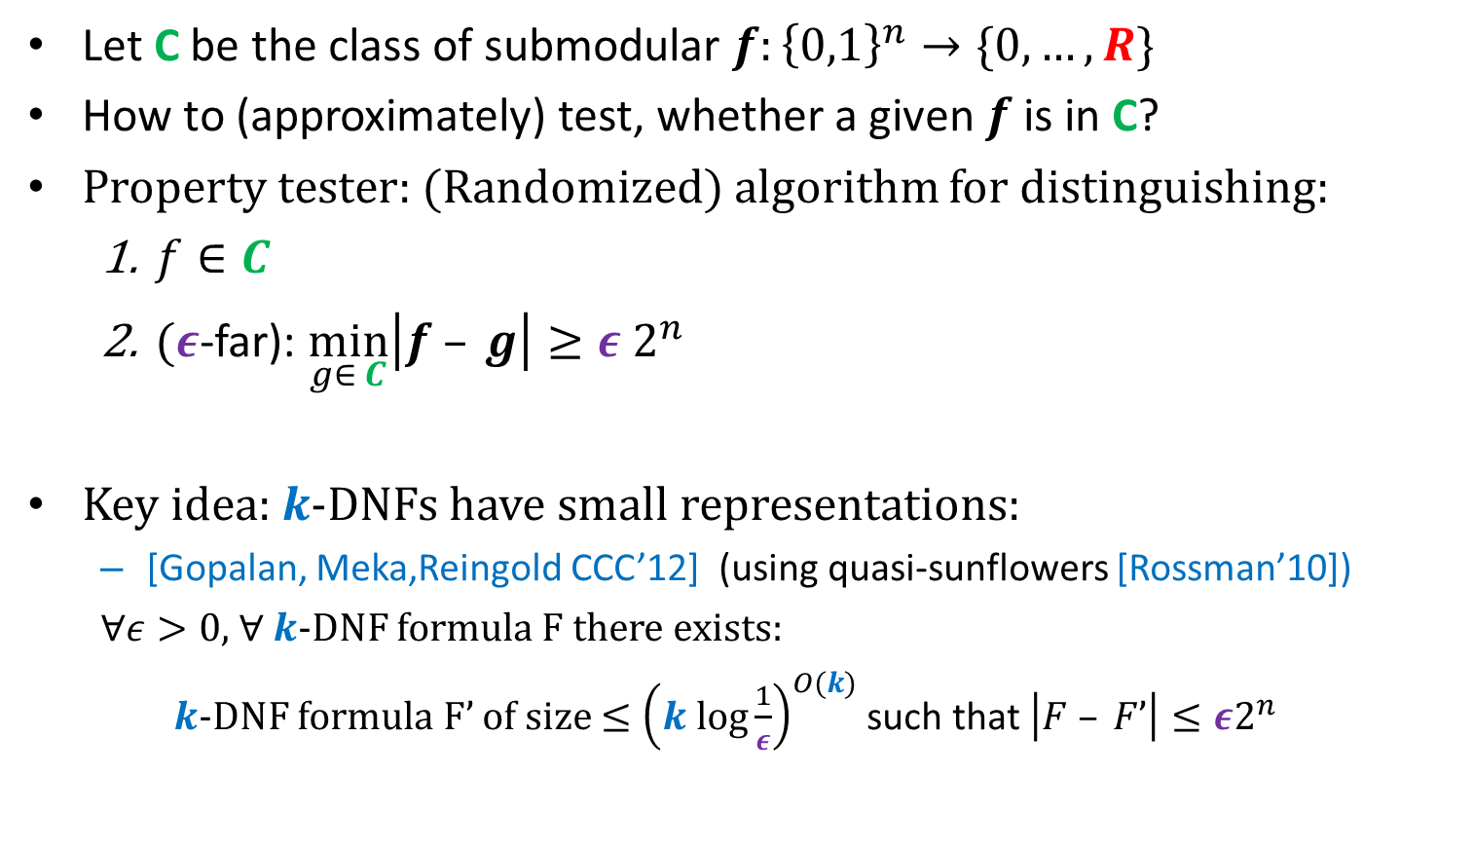
Property testing
Let C be the class of submodular $f:{\left\{0,1\right\}}^{n}→\{0, …,R\}$
How to (approximately) test, whether a given $f$ is in C?
Property tester: (Randomized) algorithm for distinguishing:
$f∈C$
$(ε$-far): $\min_{g∈ C}\left|f – g\right|≥ε 2^{n}$
Key idea: $k$-DNFs have small representations:
[Gopalan, Meka,Reingold CCC’12] (using quasi-sunflowers [Rossman’10])
$∀ε>0$,$∀$ $k$-DNF formula F there exists:
$k$-DNF formula F’ of size $≤{\left(k log\frac{1}{ε}\right)}^{O(k)}$ such that $\left|F – F’\right|≤ε2^{n}$

Slide 17
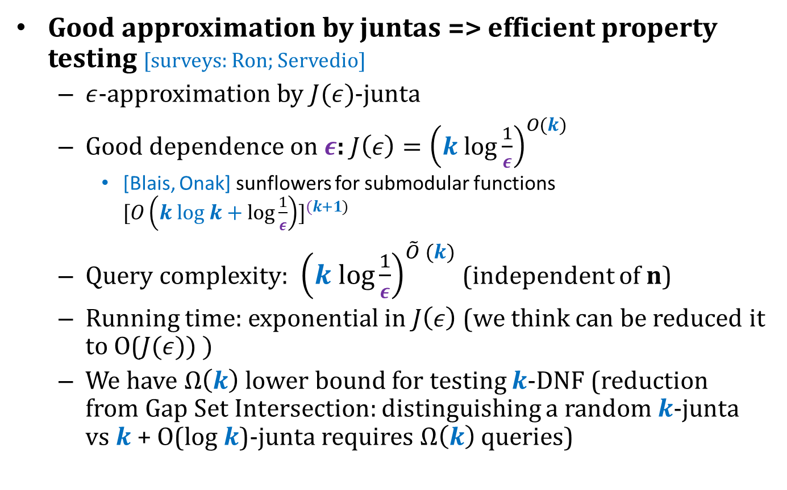
Testing by implicit learning
Good approximation by juntas => efficient property testing [surveys: Ron; Servedio]
$ε$-approximation by $J(ε)$-junta
Good dependence on $ε$: $J\left(ε\right)={\left(k log\frac{1}{ε}\right)}^{O(k)}$
[Blais, Onak] sunflowers for submodular functions ${[O\left(k log k+log\frac{1}{ε}\right)]}^{(k+1)}$
Query complexity: ${\left(k log\frac{1}{ε}\right)}^{\tilde{O} (k)}$ (independent of n)
Running time: exponential in $J\left(ε\right)$ (we think can be reduced it to O($J(ε)) )$
We have $Ω\left(k\right)$ lower bound for testing $k$-DNF (reduction from Gap Set Intersection: distinguishing a random $k$-junta vs $k$ + O(log $k$)-junta requires $Ω\left(k\right)$ queries)

Slide 18
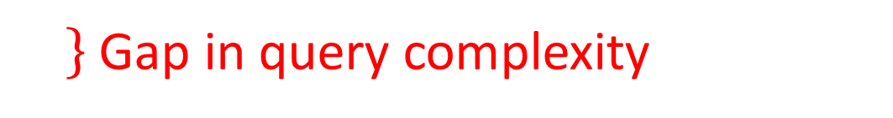

Previous work on testing submodularity
$f:{\left\{0,1\right\}}^{n}→[0,R]$[Parnas, Ron, Rubinfeld ‘03, Seshadhri, Vondrak, ICS’11]:
U$pper bound {(1/ε)}^{O(\sqrt{n})}$.
Lower bound: $Ω\left(n\right)$
Special case: coverage functions [Chakrabarty, Huang, ICALP’12].
Gap in query complexity

Slide 19
Thanks!

