Slide 1
Primal-dual algorithms for node-weighted network design in planar graphs
Grigory Yaroslavtsev
Penn State
(joint work with Piotr Berman)
Notes:
This is “Improved approximation for the Directed Spanner Problem”.
It was initially done independently, together with Piotr Berman and Sofya Raskhodnikova and by Arnab Bhattacharyya and Konstantin Makarychev.

Slide 2

Feedback Vertex Set Problems
Given: a collection of cycles in a graph
Goal: break them, removing a small # of vertices
Example: Collection = All cycles
$$⇒$$
X
X
Weighted vertices => remove set of min cost

Slide 3

FVS: Flavors and toppings
All cycles = Feedback Vertex Set
All Directed cycles = Directed FVS
All odd-length cycles = Bipartization
Cycles through a subset of vertices = Subset FVS
$$⇒$$
X

Slide 4
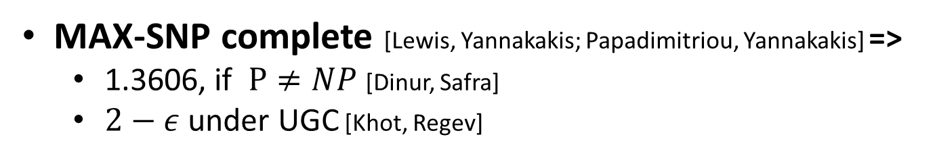
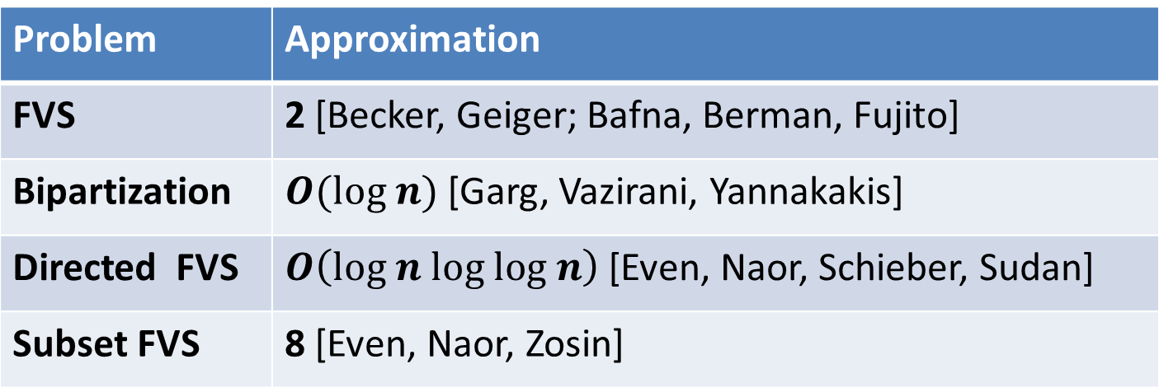
FVS in general graphs
NP-hard (even in planar graph [Yannakakis])
Problem | Approximation
FVS | 2 [Becker, Geiger; Bafna, Berman, Fujito]
Bipartization | $O(log n)$[Garg, Vazirani, Yannakakis]
Directed FVS | $O\left(log n log log n\right)$ [Even, Naor, Schieber, Sudan]
Subset FVS | 8 [Even, Naor, Zosin]
MAX-SNP complete [Lewis, Yannakakis; Papadimitriou, Yannakakis] =>
1.3606, if $P≠NP$ [Dinur, Safra]
$2−ε$ under UGC [Khot, Regev]

Slide 5
FVS in planar graphs (via primal-dual)
NP-hard (even in planar graph [Yannakakis])
Problems | Previous work |  | This work
FVS | 10 [Bar-Yehuda, Geiger, Naor, Roth] | 3 [Goemans, Williamson, 96] | 2.4 (2.57)
BIP, D-FVS, S-FVS
Node-Weighted Steiner Forest | 6 [Demaine, Hajiaghayi, Klein’09] | 3 [Moldenhauer’11]
More general class of problems

Slide 6
Bigger picture
Graphs
Weights
General
Vertices
Planar
Edges
Feedback Edge Set in general graphs = Complement of MST
Planar edge-weighted BIP and D-FVS are also in P
Planar edge-weighted Steiner Forest has a PTAS [Bateni, Hajiaghayi, Marx, STOC’11]
Planar unweighted Feedback Vertex Set has a PTAS [Baker; Demaine, Hajiaghayi, SODA’05]

Slide 7







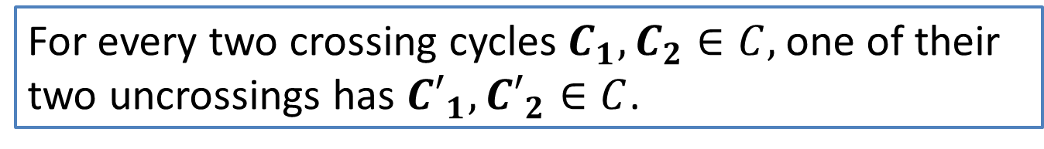
Class 1: Uncrossing property
Uncrossing:
Uncrossing property of a family of cycles $C$:
Holds for all FVS problems, crucial for the algorithm of GW
$${C′}_{1}$$
$$C_{1}$$
$$C_{2}$$
⇒
$${C′}_{2}$$
⇒
$${C′}_{1}$$
$${C′}_{2}$$
For every two crossing cycles $C_{1}, C_{2}∈C,$ one of their two uncrossings has ${C′}_{1}, {C′}_{2}∈C$.

Slide 8

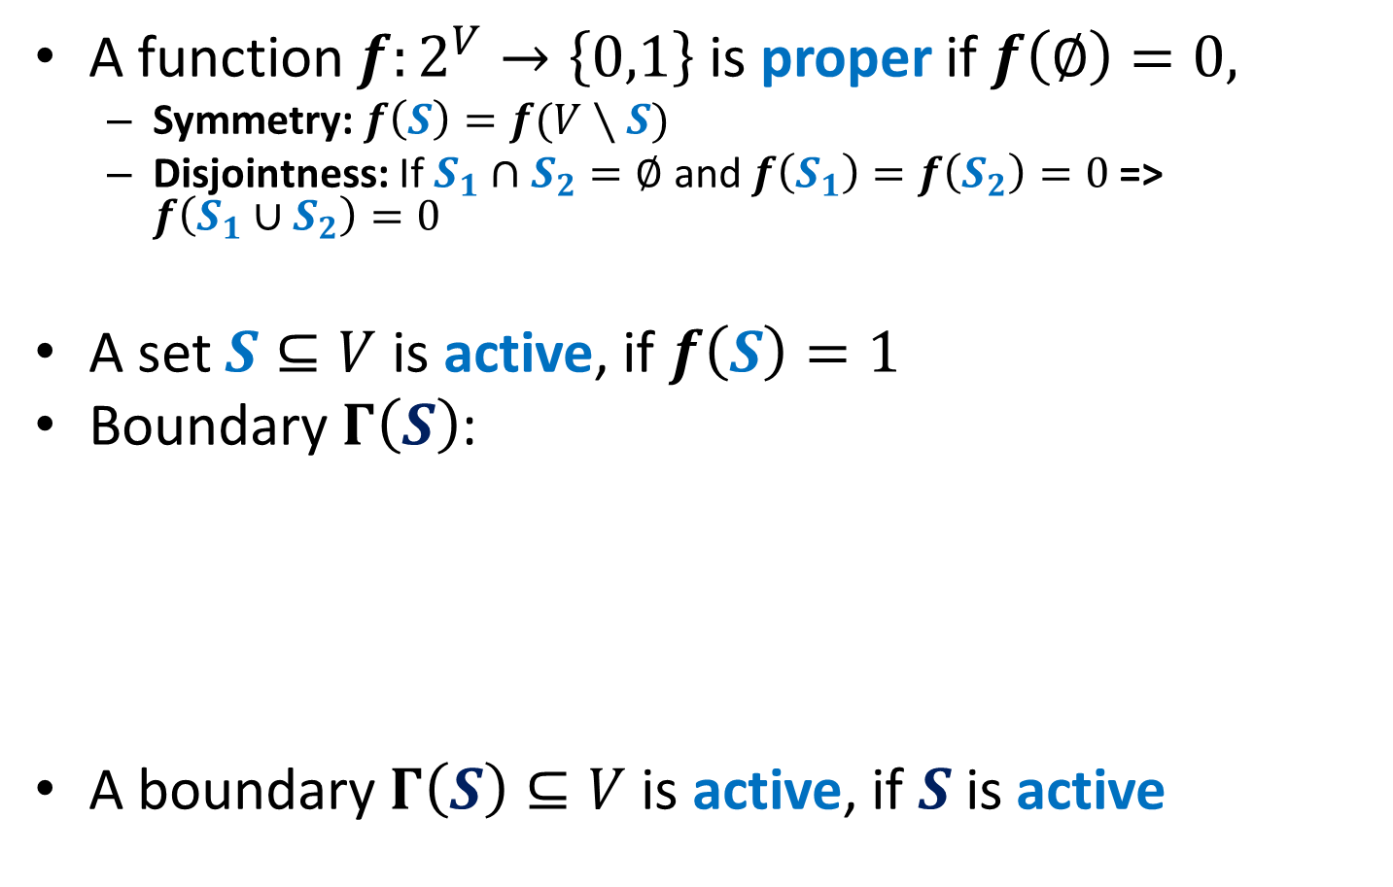
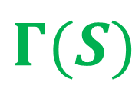
Proper functions [GW, DHK]
A function $f:2^{V}→\left\{0,1\right\}$ is proper if $f\left(∅\right)=0,$
Symmetry: $f\left(S\right)=f(V∖S)$
Disjointness: If $S_{1}∩S_{2}=∅$ and $f\left(S_{1}\right)=f\left(S_{2}\right)=0$ => $f\left(S_{1}∪S_{2}\right)=0$
A set $S⊆V$ is active, if $f\left(S\right)=1$
Boundary $Γ\left(S\right)$:
A boundary $Γ\left(S\right)⊆V$ is active, if $S$ is active
$$S$$
$$Γ(S)$$

Slide 9
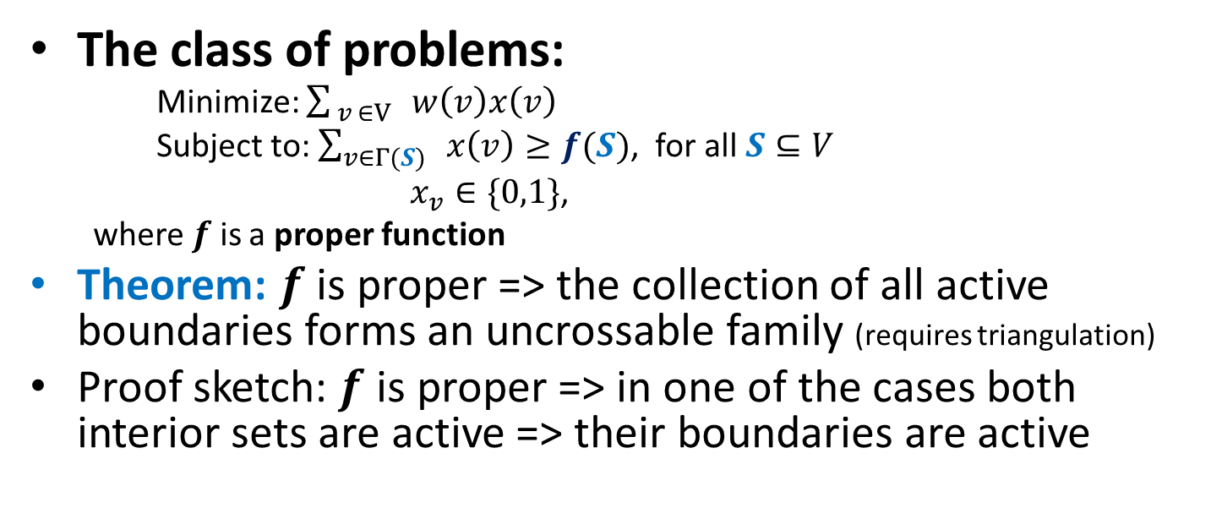
Class 2: Hitting set IP [DHK]
The class of problems:
Minimize: $\sum_{ v ∈V}{ w\left(v\right)x\left(v\right)}$
Subject to: $\sum_{v∈Γ(S)}{ x\left(v\right)≥f(S)}$, for all $S⊆V$
$x_{v}∈\{0,1\}$,
where $f$ is a proper function
Theorem: $f$ is proper => the collection of all active boundaries forms an uncrossable family (requires triangulation)
Proof sketch: $f$ is proper => in one of the cases both interior sets are active => their boundaries are active
$${C′}_{1}$$
$$C_{1}$$
$$C_{2}$$
⇒
$${C′}_{2}$$
⇒
$${C′}_{1}$$
$${C′}_{2}$$

Slide 10



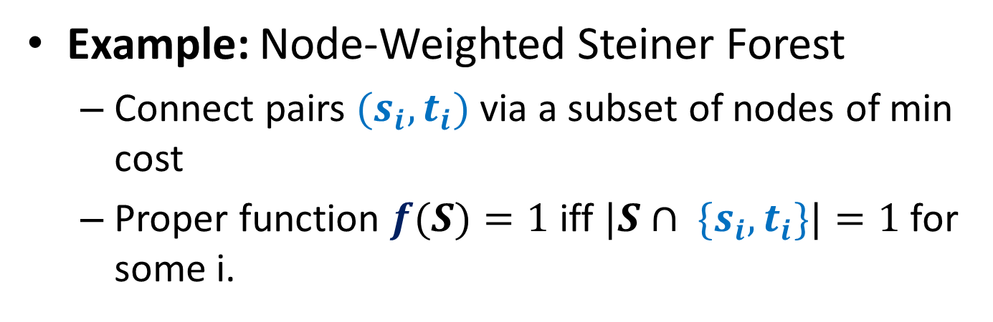






Class 1 = Class 2
Example: Node-Weighted Steiner Forest
Connect pairs $(s_{i}, t_{i})$ via a subset of nodes of min cost
Proper function $f(S)=1$ iff $|S∩ \{s_{i},t_{i}\}|=1$ for some i.
$$s_{1}$$
$$s_{1}$$
$$S$$
$$t_{2}$$
$$t_{2}$$
$$s_{2}$$
$$s_{2}$$
$$t_{1}$$
$$t_{1}$$

Slide 11
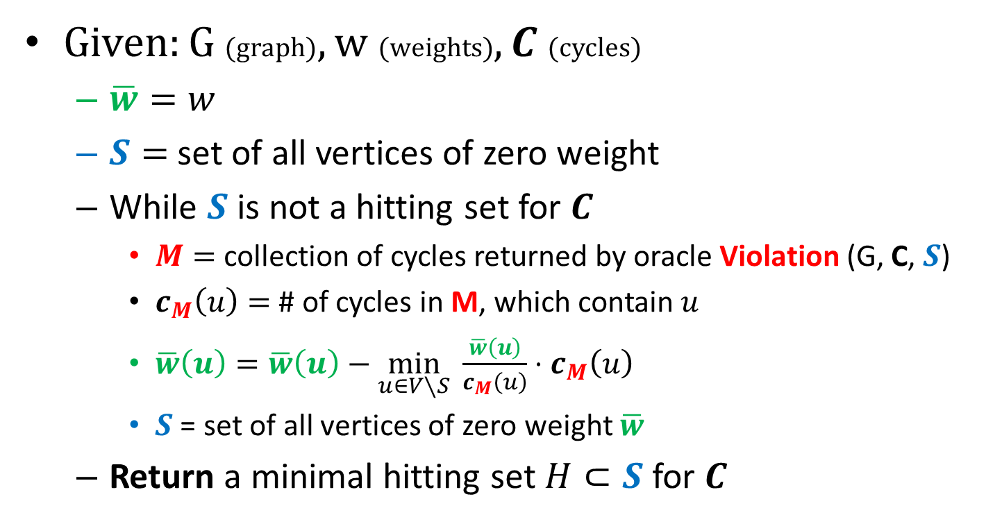
Primal-dual method (local-ratio version)
Given: G (graph), w (weights), $C$ (cycles)
$\overline{w}=w$
$S=$ set of all vertices of zero weight
While $S$ is not a hitting set for $C$
$M=$ collection of cycles returned by oracle Violation (G, C, $S$)
$c_{M}\left(u\right)=$ # of cycles in M, which contain $u$
$\overline{w}\left(u\right)=\overline{w}\left(u\right)−\min_{u∈V∖S} \frac{\overline{w}\left(u\right)}{c_{M}\left(u\right)}⋅c_{M}\left(u\right)$
$S$ = set of all vertices of zero weight $\overline{w}$
Return a minimal hitting set $H⊂S$ for $C$

Slide 12
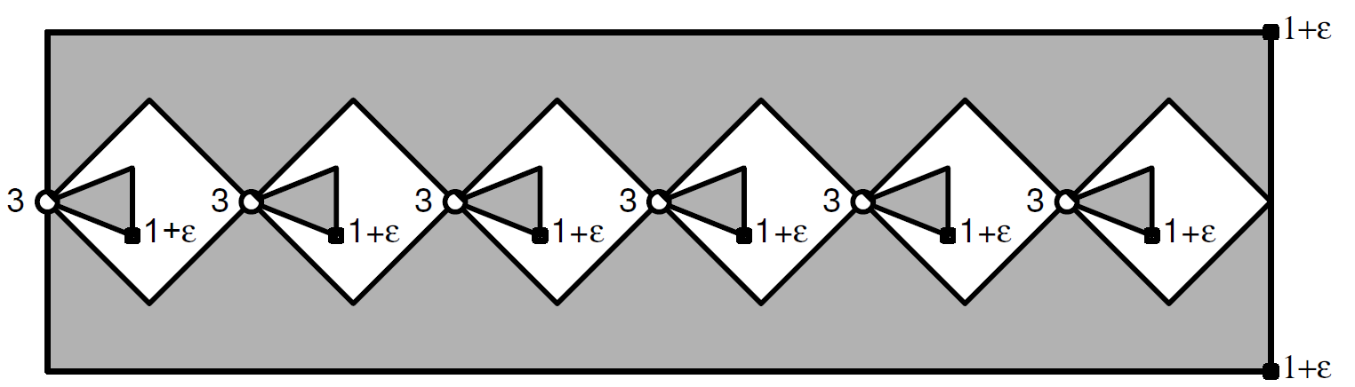
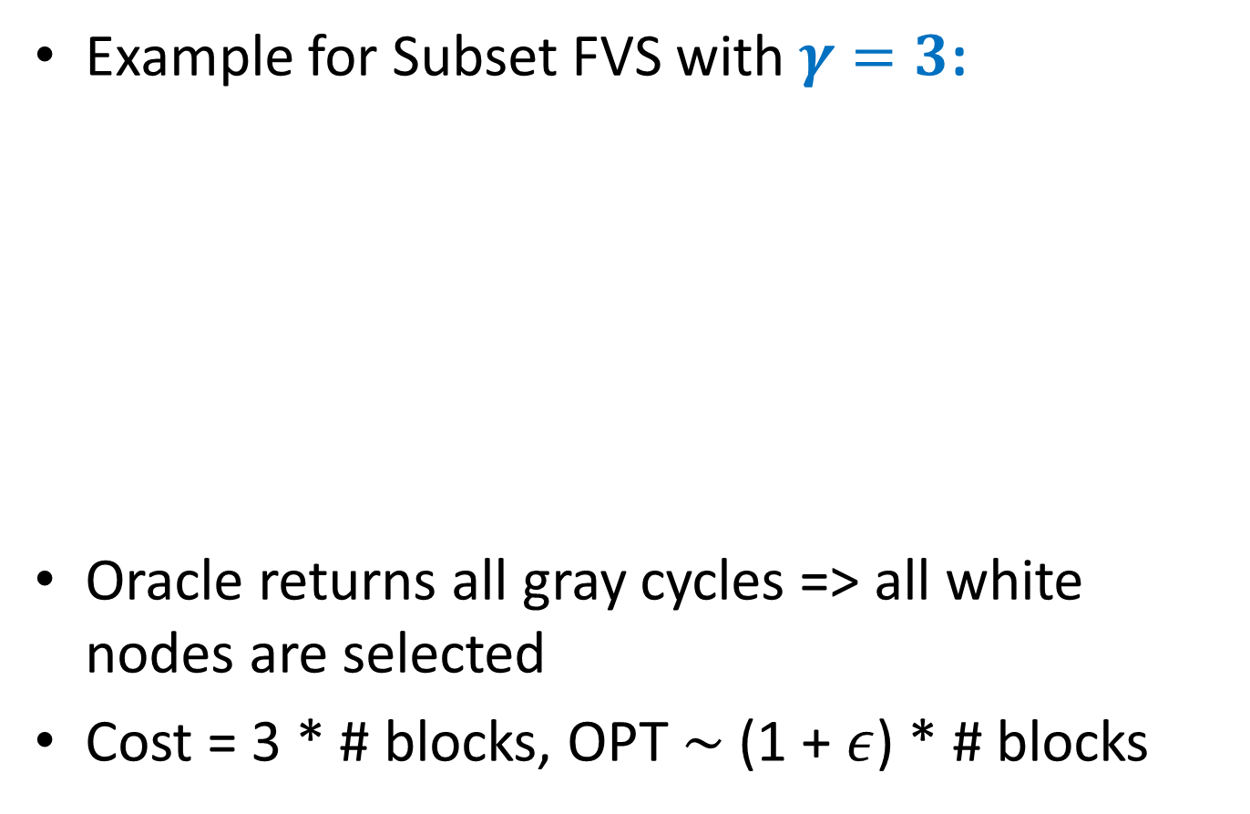
Oracle 1 = Face-minimal cycles [GW]
Example for Subset FVS with $γ=3$:
Oracle returns all gray cycles => all white nodes are selected
Cost = 3 * # blocks, OPT $∼$ (1 + $ε$) * # blocks

Slide 13
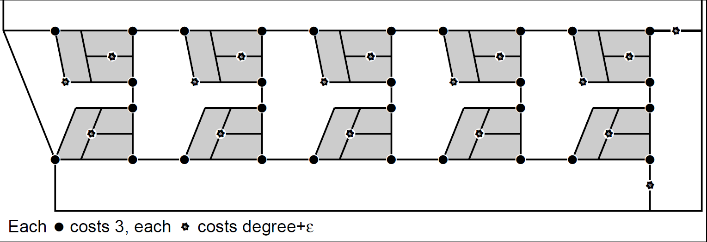
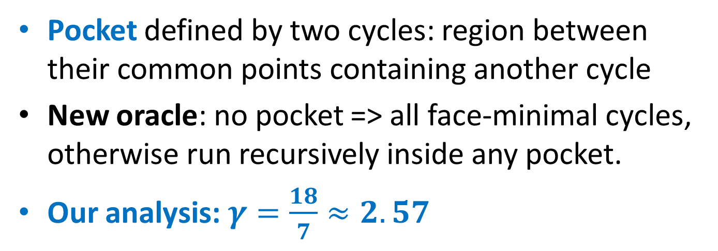
Oracle 2 = Pocket removal [GW]
Pocket defined by two cycles: region between their common points containing another cycle
New oracle: no pocket => all face-minimal cycles, otherwise run recursively inside any pocket.
Our analysis:$γ=\frac{18}{7}≈2.57$

Slide 14
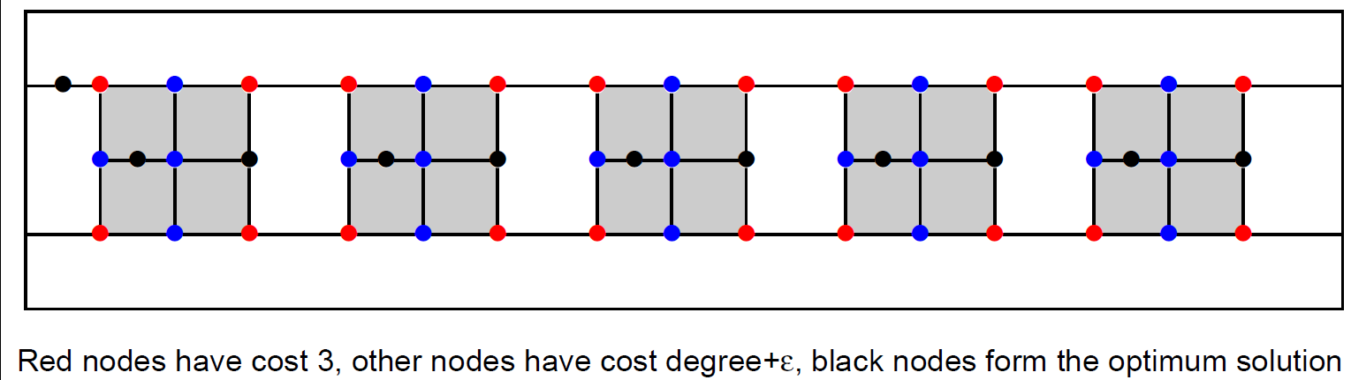
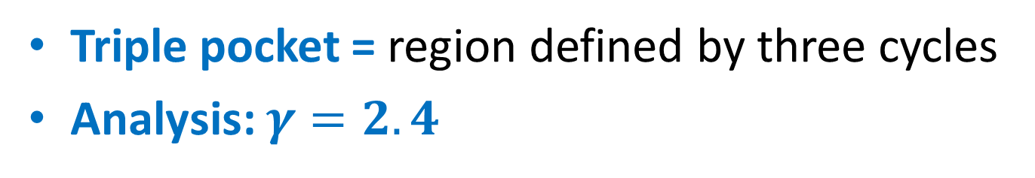
Oracle 3 = Triple pocket removal
Triple pocket = region defined by three cycles
Analysis: $γ=2.4$

Slide 15
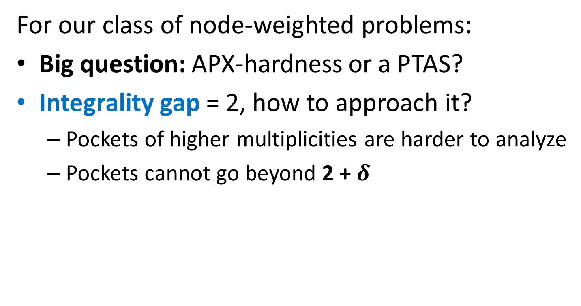
Open problems
For our class of node-weighted problems:
Big question: APX-hardness or a PTAS?
Integrality gap = 2, how to approach it?
Pockets of higher multiplicities are harder to analyze
Pockets cannot go beyond 2 + $δ$

Slide 16
Applications and ramifications
Applications: from maintenance of power networks to computational sustainability
Example: VLSI design.
Primal-dual approximation algorithms of Goemans and Williamson are competitive with heuristics [Kahng, Vaya, Zelikovsky]
Connections with bounds on the size of FVS
Conjectures of Akiyama and Watanabe and Gallai and Younger [see GW for more details]

Slide 17
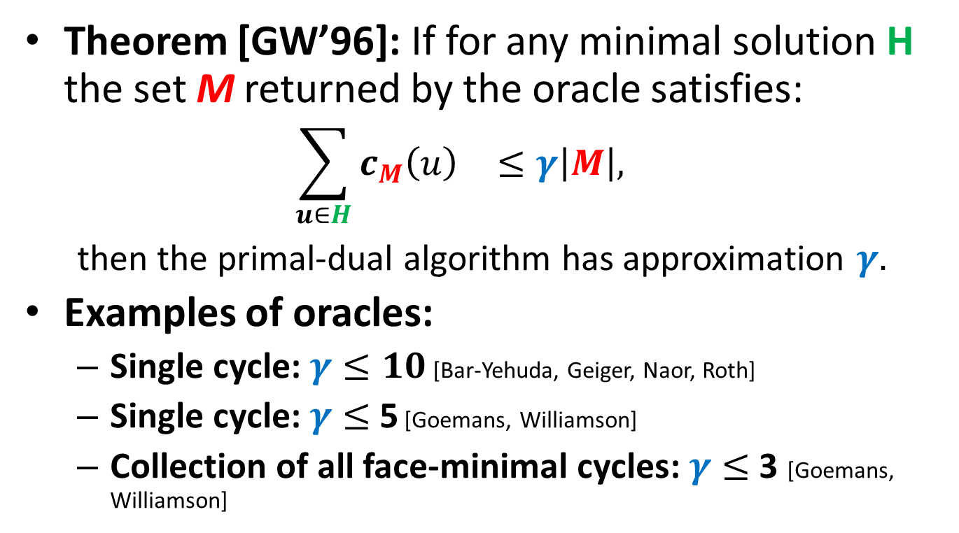
Approximation factor
Theorem [GW’96]: If for any minimal solution H the set M returned by the oracle satisfies:
$${\sum_{u∈H}{c_{M}\left(u\right)}}_{}≤γ\left|M\right|,$$
then the primal-dual algorithm has approximation $γ.$
Examples of oracles:
Single cycle: $γ≤10$ [Bar-Yehuda, Geiger, Naor, Roth]
Single cycle: $γ≤$ 5 [Goemans, Williamson]
Collection of all face-minimal cycles: $γ≤$ 3 [Goemans, Williamson]

