Slide 1
Rigorous Foundations for Privacy in Statistical Databases
Grigory Yaroslavtsev
(based on slides by Adam Smith)
Computer Science & Engineering Department
Penn State
http://logic.pdmi.ras.ru/~grigory
CSClub, May 22, 2011

Slide 2




Privacy in Statistical Databases
Individuals
Server/agency
Users
(
)
Government,
researchers,
businesses
(or)
Malicious
adversary
queries
A
answers
Large collections of personal information, census data, medical/public health data, social networks, recommendation systems, trace data, search records, intrusion-detection systems...
Recently:
larger data sets
more types of data

Slide 3
Privacy in Statistical Databases
Two conflicting goals
Utility: Users can extract “global” statistics
“Privacy”: Individual information stays hidden
How can we define these precisely?
Variations on model studied in
Statistics (“statistical disclosure control”)
Data mining / database (“privacy-preserving data mining” *)
Recently: theoretical computer science
Rigorous analysis of privacy + utility

Slide 4


This talk
Why is this hard?
External information
“Aggregate” statistics can leak info
One Approach: “Differential” privacy
Handles arbitrary external information
Privacy ≈ “stability” to changes in input
Example techniques

Slide 5


External Information
Individuals
Server/agency
Users
Internet
(
)
Government,
researchers,
businesses
(or)
Malicious
adversary
Social network
queries
A
answers
Other
anonymized data sets
Users have external information sources
Can’t assume we know the sources
Anonymization schemes regularly broken, e.g.
Netflix via IMDB [Narayanan-Shmatikov, 2008]
“Composition attacks” [Ganta-Kasiviswanathan-S., 2008]
...
Notes:
Say:
-- “background knowledge”
-- more of an issue now than it was twenty years ago

Slide 6
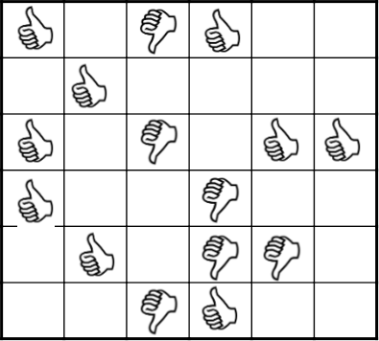
Netflix Data Release [Narayanan-Shmatikov 2008]
Ratings for subset of movies and users
Usernames replaced with random IDs
Some additional perturbation
Item 1
Item 2
Item M
User 1
User 2
User N
Credit: Arvind Narayanan
Notes:
Transactions, purchases, preferences, behavior

Slide 7









“Composition” Attacks [Ganta-Kasiviswanathan-S., KDD 2008]
Individuals
Servers
Hospital A
stats_{A}
Attacker
sensitive information
Hospital B
stats_{B}
Example: two hospitals serve overlapping populations
What if they independently release “anonymized” statistics?
Composition attack: Combine independent releases
Popular anonymization schemes leak lots of information
Litmus test for a proposed scheme’s reasonability?

Slide 8











“Composition” Attacks [Ganta-Kasiviswanathan-S., KDD 2008]
Individuals
Servers
“Adam has either diabetes or high blood pressure”
Hospital A
stats_{A}
Attacker
sensitive information
Hospital B
stats_{B}
“Adam has either diabetes or emphyzema”
Example: two hospitals serve overlapping populations
What if they independently release “anonymized” statistics?
Composition attack: Combine independent releases
Popular anonymization schemes leak lots of information
Litmus test for a proposed scheme’s reasonability?

Slide 9
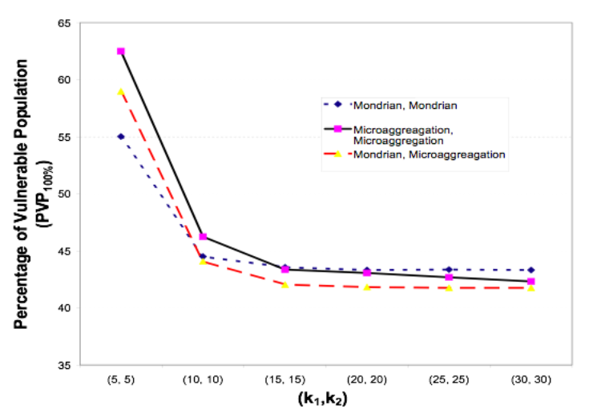


“Composition” Attacks [Ganta-Kasiviswanathan-Smith, KDD 2008]
“IPUMS” census data set. 70,000 people, randomly split into 2 pieces with overlap 5,000.
With popular technique (k-anonymity, k=30) for each database, can learn “sensitive” variable for 40% of individuals

Slide 10
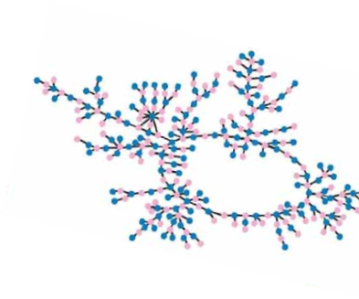
Other attacks...
Social networks [Backstrom-Dwork-Kleinberg ’07, NS’09]
Reidentifying individuals in a social network with node labels removed based on few known edges
Computer networks [Coull, Wright, Monrose, Collins, Reiter ’07, Ribeiro, Chen, Miklau, Townsley 08]
Relabeling computers and users in a network traffic dataset based on communication pattern
Genetic data [Homer et al. ’08, ...]
Identifying individuals in aggregate genomic data

Slide 11
Is the problem granularity?
Examples so far: release individual information
What if I’m releasing “global” information?
e.g. average salary at university X
Three problems:
Composition: average salary before/after football coach resigns
Global result “encodes” specific values: Support Vector Machine (output depends only on few inputs -- “support vectors”)
Noise? Too many “too accurate” stats ⇒reconstruction

Slide 12



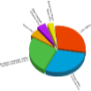




Reconstruction Example [Dinur, Nissim 03]
Data set: d “public” attributes per person, 1 “sensitive”
Suppose release allows learning rough correlations:
If a_{i} are uniformly random and d=ω(n), then attacker can reconstruct n-o(n) bits of y [Dinur,Nissim03,DMT07,DY08]
a_{i}
y
y’
y
n people
release
reconstruction
≈
d+1 attributes

Slide 13





Reconstruction Example [Dinur, Nissim 03]
Data set: d “public” attributes per person, 1 “sensitive”
Idea: view statistics as noisy linear encoding
a_{i}
y
y’
y
n people
release
reconstruction
≈
d+1 attributes
y
e
y’
a_{i}
+
M

Slide 14
This talk
Why is this hard?
One Approach: “Differential” privacy
Privacy ≈ “stability” to changes in input
Handles arbitrary external information
Example techniques

Slide 15
Differential Privacy [DiDwNi,BDMN,DMNS]
Intuition:
Changes to my data not noticeable by users
Output is “independent” of my data

Slide 16

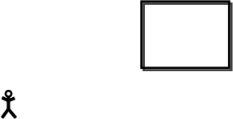


Differential Privacy [DiDwNi,BDMN,DMNS]
A
A(x)
local random coins
Data set x
Domain D can be numbers, categories, tax forms
Think of x as fixed (not random)
A = randomized procedure
A(x) is a random variable
Randomness might come from adding noise, resampling, etc.
Notes:
Say: forget this is a statistics colloquium. Think like a computer scientist.

Slide 17






Differential Privacy [DiDwNi,BDMN,DMNS]
A
A(x)
A
A(x’)
local random coins
local random coins
x’ is a neighbor of x if they differ in one data point
Neighboring databases induce close distributions on outputs
Definition: A is ε-differentially private if,
for all neighbors x, x’,
for all subsets S of outputs
Notes:
Say:
e^\eps is roughly (1+eps)
Same as requiring that probability distributions be off point for point by 1+eps.

Slide 18

Differential Privacy [DiDwNi,BDMN,DMNS]
This is a condition on the algorithm (process) A
Saying “this output is safe” doesn’t take into account how it was computed
Exact distance on distributions matters
What is ε?
Measure of information leakage
Not too small (think , not )
Neighboring databases induce close distributions on outputs
Definition: A is ε-differentially private if,
for all neighbors x, x’,
for all subsets S of outputs

Slide 19









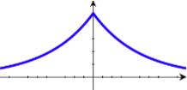
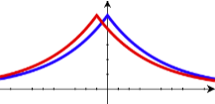



Example: Perturbing the Average
A
local random coins
Data points are binary responses
Server wants to release average
Lemma: Can obtain ε-differential privacy with noise
Laplace distribution has density
Sliding property:
A(x) = blue curve, A(x’) = red curve

Slide 20

Example: Perturbing the Average
A
local random coins
Data points are binary responses
Server wants to release average
Lemma: Can obtain ε-differential privacy with noise
Is this a lot?
If x is a random sample from a large underlying population, then sampling noise
Statistical error swamps noise required for privacy
Notes:
SAY: we’ll return to this point

Slide 21
Why is this a good definition?
Composition Lemma: If A₁ and A₂ are ε-differentially private, then joint output (A₁,A₂) is 2ε-differentially private.
Meaningful in the presence of arbitrary external information
Neighboring databases induce close distributions on outputs
Definition: A is ε-differentially private if,
for all neighbors x, x’,
for all subsets S of outputs

Slide 22




Why is this a good definition?
A naïve hope:
Your beliefs about me are the same after you see the output as they were before
Suppose you know that I smoke
A public health study could teach you that I am at risk for cancer
But it didn’t matter whether or not my data was part of it.
Has my “privacy” been compromised?
Theorem (Dwork-Naor): Learning things about individuals is unavoidable in the presence of external information
Differential privacy implies: No matter what you know ahead of time,
You learn the same things about me whether or not I am in the database
Notes:
One can formalize this in several ways. I will present one way which I find most convincing.

Slide 23
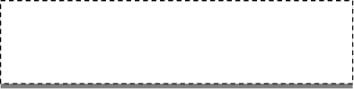






Why is this a good definition?
Consider an intruder trying to infer personal information
“Background knowledge” = prior distribution on data x
“Conclusions you draw” = posterior p(∙|output)
Experiment 0: Run A(x)
Experiment i: Run A(x_{-i}) where x_{-i} = (x₁,…,x_{i-1},0,x_{i+1},…,x_{n})
Lemma: ∀ prior, ∀ output, p₀(∙|output) ≈ p_{i}(∙|output)
Bayes’ rule with
close distributions
(distance ε)
prior(x)
output
Bayes’ rule with
Notes:
Consider an intruder (you) trying to infer things about me
Theorem holds ∀ prior, ∀ output:
Real data doesn’t appear in the theorem
Prior may be unrepresentative of real data

Slide 24
What can we compute privately?
A
A(x)
A
A(x’)
local random coins
local random coins
“Privacy” = change in one input leads to small change in output distribution
What computational tasks can we achieve privately?
Lots of recent work, open questions
Notes:
Say: Differential privacy is a constraint on the structure of algorithms and statistical procedures

Slide 25
What can we compute privately?
“Privacy” = change in one input leads to small change in output distribution
What computational tasks can we achieve privately?
A sample of research directions, circa 2009
Function approximation [DDN, DN,BDMN,DMNS,NRS,BCDKMT]
Mechanism Design [MT]
Learning [BDMN,KLNRS,CM]
Statistical estimation [S,ZW,DL]
Synthetic Data [MKAGV,BLR,DNRRV]
Distributed protocols [DKMMN,BNO]
Impossibility results / lower bounds [DiNi,DMNS,DMT,KRSU]
Notes:
Say: Differential privacy is a constraint on the structure of algorithms and statistical procedures

Slide 26
A sampling of results (STOC,FOCS,PODS,VLDB,KDD,CRYPTO,...)
Basic Techniques, e.g.
noise addition [Dwork-McSherry-Nissim-S.’06, NRS’07, ...]
Optimizations [BCDKMT’07, HRMS’10,LiHRMM’10,...]
Programming tool “PInQ” [McSherry’09]
“exponential sampling” [McSherry-Talwar’07]
Broad feasibility statements, e.g.
PAC Learning / classification [KasiviswanathanLNRS ’08]
Statistical estimation [Wasserman-Zhou ’09, S. ’09, Dwork-Lei ’09]
Synthetic data [Blum-Ligett-Roth ’08, DNRRV ’09, DRV ’10]
Distributed models [EGS’03, DKMMN’06, BNO’08, DMPR’10]
Impossibility results [Dinur-Nissim’03, DMT’07,DY’08,KRSU’10, HT’10]

Slide 27
This talk
A Hurdle: External Information
One Approach: “Differential” privacy
Privacy ≈ “stability” to changes in input
Handles arbitrary external information
Example Techniques
Output perturbation
Application: histogram estimators

Slide 28






Global Sensitivity [DMNS06]
Individuals
Server/agency
A
f(x) + noise
User
local random coins
Intuition: f(x) can be released accurately when f is insensitive to individual entries
Global Sensitivity:
Example:

Slide 29

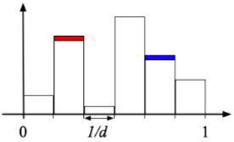
Example: Histograms
Say x₁,x₂,...,x_{n} in domain D
Partition D into d disjoint bins
GS_{f} = 1
Sufficient to add noise to each count

Slide 30
Example: Histograms
Say x₁,x₂,...,x_{n} in domain D
Partition D into d disjoint bins
GS_{f} = 1
Sufficient to add noise to each count
Example
D = [0,1]
bins = intervals

Slide 31
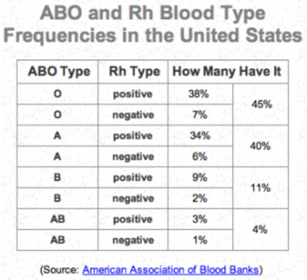

Contingency Tables
Work horse of releases from US statistical agencies
Frequencies of combinations of set of categorical attributes
Treat as a “histogram”
Eight bins (O+,O-,...,AB+,AB-)
Add constant noise to counts to achieve differential privacy
Change to proportions is
Problem for practice:
Some entries may be negative. Multiple tables inconsistent.
Multiple noisy tables can be “rounded” to a consistent set of tables corresponding to real data [Barak et al., 2007]

Slide 32

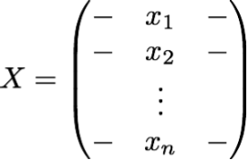




Covariance Matrix
Suppose each person’s data is a real vector
Database is a matrix X
The covariance matrix of X is (roughly) the matrix
Lemma: If then GS_{f} ≤ 1
Proof: Write Observe that
Constant noise per entry suffices for differential privacy

Slide 33


Using global sensitivity
Many natural functions have low sensitivity
e.g., sample mean, histogram, covariance matrix…
More generally, view as “programming interface”
Many algorithms can be expressed as a sequence of low-sensitivity queries [BDMN, FFKN, MW]
e.g., gradient ascent, k-means

Slide 34
Current topics
Convex optimization
When are optimal solutions “robust”?
Initial ideas: [Chaudhuri et al., ‘08, ‘10]
Network (= graph) analysis
What can you release while remaining robust to insertions / deletions of vertices? (Following [Hays et al., 2009])
Releasing many statistics with meaningful noise levels
Following [Blum, Ligett, Roth 08, ...]
Other meaningful definitions of privacy

Slide 35
Conclusions
Define privacy in terms of my effect on output
Meaningful despite arbitrary external information
I should participate if I get benefit
What can we compute with rigorous guarantees?
Illustration:
Noise addition
Other definitions? How can we exploit uncertainty?
How can we reason about privacy, more broadly?

