Slide 1
Private Analysis of Graph Structure
Grigory Yaroslavtsev
http://grigory.us
With Vishesh Karwa, Sofya Raskhodnikova and Adam Smith
Pennsylvania State University

Slide 2
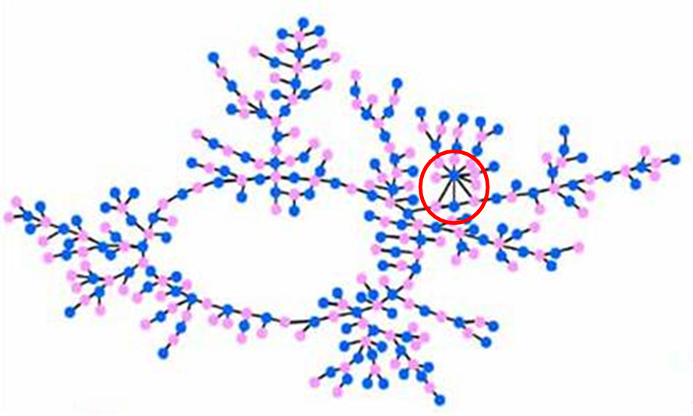
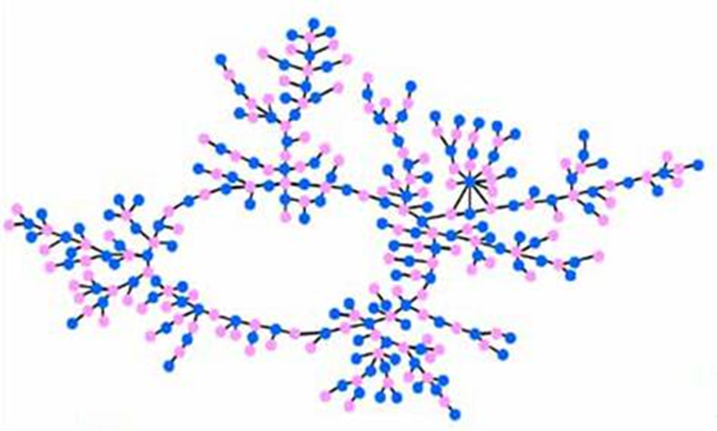
Publishing network data
Many data sets can be represented as a graph:
Friendship in online social network
Financial transactions
Romantic relationships
Publish information about a graph
Preserve privacy of relationships
Naïve approach: anonymization
American J. Sociology,
Bearman, Moody, Stovel

Slide 3
Publishing network data
Goal: Publish structural information about a graph
Relationships
Database
Users
(
)
Government,
researchers,
businesses
(or)
Malicious
adversary
queries
A
answers
Anonymization not sufficient [Backström, Dwork, Kleinberg ’07, Narayanan, Shmatikov ’09, Narayanan, Shi, Rubinstein ’11]
Ideal: Algorithms with rigorous privacy guarantee, no assumptions about attacker’s prior information/algorithm
Notes:
ADS:
The second bullet was hard to interpret (the natural tendency is to try to interpret the two bullets as being part of a list, but here they are fairly different).
IMPORTANT: emphasize verbally that we provide algorithms that meet the goal in the last bullet.

Slide 4
Differential privacy [Dwork, McSherry, Nissim, Smith ’06]
Limits incremental information by hiding presence/absence of an individual relationship
Relationships
Database
Users
(
)
Government,
researchers,
businesses
(or)
Malicious
adversary
queries
A
answers
Neighbors: Graphs G and G’ that differ in one edge
Answers on neighboring graphs should be similar
Notes:
ADS: Remove the comma, remind people that the input is a graph

Slide 5
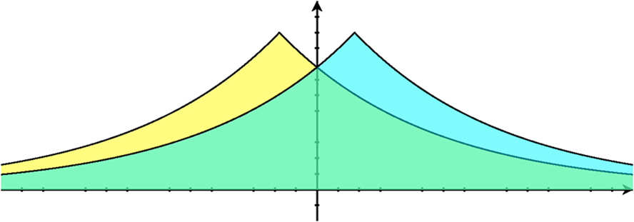
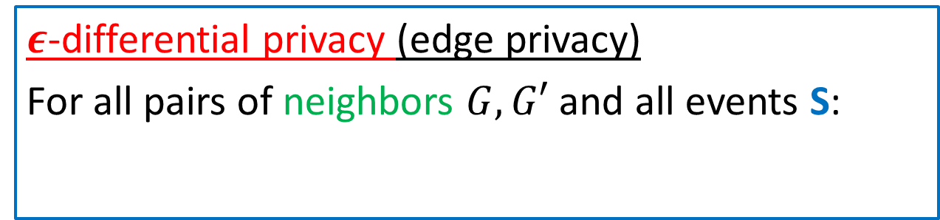
Differential privacy for relationships
$ε$-differential privacy (edge privacy)
For all pairs of neighbors $G, G′$ and all events S:
$$\operatorname{Pr}\left[A\left(G\right)∈S\right]≤e^{ε}\operatorname{Pr}\left[A\left(G^{′}\right)∈S\right]$$
Probability is over the randomness of A
Definition requires that the distributions are close:
A(G)
A(G’)
Notes:
ADS: Delete “local” since the term may be confusing (I have found that people don’t understand what I mean by that when I use it).
Also, the equations in my copy got messed up but I assume that is a PC -> Mac conversion issue.

Slide 6
Subgraph counts
For graphs G and H: # of occurrences of H in G
Example:
k-star
…
2-star:
Total: 40
k
k-triangle
Triangle:
Total: 2
…
2-triangle:
Total: 1
k

Slide 7
Subgraph counts
Subgraph counts are used in:
Exponential random graph models
Descriptive graph statistics, e.g.: Clustering coefficient =
Our focus: efficient differentially private algorithms for releasing subgraph counts
#
#
Notes:
ADS: Indent “clustering coefficient” so it is clearly a sub-item of the bullet “descriptive graph statistics”.

Slide 8
Previous work
Smooth Sensitivity [Nissim, Raskhodnikova, Smith ‘07]
Differentially private algorithm for triangles
Open: private algorithms for other subgraphs?
Private queries with joins [Rastogi, Hay, Miklau, Suciu ‘09]
Works for a wide range of subgraphs
Weaker privacy guarantee, applies only for specific class of adversaries
Private degree sequence [Hay, Li, Miklau, Jensen ’09]
Guarantees differential privacy
Works for k-stars, but not for other subgraphs
Notes:
Introduce RHMS

Slide 9

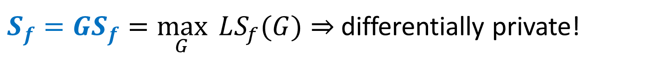
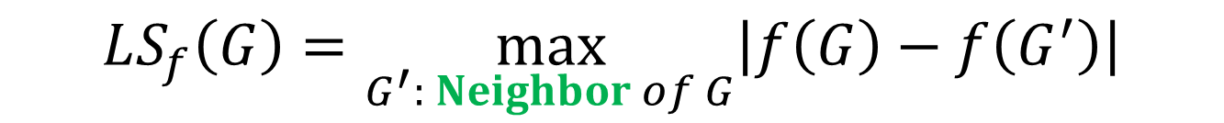
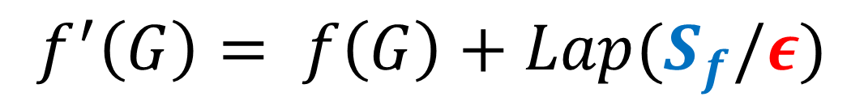
Laplace Mechanism and Sensitivity [Dwork, McSherry, Nissim, Smith ‘06]
Add noise: mean = 0, standard deviation $\sim (S_{f}/ε)$, where $S_{f}$ is sensitivity => $ε$-differential privacy:
Local sensitivity ([NRS’07], not differentially private!):
Previous work (mostly): Global sensitivity
$$f^{′}\left(G\right)= f\left(G\right)+Lap(S_{f}/ε)$$
$$LS_{f}\left(G\right)=\max_{G^{′}: Neighbor of G}\left|f\left(G\right)−f\left(G^{′}\right)\right|$$
$S_{f}=GS_{f}=\max_{G}{ LS_{f}(G)}{⇒}$ differentially private!
Notes:
ADS:
Important: Local sensitivity should be attributed to NRS, not DMNS.
2) Try to make formatting of the top bullet here and the “Cuachy” bullet on the next slide identical, so that the difference is easier to understand.

Slide 10
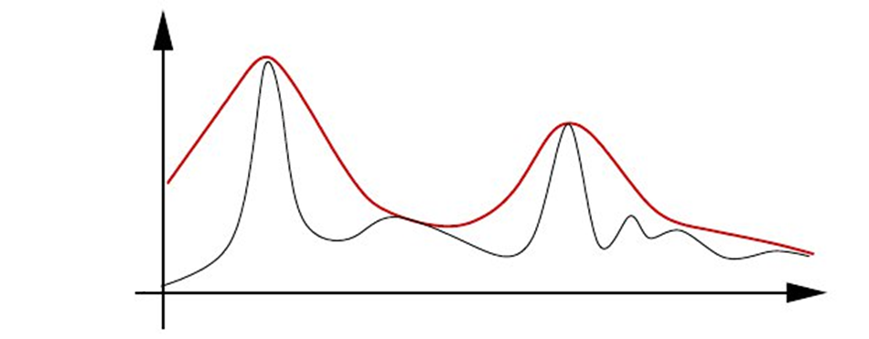
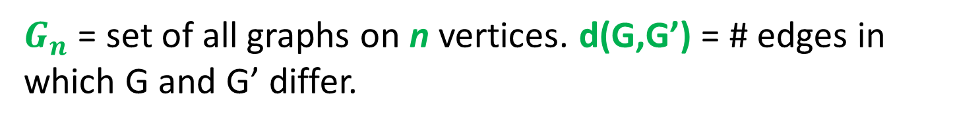


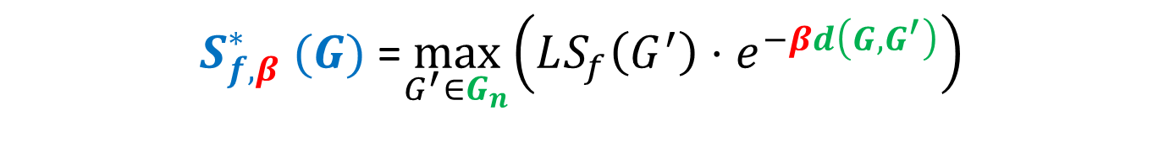
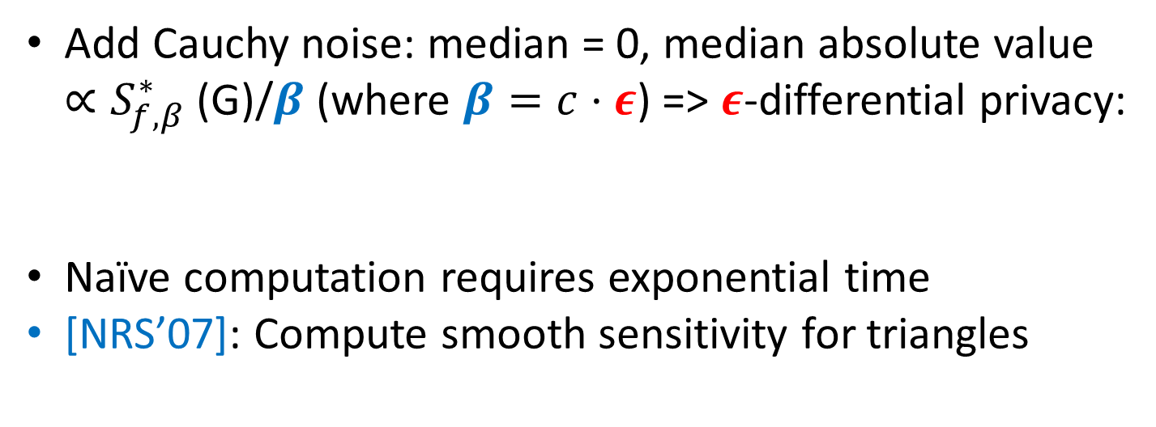
Instance-Specific Noise
$G_{n}$ = set of all graphs on n vertices. d(G,G’) = # edges in which G and G’ differ.
Smooth Sensitivity [Nissim, Raskhodnikova, Smith ’07]:
$$S_{f}^{∗}\text{(}\text{G}\text{)}$$
$S_{f, β}^{∗} (G)$ =$\max_{G^{′}∈G_{n}}\left(LS_{f}\left(G^{′}\right)⋅e^{−βd\left(G,G^{′}\right)}\right)$
$$LS_{f}\text{(}\text{G}\text{)}$$
Add Cauchy noise: median = 0, median absolute value $∝S_{f,β}^{∗}\text{ (}\text{G}\text{)/}β$ (where $β=c⋅ε$) => $ε$-differential privacy:
Naïve computation requires exponential time
[NRS’07]: Compute smooth sensitivity for triangles
$$f^{′}\left(G\right)= f\left(G\right)+Cauchy(S_{f,β}^{∗}/β)$$
Notes:
ADS:
Try to make formatting of the top bullet from the previous slide and the “Cauchy” bullet here identical, so that the difference is easier to understand.
Remove comma after the word edges in first block of text
Move [NRS07] triangles statement to this slide (from next slide)?
Add a hyphen in “instance-specific”
Naïve computation of S* is a bruteforce: going through all graphs on $n$ vertices.
We can do better for some functions we are interested in.
[Add bullet from next slide]

Slide 11
Our contributions
Differentially private algorithms for k-stars and k-triangles
Efficiently compute smooth sensitivity for k-stars
NP-hardness for k-triangles and k-cycles
Different approach for k-triangles
Average-case analysis in G(n,p)
Theoretical comparison with previous work
Experimental evaluation
Notes:
ADS: The layout here is confusing, since the first item is not our contribution. One solution would be to put the [NRS07] bullet on the previous slide.

Slide 12
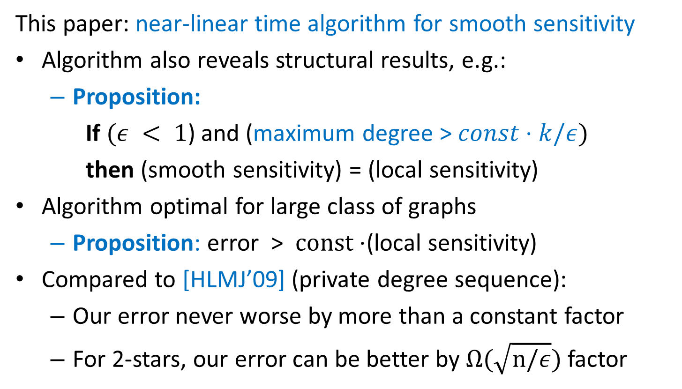
Smooth Sensitivity for k-stars ( )
…
This paper: near-linear time algorithm for smooth sensitivity
Algorithm also reveals structural results, e.g.:
Proposition:
If $(ε < 1$) and (maximum degree > $const⋅k/ε)$
then (smooth sensitivity) = (local sensitivity)
Algorithm optimal for large class of graphs
Proposition: error > $const⋅$(local sensitivity)
Compared to [HLMJ’09] (private degree sequence):
Our error never worse by more than a constant factor
For 2-stars, our error can be better by $Ω(\sqrt{n/ε})$ factor
Notes:
ADS:
First bullet should say something that makes it clear it is our contribution.
The box around the second block of text makes that the focus of the slide – it is the main thing that people will pay attention to. Is that what you want? I’ve provided a suggested alternative formatting.
Say never worse by const factor
Optmality of LS in separate bullet

Slide 13
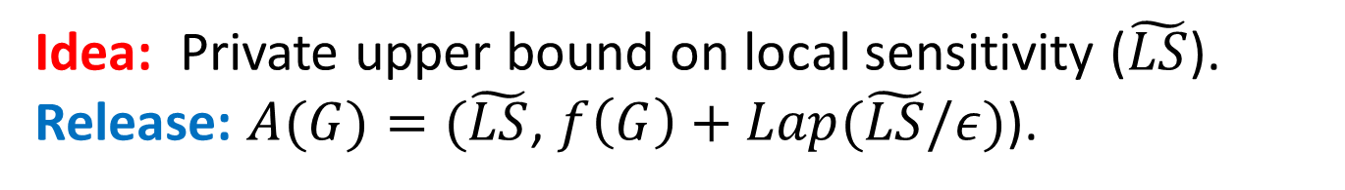
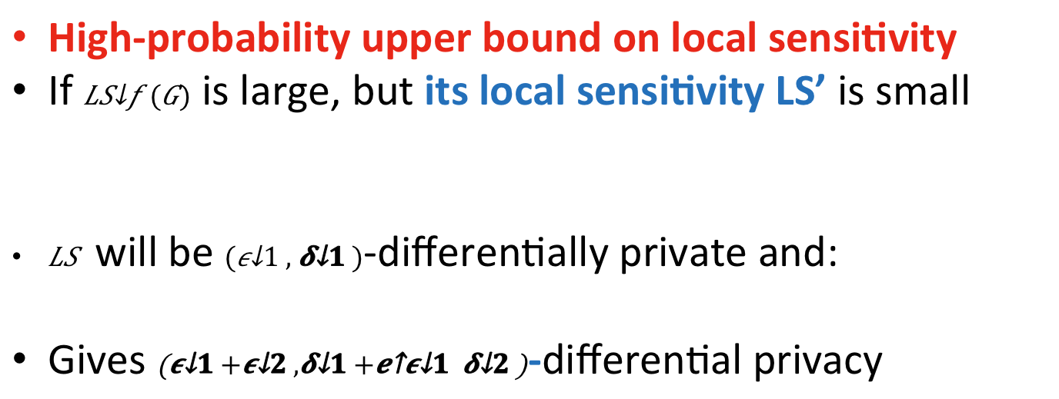
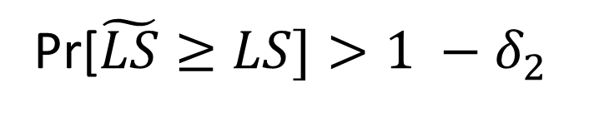
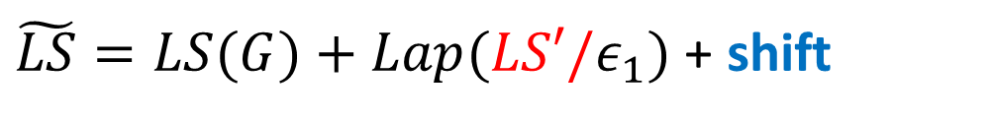
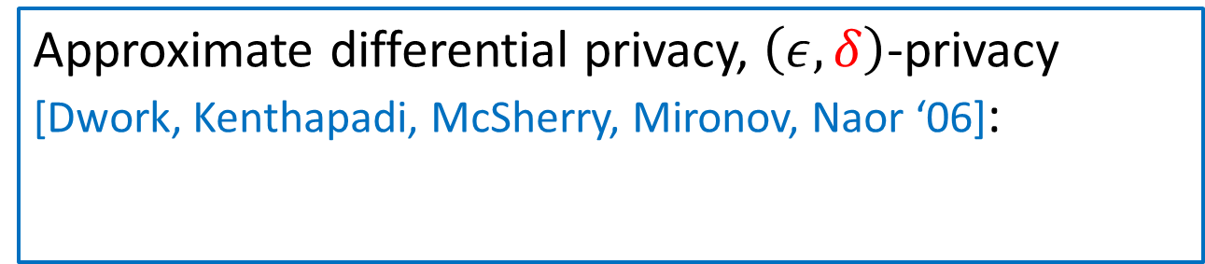
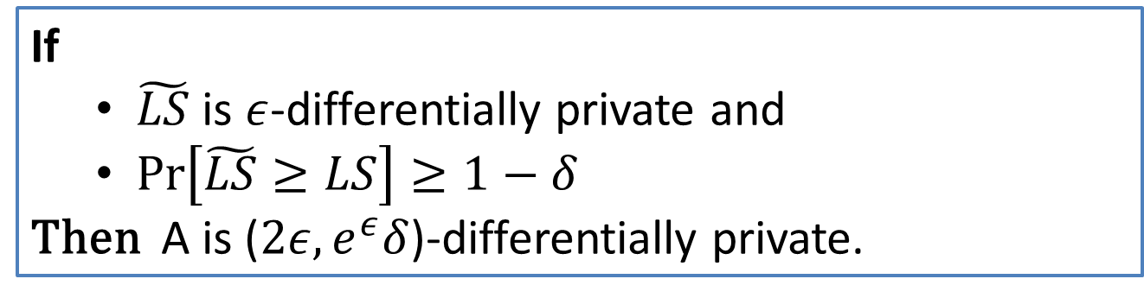
Private Approximation to Local Sensitivity: k-triangles ( )
…
Approximate differential privacy, $\left(ε, δ\right)$-privacy [Dwork, Kenthapadi, McSherry, Mironov, Naor ‘06]:
High-probability upper bound on local sensitivity
If $LS_{f}(G)$ is large, but its local sensitivity LS’ is small
$\tilde{LS}$ will be $(ε_{1}, δ_{1})$-differentially private and:
Gives $\left(ε_{1}+ε_{2},δ_{1}+e^{ε_{1}}δ_{2}\right)$-differential privacy
$$\operatorname{Pr}\left[A\left(G\right)∈S\right]≤e^{ε}\operatorname{Pr}\left[A\left(G^{′}\right)∈S\right]+δ$$
Idea: Private upper bound on local sensitivity ($\tilde{LS}$).
Release: $A(G)=(\tilde{LS}$, $f\left(G\right)+Lap(\tilde{LS}/ε)$).
$\tilde{LS}=LS(G)+Lap(LS′/ε_{1})$ + shift
If
$\tilde{LS}$ is $ε$-differentially private and
$\operatorname{Pr}\left[\tilde{LS}≥LS\right]≥1−δ$
Then A is ($2ε,e^{ε}δ$)-differentially private.
Pr[$\tilde{LS}≥LS]>1 −δ_{2}$
Notes:
ADS: Emphasize (orally) here that this is the technically most intricate part of the paper.

Slide 14
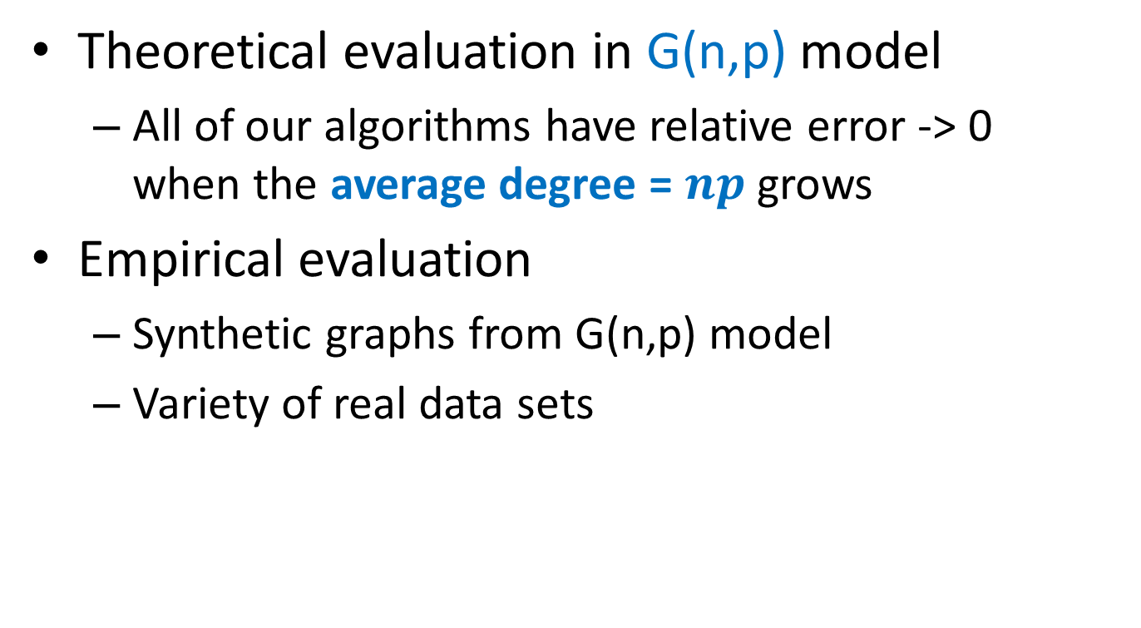
Evaluating our algorithms
Theoretical evaluation in G(n,p) model
All of our algorithms have relative error -> 0 when the average degree = $np$ grows
Empirical evaluation
Synthetic graphs from G(n,p) model
Variety of real data sets
Notes:
ADS: I suggest you add a short slide like this one to transition into experiments. I think this will actually *save* you time since you have to pause for a while anyway and tell the audience that you are entering a new part of the talk.

Slide 15

Experimental results for G(n,p)
Comparison with previous work for $p=\frac{\log{n}}{n}$
Notes:
ADS: Can you change the scale to so that more of the space is used?

Slide 16
Experimental results for G(n,p)
Comparison with previous work for $p=\frac{\log{n}}{n}$

Slide 17
Experimental results for G(n,p)
Comparison with [RHMS’09] for $p=\frac{\log{n}}{n}$

Slide 18
Experimental results (SNAP)

Slide 19
Experimental results (SNAP)
Notes:
ADS:
These colors very hard to tell apart.
Recall that many people are colorblind (and many projectors are awful) so having some other way to distinguish the curves is useful.

Slide 20
Summary
Private algorithms for subgraph counts
Rigorous privacy guarantee (differential privacy)
Running time close to best algorithms for computing the subgraph counts
Improvement in accuracy and (for some graph counts) in privacy over previous work
Techniques:
Fast computation of smooth sensitivity
Differentially private upper bound on local sensitivity

