Slide 1


Accurate and Efficient Private Release of Data Cubes & Contingency Tables
Grigory Yaroslavtsev
, work done at
With Graham Cormode,
Cecilia M. Procopiuc
Divesh Srivastava

Slide 2
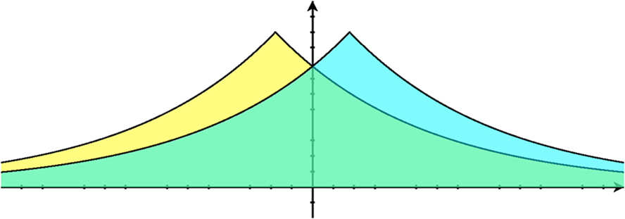
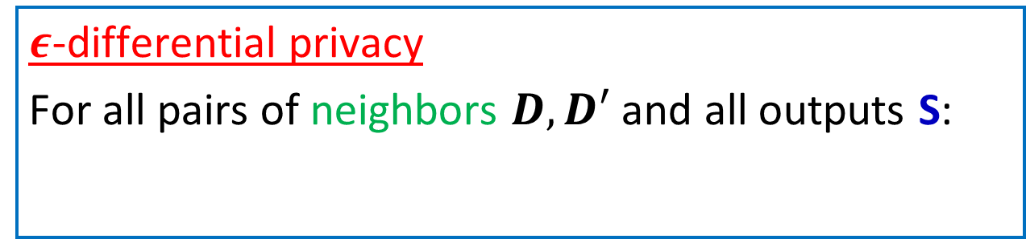
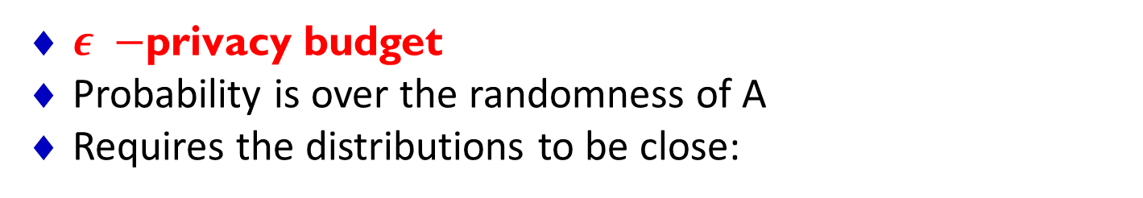
Differential privacy in databases
$ε$-differential privacy
For all pairs of neighbors $D, D′$ and all outputs S:
$$\operatorname{Pr}\left[A\left(D\right)=S\right]≤e^{ε}\operatorname{Pr}\left[A\left(D^{′}\right)=S\right]$$
$ε −$privacy budget
Probability is over the randomness of A
Requires the distributions to be close:
A(D)
A(D’)
Notes:
Differential privacy requires that the data publishing mechanism A used by the database is randomized and satisfies the following guarantee.
For every possible answer S that A might give the probabilities of A giving such answer on any pair of neighboring datasets should be close. To satisfy epsilon-differential privacy they have to be different by at most a multiplicative factor of e^\epsilon, which for small values of \epsilon is roughly (1 + \epsilon).
Here the probabilities are taken only over the randomness that the data publishing algorithm uses.
If the output of the algorithm is a single number (say, averaged salary) then this means that for every possible such number the probabilities of it being produced by A on the databases D and D’ should differ by at most a factor of (1 + \epsilon).
The most basic way to achieve this is to add some carefully chosen noise to the query answers.
In the case of one query this is fairly simple, but if the database needs to answer multiple queries the situation gets more involved.
There are multiple different mechanisms which can satisfy the definition of differential privacy.
Graham gave an introduction into such mechanisms on Monday in his Workshop tutorial.
ADS: Delete “local” since the term may be confusing (I have found that people don’t understand what I mean by that when I use it).
Also, the equations in my copy got messed up but I assume that is a PC -> Mac conversion issue.

Slide 3
Optimizing Linear Queries
Linear queries capture many common cases for data release
Data is represented as a vector x (histogram)
Want to release answers to linear combinations of entries of x
Model queries as matrix Q, want to know y=Qx
Examples: histograms, contingency tables in statistics
( )
3
5
7
0
1
4
9
2
1 | 1 | 1 | 1 | 0 | 0 | 0 | 0
0 | 0 | 0 | 0 | 1 | 1 | 1 | 1
1 | 1 | 0 | 0 | 0 | 0 | 0 | 0
0 | 0 | 1 | 1 | 0 | 0 | 0 | 0
0 | 0 | 0 | 0 | 1 | 1 | 0 | 0
0 | 0 | 0 | 0 | 0 | 0 | 1 | 1
Q=
x=
Notes:
Today we will be looking at a class of queries, called linear queries.
Let the database be represented as a histogram, where each entry corresponds to a set of values assigned to all attributes.
Then the database can be expressed as a vector x, where the values of entries in x are the counts of how many users have this combination of attribute values.
Linear queries correspond to aggregate statistics which can be expressed as a dot product of x with a query vector.
Multiple such queries correspond to a matrix Q and the answers to such queries are given by multiplying Q by x.
Today I will be talking about offline data publishing, when the full matrix Q is known to the data publisher (e.g. U.S. census data).

Slide 4
Answering Linear Queries
Basic approach:
Answer each query in Q directly, partition the privacy budget uniformly and add independent noise
Basic approach is suboptimal
Especially when some queries overlap and others are disjoint
Several opportunities for optimization:
Can assign different privacy budgets to different queries
Can ask different queries S, and recombine to answer Q
( )
1 | 1 | 1 | 1 | 0 | 0 | 0 | 0
0 | 0 | 0 | 0 | 1 | 1 | 1 | 1
1 | 1 | 0 | 0 | 0 | 0 | 0 | 0
0 | 0 | 1 | 1 | 0 | 0 | 0 | 0
0 | 0 | 0 | 0 | 1 | 1 | 0 | 0
0 | 0 | 0 | 0 | 0 | 0 | 1 | 1
Q=
Notes:
The most basic approach to answering a set of linear queries is to treat them independently.
A property of differential privacy called composition allows to partition the privacy budget between the queries.
If every query is answered within its privacy budget then the overall mechanism is \epsilon-d.p.
The most basic way of partitioning the privacy budget is just to divide it into equal parts among the queries.
The basic approach is suboptimal.
For example, if some of the queries repeat then we don’t want to lose the privacy budget on the repeated queries.
However, this is an extreme case and in practice the queries don’t repeat, but rather share some common information.
This allows to optimize the query answering by designing more sophisticated algorithms.
We can assign different privacy budgets to different queries.
More generally, we can ask a different set of queries Q’x and then compute Qx using the answers to these queries.

Slide 5
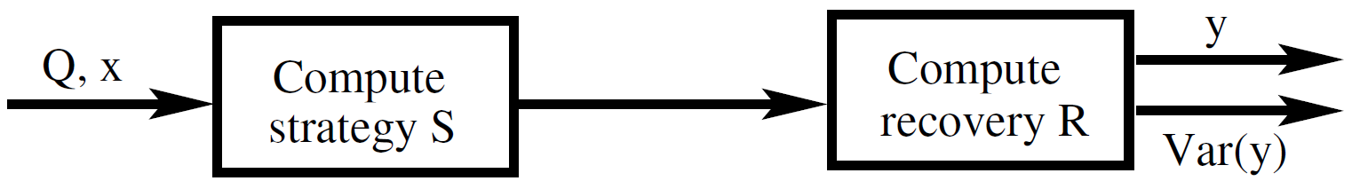
The Strategy/Recovery Approach
Pick a strategy matrix S
Compute z = Sx + v
Find R so that Q = RS
Return y = Rz = Qx + Rv as the set of answers
Accuracy given by var(y) = var(Rv)
Strategies used in prior work:
noise vector
strategy on data
Q: Query Matrix | F: Fourier Transform Matrix
I: Identity Matrix | H: Haar Wavelets
C: Selected Marginals | P: Random projections
Notes:
This approach can be expressed as follows.
We can pick a strategy matrix S and and compute z a private version of Sx by adding a noise vector v to it.
Then we reconstruct the answers to the original queries by multiplying z by a matrix R such that Q = RS.
Then the resulting answer is y = Qx + Rv.
The most common measure of accuracy is the variance of the resulting vector, which is in this case the variance of Rv.
This can be illustrated by the diagram below.
Finally, recall that we are looking to achieve three goals: privacy guarantee, utility and efficiency.
So far I’ve been talking about the first two. Note that efficiency is another reason to use the strategy-recovery approach if we pick such matrices S and R that it is faster to compute the answer in these two steps rather than multiplying directly by the matrix Q.
Examples of strategy matrices used in the previous work include:
-- Query matrix itself
-- Identity matrix, which corresponds to querying all the individual entries in the database..
-- Marginal queries, which are histograms computed on a small subset of attributes.
To speed up computation one can also use strategy matrices such as:
-- Discrete Fourier transform matrix
-- Haar Wavelets
-- Random projections to reduce the dimensionality of sparse data
However, when adding the noise vector v to the transformed data the previous work used uniform noise budgeting strategy which I described before, partitioning the epsilon-budget uniformly between the queries in the matrix S.

Slide 6
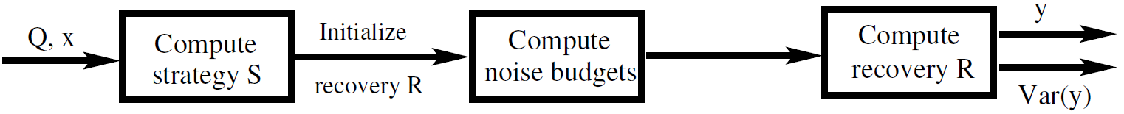
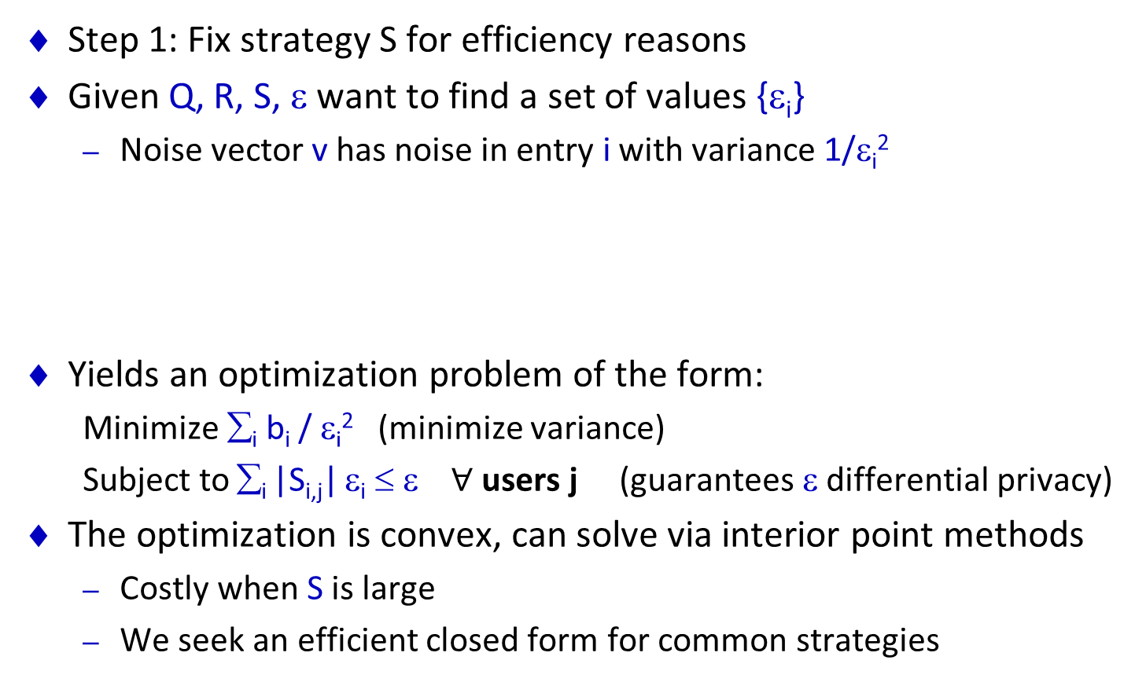
Step 2: Error Minimization
Step 1: Fix strategy S for efficiency reasons
Given Q, R, S, ε want to find a set of values {ε_{i}}
Noise vector v has noise in entry i with variance 1/ε_{i}²
Yields an optimization problem of the form:
Minimize ∑_{i} b_{i} / ε_{i}² (minimize variance)
Subject to ∑_{i} |S_{i,j}| ε_{i} ≤ ε $∀$ users j (guarantees ε differential privacy)
The optimization is convex, can solve via interior point methods
Costly when S is large
We seek an efficient closed form for common strategies
Notes:
In our work we modify the 2-step schema described before, introducing an extra step in between, which can be used to optimize noise allocation after selecting the strategy matrix.
So we fix the matrix S, for efficiency reasons (think of S as being the discrete Fourier transform).
We will be looking for the values of privacy budgets \epsilon_i, which will optimize the noise.
For each query in the matrix S it is sufficient to add noise with variance proportional to 1/epsilon_i^2 in order to guarantee \epsilon-differential privacy.
Formally, the optimization of values \epsilon_i can be expressed as follows.
For some fixed values b_i which only depend on the query matrix and the strategy matrix we will be looking to minimize the total variance --- the sum of b_i’s over epsilon_i^2. This is the noise optimization objective.
This should be done subject to the privacy constraint, which has the form that a linear combination of \epsilon_i’s should be at most the overall privacy budget \epsilon.
This gives a convex optimization problem (which can be expressed as a rank-constrained SDP) and can be solved using interior-point methods. However, if S is large then this approach becomes computationally inefficient.
In our work we’ve been looking for more efficient approaches for some common strategy matrices.
In fact, we’ve been able to obtain closed form solutions for the magnitude of noise for some common strategies and query workloads.

Slide 7
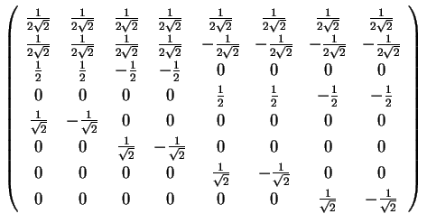
Grouping Approach
We observe that many strategies S can be broken into groups that behave in a symmetrical way
Sets of non-zero entries of rows in the group are pairwise disjoint
Non-zero values in group i have same magnitude C_{i}
Many common strategies meet this grouping condition
Identity (I), Fourier (F), Marginals (C), Projections (P), Wavelets (H)
Simplifies the optimization:
A single constraint over the ε_{i}’s
New constraint: ∑_{Groups i} C_{i} ε_{i} = ε
Closed form solution via Lagrangian
Notes:
Our key observation is that many commonly used strategy matrices have a certain symmetry.
They can be partitioned into groups, which have a CERTAIN PROPERTY.
All common strategy matrices (except for the original query matrix) sattisfy this condition.
It is helpful for us because it allows to replace all the inequalities in the original convex program with a single contraint that a linear combination of \epsilon_i’s should be equal to \epsilon.
Now a closed form solution to the resulting optimization problem can be given using Lagrange method.
We computed such closed form solution explicitly in the paper, where we give bounds on noise for a workload of all k-way marginals. This gives an asymptotic improvement over the previous work which analyzed uniform noise addition with Fourier strategy matrix [Barak et al.].

Slide 8
Step 3: Optimal Recovery Matrix
Given Q, S, {ε_{i}}, find R so that Q=RS
Minimize the variance Var(Rz) = Var(RSx + Rv) = Var(Rv)
Find an optimal solution by adapting Least Squares method
This finds x’ as an estimate of x given z = Sx + v
Define Σ = Cov(z) = diag(2/ε_{i}²) and U = Σ^{-1/2} S
OLS solution is x’ = (U^{T} U)⁻¹ U^{T} Σ^{-1/2} z
Then R = Q(S^{T} Σ⁻¹ S)⁻¹ S^{T} Σ⁻¹
Result: y = Rz = Qx’ is consistent—corresponds to queries on x’
R minimizes the variance
Special case: S is orthonormal basis (S^{T} = S⁻¹) then R=QS^{T}
Notes:
Finally, in order to reconstruct answers to the original queries Q we need to compute the recovery matrix.
If S is invertible then all we need to do is to multiply by an inverse S^{-1}.
However, in general, this might not be the case and then we look for R which minimizes the variance of the resulting noise.
This can be done using the Least Squares method.
We are looking to find a vector x’ which is the
If we define the covariance matrix of z, which is a diagonal matrix with entries proportional to 1/\epsilon_i^2 then the OLS solution can be given as follows.
So the resulting reconstruction matrix has the form.
In the special case when S is an orthonormal basis the reconstruction matrix has a particularly simple form.

Slide 9
Experimental Study
Used two real data sets:
ADULT data – census data on 32K individuals (7 attributes)
NLTCS data– binary data on 21K individuals (16 attribues)
Tried a variety of query workloads Q over these
Based on low-order k-way marginals (1-3-way)
Compared the original and optimized strategies for:
Original queries, Q/Q⁺
Fourier strategy F/F⁺ [Barak et al. 07]
Clustered sets of marginals C/C⁺ [Ding et al. 11]
Identity basis I
Notes:
We analyzed the performance of our algorithms on two datasets, which are commonly used benchmarks for aggregate private data release.
The first one is denoted as ADULT and contains census data about 32K individuals.
Each record has 7 attributes, taking multiple different values (at most 15).
The second one is the National Long Term Case Survey, which has information about 21K individuals.
We tried a variety of different workloads corresponding to low-order marginals (1-3 way, all of them and some mixtures).
This is a typical query workload generated by statisticians in order to fit statistical models to the data.
In the experiments we compared performance of the strategy/recovery approach with and without optimizing the noise budgeting for different choices of the strategy matrices.
We denote the non-optimized version by the corresponding strategy matrix and the optimized version by this matrix with a plus.

Slide 10
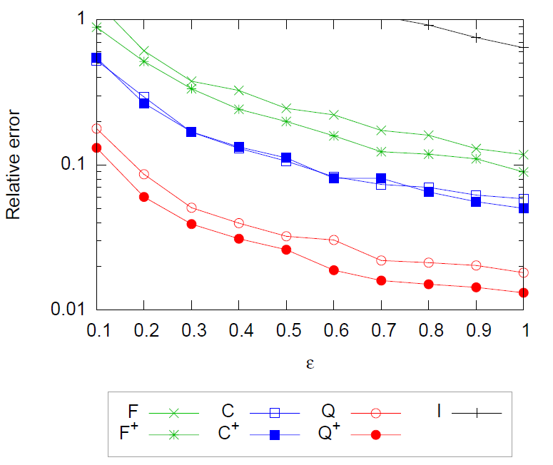
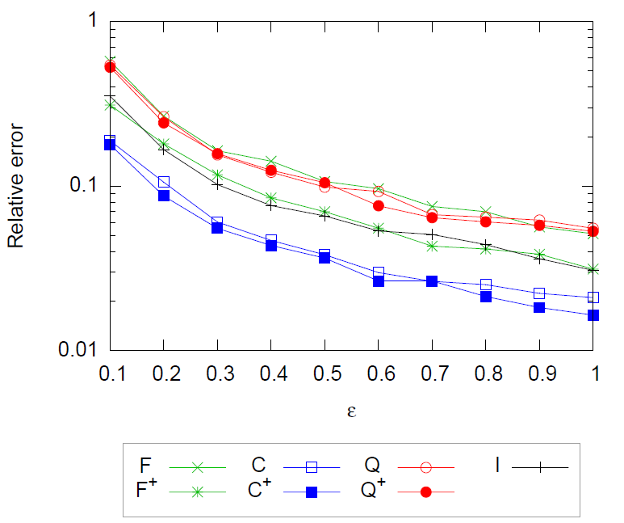
Experimental Results
ADULT, 1- and 2-way marginals
NLTCS, 2- and 3-way marginals
Optimized error gives constant factor improvement
Time cost for the optimization is negligible on this data
Notes:
We have results for ADULT on 1-2 way marginals and for NLTCS on 2-3 way marginals.
The horizontal shows the value of the privacy parameter \epsilon (between point 1 and 1).
This uses linear scale.
The vertical axis shows relative error introduced by the algorithms averaged over multiple executions.
This uses logarithmic scale.
On the plots we compare optimized and non-optimized performance of the strategies.
As the results show the optimization consistently yields and improvement.
In particular, the best strategy, which for the ADULT dataset is releasing the queries directly and for the NLTCS data corresponds to the clustering strategy of Ding et al. always benefits from adding a noise optimization step.
For the ADULT dataset we obtain a 35-50% improvement and for NLTCS we get 10-15% improvement.
We give the experimental results on the running times in the paper, but the key point is that as compared to all the other steps the optimization of noise budgeting takes negligible time.

Slide 11
Overall Process
Ideal version: given query matrix Q, compute strategy S, recovery R and noise budget {ε_{i}} to minimize Var(y)
Not practical: sets up a rank-constrained SDP [Li et al., PODS’10]
Follow the 3-step process instead
Fix S
Given query matrix Q, strategy S, compute optimal noise budgets {ε_{i}} to minimize Var(y)
Given query matrix Q, strategy S and noise budgets {ε_{i}}, compute new recovery matrix R to minimize Var(y)
Notes:
Let’s do a recap.
Ideally, the Strategy/Recovery framework could be implemented as follows.
Given Q, we would with to compute an optimum strategy matrix S and recovery R together with \epsilon_i’s in order to minimize the variance.
However, this is not practical, since it requires setting up a rank-constrained SDP.
This approach was studied by Li et al.
We suggest to use a 3-step process instead.

Slide 12
Advantages
Best on datasets with many individuals (no dependence on how many)
Best on large datasets (for small datasets, use [Li et al.])
Best realtively small query workloads (for large query workloads, use multiplicative weights [Hardt, Ligett Mcsherry’12])
Fairly fast (matrix multiplications and inversions)
Faster when S is e.g. Fourier, since can use FFT
Adds negligible computational overhead to the computation of queries themselves

