Slide 1


Property Testing and Communication Complexity
Grigory Yaroslavtsev
http://grigory.us

Slide 2
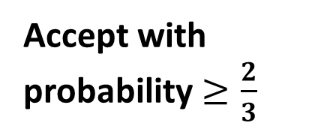
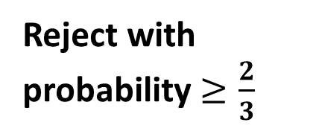

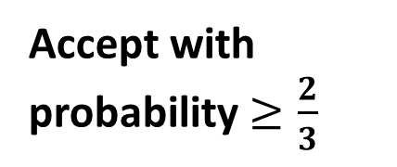
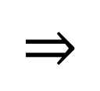
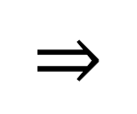
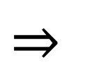
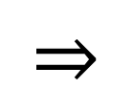
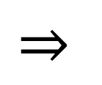
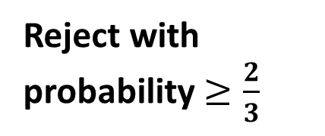
Property Testing [Goldreich, Goldwasser, Ron, Rubinfeld, Sudan]
Randomized algorithm
Property tester
YES
YES
$$⇒$$
Accept with probability $≥\frac{2}{3}$
$$⇒$$
Accept with probability $≥\frac{2}{3}$
$$⇒$$
Don’t care
No
$ε$-far
No
$$⇒$$
Reject with probability $≥\frac{2}{3}$
$$⇒$$
Reject with probability $≥\frac{2}{3}$
$ε$-far : $≥ε$fraction has to be changed to become YES

Slide 3
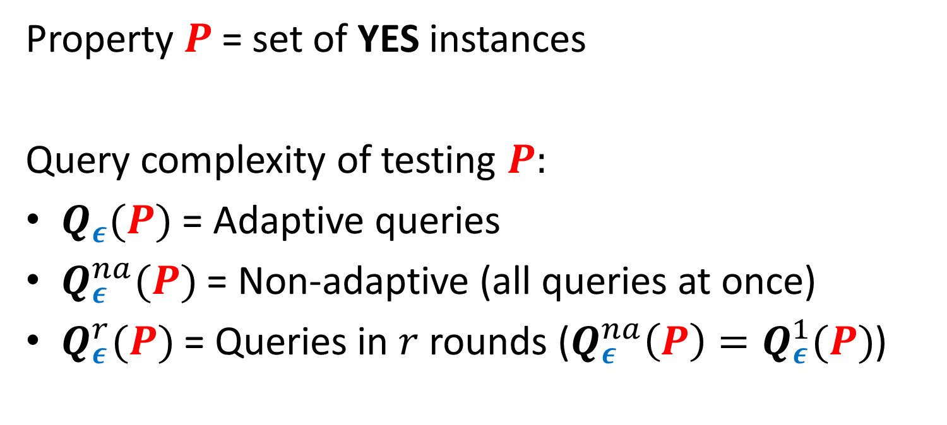
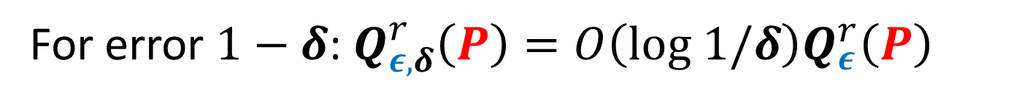
Property Testing [Goldreich, Goldwasser, Ron, Rubinfeld, Sudan]
Property $P$= set of YES instances
Query complexity of testing $P:$
$Q_{ε}(P)$ = Adaptive queries
$Q_{ε}^{na}(P)$ = Non-adaptive (all queries at once)
$Q_{ε}^{r}(P)$ = Queries in $r$ rounds ($Q_{ε}^{na}\left(P\right)=Q_{ε}^{1}(P)$)
For error $1−δ$: $Q_{ε,δ}^{r}\left(P\right)=O\left(log 1/δ\right)Q_{ε}^{r}\left(P\right)$

Slide 4

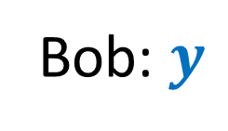

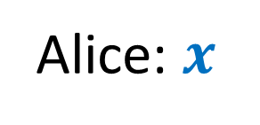



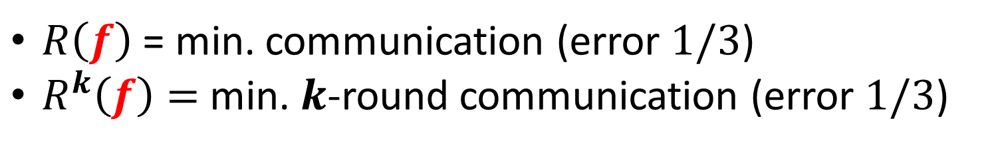
Communication Complexity [Yao’79]
Shared randomness
$M_{1}(x)$
$M_{2}(M_{1}, y)$
$$f(x,y)=?$$
$M_{3}(M_{2}, x)$
…
Alice: $x$
Bob: $y$
$$f(x,y)$$
$R\left(f\right)$ = min. communication (error $1/3$)
$R^{k}\left(f\right)=$ min. $k$-round communication (error $1/3$)

Slide 5

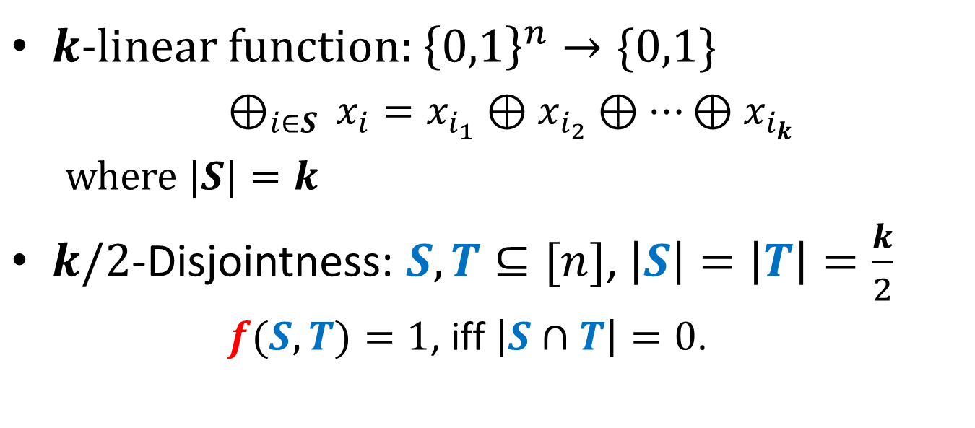
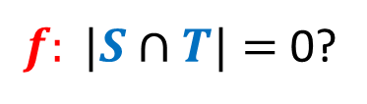
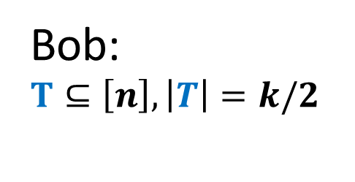
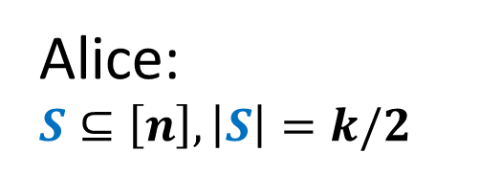
$k$/2-disjointness $⇒k$-linearity [Blais, Brody,Matulef’11]
$k$-linear function: ${\left\{0,1\right\}}^{n}→\{0,1\}$
$⊕_{i∈S }x_{i}=x_{i_{1}}⊕x_{i_{2}}⊕…⊕x_{i_{k}}$
where $|S|=k$
$k/2$-Disjointness: $S,T⊆[n]$, $\left|S\right|=\left|T\right|=\frac{k}{2}$
$f(S,T)=1$, iff $\left|S∩T\right|=0$.
$f: |S∩T|=$ 0?
Alice: $S⊆\left[n\right], \left|S\right|=k/2$
Bob:
$$T⊆\left[n\right], \left|T\right|=k/2$$

Slide 6

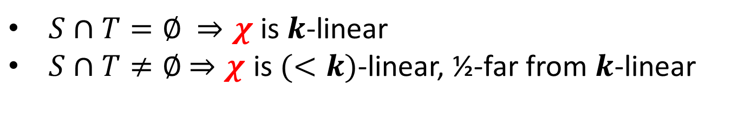





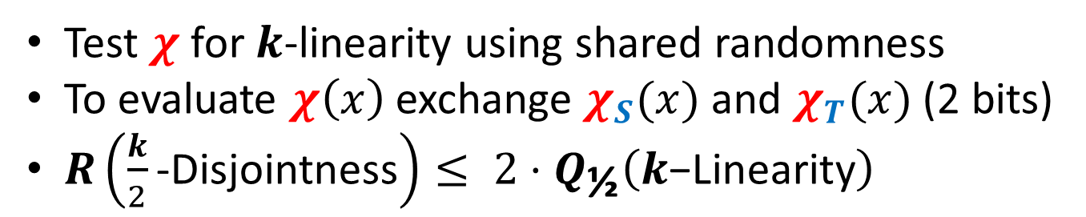
$k$/2-disjointness $⇒k$-linearity [Blais, Brody,Matulef’11]
$${χ= χ}_{S}⊕χ_{T}$$
$$S⊆\left[n\right], \left|S\right|=k/2$$
$$T⊆\left[n\right], \left|T\right|=k/2$$
$$χ_{S}=⊕_{i∈S }x_{i}$$
$$χ_{T}=⊕_{i∈T }x_{i}$$
$S∩T=∅$ $⇒χ$ is $k$-linear
$S∩T≠∅$ $⇒χ$ is $(<k)$-linear, ½-far from $k$-linear
Test $χ$ for $k$-linearity using shared randomness
To evaluate $χ\left(x\right)$ exchange $χ_{S}(x)$ and $χ_{T}(x)$ (2 bits)
$R\left(\frac{k}{2}\text{−}\text{Disjointness}\right)≤ 2⋅Q_{\text{½}}\left(k\text{−}\text{Linearity}\right)$

Slide 7

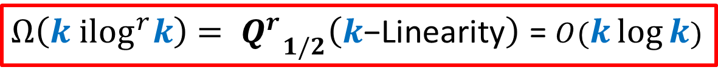

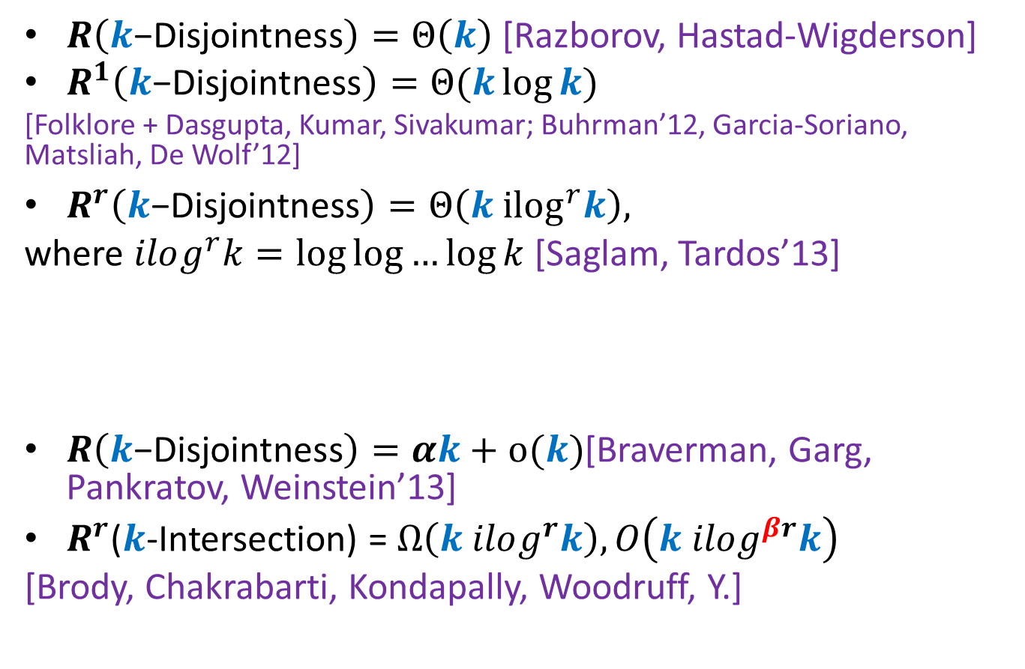
$k$-Disjointness
$R\left(k\text{−}\text{Disjointness}\right)=Θ\left(k\right)$[Razborov, Hastad-Wigderson]
$R^{1}\left(k\text{−}\text{Disjointness}\right)=Θ(k\log{k})$
[Folklore + Dasgupta, Kumar, Sivakumar; Buhrman’12, Garcia-Soriano, Matsliah, De Wolf’12]
$R^{r}\left(k\text{−}\text{Disjointness}\right)=Θ\left(k {ilog}^{r}k\right),$
where $ilog^{r}k=\log{\log{…{\log{k}}}}$ [Saglam, Tardos’13]
$R\left(k\text{−}\text{Disjointness}\right)=αk+o(k)$[Braverman, Garg, Pankratov, Weinstein’13]
$R^{r}$($k$-Intersection) = $Ω\left(k ilog^{r}k\right), O\left(k ilog^{βr}k\right)$
[Brody, Chakrabarti, Kondapally, Woodruff, Y.]
{
$r$ times
$Ω\left(k {ilog}^{r}k\right)$ $= {Q^{r}}_{1/2}^{}\left(k\text{−}\text{Linearity}\right)$ = $O(k\log{k})$
Notes:
State k-linearity as an open problem

Slide 8
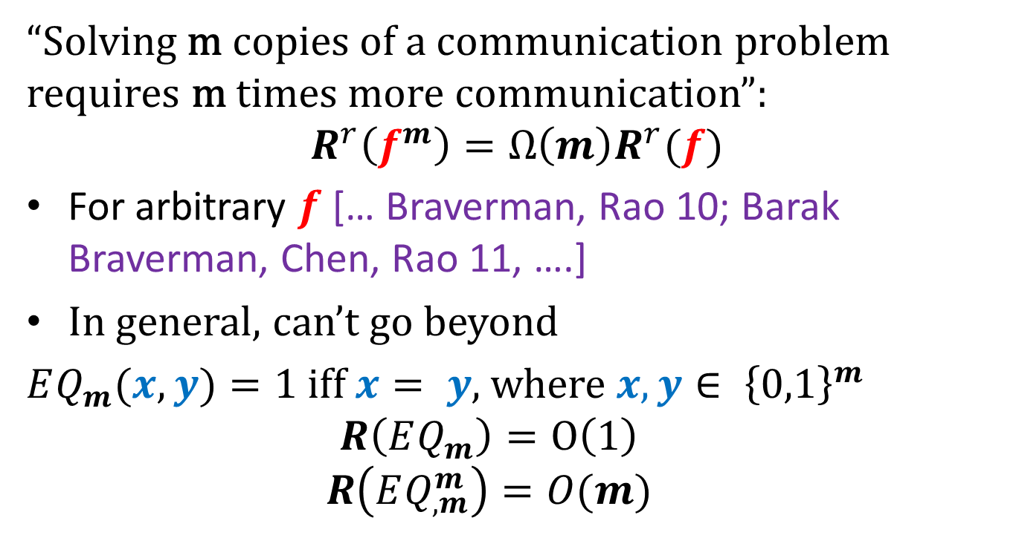
Communication Direct Sums
“Solving m copies of a communication problem requires m times more communication”:
$$R^{r}\left(f^{m}\right)=Ω\left(m\right)R^{r}(f)$$
For arbitrary $f$ [… Braverman, Rao 10; Barak Braverman, Chen, Rao 11, ….]
In general, can’t go beyond
$EQ_{m}(x,y)=1$ iff $x= y$, where $x,y∈ {\left\{0,1\right\}}^{m}$
$$R\left(EQ_{m}^{}\right)=O\left(1\right)$$
$$R\left(EQ_{,m}^{m}\right)=O(m)$$

Slide 9
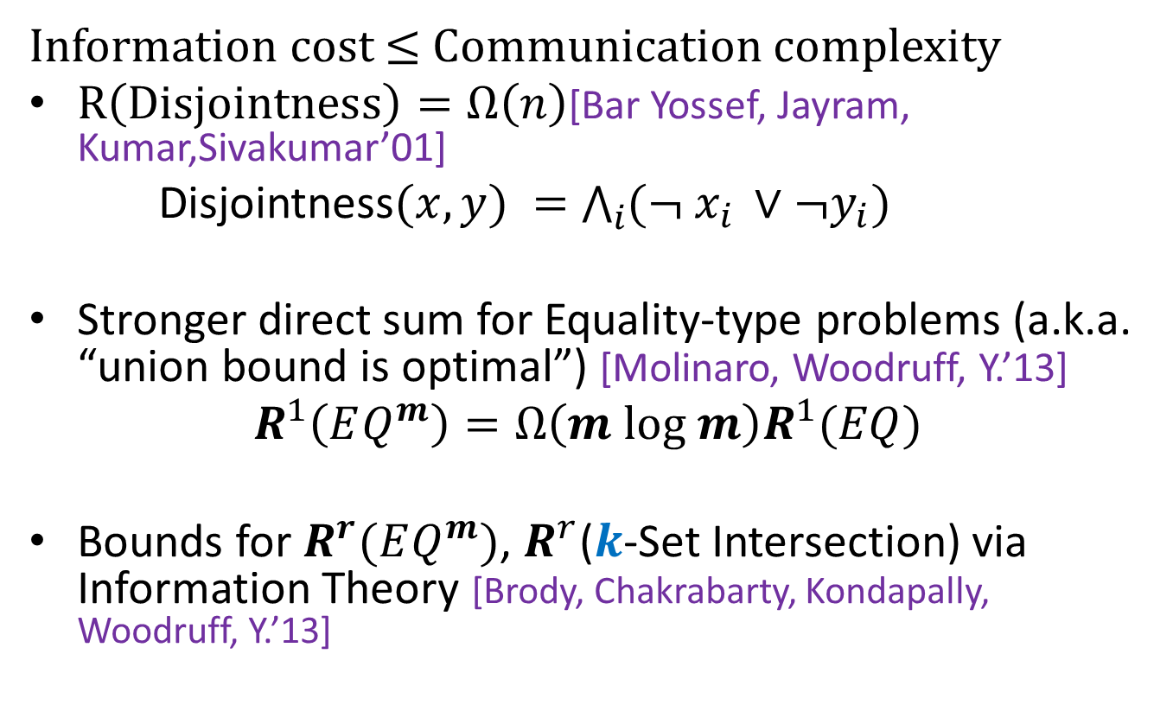
Specialized Communication Direct Sums
Information cost $≤$ Communication complexity
$R\left(Disjointness\right)=Ω\left(n\right)$[Bar Yossef, Jayram, Kumar,Sivakumar’01]
Disjointness$(x,y) =$ $\bigwedge_{i}{({¬ x}_{i }∨¬y_{i})}$
Stronger direct sum for Equality-type problems (a.k.a. “union bound is optimal”) [Molinaro, Woodruff, Y.’13]
$$R^{1}\left(EQ^{m}\right)=Ω\left(m log m\right)R^{1}(EQ)$$
Bounds for $R^{r}(EQ^{m})$, $R^{r}$($k$-Set Intersection) via Information Theory [Brody, Chakrabarty, Kondapally, Woodruff, Y.’13]

Slide 10

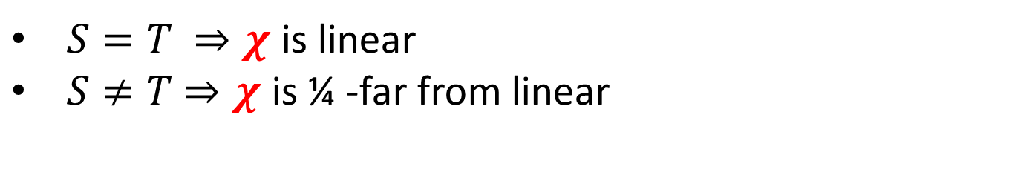

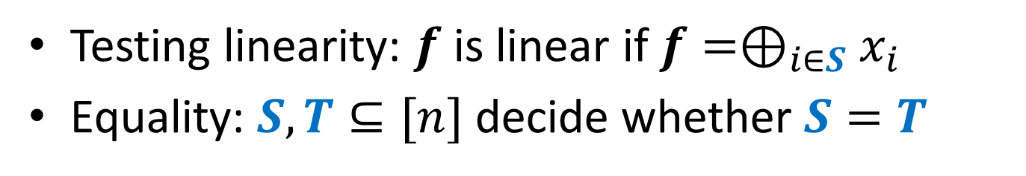



Direct Sums in Property Testing [Woodruff, Y.]
Testing linearity: $f$ is linear if $f=⊕_{i∈S}x_{i}$
Equality: $S,T⊆[n]$ decide whether $S=T$
$${χ= χ}_{S}⊕χ_{T}$$
$$S⊆\left[n\right]$$
$$T⊆\left[n\right]$$
$$χ_{S}=⊕_{i∈S }(x_{2i−1}∧x_{2i})$$
$$χ_{T}=⊕_{i∈T }(x_{2i−1}∧x_{2i})$$
$S=T$ $⇒χ$ is linear
$S≠T$ $⇒χ$ is ¼ -far from linear

Slide 11
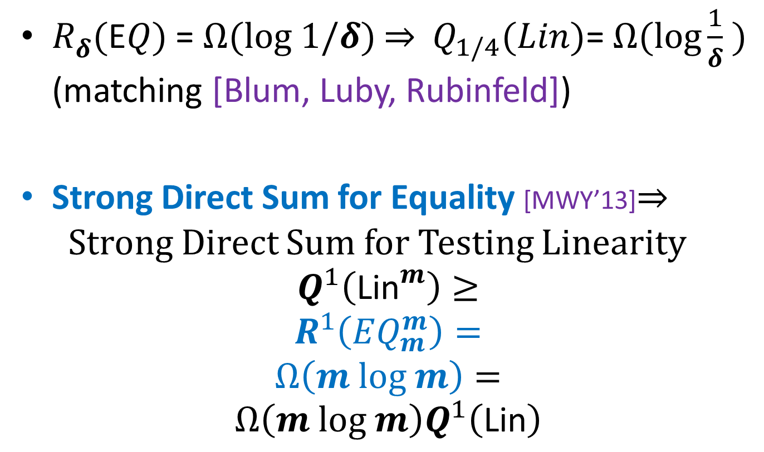
Direct Sums in Property Testing [Woodruff, Y.]
$R_{δ}^{}(\text{E}Q)$ = $Ω(log 1/δ)$ $⇒$ $Q_{1/4}(Lin)$= $Ω(\log{\frac{1}{δ}} )$ (matching [Blum, Luby, Rubinfeld])
Strong Direct Sum for Equality [MWY’13]$⇒$Strong Direct Sum for Testing Linearity
$$Q^{1}\left({\text{Lin}}^{m}\right)≥$$
$$R^{1}\left(EQ_{m}^{m}\right)=$$
$$Ω\left(m log m\right)=$$
$$Ω\left(m log m\right)Q^{1}\left(\text{Lin}\right)$$

Slide 12
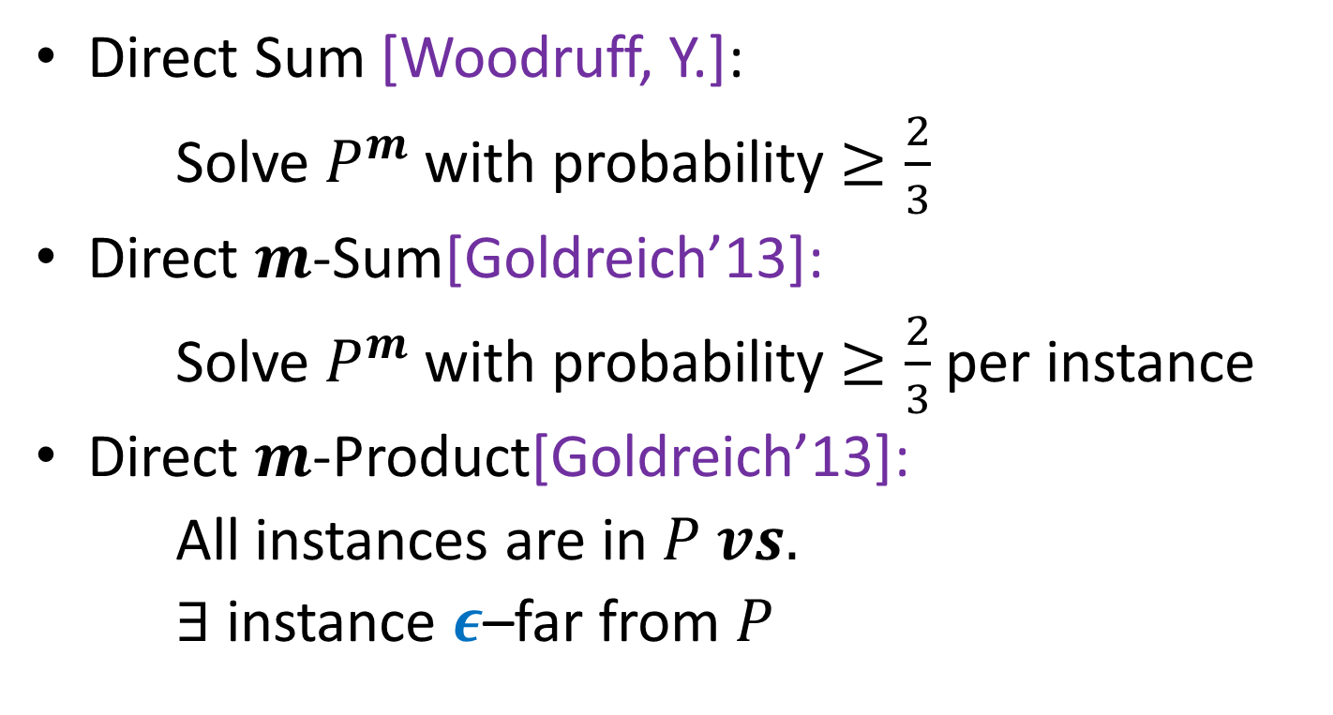
Property Testing Direct Sums [Goldreich’13]
Direct Sum [Woodruff, Y.]:
Solve $P^{m}$ with probability $≥\frac{2}{3}$
Direct $m$-Sum[Goldreich’13]:
Solve $P^{m}$ with probability $≥\frac{2}{3}$ per instance
Direct $m$-Product[Goldreich’13]:
All instances are in $P vs.$
$∃$ instance $ε$–far from $P$

Slide 13
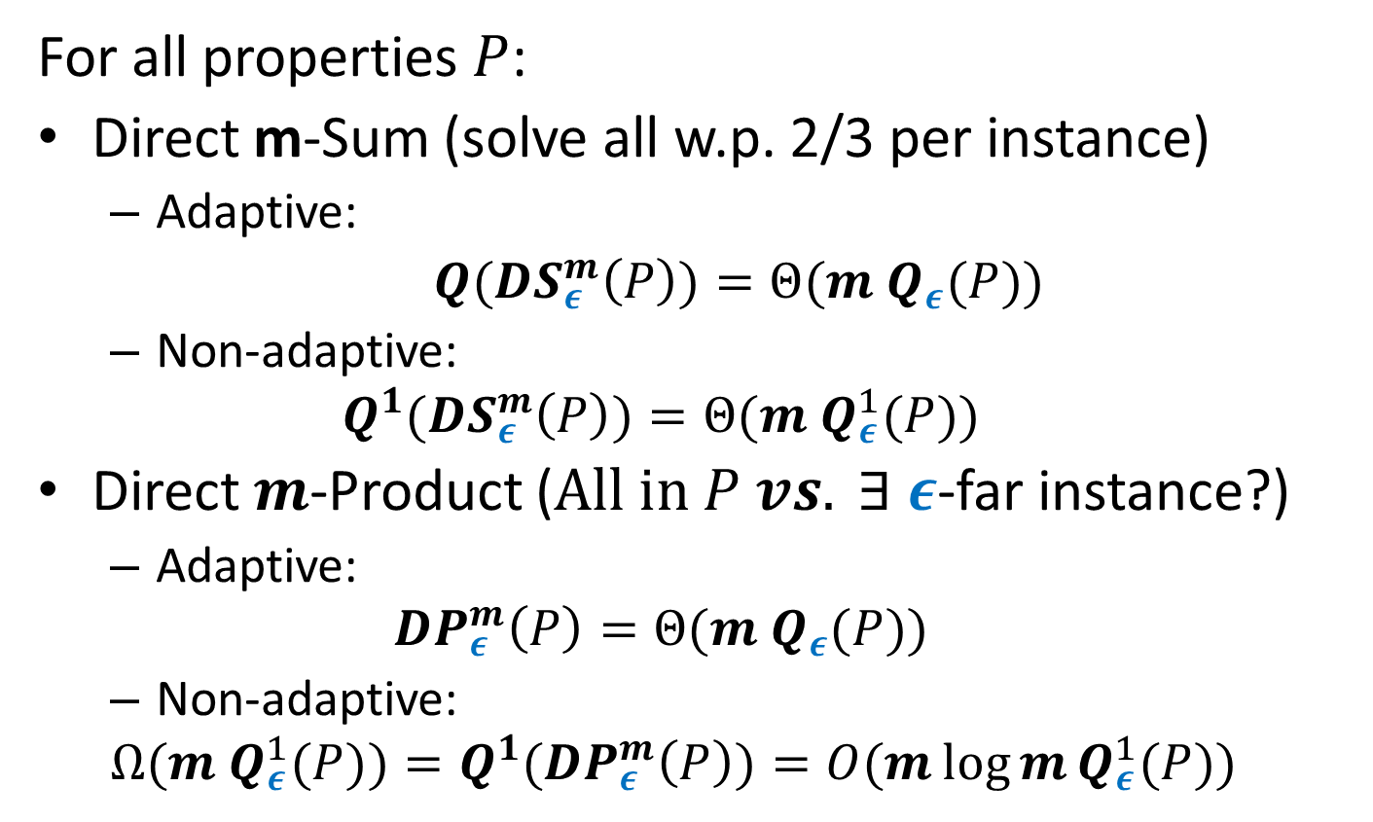
[Goldreich ‘13]
For all properties $P$:
Direct m-Sum (solve all w.p. 2/3 per instance)
Adaptive:
${Q(DS}_{ε}^{m}\left(P\right))=Θ(m Q_{ε}(P))$
Non-adaptive:
$${Q^{1}(DS}_{ε}^{m}\left(P\right))=Θ(m Q_{ε}^{1}(P))$$
Direct $m$-Product ($All in P vs. ∃ ε$-far instance?)
Adaptive:
$${DP}_{ε}^{m}\left(P\right)=Θ(m Q_{ε}(P))$$
Non-adaptive:
$$Ω(m Q_{ε}^{1}(P))={Q^{1}(DP}_{ε}^{m}\left(P\right))=O(m\log{m}Q_{ε}^{1}(P))$$

Slide 14
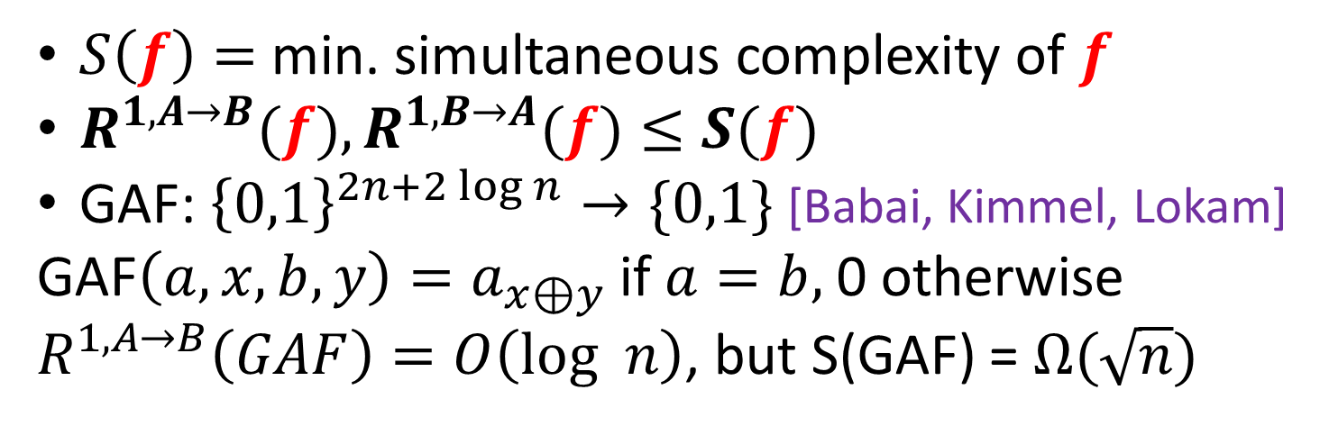


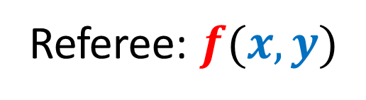
Reduction from Simultaneous Communication [Woodruff]
$M_{A}(x)$
$M_{B}(y)$
Alice: $x$
Referee: $f(x,y)$
Bob: $y$
$S\left(f\right)=$ min. simultaneous complexity of $f$
$R^{1,A→B}(f),R^{1,B→A}(f)≤S(f)$
GAF: ${\left\{0,1\right\}}^{2n+2\log{n}}→\{0,1\}$ [Babai, Kimmel, Lokam]
GAF$\left(a,x,b,y\right)=a_{x⊕y}$ if $a=b,$0 otherwise
$R^{1,A→B}\left(GAF\right)=O\left(log n\right)$, but S(GAF) = $Ω(\sqrt{n})$

Slide 15
Property testing lower bounds via CC
Monotonicity, Juntas, Low Fourier degree, Small Decision Trees [Blais, Brody, Matulef’11]
Small-width OBDD properties [Brody, Matulef, Wu’11]
Lipschitz property [Jha, Raskhodnikova’11]
Codes [Goldreich’13, Gur, Rothblum’13]
Number of relevant variables [Ron, Tsur’13]
All functions are over Boolean hypercube

Slide 16
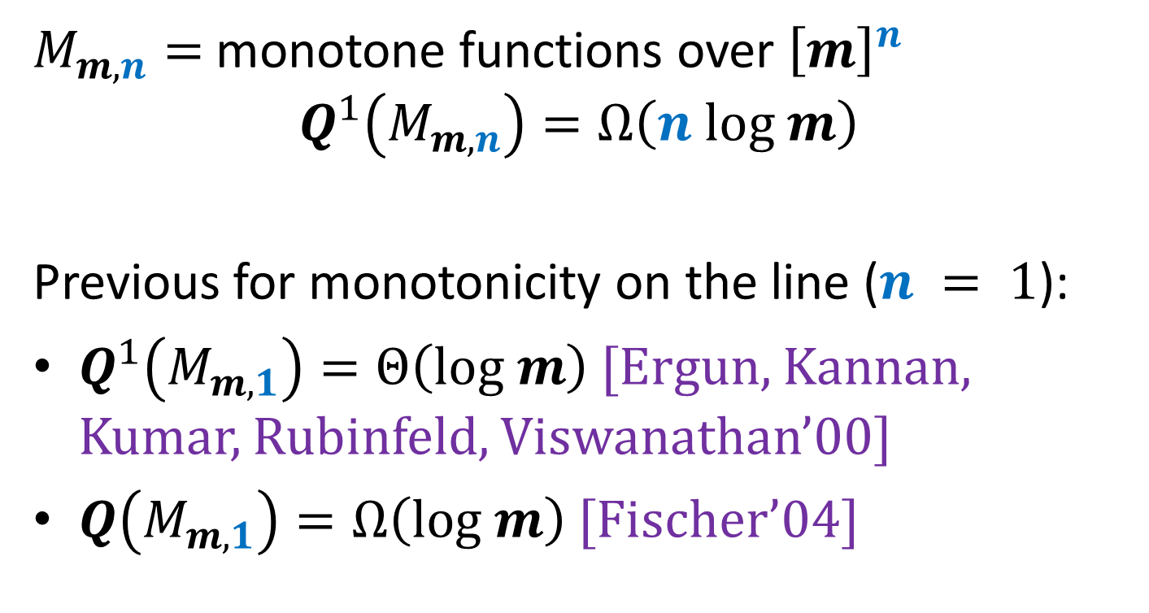
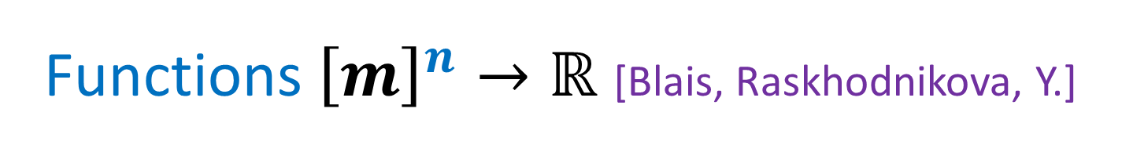
Functions ${\left[m\right]}^{n}→ℝ$ [Blais, Raskhodnikova, Y.]
$M_{m,n}=$ monotone functions over ${\left[m\right]}^{n}$
$$Q^{1}\left(M_{m,n}\right)=Ω\left(n log m\right)$$
Previous for monotonicity on the line ($n = 1$):
$Q^{1}\left(M_{m,1}\right)=Θ\left(log m\right)$ [Ergun, Kannan, Kumar, Rubinfeld, Viswanathan’00]
$Q\left(M_{m,1}\right)=Ω\left(log m\right)$ [Fischer’04]

Slide 17
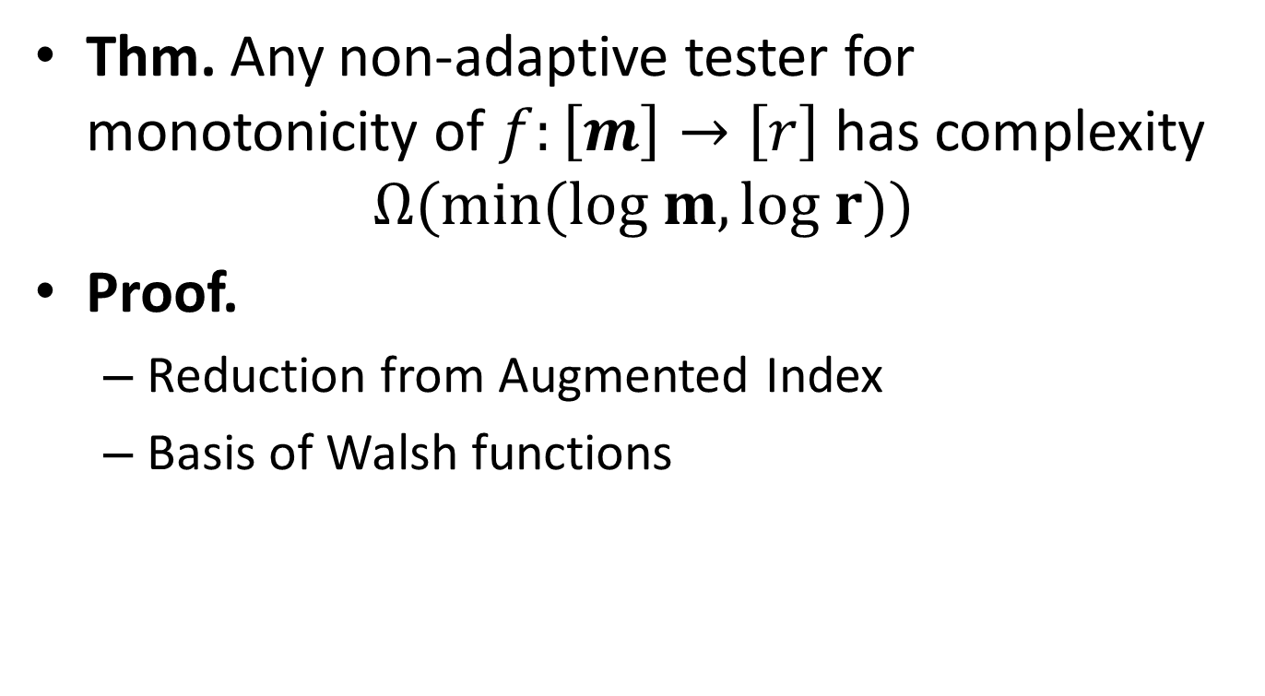

Functions ${\left[m\right]}^{n}→ℝ$ [Blais, Raskhodnikova, Y.]
Thm. Any non-adaptive tester for monotonicity of $f:\left[m\right]→\left[r\right]$ has complexity
$$Ω(min(log m, log r))$$
Proof.
Reduction from Augmented Index
Basis of Walsh functions

Slide 18




Functions ${\left[m\right]}^{n}→ℝ$ [Blais, Raskhodnikova, Y.]
Augmented Index: S, ($i, S∩[i−1]$)
$R^{1}\left[\text{Augmented} \text{Index}\right]=Ω(m)$ [Miltersen, Nisan, Safra, Wigderson, 98]
$M_{1}(S)$
$$S⊆\left[m\right]$$
$$i∈\left[m\right], S∩[i−1]$$

Slide 19



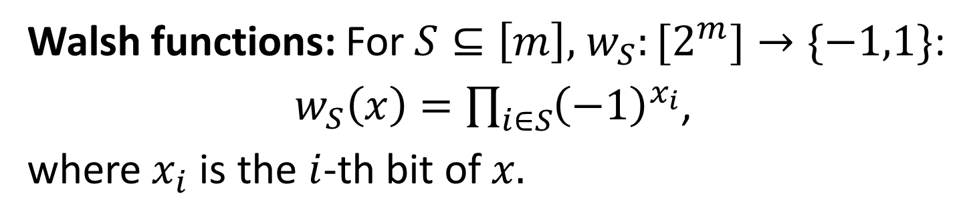




Functions ${\left[m\right]}^{n}→ℝ$ [Blais, Raskhodnikova, Y.]
Walsh functions: For $S⊆\left[m\right],$ $w_{S}:{[2}^{m}]→\{−1,1\}$:
$w_{S}\left(x\right)=\prod_{i∈S}{{\left(−1\right)}^{x_{i}}}$,
where $x_{i}$ is the $i$-th bit of $x.$
$$w_{\left\{1\right\}}=$$
$$x$$
$$w_{\left\{2\right\}}=$$
…
$$x$$
$$w_{\left\{4\right\}}=$$
$$x$$

Slide 20



Functions ${\left[m\right]}^{n}→ℝ$ [Blais, Raskhodnikova, Y.]
Step functions: For $i∈\left[m\right], step_{i}$: $\left[2^{m}\right]→\left[2^{m−i} \right]:$
$$step_{i}\left(x\right)=⌈x/2^{i}⌉$$
$$step_{2}=$$
$$x$$

Slide 21

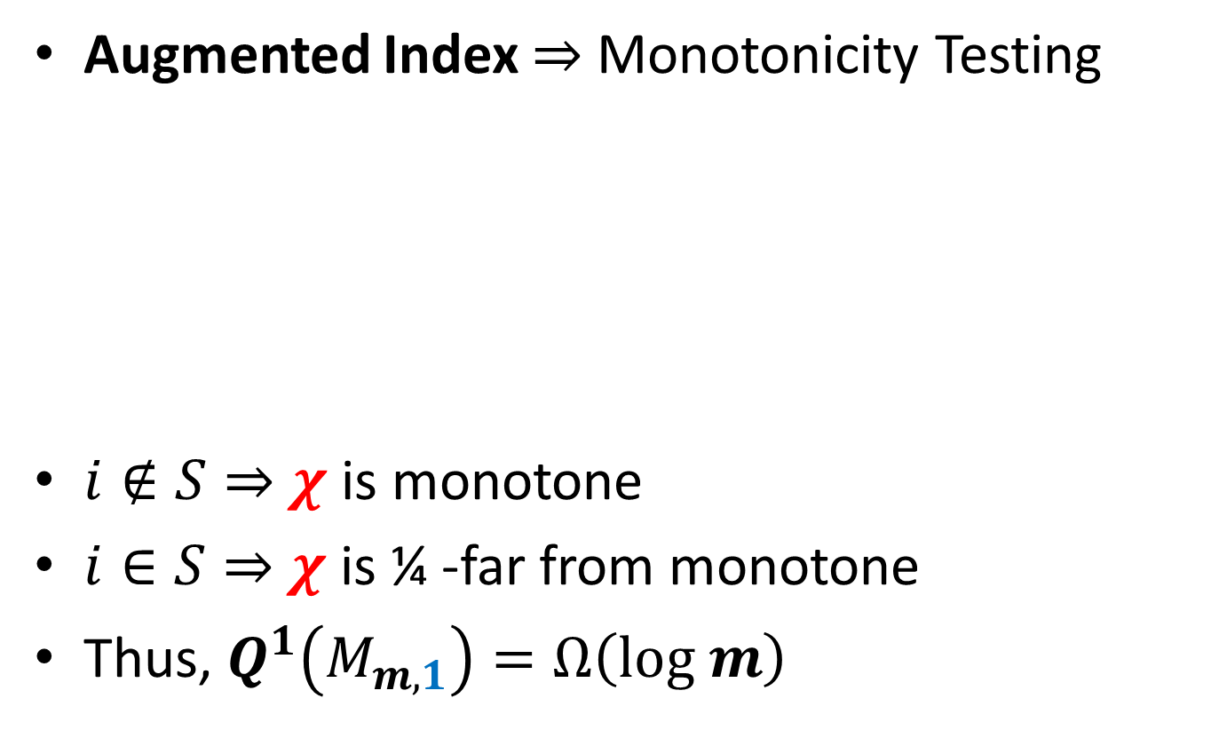



Functions ${\left[m\right]}^{n}→ℝ$ [Blais, Raskhodnikova, Y.]
Augmented Index $⇒$ Monotonicity Testing
$i∉S⇒$ $χ$ is monotone
$i∈S⇒$ $χ$ is ¼ -far from monotone
Thus, $Q^{1}\left(M_{m,1}\right)=Ω\left(log m\right)$
$χ=2 step_{i}+w_{S∩[i−1, …,m]}$
$$S⊆\left[m\right]$$
$$i∈\left[m\right], S∩[i−1]$$

Slide 22
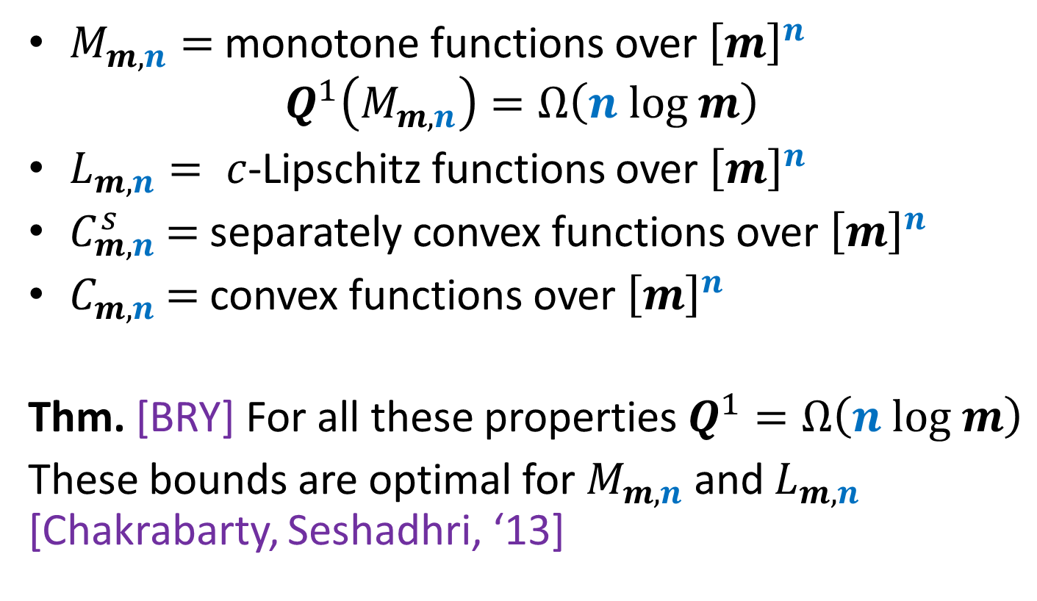
Functions ${\left[m\right]}^{n}→ℝ$ [Blais, Raskhodnikova, Y.]
$M_{m,n}=$ monotone functions over ${\left[m\right]}^{n}$
$$Q^{1}\left(M_{m,n}\right)=Ω\left(n log m\right)$$
$L_{m,n}= c$-Lipschitz functions over ${\left[m\right]}^{n}$
$C_{m,n}^{s}$ $=$separately convex functions over ${\left[m\right]}^{n}$
$C_{m,n}^{}$ $=$convex functions over ${\left[m\right]}^{n}$
Thm. [BRY] For all these properties $Q^{1}=Ω\left(n log m\right)$
These bounds are optimal for $M_{m,n}$ and $L_{m,n}$ [Chakrabarty, Seshadhri, ‘13]

Slide 23
Thank you!

