Slide 1
Sketching as a Tool for Numerical Linear Algebra
David Woodruff
IBM Almaden

Slide 2
Massive data sets
Examples
Internet traffic logs
Financial data
etc.
Algorithms
Want nearly linear time or less
Usually at the cost of a randomized approximation
Notes:
LHCb: 4 Tbyte/second

Slide 3
Regression analysis
Regression
Statistical method to study dependencies between variables in the presence of noise.

Slide 4
Regression analysis
Linear Regression
Statistical method to study linear dependencies between variables in the presence of noise.

Slide 5
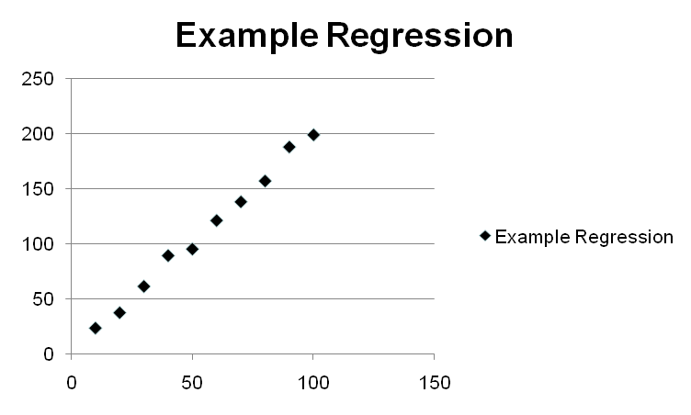
Regression analysis
Linear Regression
Statistical method to study linear dependencies between variables in the presence of noise.
Example
Ohm's law V = R ∙ I

Slide 6
Regression analysis
Linear Regression
Statistical method to study linear dependencies between variables in the presence of noise.
Example
Ohm's law V = R ∙ I
Find linear function that
best fits the data

Slide 7
Regression analysis
Linear Regression
Statistical method to study linear dependencies between variables in the presence of noise.
Standard Setting
One measured variable b
A set of predictor variables a ,…, a
Assumption:
b = x + a x + … + a x + ε
ε is assumed to be noise and the x_{i} are model parameters we want to learn
Can assume x₀ = 0
Now consider n observations of b
1
d
0
1
1
d
d

Slide 8
Regression analysis
Matrix form
Input: n×d-matrix A and a vector b=(b₁,…, b_{n})
n is the number of observations; d is the number of predictor variables
Output: x* so that Ax* and b are close
Consider the over-constrained case, when n À d
Can assume that A has full column rank

Slide 9
Regression analysis
Least Squares Method
Find x* that minimizes |Ax-b|₂² = Σ (b_{i} – <A_{i*}, x>)²
A_{i*} is i-th row of A
Certain desirable statistical properties
Method of least absolute deviation (l₁ -regression)
Find x* that minimizes |Ax-b|₁ = Σ |b_{i} – <A_{i*}, x>|
Cost is less sensitive to outliers than least squares

Slide 10
Regression analysis
Geometry of regression
We want to find an x that minimizes |Ax-b|_{p}
The product Ax can be written as
A_{*1}x₁ + A_{*2}x₂ + ... + A_{*d}x_{d}
where A_{*i} is the i-th column of A
This is a linear d-dimensional subspace
The problem is equivalent to computing the point of the column space of A nearest to b in l_{p}-norm

Slide 11
Regression analysis
Solving least squares regression via the normal equations
How to find the solution x to min_{x} |Ax-b|₂ ?
Normal Equations: A^{T}Ax = A^{T}b
x = (A^{T}A)⁻¹ A^{T} b

Slide 12
Regression analysis
Solving l₁ -regression via linear programming
Minimize (1,…,1) ∙ (α + α )
Subject to:
A x + α − α = b
α , α ≥ 0
Generic linear programming gives poly(nd) time
+
-
+
-
+
-

Slide 13
Talk Outline
Sketching to speed up Least Squares Regression
Sketching to speed up Least Absolute Deviation (l₁) Regression
Sketching to speed up Low Rank Approximation

Slide 14
Sketching to solve least squares regression
How to find an approximate solution x to min_{x} |Ax-b|₂ ?
Goal: output x‘ for which |Ax‘-b|₂ · (1+ε) min_{x} |Ax-b|₂ with high probability
Draw S from a k x n random family of matrices, for a value k << n
Compute S*A and S*b
Output the solution x‘ to min_{x‘} |(SA)x-(Sb)|₂

Slide 15
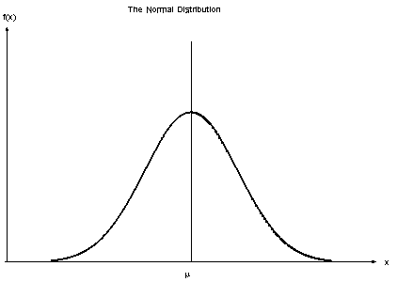
How to choose the right sketching matrix S?
Recall: output the solution x‘ to min_{x‘} |(SA)x-(Sb)|₂
Lots of matrices work
S is d/ε² x n matrix of i.i.d. Normal random variables
Computing S*A may be slow…

Slide 16
How to choose the right sketching matrix S? [S]
S is a Johnson Lindenstrauss Transform
  S = P*H*D
  D is a diagonal matrix with +1, -1 on diagonals
  H is the Hadamard transform
  P just chooses a random (small) subset of rows of H*D
  S*A can be computed much faster

Slide 17
Even faster sketching matrices [CW,MM,NN]
CountSketch matrix
Define k x n matrix S, for k = d²/ε²
S is really sparse: single randomly chosen non-zero entry per column
[
[
0 0 1 0 0 1 0 0
1 0 0 0 0 0 0 0
0 0 0 -1 1 0 -1 0
0-1 0 0 0 0 0 1
Surprisingly,
this works!

Slide 18
Talk Outline
Sketching to speed up Least Squares Regression
Sketching to speed up Least Absolute Deviation (l₁) Regression
Sketching to speed up Low Rank Approximation

Slide 19
Sketching to solve l₁-regression
How to find an approximate solution x to min_{x} |Ax-b|₁ ?
Goal: output x‘ for which |Ax‘-b|₁ · (1+ε) min_{x} |Ax-b|₁ with high probability
Natural attempt: Draw S from a k x n random family of matrices, for a value k << n
Compute S*A and S*b
Output the solution x‘ to min_{x‘} |(SA)x-(Sb)|₁
Turns out this does not work!

Slide 20
Sketching to solve l₁-regression [SW]
Why doesn’t outputting the solution x‘ to min_{x‘} |(SA)x-(Sb)|₁ work?
Don‘t know of k x n matrices S with small k for which if x‘ is solution to min_{x} |(SA)x-(Sb)|₁ then
|Ax‘-b|₁ · (1+ε) min_{x} |Ax-b|₁
with high probability
Instead: can find an S so that
|Ax‘-b|₁ · (d log d) min_{x} |Ax-b|₁
S is a matrix of i.i.d. Cauchy random variables

Slide 21
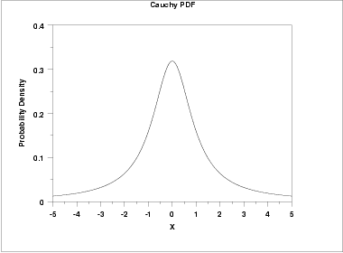
Cauchy random variables
Cauchy random variables not as nice as Normal (Gaussian) random variables
They don’t have a mean and have infinite variance
Ratio of two independent Normal random variables is Cauchy

Slide 22
Sketching to solve l₁-regression
How to find an approximate solution x to min_{x} |Ax-b|₁ ?
Want x‘ for which if x‘ is solution to min_{x} |(SA)x-(Sb)|₁ , then |Ax‘-b|₁ · (1+ε) min_{x} |Ax-b|₁ with high probability
For d log d x n matrix S of Cauchy random variables:
|Ax‘-b|₁ · (d log d) min_{x} |Ax-b|₁
For this “poor” solution x’, let b’ = Ax’-b
Might as well solve regression problem with A and b’

Slide 23
Sketching to solve l₁-regression
Main Idea: Compute a QR-factorization of S*A
Q has orthonormal columns and Q*R = S*A
A*R⁻¹ turns out to be a “well-conditioning” of original matrix A
Compute A*R⁻¹ and sample d^{3.5}/ε² rows of [A*R⁻¹ , b’] where the i-th row is sampled proportional to its 1-norm
Solve regression problem on the (reweighted) samples

Slide 24
Sketching to solve l₁-regression [MM]
Most expensive operation is computing S*A where S is the matrix of i.i.d. Cauchy random variables
All other operations are in the “smaller space”
Can speed this up by choosing S as follows:
[
[
[
[
0 0 1 0 0 1 0 0
1 0 0 0 0 0 0 0
0 0 0 -1 1 0 -1 0
0-1 0 0 0 0 0 1
C₁
C₂
C₃
…
C_{n}
¢

Slide 25
Further sketching improvements [WZ]
Can show you need a fewer number of sampled rows in later steps if instead choose S as follows
Instead of diagonal of Cauchy random variables, choose diagonal of reciprocals of exponential random variables
[
[
[
[
0 0 1 0 0 1 0 0
1 0 0 0 0 0 0 0
0 0 0 -1 1 0 -1 0
0-1 0 0 0 0 0 1
1/E₁
1/E₂
1/E₃
…
1/E_{n}
¢

Slide 26
Talk Outline
Sketching to speed up Least Squares Regression
Sketching to speed up Least Absolute Deviation (l₁) Regression
Sketching to speed up Low Rank Approximation

Slide 27
Low rank approximation
A is an n x n matrix
Typically well-approximated by low rank matrix
  E.g., only high rank because of noise
Want to output a rank k matrix A’, so that
|A-A’|_{F} · (1+ε) |A-A_{k}|_{F},
w.h.p., where A_{k} = argmin_{rank k matrices B} |A-B|_{F}
For matrix C, |C|_{F} = (Σ_{i,j} C_{i,j}²)^{1/2}

Slide 28
Solution to low-rank approximation [S]
Most time-consuming
step is computing S*A
Given n x n input matrix A
Compute S*A using a sketching matrix S with k << n rows. S*A takes random linear combinations of rows of A
S can be matrix of i.i.d. Normals
S can be a Fast Johnson Lindenstrauss Matrix
S can be a CountSketch matrix
A
SA
Project rows of A onto SA, then find best rank-k approximation to points inside of SA.

Slide 29
Caveat: projecting the points onto SA is slow [CW]
Current algorithm:
  Compute S*A (easy)
  Project each of the rows onto S*A
  Find best rank-k approximation of projected points inside of rowspace of S*A (easy)
Bottleneck is step 2
Turns out if you compute (AR)(S*A*R)⁻(SA), this is a good low-rank approximation
  Uses generalized regression: min_{X} |X(SA)-A|_{F}²

Slide 30
Conclusion
Gave fast sketching-based algorithms for numerical linear algebra problems
  Least Squares Regression
  Least Absolute Deviation (l₁) Regression
  Low Rank Approximation
Sketching also provides “dimensionality reduction”
  Communication-efficient solutions for these problems

