Slide 1
A Polynomial-Time Cutting-Plane Algorithm for Matchings
Karthekeyan Chandrasekaran
Harvard University

Slide 2











Cutting Plane Method
$$x_{0}$$
$$c$$
$$x_{2}$$
$$x_{1}$$
$$x_{3}$$
$$x_{4}$$
$$x_{opt}$$
$$P$$
$$P_{I}$$
$$P=\{x∈R^{n}:Ax≤b\}$$
$$P_{I}= \text{conv}\text{−}\text{hull}\left(P∩Z^{n}\right)$$

Slide 3
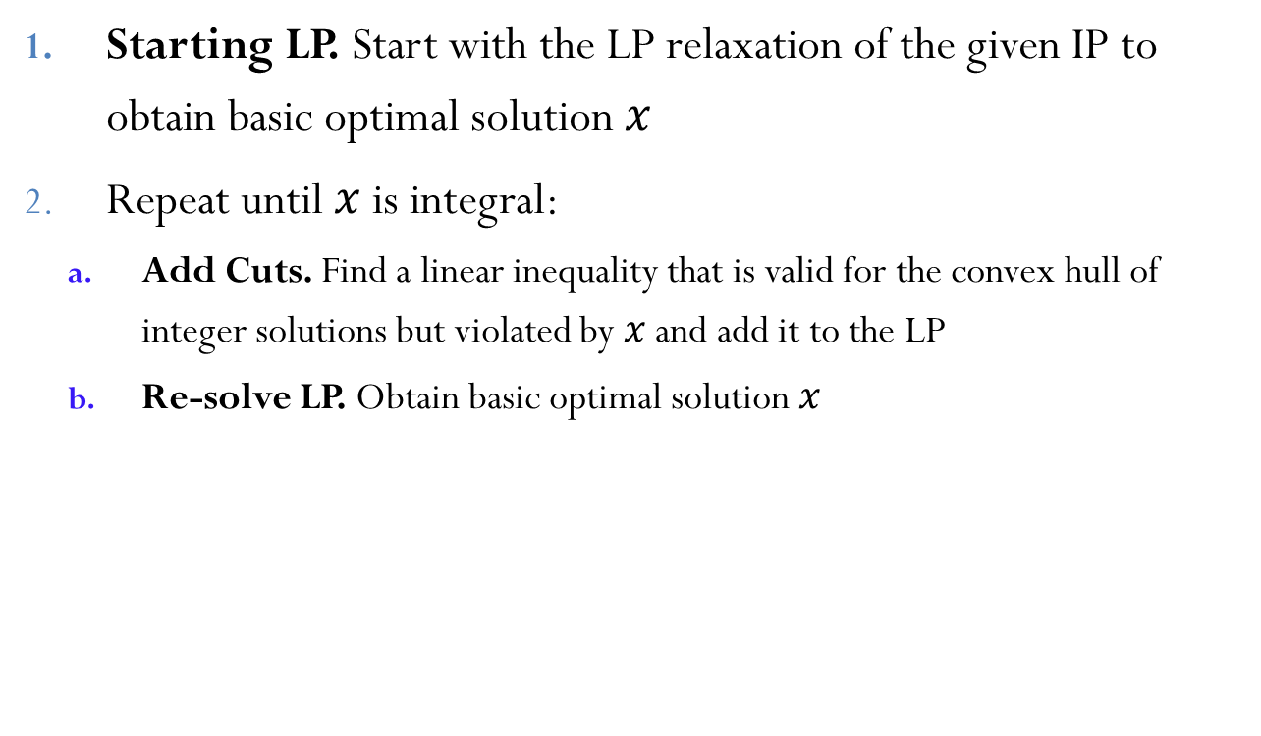
Cutting Plane Method
Starting LP. Start with the LP relaxation of the given IP to obtain basic optimal solution $x$
Repeat until $x$ is integral:
Add Cuts. Find a linear inequality that is valid for the convex hull of integer solutions but violated by $x$ and add it to the LP
Re-solve LP. Obtain basic optimal solution $x$

Slide 4
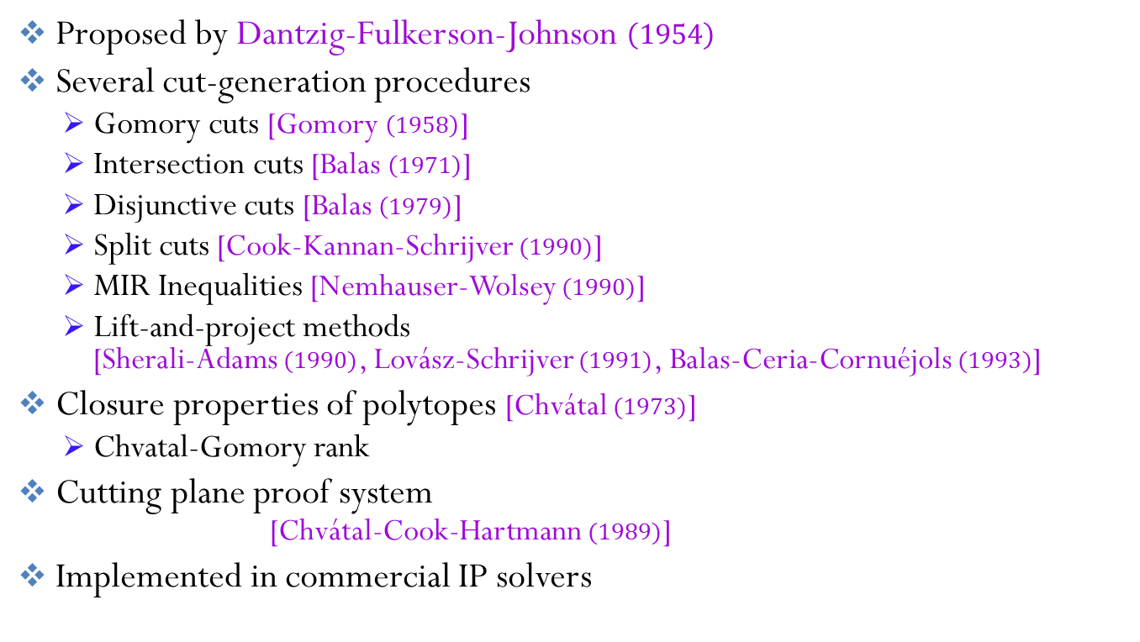
Cutting Plane Method
Proposed by Dantzig-Fulkerson-Johnson $\left(1954\right)$
Several cut-generation procedures
Gomory cuts [Gomory $\left(1958\right)$]
Intersection cuts [Balas $\left(1971\right)$]
Disjunctive cuts [Balas $\left(1979\right)$]
Split cuts [Cook-Kannan-Schrijver $(1990)$]
MIR Inequalities [Nemhauser-Wolsey $(1990)$]
Lift-and-project methods [Sherali-Adams $(1990)$, Lovász-Schrijver $(1991)$, Balas-Ceria-Cornuéjols $(1993)$]
Closure properties of polytopes [Chvátal $(1973)$]
Chvatal-Gomory rank
Cutting plane proof system [Chvátal-Cook-Hartmann $(1989)$]
Implemented in commercial IP solvers

Slide 5




Requirements – Efficient and Correct
Efficient cut-generation procedure
Convergence to integral solution
Fast convergence (number of cuts to reach integral solution)
At most $2^{n}$ cuts for $0/1$-IP
No hope for faster theoretical convergence using Gomory cuts
Practical implementations seem to be efficient for certain problems
[Gomory$\left(1958\right)$]
Is the cutting plane method efficient for polynomial-time solvable combinatorial problems?
Theoretical bound on the number of steps to convergence of cutting plane method for such problems?
[Gomory$\left(1958\right)$]
[Gomory$\left(1958\right)$]
Question: Can we explain the efficiency in practical implementations?

Slide 6


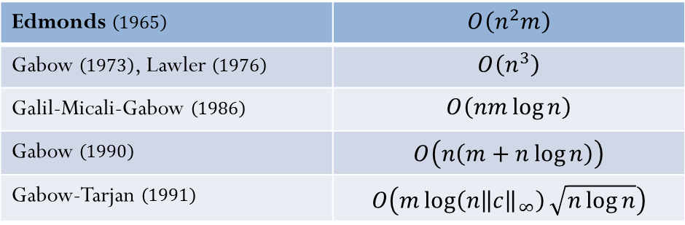
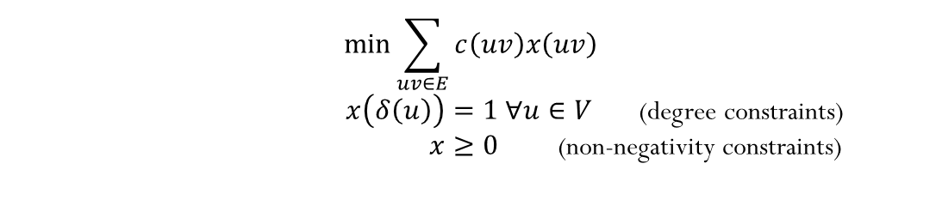
Minimum-Cost Perfect Matching
Problem: Given an edge cost function in a graph, find a minimum cost perfect matching
$$\min{\sum_{uv∈E}{c\left(uv\right)x\left(uv\right)}}$$ $x\left(δ\left(u\right)\right)=1 ∀u∈V$ (degree constraints) $x≥0$ (non-negativity constraints)
Edmonds
Gabow , Lawler
Galil-Micali-Gabow
Gabow
Gabow-Tarjan
IP formulation:
$$x∈Z^{E}$$
$$x\left(δ\left(u\right)\right)≔\sum_{e:e=uv}{x\left(e\right)}$$

Slide 7
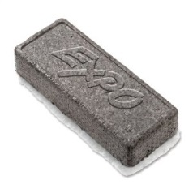







LP Relaxation
(Bipartite Relaxation)
$$\min{\sum_{uv∈E}{c\left(uv\right)x\left(uv\right)}}$$ $x\left(δ\left(u\right)\right)=1 ∀u∈V$ (degree constraints) $x≥0$ (non-negativity constraints)
In bipartite graphs, the solution is the indicator vector of a perfect matching in the graph
$$x∈Z^{E}$$
In non-bipartite graphs, the solution is not necessarily integral
Solution is half-integral and supported by a disjoint union of edges and odd cycles
$$1$$
$$\frac{1}{2}$$
$$\frac{1}{2}$$
$$\frac{1}{2}$$
$$1$$
$$x_{e}=\frac{1}{2}$$
$$\frac{1}{2}$$
$$\frac{1}{2}$$
$$\frac{1}{2}$$
$$1$$
$$\frac{1}{2}$$

Slide 8
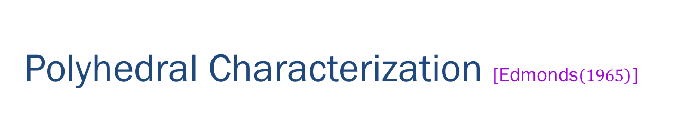
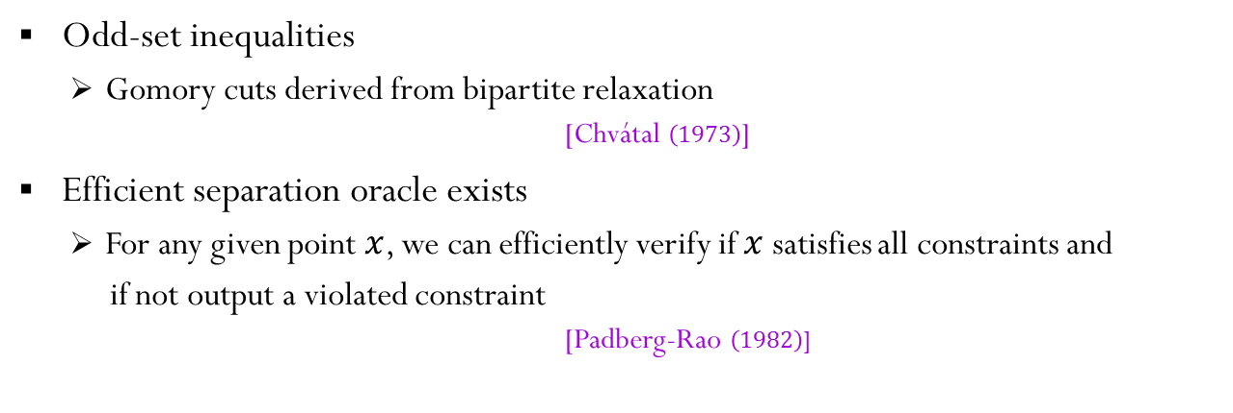


Polyhedral Characterization [Edmonds$\left(1965\right)$]
$\min{\sum_{uv∈E}{c\left(uv\right)x\left(uv\right)}}$ $x\left(δ\left(u\right)\right)=1 ∀u∈V$ (degree constraints) $x≥0$ (non-negativity constraints)
$x\left(δ\left(S\right)\right)≥1 ∀S⊆V, \left|S\right|odd$ (odd-set inequalities)
$$x\left(δ\left(S\right)\right)≔\sum_{e=uv:u∈S, v∈V∖S}{x\left(e\right)}$$
Odd-set inequalities
Gomory cuts derived from bipartite relaxation [Chvátal $\left(1973\right)$]
Efficient separation oracle exists
For any given point $x$, we can efficiently verify if $x$ satisfies all constraints and
if not output a violated constraint [Padberg-Rao $\left(1982\right)$]

Slide 9






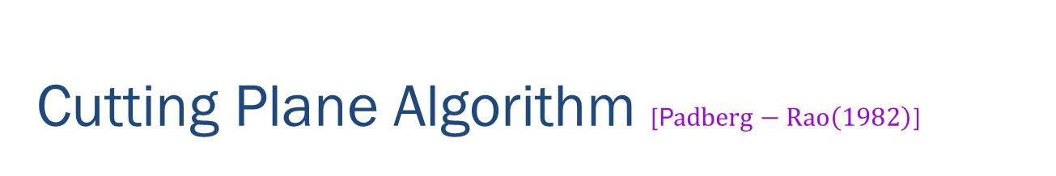
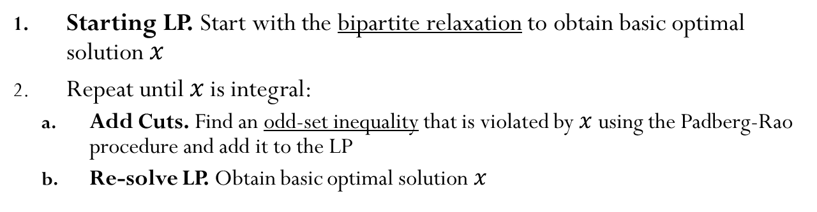

Cutting Plane Algorithm [P$adberg−Rao\left(1982\right)$]
Starting LP. Start with the bipartite relaxation to obtain basic optimal solution $x$
Repeat until $x$ is integral:
Add Cuts. Find an odd-set inequality that is violated by $x$ using the Padberg-Rao procedure and add it to the LP
Re-solve LP. Obtain basic optimal solution $x$
Easy to find cuts in the first step
Starting LP optimum is half-integral and supported by a disjoint union of odd cycles and edges
Half-integral structure is not preserved in later steps
- need Padberg-Rao for cut generation
$$\frac{1}{2}$$
$$\frac{1}{3}$$
$$\frac{1}{3}$$
$$\frac{1}{2}$$
$$\frac{1}{2}$$
$$\frac{1}{2}$$
$$\frac{1}{2}$$
$$\frac{2}{3}$$
$$\frac{2}{3}$$
$$\frac{1}{3}$$
$$\frac{1}{3}$$
$$\frac{1}{2}$$
$$\frac{1}{2}$$
$$\frac{1}{2}$$
$$\frac{2}{3}$$
$$\frac{1}{3}$$
$$\frac{2}{3}$$
$$\frac{1}{2}$$
$$\frac{1}{3}$$
$$c_{e}=1 ∀e$$
$$\frac{1}{2}$$
$$\frac{1}{3}$$

Slide 10


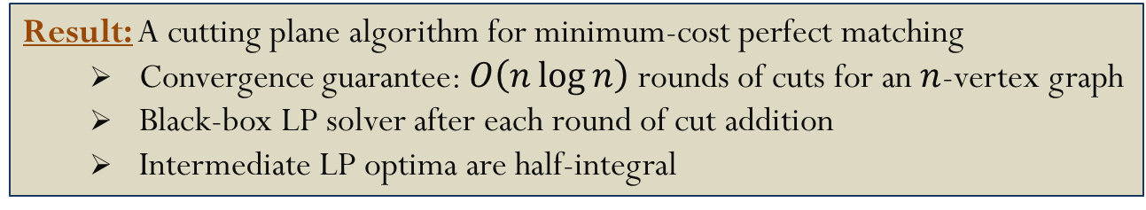
Cutting Plane Algorithm [P$adberg−Rao\left(1982\right)$]
Discussed by Lovász-Plummer $\left(1986\right)$
Implementations by Grötschel-Holland $\left(1985\right)$, Trick $\left(1987\right)$, Fischetti-Lodi $\left(2010\right)$
Computationally efficient
Result: A cutting plane algorithm for minimum-cost perfect matching
Convergence guarantee: $O\left(n\log{n}\right)$ rounds of cuts for an $n$-vertex graph
Black-box LP solver after each round of cut addition
Intermediate LP optima are half-integral

Slide 11
Outline
Cutting Plane Method for Integer Programs
Perfect Matching and Linear Constraints
Results and Techniques
New Cutting Plane Algorithm for Matching
Analysis Overview
Half-integral Structure
Progress
Coupling with a new Combinatorial Primal-Dual Algorithm for Matching

Slide 12
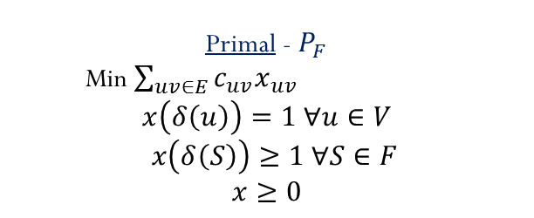
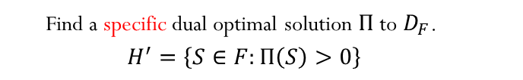

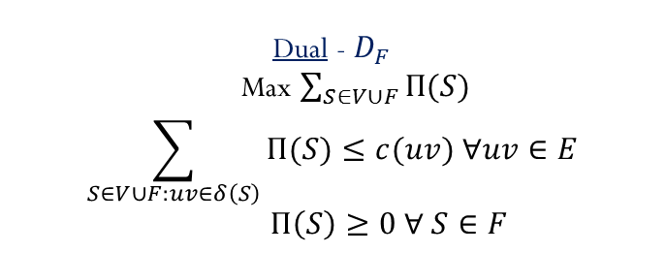

New Cutting Plane Algorithm
Primal - $P_{F}$
Min $\sum_{uv∈E}{c_{uv}x_{uv}}$
$$x\left(δ\left(u\right)\right)=1 ∀u∈V$$
$x\left(δ\left(S\right)\right)≥1 ∀S∈F$
$$x≥0$$
Dual - $D_{F}$
Max $\sum_{S∈V∪F}{Π(S)}$
$$\sum_{S∈V∪F:uv∈δ\left(S\right)}{Π(S)}≤c(uv) ∀uv∈E$$
$Π\left(S\right)≥0 ∀ S∈F$
Perturb the integral cost function by adding $\frac{1}{2^{i}}$ to edge $i$
Starting LP. Bipartite relaxation $(F=∅)$
Repeat until $x$ is integral
Retain old cuts.
Choose new cuts.
Re-solve LP. Find an optimal solution $x$ to $P_{F}$
To ensure uniqueness of intermediate optima
Min $\sum_{S∈F}{\frac{|Π\left(S\right)−Π_{prev}\left(S\right)|}{|S|}}$
Find a specific dual optimal solution $Π$ to $D_{F}$. $$H^{′}=\left\{S∈F:Π\left(S\right)>0\right\}$$
Final integral optimum to perturbed cost function is also optimum to original cost function

Slide 13
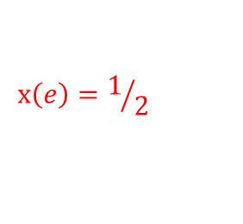

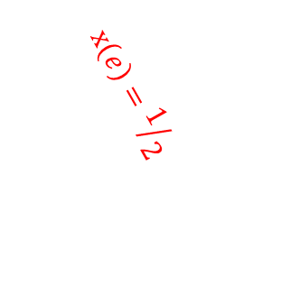
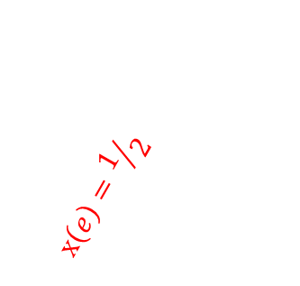



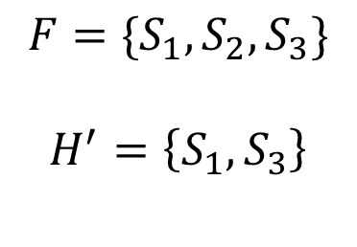



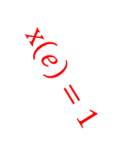
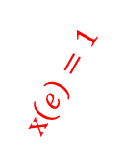
An Example
$$F=\{S_{1},S_{2},S_{3}\}$$
$$H^{′}=\left\{S_{1},S_{3}\right\}$$
$$Π\left(S_{1}\right)>0$$
$$x\left(e\right)=1$$
$$x\left(e\right)=1$$
$$x\left(e\right)=1$$
$$x\left(e\right)=1$$
$$x\left(e\right)=1/2$$
$$x\left(e\right)=1/2$$
$$x\left(e\right)=1/2$$
$$x\left(e\right)=1$$
$$x\left(e\right)=1$$
$$Π\left(S_{2}\right)=0$$
$$Π\left(S_{3}\right)>0$$

Slide 14

New Cutting Plane Algorithm
Primal - $P_{F}$
Min $\sum_{uv∈E}{c_{uv}x_{uv}}$
$$x\left(δ\left(u\right)\right)=1 ∀u∈V$$
$x\left(δ\left(S\right)\right)≥1 ∀S∈F$
$$x≥0$$
Dual - $D_{F}$
Max $\sum_{S∈V∪F}{Π(S)}$
$$\sum_{S∈V∪F:uv∈δ\left(S\right)}{Π(S)}≤c(uv) ∀uv∈E$$
$Π\left(S\right)≥0 ∀ S∈F$
Perturb the integral cost function by adding $\frac{1}{2^{i}}$ to edge $i$
Starting LP. Bipartite relaxation $(F=∅)$
Repeat until $x$ is integral
Retain old cuts.
Choose new cuts.
Re-solve LP. Find an optimal solution $x$ to $P_{F}$
Find a specific dual optimal solution $Π$ to $D_{F}$. $$H^{′}=\left\{S∈F:Π\left(S\right)>0\right\}$$

Slide 15

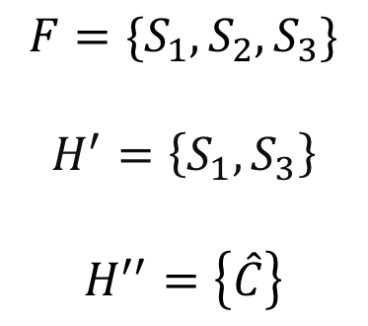

An Example
$$F=\{S_{1},S_{2},S_{3}\}$$
$$H^{′}=\left\{S_{1},S_{3}\right\}$$
$$H^{′′}=\left\{\hat{C}\right\}$$
$$\hat{C}$$
$$Π\left(S_{1}\right)>0$$
$$x\left(e\right)=1$$
$$x\left(e\right)=1$$
$$x\left(e\right)=1$$
$$x\left(e\right)=1$$
$$x\left(e\right)=1/2$$
$$x\left(e\right)=1/2$$
$$C$$
$$x\left(e\right)=1/2$$
$$x\left(e\right)=1$$
$$x\left(e\right)=1$$
$$Π\left(S_{2}\right)=0$$
$$Π\left(S_{3}\right)>0$$

Slide 16

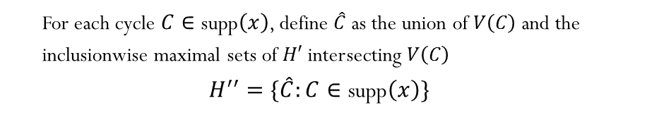
New Cutting Plane Algorithm
Primal - $P_{F}$
Min $\sum_{uv∈E}{c_{uv}x_{uv}}$
$$x\left(δ\left(u\right)\right)=1 ∀u∈V$$
$x\left(δ\left(S\right)\right)≥1 ∀S∈F$
$$x≥0$$
Dual - $D_{F}$
Max $\sum_{S∈V∪F}{Π(S)}$
$$\sum_{S∈V∪F:uv∈δ\left(S\right)}{Π(S)}≤c(uv) ∀uv∈E$$
$Π\left(S\right)≥0 ∀ S∈F$
Perturb the integral cost function by adding $\frac{1}{2^{i}}$ to edge $i$
Starting LP. Bipartite relaxation $(F=∅)$
Repeat until $x$ is integral
Retain old cuts.
Choose new cuts.
Set the new $F=H^{′}∪H′′$
Re-solve LP. Find an optimal solution $x$ to $P_{F}$
Find a specific dual optimal solution $Π$ to $D_{F}$. $$H^{′}=\left\{S∈F:Π\left(S\right)>0\right\}$$
For each cycle $C∈\text{supp}\left(x\right)$, define $\hat{C}$ as the union of $V\left(C\right)$ and the inclusionwise maximal sets of $H′$ intersecting $V\left(C\right)$ $$H^{′′}=\{\hat{C}:C∈\text{supp}\left(x\right)\}$$

Slide 17
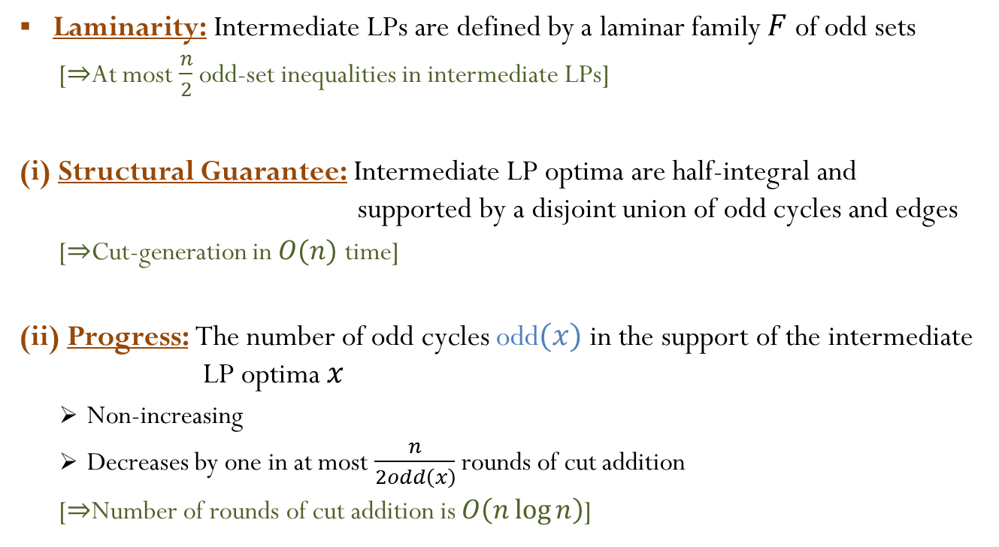
Analysis Overview
Laminarity: Intermediate LPs are defined by a laminar family $F$ of odd sets
[$⇒$At most $\frac{n}{2}$ odd-set inequalities in intermediate LPs]
(i) Structural Guarantee: Intermediate LP optima are half-integral and supported by a disjoint union of odd cycles and edges
[$⇒$Cut-generation in $O(n)$ time]
(ii) Progress: The number of odd cycles odd$(x)$ in the support of the intermediate LP optima $x$
Non-increasing
Decreases by one in at most $\frac{n}{2odd\left(x\right)}$ rounds of cut addition
[$⇒$Number of rounds of cut addition is $O\left(n\log{n}\right)$]

Slide 18
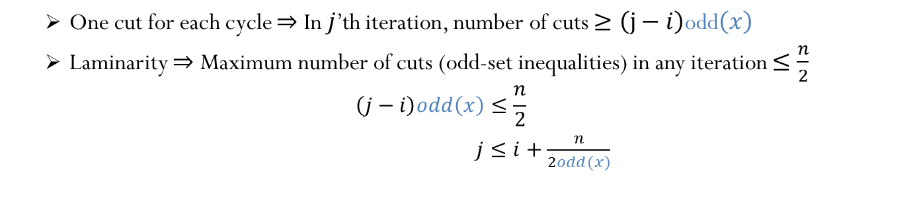
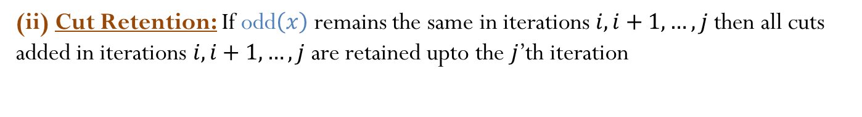
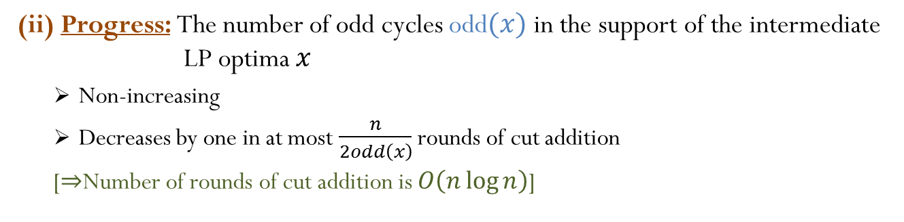
Analysis Overview
(ii) Cut Retention: If odd$\left(x\right)$ remains the same in iterations $i, i+1, …, j$ then all cuts added in iterations $i, i+1, …, j$ are retained upto the $j$’th iteration
(ii) Progress: The number of odd cycles odd$(x)$ in the support of the intermediate LP optima $x$
Non-increasing
Decreases by one in at most $\frac{n}{2odd\left(x\right)}$ rounds of cut addition
[$⇒$Number of rounds of cut addition is $O\left(n\log{n}\right)$]
One cut for each cycle $⇒$ In $j$’th iteration, number of cuts $≥\left(j−i\right)$odd$\left(x\right)$
Laminarity $⇒$ Maximum number of cuts (odd-set inequalities) in any iteration $≤\frac{n}{2}$
$$\left(j−i\right)odd\left(x\right)≤\frac{n}{2}$$ $j≤i+\frac{n}{2odd(x)}$

Slide 19
Analysis Overview
(i) Half-integral Structure: Intermediate LP optima are half-integral and supported by a disjoint union of odd cycles and edges
(ii) Cut Retention: If odd$\left(x\right)$ remains the same in iterations $i, i+1, …, j$ then all cuts added in iterations $i, i+1, …, j$ are retained upto the $j$’th iteration

Slide 20


Half-integral Structure
Conjecture 0: All intermediate solutions are Half-integral
Conjecture 1: Half-integral if odd-set inequalities correspond to a laminar family
Hey look – the optima are not unique!
$$\frac{1}{2}$$
$$\frac{1}{3}$$
$$\frac{1}{3}$$
$$\frac{1}{2}$$
$$\frac{1}{2}$$
$$\frac{1}{2}$$
$$\frac{1}{2}$$
$$\frac{2}{3}$$
$$\frac{2}{3}$$
$$\frac{1}{3}$$
$$\frac{1}{3}$$
$$\frac{1}{2}$$
$$\frac{1}{2}$$
$$\frac{1}{2}$$
$$\frac{2}{3}$$
$$\frac{1}{3}$$
$$\frac{2}{3}$$
$$\frac{1}{2}$$
$$\frac{1}{3}$$
$$c_{e}=1 ∀e$$
$$\frac{1}{2}$$
$$\frac{1}{3}$$

Slide 21
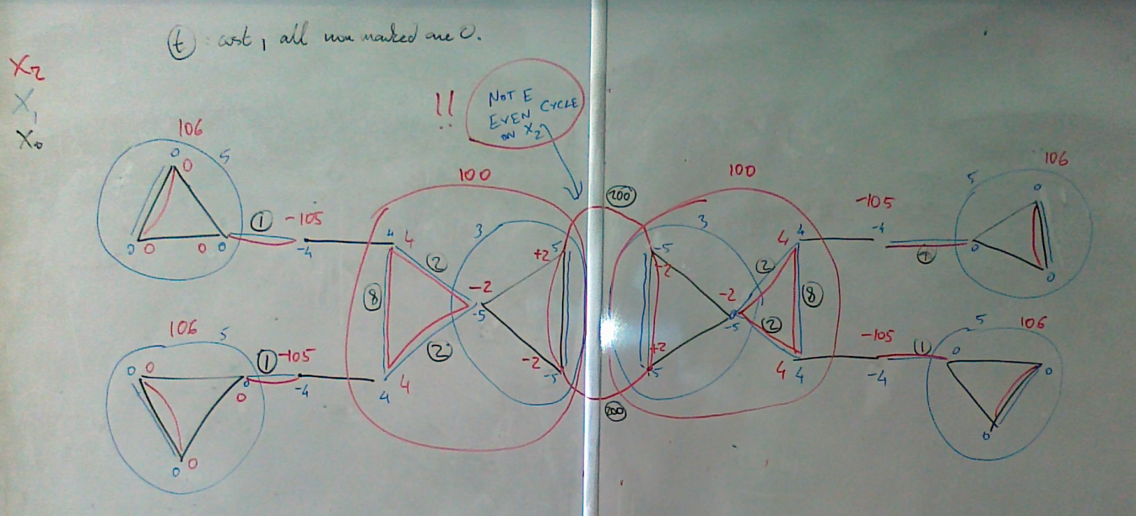
Half-integral Structure
Conjecture 2: Half-integral if the optimum is unique and odd-set inequalities correspond to a laminar family

Slide 22
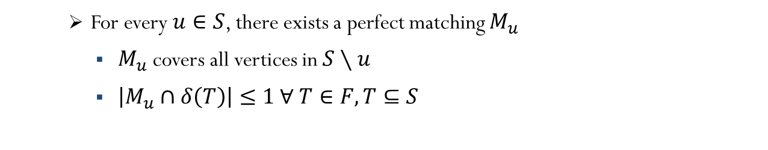







Half-integral Structure
Primal - $P_{F}$
Min $\sum_{uv∈E}{c_{uv}x_{uv}}$
$$x\left(δ\left(u\right)\right)=1 ∀u∈V$$
$x\left(δ\left(S\right)\right)≥1 ∀S∈F$
$$x≥0$$
Dual - $D_{F}$
Max $\sum_{S∈V∪F}{Π(S)}$
$$\sum_{S∈V∪F:uv∈δ\left(S\right)}{Π(S)}≤c(uv) ∀uv∈E$$
$Π\left(S\right)≥0 ∀ S∈F$
Lemma: If $x$ is unique, $F$ is laminar, and $D_{F}$ has an F-critical dual optimal solution, then $x$ is half-integral
Definition. $Π$ is a F-critical dual solution to $D_{F}$ if
$∀S∈F:Π(S)>0$,
the induced graph over $S$ using the tight edges wrt $Π$
is $F$-factor-critical
$$T_{1}$$
For every $u∈S$, there exists a perfect matching $M_{u}$
$M_{u}$ covers all vertices in $S∖u$
$\left|M_{u}∩δ\left(T\right)\right|≤1 ∀ T∈F, T⊆S$
$$S$$
$$T_{2}$$

Slide 23








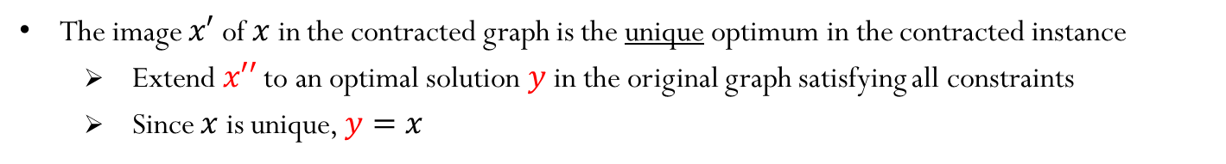




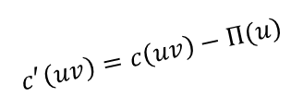


Half-integral Structure
Say we have a primal-dual optimal pair $\left(x,Π\right)$ such that $Π$ is F-critical.
$$u$$
$$Π\left(v\right)$$
$$v$$
$$1/4$$
$$c^{′}\left(uv\right)=c\left(uv\right)−Π(u)$$
$$1/2$$
$$1/4$$
$$1/4$$
$$S$$
$$Π\left(S\right)$$
$$1/4$$
$$1/2$$
$$Π\left(S\right)>0$$
$$x′′$$
Tight Edge
$$x\left(e\right)=\frac{1}{3}$$
$$x\left(e\right)=\frac{2}{3}$$
Projection of primal-dual optimal pair gives primal-dual optimal pair in the contracted instance
The image $x′$ of $x$ in the contracted graph is the unique optimum in the contracted instance
Extend $x′′$ to an optimal solution $y$ in the original graph satisfying all constraints
Since $x$ is unique, $y=x$

Slide 24

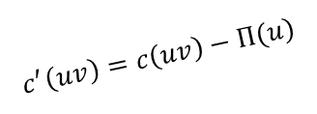












Half-integral Structure
Say we have a primal-dual optimal pair $\left(x,Π\right)$ such that $Π$ is F-critical.
$$1/4$$
$$u$$
$$Π\left(v\right)$$
$$1/4$$
$$1/4$$
$$v$$
$$c^{′}\left(uv\right)=c\left(uv\right)−Π(u)$$
$$1/4$$
$$1/2$$
$$1/2$$
$$1/2$$
$$1/4$$
$$S$$
$$+1/2$$
$$1/4$$
$$1/4$$
$$1/4$$
$$Π\left(S\right)$$
$$1/4$$
$$1/4$$
$$1/4$$
$$1/2$$
$$1/4$$
$$1/2$$
$$1/4$$
$$x′′$$
$$1/4$$
$$+1/2$$
Projection of primal-dual optimal pair gives primal-dual optimal pair in the contracted instance
The image $x′$ of $x$ in the contracted graph is the unique optimum in the contracted instance
Extend $x′′$ to an optimal solution $y$ in the original graph satisfying all constraints
Since $x$ is unique, $y=x$
If $x’$ is half-integral then so is $x$
Once we contract all $S∈F:Π\left(S\right)>0$, the image $x′$ is the unique optimal solution to the bipartite relaxation $⇒$ $x′$ is half-integral
Notes:
Projection of primal-dual optimal pair gives primal-dual optimal pair in the contracted instance

Slide 25
New Cutting Plane Algorithm
Primal - $P_{F}$
Min $\sum_{uv∈E}{c_{uv}x_{uv}}$
$$x\left(δ\left(u\right)\right)=1 ∀u∈V$$
$x\left(δ\left(S\right)\right)≥1 ∀S∈F$
$$x≥0$$
Dual - $D_{F}$
Max $\sum_{S∈V∪F}{Π(S)}$
$$\sum_{S∈V∪F:uv∈δ\left(S\right)}{Π(S)}≤c(uv) ∀uv∈E$$
$Π\left(S\right)≥0 ∀ S∈F$
Perturb the integral cost function by adding $\frac{1}{2^{i}}$ to edge $i$
Starting LP. Bipartite relaxation $(F=∅)$
Repeat until $x$ is integral
Retain old cuts.
Choose new cuts.
Set the new $F=H^{′}∪H′′$
Re-solve LP. Find an optimal solution $x$ to $P_{F}$
Find a specific dual optimal solution $Π$ to $D_{F}$. $$H^{′}=\left\{S∈F:Π\left(S\right)>0\right\}$$
For each cycle $C∈\text{supp}\left(x\right)$, define $\hat{C}$ as the union of $V\left(C\right)$ and the inclusionwise maximal sets of $H′$ intersecting $V\left(C\right)$ $$H^{′′}=\{\hat{C}:C∈\text{supp}\left(x\right)\}$$

Slide 26
Analysis Overview
(i) Half-integral Structure: Intermediate LP optima are half-integral and supported by a disjoint union of odd cycles and edges
(ii) Cut Retention: If odd$\left(x\right)$ remains the same in iterations $i, i+1, …, j$ then all cuts added in iterations $i, i+1, …, j$ are retained upto the $j$’th iteration
Proof of Cut Retention: Coupling with the intermediate solutions of a Half-Integral Primal-Dual Algorithm for matching
The choice of specific dual optimal solution to retain cuts comes from this coupling

Slide 27

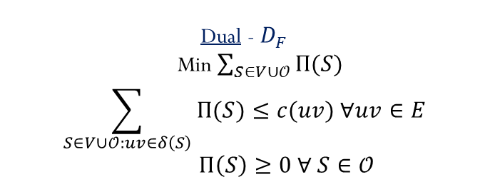
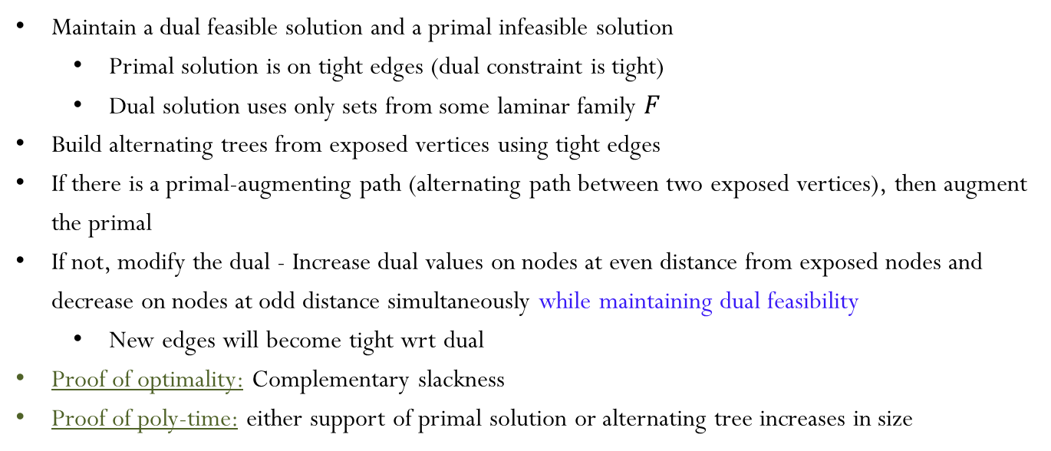





Edmonds’ Algorithm (Bipartite)
Primal - $P_{F}$
Max $\sum_{uv∈E}{c_{uv}x_{uv}}$
$$x\left(δ\left(u\right)\right)=1 ∀u∈V$$
$x\left(δ\left(S\right)\right)≥1 ∀S∈𝒪$
$$x≥0$$
Dual - $D_{F}$
Min $\sum_{S∈V∪𝒪}{Π(S)}$
$$\sum_{S∈V∪𝒪:uv∈δ\left(S\right)}{Π(S)}≤c(uv) ∀uv∈E$$
$Π\left(S\right)≥0 ∀ S∈𝒪$
Maintain a dual feasible solution and a primal infeasible solution
Primal solution is on tight edges (dual constraint is tight)
Dual solution uses only sets from some laminar family $F$
Build alternating trees from exposed vertices using tight edges
If there is a primal-augmenting path (alternating path between two exposed vertices), then augment the primal
If not, modify the dual - Increase dual values on nodes at even distance from exposed nodes and decrease on nodes at odd distance simultaneously while maintaining dual feasibility
New edges will become tight wrt dual
Proof of optimality: Complementary slackness
Proof of poly-time: either support of primal solution or alternating tree increases in size
$$+$$
$$+$$
$$+$$
$$+$$
$$+$$
$$+$$
$$+$$
$$+$$
$$+$$
$$+$$
$$+$$
$$+$$
$$+$$
$$+$$
$$+$$
$$+$$
$$−$$
$$−$$

Slide 28
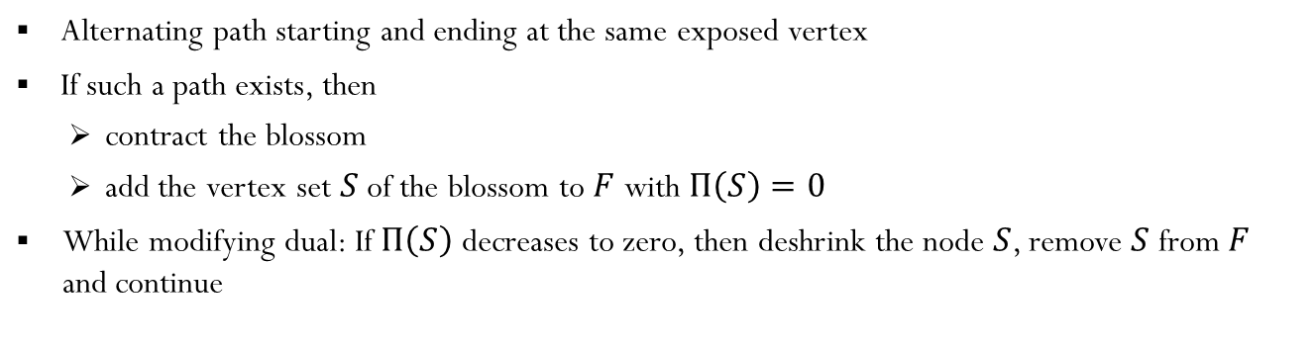


Edmonds’ Algorithm (Non-bipartite)
Primal - $P_{F}$
Max $\sum_{uv∈E}{c_{uv}x_{uv}}$
$$x\left(δ\left(u\right)\right)=1 ∀u∈V$$
$x\left(δ\left(S\right)\right)≥1 ∀S∈𝒪$
$$x≥0$$
Dual - $D_{F}$
Min $\sum_{S∈V∪𝒪}{Π(S)}$
$$\sum_{S∈V∪𝒪:uv∈δ\left(S\right)}{Π(S)}≤c(uv) ∀uv∈E$$
$Π\left(S\right)≥0 ∀ S∈𝒪$
$$S$$
Blossom
$$S$$
Alternating path starting and ending at the same exposed vertex
If such a path exists, then
contract the blossom
add the vertex set $S$ of the blossom to $F$ with $Π\left(S\right)=0$
While modifying dual: If $Π\left(S\right)$ decreases to zero, then deshrink the node $S$, remove $S$ from $F$ and continue

Slide 29
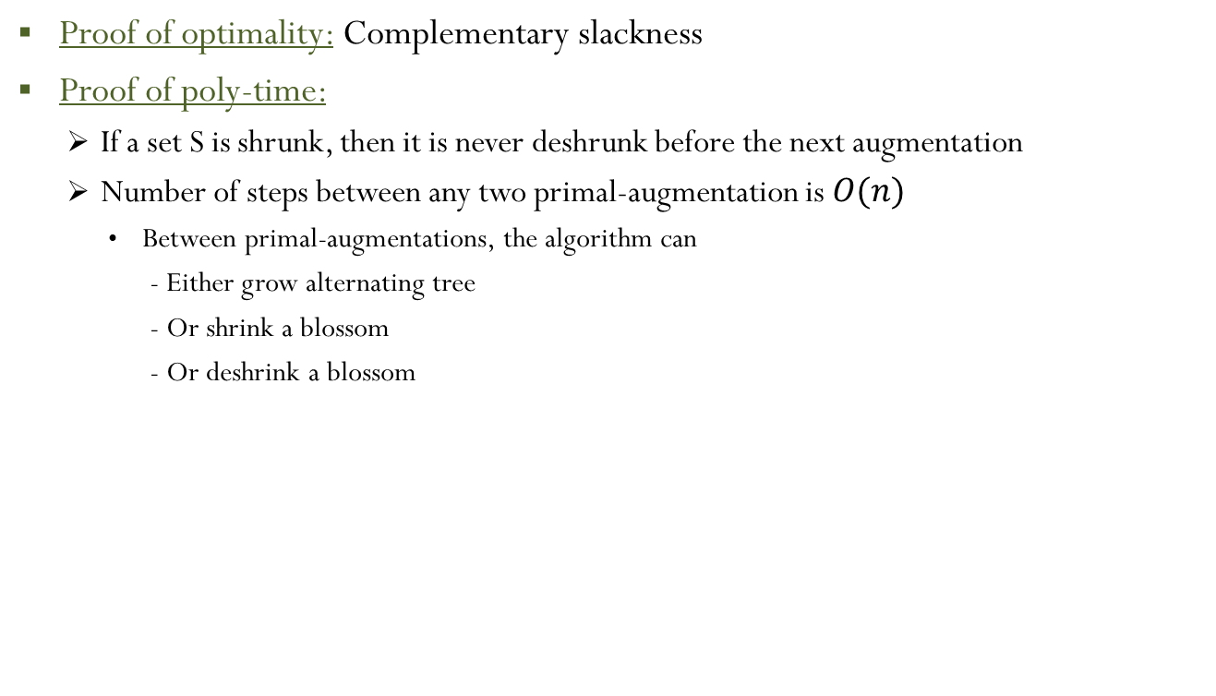
Edmonds’ Algorithm (Non-bipartite)
Proof of optimality: Complementary slackness
Proof of poly-time:
If a set S is shrunk, then it is never deshrunk before the next augmentation
Number of steps between any two primal-augmentation is $O(n)$
Between primal-augmentations, the algorithm can
- Either grow alternating tree
- Or shrink a blossom
- Or deshrink a blossom

Slide 30
Half-Integral Primal-Dual Algorithm
Edmonds’ Algorithm
Half-Integral Algorithm
Intermediate Primal – integral
Unique way to augment primal
Build an alternating tree using tight edges and repeatedly attempt to augment primal and change dual values until there are no more exposed nodes
Deshrink if dual value on a set decreases to zero
Shrink if a set forms a blossom
Intermediate Primal – half-integral
3 ways to augment primal
Build an alternating tree using tight edges and repeatedly attempt to augment primal and change dual values until there are no more exposed nodes
Deshrink if dual value on a set decreases to zero
Augment primal if a set forms a blossom

Slide 31
Half-Integral Primal-Dual Algorithm
Primal Augmentations
$$\frac{1}{2}$$
$$\frac{1}{2}$$
$$\frac{1}{2}$$
$$\frac{1}{2}$$
$$\frac{1}{2}$$
$$\frac{1}{2}$$

Slide 32
Half-Integral Primal-Dual Algorithm
Edmonds’ Algorithm
Half-Integral Algorithm
Intermediate Primal – integral
Unique way to augment primal
Build an alternating tree using tight edges and repeatedly attempt to augment primal and change dual values until there are no more exposed nodes
Deshrink if dual value on a set decreases to zero
Shrink if a set forms a blossom
Intermediate Primal – half-integral
3 ways to augment primal
Build an alternating tree using tight edges and repeatedly attempt to augment primal and change dual values until there are no more exposed nodes
Deshrink if dual value on a set decreases to zero
Augment primal if a set forms a blossom
After covering all exposed nodes, shrink all odd cycles to exposed nodes and proceed again until no more odd cycles
Node Covering Phase
Cycle Shrinking Phase

Slide 33
Half-Integral Primal-Dual Algorithm
Primal Augmentations
$$\frac{1}{2}$$
$$\frac{1}{2}$$
$$\frac{1}{2}$$
$$\frac{1}{2}$$
$$\frac{1}{2}$$
$$\frac{1}{2}$$

Slide 34
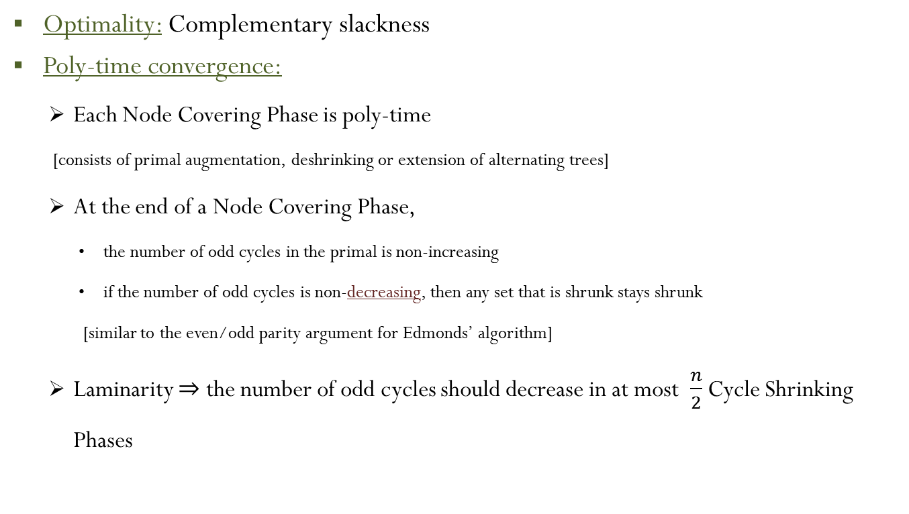
Half-Integral Primal-Dual Algorithm
Optimality: Complementary slackness
Poly-time convergence:
Each Node Covering Phase is poly-time
[consists of primal augmentation, deshrinking or extension of alternating trees]
At the end of a Node Covering Phase,
the number of odd cycles in the primal is non-increasing
if the number of odd cycles is non-decreasing, then any set that is shrunk stays shrunk
[similar to the even/odd parity argument for Edmonds’ algorithm]
Laminarity $⇒$ the number of odd cycles should decrease in at most $\frac{n}{2}$ Cycle Shrinking Phases

Slide 35
Future Directions
Implications of the Dual-based cut-retention procedure for other poly-time solvable combinatorial problems
Combinatorial polytopes with Chvátal rank one (Edmonds-Johnson matrices)
Efficient cutting plane algorithms for optimization over
two-matroid-intersection polytope
subtour elimination polytope
Questions?
Thank you

