Slide 1


Private Analysis of Graphs
Sofya Raskhodnikova
Penn State University,
on sabbatical at BU for 2013-2014 privacy year
Joint work with Shiva Kasiviswanathan (GE Research),
Kobbi Nissim (Ben-Gurion, Harvard, BU),
Adam Smith (Penn State, BU)

Slide 2
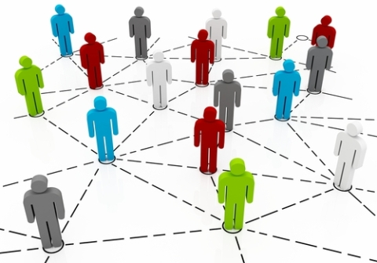
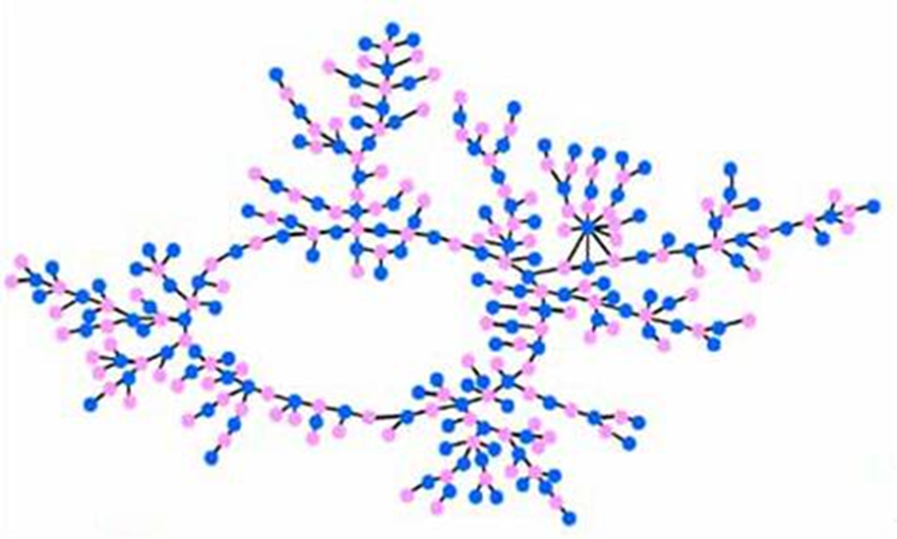

Publishing information about graphs
Many types of data can be represented as graphs
“Friendships” in online social network
Financial transactions
Email communication
Health networks (of doctors and patients)
Romantic relationships
image source http://community.expressor-software.com/blogs/mtarallo/36-extracting-data-facebook-social-graph-expressor-tutorial.html
Privacy is a big issue!
American J. Sociology,
Bearman, Moody, Stovel
Notes:
Many types of data can be represented as graphs, where nodes correspond to individuals and edges capture relationships between them.
Examples include … In many situations, somebody might want to publish or release some information about these graphs: say, for research or oversight or advertising purposes. However, one has to be careful about how it is done because these graphs contain very sensitive information.
This is the graph of romantic relationships in one American high school from a famous sociological study. In this case, the researchers decided to publish the entire largest connected component of the graph, after removing all information associated with each node, except for gender. Is this graph really anonymized? Taking a closer look at this blue node and its connections, one might wonder how the researchers managed to get this boy to sign the consent form for releasing his data. Even though they released no “identifying information”, only “graph data”, other participants in this study who knew just a bit about him, could have learned much more.
You might say that I picked the most interesting node in this graph. And you’d be right. However, there is lots of curious observations one can make about this graph. For instance, there is only one pink node with four neighbors. More generally, it has been pointed out that in real-world social networks, if we look at relatively small neighborhoods, each node’s neighborhood is unique.

Slide 3
Private analysis of graph data
Graph G
Users
Trusted
curator
(
)
Government,
researchers,
businesses
(or)
malicious
adversary
queries
answers
Two conflicting goals: utility and privacy
image source http://www.queticointernetmarketing.com/new-amazing-facebook-photo-mapper/

Slide 4

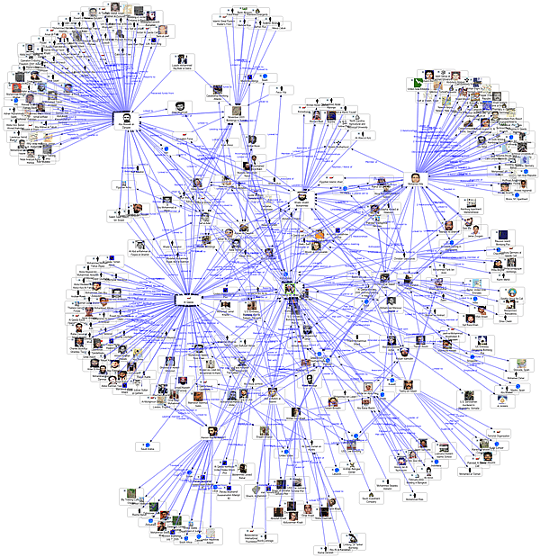

Private analysis of graph data
Graph G
Users
Trusted
curator
(
)
Government,
researchers,
businesses
(or)
malicious
adversary
internet
queries
answers
social networks
Why is it hard?
Presence of external information
Can’t assume we know the sources
“Anonymization” schemes are regularly broken
anonymized datasets
image source http://www.queticointernetmarketing.com/new-amazing-facebook-photo-mapper/

Slide 5
Some published attacks
Reidentifying individuals based on external sources
Social networks [Backstrom Dwork Kleinberg 07, Narayanan Shmatikov 09]
Computer networks [Coull Wright Monrose Collins Reiter 07, Ribeiro Chen Miklau Townsley 08]
Genetic data (GWAS) [Homer et al. 08, ...]
Microtargeted advertising [Korolova 11]
Recommendation systems [Calandrino Kiltzer Narayanan Felten Shmatikov 11]
Composition attacks
Combining independent anonymized releases [Ganta Kasiviswanathan Smith 08]
Reconstruction attacks
Combining multiple noisy statistics [Dinur Nissim 03, …]
Hospital A
Attacker
Hospital B

Slide 6
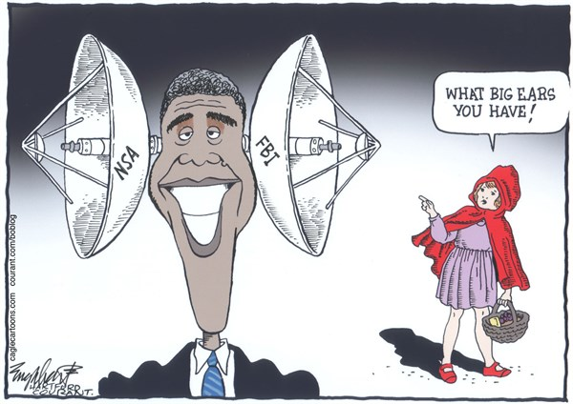



Who’d want to de-anonymize a social network graph?
image sources © Depositphotos.com/fabioberti.it, Andrew Joyner, http://dukeromkey.com/
Notes:
Government agency interested in surveillance. A phisher or a spammer in order to craft a highly individualized, believable message. Marketers.
Stalkers, nosy colleagues, employers or neighbors.

Slide 7

Private analysis of graph data
Graph G
Users
Trusted
curator
(
)
Government,
researchers,
businesses
(or)
malicious
adversary
queries
answers
Two conflicting goals: utility and privacy
utility: accurate answers
privacy: ?
A definition that
quantifies privacy loss
composes
is robust to external information
image source http://www.queticointernetmarketing.com/new-amazing-facebook-photo-mapper/

Slide 8
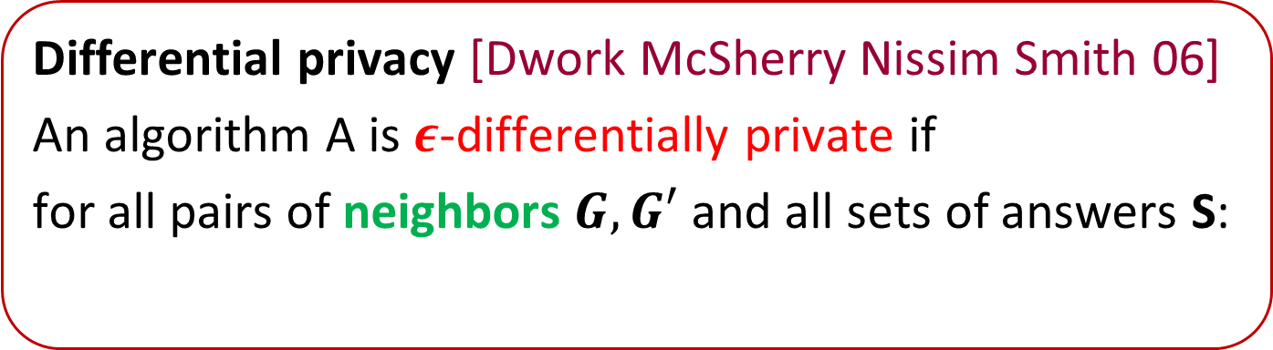
Differential privacy (for graph data)
Graph G
Users
Trusted
curator
(
)
Government,
researchers,
businesses
(or)
malicious
adversary
queries
A
answers
Intuition: neighbors are datasets that differ only in some information we’d like to hide (e.g., one person’s data)
Differential privacy [Dwork McSherry Nissim Smith 06]
An algorithm A is $ε$-differentially private if
for all pairs of neighbors $G, G′$ and all sets of answers S:
$$\operatorname{Pr}\left[A\left(G\right)∈S\right]≤e^{ε}\operatorname{Pr}\left[A\left(G^{′}\right)∈S\right]$$
image source http://www.queticointernetmarketing.com/new-amazing-facebook-photo-mapper/
Notes:
This is the standard definition of differential privacy. The only innovation is that the usual picture with discs got updated to a graph.
An algorithm … the usual condition holds. What does it mean for two graphs to be neighbors?

Slide 9

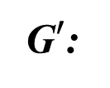
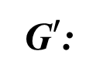
Two variants of differential privacy for graphs
Edge differential privacy
Two graphs are neighbors if they differ in one edge.
Node differential privacy
Two graphs are neighbors if one can be obtained from the other by deleting a node and its adjacent edges.
G:
G$′$:
G:
G$′$:
Notes:
Node differential privacy is more in the spirit of protecting privacy of each individual. However, this definition is significantly harder to satisfy because you have to cover much larger changes in the graph.

Slide 10
Node differentially private analysis of graphs
Graph G
Users
Trusted
curator
(
)
Government,
researchers,
businesses
(or)
malicious
adversary
queries
A
answers
Two conflicting goals: utility and privacy
Impossible to get both in the worst case
Previously: no node differentially private algorithms that are accurate on realistic graphs
image source http://www.queticointernetmarketing.com/new-amazing-facebook-photo-mapper/

Slide 11
Our contributions
First node differentially private algorithms that are accurate for sparse graphs
node differentially private for all graphs
accurate for a subclass of graphs, which includes
graphs with sublinear (not necessarily constant) degree bound
graphs where the tail of the degree distribution is not too heavy
dense graphs
Techniques for node differentially private algorithms
Methodology for analyzing the accuracy of such algorithms on realistic networks
Concurrent work on node privacy [Blocki Blum Datta Sheffet 13]

Slide 12
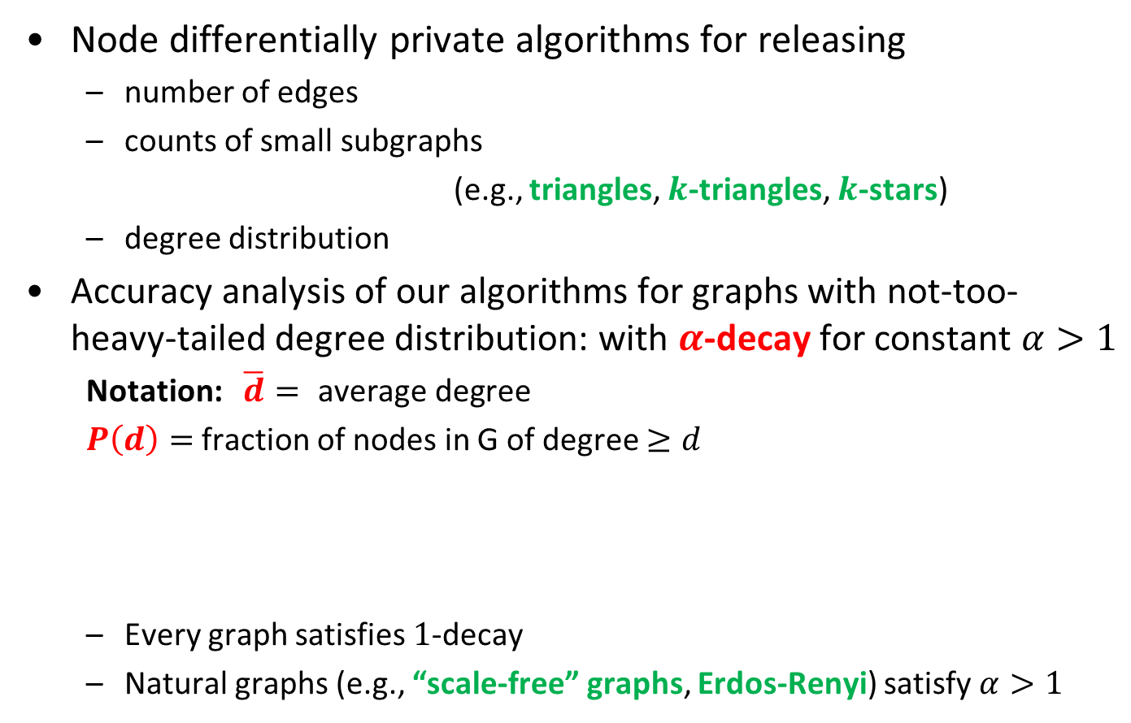



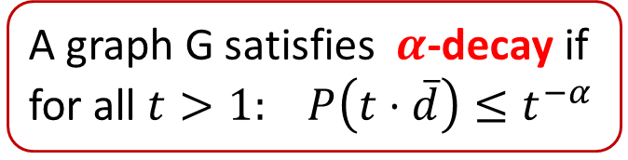
Our contributions: algorithms
Node differentially private algorithms for releasing
number of edges
counts of small subgraphs
(e.g., triangles, $k$-triangles, $k$-stars)
degree distribution
Accuracy analysis of our algorithms for graphs with not-too-heavy-tailed degree distribution: with $α$-decay for constant $α>1$
Notation: $\overline{d}= \text{average} \text{degree}$
$P\left(d\right)=$ fraction of nodes in G of degree $≥d$
Every graph satisfies $1$-decay
Natural graphs (e.g., “scale-free” graphs, Erdos-Renyi) satisfy $α>1$
…
…
Frequency
A graph G satisfies $α$-decay if for all $t>1:$ $P\left(t⋅\overline{d}\right)≤t^{−α}$
$${≤t}^{−α}$$
…
…
…
$$\overline{d}$$
$$t⋅\overline{d}$$
Degrees
Notes:
Scale-free = network whose distribution follows a power law.

Slide 13
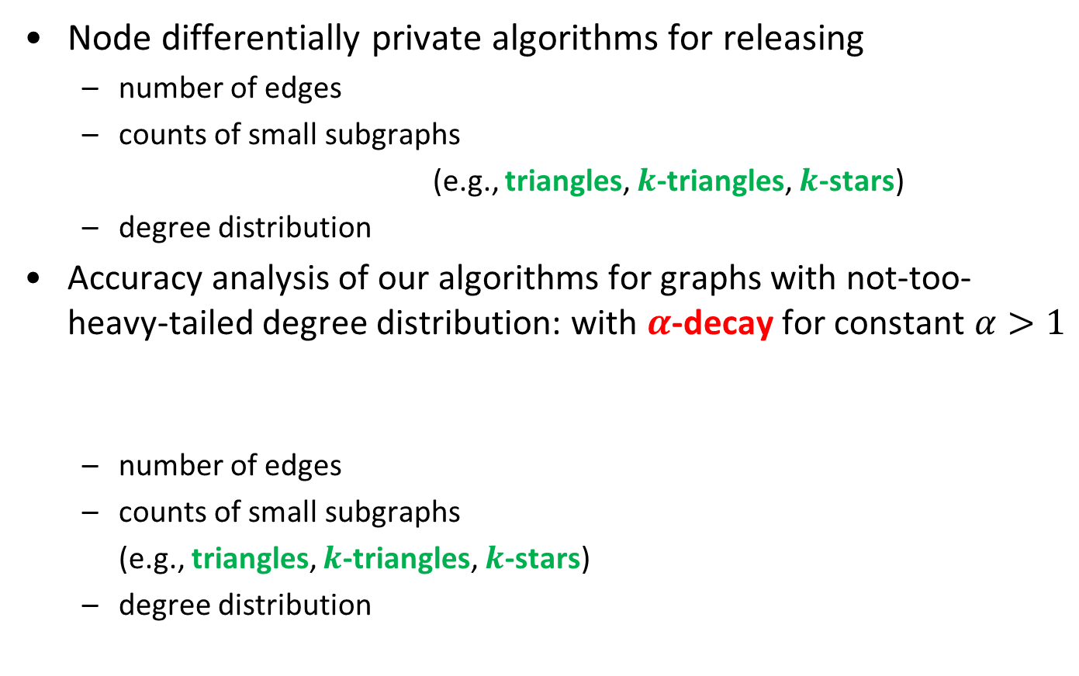
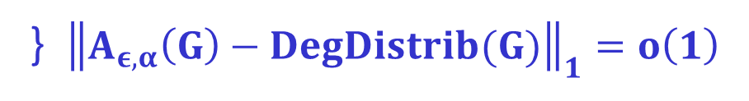
Our contributions: accuracy analysis
Node differentially private algorithms for releasing
number of edges
counts of small subgraphs
(e.g., triangles, $k$-triangles, $k$-stars)
degree distribution
Accuracy analysis of our algorithms for graphs with not-too-heavy-tailed degree distribution: with $α$-decay for constant $α>1$
number of edges
counts of small subgraphs
(e.g., triangles, $k$-triangles, $k$-stars)
degree distribution
…
…
A graph G satisfies $α$-decay if for all $t>1:$ $P\left(t⋅\overline{d}\right)≤t^{−α}$
(1+o(1))-approximation
} ${\left\|A_{ε,α}\left(G\right)−DegDistrib(G)\right\|}_{1}=o\left(1\right)$

Slide 14
Previous work on
differentially private computations on graphs
Edge differentially private algorithms
number of triangles, MST cost [Nissim Raskhodnikova Smith 07]
degree distribution [Hay Rastogi Miklau Suciu 09, Hay Li Miklau Jensen 09, Karwa Slavkovic 12]
small subgraph counts [Karwa Raskhodnikova Smith Yaroslavtsev 11]
cuts [Blocki Blum Datta Sheffet 12]
Edge private against Bayesian adversary (weaker privacy)
small subgraph counts [Rastogi Hay Miklau Suciu 09]
Node zero-knowledge private (stronger privacy)
average degree, distances to nearest connected, Eulerian, cycle-free graphs (privacy only for bounded-degree graphs) [Gehrke Lui Pass 12]

Slide 15
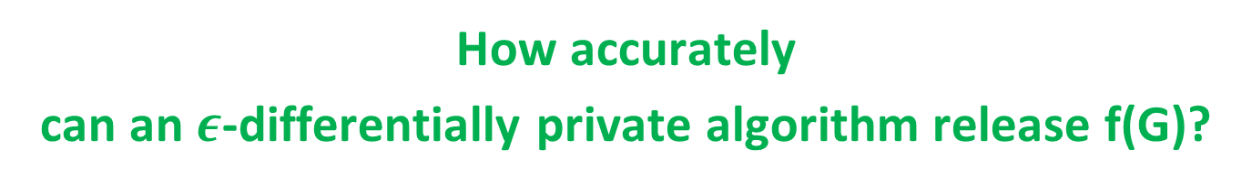
Differential privacy basics
Graph G
Users
Trusted
curator
(
)
Government,
researchers,
businesses
(or)
malicious
adversary
statistic f
A
approximation to f(G)
How accurately
can an $ε$-differentially private algorithm release f(G)?

Slide 16
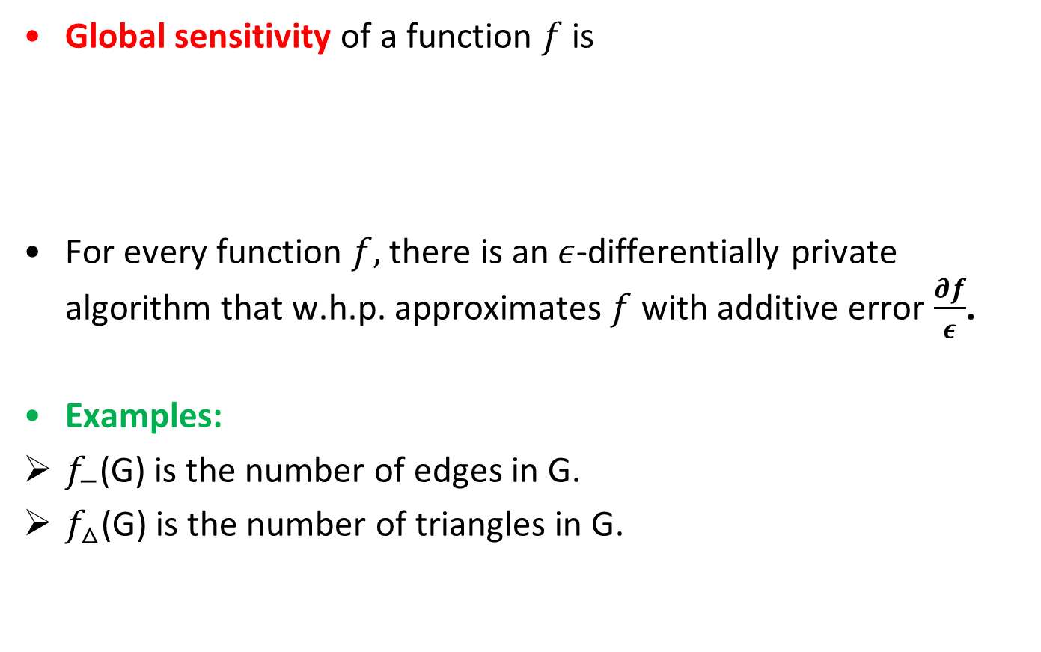
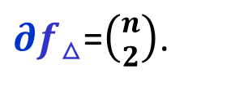
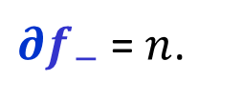
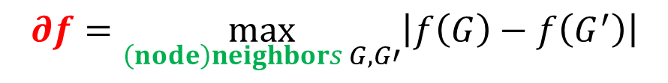
Global sensitivity framework [DMNS’06]
Global sensitivity of a function $f$ is
For every function $f,$ there is an $ε$-differentially private algorithm that w.h.p. approximates $f$ with additive error $\frac{∂f}{ε}$.
Examples:
$f_{−}$(G) is the number of edges in G.
$f_{△}$(G) is the number of triangles in G.
$$∂f=\max_{\left(node\right)neighbors G,G′}\left|f\left(G\right)−f\left(G^{′}\right)\right|$$
$∂f_{−}$ = $n$.
$∂f_{△}$=$\left({n \atop 2}\right)$.
Notes:
The first upper bound on the error was given in the paper that defined DP by DMNS.

Slide 17
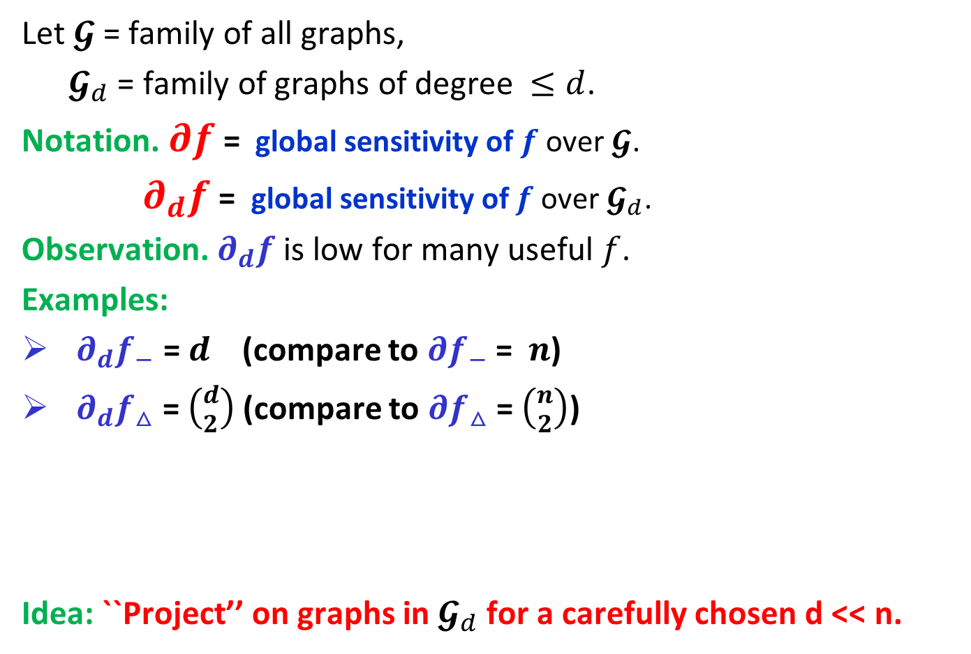


“Projections” on graphs of small degree
Let $𝓖$= family of all graphs,
$𝓖_{d}$ = family of graphs of degree $≤d$.
Notation. $∂f$ = global sensitivity of $f$ over$𝓖$.
$∂_{d}f$ = global sensitivity of $f$over $𝓖_{d}$.
Observation. $∂_{d}f$ is low for many useful $f$.
Examples:
$∂_{d}f_{−}$ = $d$ (compare to $∂f_{−}$= $n$)
$∂_{d}f_{△}$ = $\left({d \atop 2}\right)$(compare to $∂f_{△}$= $\left({n \atop 2}\right)$)
Idea: ``Project’’ on graphs in $𝓖_{d}$ for a carefully chosen d << n.
$$𝓖$$
$$𝓖_{d}$$
Goal: privacy for all graphs
Notes:
The starting point of our algorithms is a simple observation that global sensitivity is much smaller if we restrict our attention to bounded-degree graphs.

Slide 18






Method 1: Lipschitz extensions
Release $f′$ via GS framework [DMNS’06]
Requires designing Lipschitz extension for each function $f$
we base ours on maximum flow and linear and convex programs
A function $f′$ is a Lipschitz extension
of $f$ from $𝓖_{d}$ to $𝓖$ if
$f′$ agrees with $f$ on $𝓖_{d}$ and
$∂f′$= $∂_{d}f$
$$𝓖$$
high $∂f$
$∂f′$= $∂_{d}f$
low $∂_{d}f$
$$𝓖_{d}$$
$$f^{′}=f$$

Slide 19
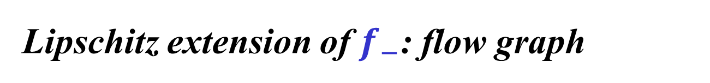



Lipschitz extension of $f_{−}$: flow graph
For a graph G=(V, E), define flow graph of G:
Add edge $(u,v′)$ iff $\left(u,v\right)∈ E$.
$v_{flow}$(G) is the value of the maximum flow in this graph.
Lemma. $v_{flow}$(G)/2 is a Lipschitz extension of $f_{−}$.
1
1
1'
$$d$$
$$d$$
2
2'
s
3
3'
t
4
4'
5
5'

Slide 20



Lipschitz extension of $f_{−}$: flow graph
For a graph G=(V, E), define flow graph of G:
Add edge $(u,v′)$ iff $\left(u,v\right)∈ E$.
$v_{flow}$(G) is the value of the maximum flow in this graph.
Lemma. $v_{flow}$(G)/2 is a Lipschitz extension of $f_{−}$.
Proof: (1) $v_{flow}$(G) =${2f}_{−}\text{(}\text{G}\text{)}$ for all G$∈𝓖_{d}$
(2) $∂ v_{flow}$ = 2⋅$∂_{d}f_{−}$
1
1/
1
1'
$$\deg\left(v\right)/$$
$$d$$
$$\deg\left(v\right)/$$
$$d$$
2
2'
s
3
3'
t
4
4'
5
5'

Slide 21



Lipschitz extension of $f_{−}$: flow graph
For a graph G=(V, E), define flow graph of G:
$v_{flow}$(G) is the value of the maximum flow in this graph.
Lemma. $v_{flow}$(G)/2 is a Lipschitz extension of $f_{−}$.
Proof: (1) $v_{flow}$(G) = ${2f}_{−}\text{(}\text{G}\text{)}$ for all G$∈𝓖_{d}$
(2) $∂ v_{flow}$ = 2⋅$∂_{d}f_{−}$ = 2$d$
1
1
1'
$$d$$
$$d$$
2
2'
s
3
3'
t
4
4'
$$d$$
$$d$$
5
5'
6
6'

Slide 22





Lipschitz extensions via linear/convex programs
For a graph G=([n], E), define LP with variables $x_{T}$ for all triangles $T$:
$v_{LP}$(G) is the value of LP.
Lemma. $v_{LP}$(G) is a Lipschitz extension of $f_{△}$.
Can be generalized to other counting queries
Other queries use convex programs
$$\sum_{T=△ of G}{x_{T}}$$
Maximize
$0≤x_{T}≤1$ for all triangles $T$
for all nodes $v$
$$\sum_{T:v∈V(T)}{x_{T}}≤\left({d \atop 2}\right)$$
$$=∂_{d}f_{△}$$

Slide 23

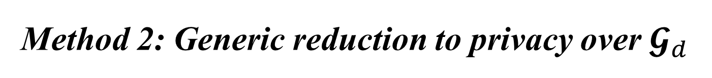

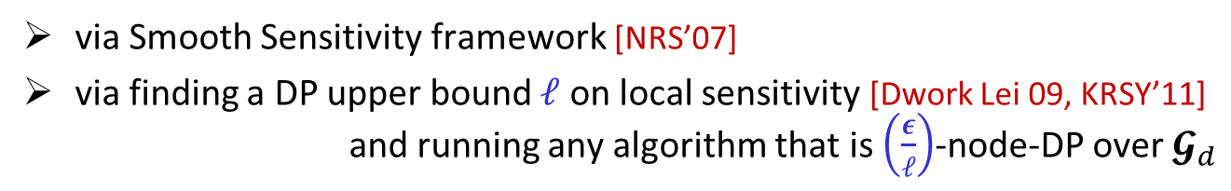
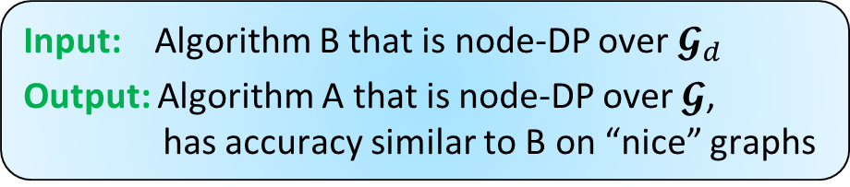



Method 2: Generic reduction to privacy over $𝓖_{d}$
Input: Algorithm B that is node-DP over $𝓖_{d}$
Output: Algorithm A that is node-DP over $𝓖$, has accuracy similar to B on “nice” graphs
Time(A) = Time(B) + O(m+n)
Reduction works for all functions $f$
How it works: Truncation T(G) outputs G with nodes of degree $>d$ removed.
Answer queries on T(G) instead of G
$$𝓖$$
high $∂f$
$$T$$
low $∂_{d}f$
$$𝓖_{d}$$
via Smooth Sensitivity framework [NRS’07]
via finding a DP upper bound $ℓ$ on local sensitivity [Dwork Lei 09, KRSY’11]
and running any algorithm that is $\left(\frac{ε}{ℓ}\right)$-node-DP over $𝓖_{d}$
G
A
T
T(G)
query f
S
$S_{T}$(G)
$f(T\left(G\right))$+ noise$(S_{T}\left(G\right)⋅∂_{d}f)$

Slide 24
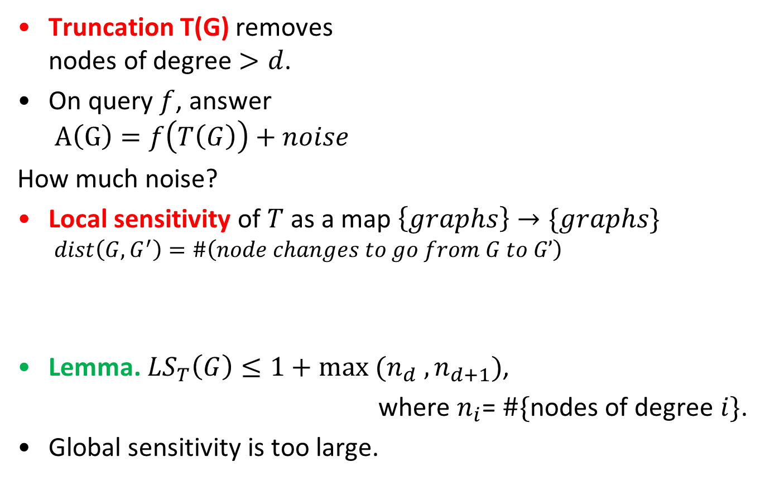
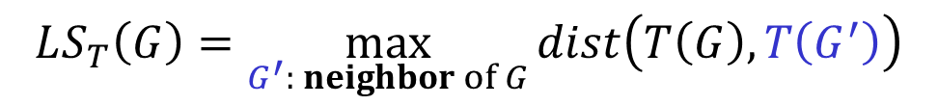
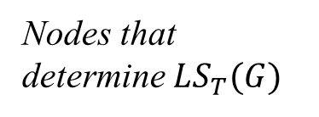
Generic Reduction via Truncation
Truncation T(G) removes nodes of degree $>d$.
On query $f$, answer $A\left(G\right)=f\left(T\left(G\right)\right)+noise$
How much noise?
Local sensitivity of $T$ as a map $\left\{graphs\right\}→\{graphs\}$
$$dist\left(G,G^{′}\right)=\#\left(node changes to go from G to G’\right)$$
Lemma.$LS_{T}\left(G\right)≤1+max (n_{d} , n_{d+1})$,
where $n_{i}$= $\#\{$nodes of degree $i\}$.
Global sensitivity is too large.
Frequency
Nodes that determine $LS_{T}(G)$
…
…
d
Degrees
$$LS_{T}\left(G\right)=\max_{G^{′}: neighbor of G}{dist\left(T\left(G\right),T\left(G^{′}\right)\right)}$$

Slide 25


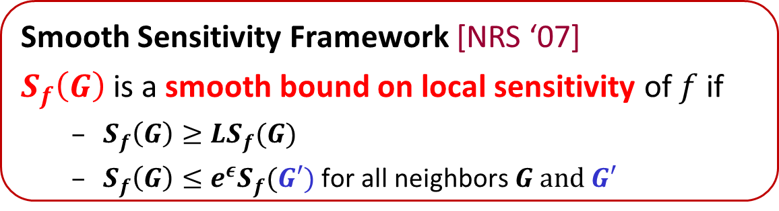

Smooth Sensitivity of Truncation
Smooth Sensitivity Framework [NRS ‘07]
$S_{f}\left(G\right)$is a smooth bound on local sensitivity of$f$if
$S_{f}\left(G\right)≥LS_{f}(G)$
$S_{f}\left(G\right)≤e^{ε}S_{f}(G′)$ for all neighbors$G and G′$
Lemma. $S_{T}\left(G\right)=\max_{k≥0}{e^{−εk}\left(1+\sum_{i=d−\left(k+1\right)}^{d−\left(k+1\right)}{n_{i}}\right) }$ is a smooth bound for $T$, computable in time $O(m+n)$
“Chain rule”: $S_{T}\left(G\right)⋅∂_{d}f$ is a smooth bound for $f∘T$
G
A
T
T(G)
query f
S
$S_{T}$(G)
$f(T\left(G\right))$+ noise$(S_{T}\left(G\right)⋅∂_{d}f)$

Slide 26
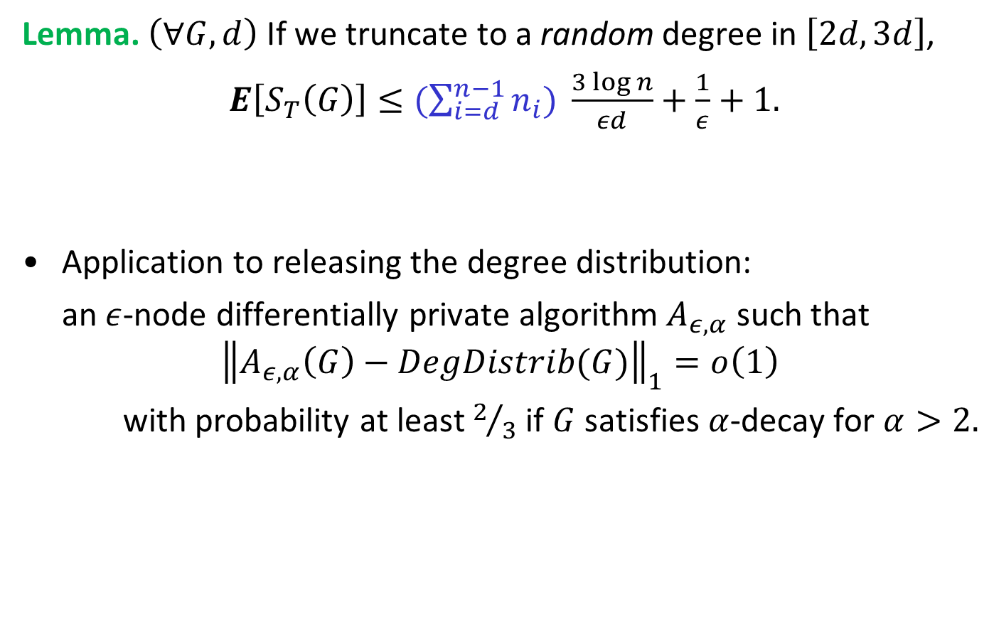
Utility of the Truncation Mechanism
Lemma. $\left(∀G,d\right)$ If we truncate to a random degree in $\left[2d,3d\right]$,
$E\left[S_{T}\left(G\right)\right]≤(\sum_{i=d}^{n−1}{n_{i})} \frac{3 log n}{εd}+\frac{1}{ε}+1.$
Application to releasing the degree distribution:
an $ε$-node differentially private algorithm$A_{ε,α}$ such that
$${\left\|A_{ε,α}\left(G\right)−DegDistrib(G)\right\|}_{1}=o\left(1\right)$$
with probability at least $2/3$ if $G$ satisfies $α$-decay for $α>2.$
Utility: If G is $d$-bounded, expected noise magnitude is $O\left(\frac{{ ∂}_{3d}f}{ε^{2}}\right)$.
G
A
T
T(G)
query f
S
$S_{T}$(G)
$f(T\left(G\right))$+ noise$(S_{T}\left(G\right)⋅∂_{d}f)$

Slide 27

Techniques used to obtain our results
Node differentially private algorithms for releasing
number of edges
counts of small subgraphs
(e.g., triangles, $k$-triangles, $k$-stars)
degree distribution
via Lipschitz extensions
} via generic reduction

Slide 28
Conclusions
It is possible to design node differentially private algorithms with good utility on sparse graphs
One can first test whether the graph is sparse privately
Directions for future work
Node-private algorithm for releasing cuts
Node-private synthetic graphs
What are the right notions of privacy for graph data?

