Slide 1


Beyond Set Disjointness: The Communication Complexity of Finding the Intersection
Grigory Yaroslavtsev
http://grigory.us
Joint with Brody, Chakrabarti, Kondapally and Woodruff

Slide 2

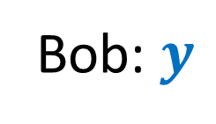

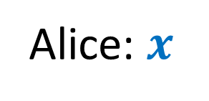



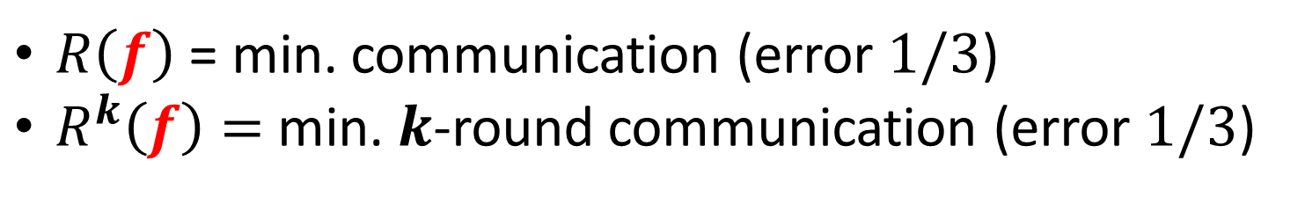
Communication Complexity [Yao’79]
Shared randomness
$M_{1}(x)$
$M_{2}(M_{1}, y)$
$$f(x,y)=?$$
$M_{3}(M_{2}, x)$
…
Alice: $x$
Bob: $y$
$$f(x,y)$$
$R\left(f\right)$ = min. communication (error $1/3$)
$R^{k}\left(f\right)=$ min. $k$-round communication (error $1/3$)

Slide 3


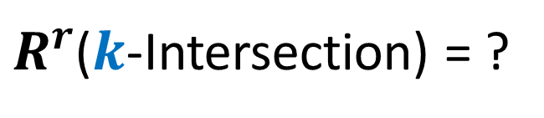
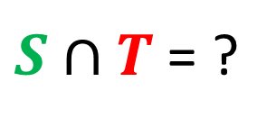

Set Intersection
$x = S, y = T, f\left(x,y\right)= S∩T$
$$S⊆\left[n\right], \left|S\right|≤k$$
$$T⊆\left[n\right], \left|T\right|≤k$$
$S∩T$ = ?
$R^{r}$($k$-Intersection) = ?

Slide 4

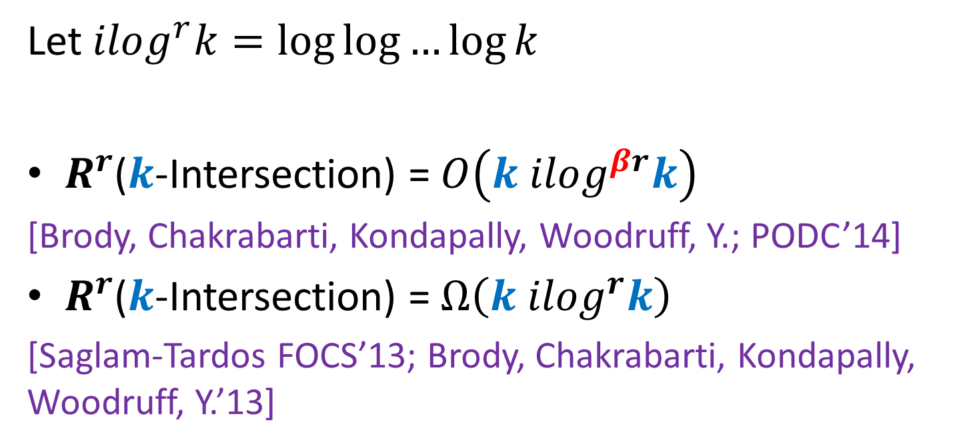
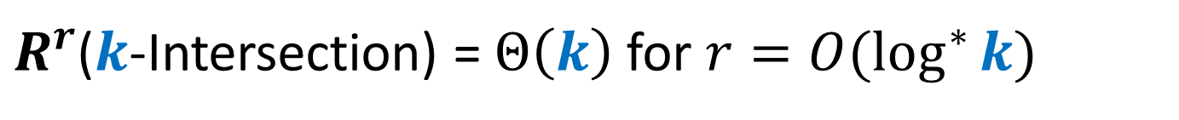
This talk
{
Let $ilog^{r}k=\log{\log{…{\log{k}}}}$
$R^{r}$($k$-Intersection) = $O\left(k ilog^{βr}k\right)$
[Brody, Chakrabarti, Kondapally, Woodruff, Y.; PODC’14]
$R^{r}$($k$-Intersection) = $Ω\left(k ilog^{r}k\right)$
[Saglam-Tardos FOCS’13; Brody, Chakrabarti, Kondapally, Woodruff, Y.’13]
$r$ times
$R^{r}$($k$-Intersection) = $Θ\left(k\right)$ for $r=O(\log^{∗}{k})$

Slide 5

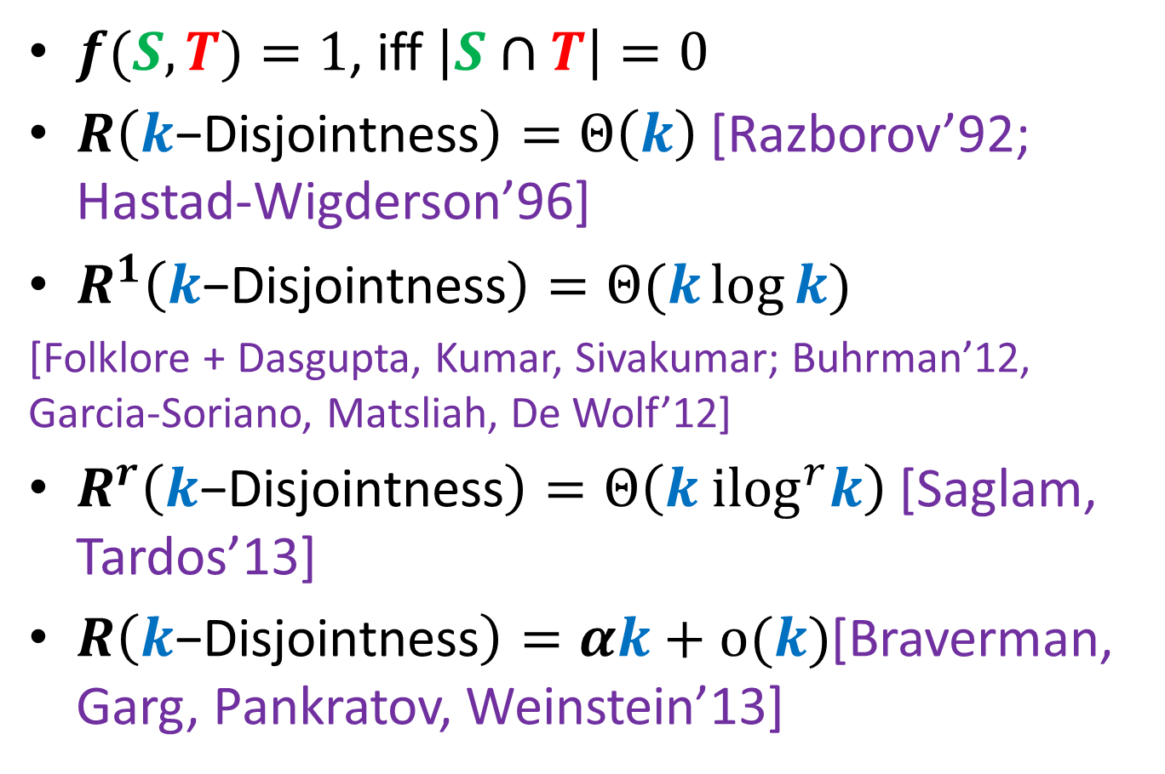
$k$-Disjointness
$f(S,T)=1$, iff $\left|S∩T\right|=0$
$R\left(k\text{−}\text{Disjointness}\right)=Θ\left(k\right)$[Razborov’92; Hastad-Wigderson’96]
$R^{1}\left(k\text{−}\text{Disjointness}\right)=Θ(k\log{k})$
[Folklore + Dasgupta, Kumar, Sivakumar; Buhrman’12, Garcia-Soriano, Matsliah, De Wolf’12]
$R^{r}\left(k\text{−}\text{Disjointness}\right)=Θ\left(k {ilog}^{r}k\right)$[Saglam, Tardos’13]
$R\left(k\text{−}\text{Disjointness}\right)=αk+o(k)$[Braverman, Garg, Pankratov, Weinstein’13]
Notes:
State k-linearity as an open problem

Slide 6
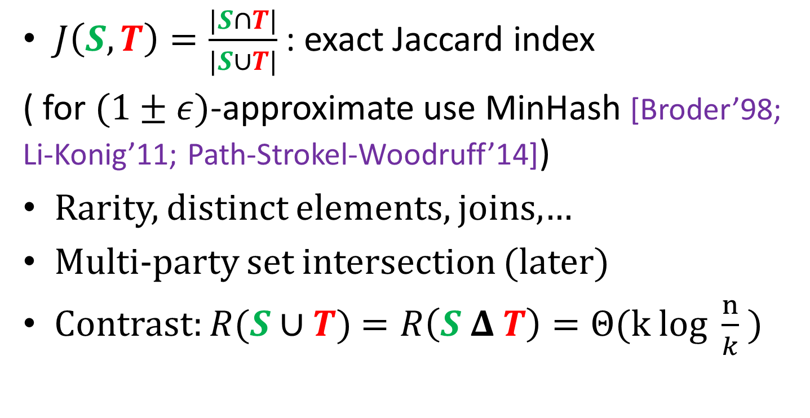
Applications
$J\left(S,T\right)=\frac{|S∩T|}{|S∪T|}$: exact Jaccard index
( for $(1±ε)$-approximate use MinHash [Broder’98; Li-Konig’11; Path-Strokel-Woodruff’14])
Rarity, distinct elements, joins,…
Multi-party set intersection (later)
Contrast: $R(S∪T)$ $=R\left(S Δ T\right)=Θ(k log \frac{n}{k} )$

Slide 7












1-round $O\left(k\log{k}\right)$-protocol
$$\left[n\right]$$
$$\left[n\right]$$
$$S$$
$$T$$
$$h:\left[n\right]→[k^{3}]$$
$$h(S)$$
$$h(T)$$
$$[k^{3}]$$
$$[k^{3}]$$
$\left|h\left(S\right)\right|=O(k log k)$
$\left|h\left(T\right)\right|=O(k log k)$
$S∩T=$ $S∩h^{−1}\left(h\left(T\right)\right)=h^{−1}\left(h\left(S\right)\right)∩T$

Slide 8
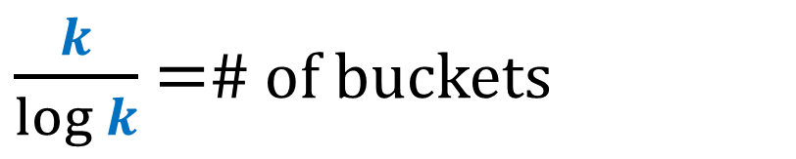


Hashing
$$h:\left[n\right]→[k/\log{k}]$$
Expected
# of elements
$$log⁡k$$
$\frac{k}{\log{k}}$ =# of buckets

Slide 9

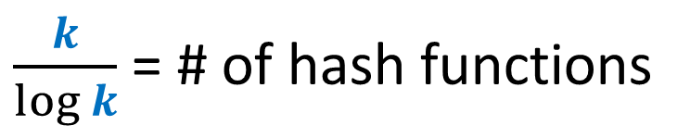

Secondary Hashing
$h_{1}…h_{\frac{k}{\log{k}}},$ where $h_{i}:\left[n\right]→[\log^{3}{k}]$
$$\log^{3}{k}$$
$\frac{k}{\log{k}}$ = # of hash functions

Slide 10






2-Round $O\left(k\log{\log{k}}\right)$-protocol
$$\log^{3}{k}$$
$$\log^{3}{k}$$
$\frac{k}{\log{k}}$
$\frac{k}{\log{k}}$
$$\left|h_{i}\left(S\right)\right|=\left|h_{i}\left(T\right)\right|=O\left(\log{k}\log{\log{k}}\right)$$
Total communication = $\frac{k}{\log{k}}$ $O\left(\log{k}\log{\log{k}}\right)$ = O($k \log{\log{k}}$)

Slide 11


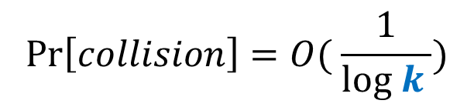
Collisions
$$\operatorname{Pr}\left[collision\right]=O( \frac{1}{log k })$$
$$\log^{3}{k}$$
$$\frac{k}{\log{k}}$$

Slide 12







Collisions
$$\log^{3}{k}$$
$$\log^{3}{k}$$
$\frac{k}{\log{k}}$
$\frac{k}{\log{k}}$
$S∩T⊆S∩ h^{−1}\left(\right)$
$S∩T⊆T∩ h^{−1}\left(\right)$

Slide 13
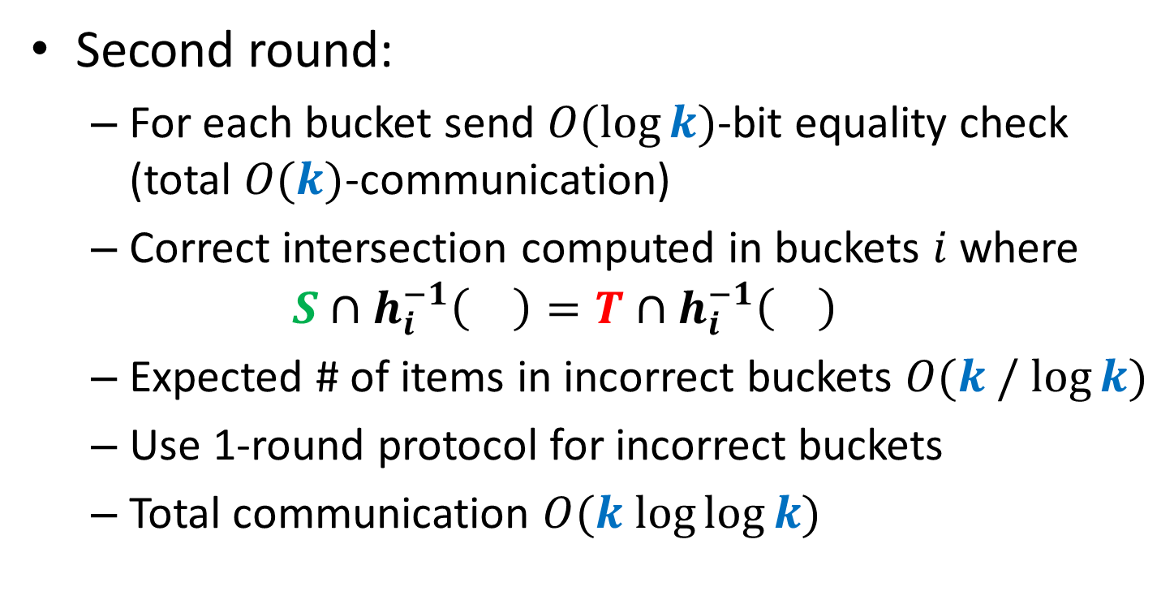
Collisions
Second round:
For each bucket send $O(\log{k})$-bit equality check (total $O(k)$-communication)
Correct intersection computed in buckets $i$ where
$$S∩h_{i}^{−1}\left(\right)=T∩h_{i}^{−1}\left(\right)$$
Expected # of items in incorrect buckets $O(k / log⁡k)$
Use 1-round protocol for incorrect buckets
Total communication $O(k log⁡log⁡k)$

Slide 14
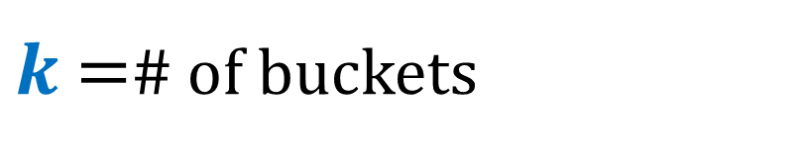


Main protocol
$$h:\left[n\right]→[k]$$
Expected
# of elements
$$O(1)$$
$k$ =# of buckets

Slide 15
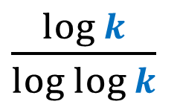
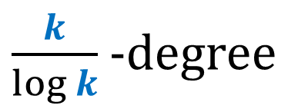
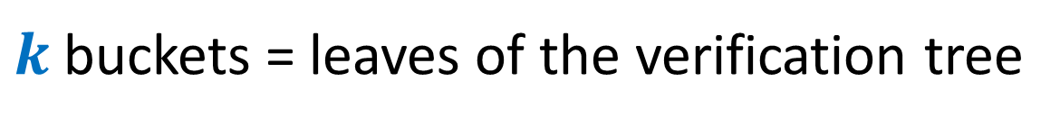

Verification tree
$\frac{k}{\log{k}}$ -degree
$\frac{\log{k}}{log log{k}}$
…
$$\log^{r−1 }{k}$$
$k$buckets = leaves of the verification tree

Slide 16






Verification bottom-up
$$S_{1}^{}∪S_{2}, T_{1}^{}∪T_{2}$$
$$S_{1}^{}, T_{1}^{}$$
$$S_{2}^{}, T_{2}^{}$$
$$\left(S_{1}^{}∪S_{2}\right)∩{(T}_{1}^{}∪T_{2})$$
$$S_{1}^{}∩T_{1}^{}$$
$$S_{2}^{}∩T_{2}^{}$$

Slide 17

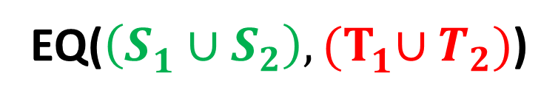





Verification bottom-up
Incorrect
$$\left(S_{1}^{}∪S_{2}\right)∩{(T}_{1}^{}∪T_{2})$$
Correct
Incorrect
$$S_{1}^{}∩T_{1}^{}$$
$$S_{2}^{}∩T_{2}^{}$$
EQ($\left(S_{1}^{}∪S_{2}\right),{(T}_{1}^{}∪T_{2})$)
$$\left(S_{1}^{}∪S_{2}\right)∩{(T}_{1}^{}∪T_{2})$$
Correct
Incorrect
$$S_{1}^{}∩T_{1}^{}$$
$$S_{2}^{}∩T_{2}^{}$$

Slide 18
Verification bottom-up
Incorrect
$$\left(S_{1}^{}∪S_{2}\right)∩{(T}_{1}^{}∪T_{2})$$
Correct
Incorrect
$$S_{1}^{}∩T_{1}^{}$$
$$S_{2}^{}∩T_{2}^{}$$
EQ($\left(S_{1}^{}∪S_{2}\right),{(T}_{1}^{}∪T_{2})$)
Correct
$$\left(S_{1}^{}∪S_{2}\right)∩{(T}_{1}^{}∪T_{2})$$
Correct
Correct
Incorrect
$$S_{1}^{}∩T_{1}^{}$$
$$S_{2}^{}∩T_{2}^{}$$

Slide 19







Verification bottom-up
$$p_{r−1}$$
$$p_{r−2}$$
…
$$p_{1}$$
…
…
$$S_{1}^{1}, T_{1}^{1}$$
$$S_{2}^{1}, T_{2}^{1}$$
$$S_{i}^{1}, T_{i}^{1}$$
$$S_{k}^{1}, T_{k}^{1}$$

Slide 20
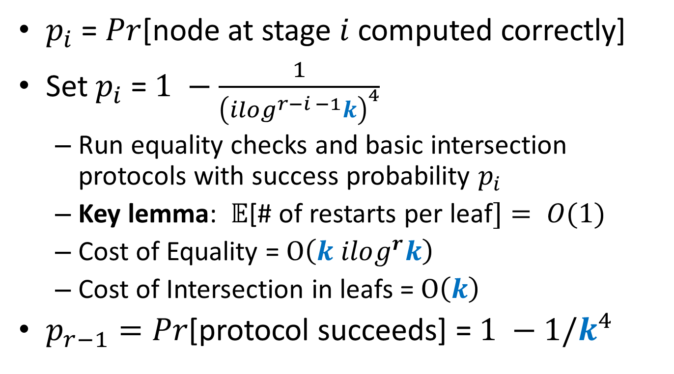

Analysis of Stage $i$
$p_{i}$ = $Pr$[node at stage $i$ computed correctly]
Set $p_{i}$ = $1 −\frac{1}{{\left(ilog^{r−i −1}k\right)}^{4}}$
Run equality checks and basic intersection protocols with success probability $p_{i}$
Key lemma: $𝔼$[# of restarts per leaf$]= O(1)$
Cost of Equality = $O\left(k ilog^{r}k\right)$
Cost of Intersection in leafs = $O\left(k\right)$
$p_{r−1}=Pr$[protocol succeeds] = $1 −1/k^{4}$

Slide 21
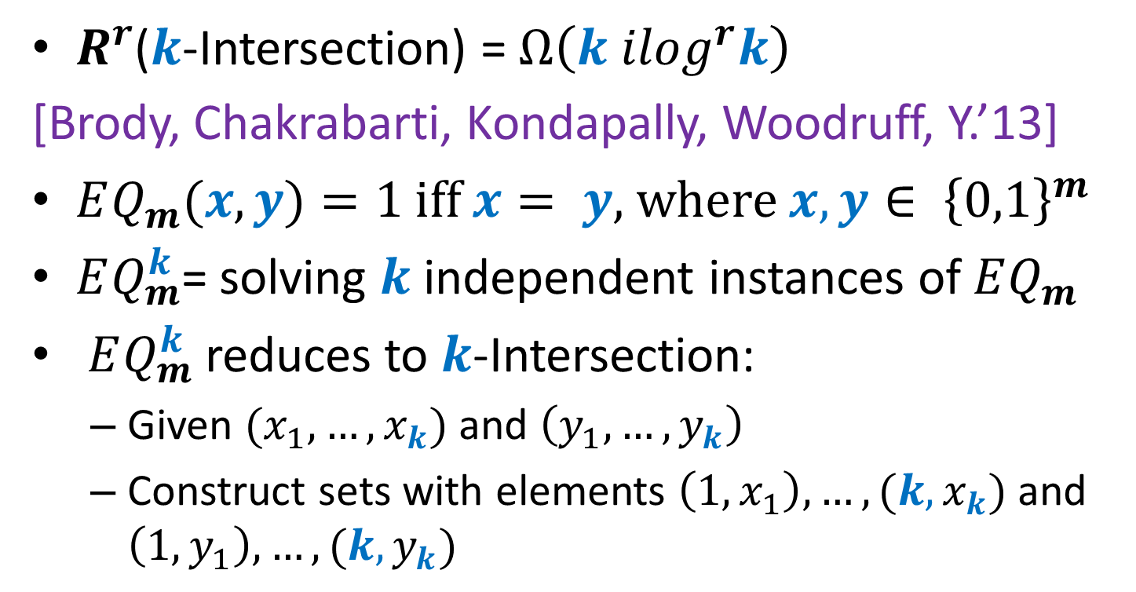
Lower Bound
$R^{r}$($k$-Intersection) = $Ω\left(k ilog^{r}k\right)$
[Brody, Chakrabarti, Kondapally, Woodruff, Y.’13]
$EQ_{m}(x,y)=1$ iff $x= y$, where $x,y∈ {\left\{0,1\right\}}^{m}$
$EQ_{m}^{k}$= solving $k$ independent instances of $EQ_{m}$
$EQ_{m}^{k}$ reduces to $k$-Intersection:
Given $(x_{1},…, x_{k})$ and $\left(y_{1},…, y_{k}\right)$
Construct sets with elements $\left(1,x_{1}\right), …, (k, x_{k})$ and $\left(1,y_{1}\right), …, (k, y_{k})$

Slide 22
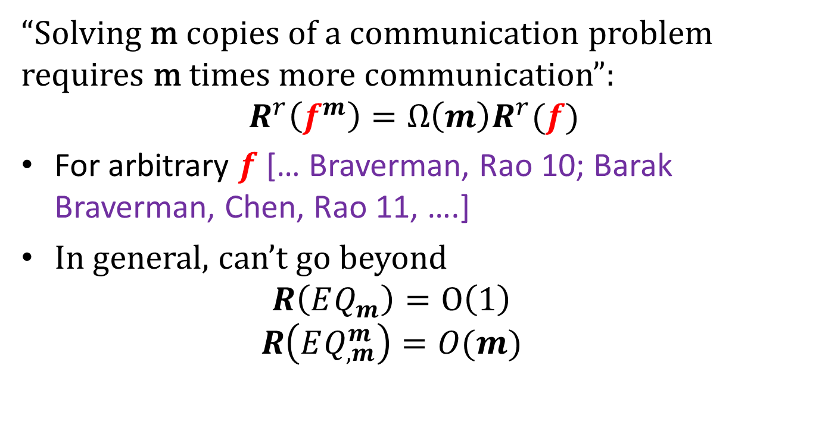
Communication Direct Sums
“Solving m copies of a communication problem requires m times more communication”:
$$R^{r}\left(f^{m}\right)=Ω\left(m\right)R^{r}(f)$$
For arbitrary $f$ [… Braverman, Rao 10; Barak Braverman, Chen, Rao 11, ….]
In general, can’t go beyond
$$R\left(EQ_{m}^{}\right)=O\left(1\right)$$
$$R\left(EQ_{,m}^{m}\right)=O(m)$$

Slide 23
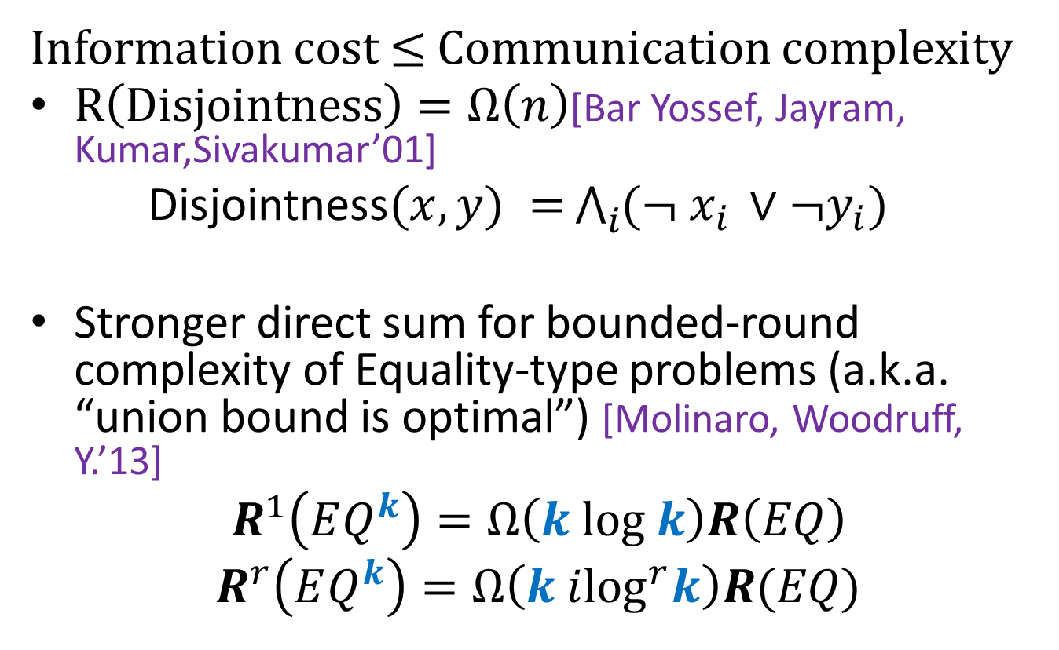
Specialized Communication Direct Sums
Information cost $≤$ Communication complexity
$R\left(Disjointness\right)=Ω\left(n\right)$[Bar Yossef, Jayram, Kumar,Sivakumar’01]
Disjointness$(x,y) =$ $\bigwedge_{i}{({¬ x}_{i }∨¬y_{i})}$
Stronger direct sum for bounded-round complexity of Equality-type problems (a.k.a. “union bound is optimal”) [Molinaro, Woodruff, Y.’13]
$$R^{1}\left(EQ^{k}\right)=Ω\left(k log k\right)R\left(EQ\right)$$
$$R^{r}\left(EQ^{k}\right)=Ω\left(k i\log^{r}k\right)R(EQ)$$

Slide 24
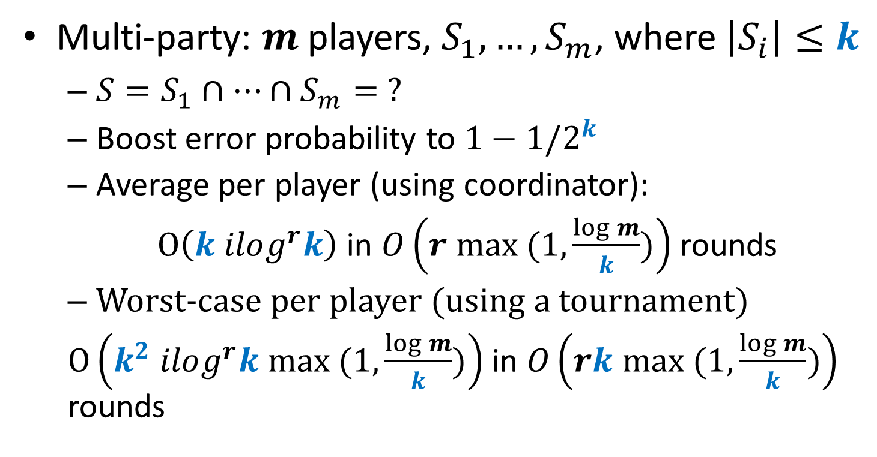
Extensions
Multi-party: $m$players, $S_{1},…, S_{m}$, where $\left|S_{i}\right|≤k$
$S=S_{1}∩…∩S_{m}= ?$
Boost error probability to $1−1/2^{k}$
Average per player (using coordinator):
$O\left(k ilog^{r}k\right)$ in $O\left(r max (1, \frac{\log{m}}{k})\right)$ rounds
Worst-case per player (using a tournament)
$O\left(k^{2} ilog^{r}k max (1, \frac{\log{m}}{k})\right)$ in $O\left(rk max (1, \frac{\log{m}}{k})\right)$ rounds

Slide 25

Open Problems
$R^{r}$($k$-Intersection) = $O\left(k ilog^{r}k\right) ?$
Better protocols for the multi-party setting

