Slide 1
CSCI B609: “Foundations of Data Science”
Lecture 13/14: Gradient Descent, Boosting and Learning from Experts
Slides at http://grigory.us/data-science-class.html
Grigory Yaroslavtsev
http://grigory.us

Slide 2
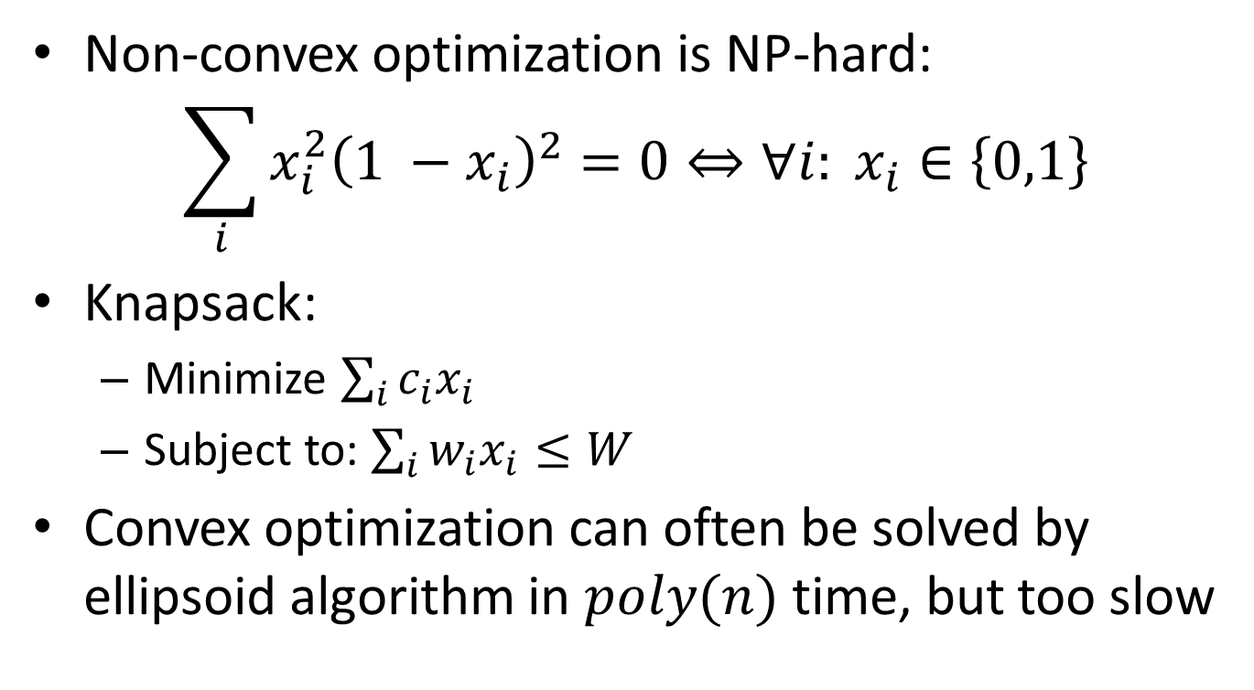
Constrained Convex Optimization
Non-convex optimization is NP-hard:
$$\sum_{i}{x_{i}^{2}{\left(1 −x_{i}\right)}^{2}=0}⇔∀i: x_{i}∈\left\{0,1\right\}$$
Knapsack:
Minimize $\sum_{i}{c_{i}x_{i}}$
Subject to: $\sum_{i}{w_{i}x_{i}≤W}$
Convex optimization can often be solved by ellipsoid algorithm in $poly(n)$ time, but too slow

Slide 3
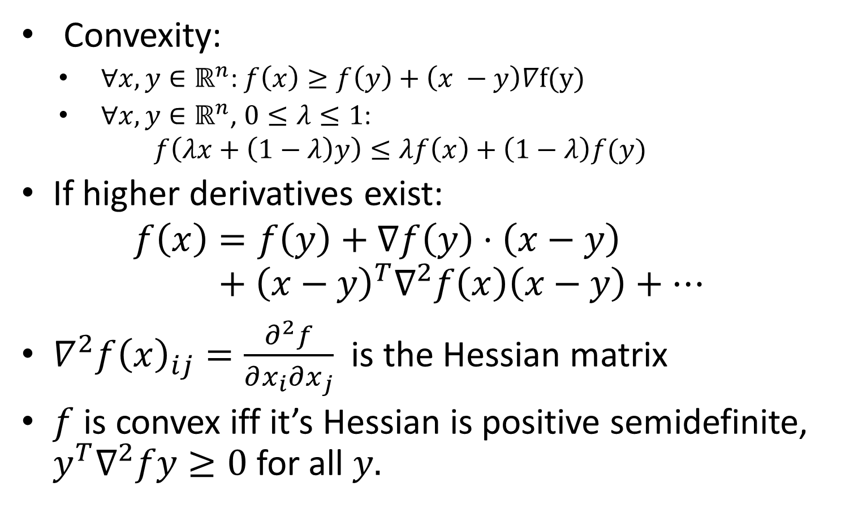
Convex multivariate functions
Convexity:
$∀x,y∈ℝ^{n}$: $f\left(x\right)≥f\left(y\right)+\left(x −y\right)∇f(y)$
$∀x,y∈ℝ^{n}$, $0≤λ≤1$:
$$f\left(λx+\left(1−λ\right)y\right)≤λf\left(x\right)+\left(1−λ\right)f(y)$$
If higher derivatives exist:
$$f\left(x\right)=f\left(y\right)+∇f\left(y\right)⋅\left(x−y\right)+{\left(x−y\right)}^{T}∇^{2}f\left(x\right)\left(x−y\right)+…$$
$∇^{2}f{\left(x\right)}_{ij}=\frac{∂^{2}f}{∂x_{i}∂x_{j}}$ is the Hessian matrix
$f$ is convex iff it’s Hessian is positive semidefinite, $y^{T}∇^{2}fy≥0$ for all $y.$

Slide 4
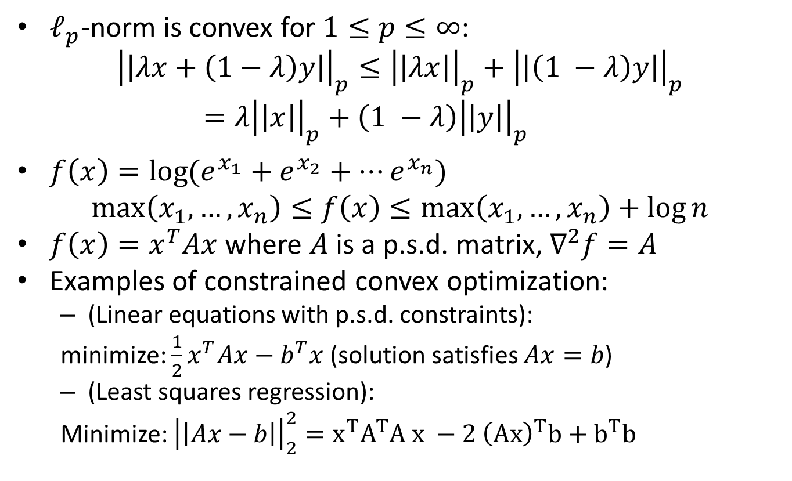
Examples of convex functions
$ℓ_{p}$-norm is convex for $1≤p≤∞$:
$${\left|\left|λx+\left(1−λ\right)y\right|\right|}_{p}≤{\left|\left|λx\right|\right|}_{p}+{\left|\left|\left(1 −λ\right)y\right|\right|}_{p}=λ{\left|\left|x\right|\right|}_{p}+\left(1 −λ\right){\left|\left|y\right|\right|}_{p}$$
$f\left(x\right)=\log{(e_{}^{x_{1}}+e_{}^{x_{2}}+⋯e_{}^{x_{n}})}$
$$\max\left(x_{1},…, x_{n}\right)≤f\left(x\right)≤\max\left(x_{1},…, x_{n}\right)+\log{n}$$
$f\left(x\right)=x^{T}Ax$ where $A$ is a p.s.d. matrix, $∇^{2}f=A$
Examples of constrained convex optimization:
(Linear equations with p.s.d. constraints):
minimize: $\frac{1}{2}x^{T}Ax−b^{T}x$ (solution satisfies $Ax=b$)
(Least squares regression):
Minimize: ${\left|\left|Ax−b\right|\right|}_{2}^{2}=x^{T}A^{T}A x −2 {\left(Ax\right)}^{T}b+b^{T}b$

Slide 5
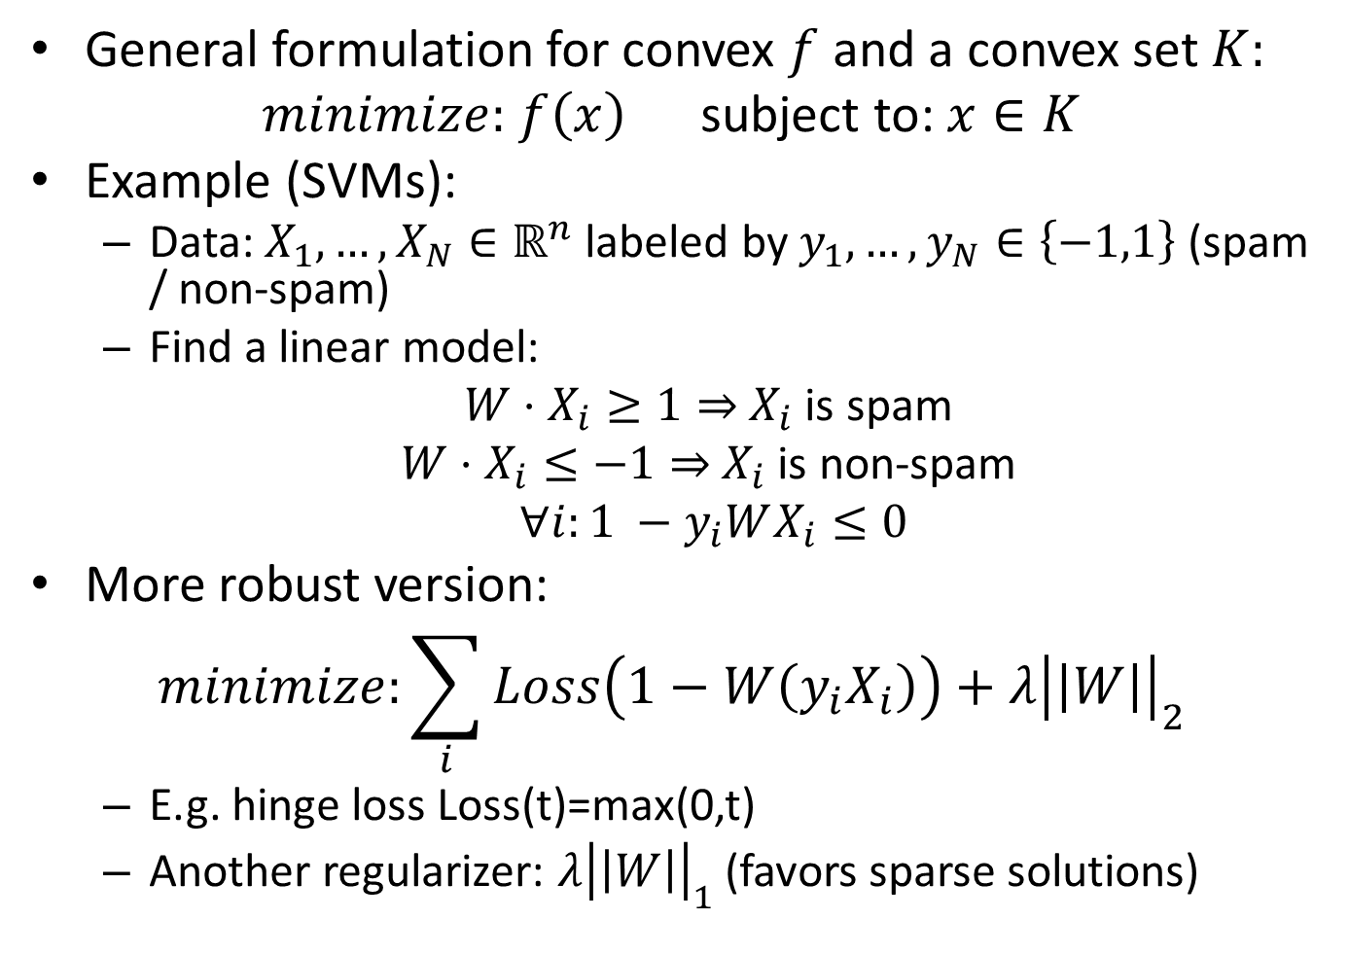
Constrained Convex Optimization
General formulation for convex $f$ and a convex set $K:$
$minimize:$ $f\left(x\right)$ subject to: $x∈K$
Example (SVMs):
Data: $X_{1},…,X_{N}∈ℝ^{n}$ labeled by $y_{1},…, y_{N}∈\left\{−1,1\right\}$ (spam / non-spam)
Find a linear model:
$W⋅X_{i}≥1⇒$ $X_{i}$ is spam
$W⋅X_{i}≤−1⇒$ $X_{i}$ is non-spam
$∀i:1 −y_{i}WX_{i}≤0$
More robust version:
$$minimize:\sum_{i}{Loss\left(1−W\left(y_{i}X_{i}\right)\right)+λ{\left|\left|W\right|\right|}_{2}^{}}$$
E.g. hinge loss Loss(t)=max(0,t)
Another regularizer: ${λ\left|\left|W\right|\right|}_{1}$ (favors sparse solutions)

Slide 6
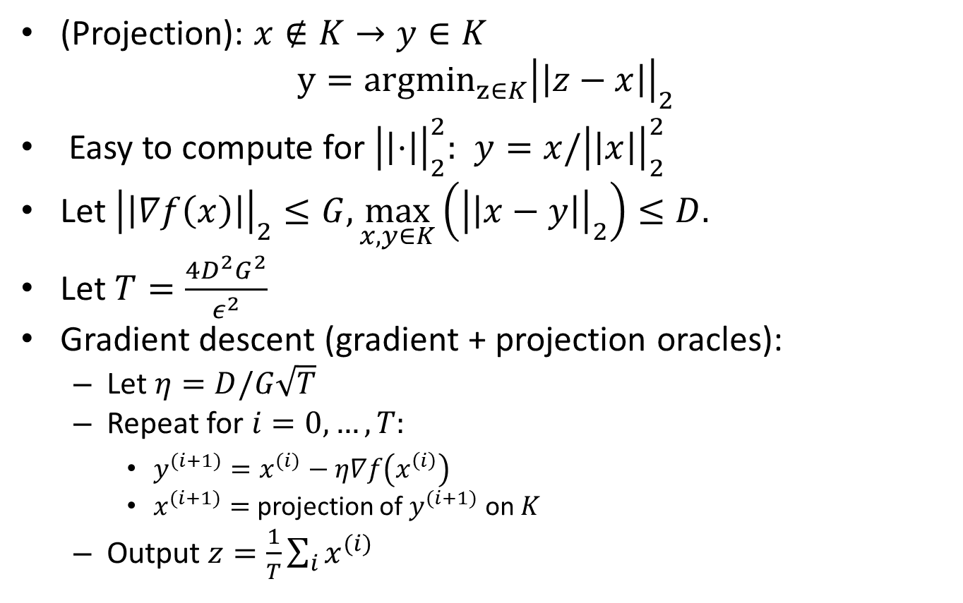
Gradient Descent for Constrained Convex Optimization
(Projection): $x∉K→y∈K$
$$y={argmin}_{z∈K}{\left|\left|z−x\right|\right|}_{2}$$
Easy to compute for ${\left|\left|⋅\right|\right|}_{2}^{2}:$ $y=x/{\left|\left|x\right|\right|}_{2}^{2}$
Let ${\left|\left|∇f\left(x\right)\right|\right|}_{2}≤G,\max_{x,y∈K}\left({\left|\left|x−y\right|\right|}_{2}\right)≤D.$
Let $T=\frac{4D^{2}G^{2}}{ε^{2}}$
Gradient descent (gradient + projection oracles):
Let $η=D/G\sqrt{T}$
Repeat for $i=0, …, T:$
$y^{(i+1)}=x^{(i)}−η∇f\left(x^{\left(i\right)}\right)$
$x^{(i+1)}=$ projection of $y^{(i+1)}$ on $K$
Output $z=\frac{1}{T}\sum_{i}{x^{(i)}}$

Slide 7
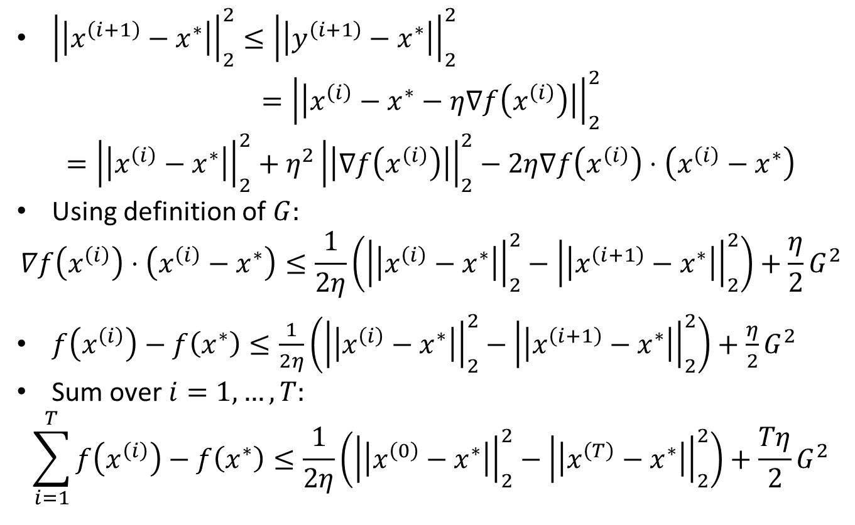
Gradient Descent for Constrained Convex Optimization
${\left|\left|x^{\left(i+1\right)}−x^{∗}\right|\right|}_{2}^{2}≤{\left|\left|y^{\left(i+1\right)}−x^{∗}\right|\right|}_{2}^{2}$
$$={\left|\left|x^{\left(i\right)}−x^{∗}−η∇f\left(x^{\left(i\right)}\right)\right|\right|}_{2}^{2}$$
$$={\left|\left|x^{\left(i\right)}−x^{∗}\right|\right|}_{2}^{2}+η^{2}{\left|\left|∇f\left(x^{\left(i\right)}\right)\right|\right|}_{2}^{2}−2η∇f\left(x^{\left(i\right)}\right)⋅\left(x^{\left(i\right)}−x^{∗}\right)$$
Using definition of $G:$
$$∇f\left(x^{\left(i\right)}\right)⋅\left(x^{\left(i\right)}−x^{∗}\right)≤\frac{1}{2η}\left({\left|\left|x^{\left(i\right)}−x^{∗}\right|\right|}_{2}^{2}−{\left|\left|x^{\left(i+1\right)}−x^{∗}\right|\right|}_{2}^{2}\right)+\frac{η}{2}G^{2}$$
$f\left(x^{\left(i\right)}\right)−f\left(x^{∗}\right)≤\frac{1}{2η}\left({\left|\left|x^{\left(i\right)}−x^{∗}\right|\right|}_{2}^{2}−{\left|\left|x^{\left(i+1\right)}−x^{∗}\right|\right|}_{2}^{2}\right)+\frac{η}{2}G^{2}$
Sum over $i=1,…, T:$
$$\sum_{i=1}^{T}{f\left(x^{\left(i\right)}\right)−f\left(x^{∗}\right)}≤\frac{1}{2η}\left({\left|\left|x^{\left(0\right)}−x^{∗}\right|\right|}_{2}^{2}−{\left|\left|x^{\left(T\right)}−x^{∗}\right|\right|}_{2}^{2}\right)+\frac{Tη}{2}G^{2}$$

Slide 8
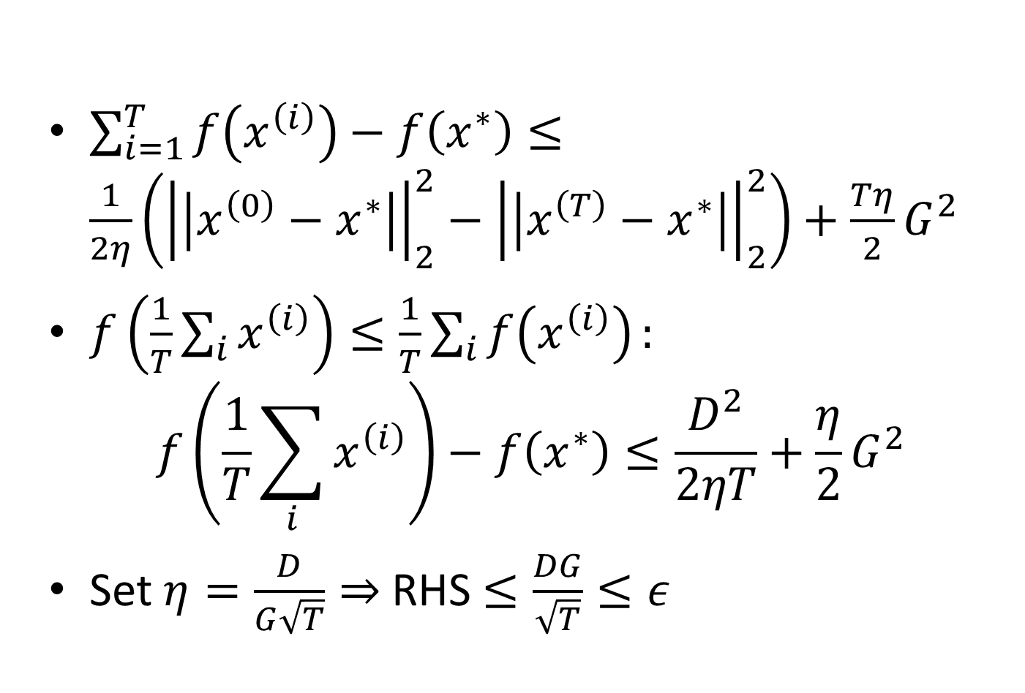
Gradient Descent for Constrained Convex Optimization
$\sum_{i=1}^{T}{f\left(x^{\left(i\right)}\right)−f\left(x^{∗}\right)}≤\frac{1}{2η}\left({\left|\left|x^{\left(0\right)}−x^{∗}\right|\right|}_{2}^{2}−{\left|\left|x^{\left(T\right)}−x^{∗}\right|\right|}_{2}^{2}\right)+\frac{Tη}{2}G^{2}$
$f\left(\frac{1}{T}\sum_{i}{x^{\left(i\right)}}\right)≤\frac{1}{T}\sum_{i}{f\left(x^{\left(i\right)}\right)}:$
$$f\left(\frac{1}{T}\sum_{i}{x^{\left(i\right)}}\right)−f\left(x^{∗}\right)≤\frac{D^{2}}{2ηT}+\frac{η}{2}G^{2}$$
Set $η=\frac{D}{G\sqrt{T}}⇒$ RHS $≤\frac{DG}{\sqrt{T}}≤ε$

Slide 9
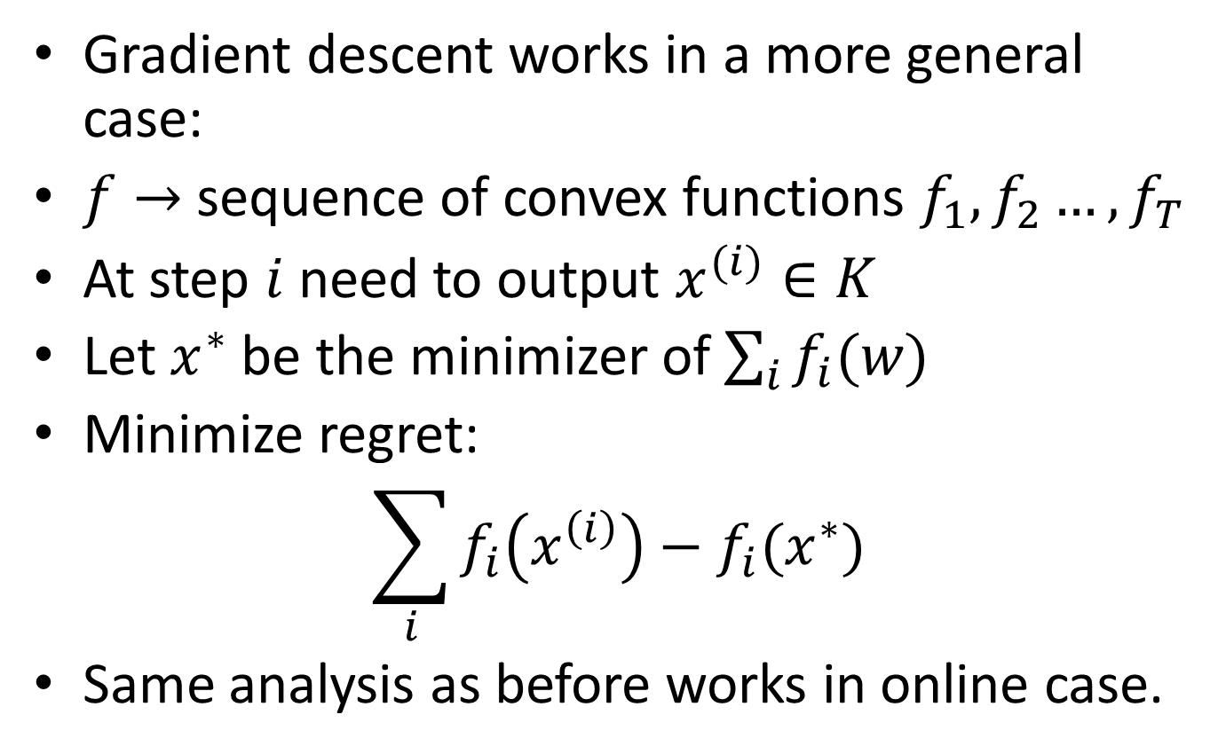
Online Gradient Descent
Gradient descent works in a more general case:
$f→$ sequence of convex functions $f_{1},f_{2}…, f_{T}$
At step $i$ need to output $x^{(i)}∈K$
Let $x^{∗}$ be the minimizer of $\sum_{i}{f_{i}(w)}$
Minimize regret:
$$\sum_{i}{f_{i}\left(x^{\left(i\right)}\right)−f_{i}(x^{∗})}$$
Same analysis as before works in online case.

Slide 10
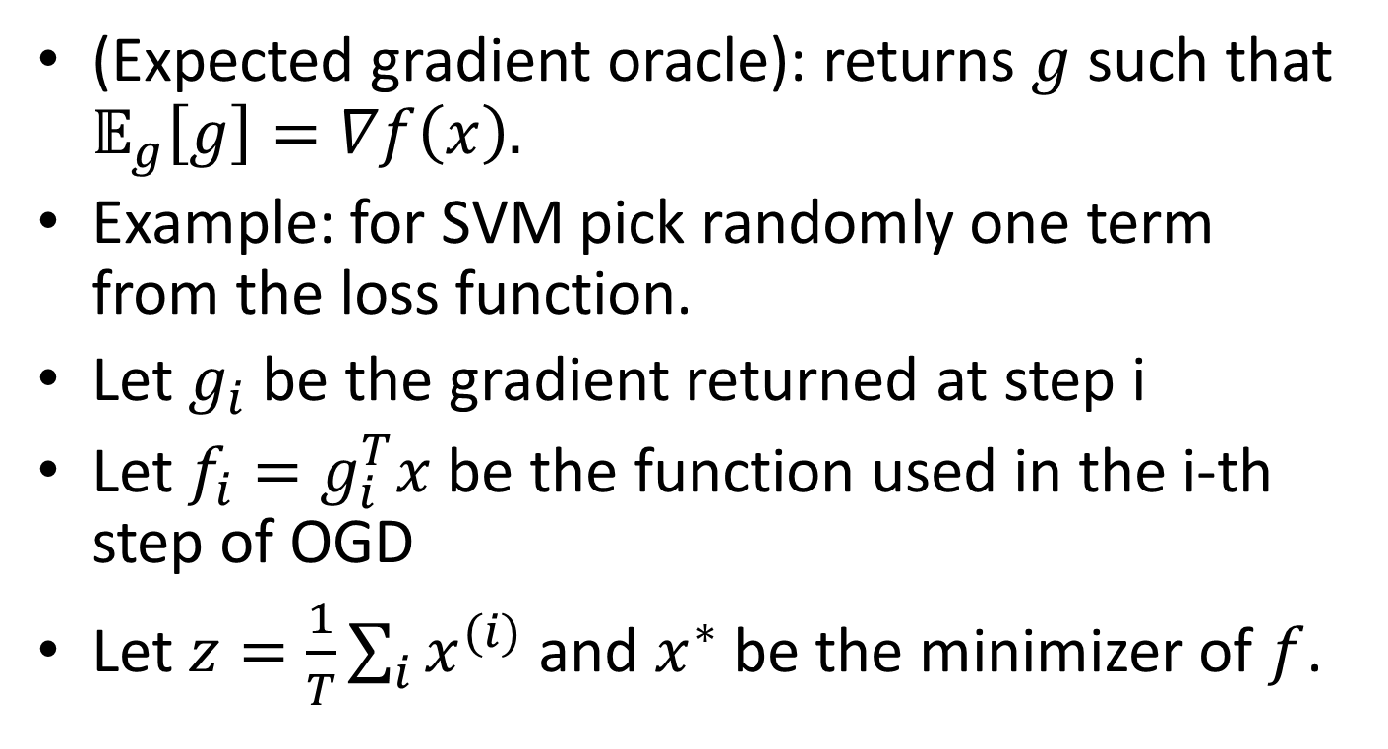
Stochastic Gradient Descent
(Expected gradient oracle): returns $g$such that $𝔼_{g}\left[g\right]=∇f\left(x\right).$
Example: for SVM pick randomly one term from the loss function.
Let $g_{i}$ be the gradient returned at step i
Let $f_{i}=g_{i}^{T}x$ be the function used in the i-th step of OGD
Let $z=\frac{1}{T}\sum_{i}{x^{(i)}}$ and $x^{∗}$ be the minimizer of $f$.

Slide 11
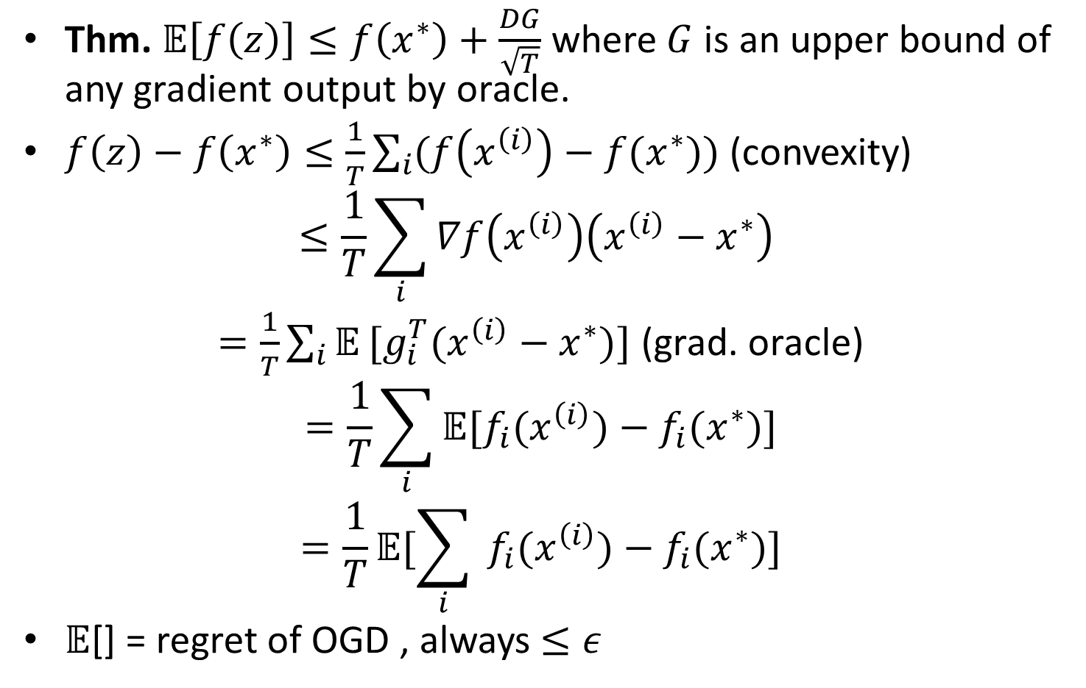
Stochastic Gradient Descent
Thm. 𝔼$\left[f\left(z\right)\right]≤f\left(x^{∗}\right)+\frac{DG}{\sqrt{T}}$ where $G$ is an upper bound of any gradient output by oracle.
$f\left(z\right)−f\left(x^{∗}\right)≤\frac{1}{T}\sum_{i}{(f\left(x^{\left(i\right)}\right)−f(x^{∗}))}$ (convexity)
$$≤\frac{1}{T}\sum_{i}{∇f\left(x^{\left(i\right)}\right)\left(x^{\left(i\right)}−x^{∗}\right)}$$
$=\frac{1}{T}\sum_{i}{𝔼}[g_{i}^{T}(x^{\left(i\right)}−x^{∗})]$ (grad. oracle)
$$=\frac{1}{T}\sum_{i}{𝔼[f_{i}(x^{\left(i\right)})−{f_{i}(x}^{∗})]}$$
$$=\frac{1}{T}𝔼[\sum_{i}{ f_{i}(x^{\left(i\right)})−{f_{i}(x}^{∗})]}$$
$𝔼$[] = regret of OGD , always $≤ε$

Slide 12
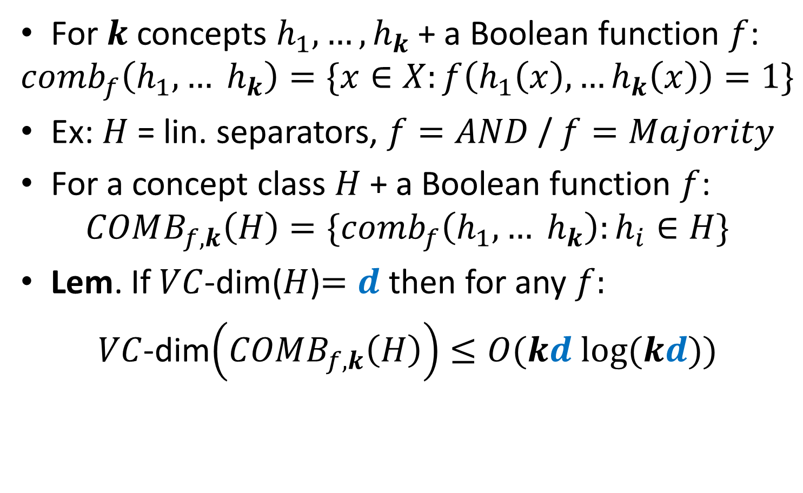
VC-dim of combinations of concepts
For $k$ concepts $h_{1},…, h_{k}$ + a Boolean function $f$:
$$comb_{f}\left(h_{1},… h_{k}\right)=\{x∈X:f\left(h_{1}\left(x\right),…h_{k}\left(x\right)\right)=1\}$$
Ex: $H$ = lin. separators, $f=AND$ / $f=Majority$
For a concept class $H$ + a Boolean function $f$:
$$COMB_{f,k}\left(H\right)=\{comb_{f}\left(h_{1},… h_{k}\right):h_{i}∈H\}$$
Lem. If $VC$-dim($H$)$=d$ then for any $f:$
$VC$-dim$\left(COMB_{f,k}\left(H\right)\right)≤O(kd log(kd))$

Slide 13
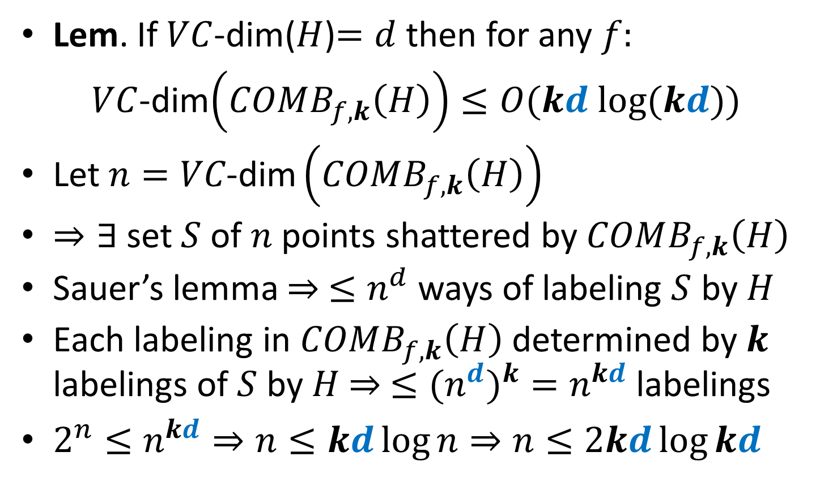
VC-dim of combinations of concepts
Lem. If $VC$-dim($H$)$=d$ then for any $f:$
$VC$-dim$\left(COMB_{f,k}\left(H\right)\right)≤O(kd log(kd))$
Let $n=VC\text{-}\text{dim}\left(COMB_{f,k}\left(H\right)\right)$
$⇒∃$ set $S$ of $n$ points shattered by $COMB_{f,k}\left(H\right)$
Sauer’s lemma $⇒ ≤n^{d}$ ways of labeling $S$ by $H$
Each labeling in $COMB_{f,k}\left(H\right)$ determined by $k$ labelings of $S$ by $H$ $⇒ ≤{{(n}^{d})}^{k}=n^{kd}$ labelings
$2^{n}≤n^{kd}⇒n≤kd\log{n}⇒n≤2kd\log{kd}$

Slide 14
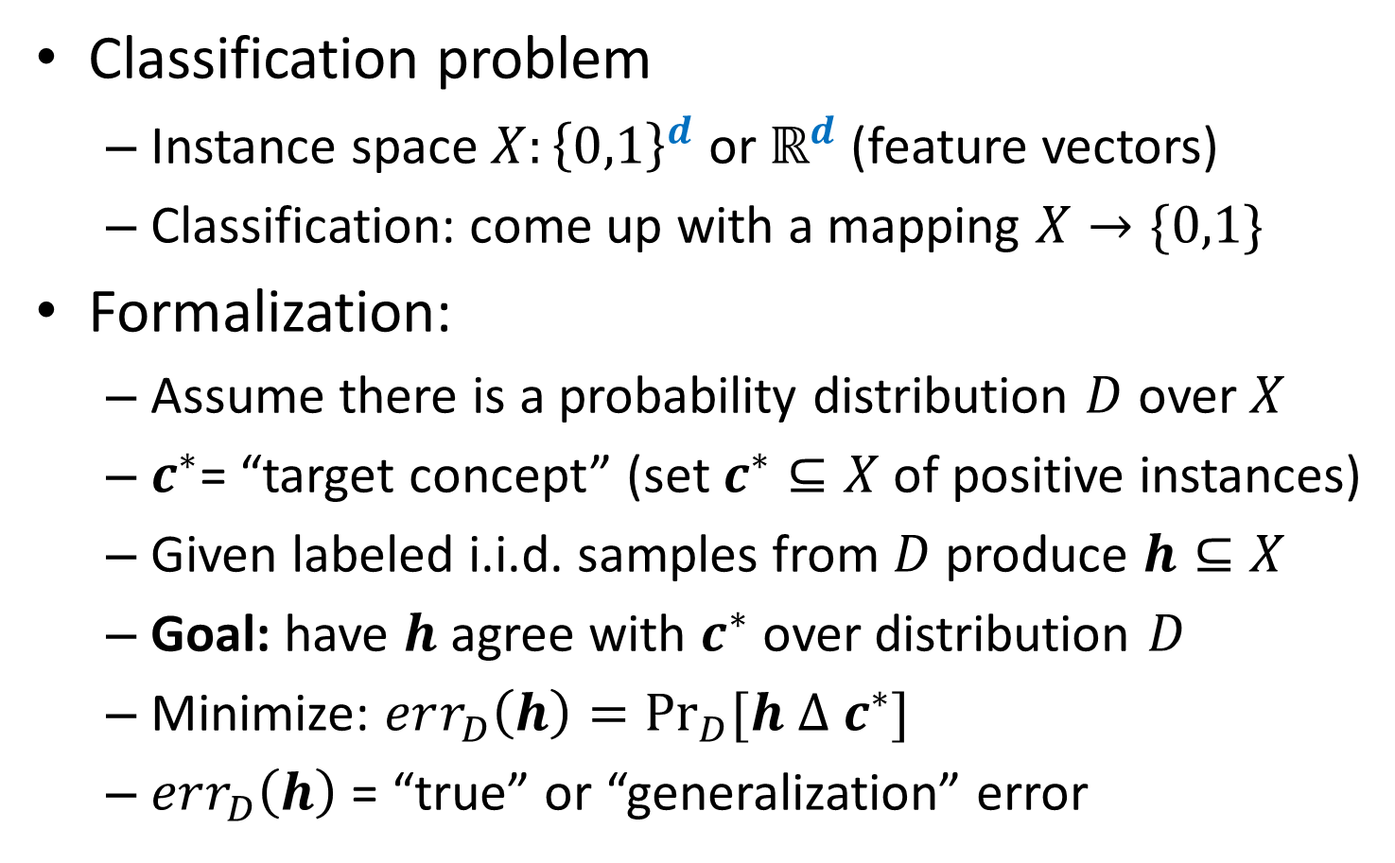
Back to the batch setting
Classification problem
Instance space $X:{\left\{0,1\right\}}^{d}$ or $ℝ^{d}$ (feature vectors)
Classification: come up with a mapping $X→\{0,1\}$
Formalization:
Assume there is a probability distribution $D$ over $X$
$c^{∗}$= “target concept” (set $c^{∗}⊆X$ of positive instances)
Given labeled i.i.d. samples from $D$ produce $h⊆X$
Goal: have $h$ agree with $c^{∗}$ over distribution $D$
Minimize: $err_{D}\left(h\right)=\underset{D}{Pr}{[h Δ c^{∗}]}$
$err_{D}\left(h\right)$ = “true” or “generalization” error

Slide 15
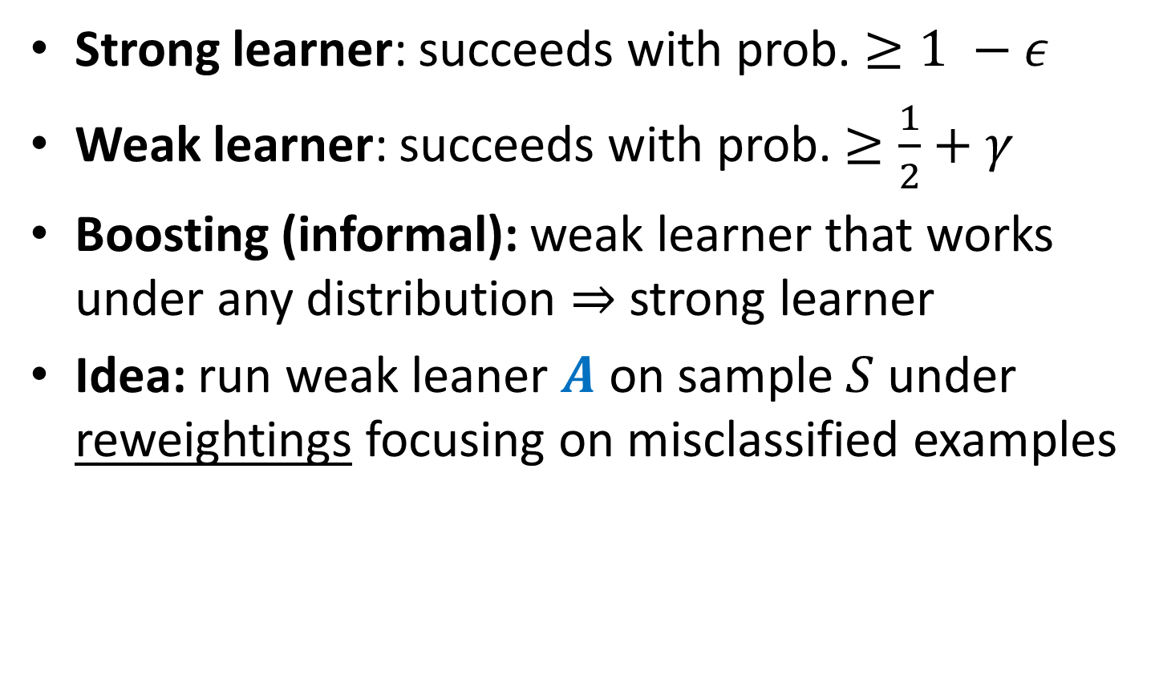
Boosting
Strong learner: succeeds with prob. $≥1 −ε$
Weak learner: succeeds with prob. $≥\frac{1}{2}+γ$
Boosting (informal): weak learner that works under any distribution $⇒$ strong learner
Idea: run weak leaner $A$ on sample $S$ under reweightings focusing on misclassified examples

Slide 16
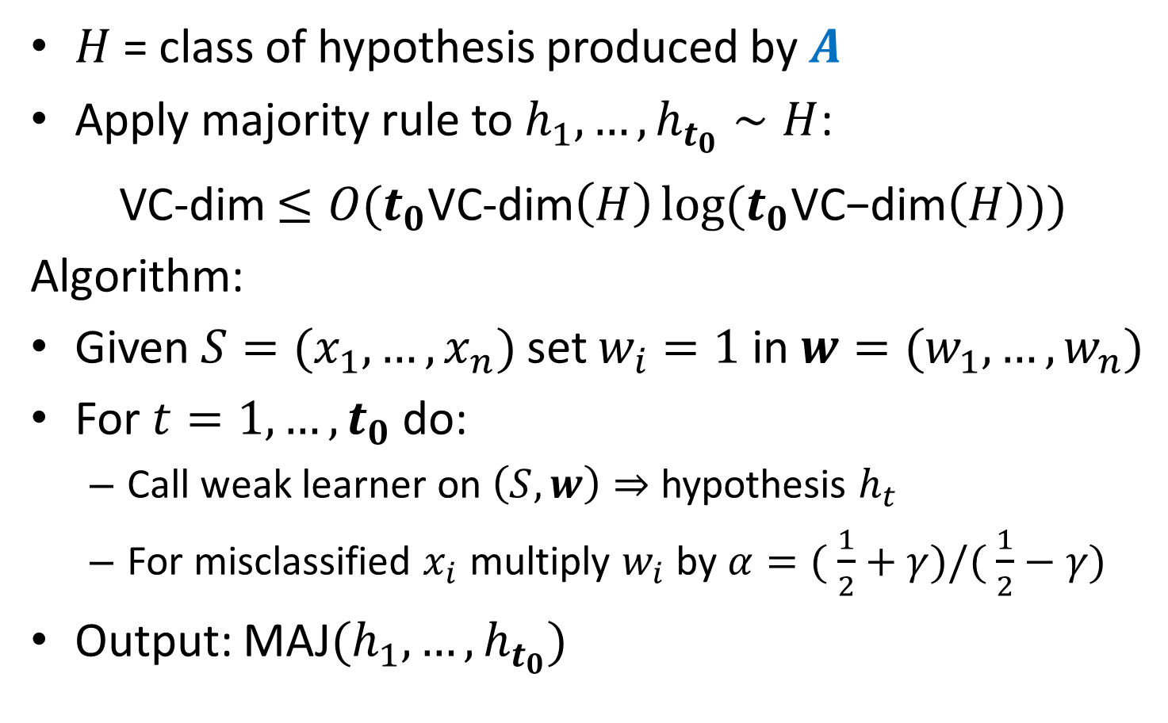
Boosting (cont.)
$H$ = class of hypothesis produced by $A$
Apply majority rule to $h_{1},…, h_{t_{0}}∼H$:
VC-dim $≤O(t_{0}\text{VC}\text{-}\text{dim}\left(H\right)\log{(t_{0}\text{VC}\text{−}\text{dim}\left(H\right)}))$
Algorithm:
Given $S=(x_{1},…, x_{n})$ set $w_{i}=1$ in $w=(w_{1},…,w_{n})$
For $t=1,…, t_{0}$ do:
Call weak learner on $\left(S,w\right)⇒$ hypothesis $h_{t}$
For misclassified $x_{i}$ multiply $w_{i}$ by $α=( \frac{1}{2}+γ)/( \frac{1}{2}−γ)$
Output: MAJ$(h_{1}, …, h_{t_{0}})$

Slide 17
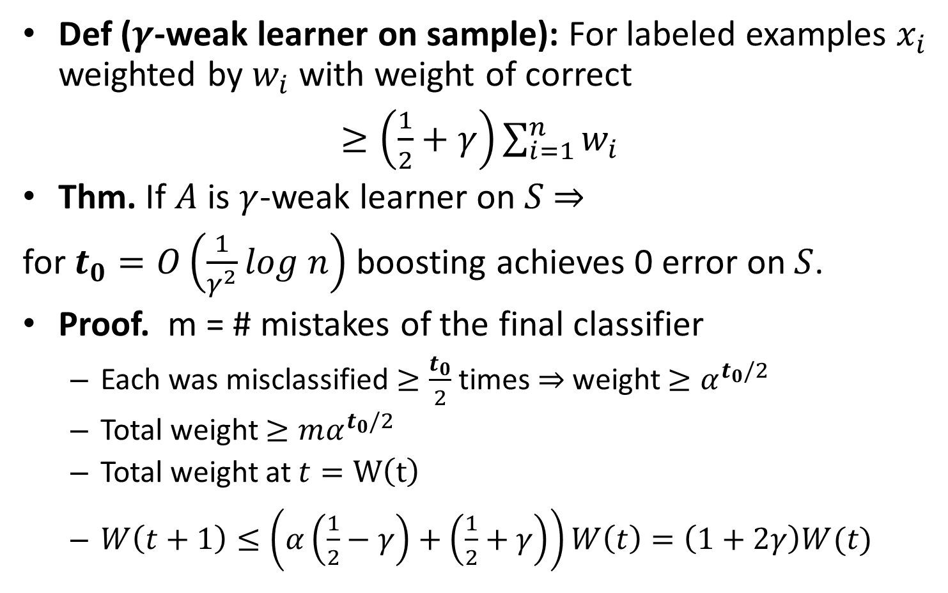
Boosting: analysis
Def ($γ$-weak learner on sample): For labeled examples $x_{i}$ weighted by $w_{i}$ with weight of correct
$≥\left(\frac{1}{2}+γ\right)\sum_{i=1}^{n}{w_{i}}$
Thm. If $A$ is $γ$-weak learner on $S$ $⇒$
for $t_{0}=O\left(\frac{1}{γ^{2}}log n\right)$ boosting achieves 0 error on $S$.
Proof. m = # mistakes of the final classifier
Each was misclassified $≥\frac{t_{0}}{2}$times$⇒$ weight $≥α^{t_{0}/2 }$
Total weight $≥mα^{t_{0}/2 }$
Total weight at $t=W\left(t\right)$
$W\left(t+1\right)≤\left(α\left(\frac{1}{2}−γ\right)+\left(\frac{1}{2}+γ\right)\right)W\left(t\right)=\left(1+2γ\right)W(t)$

Slide 18
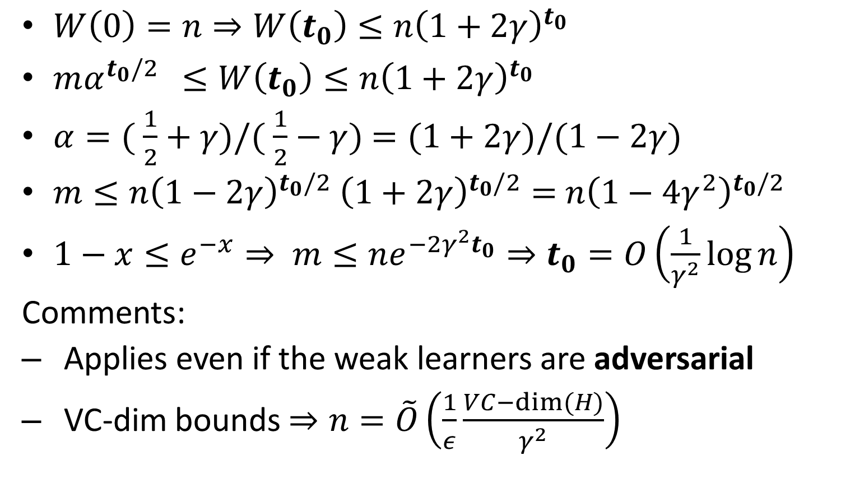
Boosting: analysis (cont.)
$W\left(0\right)=n⇒W\left(t_{0}\right)≤n{\left(1+2γ\right)}^{t_{0}}$
$mα^{t_{0}/2 } ≤W\left(t_{0}\right)≤n{\left(1+2γ\right)}^{t_{0}}$
$α=( \frac{1}{2}+γ)/( \frac{1}{2}−γ)$ $=(1+2γ)/(1−2γ)$
$m≤n{\left(1−2γ\right)}^{t_{0}/2}$ ${\left(1+2γ\right)}^{t_{0}/2}=$ $n{\left(1−4γ^{2}\right)}^{t_{0}/2}$
$1−x≤e^{−x}⇒ m≤ne^{−2γ^{2}t_{0}}⇒t_{0}=O\left(\frac{1}{γ^{2}}\log{n}\right)$
Comments:
Applies even if the weak learners are adversarial
VC-dim bounds $⇒n=\tilde{O}\left(\frac{1}{ε}\frac{VC−dim⁡(H)}{γ^{2}}\right)$

