Slide 1
CSCI B609: “Foundations of Data Science”
Lecture 3: High-Dimensional Space
Slides at http://grigory.us/data-science-class.html
Grigory Yaroslavtsev
http://grigory.us

Slide 2
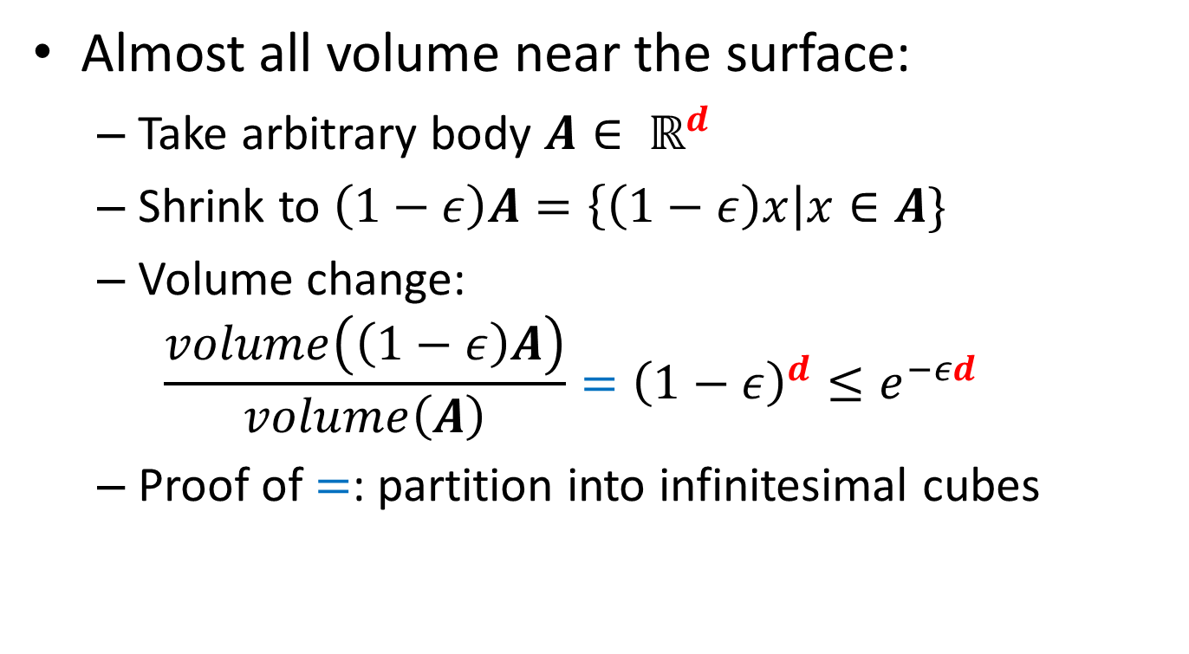
Geometry of High Dimensions
Almost all volume near the surface:
Take arbitrary body $A∈ ℝ^{d}$
Shrink to $\left(1−ε\right)A=\left\{\left(1−ε\right)x\right|x∈A\}$
Volume change:
$$\frac{volume\left(\left(1−ε\right)A\right)}{volume\left(A\right)}={\left(1−ε\right)}^{d}≤e^{−εd}$$
Proof of $=$: partition into infinitesimal cubes

Slide 3
Today
Geometry of High Dimensions (Sec 2.3 – 2.4)
Volume is near the surface
Volume of d-dimensional unit ball
Most of the volume is near equator
Near orthogonality of random vectors

Slide 4
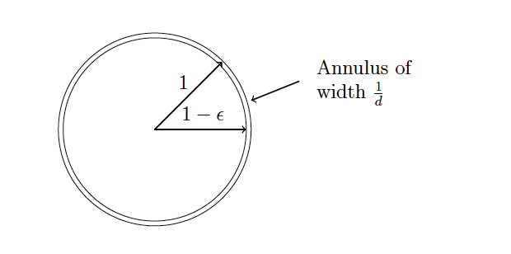
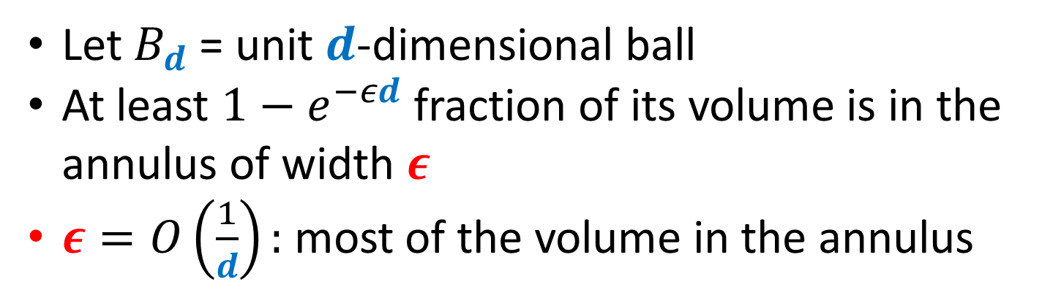
Geometry of High Dimensions
Let $B_{d}$ = unit $d$-dimensional ball
At least $1−e^{−εd}$ fraction of its volume is in the annulus of width $ε$
$ε=O\left(\frac{1}{d}\right):$ most of the volume in the annulus

Slide 5
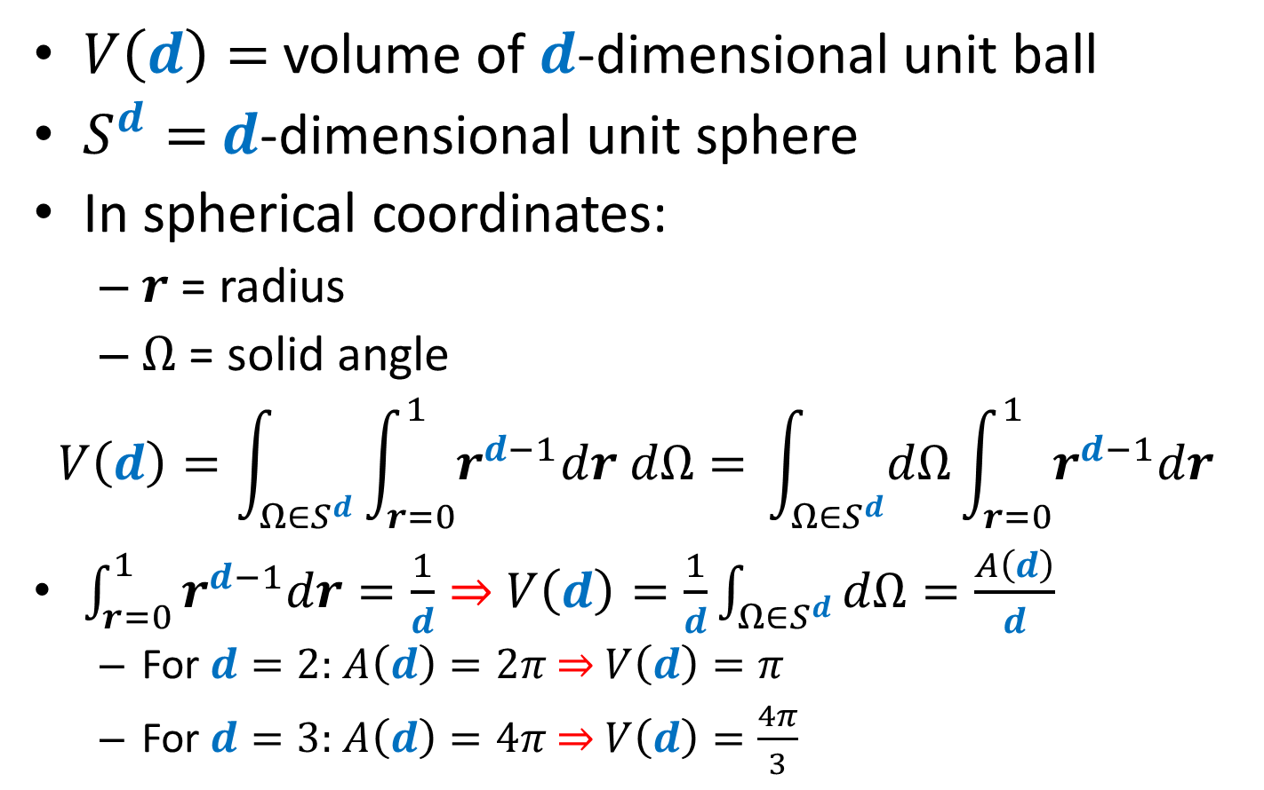
Volume of d-dimensional unit ball
$V\left(d\right)=$ volume of $d$-dimensional unit ball
$S^{d}=$ $d$-dimensional unit sphere
In spherical coordinates:
$r$ = radius
$Ω$ = solid angle
$$V\left(d\right)=\int_{{Ω∈S}^{d}}{\int_{r=0}^{1}{r^{d−1}dr dΩ}= }\int_{{Ω∈S}^{d}}{dΩ}\int_{r=0}^{1}{r^{d−1}dr }$$
$\int_{r=0}^{1}{r^{d−1}dr=\frac{1}{d}}⇒$ $V\left(d\right)=\frac{1}{d}\int_{{Ω∈S}^{d}}{dΩ}=\frac{A\left(d\right)}{d}$
For $d=2:$ $A\left(d\right)=2π$ $⇒$ $V\left(d\right)=π$
For $d=3:$ $A\left(d\right)=4π$ $⇒$ $V\left(d\right)=\frac{4π}{3}$

Slide 6
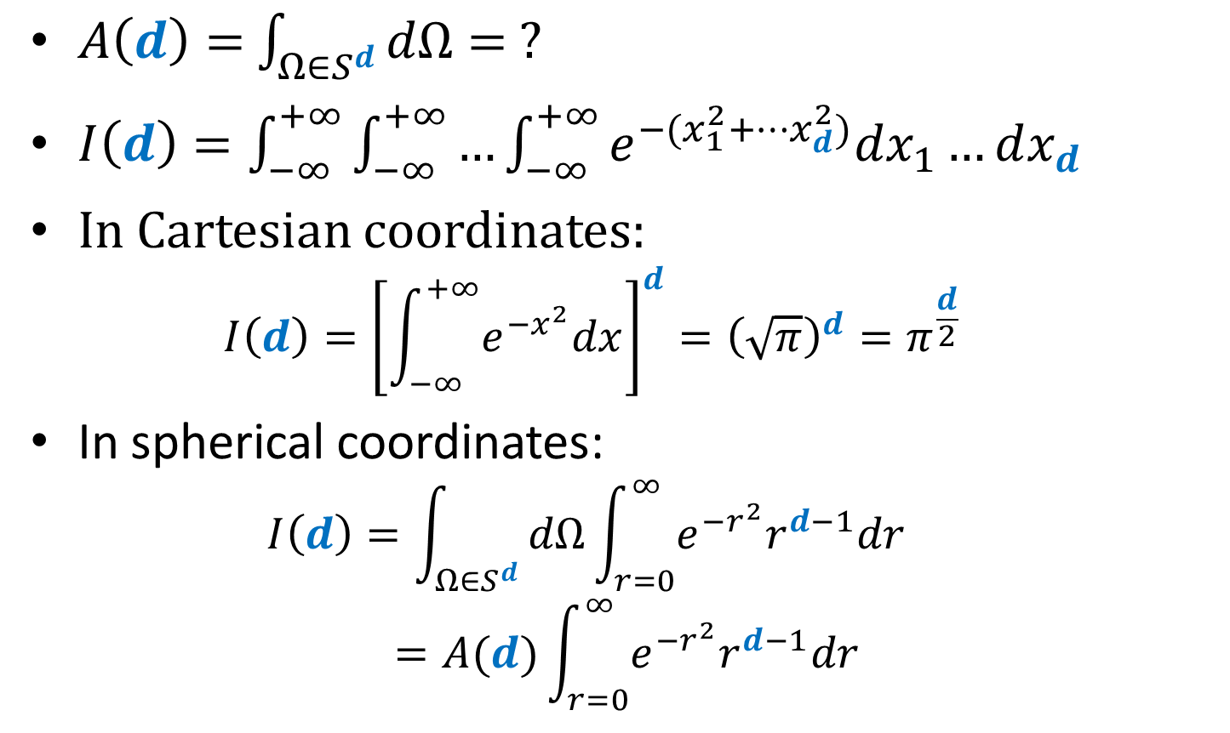
Volume of d-dimensional unit ball
$A\left(d\right)=$ $\int_{{Ω∈S}^{d}}{dΩ}= ?$
$I\left(d\right)=\int_{−∞}^{+∞}{\int_{−∞}^{+∞}{…\int_{−∞}^{+∞}{e^{−(x_{1}^{2}+…x_{d}^{2})}dx_{1}…dx_{d}}}}$
In Cartesian coordinates:
$$I\left(d\right)={\left[\int_{−∞}^{+∞}{e^{−x^{2}}dx}\right]}^{d}={\left(\sqrt{π}\right)}^{d}=π^{\frac{d}{2}}$$
In spherical coordinates:
$$I\left(d\right)=\int_{Ω∈S^{d}}{dΩ\int_{r=0}^{∞}{e^{−r^{2}}r^{d−1}dr }}=A(d)\int_{r=0}^{∞}{e^{−r^{2}}r^{d−1}dr }$$

Slide 7
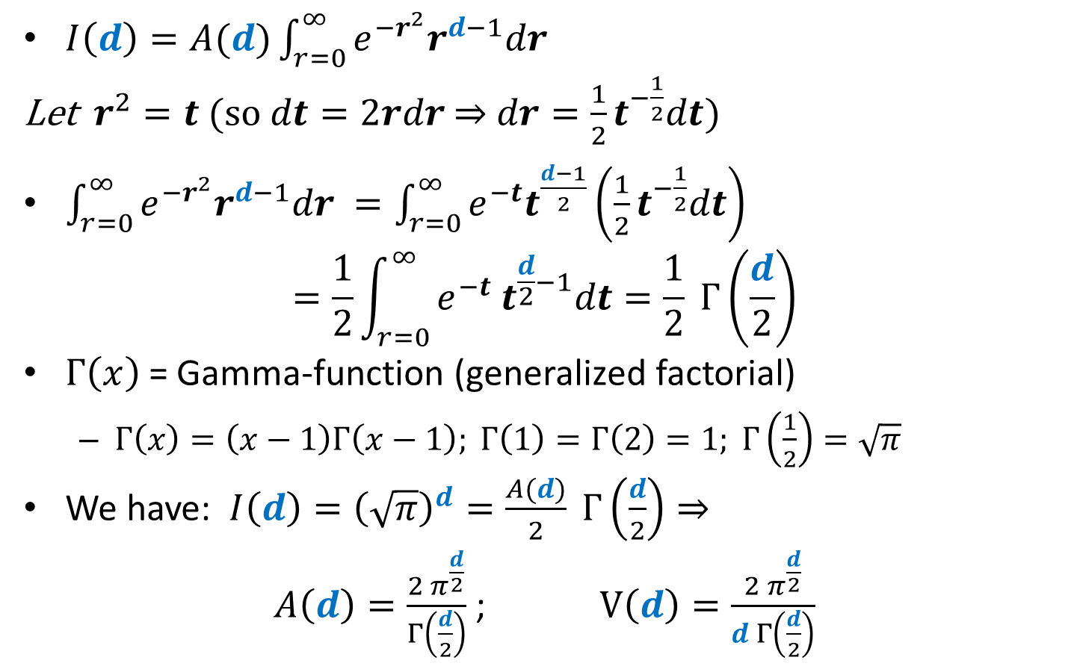
Volume of d-dimensional unit ball
$I\left(d\right)=A(d)\int_{r=0}^{∞}{e^{−r^{2}}r^{d−1}dr }$
Let $r^{2}=t$(so $dt=2rdr$ $⇒$ $dr=\frac{1}{2}t^{−\frac{1}{2}}dt$)
$\int_{r=0}^{∞}{e^{−r^{2}}r^{d−1}dr }=\int_{r=0}^{∞}{e^{−t}t^{\frac{d−1}{2}}\left(\frac{1}{2}t^{−\frac{1}{2}}dt\right) }$
$$=\frac{1}{2}\int_{r=0}^{∞}{e^{−t} t^{\frac{d}{2}−1}dt}=\frac{1}{2} Γ\left(\frac{d}{2}\right)$$
$Γ\left(x\right)$ = Gamma-function (generalized factorial)
$Γ\left(x\right)=\left(x−1\right)Γ\left(x−1\right); Γ\left(1\right)=Γ\left(2\right)=1; Γ\left(\frac{1}{2}\right)=\sqrt{π}$
We have: $I\left(d\right)={\left(\sqrt{π}\right)}^{d}=\frac{A(d)}{2} Γ\left(\frac{d}{2}\right)⇒$
$A\left(d\right)=\frac{2 π^{\frac{d}{2}}}{Γ\left(\frac{d}{2}\right)}$ ; $V\left(d\right)=\frac{2 π^{\frac{d}{2}}}{d Γ\left(\frac{d}{2}\right)}$

Slide 8
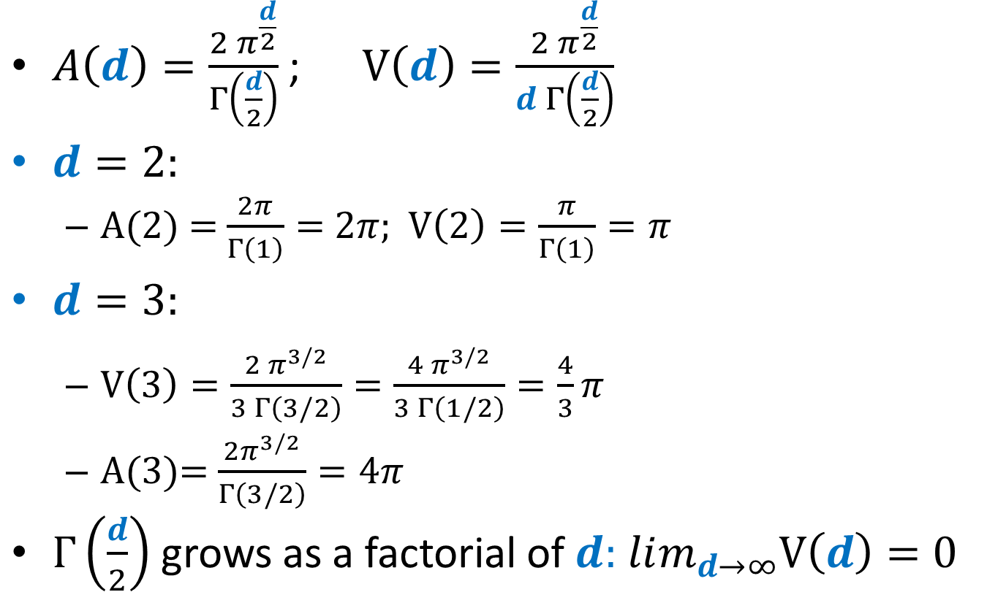
Volume of d-dimensional unit ball
$A\left(d\right)=\frac{2 π^{\frac{d}{2}}}{Γ\left(\frac{d}{2}\right)}$ ;$V\left(d\right)=\frac{2 π^{\frac{d}{2}}}{d Γ\left(\frac{d}{2}\right)}$
$d=2:$
A(2) = $\frac{2π}{Γ\left(1\right)}=$ $2π$; $V\left(2\right)=\frac{π}{Γ\left(1\right)}=π$
$d=3:$
$V\left(3\right)=\frac{2 π^{3/2}}{3 Γ\left(3/2\right)}=\frac{4 π^{3/2}}{3 Γ\left(1/2\right)}=\frac{4}{3}π$
A(3)= $\frac{2π^{3/2}}{Γ\left(3/2\right)}=4π$
$Γ\left(\frac{d}{2}\right)$ grows as a factorial of $d:$ $lim_{d→∞}V\left(d\right)=0$

Slide 9
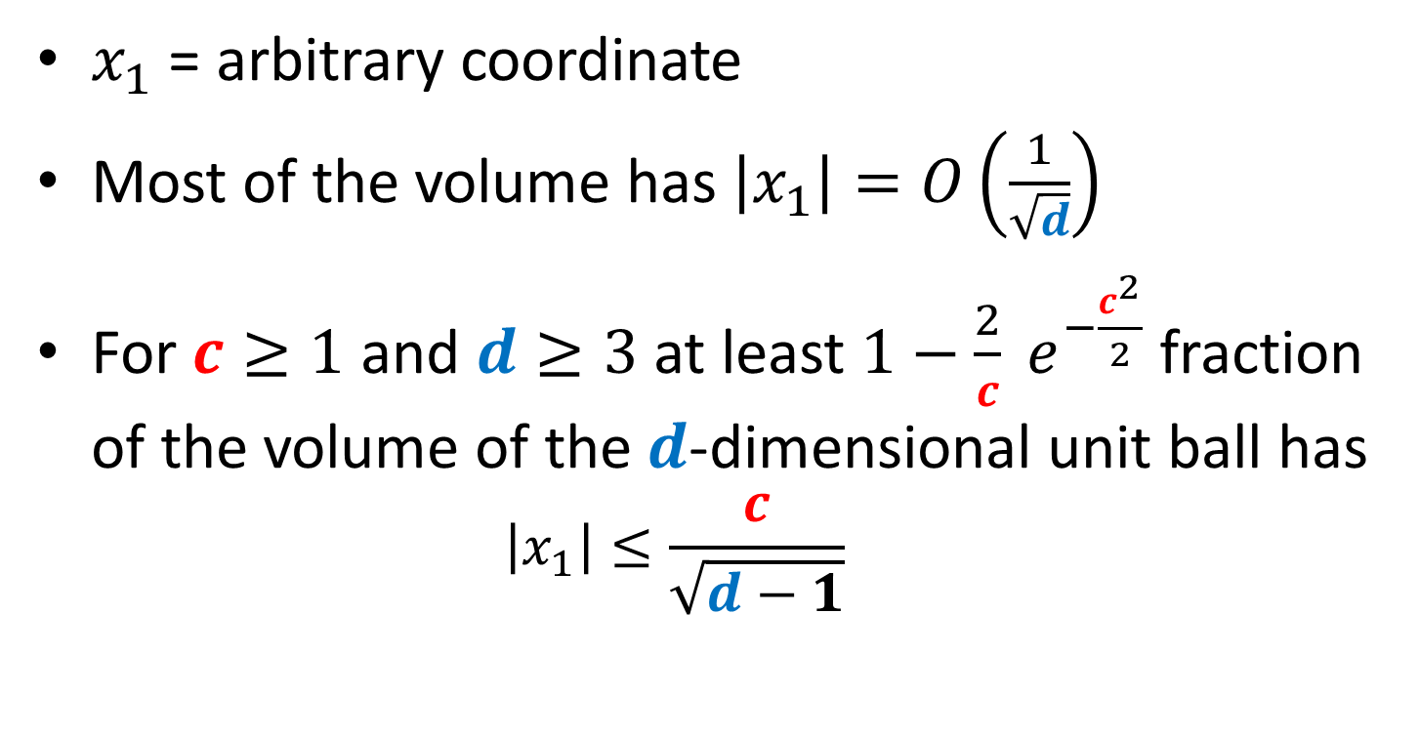
Most of the volume is near equator
$x_{1}$ = arbitrary coordinate
Most of the volume has $\left|x_{1}\right|=O\left(\frac{1}{\sqrt{d}}\right)$
For $c≥1$ and $d≥3$ at least $1−\frac{2}{c} e^{−\frac{c^{2}}{2}}$ fraction of the volume of the $d$-dimensional unit ball has
$$\left|x_{1}\right|≤\frac{c}{\sqrt{d−1}}$$

Slide 10
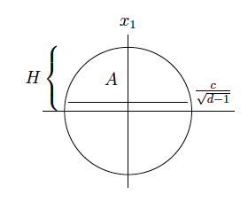
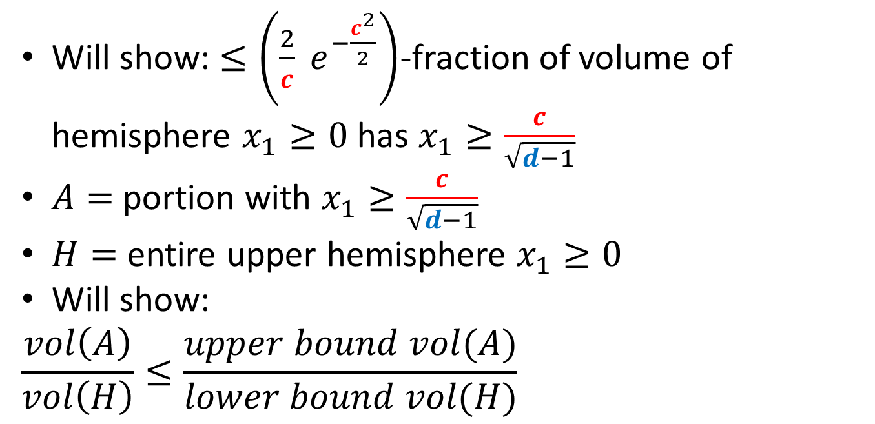
Most of the volume is near equator
Will show: $≤\left(\frac{2}{c} e^{−\frac{c^{2}}{2}}\right)$-fraction of volume of hemisphere $x_{1}≥0$ has $x_{1}≥\frac{c}{\sqrt{d−1}}$
$A=$portion with $x_{1}≥\frac{c}{\sqrt{d−1}}$
$H=$ entire upper hemisphere $x_{1}≥0$
Will show:
$$\frac{vol\left(A\right)}{vol\left(H\right)}≤\frac{upper bound vol(A)}{lower bound vol(H)}$$

Slide 11
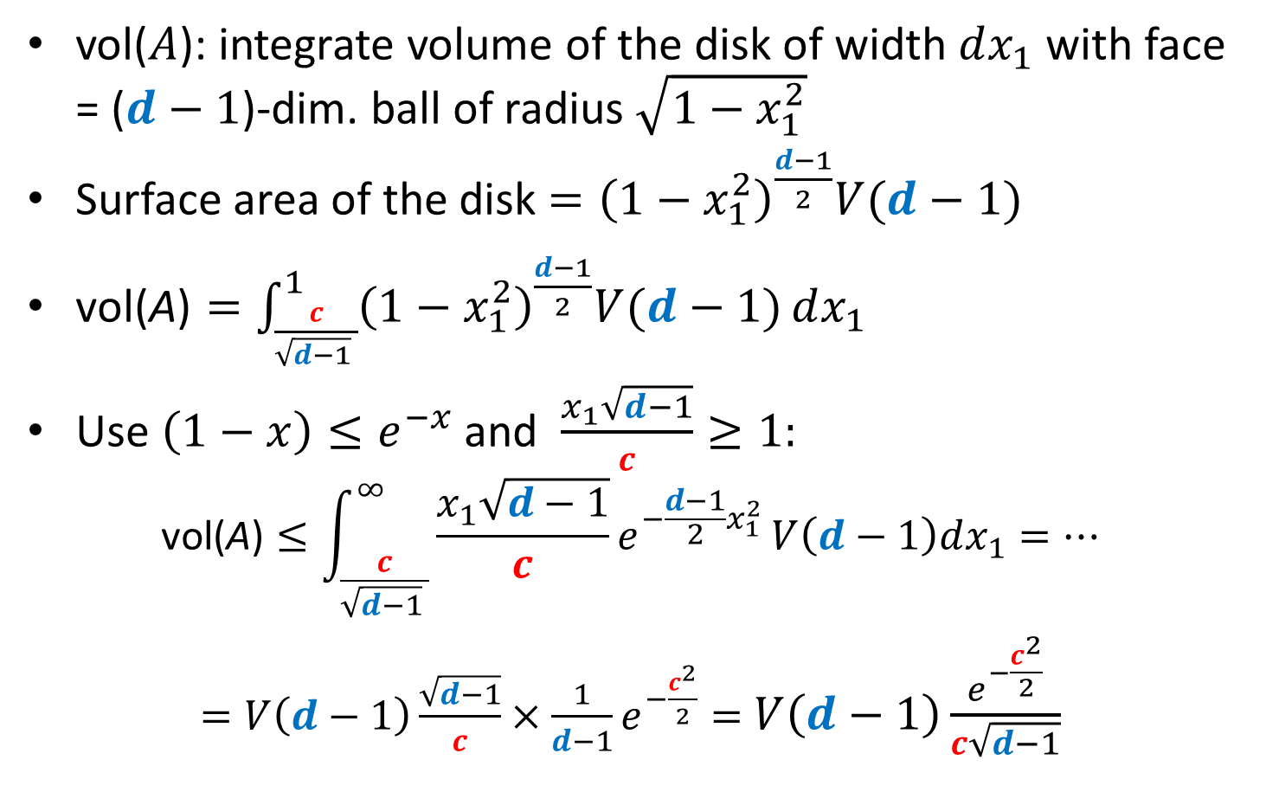
Upper bound on vol(A)
vol($A$): integrate volume of the disk of width $dx_{1}$ with face = ($d−1$)-dim. ball of radius $\sqrt{1−x_{1}^{2}}$
Surface area of the disk $={\left(1−x_{1}^{2}\right)}^{\frac{d−1}{2}}V(d−1)$
$\text{vol}\text{(}\text{A}\text{)}=\int_{\frac{c}{\sqrt{d−1} }}^{1}{{\left(1−x_{1}^{2}\right)}^{\frac{d−1}{2}}V(d−1)}dx_{1}$
Use $\left(1−x\right)≤e^{−x}$ and $\frac{x_{1}\sqrt{d−1}}{c}≥1:$
$$\text{vol}\text{(}\text{A}\text{)}≤\int_{\frac{c}{\sqrt{d−1} }}^{∞}{\frac{x_{1}\sqrt{d−1}}{c}e^{−\frac{d−1}{2}x_{1}^{2}}}V\left(d−1\right)dx_{1}=…$$
$=V\left(d−1\right)\frac{\sqrt{d−1}}{c}×\frac{1}{d−1}e^{−\frac{c^{2}}{2}}=$ $V\left(d−1\right)\frac{e^{−\frac{c^{2}}{2}}}{c\sqrt{d−1}}$

Slide 12
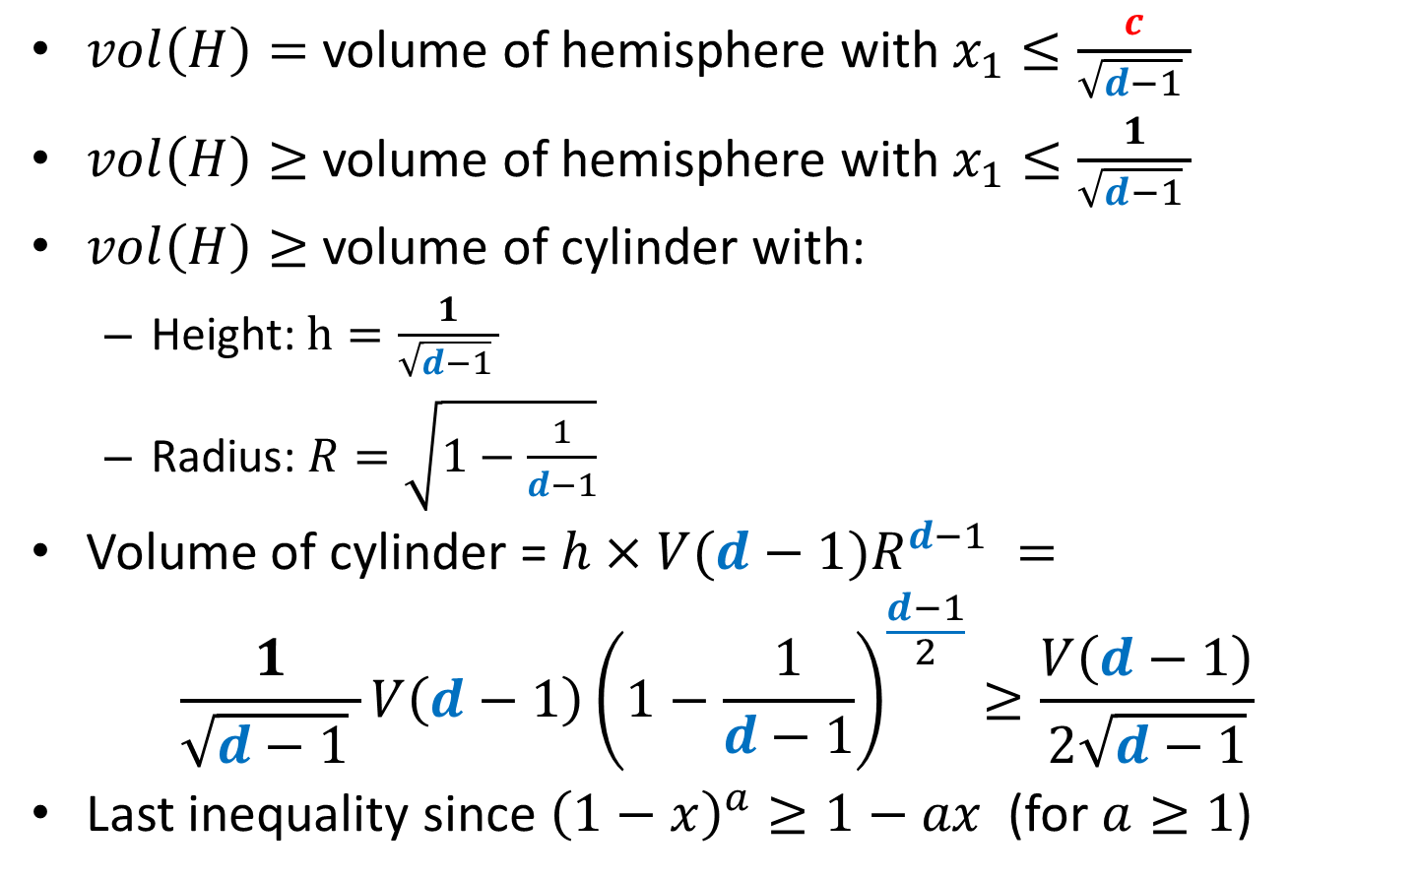
Lower bound on vol(H)
$vol\left(H\right)=$ volume of hemisphere with $x_{1}≤\frac{c}{\sqrt{d−1} }$
$vol\left(H\right)≥$ volume of hemisphere with $x_{1}≤\frac{1}{\sqrt{d−1} }$
$vol\left(H\right)≥$ volume of cylinder with:
Height: $h=\frac{1}{\sqrt{d−1} }$
Radius: $R=\sqrt{1−\frac{1}{d−1}}$
Volume of cylinder = $h×{V(d−1)R}^{d−1} =$
$$\frac{1}{\sqrt{d−1} }V\left(d−1\right){\left(1−\frac{1}{d−1}\right)}^{\frac{d−1}{2}}≥\frac{V\left(d−1\right)}{2\sqrt{d−1}}$$
Last inequality since ${\left(1−x\right)}^{a}≥1−ax$ (for $a≥1$)

Slide 13
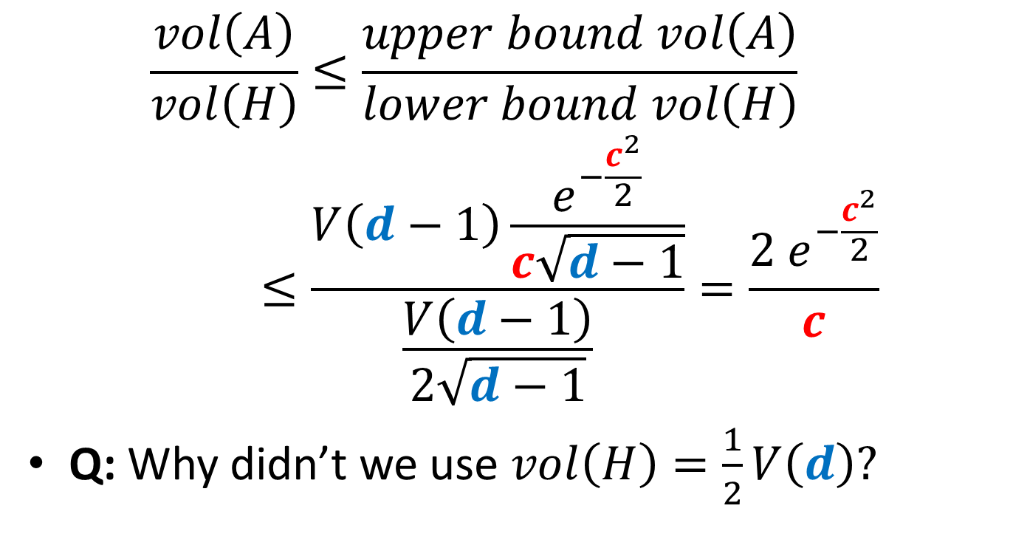
Putting things together
$$\frac{vol\left(A\right)}{vol\left(H\right)}≤\frac{upper bound vol\left(A\right)}{lower bound vol\left(H\right)}≤\frac{V\left(d−1\right)\frac{e^{−\frac{c^{2}}{2}}}{c\sqrt{d−1}}}{\frac{V\left(d−1\right)}{2\sqrt{d−1}}}=\frac{{2 e}^{−\frac{c^{2}}{2}}}{c}$$
Q: Why didn’t we use $vol\left(H\right)=\frac{1}{2}V\left(d\right)?$

Slide 14
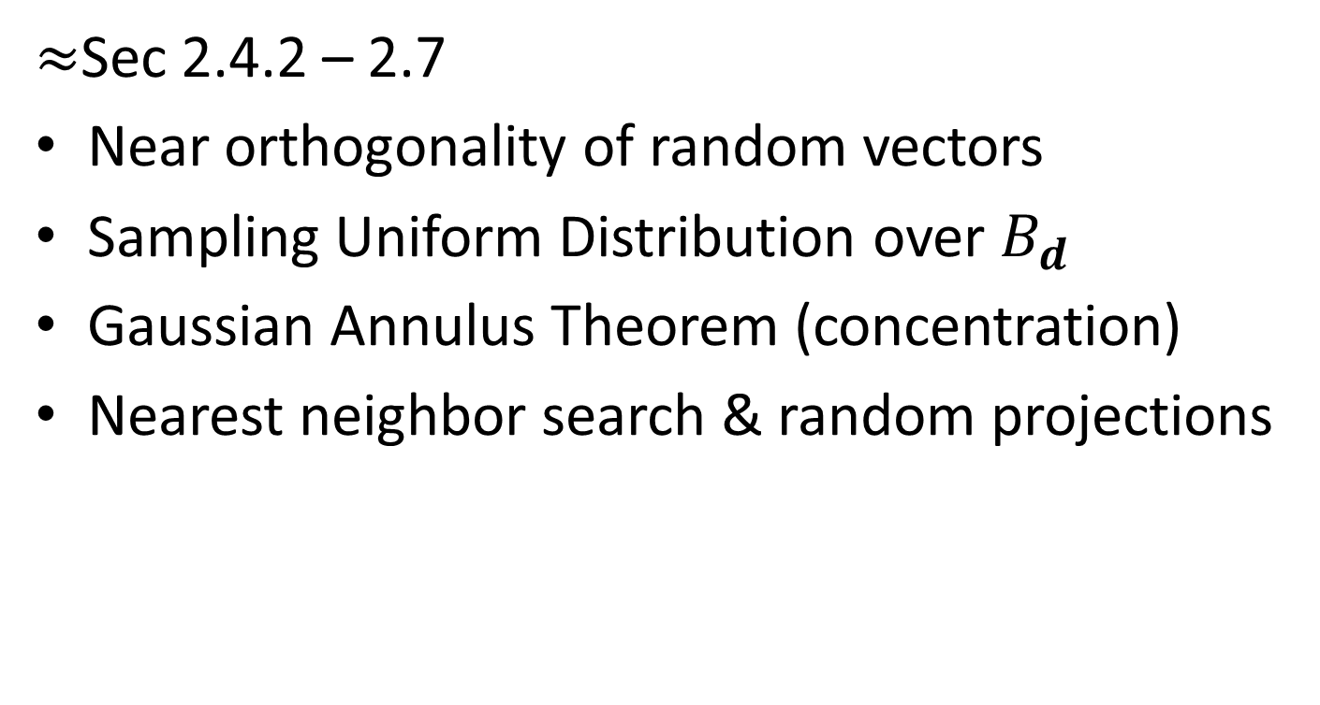
Today:
$≈$Sec 2.4.2 – 2.7
Near orthogonality of random vectors
Sampling Uniform Distribution over $B_{d}$
Gaussian Annulus Theorem (concentration)
Nearest neighbor search & random projections

Slide 15
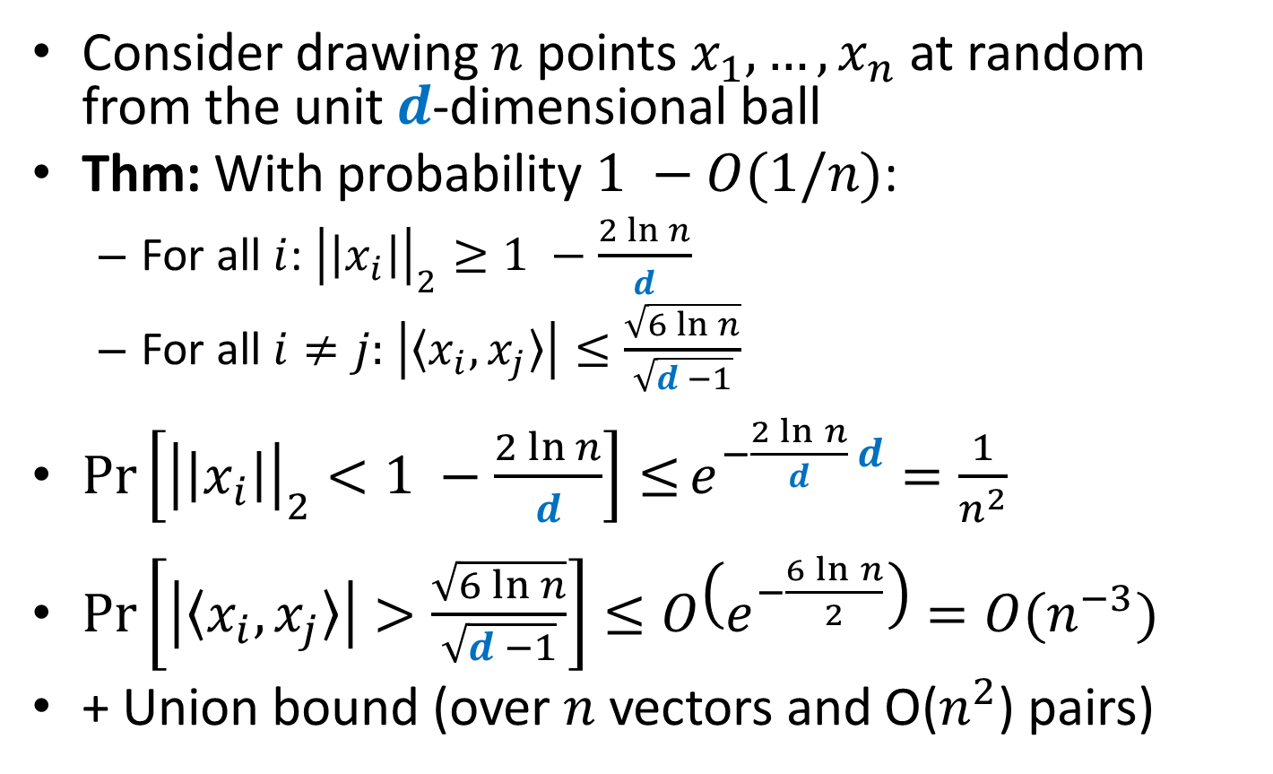
Near orthogonality
Consider drawing $n$ points $x_{1},…, x_{n}$ at random from the unit $d$-dimensional ball
Thm: With probability $1 −O(1/n)$:
For all $i$: ${\left|\left|x_{i}\right|\right|}_{2}≥1 −\frac{2\ln{n}}{d}$
For all $i≠j:$ $\left|〈x_{i},x_{j}〉\right|≤\frac{\sqrt{6\ln{n}}}{\sqrt{d −1}}$
$\operatorname{Pr}\left[{\left|\left|x_{i}\right|\right|}_{2}<1 −\frac{2\ln{n}}{d}\right]≤e^{−\frac{2\ln{n}}{d} d}=\frac{1}{n^{2}}$
$Pr\left[\left|〈x_{i},x_{j}〉\right|>\frac{\sqrt{6\ln{n}}}{\sqrt{d −1}}\right]≤O\left(e^{−\frac{6\ln{n}}{2}}\right)=O(n^{−3})$
+ Union bound (over $n$ vectors and O($n^{2}$) pairs)

Slide 16
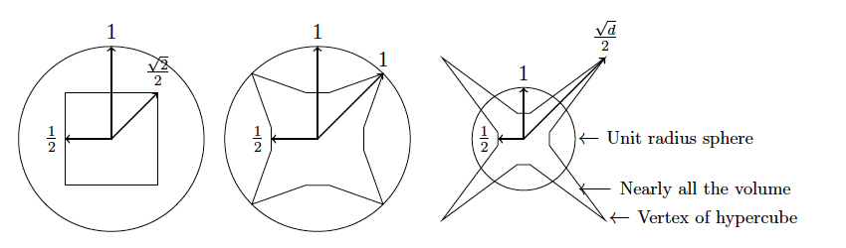
Sphere vs. cube in 2, 4, d dimensions

Slide 17
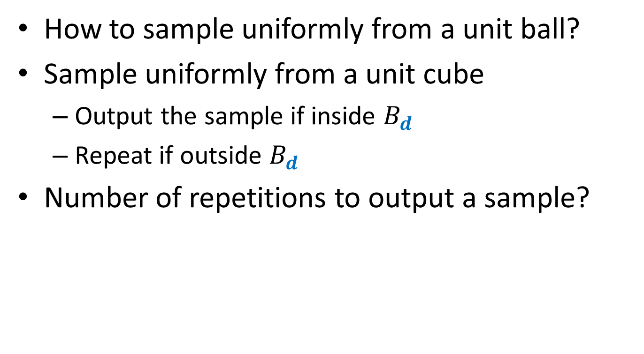

Sampling Uniform Distribution over $B_{d}$
How to sample uniformly from a unit ball?
Sample uniformly from a unit cube
Output the sample if inside $B_{d}$
Repeat if outside $B_{d}$
Number of repetitions to output a sample?

Slide 18
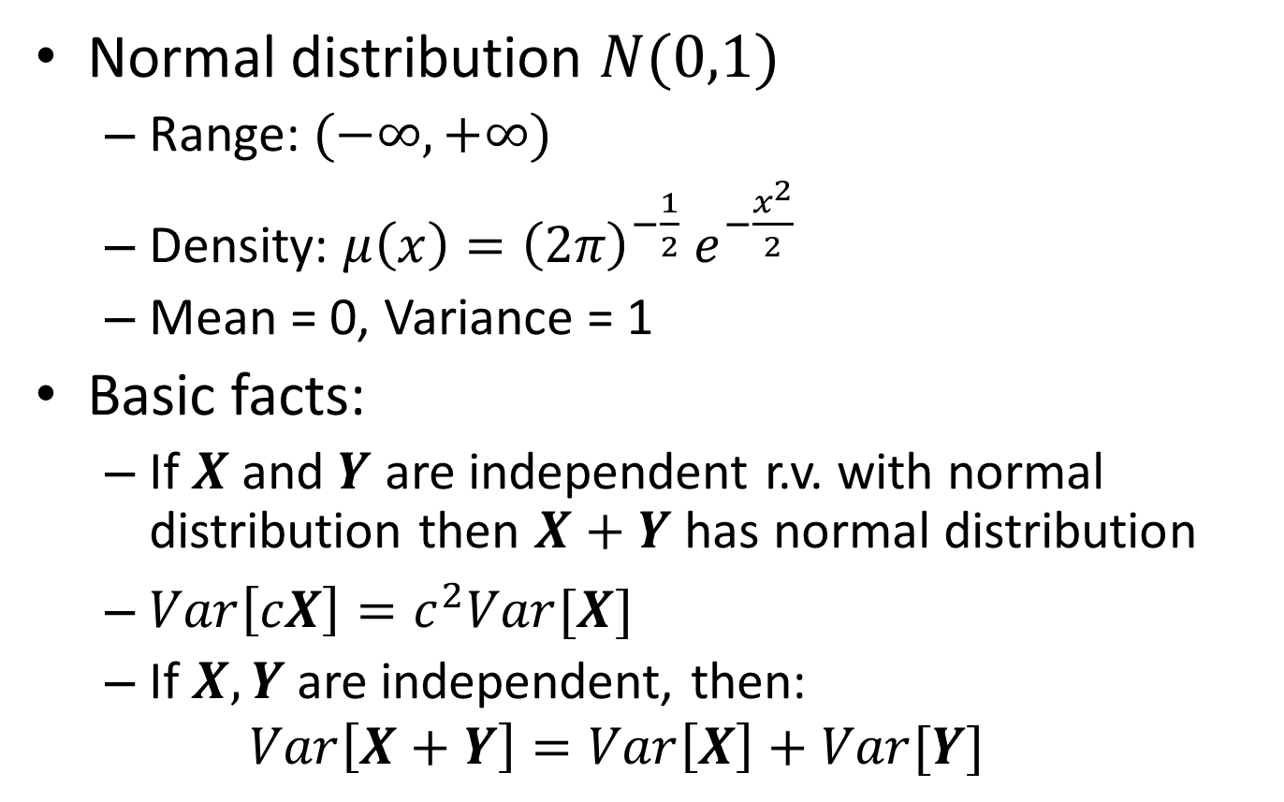
Normal Distribution
Normal distribution $N(0,1)$
Range: $(−∞, +∞)$
Density: $μ\left(x\right)={{\left(2π\right)}^{−\frac{1}{2}} e}^{−\frac{x^{2}}{2}}$
Mean = 0, Variance = 1
Basic facts:
If $X$ and $Y$ are independent r.v. with normal distribution then $X+Y$ has normal distribution
$Var\left[cX\right]=c^{2}Var[X]$
If $X, Y$ are independent, then:
$$Var\left[X+Y\right]=Var\left[X\right]+Var[Y]$$

Slide 19
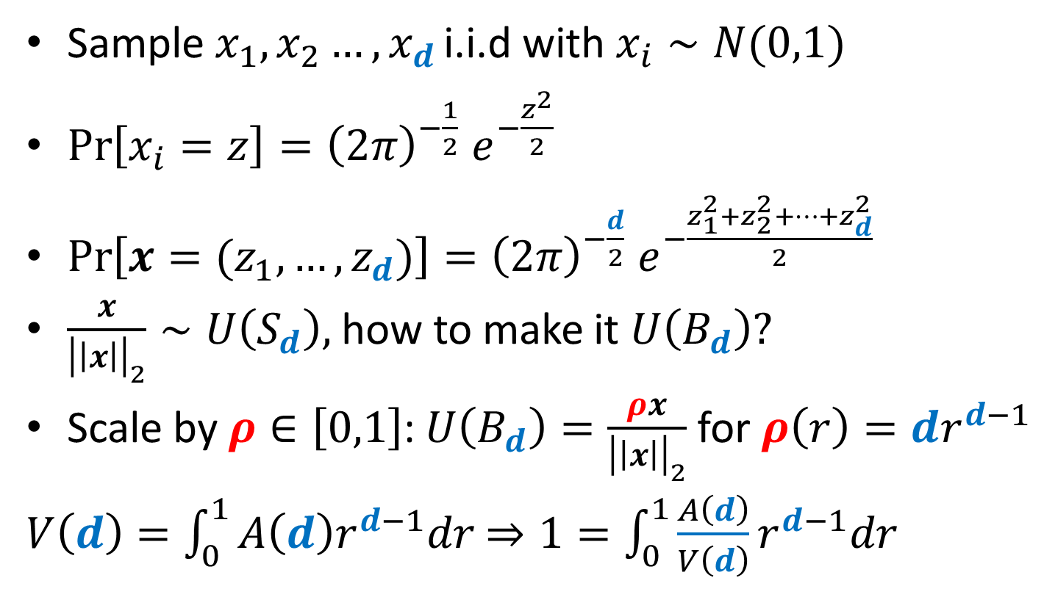
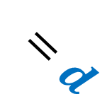
Sampling Uniform Distribution over $B_{d}$
Sample $x_{1}, x_{2}…, x_{d }$i.i.d with $x_{i}∼N(0,1)$
$\operatorname{Pr}\left[x_{i}=z\right]={{\left(2π\right)}^{−\frac{1}{2}} e}^{−\frac{z^{2}}{2}}$
$\operatorname{Pr}\left[x=(z_{1},…,z_{d})\right]={{\left(2π\right)}^{−\frac{d}{2}} e}^{−\frac{z_{1}^{2}+z_{2}^{2}+…+z_{d}^{2}}{2}}$
$\frac{x}{{\left|\left|x\right|\right|}_{2}}∼U\left(S_{d}\right),$ how to make it $U\left(B_{d}\right)?$
Scale by $ρ∈\left[0,1\right]$: $U\left(B_{d}\right)=\frac{ρx}{{\left|\left|x\right|\right|}_{2}}$ for $ρ\left(r\right)=dr^{d−1}$
$V\left(d\right)=\int_{0}^{1}{A\left(d\right)r^{d−1}dr}$ $⇒1=\int_{0}^{1}{\frac{A\left(d\right)}{V\left(d\right)}r^{d−1}dr}$
$$=d$$

Slide 20
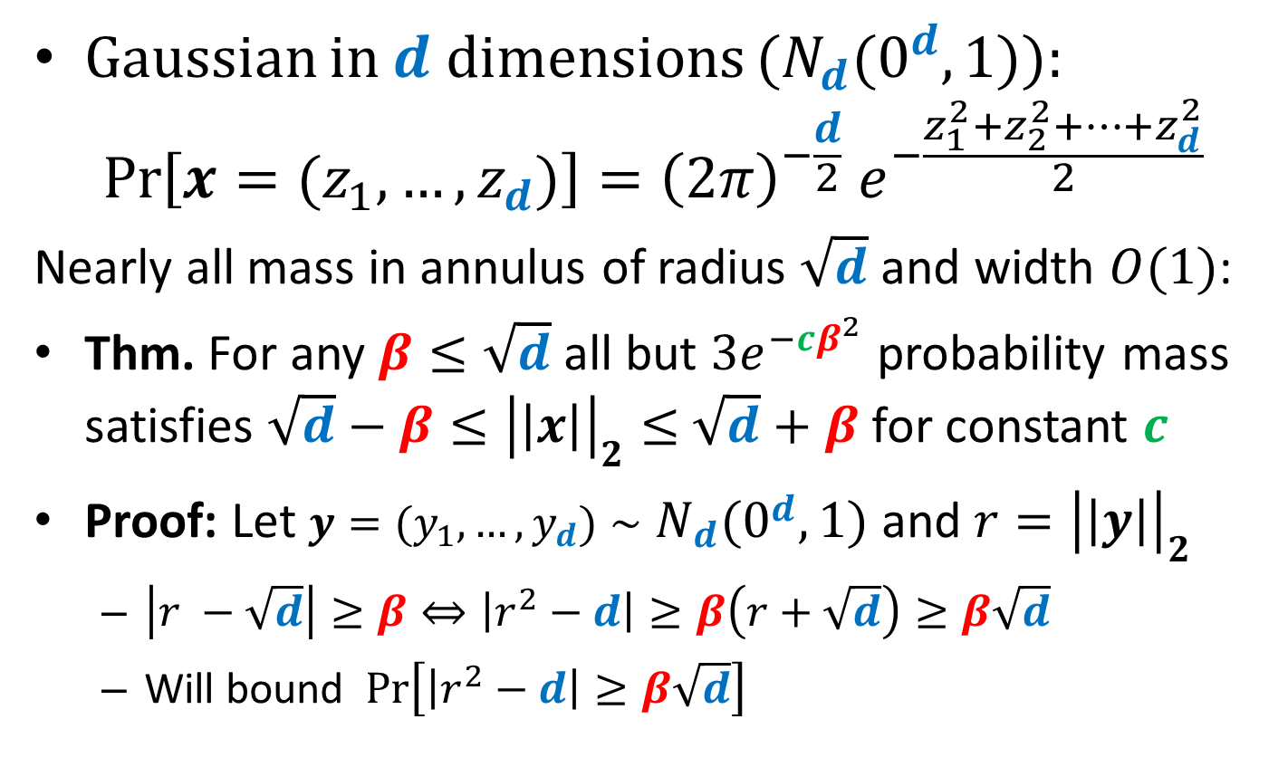
Gaussian Annulus Theorem
Gaussian in $d$ dimensions ($N_{d}(0^{d}, 1)$):
$$\operatorname{Pr}\left[x=(z_{1},…,z_{d})\right]={{\left(2π\right)}^{−\frac{d}{2}} e}^{−\frac{z_{1}^{2}+z_{2}^{2}+…+z_{d}^{2}}{2}}$$
Nearly all mass in annulus of radius $\sqrt{d}$ and width $O(1)$:
Thm. For any $β≤\sqrt{d}$ all but $3e^{−cβ^{2}}$ probability mass satisfies ${\sqrt{d}−β≤\left|\left|x\right|\right|}_{2}≤$ $\sqrt{d}+β$ for constant $c$
Proof: Let $y=(y_{1}, …, y_{d})∼N_{d}(0^{d}, 1)$ and $r={\left|\left|y\right|\right|}_{2}$
$\left|r −\sqrt{d}\right|≥β⇔\left|r^{2}−d\right|≥β\left(r+\sqrt{d}\right)≥β\sqrt{d}$
Will bound $Pr\left[\left|r^{2}−d\right|≥β\sqrt{d}\right]$

Slide 21
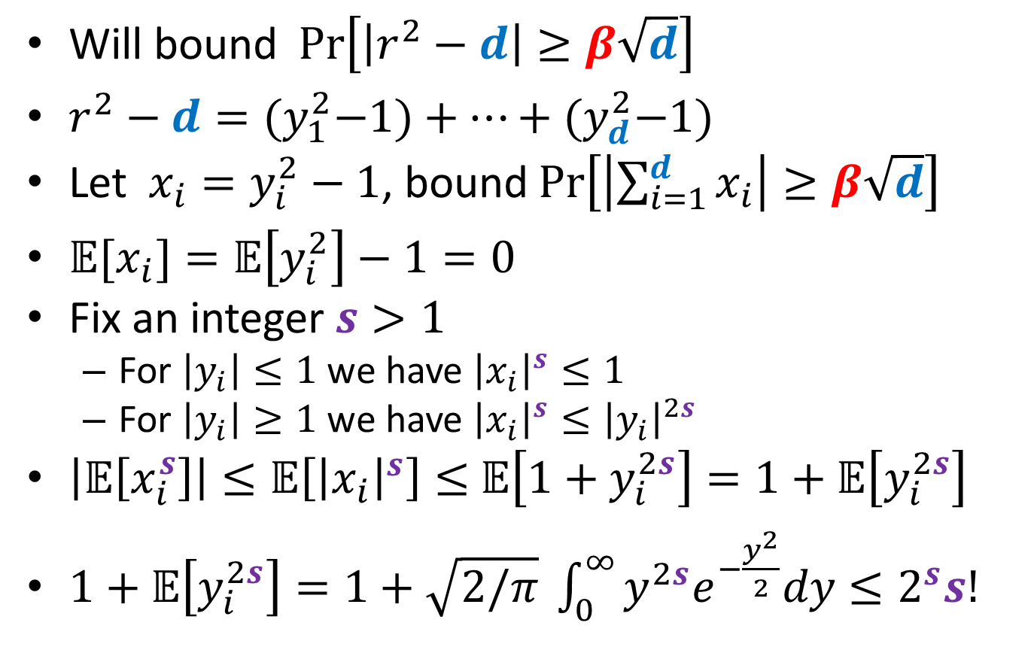
Gaussians in High Dimension
Will bound $Pr\left[\left|r^{2}−d\right|≥β\sqrt{d}\right]$
$r^{2}−d={(y}_{1}^{2}−1)+…+{(y}_{d}^{2}−1)$
Let $x_{i}=y_{i}^{2}−1$, bound $Pr\left[\left|\sum_{i=1}^{d}{x_{i}}\right|≥β\sqrt{d}\right]$
${𝔼[x}_{i}]=𝔼\left[y_{i}^{2}\right]−1=0$
Fix an integer $s>1$
For $\left|y_{i}\right|≤1$ we have ${\left|x_{i}\right|}^{s}≤1$
For $\left|y_{i}\right|≥1$ we have ${\left|x_{i}\right|}^{s}≤{\left|y_{i}\right|}^{2s}$
$\left|𝔼\left[x_{i}^{s}\right]\right|≤𝔼\left[{\left|x_{i}\right|}^{s}\right]≤$ $𝔼\left[1+y_{i}^{2s}\right]=1+𝔼\left[y_{i}^{2s}\right]$
$1+𝔼\left[y_{i}^{2s}\right]=1+\sqrt{2/π} \int_{0}^{∞}{y^{2s}e^{−\frac{y^{2}}{2}}dy}≤2^{s}s!$

Slide 22

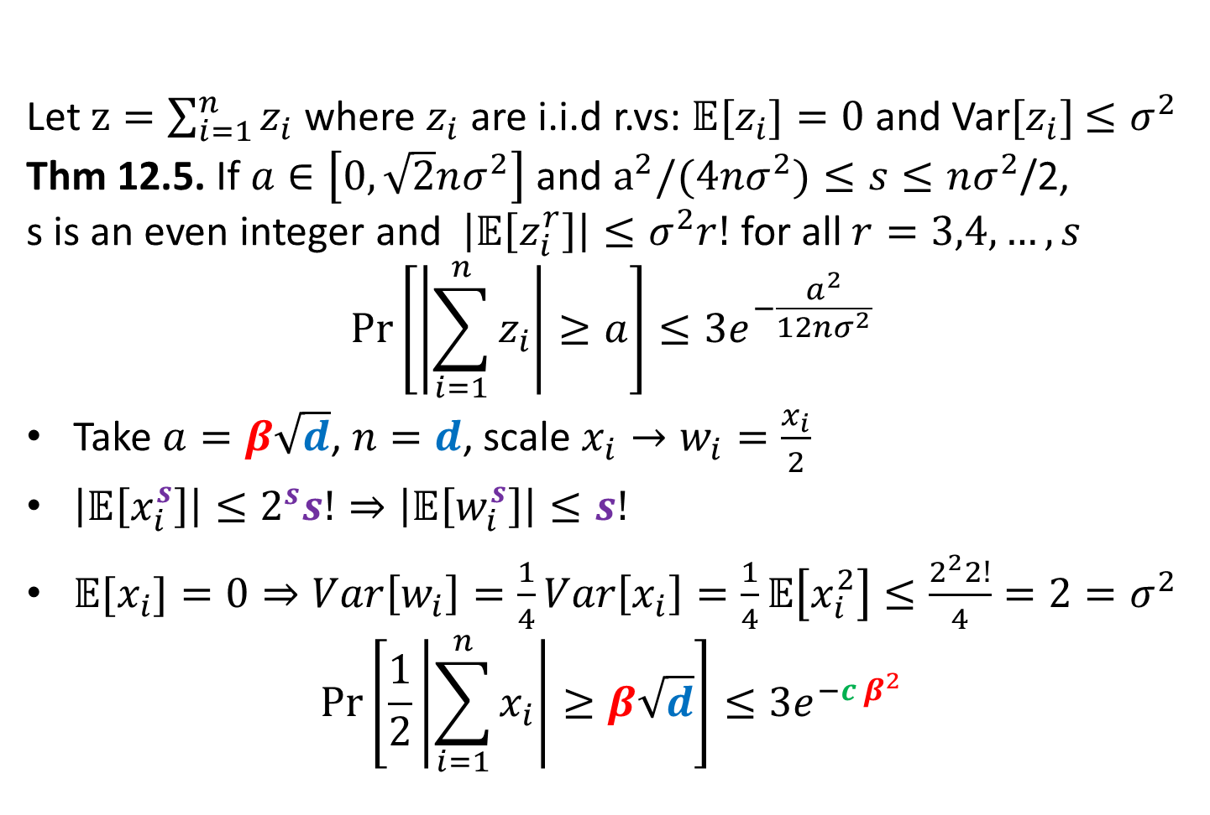
Gaussians in High Dimension
Let $z=\sum_{i=1}^{n}{z_{i}}$ where $z_{i}$ are i.i.d r.vs: $𝔼[z_{i}]=0$ and Var$[z_{i}]$ $≤σ^{2}$
Thm 12.5. If $a∈\left[0,\sqrt{2}nσ^{2}\right]$ and $a^{2}/(4nσ^{2})≤s≤nσ^{2}$/2,
s is an even integer and $\left|𝔼\left[z_{i}^{r}\right]\right|≤σ^{2}r!$ for all $r=3,4,…, s$
$$\operatorname{Pr}\left[\left|\sum_{i=1}^{n}{z_{i}}\right|≥a\right]≤3e^{−\frac{a^{2}}{12nσ^{2}}}$$
Take $a=β\sqrt{d}$, $n=d$, scale $x_{i}→w_{i}=\frac{x_{i}}{2}$
$\left|𝔼\left[x_{i}^{s}\right]\right|≤2^{s}s!⇒\left|𝔼\left[w_{i}^{s}\right]\right|≤s!$
${𝔼[x}_{i}]=0⇒Var\left[w_{i}\right]=\frac{1}{4}Var\left[x_{i}\right]=\frac{1}{4}𝔼\left[x_{i}^{2}\right]≤\frac{2^{2}2!}{4}=2=σ^{2}$
$$\operatorname{Pr}\left[\frac{1}{2}\left|\sum_{i=1}^{n}{x_{i}}\right|≥β\sqrt{d}\right]≤3e^{−{c β}^{2}}$$
$$⇒$$

Slide 23
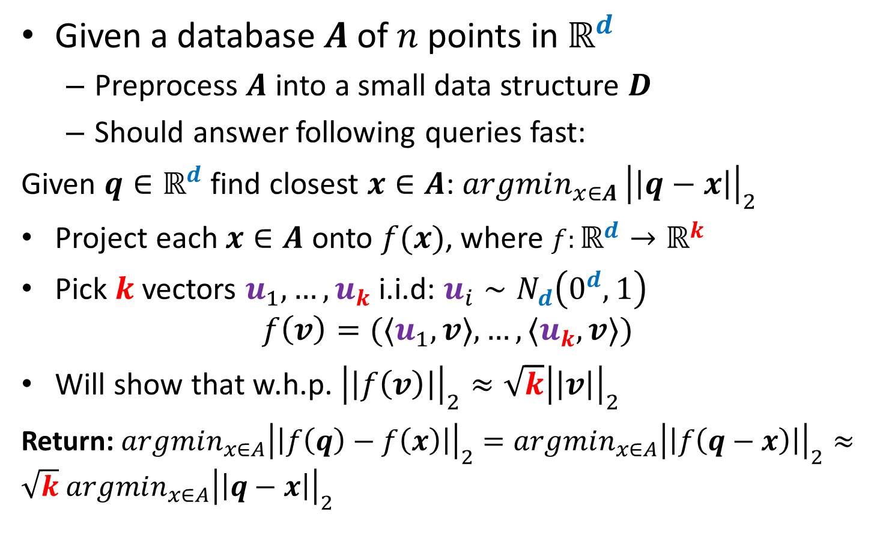
Nearest Neighbors and Random Projections
Given a database $A$ of $n$ points in $ℝ^{d}$
Preprocess $A$ into a small data structure $D$
Should answer following queries fast:
Given $q∈ℝ^{d}$ find closest $x∈A$: $argmin_{x∈A }{\left|\left|q−x\right|\right|}_{2}$
Project each $x∈A$ onto $f(x)$, where $f:ℝ^{d}→ℝ^{k}$
Pick $k$ vectors $u_{1},…, u_{k}$ i.i.d: $u_{i}∼N_{d}\left(0^{d},1\right)$
$$f\left(v\right)=(〈u_{1},v〉,…, {〈u}_{k},v〉)$$
Will show that w.h.p. ${\left|\left|f\left(v\right)\right|\right|}_{2}≈\sqrt{k}{\left|\left|v\right|\right|}_{2}$
Return: $argmin_{x∈A}{\left|\left|f\left(q\right)−f\left(x\right)\right|\right|}_{2}=argmin_{x∈A}{\left|\left|f\left(q−x\right)\right|\right|}_{2}≈\sqrt{k}$ $argmin_{x∈A}{\left|\left|q−x\right|\right|}_{2}$

Slide 24
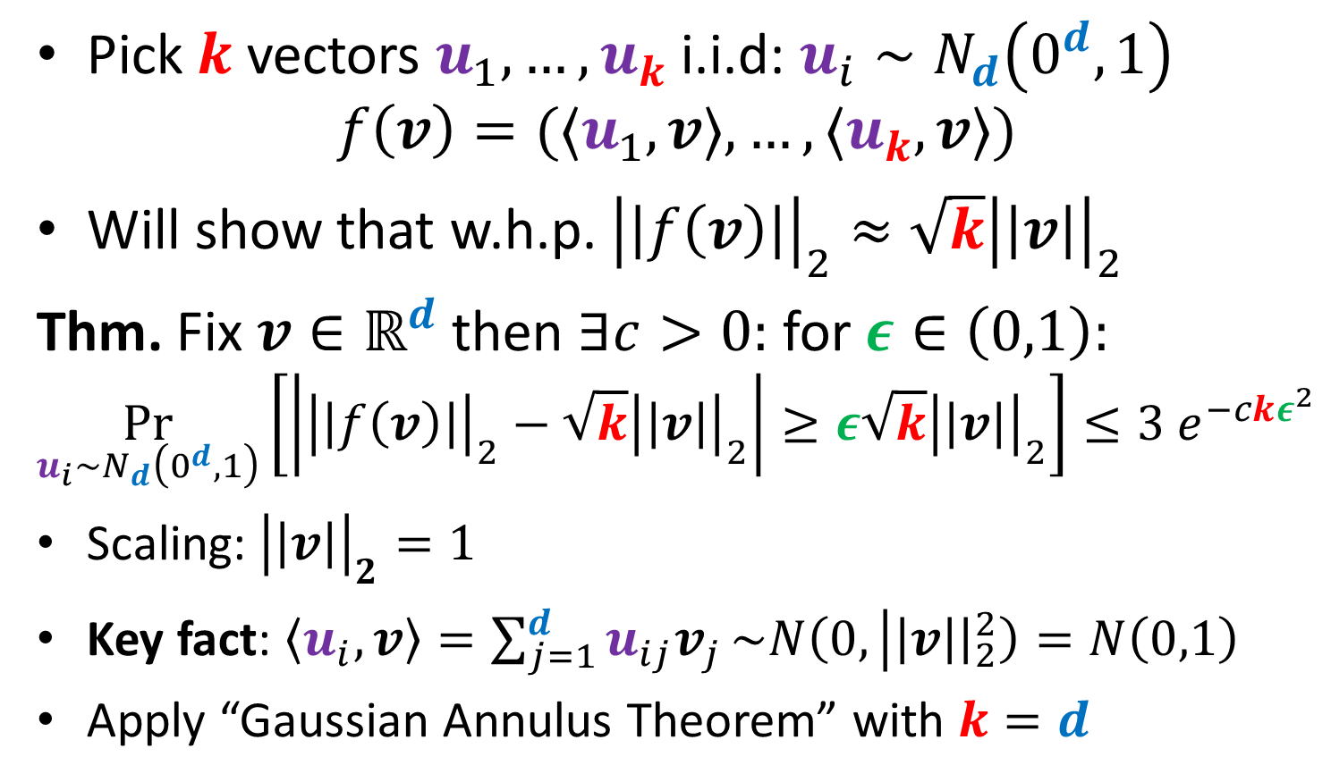
Random Projection Theorem
Pick $k$ vectors $u_{1},…, u_{k}$ i.i.d: $u_{i}∼N_{d}\left(0^{d},1\right)$
$$f\left(v\right)=(〈u_{1},v〉,…, {〈u}_{k},v〉)$$
Will show that w.h.p. ${\left|\left|f\left(v\right)\right|\right|}_{2}≈\sqrt{k}{\left|\left|v\right|\right|}_{2}$
Thm. Fix $v∈ℝ^{d}$ then $∃c>0:$ for $ε∈\left(0,1\right):$
$$\underset{u_{i}∼N_{d}\left(0^{d},1\right)}{Pr}\left[\left|{\left|\left|f\left(v\right)\right|\right|}_{2}−\sqrt{k}{\left|\left|v\right|\right|}_{2}\right|≥ε\sqrt{k}{\left|\left|v\right|\right|}_{2}\right]≤3 e^{−ckε^{2}}$$
Scaling: ${\left|\left|v\right|\right|}_{2}=1$
Key fact: $〈u_{i},v〉=\sum_{j=1}^{d}{u_{ij}v_{j}}\sim N\left(0, | \left|v\right|{\left.​\right|}_{2}^{2}\right)=N\left(0,1\right)$
Apply “Gaussian Annulus Theorem” with $k=d$

Slide 25

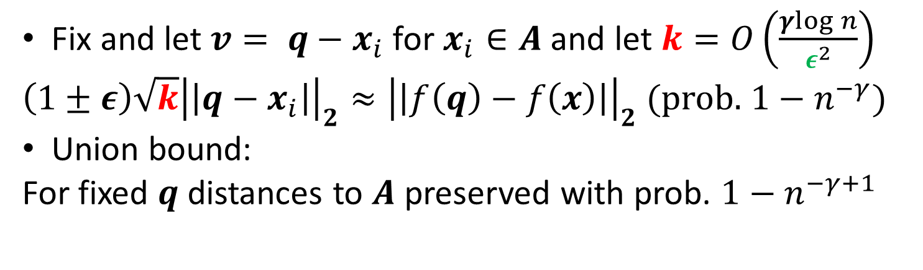
Nearest Neighbors and Random Projections
Thm. Fix $v∈ℝ^{d}$ then $∃c>0:$ for $ε∈\left(0,1\right):$
$$\underset{u_{i}∼N_{d}\left(0^{d},1\right)}{Pr}\left[\left|{\left|\left|f\left(v\right)\right|\right|}_{2}−\sqrt{k}{\left|\left|v\right|\right|}_{2}\right|≥ε\sqrt{k}{\left|\left|v\right|\right|}_{2}\right]≤3 e^{−ckε^{2}}$$
Return: $argmin_{x∈A}{\left|\left|f\left(q\right)−f\left(x\right)\right|\right|}_{2}≈\sqrt{k}$ $argmin_{x∈A}{\left|\left|q−x\right|\right|}_{2}$
Fix and let $v= q−x_{i}$ for $x_{i}∈A$ and let $k=O\left(\frac{γlog{n}}{ε^{2}}\right)$
$\left(1±ε\right){\sqrt{k}\left|\left|q−x_{i}\right|\right|}_{2}≈{\left|\left|f\left(q\right)−f\left(x\right)\right|\right|}_{2}$ (prob. $1−n^{−γ}$)
Union bound:
For fixed $q$ distances to $A$ preserved with prob. $1−n^{−γ+1}$

