Slide 1
CSCI B609: “Foundations of Data Science”
Lecture 6/7: Best-Fit Subspaces and Singular Value Decomposition
Slides at http://grigory.us/data-science-class.html
Grigory Yaroslavtsev
http://grigory.us

Slide 2
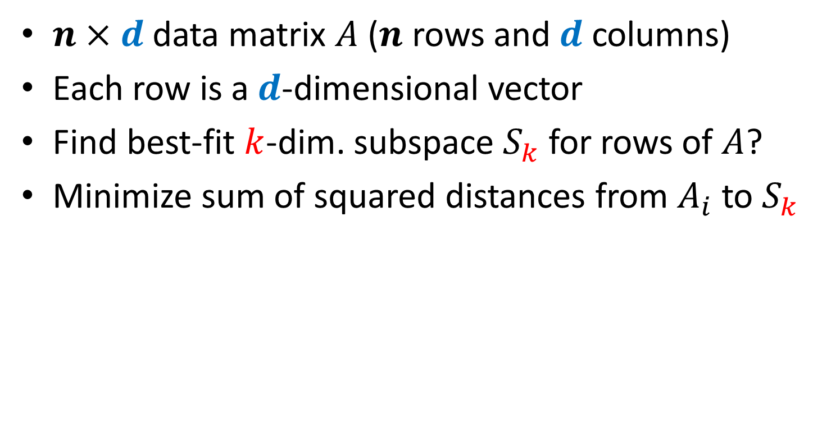
Singular Value Decomposition: Intro
$n×d$ data matrix $A$ ($n$ rows and $d$ columns)
Each row is a $d$-dimensional vector
Find best-fit $k$-dim. subspace $S_{k}$ for rows of $A$?
Minimize sum of squared distances from $A_{i}$ to $S_{k}$

Slide 3
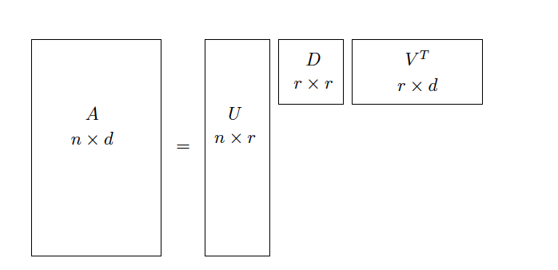

SVD: Greedy Strategy
Find best fit 1-dimensional line
Repeat $k$ times
When $k=r=rank(A)$ we get the SVD:
$$A=UDV^{T}$$

Slide 4

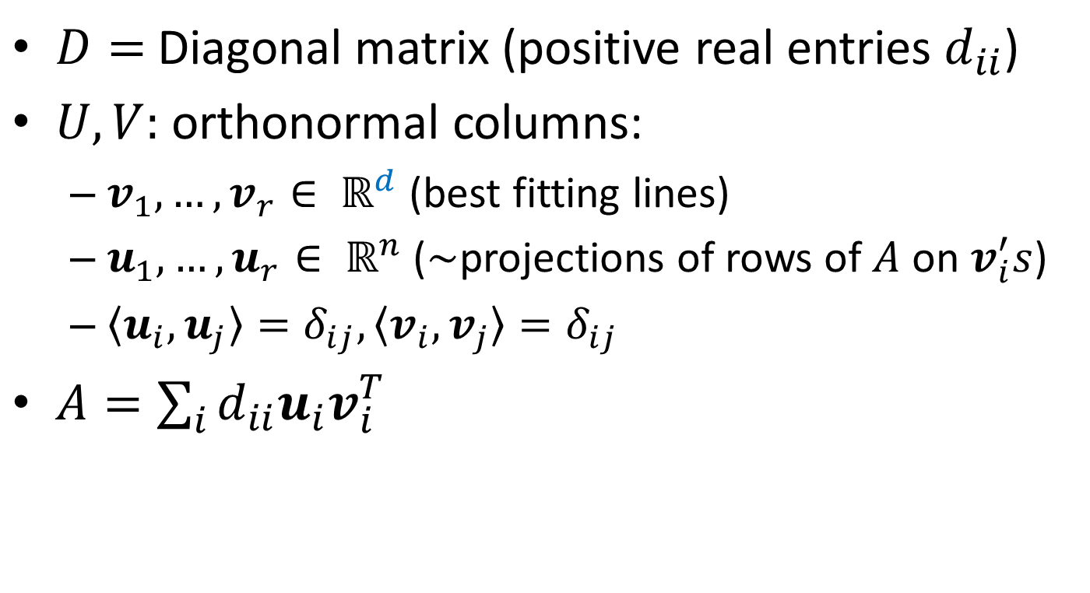
$A=UDV^{T}$: Basic Properties
$D=$ Diagonal matrix (positive real entries $d_{ii}$)
$U,V:$ orthonormal columns:
$v_{1},…, v_{r}∈ ℝ^{d}$ (best fitting lines)
$u_{1},…, u_{r}∈ ℝ^{n}$ ($\sim$projections of rows of $A$ on $v_{i}^{′}s$)
$〈u_{i},u_{j}〉=δ_{ij},〈v_{i},v_{j}〉=δ_{ij}$
$A=\sum_{i}{d_{ii}u_{i}v_{i}^{T}}$

Slide 5
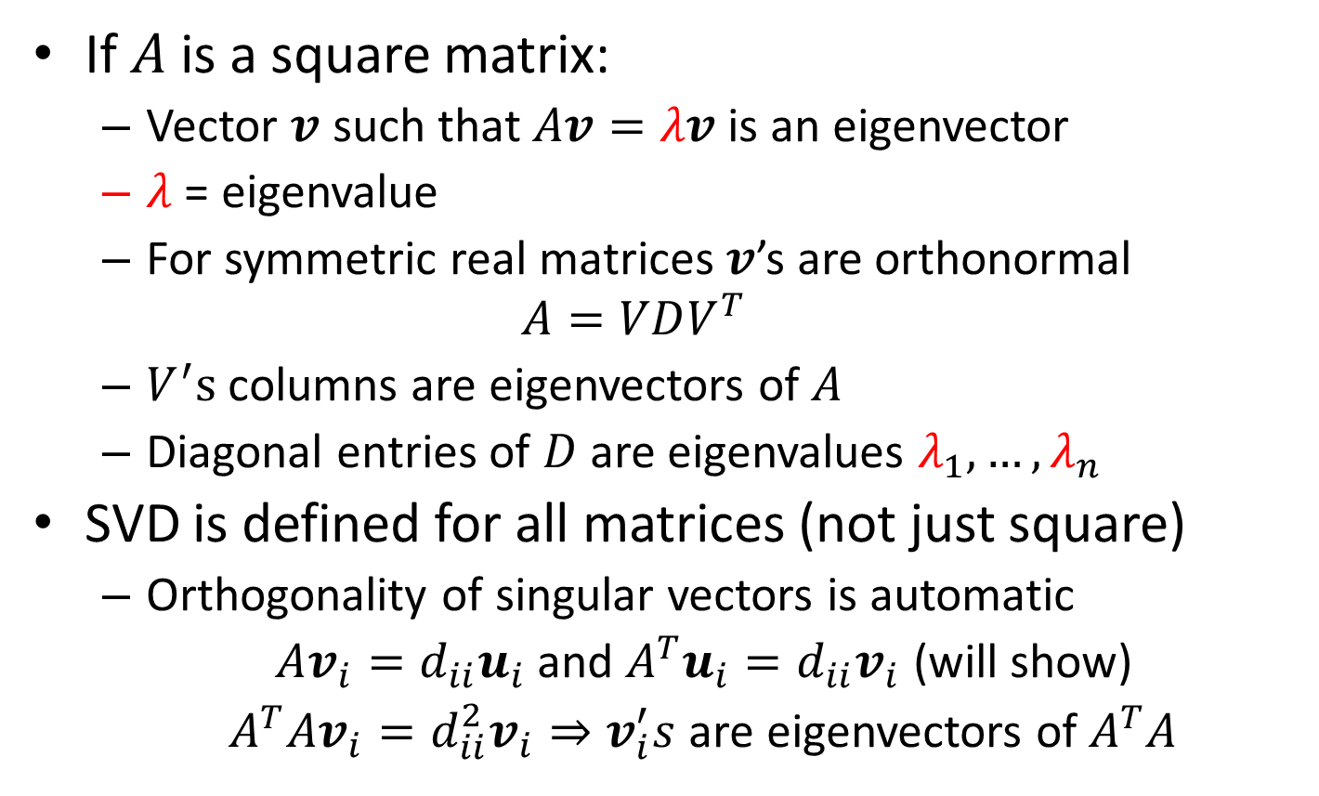
Singular Values vs. Eigenvalues
If $A$ is a square matrix:
Vector $v$ such that $Av=λv$ is an eigenvector
$λ$ = eigenvalue
For symmetric real matrices $v$’s are orthonormal
$$A=VDV^{T}$$
$V^{′}s$ columns are eigenvectors of $A$
Diagonal entries of $D$ are eigenvalues $λ_{1},…, λ_{n}$
SVD is defined for all matrices (not just square)
Orthogonality of singular vectors is automatic
$Av_{i}=d_{ii}u_{i}$ and $A^{T}u_{i}=d_{ii}v_{i}$ (will show)
$A^{T}Av_{i}=d_{ii}^{2}v_{i}⇒v_{i}^{′}s$ are eigenvectors of $A^{T}A$

Slide 6
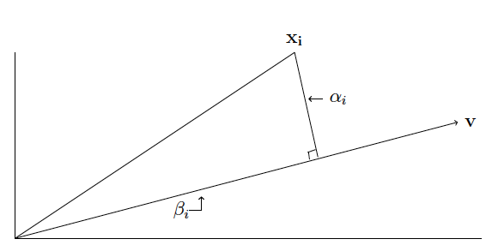
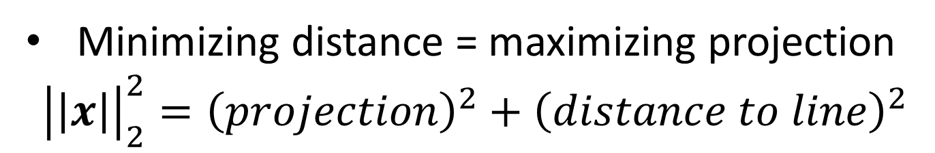
Projections and Distances
Minimizing distance = maximizing projection
$${\left|\left|x\right|\right|}_{2}^{2}={\left(projection\right)}^{2}+{\left(distance to line\right)}^{2}$$

Slide 7
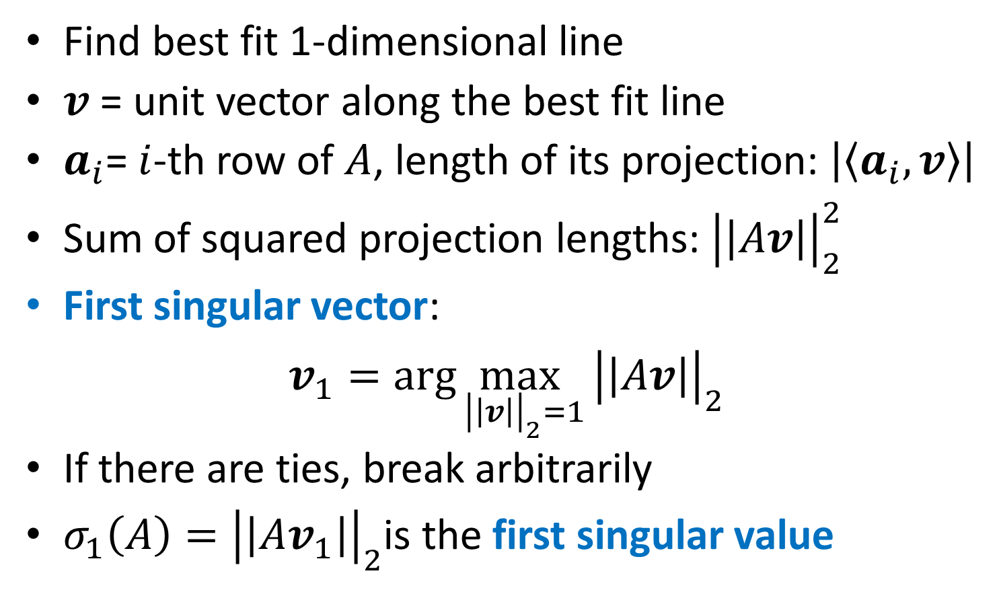
SVD: First Singular Vector
Find best fit 1-dimensional line
$v$ = unit vector along the best fit line
$a_{i}$= $i$-th row of $A$, length of its projection: $\left|〈a_{i},v〉\right|$
Sum of squared projection lengths: ${\left|\left|Av\right|\right|}_{2}^{2}$
First singular vector:
$v_{1}=\arg{\max_{{\left|\left|v\right|\right|}_{2}=1}}{\left|\left|Av\right|\right|}_{2}^{}$
If there are ties, break arbitrarily
$σ_{1}\left(A\right)={\left|\left|Av_{1}\right|\right|}_{2}$is the first singular value

Slide 8
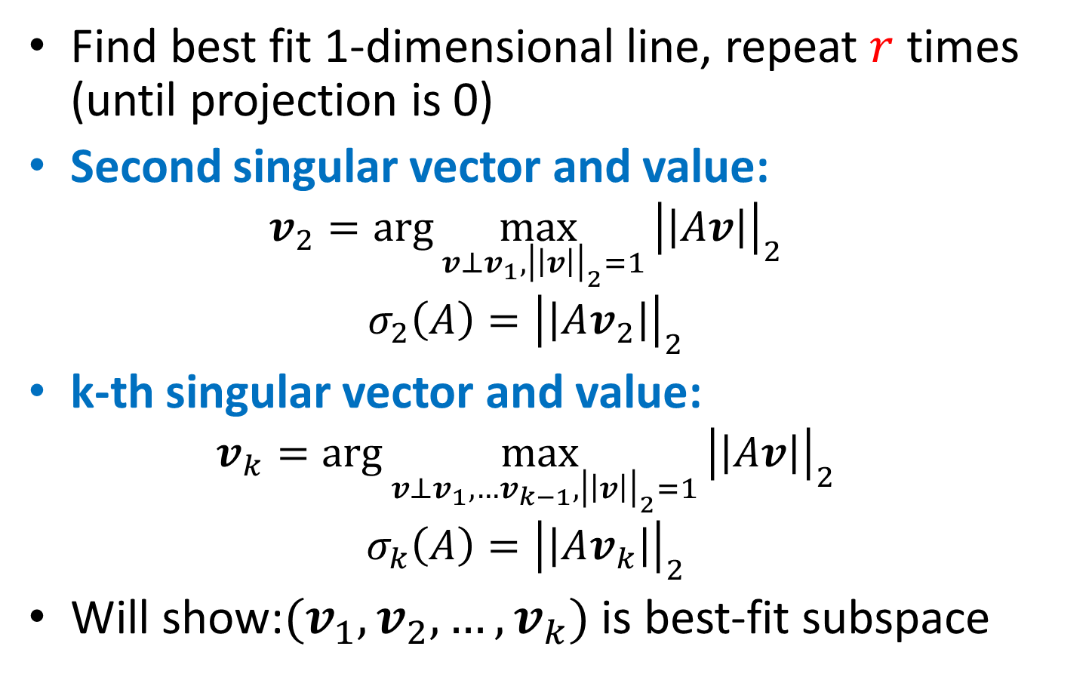
SVD: Greedy Construction
Find best fit 1-dimensional line, repeat $r$ times (until projection is 0)
Second singular vector and value:
$$v_{2}=\arg{\max_{{v⊥v_{1},\left|\left|v\right|\right|}_{2}=1}}{\left|\left|Av\right|\right|}_{2}^{}$$
$$σ_{2}\left(A\right)={\left|\left|Av_{2}\right|\right|}_{2}$$
k-th singular vector and value:
$$v_{k}=\arg{\max_{{v⊥v_{1},…v_{k−1},\left|\left|v\right|\right|}_{2}=1}}{\left|\left|Av\right|\right|}_{2}^{}$$
$$σ_{k}\left(A\right)={\left|\left|Av_{k}\right|\right|}_{2}$$
Will show:$(v_{1},v_{2},…,v_{k})$ is best-fit subspace

Slide 9
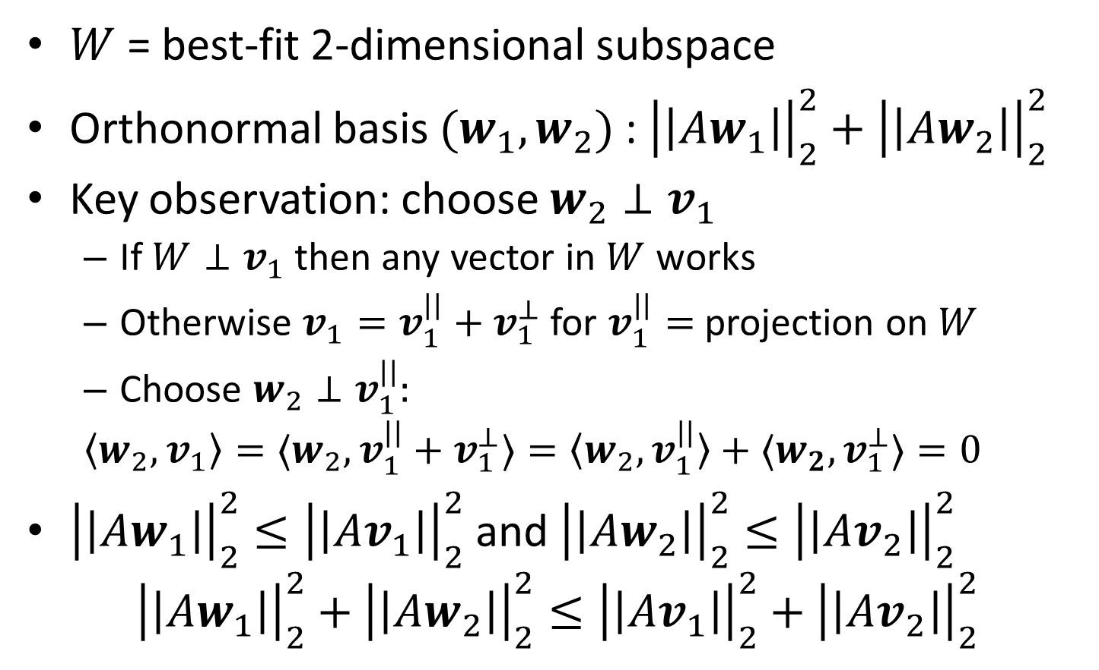

Best-Fit Subspace Proof: $k=2$
$W$ = best-fit 2-dimensional subspace
Orthonormal basis $(w_{1},w_{2})$ : ${\left|\left|Aw_{1}\right|\right|}_{2}^{2}+{\left|\left|Aw_{2}\right|\right|}_{2}^{2}$
Key observation: choose $w_{2}⊥v_{1}$
If $W⊥v_{1}$ then any vector in $W$ works
Otherwise ${v_{1}=v}_{1}^{||}+v_{1}^{⊥}$ for $v_{1}^{||}=$ projection on $W$
Choose $w_{2}⊥v_{1}^{||}:$
$$〈w_{2},v_{1}〉=〈w_{2},v_{1}^{||}+v_{1}^{⊥}〉=〈w_{2},v_{1}^{||}〉+{〈w_{2},v}_{1}^{⊥}〉=0$$
${\left|\left|Aw_{1}\right|\right|}_{2}^{2}≤{\left|\left|Av_{1}\right|\right|}_{2}^{2}$ and ${\left|\left|Aw_{2}\right|\right|}_{2}^{2}≤{\left|\left|Av_{2}\right|\right|}_{2}^{2}$
$${\left|\left|Aw_{1}\right|\right|}_{2}^{2}+{\left|\left|Aw_{2}\right|\right|}_{2}^{2}≤{\left|\left|Av_{1}\right|\right|}_{2}^{2}+{\left|\left|Av_{2}\right|\right|}_{2}^{2}$$

Slide 10
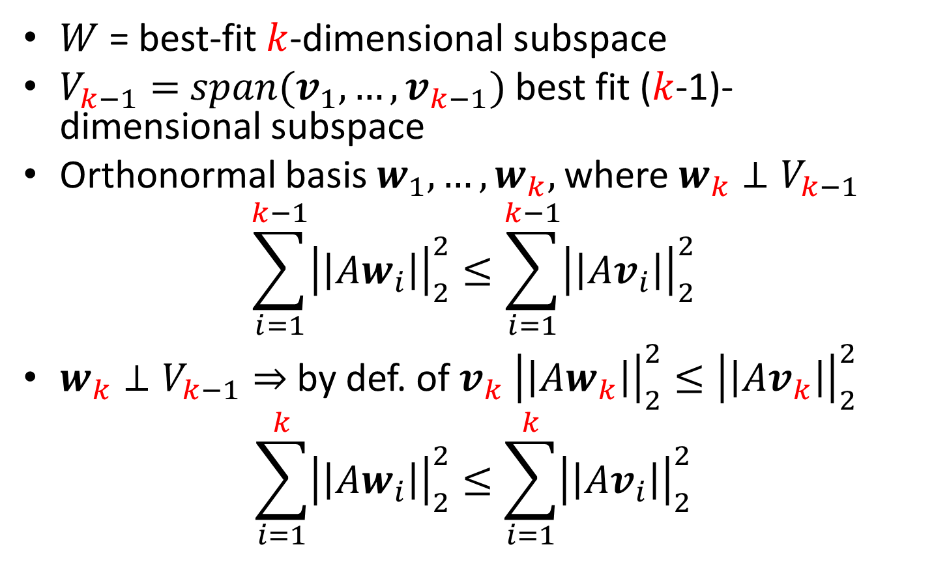

Best-Fit Subspace Proof: General $k$
$W$ = best-fit $k$-dimensional subspace
$V_{k−1}=$ $span(v_{1},…, v_{k−1})$ best fit ($k$-1)-dimensional subspace
Orthonormal basis $w_{1}, …,w_{k},$ where $w_{k}⊥V_{k−1}$
$$\sum_{i=1}^{k−1}{{\left|\left|Aw_{i}\right|\right|}_{2}^{2}}≤\sum_{i=1}^{k−1}{{\left|\left|Av_{i}\right|\right|}_{2}^{2}}$$
$w_{k}⊥V_{k−1}⇒$by def. of $v_{k}$ ${\left|\left|Aw_{k}\right|\right|}_{2}^{2}≤{\left|\left|Av_{k}\right|\right|}_{2}^{2}$
$$\sum_{i=1}^{k}{{\left|\left|Aw_{i}\right|\right|}_{2}^{2}}≤\sum_{i=1}^{k}{{\left|\left|Av_{i}\right|\right|}_{2}^{2}}$$

Slide 11
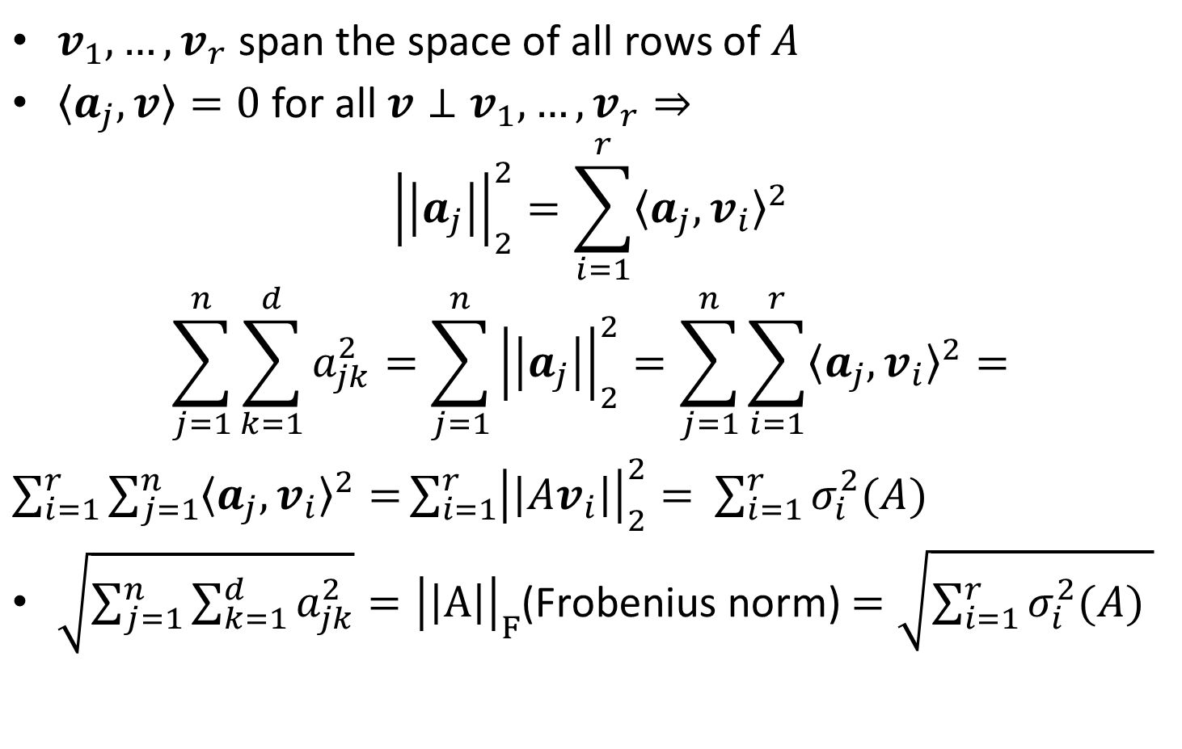
Singular Values and Frobenius Norm
$v_{1}, …, v_{r}$ span the space of all rows of $A$
$〈a_{j},v〉=0$ for all $v⊥v_{1},…,v_{r}⇒$
$${\left|\left|a_{j}\right|\right|}_{2}^{2}=\sum_{i=1}^{r}{{〈a_{j},v_{i}〉}^{2}}$$
$$\sum_{j=1}^{n}{\sum_{k=1}^{d}{a_{jk}^{2}}}=\sum_{j=1}^{n}{{\left|\left|a_{j}\right|\right|}_{2}^{2}}=\sum_{j=1}^{n}{\sum_{i=1}^{r}{{〈a_{j},v_{i}〉}^{2}}=}$$
$\sum_{i=1}^{r}{\sum_{j=1}^{n}{{〈a_{j},v_{i}〉}^{2}}=}\sum_{i=1}^{r}{{\left|\left|Av_{i}\right|\right|}_{2}^{2}= }$ $\sum_{i=1}^{r}{σ_{i}^{2}(A) }$
$\sqrt{\sum_{j=1}^{n}{\sum_{k=1}^{d}{a_{jk}^{2}}}}={\left|\left|A\right|\right|}_{F}$(Frobenius norm) $=\sqrt{\sum_{i=1}^{r}{σ_{i}^{2}(A) }}$

Slide 12

Singular Value Decomposition
$v_{1}, …, v_{r}$ are right singular vectors
${\left|\left|Av_{i}\right|\right|}_{2}^{}=σ_{i}(A)$ are singular values
$u_{1}, …, u_{r}$ for $u_{i}=\frac{Av_{i}}{σ_{i}\left(A\right)}$ are left singular vectors

Slide 13
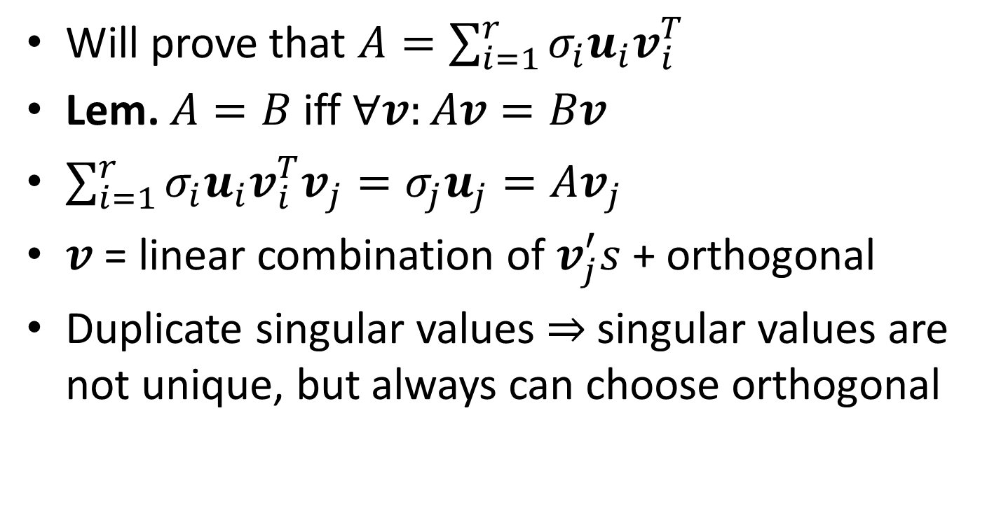
Singular Value Decomposition
Will prove that $A=\sum_{i=1}^{r}{σ_{i}u_{i}v_{i}^{T}}$
Lem. $A=B$ iff $∀v:Av=Bv$
$\sum_{i=1}^{r}{σ_{i}u_{i}v_{i}^{T}v_{j}}=σ_{j}u_{j}=Av_{j}$
$v$ = linear combination of $v_{j}^{′}s$ + orthogonal
Duplicate singular values $⇒$singular values are not unique, but always can choose orthogonal

Slide 14
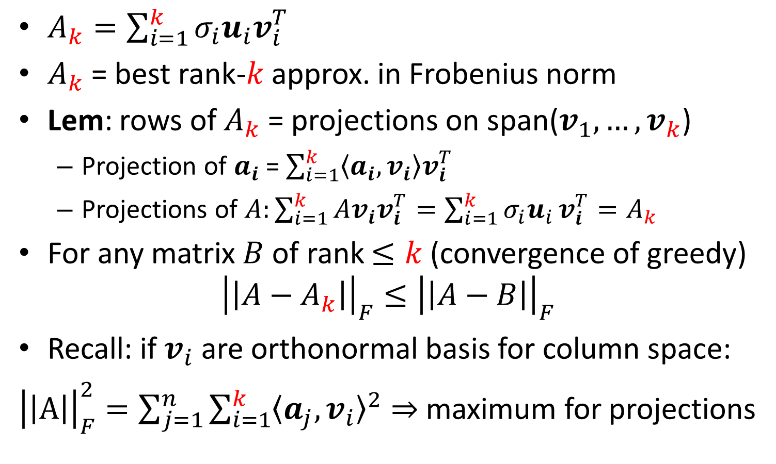

Best rank-$k$ Approximation
$A_{k}=\sum_{i=1}^{k}{σ_{i}u_{i}v_{i}^{T}}$
$A_{k}$ = best rank-$k$ approx. in Frobenius norm
Lem: rows of $A_{k}$ = projections on span($v_{1},…, v_{k}$)
Projection of $a_{i}$ = $\sum_{i=1}^{k}{〈a_{i},v_{i}〉v_{i}^{T}}$
Projections of $A:\sum_{i=1}^{k}{Av_{i}v_{i}^{T}}=\sum_{i=1}^{k}{σ_{i}u_{i}}v_{i}^{T}=A_{k}$
For any matrix $B$ of rank $≤k$ (convergence of greedy)
$${\left|\left|A−A_{k}\right|\right|}_{F}≤{\left|\left|A−B\right|\right|}_{F}$$
Recall: if $v_{i}$ are orthonormal basis for column space:
${\left|\left|A\right|\right|}_{F}^{2}=\sum_{j=1}^{n}{\sum_{i=1}^{k}{{〈a_{j},v_{i}〉}^{2}⇒}}$ maximum for projections

Slide 15
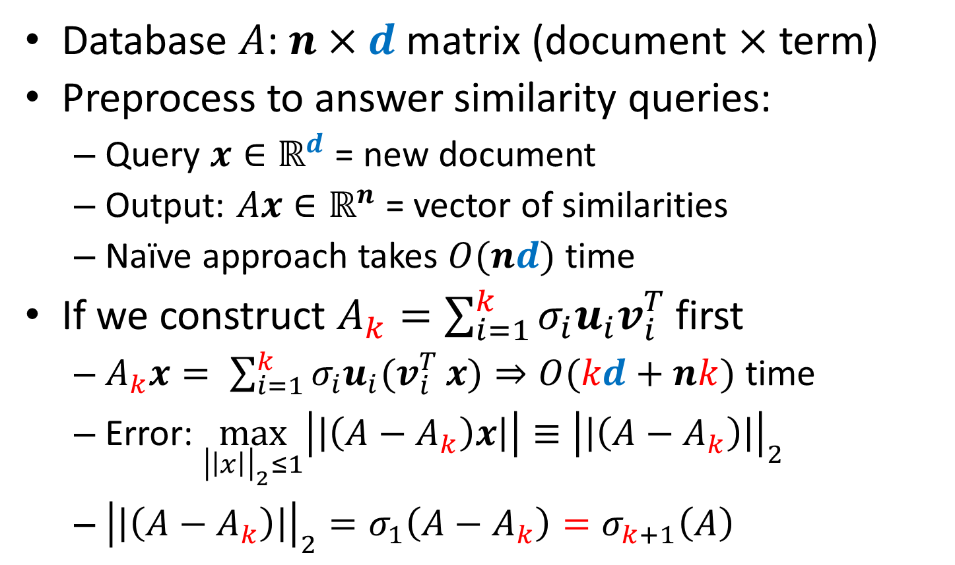

Rank-$k$ Approximation and Similarity
Database $A$: $n×d$ matrix (document $×$ term)
Preprocess to answer similarity queries:
Query $x∈ℝ^{d}$ = new document
Output: $Ax∈ℝ^{n}$ = vector of similarities
Naïve approach takes $O(nd)$ time
If we construct $A_{k}=\sum_{i=1}^{k}{σ_{i}u_{i}v_{i}^{T}}$ first
$A_{k}x= \sum_{i=1}^{k}{σ_{i}u_{i}{(v}_{i}^{T}}x)⇒O(kd+nk)$ time
Error: $\max_{{\left|\left|x\right|\right|}_{2}≤1}\left|\left|\left(A−A_{k}\right)x\right|\right|≡{\left|\left|\left(A−A_{k}\right)\right|\right|}_{2}$
${\left|\left|\left(A−A_{k}\right)\right|\right|}_{2}=σ_{1}\left(A−A_{k}\right)=σ_{k+1}\left(A\right)$

Slide 16
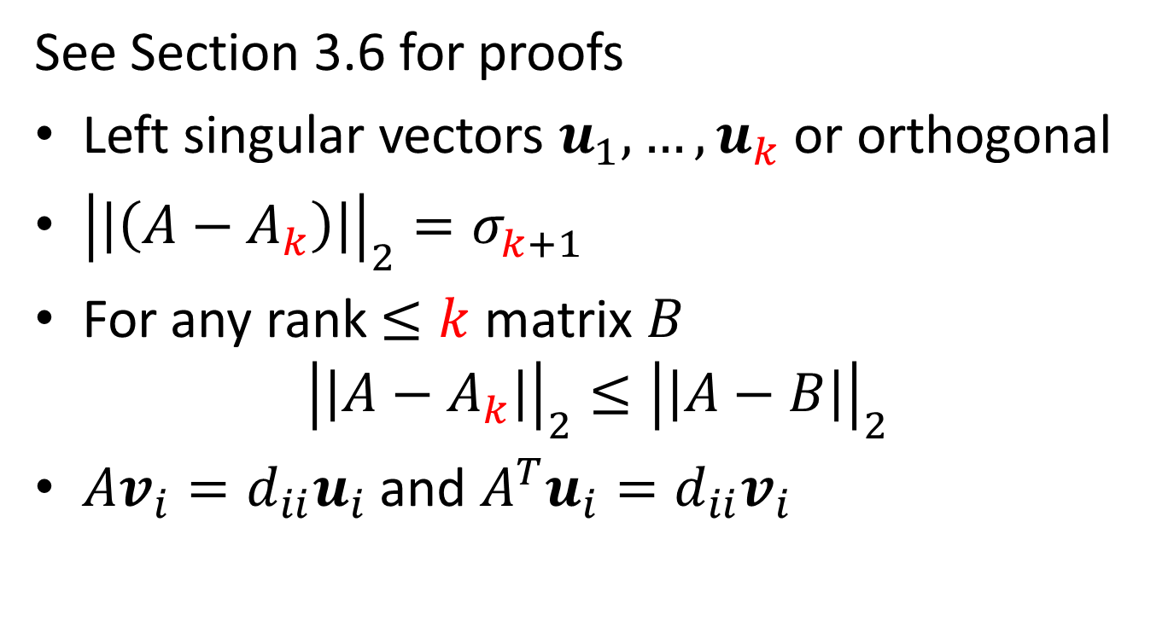
Left Singular Values and Spectral Norm
See Section 3.6 for proofs
Left singular vectors $u_{1},…, u_{k}$ or orthogonal
${\left|\left|\left(A−A_{k}\right)\right|\right|}_{2}=σ_{k+1}^{}$
For any rank$≤k$ matrix $B$
$${\left|\left|A−A_{k}\right|\right|}_{2}≤{\left|\left|A−B\right|\right|}_{2}$$
$Av_{i}=d_{ii}u_{i}$ and $A^{T}u_{i}=d_{ii}v_{i}$

Slide 17
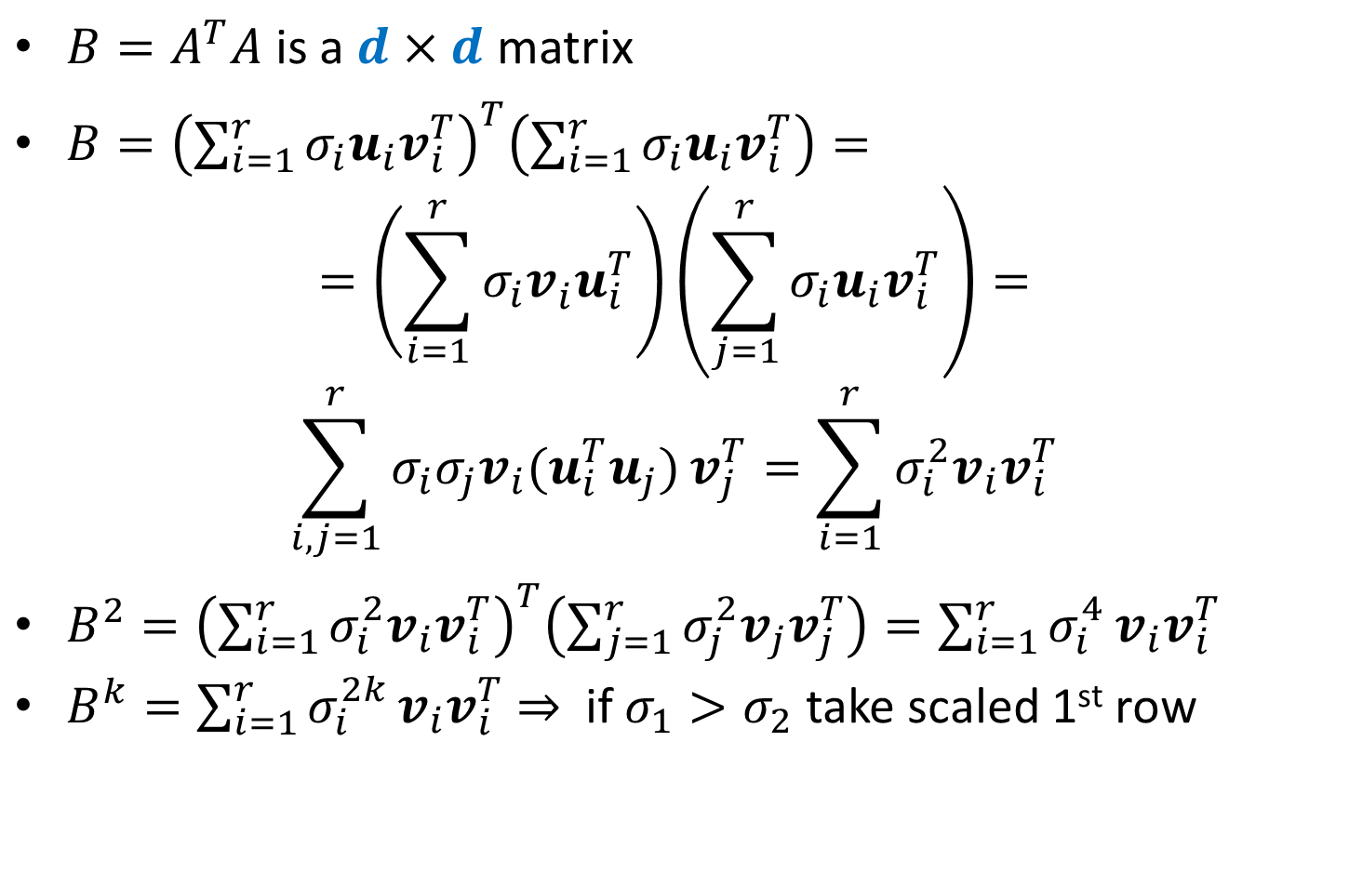
Power Method
$B=A^{T}A$ is a $d×d$ matrix
$B={\left(\sum_{i=1}^{r}{σ_{i}u_{i}v_{i}^{T}}\right)}^{T}\left(\sum_{i=1}^{r}{σ_{i}u_{i}v_{i}^{T}}\right)=$
$$=\left(\sum_{i=1}^{r}{σ_{i}v_{i}^{}u_{i}^{T}}\right)\left(\sum_{j=1}^{r}{σ_{i}u_{i}v_{i}^{T}}\right)=$$
$$\sum_{i,j=1}^{r}{σ_{i}σ_{j}v_{i}{(u}_{i}^{T}u_{j})}v_{j}^{T}=\sum_{i=1}^{r}{σ_{i}^{2}v_{i}v_{i}^{T}}$$
$B^{2}={\left(\sum_{i=1}^{r}{σ_{i}^{2}v_{i}v_{i}^{T}}\right)}^{T}\left(\sum_{j=1}^{r}{σ_{j}^{2}v_{j}v_{j}^{T}}\right)=\sum_{i=1}^{r}{σ_{i}^{4}}v_{i}v_{i}^{T}$
$B^{k}=\sum_{i=1}^{r}{σ_{i}^{2k}}v_{i}v_{i}^{T}$ $⇒$ if $σ_{1}>σ_{2}$ take scaled 1st row

Slide 18

Faster Power Method
PM drawback: $A^{T}A$ is dense even for sparse $A$
Pick random Gaussian $x$ and compute $B^{k}x$
$x=\sum_{i=1}^{d}{c_{i}v_{i}}$(augment $v_{i}$’s to o.n.b. if $r<d$)
$B^{k}x≈\left(σ_{1}^{2k}v_{1}^{}v_{1}^{T}\right)\left(\sum_{i=1}^{d}{c_{i}v_{i}}\right)= σ_{1}^{2k}c_{1}v_{1}$
$$B^{k}x=\left(A^{T}A\right)\left(A^{T}A\right)…(A^{T}A)x$$
Theorem: If $x$ is unit $ℝ^{d}$-vector, $\left|x^{T}v_{1}\right|≥δ$:
$V$ = subspace spanned by $v_{i}^{′}s$for $σ_{j}≥\left(1−ε\right)σ_{1}$
$w=$ unit vector after $k=\frac{1}{2ε}\ln\left(\frac{1}{εδ}\right)$ iterations of PM
$⇒$ $w$has a component at most $ε$ orthogonal to $V$

Slide 19
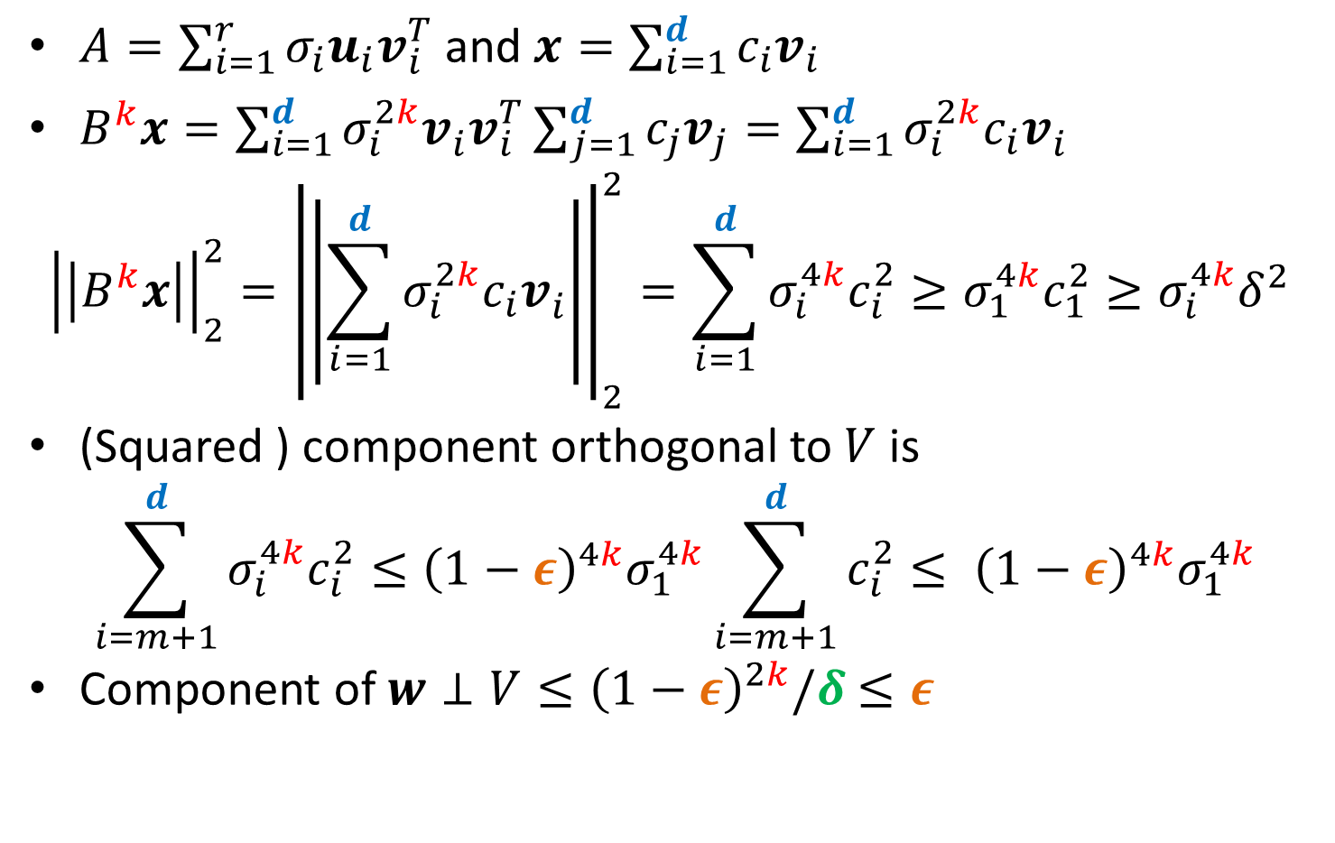
Faster Power Method: Analysis
$A=\sum_{i=1}^{r}{σ_{i}u_{i}v_{i}^{T}}$ and $x=\sum_{i=1}^{d}{c_{i}v_{i}}$
$B^{k}x=\sum_{i=1}^{d}{σ_{i}^{2k}v_{i}^{}v_{i}^{T}}\sum_{j=1}^{d}{c_{j}v_{j}}=\sum_{i=1}^{d}{σ_{i}^{2k}c_{i}v_{i}^{}}$
$${\left|\left|B^{k}x\right|\right|}_{2}^{2}={\left|\left|\sum_{i=1}^{d}{σ_{i}^{2k}c_{i}v_{i}^{}}\right|\right|}_{2}^{2}=\sum_{i=1}^{d}{σ_{i}^{4k}c_{i}^{2}}≥σ_{1}^{4k}c_{1}^{2}≥σ_{i}^{4k}δ^{2}$$
(Squared ) component orthogonal to $V$ is
$$\sum_{i=m+1}^{d}{σ_{i}^{4k}c_{i}^{2}}≤{\left(1−ε\right)}_{}^{4k}σ_{1}^{4k}\sum_{i=m+1}^{d}{c_{i}^{2}}≤ {\left(1−ε\right)}_{}^{4k}σ_{1}^{4k}$$
Component of $w⊥V≤{\left(1−ε\right)}_{}^{2k}/δ$ $≤ε$

Slide 20
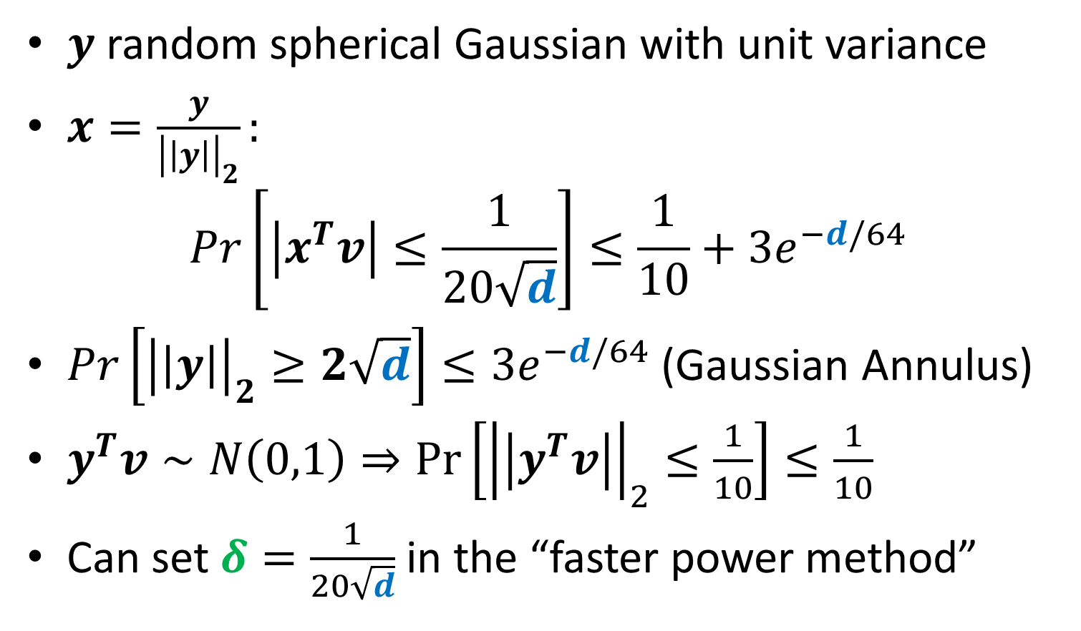

Choice of $x$
$y$ random spherical Gaussian with unit variance
$x=\frac{y}{{\left|\left|y\right|\right|}_{2}}:$
$$Pr\left[\left|x^{T}v\right|≤\frac{1}{20\sqrt{d}}\right]≤\frac{1}{10}+3e^{−d/64}$$
$Pr\left[{\left|\left|y\right|\right|}_{2}≥2\sqrt{d}\right]≤3e^{−d/64}$ (Gaussian Annulus)
$y^{T}v∼N\left(0,1\right)⇒\operatorname{Pr}\left[{\left|\left|y^{T}v\right|\right|}_{2}≤\frac{1}{10}\right]≤\frac{1}{10}$
Can set $δ=\frac{1}{20\sqrt{d}}$ in the “faster power method”

Slide 21
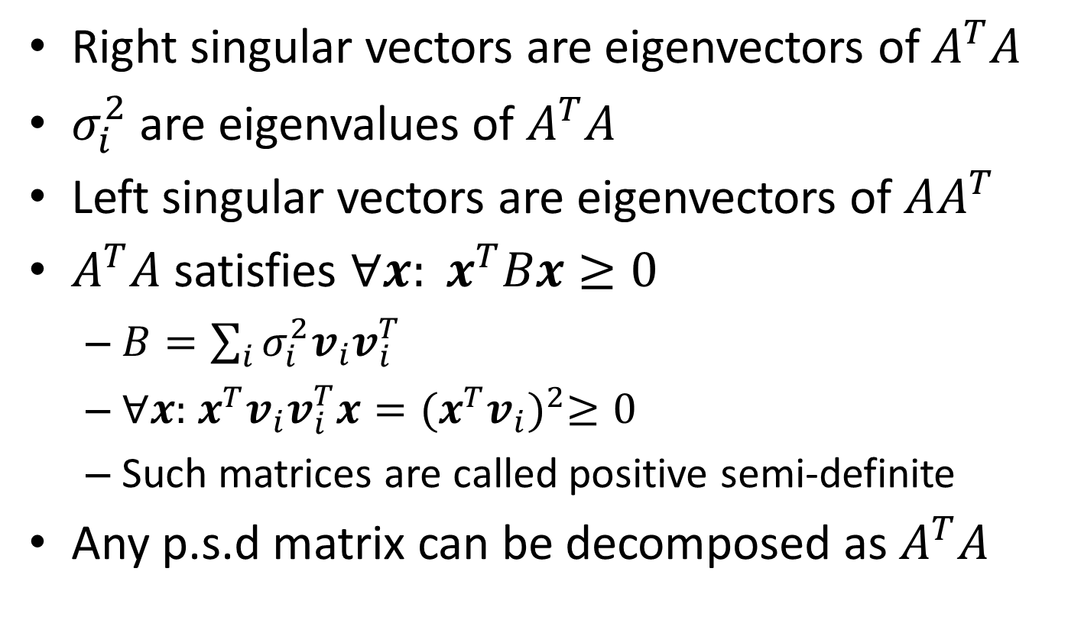
Singular Vectors and Eigenvectors
Right singular vectors are eigenvectors of $A^{T}A$
$σ_{i}^{2}$ are eigenvalues of $A^{T}A$
Left singular vectors are eigenvectors of $AA^{T}$
$A^{T}A$ satisfies ${∀x: x}^{T}Bx≥0$
$B=\sum_{i}{σ_{i}^{2}v_{i}v_{i}^{T}}$
$∀x:$ $x^{T}v_{i}v_{i}^{T}x{={(x}^{T}v_{i})}^{2}≥0$
Such matrices are called positive semi-definite
Any p.s.d matrix can be decomposed as $A^{T}A$

Slide 22
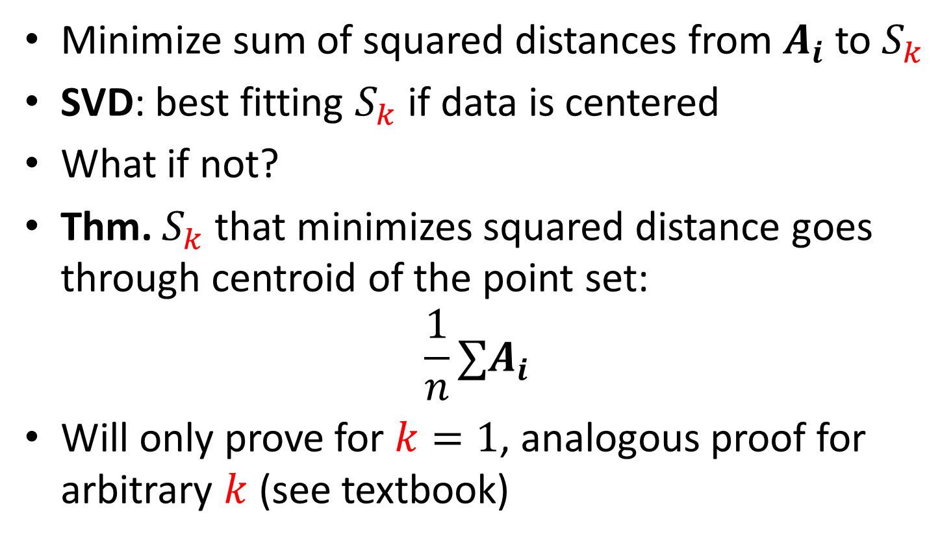
Application of SVD: Centering Data
Minimize sum of squared distances from $A_{i}$ to $S_{k}$
SVD: best fitting $S_{k}$ if data is centered
What if not?
Thm. $S_{k}$ that minimizes squared distance goes through centroid of the point set:
$$\frac{1}{n}∑A_{i}$$
Will only prove for $k=1$, analogous proof for arbitrary $k$ (see textbook)

Slide 23
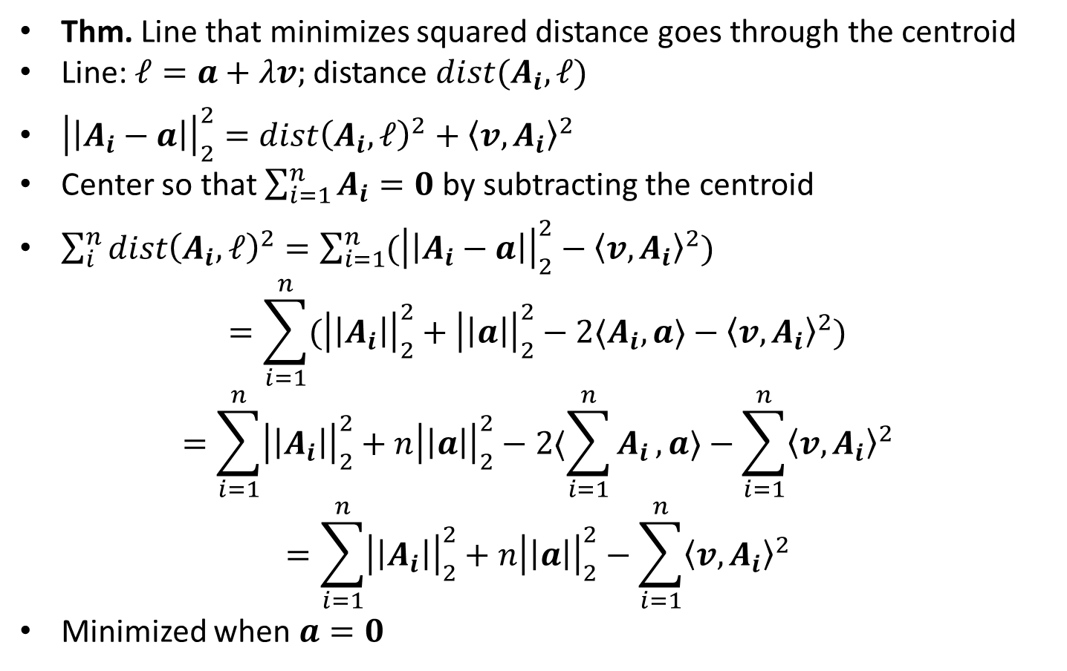
Application of SVD: Centering Data
Thm. Line that minimizes squared distance goes through the centroid
Line: $ℓ=a+λv;$ distance $dist(A_{i},ℓ)$
${\left|\left|A_{i}−a\right|\right|}_{2}^{2}=dist{\left(A_{i},ℓ\right)}^{2}+{〈v,A_{i}〉}^{2}$
Center so that $\sum_{i=1}^{n}{A_{i}}=0$ by subtracting the centroid
$\sum_{i}^{n}{dist{\left(A_{i},ℓ\right)}^{2}}=\sum_{i=1}^{n}{({\left|\left|A_{i}−a\right|\right|}_{2}^{2}−{〈v,A_{i}〉}^{2})}$
$$=\sum_{i=1}^{n}{({\left|\left|A_{i}\right|\right|}_{2}^{2}+{\left|\left|a\right|\right|}_{2}^{2}−2〈A_{i},a〉−{〈v,A_{i}〉}^{2})}$$
$$=\sum_{i=1}^{n}{{\left|\left|A_{i}\right|\right|}_{2}^{2}+{n\left|\left|a\right|\right|}_{2}^{2}−2〈\sum_{i=1}^{n}{A_{i}},a〉−\sum_{i=1}^{n}{{〈v,A_{i}〉}^{2}}}$$
$$=\sum_{i=1}^{n}{{\left|\left|A_{i}\right|\right|}_{2}^{2}+{n\left|\left|a\right|\right|}_{2}^{2}−\sum_{i=1}^{n}{{〈v,A_{i}〉}^{2}}}$$
Minimized when $a=0$

Slide 24
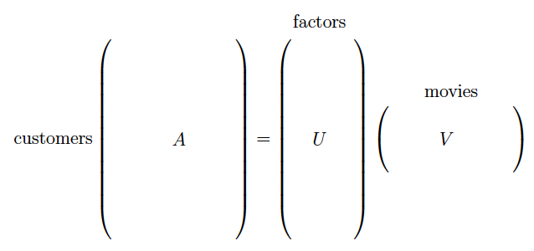
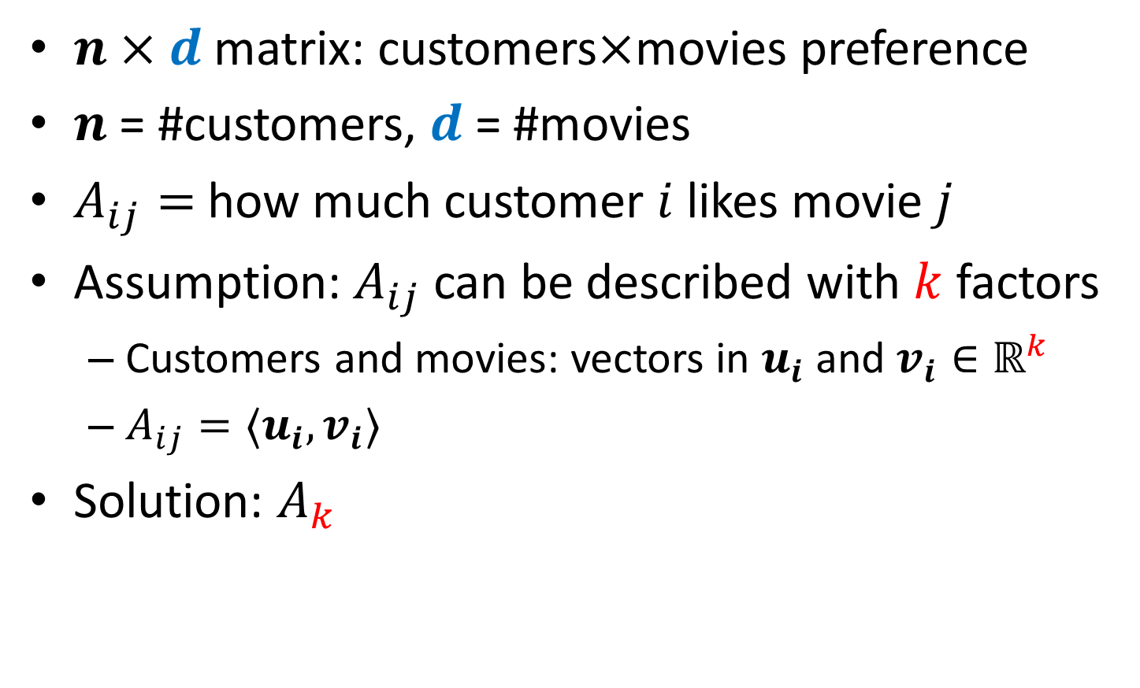
Principal Component Analysis
$n×d$ matrix: customers$×$movies preference
$n$ = #customers, $d$ = #movies
$A_{ij}=$ how much customer $i$ likes movie $j$
Assumption: $A_{ij}$ can be described with $k$ factors
Customers and movies: vectors in $u_{i}$ and $v_{i}∈ℝ^{k}$
$A_{ij}=〈u_{i},v_{i}〉$
Solution: $A_{k}$

Slide 25
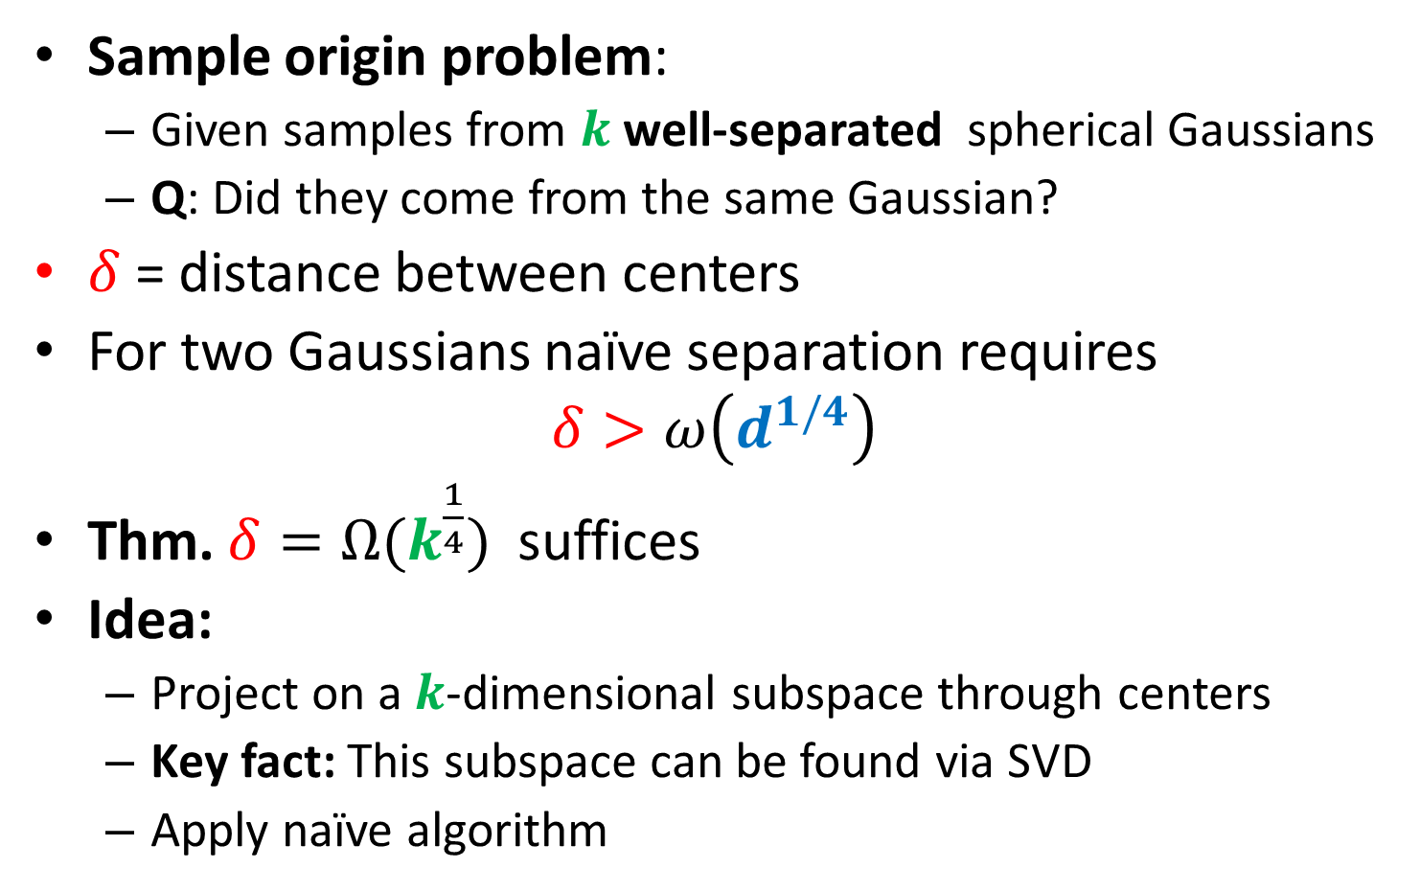

Separating mixture of $k$ Gaussians
Sample origin problem:
Given samples from $k$well-separated spherical Gaussians
Q: Did they come from the same Gaussian?
$δ$ = distance between centers
For two Gaussians naïve separation requires
$$δ>ω\left(d^{1/4}\right)$$
Thm. ${δ=Ω(k}^{\frac{1}{4}})$ suffices
Idea:
Project on a $k$-dimensional subspace through centers
Key fact: This subspace can be found via SVD
Apply naïve algorithm

Slide 26
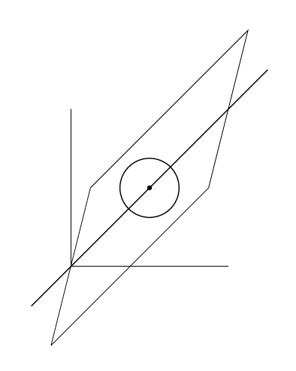

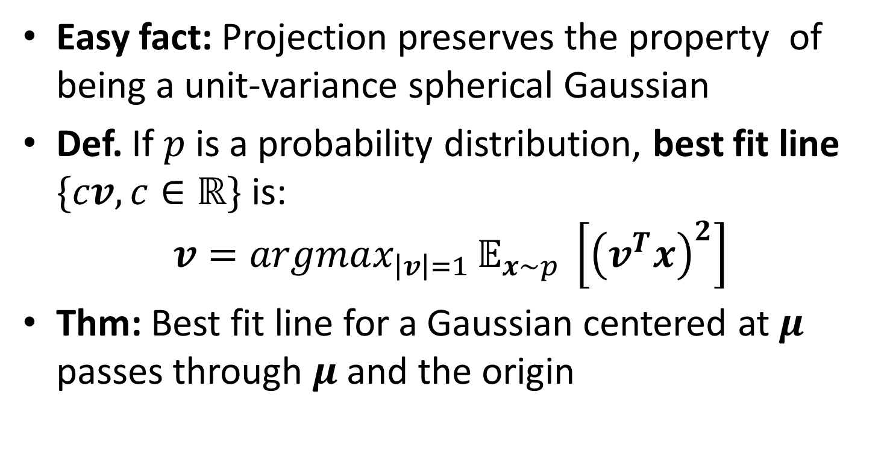
Separating mixture of $k$ Gaussians
Easy fact: Projection preserves the property of being a unit-variance spherical Gaussian
Def. If $p$ is a probability distribution, best fit line $\{cv, c∈ℝ\}$ is:
$$v=argmax_{\left|v\right|=1 }𝔼_{x∼p} \left[{\left(v^{T}x\right)}^{2}\right]$$
Thm: Best fit line for a Gaussian centered at $μ$ passes through $μ$ and the origin

Slide 27
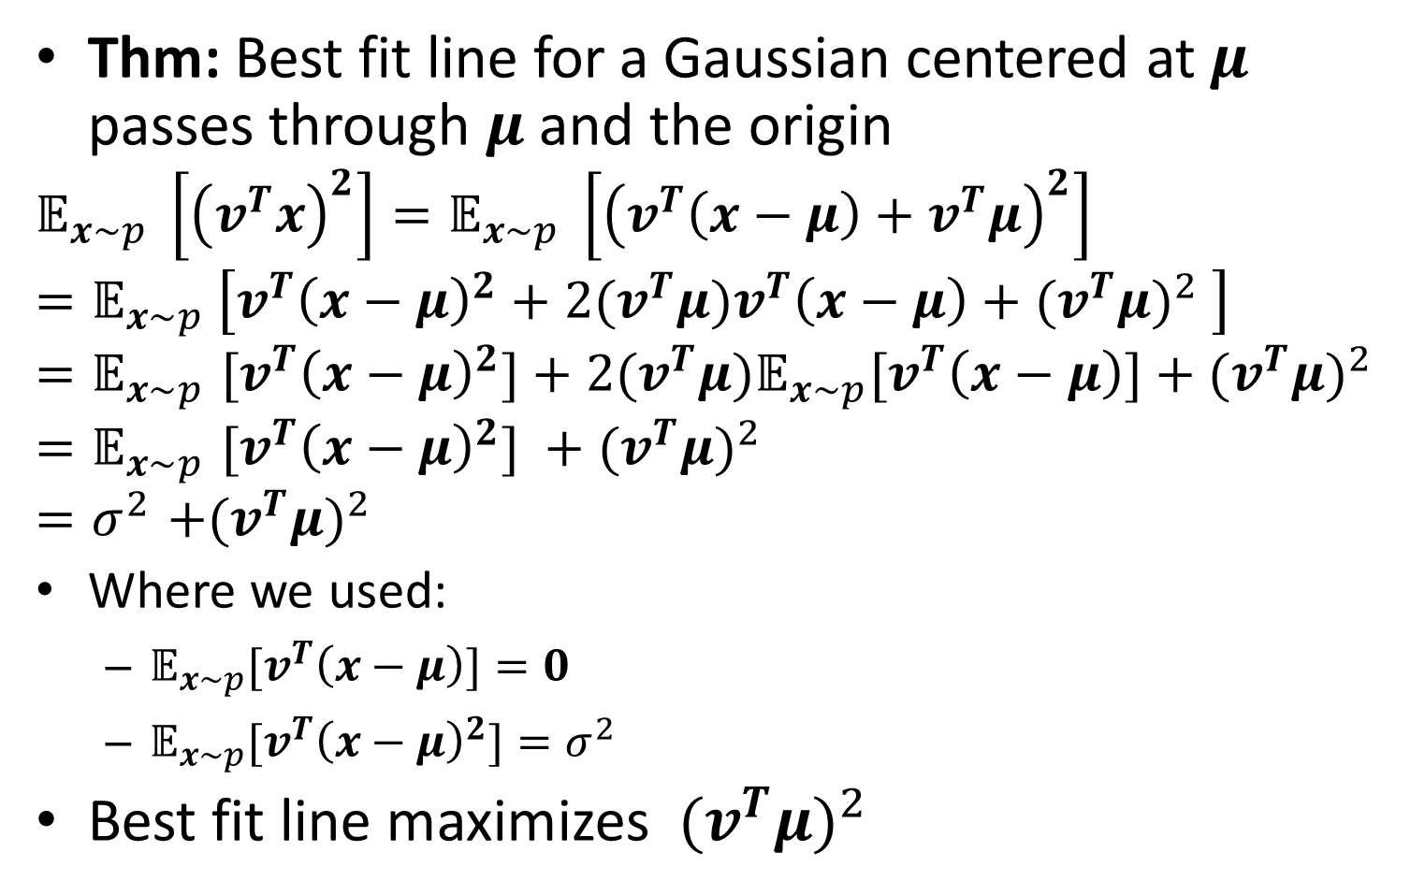
Best fit line for a Gaussian
Thm: Best fit line for a Gaussian centered at $μ$ passes through $μ$ and the origin
$$𝔼_{x∼p} \left[{\left(v^{T}x\right)}^{2}\right]=𝔼_{x∼p} \left[{\left(v^{T}\left(x−μ\right)+v^{T}μ\right)}^{2}\right]$$
$$=𝔼_{x∼p} \left[v^{T}{\left(x−μ\right)}^{2}+2{(v}^{T}μ)v^{T}\left(x−μ\right)+{{(v}^{T}μ)}^{2} \right]$$
$${=𝔼}_{x∼p}{[v}^{T}{\left(x−μ\right)}^{2}]+2{(v}^{T}μ){𝔼_{x∼p}[v}^{T}\left(x−μ\right)]+{{(v}^{T}μ)}^{2}$$
$${=𝔼}_{x∼p}{[v}^{T}{\left(x−μ\right)}^{2}] +{{(v}^{T}μ)}^{2}$$
$${=σ}^{2}+{{(v}^{T}μ)}^{2}$$
Where we used:
${𝔼_{x∼p}[v}^{T}\left(x−μ\right)]=0$
$𝔼_{x∼p}{[v}^{T}{\left(x−μ\right)}^{2}]=σ^{2}$
Best fit line maximizes ${{ (v}^{T}μ)}^{2}$

