Slide 1

Sublinear Algorihms for Big Data
Lecture 1
Grigory Yaroslavtsev
http://grigory.us

Slide 2
Part 0: Introduction
Disclaimers
Logistics
Materials
…

Slide 3
Name
Correct:
Grigory
Gregory (easiest and highly recommended!)
Also correct:
Dr. Yaroslavtsev (I bet it’s difficult to pronounce)
Wrong:
Prof. Yaroslavtsev (Not any easier)

Slide 4

Disclaimers
A lot of Math!

Slide 5
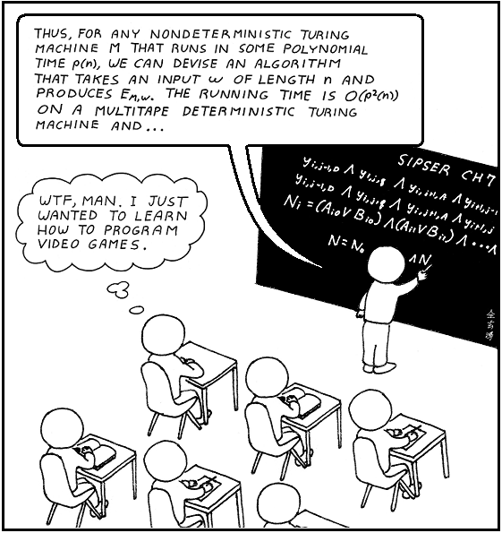
Disclaimers
No programming!

Slide 6
Disclaimers
10-15 times longer than “Fuerza Bruta”, soccer game, milonga…

Slide 7
Big Data
Data
Programming and Systems
Algorithms
Probability and Statistics

Slide 8
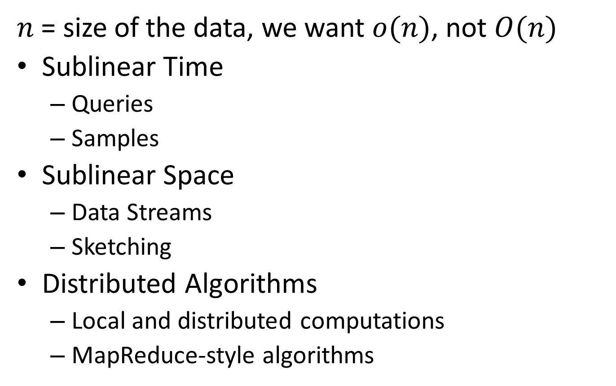
Sublinear Algorithms
$n$ = size of the data, we want $o(n)$, not $O(n)$
Sublinear Time
Queries
Samples
Sublinear Space
Data Streams
Sketching
Distributed Algorithms
Local and distributed computations
MapReduce-style algorithms

Slide 9



Why is it useful?
Algorithms for big data used by big companies (ultra-fast (randomized algorithms for approximate decision making)
Networking applications (counting and detecting patterns in small space)
Distributed computations (small sketches to reduce communication overheads)
Aggregate Knowledge: startup doing streaming algorithms, acquired for $150M
Today: Applications to soccer

Slide 10
Course Materials
Will be posted at the class homepage:
http://grigory.us/big-data.html
Related and further reading:
Sublinear Algorithms (MIT) by Indyk, Rubinfeld
Algorithms for Big Data (Harvard) by Nelson
Data Stream Algorithms (University of Massachusetts) by McGregor
Sublinear Algorithms (Penn State) by Raskhodnikova

Slide 11
Course Overview
Lecture 1
Lecture 2
Lecture 3
Lecture 4
Lecture 5
3 hours = 3 x (45-50 min lecture + 10-15 min break).

Slide 12
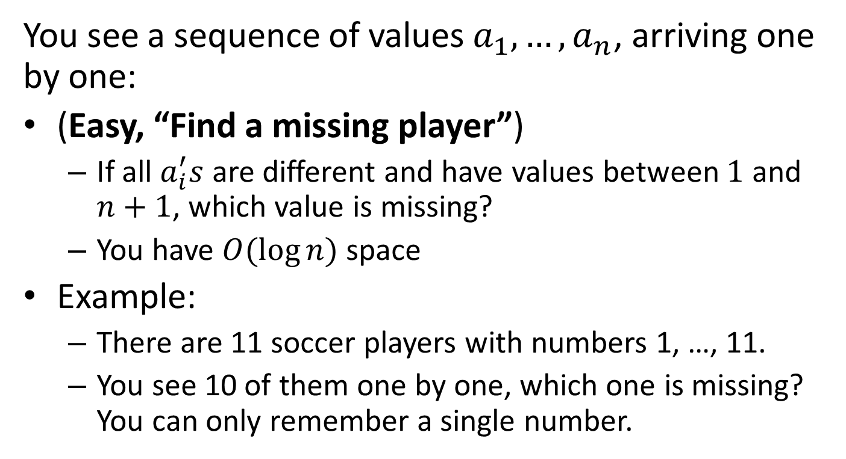
Puzzles
You see a sequence of values $a_{1}, …, a_{n}$, arriving one by one:
(Easy, “Find a missing player”)
If all $a_{i}^{′}s$ are different and have values between $1$ and $n+1$, which value is missing?
You have $O(\log{n})$ space
Example:
There are 11 soccer players with numbers 1, …, 11.
You see 10 of them one by one, which one is missing? You can only remember a single number.

Slide 13
1

Slide 14
8

Slide 15
5

Slide 16
11

Slide 17
3

Slide 18
9

Slide 19
2

Slide 20
6

Slide 21
7

Slide 22
4

Slide 23
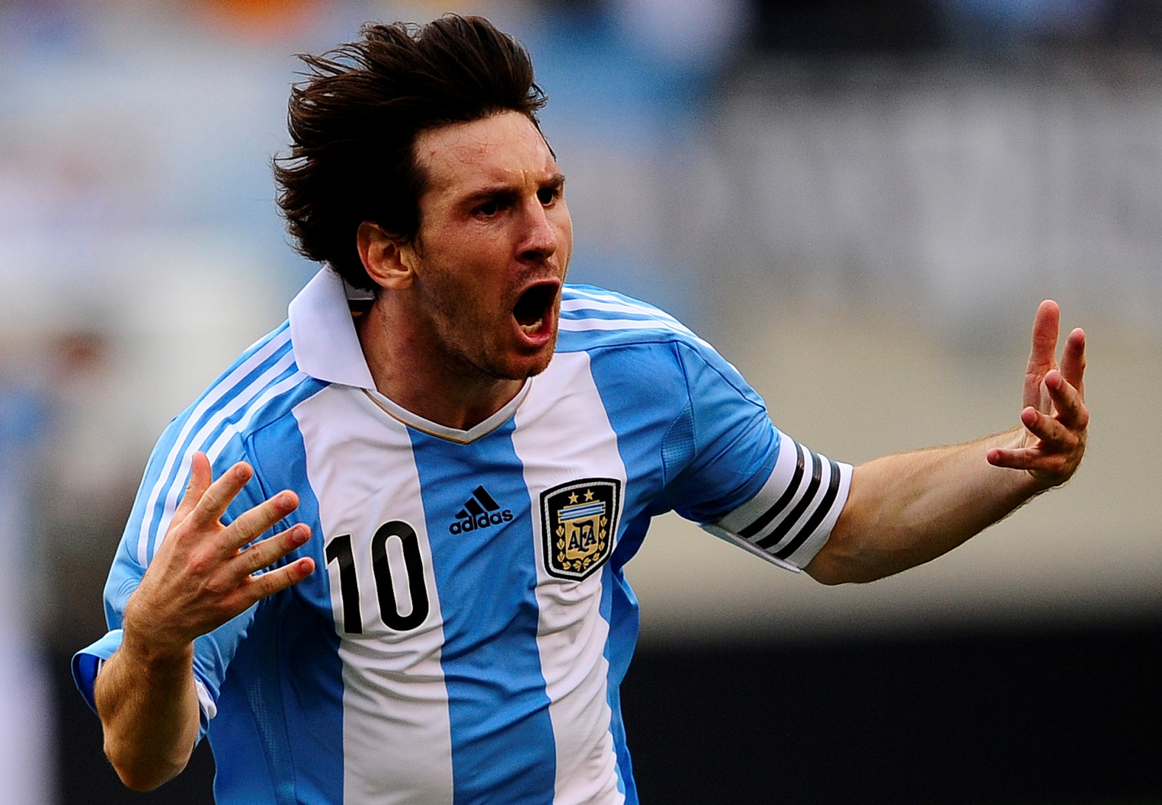
Which number was missing?

Slide 24
Puzzle #1
You see a sequence of values $a_{1}, …, a_{n}$, arriving one by one:
(Easy, “Find a missing player”)
If all $a_{i}^{′}s$ are different and have values between $1$ and $n+1$, which value is missing?
You have $O(\log{n})$ space
Example:
There are 11 soccer players with numbers 1, …, 11.
You see 10 of them one by one, which one is missing? You can only remember a single number.

Slide 25
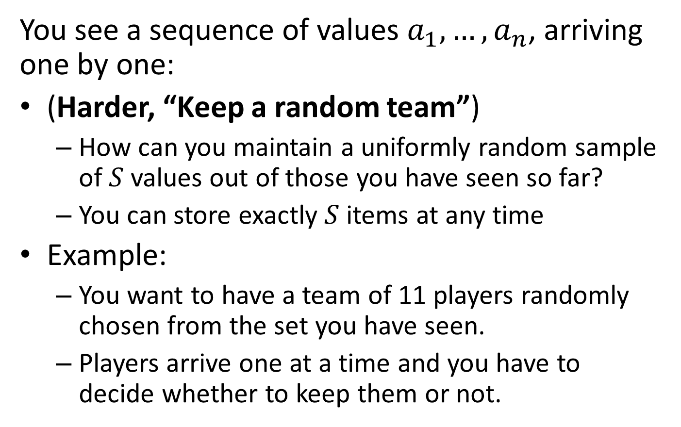
Puzzle #2
You see a sequence of values $a_{1}, …, a_{n}$, arriving one by one:
(Harder, “Keep a random team”)
How can you maintain a uniformly random sample of $S$ values out of those you have seen so far?
You can store exactly $S$ items at any time
Example:
You want to have a team of 11 players randomly chosen from the set you have seen.
Players arrive one at a time and you have to decide whether to keep them or not.

Slide 26
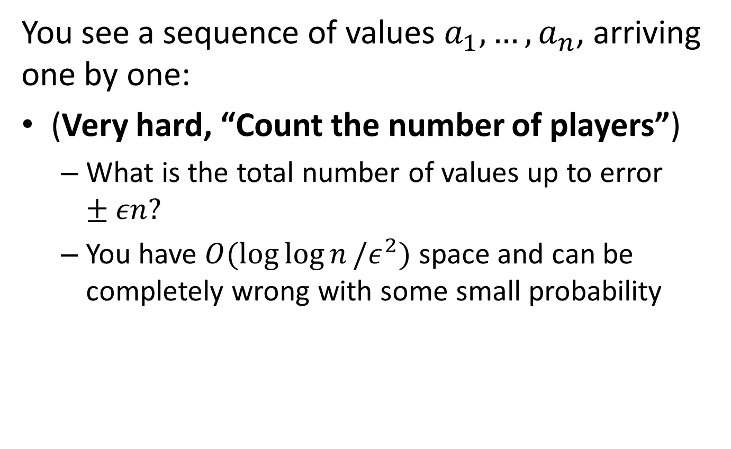
Puzzle #3
You see a sequence of values $a_{1}, …, a_{n}$, arriving one by one:
(Very hard, “Count the number of players”)
What is the total number of values up to error $±εn?$
You have $O(\log{\log{n}}/ε^{2})$ space and can be completely wrong with some small probability

Slide 27
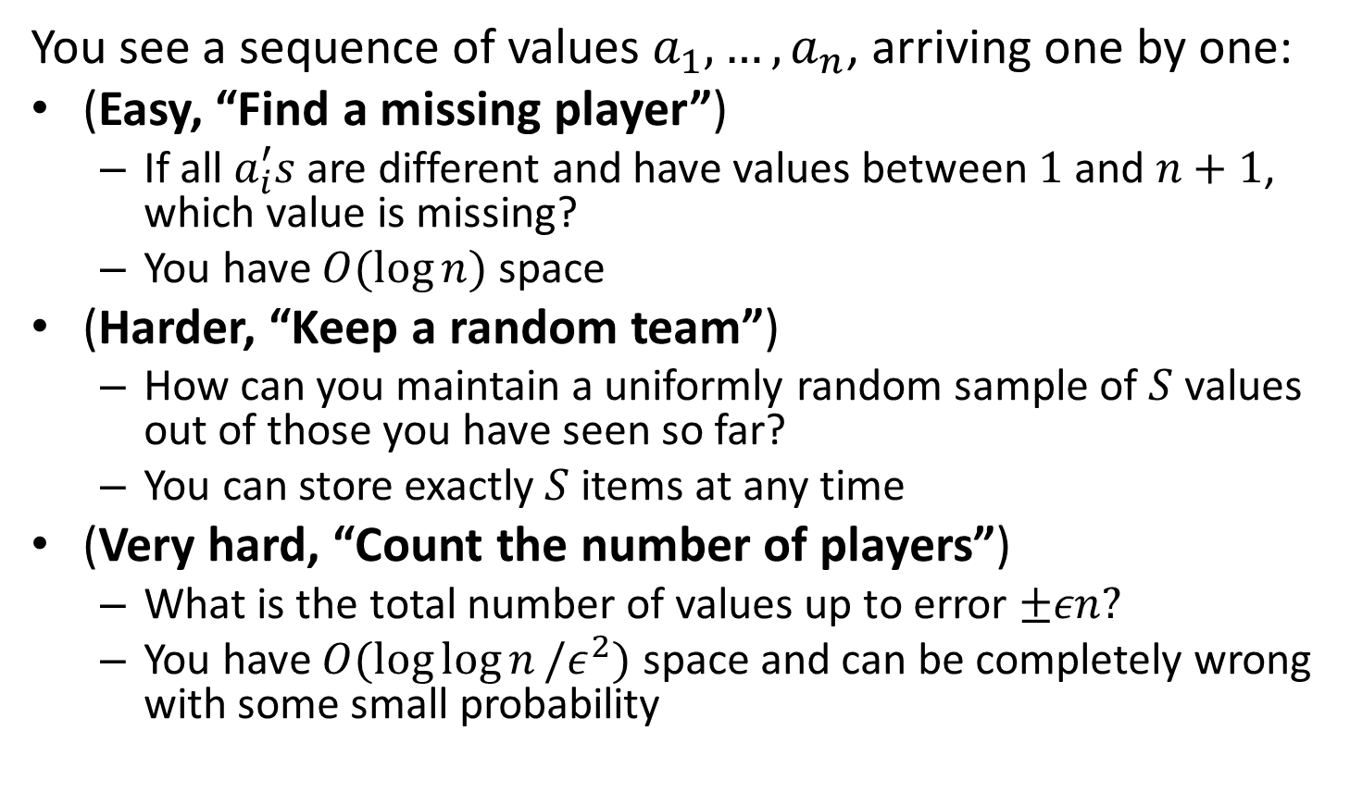
Puzzles
You see a sequence of values $a_{1}, …, a_{n}$, arriving one by one:
(Easy, “Find a missing player”)
If all $a_{i}^{′}s$ are different and have values between $1$ and $n+1$, which value is missing?
You have $O(\log{n})$ space
(Harder, “Keep a random team”)
How can you maintain a uniformly random sample of $S$ values out of those you have seen so far?
You can store exactly $S$ items at any time
(Very hard, “Count the number of players”)
What is the total number of values up to error $±εn?$
You have $O(\log{\log{n}}/ε^{2})$ space and can be completely wrong with some small probability

Slide 28
Part 1: Probability 101
“The bigger the data the better you should know your Probability”
Basic Spanish: Hola, Gracias, Bueno, Por favor, Bebida, Comida, Jamon, Queso, Gringo, Chica, Amigo, …
Basic Probability:
Probability, events, random variables
Expectation, variance / standard deviation
Conditional probability, independence, pairwise independence, mutual independence

Slide 29
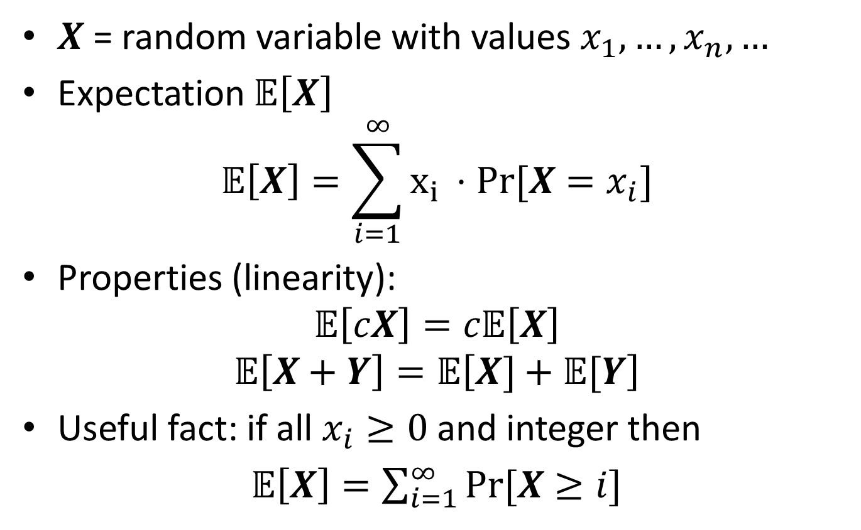
Expectation
$X$ = random variable with values $x_{1},…, x_{n}, …$
Expectation 𝔼$\left[X\right]$
$$\text{𝔼}\left[X\right]=\sum_{i=1}^{∞}{x_{i }⋅Pr⁡[X=x_{i}]}$$
Properties (linearity):
$$\text{𝔼}\left[cX\right]=c\text{𝔼}\left[X\right]$$
$$\text{𝔼}\left[X+Y\right]=\text{𝔼}\left[X]+\text{𝔼}[Y\right]$$
Useful fact: if all $x_{i}≥0$ and integer then
𝔼$\left[X\right]=\sum_{i=1}^{∞}{Pr⁡[X≥i]}$

Slide 30

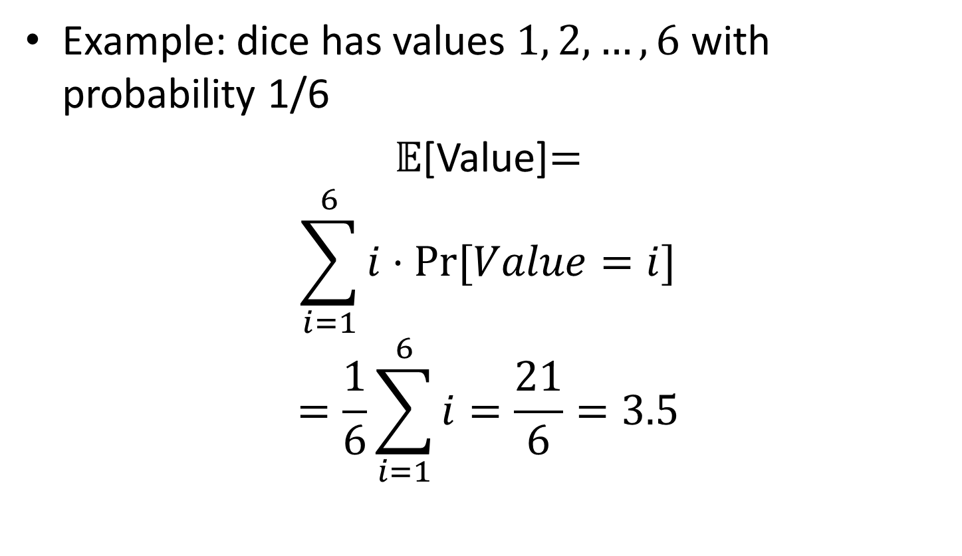
Expectation
Example: dice has values $1, 2,…, 6$ with probability 1/6
$\text{𝔼}$[Value]$=$
$$\sum_{i=1}^{6}{i⋅Pr⁡[Value=i]}$$
$$=\frac{1}{6}\sum_{i=1}^{6}{i}=\frac{21}{6}=3.5$$

Slide 31
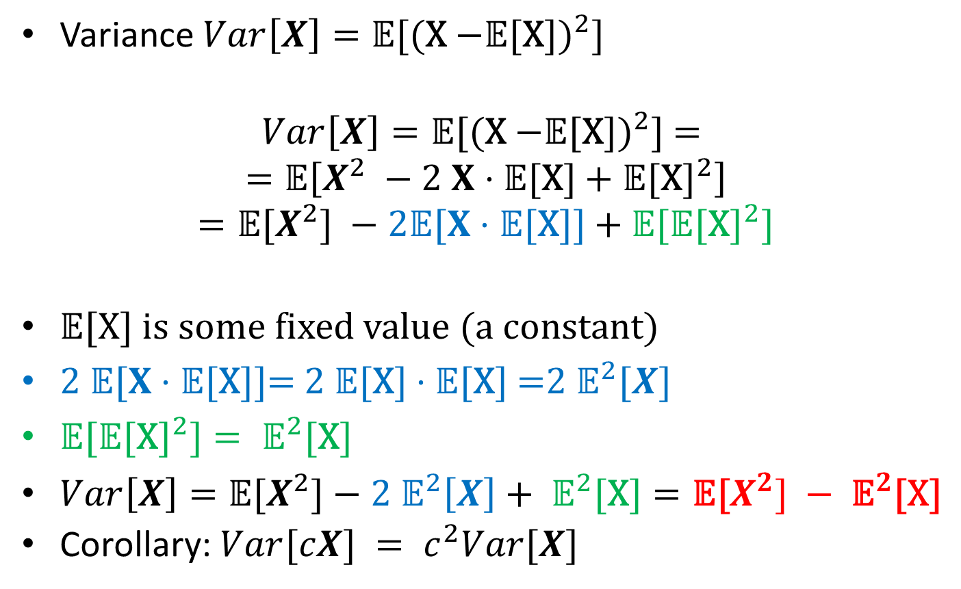
Variance
Variance ${Var\left[X\right]=\text{𝔼}\text{[(}\text{X}\text{ −}\text{𝔼}\text{[}\text{X}\text{])}}^{2}\text{]}$
$${Var\left[X\right]=\text{𝔼}\text{[(}\text{X}\text{ −}\text{𝔼}\text{[}\text{X}\text{])}}^{2}\text{] = }$$
$$=\text{𝔼}\left[X^{2} −2 X⋅\text{𝔼}\text{[}\text{X}\text{]}+{\text{𝔼}\text{[}\text{X}\text{]}}^{2}\right]$$
$$={\text{𝔼}\text{[}X^{2}\text{] }−2\text{𝔼}[X⋅\text{𝔼}\text{[}\text{X}\text{]] }\text{+} \text{𝔼}\text{[}\text{𝔼}\text{[}\text{X}\text{]}}^{2}]$$
$\text{𝔼}\text{[}\text{X}\text{]}$ is some fixed value (a constant)
$\text{2 }\text{𝔼}[X⋅\text{𝔼}\text{[}\text{X}\text{]]= 2 }\text{𝔼}\text{[}\text{X}\text{]}⋅\text{𝔼}\text{[}\text{X}\text{] =}{2 \text{𝔼}}^{2}[X]$
${\text{𝔼}\text{[}\text{𝔼}\text{[}\text{X}\text{]}}^{2}]={ \text{𝔼}}^{2}\text{[}\text{X}\text{]}$
$Var\left[X\right]=\text{𝔼}\text{[}X^{2}\text{]}−{2 \text{𝔼}}^{2}\left[X\right]+{ \text{𝔼}}^{2}\text{[}\text{X}\text{]}=\text{𝔼}\text{[}X^{2}] −{ \text{𝔼}}^{2}\text{[}\text{X}\text{]}$
Corollary: $Var[cX] = c^{2}Var[X]$

Slide 32
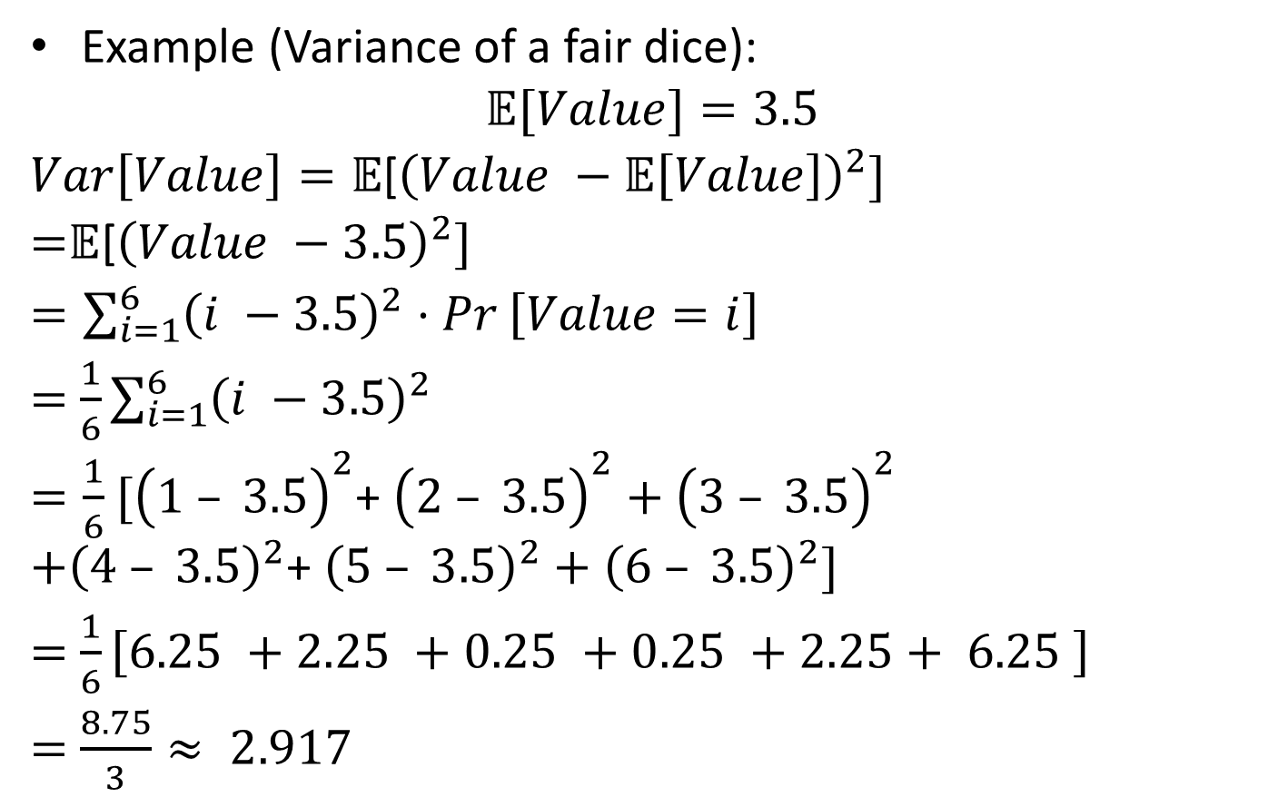
Variance
Example (Variance of a fair dice):
$$\text{𝔼}[Value]=3.5$$
$Var\left[Value\right]=\text{𝔼}$[${\left(Value −\text{𝔼}\left[Value\right]\right)}^{2}]$
=$\text{𝔼}$[${\left(Value −3.5\right)}^{2}]$
$=\sum_{i=1}^{6}{{\left(i −3.5\right)}^{2}⋅Pr}\left[Value=i\right]$
$=$ $\frac{1}{6}\sum_{i=1}^{6}{{\left(i −3.5\right)}^{2}}$
$=\frac{1}{6}$ ${[\left(1 – 3.5\right)}^{2}$+ ${\left(2 – 3.5\right)}^{2}+{\left(3 – 3.5\right)}^{2}$
$$+{\left(4 – 3.5\right)}^{2}\text{+ }{\left(5 – 3.5\right)}^{2}+{\left(6 – 3.5\right)}^{2}]$$
$=$ $\frac{1}{6}\left[6.25 +2.25 +0.25 +0.25 +2.25+ 6.25 \right]$
$=$ $\frac{8.75}{3}≈ 2.917$

Slide 33
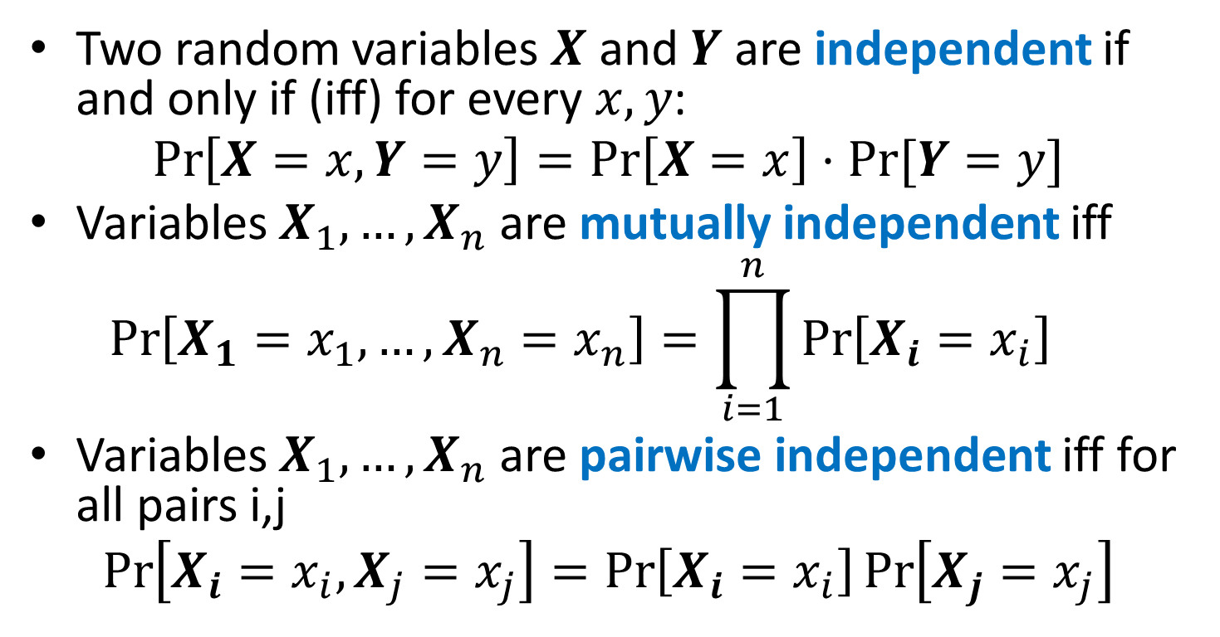
Independence
Two random variables $X$ and $Y$ are independent if and only if (iff) for every $x, y$:
$$\operatorname{Pr}\left[X=x, Y=y\right]=\operatorname{Pr}\left[X=x\right]⋅Pr⁡[Y=y]$$
Variables $X_{1},…, X_{n}$ are mutually independent iff
$$\operatorname{Pr}\left[X_{1}=x_{1}, …,X_{n}=x_{n}\right]=\prod_{i=1}^{n}{\operatorname{Pr}\left[X_{i}=x_{i}\right]}{}$$
Variables $X_{1},…, X_{n}$ are pairwise independent iff for all pairs i,j
$$\operatorname{Pr}\left[X_{i}=x_{i}, X_{j}=x_{j}\right]=\operatorname{Pr}\left[X_{i}=x_{i}\right]\operatorname{Pr}\left[X_{j}=x_{j}\right]$$

Slide 34
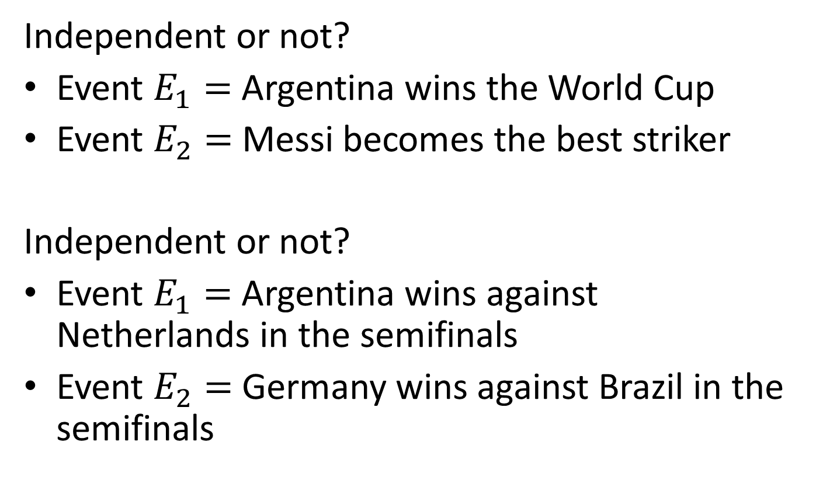
Independence: Example
Independent or not?
Event $E_{1}=$ Argentina wins the World Cup
Event $E_{2}=$ Messi becomes the best striker
Independent or not?
Event $E_{1}=$ Argentina wins against Netherlands in the semifinals
Event $E_{2}=$ Germany wins against Brazil in the semifinals

Slide 35
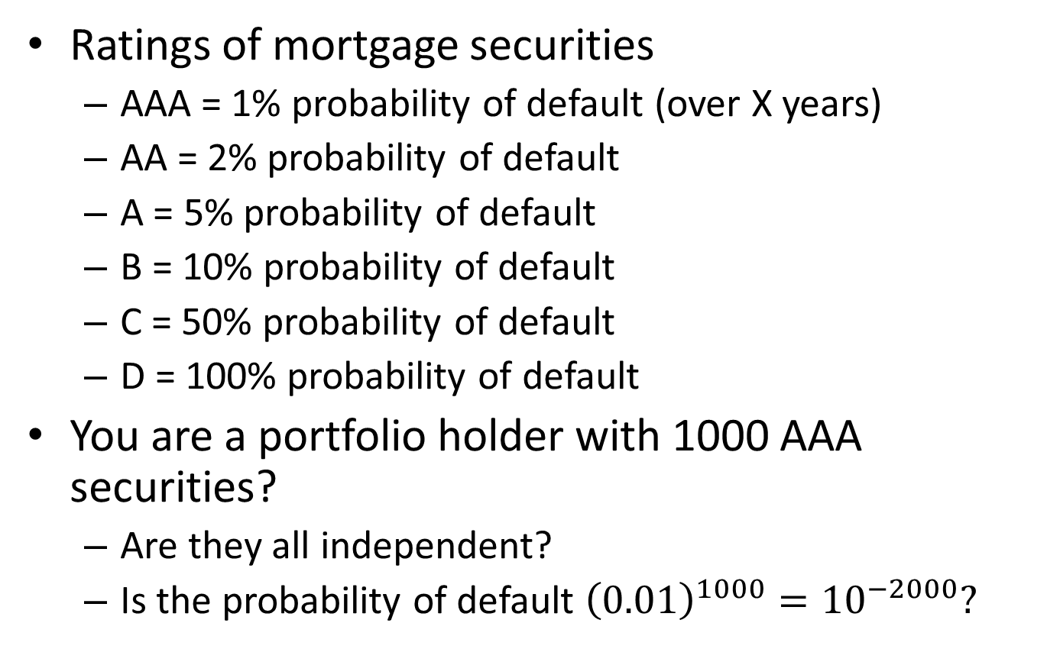
Independence: Example
Ratings of mortgage securities
AAA = 1% probability of default (over X years)
AA = 2% probability of default
A = 5% probability of default
B = 10% probability of default
C = 50% probability of default
D = 100% probability of default
You are a portfolio holder with 1000 AAA securities?
Are they all independent?
Is the probability of default ${\left(0.01\right)}^{1000}={10}^{−2000}?$

Slide 36
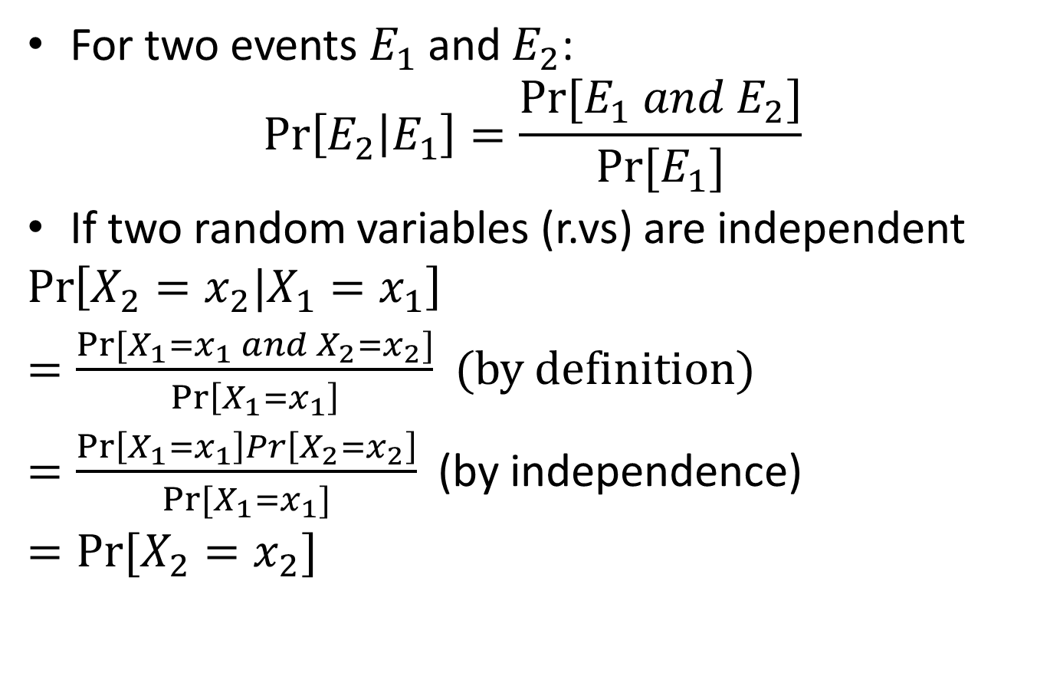
Conditional Probabilities
For two events $E_{1}$ and $E_{2}$:
$$\operatorname{Pr}\left[E_{2} | E_{1}\right]=\frac{Pr⁡[E_{1} and E_{2}]}{Pr⁡[E_{1}]}$$
If two random variables (r.vs) are independent
$$\operatorname{Pr}\left[X_{2}=x_{2}|X_{1}=x_{1}\right]$$
$=\frac{Pr⁡[X_{1}=x_{1} and X_{2}=x_{2}]}{\operatorname{Pr}\left[X_{1}=x_{1}\right]}$ (by definition)
$=\frac{\operatorname{Pr}\left[X_{1}=x_{1}\right]Pr\left[X_{2}=x_{2}\right]}{Pr[X_{1}=x_{1}]}$ (by independence)
$=Pr⁡[X_{2}=x_{2}]$

Slide 37
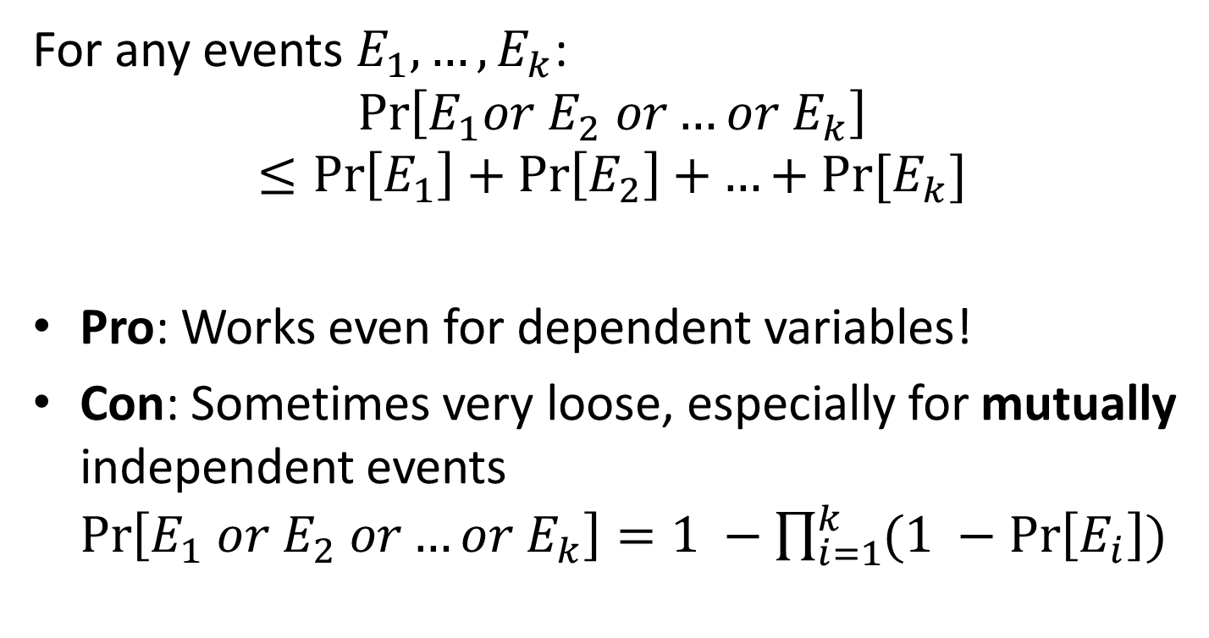
Union Bound
For any events $E_{1}, …, E_{k}$:
$$\operatorname{Pr}\left[E_{1}or E_{2} or…or{ E}_{k}\right]≤\operatorname{Pr}\left[E_{1}\right]+\operatorname{Pr}\left[E_{2}\right]+…+Pr⁡[E_{k}]$$
Pro: Works even for dependent variables!
Con: Sometimes very loose, especially for mutually independent events $\operatorname{Pr}\left[E_{1} or E_{2} or…or{ E}_{k}\right]=1 −\prod_{i=1}^{k}{(1 −\operatorname{Pr}\left[E_{i}\right])}$

Slide 38
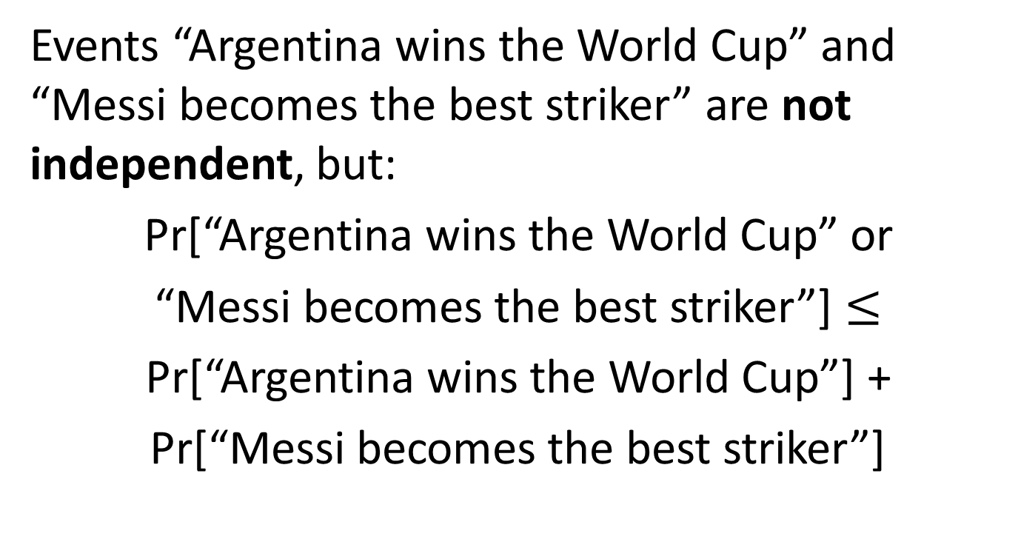
Union Bound: Example
Events “Argentina wins the World Cup” and “Messi becomes the best striker” are not independent, but:
Pr[“Argentina wins the World Cup” or
“Messi becomes the best striker”] $≤$
Pr[“Argentina wins the World Cup”] +
Pr[“Messi becomes the best striker”]

Slide 39
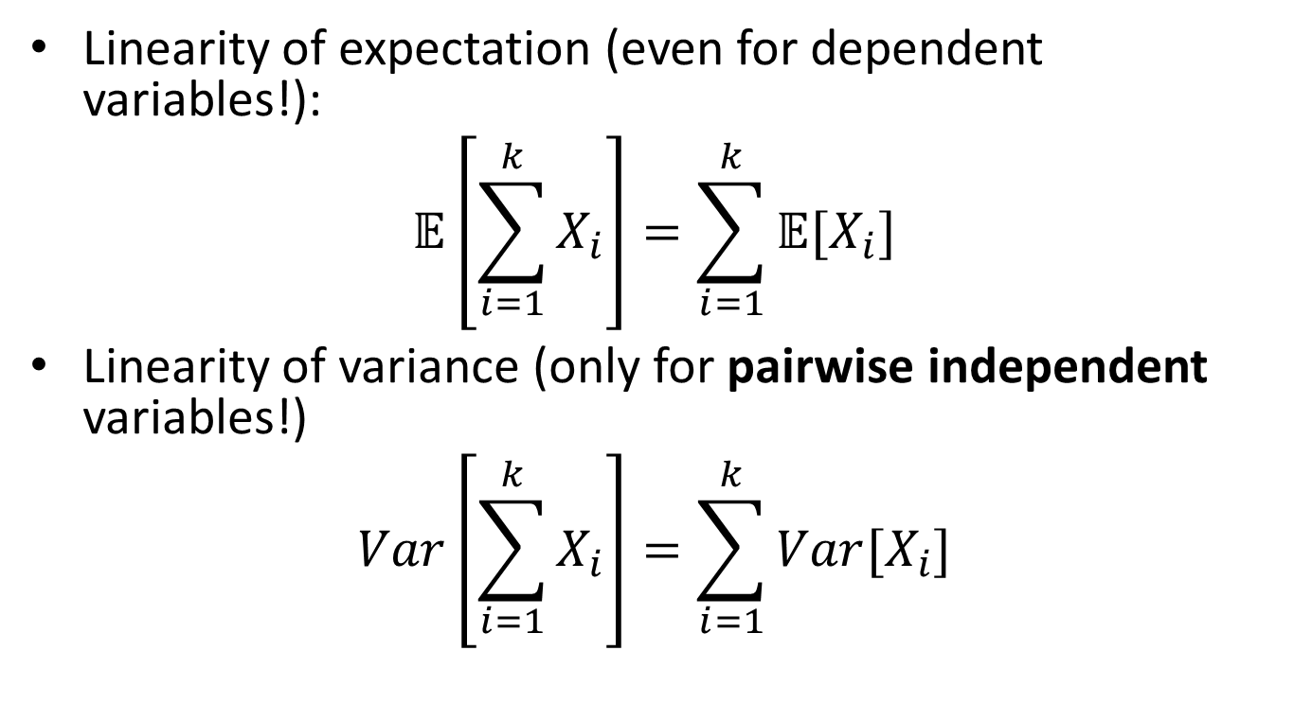
Independence and Linearity of Expectation/Variance
Linearity of expectation (even for dependent variables!):
$$\text{𝔼}\left[\sum_{i=1}^{k}{X_{i}}\right]=\sum_{i=1}^{k}{\text{𝔼}[X_{i}]}$$
Linearity of variance (only for pairwise independent variables!)
$$Var\left[\sum_{i=1}^{k}{X_{i}}\right]=\sum_{i=1}^{k}{Var[X_{i}]}$$

Slide 40
Part 2: Inequalities
Markov inequality
Chebyshev inequality
Chernoff bound

Slide 41
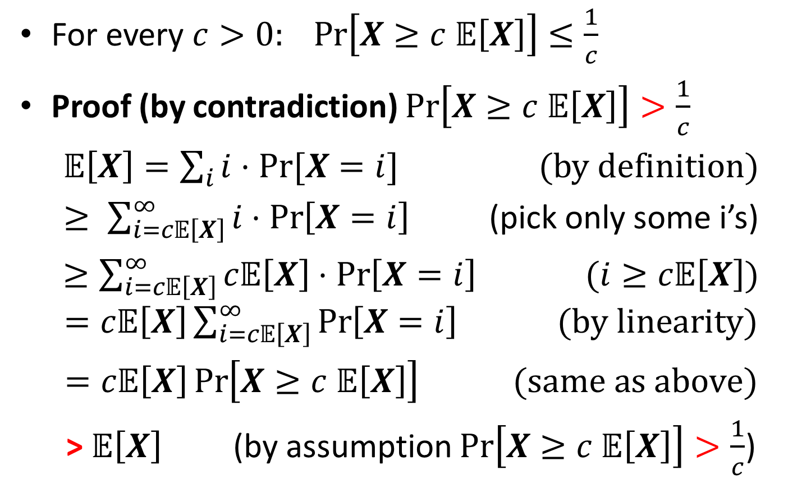
Markov’s Inequality
For every $c>0: Pr\left[X≥c 𝔼\left[X\right]\right]≤\frac{1}{c}$
Proof (by contradiction) $Pr\left[X≥c 𝔼\left[X\right]\right]>\frac{1}{c}$
$𝔼\left[X\right]=\sum_{i}{i⋅Pr⁡[X=i]}$ (by definition)
$≥ \sum_{i=c𝔼\left[X\right]}^{∞}{i⋅\operatorname{Pr}\left[X=i\right]}$ (pick only some i’s)
$≥\sum_{i=c𝔼\left[X\right]}^{∞}{c𝔼\left[X\right]⋅\operatorname{Pr}\left[X=i\right] }$ $(i≥c𝔼\left[X\right])$ $=c𝔼\left[X\right]\sum_{i=c𝔼\left[X\right]}^{∞}{\operatorname{Pr}\left[X=i\right] } (by linearity)$
$=c𝔼\left[X\right]\operatorname{Pr}\left[X≥c 𝔼\left[X\right]\right]$ $(same as above)$
> $𝔼\left[X\right]$ (by assumption $Pr\left[X≥c 𝔼\left[X\right]\right]>\frac{1}{c}$)

Slide 42
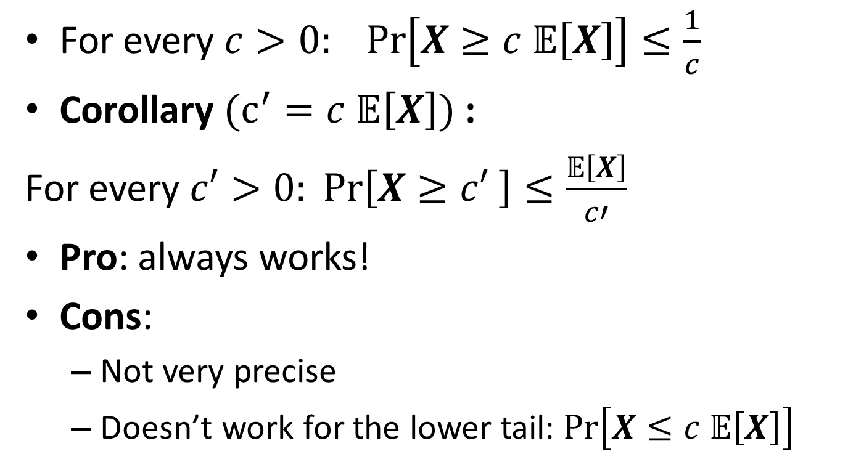
Markov’s Inequality
For every $c>0: Pr\left[X≥c 𝔼\left[X\right]\right]≤\frac{1}{c}$
Corollary $(c^{′}=c 𝔼\left[X\right])$:
For every $c′>0: Pr\left[X≥c′ \right]≤\frac{𝔼\left[X\right]}{c′}$
Pro: always works!
Cons:
Not very precise
Doesn’t work for the lower tail: $Pr\left[X≤c 𝔼\left[X\right]\right]$

Slide 43
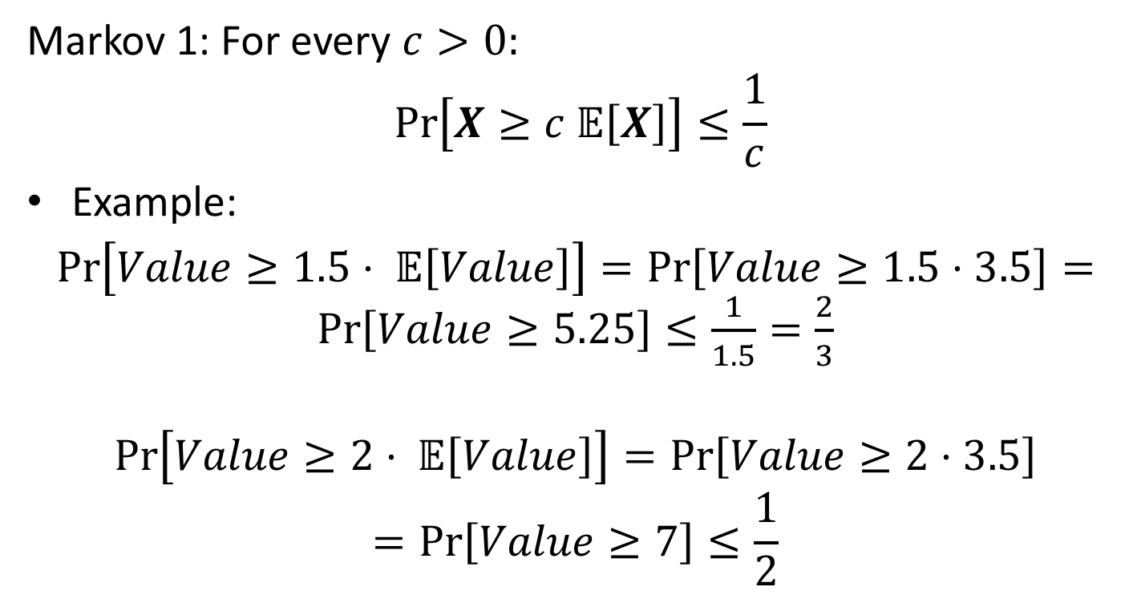
Markov Inequality: Example
Markov 1: For every $c>0:$
$$Pr\left[X≥c 𝔼\left[X\right]\right]≤\frac{1}{c}$$
Example:
$\operatorname{Pr}\left[Value≥1.5⋅ 𝔼\left[Value\right]\right]=\operatorname{Pr}\left[Value≥1.5⋅3.5\right]=\operatorname{Pr}\left[Value≥5.25\right]≤\frac{1}{1.5}=\frac{2}{3}$
$$\operatorname{Pr}\left[Value≥2⋅ 𝔼\left[Value\right]\right]=\operatorname{Pr}\left[Value≥2⋅3.5\right]$$
$$=\operatorname{Pr}\left[Value≥7\right]≤\frac{1}{2}$$

Slide 44
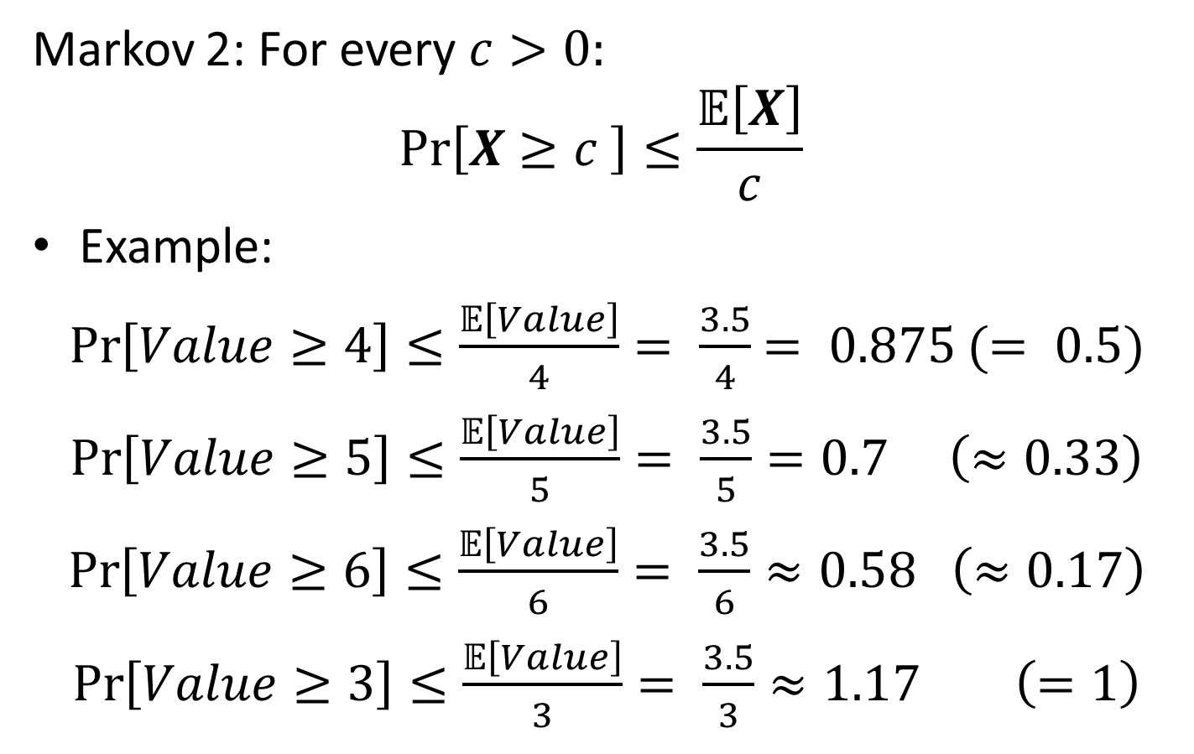
Markov Inequality: Example
Markov 2: For every $c>0:$
$$Pr\left[X≥c \right]≤\frac{𝔼\left[X\right]}{c}$$
Example:
$\operatorname{Pr}\left[Value≥4\right]≤\frac{𝔼\left[Value\right]}{4}= \frac{3.5}{4}$ $= 0.875$ $(= 0.5)$
$\operatorname{Pr}\left[Value≥5\right]≤\frac{𝔼\left[Value\right]}{5}= \frac{3.5}{5}=0.7$ $\left(≈0.33\right)$
$\operatorname{Pr}\left[Value≥6\right]≤\frac{𝔼\left[Value\right]}{6}= \frac{3.5}{6}≈0.58$ $\left(≈0.17\right)$
$\operatorname{Pr}\left[Value≥3\right]≤\frac{𝔼\left[Value\right]}{3}= \frac{3.5}{3}≈1.17$ $\left(=1\right)$

Slide 45
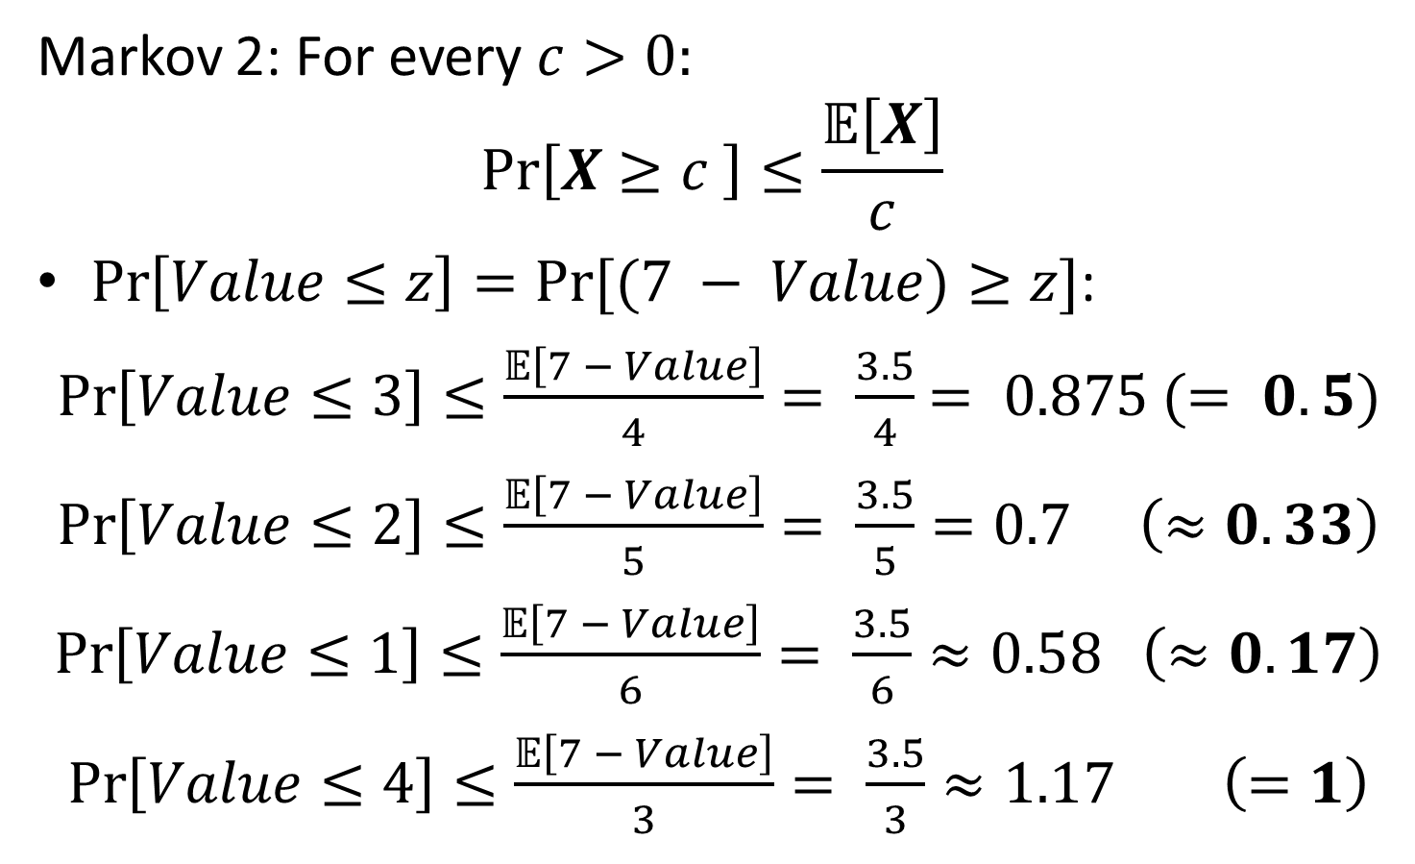
Markov Inequality: Example
Markov 2: For every $c>0:$
$$Pr\left[X≥c \right]≤\frac{𝔼\left[X\right]}{c}$$
$\operatorname{Pr}\left[Value≤z\right]=Pr⁡[(7 − Value)≥z]$:
$\operatorname{Pr}\left[Value≤3\right]≤\frac{𝔼\left[7 − Value\right]}{4}= \frac{3.5}{4}$ $= 0.875$ $(= 0.5)$
$\operatorname{Pr}\left[Value≤2\right]≤\frac{𝔼\left[7 − Value\right]}{5}= \frac{3.5}{5}=0.7$ $\left(≈0.33\right)$
$\operatorname{Pr}\left[Value≤1\right]≤\frac{𝔼\left[7 − Value\right]}{6}= \frac{3.5}{6}≈0.58$ $\left(≈0.17\right)$
$\operatorname{Pr}\left[Value≤4\right]≤\frac{𝔼\left[7 − Value\right]}{3}= \frac{3.5}{3}≈1.17$ $\left(=1\right)$

Slide 46
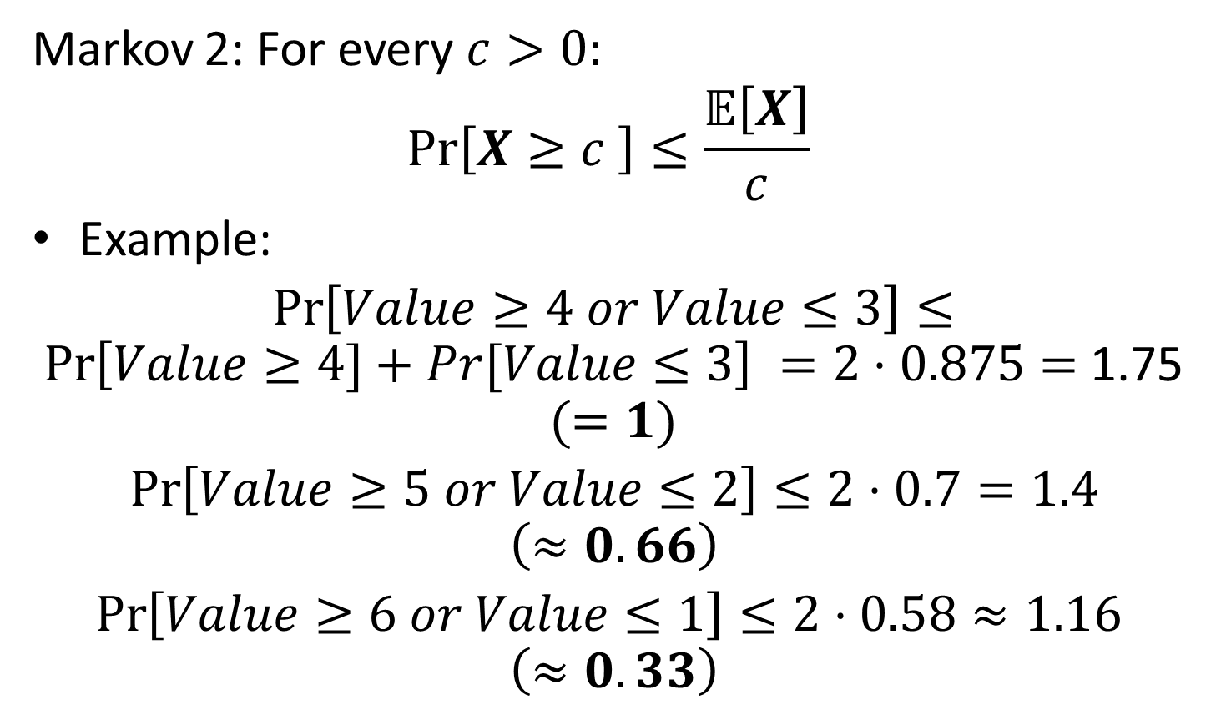
Markov + Union Bound: Example
Markov 2: For every $c>0:$
$$Pr\left[X≥c \right]≤\frac{𝔼\left[X\right]}{c}$$
Example:
$\operatorname{Pr}\left[Value≥4 or Value≤3\right]≤$ $\operatorname{Pr}\left[Value≥4]+Pr[Value≤3\right] =2⋅0.875=$1.75 $(=1)$
$\operatorname{Pr}\left[Value≥5 or Value≤2\right]≤2⋅0.7=1.4$ $\left(≈0.66\right)$
$\operatorname{Pr}\left[Value≥6 or Value≤1\right]≤2⋅0.58≈1.16$ $\left(≈0.33\right)$

Slide 47
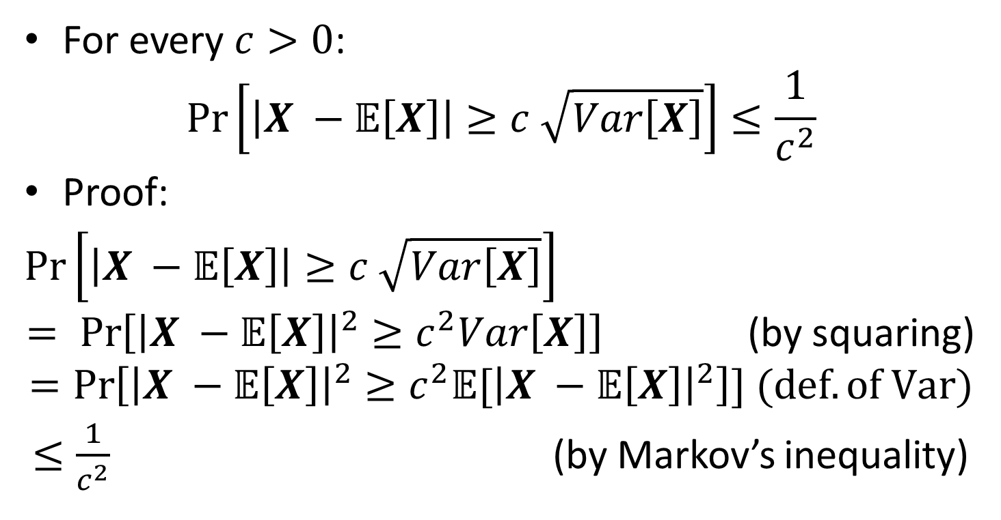
Chebyshev’s Inequality
For every $c>0$:
$$\operatorname{Pr}\left[\left|X −𝔼\left[X\right]\right|≥c \sqrt{Var\left[X\right]}\right]≤\frac{1}{c^{2}}$$
Proof:
$\operatorname{Pr}\left[\left|X −𝔼\left[X\right]\right|≥c \sqrt{Var\left[X\right]}\right]$
$= \operatorname{Pr}\left[{\left|X −𝔼\left[X\right]\right|}^{2}≥c^{2}Var\left[X\right]\right]$ (by squaring)
$$=\operatorname{Pr}\left[{\left|X −𝔼\left[X\right]\right|}^{2}≥c^{2}{𝔼[\left|X −𝔼\left[X\right]\right|}^{2}\right]] (def. of Var)$$
$≤\frac{1}{c^{2}}$ (by Markov’s inequality)

Slide 48
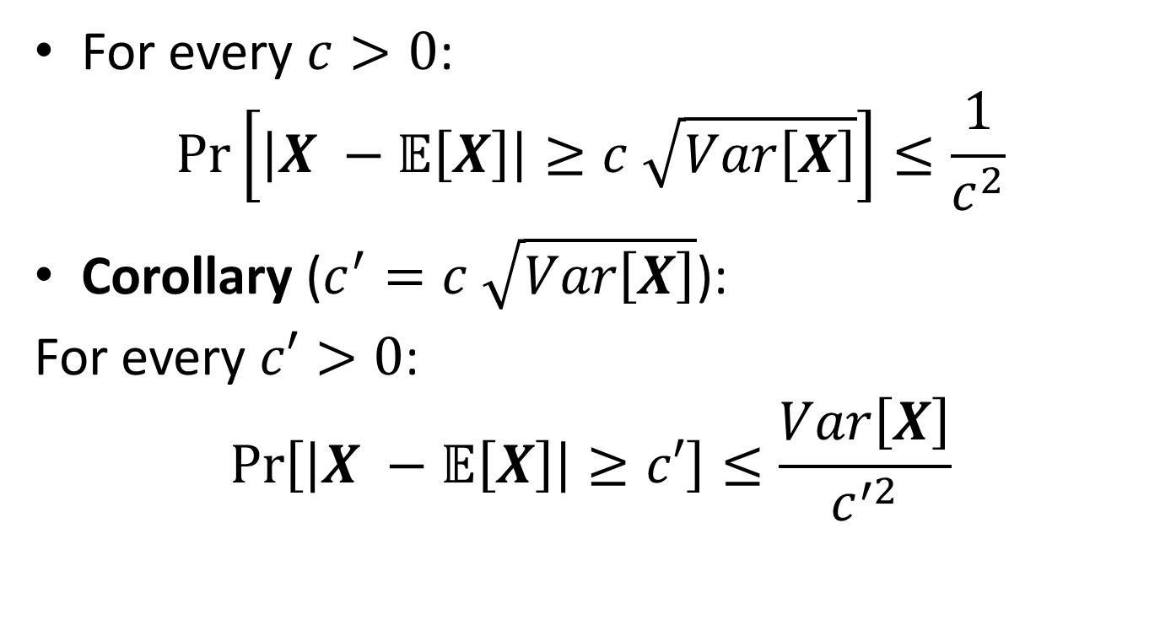
Chebyshev’s Inequality
For every $c>0$:
$$\operatorname{Pr}\left[\left|X −𝔼\left[X\right]\right|≥c \sqrt{Var\left[X\right]}\right]≤\frac{1}{c^{2}}$$
Corollary ($c^{′}=c \sqrt{Var\left[X\right]}$):
For every $c′>0$:
$$\operatorname{Pr}\left[\left|X −𝔼\left[X\right]\right|≥c′\right]≤\frac{Var\left[X\right]}{c^{′2}}$$

Slide 49
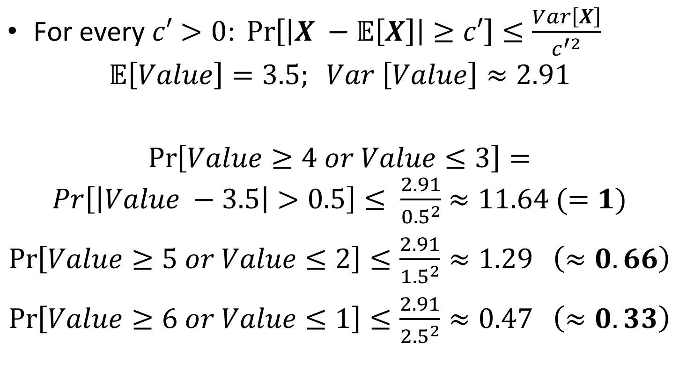
Chebyshev: Example
$\text{For} \text{every} c′>0\text{: }\operatorname{Pr}\left[\left|X −𝔼\left[X\right]\right|≥c′\right]≤\frac{Var\left[X\right]}{c^{′2}}$
$$𝔼\left[Value\right]=3.5; Var \left[Value\right]≈2.91$$
$\operatorname{Pr}\left[Value≥4 or Value≤3\right]=Pr\left[\left|Value −3.5\right|>0.5\right]≤ \frac{2.91}{{0.5}^{2}}$ $≈11.64 (=1)$
$\operatorname{Pr}\left[Value≥5 or Value≤2\right]≤\frac{2.91}{{1.5}^{2}}≈1.29$ $\left(≈0.66\right)$
$\operatorname{Pr}\left[Value≥6 or Value≤1\right]≤\frac{2.91}{{2.5}^{2}}≈0.47$ $\left(≈0.33\right)$

Slide 50
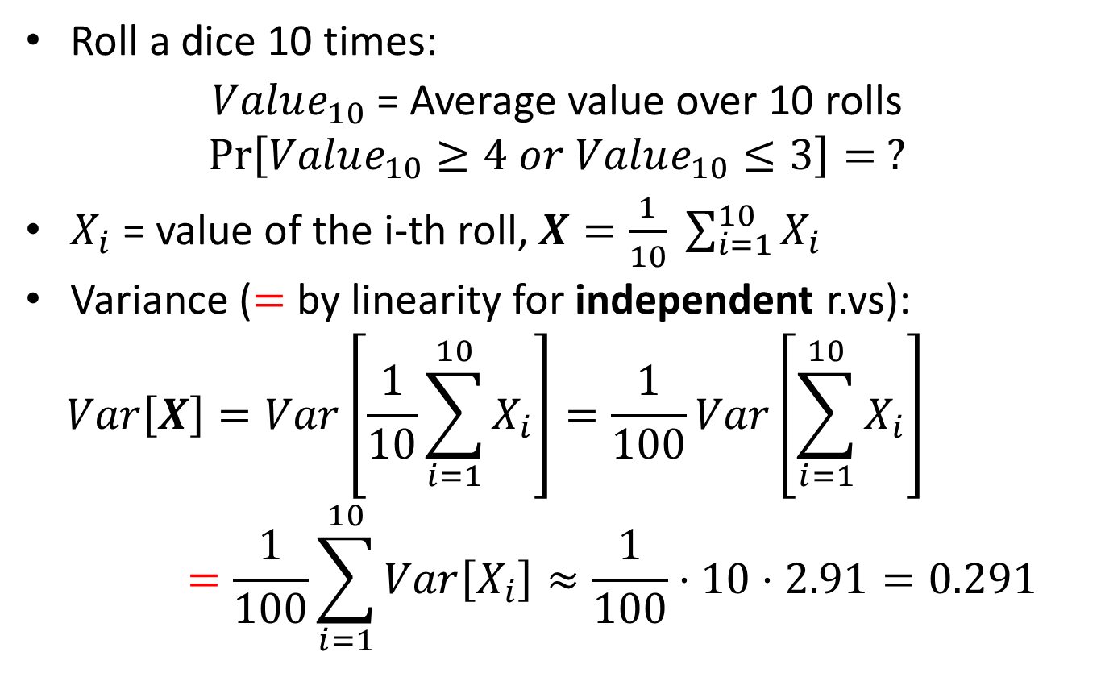
Chebyshev: Example
Roll a dice 10 times:
$Value_{10}$ = Average value over 10 rolls
$$\operatorname{Pr}\left[Value_{10}≥4 or Value_{10}≤3\right]= ?$$
$X_{i}$ = value of the i-th roll, $X=\frac{1}{10} \sum_{i=1}^{10}{X_{i}}$
Variance ($=$ by linearity for independent r.vs):
$$Var\left[X\right]=Var\left[\frac{1}{10}\sum_{i=1}^{10}{X_{i}}\right]=\frac{1}{100}Var\left[\sum_{i=1}^{10}{X_{i}}\right]=\frac{1}{100}\sum_{i=1}^{10}{Var\left[X_{i}\right]≈\frac{1}{100}⋅10⋅2.91=0.291}$$

Slide 51
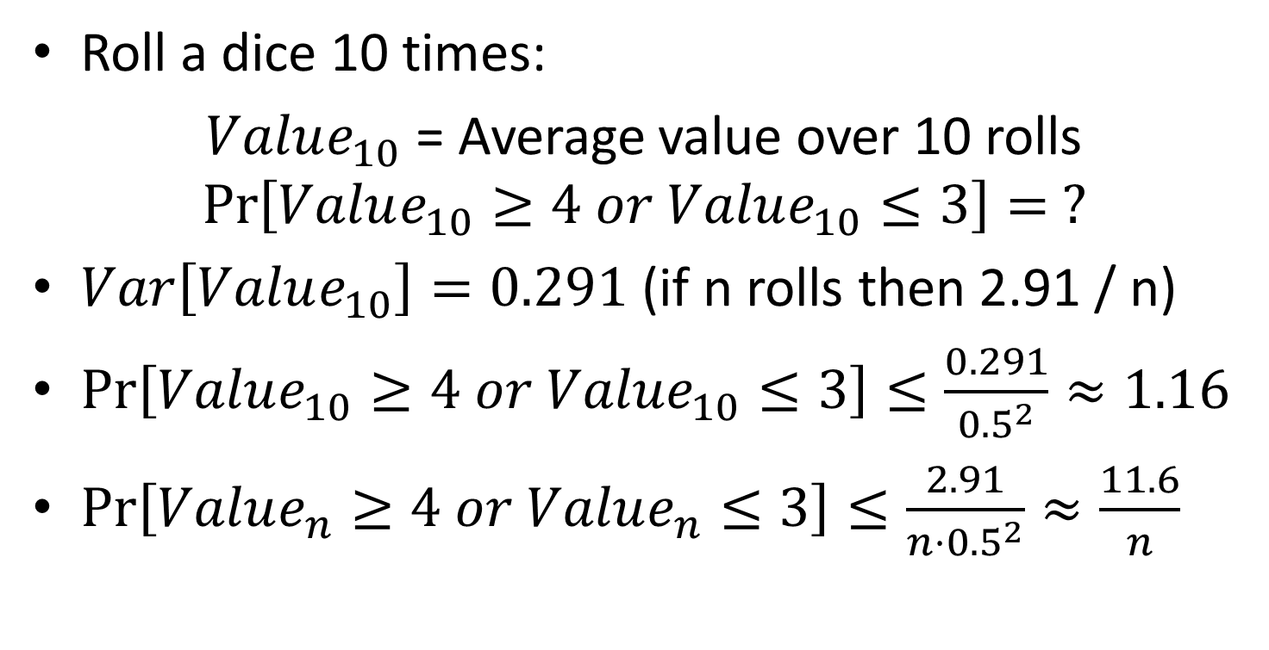
Chebyshev: Example
Roll a dice 10 times:
$Value_{10}$ = Average value over 10 rolls
$$\operatorname{Pr}\left[Value_{10}≥4 or Value_{10}≤3\right]= ?$$
$Var\left[Value_{10}\right]=0.291$ (if n rolls then 2.91 / n)
$\operatorname{Pr}\left[Value_{10}≥4 or Value_{10}≤3\right]≤\frac{0.291}{{0.5}^{2}}≈1.16$
$\operatorname{Pr}\left[Value_{n}≥4 or Value_{n}≤3\right]≤\frac{2.91}{{n⋅0.5}^{2}}≈\frac{11.6}{n}$

Slide 52
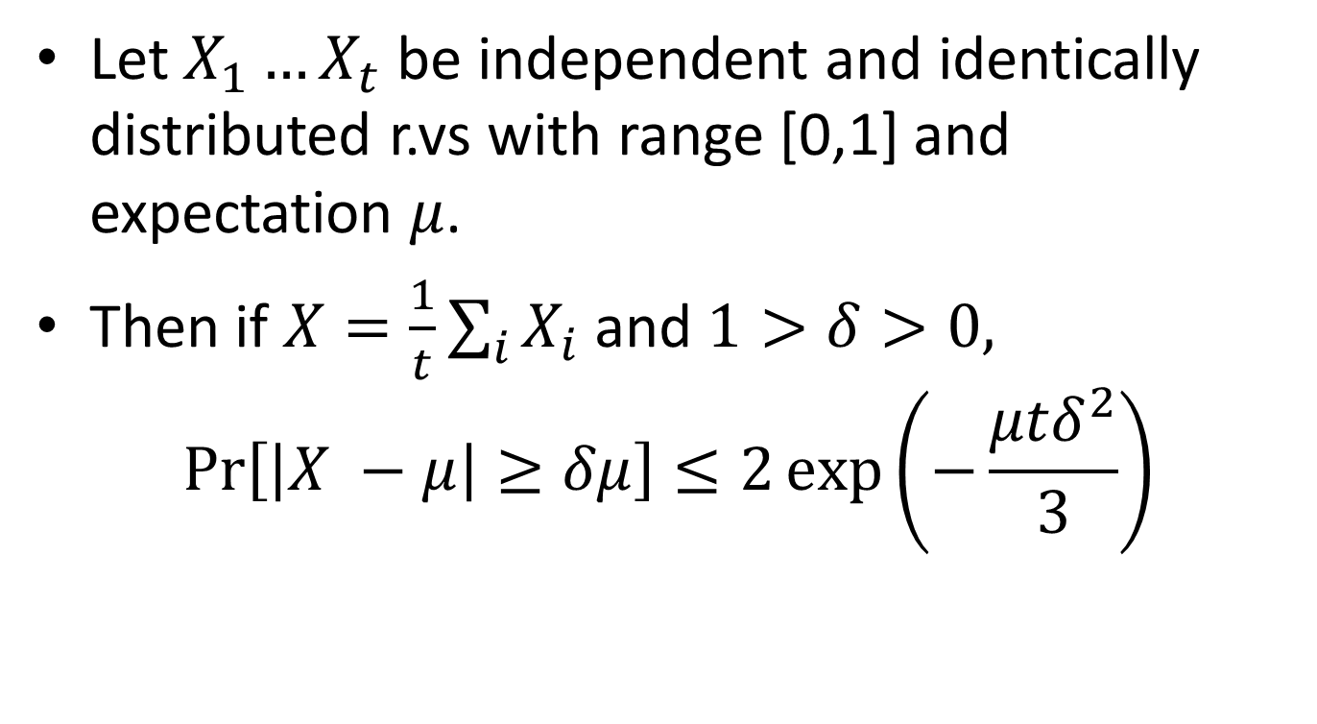
Chernoff bound
Let $X_{1}…X_{t}$ be independent and identically distributed r.vs with range [0,1] and expectation $μ$.
Then if $X=\frac{1}{t}\sum_{i}{X_{i}}$ and $1>δ>0,$
$$\operatorname{Pr}\left[\left|X −μ\right|≥δμ\right]≤2\exp\left(−\frac{μtδ^{2}}{3}\right)$$

Slide 53
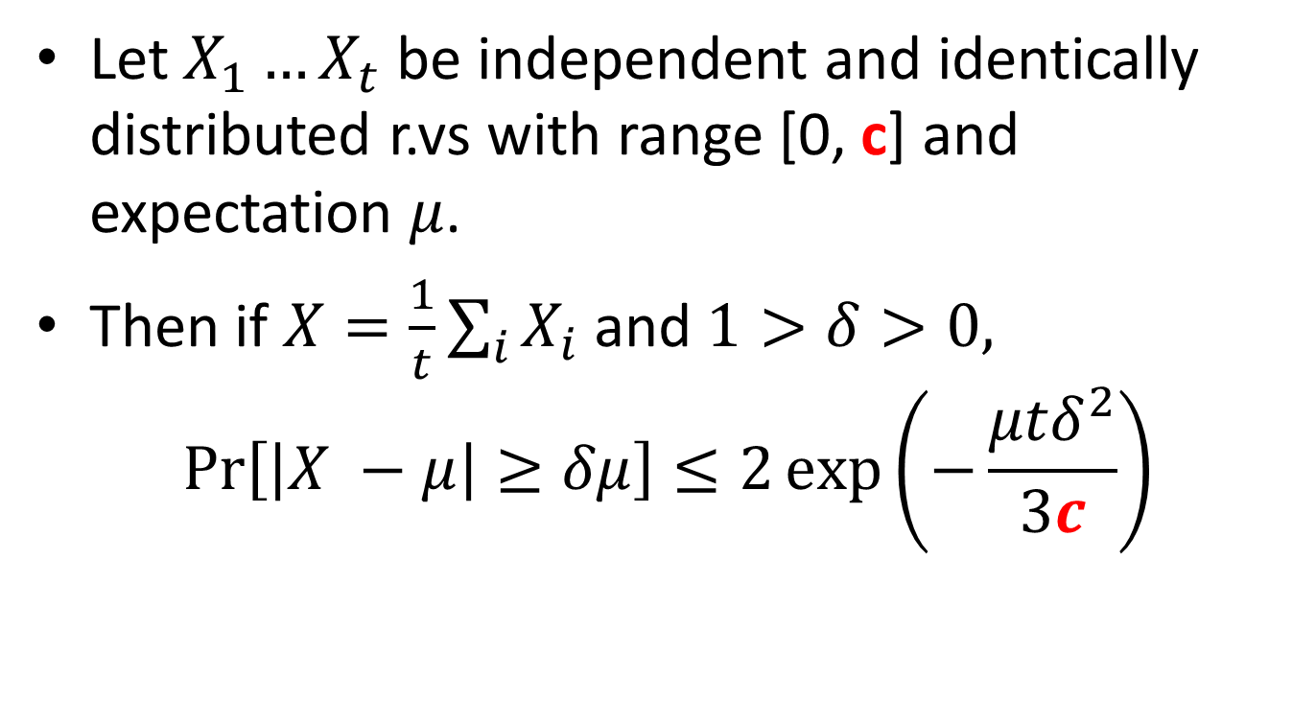
Chernoff bound (corollary)
Let $X_{1}…X_{t}$ be independent and identically distributed r.vs with range [0, c] and expectation $μ$.
Then if $X=\frac{1}{t}\sum_{i}{X_{i}}$ and $1>δ>0,$
$$\operatorname{Pr}\left[\left|X −μ\right|≥δμ\right]≤2\exp\left(−\frac{μtδ^{2}}{3c}\right)$$

Slide 54
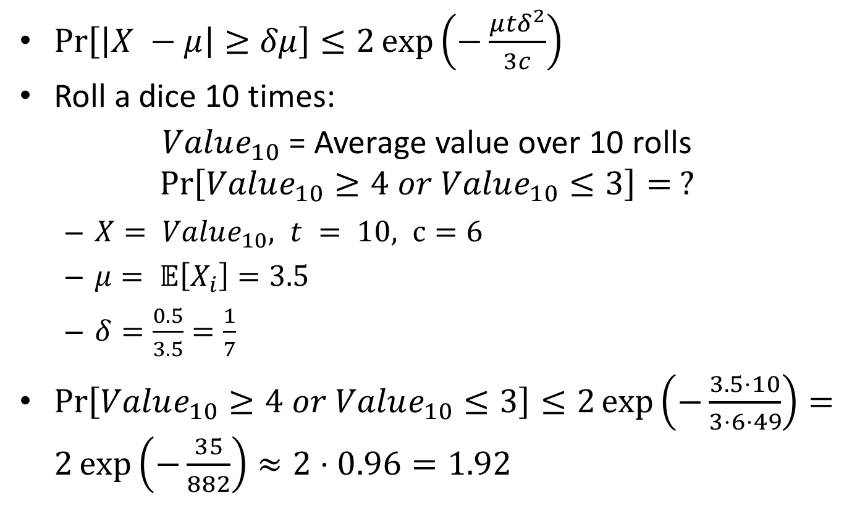
Chernoff: Example
$\operatorname{Pr}\left[\left|X −μ\right|≥δμ\right]≤2\exp\left(−\frac{μtδ^{2}}{3c}\right)$
Roll a dice 10 times:
$Value_{10}$ = Average value over 10 rolls
$$\operatorname{Pr}\left[Value_{10}≥4 or Value_{10}≤3\right]= ?$$
$X= Value_{10}, t = 10, c=6$
$μ= 𝔼\left[X_{i}\right]=3.5$
$δ=\frac{0.5}{3.5}=\frac{1}{7}$
$\operatorname{Pr}\left[Value_{10}≥4 or Value_{10}≤3\right]≤2\exp\left(−\frac{3.5⋅10}{3⋅6⋅49}\right)=2\exp\left(−\frac{35}{882}\right)≈2⋅0.96=1.92$

Slide 55
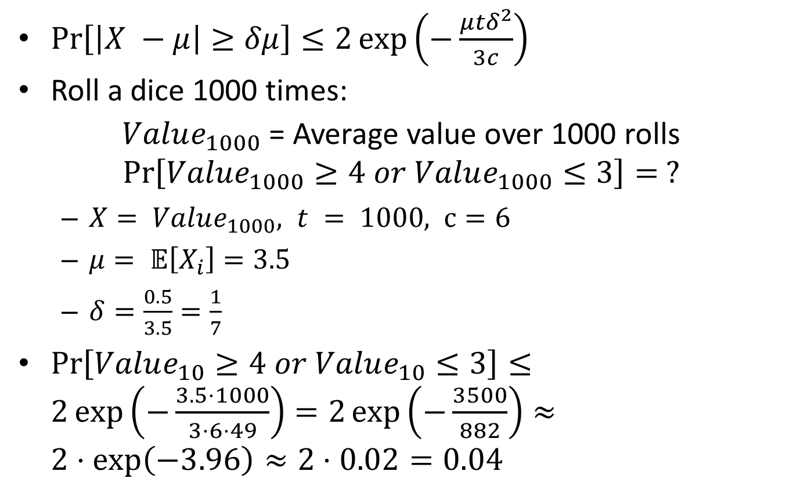
Chernoff: Example
$\operatorname{Pr}\left[\left|X −μ\right|≥δμ\right]≤2\exp\left(−\frac{μtδ^{2}}{3c}\right)$
Roll a dice 1000 times:
$Value_{1000}$ = Average value over 1000 rolls
$$\operatorname{Pr}\left[Value_{1000}≥4 or Value_{1000}≤3\right]= ?$$
$X= Value_{1000}, t = 1000, c=6$
$μ= 𝔼\left[X_{i}\right]=3.5$
$δ=\frac{0.5}{3.5}=\frac{1}{7}$
$\operatorname{Pr}\left[Value_{10}≥4 or Value_{10}≤3\right]≤2\exp\left(−\frac{3.5⋅1000}{3⋅6⋅49}\right)=2\exp\left(−\frac{3500}{882}\right)≈2⋅\exp\left(−3.96\right)≈2⋅0.02=0.04$

Slide 56
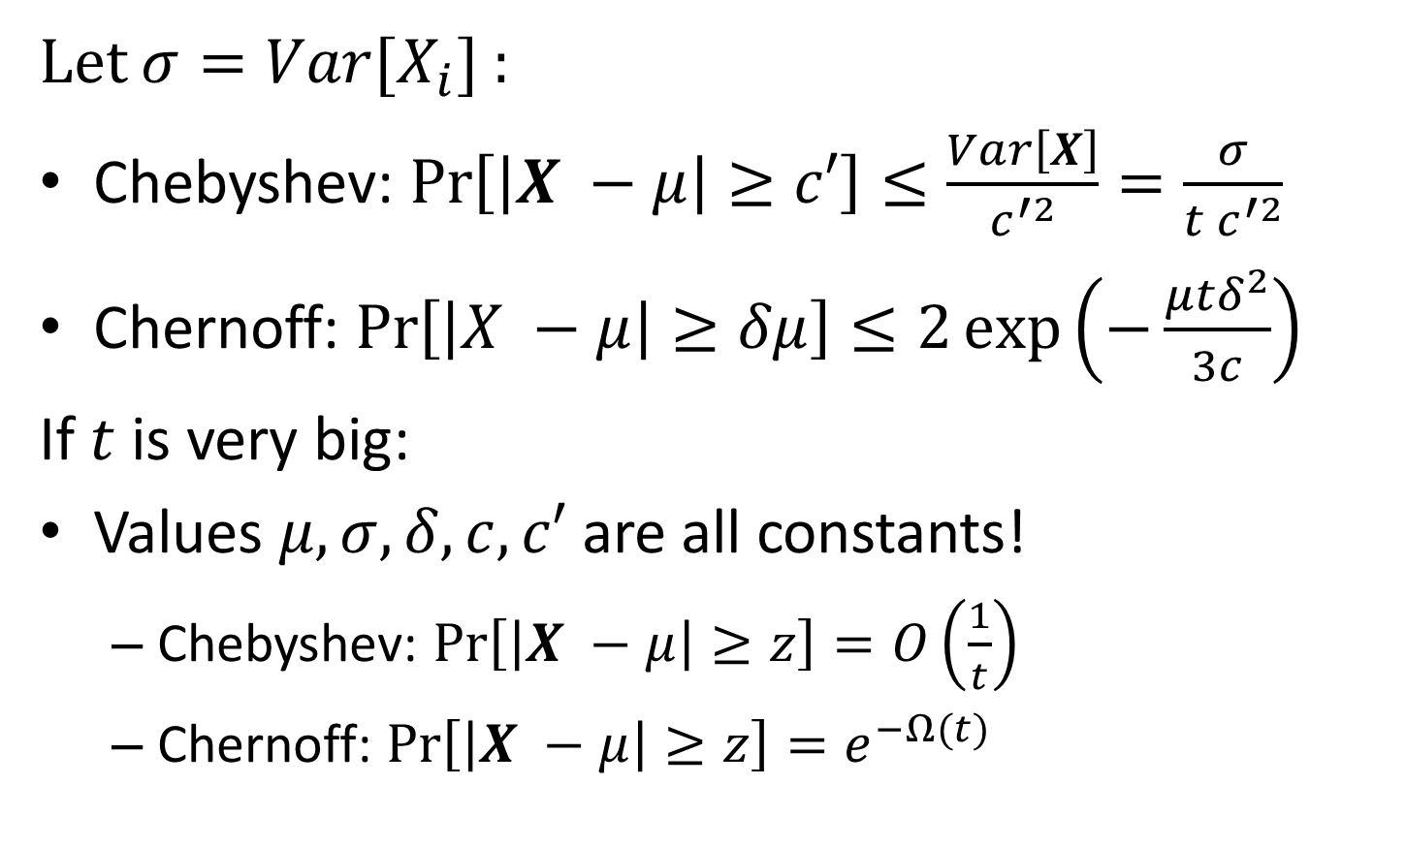
Chernoff v.s Chebyshev: Example
Let $σ=Var[X_{i}]$ :
Chebyshev: $\operatorname{Pr}\left[\left|X −μ\right|≥c′\right]≤\frac{Var\left[X\right]}{c^{′2}}=\frac{σ}{{t c}^{′2}}$
Chernoff: $\operatorname{Pr}\left[\left|X −μ\right|≥δμ\right]≤2\exp\left(−\frac{μtδ^{2}}{3c}\right)$
If $t$ is very big:
Values $μ, σ, δ, c, c′$ are all constants!
Chebyshev: $\operatorname{Pr}\left[\left|X −μ\right|≥z\right]=O\left(\frac{1}{t}\right)$
Chernoff: $\operatorname{Pr}\left[\left|X −μ\right|≥z\right]=e^{−Ω(t)}$

Slide 57
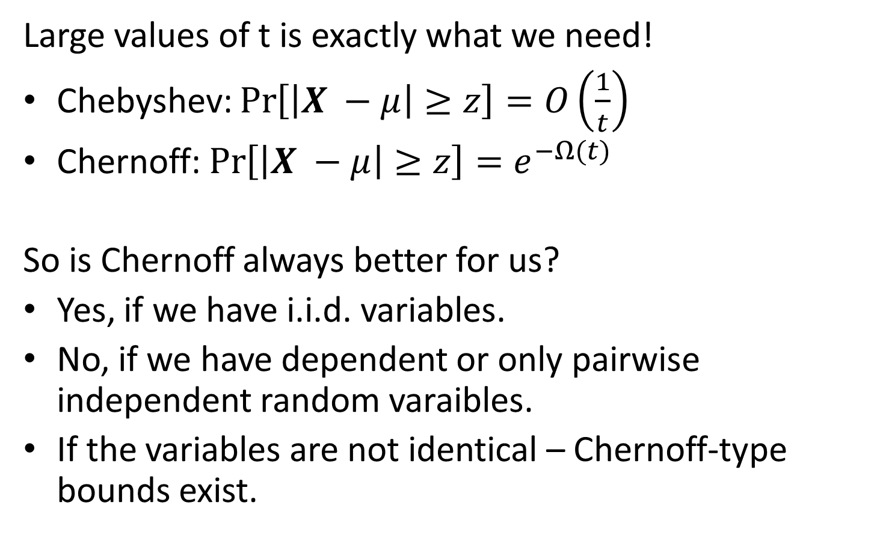
Chernoff v.s Chebyshev: Example
Large values of t is exactly what we need!
Chebyshev: $\operatorname{Pr}\left[\left|X −μ\right|≥z\right]=O\left(\frac{1}{t}\right)$
Chernoff: $\operatorname{Pr}\left[\left|X −μ\right|≥z\right]=e^{−Ω(t)}$
So is Chernoff always better for us?
Yes, if we have i.i.d. variables.
No, if we have dependent or only pairwise independent random varaibles.
If the variables are not identical – Chernoff-type bounds exist.

Slide 58
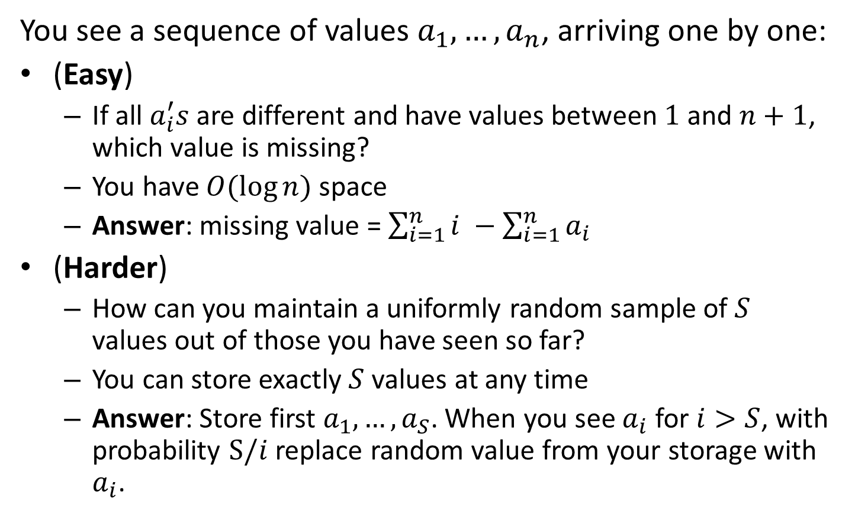
Answers to the puzzles
You see a sequence of values $a_{1}, …, a_{n}$, arriving one by one:
(Easy)
If all $a_{i}^{′}s$ are different and have values between $1$ and $n+1$, which value is missing?
You have $O(\log{n})$ space
Answer: missing value = $\sum_{i=1}^{n}{i} −\sum_{i=1}^{n}{a_{i}}$
(Harder)
How can you maintain a uniformly random sample of $S$ values out of those you have seen so far?
You can store exactly $S$ values at any time
Answer: Store first $a_{1},…, a_{S}$. When you see $a_{i}$ for $i>S$, with probability $S/i$ replace random value from your storage with $a_{i}$.

Slide 59
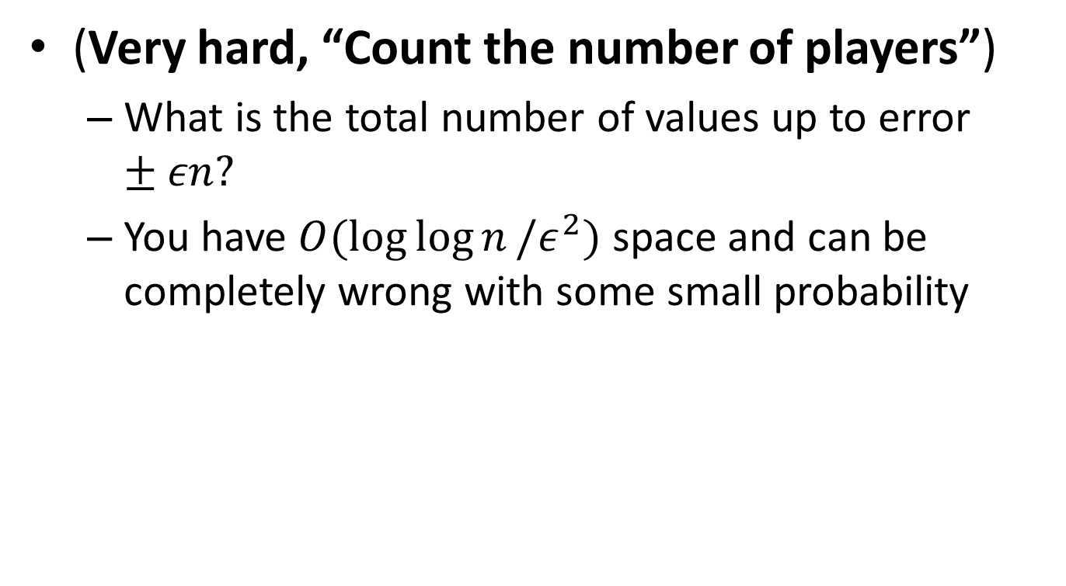
Part 3: Morris’s Algorithm
(Very hard, “Count the number of players”)
What is the total number of values up to error $±εn?$
You have $O(\log{\log{n}}/ε^{2})$ space and can be completely wrong with some small probability

Slide 60
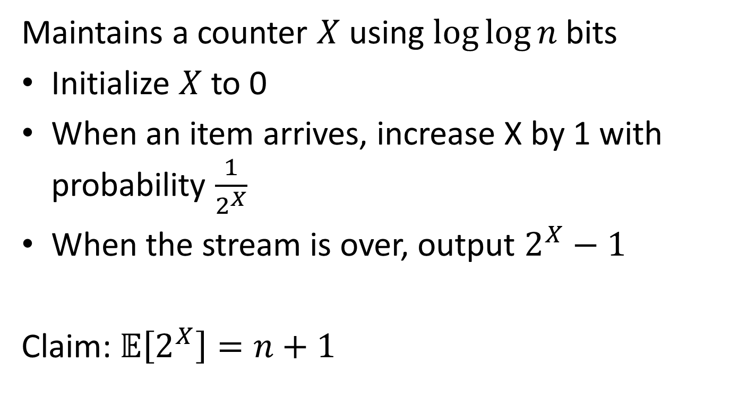
Morris’s Algorithm: Alpha-version
Maintains a counter $X$ using $log⁡log⁡n$ bits
Initialize $X$ to 0
When an item arrives, increase X by 1 with probability $\frac{1}{2^{X}}$
When the stream is over, output $2^{X}−1$
Claim: $𝔼\left[2^{X}\right]=n+1$

Slide 61
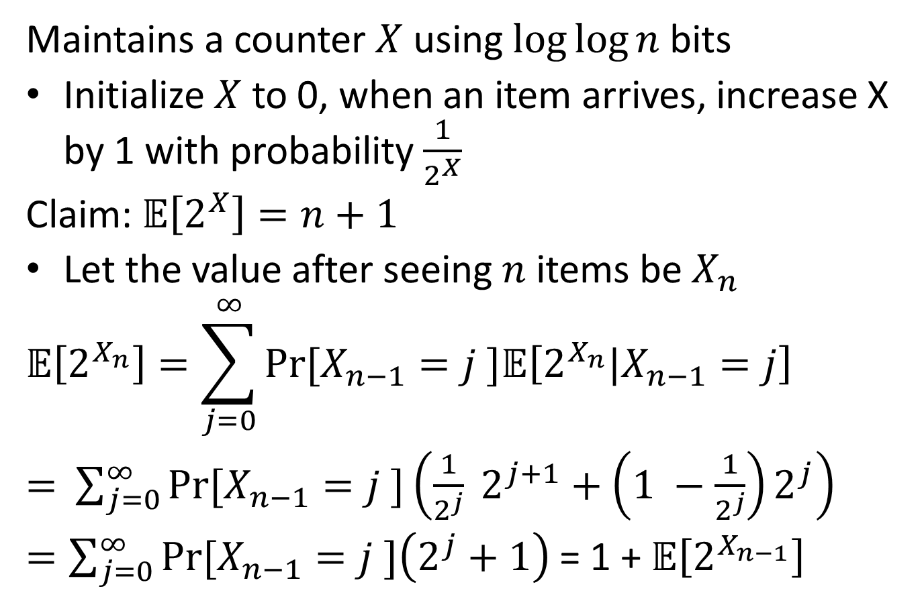
Morris’s Algorithm: Alpha-version
Maintains a counter $X$ using $log⁡log⁡n$ bits
Initialize $X$ to 0, when an item arrives, increase X by 1 with probability $\frac{1}{2^{X}}$
Claim: $𝔼\left[2^{X}\right]=n+1$
Let the value after seeing $n$ items be $X_{n}$
$$𝔼\left[2^{X_{n}}\right]=\sum_{j=0}^{∞}{Pr⁡[X_{n−1}=j ]𝔼\left[2^{X_{n}}|X_{n−1}=j\right]}$$
$=$ $\sum_{j=0}^{∞}{Pr⁡[X_{n−1}=j ]\left(\frac{1}{2^{j}} 2^{j+1}+\left(1 −\frac{1}{2^{j}}\right)2^{j}\right)}$
$=\sum_{j=0}^{∞}{Pr⁡[X_{n−1}=j ]\left(2^{j}+1\right) }$= 1 + $𝔼\left[2^{X_{n−1}}\right]$

Slide 62
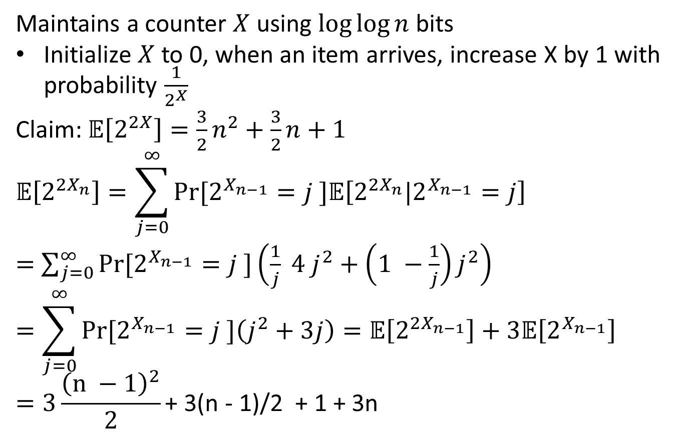
Morris’s Algorithm: Alpha-version
Maintains a counter $X$ using $log⁡log⁡n$ bits
Initialize $X$ to 0, when an item arrives, increase X by 1 with probability $\frac{1}{2^{X}}$
Claim: $𝔼\left[2^{2X}\right]=\frac{3}{2}n^{2}+\frac{3}{2}n+1$
$$𝔼\left[2^{{2X}_{n}}\right]=\sum_{j=0}^{∞}{Pr⁡[2^{X_{n−1}}=j ]𝔼\left[2^{2X_{n}}|2^{X_{n−1}}=j\right]}$$
$=$ $\sum_{j=0}^{∞}{Pr⁡[2^{X_{n−1}}=j ]\left(\frac{1}{j} 4 j^{2}+\left(1 −\frac{1}{j}\right)j^{2}\right)}$
$$=\sum_{j=0}^{∞}{Pr⁡[2^{X_{n−1}}=j ]\left(j^{2}+3j\right)=𝔼\left[2^{{2X}_{n−1}}\right]+3𝔼\left[2^{X_{n−1}}\right] }$$
$$=3\frac{{\left(n −1\right)}^{2}}{2}\text{+ 3(}\text{n}\text{ − 1)/2 + 1 + 3}\text{n}$$

Slide 63
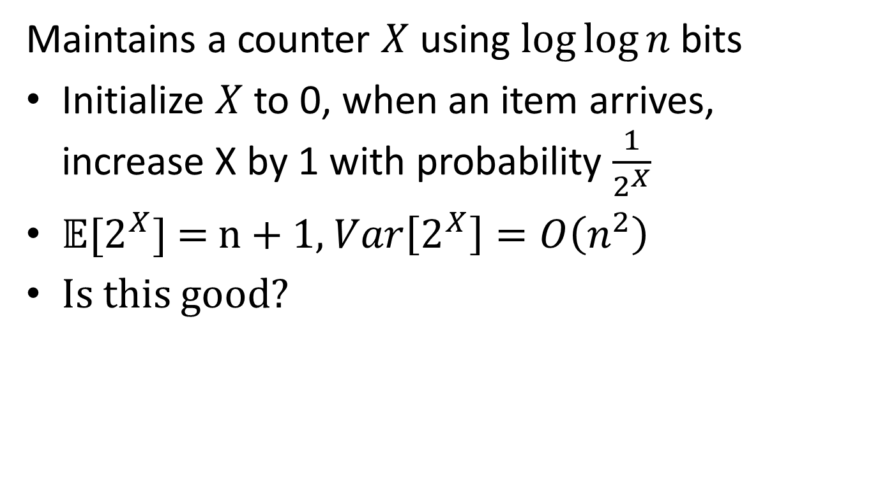
Morris’s Algorithm: Alpha-version
Maintains a counter $X$ using $log⁡log⁡n$ bits
Initialize $X$ to 0, when an item arrives, increase X by 1 with probability $\frac{1}{2^{X}}$
$𝔼[2^{X}]$ = n + 1, $Var\left[2^{X}\right]=O\left(n^{2}\right)$
Is this good?

Slide 64
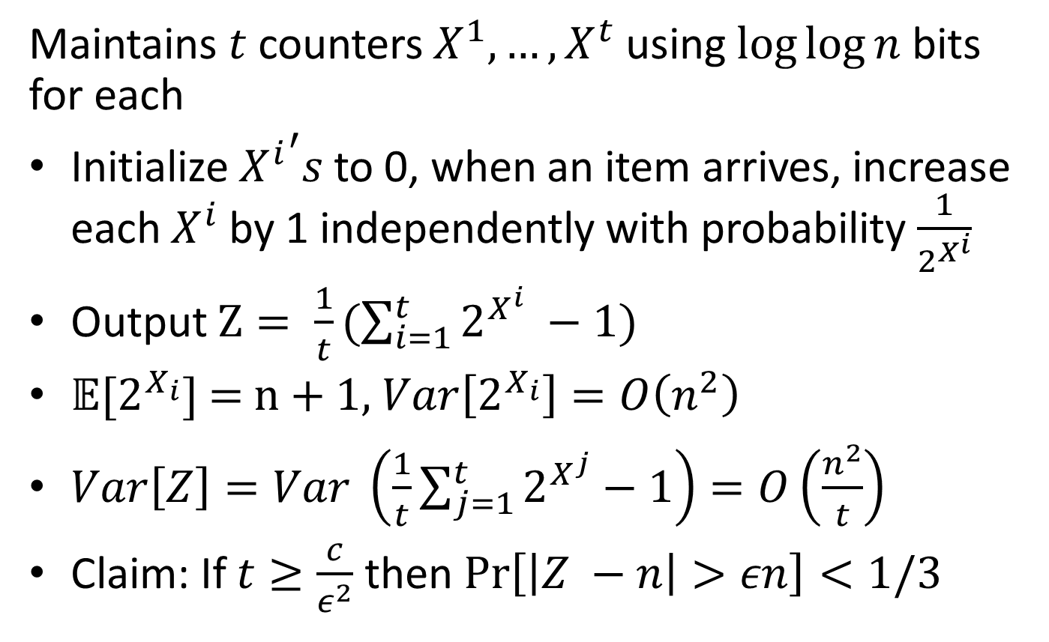
Morris’s Algorithm: Beta-version
Maintains $t$ counters $X^{1}, …,X^{t}$ using $log⁡log⁡n$ bits for each
Initialize ${X^{i}}^{′}s$ to 0, when an item arrives, increase each $X^{i}$ by 1 independently with probability $\frac{1}{2^{X^{i}}}$
Output $Z= \frac{1}{t}(\sum_{i=1}^{t}{2^{X^{i}} −1)}$
$𝔼[2^{X_{i}}]$ = n + 1, $Var\left[2^{X_{i}}\right]=O\left(n^{2}\right)$
$Var\left[Z\right]=Var \left(\frac{1}{t}\sum_{j=1}^{t}{2^{X^{j}}}−1\right)=O\left(\frac{n^{2}}{t}\right)$
Claim: If $t≥\frac{c}{ε^{2}}$ then $\operatorname{Pr}\left[\left|Z −n\right|>εn\right]<1/3$

Slide 65
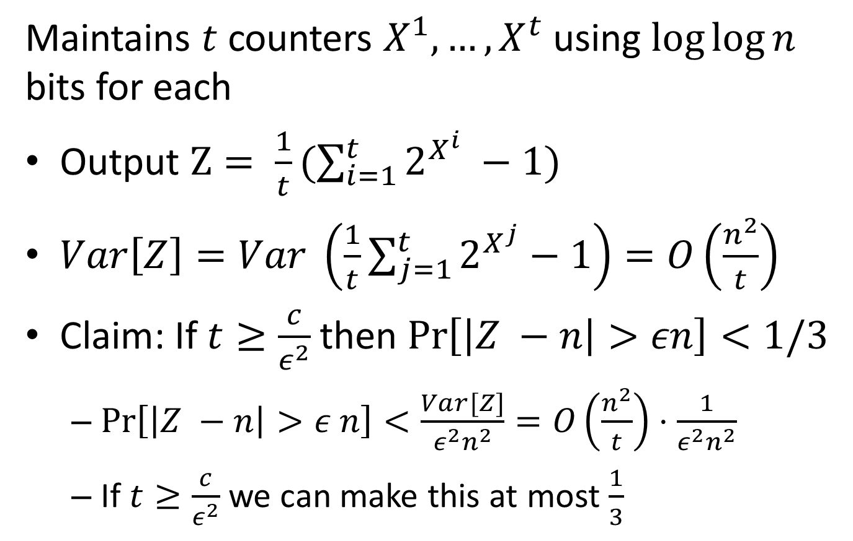
Morris’s Algorithm: Beta-version
Maintains $t$ counters $X^{1}, …,X^{t}$ using $log⁡log⁡n$ bits for each
Output $Z= \frac{1}{t}(\sum_{i=1}^{t}{2^{X^{i}} −1)}$
$Var\left[Z\right]=Var \left(\frac{1}{t}\sum_{j=1}^{t}{2^{X^{j}}}−1\right)=O\left(\frac{n^{2}}{t}\right)$
Claim: If $t≥\frac{c}{ε^{2}}$ then $\operatorname{Pr}\left[\left|Z −n\right|>εn\right]<1/3$
$\operatorname{Pr}\left[\left|Z −n\right|>ε n\right]<\frac{Var[Z]}{ε^{2}n^{2}}=O\left(\frac{n^{2}}{t}\right)⋅\frac{1}{ε^{2}n^{2}}$
If $t≥\frac{c}{ε^{2}}$ we can make this at most $\frac{1}{3}$

Slide 66
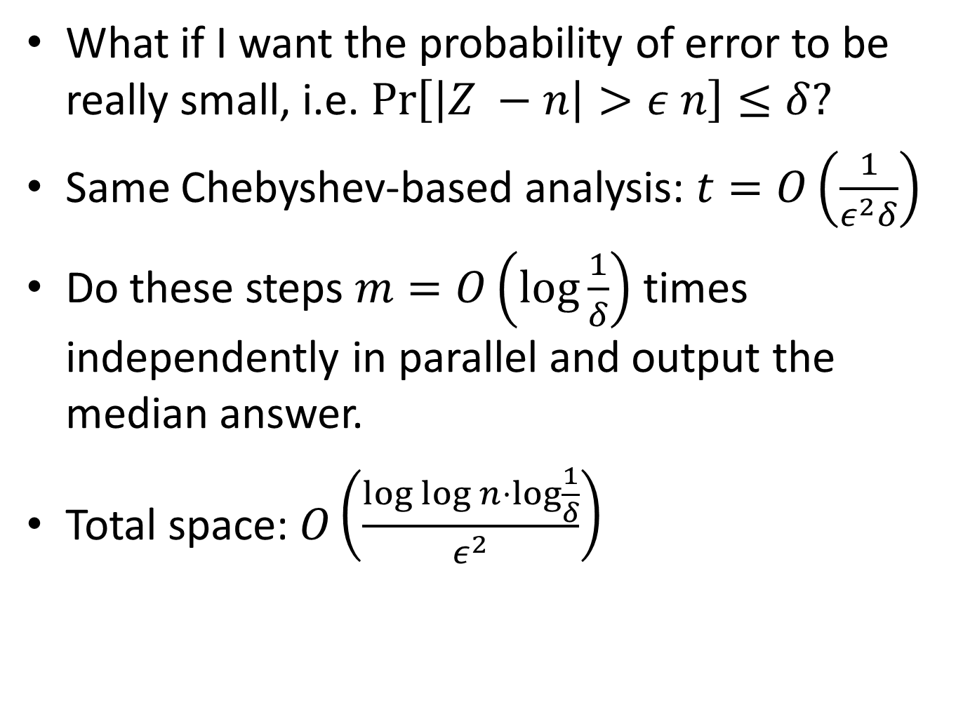
Morris’s Algorithm: Final
What if I want the probability of error to be really small, i.e. $\operatorname{Pr}\left[\left|Z −n\right|>ε n\right]≤δ?$
Same Chebyshev-based analysis: $t=O\left(\frac{1}{ε^{2}δ}\right)$
Do these steps $m=O\left(\log{\frac{1}{δ}}\right)$ times independently in parallel and output the median answer.
Total space: $O\left(\frac{\log{\log{n}}⋅\log{\frac{1}{δ}}}{ε^{2}}\right)$

Slide 67
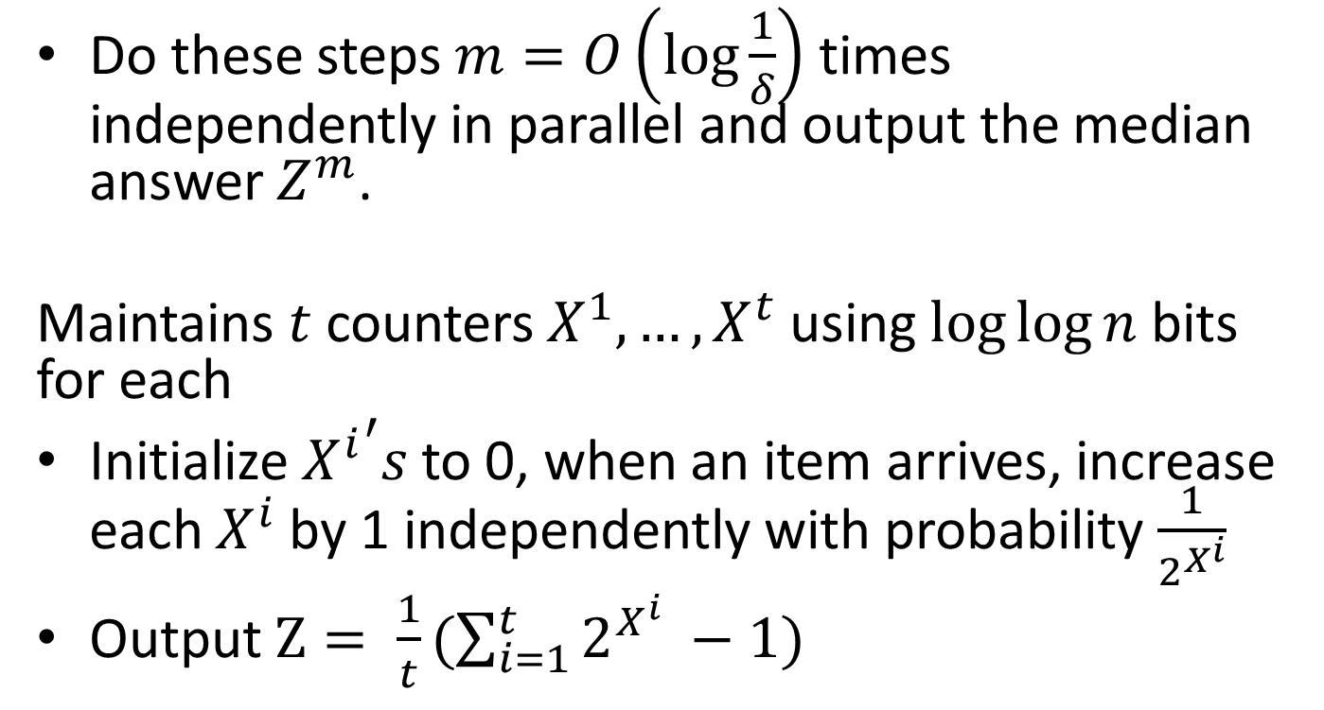
Morris’s Algorithm: Final
Do these steps $m=O\left(\log{\frac{1}{δ}}\right)$ times independently in parallel and output the median answer $Z^{m}$.
Maintains $t$ counters $X^{1}, …,X^{t}$ using $log⁡log⁡n$ bits for each
Initialize ${X^{i}}^{′}s$ to 0, when an item arrives, increase each $X^{i}$ by 1 independently with probability $\frac{1}{2^{X^{i}}}$
Output $Z= \frac{1}{t}(\sum_{i=1}^{t}{2^{X^{i}} −1)}$

Slide 68
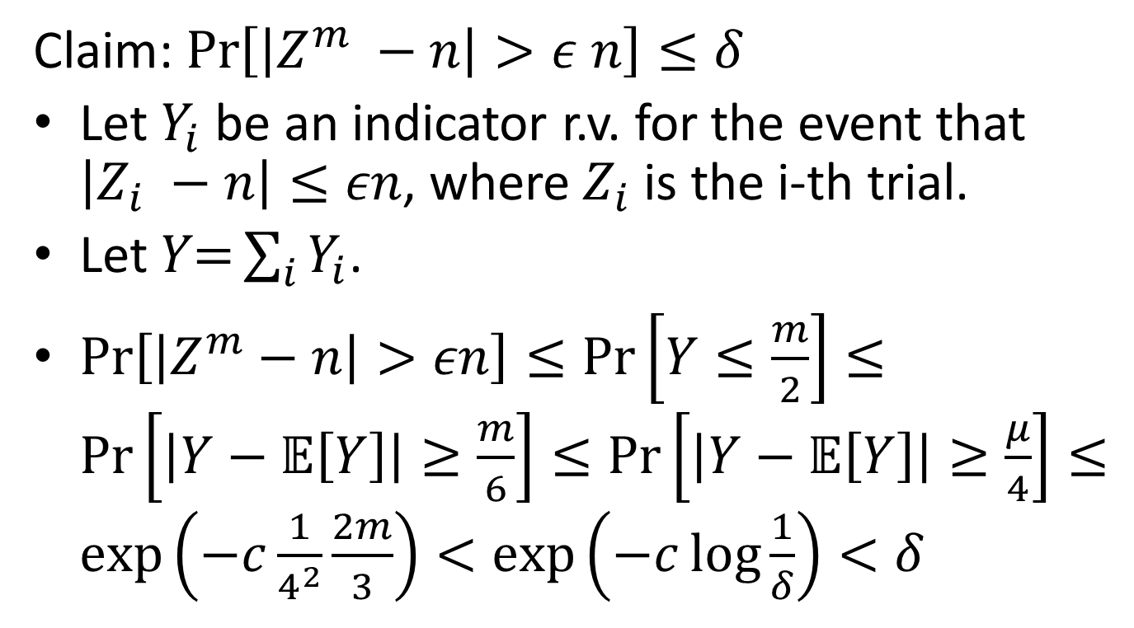
Morris’s Algorithm: Final Analysis
Claim: $\operatorname{Pr}\left[\left|Z^{m} −n\right|>ε n\right]≤δ$
Let $Y_{i}$ be an indicator r.v. for the event that $\left|Z_{i} −n\right|≤εn$, where $Z_{i}$ is the i-th trial.
Let $Y\text{=}\sum_{i}{Y_{i}}$.
$\operatorname{Pr}\left[\left|Z^{m}−n\right|>εn\right]≤\operatorname{Pr}\left[Y≤\frac{m}{2}\right]≤\operatorname{Pr}\left[\left|Y−𝔼\left[Y\right]\right|≥\frac{m}{6}\right]≤\operatorname{Pr}\left[\left|Y−𝔼\left[Y\right]\right|≥\frac{μ}{4}\right]≤\exp\left(−c\frac{1}{4^{2}}\frac{2m}{3}\right)<\exp\left(−c\log{\frac{1}{δ}}\right)<δ$

Slide 69
Thank you!
Questions?
Next time:
More streaming algorithms
Testing distributions

