Slide 1

Sublinear Algorihms for Big Data
Lecture 3
Grigory Yaroslavtsev
http://grigory.us

Slide 2

SOFSEM 2015
URL: http://www.sofsem.cz
41st International Conference on Current Trends in Theory and Practice of Computer Science (SOFSEM’15)
When and where?
January 24-29, 2015. Czech Republic, Pec pod Snezkou
Deadlines:
August 1st (tomorrow!): Abstract submission
August 15th: Full papers (proceedings in LNCS)
I am on the Program Committee ;)

Slide 3
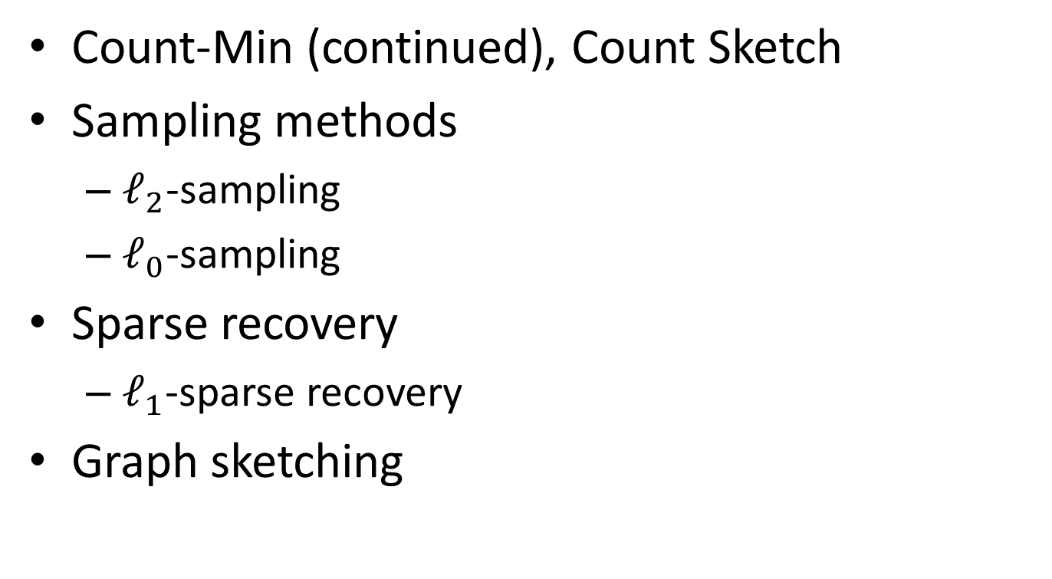
Today
Count-Min (continued), Count Sketch
Sampling methods
$ℓ_{2}$-sampling
$ℓ_{0}$-sampling
Sparse recovery
$ℓ_{1}$-sparse recovery
Graph sketching

Slide 4

Recap
Stream: $m$ elements from universe $\left[n\right]=\{1, 2, …, n\}$, e.g.
$$〈x_{1},x_{2},…, x_{m}〉=〈5, 8, 1, 1, 1, 4, 3, 5, …, 10〉$$
$f_{i}$ = frequency of $i$ in the stream = # of occurrences of value $i, f=〈f_{1},…, f_{n}〉$

Slide 5
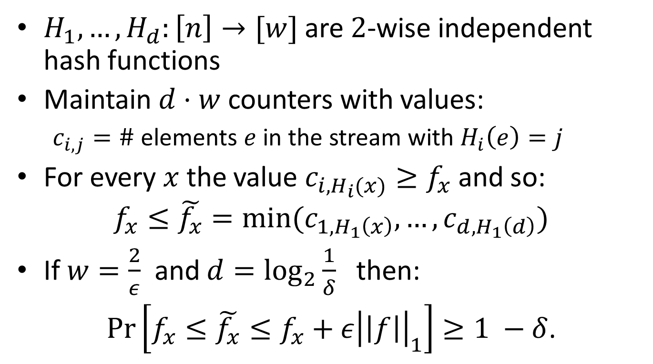
Count-Min
$H_{1},…,H_{d}:\left[n\right]→[w]$ are $2$-wise independent hash functions
Maintain $d⋅w$ counters with values:
$c_{i,j}=\#$ elements $e$ in the stream with $H_{i}\left(e\right)=j$
For every $x$ the value $c_{i,H_{i}(x)}≥f_{x}$ and so:
$$f_{x}≤\tilde{f_{x}}=min⁡(c_{1,H_{1}\left(x\right)}, …,c_{d,H_{1}\left(d\right)})$$
If $w=\frac{2}{ε}$ and $d=\log_{2}{\frac{1}{δ}}$ then:
$\operatorname{Pr}\left[f_{x}≤\tilde{f_{x}}≤f_{x}+ε{\left|\left|f\right|\right|}_{1}\right]≥1 −δ$.

Slide 6
More about Count-Min
Authors: Graham Cormode, S. Muthukrishnan [LATIN’04]
Count-Min is linear:
Count-Min(S1 + S2) = Count-Min(S1) + Count-Min(S2)
Deterministic version: CR-Precis
Count-Min vs. Bloom filters
Allows to approximate values, not just 0/1 (set membership)
Doesn’t require mutual independence (only 2-wise)
FAQ and Applications:
https://sites.google.com/site/countminsketch/home/
https://sites.google.com/site/countminsketch/home/faq

Slide 7
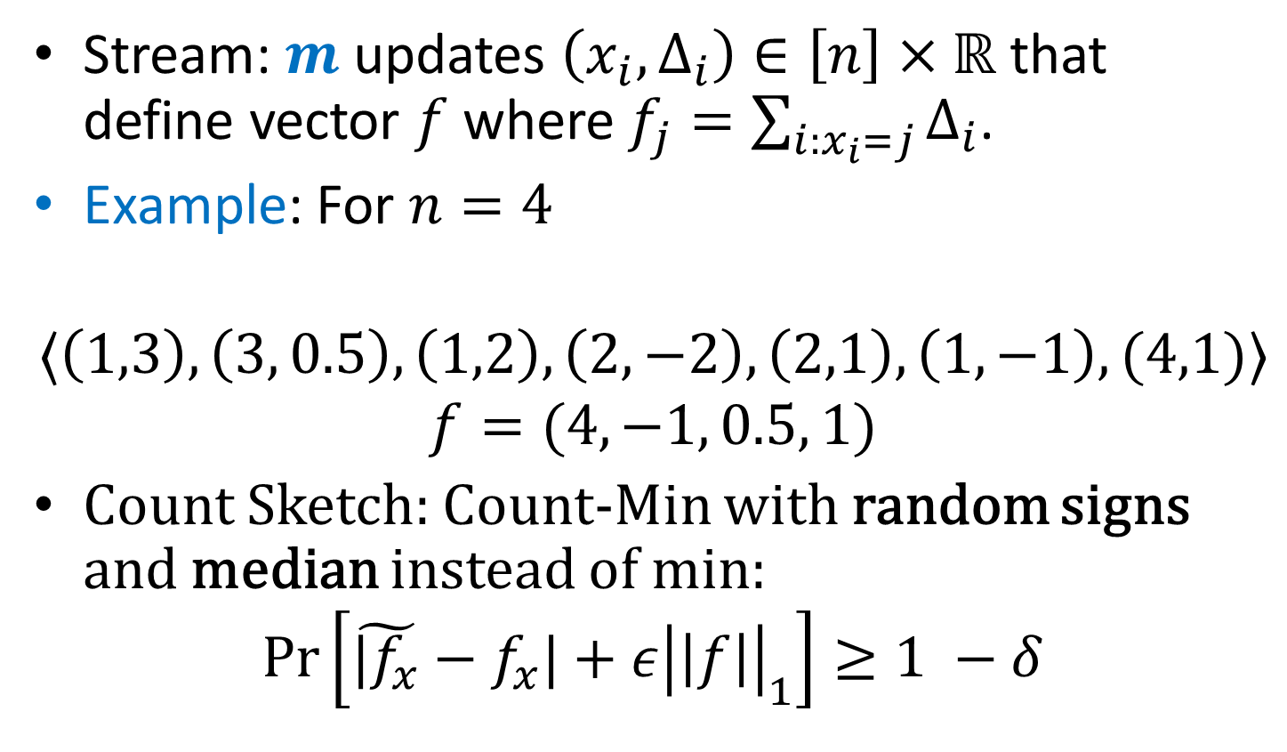
Fully Dynamic Streams
Stream: $m$ updates $\left(x_{i}, Δ_{i}\right)∈\left[n\right]×ℝ$ that define vector $f$ where $f_{j}=\sum_{i:x_{i}=j}{Δ_{i}}$.
Example: For $n=4$
$$〈\left(1,3\right), \left(3, 0.5\right), \left(1,2\right), \left(2,−2\right),\left(2,1\right), \left(1,−1\right), (4,1)〉$$
$$f=(4, −1, 0.5, 1)$$
Count Sketch: Count-Min with random signs and median instead of min:
$$\operatorname{Pr}\left[\tilde{|f_{x}}−f_{x}|+ε{\left|\left|f\right|\right|}_{1}\right]≥1 −δ$$

Slide 8
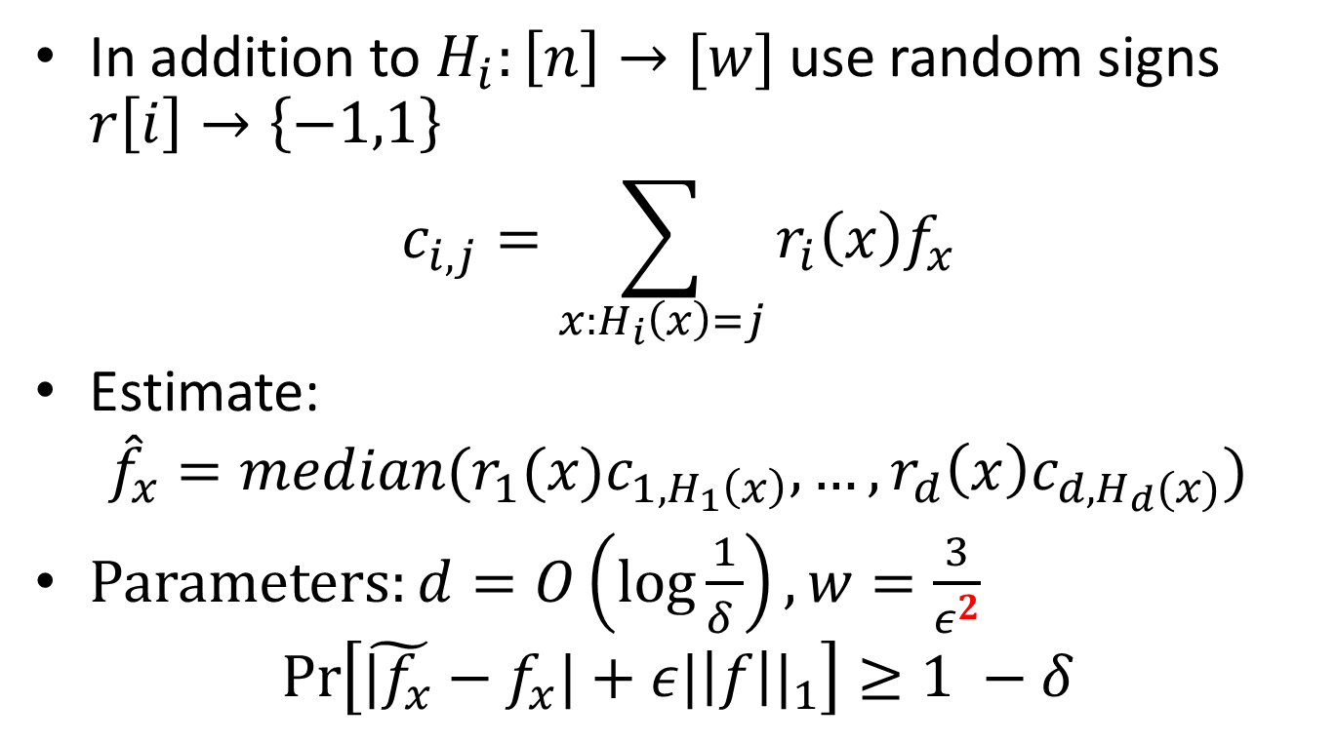
Count Sketch
In addition to $H_{i}:\left[n\right]→[w]$ use random signs $r\left[i\right]→\left\{−1,1\right\}$
$$c_{i,j}=\sum_{x:H_{i}\left(x\right)=j}{r_{i}\left(x\right)f_{x}}$$
Estimate:
$${\hat{f}}_{x}=median(r_{1}(x)c_{1,H_{1}\left(x\right)}, …,r_{d}\left(x\right)c_{d,H_{d}(x)})$$
Parameters: $d=O\left(\log{\frac{1}{δ }}\right), w=\frac{3}{ε^{2}}$
$$\operatorname{Pr}\left[\tilde{|f_{x}}−f_{x}|+ε{|\left|f\right||}_{1}\right]≥1 −δ$$

Slide 9
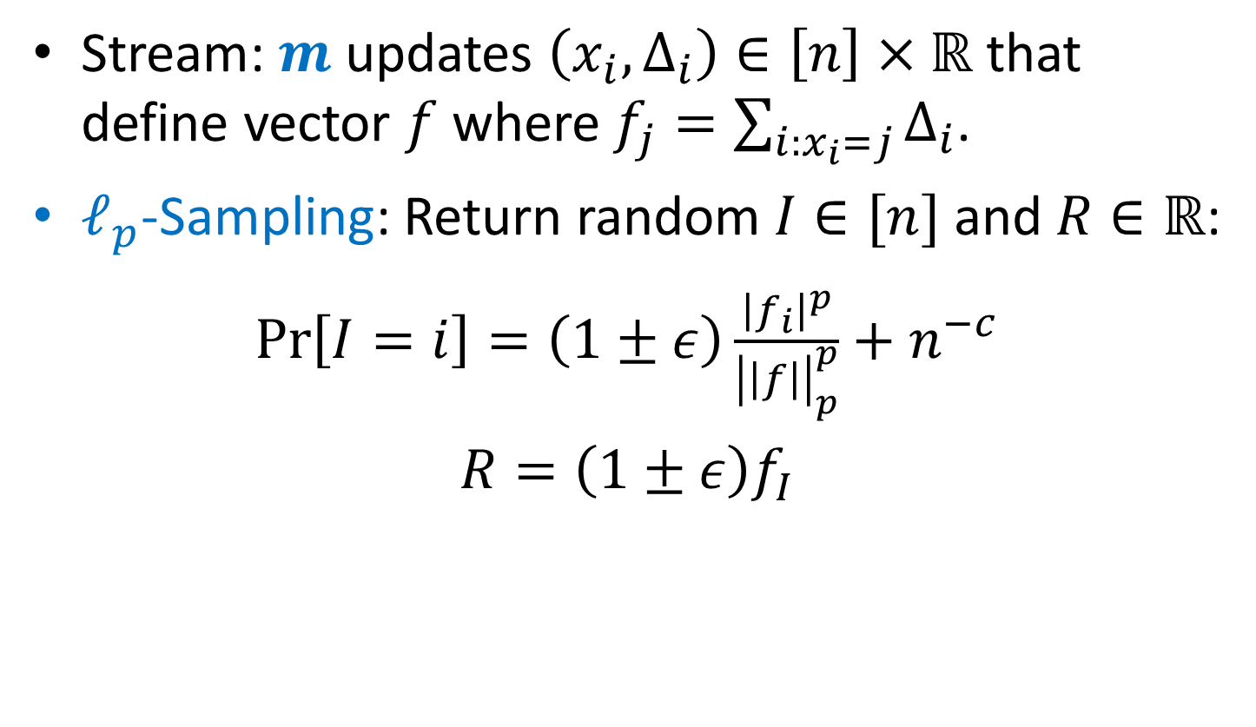

$ℓ_{p}$-Sampling
Stream: $m$ updates $\left(x_{i}, Δ_{i}\right)∈\left[n\right]×ℝ$ that define vector $f$ where $f_{j}=\sum_{i:x_{i}=j}{Δ_{i}}$.
$ℓ_{p}$-Sampling: Return random $I∈[n]$ and $R∈ℝ$:
$\operatorname{Pr}\left[I=i\right]=\left(1±ε\right)\frac{{\left|f_{i}\right|}^{p}}{{\left|\left|f\right|\right|}_{p}^{p}}+n^{−c}$
$R=\left(1±ε\right)f_{I}$

Slide 10
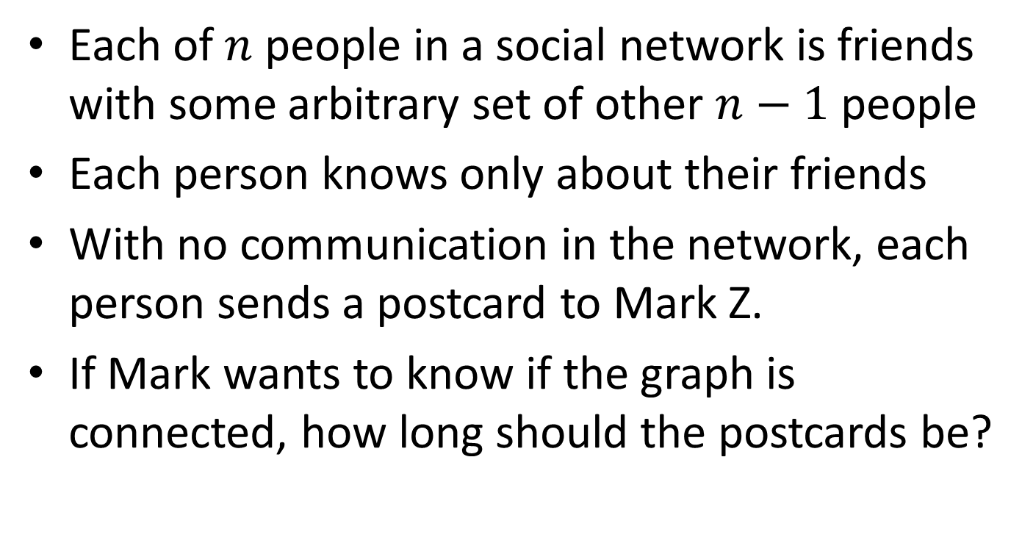
Application: Social Networks
Each of $n$ people in a social network is friends with some arbitrary set of other $n−1$ people
Each person knows only about their friends
With no communication in the network, each person sends a postcard to Mark Z.
If Mark wants to know if the graph is connected, how long should the postcards be?

Slide 11
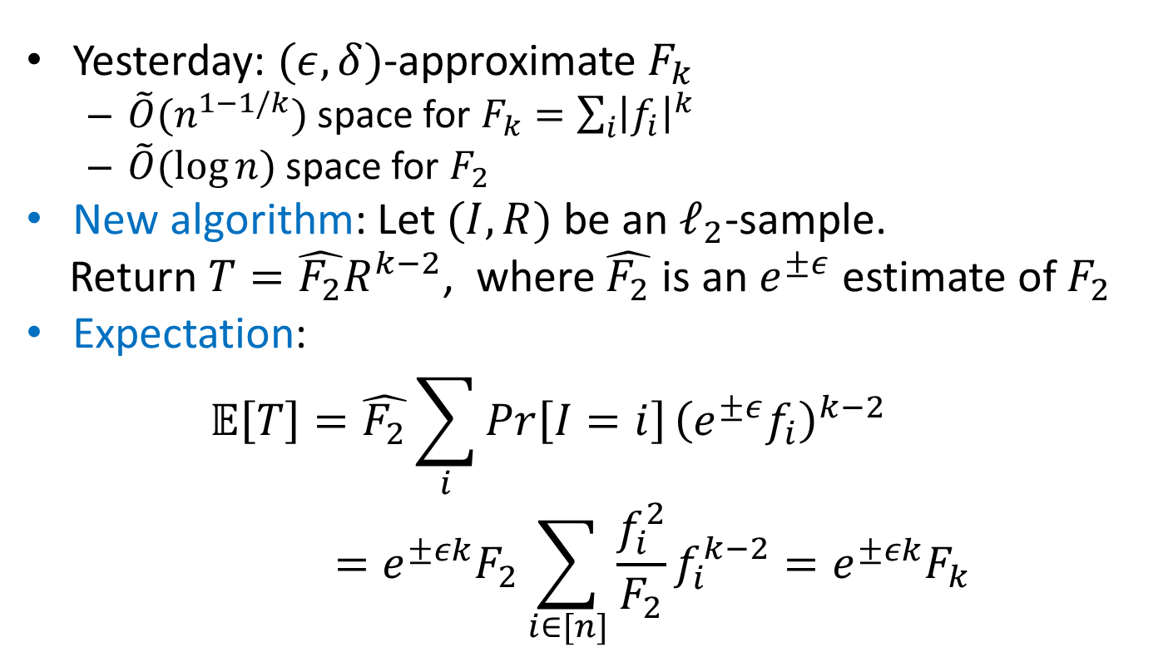

Optimal $F_{k}$ estimation
Yesterday: $(ε,δ)$-approximate $F_{k}$
$\tilde{O}(n^{1−1/k})$ space for $F_{k}=\sum_{i}{{\left|f_{i}\right|}^{k}}$
$\tilde{O}(\log{n})$ space for $F_{2}$
New algorithm: Let $(I,R)$ be an $ℓ_{2}$-sample.
Return $T=\hat{F_{2}}R^{k−2}$, where $\hat{F_{2}}$ is an $e^{±ε}$ estimate of $F_{2}$
Expectation:
$$𝔼\left[T\right]=\hat{F_{2}}\sum_{i}{Pr}\left[I=i\right]{\left(e^{±ε}f_{i}\right)}^{k−2}=e^{±εk}F_{2}\sum_{i∈[n]}{\frac{f_{i}^{2}}{F_{2}}f_{i}^{k−2}=e^{±εk}F_{k}}$$

Slide 12
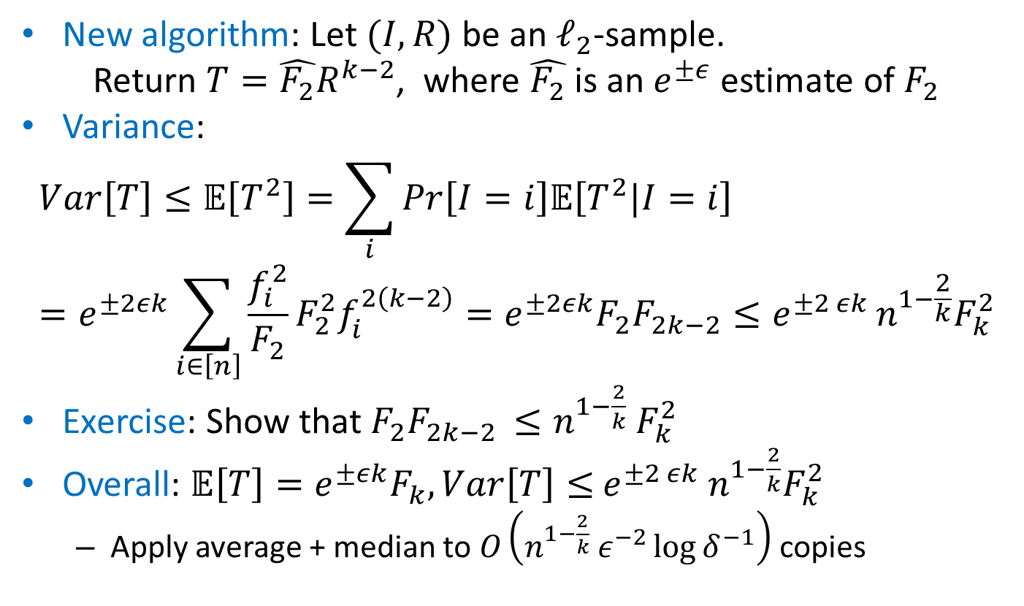
Optimal $F_{k}$ estimation
New algorithm: Let $(I,R)$ be an $ℓ_{2}$-sample.
Return $T=\hat{F_{2}}R^{k−2}$, where $\hat{F_{2}}$ is an $e^{±ε}$ estimate of $F_{2}$
Variance:
$$Var\left[T\right]≤𝔼\left[T^{2}\right]=\sum_{i}{Pr}\left[I=i\right]𝔼\left[T^{2}|I=i\right]=e^{±2εk}\sum_{i∈\left[n\right]}{\frac{f_{i}^{2}}{F_{2}}{F_{2}^{2}f}_{i}^{2\left(k−2\right)}=e^{±2εk}F_{2}F_{2k−2}≤e^{±2 εk}}n^{1−\frac{2}{k}}F_{k}^{2}$$
Exercise: Show that $F_{2}F_{2k−2 }≤n^{1−\frac{2}{k}} F_{k}^{2}$
Overall: ${𝔼\left[T\right]=e}^{±εk}F_{k}, Var\left[T\right]≤$ ${e^{±2 εk} n}^{1−\frac{2}{k}}F_{k}^{2}$
Apply average + median to $O\left(n^{1−\frac{2}{k}} ε^{−2}\log{δ^{−1}}\right)$ copies

Slide 13
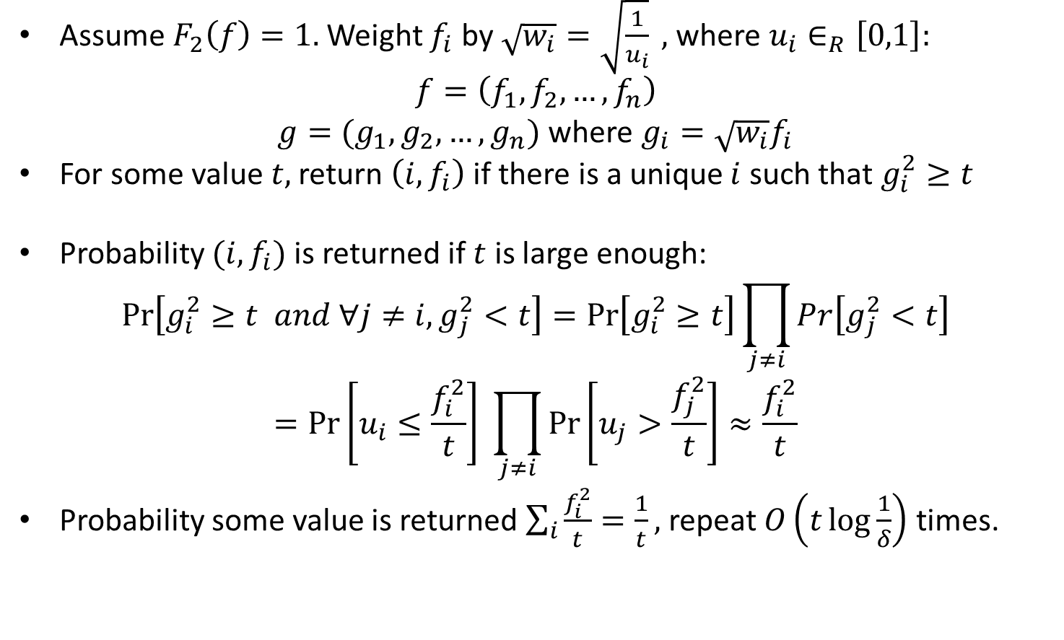

$ℓ_{2}$-Sampling: Basic Overview
Assume $F_{2}\left(f\right)=1.$ Weight $f_{i}$ by $\sqrt{w_{i}}=\sqrt{\frac{1}{u_{i}}} ,$ where $u_{i}∈_{R}\left[0,1\right]:$
$$f=\left(f_{1},f_{2},…, f_{n}\right)$$
$g=(g_{1},g_{2},…, g_{n})$ where $g_{i}=\sqrt{w_{i}}f_{i}$
For some value $t,$ return $\left(i,f_{i}\right)$ if there is a unique $i$ such that $g_{i}^{2}≥t$
Probability $(i,f_{i})$ is returned if $t$ is large enough:
$$\operatorname{Pr}\left[g_{i}^{2}≥t and ∀j≠i, g_{j}^{2}<t\right]=\operatorname{Pr}\left[g_{i}^{2}≥t\right]\prod_{j≠i}{Pr\left[g_{j}^{2}<t\right]}$$
$$=\operatorname{Pr}\left[u_{i}≤\frac{f_{i}^{2}}{t}\right] \prod_{j≠i}{\operatorname{Pr}\left[u_{j}>\frac{f_{j}^{2}}{t}\right]}≈\frac{f_{i}^{2}}{t}$$
Probability some value is returned $\sum_{i}{\frac{f_{i}^{2}}{t}}=\frac{1}{t},$ repeat $O\left(t\log{\frac{1}{δ}}\right)$ times.

Slide 14
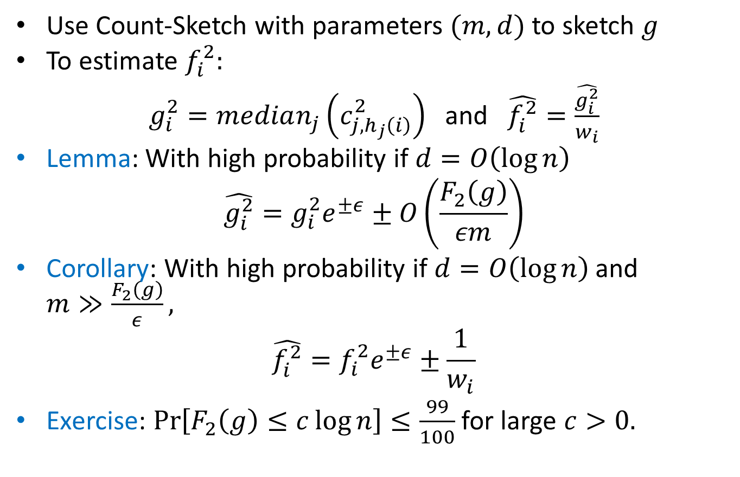

$ℓ_{2}$-Sampling: Part 1
Use Count-Sketch with parameters $(m,d)$ to sketch $g$
To estimate $f_{i}^{2}:$
$g_{i}^{2}=median_{j}\left(c_{j,h_{j}\left(i\right)}^{2}\right)$ and $\hat{f_{i}^{2}}=\frac{\hat{g_{i}^{2}}}{w_{i}}$
Lemma: With high probability if $d=O\left(\log{n}\right)$
$$\hat{g_{i}^{2}}=g_{i}^{2}e^{±ε}±O\left(\frac{F_{2}\left(g\right)}{εm}\right)$$
Corollary: With high probability if $d=O\left(\log{n}\right)$ and $m≫\frac{F_{2}\left(g\right)}{ε},$
$$\hat{f_{i}^{2}}=f_{i}^{2}e^{±ε}±\frac{1}{w_{i}}$$
Exercise: $\operatorname{Pr}\left[F_{2}\left(g\right)≤c\log{n}\right]≤\frac{99}{100}$ for large $c>0.$

Slide 15
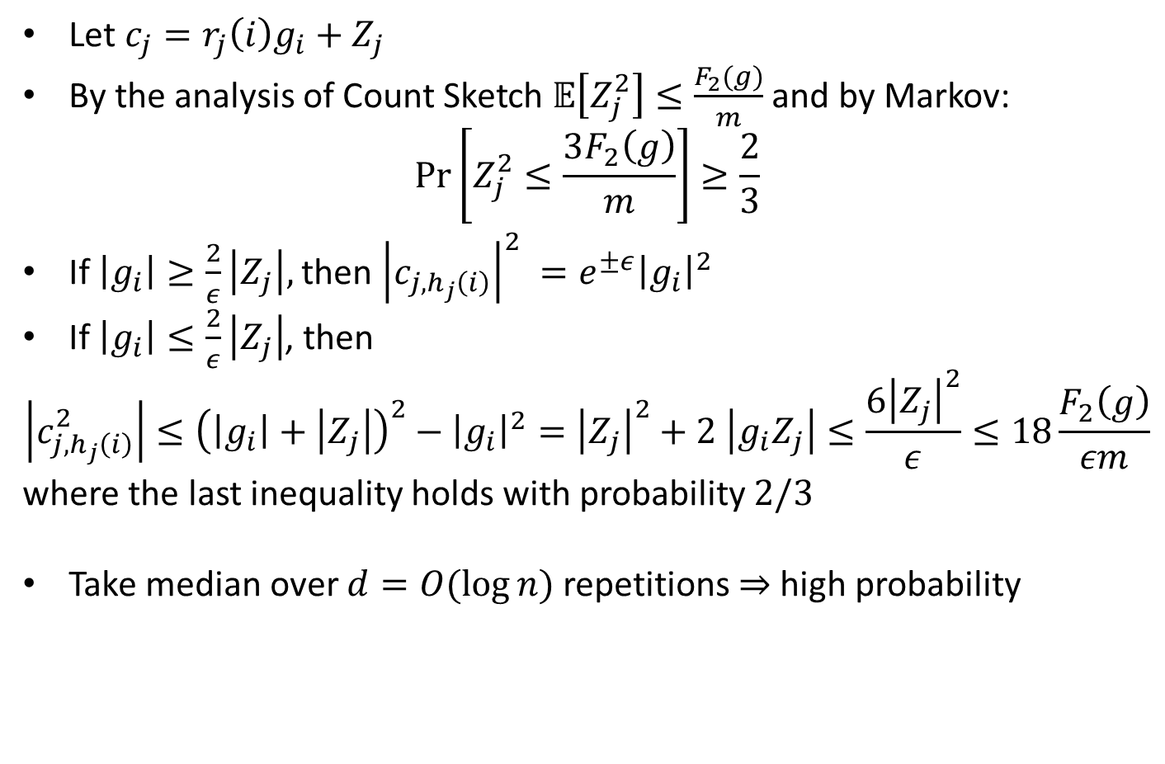
Proof of Lemma
Let $c_{j}=r_{j}\left(i\right)g_{i}+Z_{j}$
By the analysis of Count Sketch $𝔼\left[Z_{j}^{2}\right]≤\frac{F_{2}(g)}{m}$ and by Markov:
$$\operatorname{Pr}\left[Z_{j}^{2}≤\frac{3F_{2}\left(g\right)}{m}\right]≥\frac{2}{3}$$
If $\left|g_{i}\right|≥\frac{2}{ε}\left|Z_{j}\right|,$ then ${\left|c_{j, h_{j}\left(i\right)}\right|}^{2} =e^{±ε}{\left|g_{i}\right|}^{2}$
If $\left|g_{i}\right|≤\frac{2}{ε}\left|Z_{j}\right|$, then
$$\left|c_{j,h_{j}\left(i\right)}^{2}\right|≤{\left(\left|g_{i}\right|+\left|Z_{j}\right|\right)}^{2}−{\left|g_{i}\right|}^{2}={\left|Z_{j}\right|}^{2}+2 \left|g_{i}Z_{j}\right|≤\frac{6{\left|Z_{j}\right|}^{2}}{ε}≤18\frac{F_{2}\left(g\right)}{εm}$$
where the last inequality holds with probability $2/3$
Take median over $d=O(\log{n})$ repetitions $⇒$high probability

Slide 16
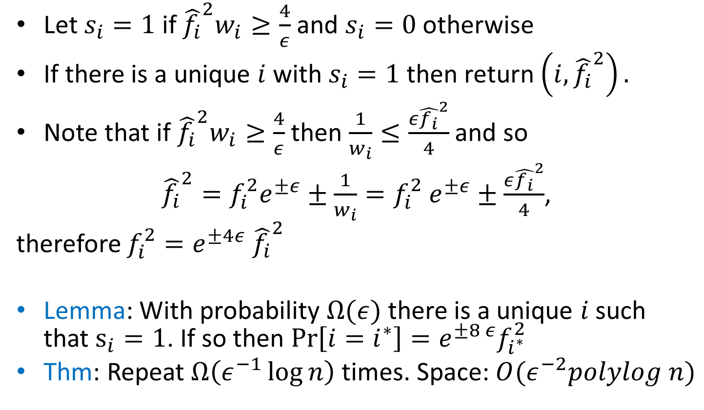

$ℓ_{2}$-Sampling: Part 2
Let $s_{i}=1$ if ${\hat{f_{i}}}^{2}w_{i}≥\frac{4}{ε}$ and $s_{i}=0$ otherwise
If there is a unique $i$ with $s_{i}=1$ then return $\left(i, {\hat{f_{i}}}^{2}\right).$
Note that if ${\hat{f_{i}}}^{2}w_{i}≥\frac{4}{ε}$ then $\frac{1}{w_{i}}≤\frac{ε{\hat{f_{i}}}^{2}}{4}$ and so
${\hat{f_{i}}}^{2}=f_{i}^{2}e^{±ε}±\frac{1}{w_{i}}=f_{i}^{2} e^{±ε}±\frac{ε{\hat{f_{i}}}^{2}}{4}$,
therefore $f_{i}^{2}=e^{±4ε} {\hat{f_{i}}}^{2}$
Lemma: With probability $Ω(ε)$ there is a unique $i$ such that $s_{i}=1$. If so then $\operatorname{Pr}\left[i=i^{∗}\right]=e^{±8 ε}f_{i^{∗}}^{2}$
Thm: Repeat $Ω\left(ε^{−1}\log{n}\right)$ times. Space: $O(ε^{−2}polylog n)$

Slide 17
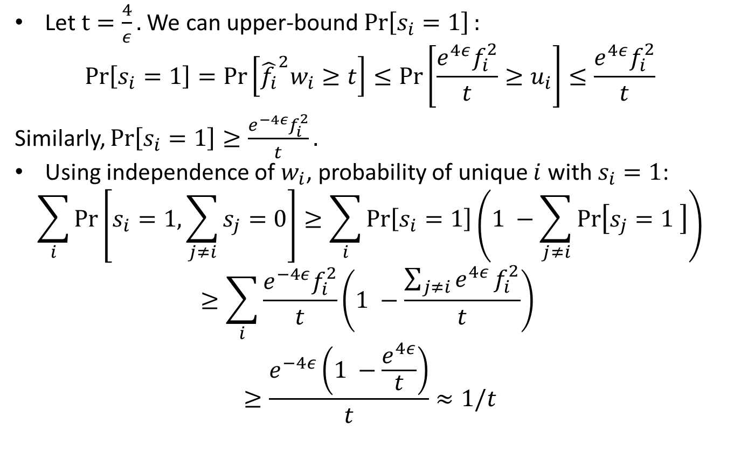
Proof of Lemma
Let $t=\frac{4}{ε}.$ We can upper-bound $\operatorname{Pr}\left[s_{i}=1\right]:$
$$\operatorname{Pr}\left[s_{i}=1\right]=\operatorname{Pr}\left[{\hat{f_{i}}}^{2}w_{i}≥t\right]≤\operatorname{Pr}\left[\frac{e^{4ε}f_{i}^{2}}{t}≥u_{i}\right]≤\frac{e^{4ε}f_{i}^{2}}{t}$$
Similarly, $\operatorname{Pr}\left[s_{i}=1\right]≥\frac{e^{−4ε}f_{i}^{2}}{t}.$
Using independence of $w_{i}$, probability of unique $i$ with $s_{i}=1$:
$$\sum_{i}{\operatorname{Pr}\left[s_{i}=1, \sum_{j≠i}{s_{j}=0}\right]≥\sum_{i}{\operatorname{Pr}\left[s_{i}=1\right]\left(1 −\sum_{j≠i}{\operatorname{Pr}\left[s_{j}=1 \right]}\right)}}$$
$$≥\sum_{i}{\frac{e^{−4ε}f_{i}^{2}}{t}}\left(1 −\frac{\sum_{j≠i}{e^{4ε}}f_{i}^{2}}{t}\right)$$
$$≥\frac{e^{−4ε}\left(1 −\frac{e^{4ε}}{t}\right)}{t}≈1/t$$

Slide 18
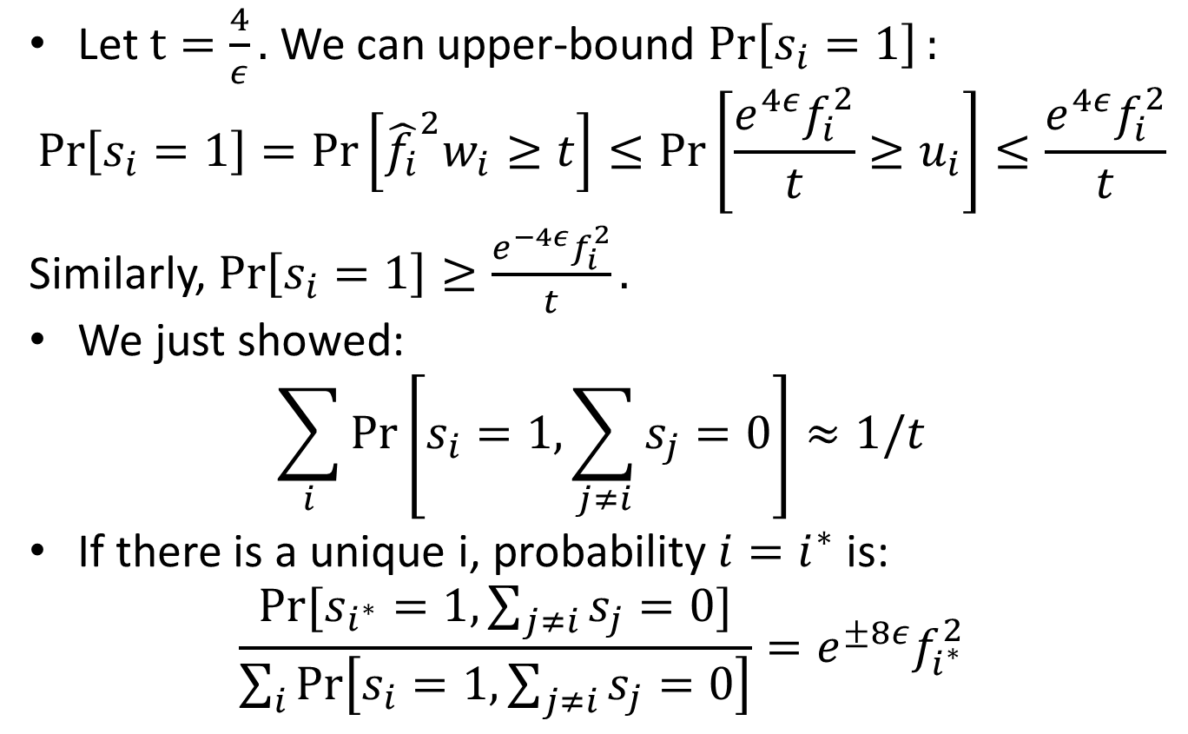
Proof of Lemma
Let $t=\frac{4}{ε}.$ We can upper-bound $\operatorname{Pr}\left[s_{i}=1\right]:$
$$\operatorname{Pr}\left[s_{i}=1\right]=\operatorname{Pr}\left[{\hat{f_{i}}}^{2}w_{i}≥t\right]≤\operatorname{Pr}\left[\frac{e^{4ε}f_{i}^{2}}{t}≥u_{i}\right]≤\frac{e^{4ε}f_{i}^{2}}{t}$$
Similarly, $\operatorname{Pr}\left[s_{i}=1\right]≥\frac{e^{−4ε}f_{i}^{2}}{t}.$
We just showed:
$$\sum_{i}{\operatorname{Pr}\left[s_{i}=1, \sum_{j≠i}{s_{j}=0}\right]}≈1/t$$
If there is a unique i, probability $i=i^{∗}$ is:
$$\frac{Pr⁡[s_{i^{∗}}=1, \sum_{j≠i}{s_{j}=0}]}{\sum_{i}{\operatorname{Pr}\left[s_{i}=1, \sum_{j≠i}{s_{j}=0}\right]}}=e^{±8ε}f_{i^{∗}}^{2}$$

Slide 19
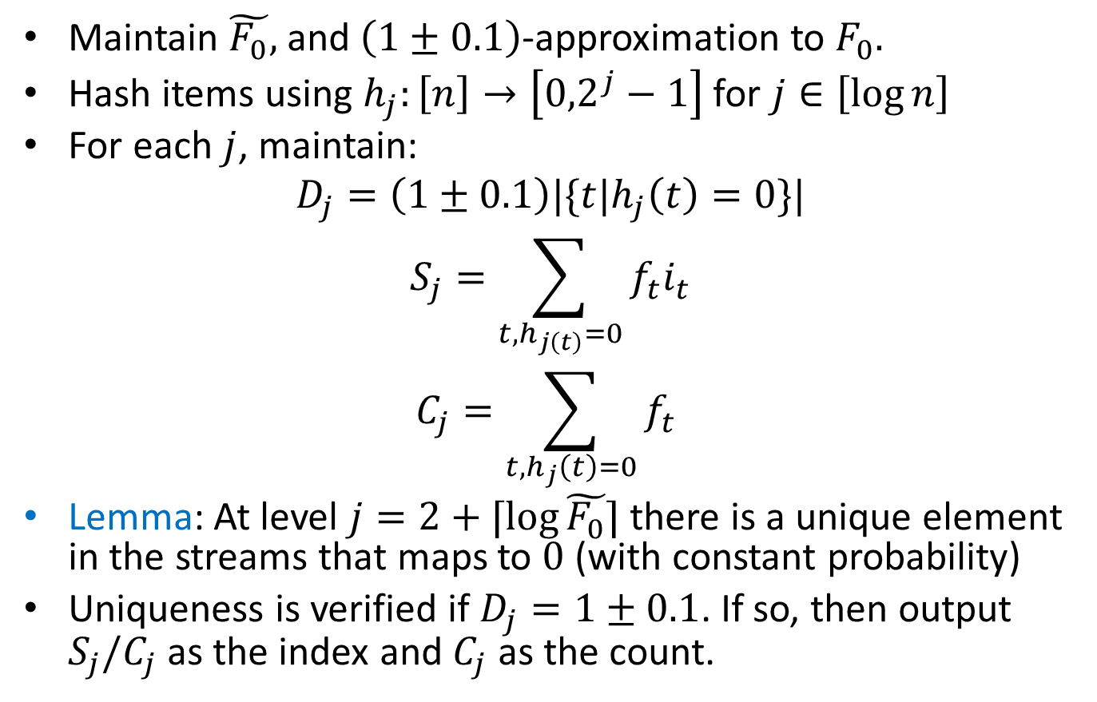

$ℓ_{0}$-sampling
Maintain $\tilde{F_{0}},$ and $\left(1±0.1\right)$-approximation to $F_{0}.$
Hash items using $h_{j}:\left[n\right]→\left[{0,2}^{j}−1\right]$ for $j∈\left[\log{n}\right]$
For each $j$, maintain:
$$D_{j}=\left(1±0.1\right)|\{t|h_{j}\left(t\right)=0\}|$$
$$S_{j}=\sum_{t, h_{j\left(t\right)}=0}{f_{t}i_{t}}$$
$$C_{j}=\sum_{t, h_{j}\left(t\right)=0}{f_{t}}$$
Lemma: At level $j=2+⌈\log{\tilde{F_{0}}}⌉$ there is a unique element in the streams that maps to $0$ (with constant probability)
Uniqueness is verified if $D_{j}=1±0.1$. If so, then output $S_{j}/C_{j}$ as the index and $C_{j}$ as the count.

Slide 20
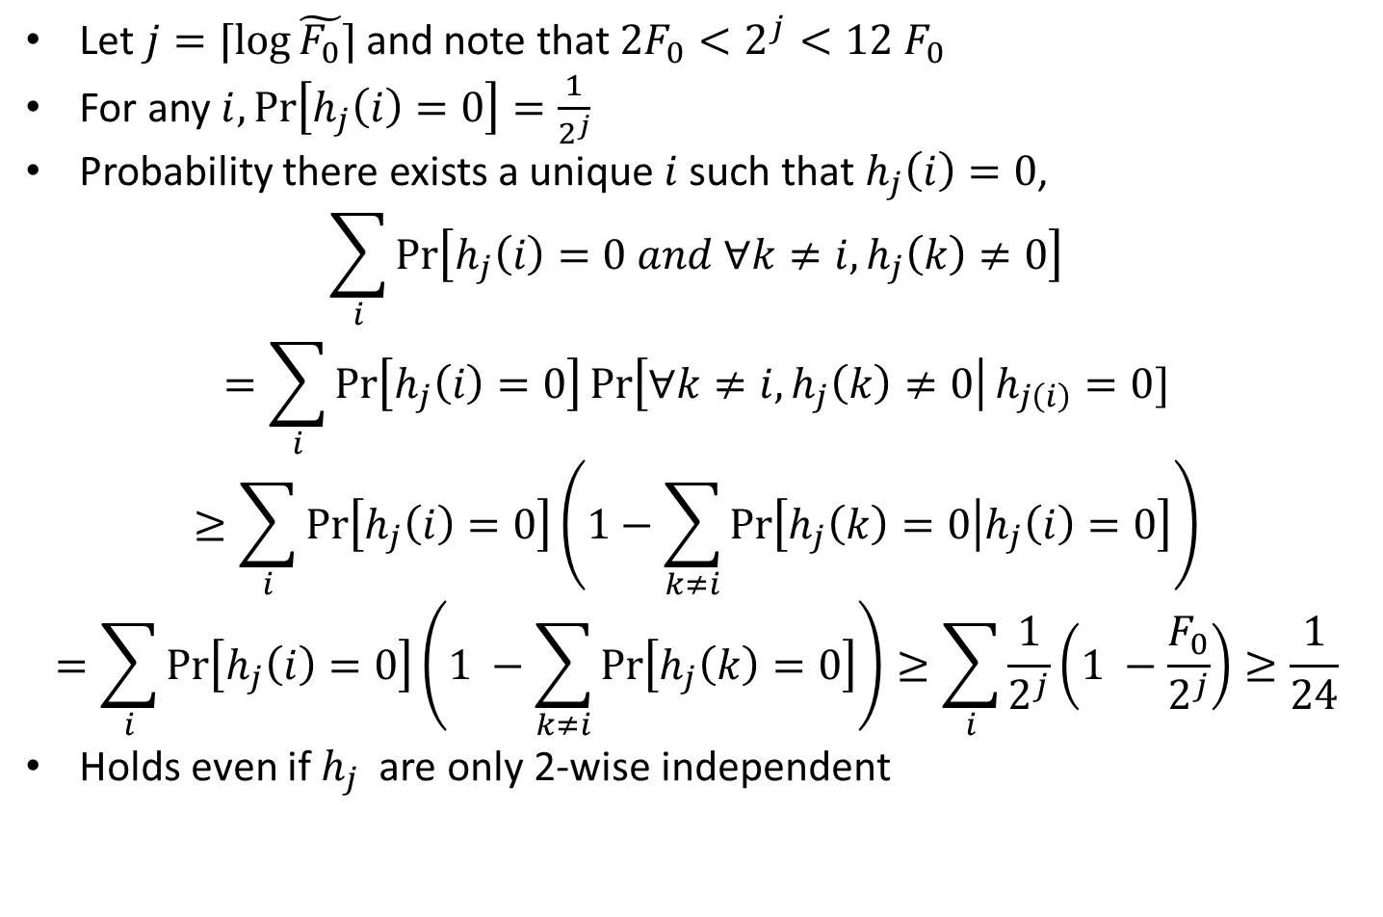
Proof of Lemma
Let $j=⌈\log{\tilde{F_{0}}}⌉$ and note that $2F_{0}<2^{j}<12 F_{0}$
For any $i,\operatorname{Pr}\left[h_{j}\left(i\right)=0\right]=\frac{1}{2^{j}}$
Probability there exists a unique $i$ such that $h_{j}\left(i\right)=0$,
$$\sum_{i}{\operatorname{Pr}\left[h_{j}\left(i\right)=0 and ∀k≠i, h_{j}\left(k\right)≠0\right]}$$
$$=\sum_{i}{\operatorname{Pr}\left[h_{j}\left(i\right)=0\right]\operatorname{Pr}\left[∀k≠i, h_{j}\left(k\right)≠0\right|h_{j\left(i\right)}=0]}$$
$$≥\sum_{i}{\operatorname{Pr}\left[h_{j}\left(i\right)=0\right]\left(1−\sum_{k≠i}{\operatorname{Pr}\left[h_{j}\left(k\right)=0 | h_{j}\left(i\right)=0\right]}\right)}$$
$$=\sum_{i}{\operatorname{Pr}\left[h_{j}\left(i\right)=0\right]\left(1 −\sum_{k≠i}{\operatorname{Pr}\left[h_{j}\left(k\right)=0\right]}\right)}≥\sum_{i}{\frac{1}{2^{j}}\left(1 −\frac{F_{0}}{2^{j}}\right)≥\frac{1}{24}}$$
Holds even if $h_{j}$ are only 2-wise independent

Slide 21
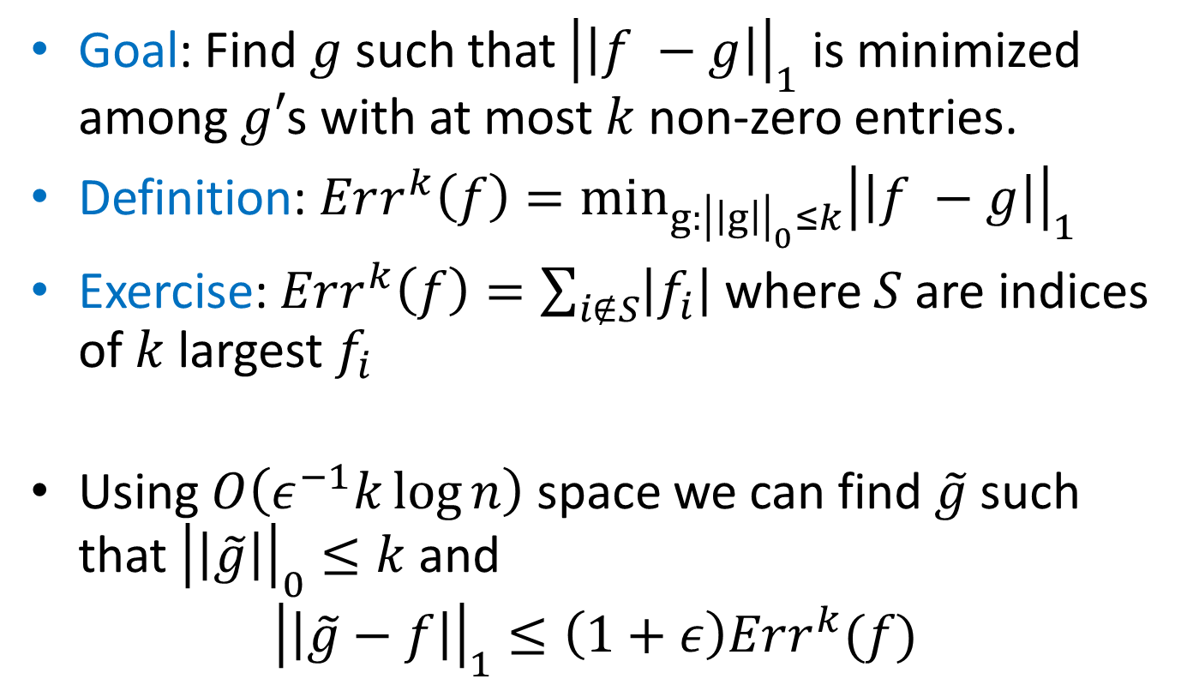
Sparse Recovery
Goal: Find $g$ such that ${\left|\left|f −g\right|\right|}_{1}$ is minimized among $g′$s with at most $k$ non-zero entries.
Definition: $Err^{k}\left(f\right)=\min_{g:{\left|\left|g\right|\right|}_{0}≤k}{{\left|\left|f −g\right|\right|}_{1}}$
Exercise: $Err^{k}\left(f\right)=\sum_{i∉S}{\left|f_{i}\right|}$ where $S$ are indices of $k$ largest $f_{i}$
Using $O\left(ε^{−1}k\log{n}\right)$ space we can find $\tilde{g}$ such that ${\left|\left|\tilde{g}\right|\right|}_{0}≤k$ and
$${\left|\left|\tilde{g}−f\right|\right|}_{1}≤\left(1+ε\right)Err^{k}(f)$$

Slide 22
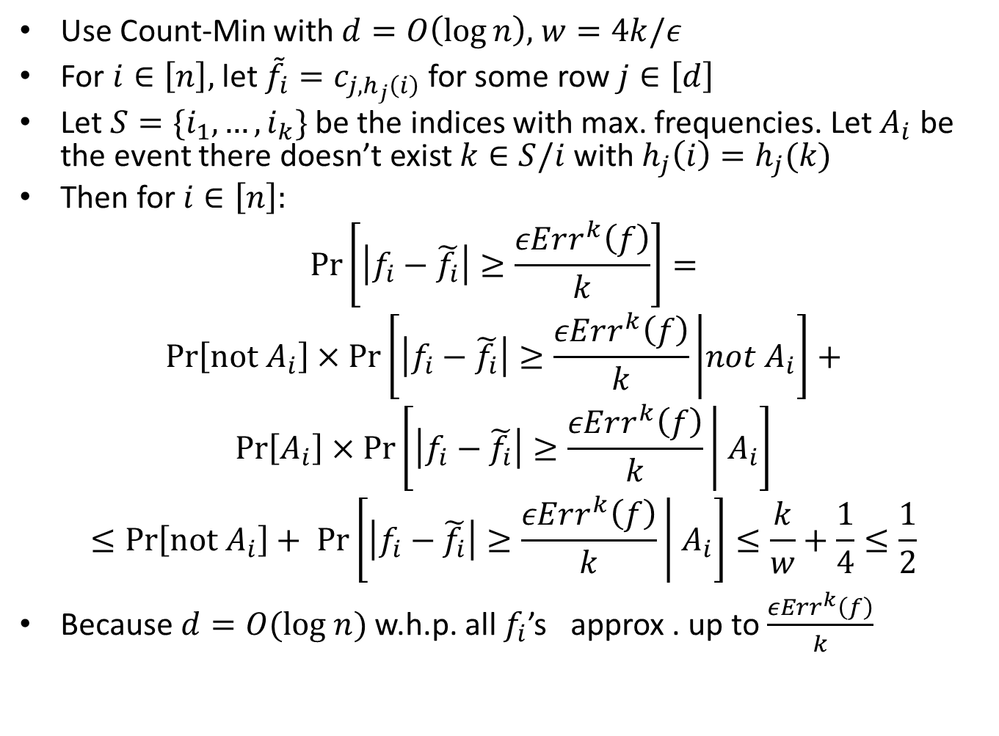
Count-Min Revisited
Use Count-Min with $d=O\left(\log{n}\right),$ $w=4k/ε$
For $i∈\left[n\right],$ let ${\tilde{f}}_{i}=c_{j,h_{j}\left(i\right)}$ for some row $j∈\left[d\right]$
Let $S=\{i_{1},…, i_{k}\}$ be the indices with max. frequencies. Let $A_{i}$ be the event there doesn’t exist $k∈S/i$ with $h_{j}\left(i\right)=h_{j}(k)$
Then for $i∈\left[n\right]:$
$$\operatorname{Pr}\left[\left|f_{i}−\tilde{f_{i}}\right|≥\frac{εErr^{k}\left(f\right)}{k}\right]=$$
$$\operatorname{Pr}\left[not A_{i}\right]×\operatorname{Pr}\left[\left|f_{i}−\tilde{f_{i}}\right|≥\frac{εErr^{k}\left(f\right)}{k} | not A_{i}\right]+$$
$$\operatorname{Pr}\left[A_{i}\right]×\operatorname{Pr}\left[\left|f_{i}−\tilde{f_{i}}\right|≥\frac{εErr^{k}\left(f\right)}{k} | A_{i}\right]$$
$$≤\operatorname{Pr}\left[not A_{i}\right]+ \operatorname{Pr}\left[\left|f_{i}−\tilde{f_{i}}\right|≥\frac{εErr^{k}\left(f\right)}{k} | A_{i}\right]≤\frac{k}{w}+\frac{1}{4}≤\frac{1}{2}$$
Because $d=O(log n)$ w.h.p. all $f_{i}$’s approx . up to $\frac{εErr^{k}\left(f\right)}{k}$

Slide 23
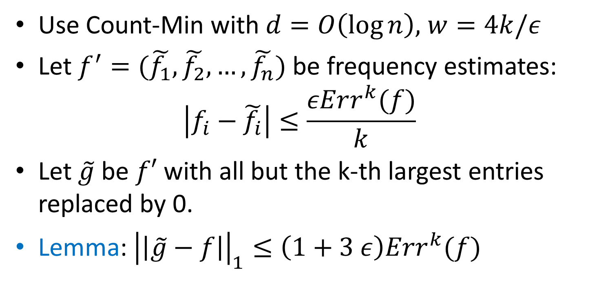
Sparse Recovery Algorithm
Use Count-Min with $d=O\left(\log{n}\right),$ $w=4k/ε$
Let $f^{′}=(\tilde{f_{1}}, \tilde{f_{2}}, …, \tilde{f_{n}})$ be frequency estimates:
$$\left|f_{i}−\tilde{f_{i}}\right|≤\frac{εErr^{k}(f)}{k}$$
Let $\tilde{g}$ be $f′$ with all but the k-th largest entries replaced by 0.
Lemma: ${\left|\left|\tilde{g}−f\right|\right|}_{1}≤\left(1+3 ε\right)Err^{k}(f)$

Slide 24
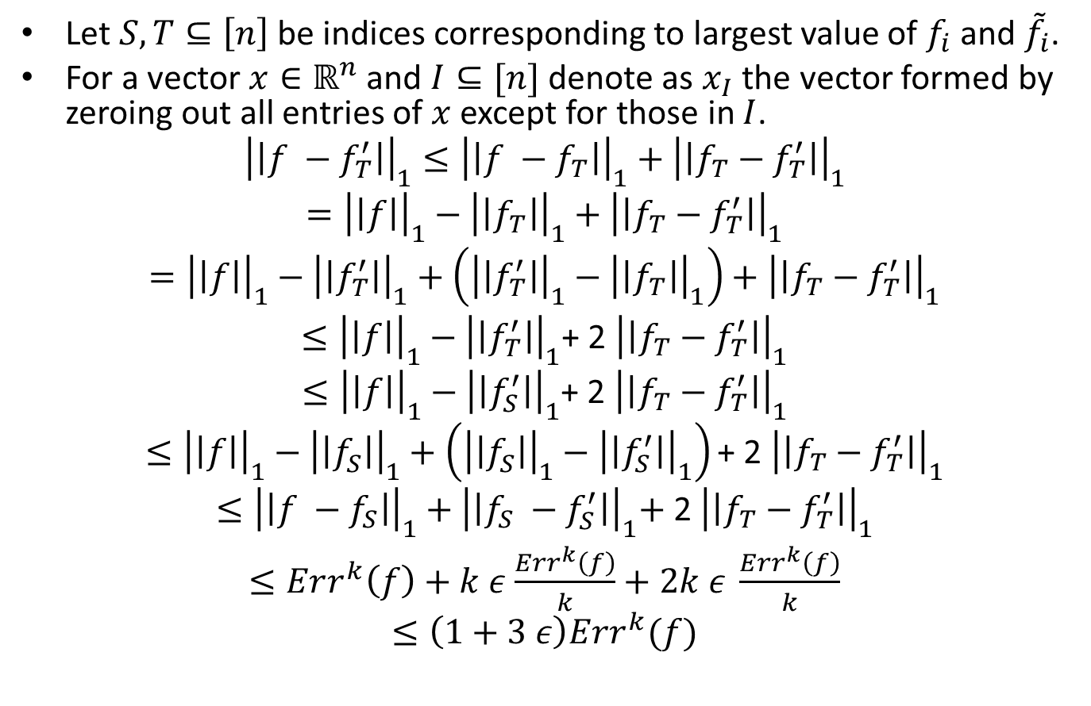

$${\left|\left|\tilde{g}−f\right|\right|}_{1}≤\left(1+3 ε\right)Err^{k}(f)$$
Let $S, T⊆\left[n\right]$ be indices corresponding to largest value of $f_{i}$ and ${\tilde{f}}_{i}$.
For a vector $x∈ℝ^{n}$ and $I⊆[n]$ denote as $x_{I}$ the vector formed by zeroing out all entries of $x$ except for those in $I$.
$${\left|\left|f −f_{T}^{′}\right|\right|}_{1}≤{\left|\left|f −f_{T}\right|\right|}_{1}+{\left|\left|f_{T}−f_{T}^{′}\right|\right|}_{1}$$
$$={\left|\left|f\right|\right|}_{1}−{\left|\left|f_{T}\right|\right|}_{1}+{\left|\left|f_{T}−f_{T}^{′}\right|\right|}_{1}$$
$$={\left|\left|f\right|\right|}_{1}−{\left|\left|f_{T}^{′}\right|\right|}_{1}+\left({\left|\left|f_{T}^{′}\right|\right|}_{1}−{\left|\left|f_{T}\right|\right|}_{1}\right)+{\left|\left|f_{T}−f_{T}^{′}\right|\right|}_{1}$$
$≤{\left|\left|f\right|\right|}_{1}−{\left|\left|f_{T}^{′}\right|\right|}_{1}$+ 2 ${\left|\left|f_{T}−f_{T}^{′}\right|\right|}_{1}$
$≤{\left|\left|f\right|\right|}_{1}−{\left|\left|f_{S}^{′}\right|\right|}_{1}$+ 2 ${\left|\left|f_{T}−f_{T}^{′}\right|\right|}_{1}$
$$≤{\left|\left|f\right|\right|}_{1}−{\left|\left|f_{S}^{}\right|\right|}_{1}+\left({\left|\left|f_{S}^{}\right|\right|}_{1}−{\left|\left|f_{S}^{′}\right|\right|}_{1}\right)\text{+ 2 }{\left|\left|f_{T}−f_{T}^{′}\right|\right|}_{1}$$
$$≤{\left|\left|f −f_{S}\right|\right|}_{1}+{\left|\left|f_{S} −f_{S}^{′}\right|\right|}_{1}\text{+}\text{ 2 }{\left|\left|f_{T}−f_{T}^{′}\right|\right|}_{1}$$
$≤Err^{k}\left(f\right)+k ε$ $\frac{Err^{k}\left(f\right)}{k}+2k ε \frac{Err^{k}\left(f\right)}{k}$
$$≤\left(1+3 ε\right)Err^{k}(f)$$

Slide 25
Thank you!
Questions?

