Slide 1

Sublinear Algorihms for Big Data
Slides are available at http://grigory.us/big-data.html
Lecture 4
Grigory Yaroslavtsev
http://grigory.us

Slide 2
Today
Dimensionality reduction
AMS as dimensionality reduction
Johnson-Lindenstrauss transform
Sublinear time algorithms
Definitions: approximation, property testing
Basic examples: approximating diameter, testing properties of images
Testing sortedness
Testing connectedness

Slide 3
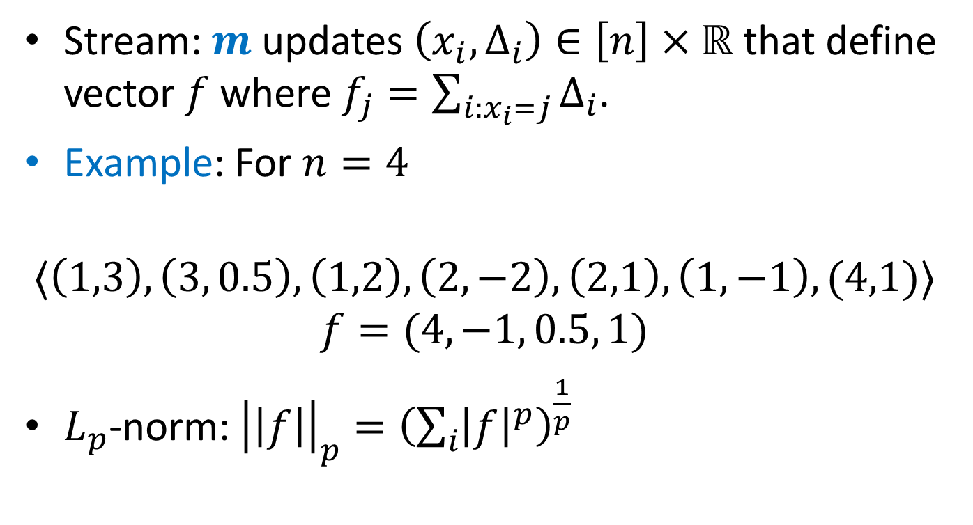

$L_{p}$-norm Estimation
Stream: $m$ updates $\left(x_{i}, Δ_{i}\right)∈\left[n\right]×ℝ$ that define vector $f$ where $f_{j}=\sum_{i:x_{i}=j}{Δ_{i}}$.
Example: For $n=4$
$$〈\left(1,3\right), \left(3, 0.5\right), \left(1,2\right), \left(2,−2\right),\left(2,1\right), \left(1,−1\right), (4,1)〉$$
$$f=(4, −1, 0.5, 1)$$
$L_{p}$-norm: ${\left|\left|f\right|\right|}_{p}={\left(\sum_{i}{{\left|f\right|}^{p}}\right)}^{\frac{1}{p}}$

Slide 4
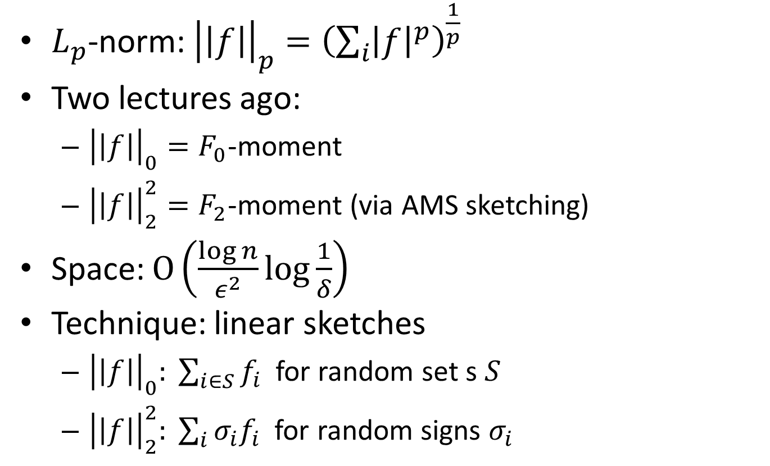
$L_{p}$-norm Estimation
$L_{p}$-norm: ${\left|\left|f\right|\right|}_{p}={\left(\sum_{i}{{\left|f\right|}^{p}}\right)}^{\frac{1}{p}}$
Two lectures ago:
${\left|\left|f\right|\right|}_{0}=F_{0}$-moment
${\left|\left|f\right|\right|}_{2}^{2}=F_{2}$-moment (via AMS sketching)
Space: $O\left(\frac{\log{n}}{ε^{2}}\log{\frac{1}{δ}}\right)$
Technique: linear sketches
${\left|\left|f\right|\right|}_{0}: \sum_{i∈S}{f_{i}}$ for random set s $S$
${\left|\left|f\right|\right|}_{2}^{2}: \sum_{i}{σ_{i}f_{i}}$ for random signs $σ_{i}$

Slide 5
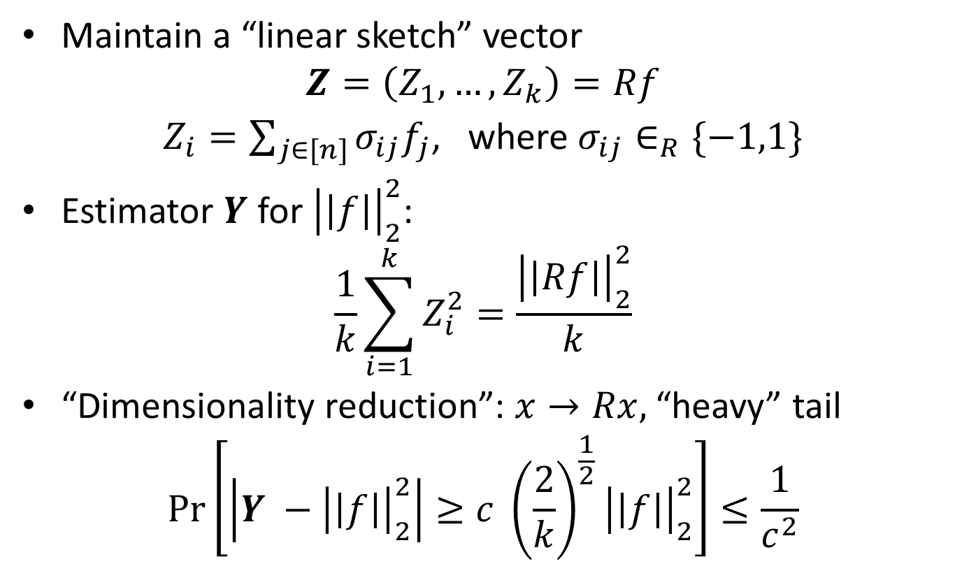
AMS as dimensionality reduction
Maintain a “linear sketch” vector
$$Z=\left(Z_{1}, …, Z_{k}\right)=Rf$$
$Z_{i}=\sum_{j∈[n]}{σ_{ij}f_{j}}$, where $σ_{ij}∈_{R}\{−1,1\}$
Estimator $Y$ for ${\left|\left|f\right|\right|}_{2}^{2}$:
$$\frac{1}{k}\sum_{i=1}^{k}{Z_{i}^{2}}=\frac{{\left|\left|Rf\right|\right|}_{2}^{2}}{k}$$
“Dimensionality reduction”: $x→Rx,$ “heavy” tail
$$\operatorname{Pr}\left[\left|Y −{\left|\left|f\right|\right|}_{2}^{2}\right|≥c {\left(\frac{2}{k}\right)}^{\frac{1}{2}}{\left|\left|f\right|\right|}_{2}^{2}\right]≤\frac{1}{c^{2}}$$

Slide 6
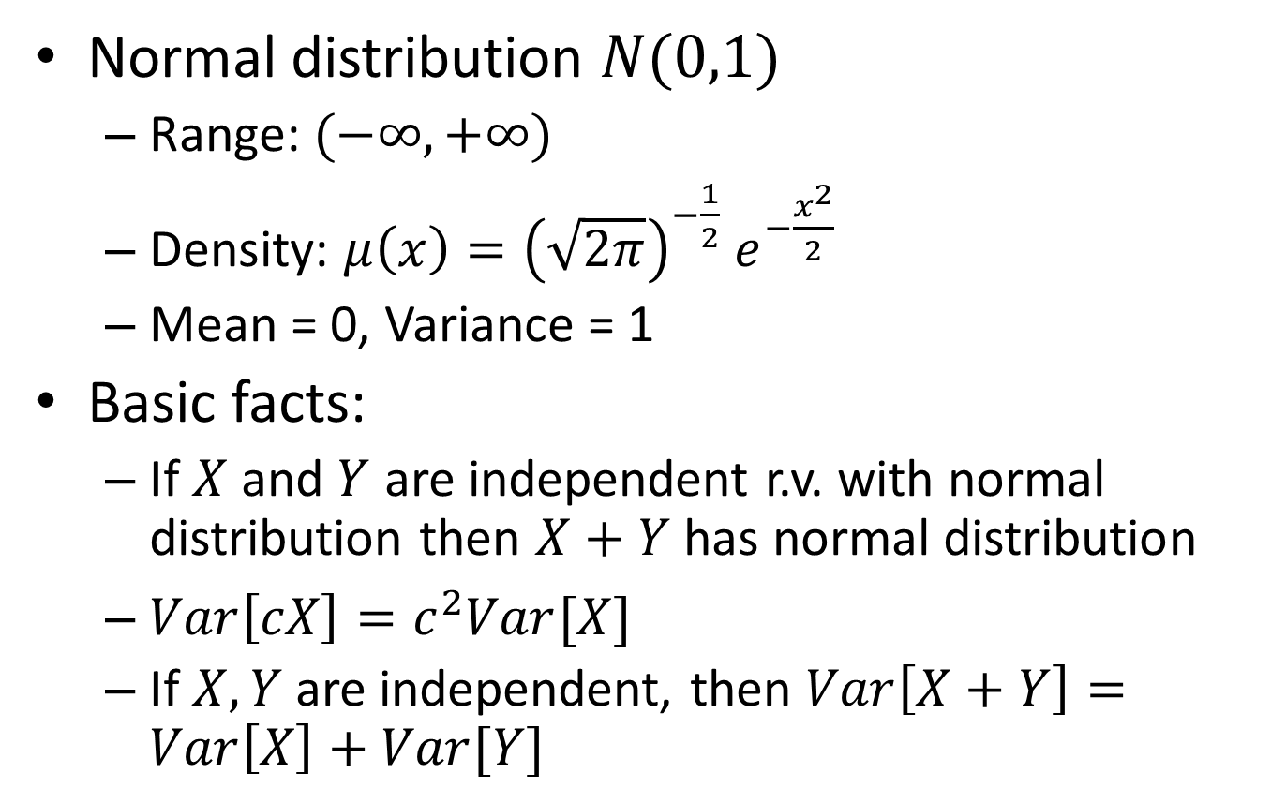
Normal Distribution
Normal distribution $N(0,1)$
Range: $(−∞, +∞)$
Density: $μ\left(x\right)={{\left(\sqrt{2π}\right)}^{−\frac{1}{2}} e}^{−\frac{x^{2}}{2}}$
Mean = 0, Variance = 1
Basic facts:
If $X$ and $Y$ are independent r.v. with normal distribution then $X+Y$ has normal distribution
$Var\left[cX\right]=c^{2}Var[X]$
If $X, Y$ are independent, then $Var\left[X+Y\right]=Var\left[X\right]+Var[Y]$

Slide 7
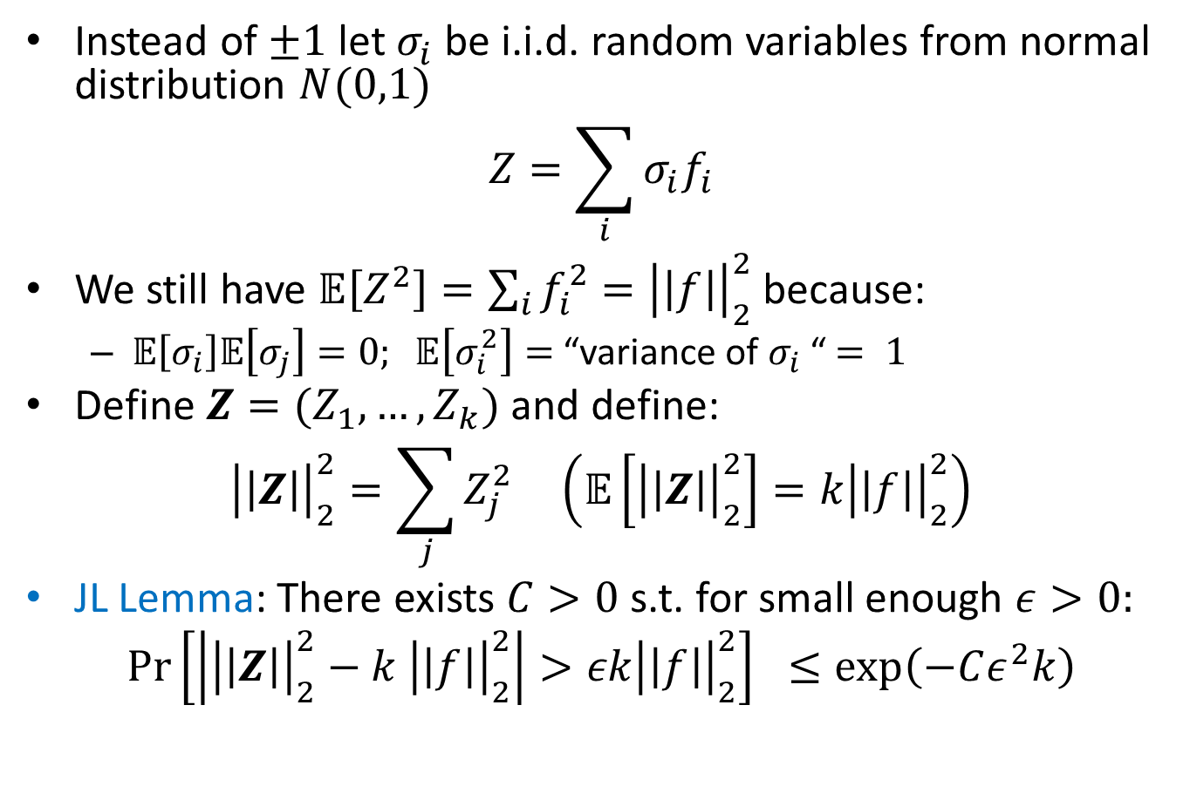
Johnson-Lindenstrauss Transform
Instead of $±1$ let $σ_{i}$ be i.i.d. random variables from normal distribution $N(0,1)$
$$Z=\sum_{i}{σ_{i}f_{i}}$$
We still have $𝔼\left[Z^{2}\right]=\sum_{i}{f_{i}^{2}}={\left|\left|f\right|\right|}_{2}^{2}$ because:
$𝔼\left[σ_{i}\right]𝔼\left[σ_{j}\right]=0; 𝔼\left[σ_{i}^{2}\right]=$ “variance of $σ_{i}$ “$= 1$
Define $Z=(Z_{1}, …, Z_{k})$ and define:
$${\left|\left|Z\right|\right|}_{2}^{2}=\sum_{j}{Z_{j}^{2}} \left(𝔼\left[{\left|\left|Z\right|\right|}_{2}^{2}\right]=k{\left|\left|f\right|\right|}_{2}^{2}\right)$$
JL Lemma: There exists $C>0$s.t. for small enough $ε>0:$
$$\operatorname{Pr}\left[\left|{\left|\left|Z\right|\right|}_{2}^{2}−k {\left|\left|f\right|\right|}_{2}^{2}\right|>εk{\left|\left|f\right|\right|}_{2}^{2}\right] ≤\exp\left(−Cε^{2}k\right)$$

Slide 8
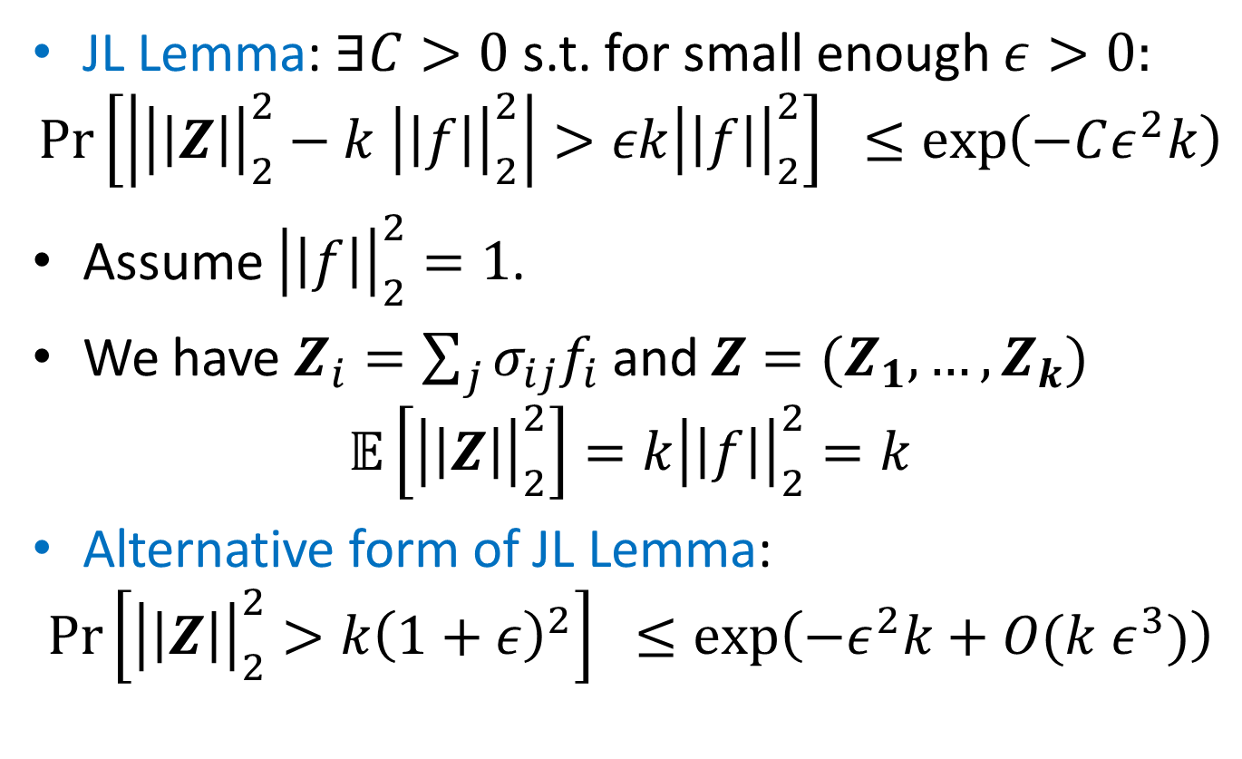
Proof of JL Lemma
JL Lemma: $∃C>0$s.t. for small enough $ε>0:$
$$\operatorname{Pr}\left[\left|{\left|\left|Z\right|\right|}_{2}^{2}−k {\left|\left|f\right|\right|}_{2}^{2}\right|>εk{\left|\left|f\right|\right|}_{2}^{2}\right] ≤\exp\left(−Cε^{2}k\right)$$
Assume ${\left|\left|f\right|\right|}_{2}^{2}=1$.
We have $Z_{i}=\sum_{j}{σ_{ij}f_{i}}$ and $Z=(Z_{1}, …,Z_{k})$
$$𝔼\left[{\left|\left|Z\right|\right|}_{2}^{2}\right]=k{\left|\left|f\right|\right|}_{2}^{2}=k$$
Alternative form of JL Lemma:
$$\operatorname{Pr}\left[{\left|\left|Z\right|\right|}_{2}^{2}>k{\left(1+ε\right)}^{2}\right] ≤\exp\left(−ε^{2}k+O(k ε^{3})\right)$$

Slide 9
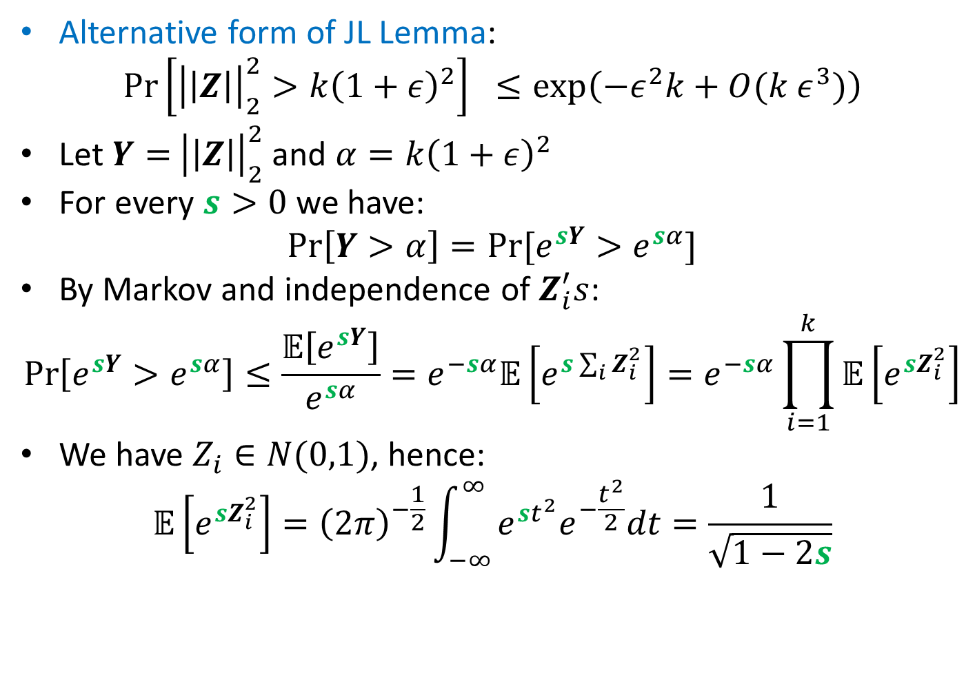
Proof of JL Lemma
Alternative form of JL Lemma:
$$\operatorname{Pr}\left[{\left|\left|Z\right|\right|}_{2}^{2}>k{\left(1+ε\right)}^{2}\right] ≤\exp\left(−ε^{2}k+O(k ε^{3})\right)$$
Let $Y=$ ${\left|\left|Z\right|\right|}_{2}^{2}$ and $α=k{\left(1+ε\right)}^{2}$
For every $s>0$ we have:
$$\operatorname{Pr}\left[Y>α\right]=Pr⁡[e^{sY}>e^{sα}]$$
By Markov and independence of $Z_{i}^{′}s$:
$$\operatorname{Pr}\left[e^{sY}>e^{sα}\right]≤\frac{𝔼\left[e^{sY}\right]}{e^{sα}}=e^{−sα}𝔼\left[e^{s\sum_{i}{Z_{i}^{2}}}\right]=e^{−sα}\prod_{i=1}^{k}{𝔼\left[e^{sZ_{i}^{2}}\right]}$$
We have $Z_{i}∈N(0,1)$, hence:
$$𝔼\left[e^{sZ_{i}^{2}}\right]={\left(2π\right)}^{−\frac{1}{2}}\int_{−∞}^{∞}{e^{st^{2}}e^{−\frac{t^{2}}{2}}dt}=\frac{1}{\sqrt{1−2s}}$$

Slide 10
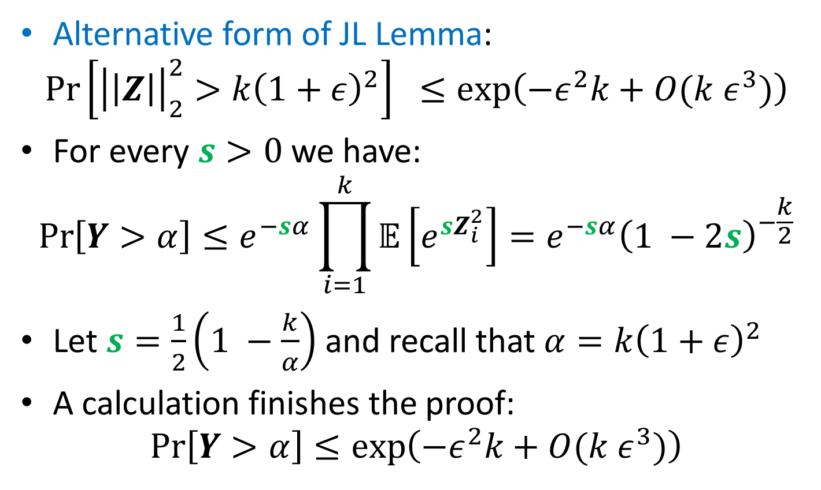
Proof of JL Lemma
Alternative form of JL Lemma:
$$\operatorname{Pr}\left[{\left|\left|Z\right|\right|}_{2}^{2}>k{\left(1+ε\right)}^{2}\right] ≤\exp\left(−ε^{2}k+O(k ε^{3})\right)$$
For every $s>0$ we have:
$$\operatorname{Pr}\left[Y>α\right]≤e^{−sα}\prod_{i=1}^{k}{𝔼\left[e^{sZ_{i}^{2}}\right]}=e^{−sα}{\left(1 −2s\right)}^{−\frac{k}{2}}$$
Let $s=\frac{1}{2}\left(1 −\frac{k}{α}\right)$ and recall that $α=k{\left(1+ε\right)}^{2}$
A calculation finishes the proof:
$$\operatorname{Pr}\left[Y>α\right]≤\exp\left(−ε^{2}k+O(k ε^{3})\right)$$

Slide 11
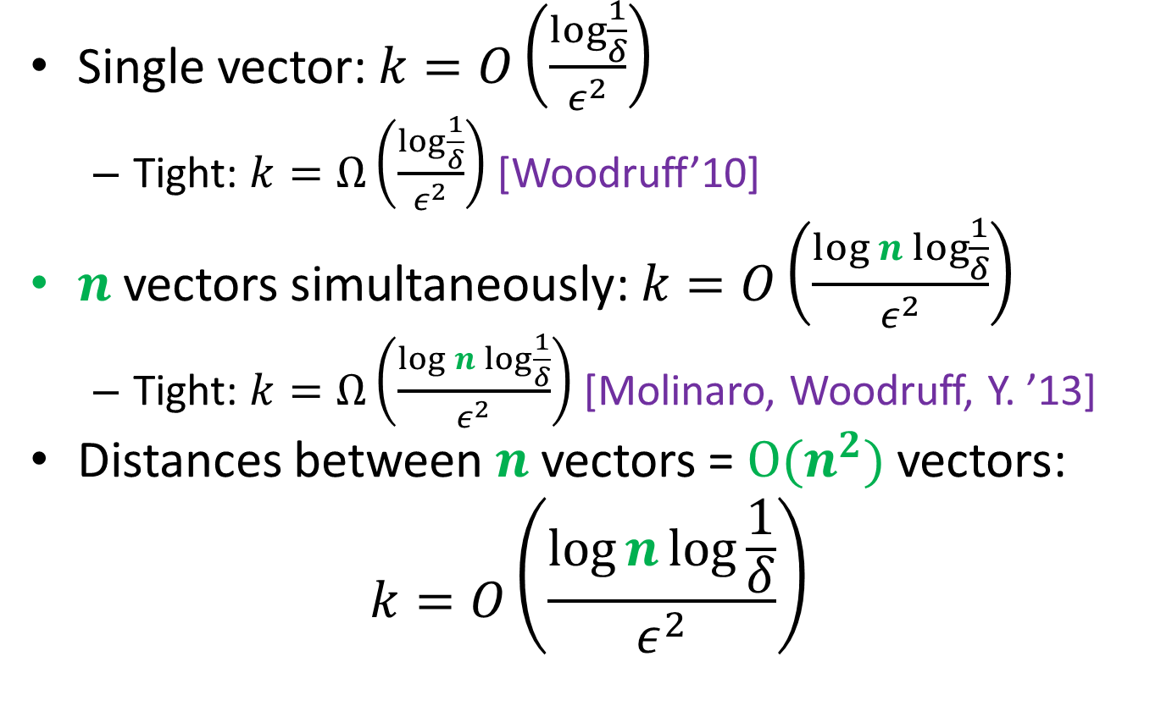
Johnson-Lindenstrauss Transform
Single vector: $k=O\left(\frac{\log{\frac{1}{δ}}}{ε^{2}}\right)$
Tight: $k=Ω\left(\frac{\log{\frac{1}{δ}}}{ε^{2}}\right)$ [Woodruff’10]
$n$ vectors simultaneously: $k=O\left(\frac{\log{n}\log{\frac{1}{δ}}}{ε^{2}}\right)$
Tight: $k=Ω\left(\frac{\log{n}\log{\frac{1}{δ}}}{ε^{2}}\right)$ [Molinaro, Woodruff, Y. ’13]
Distances between $n$ vectors = $O(n^{2})$ vectors:
$$k=O\left(\frac{\log{n}\log{\frac{1}{δ}}}{ε^{2}}\right)$$

