Slide 1

Sublinear Algorihms for Big Data
Exam Problems
Grigory Yaroslavtsev
http://grigory.us

Slide 2
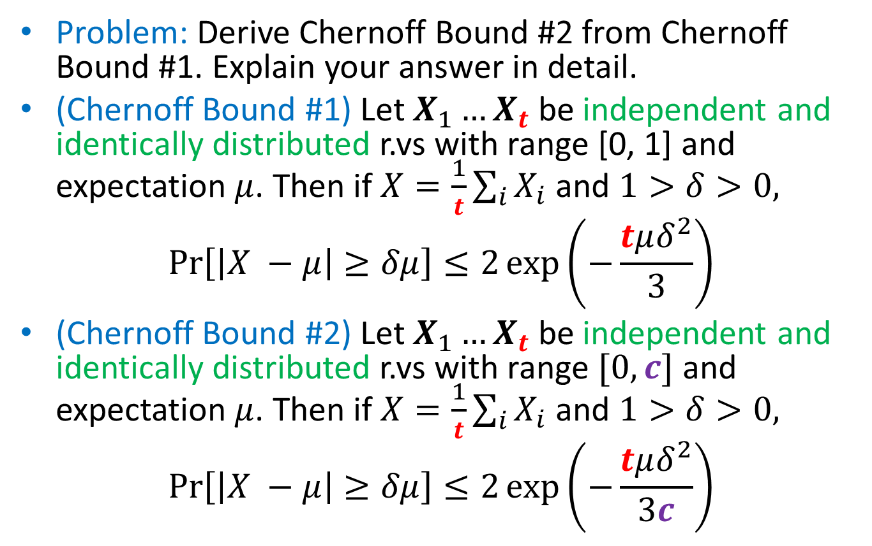
Problem 1: Modified Chernoff Bound
Problem: Derive Chernoff Bound #2 from Chernoff Bound #1. Explain your answer in detail.
(Chernoff Bound #1) Let $X_{1}…X_{t}$ be independent and identically distributed r.vs with range [0, 1] and expectation $μ$. Then if $X=\frac{1}{t}\sum_{i}{X_{i}}$ and $1>δ>0,$
$$\operatorname{Pr}\left[\left|X −μ\right|≥δμ\right]≤2\exp\left(−\frac{tμδ^{2}}{3}\right)$$
(Chernoff Bound #2) Let $X_{1}…X_{t}$ be independent and identically distributed r.vs with range $[0, c]$ and expectation $μ$. Then if $X=\frac{1}{t}\sum_{i}{X_{i}}$ and $1>δ>0,$
$$\operatorname{Pr}\left[\left|X −μ\right|≥δμ\right]≤2\exp\left(−\frac{tμδ^{2}}{3c}\right)$$

Slide 3
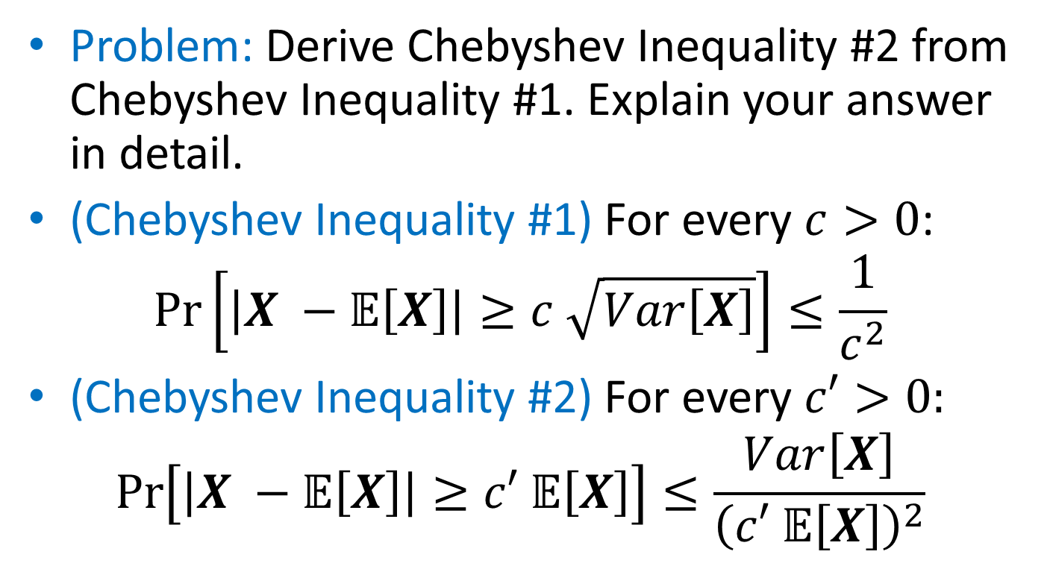
Problem 2: Modified Chebyshev
Problem: Derive Chebyshev Inequality #2 from Chebyshev Inequality #1. Explain your answer in detail.
(Chebyshev Inequality #1) For every $c>0$:
$$\operatorname{Pr}\left[\left|X −𝔼\left[X\right]\right|≥c \sqrt{Var\left[X\right]}\right]≤\frac{1}{c^{2}}$$
(Chebyshev Inequality #2) For every $c′>0:$
$$\operatorname{Pr}\left[\left|X −𝔼\left[X\right]\right|≥c′ 𝔼\left[X\right]\right]≤\frac{Var\left[X\right]}{{\left(c′ 𝔼\left[X\right]\right)}^{2}}$$

Slide 4
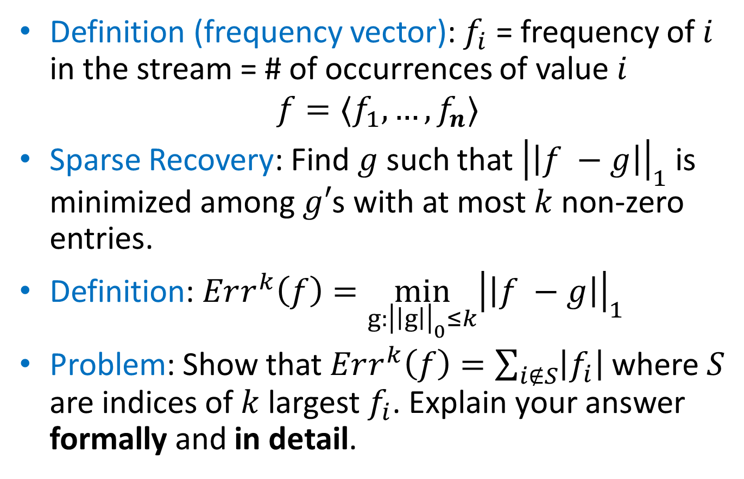
Problem 3: Sparse Recovery Error
Definition (frequency vector): $f_{i}$ = frequency of $i$ in the stream = # of occurrences of value $i$
$$f=〈f_{1},…, f_{n}〉$$
Sparse Recovery: Find $g$ such that ${\left|\left|f −g\right|\right|}_{1}$ is minimized among $g′$s with at most $k$ non-zero entries.
Definition: $Err^{k}\left(f\right)=\min_{g:{\left|\left|g\right|\right|}_{0}≤k}{{\left|\left|f −g\right|\right|}_{1}}$
Problem: Show that $Err^{k}\left(f\right)=\sum_{i∉S}{\left|f_{i}\right|}$ where $S$ are indices of $k$ largest $f_{i}$. Explain your answer formally and in detail.

Slide 5
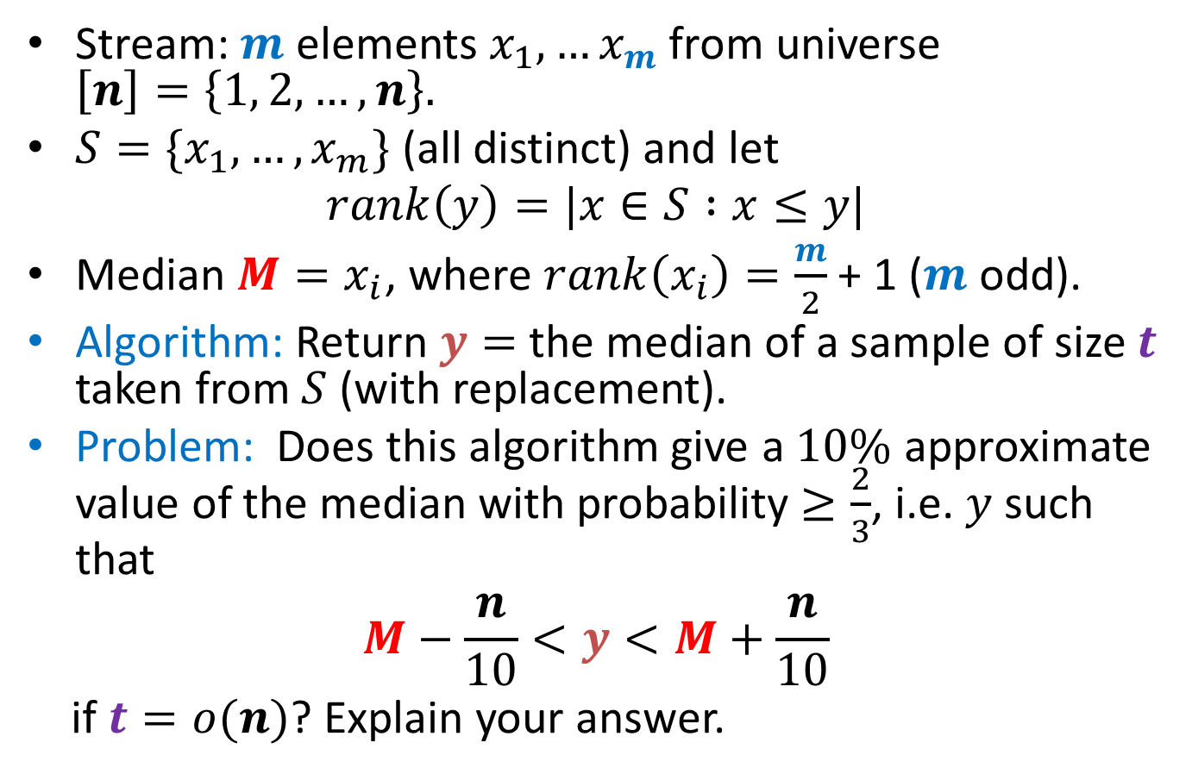
Problem 4: Approximate Median Value
Stream: $m$ elements $x_{1},…x_{m}$ from universe $\left[n\right]=\left\{1, 2, …, n\right\}.$
$S=\{x_{1},…, x_{m}\}$ (all distinct) and let
$$rank\left(y\right)=|x∈S :x≤y|$$
Median $M=x_{i}$, where $rank\left(x_{i}\right)=\frac{m}{2}$ + 1 ($m$ odd).
Algorithm: Return $y=$the median of a sample of size $t$ taken from $S$ (with replacement).
Problem: Does this algorithm give a $10\%$ approximate value of the median with probability $≥\frac{2}{3}$, i.e. $y$ such that
$$M−\frac{n}{10}<y<M+\frac{n}{10}$$
if $t=o(n)$? Explain your answer.

Slide 6
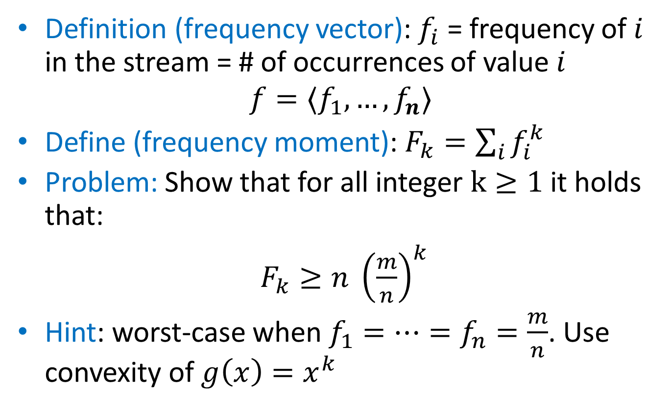

Problem 5: Lower bound on $F_{k}$
Definition (frequency vector): $f_{i}$ = frequency of $i$ in the stream = # of occurrences of value $i$
$$f=〈f_{1},…, f_{n}〉$$
Define (frequency moment): $F_{k}=\sum_{i}{f_{i}^{k}}$
Problem: Show that for all integer $k≥1$ it holds that:
$F_{k}≥n {\left(\frac{m}{n}\right)}^{k}$
Hint: worst-case when $f_{1}=…=f_{n}=\frac{m}{n}$. Use convexity of $g\left(x\right)=x^{k}$

Slide 7
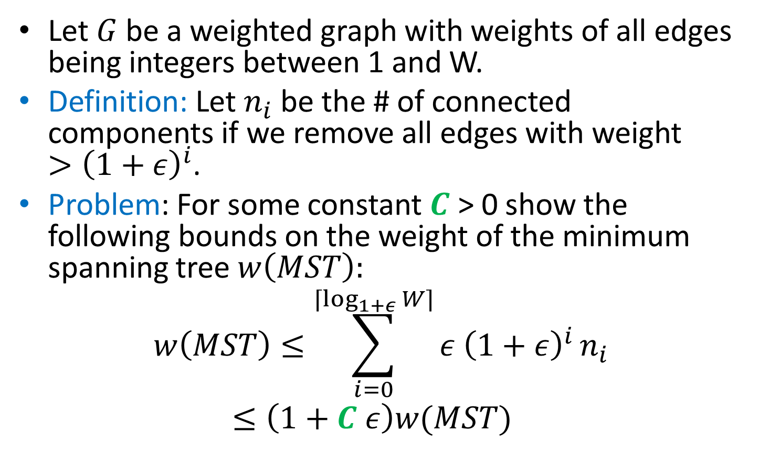
Problem 6: Approximate MST Weight
Let $G$ be a weighted graph with weights of all edges being integers between 1 and W.
Definition: Let $n_{i}$ be the # of connected components if we remove all edges with weight $>{\left(1+ε\right)}^{i}$.
Problem: For some constant $C \text{>} \text{0}$show the following bounds on the weight of the minimum spanning tree $w\left(MST\right):$
$$w\left(MST\right)≤\sum_{i=0}^{{⌈log}_{1+ε}{W}⌉}{ε {\left(1+ε\right)}^{i}}n_{i}≤\left(1+C ε\right)w(MST)$$

Slide 8
Evaluation
Deadline: September 1st , 2014, 23:59 GMT
Submissions in English: grigory@grigory.us
Submission Title (once): Exam + Space + “Your Name”
Question Title: Question + Space + “Your Name”
Submission format
PDF from LaTeX (best)
PDF
You can work in groups (up to 3 people)
Each group member lists all others on the submission
Point system
Course Credit = 2 points
Problems 1-3 = 0.5 point each
Problem 4 = 1 point
Problems 5-6 = 2 point each

