Slide 1

“algorithms for Big Data”
Lecture 1: Intro + Streaming
Slides at http://grigory.us/big-data-csclub.html
Grigory Yaroslavtsev
(Indiana University, Bloomington)
http://grigory.us

Slide 2

Disclaimers
A lot of Math!

Slide 3
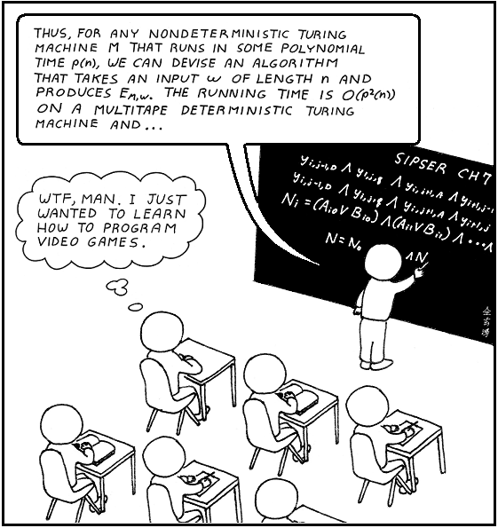
Disclaimers
No programming!

Slide 4

What is this class about?
Not about the band (https://en.wikipedia.org/wiki/Big_Data_(band))

Slide 5
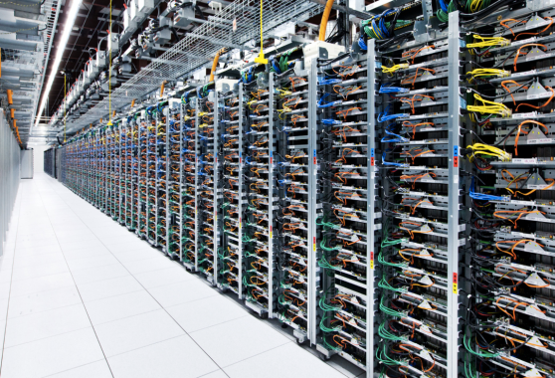


What is this class about?
The four V’s: volume, velocity, variety, veracity
Volume: “Big Data” = too big to fit in RAM
If 16GB $≈100\$$ => “big” starts at terabytes
Velocity: real-time
Doesn’t fit in RAM + has to be processed on the fly
N = size of data, time and memory o(N)
o(N): $O\left(1\right), O(log{\text{N})},O(N^{ε})$ where $0<ε<1$

Slide 6



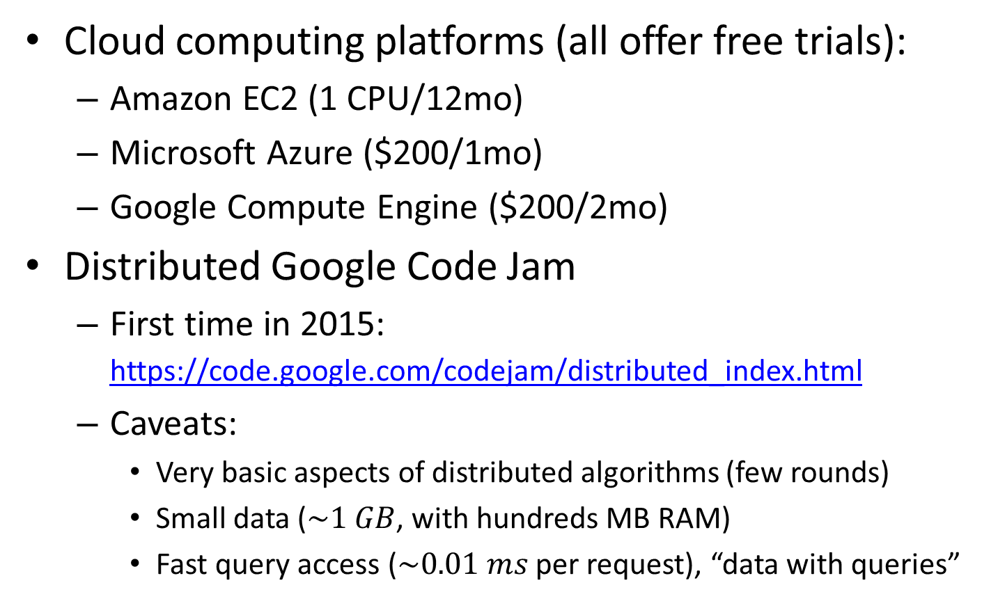
Getting hands dirty
Cloud computing platforms (all offer free trials):
Amazon EC2 (1 CPU/12mo)
Microsoft Azure ($200/1mo)
Google Compute Engine ($200/2mo)
Distributed Google Code Jam
First time in 2015: https://code.google.com/codejam/distributed_index.html
Caveats:
Very basic aspects of distributed algorithms (few rounds)
Small data ($\sim 1 GB$, with hundreds MB RAM)
Fast query access ($\sim 0.01 ms$ per request), “data with queries”

Slide 7

Outline
Part 1: Streaming Algorithms
Highlights:
Approximate counting
# Distinct Elements
Median
Frequency moments
Heavy hitters
Graph sketching

Slide 8


Outline
Part 2: Massively Parallel Algorithms
Highlights:
Computational Model
Sorting (Terasort)
Connectivity, MST
Filtering dense graphs
Euclidean MST

Slide 9

Outline
Part 3: Sublinear Time Algorithms
Highlights:
“Data with queries”
Sublinear approximation
Property Testing
Testing images, sortedness, connectedness
Testing noisy data

Slide 10
Today
Approximate counting: Morris’ algorithm
Approximate Median
Alon-Mathias-Szegedy Sampling
Frequency Moments
Distinct Elements
Count-Min

Slide 11
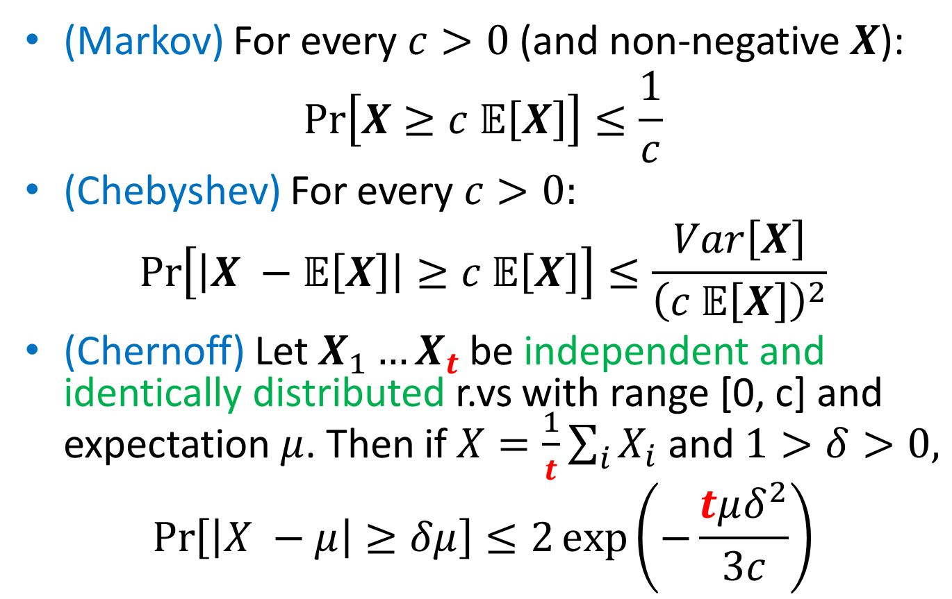
Recap
(Markov) For every $c>0$ (and non-negative $X$):
$$Pr\left[X≥c 𝔼\left[X\right]\right]≤\frac{1}{c}$$
(Chebyshev) For every $c>0:$
$$\operatorname{Pr}\left[\left|X −𝔼\left[X\right]\right|≥c 𝔼\left[X\right]\right]≤\frac{Var\left[X\right]}{{\left(c 𝔼\left[X\right]\right)}^{2}}$$
(Chernoff) Let $X_{1}…X_{t}$ be independent and identically distributed r.vs with range [0, c] and expectation $μ$. Then if $X=\frac{1}{t}\sum_{i}{X_{i}}$ and $1>δ>0,$
$$\operatorname{Pr}\left[\left|X −μ\right|≥δμ\right]≤2\exp\left(−\frac{tμδ^{2}}{3c}\right)$$

Slide 12
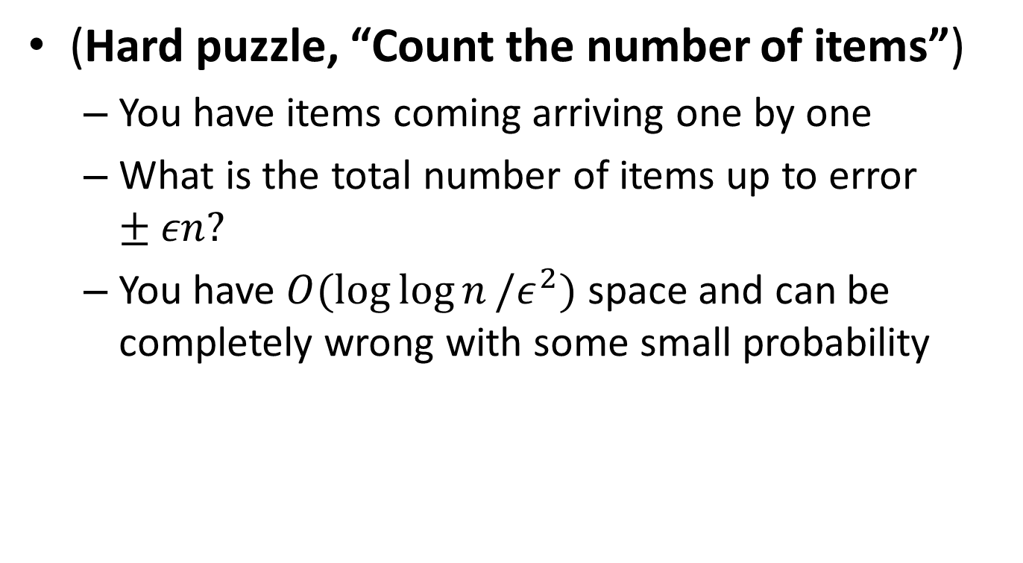
Morris’s Algorithm
(Hard puzzle, “Count the number of items”)
You have items coming arriving one by one
What is the total number of items up to error $±εn?$
You have $O(\log{\log{n}}/ε^{2})$ space and can be completely wrong with some small probability

Slide 13
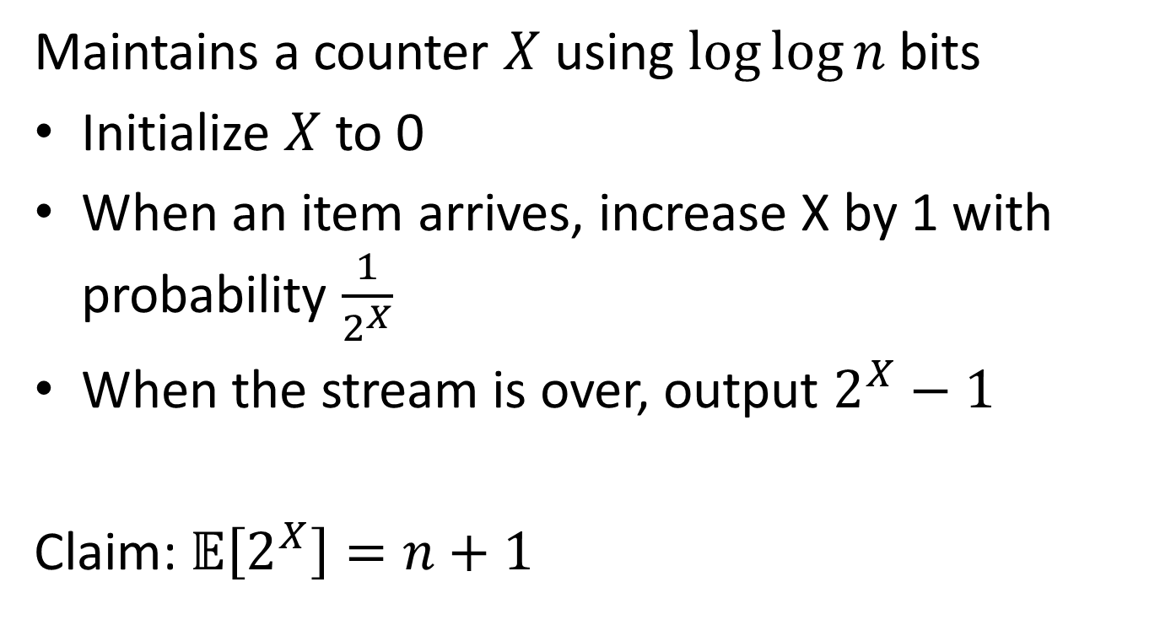
Morris’s Algorithm: Alpha-version
Maintains a counter $X$ using $log⁡log⁡n$ bits
Initialize $X$ to 0
When an item arrives, increase X by 1 with probability $\frac{1}{2^{X}}$
When the stream is over, output $2^{X}−1$
Claim: $𝔼\left[2^{X}\right]=n+1$

Slide 14
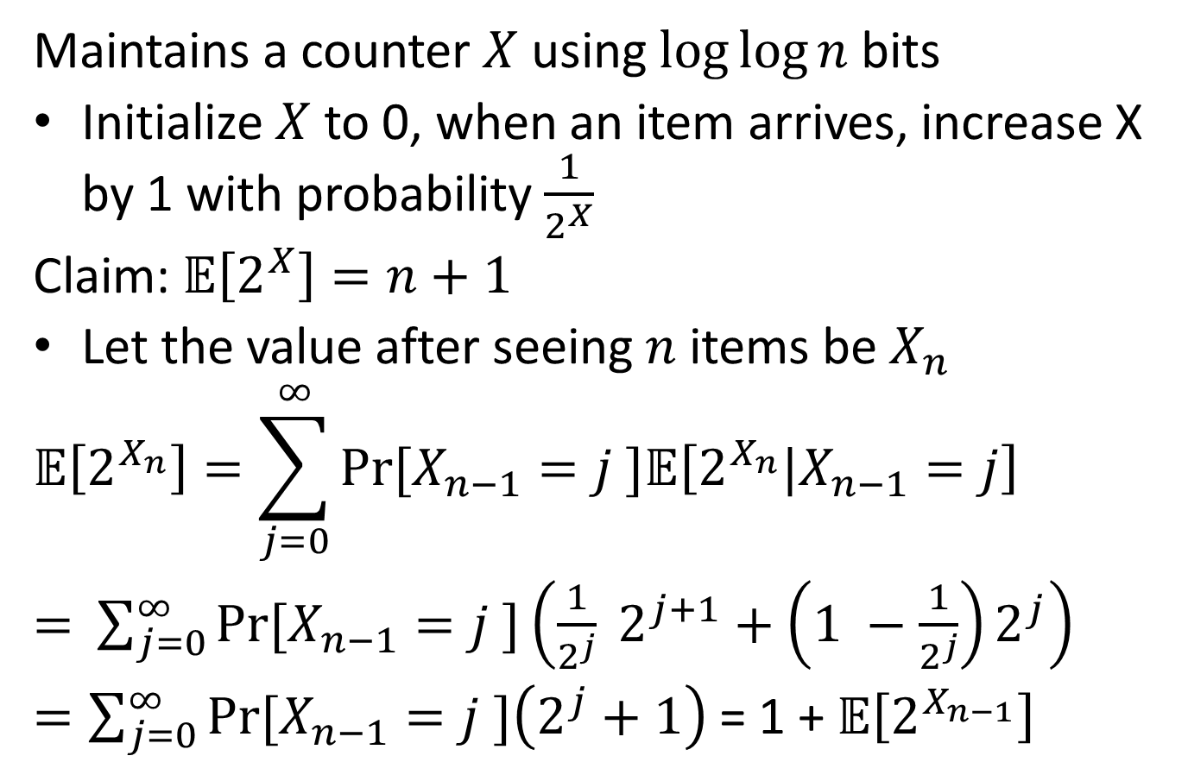
Morris’s Algorithm: Alpha-version
Maintains a counter $X$ using $log⁡log⁡n$ bits
Initialize $X$ to 0, when an item arrives, increase X by 1 with probability $\frac{1}{2^{X}}$
Claim: $𝔼\left[2^{X}\right]=n+1$
Let the value after seeing $n$ items be $X_{n}$
$$𝔼\left[2^{X_{n}}\right]=\sum_{j=0}^{∞}{Pr⁡[X_{n−1}=j ]𝔼\left[2^{X_{n}}|X_{n−1}=j\right]}$$
$=$ $\sum_{j=0}^{∞}{Pr⁡[X_{n−1}=j ]\left(\frac{1}{2^{j}} 2^{j+1}+\left(1 −\frac{1}{2^{j}}\right)2^{j}\right)}$
$=\sum_{j=0}^{∞}{Pr⁡[X_{n−1}=j ]\left(2^{j}+1\right) }$= 1 + $𝔼\left[2^{X_{n−1}}\right]$

Slide 15
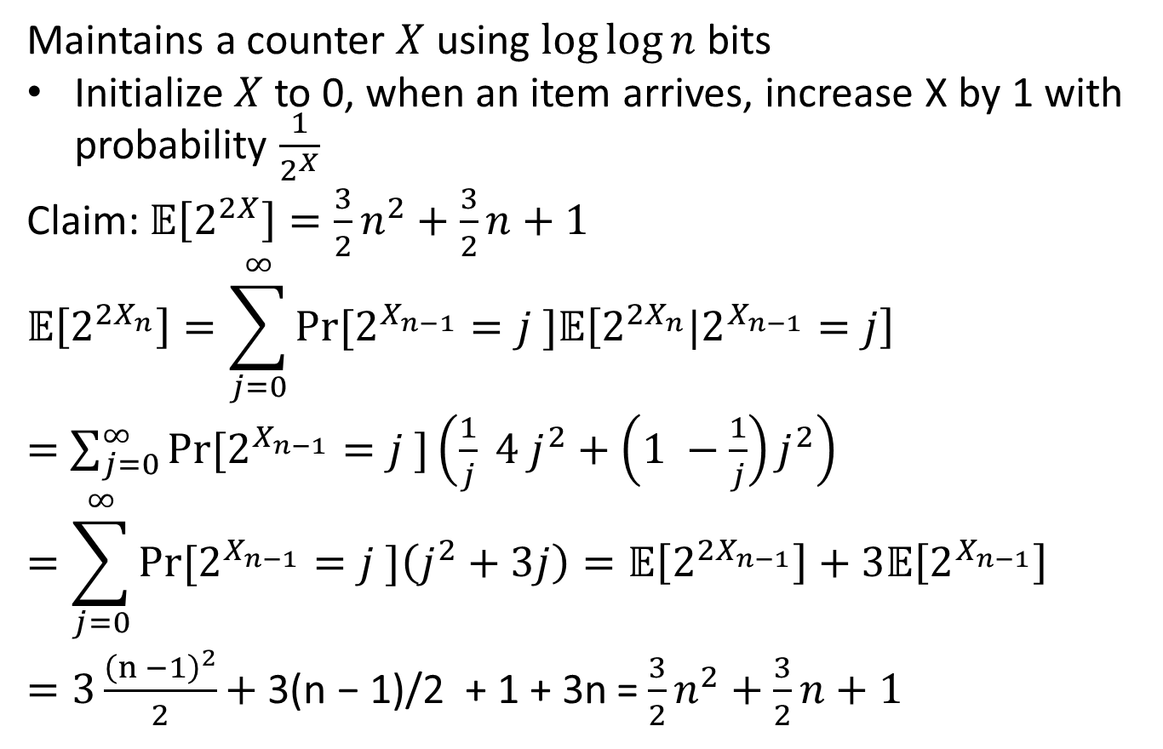
Morris’s Algorithm: Alpha-version
Maintains a counter $X$ using $log⁡log⁡n$ bits
Initialize $X$ to 0, when an item arrives, increase X by 1 with probability $\frac{1}{2^{X}}$
Claim: $𝔼\left[2^{2X}\right]=\frac{3}{2}n^{2}+\frac{3}{2}n+1$
$$𝔼\left[2^{{2X}_{n}}\right]=\sum_{j=0}^{∞}{Pr⁡[2^{X_{n−1}}=j ]𝔼\left[2^{2X_{n}}|2^{X_{n−1}}=j\right]}$$
$=$ $\sum_{j=0}^{∞}{Pr⁡[2^{X_{n−1}}=j ]\left(\frac{1}{j} 4 j^{2}+\left(1 −\frac{1}{j}\right)j^{2}\right)}$
$$=\sum_{j=0}^{∞}{Pr⁡[2^{X_{n−1}}=j ]\left(j^{2}+3j\right)=𝔼\left[2^{{2X}_{n−1}}\right]+3𝔼\left[2^{X_{n−1}}\right] }$$
$=3\frac{{\left(n −1\right)}^{2}}{2}\text{+ }\text{3(}\text{n}\text{ − 1)/2 + 1 + 3}\text{n}$ = $\frac{3}{2}n^{2}+\frac{3}{2}n+1$

Slide 16
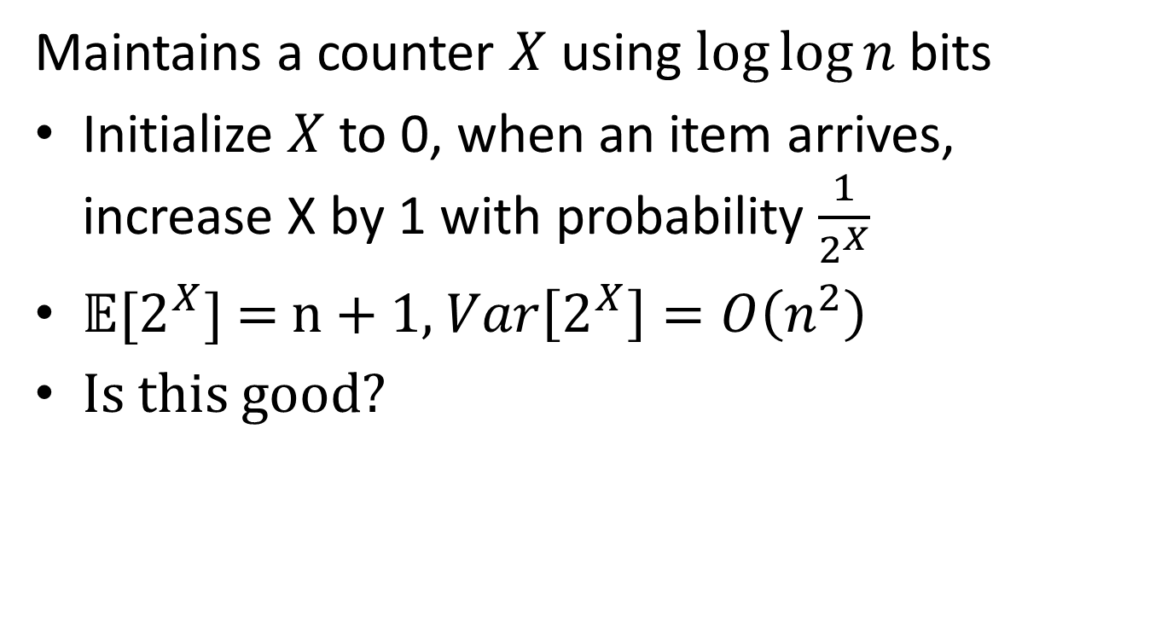
Morris’s Algorithm: Alpha-version
Maintains a counter $X$ using $log⁡log⁡n$ bits
Initialize $X$ to 0, when an item arrives, increase X by 1 with probability $\frac{1}{2^{X}}$
$𝔼[2^{X}]$ = n + 1, $Var\left[2^{X}\right]=O\left(n^{2}\right)$
Is this good?

Slide 17
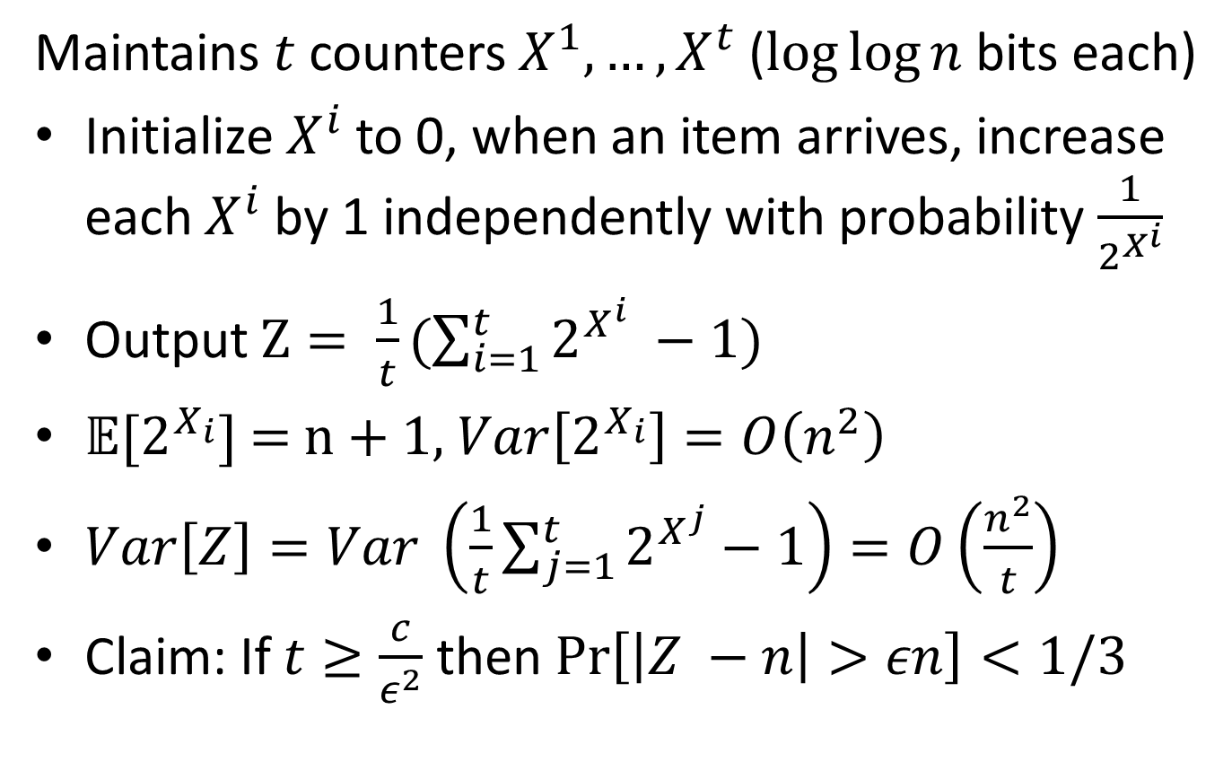
Morris’s Algorithm: Beta-version
Maintains $t$ counters $X^{1}, …,X^{t}$ ($log⁡log⁡n$ bits each)
Initialize$X^{i}$ to 0, when an item arrives, increase each $X^{i}$ by 1 independently with probability $\frac{1}{2^{X^{i}}}$
Output $Z= \frac{1}{t}(\sum_{i=1}^{t}{2^{X^{i}} −1)}$
$𝔼[2^{X_{i}}]$ = n + 1, $Var\left[2^{X_{i}}\right]=O\left(n^{2}\right)$
$Var\left[Z\right]=Var \left(\frac{1}{t}\sum_{j=1}^{t}{2^{X^{j}}}−1\right)=O\left(\frac{n^{2}}{t}\right)$
Claim: If $t≥\frac{c}{ε^{2}}$ then $\operatorname{Pr}\left[\left|Z −n\right|>εn\right]<1/3$

Slide 18
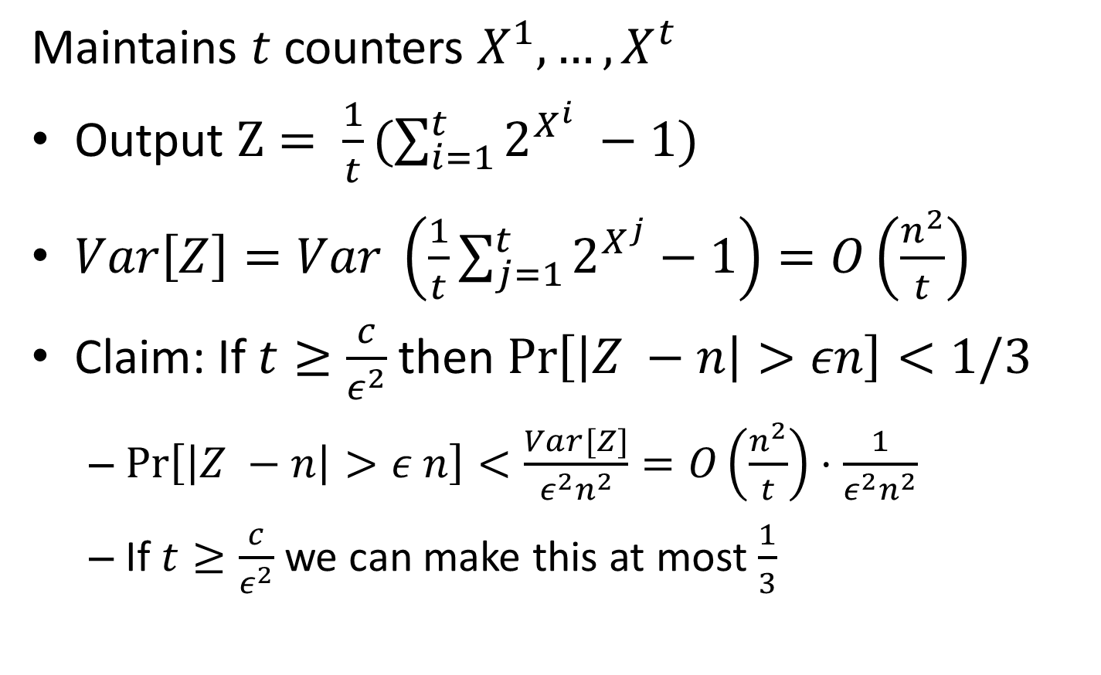
Morris’s Algorithm: Beta-version
Maintains $t$ counters $X^{1}, …,X^{t}$
Output $Z= \frac{1}{t}(\sum_{i=1}^{t}{2^{X^{i}} −1)}$
$Var\left[Z\right]=Var \left(\frac{1}{t}\sum_{j=1}^{t}{2^{X^{j}}}−1\right)=O\left(\frac{n^{2}}{t}\right)$
Claim: If $t≥\frac{c}{ε^{2}}$ then $\operatorname{Pr}\left[\left|Z −n\right|>εn\right]<1/3$
$\operatorname{Pr}\left[\left|Z −n\right|>ε n\right]<\frac{Var[Z]}{ε^{2}n^{2}}=O\left(\frac{n^{2}}{t}\right)⋅\frac{1}{ε^{2}n^{2}}$
If $t≥\frac{c}{ε^{2}}$ we can make this at most $\frac{1}{3}$

Slide 19
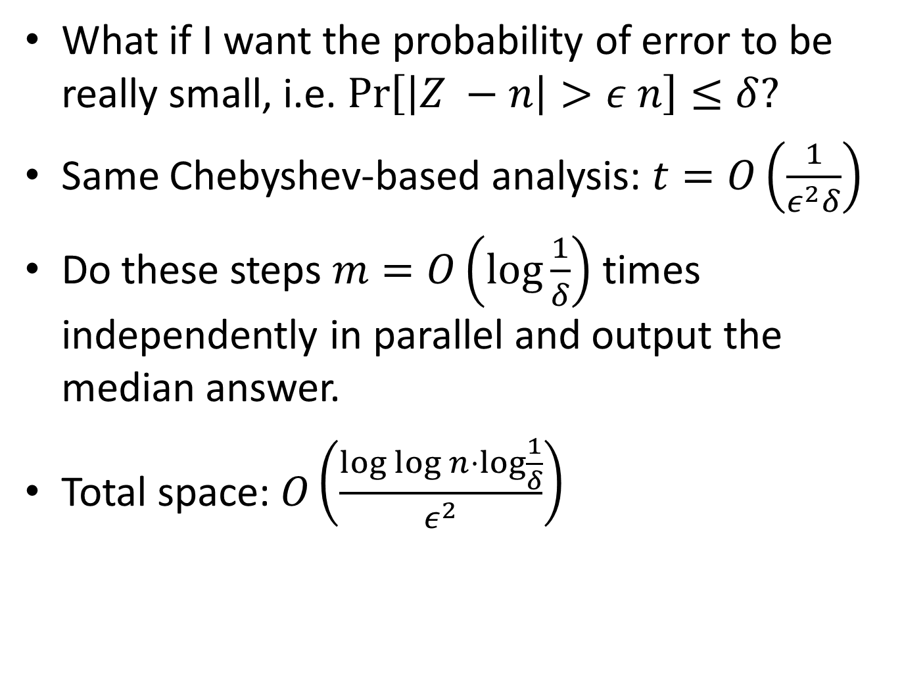
Morris’s Algorithm: Final
What if I want the probability of error to be really small, i.e. $\operatorname{Pr}\left[\left|Z −n\right|>ε n\right]≤δ?$
Same Chebyshev-based analysis: $t=O\left(\frac{1}{ε^{2}δ}\right)$
Do these steps $m=O\left(\log{\frac{1}{δ}}\right)$ times independently in parallel and output the median answer.
Total space: $O\left(\frac{\log{\log{n}}⋅\log{\frac{1}{δ}}}{ε^{2}}\right)$

Slide 20
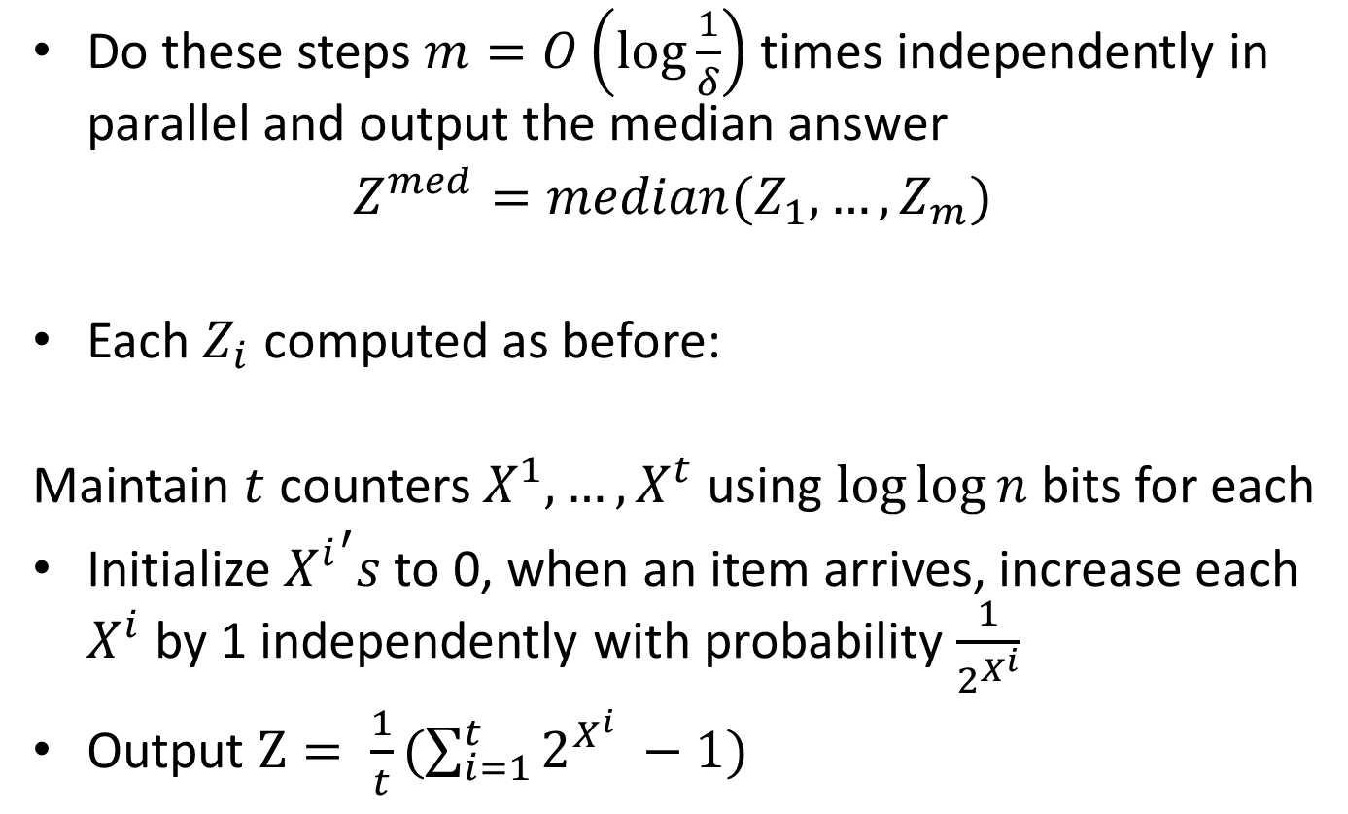
Morris’s Algorithm: Final
Do these steps $m=O\left(\log{\frac{1}{δ}}\right)$ times independently in parallel and output the median answer
$Z^{med}=median(Z_{1},…, Z_{m})$
Each $Z_{i}$ computed as before:
Maintain $t$ counters $X^{1}, …,X^{t}$ using $log⁡log⁡n$ bits for each
Initialize ${X^{i}}^{′}s$ to 0, when an item arrives, increase each $X^{i}$ by 1 independently with probability $\frac{1}{2^{X^{i}}}$
Output $Z= \frac{1}{t}(\sum_{i=1}^{t}{2^{X^{i}} −1)}$

Slide 21
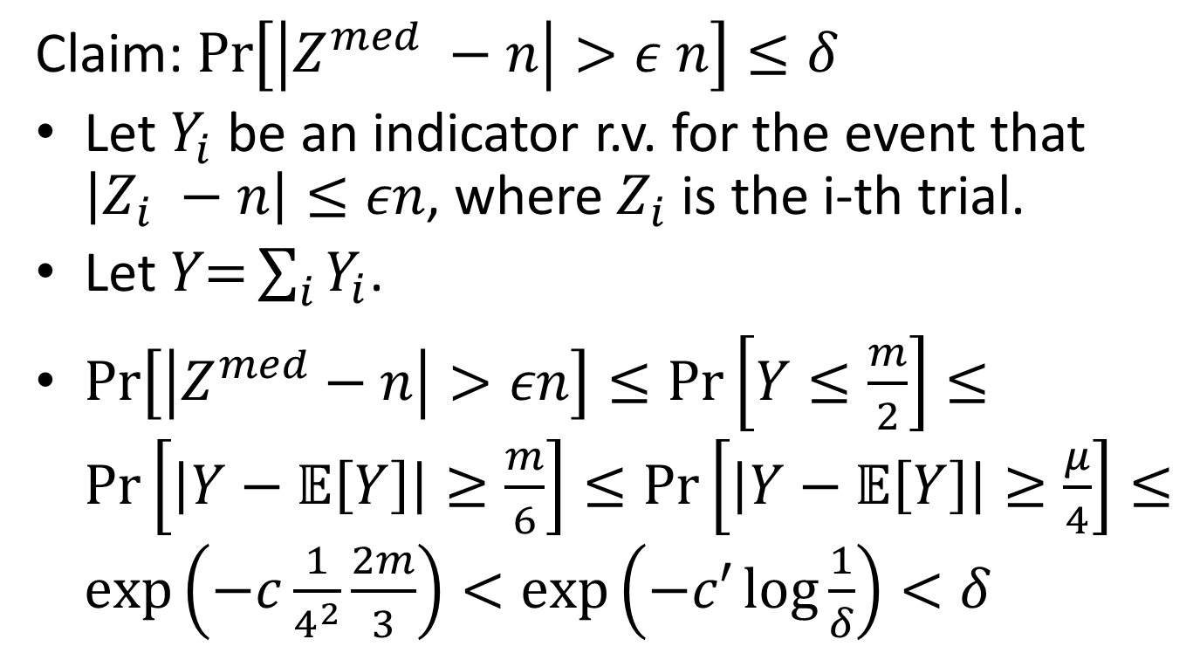
Morris’s Algorithm: Final Analysis
Claim: $\operatorname{Pr}\left[\left|Z^{med} −n\right|>ε n\right]≤δ$
Let $Y_{i}$ be an indicator r.v. for the event that $\left|Z_{i} −n\right|≤εn$, where $Z_{i}$ is the i-th trial.
Let $Y\text{=}\sum_{i}{Y_{i}}$.
$\operatorname{Pr}\left[\left|Z^{med}−n\right|>εn\right]≤\operatorname{Pr}\left[Y≤\frac{m}{2}\right]≤\operatorname{Pr}\left[\left|Y−𝔼\left[Y\right]\right|≥\frac{m}{6}\right]≤\operatorname{Pr}\left[\left|Y−𝔼\left[Y\right]\right|≥\frac{μ}{4}\right]≤\exp\left(−c\frac{1}{4^{2}}\frac{2m}{3}\right)<\exp\left(−c′\log{\frac{1}{δ}}\right)<δ$

Slide 22

Data Streams
Stream: $m$ elements from universe $\left[n\right]=\{1, 2, …, n\}$, e.g.
$$〈x_{1},x_{2},…, x_{m}〉=〈5, 8, 1, 1, 1, 4, 3, 5, …, 10〉$$

Slide 23
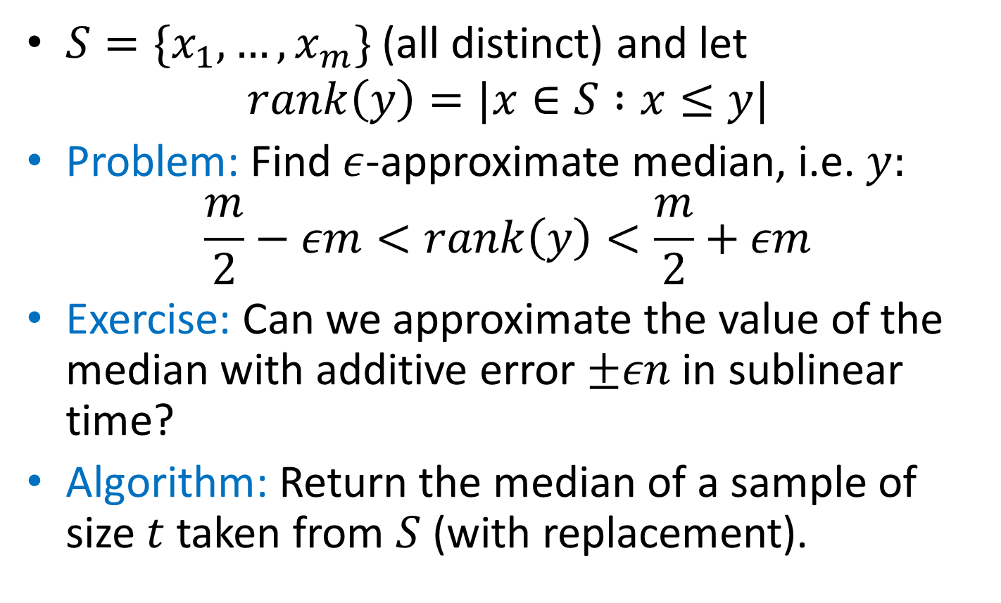
Approximate Median
$S=\{x_{1},…, x_{m}\}$ (all distinct) and let
$$rank\left(y\right)=|x∈S :x≤y|$$
Problem: Find $ε$-approximate median, i.e. $y:$
$$\frac{m}{2}−εm<rank\left(y\right)<\frac{m}{2}+εm$$
Exercise: Can we approximate the value of the median with additive error $±εn$ in sublinear time?
Algorithm: Return the median of a sample of size $t$ taken from $S$ (with replacement).

Slide 24
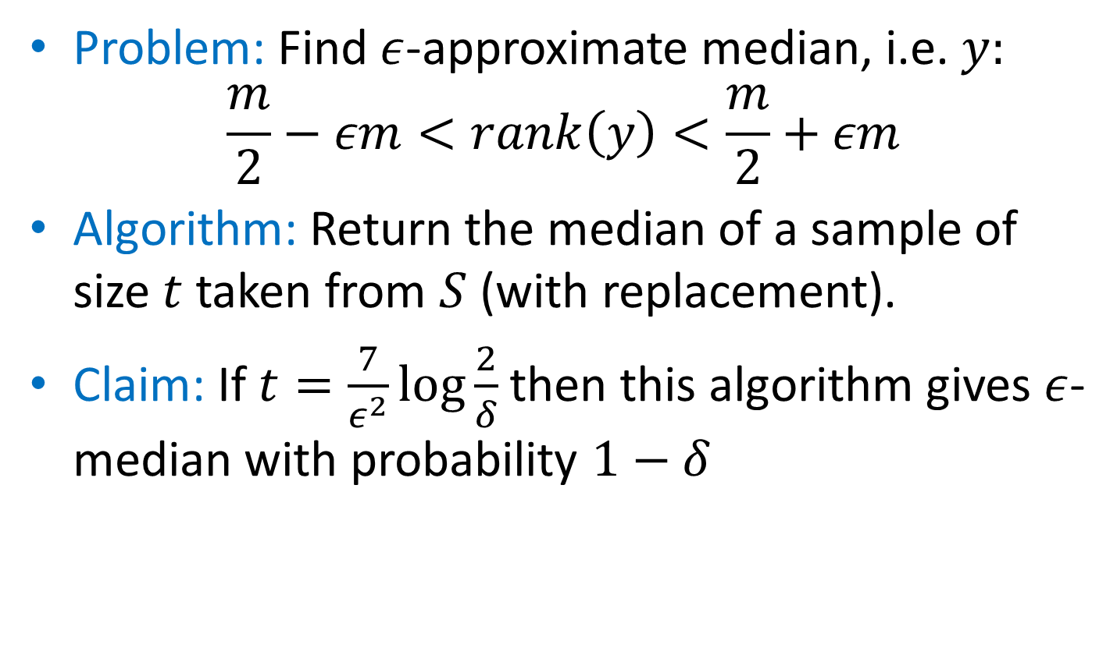
Approximate Median
Problem: Find $ε$-approximate median, i.e. $y:$
$$\frac{m}{2}−εm<rank\left(y\right)<\frac{m}{2}+εm$$
Algorithm: Return the median of a sample of size $t$ taken from $S$ (with replacement).
Claim: If $t=\frac{7}{ε^{2}}\log{\frac{2}{δ}}$ then this algorithm gives $ε$-median with probability $1−δ$

Slide 25
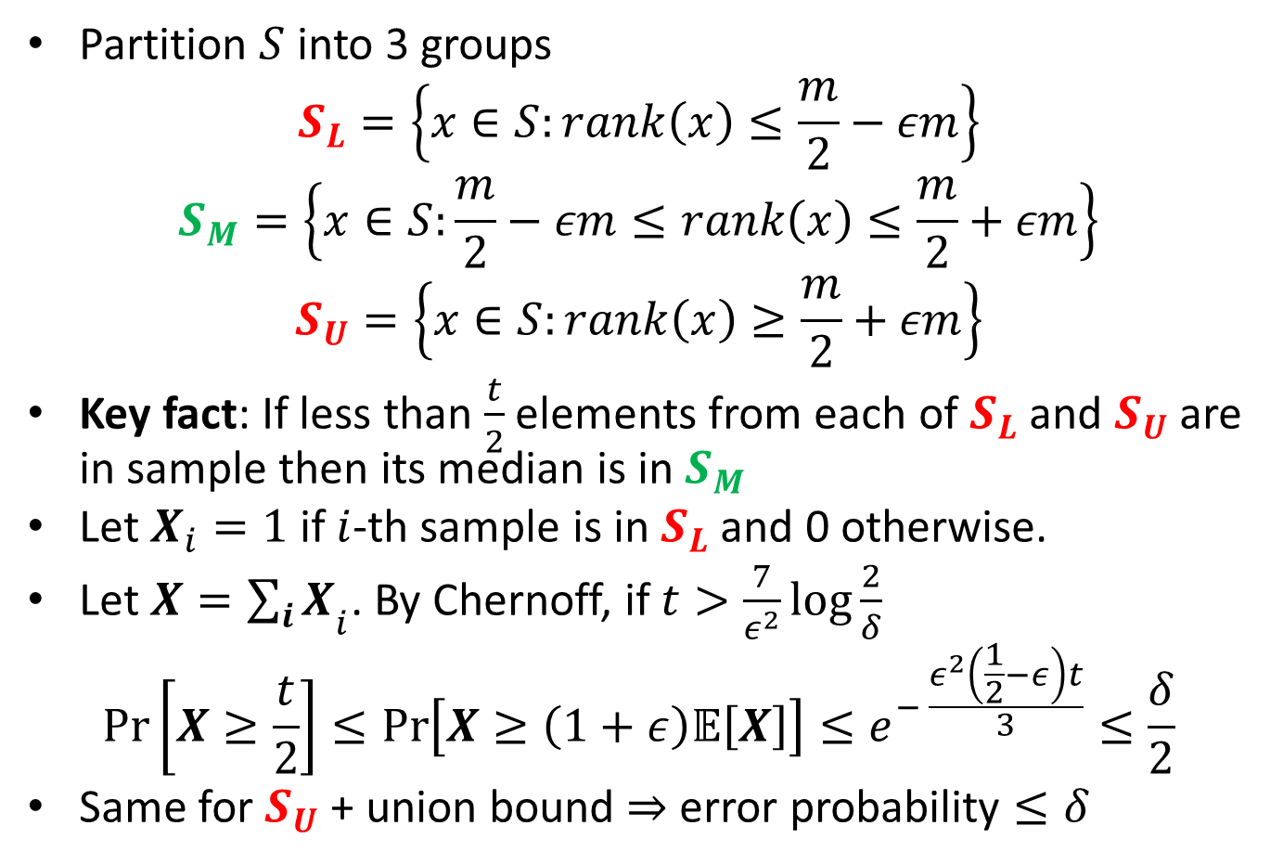
Approximate Median
Partition $S$ into 3 groups
$$S_{L}=\left\{x∈S:rank\left(x\right)≤\frac{m}{2}−εm\right\}$$
$$S_{M}=\left\{x∈S:\frac{m}{2}−εm≤rank\left(x\right)≤\frac{m}{2}+εm\right\}$$
$$S_{U}=\left\{x∈S:rank\left(x\right)≥\frac{m}{2}+εm\right\}$$
Key fact: If less than $\frac{t}{2}$ elements from each of $S_{L}$ and $S_{U}$ are in sample then its median is in $S_{M}$
Let $X_{i}=1$ if $i$-th sample is in $S_{L}$ and 0 otherwise.
Let ${X=\sum_{i}{X}}_{i}$. By Chernoff, if $t>\frac{7}{ε^{2}}\log{\frac{2}{δ}}$
$$\operatorname{Pr}\left[X≥\frac{t}{2}\right]≤\operatorname{Pr}\left[X≥\left(1+ε\right)𝔼\left[X\right]\right]≤e^{− \frac{ε^{2}\left(\frac{1}{2}−ε\right)t}{3}}≤\frac{δ}{2}$$
Same for $S_{U}$ + union bound $⇒$ error probability $≤δ$

Slide 26
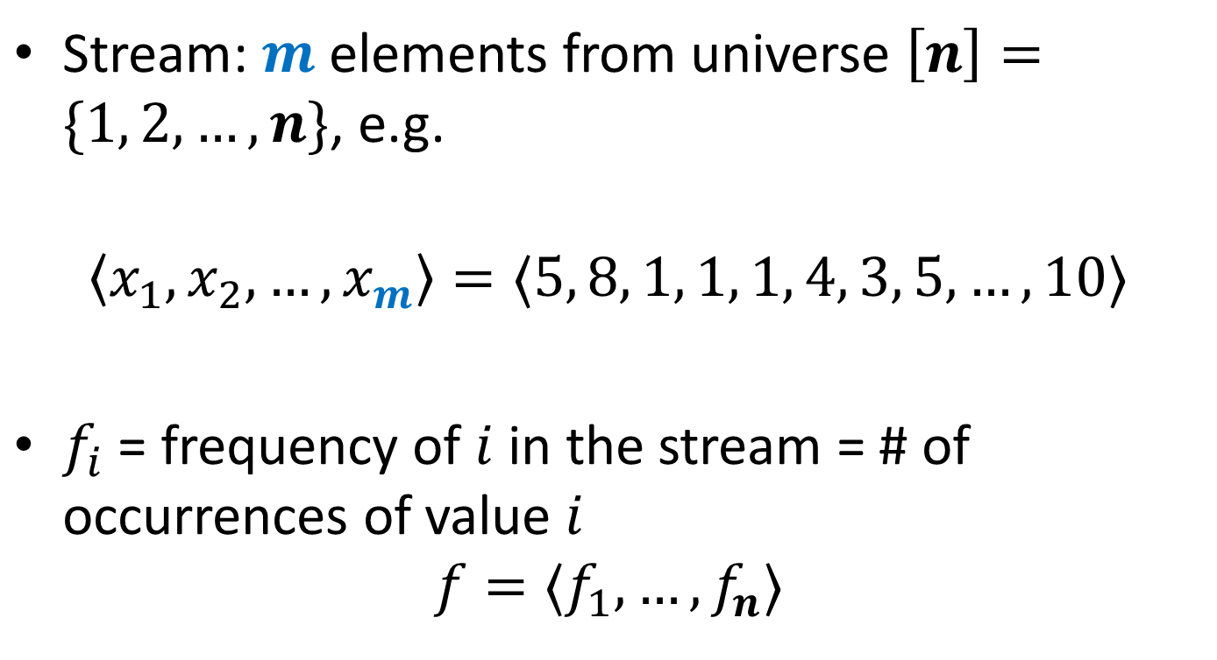
Data Streams
Stream: $m$ elements from universe $\left[n\right]=\{1, 2, …, n\}$, e.g.
$$〈x_{1},x_{2},…, x_{m}〉=〈5, 8, 1, 1, 1, 4, 3, 5, …, 10〉$$
$f_{i}$ = frequency of $i$ in the stream = # of occurrences of value $i$
$$f=〈f_{1},…, f_{n}〉$$

Slide 27
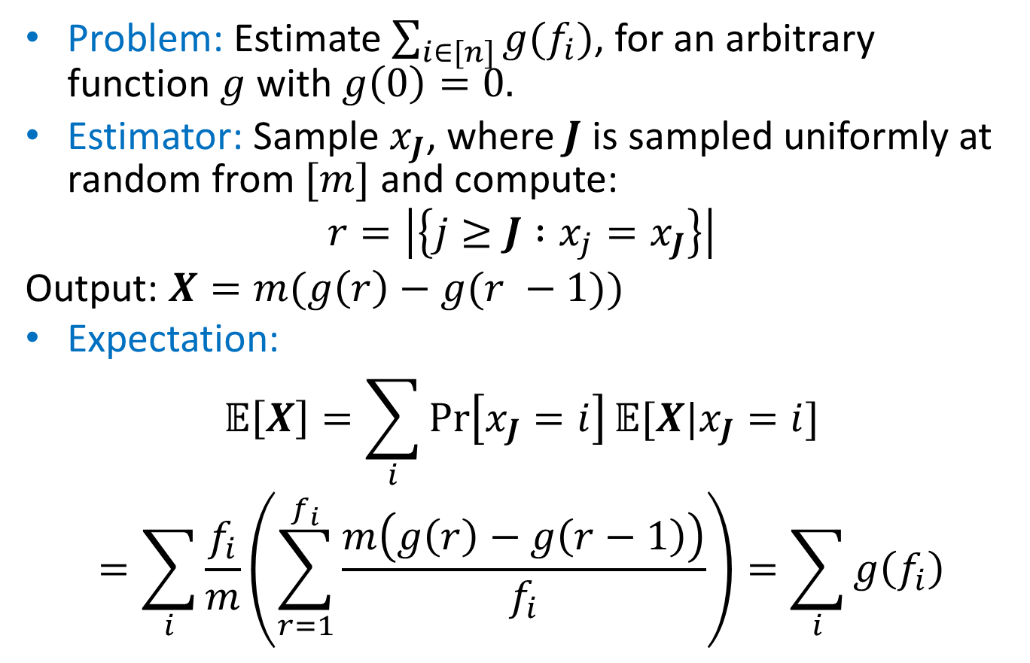
AMS Sampling
Problem: Estimate $\sum_{i∈[n]}{g(f_{i})}$, for an arbitrary function $g$ with $g\left(0\right)=0.$
Estimator: Sample $x_{J}$, where $J$ is sampled uniformly at random from $[m]$ and compute:
$$r=\left|\left\{j≥J :x_{j}=x_{J}\right\}\right|$$
Output: $X=m(g\left(r\right)−g(r −1))$
Expectation:
$$𝔼\left[X\right]=\sum_{i}{\operatorname{Pr}\left[x_{J}=i\right]𝔼[X|x_{J}=i]}$$
$$=\sum_{i}{\frac{f_{i}}{m}\left(\sum_{r=1}^{f_{i}}{\frac{m\left(g\left(r\right)−g\left(r−1\right)\right)}{f_{i}}}\right)}=\sum_{i}{g\left(f_{i}\right)}$$

Slide 28

Frequency Moments
Define $F_{k}=\sum_{i}{f_{i}^{k}}$ for $k∈\{0,1,2,…\}$
$F_{0}=$ # number of distinct elements
$F_{1}=$ # elements
$F_{2}$ = “Gini index”, “surprise index”

Slide 29
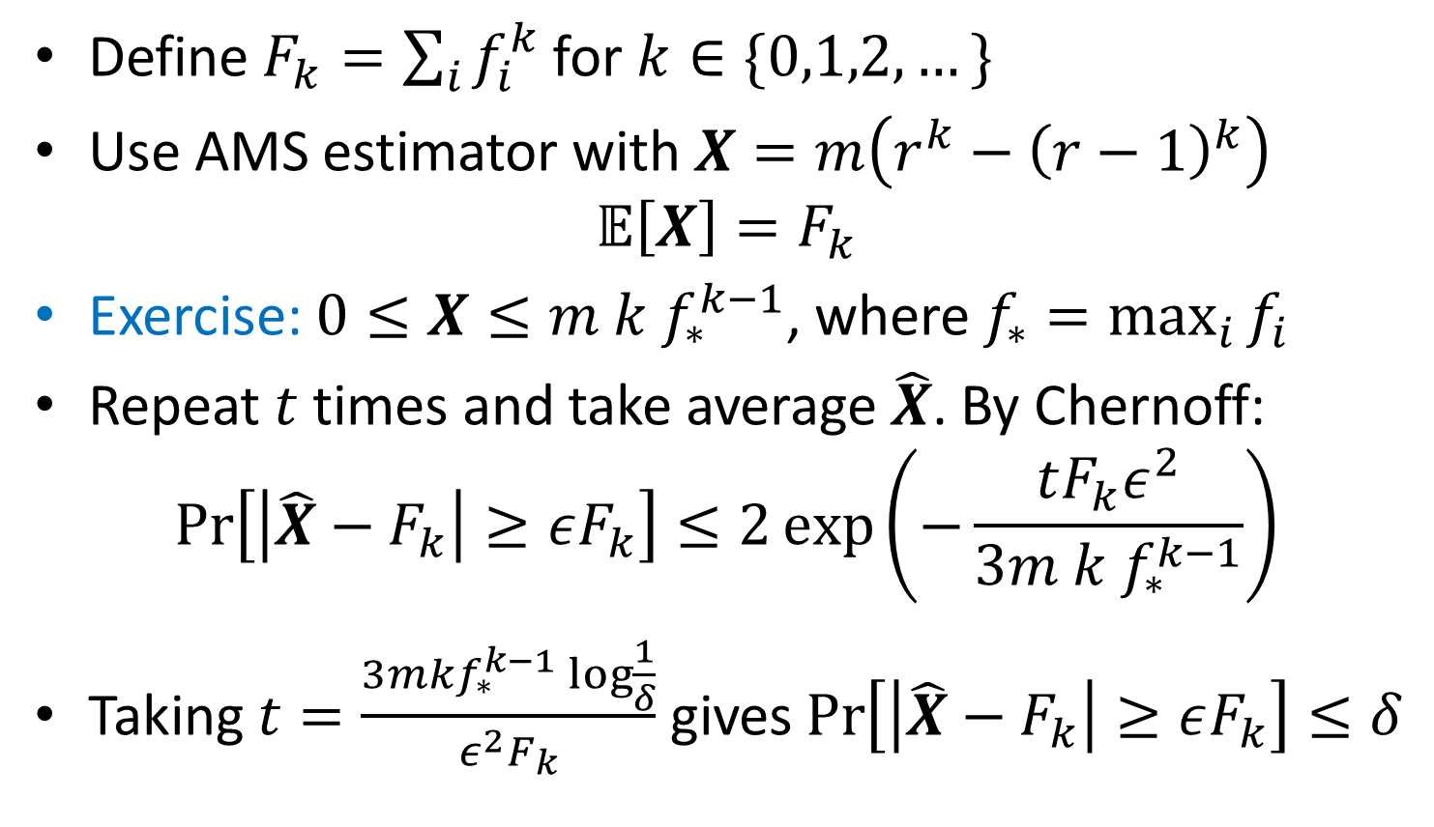
Frequency Moments
Define $F_{k}=\sum_{i}{f_{i}^{k}}$ for $k∈\{0,1,2,…\}$
Use AMS estimator with $X=m\left(r^{k}−{\left(r−1\right)}^{k}\right)$
$$𝔼\left[X\right]=F_{k}$$
Exercise: $0≤X≤m k f_{∗}^{k−1}$, where $f_{∗}=\max_{i}{f_{i}}$
Repeat $t$ times and take average $\hat{X}$. By Chernoff:
$$\operatorname{Pr}\left[\left|\hat{X}−F_{k}\right|≥εF_{k}\right]≤2\exp\left(−\frac{tF_{k}ε^{2}}{3m k f_{∗}^{k−1}}\right)$$
Taking $t=\frac{3mkf_{∗}^{k−1}\log{\frac{1}{δ}}}{ε^{2}F_{k}}$ gives $\operatorname{Pr}\left[\left|\hat{X}−F_{k}\right|≥εF_{k}\right]≤δ$

Slide 30
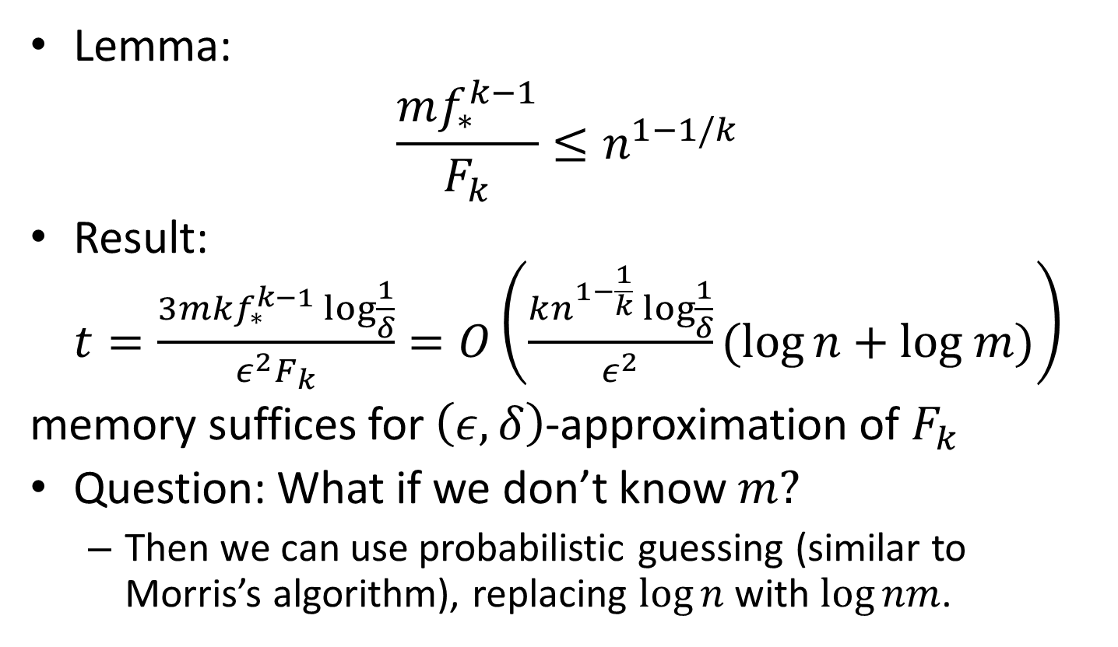
Frequency Moments
Lemma:
$$\frac{mf_{∗}^{k−1}}{F_{k}}≤n^{1−1/k}$$
Result: $t=\frac{3mkf_{∗}^{k−1}\log{\frac{1}{δ}}}{ε^{2}F_{k}}=O\left(\frac{kn^{1−\frac{1}{k}}\log{\frac{1}{δ}}}{ε^{2}}(log{n}+log m)\right)$
memory suffices for $\left(ε, δ\right)$-approximation of $F_{k}$
Question: What if we don’t know $m?$
Then we can use probabilistic guessing (similar to Morris’s algorithm), replacing $\log{n}$ with $\log{nm}$.

Slide 31
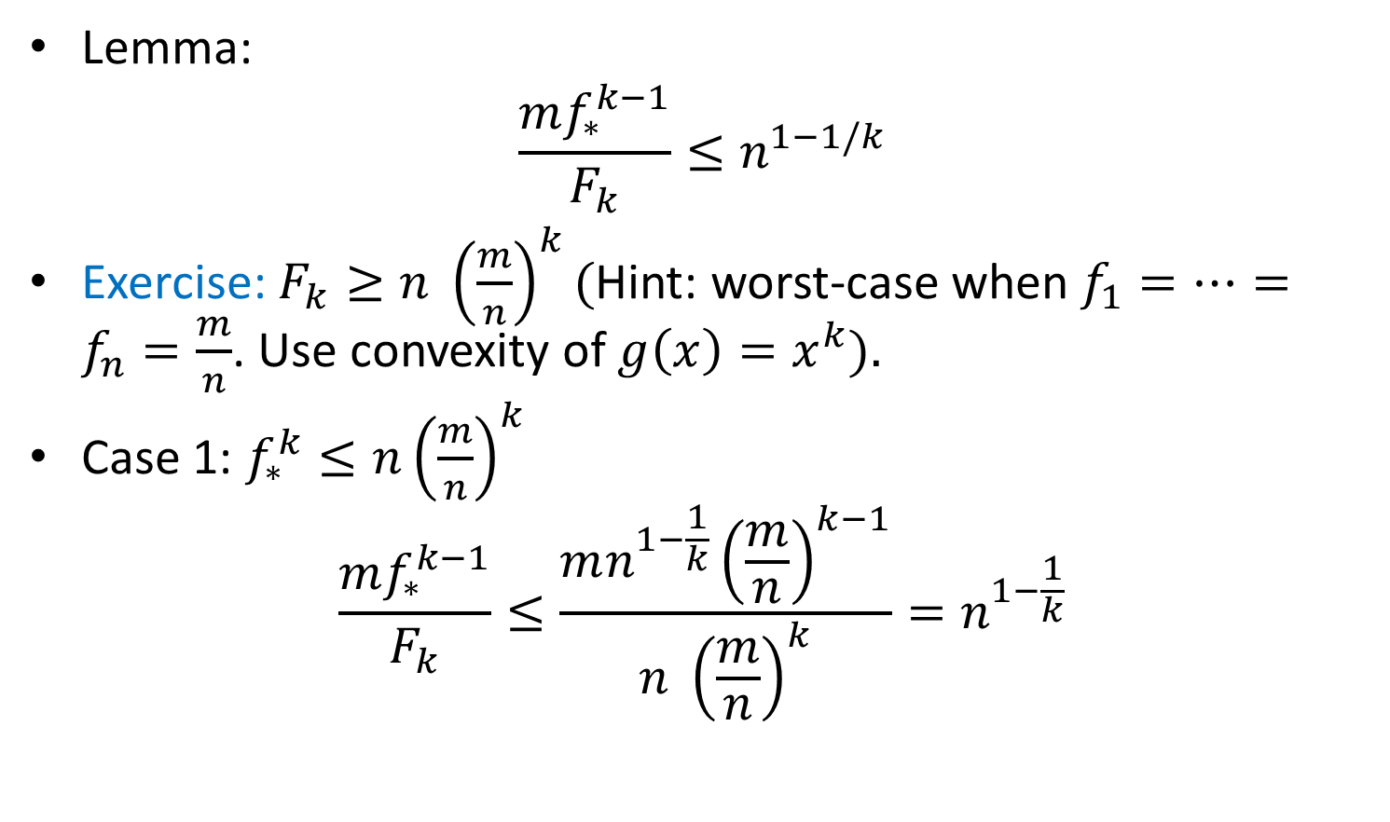
Frequency Moments
Lemma:
$$\frac{mf_{∗}^{k−1}}{F_{k}}≤n^{1−1/k}$$
Exercise: $F_{k}≥n {\left(\frac{m}{n}\right)}^{k}($Hint: worst-case when $f_{1}=…=f_{n}=\frac{m}{n}$. Use convexity of $g\left(x\right)=x^{k}).$
Case 1: $f_{∗}^{k}≤n{\left(\frac{m}{n}\right)}^{k}$
$$\frac{mf_{∗}^{k−1}}{F_{k}}≤\frac{mn^{1−\frac{1}{k}}{\left(\frac{m}{n}\right)}^{k−1}}{n {\left(\frac{m}{n}\right)}^{k}}=n^{1−\frac{1}{k}}$$

Slide 32

Frequency Moments
Lemma:
$$\frac{mf_{∗}^{k−1}}{F_{k}}≤n^{1−1/k}$$
Case 2: $f_{∗}^{k}≥n{\left(\frac{m}{n}\right)}^{k}$
$$\frac{mf_{∗}^{k−1}}{F_{k}}≤\frac{mf_{∗}^{k−1}}{f_{∗}^{k}}=\frac{m}{f_{∗}}≤\frac{m}{n^{\frac{1}{k}} \left(\frac{m}{n}\right)}=n^{1−\frac{1}{k}}$$

Slide 33
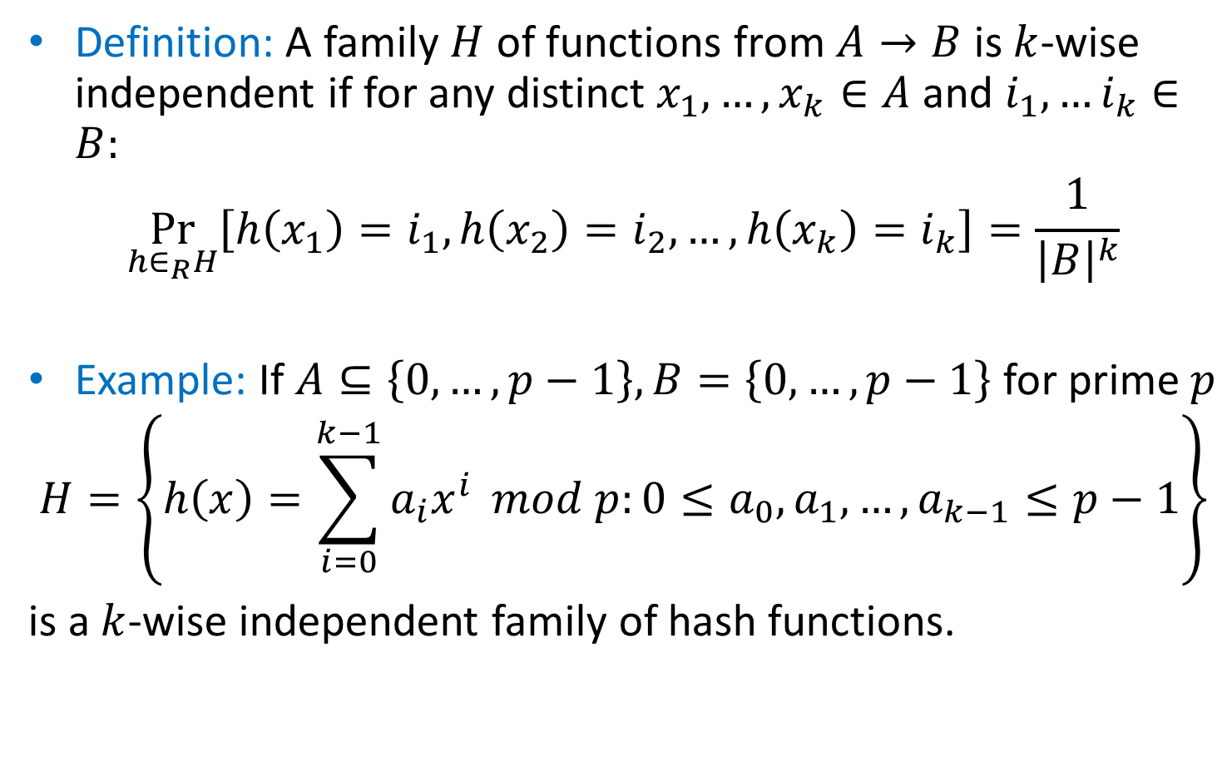
Hash Functions
Definition: A family $H$ of functions from $A→B$ is $k$-wise independent if for any distinct $x_{1},…, x_{k}∈A$ and $i_{1},…i_{k}∈B:$
$$\underset{h∈_{R}H}{Pr}\left[h\left(x_{1}\right)=i_{1},h\left(x_{2}\right)=i_{2},…,h\left(x_{k}\right)=i_{k}\right]=\frac{1}{{\left|B\right|}^{k}}$$
Example: If $A⊆\left\{0,…, p−1\right\},B=\left\{0,…, p−1\right\}$ for prime $p$
$$H=\left\{h\left(x\right)=\sum_{i=0}^{k−1}{a_{i}x^{i}} mod p:0≤a_{0},a_{1},…, a_{k−1}≤p−1\right\}$$
is a $k$-wise independent family of hash functions.

Slide 34
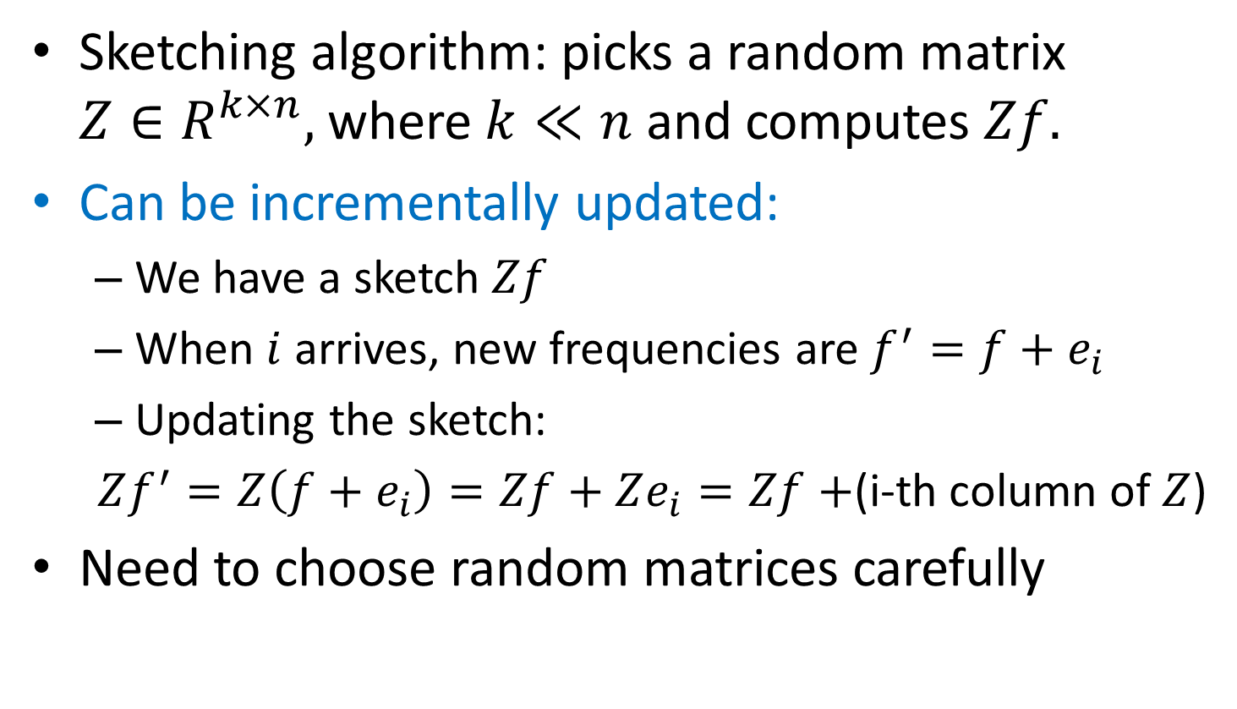
Linear Sketches
Sketching algorithm: picks a random matrix $Z∈R^{k×n},$ where $k≪n$ and computes $Zf.$
Can be incrementally updated:
We have a sketch $Zf$
When $i$ arrives, new frequencies are $f^{′}=f+e_{i}$
Updating the sketch:
$Zf^{′}=Z\left(f+e_{i}\right)=Zf+Ze_{i}=Zf+$(i-th column of $Z$)
Need to choose random matrices carefully

Slide 35
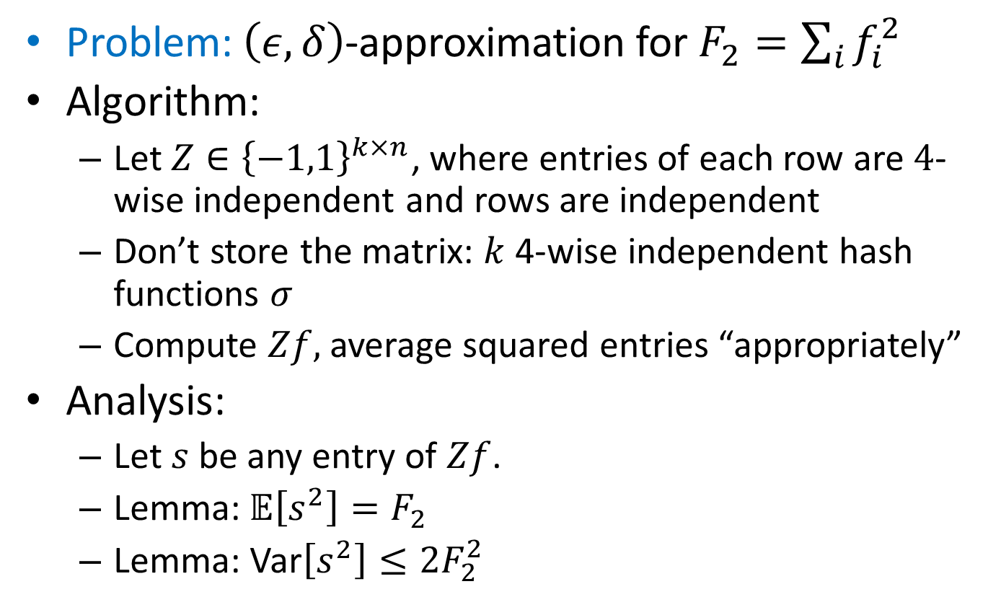

$$F_{2}$$
Problem: $\left(ε,δ\right)$-approximation for $F_{2}=\sum_{i}{f_{i}^{2}}$
Algorithm:
Let $Z∈{\left\{−1,1\right\}}^{k×n}$, where entries of each row are $4$-wise independent and rows are independent
Don’t store the matrix: $k$ 4-wise independent hash functions $σ$
Compute $Zf,$average squared entries “appropriately”
Analysis:
Let $s$ be any entry of $Zf$.
Lemma:$𝔼\left[s^{2}\right]=F_{2}$
Lemma: Var$\left[s^{2}\right]≤2F_{2}^{2}$

Slide 36
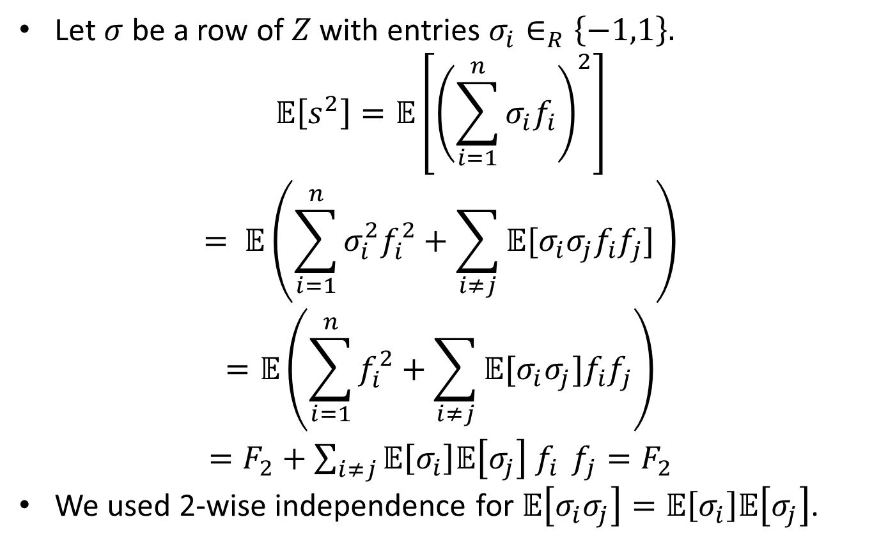

$$F_{2}:Expectaton$$
Let $σ$ be a row of $Z$ with entries $σ_{i}∈_{R}\left\{−1,1\right\}.$
$$𝔼\left[s^{2}\right]=𝔼\left[{\left(\sum_{i=1}^{n}{σ_{i}f_{i}}\right)}^{2}\right]$$
$$= 𝔼\left(\sum_{i=1}^{n}{σ_{i}^{2}f_{i}^{2}}+\sum_{i≠j}{𝔼[σ_{i}σ_{j}f_{i}f_{j}]}\right)$$
$$=𝔼\left(\sum_{i=1}^{n}{f_{i}^{2}}+\sum_{i≠j}{𝔼[σ_{i}σ_{j}]f_{i}f_{j}}\right)$$
$=F_{2}+\sum_{i≠j}{𝔼\left[σ_{i}\right]𝔼\left[σ_{j}\right] f_{i}} f_{j}=F_{2}$
We used 2-wise independence for $𝔼\left[σ_{i}σ_{j}\right]=𝔼\left[σ_{i}\right]𝔼\left[σ_{j}\right]$.

Slide 37
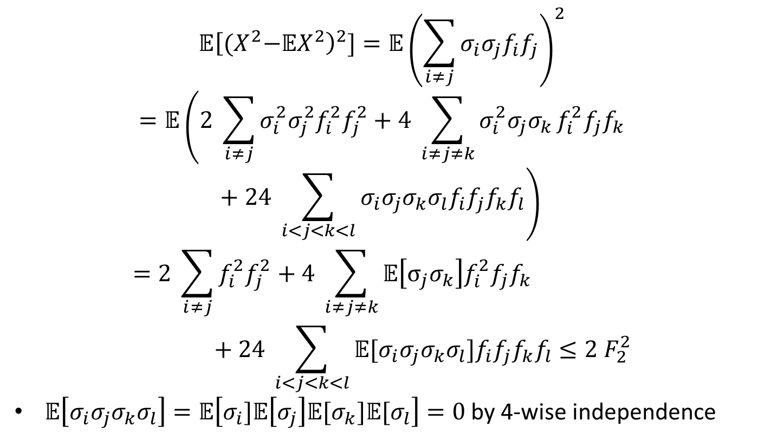

$$F_{2}:Variance$$
$$𝔼{\left[{(X}^{2}−𝔼X^{2}\right)}^{2}]=𝔼{\left(\sum_{i≠j}{σ_{i}σ_{j}f_{i}f_{j}}\right)}^{2}$$
$$=𝔼\left(2 \sum_{i≠j}{σ_{i}^{2}σ_{j}^{2}f_{i}^{2}f_{j}^{2}}+4 \sum_{i≠j≠k}{σ_{i}^{2}σ_{j}σ_{k}}f_{i}^{2}f_{j}f_{k}+24 \sum_{i<j<k<l}{σ_{i}σ_{j}σ_{k}σ_{l}f_{i}f_{j}f_{k}f_{l}}\right)$$
$$=2 \sum_{i≠j}{f_{i}^{2}f_{j}^{2}}+4 \sum_{i≠j≠k}{𝔼\left[σ_{j}σ_{k}\right]f_{i}^{2}f_{j}f_{k}}+24 \sum_{i<j<k<l}{𝔼[σ_{i}σ_{j}σ_{k}σ_{l}]f_{i}f_{j}f_{k}f_{l}}≤2 F_{2}^{2}$$
$𝔼\left[σ_{i}σ_{j}σ_{k}σ_{l}\right]=𝔼\left[σ_{i}]𝔼\left[σ_{j}\right]𝔼[σ_{k}{]𝔼[σ}_{l}\right]=0$ by 4-wise independence

Slide 38
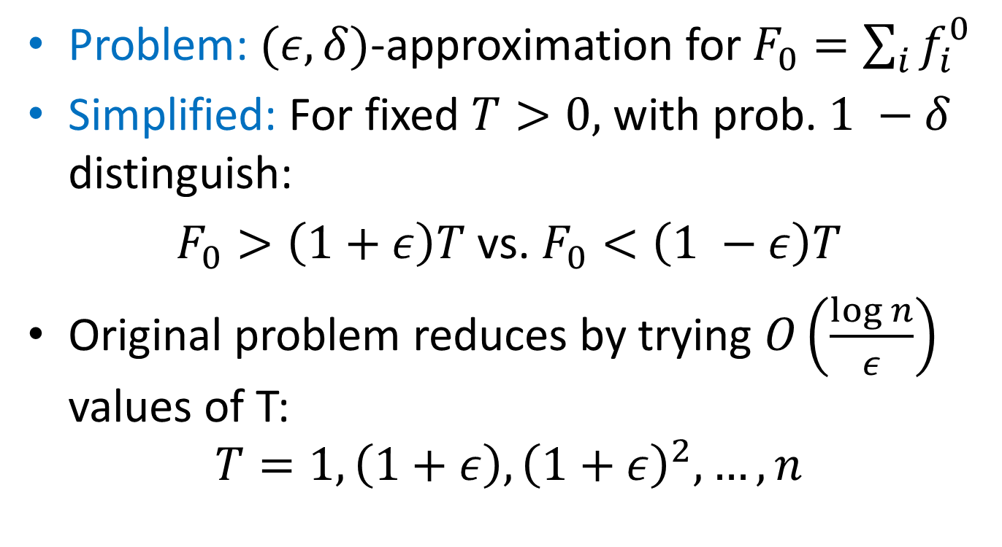

$F_{0}$: Distinct Elements
Problem: $(ε,δ)$-approximation for $F_{0}=\sum_{i}{f_{i}^{0}}$
Simplified: For fixed $T>0,$ with prob. $1 −δ$ distinguish:
$F_{0}>\left(1+ε\right)T$ vs. $F_{0}<\left(1 −ε\right)T$
Original problem reduces by trying $O\left(\frac{\log{n}}{ε}\right)$ values of T:
$$T=1, \left(1+ε\right), {\left(1+ε\right)}^{2},…, n$$

Slide 39
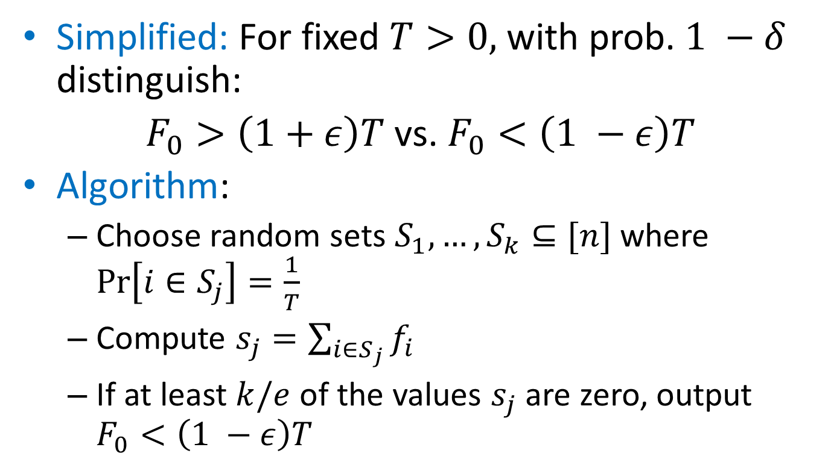
$F_{0}$: Distinct Elements
Simplified: For fixed $T>0,$ with prob. $1 −δ$ distinguish:
$F_{0}>\left(1+ε\right)T$ vs. $F_{0}<\left(1 −ε\right)T$
Algorithm:
Choose random sets $S_{1},…, S_{k}⊆[n]$ where $\operatorname{Pr}\left[i∈S_{j}\right]=\frac{1}{T}$
Compute $s_{j}=\sum_{i∈S_{j}}{f_{i}}$
If at least $k/e$ of the values $s_{j}$ are zero, output $F_{0}<\left(1 −ε\right)T$

Slide 40
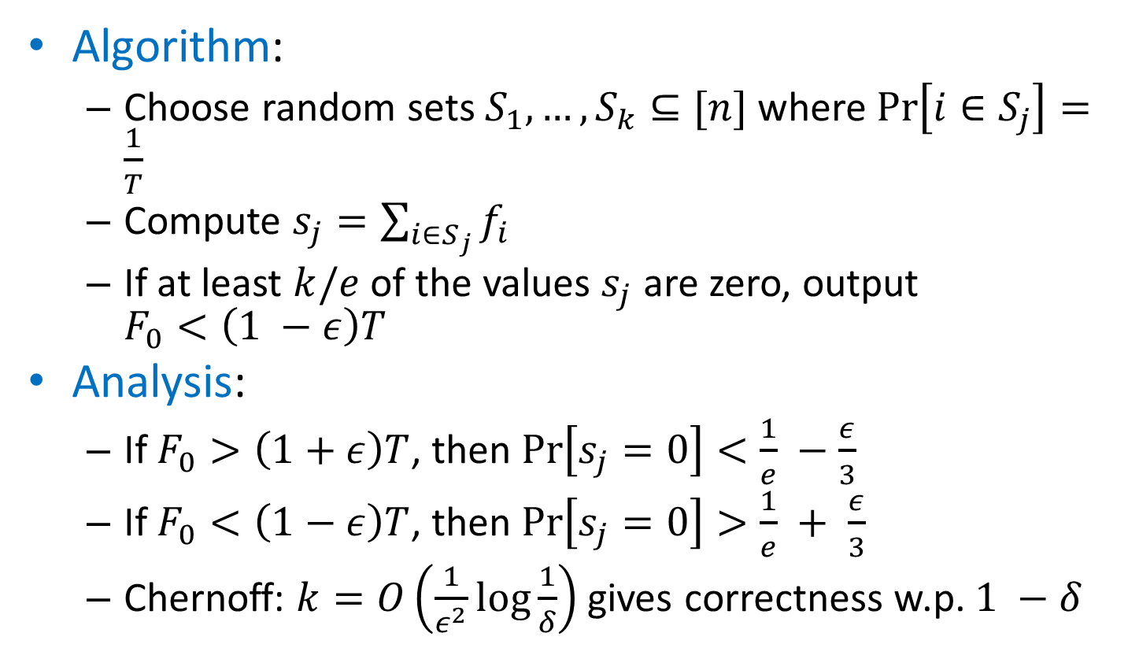
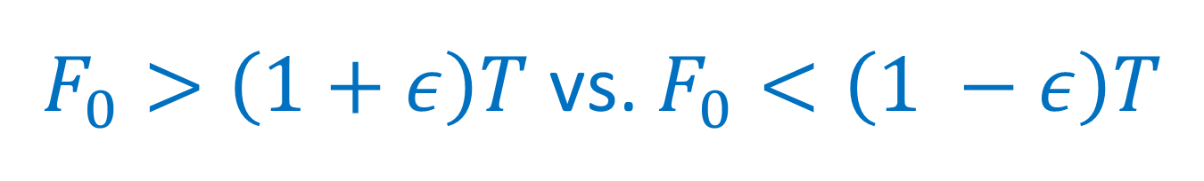
$F_{0}>\left(1+ε\right)T$ vs. $F_{0}<\left(1 −ε\right)T$
Algorithm:
Choose random sets $S_{1},…, S_{k}⊆[n]$ where $\operatorname{Pr}\left[i∈S_{j}\right]=\frac{1}{T}$
Compute $s_{j}=\sum_{i∈S_{j}}{f_{i}}$
If at least $k/e$ of the values $s_{j}$ are zero, output $F_{0}<\left(1 −ε\right)T$
Analysis:
If $F_{0}>\left(1+ε\right)T$, then $\operatorname{Pr}\left[s_{j}=0\right]<\frac{1}{e} −\frac{ε}{3}$
If $F_{0}<\left(1−ε\right)T$, then $\operatorname{Pr}\left[s_{j}=0\right]>\frac{1}{e} + \frac{ε}{3}$
Chernoff: $k=O\left(\frac{1}{ε^{2}}\log{\frac{1}{δ}}\right)$ gives correctness w.p. $1 −δ$

Slide 41
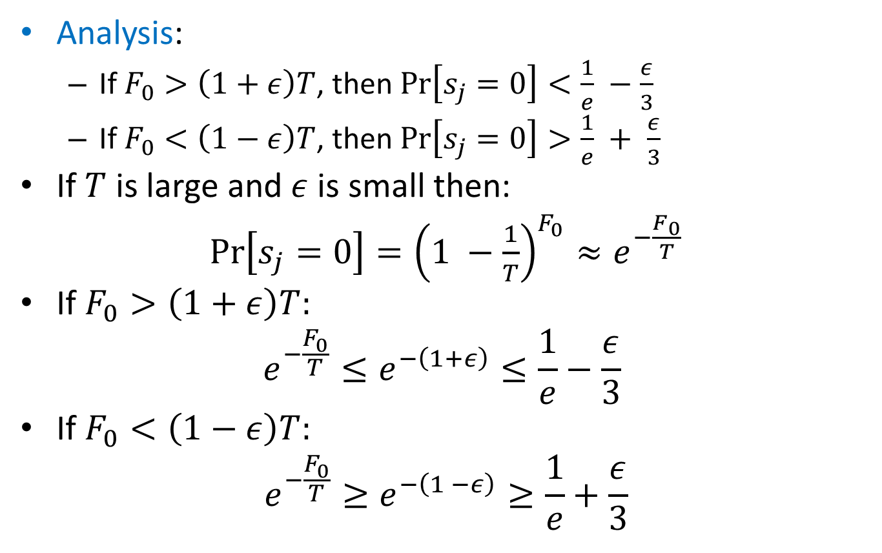
$F_{0}>\left(1+ε\right)T$ vs. $F_{0}<\left(1 −ε\right)T$
Analysis:
If $F_{0}>\left(1+ε\right)T$, then $\operatorname{Pr}\left[s_{j}=0\right]<\frac{1}{e} −\frac{ε}{3}$
If $F_{0}<\left(1−ε\right)T$, then $\operatorname{Pr}\left[s_{j}=0\right]>\frac{1}{e} + \frac{ε}{3}$
If $T$ is large and $ε$ is small then:
$\operatorname{Pr}\left[s_{j}=0\right]={\left(1 −\frac{1}{T}\right)}^{F_{0}}≈e^{−\frac{F_{0}}{T}}$
If $F_{0}>\left(1+ε\right)T:$
$$e^{−\frac{F_{0}}{T}}≤e^{−\left(1+ε\right)}≤\frac{1}{e}−\frac{ε}{3}$$
If $F_{0}<\left(1−ε\right)T:$
$$e^{−\frac{F_{0}}{T}}≥e^{−\left(1 −ε\right)}≥\frac{1}{e}+\frac{ε}{3}$$

Slide 42
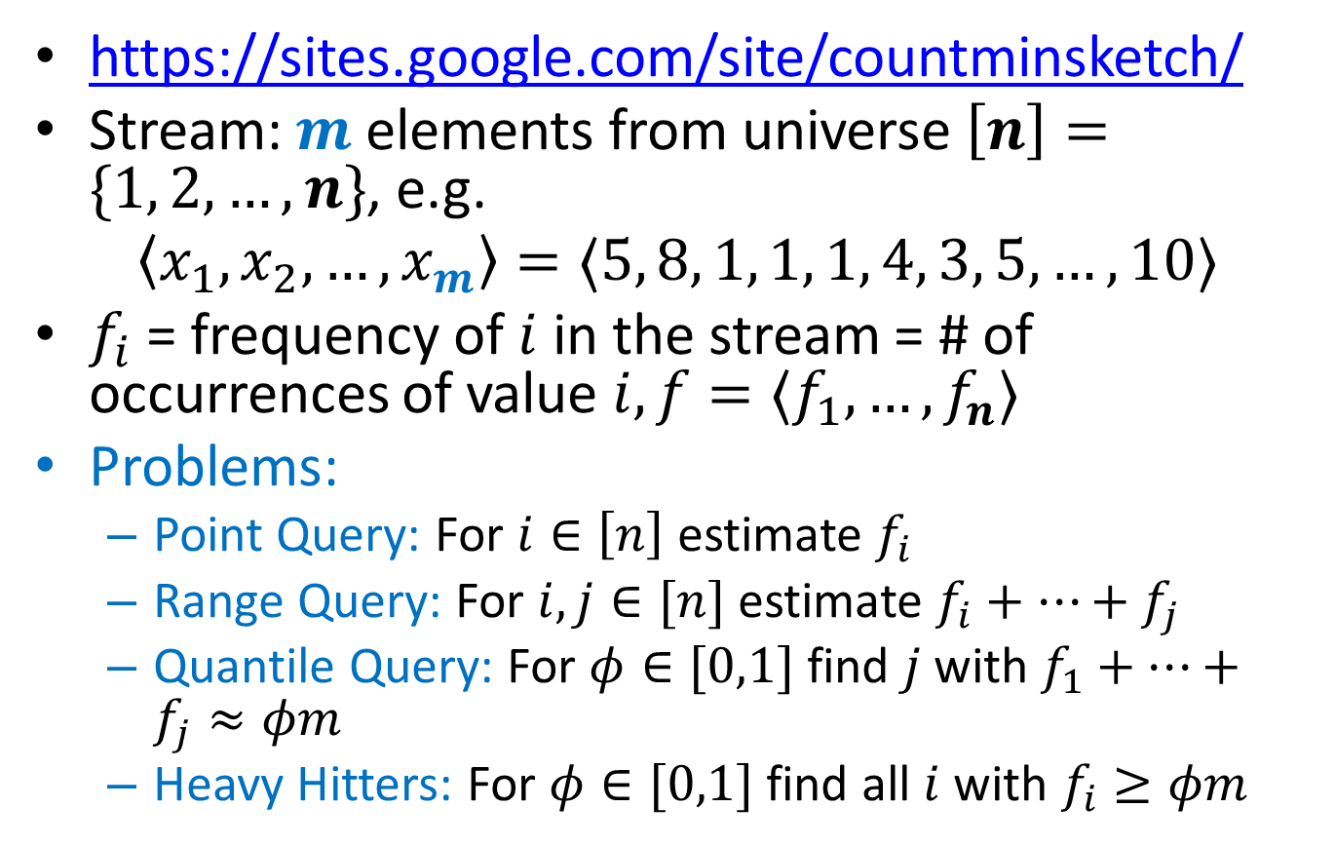
Count-Min Sketch
https://sites.google.com/site/countminsketch/
Stream: $m$ elements from universe $\left[n\right]=\{1, 2, …, n\}$, e.g.
$$〈x_{1},x_{2},…, x_{m}〉=〈5, 8, 1, 1, 1, 4, 3, 5, …, 10〉$$
$f_{i}$ = frequency of $i$ in the stream = # of occurrences of value $i, f=〈f_{1},…, f_{n}〉$
Problems:
Point Query: For $i∈\left[n\right]$ estimate $f_{i}$
Range Query: For $i,j∈[n]$ estimate $f_{i}+…+f_{j}$
Quantile Query: For $φ∈[0,1]$ find $j$ with $f_{1}+…+f_{j}≈φm$
Heavy Hitters: For $φ∈[0,1]$ find all $i$ with $f_{i}≥φm$

Slide 43
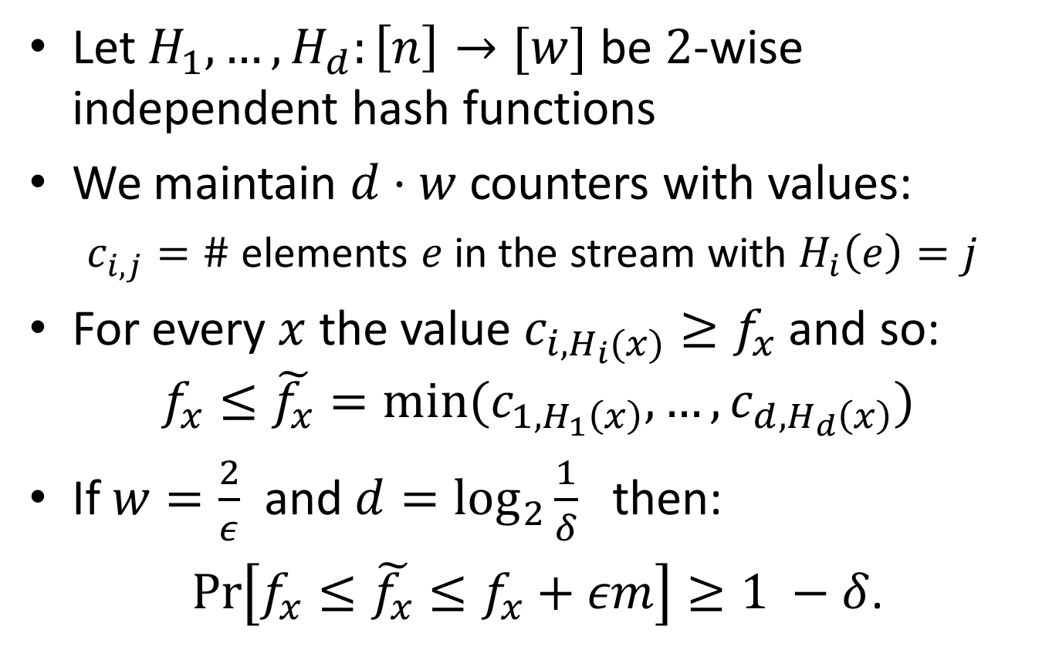
Count-Min Sketch: Construction
Let $H_{1},…,H_{d}:\left[n\right]→[w]$ be $2$-wise independent hash functions
We maintain $d⋅w$ counters with values:
$c_{i,j}=\#$ elements $e$ in the stream with $H_{i}\left(e\right)=j$
For every $x$ the value $c_{i,H_{i}(x)}≥f_{x}$ and so:
$$f_{x}≤\tilde{f_{x}}=min⁡(c_{1,H_{1}\left(x\right)}, …,c_{d,H_{d}\left(x\right)})$$
If $w=\frac{2}{ε}$ and $d=\log_{2}{\frac{1}{δ}}$ then:
$\operatorname{Pr}\left[f_{x}≤\tilde{f_{x}}≤f_{x}+εm\right]≥1 −δ$.

Slide 44
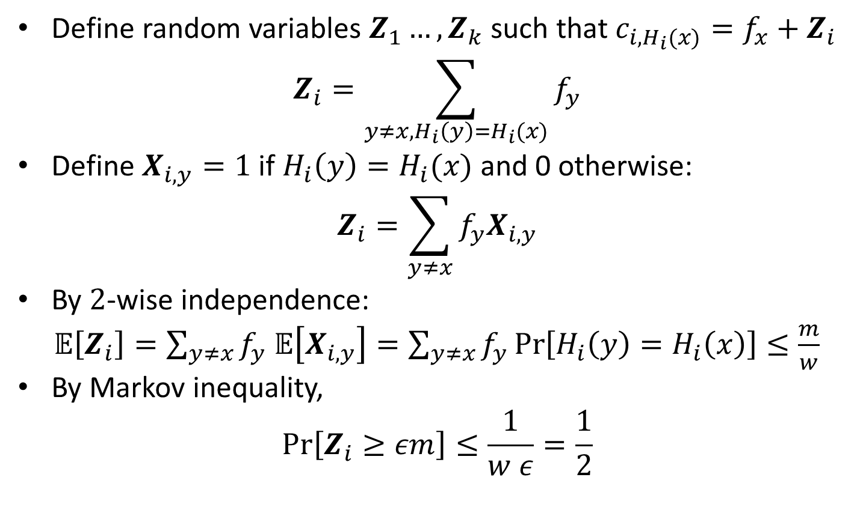
Count-Min Sketch: Analysis
Define random variables $Z_{1}…, Z_{k}$ such that $c_{i, H_{i}(x)}=f_{x}+Z_{i}$
$$Z_{i}=\sum_{y≠x, H_{i}\left(y\right)=H_{i}(x)}{f_{y}}$$
Define $X_{i, y}=1$ if $H_{i}\left(y\right)=H_{i}(x)$ and 0 otherwise:
$$Z_{i}=\sum_{y≠x}{f_{y}X_{i,y}}$$
By $2$-wise independence:
$𝔼\left[Z_{i}\right]=\sum_{y≠x}{f_{y}}$ $𝔼\left[X_{i,y}\right]=\sum_{y≠x}{f_{y}}\operatorname{Pr}\left[H_{i}\left(y\right)=H_{i}\left(x\right)\right]≤\frac{m}{w}$
By Markov inequality,
$$\operatorname{Pr}\left[Z_{i}≥εm\right]≤\frac{1}{w ε}=\frac{1}{2}$$

Slide 45
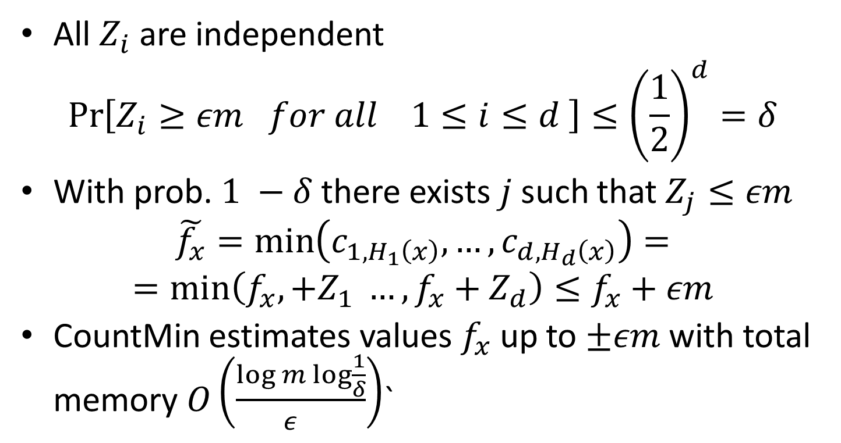
Count-Min Sketch: Analysis
All $Z_{i}$ are independent
$$\operatorname{Pr}\left[Z_{i}≥εm for all 1≤i≤d \right]≤{\left(\frac{1}{2}\right)}^{d}=δ$$
With prob.$1 −δ$ there exists $j$ such that $Z_{j}≤εm$
$$\tilde{f_{x}}=\min\left(c_{1, H_{1}\left(x\right)}, …,c_{d, H_{d}\left(x\right)}\right)=$$
$$=\min\left(f_{x},+Z_{1} …,f_{x}+Z_{d}\right)≤f_{x}+εm$$
CountMin estimates values $f_{x}$ up to $±εm$ with total memory $O\left(\frac{log m\log{\frac{1}{δ}}}{ε^{}}\right)$`

Slide 46
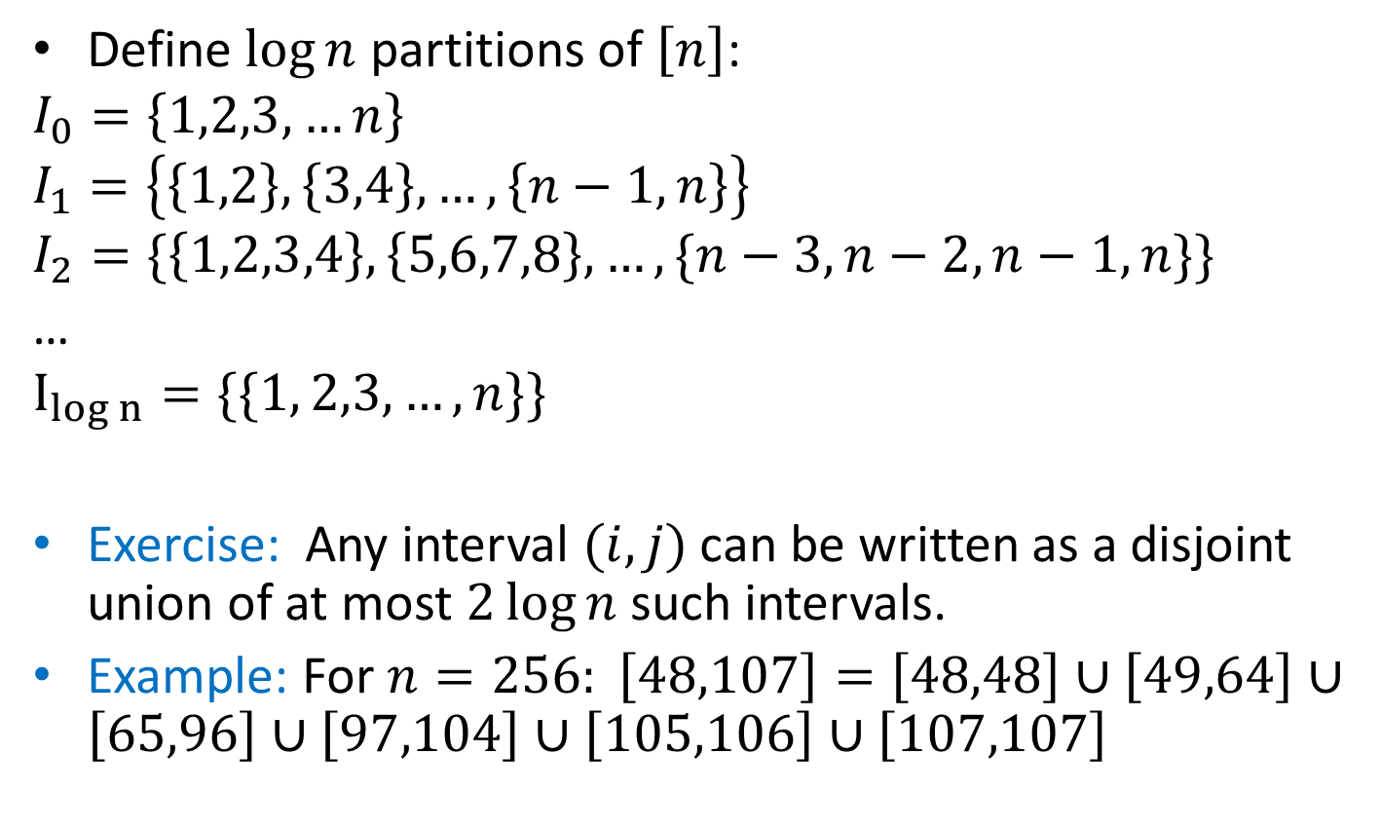
Dyadic Intervals
Define $\log{n}$ partitions of $\left[n\right]$:
$$I_{0}=\left\{1,2,3,…n\right\}$$
$$I_{1}=\left\{\left\{1,2\right\},\left\{3,4\right\},…,\left\{n−1,n\right\}\right\}$$
$$I_{2}=\{\left\{1,2,3,4\right\},\left\{5,6,7,8\right\}, …,\{n−3,n−2,n−1,n\}\}$$
…
$$I_{log n}=\{\{1, 2,3,…, n\}\}{}$$
Exercise: Any interval $(i,j)$ can be written as a disjoint union of at most $2\log{n }$such intervals.
Example: For $n=256: \left[48,107\right]=\left[48,48\right]∪\left[49,64\right]∪\left[65,96\right]∪\left[97,104\right]∪\left[105,106\right]∪\left[107,107\right]$

Slide 47
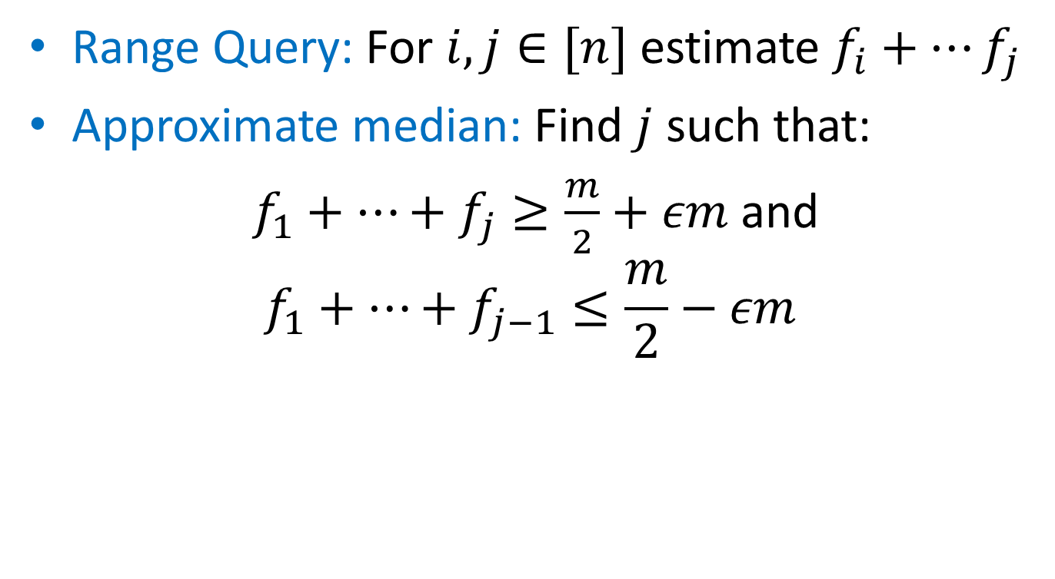
Count-Min: Range Queries and Quantiles
Range Query: For $i,j∈[n]$ estimate $f_{i}+…f_{j}$
Approximate median: Find $j$ such that:
$f_{1}+…+f_{j}≥\frac{m}{2}+εm$ and
$$f_{1}+…+f_{j−1}≤\frac{m}{2}−εm$$

Slide 48
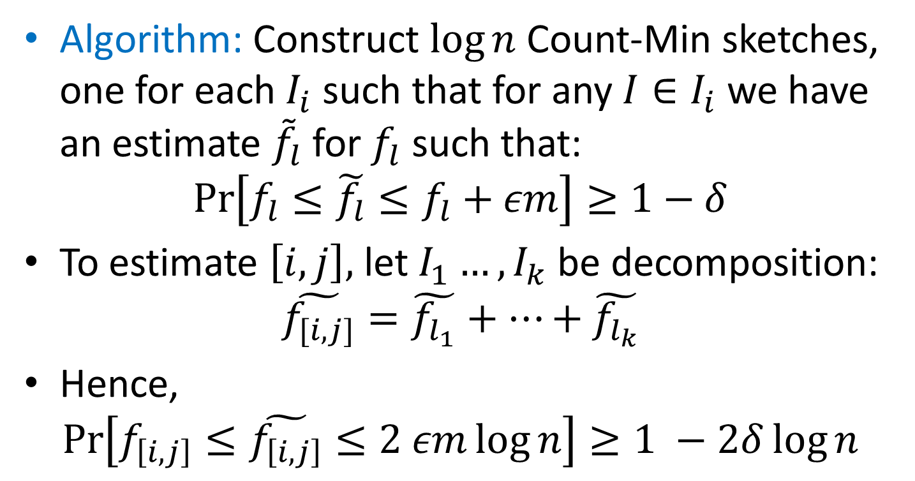
Count-Min: Range Queries and Quantiles
Algorithm: Construct $\log{n}$ Count-Min sketches, one for each $I_{i}$ such that for any $I∈I_{i}$ we have an estimate ${\tilde{f}}_{l}$for $f_{l}$ such that:
$$\operatorname{Pr}\left[f_{l}≤\tilde{f_{l}}≤f_{l}+εm\right]≥1−δ$$
To estimate $\left[i,j\right],$ let $I_{1}…, I_{k}$ be decomposition:
$$\tilde{f_{[i,j]}}=\tilde{f_{l_{1}}}+…+\tilde{f_{l_{k}}}$$
Hence,
$$\operatorname{Pr}\left[f_{\left[i,j\right]}≤\tilde{f_{\left[i,j\right]}}≤2 εm\log{n}\right]≥1 −2δ\log{n}$$

Slide 49
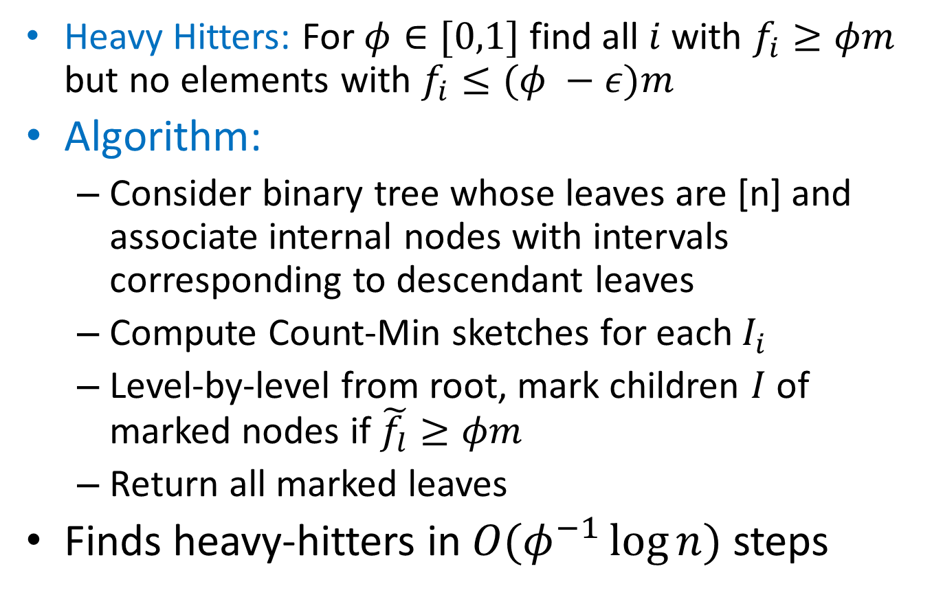
Count-Min: Heavy Hitters
Heavy Hitters: For $φ∈[0,1]$ find all $i$ with $f_{i}≥φm$ but no elements with $f_{i}≤(φ −ε)m$
Algorithm:
Consider binary tree whose leaves are [n] and associate internal nodes with intervals corresponding to descendant leaves
Compute Count-Min sketches for each $I_{i}$
Level-by-level from root, mark children $I$ of marked nodes if $\tilde{f_{l}}≥φm$
Return all marked leaves
Finds heavy-hitters in $O(φ^{−1}\log{n})$ steps

