Slide 1


Linear sketching over $𝔽_{2}$
Grigory Yaroslavtsev
(Indiana University, Bloomington)
http://grigory.us
with Sampath Kannan (U. Pennsylvania),
Elchanan Mossel (MIT) and Swagato Sanyal (NUS)

Slide 2
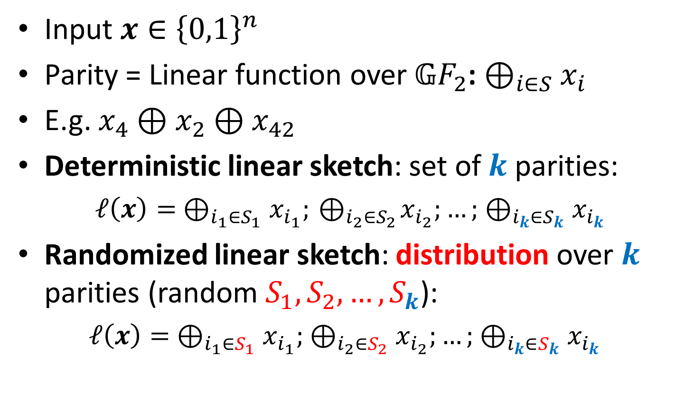
Linear sketching with parities
Input $x∈{\left\{0,1\right\}}^{n}$
Parity = Linear function over 𝔾$F_{2}$: $⊕_{i∈S}x_{i}$
E.g. $x_{4}⊕x_{2}⊕x_{42}$
Deterministic linear sketch: set of $k$ parities:
$ℓ\left(x\right)= ⊕_{i_{1}∈S_{1}}x_{i_{1}};{ ⊕}_{i_{2}∈S_{2}}x_{i_{2}};…; ⊕_{i_{k}∈S_{k}}x_{i_{k}}$
Randomized linear sketch: distribution over $k$ parities (random $S_{1}, S_{2}, …,S_{k}$):
$ℓ\left(x\right)= ⊕_{i_{1}∈S_{1}}x_{i_{1}}; ⊕_{i_{2}∈S_{2}}x_{i_{2}};…; ⊕_{i_{k}∈S_{k}}x_{i_{k}}$

Slide 3
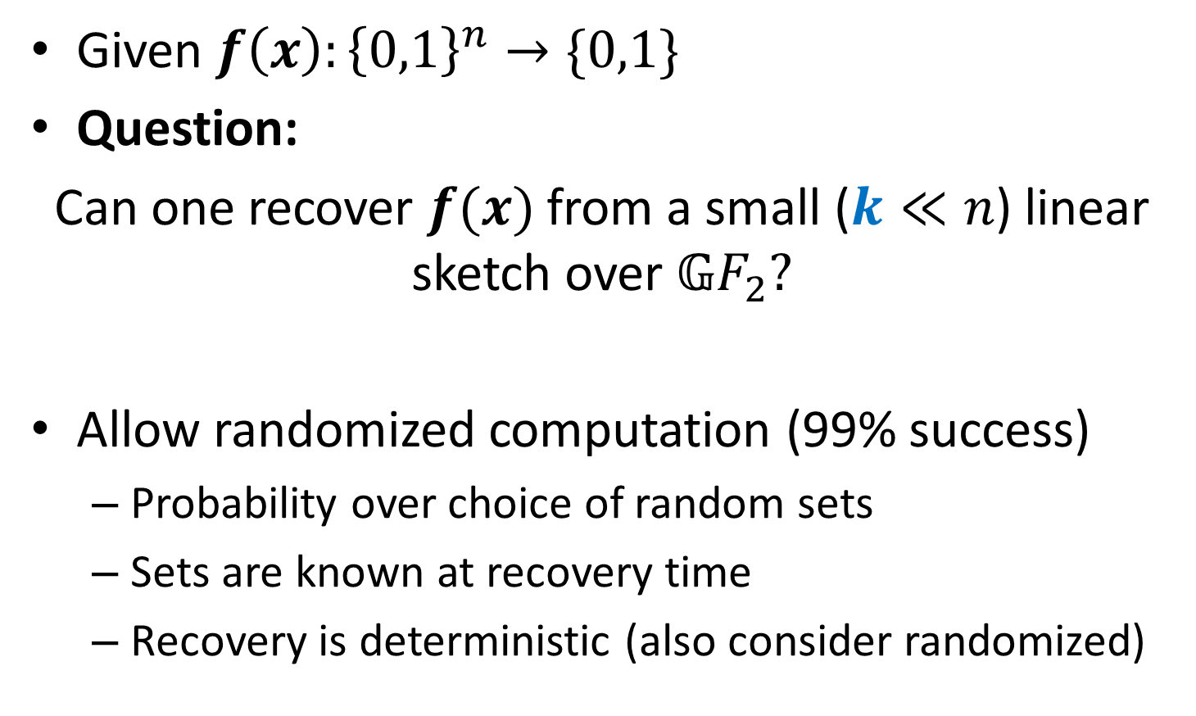

Linear sketching over $𝔾F_{2}$
Given $f\left(x\right):{\left\{0,1\right\}}^{n}→\{0,1\}$
Question:
Can one recover $f(x)$ from a small ($k≪n$) linear sketch over 𝔾$F_{2}?$
Allow randomized computation (99% success)
Probability over choice of random sets
Sets are known at recovery time
Recovery is deterministic (also consider randomized)

Slide 4

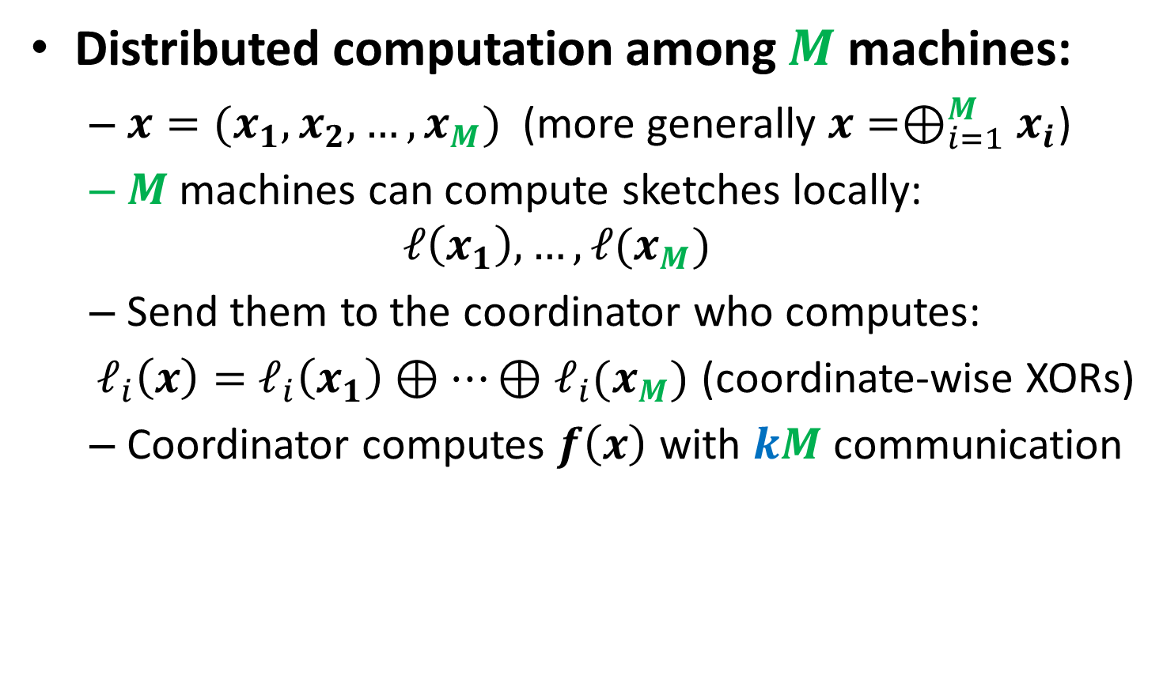


Motivation: Distributed Computing
Distributed computation among $M$ machines:
$x=(x_{1}, x_{2}, …, x_{M})$ (more generally $x=⊕_{i=1}^{M}x_{i}$)
$M$ machines can compute sketches locally:
$$ℓ\left(x_{1}\right), …, ℓ(x_{M})$$
Send them to the coordinator who computes:
$ℓ_{i}\left(x\right)=$ $ℓ_{i}\left(x_{1}\right)⊕⋯⊕ℓ_{i}(x_{M})$ (coordinate-wise XORs)
Coordinator computes $f\left(x\right)$ with $kM$ communication
$$x$$
0 | 1 | 1 | 1 | 1 | 1 | 0 | 0 | 0 | 0
$$x_{1}$$
$$x_{2}$$

Slide 5

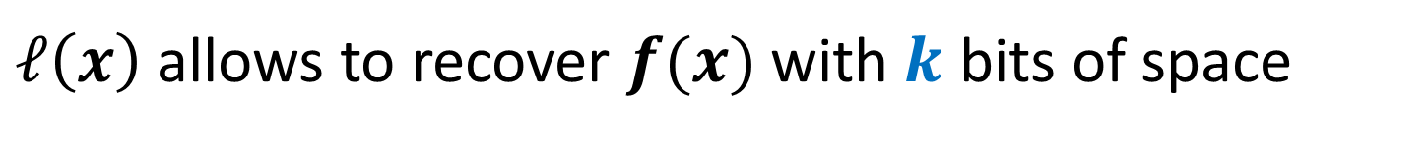


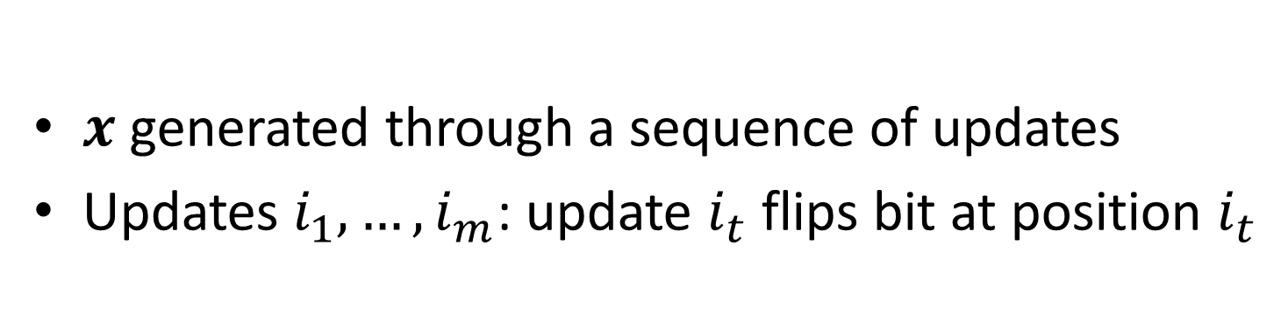



Motivation: Streaming
$x$ generated through a sequence of updates
Updates $i_{1},…, i_{m}$: update $i_{t}$ flips bit at position $i_{t}$
$$x_{0}$$
0 | 0 | 0 | 0 | 0 | 0 | 0 | 0 | 0 | 0
Updates: (1, 3, 8, 3)
$$x_{1}$$
1 | 0 | 0 | 0 | 0 | 0 | 0 | 0 | 0 | 0
$$x_{2}$$
1 | 0 | 1 | 0 | 0 | 0 | 0 | 0 | 0 | 0
$$x_{3}$$
1 | 0 | 1 | 0 | 0 | 0 | 0 | 1 | 0 | 0
$$x$$
1 | 0 | 0 | 0 | 0 | 0 | 0 | 1 | 0 | 0
$ℓ\left(x\right)$ allows to recover $f(x)$ with $k$ bits of space

Slide 6
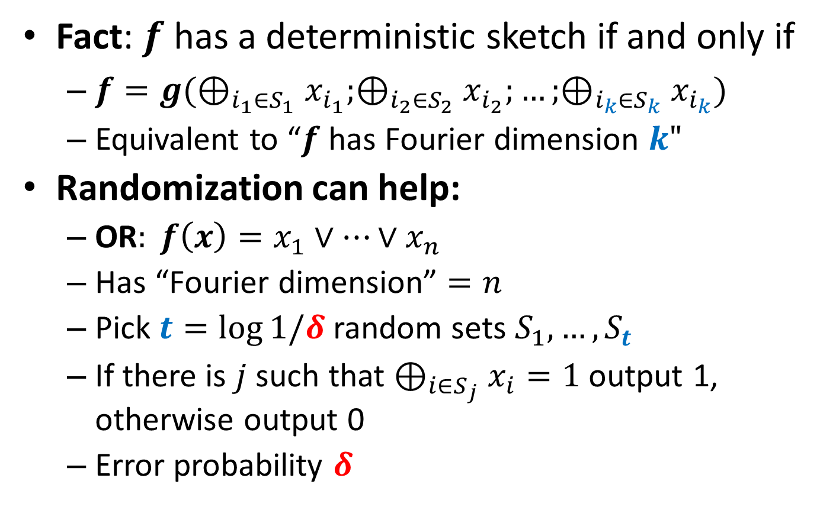
Deterministic vs. Randomized
Fact: $f$ has a deterministic sketch if and only if
$f=g(⊕_{i_{1}∈S_{1}}x_{i_{1}};⊕_{i_{2}∈S_{2}}x_{i_{2}};…;⊕_{i_{k}∈S_{k}}x_{i_{k}})$
Equivalent to “$f$ has Fourier dimension $k"$
Randomization can help:
OR$: f\left(x\right)=x_{1}∨⋯∨x_{n}$
Has “Fourier dimension” $=n$
Pick $t=\log{1/δ}$ random sets $S_{1},…, S_{t}$
If there is $j$ such that $⊕_{i∈S_{j}}x_{i}=1$ output 1, otherwise output 0
Error probability $δ$

Slide 7
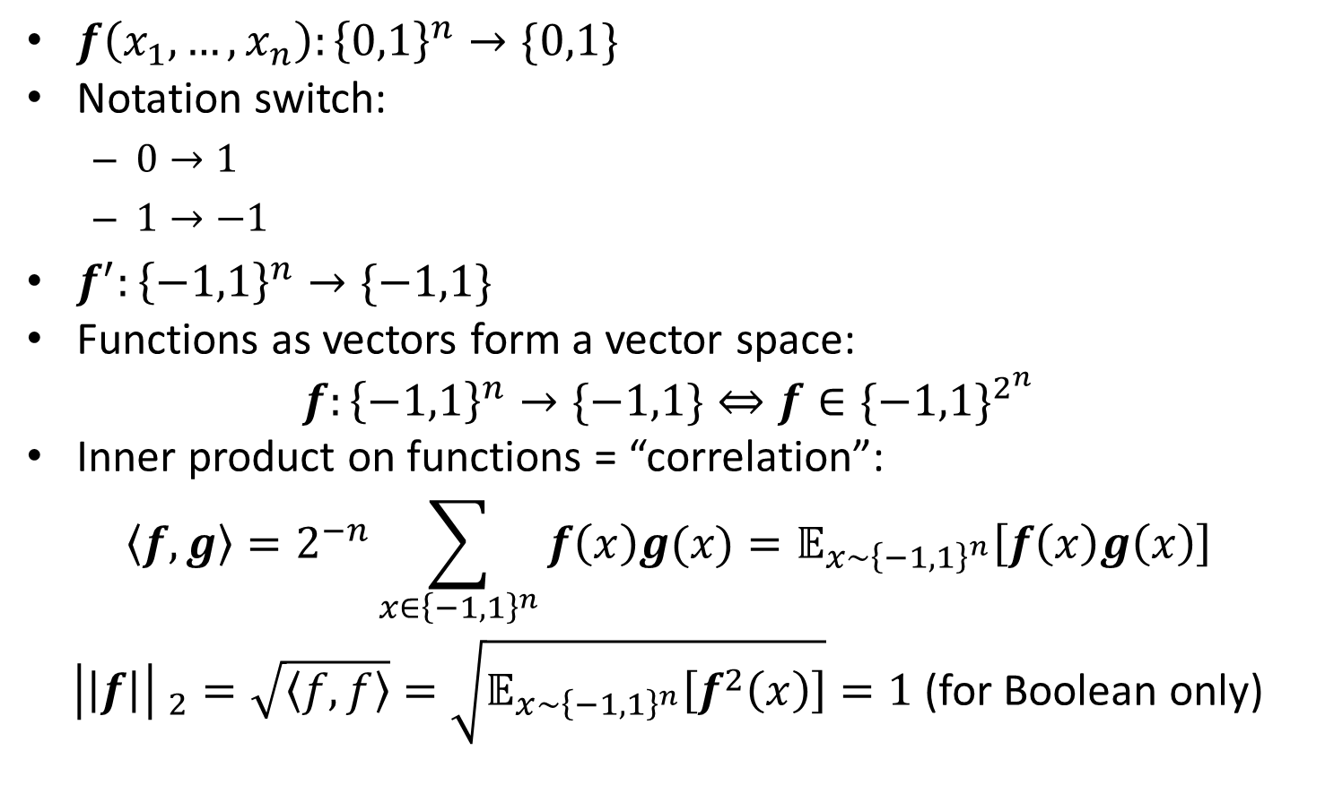
Fourier Analysis
$f\left(x_{1}, …, x_{n}\right):{\left\{0,1\right\}}^{n}→\{0,1\}$
Notation switch:
$0→1$
$1→−1$
$f^{′}:{\left\{−1,1\right\}}^{n}→\{−1,1\}$
Functions as vectors form a vector space:
$$f:{\left\{−1,1\right\}}^{n}→\{−1,1\}⇔f∈{\{−1,1\}}^{2^{n}}$$
Inner product on functions = “correlation”:
$$〈f,g〉=2^{−n}\sum_{x∈{\left\{−1,1\right\}}^{n}}{f\left(x\right)g(x)}=𝔼_{x∼{\left\{−1,1\right\}}^{n}}\left[f\left(x\right)g\left(x\right)\right]$$
${\left|\left|f\right|\right| }_{2}=\sqrt{〈f,f〉}=\sqrt{𝔼_{x∼{\left\{−1,1\right\}}^{n}}\left[f^{2}\left(x\right)\right]}=1$ (for Boolean only)

Slide 8
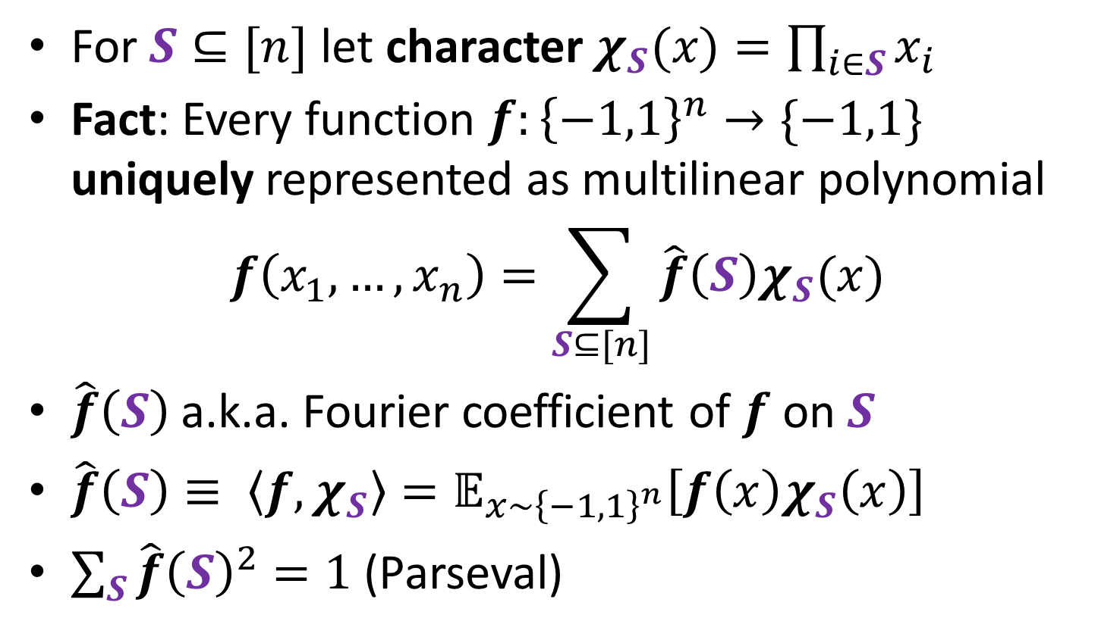
“Main Characters” are Parities
For $S⊆[n]$ let character $χ_{S}(x)=\prod_{i∈S}{x_{i}}$
Fact: Every function $f:{\left\{−1,1\right\}}^{n}→\{−1,1\}$ uniquely represented as multilinear polynomial
$$f\left(x_{1}, …, x_{n}\right)=\sum_{S⊆[n]}{\hat{f}\left(S\right)χ_{S}(x)}$$
$\hat{f}\left(S\right)$a.k.a. Fourier coefficient of $f$ on $S$
$\hat{f}\left(S\right)≡ 〈f,χ_{S}〉=𝔼_{x∼{\left\{−1,1\right\}}^{n}}\left[f\left(x\right)χ_{S}\left(x\right)\right]$
$\sum_{S}{\hat{f}{\left(S\right)}^{2}=1}$ (Parseval)

Slide 9
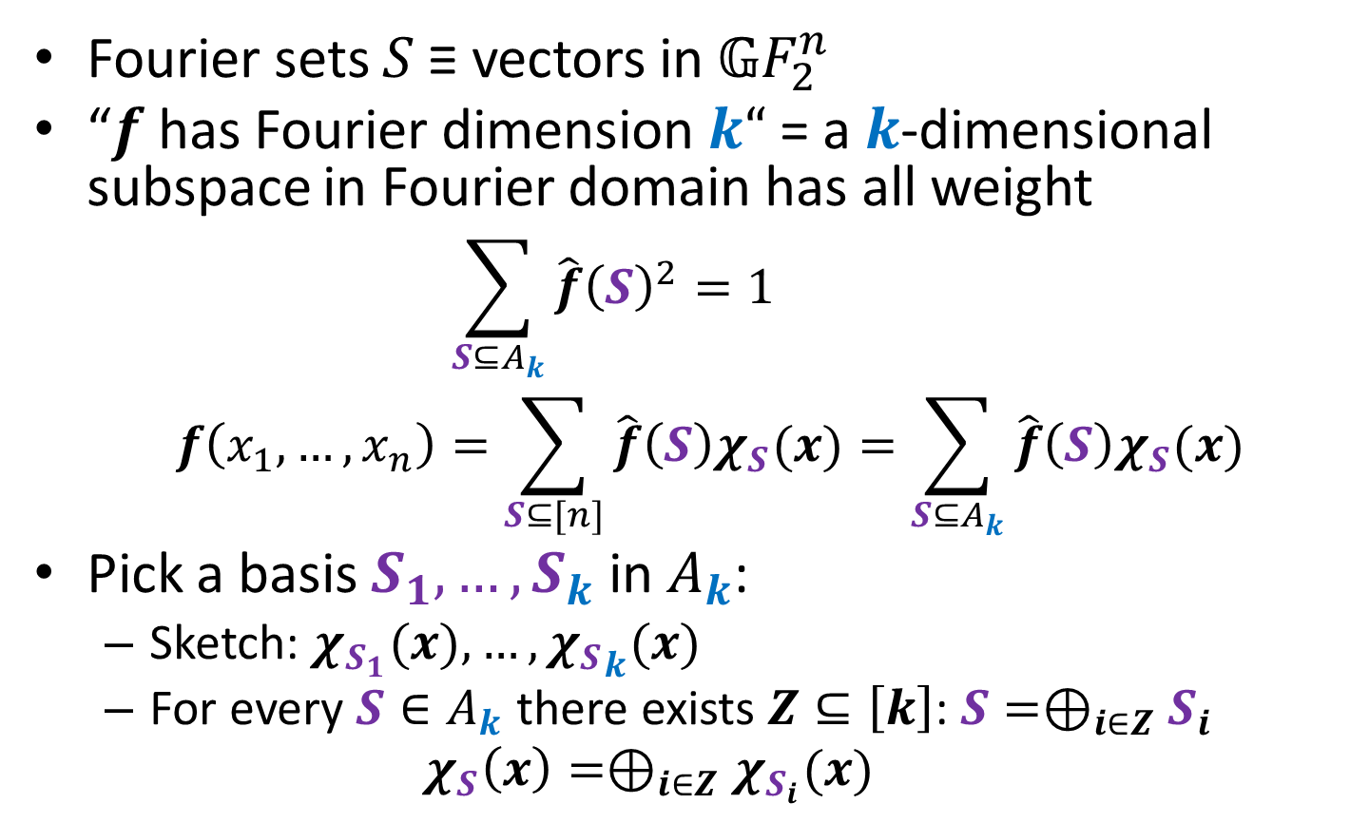
Fourier Dimension
Fourier sets $S$ ≡ vectors in 𝔾$F_{2}^{n}$
“$f$ has Fourier dimension $k“$ = a $k$-dimensional subspace in Fourier domain has all weight
$$\sum_{S⊆A_{k}}{\hat{f}{\left(S\right)}^{2}=1}$$
$$f\left(x_{1}, …, x_{n}\right)=\sum_{S⊆[n]}{\hat{f}\left(S\right)χ_{S}(x)}=\sum_{S⊆A_{k}}{\hat{f}\left(S\right)χ_{S}(x)}$$
Pick a basis $S_{1}, …, S_{k}$ in $A_{k}$:
Sketch: $χ_{S_{1}}(x), …, {χ_{S}}_{k}(x)$
For every $S∈A_{k}$ there exists $Z⊆\left[k\right]$: $S=⊕_{i∈Z}S_{i}$
$$χ_{S}\left(x\right)=⊕_{i∈Z}χ_{S_{i}}(x)$$

Slide 10
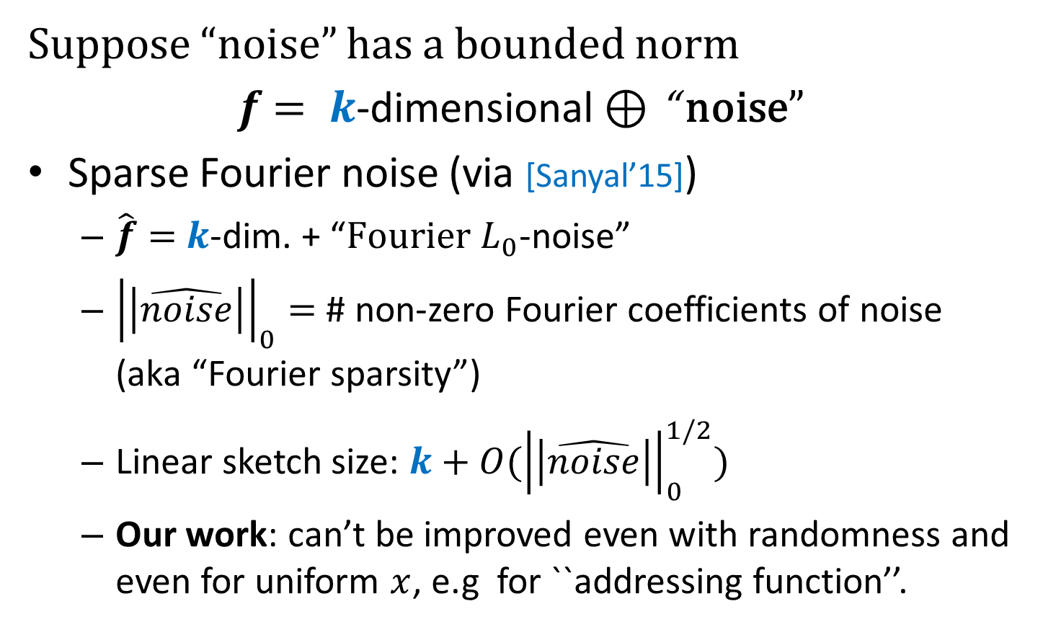
Deterministic Sketching and Noise
Suppose “noise” has a bounded norm
$f$ $= k$-dimensional $⊕$ “ noise”
Sparse Fourier noise (via [Sanyal’15])
$\hat{f}=$ $k$-dim. + “$Fourier L_{0}$-noise”
${\left|\left|\hat{noise}\right|\right|}_{0}^{}=$ # non-zero Fourier coefficients of noise (aka “Fourier sparsity”)
Linear sketch size: $k+O({\left|\left|\hat{noise}\right|\right|}_{0}^{1/2})$
Our work: can’t be improved even with randomness and even for uniform $x$, e.g for ``addressing function’’.

Slide 11
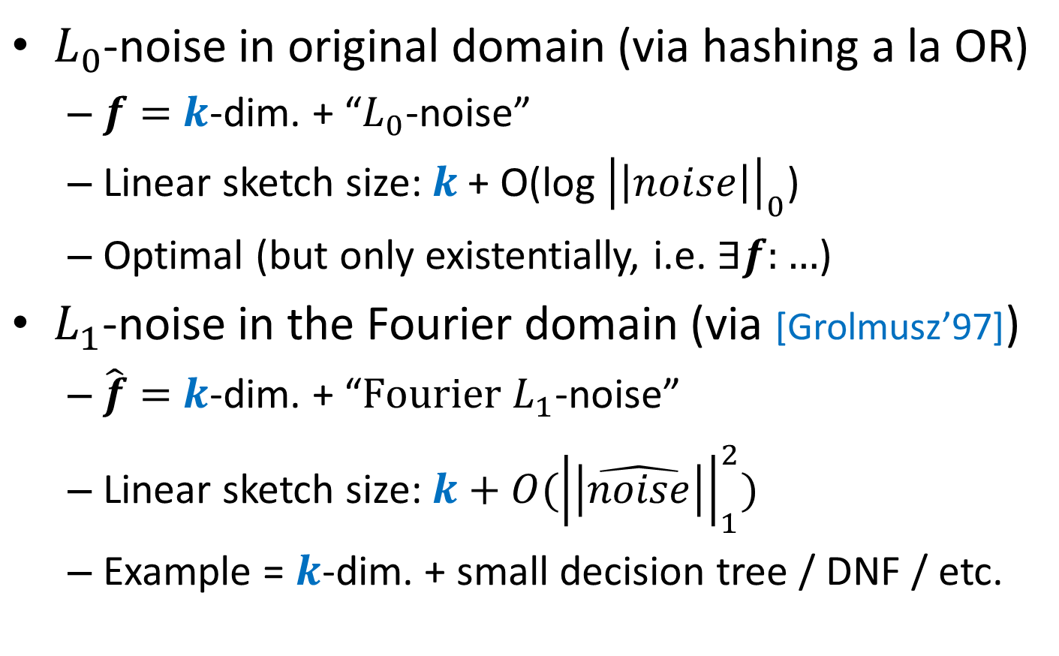
How Randomization Handles Noise
$L_{0}$-noise in original domain (via hashing a la OR)
$f=$ $k$-dim. + “$L_{0}$-noise”
Linear sketch size: $k \text{+ }\text{O}\text{(}\text{log} {\left|\left|noise\right|\right|}_{0}\text{)}$
Optimal (but only existentially, i.e. $∃f:…$)
$L_{1}$-noise in the Fourier domain (via [Grolmusz’97])
$\hat{f}=$ $k$-dim. + “$Fourier L_{1}$-noise”
Linear sketch size: $k+O({\left|\left|\hat{noise}\right|\right|}_{1}^{2})$
Example = $k$-dim. + small decision tree / DNF / etc.

Slide 12
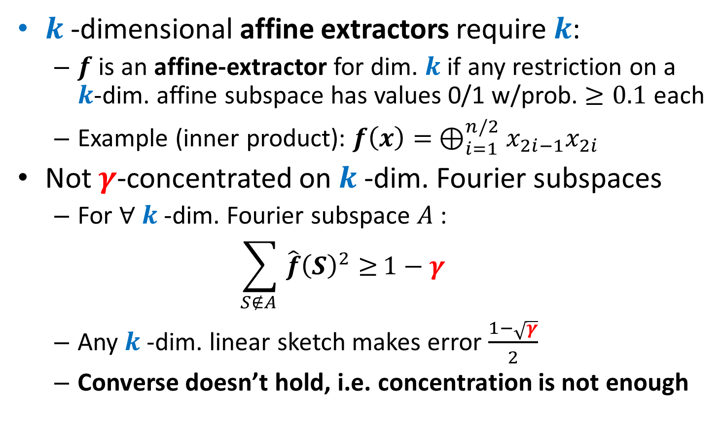
Randomized Sketching: Hardness
$k$-dimensional affine extractors require $k$:
$f$ is an affine-extractor for dim. $k$ if any restriction on a $k$-dim. affine subspace has values 0/1 w/prob. $≥0.1$ each
Example (inner product): $f\left(x\right)= ⊕_{i=1}^{n/2}x_{2i−1}x_{2i}$
Not $γ$-concentrated on $k$-dim. Fourier subspaces
For $∀ k$-dim. Fourier subspace $A$ :
$$\sum_{S∉A }{\hat{f}{\left(S\right)}^{2}≥}1−γ$$
Any $k$-dim. linear sketch makes error $\frac{1−\sqrt{γ}}{2}$
Converse doesn’t hold, i.e. concentration is not enough

Slide 13
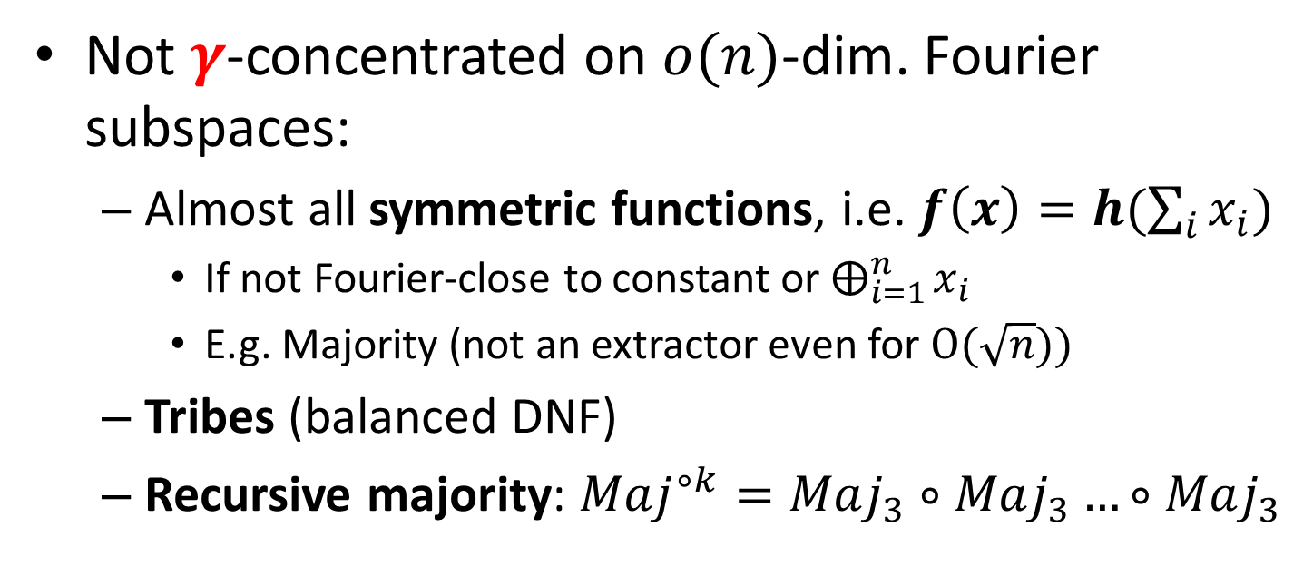
Randomized Sketching: Hardness
Not $γ$-concentrated on $o(n)$-dim. Fourier subspaces:
Almost all symmetric functions, i.e. $f\left(x\right)=h(\sum_{i}{x_{i}})$
If not Fourier-close to constant or $⨁_{i=1}^{n}{x_{i}}$
E.g. Majority (not an extractor even for $O(\sqrt{n}))$
Tribes (balanced DNF)
Recursive majority: $Maj^{∘k}=Maj_{3}∘Maj_{3}…∘Maj_{3}$

Slide 14



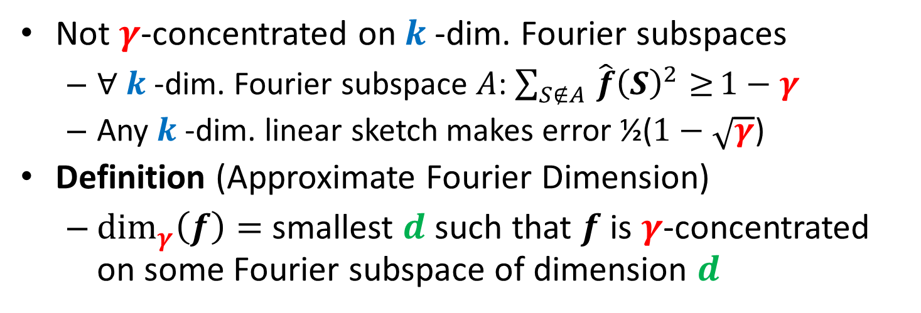





Approximate Fourier Dimension
Not $γ$-concentrated on $k$-dim. Fourier subspaces
$∀ k$-dim. Fourier subspace $A$: $\sum_{S∉A }{\hat{f}{\left(S\right)}^{2}≥}1−γ$
Any $k$-dim. linear sketch makes error ½($1−\sqrt{γ}$)
Definition (Approximate Fourier Dimension)
$\dim_{γ}\left(f\right)=$smallest $d$ such that $f$ is $γ$-concentrated on some Fourier subspace of dimension $d$
$$\hat{f}(S_{1}+S_{3})$$
$$\hat{f}({S_{1}+S}_{2}+S_{3})$$
$$\hat{f}(S_{1})$$
$$\hat{f}(S_{2}+S_{3})$$
$$\hat{f}(S_{2}+S_{3})$$
$$\hat{f}(S_{3})$$
$\sum_{S∈A }{\hat{f}{\left(S\right)}^{2}≥}$ $γ$
$$\hat{f}(S_{2})$$

Slide 15
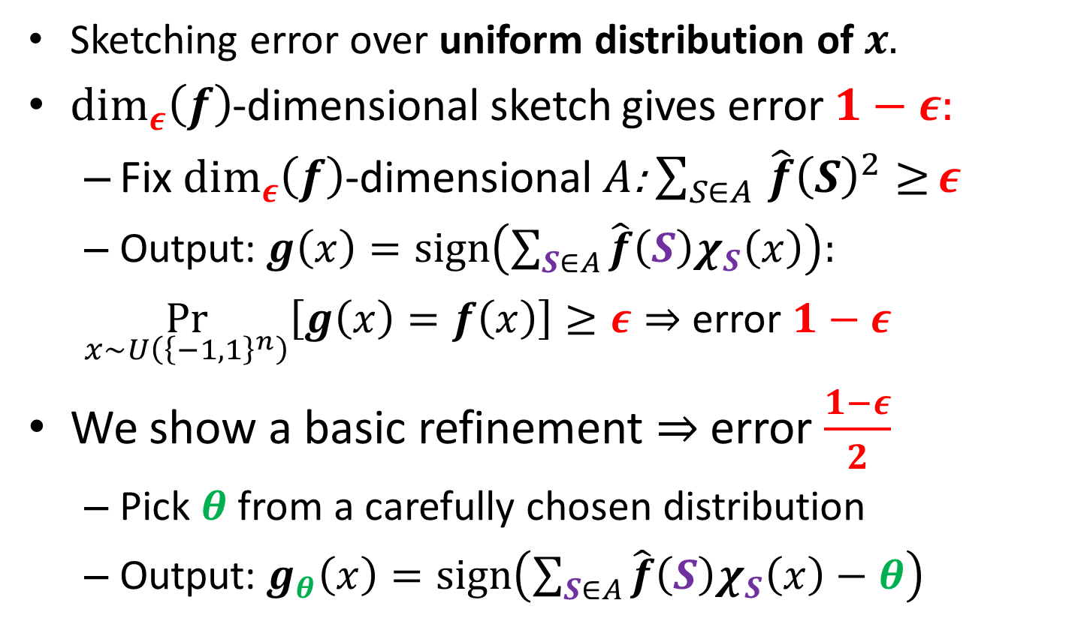
Sketching over Uniform Distribution + Approximate Fourier Dimension
Sketching error over uniform distribution of $x.$
$\dim_{ε}\left(f\right)$-dimensional sketch gives error $1−ε:$
Fix $\dim_{ε}\left(f\right)$-dimensional $A$: $\sum_{S∈A }{\hat{f}{\left(S\right)}^{2}≥}ε$
Output:$g\left(x\right)=sign\left(\sum_{S∈A}{\hat{f}\left(S\right)χ_{S}\left(x\right)}\right):$
$\underset{x∼U\left({\left\{−1,1\right\}}^{n}\right)}{Pr}\left[g\left(x\right)=f\left(x\right)\right]≥ε⇒$ error $1−ε$
We show a basic refinement $⇒$error $\frac{1−ε}{2}$
Pick $θ$ from a carefully chosen distribution
Output:$g_{θ}\left(x\right)=sign\left(\sum_{S∈A}{\hat{f}\left(S\right)χ_{S}\left(x\right)}−θ\right)$
1
-1
+1

Slide 16
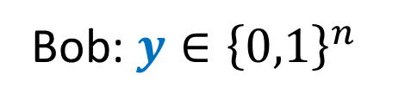
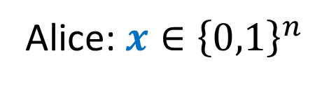
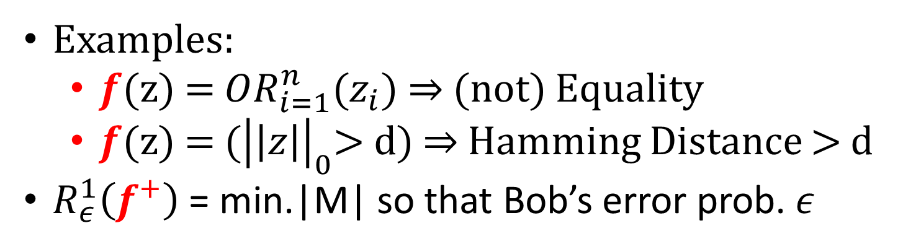


1-way Communication Complexity of XOR-functions
Shared randomness
Alice: $x{∈\left\{0,1\right\}}^{n}$
Bob: $y{∈\left\{0,1\right\}}^{n}$
$M(x)$
$$f^{+}=f(x⊕y)$$
Examples:
$f$(z) = $OR_{i=1}^{n}(z_{i})$ $⇒$(not) Equality
$f$(z) = $({\left|\left|z\right|\right|}_{0}\text{> }\text{d}\text{)}$ $⇒$Hamming Distance > d
$R_{ε}^{1}\left(f^{+}\right)$ = min.|M| so that Bob’s error prob. $ε$

Slide 17
Communication Complexity of XOR-functions
Well-studied (often for 2-way communication):
[Montanaro,Osborne], ArXiv’09
[Shi, Zhang], QIC’09,
[Tsang, Wong, Xie, Zhang], FOCS’13
[O’Donnell, Wright, Zhao,Sun,Tan], CCC’14
[Hatami, Hosseini, Lovett], FOCS’16
Connections to log-rank conjecture [Lovett’14]:
Even special case for XOR-functions still open

Slide 18
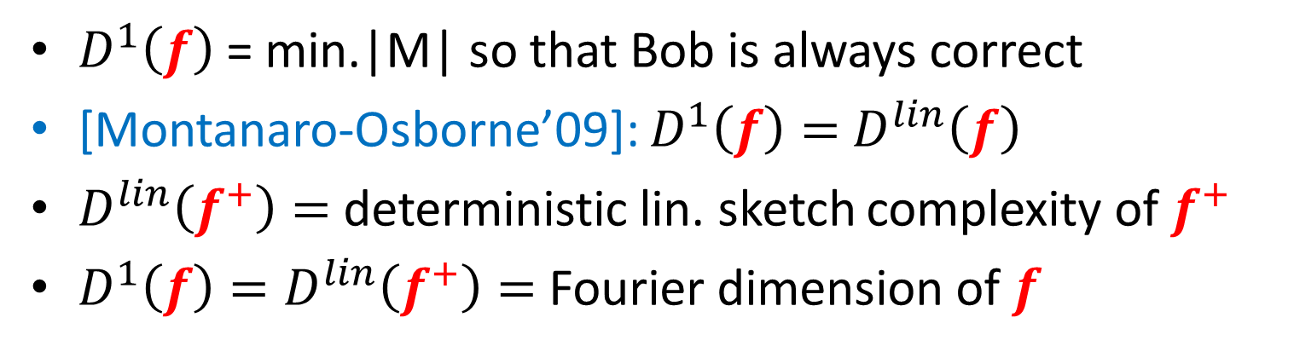
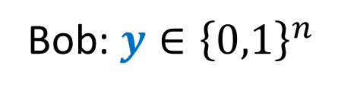


Deterministic 1-way Communication Complexity of XOR-functions
Alice: $x{∈\left\{0,1\right\}}^{n}$
Bob: $y{∈\left\{0,1\right\}}^{n}$
$M(x)$
$$f^{+}=f(x⊕y)$$
$D_{}^{1}\left(f\right)$ = min.|M| so that Bob is always correct
[Montanaro-Osborne’09]: $D_{}^{1}\left(f\right)=$ $D_{}^{lin}\left(f\right)$
$D_{}^{lin}\left(f^{+}\right)=$ deterministic lin. sketch complexity of $f^{+}$
$D_{}^{1}\left(f\right)=D_{}^{lin}\left(f^{+}\right)=$ Fourier dimension of $f$

Slide 19


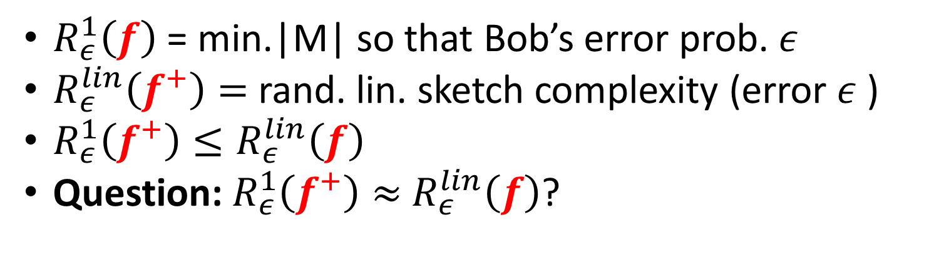

1-way Communication Complexity of XOR-functions
Shared randomness
Alice: $x{∈\left\{0,1\right\}}^{n}$
Bob: $y{∈\left\{0,1\right\}}^{n}$
$M(x)$
$$f(x⊕y)$$
$R_{ε}^{1}\left(f\right)$ = min.|M| so that Bob’s error prob. $ε$
$R_{ε}^{lin}\left(f^{+}\right)=$ rand. lin. sketch complexity (error $ε$ )
$R_{ε}^{1}\left(f^{+}\right)≤R_{ε}^{lin}\left(f\right)$
Question: $R_{ε}^{1}\left(f^{+}\right)≈$ $R_{ε}^{lin}\left(f\right)$?

Slide 20
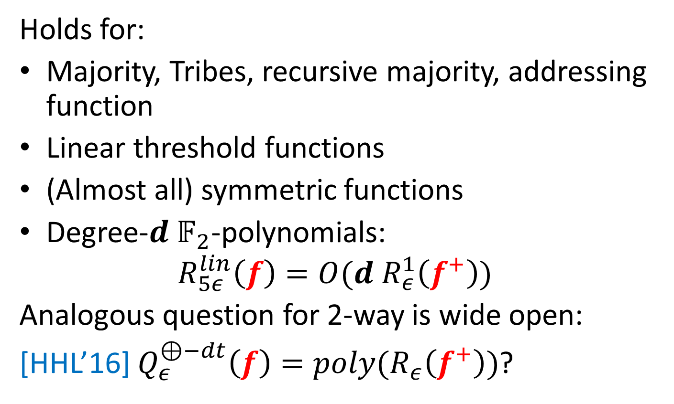

$R_{ε}^{1}\left(f^{+}\right)≈$ $R_{ε}^{lin}\left(f\right)$?
Holds for:
Majority, Tribes, recursive majority, addressing function
Linear threshold functions
(Almost all) symmetric functions
Degree-$d$ $𝔽_{2}$-polynomials:
$${R_{5ε}^{lin}\left(f\right)=O(d R}_{ε}^{1}\left(f^{+}\right))$$
Analogous question for 2-way is wide open:
[HHL’16] $Q_{ε}^{⊕−dt}\left(f\right)=poly(R_{ε}^{}\left(f^{+}\right))$?

Slide 21

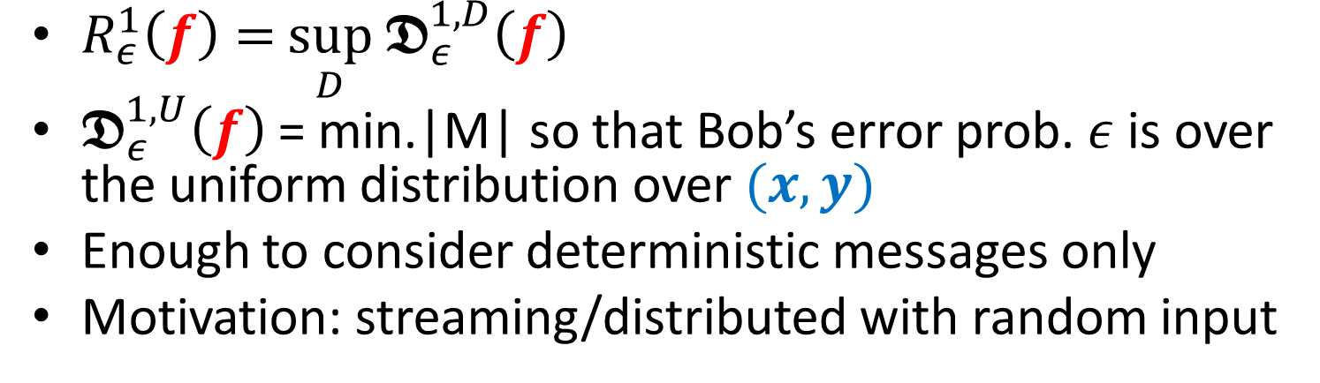
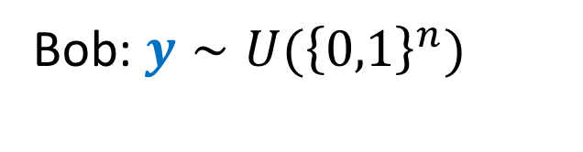

Distributional 1-way Communication under Uniform Distribution
Alice: $x{∼U(\left\{0,1\right\}}^{n})$
Bob: $y{∼U(\left\{0,1\right\}}^{n})$
$M(x)$
$$f(x⊕y)$$
$R_{ε}^{1}\left(f\right)=$ $\sup_{D}$ $𝕯_{ε}^{1,D}\left(f\right)$
$𝕯_{ε}^{1,U}\left(f\right)$ = min.|M| so that Bob’s error prob. $ε$ is over the uniform distribution over $(x,y)$
Enough to consider deterministic messages only
Motivation: streaming/distributed with random input

Slide 22

Sketching over Uniform Distribution
$$\text{Thm}\text{: }\text{If}\dim_{ε}\left(f\right)= d−1 \text{then} 𝕯_{\frac{1−ε_{ }}{6}}^{1,U}\left(f^{+}\right)≥\frac{d}{6}.$$
Optimal up to error as $d$-dim. linear sketch has error $\frac{1−ε_{ }}{2}$
Weaker: If $ε_{2}>ε_{1}, \dim_{ε_{1}}(f){=\dim_{ε_{2}}(f)}=$ $d−1$ then:
$$𝕯_{δ }^{1,U}(f)≥d,$$
where $δ=(ε_{2}−ε_{1})/4.$
Corollary: If$\hat{f}(∅)<C$ for $C<1$ then there exists $d$:
$𝕯_{Θ\left(\frac{1}{n}\right)}^{1,U}\left(f\right)≥d$.
Tight for the Majority function, etc.

Slide 23
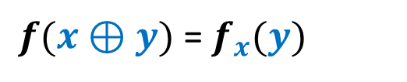








$𝕯_{ε}^{1,U}$ and Approximate Fourier Dimension
Thm: If $ε_{2}>ε_{1}>0, \dim_{ε_{1}}(f){=\dim_{ε_{2}}(f)}=$ $d−1$ then:
$$𝕯_{δ }^{1,U}(f)≥d,$$
where $δ=(ε_{2}−ε_{1})/4.$
$$y∈{\left\{0,1\right\}}^{n}$$
$f(x⊕y)$ = $f_{x}(y)$
$f_{x_{1}}$
$f_{x_{2}}$
00
01
10
11
$f_{x_{3}}$
$$x∈{\left\{0,1\right\}}^{n}$$
$$M(x)=$$

Slide 24
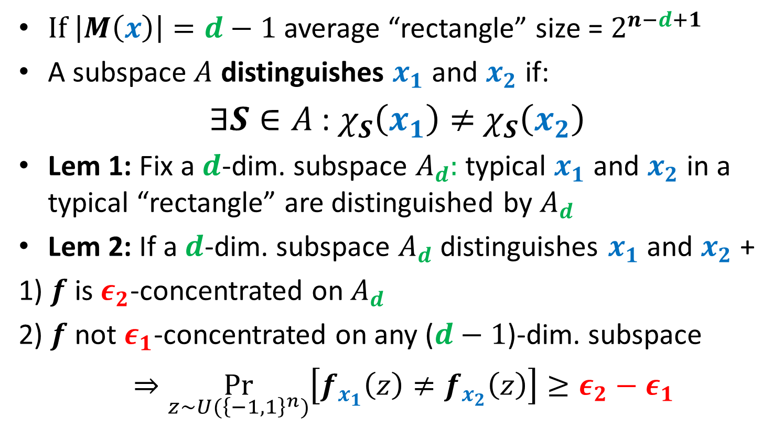
$𝕯_{ε}^{1,U}$ and Approximate Fourier Dimension
$If \left|M\left(x\right)\right|=d−1$ average “rectangle” size = $2^{n−d+1}$
A subspace$A$ distinguishes $x_{1}$ and $x_{2}$ if:
$∃S∈A$:$χ_{S}\left(x_{1}\right)≠$ $χ_{S}\left(x_{2}\right)$
Lem 1: Fix a $d$-dim. subspace $A_{d}:$ typical $x_{1}$ and $x_{2}$ in a typical “rectangle” are distinguished by $A_{d}$
Lem 2: If a $d$-dim. subspace $A_{d}$ distinguishes $x_{1}$and $x_{2}$ +
1) $f$ is $ε_{2}$-concentrated on $A_{d}$
2) $f$ not $ε_{1}$-concentrated on any ($d−1$)-dim. subspace
$⇒\underset{z∼U({\left\{−1,1\right\}}^{n})}{Pr}\left[f_{x_{1}}\left(z\right)≠f_{x_{2}}\left(z\right)\right]≥ε_{2}−ε_{1}$

Slide 25

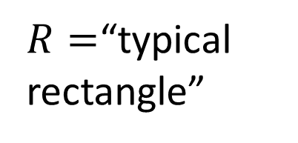



$𝕯_{ε}^{1,U}$ and Approximate Fourier Dimension
Thm: If $ε_{2}>ε_{1}>0, \dim_{ε_{1}}(f){=\dim_{ε_{2}}(f)}=$ $d−1$ then:
$$𝕯_{δ }^{1,U}(f)≥d,$$
Where $δ=(ε_{2}−ε_{1})/4.$
$\underset{z∼U({\left\{−1,1\right\}}^{n})}{Pr}\left[f_{x_{1}}\left(z\right)≠f_{x_{2}}\left(z\right)\right]≥ε_{2}−ε_{1}$
Error for fixed $y$ = min($\underset{x∈R}{Pr}$[$f_{x}\left(y\right)=0$], $\underset{x∈R}{Pr}[f_{x}\left(y\right)=1$])
Average error for ($x,y$)$∈R$ = $Ω(ε_{2}−ε_{1})$
$$y$$
$g_{x_{1}}$
0 | 1 | 1 | 0 | 0 | 0 | 1 | 0
0 | 1 | 0 | 1 | 0 | 1 | 1 | 0
 |  |  | 0
$R=$“typical rectangle”
$g_{x_{2}}$

Slide 26
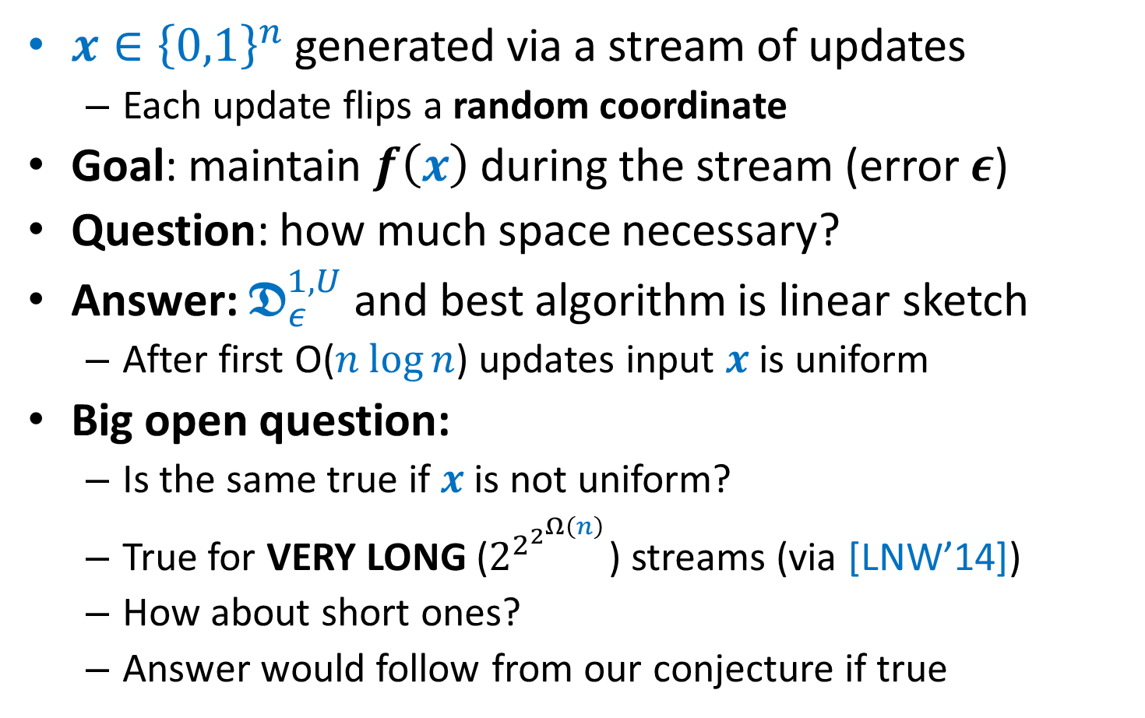
Application: Random Streams
$x∈{\left\{0,1\right\}}^{n}$ generated via a stream of updates
Each update flips a random coordinate
Goal: maintain $f\left(x\right)$ during the stream (error $ε$)
Question: how much space necessary?
Answer: $𝕯_{ε}^{1,U}$ and best algorithm is linear sketch
After first O($n log⁡n$) updates input $x$ is uniform
Big open question:
Is the same true if $x$ is not uniform?
True for VERY LONG ($2^{2^{2^{Ω\left(n\right)}}}$) streams (via [LNW’14])
How about short ones?
Answer would follow from our conjecture if true

Slide 27

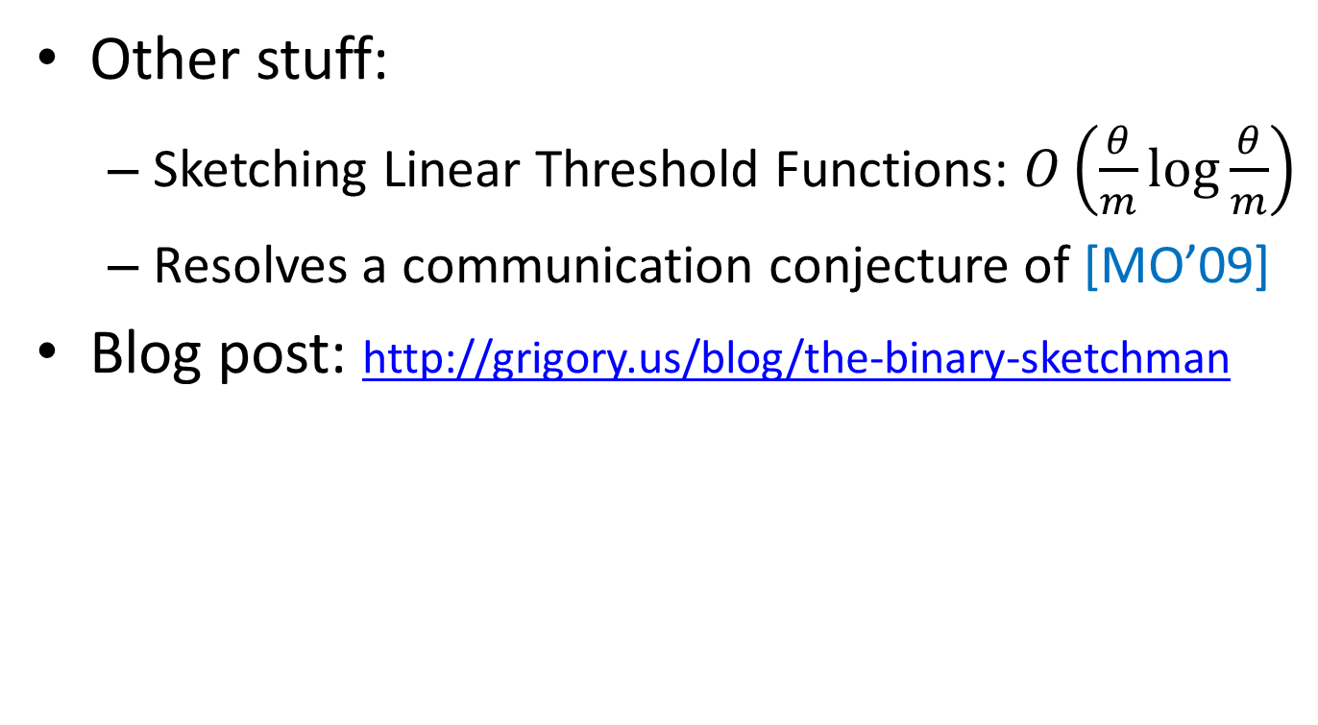
Thanks! Questions?
Other stuff:
Sketching Linear Threshold Functions: $O\left(\frac{θ}{m}\log{\frac{θ}{m}}\right)$
Resolves a communication conjecture of [MO’09]
Blog post: http://grigory.us/blog/the-binary-sketchman

Slide 28
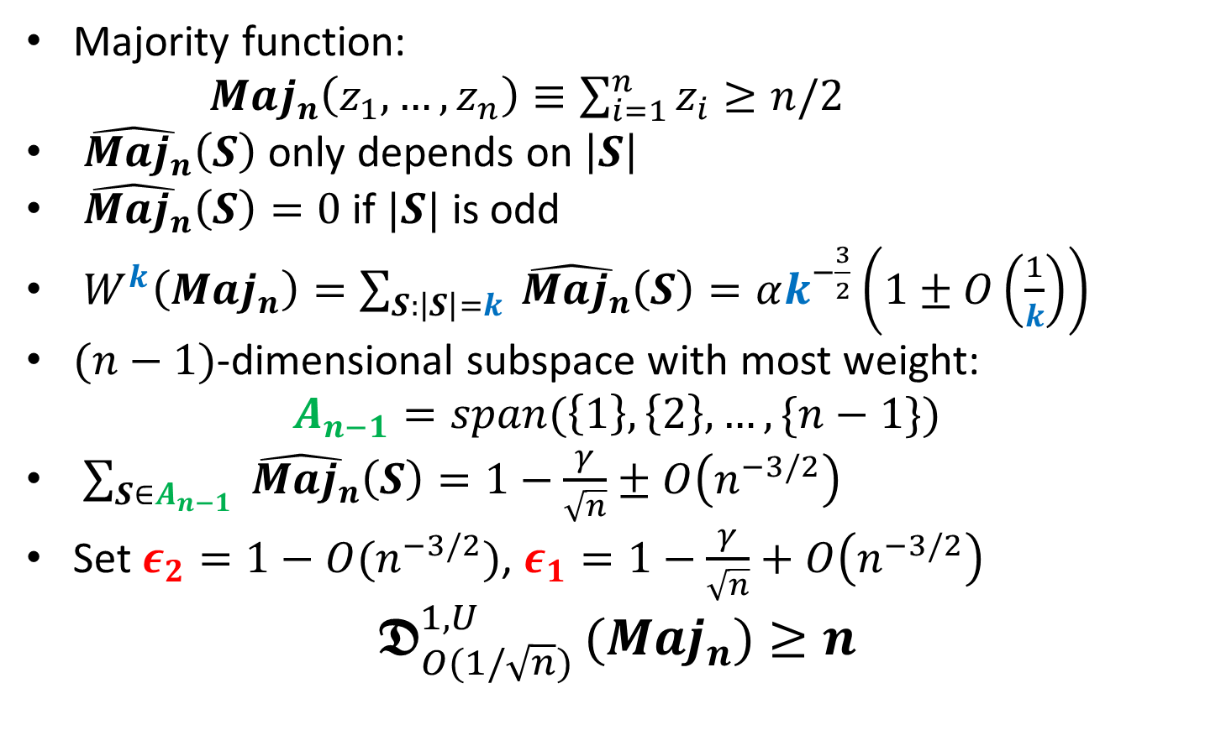
Example: Majority
Majority function:
$Maj_{n}\left(z_{1},…,z_{n}\right)≡\sum_{i=1}^{n}{z_{i}≥n/2}$
$\hat{ Maj_{n}}\left(S\right)$ only depends on $\left|S\right|$
$\hat{ Maj_{n}}\left(S\right)=0$ if $|S|$ is odd
$W^{k}\left(Maj_{n}\right)=\sum_{S:\left|S\right|=k}{\hat{ Maj_{n}}\left(S\right)=αk^{−\frac{3}{2}}\left(1±O\left(\frac{1}{k}\right)\right)}$
$(n−1)$-dimensional subspace with most weight:
$$A_{n−1}=span(\left\{1\right\},\left\{2\right\},…,\{n−1\})$$
$\sum_{S∈A_{n−1}}{\hat{ Maj_{n}}\left(S\right)}=1−\frac{γ}{\sqrt{n}}±O\left(n^{−3/2}\right)$
Set $ε_{2}=1−O(n^{−3/2})$, $ε_{1}=1−\frac{γ}{\sqrt{n}}+O\left(n^{−3/2}\right)$
$$𝕯_{O(1/\sqrt{n}) }^{1,U}(Maj_{n})≥n$$

