Slide 1

CIS 700: “algorithms for Big Data”
Lecture 8:
Gradient Descent
Slides at http://grigory.us/big-data-class.html
Grigory Yaroslavtsev
http://grigory.us

Slide 2
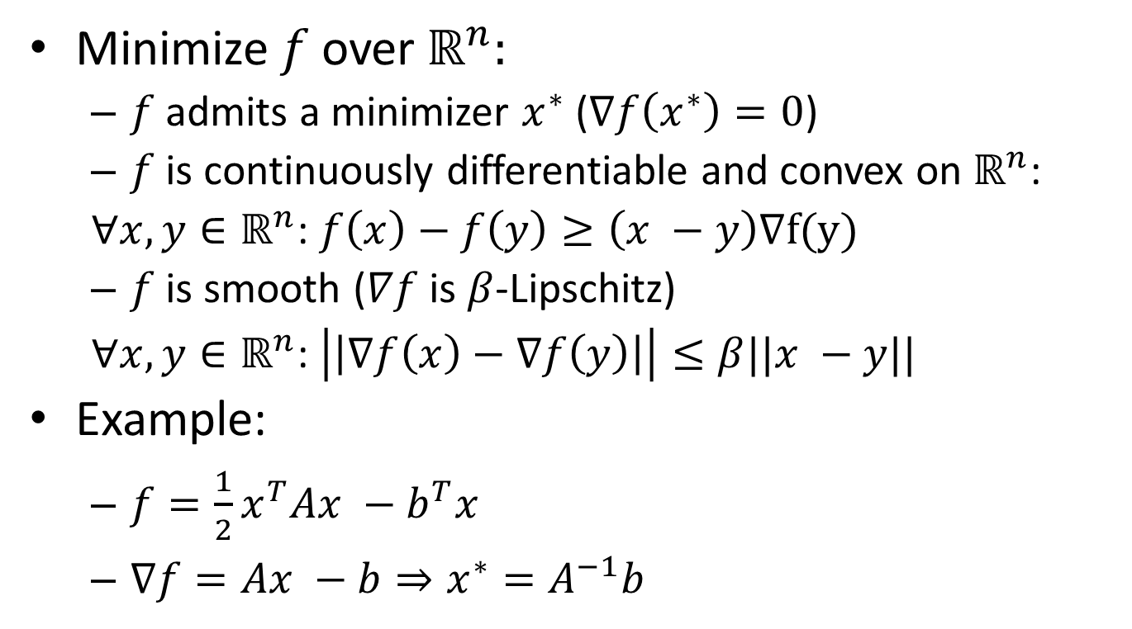
Smooth Convex Optimization
Minimize $f$ over $ℝ^{n}:$
$f$ admits a minimizer $x^{∗}$ ($∇f\left(x^{∗}\right)=0$)
$f$ is continuously differentiable and convex on $ℝ^{n}$:
$∀x,y∈ℝ^{n}$: $f\left(x\right)−f\left(y\right)≥\left(x −y\right)∇f(y)$
$f$ is smooth ($∇f$ is $β$-Lipschitz)
$∀x,y∈ℝ^{n}$: $\left|\left|∇f\left(x\right)−∇f\left(y\right)\right|\right|≤β||x −y||$
Example:
$f={\frac{1}{2}x}^{T}Ax −b^{T}x$
$∇f=Ax −b⇒x^{∗}=A^{−1}b$

Slide 3
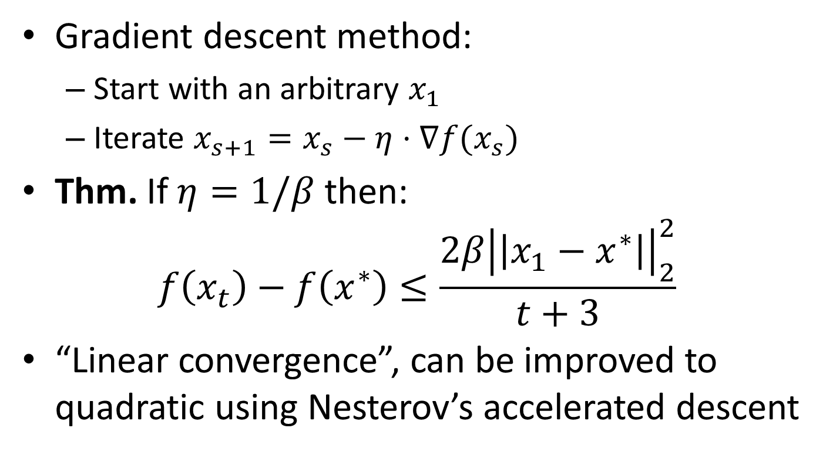
Gradient Descent Method
Gradient descent method:
Start with an arbitrary $x_{1}$
Iterate $x_{s+1}=x_{s}−η⋅∇f(x_{s})$
Thm. If $η=1/β$ then:
$$f\left(x_{t}\right)−f\left(x^{∗}\right)≤\frac{2β{\left|\left|x_{1}−x^{∗}\right|\right|}_{2}^{2}}{t+3}$$
“Linear convergence”, can be improved to quadratic using Nesterov’s accelerated descent

Slide 4
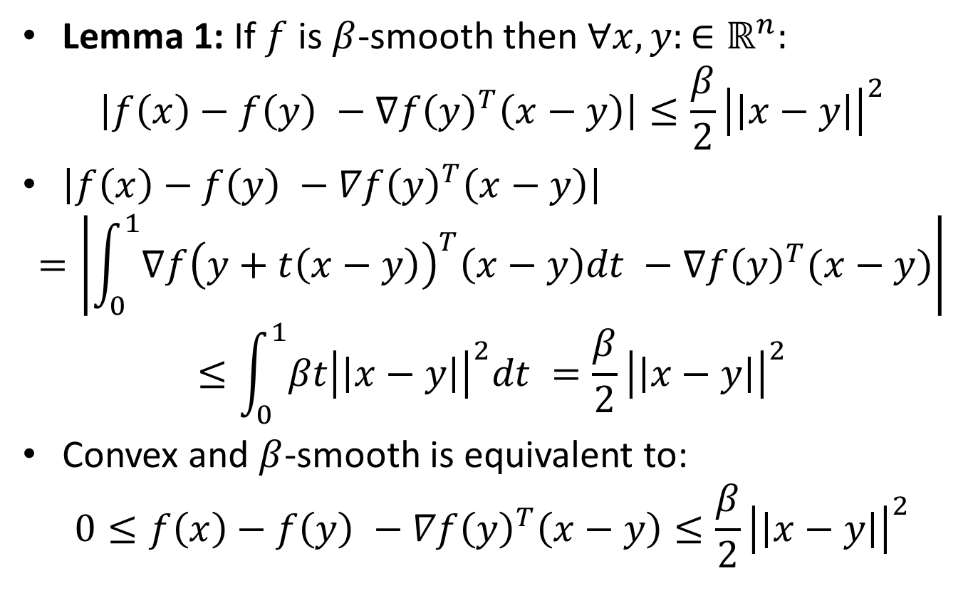
Gradient Descent: Analysis
Lemma 1: If $f$ is $β$-smooth then $∀x,y:∈ℝ^{n}:$
$$\left|f\left(x\right)−f\left(y\right) −∇f{\left(y\right)}^{T}\left(x−y\right)\right|≤\frac{β}{2}{\left|\left|x−y\right|\right|}^{2}$$
$\left|f\left(x\right)−f\left(y\right) −∇f{\left(y\right)}^{T}\left(x−y\right)\right|$
$$=\left|\int_{0}^{1}{∇f{\left(y+t\left(x−y\right)\right)}^{T}\left(x−y\right)dt} −∇f{\left(y\right)}^{T}(x−y)\right|$$
$$≤\int_{0}^{1}{βt{\left|\left|x−y\right|\right|}^{2}dt }=\frac{β}{2}{\left|\left|x−y\right|\right|}^{2}$$
Convex and $β$-smooth is equivalent to:
$$0≤f\left(x\right)−f\left(y\right) −∇f{\left(y\right)}^{T}\left(x−y\right)≤\frac{β}{2}{\left|\left|x−y\right|\right|}^{2}$$

Slide 5
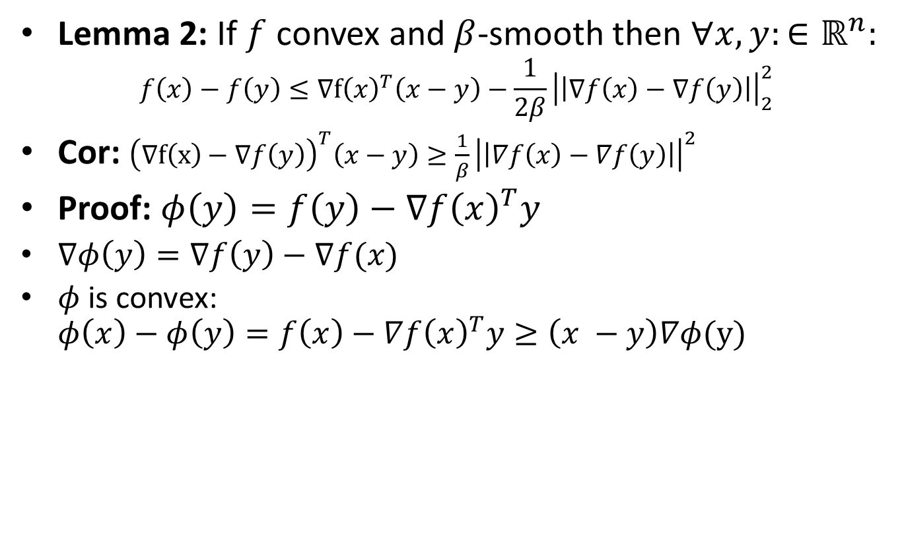
Gradient Descent: Analysis
Lemma 2: If $f$ convex and $β$-smooth then $∀x,y:∈ℝ^{n}:$
$$f\left(x\right)−f\left(y\right)≤∇f{\left(x\right)}^{T}\left(x−y\right)−\frac{1}{2β}{\left|\left|∇f\left(x\right)−∇f\left(y\right)\right|\right|}_{2}^{2}$$
Cor: ${\left(∇f\left(x\right)−∇f\left(y\right)\right)}^{T}\left(x−y\right)≥\frac{1}{β}{\left|\left|∇f\left(x\right)−∇f\left(y\right)\right|\right|}^{2}$
Proof: $φ\left(y\right)=f\left(y\right)−∇f{\left(x\right)}^{T}y$
$∇φ\left(y\right)=∇f\left(y\right)−∇f(x)$
$φ$ is convex: $φ\left(x\right)−φ\left(y\right)=f\left(x\right)−∇f{\left(x\right)}^{T}y≥\left(x −y\right)∇φ(y)$

