Slide 1
CSCI B609: “Foundations of Data Science”
Lecture 6: Best-Fit Subspaces and SVD
Slides at http://grigory.us/data-science-class.html
Grigory Yaroslavtsev
http://grigory.us

Slide 2
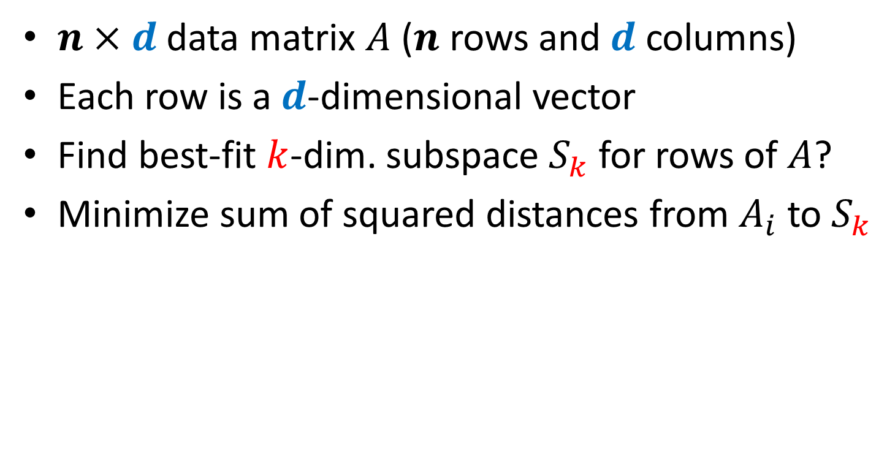
Singular Value Decomposition: Intro
$n×d$ data matrix $A$ ($n$ rows and $d$ columns)
Each row is a $d$-dimensional vector
Find best-fit $k$-dim. subspace $S_{k}$ for rows of $A$?
Minimize sum of squared distances from $A_{i}$ to $S_{k}$

Slide 3
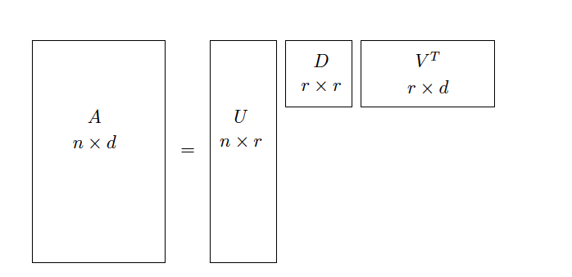

SVD: Greedy Strategy
Find best fit 1-dimensional line
Repeat $k$ times
When $k=r=rank(A)$ we get the SVD:
$$A=UDV^{T}$$

Slide 4

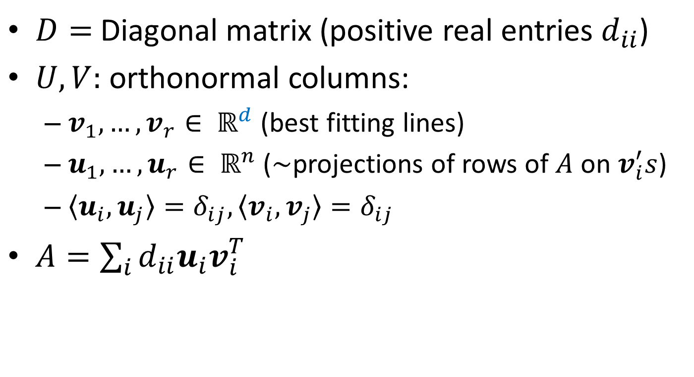
$A=UDV^{T}$: Basic Properties
$D=$ Diagonal matrix (positive real entries $d_{ii}$)
$U,V:$ orthonormal columns:
$v_{1},…, v_{r}∈ ℝ^{d}$ (best fitting lines)
$u_{1},…, u_{r}∈ ℝ^{n}$ ($\sim$projections of rows of $A$ on $v_{i}^{′}s$)
$〈u_{i},u_{j}〉=δ_{ij},〈v_{i},v_{j}〉=δ_{ij}$
$A=\sum_{i}{d_{ii}u_{i}v_{i}^{T}}$

Slide 5
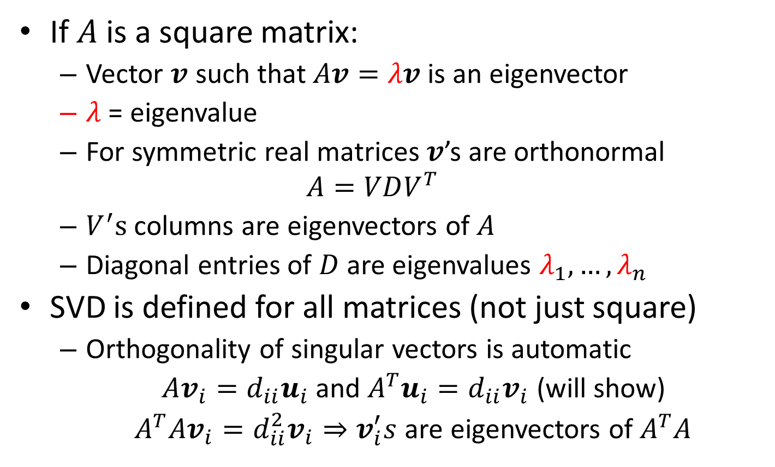
Singular Values vs. Eigenvalues
If $A$ is a square matrix:
Vector $v$ such that $Av=λv$ is an eigenvector
$λ$ = eigenvalue
For symmetric real matrices $v$’s are orthonormal
$$A=VDV^{T}$$
$V^{′}s$ columns are eigenvectors of $A$
Diagonal entries of $D$ are eigenvalues $λ_{1},…, λ_{n}$
SVD is defined for all matrices (not just square)
Orthogonality of singular vectors is automatic
$Av_{i}=d_{ii}u_{i}$ and $A^{T}u_{i}=d_{ii}v_{i}$ (will show)
$A^{T}Av_{i}=d_{ii}^{2}v_{i}⇒v_{i}^{′}s$ are eigenvectors of $A^{T}A$

Slide 6
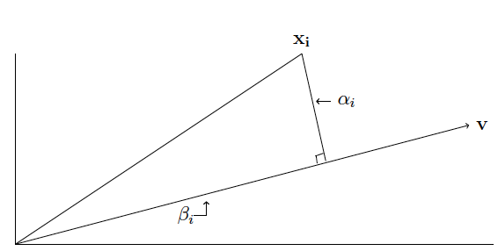
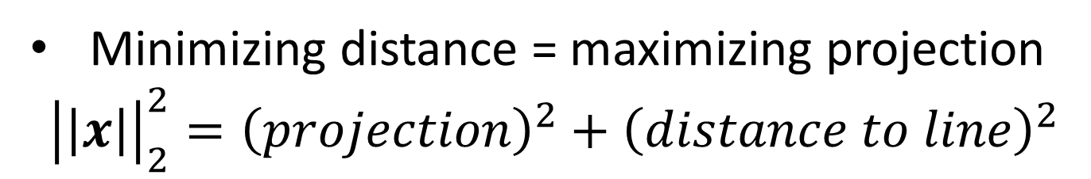
Projections and Distances
Minimizing distance = maximizing projection
$${\left|\left|x\right|\right|}_{2}^{2}={\left(projection\right)}^{2}+{\left(distance to line\right)}^{2}$$

Slide 7
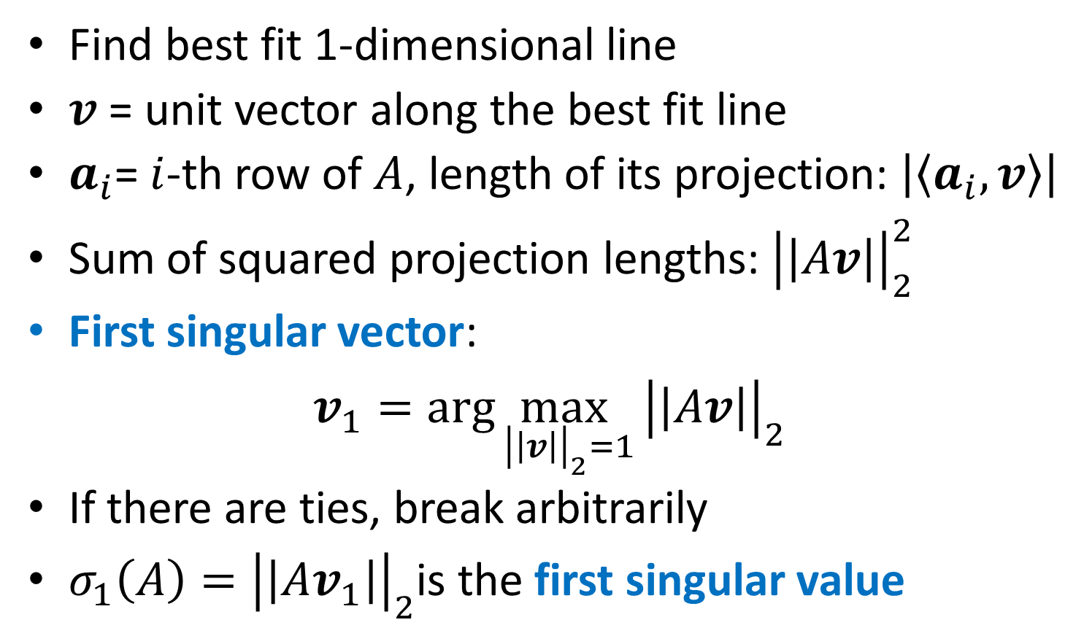
SVD: First Singular Vector
Find best fit 1-dimensional line
$v$ = unit vector along the best fit line
$a_{i}$= $i$-th row of $A$, length of its projection: $\left|〈a_{i},v〉\right|$
Sum of squared projection lengths: ${\left|\left|Av\right|\right|}_{2}^{2}$
First singular vector:
$v_{1}=\arg{\max_{{\left|\left|v\right|\right|}_{2}=1}}{\left|\left|Av\right|\right|}_{2}^{}$
If there are ties, break arbitrarily
$σ_{1}\left(A\right)={\left|\left|Av_{1}\right|\right|}_{2}$is the first singular value

Slide 8
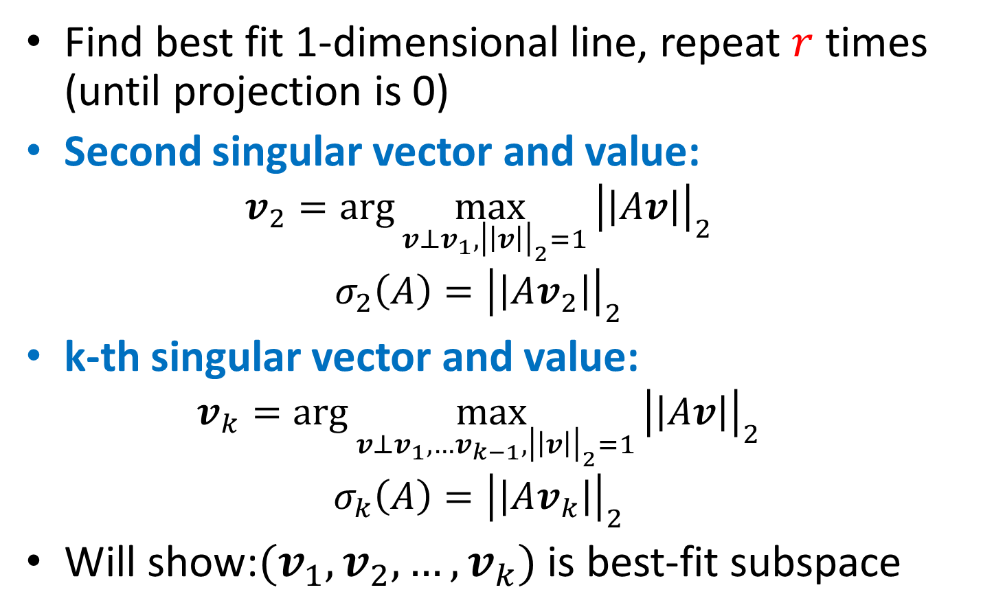
SVD: Greedy Construction
Find best fit 1-dimensional line, repeat $r$ times (until projection is 0)
Second singular vector and value:
$$v_{2}=\arg{\max_{{v⊥v_{1},\left|\left|v\right|\right|}_{2}=1}}{\left|\left|Av\right|\right|}_{2}^{}$$
$$σ_{2}\left(A\right)={\left|\left|Av_{2}\right|\right|}_{2}$$
k-th singular vector and value:
$$v_{k}=\arg{\max_{{v⊥v_{1},…v_{k−1},\left|\left|v\right|\right|}_{2}=1}}{\left|\left|Av\right|\right|}_{2}^{}$$
$$σ_{k}\left(A\right)={\left|\left|Av_{k}\right|\right|}_{2}$$
Will show:$(v_{1},v_{2},…,v_{k})$ is best-fit subspace

Slide 9
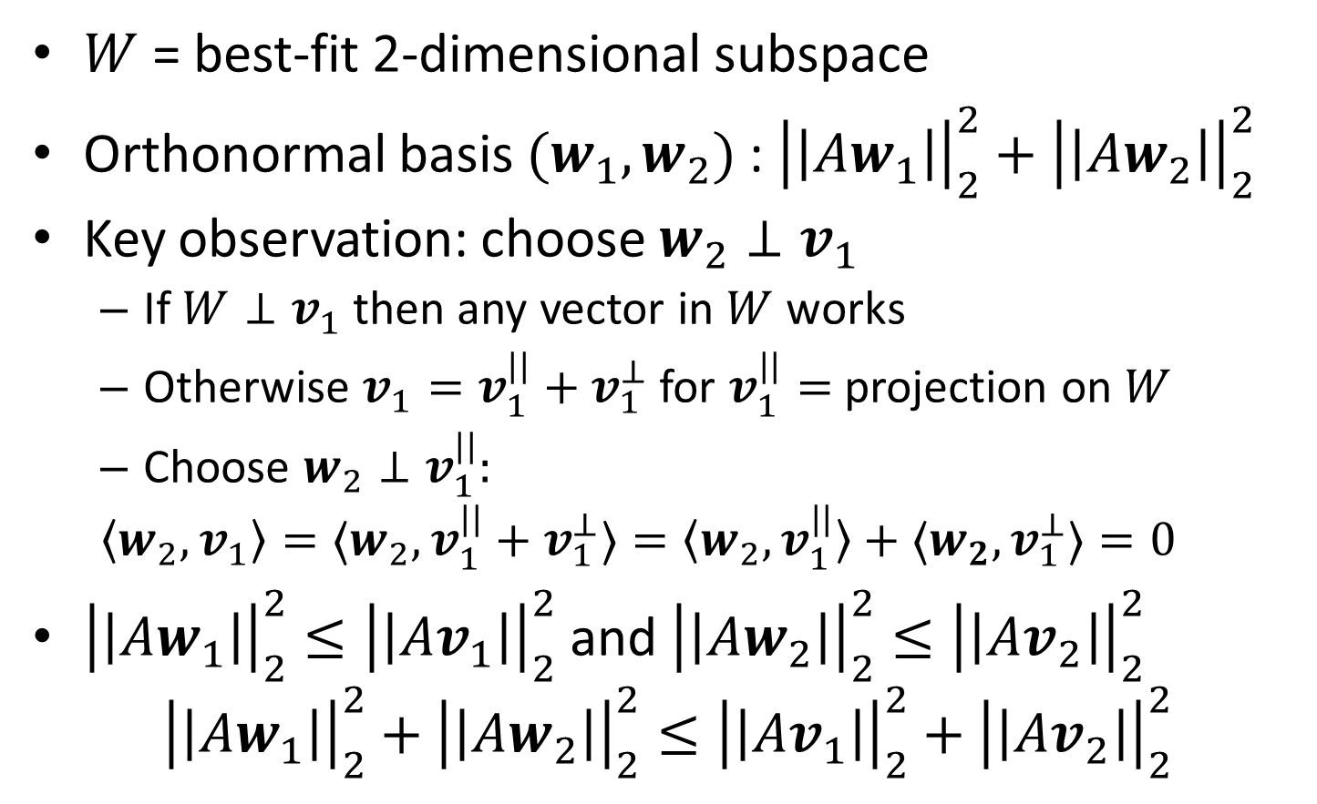
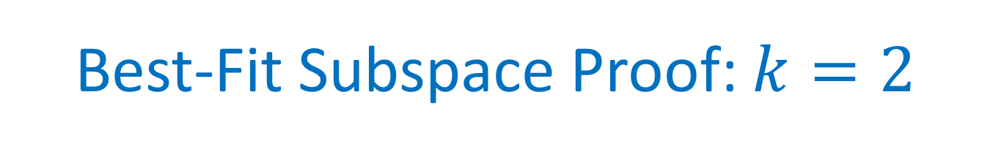
Best-Fit Subspace Proof: $k=2$
$W$ = best-fit 2-dimensional subspace
Orthonormal basis $(w_{1},w_{2})$ : ${\left|\left|Aw_{1}\right|\right|}_{2}^{2}+{\left|\left|Aw_{2}\right|\right|}_{2}^{2}$
Key observation: choose $w_{2}⊥v_{1}$
If $W⊥v_{1}$ then any vector in $W$ works
Otherwise ${v_{1}=v}_{1}^{||}+v_{1}^{⊥}$ for $v_{1}^{||}=$ projection on $W$
Choose $w_{2}⊥v_{1}^{||}:$
$$〈w_{2},v_{1}〉=〈w_{2},v_{1}^{||}+v_{1}^{⊥}〉=〈w_{2},v_{1}^{||}〉+{〈w_{2},v}_{1}^{⊥}〉=0$$
${\left|\left|Aw_{1}\right|\right|}_{2}^{2}≤{\left|\left|Av_{1}\right|\right|}_{2}^{2}$ and ${\left|\left|Aw_{2}\right|\right|}_{2}^{2}≤{\left|\left|Av_{2}\right|\right|}_{2}^{2}$
$${\left|\left|Aw_{1}\right|\right|}_{2}^{2}+{\left|\left|Aw_{2}\right|\right|}_{2}^{2}≤{\left|\left|Av_{1}\right|\right|}_{2}^{2}+{\left|\left|Av_{2}\right|\right|}_{2}^{2}$$

Slide 10
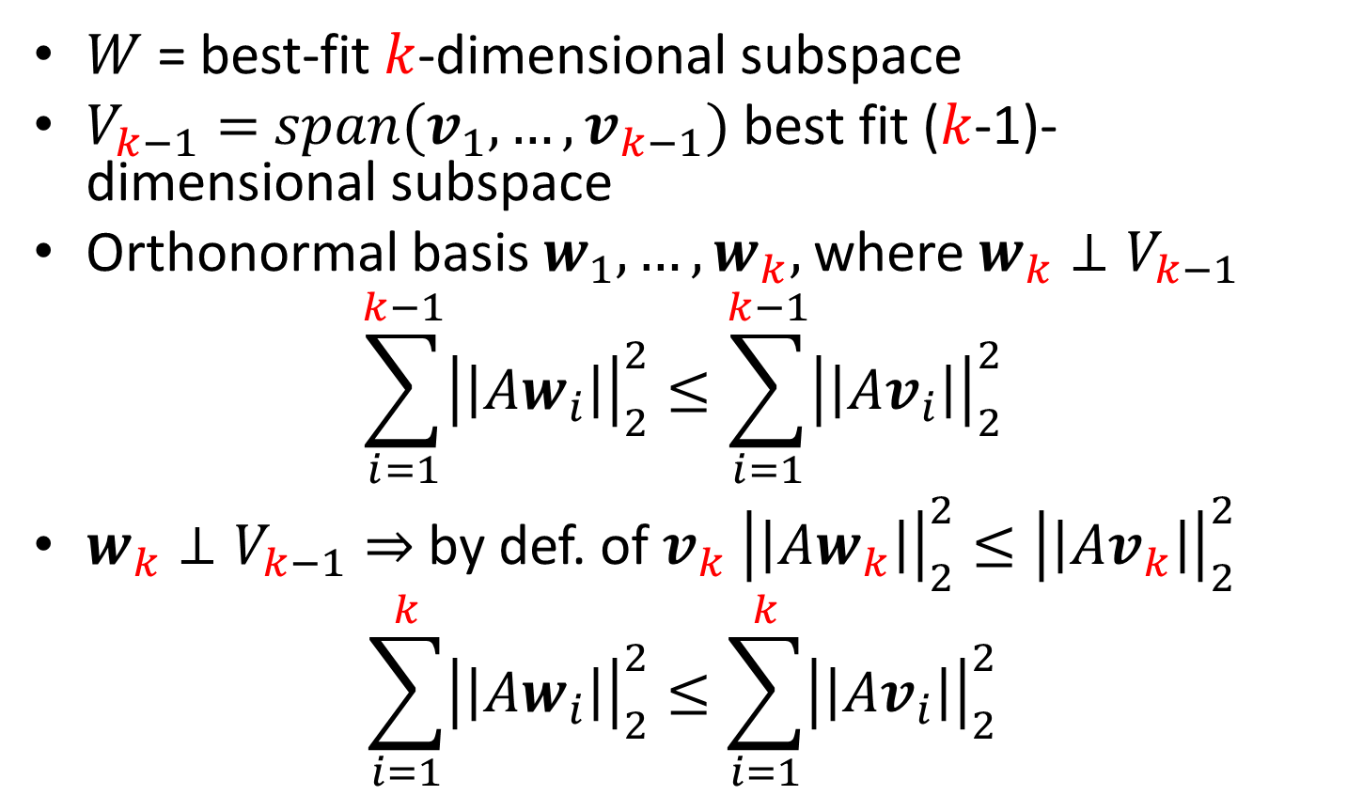

Best-Fit Subspace Proof: General $k$
$W$ = best-fit $k$-dimensional subspace
$V_{k−1}=$ $span(v_{1},…, v_{k−1})$ best fit ($k$-1)-dimensional subspace
Orthonormal basis $w_{1}, …,w_{k},$ where $w_{k}⊥V_{k−1}$
$$\sum_{i=1}^{k−1}{{\left|\left|Aw_{i}\right|\right|}_{2}^{2}}≤\sum_{i=1}^{k−1}{{\left|\left|Av_{i}\right|\right|}_{2}^{2}}$$
$w_{k}⊥V_{k−1}⇒$by def. of $v_{k}$ ${\left|\left|Aw_{k}\right|\right|}_{2}^{2}≤{\left|\left|Av_{k}\right|\right|}_{2}^{2}$
$$\sum_{i=1}^{k}{{\left|\left|Aw_{i}\right|\right|}_{2}^{2}}≤\sum_{i=1}^{k}{{\left|\left|Av_{i}\right|\right|}_{2}^{2}}$$

Slide 11
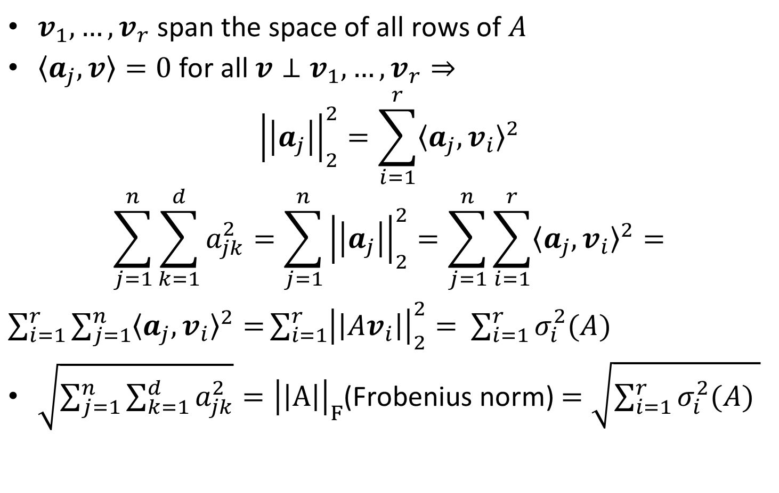
Singular Values and Frobenius Norm
$v_{1}, …, v_{r}$ span the space of all rows of $A$
$〈a_{j},v〉=0$ for all $v⊥v_{1},…,v_{r}⇒$
$${\left|\left|a_{j}\right|\right|}_{2}^{2}=\sum_{i=1}^{r}{{〈a_{j},v_{i}〉}^{2}}$$
$$\sum_{j=1}^{n}{\sum_{k=1}^{d}{a_{jk}^{2}}}=\sum_{j=1}^{n}{{\left|\left|a_{j}\right|\right|}_{2}^{2}}=\sum_{j=1}^{n}{\sum_{i=1}^{r}{{〈a_{j},v_{i}〉}^{2}}=}$$
$\sum_{i=1}^{r}{\sum_{j=1}^{n}{{〈a_{j},v_{i}〉}^{2}}=}\sum_{i=1}^{r}{{\left|\left|Av_{i}\right|\right|}_{2}^{2}= }$ $\sum_{i=1}^{r}{σ_{i}^{2}(A) }$
$\sqrt{\sum_{j=1}^{n}{\sum_{k=1}^{d}{a_{jk}^{2}}}}={\left|\left|A\right|\right|}_{F}$(Frobenius norm) $=\sqrt{\sum_{i=1}^{r}{σ_{i}^{2}(A) }}$

