Slide 1

“algorithms for Big Data”
Lecture 3: Streaming and Sketching
Slides at http://grigory.us/big-data-csclub.html
Grigory Yaroslavtsev
(Indiana University, Bloomington)
http://grigory.us

Slide 2
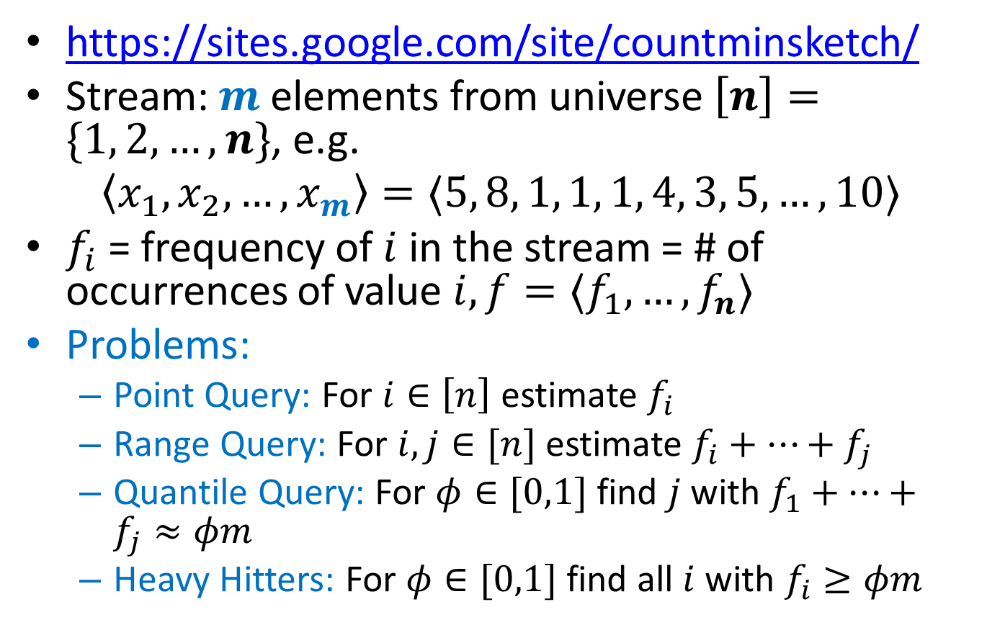
Count-Min Sketch
https://sites.google.com/site/countminsketch/
Stream: $m$ elements from universe $\left[n\right]=\{1, 2, …, n\}$, e.g.
$$〈x_{1},x_{2},…, x_{m}〉=〈5, 8, 1, 1, 1, 4, 3, 5, …, 10〉$$
$f_{i}$ = frequency of $i$ in the stream = # of occurrences of value $i, f=〈f_{1},…, f_{n}〉$
Problems:
Point Query: For $i∈\left[n\right]$ estimate $f_{i}$
Range Query: For $i,j∈[n]$ estimate $f_{i}+…+f_{j}$
Quantile Query: For $φ∈[0,1]$ find $j$ with $f_{1}+…+f_{j}≈φm$
Heavy Hitters: For $φ∈[0,1]$ find all $i$ with $f_{i}≥φm$

Slide 3
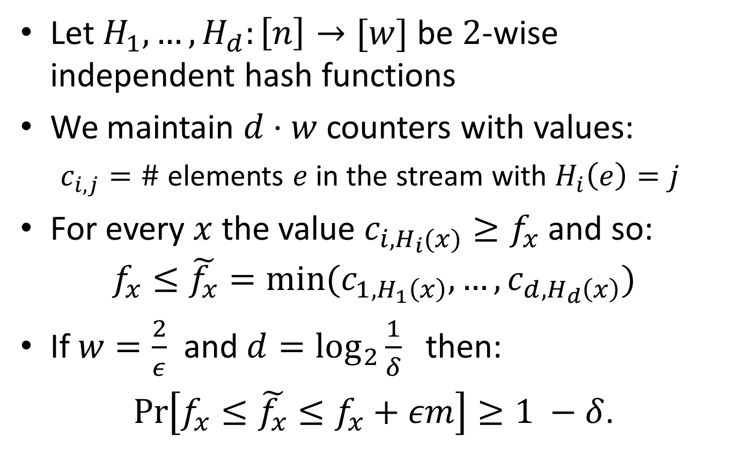
Count-Min Sketch: Construction
Let $H_{1},…,H_{d}:\left[n\right]→[w]$ be $2$-wise independent hash functions
We maintain $d⋅w$ counters with values:
$c_{i,j}=\#$ elements $e$ in the stream with $H_{i}\left(e\right)=j$
For every $x$ the value $c_{i,H_{i}(x)}≥f_{x}$ and so:
$$f_{x}≤\tilde{f_{x}}=min⁡(c_{1,H_{1}\left(x\right)}, …,c_{d,H_{d}\left(x\right)})$$
If $w=\frac{2}{ε}$ and $d=\log_{2}{\frac{1}{δ}}$ then:
$\operatorname{Pr}\left[f_{x}≤\tilde{f_{x}}≤f_{x}+εm\right]≥1 −δ$.

Slide 4
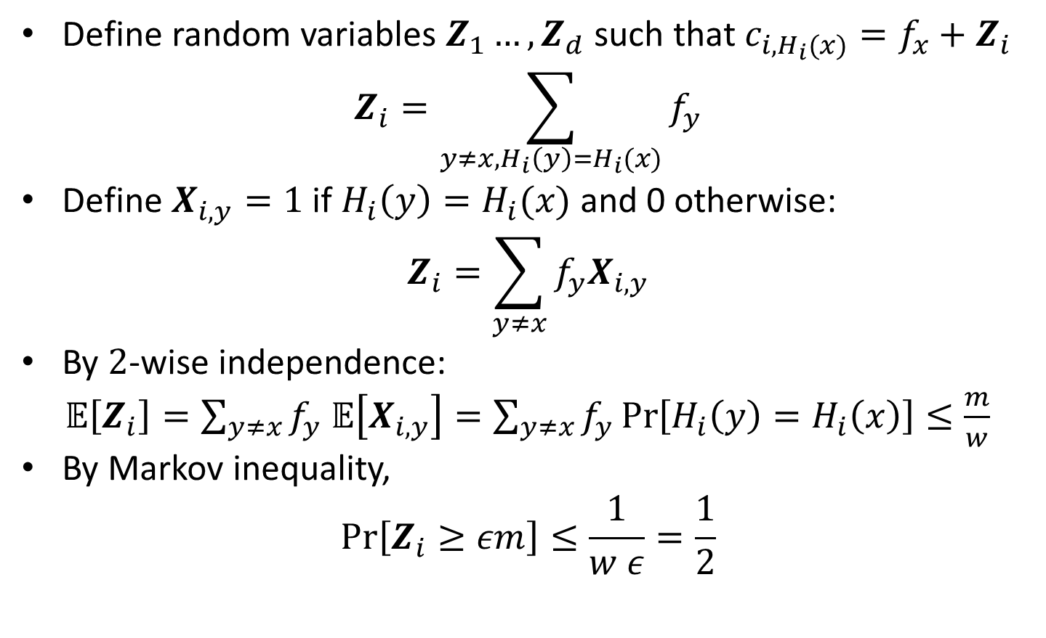
Count-Min Sketch: Analysis
Define random variables $Z_{1}…, Z_{d}$ such that $c_{i, H_{i}(x)}=f_{x}+Z_{i}$
$$Z_{i}=\sum_{y≠x, H_{i}\left(y\right)=H_{i}(x)}{f_{y}}$$
Define $X_{i, y}=1$ if $H_{i}\left(y\right)=H_{i}(x)$ and 0 otherwise:
$$Z_{i}=\sum_{y≠x}{f_{y}X_{i,y}}$$
By $2$-wise independence:
$𝔼\left[Z_{i}\right]=\sum_{y≠x}{f_{y}}$ $𝔼\left[X_{i,y}\right]=\sum_{y≠x}{f_{y}}\operatorname{Pr}\left[H_{i}\left(y\right)=H_{i}\left(x\right)\right]≤\frac{m}{w}$
By Markov inequality,
$$\operatorname{Pr}\left[Z_{i}≥εm\right]≤\frac{1}{w ε}=\frac{1}{2}$$

Slide 5
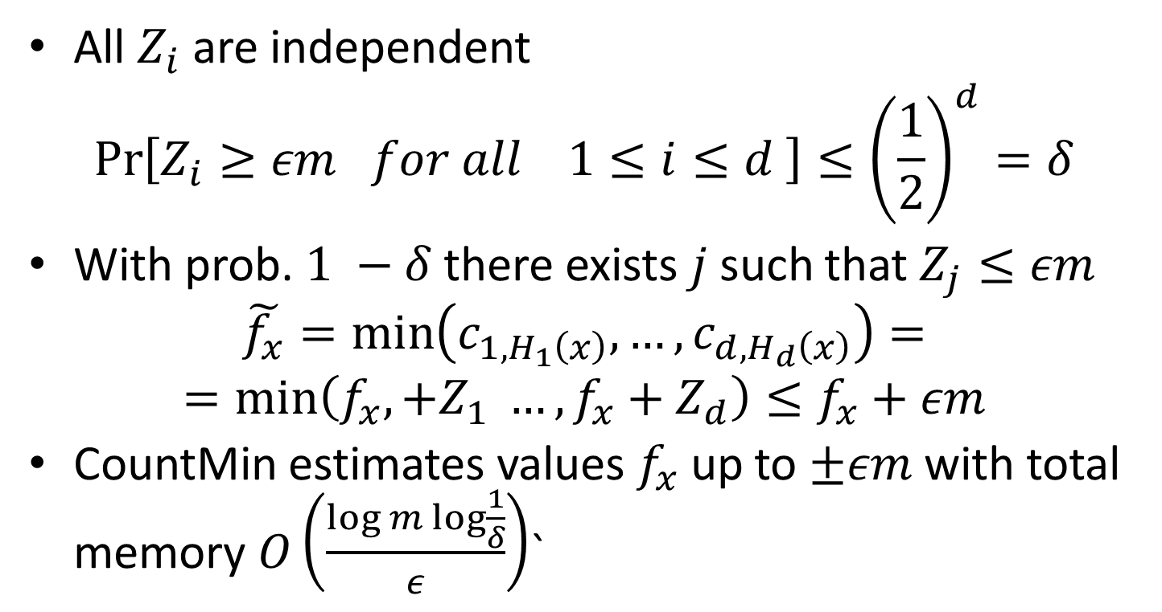
Count-Min Sketch: Analysis
All $Z_{i}$ are independent
$$\operatorname{Pr}\left[Z_{i}≥εm for all 1≤i≤d \right]≤{\left(\frac{1}{2}\right)}^{d}=δ$$
With prob.$1 −δ$ there exists $j$ such that $Z_{j}≤εm$
$$\tilde{f_{x}}=\min\left(c_{1, H_{1}\left(x\right)}, …,c_{d, H_{d}\left(x\right)}\right)=$$
$$=\min\left(f_{x},+Z_{1} …,f_{x}+Z_{d}\right)≤f_{x}+εm$$
CountMin estimates values $f_{x}$ up to $±εm$ with total memory $O\left(\frac{log m\log{\frac{1}{δ}}}{ε}\right)$`

Slide 6
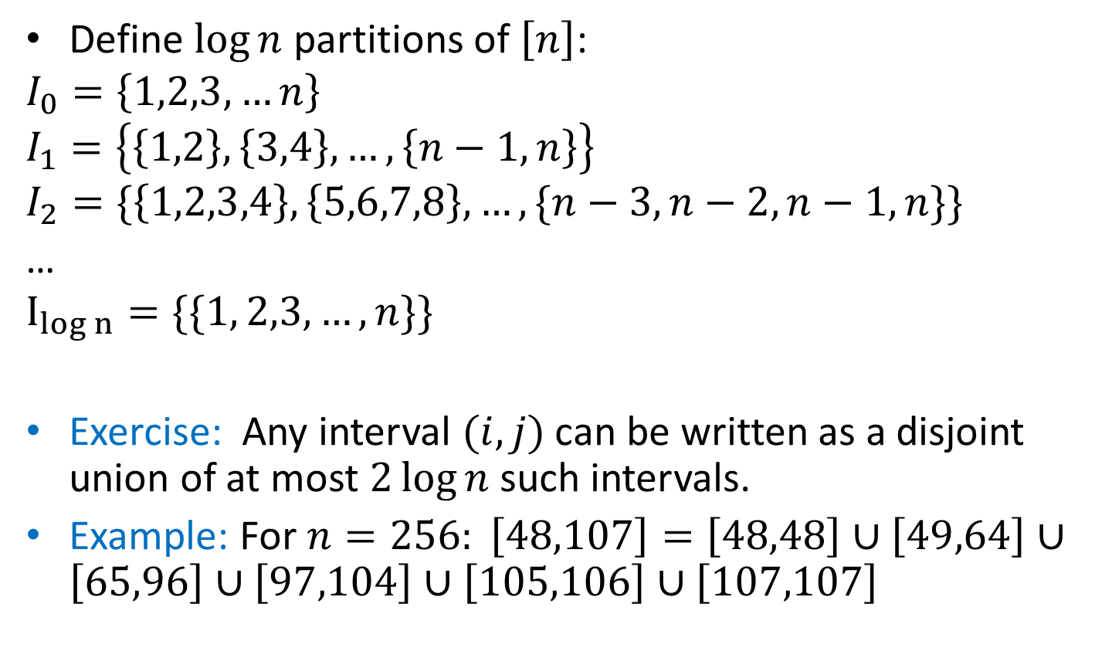
Dyadic Intervals
Define $\log{n}$ partitions of $\left[n\right]$:
$$I_{0}=\left\{1,2,3,…n\right\}$$
$$I_{1}=\left\{\left\{1,2\right\},\left\{3,4\right\},…,\left\{n−1,n\right\}\right\}$$
$$I_{2}=\{\left\{1,2,3,4\right\},\left\{5,6,7,8\right\}, …,\{n−3,n−2,n−1,n\}\}$$
…
$$I_{log n}=\{\{1, 2,3,…, n\}\}{}$$
Exercise: Any interval $(i,j)$ can be written as a disjoint union of at most $2\log{n }$such intervals.
Example: For $n=256: \left[48,107\right]=\left[48,48\right]∪\left[49,64\right]∪\left[65,96\right]∪\left[97,104\right]∪\left[105,106\right]∪\left[107,107\right]$

Slide 7
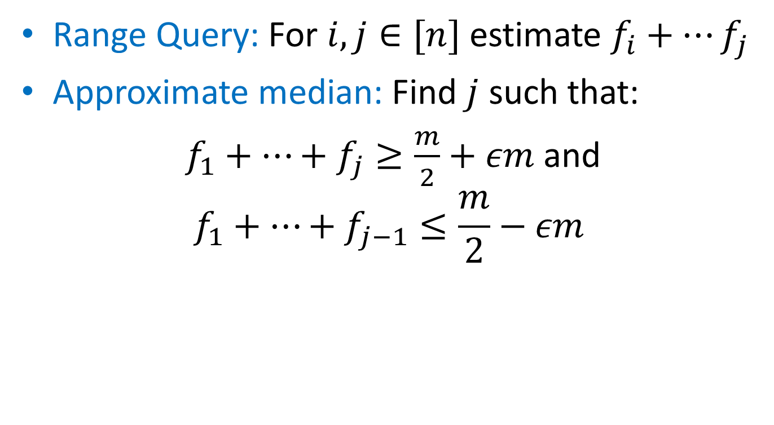
Count-Min: Range Queries and Quantiles
Range Query: For $i,j∈[n]$ estimate $f_{i}+…f_{j}$
Approximate median: Find $j$ such that:
$f_{1}+…+f_{j}≥\frac{m}{2}+εm$ and
$$f_{1}+…+f_{j−1}≤\frac{m}{2}−εm$$

Slide 8
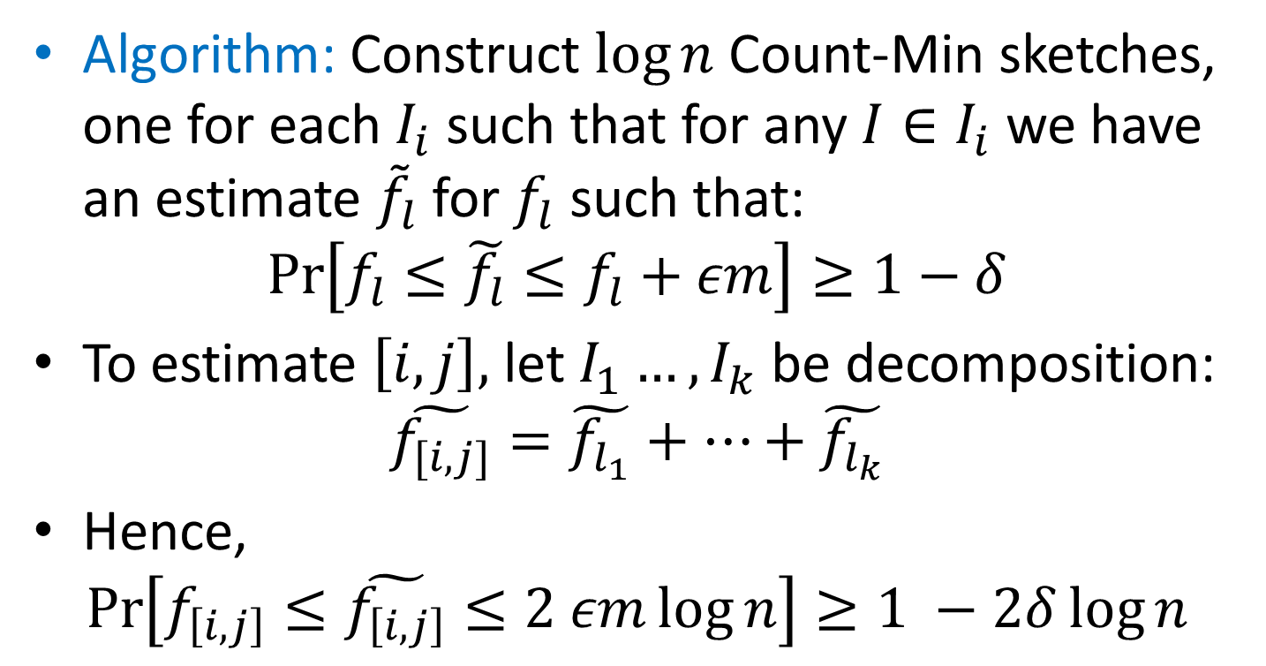
Count-Min: Range Queries and Quantiles
Algorithm: Construct $\log{n}$ Count-Min sketches, one for each $I_{i}$ such that for any $I∈I_{i}$ we have an estimate ${\tilde{f}}_{l}$for $f_{l}$ such that:
$$\operatorname{Pr}\left[f_{l}≤\tilde{f_{l}}≤f_{l}+εm\right]≥1−δ$$
To estimate $\left[i,j\right],$ let $I_{1}…, I_{k}$ be decomposition:
$$\tilde{f_{[i,j]}}=\tilde{f_{l_{1}}}+…+\tilde{f_{l_{k}}}$$
Hence,
$$\operatorname{Pr}\left[f_{\left[i,j\right]}≤\tilde{f_{\left[i,j\right]}}≤2 εm\log{n}\right]≥1 −2δ\log{n}$$

Slide 9
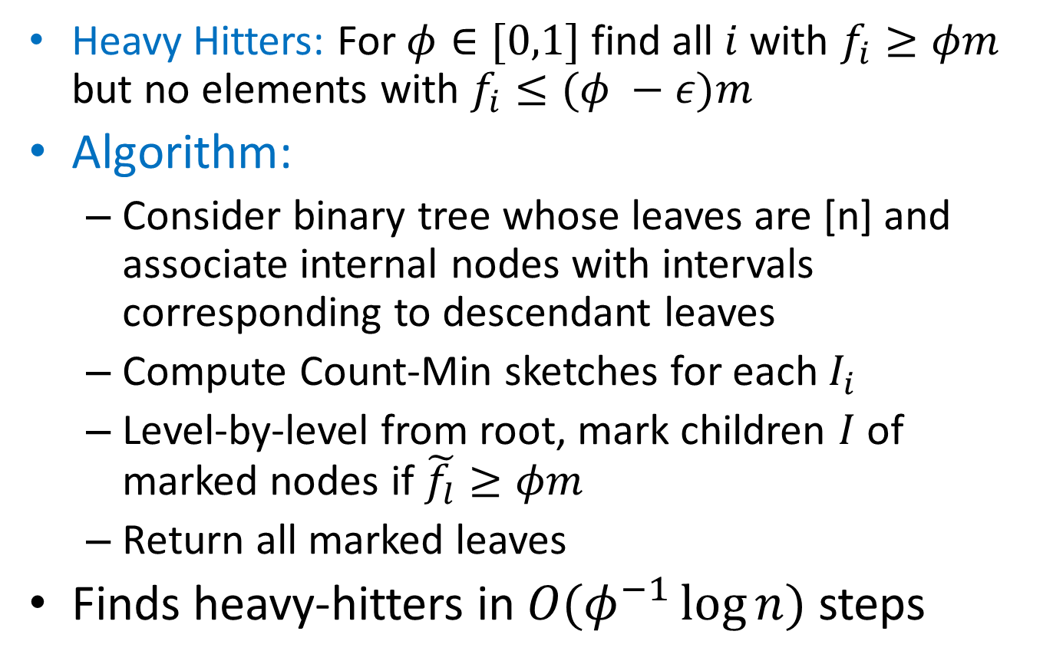
Count-Min: Heavy Hitters
Heavy Hitters: For $φ∈[0,1]$ find all $i$ with $f_{i}≥φm$ but no elements with $f_{i}≤(φ −ε)m$
Algorithm:
Consider binary tree whose leaves are [n] and associate internal nodes with intervals corresponding to descendant leaves
Compute Count-Min sketches for each $I_{i}$
Level-by-level from root, mark children $I$ of marked nodes if $\tilde{f_{l}}≥φm$
Return all marked leaves
Finds heavy-hitters in $O(φ^{−1}\log{n})$ steps

Slide 10
More about Count-Min
Authors: Graham Cormode, S. Muthukrishnan [LATIN’04]
Count-Min is linear:
Count-Min(S1 + S2) = Count-Min(S1) + Count-Min(S2)
Deterministic version: CR-Precis
Count-Min vs. Bloom filters
Allows to approximate values, not just 0/1 (set membership)
Doesn’t require mutual independence (only 2-wise)
FAQ and Applications:
https://sites.google.com/site/countminsketch/home/
https://sites.google.com/site/countminsketch/home/faq

Slide 11
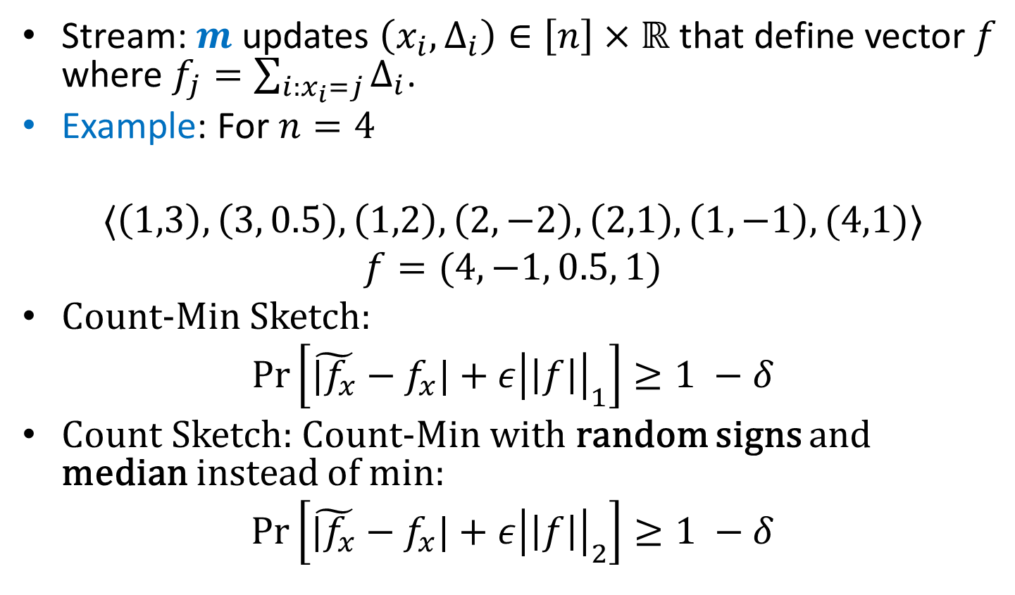
Fully Dynamic Streams
Stream: $m$ updates $\left(x_{i}, Δ_{i}\right)∈\left[n\right]×ℝ$ that define vector $f$ where $f_{j}=\sum_{i:x_{i}=j}{Δ_{i}}$.
Example: For $n=4$
$$〈\left(1,3\right), \left(3, 0.5\right), \left(1,2\right), \left(2,−2\right),\left(2,1\right), \left(1,−1\right), (4,1)〉$$
$$f=(4, −1, 0.5, 1)$$
Count-Min Sketch:
$$\operatorname{Pr}\left[\tilde{|f_{x}}−f_{x}|+ε{\left|\left|f\right|\right|}_{1}\right]≥1 −δ$$
Count Sketch: Count-Min with random signs and median instead of min:
$$\operatorname{Pr}\left[\tilde{|f_{x}}−f_{x}|+ε{\left|\left|f\right|\right|}_{2}\right]≥1 −δ$$

Slide 12
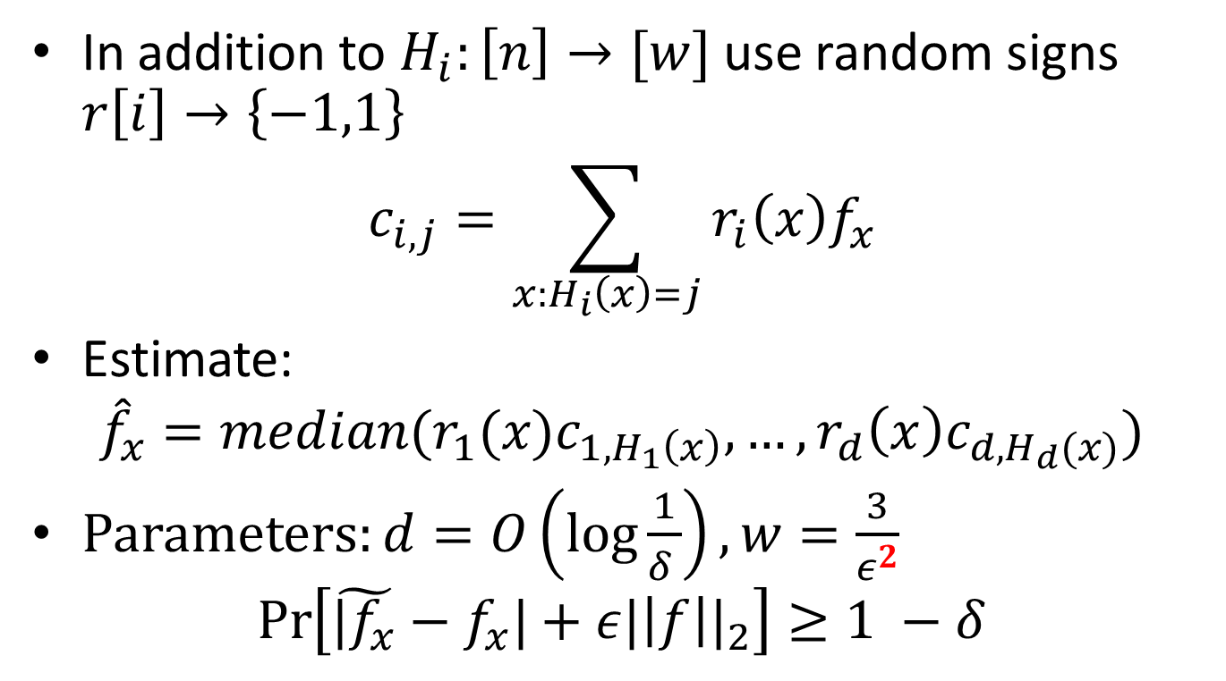
Count Sketch
In addition to $H_{i}:\left[n\right]→[w]$ use random signs $r\left[i\right]→\left\{−1,1\right\}$
$$c_{i,j}=\sum_{x:H_{i}\left(x\right)=j}{r_{i}\left(x\right)f_{x}}$$
Estimate:
$${\hat{f}}_{x}=median(r_{1}(x)c_{1,H_{1}\left(x\right)}, …,r_{d}\left(x\right)c_{d,H_{d}(x)})$$
Parameters: $d=O\left(\log{\frac{1}{δ }}\right), w=\frac{3}{ε^{2}}$
$$\operatorname{Pr}\left[\tilde{|f_{x}}−f_{x}|+ε{|\left|f\right||}_{2}\right]≥1 −δ$$

Slide 13
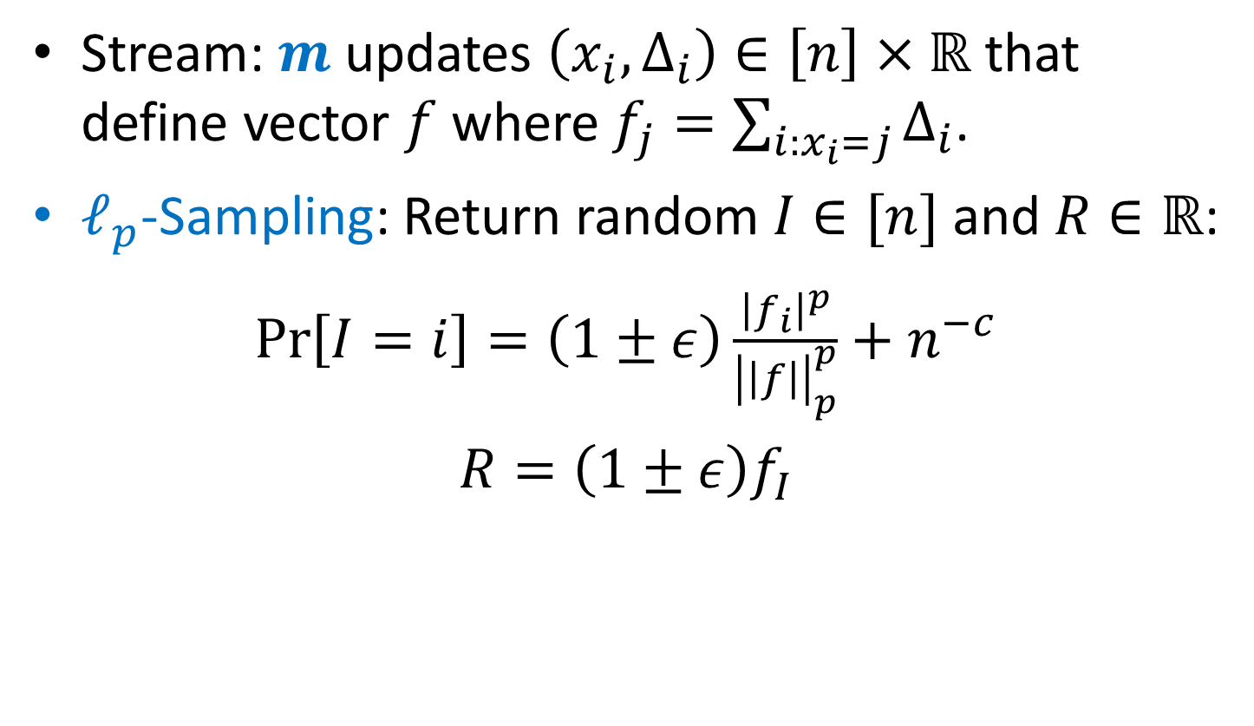

$ℓ_{p}$-Sampling
Stream: $m$ updates $\left(x_{i}, Δ_{i}\right)∈\left[n\right]×ℝ$ that define vector $f$ where $f_{j}=\sum_{i:x_{i}=j}{Δ_{i}}$.
$ℓ_{p}$-Sampling: Return random $I∈[n]$ and $R∈ℝ$:
$\operatorname{Pr}\left[I=i\right]=\left(1±ε\right)\frac{{\left|f_{i}\right|}^{p}}{{\left|\left|f\right|\right|}_{p}^{p}}+n^{−c}$
$R=\left(1±ε\right)f_{I}$

Slide 14
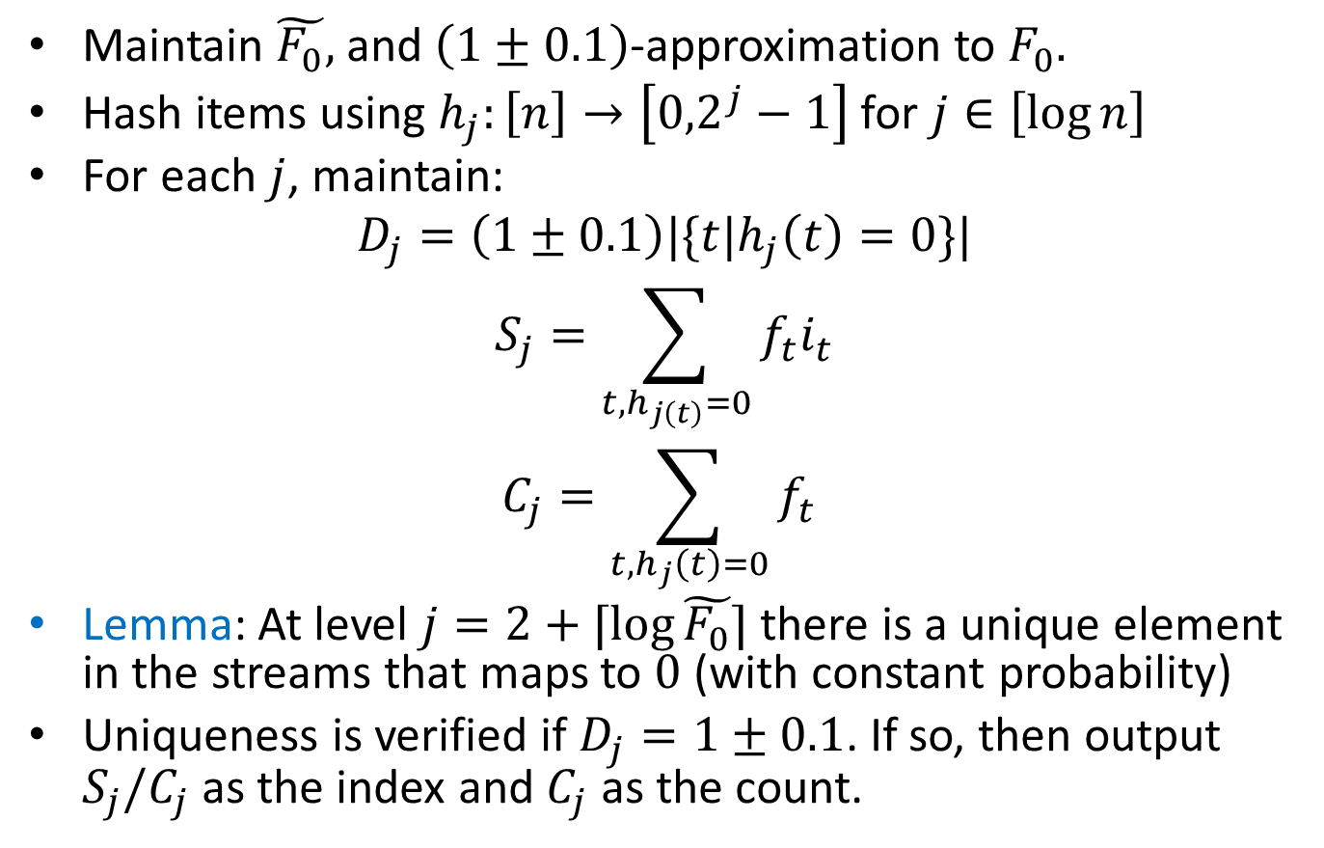

$ℓ_{0}$-sampling
Maintain $\tilde{F_{0}},$ and $\left(1±0.1\right)$-approximation to $F_{0}.$
Hash items using $h_{j}:\left[n\right]→\left[{0,2}^{j}−1\right]$ for $j∈\left[\log{n}\right]$
For each $j$, maintain:
$$D_{j}=\left(1±0.1\right)|\{t|h_{j}\left(t\right)=0\}|$$
$$S_{j}=\sum_{t, h_{j\left(t\right)}=0}{f_{t}i_{t}}$$
$$C_{j}=\sum_{t, h_{j}\left(t\right)=0}{f_{t}}$$
Lemma: At level $j=2+⌈\log{\tilde{F_{0}}}⌉$ there is a unique element in the streams that maps to $0$ (with constant probability)
Uniqueness is verified if $D_{j}=1±0.1$. If so, then output $S_{j}/C_{j}$ as the index and $C_{j}$ as the count.

Slide 15
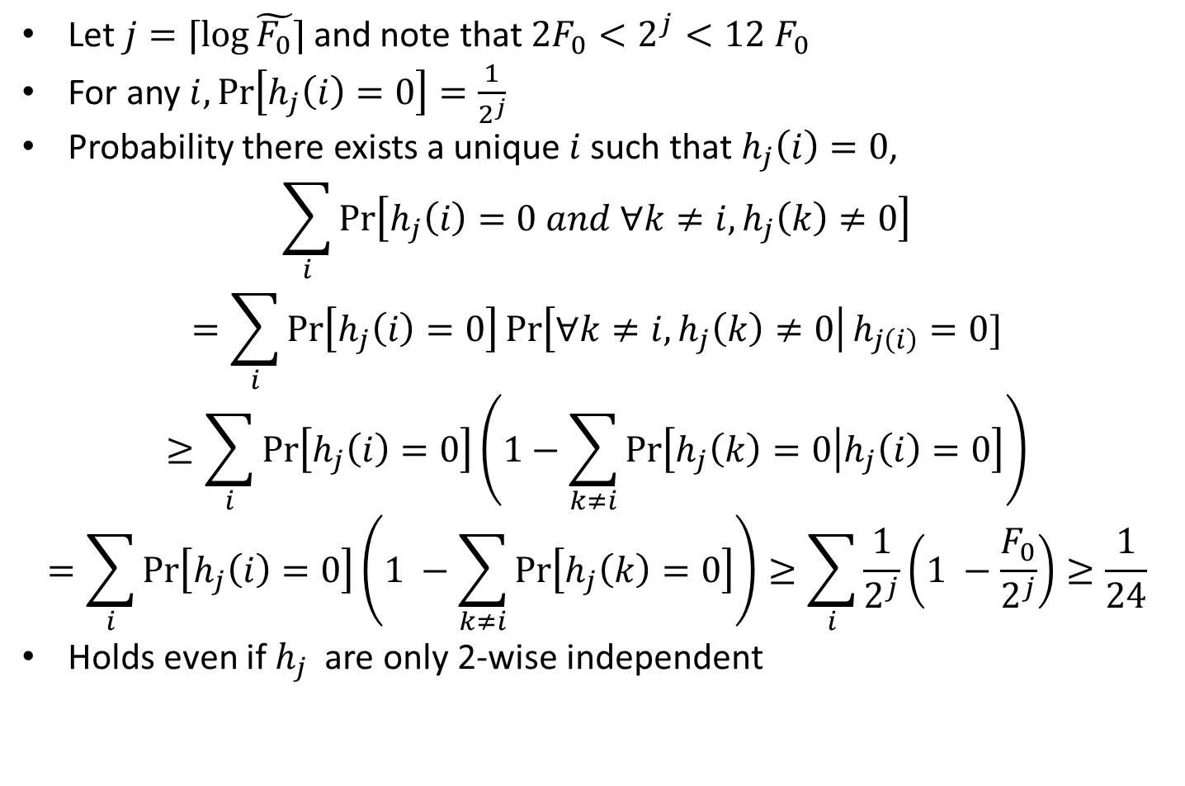
Proof of Lemma
Let $j=⌈\log{\tilde{F_{0}}}⌉$ and note that $2F_{0}<2^{j}<12 F_{0}$
For any $i,\operatorname{Pr}\left[h_{j}\left(i\right)=0\right]=\frac{1}{2^{j}}$
Probability there exists a unique $i$ such that $h_{j}\left(i\right)=0$,
$$\sum_{i}{\operatorname{Pr}\left[h_{j}\left(i\right)=0 and ∀k≠i, h_{j}\left(k\right)≠0\right]}$$
$$=\sum_{i}{\operatorname{Pr}\left[h_{j}\left(i\right)=0\right]\operatorname{Pr}\left[∀k≠i, h_{j}\left(k\right)≠0\right|h_{j\left(i\right)}=0]}$$
$$≥\sum_{i}{\operatorname{Pr}\left[h_{j}\left(i\right)=0\right]\left(1−\sum_{k≠i}{\operatorname{Pr}\left[h_{j}\left(k\right)=0 | h_{j}\left(i\right)=0\right]}\right)}$$
$$=\sum_{i}{\operatorname{Pr}\left[h_{j}\left(i\right)=0\right]\left(1 −\sum_{k≠i}{\operatorname{Pr}\left[h_{j}\left(k\right)=0\right]}\right)}≥\sum_{i}{\frac{1}{2^{j}}\left(1 −\frac{F_{0}}{2^{j}}\right)≥\frac{1}{24}}$$
Holds even if $h_{j}$ are only 2-wise independent

Slide 16
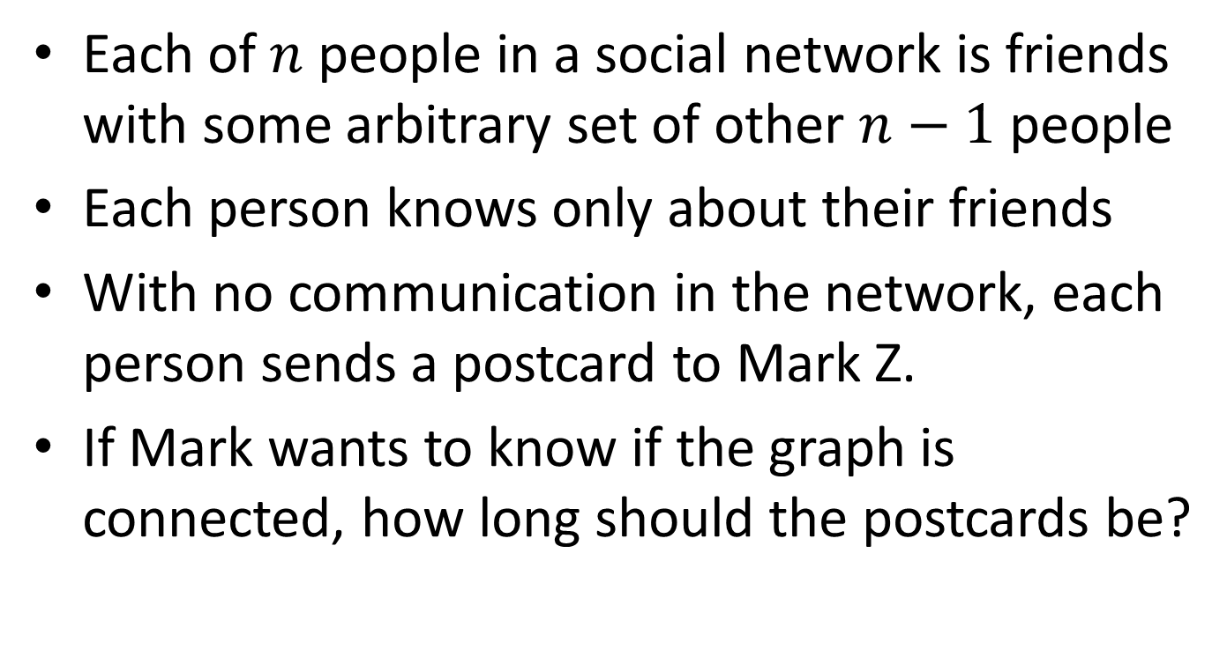
Application: Social Networks
Each of $n$ people in a social network is friends with some arbitrary set of other $n−1$ people
Each person knows only about their friends
With no communication in the network, each person sends a postcard to Mark Z.
If Mark wants to know if the graph is connected, how long should the postcards be?

Slide 17
Sketching Graphs?
We know how to sketch vectors:$v→Mv$
How about sketching graphs?
$G\left(V,E\right)≡A_{G}$ (adjacency matrix): $A_{G}→MA_{G}$
Sketch columns of $A_{G}$
$n=\left|V\right|, m=|E|$
$O(poly(\log{n}))$ sketch per vertex / $\tilde{O}(n)$ total
Check connectivity
Check bipartiteness
As always, space rather than dimension. Why?

Slide 18
Graph Streams
Semi-streaming model: [Muthukrishnan ’05; Feigenbaum, Kannan, McGregor, Suri, Zhang’05]
Graph defined by the stream of edges $e_{1},…, e_{m}$
Space $\tilde{O}\left(n\right)$, edges processed in order
Connectivity is easy on $\tilde{O}(n)$ space for insertion-only
Dynamic graphs:
Stream of insertion/deletion updates $+e_{i_{1}}, −e_{i_{2}}, …, −e_{i_{t}}$ (assume sequence is correct)
Resulting graph has edge $e_{i}$ if it wasn’t deleted after the last insertion
Linear sketching dynamic graphs:
$MA_{G∖e}=MA_{G}−{MA}_{e}$

Slide 19
Distributed Computing
Linear sketches for distributed processing
$S$ servers with o(m) memory:
Send $m/S$ edges $(E_{1},…, E_{s})$ to each server
Compute sketches $ME_{1},…, ME_{s}$ locally
Send sketches to a central server
Compute $MA_{G}=\sum_{i}^{s}{ME_{i}}$
$M$ has to have a small representation (same issue as in streaming)

Slide 20
Connectivity
Thm. Connectivity is sketchable in $\tilde{O}(n)$ space
Framework:
Take existing connectivity algorithm (Boruvka)
Sketch $A_{G}→MA_{G}$
Run Boruvka on $MA_{G}$
Important that the sketch is homomorphic w.r.t the algorithm

Slide 21
Part 1: Parallel Connectivity (Boruvka)
Repeat until no edges left:
For each vertex, select any incident edge
Contract selected edges
Lemma: process converges in $O(\log{n})$ steps

Slide 22
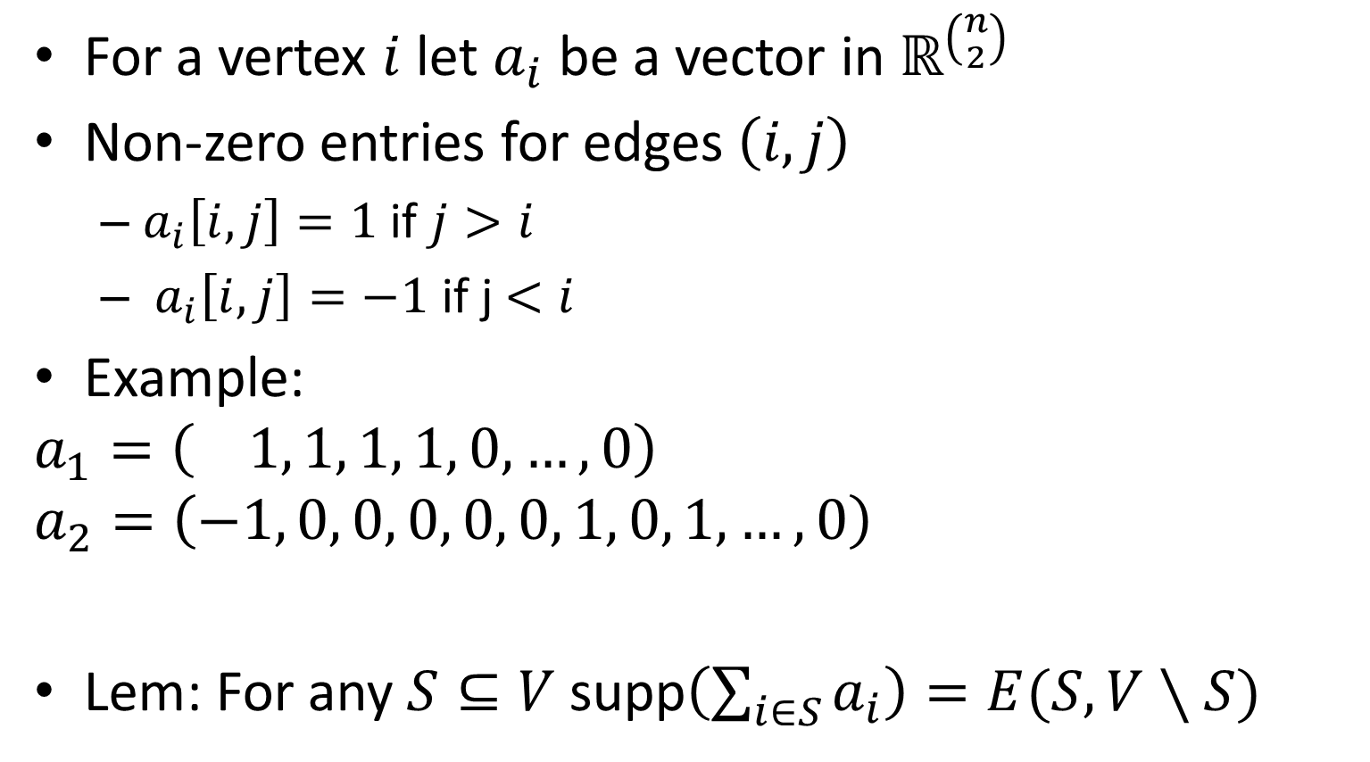
Part 2: Graph Representation
For a vertex $i$ let $a_{i}$ be a vector in $ℝ^{\left({n \atop 2}\right)}$
Non-zero entries for edges $\left(i,j\right)$
$a_{i}\left[i,j\right]=1$ if $j>i$
$a_{i}\left[i,j\right]=−1$ if j$<i$
Example:
$$a_{1}=\left( 1, 1, 1, 1, 0, …,0\right)$$
$$a_{2}=\left(−1, 0, 0, 0, 0, 0, 1, 0, 1, …, 0\right)$$
Lem: For any $S⊆V$ supp$\left(\sum_{i∈S}{a_{i}}\right)=E(S,V∖S)$
7
3
2
6
1
4
5
$$\left\{1,2\right\},\left\{1,3\right\},\left\{1,4\right\},\left\{1,5\right\},\left\{1,6\right\},\left\{1,7\right\},\left\{2,3\right\},\left\{2.4\right\}.\left\{2,5\right\}, …$$

Slide 23
Part 3: $L_{0}$-Sampling
There is a distribution over $M∈ℝ^{d×m}$ with $d=O(\log^{2}{m})$ such w.p. 9/10 that $∀a∈ℝ^{m}:$
$$Ca→e∈supp(a)$$
[Cormode, Muthukrishnan, Rozenbaum’05; Jowhari, Saglam, Tardos ‘11]
Constant probability suffices $−$ still $O\left(\log{n}\right)$ Boruvka iterations

Slide 24
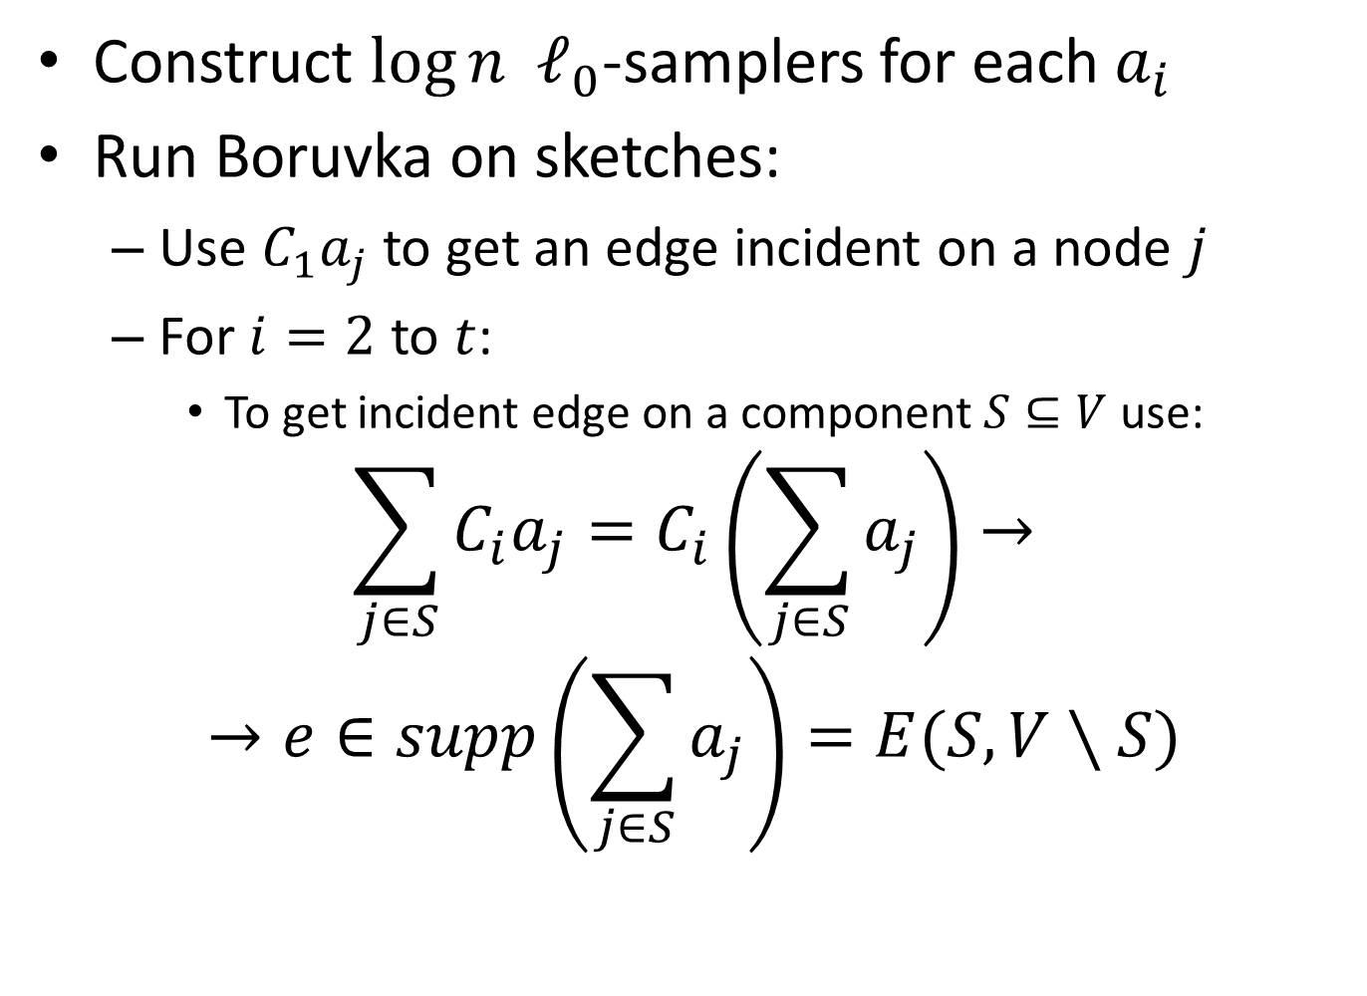
Final Algorithm
Construct $\log{n}$ $ℓ_{0}$-samplers for each $a_{i}$
Run Boruvka on sketches:
Use $C_{1}a_{j}$ to get an edge incident on a node $j$
For $i=2$ to $t$:
To get incident edge on a component $S⊆V$ use:
$$\sum_{j∈S}{C_{i}a_{j}=C_{i}\left(\sum_{j∈S}{a_{j}}\right)→}$$
$$→e∈supp\left(\sum_{j∈S}{a_{j}}\right)=E(S,V∖S)$$

Slide 25
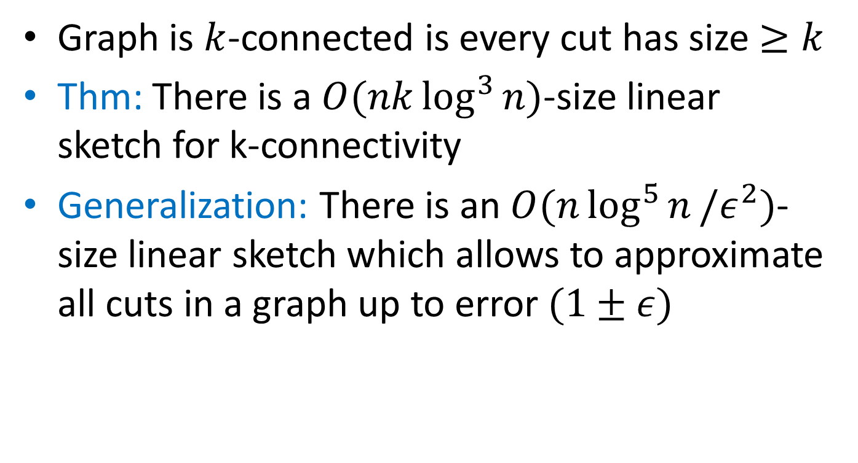
K-Connectivity
Graph is $k$-connected is every cut has size $≥k$
Thm: There is a $O(nk\log^{3}{n})$-size linear sketch for k-connectivity
Generalization: There is an $O(n\log^{5}{n}/ε^{2})$-size linear sketch which allows to approximate all cuts in a graph up to error $(1±ε)$

Slide 26
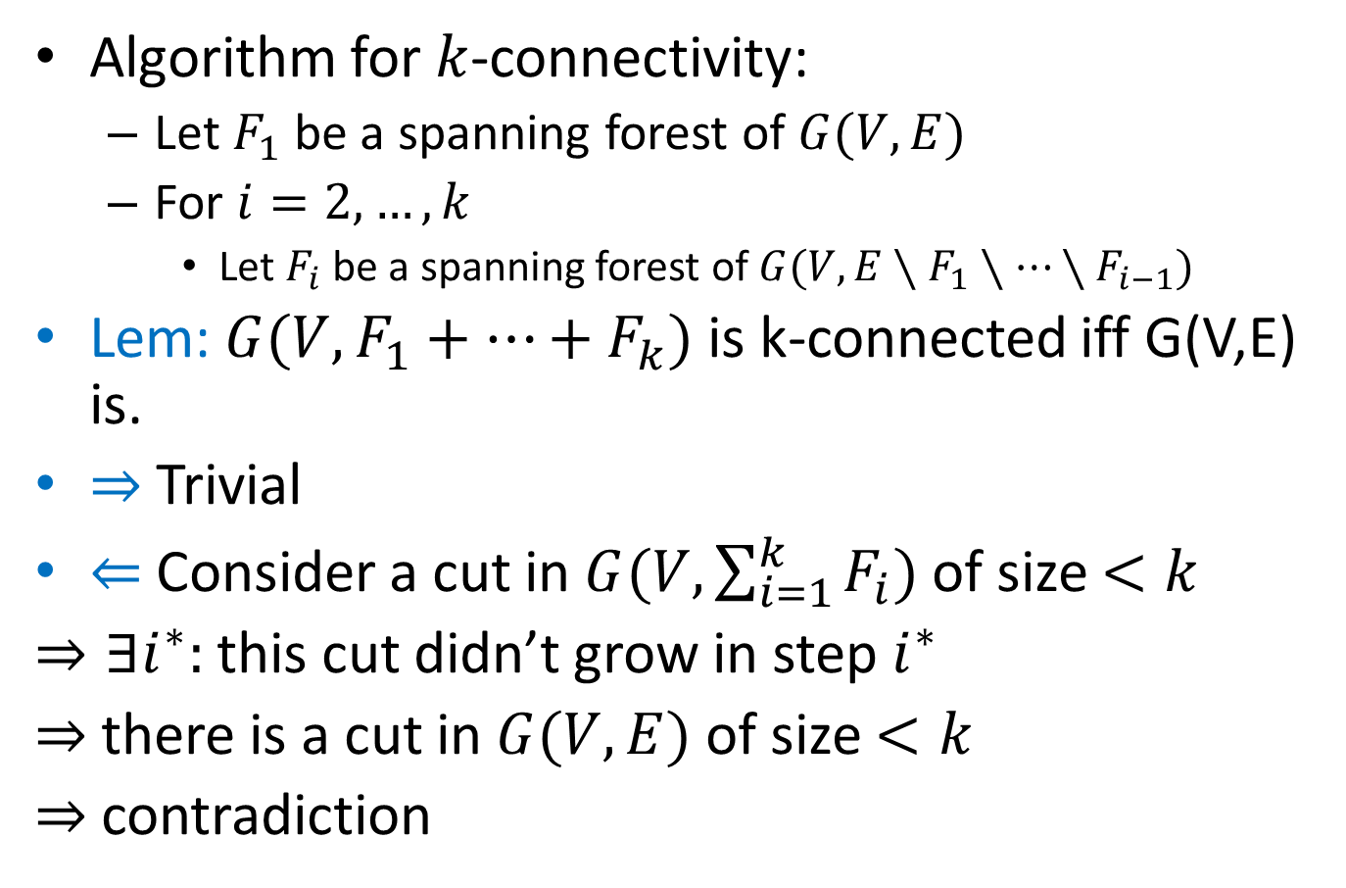
K-connectivity Algorithm
Algorithm for $k$-connectivity:
Let $F_{1}$ be a spanning forest of $G(V,E)$
For $i=2, …, k$
Let $F_{i}$ be a spanning forest of $G(V, E∖F_{1}∖…∖F_{i−1})$
Lem: $G(V,F_{1}+…+F_{k})$ is k-connected iff G(V,E) is.
$⇒$ Trivial
$⇐$ Consider a cut in $G(V,\sum_{i=1}^{k}{F_{i}})$ of size $<k$
$⇒∃i^{∗}:$ this cut didn’t grow in step $i^{∗}$
$⇒$ there is a cut in $G(V,E)$ of size $<k$
$⇒$contradiction

Slide 27
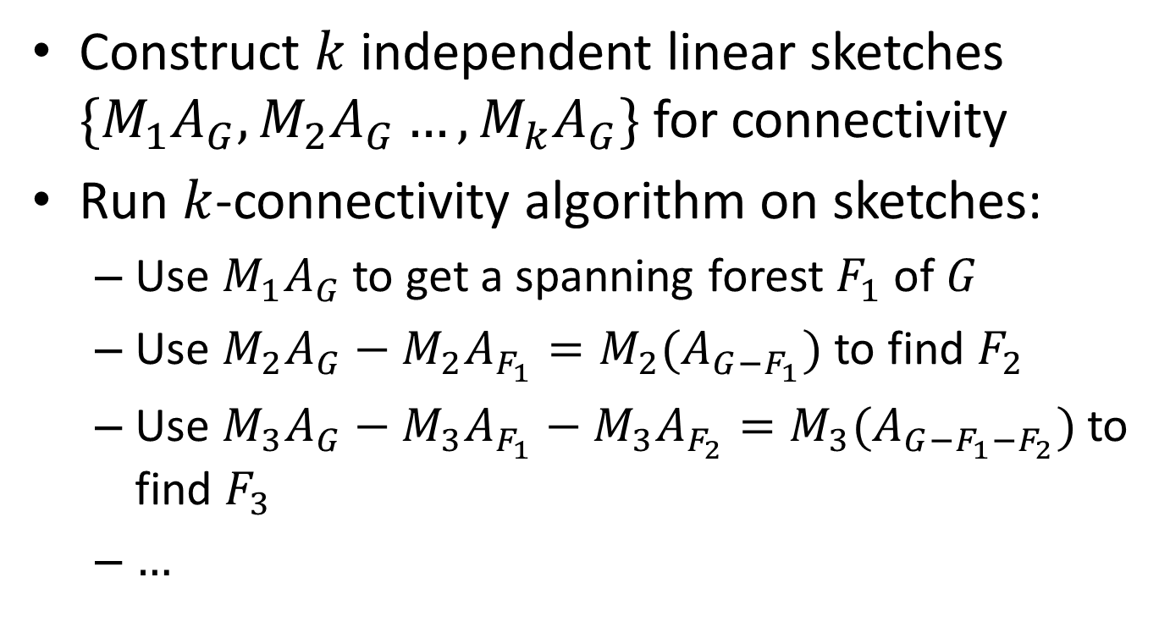
K-connectivity Algorithm
Construct $k$ independent linear sketches $\{M_{1}A_{G},M_{2}A_{G}…, M_{k}A_{G}\}$ for connectivity
Run $k$-connectivity algorithm on sketches:
Use $M_{1}A_{G}$ to get a spanning forest $F_{1}$ of $G$
Use $M_{2}A_{G}−M_{2}A_{F_{1}}=M_{2}(A_{G−F_{1}})$ to find $F_{2}$
Use $M_{3}A_{G}−M_{3}A_{F_{1}}−M_{3}A_{F_{2}}=M_{3}(A_{G−F_{1}−F_{2}})$ to find $F_{3}$
$…$

Slide 28



Bipartiteness
Reduction: Given $G$ define $G′$ where vertices $v→(v_{1},v_{2})$; edges $\left(u,v\right)→(u_{1},v_{2})$ & $(u_{2},v_{1})$
Lem: # connected components doubles iff the graph is bipartite.
Thm: $O(n\log^{3}{n})$-size linear sketch for k-connectivity (sketch $G′$ (implicitly).)
$$→$$
$$→$$

Slide 29
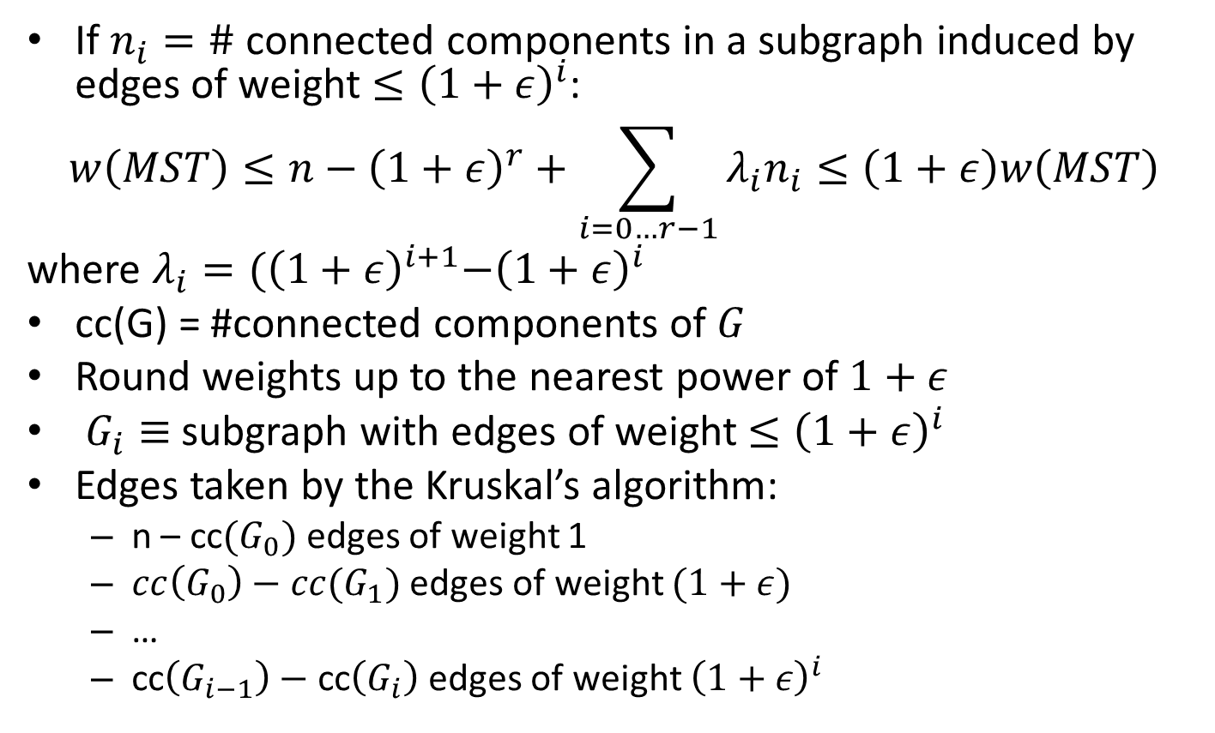
Minimum Spanning Tree
If $n_{i}=\#$ connected components in a subgraph induced by edges of weight $≤{\left(1+ε\right)}^{i}$:
$$w\left(MST\right)≤n−{\left(1+ε\right)}^{r}+\sum_{i=0…r−1}{λ_{i}n_{i}≤\left(1+ε\right)w\left(MST\right)}$$
where $λ_{i}={(\left(1+ε\right)}^{i+1}−{\left(1+ε\right)}^{i}$
cc(G) = #connected components of $G$
Round weights up to the nearest power of $1+ε$
$G_{i}≡$ subgraph with edges of weight $≤{\left(1+ε\right)}^{i}$
Edges taken by the Kruskal’s algorithm:
n – cc$(G_{0})$ edges of weight 1
$cc\left(G_{0}\right)−cc(G_{1})$ edges of weight $(1+ε)$
…
cc$\left(G_{i−1}\right)−$ cc$\left(G_{i}\right)$ edges of weight ${\left(1+ε\right)}^{i}$

Slide 30
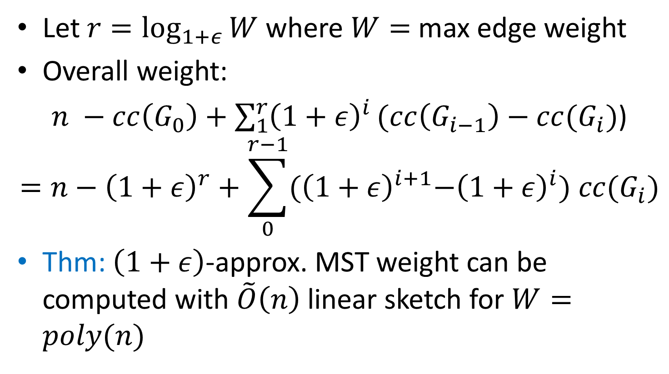
Minimum Spanning Tree
Let $r=\log_{1+ε}{W}$ where $W=$ max edge weight
Overall weight:
$n −cc\left(G_{0}\right)+\sum_{1}^{r}{{\left(1+ε\right)}^{i}}(cc\left(G_{i−1}\right)−cc(G_{i})$)
$$=n−{\left(1+ε\right)}^{r}+\sum_{0}^{r−1}{{(\left(1+ε\right)}^{i+1}−{\left(1+ε\right)}^{i}) cc(G_{i})}$$
Thm: $\left(1+ε\right)$-approx. MST weight can be computed with $\tilde{O}\left(n\right)$ linear sketch for $W=poly(n)$

Slide 31
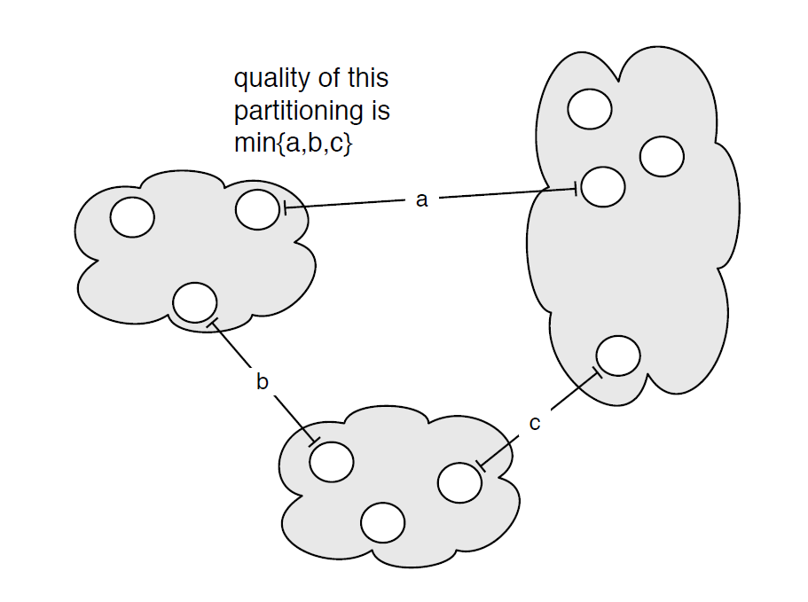

MST: Single Linkage Clustering
[Zahn’71] Clustering via MST (Single-linkage):
k clusters: remove $k−1$ longest edges from MST
Maximizes minimum intercluster distance
[Kleinberg, Tardos]
Notes:
“”

Slide 32
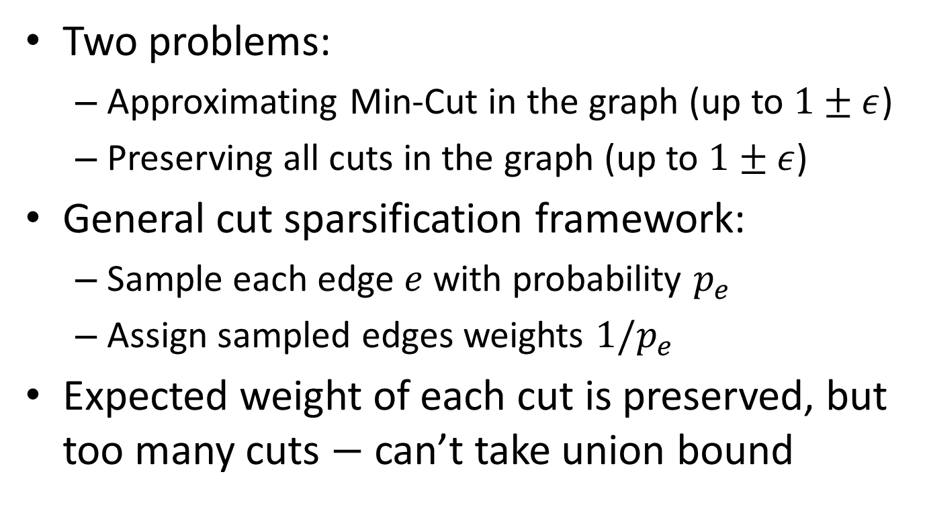
Cut Sparsification
Two problems:
Approximating Min-Cut in the graph (up to $1±ε$)
Preserving all cuts in the graph (up to $1±ε$)
General cut sparsification framework:
Sample each edge $e$ with probability $p_{e}$
Assign sampled edges weights $1/p_{e}$
Expected weight of each cut is preserved, but too many cuts $−$ can’t take union bound

Slide 33
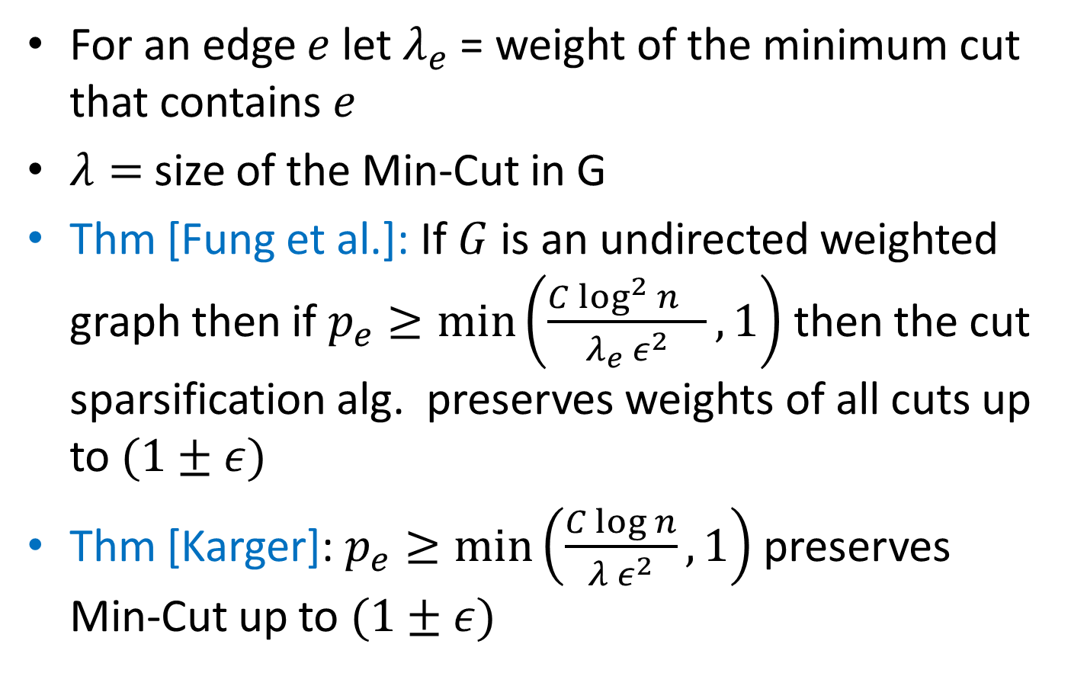
Cut Sparsification
For an edge $e$ let $λ_{e}$ = weight of the minimum cut that contains $e$
$λ=$ size of the Min-Cut in G
Thm [Fung et al.]: If $G$ is an undirected weighted graph then if $p_{e}≥\min\left(\frac{C{\log^{2}{n}}^{}}{{λ_{e} ε}^{2}},1\right)$ then the cut sparsification alg. preserves weights of all cuts up to $(1±ε)$
Thm [Karger]: $p_{e}≥\min\left(\frac{C\log{n}}{{λ ε}^{2}},1\right)$ preserves Min-Cut up to $(1±ε)$

Slide 34
Minimum Cut
Algorithm:
For $i = \left\{0,1,…, 2\log{n}\right\}:$
Let $G_{i}$ be the subgraph of $G$ where each edge is sampled with probability $1/2^{i}$
Let $H_{i}=F_{1},…, F_{k}$ where $k=O\left(\frac{1}{ε^{2}}⋅\log{n}\right)$ and $F_{i}$ are forests constructed by the k-connectivity alg.
Return $2^{j}λ(H_{j})$ where $j=min⁡\{i :λ\left(H_{i}\right)<k\}$
Space: $O\left(\frac{n\log^{4}{n}}{ε^{2}}\right),$works for dynamic graph streams

Slide 35
Minimum Cut: Analysis
Key property: If $G_{i}$ has $≤k$ edges across a cut then $H_{i}$ contains all such edges
$i^{∗}=\left\lfloor \log{\max\left\{1,\frac{λε^{2}}{6\log{n}}\right\}} \right\rfloor$
$i≤i^{∗}⇒$ $p_{e}≥\min\left(\frac{6\log{n}}{λε^{2}},1\right)⇒$ min cut in $G_{i}$ is approximating min-cut in $G$ up to $(1±ε)$
$i=i^{∗}:$ By Chernoff bound # edges in $G_{i^{∗}}$ that crosses min-cut in $G$ is $O\left(\frac{1}{ε^{2}}\log{n}\right)≤k$ w.h.p.

Slide 36
Cut Sparsification
Algorithm:
For $i = \left\{0,1,…, 2\log{n}\right\}:$
Let $G_{i}$ be the subgraph of $G$ where each edge is sampled with probability $1/2^{i}$
Let $H_{i}=F_{1},…, F_{k}$ where $k=O\left(\frac{1}{ε^{2}}⋅\log^{2}{n}\right)$ and $F_{i}$ are forests constructed by the k-connectivity alg.
For each edge $e$ let $j_{e}=min \left\{i:λ_{e}\left(H_{i}\right)<k\right\}.$
If $e∈H_{j_{e}}$ then add e to the sparsifier with weight $2_{}^{j_{e}}$
Space: $O\left(\frac{n\log^{5}{n}}{ε^{2}}\right),$works for dynamic graph streams
Analysis similar to the Min-Cut using [Fung et al.]

