Slide 1
CSCI B609: “Foundations of Data Science”
Lecture 1 & 2: Intro
Slides at http://grigory.us/data-science-class.html
Grigory Yaroslavtsev
http://grigory.us

Slide 2

Disclaimers
A lot of Math!

Slide 3
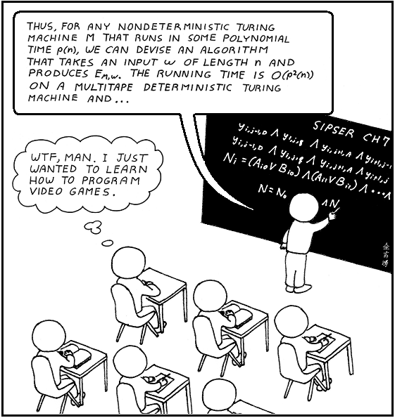
Disclaimers
No programming!

Slide 4
Class info
Advanced graduate class, not an intro-level class
Primary audience: Ph.D. students
MW 16:00 – 17:15, Ballantine 310
Grading:
Class attendance/participation (20%)
Homework assignments (40%)
Only accepted via e-mail in LaTeX-generated PDF format
No handwritten homework accepted
Project (40%)
Text: Blum-Hopcroft-Kannan, “Foundations of Data Science”
http://grigory.us/files/bhk-book.pdf
06/09/16 version
Office hours announced later
Slides will be posted

Slide 5
Plan for today
Lecture: first 45 minutes:
Basic probability
Inequalities for random variables
Concentration bounds
Quiz: last 20 minutes:
Tests background knowledge
Graded but doesn’t count towards final grade
Quiz too hard => take intro-level classes first

Slide 6
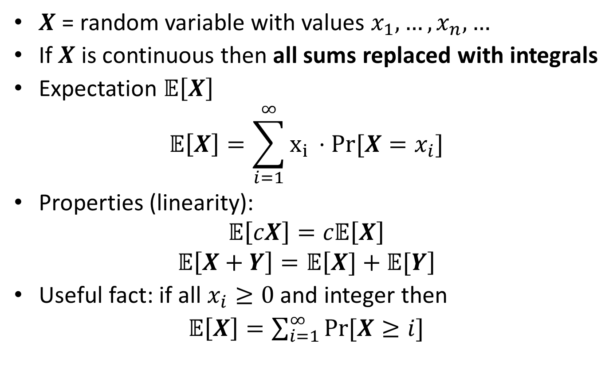
Expectation
$X$ = random variable with values $x_{1},…, x_{n}, …$
If $X$ is continuous then all sums replaced with integrals
Expectation 𝔼$\left[X\right]$
$$\text{𝔼}\left[X\right]=\sum_{i=1}^{∞}{x_{i }⋅Pr⁡[X=x_{i}]}$$
Properties (linearity):
$$\text{𝔼}\left[cX\right]=c\text{𝔼}\left[X\right]$$
$$\text{𝔼}\left[X+Y\right]=\text{𝔼}\left[X]+\text{𝔼}[Y\right]$$
Useful fact: if all $x_{i}≥0$ and integer then
𝔼$\left[X\right]=\sum_{i=1}^{∞}{Pr⁡[X≥i]}$

Slide 7

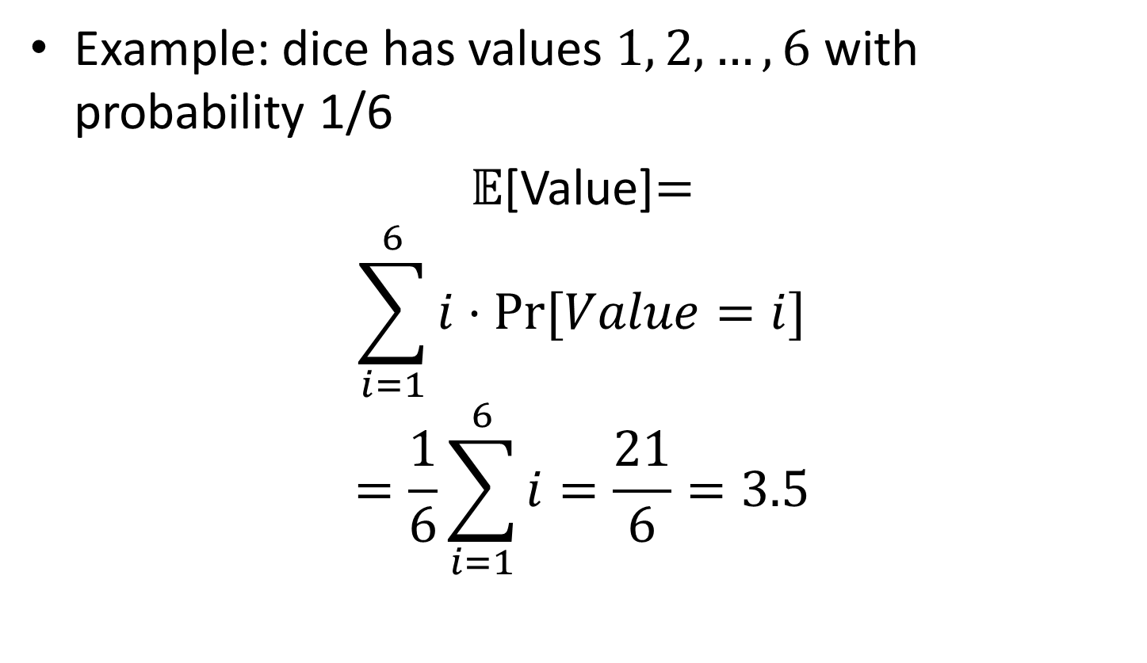
Expectation
Example: dice has values $1, 2,…, 6$ with probability 1/6
$\text{𝔼}$[Value]$=$
$$\sum_{i=1}^{6}{i⋅Pr⁡[Value=i]}$$
$$=\frac{1}{6}\sum_{i=1}^{6}{i}=\frac{21}{6}=3.5$$

Slide 8
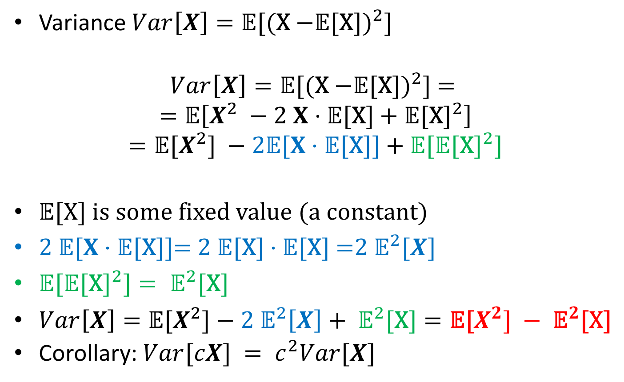
Variance
Variance ${Var\left[X\right]=\text{𝔼}\text{[(}\text{X}\text{ −}\text{𝔼}\text{[}\text{X}\text{])}}^{2}\text{]}$
$${Var\left[X\right]=\text{𝔼}\text{[(}\text{X}\text{ −}\text{𝔼}\text{[}\text{X}\text{])}}^{2}\text{] = }$$
$$=\text{𝔼}\left[X^{2} −2 X⋅\text{𝔼}\text{[}\text{X}\text{]}+{\text{𝔼}\text{[}\text{X}\text{]}}^{2}\right]$$
$$={\text{𝔼}\text{[}X^{2}\text{] }−2\text{𝔼}[X⋅\text{𝔼}\text{[}\text{X}\text{]] }\text{+} \text{𝔼}\text{[}\text{𝔼}\text{[}\text{X}\text{]}}^{2}]$$
$\text{𝔼}\text{[}\text{X}\text{]}$ is some fixed value (a constant)
$\text{2 }\text{𝔼}[X⋅\text{𝔼}\text{[}\text{X}\text{]]= 2 }\text{𝔼}\text{[}\text{X}\text{]}⋅\text{𝔼}\text{[}\text{X}\text{] =}{2 \text{𝔼}}^{2}[X]$
${\text{𝔼}\text{[}\text{𝔼}\text{[}\text{X}\text{]}}^{2}]={ \text{𝔼}}^{2}\text{[}\text{X}\text{]}$
$Var\left[X\right]=\text{𝔼}\text{[}X^{2}\text{]}−{2 \text{𝔼}}^{2}\left[X\right]+{ \text{𝔼}}^{2}\text{[}\text{X}\text{]}=\text{𝔼}\text{[}X^{2}] −{ \text{𝔼}}^{2}\text{[}\text{X}\text{]}$
Corollary: $Var[cX] = c^{2}Var[X]$

Slide 9
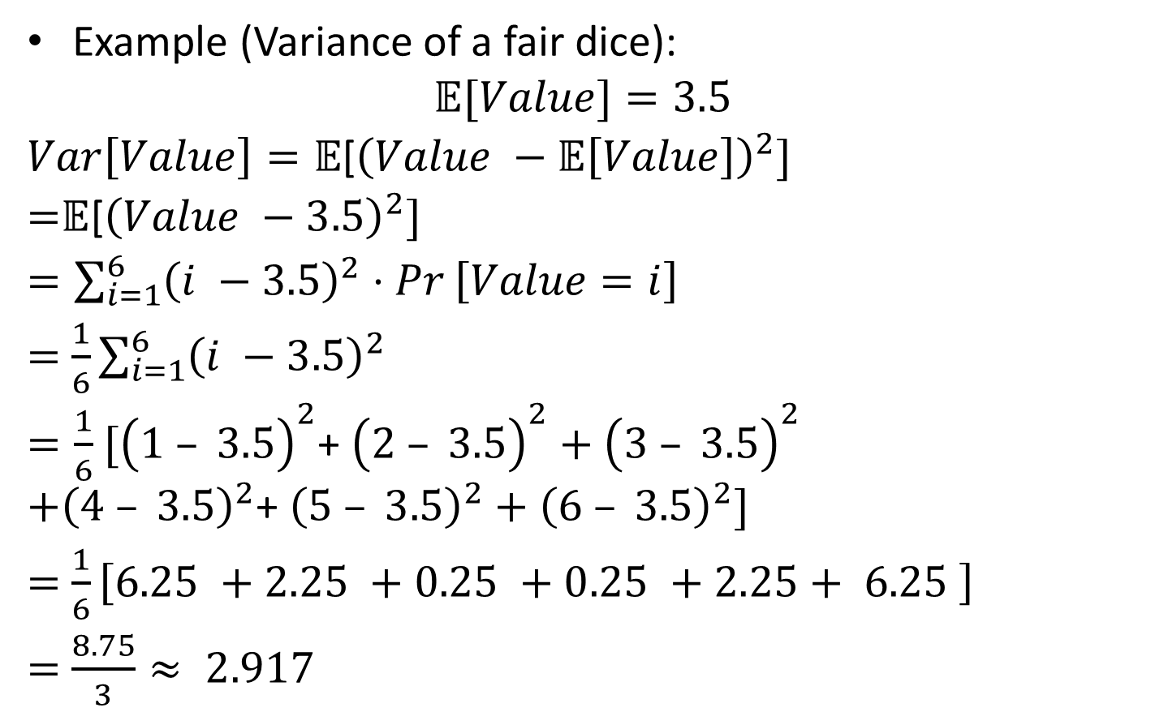
Variance
Example (Variance of a fair dice):
$$\text{𝔼}[Value]=3.5$$
$Var\left[Value\right]=\text{𝔼}$[${\left(Value −\text{𝔼}\left[Value\right]\right)}^{2}]$
=$\text{𝔼}$[${\left(Value −3.5\right)}^{2}]$
$=\sum_{i=1}^{6}{{\left(i −3.5\right)}^{2}⋅Pr}\left[Value=i\right]$
$=$ $\frac{1}{6}\sum_{i=1}^{6}{{\left(i −3.5\right)}^{2}}$
$=\frac{1}{6}$ ${[\left(1 – 3.5\right)}^{2}$+ ${\left(2 – 3.5\right)}^{2}+{\left(3 – 3.5\right)}^{2}$
$$+{\left(4 – 3.5\right)}^{2}\text{+ }{\left(5 – 3.5\right)}^{2}+{\left(6 – 3.5\right)}^{2}]$$
$=$ $\frac{1}{6}\left[6.25 +2.25 +0.25 +0.25 +2.25+ 6.25 \right]$
$=$ $\frac{8.75}{3}≈ 2.917$

Slide 10
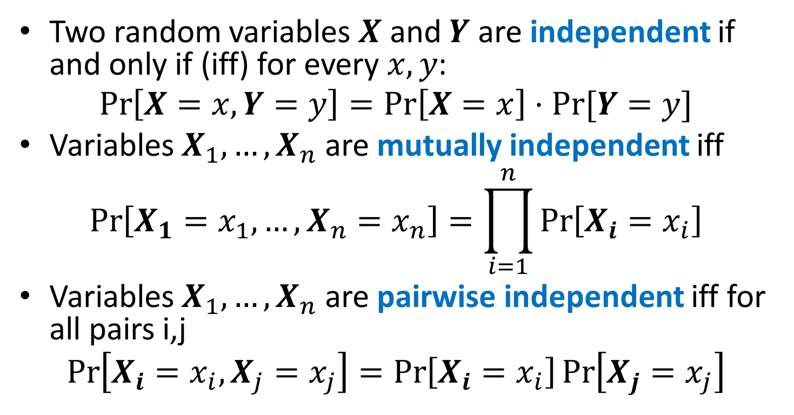
Independence
Two random variables $X$ and $Y$ are independent if and only if (iff) for every $x, y$:
$$\operatorname{Pr}\left[X=x, Y=y\right]=\operatorname{Pr}\left[X=x\right]⋅Pr⁡[Y=y]$$
Variables $X_{1},…, X_{n}$ are mutually independent iff
$$\operatorname{Pr}\left[X_{1}=x_{1}, …,X_{n}=x_{n}\right]=\prod_{i=1}^{n}{\operatorname{Pr}\left[X_{i}=x_{i}\right]}$$
Variables $X_{1},…, X_{n}$ are pairwise independent iff for all pairs i,j
$$\operatorname{Pr}\left[X_{i}=x_{i}, X_{j}=x_{j}\right]=\operatorname{Pr}\left[X_{i}=x_{i}\right]\operatorname{Pr}\left[X_{j}=x_{j}\right]$$

Slide 11
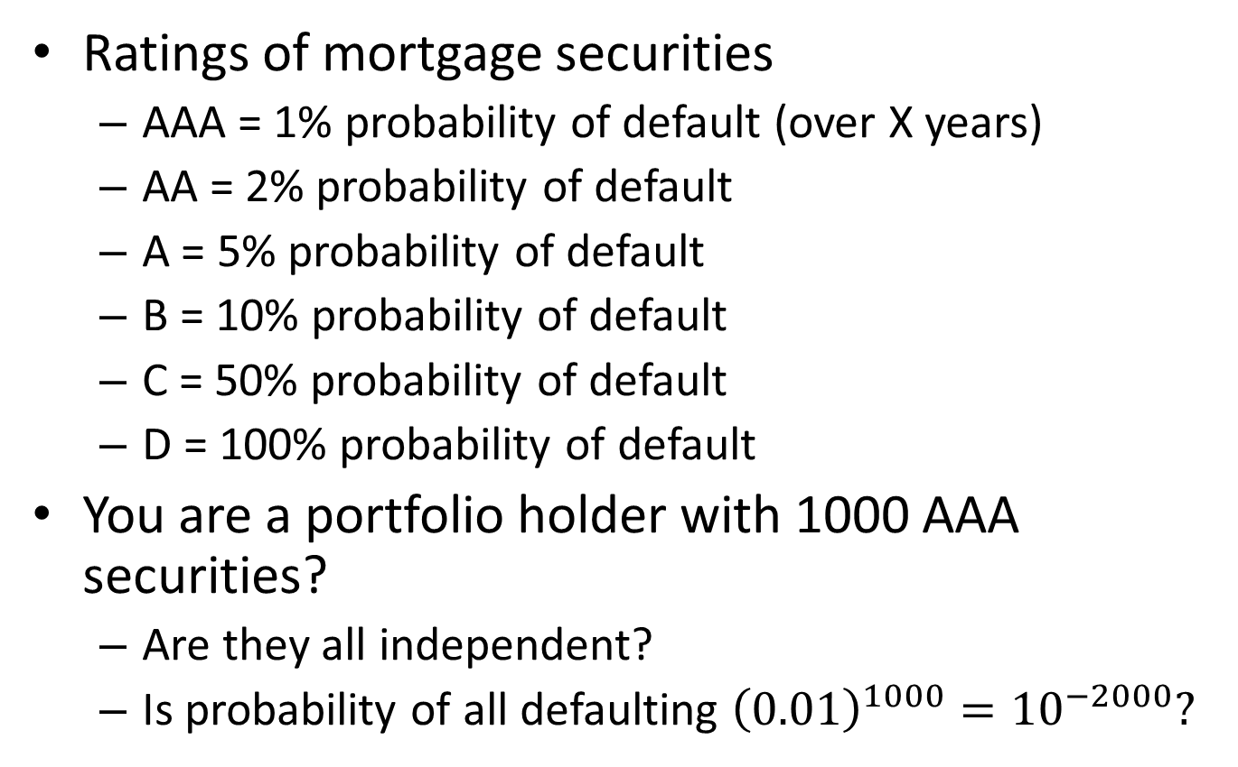
Independence: Example
Ratings of mortgage securities
AAA = 1% probability of default (over X years)
AA = 2% probability of default
A = 5% probability of default
B = 10% probability of default
C = 50% probability of default
D = 100% probability of default
You are a portfolio holder with 1000 AAA securities?
Are they all independent?
Is probability of all defaulting ${\left(0.01\right)}^{1000}={10}^{−2000}?$

Slide 12
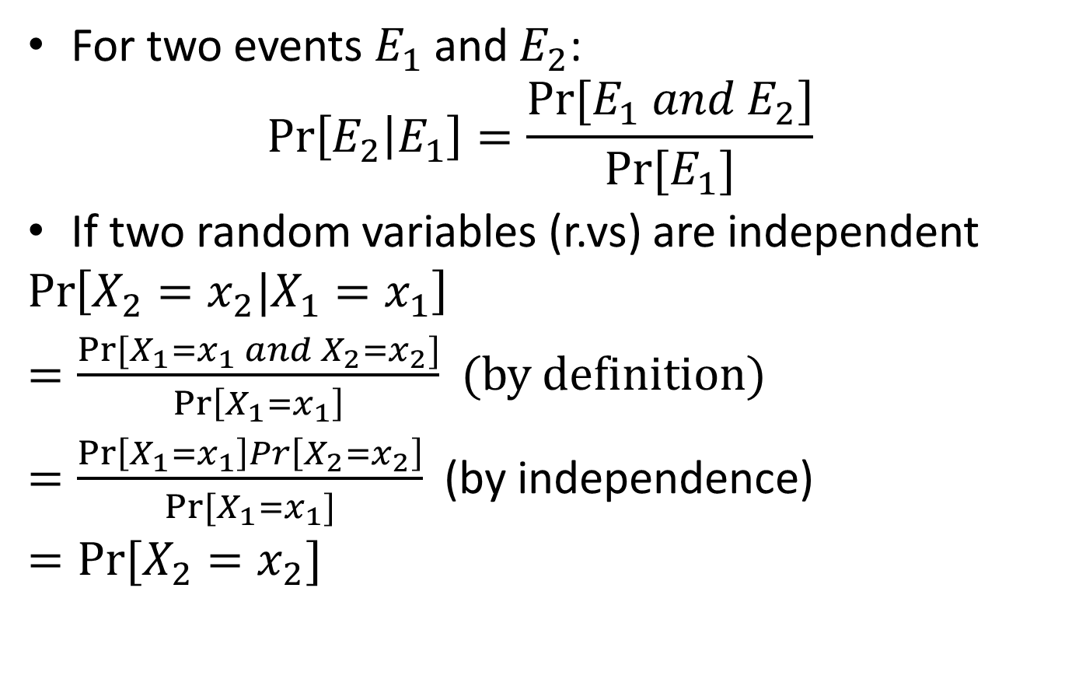
Conditional Probabilities
For two events $E_{1}$ and $E_{2}$:
$$\operatorname{Pr}\left[E_{2} | E_{1}\right]=\frac{Pr⁡[E_{1} and E_{2}]}{Pr⁡[E_{1}]}$$
If two random variables (r.vs) are independent
$$\operatorname{Pr}\left[X_{2}=x_{2}|X_{1}=x_{1}\right]$$
$=\frac{Pr⁡[X_{1}=x_{1} and X_{2}=x_{2}]}{\operatorname{Pr}\left[X_{1}=x_{1}\right]}$ (by definition)
$=\frac{\operatorname{Pr}\left[X_{1}=x_{1}\right]Pr\left[X_{2}=x_{2}\right]}{Pr[X_{1}=x_{1}]}$ (by independence)
$=Pr⁡[X_{2}=x_{2}]$

Slide 13
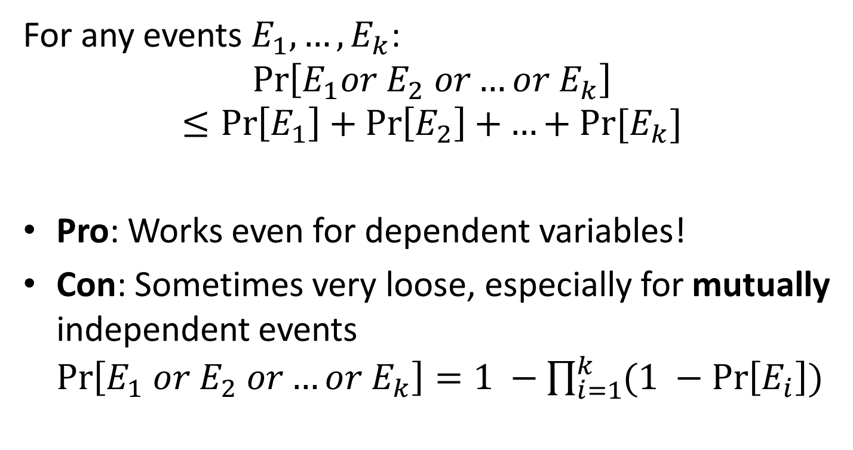
Union Bound
For any events $E_{1}, …, E_{k}$:
$$\operatorname{Pr}\left[E_{1}or E_{2} or…or{ E}_{k}\right]≤\operatorname{Pr}\left[E_{1}\right]+\operatorname{Pr}\left[E_{2}\right]+…+Pr⁡[E_{k}]$$
Pro: Works even for dependent variables!
Con: Sometimes very loose, especially for mutually independent events $\operatorname{Pr}\left[E_{1} or E_{2} or…or{ E}_{k}\right]=1 −\prod_{i=1}^{k}{(1 −\operatorname{Pr}\left[E_{i}\right])}$

Slide 14
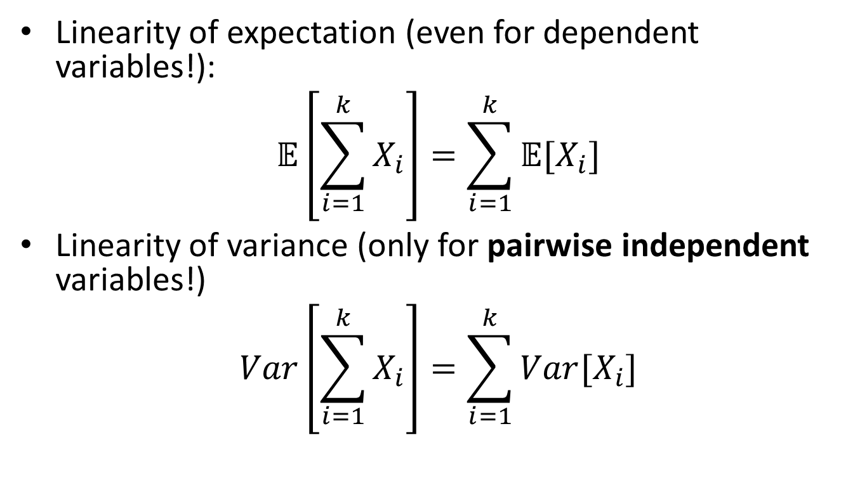
Independence and Linearity of Expectation/Variance
Linearity of expectation (even for dependent variables!):
$$\text{𝔼}\left[\sum_{i=1}^{k}{X_{i}}\right]=\sum_{i=1}^{k}{\text{𝔼}[X_{i}]}$$
Linearity of variance (only for pairwise independent variables!)
$$Var\left[\sum_{i=1}^{k}{X_{i}}\right]=\sum_{i=1}^{k}{Var[X_{i}]}$$

Slide 15
Part 2: Inequalities
Markov inequality
Chebyshev inequality
Chernoff bound

Slide 16
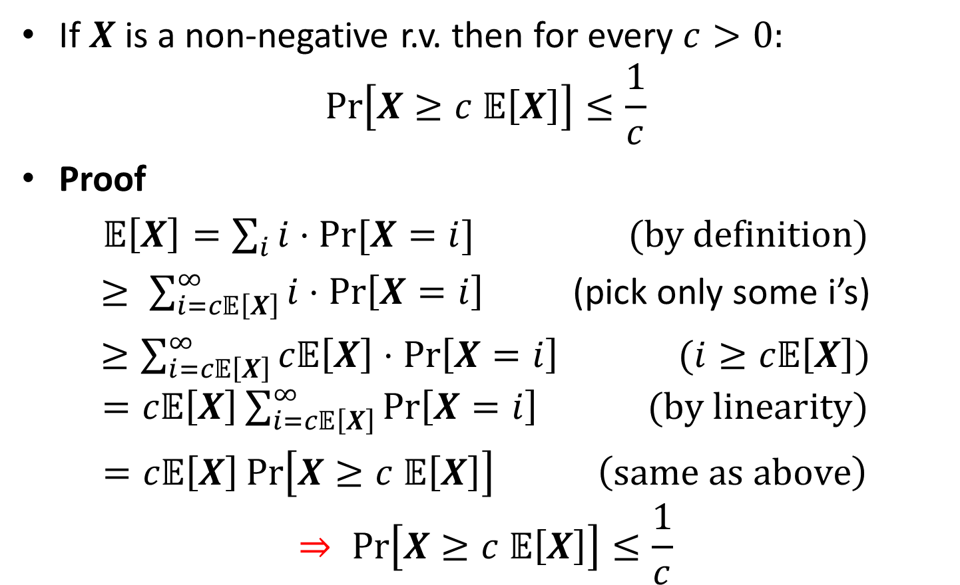
Markov’s Inequality
If $X$is a non-negative r.v. then for every $c>0:$
$$Pr\left[X≥c 𝔼\left[X\right]\right]≤\frac{1}{c}$$
Proof
$𝔼\left[X\right]=\sum_{i}{i⋅Pr⁡[X=i]}$ (by definition)
$≥ \sum_{i=c𝔼\left[X\right]}^{∞}{i⋅\operatorname{Pr}\left[X=i\right]}$ (pick only some i’s)
$≥\sum_{i=c𝔼\left[X\right]}^{∞}{c𝔼\left[X\right]⋅\operatorname{Pr}\left[X=i\right] }$ $(i≥c𝔼\left[X\right])$ $=c𝔼\left[X\right]\sum_{i=c𝔼\left[X\right]}^{∞}{\operatorname{Pr}\left[X=i\right] } (by linearity)$
$=c𝔼\left[X\right]\operatorname{Pr}\left[X≥c 𝔼\left[X\right]\right]$ $\left(same as above\right)$
$$⇒ Pr\left[X≥c 𝔼\left[X\right]\right]≤\frac{1}{c}$$

Slide 17
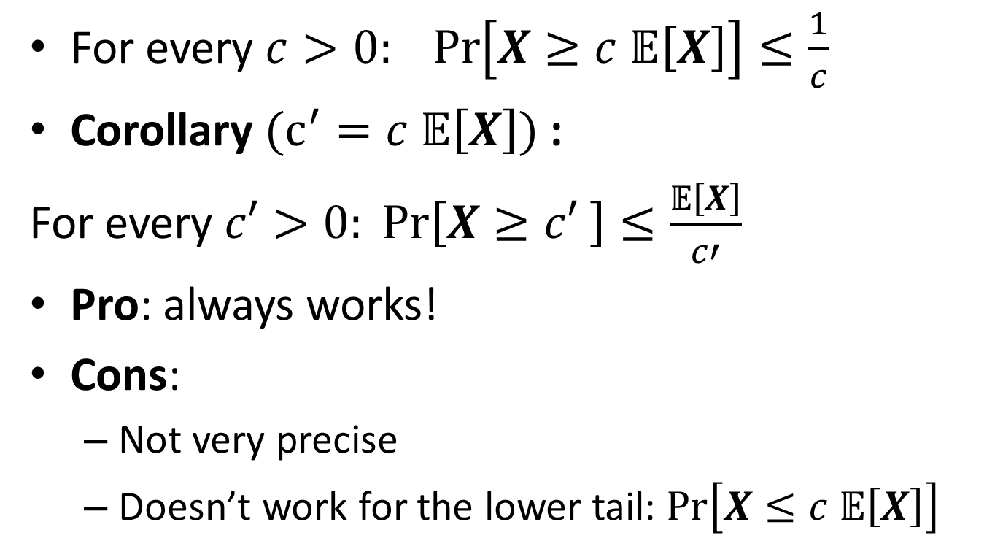
Markov’s Inequality
For every $c>0: Pr\left[X≥c 𝔼\left[X\right]\right]≤\frac{1}{c}$
Corollary $(c^{′}=c 𝔼\left[X\right])$:
For every $c′>0: Pr\left[X≥c′ \right]≤\frac{𝔼\left[X\right]}{c′}$
Pro: always works!
Cons:
Not very precise
Doesn’t work for the lower tail: $Pr\left[X≤c 𝔼\left[X\right]\right]$

Slide 18
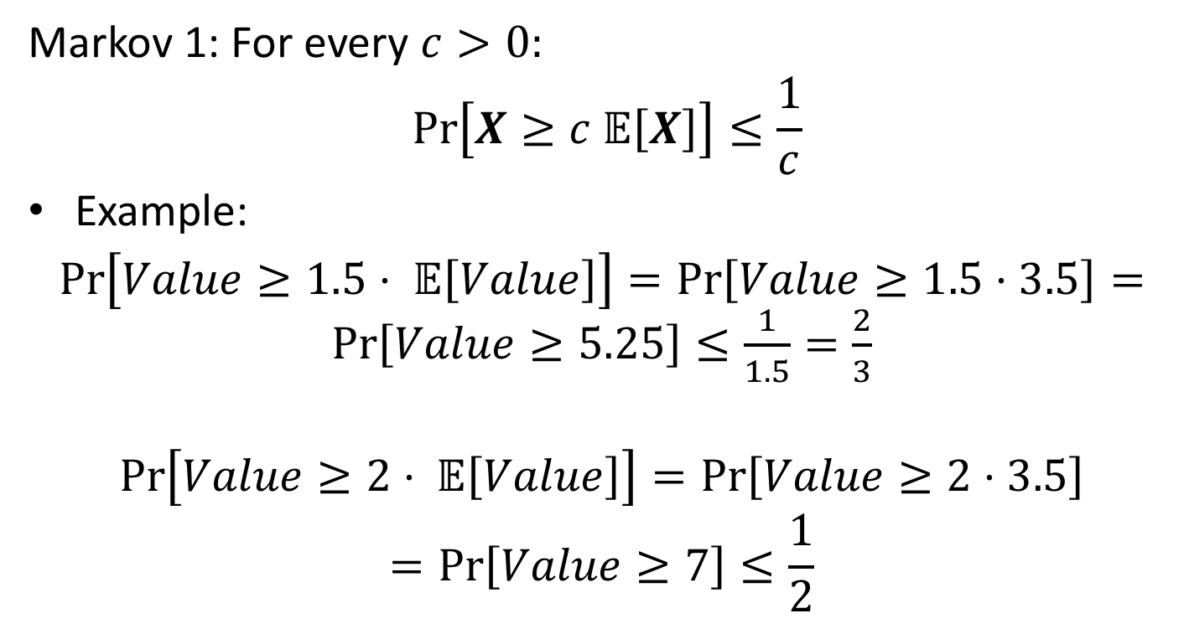
Markov Inequality: Example
Markov 1: For every $c>0:$
$$Pr\left[X≥c 𝔼\left[X\right]\right]≤\frac{1}{c}$$
Example:
$\operatorname{Pr}\left[Value≥1.5⋅ 𝔼\left[Value\right]\right]=\operatorname{Pr}\left[Value≥1.5⋅3.5\right]=\operatorname{Pr}\left[Value≥5.25\right]≤\frac{1}{1.5}=\frac{2}{3}$
$$\operatorname{Pr}\left[Value≥2⋅ 𝔼\left[Value\right]\right]=\operatorname{Pr}\left[Value≥2⋅3.5\right]$$
$$=\operatorname{Pr}\left[Value≥7\right]≤\frac{1}{2}$$

Slide 19
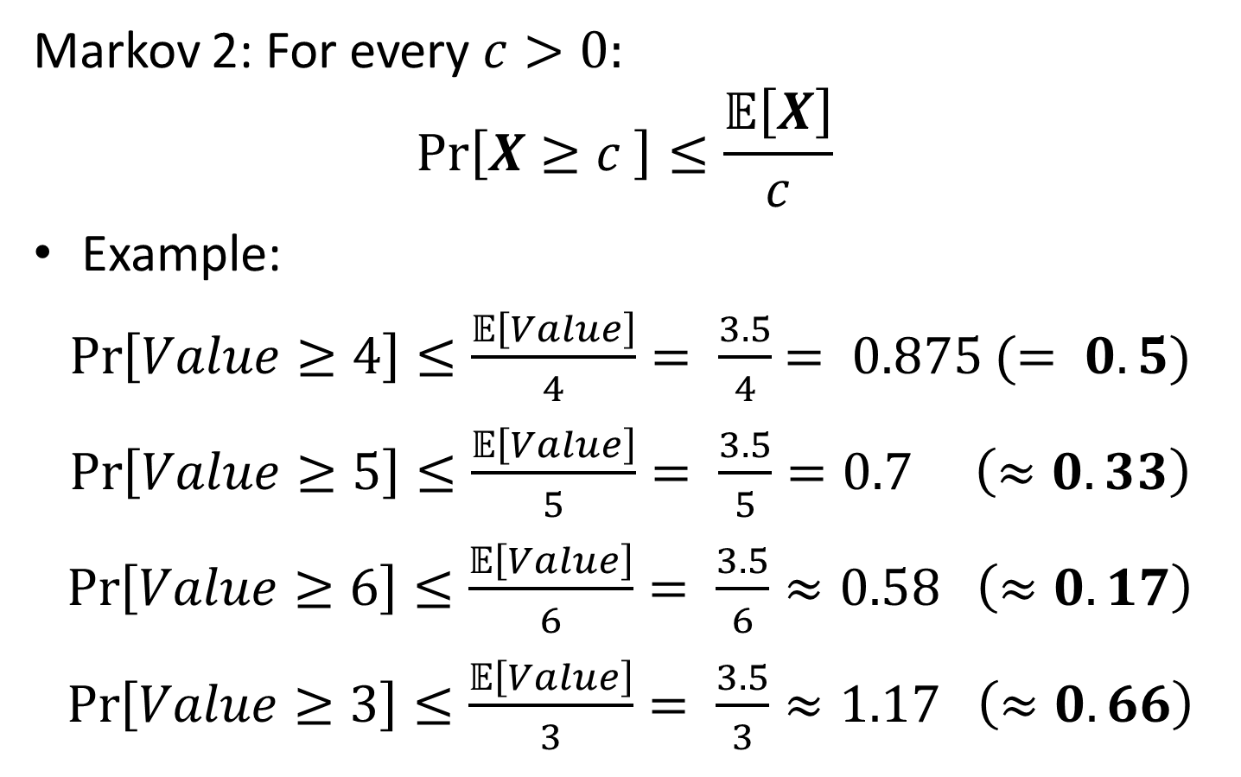
Markov Inequality: Example
Markov 2: For every $c>0:$
$$Pr\left[X≥c \right]≤\frac{𝔼\left[X\right]}{c}$$
Example:
$\operatorname{Pr}\left[Value≥4\right]≤\frac{𝔼\left[Value\right]}{4}= \frac{3.5}{4}$ $= 0.875$ $(= 0.5)$
$\operatorname{Pr}\left[Value≥5\right]≤\frac{𝔼\left[Value\right]}{5}= \frac{3.5}{5}=0.7$ $\left(≈0.33\right)$
$\operatorname{Pr}\left[Value≥6\right]≤\frac{𝔼\left[Value\right]}{6}= \frac{3.5}{6}≈0.58$ $\left(≈0.17\right)$
$\operatorname{Pr}\left[Value≥3\right]≤\frac{𝔼\left[Value\right]}{3}= \frac{3.5}{3}≈1.17$ $\left(≈0.66\right)$

Slide 20
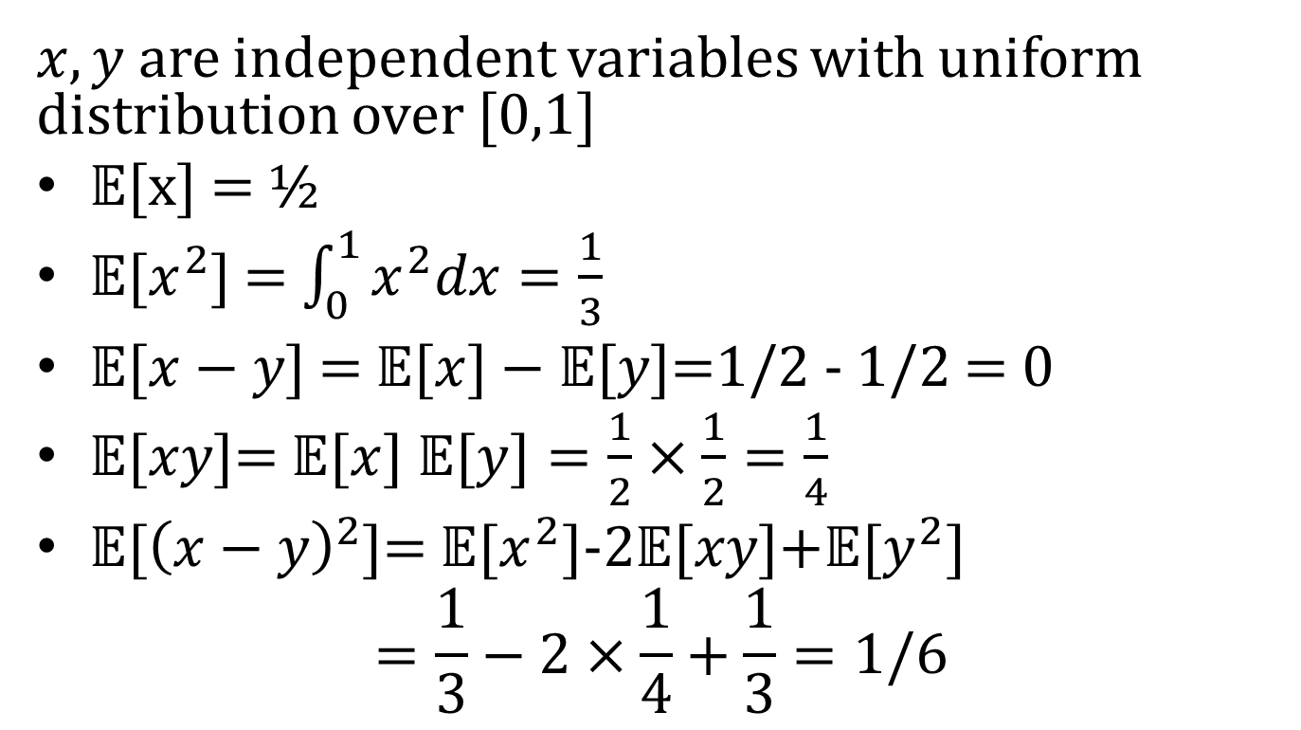
Quiz analysis: P1, part 1
$x,y$ are independent variables with uniform distribution over [0,1]
𝔼[x] = ½
𝔼[$x^{2}$] = $\int_{0}^{1}{x^{2}dx}=\frac{1}{3}$
$\text{𝔼}\text{[}x−y\text{]}$ = $\text{𝔼}\text{[}x]−\text{𝔼}[y\text{]}\text{=1/2 − 1/2 = 0}$
𝔼[$xy$]= $\text{𝔼}\text{[}x]$ $\text{𝔼}\text{[}y]=\frac{1}{2}×\frac{1}{2}=\frac{1}{4}$
𝔼[${\left(x−y\right)}^{2}$]= 𝔼[$x^{2}]\text{−2}\text{𝔼}\text{[}xy]\text{+}\text{𝔼}\text{[}y^{2}]$
$$=\frac{1}{3}−2×\frac{1}{4}+\frac{1}{3}=1/6$$

Slide 21
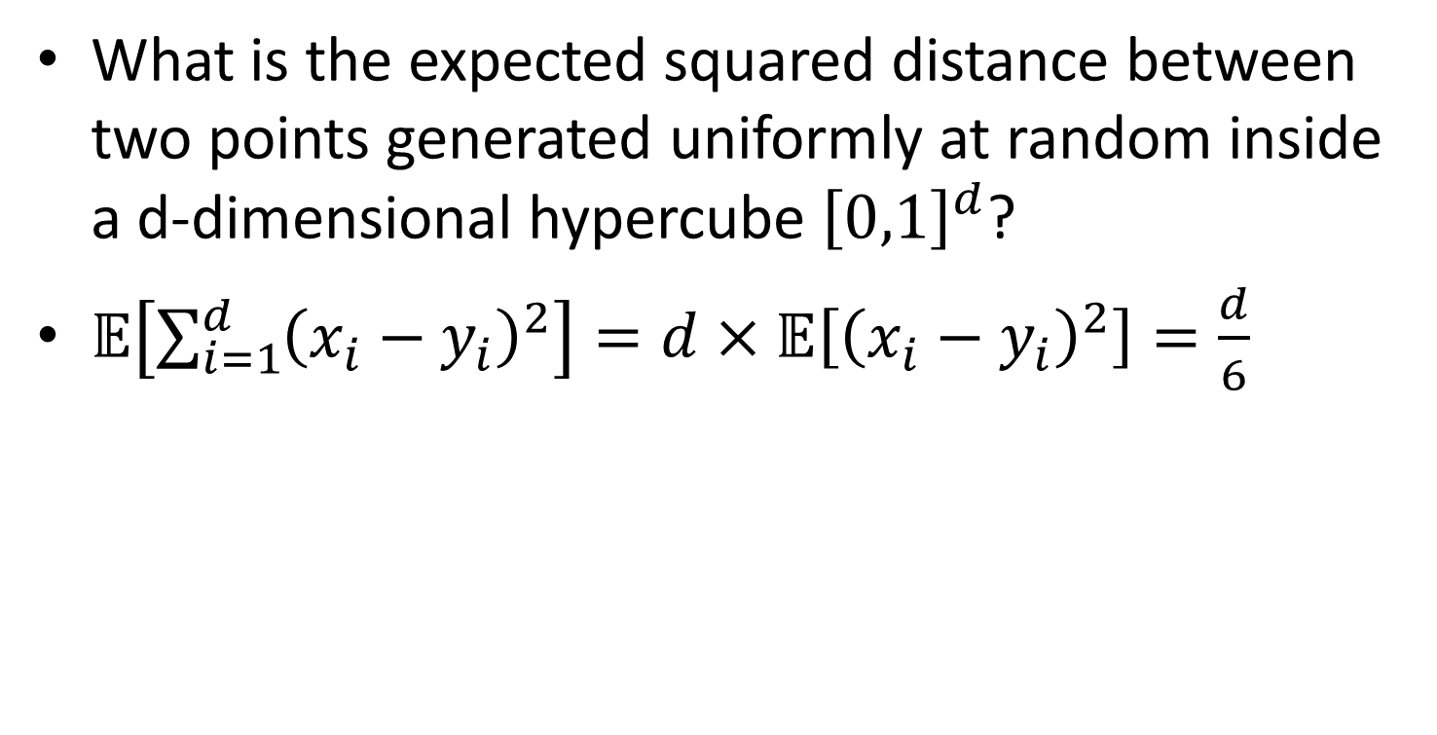
Quiz analysis: P1, part 2
What is the expected squared distance between two points generated uniformly at random inside a d-dimensional hypercube ${\left[0,1\right]}^{d}$?
$𝔼\left[\sum_{i=1}^{d}{{\left(x_{i}−y_{i}\right)}^{2}}\right]=d×𝔼\left[{\left(x_{i}−y_{i}\right)}^{2}\right]=\frac{d}{6}$

Slide 22
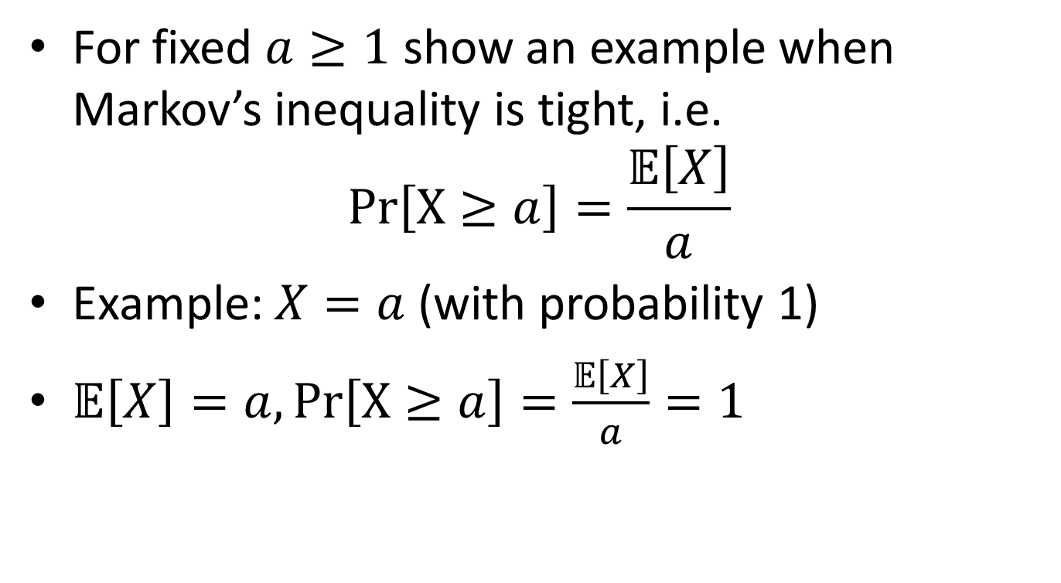
Quiz analysis: P2
For fixed $a≥1$ show an example when Markov’s inequality is tight, i.e.
$$Pr\left[X≥a\right]=\frac{𝔼\left[X\right]}{a}$$
Example: $X=a$ (with probability 1)
$𝔼\left[X\right]=a, Pr\left[X≥a\right]=\frac{𝔼\left[X\right]}{a}=1$

Slide 23
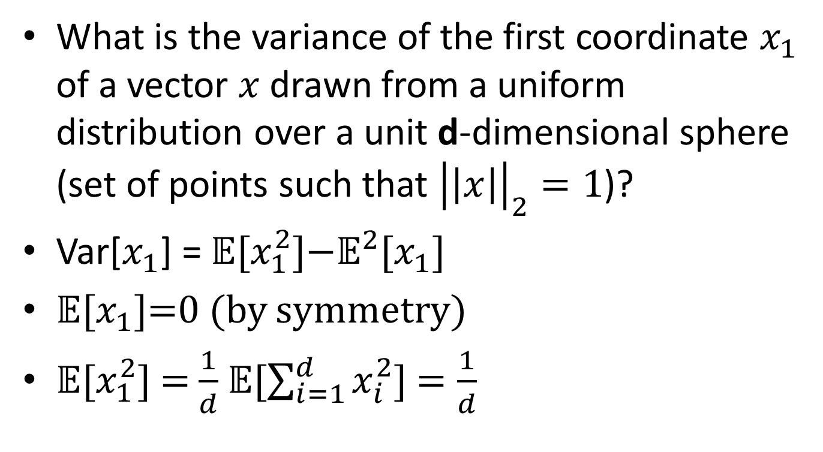
Quiz analysis: P3
What is the variance of the first coordinate $x_{1}$ of a vector $x$ drawn from a uniform distribution over a unit d-dimensional sphere (set of points such that ${\left|\left|x\right|\right|}_{2}=1$)?
Var[$x_{1}$] = 𝔼[$x_{1}^{2}$]$−{\text{𝔼}}^{2}$[$x_{1}$]
𝔼[$x_{1}$]=0 (by symmetry)
𝔼[$x_{1}^{2}$] = $\frac{1}{d}$ 𝔼[$\sum_{i=1}^{d}{x_{i}^{2}}$] $=\frac{1}{d}$

Slide 24
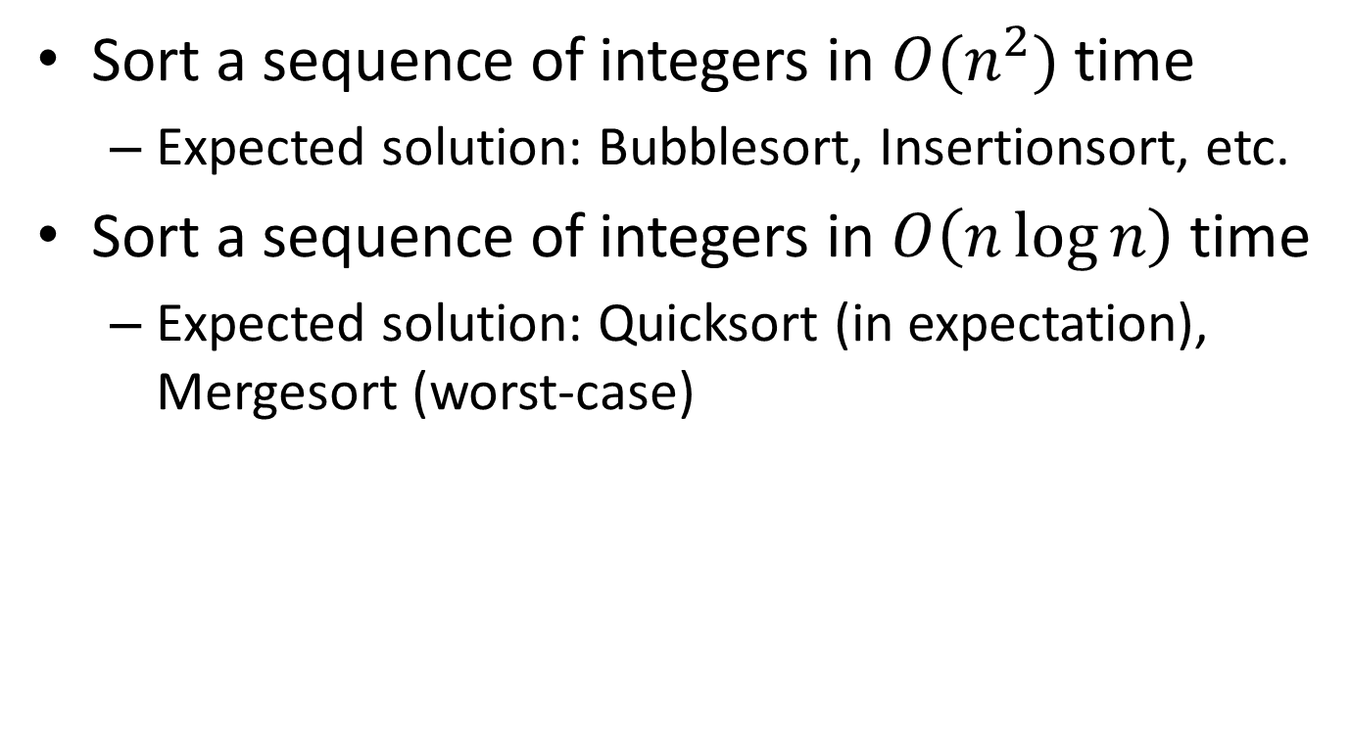
Quiz analysis: P4
Sort a sequence of integers in $O(n^{2})$ time
Expected solution: Bubblesort, Insertionsort, etc.
Sort a sequence of integers in $O\left(n\log{n}\right)$ time
Expected solution: Quicksort (in expectation), Mergesort (worst-case)

Slide 25
Core Classes to Take
B503 (Algorithms), MW + TR
B551 (Elements of Artificial Intelligence), TR
B555 (Machine Learning), MW, this time
B561 (Databases), MW + TR
B565 (Data Mining), TR

Slide 26
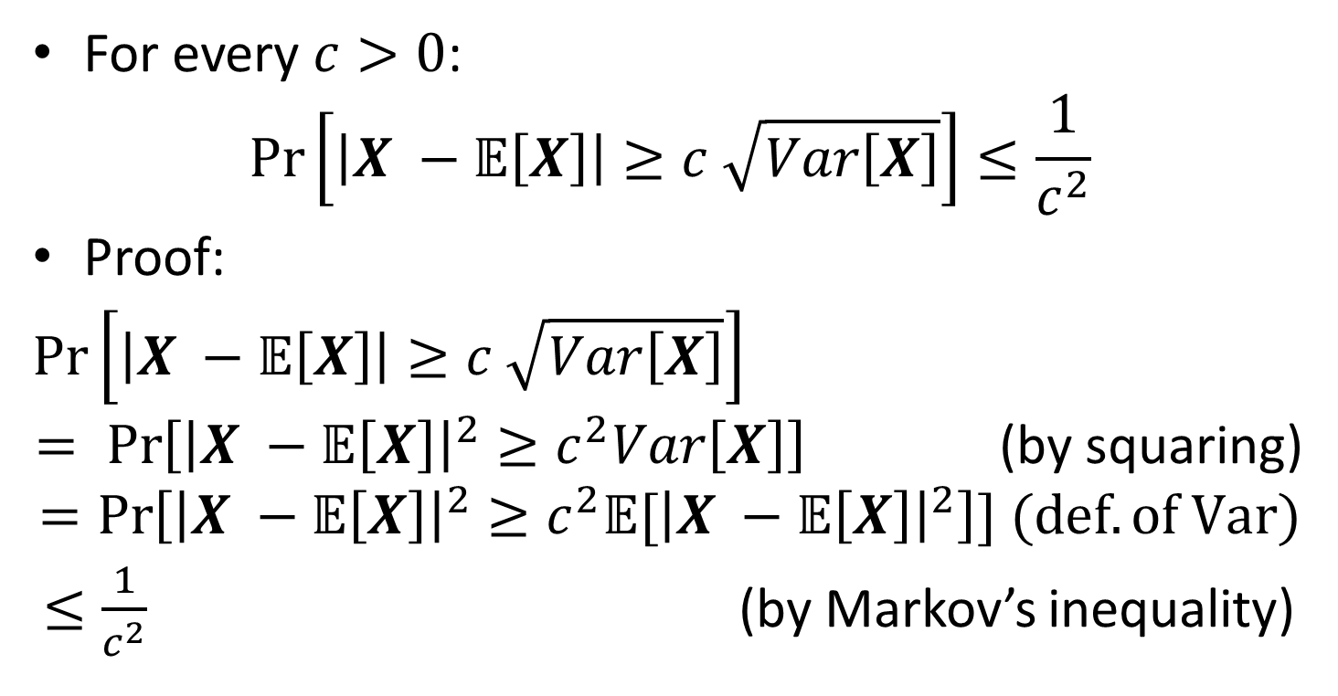
Chebyshev’s Inequality
For every $c>0$:
$$\operatorname{Pr}\left[\left|X −𝔼\left[X\right]\right|≥c \sqrt{Var\left[X\right]}\right]≤\frac{1}{c^{2}}$$
Proof:
$\operatorname{Pr}\left[\left|X −𝔼\left[X\right]\right|≥c \sqrt{Var\left[X\right]}\right]$
$= \operatorname{Pr}\left[{\left|X −𝔼\left[X\right]\right|}^{2}≥c^{2}Var\left[X\right]\right]$ (by squaring)
$$=\operatorname{Pr}\left[{\left|X −𝔼\left[X\right]\right|}^{2}≥c^{2}{𝔼[\left|X −𝔼\left[X\right]\right|}^{2}\right]] (def. of Var)$$
$≤\frac{1}{c^{2}}$ (by Markov’s inequality)

Slide 27
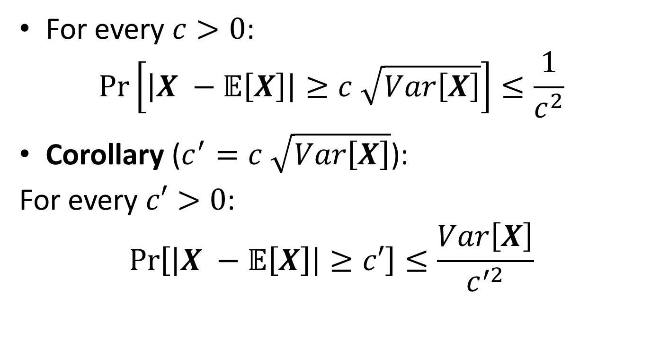
Chebyshev’s Inequality
For every $c>0$:
$$\operatorname{Pr}\left[\left|X −𝔼\left[X\right]\right|≥c \sqrt{Var\left[X\right]}\right]≤\frac{1}{c^{2}}$$
Corollary ($c^{′}=c \sqrt{Var\left[X\right]}$):
For every $c′>0$:
$$\operatorname{Pr}\left[\left|X −𝔼\left[X\right]\right|≥c′\right]≤\frac{Var\left[X\right]}{c^{′2}}$$

Slide 28
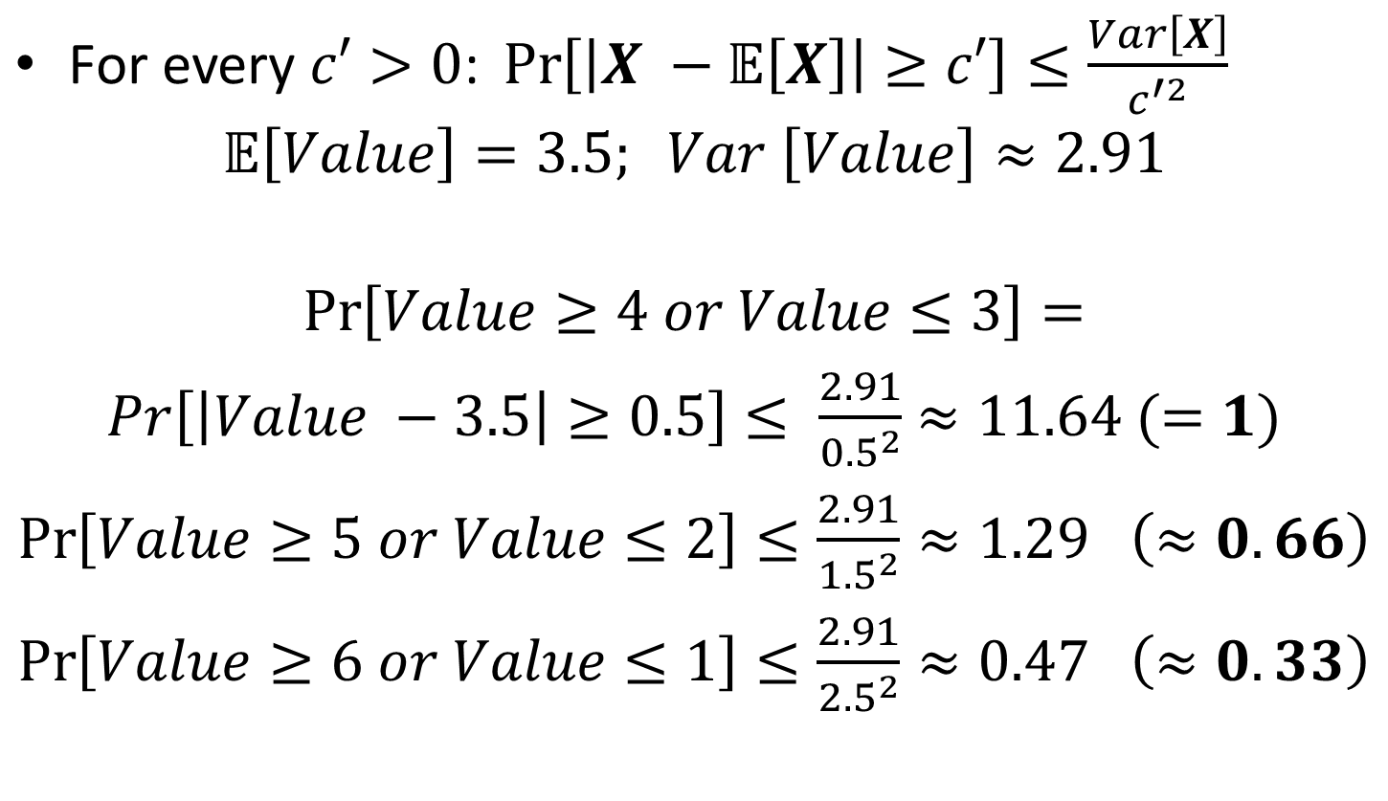
Chebyshev: Example
$\text{For} \text{every} c′>0\text{: }\operatorname{Pr}\left[\left|X −𝔼\left[X\right]\right|≥c′\right]≤\frac{Var\left[X\right]}{c^{′2}}$
$$𝔼\left[Value\right]=3.5; Var \left[Value\right]≈2.91$$
$$\operatorname{Pr}\left[Value≥4 or Value≤3\right]=$$
$Pr\left[\left|Value −3.5\right|≥0.5\right]≤ \frac{2.91}{{0.5}^{2}}$ $≈11.64 (=1)$
$\operatorname{Pr}\left[Value≥5 or Value≤2\right]≤\frac{2.91}{{1.5}^{2}}≈1.29$ $\left(≈0.66\right)$
$\operatorname{Pr}\left[Value≥6 or Value≤1\right]≤\frac{2.91}{{2.5}^{2}}≈0.47$ $\left(≈0.33\right)$

Slide 29
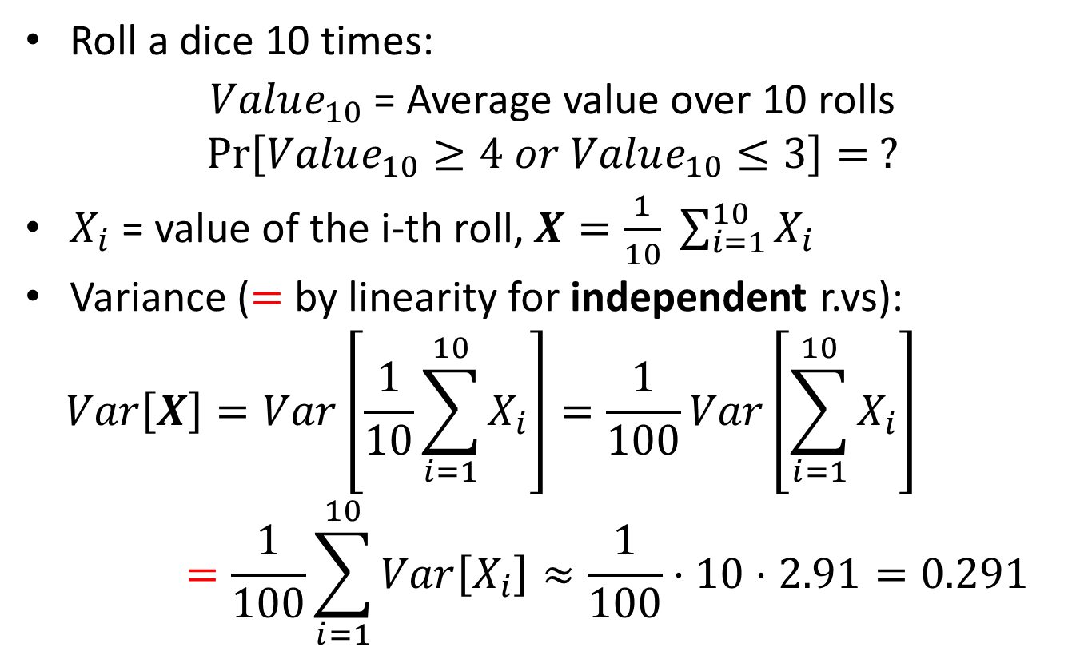
Chebyshev: Example
Roll a dice 10 times:
$Value_{10}$ = Average value over 10 rolls
$$\operatorname{Pr}\left[Value_{10}≥4 or Value_{10}≤3\right]= ?$$
$X_{i}$ = value of the i-th roll, $X=\frac{1}{10} \sum_{i=1}^{10}{X_{i}}$
Variance ($=$ by linearity for independent r.vs):
$$Var\left[X\right]=Var\left[\frac{1}{10}\sum_{i=1}^{10}{X_{i}}\right]=\frac{1}{100}Var\left[\sum_{i=1}^{10}{X_{i}}\right]=\frac{1}{100}\sum_{i=1}^{10}{Var\left[X_{i}\right]≈\frac{1}{100}⋅10⋅2.91=0.291}$$

Slide 30
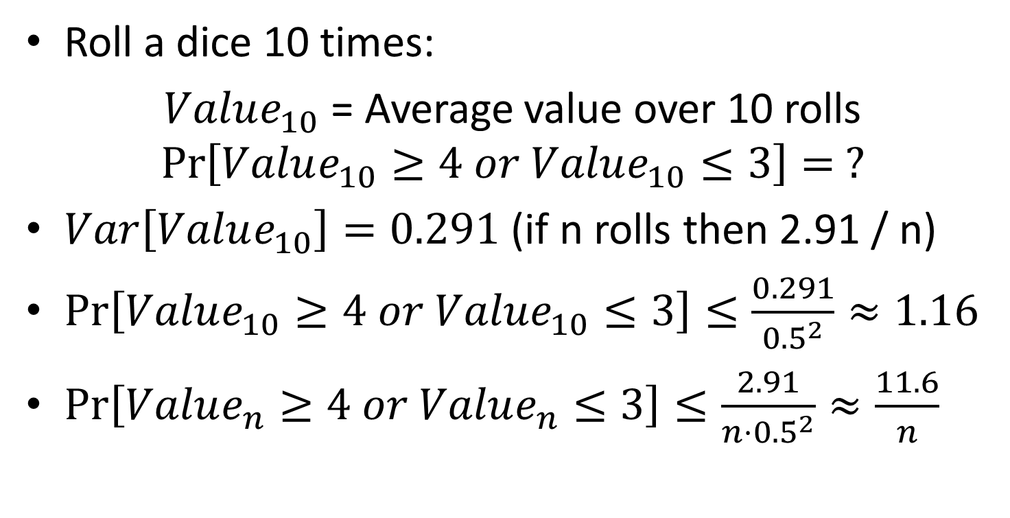
Chebyshev: Example
Roll a dice 10 times:
$Value_{10}$ = Average value over 10 rolls
$$\operatorname{Pr}\left[Value_{10}≥4 or Value_{10}≤3\right]= ?$$
$Var\left[Value_{10}\right]=0.291$ (if n rolls then 2.91 / n)
$\operatorname{Pr}\left[Value_{10}≥4 or Value_{10}≤3\right]≤\frac{0.291}{{0.5}^{2}}≈1.16$
$\operatorname{Pr}\left[Value_{n}≥4 or Value_{n}≤3\right]≤\frac{2.91}{{n⋅0.5}^{2}}≈\frac{11.6}{n}$

Slide 31
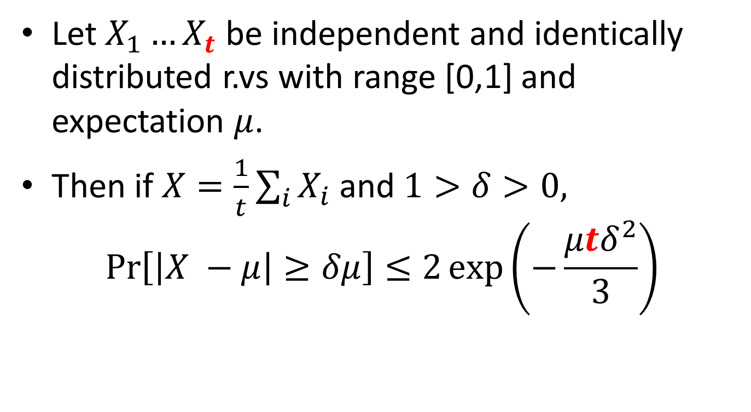
Chernoff bound
Let $X_{1}…X_{t}$ be independent and identically distributed r.vs with range [0,1] and expectation $μ$.
Then if $X=\frac{1}{t}\sum_{i}{X_{i}}$ and $1>δ>0,$
$$\operatorname{Pr}\left[\left|X −μ\right|≥δμ\right]≤2\exp\left(−\frac{μtδ^{2}}{3}\right)$$

Slide 32
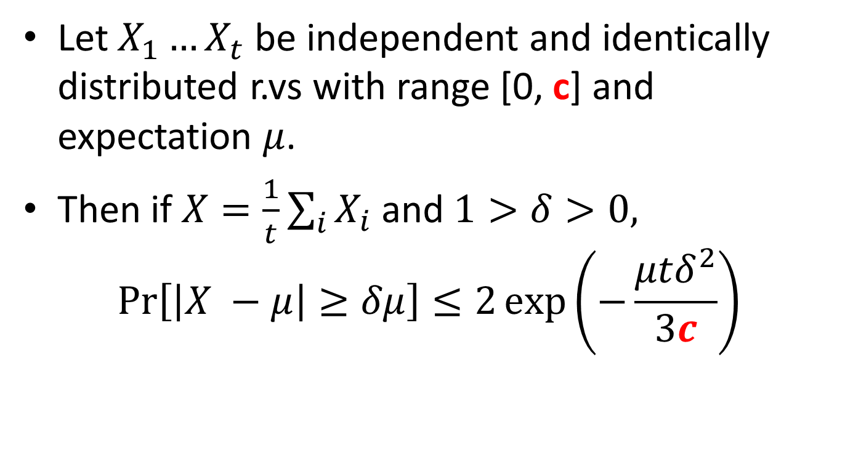
Chernoff bound (corollary)
Let $X_{1}…X_{t}$ be independent and identically distributed r.vs with range [0, c] and expectation $μ$.
Then if $X=\frac{1}{t}\sum_{i}{X_{i}}$ and $1>δ>0,$
$$\operatorname{Pr}\left[\left|X −μ\right|≥δμ\right]≤2\exp\left(−\frac{μtδ^{2}}{3c}\right)$$

Slide 33
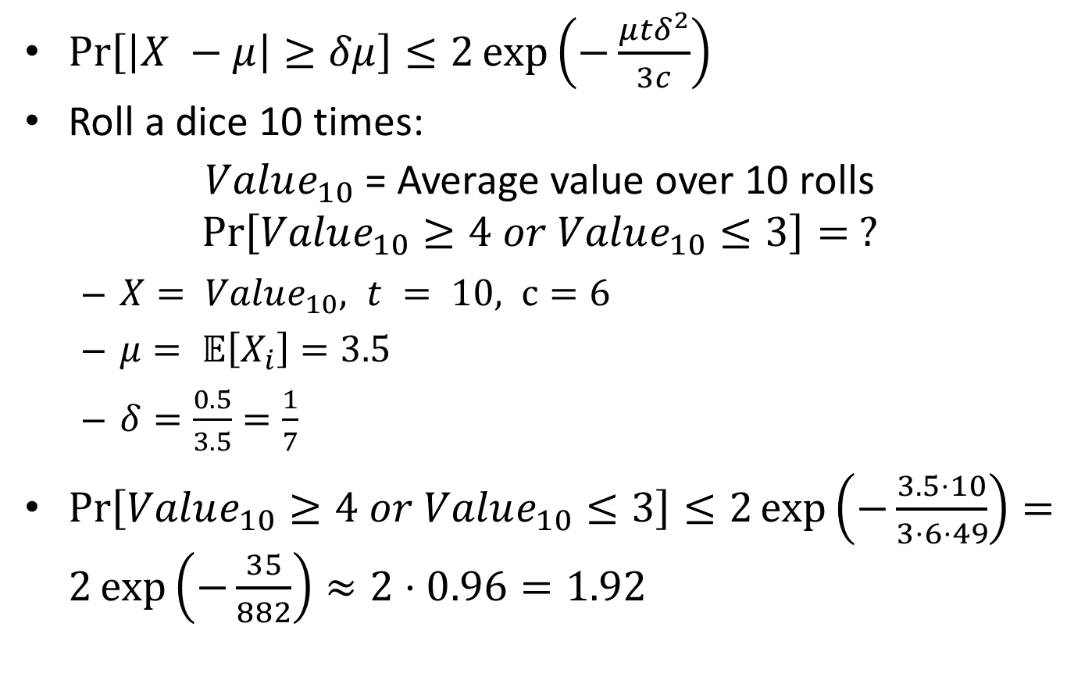
Chernoff: Example
$\operatorname{Pr}\left[\left|X −μ\right|≥δμ\right]≤2\exp\left(−\frac{μtδ^{2}}{3c}\right)$
Roll a dice 10 times:
$Value_{10}$ = Average value over 10 rolls
$$\operatorname{Pr}\left[Value_{10}≥4 or Value_{10}≤3\right]= ?$$
$X= Value_{10}, t = 10, c=6$
$μ= 𝔼\left[X_{i}\right]=3.5$
$δ=\frac{0.5}{3.5}=\frac{1}{7}$
$\operatorname{Pr}\left[Value_{10}≥4 or Value_{10}≤3\right]≤2\exp\left(−\frac{3.5⋅10}{3⋅6⋅49}\right)=2\exp\left(−\frac{35}{882}\right)≈2⋅0.96=1.92$

Slide 34
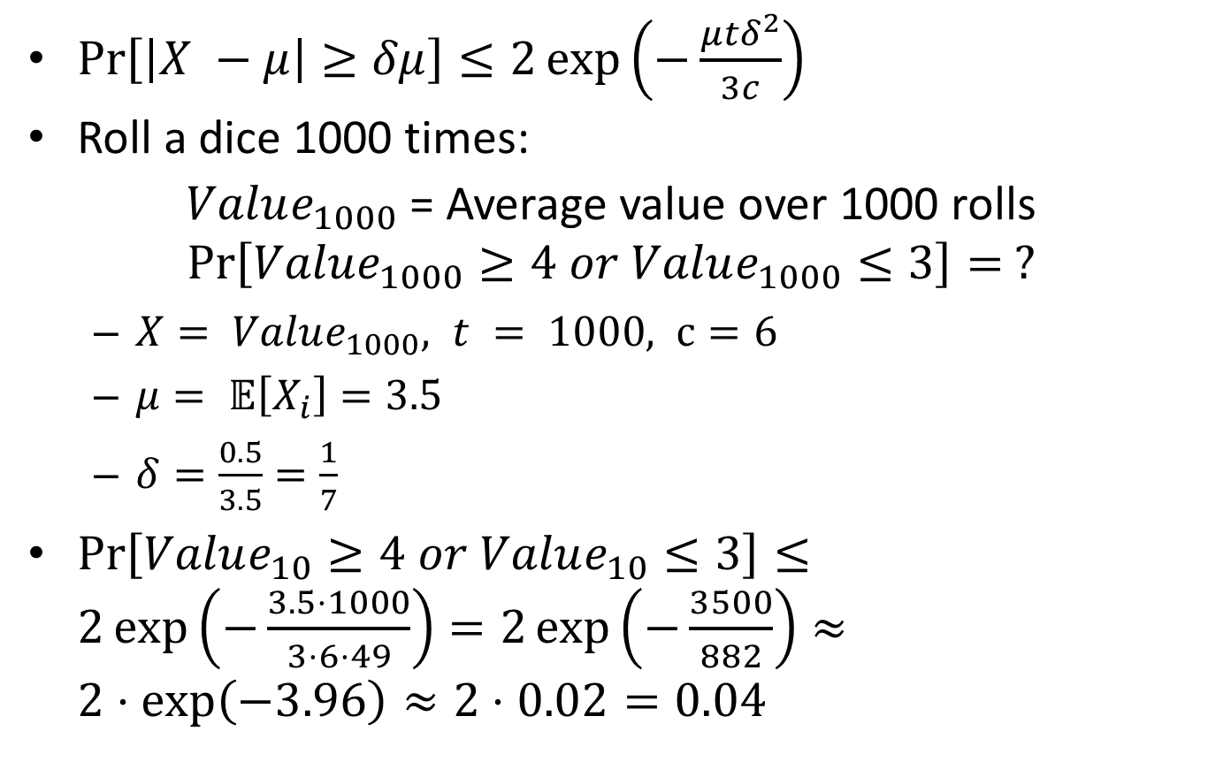
Chernoff: Example
$\operatorname{Pr}\left[\left|X −μ\right|≥δμ\right]≤2\exp\left(−\frac{μtδ^{2}}{3c}\right)$
Roll a dice 1000 times:
$Value_{1000}$ = Average value over 1000 rolls
$$\operatorname{Pr}\left[Value_{1000}≥4 or Value_{1000}≤3\right]= ?$$
$X= Value_{1000}, t = 1000, c=6$
$μ= 𝔼\left[X_{i}\right]=3.5$
$δ=\frac{0.5}{3.5}=\frac{1}{7}$
$\operatorname{Pr}\left[Value_{10}≥4 or Value_{10}≤3\right]≤2\exp\left(−\frac{3.5⋅1000}{3⋅6⋅49}\right)=2\exp\left(−\frac{3500}{882}\right)≈2⋅\exp\left(−3.96\right)≈2⋅0.02=0.04$

Slide 35
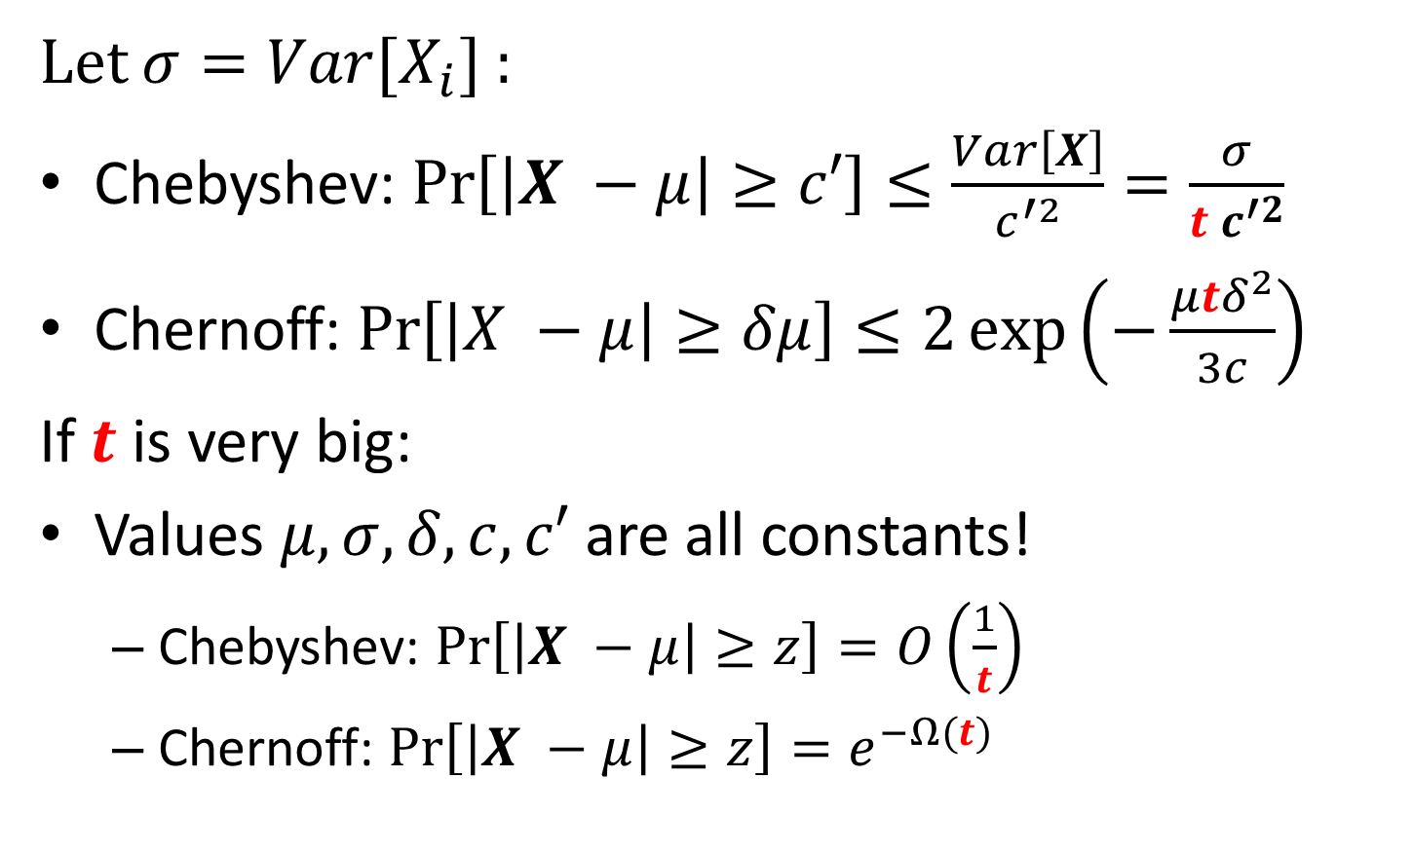
Chernoff v.s Chebyshev: Example
Let $σ=Var[X_{i}]$ :
Chebyshev: $\operatorname{Pr}\left[\left|X −μ\right|≥c′\right]≤\frac{Var\left[X\right]}{c^{′2}}=\frac{σ}{{t c}^{′2}}$
Chernoff: $\operatorname{Pr}\left[\left|X −μ\right|≥δμ\right]≤2\exp\left(−\frac{μtδ^{2}}{3c}\right)$
If $t$ is very big:
Values $μ, σ, δ, c, c′$ are all constants!
Chebyshev: $\operatorname{Pr}\left[\left|X −μ\right|≥z\right]=O\left(\frac{1}{t}\right)$
Chernoff: $\operatorname{Pr}\left[\left|X −μ\right|≥z\right]=e^{−Ω(t)}$

Slide 36
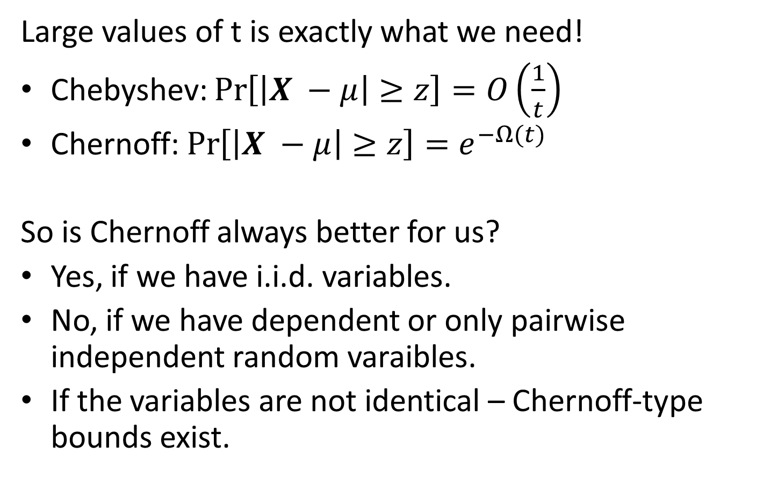
Chernoff v.s Chebyshev: Example
Large values of t is exactly what we need!
Chebyshev: $\operatorname{Pr}\left[\left|X −μ\right|≥z\right]=O\left(\frac{1}{t}\right)$
Chernoff: $\operatorname{Pr}\left[\left|X −μ\right|≥z\right]=e^{−Ω(t)}$
So is Chernoff always better for us?
Yes, if we have i.i.d. variables.
No, if we have dependent or only pairwise independent random varaibles.
If the variables are not identical – Chernoff-type bounds exist.

