Slide 1

CSCI B609: “Foundations of Data Science”
Lecture 19: $L_{0}$-sampling, $L_{1}$-sparse recovery, Count Sketch
Slides at http://grigory.us/data-science-class.html
Grigory Yaroslavtsev
http://grigory.us

Slide 2
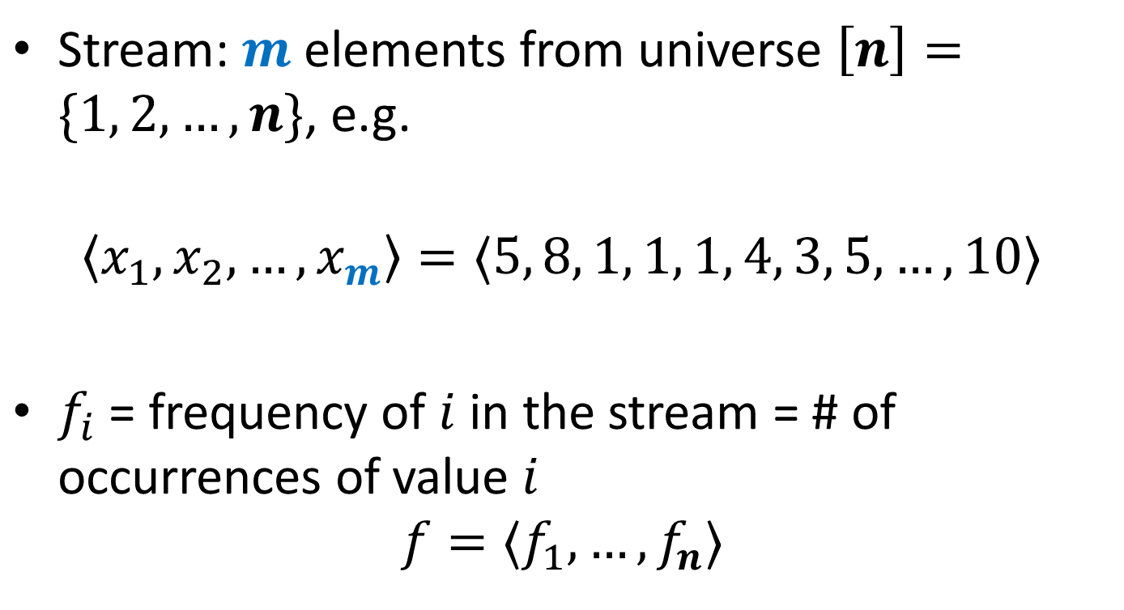
Data Streams
Stream: $m$ elements from universe $\left[n\right]=\{1, 2, …, n\}$, e.g.
$$〈x_{1},x_{2},…, x_{m}〉=〈5, 8, 1, 1, 1, 4, 3, 5, …, 10〉$$
$f_{i}$ = frequency of $i$ in the stream = # of occurrences of value $i$
$$f=〈f_{1},…, f_{n}〉$$

Slide 3

Frequency Moments
Define $F_{k}=\sum_{i}{f_{i}^{k}}$ for $k∈\{0,1,2,…\}$
$F_{0}=$ # number of distinct elements
$F_{1}=$ # elements
$F_{2}$ = “Gini index”, “surprise index”

Slide 4
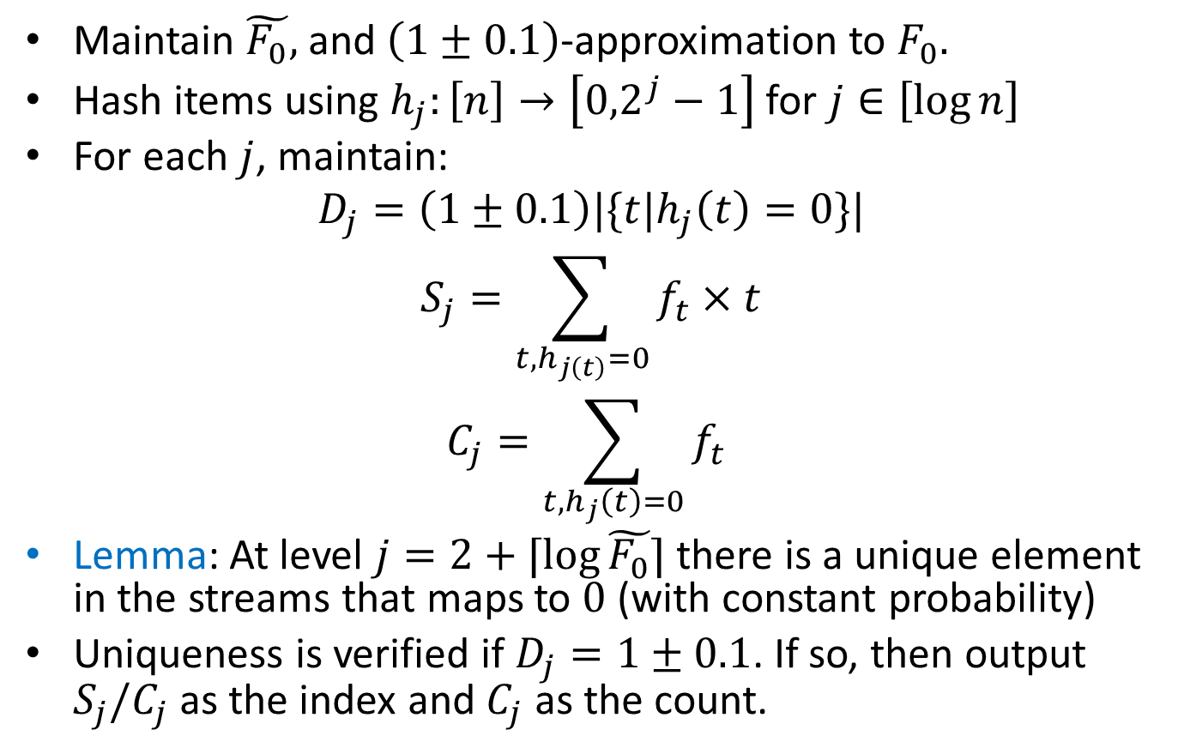

$ℓ_{0}$-sampling
Maintain $\tilde{F_{0}},$ and $\left(1±0.1\right)$-approximation to $F_{0}.$
Hash items using $h_{j}:\left[n\right]→\left[{0,2}^{j}−1\right]$ for $j∈\left[\log{n}\right]$
For each $j$, maintain:
$$D_{j}=\left(1±0.1\right)|\{t|h_{j}\left(t\right)=0\}|$$
$$S_{j}=\sum_{t, h_{j\left(t\right)}=0}{f_{t}×t}$$
$$C_{j}=\sum_{t, h_{j}\left(t\right)=0}{f_{t}}$$
Lemma: At level $j=2+⌈\log{\tilde{F_{0}}}⌉$ there is a unique element in the streams that maps to $0$ (with constant probability)
Uniqueness is verified if $D_{j}=1±0.1$. If so, then output $S_{j}/C_{j}$ as the index and $C_{j}$ as the count.

Slide 5
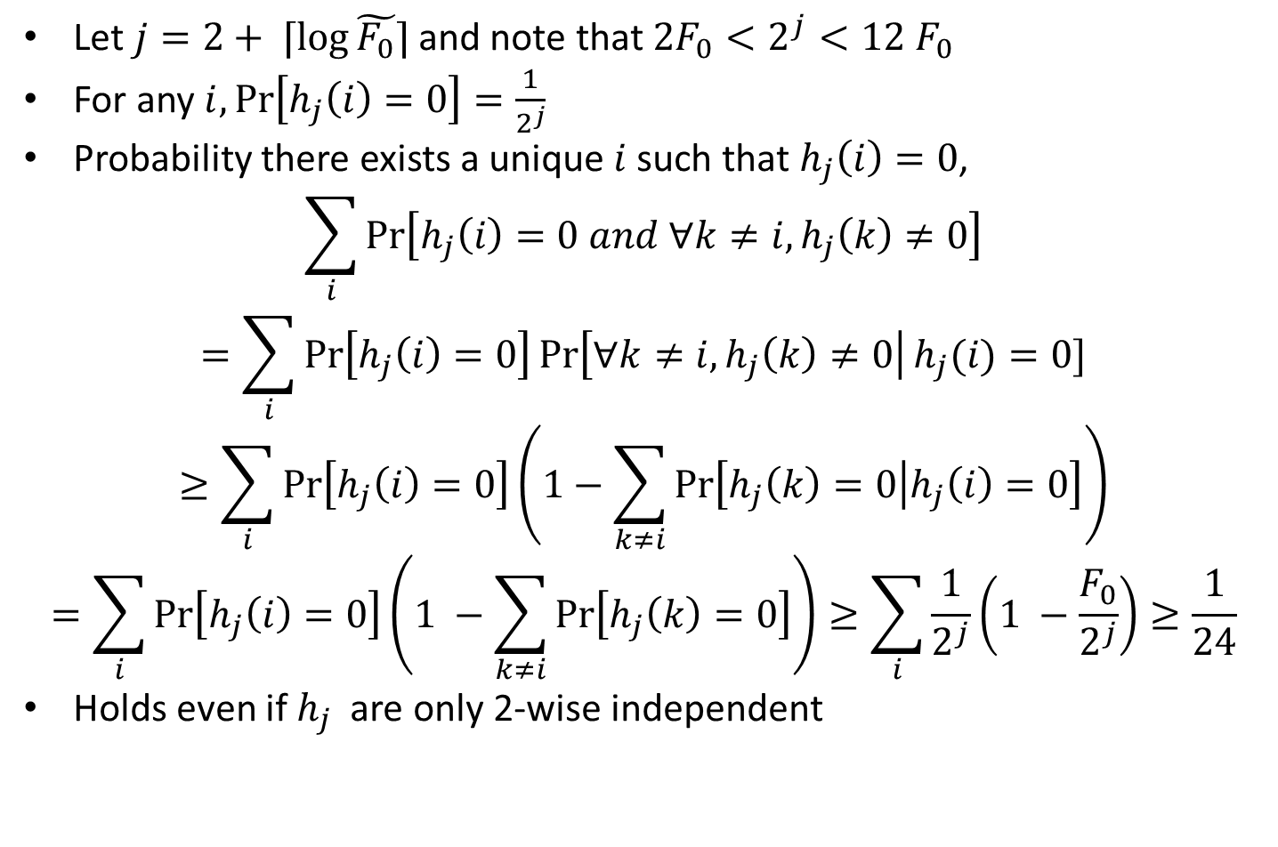
Proof of Lemma
Let $j=2+ ⌈\log{\tilde{F_{0}}}⌉$ and note that ${2F}_{0}<2^{j}<12 F_{0}$
For any $i,\operatorname{Pr}\left[h_{j}\left(i\right)=0\right]=\frac{1}{2^{j}}$
Probability there exists a unique $i$ such that $h_{j}\left(i\right)=0$,
$$\sum_{i}{\operatorname{Pr}\left[h_{j}\left(i\right)=0 and ∀k≠i, h_{j}\left(k\right)≠0\right]}$$
$$=\sum_{i}{\operatorname{Pr}\left[h_{j}\left(i\right)=0\right]\operatorname{Pr}\left[∀k≠i, h_{j}\left(k\right)≠0\right|h_{j}(i)=0]}$$
$$≥\sum_{i}{\operatorname{Pr}\left[h_{j}\left(i\right)=0\right]\left(1−\sum_{k≠i}{\operatorname{Pr}\left[h_{j}\left(k\right)=0 | h_{j}\left(i\right)=0\right]}\right)}$$
$$=\sum_{i}{\operatorname{Pr}\left[h_{j}\left(i\right)=0\right]\left(1 −\sum_{k≠i}{\operatorname{Pr}\left[h_{j}\left(k\right)=0\right]}\right)}≥\sum_{i}{\frac{1}{2^{j}}\left(1 −\frac{F_{0}}{2^{j}}\right)≥\frac{1}{24}}$$
Holds even if $h_{j}$ are only 2-wise independent

Slide 6
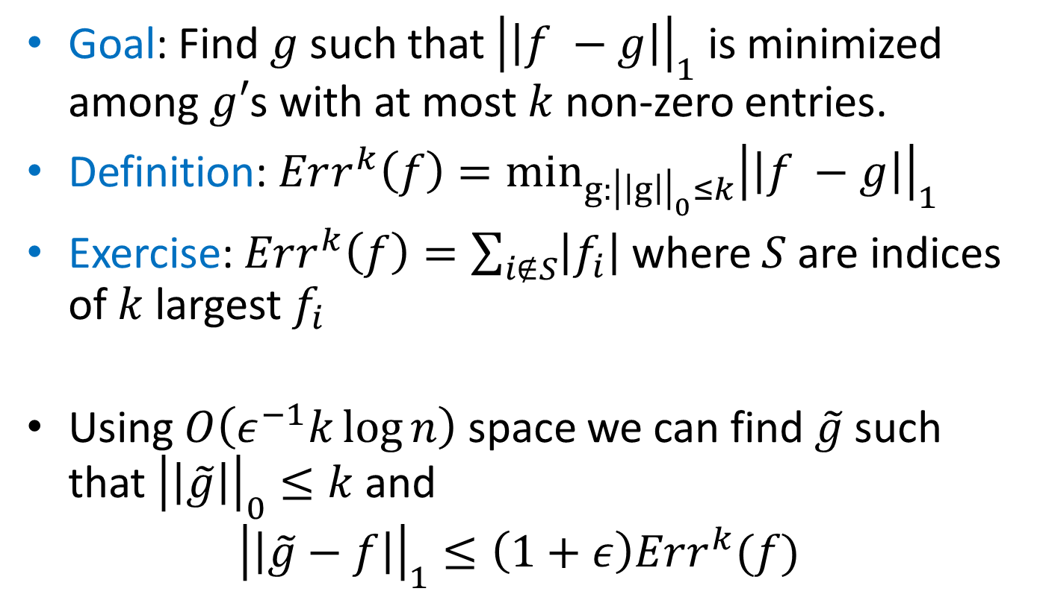
Sparse Recovery
Goal: Find $g$ such that ${\left|\left|f −g\right|\right|}_{1}$ is minimized among $g′$s with at most $k$ non-zero entries.
Definition: $Err^{k}\left(f\right)=\min_{g:{\left|\left|g\right|\right|}_{0}≤k}{{\left|\left|f −g\right|\right|}_{1}}$
Exercise: $Err^{k}\left(f\right)=\sum_{i∉S}{\left|f_{i}\right|}$ where $S$ are indices of $k$ largest $f_{i}$
Using $O\left(ε^{−1}k\log{n}\right)$ space we can find $\tilde{g}$ such that ${\left|\left|\tilde{g}\right|\right|}_{0}≤k$ and
$${\left|\left|\tilde{g}−f\right|\right|}_{1}≤\left(1+ε\right)Err^{k}(f)$$

Slide 7
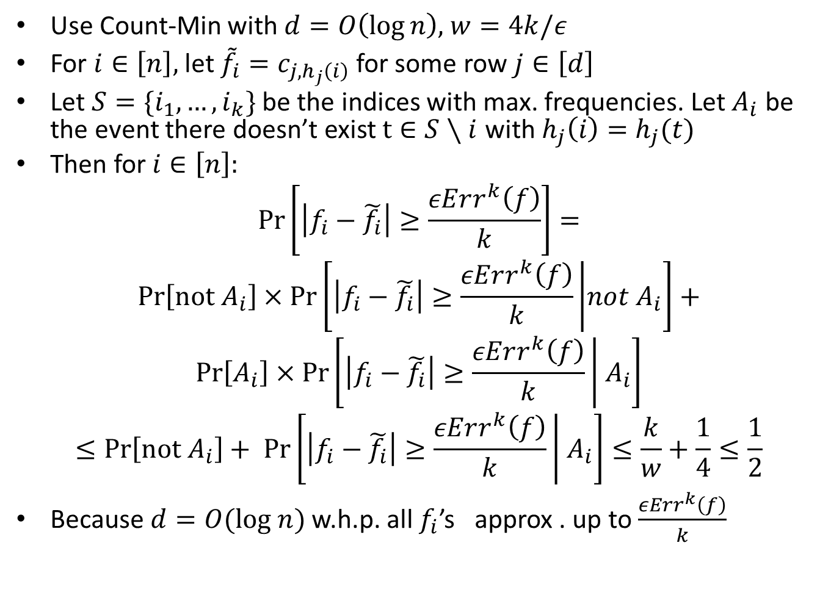
Count-Min Revisited
Use Count-Min with $d=O\left(\log{n}\right),$ $w=4k/ε$
For $i∈\left[n\right],$ let ${\tilde{f}}_{i}=c_{j,h_{j}\left(i\right)}$ for some row $j∈\left[d\right]$
Let $S=\{i_{1},…, i_{k}\}$ be the indices with max. frequencies. Let $A_{i}$ be the event there doesn’t exist $t∈S∖i$ with $h_{j}\left(i\right)=h_{j}(t)$
Then for $i∈\left[n\right]:$
$$\operatorname{Pr}\left[\left|f_{i}−\tilde{f_{i}}\right|≥\frac{εErr^{k}\left(f\right)}{k}\right]=$$
$$\operatorname{Pr}\left[not A_{i}\right]×\operatorname{Pr}\left[\left|f_{i}−\tilde{f_{i}}\right|≥\frac{εErr^{k}\left(f\right)}{k} | not A_{i}\right]+$$
$$\operatorname{Pr}\left[A_{i}\right]×\operatorname{Pr}\left[\left|f_{i}−\tilde{f_{i}}\right|≥\frac{εErr^{k}\left(f\right)}{k} | A_{i}\right]$$
$$≤\operatorname{Pr}\left[not A_{i}\right]+ \operatorname{Pr}\left[\left|f_{i}−\tilde{f_{i}}\right|≥\frac{εErr^{k}\left(f\right)}{k} | A_{i}\right]≤\frac{k}{w}+\frac{1}{4}≤\frac{1}{2}$$
Because $d=O(log n)$ w.h.p. all $f_{i}$’s approx . up to $\frac{εErr^{k}\left(f\right)}{k}$

Slide 8
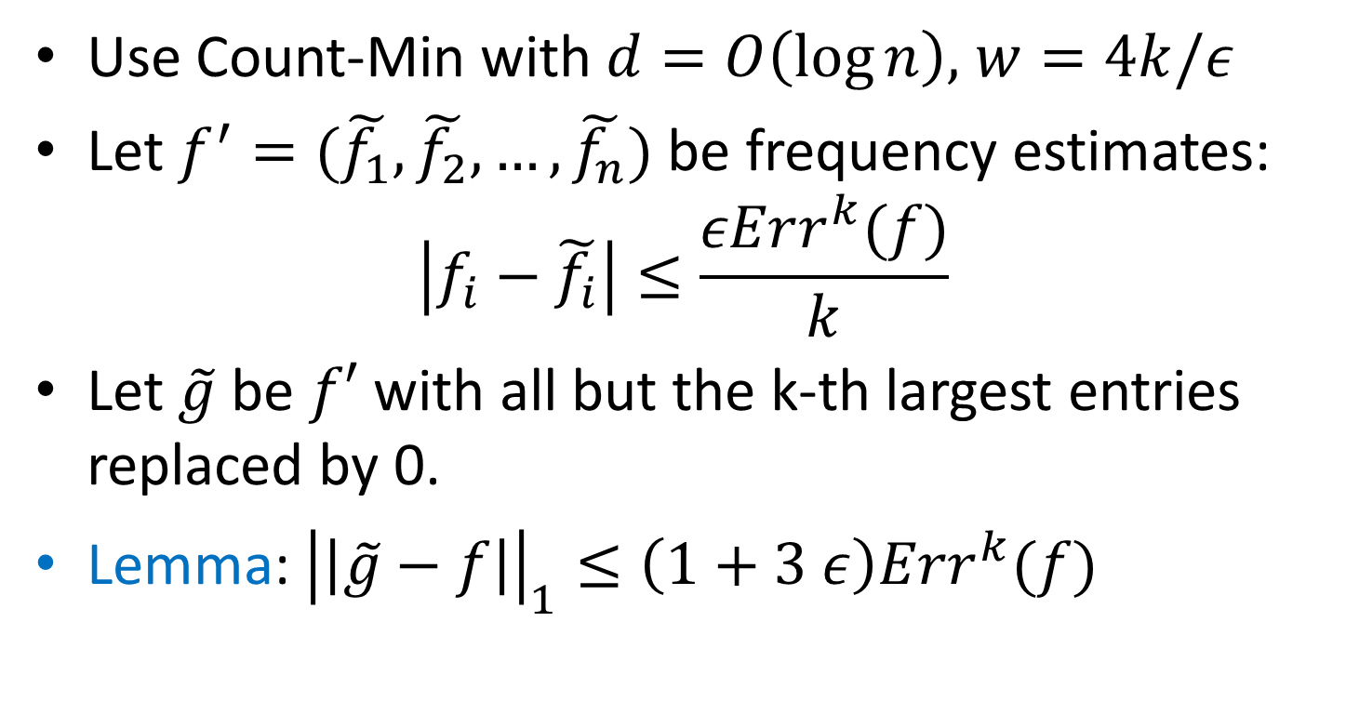
Sparse Recovery Algorithm
Use Count-Min with $d=O\left(\log{n}\right),$ $w=4k/ε$
Let $f^{′}=(\tilde{f_{1}}, \tilde{f_{2}}, …, \tilde{f_{n}})$ be frequency estimates:
$$\left|f_{i}−\tilde{f_{i}}\right|≤\frac{εErr^{k}(f)}{k}$$
Let $\tilde{g}$ be $f′$ with all but the k-th largest entries replaced by 0.
Lemma: ${\left|\left|\tilde{g}−f\right|\right|}_{1}≤\left(1+3 ε\right)Err^{k}(f)$

Slide 9
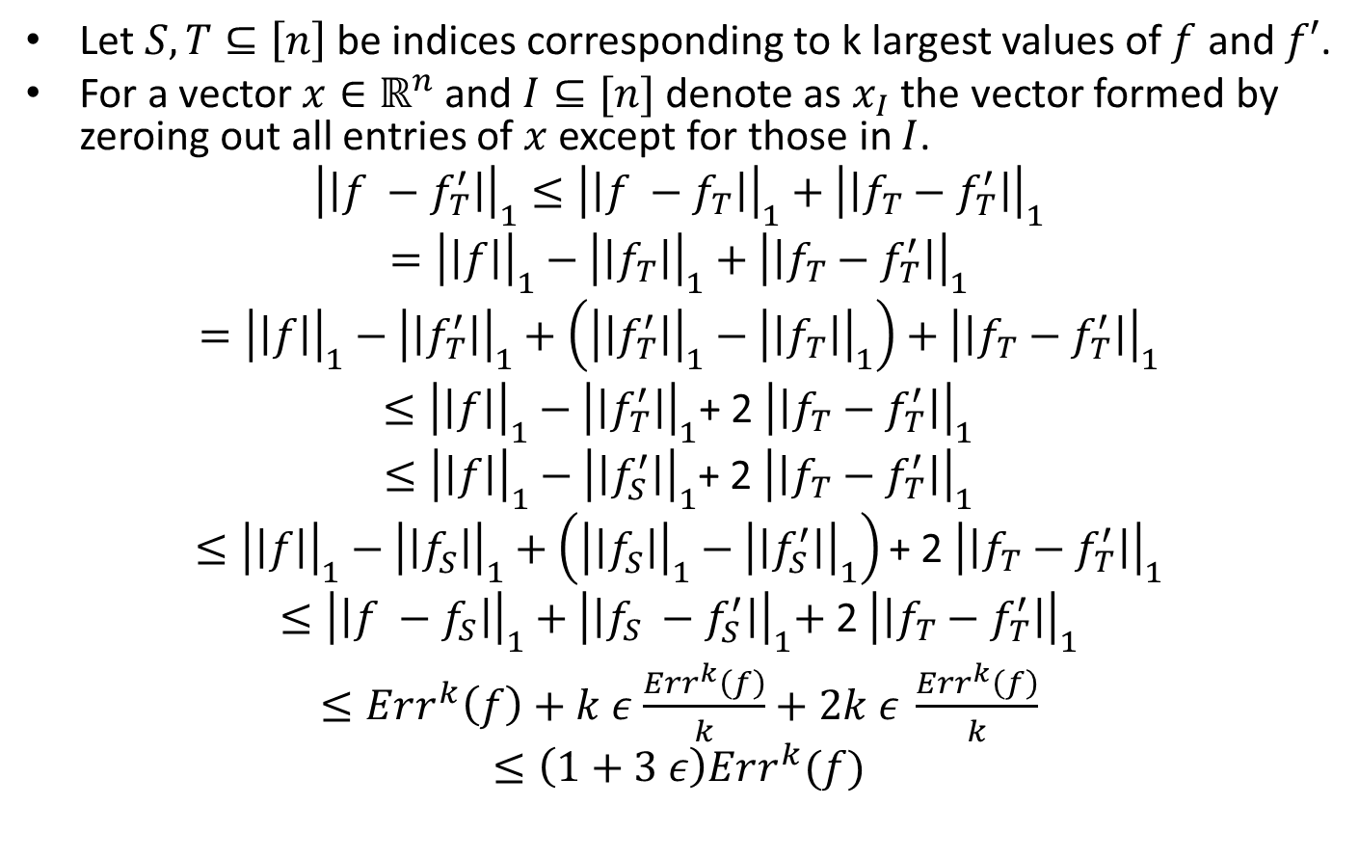

$${\left|\left|\tilde{g}−f\right|\right|}_{1}≤\left(1+3 ε\right)Err^{k}(f)$$
Let $S, T⊆\left[n\right]$ be indices corresponding to k largest values of $f$ and $f′$.
For a vector $x∈ℝ^{n}$ and $I⊆[n]$ denote as $x_{I}$ the vector formed by zeroing out all entries of $x$ except for those in $I$.
$${\left|\left|f −f_{T}^{′}\right|\right|}_{1}≤{\left|\left|f −f_{T}\right|\right|}_{1}+{\left|\left|f_{T}−f_{T}^{′}\right|\right|}_{1}$$
$$={\left|\left|f\right|\right|}_{1}−{\left|\left|f_{T}\right|\right|}_{1}+{\left|\left|f_{T}−f_{T}^{′}\right|\right|}_{1}$$
$$={\left|\left|f\right|\right|}_{1}−{\left|\left|f_{T}^{′}\right|\right|}_{1}+\left({\left|\left|f_{T}^{′}\right|\right|}_{1}−{\left|\left|f_{T}\right|\right|}_{1}\right)+{\left|\left|f_{T}−f_{T}^{′}\right|\right|}_{1}$$
$≤{\left|\left|f\right|\right|}_{1}−{\left|\left|f_{T}^{′}\right|\right|}_{1}$+ 2 ${\left|\left|f_{T}−f_{T}^{′}\right|\right|}_{1}$
$≤{\left|\left|f\right|\right|}_{1}−{\left|\left|f_{S}^{′}\right|\right|}_{1}$+ 2 ${\left|\left|f_{T}−f_{T}^{′}\right|\right|}_{1}$
$$≤{\left|\left|f\right|\right|}_{1}−{\left|\left|f_{S}^{}\right|\right|}_{1}+\left({\left|\left|f_{S}^{}\right|\right|}_{1}−{\left|\left|f_{S}^{′}\right|\right|}_{1}\right)\text{+ 2 }{\left|\left|f_{T}−f_{T}^{′}\right|\right|}_{1}$$
$$≤{\left|\left|f −f_{S}\right|\right|}_{1}+{\left|\left|f_{S} −f_{S}^{′}\right|\right|}_{1}\text{+}\text{ 2 }{\left|\left|f_{T}−f_{T}^{′}\right|\right|}_{1}$$
$≤Err^{k}\left(f\right)+k ε$ $\frac{Err^{k}\left(f\right)}{k}+2k ε \frac{Err^{k}\left(f\right)}{k}$
$$≤\left(1+3 ε\right)Err^{k}(f)$$

Slide 10
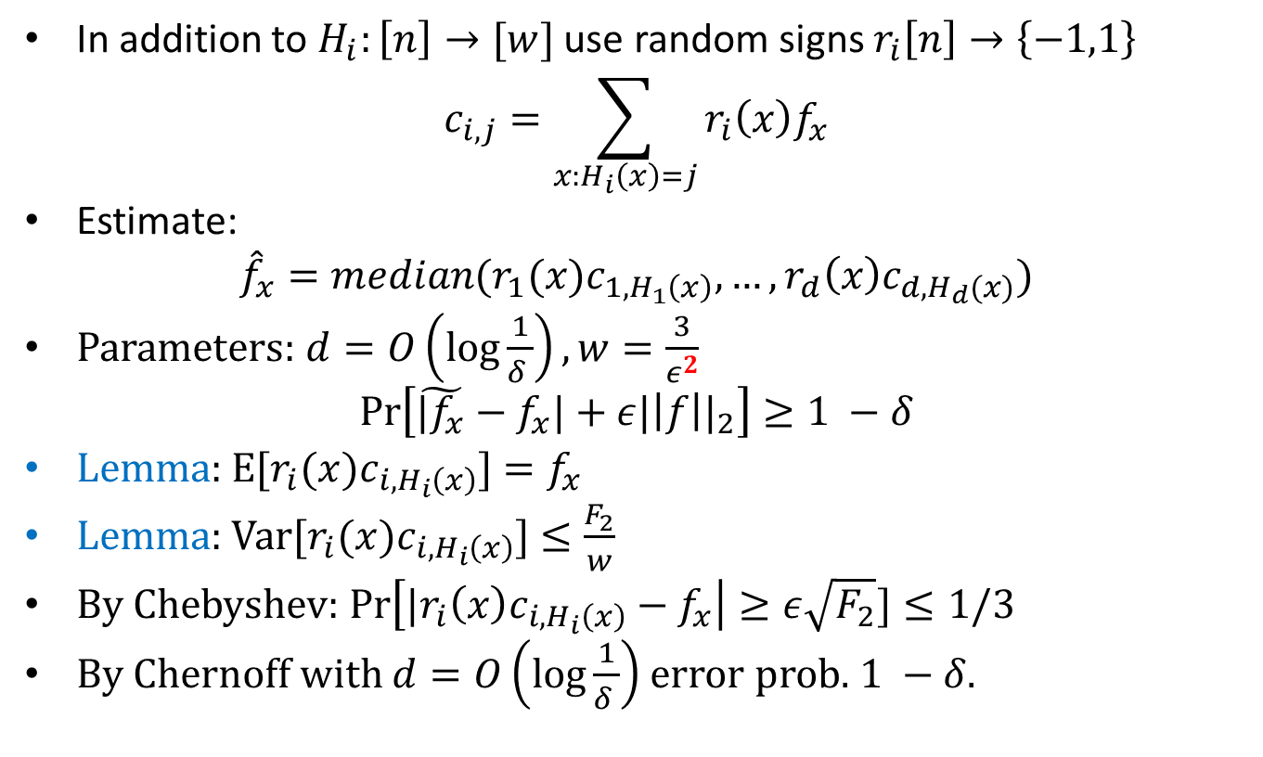
Count Sketch [Charikar, Chen, Farach-Colton]
In addition to $H_{i}:\left[n\right]→[w]$ use random signs $r_{i}\left[n\right]→\left\{−1,1\right\}$
$$c_{i,j}=\sum_{x:H_{i}\left(x\right)=j}{r_{i}\left(x\right)f_{x}}$$
Estimate:
$${\hat{f}}_{x}=median(r_{1}(x)c_{1,H_{1}\left(x\right)}, …,r_{d}\left(x\right)c_{d,H_{d}(x)})$$
Parameters: $d=O\left(\log{\frac{1}{δ }}\right), w=\frac{3}{ε^{2}}$
$$\operatorname{Pr}\left[\tilde{|f_{x}}−f_{x}|+ε{|\left|f\right||}_{2}\right]≥1 −δ$$
Lemma: E[$r_{i}(x)c_{i,H_{i}\left(x\right)}$] $=f_{x}$
Lemma: Var[$r_{i}(x)c_{i,H_{i}\left(x\right)}$] $≤\frac{F_{2}}{w}$
By Chebyshev: $\operatorname{Pr}\left[{|r}_{i}\left(x\right)c_{i,H_{i}\left(x\right)}−f_{x}\right|≥ε\sqrt{F_{2}}]≤1/3$
By Chernoff with $d=O\left(\log{\frac{1}{δ }}\right)$ error prob. $1 −δ$.

Slide 11
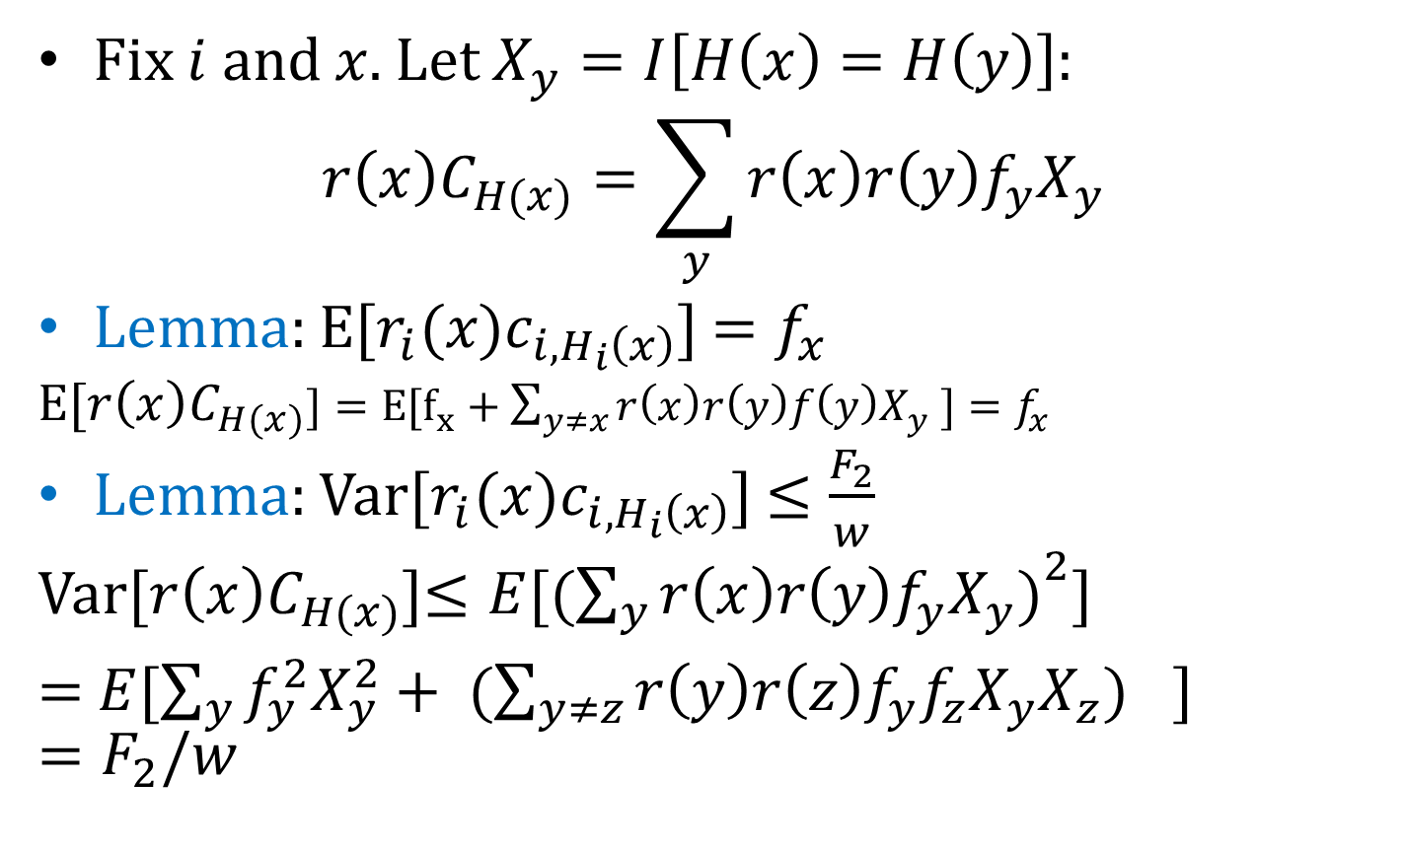
Count Sketch Analysis
Fix $i$ and $x$. Let $X_{y}=I\left[H\left(x\right)=H\left(y\right)\right]$:
$$r\left(x\right)C_{H(x)}=\sum_{y}{r\left(x\right)r\left(y\right)f_{y}X_{y}}$$
Lemma: E[$r_{i}(x)c_{i,H_{i}\left(x\right)}$] $=f_{x}$
E[$r\left(x\right)C_{H(x)}]=E[f_{x}+\sum_{y≠x}{r\left(x\right)r\left(y\right)f\left(y\right)X_{y}} ]=f_{x}$
Lemma: Var[$r_{i}(x)c_{i,H_{i}\left(x\right)}$] $≤\frac{F_{2}}{w}$
Var[$r\left(x\right)C_{H(x)}$]$≤E[({\sum_{y}{r\left(x\right)r\left(y\right)f_{y}X_{y})}}^{2}]$
= $E[\sum_{y}{f_{y}^{2}X_{y}^{2}}+ ({\sum_{y≠z}{r\left(y\right)r\left(z\right)f_{y}f_{z}X_{y}X_{z})}}^{}$] $=F_{2}/w$

