Slide 1

CIS 700: “algorithms for Big Data”
Lecture 7:
Sketching for Linear Algebra
Slides at http://grigory.us/big-data-class.html
Grigory Yaroslavtsev
http://grigory.us

Slide 2
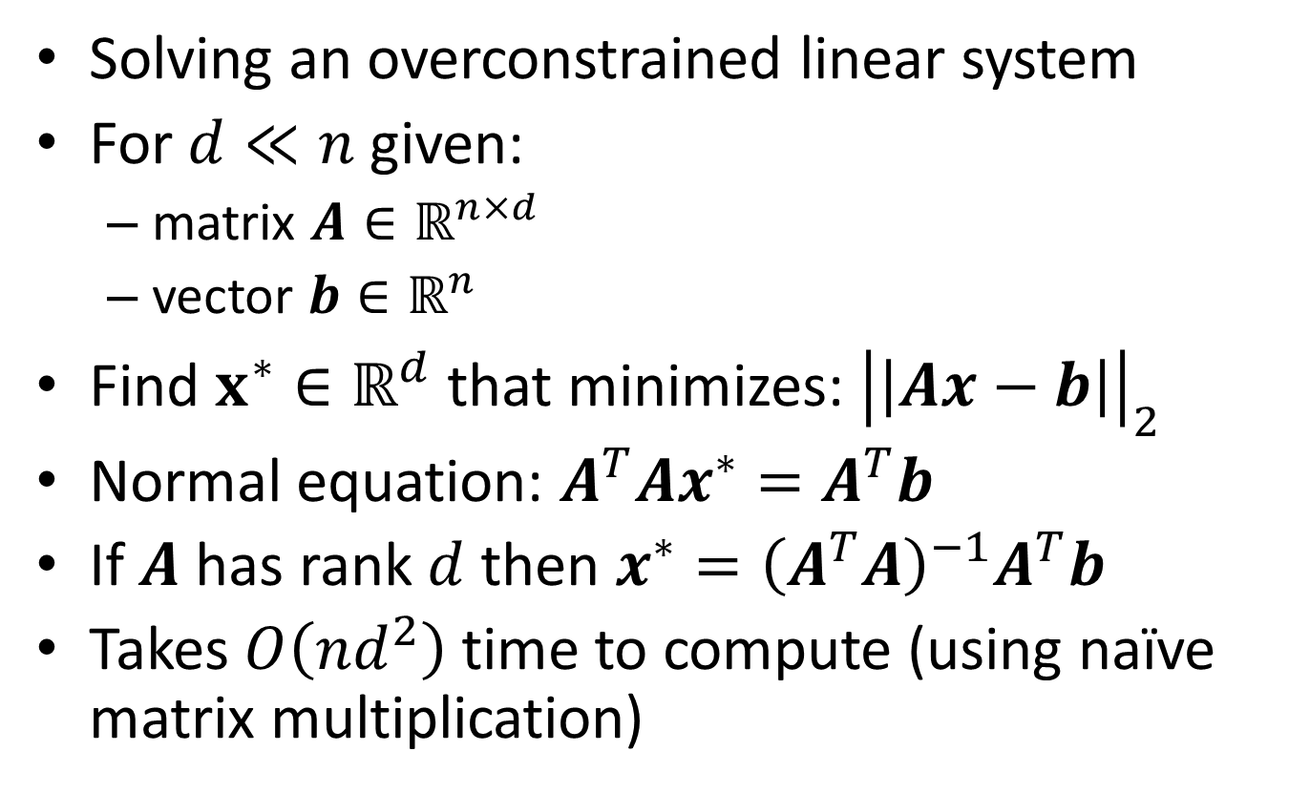
Least Squares Regression
Solving an overconstrained linear system
For $d≪n$ given:
matrix $A∈ℝ^{n×d}$
vector $b∈ℝ^{n}$
Find $x^{∗}∈ℝ^{d}$ that minimizes: ${\left|\left|Ax−b\right|\right|}_{2}$
Normal equation: $A^{T}Ax^{∗}=A^{T}b$
If $A$ has rank $d$ then ${x^{∗}=\left(A^{T}A\right)}^{−1}A^{T}b$
Takes $O\left(nd^{2}\right)$ time to compute (using naïve matrix multiplication)

Slide 3
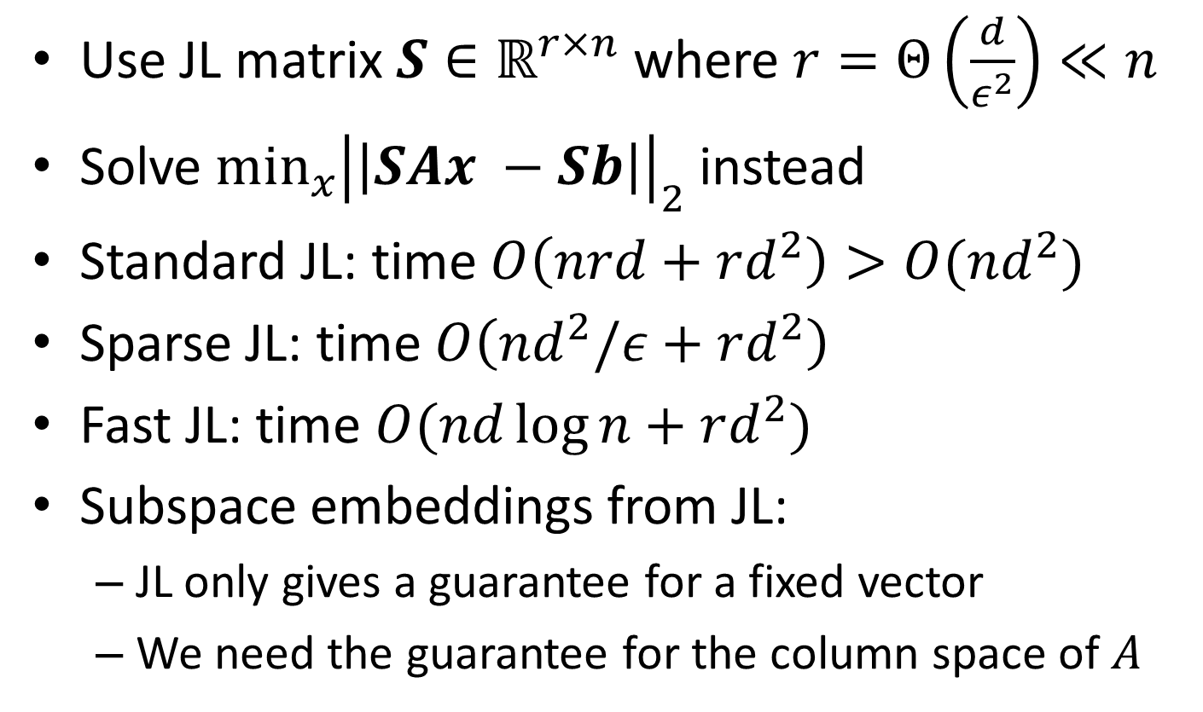
Sketching for Least Squares Regression
Use JL matrix $S∈ℝ^{r×n}$ where $r=Θ\left(\frac{d}{ε^{2}}\right)≪n$
Solve $\min_{x}{{\left|\left|SAx −Sb\right|\right|}_{2}}$ instead
Standard JL: time $O\left(nrd+rd^{2}\right)>O(nd^{2})$
Sparse JL: time $O\left(nd^{2}/ε+rd^{2}\right)$
Fast JL: time $O(nd\log{n}+rd^{2})$
Subspace embeddings from JL:
JL only gives a guarantee for a fixed vector
We need the guarantee for the column space of $A$

Slide 4
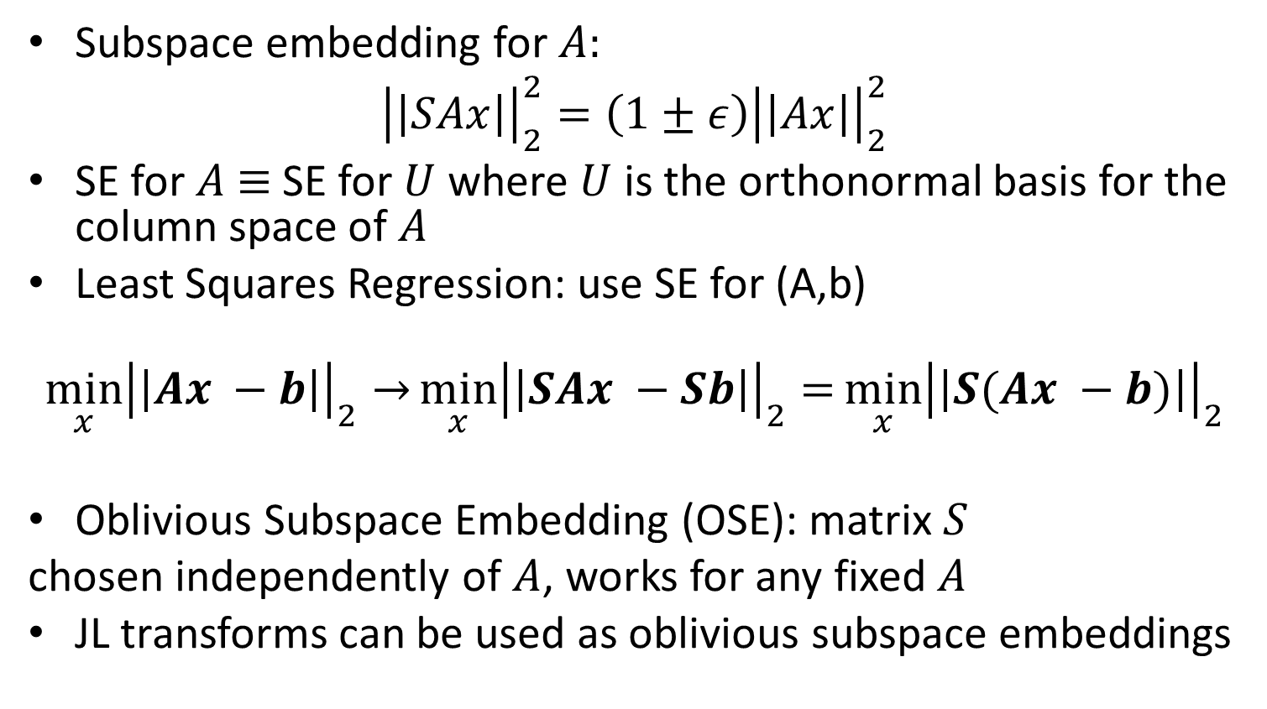
Oblivious Subspace Embeddings
Subspace embedding for $A:$
$${\left|\left|SAx\right|\right|}_{2}^{2}=\left(1±ε\right){\left|\left|Ax\right|\right|}_{2}^{2}$$
SE for $A$ $≡$ SE for $U$ where $U$ is the orthonormal basis for the column space of $A$
Least Squares Regression: use SE for (A,b)
$$\min_{x}{{\left|\left|Ax −b\right|\right|}_{2}→}\min_{x}{{\left|\left|SAx −Sb\right|\right|}_{2}=}\min_{x}{{\left|\left|S(Ax −b)\right|\right|}_{2}}$$
Oblivious Subspace Embedding (OSE): matrix $S$
chosen independently of $A$, works for any fixed $A$
JL transforms can be used as oblivious subspace embeddings

Slide 5
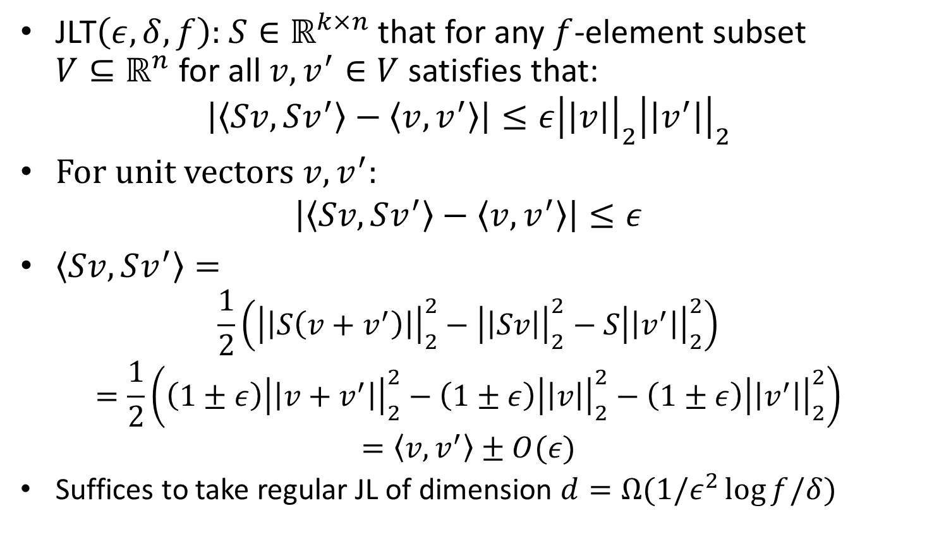

JLT$\left(ε, δ,f\right)$
JLT$\left(ε, δ,f\right):$ $S∈ℝ^{k×n}$ that for any $f$-element subset $V⊆ℝ^{n}$ for all $v, v^{′}∈V$ satisfies that:
$$\left|〈Sv,Sv^{′}〉−〈v,v^{′}〉\right|≤ε{\left|\left|v\right|\right|}_{2}{\left|\left|v^{′}\right|\right|}_{2}$$
For unit vectors $v,v^{′}:$
$$\left|〈Sv,Sv^{′}〉−〈v,v^{′}〉\right|≤ε$$
$〈Sv,Sv^{′}〉=$
$$\frac{1}{2}\left({\left|\left|S\left(v+v^{′}\right)\right|\right|}_{2}^{2}−{\left|\left|Sv\right|\right|}_{2}^{2}−S{\left|\left|v^{′}\right|\right|}_{2}^{2}\right)$$
$$=\frac{1}{2}\left(\left(1±ε\right){\left|\left|v+v^{′}\right|\right|}_{2}^{2}−\left(1±ε\right){\left|\left|v\right|\right|}_{2}^{2}−\left(1±ε\right){\left|\left|v^{′}\right|\right|}_{2}^{2}\right)$$
$$=〈v,v^{′}〉±O(ε)$$
Suffices to take regular JL of dimension $d=Ω(1/ε^{2}\log{f/δ})$

Slide 6
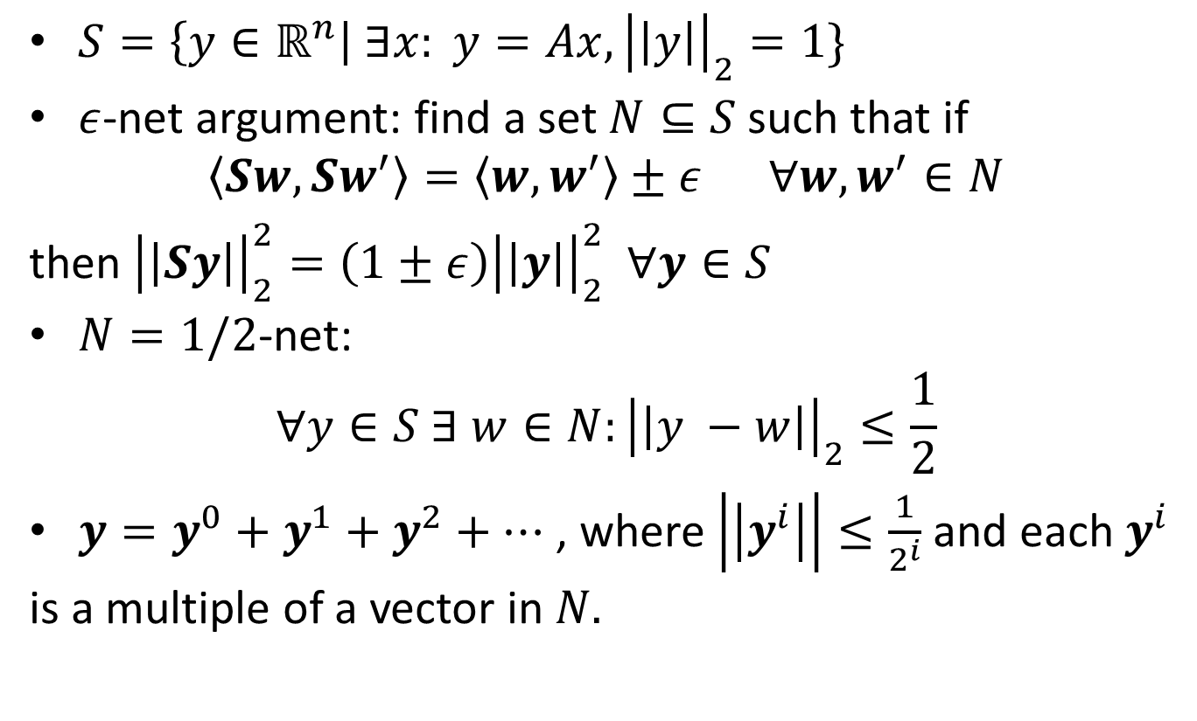
OSE construction
$S=\left\{y∈ℝ^{n}\right| ∃x: y=Ax, {\left|\left|y\right|\right|}_{2}=1\}$
$ε$-net argument: find a set $N⊆S$ such that if
$$〈Sw,Sw^{′}〉=〈w,w^{′}〉±ε ∀w,w^{′}∈N$$
then ${\left|\left|Sy\right|\right|}_{2}^{2}=\left(1±ε\right){\left|\left|y\right|\right|}_{2}^{2} ∀y∈S$
$N=1/2$-net:
$$∀y∈S ∃ w∈N:{\left|\left|y −w\right|\right|}_{2}≤\frac{1}{2}$$
$y=y^{0}+y^{1}+y^{2}+…$ , where $\left|\left|y^{i}\right|\right|≤\frac{1}{2^{i}}$ and each $y^{i}$
is a multiple of a vector in $N.$

Slide 7
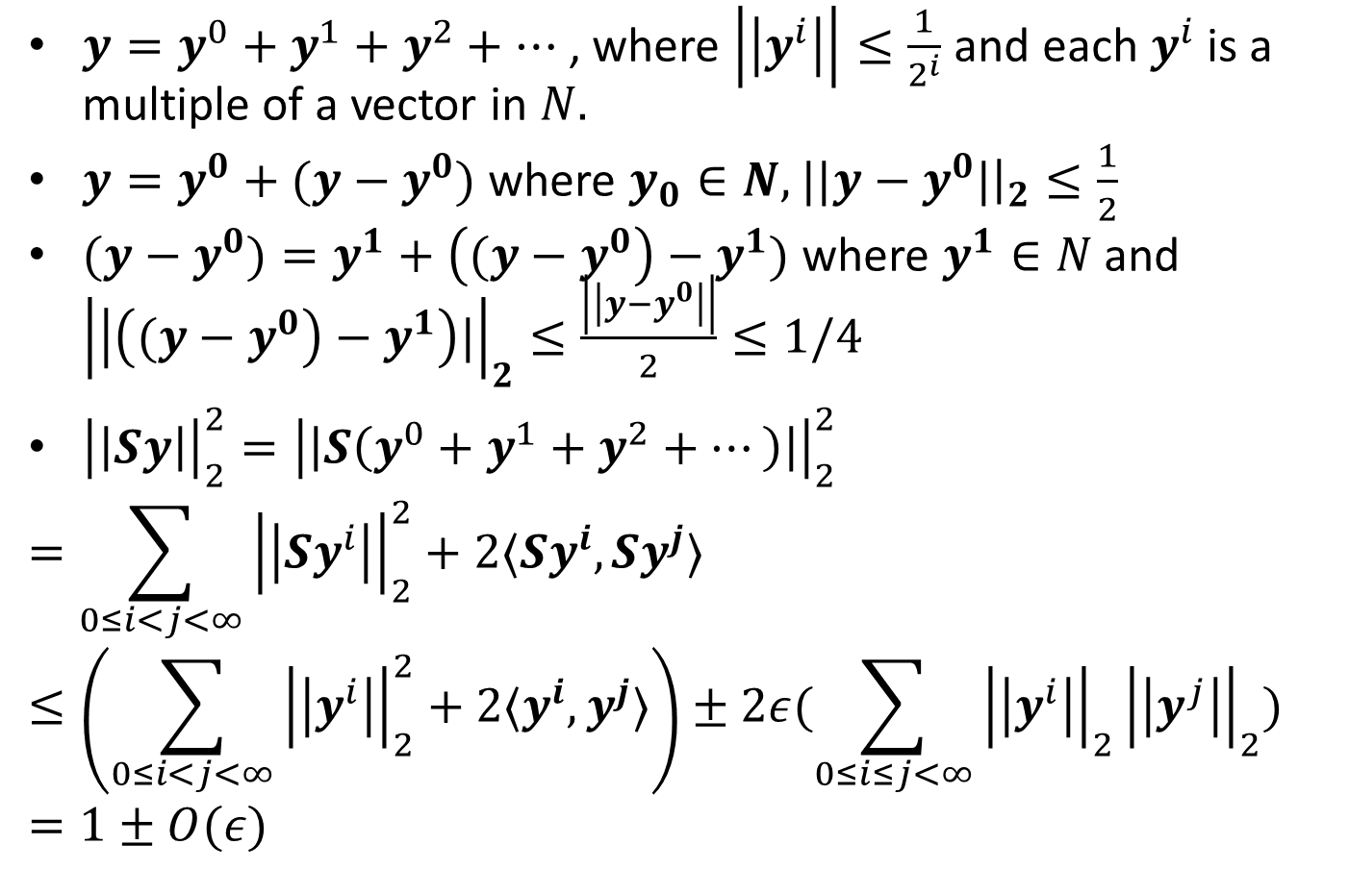
Net argument
$y=y^{0}+y^{1}+y^{2}+…$ , where $\left|\left|y^{i}\right|\right|≤\frac{1}{2^{i}}$ and each $y^{i}$ is a multiple of a vector in $N.$
$y=y^{0}+(y−y^{0})$ where $y_{0}∈N,$ $||y−y^{0}|{\left.​\right|}_{2}≤\frac{1}{2}$
$(y−y^{0})=y^{1}+\left((y−y^{0}\right)−y^{1})$ where $y^{1}∈N$ and ${\left|\left|\left((y−y^{0}\right)−y^{1}\right)|\right|}_{2}≤\frac{\left|\left|y−y^{0}\right|\right|}{2}≤1/4$
${\left|\left|Sy\right|\right|}_{2}^{2}={\left|\left|S\left(y^{0}+y^{1}+y^{2}+…\right)\right|\right|}_{2}^{2}$
$$=\sum_{0≤i<j<∞}{{\left|\left|Sy^{i}\right|\right|}_{2}^{2}+2〈Sy^{i},Sy^{j}〉}$$
$$≤\left(\sum_{0≤i<j<∞}{{\left|\left|y^{i}\right|\right|}_{2}^{2}+2〈y^{i},y^{j}〉}\right)±2ε(\sum_{0≤i≤j<∞}{{\left|\left|y^{i}\right|\right|}_{2}{\left|\left|y^{j}\right|\right|}_{2}})$$
$$=1±O(ε)$$

Slide 8
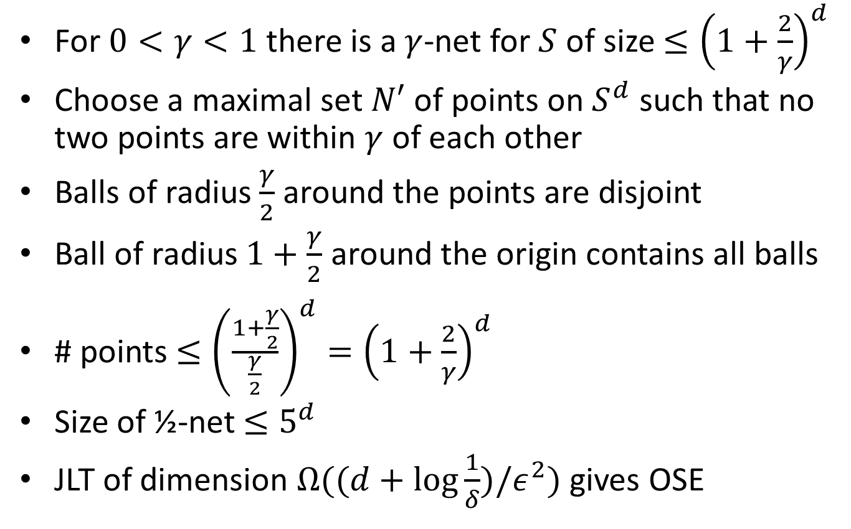
½ -Net construction
For $0<γ<1$ there is a $γ$-net for $S$ of size $≤{\left(1+\frac{2}{γ}\right)}^{d}$
Choose a maximal set $N′$ of points on $S^{d}$ such that no two points are within $γ$ of each other
Balls of radius $\frac{γ}{2}$ around the points are disjoint
Ball of radius $1+\frac{γ}{2}$ around the origin contains all balls
# points $≤{\left(\frac{1+\frac{γ}{2}}{\frac{γ}{2}}\right)}^{d}={\left(1+\frac{2}{γ}\right)}^{d}$
Size of ½-net $≤5^{d}$
JLT of dimension $Ω((d+log\frac{1}{δ})/ε^{2})$ gives OSE

Slide 9
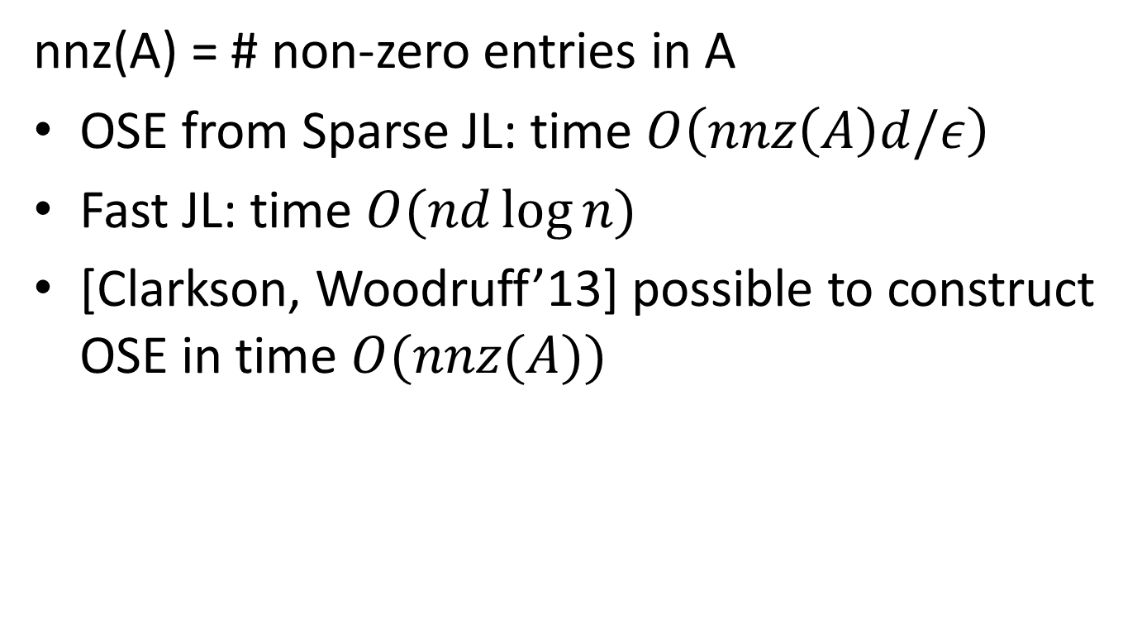
OSE constructions Running Times
nnz(A) = # non-zero entries in A
OSE from Sparse JL: time $O\left(nnz\left(A\right)d/ε\right)$
Fast JL: time $O(nd\log{n})$
[Clarkson, Woodruff’13] possible to construct OSE in time $O(nnz(A))$

Slide 10
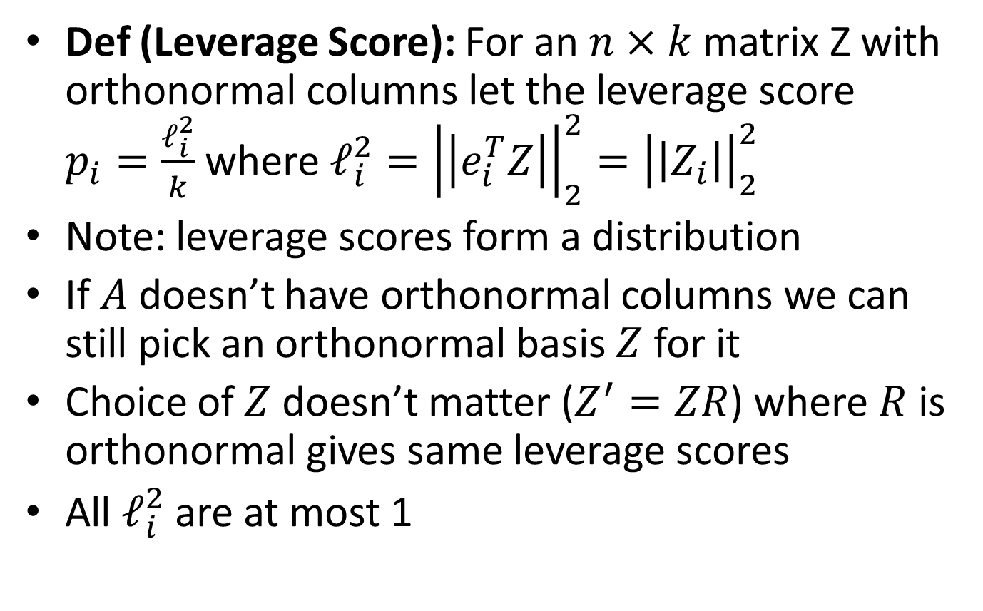
Leverage Score Sampling
Def (Leverage Score): For an $n×k$ matrix Z with orthonormal columns let the leverage score $p_{i}=\frac{ℓ_{i}^{2}}{k}$ where $ℓ_{i}^{2}={\left|\left|e_{i}^{T}Z\right|\right|}_{2}^{2}={\left|\left|Z_{i}\right|\right|}_{2}^{2}$
Note: leverage scores form a distribution
If $A$ doesn’t have orthonormal columns we can still pick an orthonormal basis $Z$ for it
Choice of $Z$ doesn’t matter ($Z^{′}=ZR$) where $R$ is orthonormal gives same leverage scores
All $ℓ_{i}^{2}$ are at most 1

Slide 11
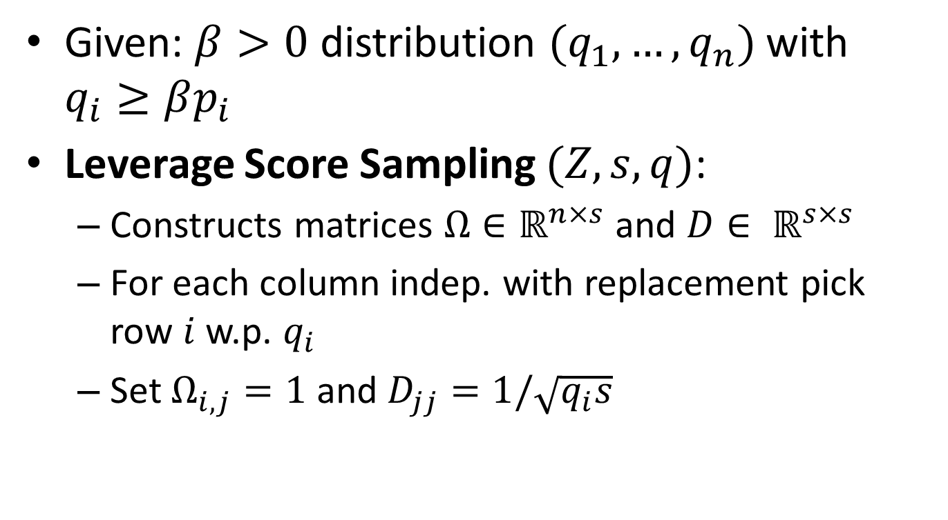
Leverage Score Sampling
Given: $β>0$ distribution $(q_{1}, …,q_{n})$ with $q_{i}≥βp_{i}$
Leverage Score Sampling $(Z,s,q)$:
Constructs matrices $Ω∈ℝ^{n×s}$ and $D∈ ℝ^{s×s}$
For each column indep. with replacement pick row $i$ w.p. $q_{i}$
Set $Ω_{i,j}=1$ and $D_{jj}=1/\sqrt{q_{i}s}$

Slide 12
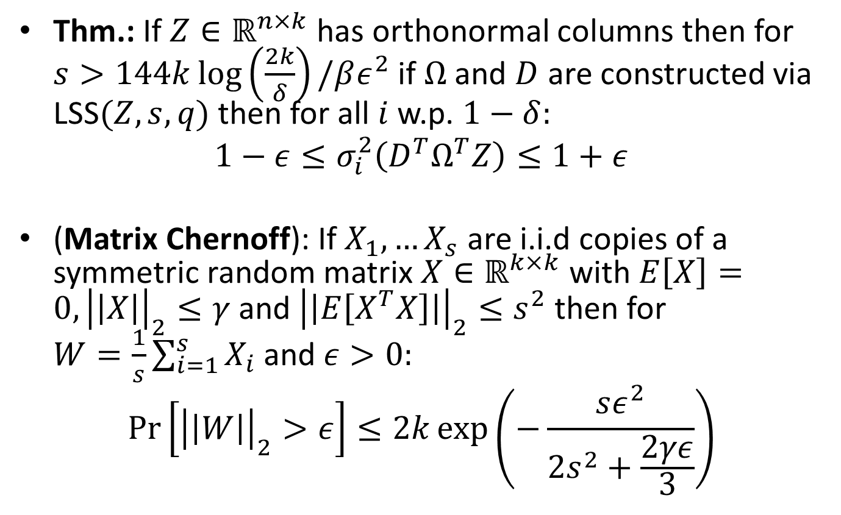
LSS as a Subspace Embedding
Thm.: If $Z∈ℝ^{n×k}$ has orthonormal columns then for $s>144k\log\left(\frac{2k}{δ}\right)/βε^{2}$ if $Ω$ and $D$ are constructed via LSS$(Z,s,q)$ then for all $i$ w.p. $1−δ:$
$$1−ε≤σ_{i}^{2}\left(D^{T}Ω^{T}Z\right)≤1+ε$$
(Matrix Chernoff): If $X_{1},…X_{s}$ are i.i.d copies of a symmetric random matrix $X∈ℝ^{k×k}$ with $E\left[X\right]=0, {\left|\left|X\right|\right|}_{2}≤γ$ and ${\left|\left|E\left[X^{T}X\right]\right|\right|}_{2}≤s^{2}$ then for $W=\frac{1}{s}\sum_{i=1}^{s}{X_{i}}$ and $ε>0:$
$$\operatorname{Pr}\left[{\left|\left|W\right|\right|}_{2}>ε\right]≤2k\exp\left(−\frac{sε^{2}}{2s^{2}+\frac{2γε}{3}}\right)$$

Slide 13
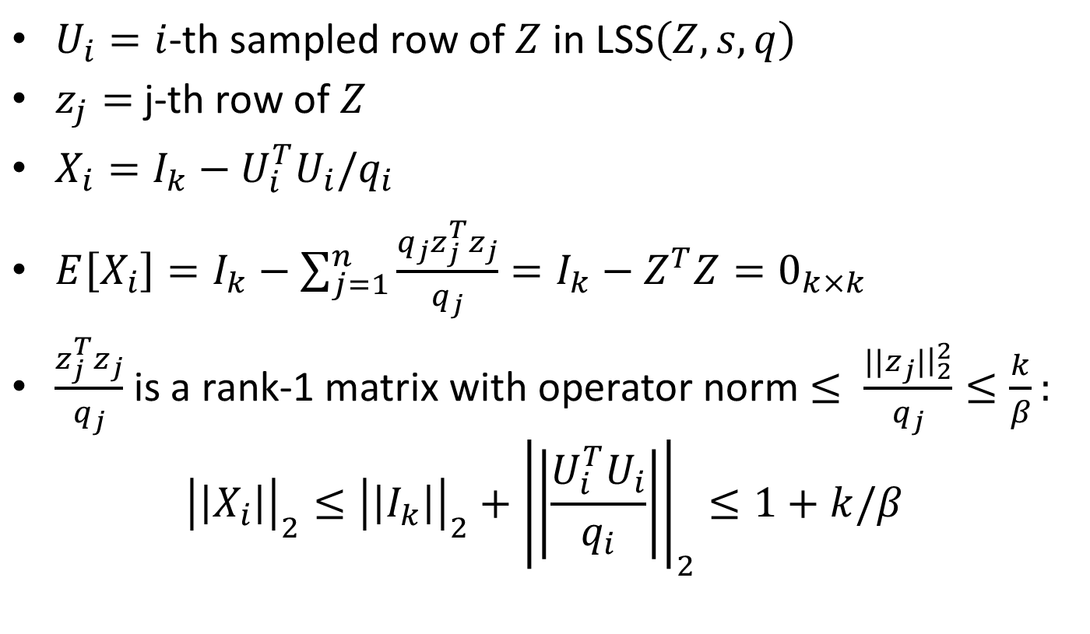
Proof: LSS as a Subspace Embedding
$U_{i}=i$-th sampled row of $Z$ in LSS$\left(Z,s,q\right)$
$z_{j}=$ j-th row of $Z$
$X_{i}=I_{k}−U_{i}^{T}U_{i}/q_{i}$
$E\left[X_{i}\right]=I_{k}−\sum_{j=1}^{n}{\frac{q_{j}z_{j}^{T}z_{j}}{q_{j}}=I_{k}−Z^{T}Z=0_{k×k}}$
$\frac{z_{j}^{T}z_{j}}{q_{j}}$ is a rank-1 matrix with operator norm $≤ \frac{{||z}_{j}|{\left.​\right|}_{2}^{2}}{q_{j}}≤\frac{k}{β}:$
$${\left|\left|X_{i}\right|\right|}_{2}≤{\left|\left|I_{k}\right|\right|}_{2}+{\left|\left|\frac{U_{i}^{T}U_{i}}{q_{i}}\right|\right|}_{2}≤1+k/β$$

Slide 14
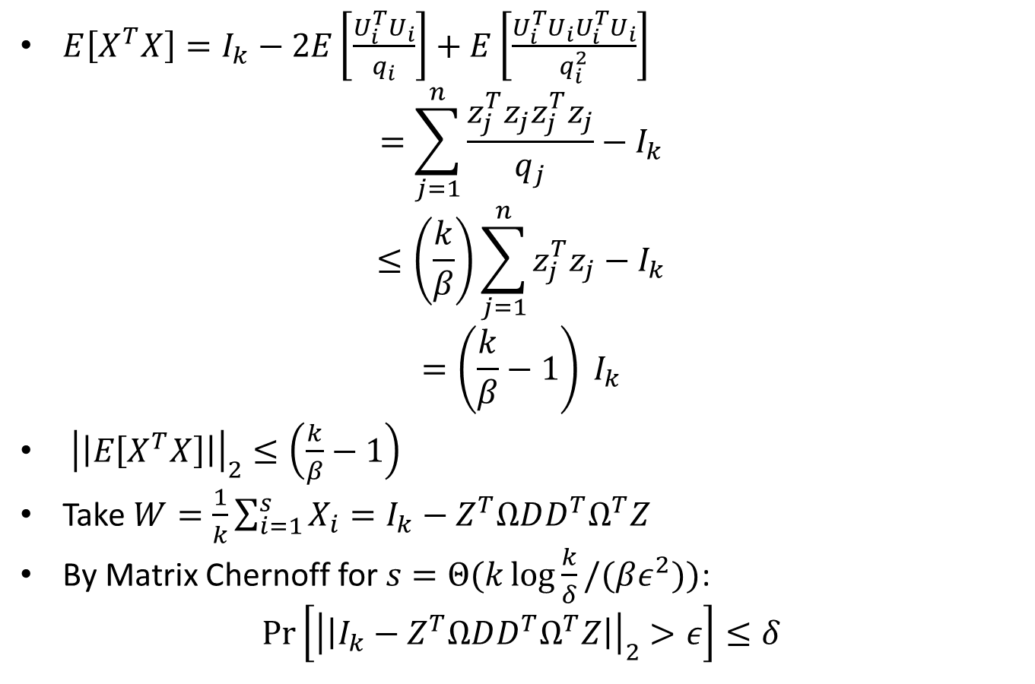
Proof: LSS as a Subspace Embedding
$E\left[X^{T}X\right]=I_{k}−2E\left[\frac{U_{i}^{T}U_{i}}{q_{i}}\right]+E\left[\frac{U_{i}^{T}U_{i}U_{i}^{T}U_{i}}{q_{i}^{2}}\right]$
$$=\sum_{j=1}^{n}{\frac{z_{j}^{T}z_{j}z_{j}^{T}z_{j}}{q_{j}}−I_{k}}$$
$$≤\left(\frac{k}{β}\right)\sum_{j=1}^{n}{z_{j}^{T}z_{j}−I_{k}}$$
$$=\left(\frac{k}{β}−1\right) I_{k}$$
${\left|\left|E\left[X^{T}X\right]\right|\right|}_{2}≤\left(\frac{k}{β}−1\right)$
Take $W=\frac{1}{k}\sum_{i=1}^{s}{X_{i}}=I_{k}−Z^{T}ΩDD^{T}Ω^{T}Z$
By Matrix Chernoff for $s=Θ(k\log{\frac{k}{δ}}/(βε^{2}))$:
$$\operatorname{Pr}\left[{\left|\left|I_{k}−Z^{T}ΩDD^{T}Ω^{T}Z\right|\right|}_{2}>ε\right]≤δ$$

Slide 15
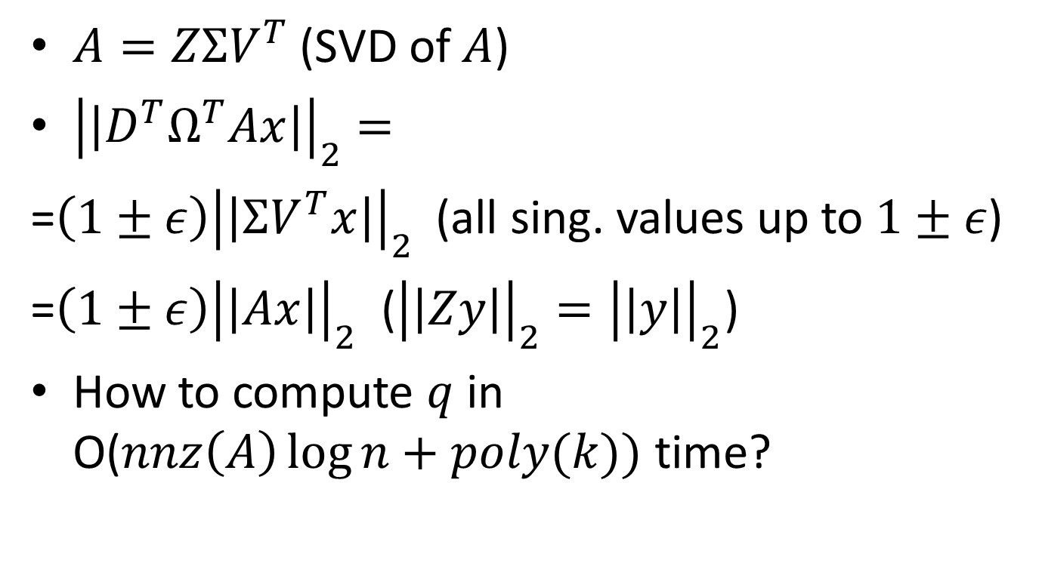
LSS as a Subspace Embedding
$A=ZΣV^{T}$ (SVD of $A$)
${\left|\left|D^{T}Ω^{T}Ax\right|\right|}_{2}=$
=$\left(1±ε\right){\left|\left|ΣV^{T}x\right|\right|}_{2}$ (all sing. values up to $1±ε$)
=$\left(1±ε\right){\left|\left|Ax\right|\right|}_{2}$ (${\left|\left|Zy\right|\right|}_{2}={\left|\left|y\right|\right|}_{2}$)
How to compute $q$ in O($nnz\left(A\right)\log{n+poly(k))}$ time?

Slide 16
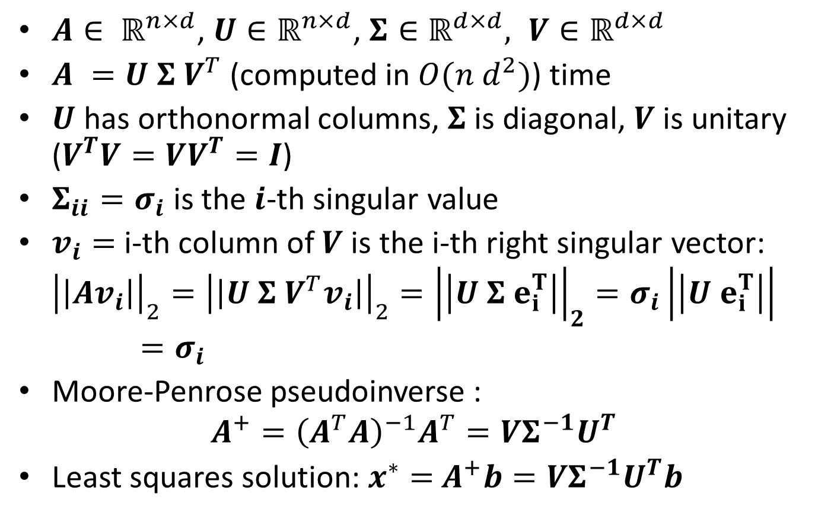
Thin Singular Value Decomposition
$A∈ ℝ^{n×d}$, $U∈ℝ^{n×d}$, $Σ∈ℝ^{d×d}, V∈ℝ^{d×d}$
$A =U Σ V^{T}$ (computed in $O(n d^{2})$) time
$U$ has orthonormal columns, $Σ$ is diagonal, $V$ is unitary ($V^{T}V=VV^{T}=I$)
$Σ_{ii}=σ_{i}$ is the $i$-th singular value
$v_{i}=$i-th column of $V$ is the i-th right singular vector:
$${\left|\left|Av_{i}\right|\right|}_{2}={\left|\left|U Σ V^{T}v_{i}\right|\right|}_{2}={\left|\left|U Σ e_{i}^{T}\right|\right|}_{2}=σ_{i}\left|\left|U e_{i}^{T}\right|\right|=σ_{i}$$
Moore-Penrose pseudoinverse :
$$A^{+}={\left(A^{T}A\right)}^{−1}A^{T}=VΣ^{−1}U^{T}$$
Least squares solution: $x^{∗}=$ $A^{+}b=VΣ^{−1}U^{T}b$

Slide 17
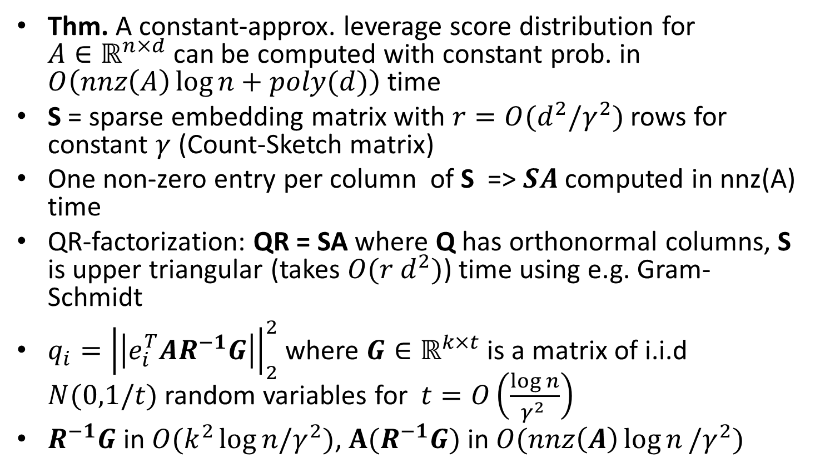
Approximating Leverage Scores
Thm. A constant-approx. leverage score distribution for $A∈ℝ^{n×d}$ can be computed with constant prob. in $O\left(nnz\left(A\right)\log{n}+poly(d)\right)$ time
S = sparse embedding matrix with $r=O(d^{2}/γ^{2})$ rows for constant $γ$ (Count-Sketch matrix)
One non-zero entry per column of S => $SA$ computed in nnz(A) time
QR-factorization: QR = SA where Q has orthonormal columns, S is upper triangular (takes $O(r d^{2})$) time using e.g. Gram-Schmidt
$q_{i}={\left|\left|e_{i}^{T}AR^{−1}G\right|\right|}_{2}^{2}$ where $G∈ℝ^{k×t}$ is a matrix of i.i.d $N(0,1/t)$ random variables for $t=O\left(\frac{\log{n}}{γ^{2} }\right)$
$R^{−1}G$ in $O(k^{2}\log{n/γ^{2}})$, $A(R^{−1}G)$ in $O(nnz\left(A\right)\log{n}/γ^{2})$

Slide 18
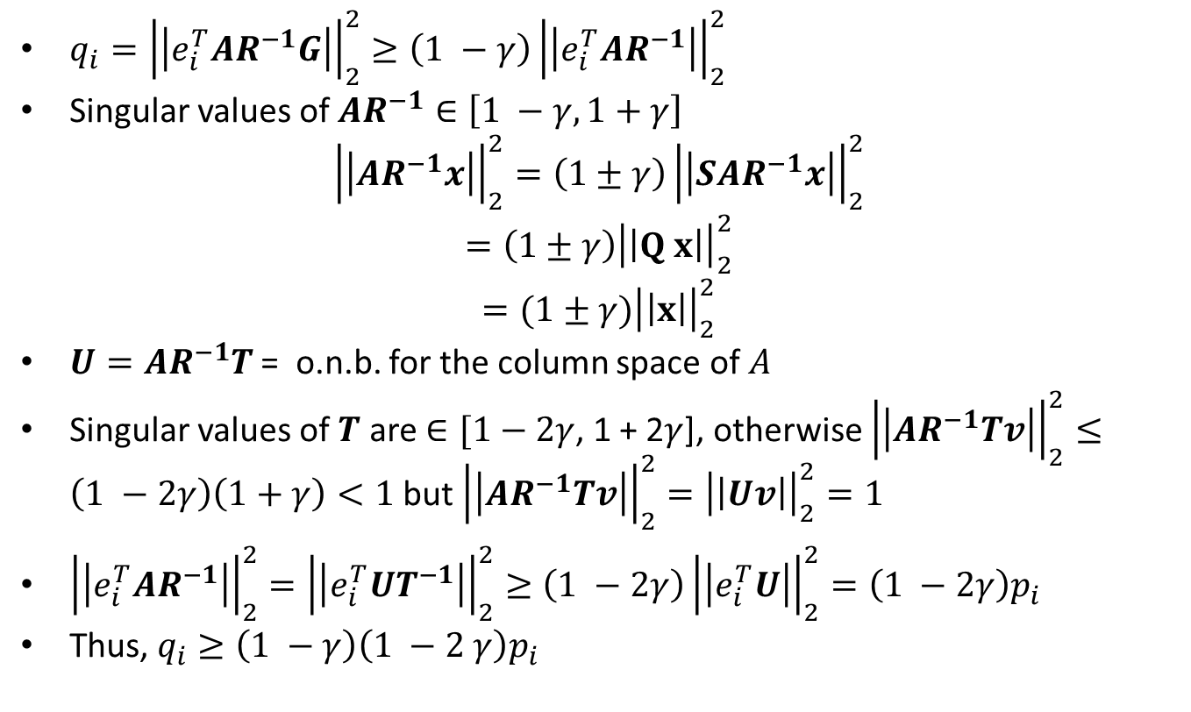
Approximating Leverage Scores
$q_{i}={\left|\left|e_{i}^{T}AR^{−1}G\right|\right|}_{2}^{2}≥\left(1 −γ\right){\left|\left|e_{i}^{T}AR^{−1}\right|\right|}_{2}^{2}$
Singular values of $AR^{−1}∈\left[1 −γ, 1+γ\right]$
$${\left|\left|AR^{−1}x\right|\right|}_{2}^{2}=\left(1±γ\right){\left|\left|SAR^{−1}x\right|\right|}_{2}^{2}$$
$$=\left(1±γ\right){\left|\left|Q x\right|\right|}_{2}^{2}$$
$$=(1±γ){\left|\left|x\right|\right|}_{2}^{2}$$
$U=AR^{−1}T$ = o.n.b. for the column space of $A$
Singular values of $T$ are $∈[1−2γ$, 1 + 2$γ$], otherwise ${\left|\left|AR^{−1}Tv\right|\right|}_{2}^{2}≤\left(1 −2γ\right)\left(1+γ\right)<1$but ${\left|\left|AR^{−1}Tv\right|\right|}_{2}^{2}={\left|\left|Uv\right|\right|}_{2}^{2}=1$
${\left|\left|e_{i}^{T}AR^{−1}\right|\right|}_{2}^{2}={\left|\left|e_{i}^{T}UT^{−1}\right|\right|}_{2}^{2}≥\left(1 −2γ\right){\left|\left|e_{i}^{T}U\right|\right|}_{2}^{2}=\left(1 −2γ\right)p_{i}$
Thus, $q_{i}≥\left(1 −γ\right)\left(1 −2 γ\right)p_{i}$

Slide 19
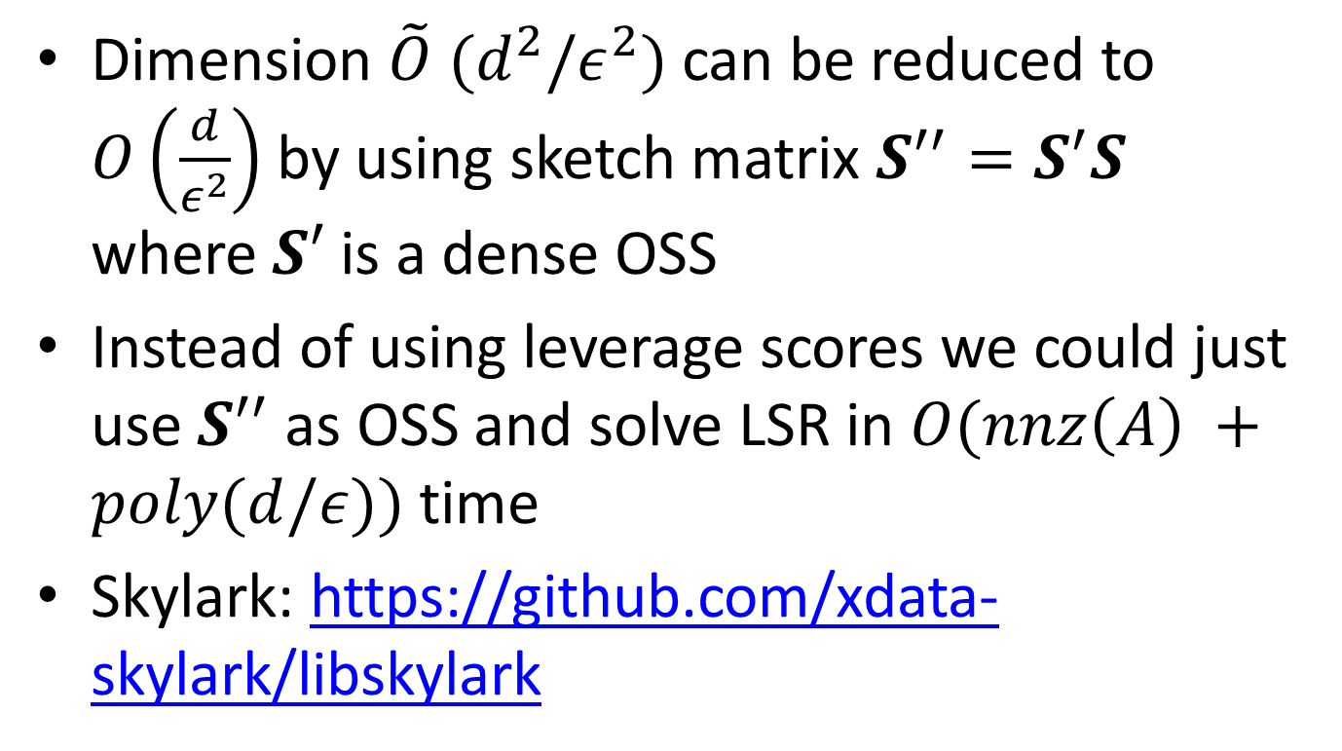
Least Squares Regression
Dimension $\tilde{O} (d^{2}/ε^{2})$ can be reduced to $O\left(\frac{d}{ε^{2}}\right)$ by using sketch matrix $S^{′′}=S^{′}S$ where$S′$ is a dense OSS
Instead of using leverage scores we could just use $S^{′′}$ as OSS and solve LSR in $O(nnz\left(A\right) +poly(d/ε))$ time
Skylark: https://github.com/xdata-skylark/libskylark

Slide 20
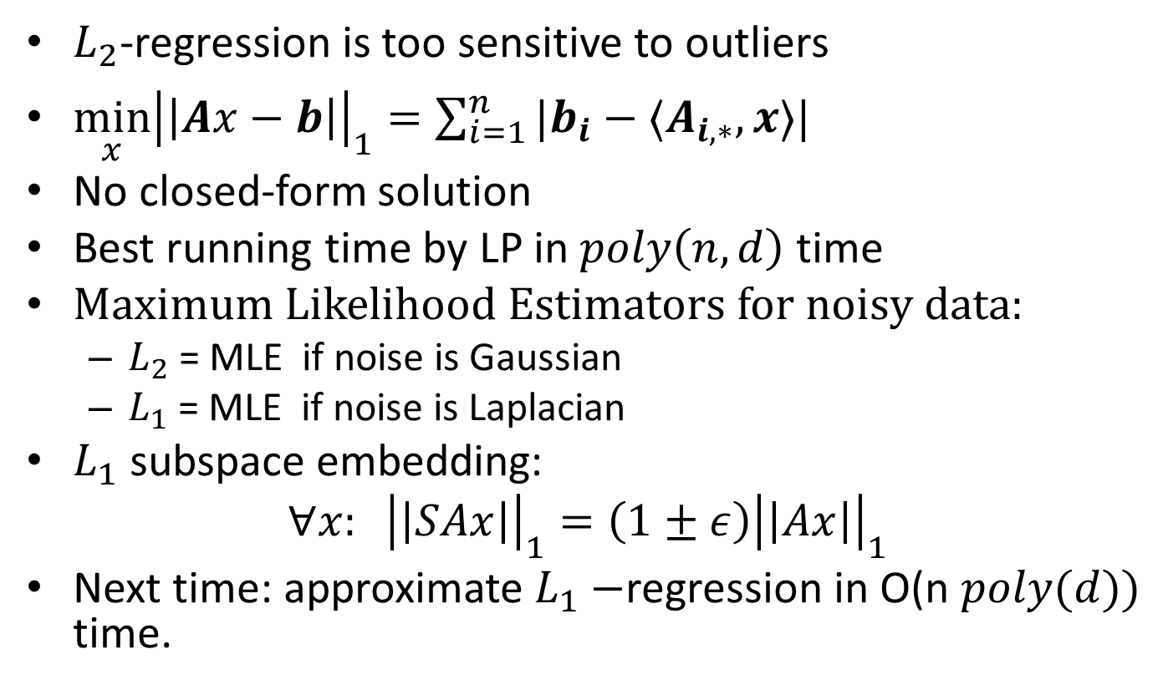

$L_{1}$-regression
$L_{2}$-regression is too sensitive to outliers
$\min_{x}{\left|\left|Ax−b\right|\right|}_{1}=\sum_{i=1}^{n}{|b_{i}−〈A_{i,∗},x〉|}$
No closed-form solution
Best running time by LP in $poly\left(n,d\right)$ time
Maximum Likelihood Estimators for noisy data:
$L_{2}$ = MLE if noise is Gaussian
$L_{1}$ = MLE if noise is Laplacian
$L_{1}$ subspace embedding:
$$∀x: {\left|\left|SAx\right|\right|}_{1}^{}=\left(1±ε\right){\left|\left|Ax\right|\right|}_{1}^{}$$
Next time: approximate $L_{1}−$regression in O(n $poly(d))$ time.

