Slide 1

Beyond Set Disjointness: The Communication Complexity of Finding the Intersection
Grigory Yaroslavtsev
http://grigory.us
Joint with Brody, Chakrabarti, Kondapally and Woodruff

Slide 2

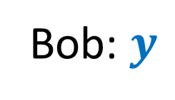

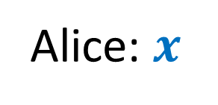



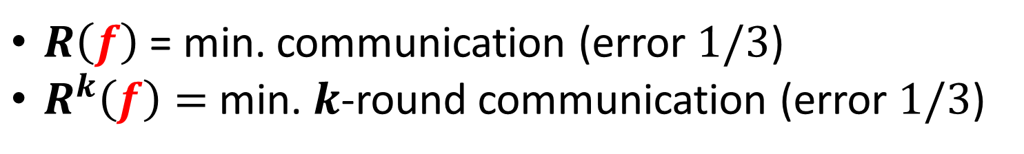
Communication Complexity [Yao’79]
Shared randomness
$M_{1}(x)$
$M_{2}(M_{1}, y)$
$$f(x,y)=?$$
$M_{3}(M_{2}, x)$
…
Alice: $x$
Bob: $y$
$$f(x,y)$$
$R\left(f\right)$ = min. communication (error $1/3$)
$R^{k}\left(f\right)=$ min. $k$-round communication (error $1/3$)

Slide 3

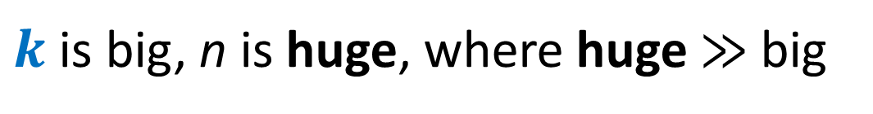

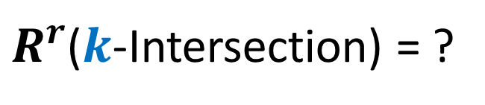
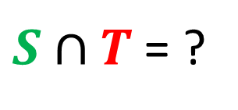

Set Intersection
$x = S, y = T, f\left(x,y\right)= S∩T$
$$S⊆\left[n\right], \left|S\right|≤k$$
$$T⊆\left[n\right], \left|T\right|≤k$$
$S∩T$ = ?
$R^{r}$($k$-Intersection) = ?
$k$ is big, n is huge, where huge $≫$ big

Slide 4

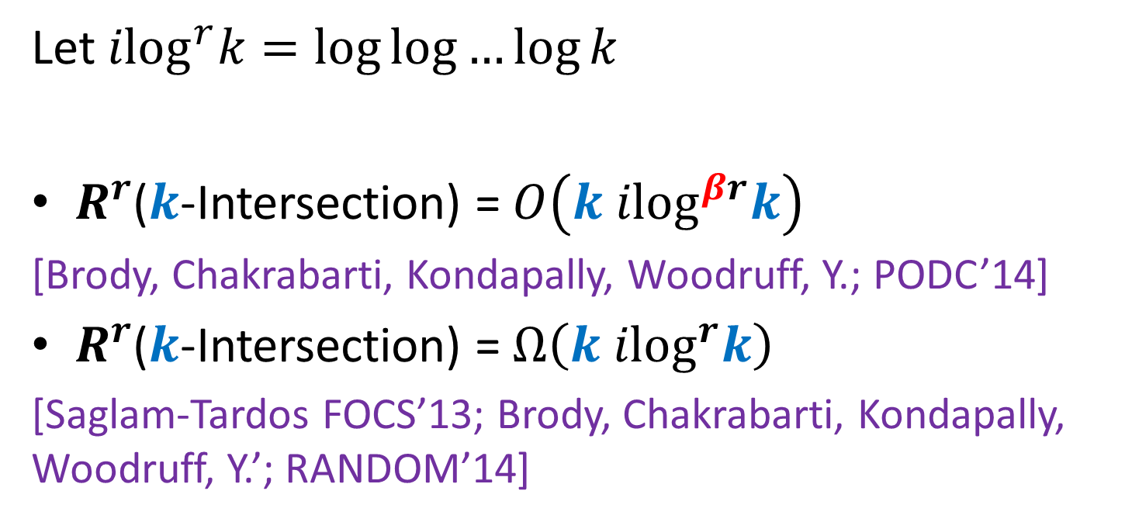
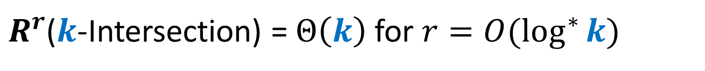
Our results
{
Let $ilog^{r}k=\log{\log{…{\log{k}}}}$
$R^{r}$($k$-Intersection) = $O\left(k ilog^{βr}k\right)$
[Brody, Chakrabarti, Kondapally, Woodruff, Y.; PODC’14]
$R^{r}$($k$-Intersection) = $Ω\left(k ilog^{r}k\right)$
[Saglam-Tardos FOCS’13; Brody, Chakrabarti, Kondapally, Woodruff, Y.’; RANDOM’14]
$r$ times
$R^{r}$($k$-Intersection) = $Θ\left(k\right)$ for $r=O(\log^{∗}{k})$

Slide 5
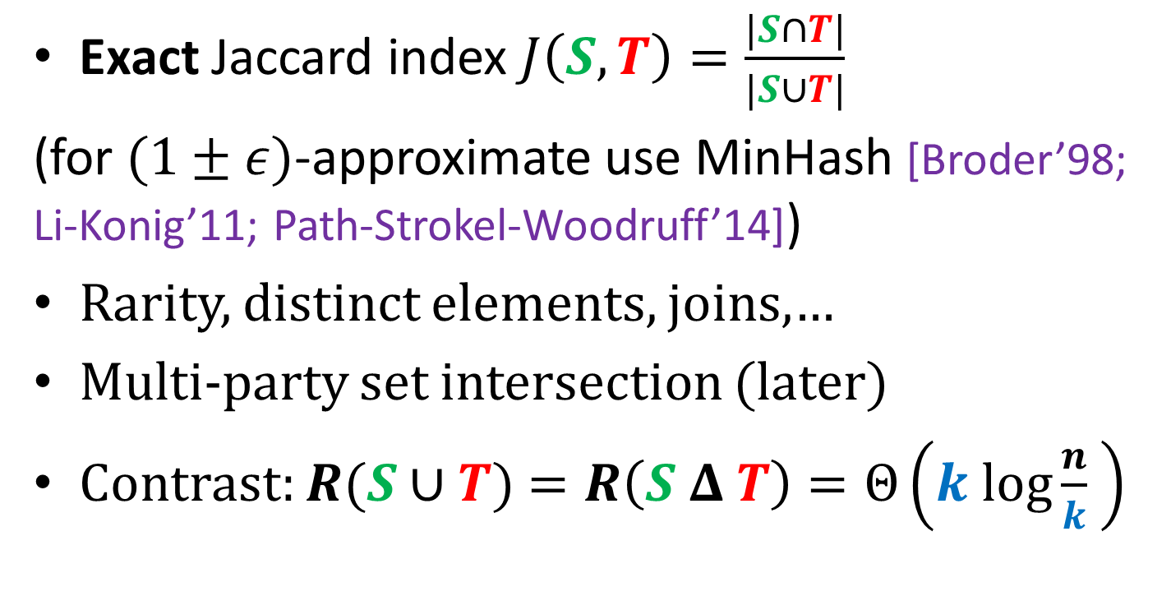
Applications
Exact Jaccard index $J\left(S,T\right)=\frac{|S∩T|}{|S∪T|}$
(for $(1±ε)$-approximate use MinHash [Broder’98; Li-Konig’11; Path-Strokel-Woodruff’14])
Rarity, distinct elements, joins,…
Multi-party set intersection (later)
Contrast: $R(S∪T)$ $=R\left(S Δ T\right)=Θ\left(k log\frac{n}{k} \right)$

Slide 6





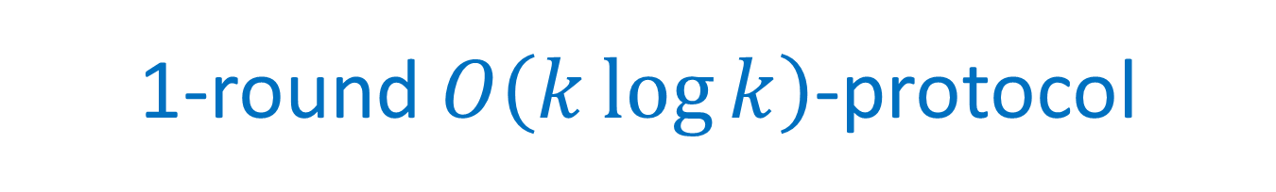






1-round $O\left(k\log{k}\right)$-protocol
$$\left[n\right]$$
$$\left[n\right]$$
$$S$$
$$T$$
$$h:\left[n\right]→[k^{3}]$$
$$h(S)$$
$$h(T)$$
$$[k^{3}]$$
$$[k^{3}]$$
$\left|h\left(S\right)\right|=O(k log k)$
$\left|h\left(T\right)\right|=O(k log k)$
$S∩T=$ $S∩h^{−1}\left(h\left(T\right)\right)=h^{−1}\left(h\left(S\right)\right)∩T$

Slide 7
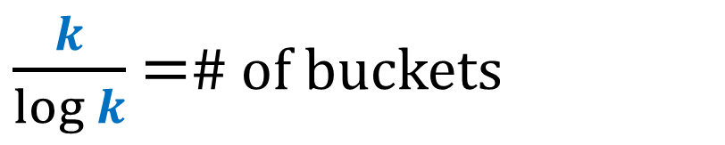


Hashing
$$h:\left[n\right]→[k/\log{k}]$$
Expected
# of elements
$$log⁡k$$
$\frac{k}{\log{k}}$ =# of buckets

Slide 8

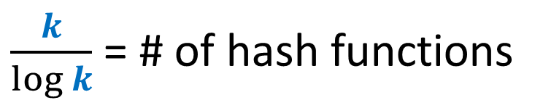
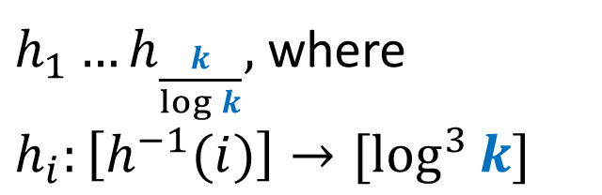
Secondary Hashing
$h_{1}…h_{\frac{k}{\log{k}}},$ where $h_{i}:\left[h^{−1}(i)\right]→[\log^{3}{k}]$
$$\log^{3}{k}$$
$\frac{k}{\log{k}}$ = # of hash functions

Slide 9






2-Round $O\left(k\log{\log{k}}\right)$-protocol
$$\log^{3}{k}$$
$$\log^{3}{k}$$
$\frac{k}{\log{k}}$
$\frac{k}{\log{k}}$
$$\left|h_{i}\left(S\right)\right|, \left|h_{i}\left(T\right)\right|=O\left(\log{k}\log{\log{k}}\right)$$
Total communication = $\frac{k}{\log{k}}$ $O\left(\log{k}\log{\log{k}}\right)$ = O($k \log{\log{k}}$)

Slide 10


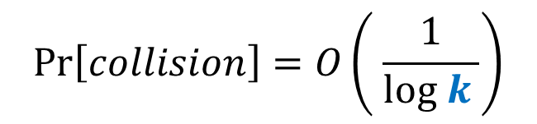
Collisions
$$\operatorname{Pr}\left[collision\right]=O\left( \frac{1}{log k }\right)$$
$$\log^{3}{k}$$
$$\frac{k}{\log{k}}$$

Slide 11







Collisions
$$\log^{3}{k}$$
$$\log^{3}{k}$$
$\frac{k}{\log{k}}$
$\frac{k}{\log{k}}$
$S∩T⊆S∩ H^{−1}\left(\right)$
$S∩T⊆T∩ H^{−1}\left(\right)$
Key fact: If $S∩ H^{−1}\left(\right)=T∩ H^{−1}\left( \right)$ then also = $S∩T$

Slide 12
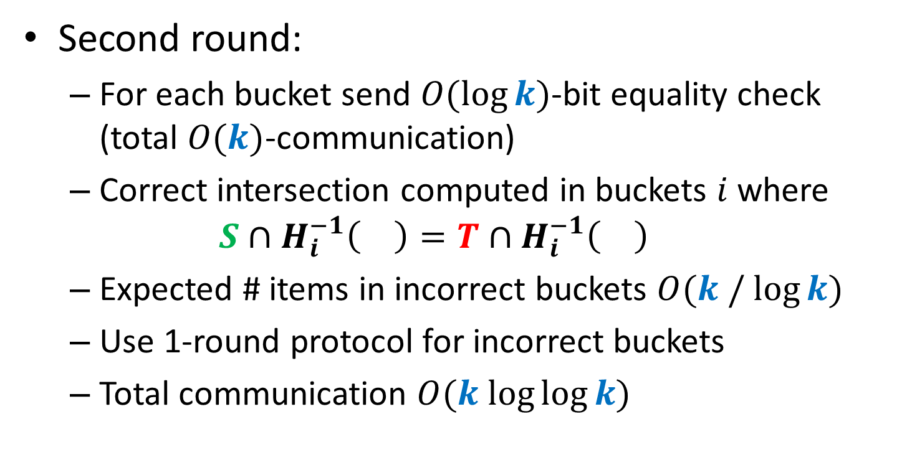
Collisions
Second round:
For each bucket send $O(\log{k})$-bit equality check (total $O(k)$-communication)
Correct intersection computed in buckets $i$ where
$$S∩H_{i}^{−1}\left(\right)=T∩H_{i}^{−1}\left(\right)$$
Expected # items in incorrect buckets $O(k / log⁡k)$
Use 1-round protocol for incorrect buckets
Total communication $O(k log⁡log⁡k)$

Slide 13
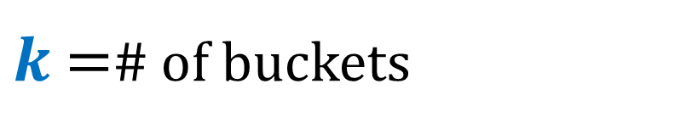


Main protocol
$$h:\left[n\right]→[k]$$
Expected
# of elements
$$O(1)$$
$k$ =# of buckets

Slide 14
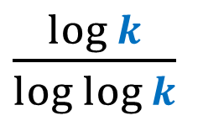
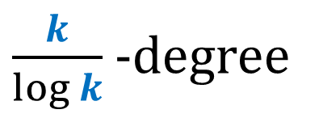


Verification tree
$\frac{k}{\log{k}}$ -degree
$\frac{\log{k}}{log log{k}}$
…
$${ilog}^{r−1 }{k}$$
$k$buckets = leaves of the verification tree

Slide 15






Verification bottom-up
$$S_{1}^{}∪S_{2}, T_{1}^{}∪T_{2}$$
$$S_{1}^{}, T_{1}^{}$$
$$S_{2}^{}, T_{2}^{}$$
$$\left(S_{1}^{}∪S_{2}\right)∩{(T}_{1}^{}∪T_{2})$$
$$S_{1}^{}∩T_{1}^{}$$
$$S_{2}^{}∩T_{2}^{}$$

Slide 16






Verification bottom-up
Incorrect
$$\left(S_{1}^{}∪S_{2}\right)∩{(T}_{1}^{}∪T_{2})$$
Correct
Incorrect
$$S_{1}^{}∩T_{1}^{}$$
$$S_{2}^{}∩T_{2}^{}$$
EQUALITY CHECK
$$\left(S_{1}^{}∪S_{2}\right)∩{(T}_{1}^{}∪T_{2})$$
Correct
Incorrect
$$S_{1}^{}∩T_{1}^{}$$
$$S_{2}^{}∩T_{2}^{}$$

Slide 17
Verification bottom-up
EQUALITY CHECK FAILS =>
RESTART THE SUBTREE
$$\left(S_{1}^{}∪S_{2}\right)∩{(T}_{1}^{}∪T_{2})$$
Correct
Incorrect
$$S_{1}^{}∩T_{1}^{}$$
$$S_{2}^{}∩T_{2}^{}$$
Correct
$$\left(S_{1}^{}∪S_{2}\right)∩{(T}_{1}^{}∪T_{2})$$
Correct
Correct
Incorrect
$$S_{1}^{}∩T_{1}^{}$$
$$S_{2}^{}∩T_{2}^{}$$

Slide 18







Verification bottom-up
$$p_{r−1}$$
$$p_{r−2}$$
…
$$p_{1}$$
…
…
$$S_{1}^{1}, T_{1}^{1}$$
$$S_{2}^{1}, T_{2}^{1}$$
$$S_{i}^{1}, T_{i}^{1}$$
$$S_{k}^{1}, T_{k}^{1}$$

Slide 19
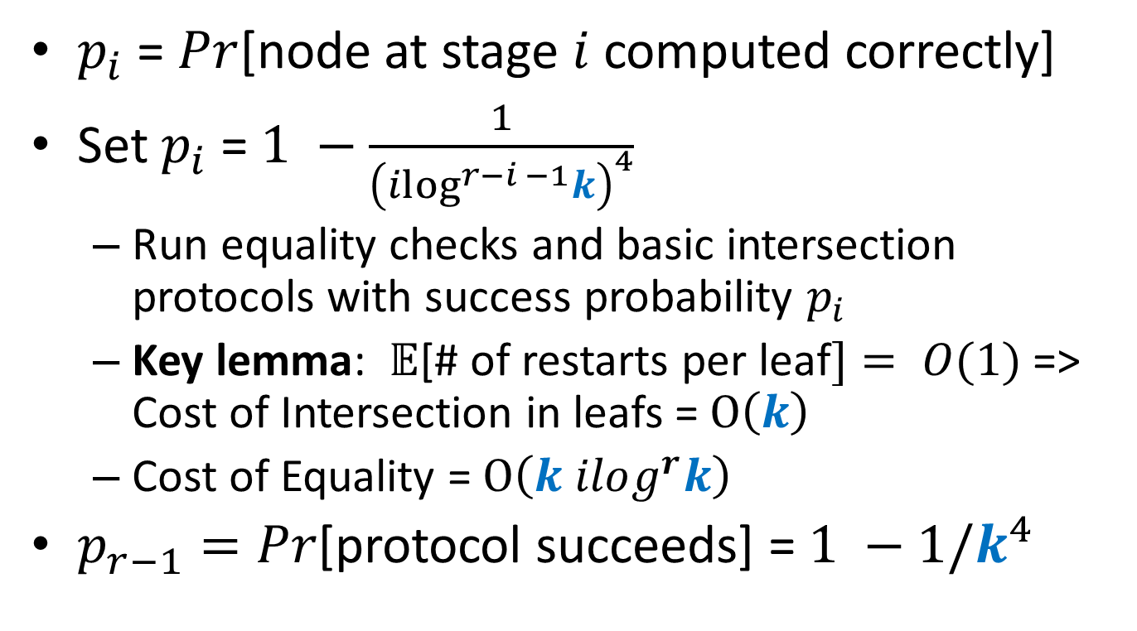

Analysis of Stage $i$
$p_{i}$ = $Pr$[node at stage $i$ computed correctly]
Set $p_{i}$ = $1 −\frac{1}{{\left(ilog^{r−i −1}k\right)}^{4}}$
Run equality checks and basic intersection protocols with success probability $p_{i}$
Key lemma: $𝔼$[# of restarts per leaf$]= O(1)$ => Cost of Intersection in leafs = $O\left(k\right)$
Cost of Equality = $O\left(k ilog^{r}k\right)$
$p_{r−1}=Pr$[protocol succeeds] = $1 −1/k^{4}$

Slide 20
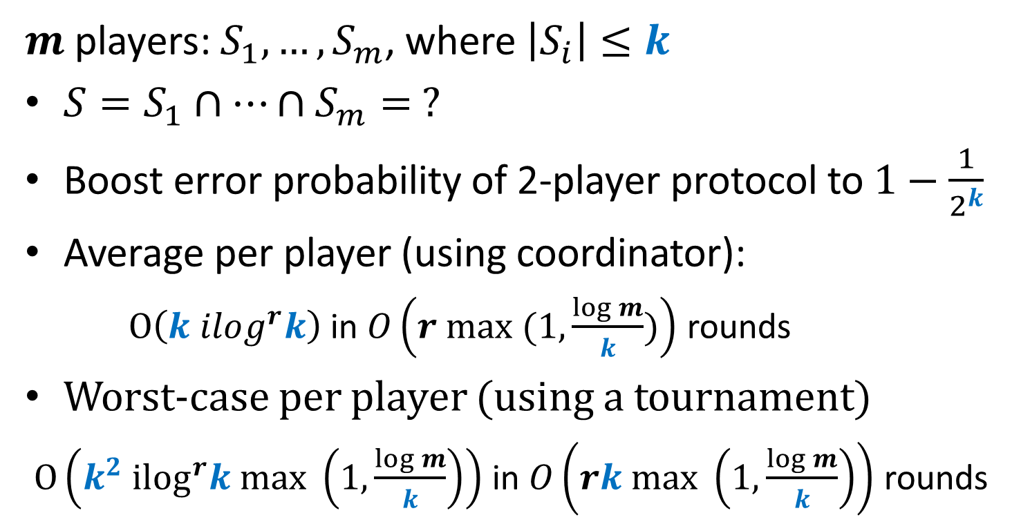
Multi-party extensions
$m$players: $S_{1},…, S_{m}$, where $\left|S_{i}\right|≤k$
$S=S_{1}∩…∩S_{m}= ?$
Boost error probability of 2-player protocol to $1−\frac{1}{2^{k}}$
Average per player (using coordinator):
$O\left(k ilog^{r}k\right)$ in $O\left(r max (1, \frac{\log{m}}{k})\right)$ rounds
Worst-case per player (using a tournament)
$O\left(k^{2} ilog^{r}k max \left(1, \frac{\log{m}}{k}\right)\right)$ in $O\left(rk max \left(1, \frac{\log{m}}{k}\right)\right)$ rounds

Slide 21

Open Problems
$R^{r}$($k$-Intersection) = $O\left(k ilog^{r}k\right)$?
Better protocols for the multi-party setting?

Slide 22

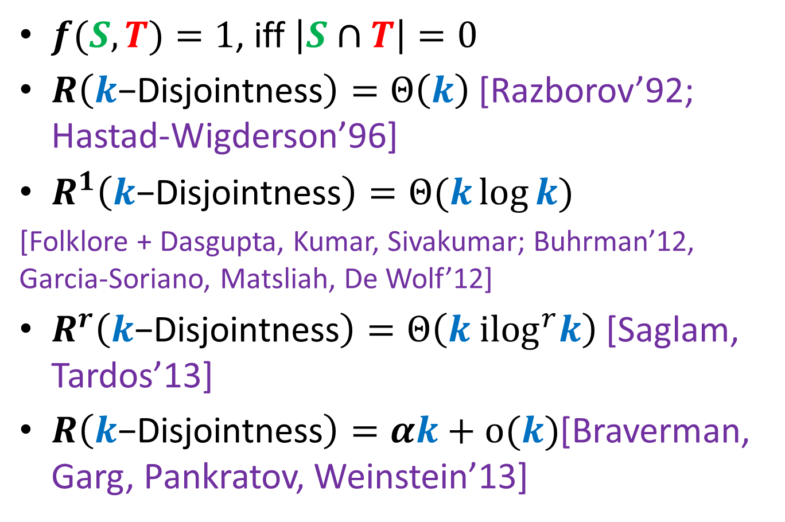
$k$-Disjointness
$f(S,T)=1$, iff $\left|S∩T\right|=0$
$R\left(k\text{−}\text{Disjointness}\right)=Θ\left(k\right)$[Razborov’92; Hastad-Wigderson’96]
$R^{1}\left(k\text{−}\text{Disjointness}\right)=Θ(k\log{k})$
[Folklore + Dasgupta, Kumar, Sivakumar; Buhrman’12, Garcia-Soriano, Matsliah, De Wolf’12]
$R^{r}\left(k\text{−}\text{Disjointness}\right)=Θ\left(k {ilog}^{r}k\right)$[Saglam, Tardos’13]
$R\left(k\text{−}\text{Disjointness}\right)=αk+o(k)$[Braverman, Garg, Pankratov, Weinstein’13]
Notes:
State k-linearity as an open problem

