Slide 1

CIS 700: “algorithms for Big Data”
Lecture 1: Intro
Slides at http://grigory.us/big-data-class.html
Grigory Yaroslavtsev
http://grigory.us

Slide 2
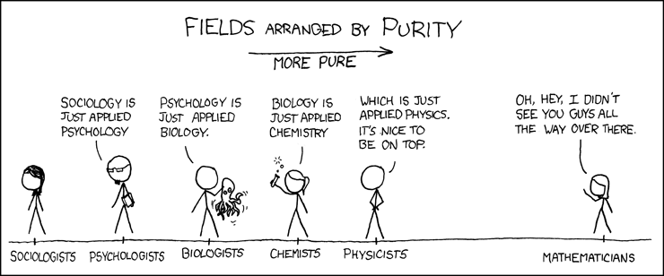
Disclaimers
A lot of Math!

Slide 3
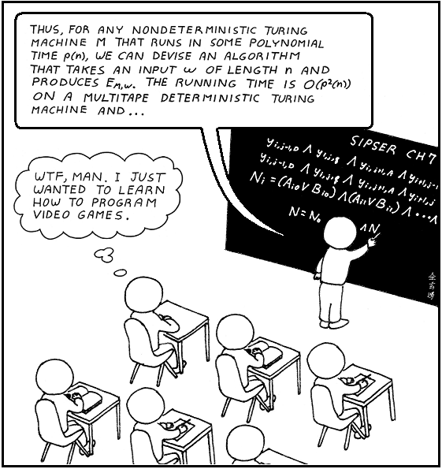
Disclaimers
(Almost) no programming!

Slide 4
Class info
MW 10:30 – 12:00, Towne 307
Grading:
1-2 homework assignments (40%)
Project (60%)
Office hours by appointment
Slides will be posted

Slide 5

What is this class about?
Not about the band (https://en.wikipedia.org/wiki/Big_Data_(band))

Slide 6
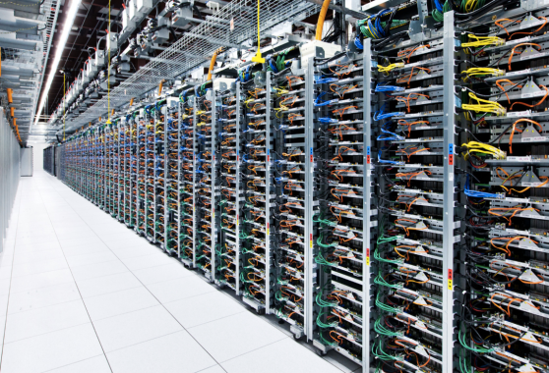


What is this class about?
The four V’s: volume, velocity, variety, veracity
Volume: “Big Data” = too big to fit in RAM
Today 16GB $≈100\$$ => “big” starts at terabytes
Velocity: real-time
Doesn’t fit in RAM + has to be processed on the fly
N = size of data, time and memory o(N)
o(N): $O\left(1\right), O(log{\text{N})},O(N^{ε})$ where $0<ε<1$

Slide 7



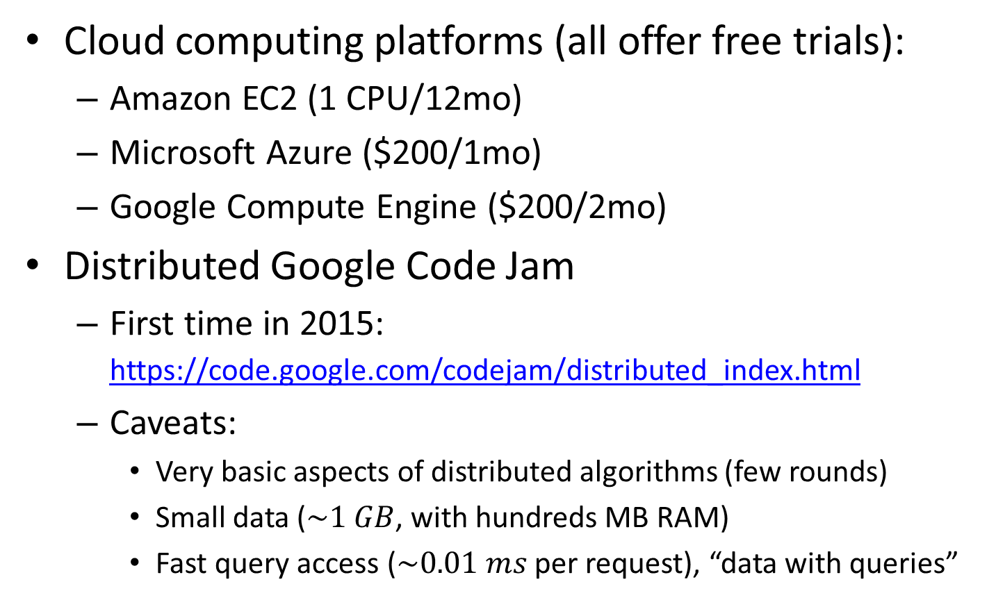
Getting hands dirty
Cloud computing platforms (all offer free trials):
Amazon EC2 (1 CPU/12mo)
Microsoft Azure ($200/1mo)
Google Compute Engine ($200/2mo)
Distributed Google Code Jam
First time in 2015: https://code.google.com/codejam/distributed_index.html
Caveats:
Very basic aspects of distributed algorithms (few rounds)
Small data ($\sim 1 GB$, with hundreds MB RAM)
Fast query access ($\sim 0.01 ms$ per request), “data with queries”

Slide 8

Outline
Part 1: Streaming Algorithms
Highlights:
Approximate counting
# Distinct Elements, Hyperloglog
Median
Frequency moments
Heavy hitters
Graph sketching

Slide 9

Outline
Part 2: Algorithms for numerical linear algebra
Highlights:
Dimension reduction
Nearest neighbor search
Linear sketching
Linear regression
Low rank approximation

Slide 10

Outline
Part 3: Massively Parallel Algorithms
Highlights:
Computational Model
Sorting (Terasort)
Connectivity, MST
Filtering dense graphs
Euclidean MST

Slide 11

Outline
Part 4: Sublinear Time Algorithms
Highlights:
“Data with queries”
Sublinear approximation
Property Testing
Testing images, sortedness, connectedness
Testing noisy data

Slide 12
Today

Slide 13

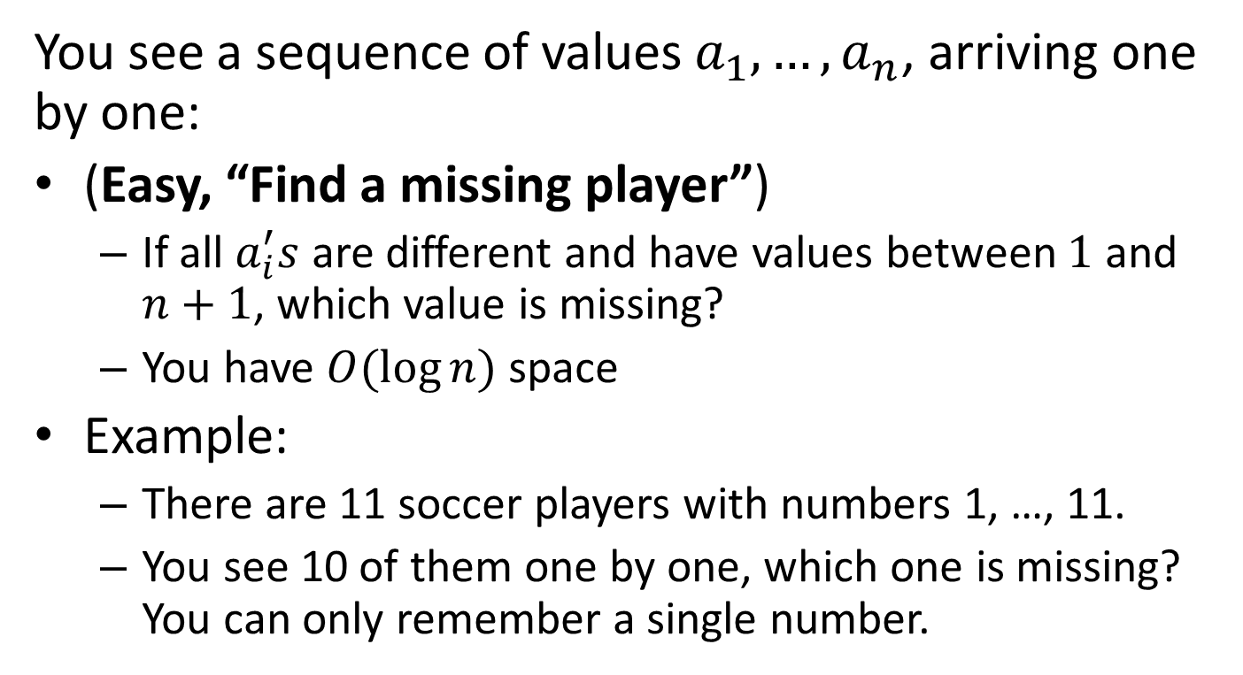
Puzzles
You see a sequence of values $a_{1}, …, a_{n}$, arriving one by one:
(Easy, “Find a missing player”)
If all $a_{i}^{′}s$ are different and have values between $1$ and $n+1$, which value is missing?
You have $O(\log{n})$ space
Example:
There are 11 soccer players with numbers 1, …, 11.
You see 10 of them one by one, which one is missing? You can only remember a single number.

Slide 14
1

Slide 15
8

Slide 16
5

Slide 17
11

Slide 18
3

Slide 19
9

Slide 20
2

Slide 21
6

Slide 22
7

Slide 23
4

Slide 24

Which number was missing?

Slide 25
Puzzle #1
You see a sequence of values $a_{1}, …, a_{n}$, arriving one by one:
(Easy, “Find a missing player”)
If all $a_{i}^{′}s$ are different and have values between $1$ and $n+1$, which value is missing?
You have $O(\log{n})$ space
Example:
There are 11 soccer players with numbers 1, …, 11.
You see 10 of them one by one, which one is missing? You can only remember a single number.

Slide 26
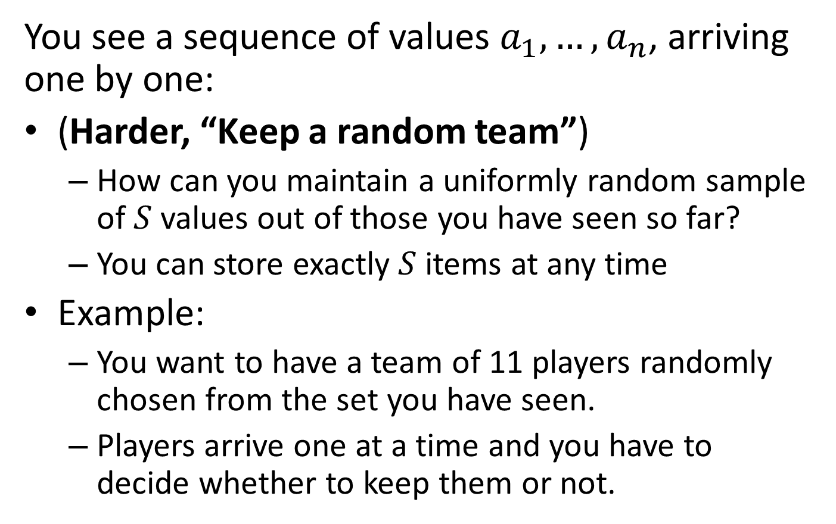
Puzzle #2
You see a sequence of values $a_{1}, …, a_{n}$, arriving one by one:
(Harder, “Keep a random team”)
How can you maintain a uniformly random sample of $S$ values out of those you have seen so far?
You can store exactly $S$ items at any time
Example:
You want to have a team of 11 players randomly chosen from the set you have seen.
Players arrive one at a time and you have to decide whether to keep them or not.

Slide 27
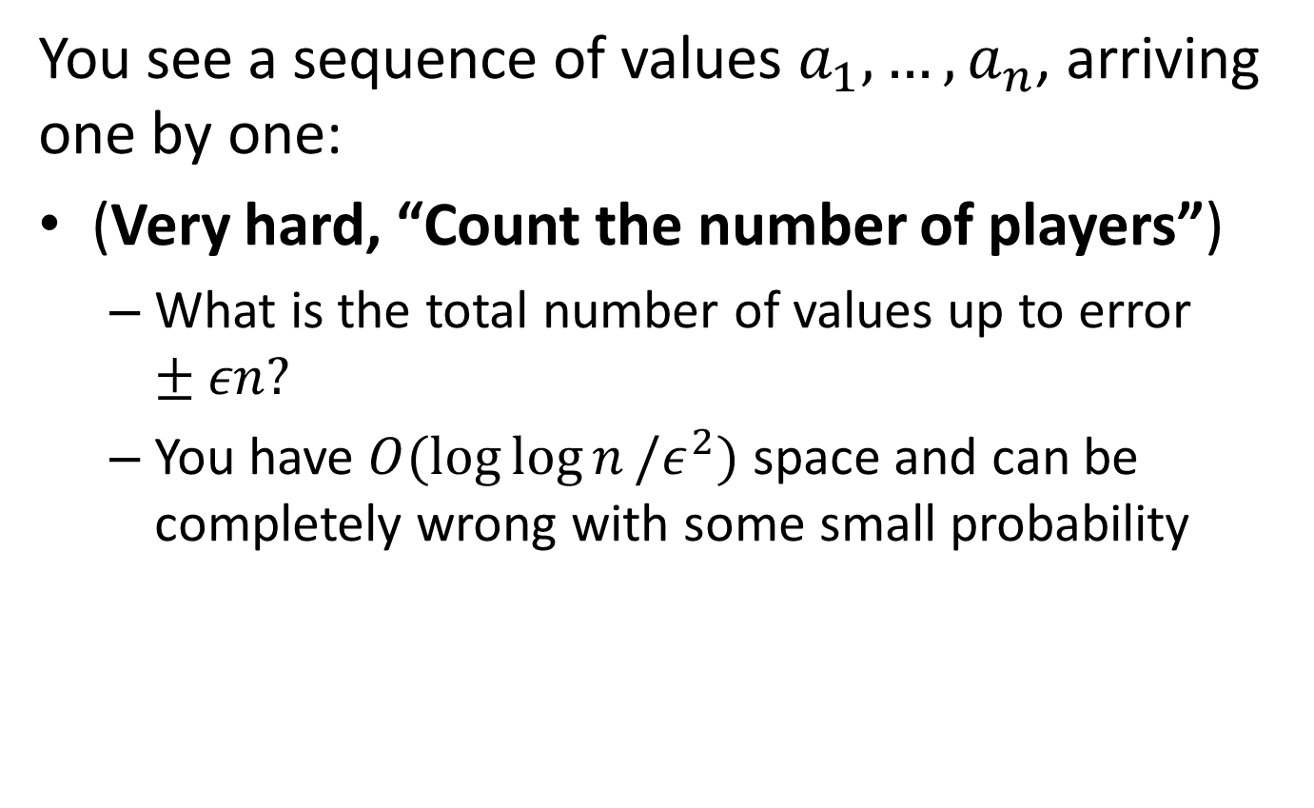
Puzzle #3
You see a sequence of values $a_{1}, …, a_{n}$, arriving one by one:
(Very hard, “Count the number of players”)
What is the total number of values up to error $±εn?$
You have $O(\log{\log{n}}/ε^{2})$ space and can be completely wrong with some small probability

Slide 28
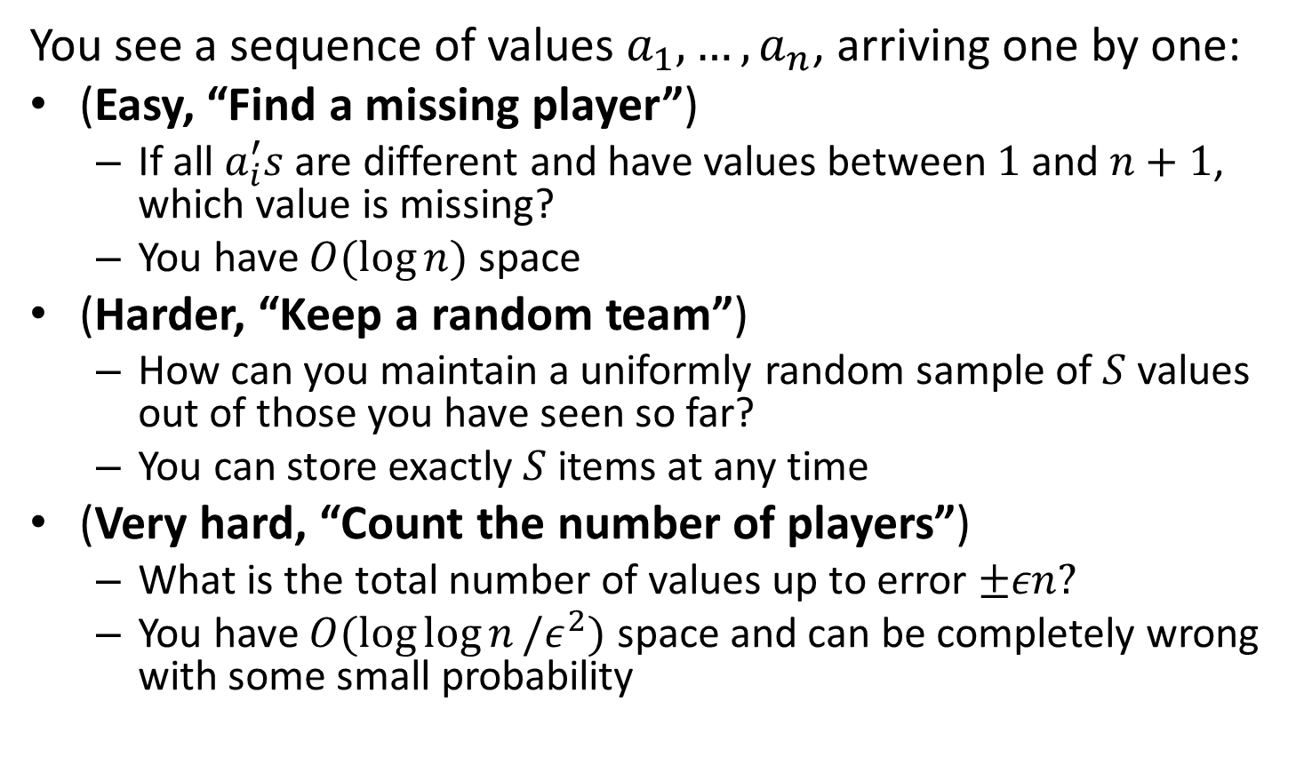
Puzzles
You see a sequence of values $a_{1}, …, a_{n}$, arriving one by one:
(Easy, “Find a missing player”)
If all $a_{i}^{′}s$ are different and have values between $1$ and $n+1$, which value is missing?
You have $O(\log{n})$ space
(Harder, “Keep a random team”)
How can you maintain a uniformly random sample of $S$ values out of those you have seen so far?
You can store exactly $S$ items at any time
(Very hard, “Count the number of players”)
What is the total number of values up to error $±εn?$
You have $O(\log{\log{n}}/ε^{2})$ space and can be completely wrong with some small probability

Slide 29
Part 1: Probability 101
“The bigger the data the better you should know your Probability”
Basic Probability:
Probability, events, random variables
Expectation, variance / standard deviation
Conditional probability, independence, pairwise independence, mutual independence

Slide 30
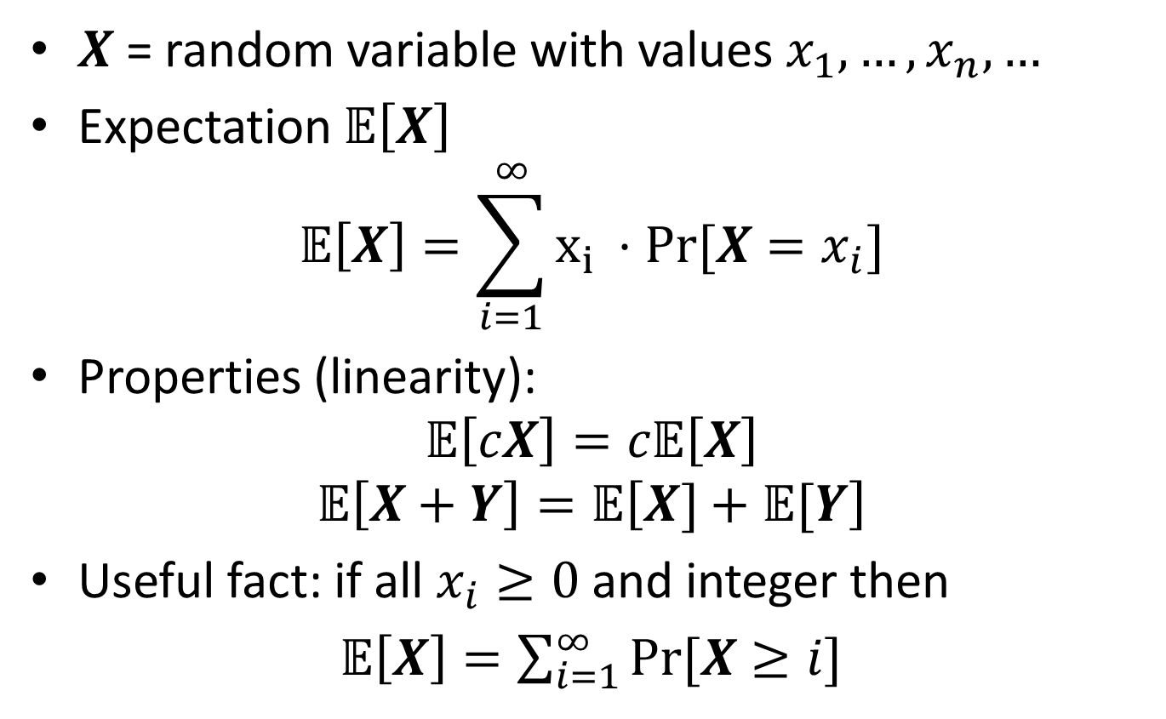
Expectation
$X$ = random variable with values $x_{1},…, x_{n}, …$
Expectation 𝔼$\left[X\right]$
$$\text{𝔼}\left[X\right]=\sum_{i=1}^{∞}{x_{i }⋅Pr⁡[X=x_{i}]}$$
Properties (linearity):
$$\text{𝔼}\left[cX\right]=c\text{𝔼}\left[X\right]$$
$$\text{𝔼}\left[X+Y\right]=\text{𝔼}\left[X]+\text{𝔼}[Y\right]$$
Useful fact: if all $x_{i}≥0$ and integer then
𝔼$\left[X\right]=\sum_{i=1}^{∞}{Pr⁡[X≥i]}$

Slide 31
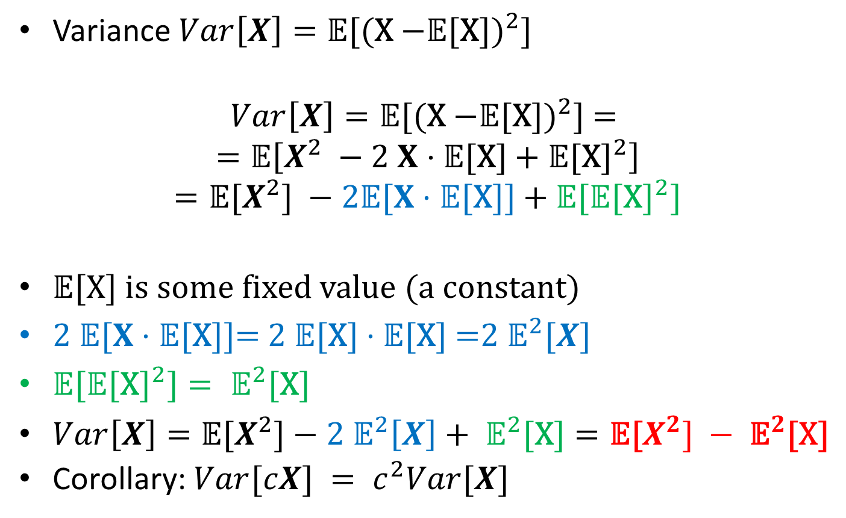
Variance
Variance ${Var\left[X\right]=\text{𝔼}\text{[(}\text{X}\text{ −}\text{𝔼}\text{[}\text{X}\text{])}}^{2}\text{]}$
$${Var\left[X\right]=\text{𝔼}\text{[(}\text{X}\text{ −}\text{𝔼}\text{[}\text{X}\text{])}}^{2}\text{] = }$$
$$=\text{𝔼}\left[X^{2} −2 X⋅\text{𝔼}\text{[}\text{X}\text{]}+{\text{𝔼}\text{[}\text{X}\text{]}}^{2}\right]$$
$$={\text{𝔼}\text{[}X^{2}\text{] }−2\text{𝔼}[X⋅\text{𝔼}\text{[}\text{X}\text{]] }\text{+} \text{𝔼}\text{[}\text{𝔼}\text{[}\text{X}\text{]}}^{2}]$$
$\text{𝔼}\text{[}\text{X}\text{]}$ is some fixed value (a constant)
$\text{2 }\text{𝔼}[X⋅\text{𝔼}\text{[}\text{X}\text{]]= 2 }\text{𝔼}\text{[}\text{X}\text{]}⋅\text{𝔼}\text{[}\text{X}\text{] =}{2 \text{𝔼}}^{2}[X]$
${\text{𝔼}\text{[}\text{𝔼}\text{[}\text{X}\text{]}}^{2}]={ \text{𝔼}}^{2}\text{[}\text{X}\text{]}$
$Var\left[X\right]=\text{𝔼}\text{[}X^{2}\text{]}−{2 \text{𝔼}}^{2}\left[X\right]+{ \text{𝔼}}^{2}\text{[}\text{X}\text{]}=\text{𝔼}\text{[}X^{2}] −{ \text{𝔼}}^{2}\text{[}\text{X}\text{]}$
Corollary: $Var[cX] = c^{2}Var[X]$

Slide 32
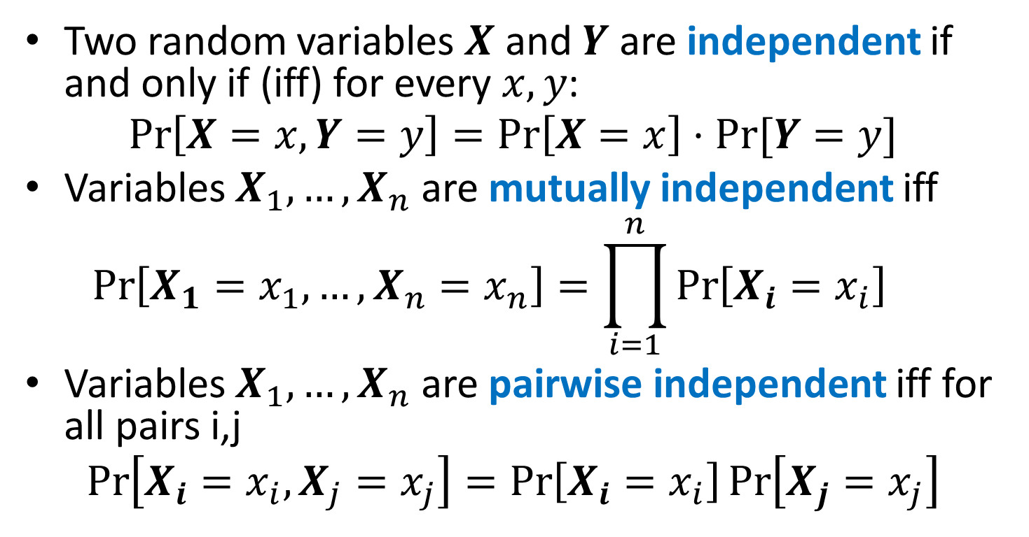
Independence
Two random variables $X$ and $Y$ are independent if and only if (iff) for every $x, y$:
$$\operatorname{Pr}\left[X=x, Y=y\right]=\operatorname{Pr}\left[X=x\right]⋅Pr⁡[Y=y]$$
Variables $X_{1},…, X_{n}$ are mutually independent iff
$$\operatorname{Pr}\left[X_{1}=x_{1}, …,X_{n}=x_{n}\right]=\prod_{i=1}^{n}{\operatorname{Pr}\left[X_{i}=x_{i}\right]}{}$$
Variables $X_{1},…, X_{n}$ are pairwise independent iff for all pairs i,j
$$\operatorname{Pr}\left[X_{i}=x_{i}, X_{j}=x_{j}\right]=\operatorname{Pr}\left[X_{i}=x_{i}\right]\operatorname{Pr}\left[X_{j}=x_{j}\right]$$

Slide 33
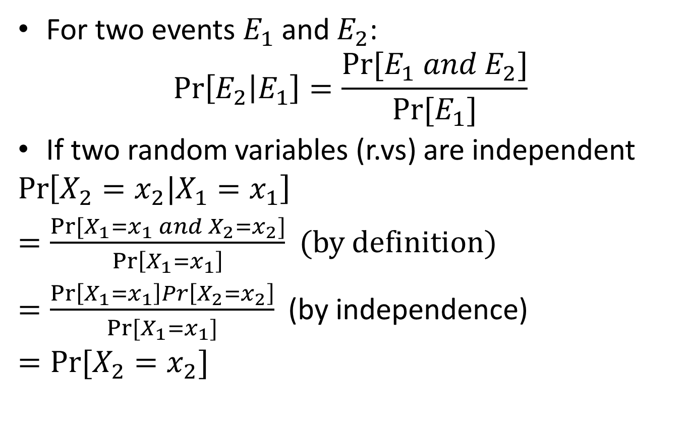
Conditional Probabilities
For two events $E_{1}$ and $E_{2}$:
$$\operatorname{Pr}\left[E_{2} | E_{1}\right]=\frac{Pr⁡[E_{1} and E_{2}]}{Pr⁡[E_{1}]}$$
If two random variables (r.vs) are independent
$$\operatorname{Pr}\left[X_{2}=x_{2}|X_{1}=x_{1}\right]$$
$=\frac{Pr⁡[X_{1}=x_{1} and X_{2}=x_{2}]}{\operatorname{Pr}\left[X_{1}=x_{1}\right]}$ (by definition)
$=\frac{\operatorname{Pr}\left[X_{1}=x_{1}\right]Pr\left[X_{2}=x_{2}\right]}{Pr[X_{1}=x_{1}]}$ (by independence)
$=Pr⁡[X_{2}=x_{2}]$

Slide 34
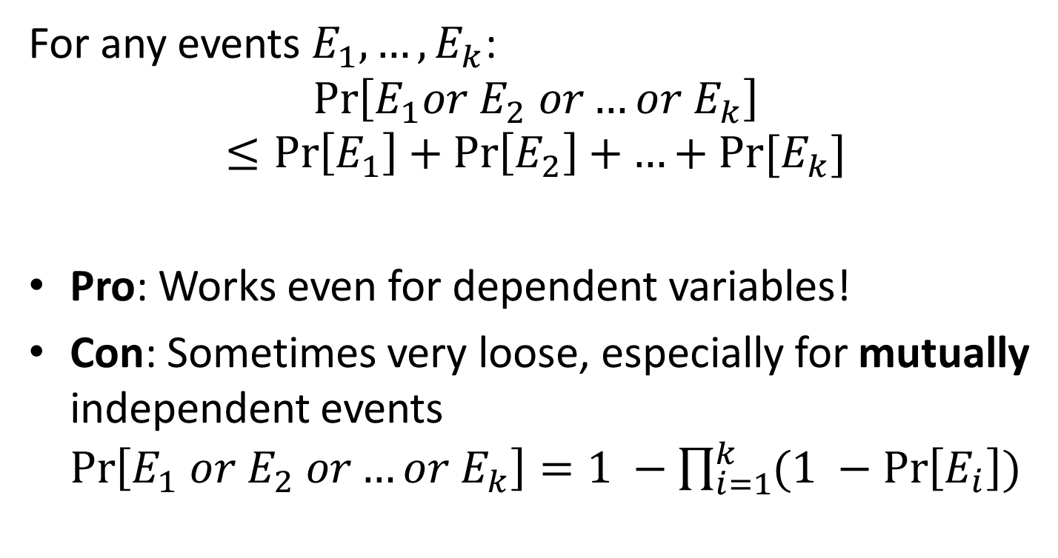
Union Bound
For any events $E_{1}, …, E_{k}$:
$$\operatorname{Pr}\left[E_{1}or E_{2} or…or{ E}_{k}\right]≤\operatorname{Pr}\left[E_{1}\right]+\operatorname{Pr}\left[E_{2}\right]+…+Pr⁡[E_{k}]$$
Pro: Works even for dependent variables!
Con: Sometimes very loose, especially for mutually independent events $\operatorname{Pr}\left[E_{1} or E_{2} or…or{ E}_{k}\right]=1 −\prod_{i=1}^{k}{(1 −\operatorname{Pr}\left[E_{i}\right])}$

Slide 35
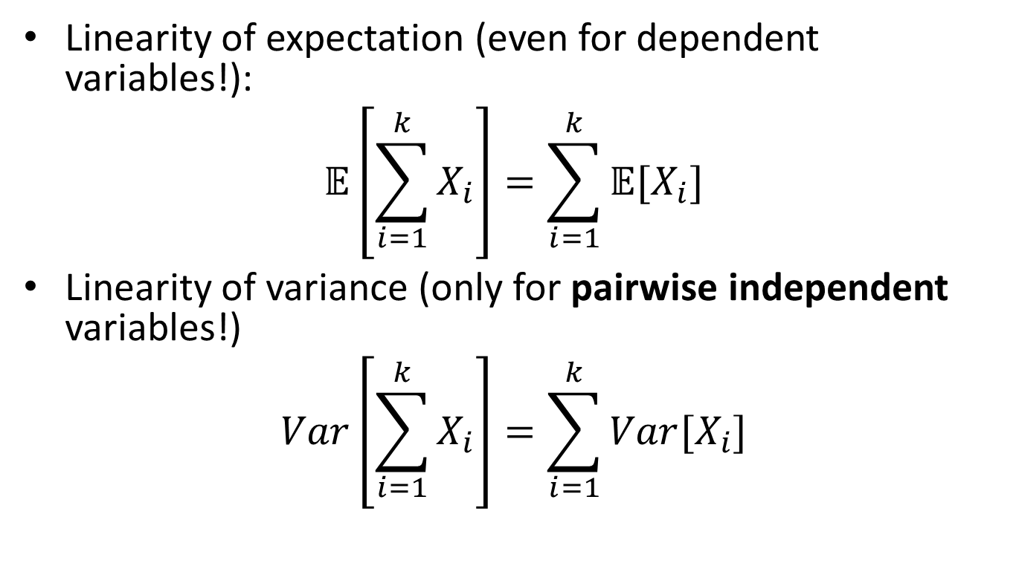
Independence and Linearity of Expectation/Variance
Linearity of expectation (even for dependent variables!):
$$\text{𝔼}\left[\sum_{i=1}^{k}{X_{i}}\right]=\sum_{i=1}^{k}{\text{𝔼}[X_{i}]}$$
Linearity of variance (only for pairwise independent variables!)
$$Var\left[\sum_{i=1}^{k}{X_{i}}\right]=\sum_{i=1}^{k}{Var[X_{i}]}$$

Slide 36
Part 2: Inequalities
Markov inequality
Chebyshev inequality
Chernoff bound

Slide 37
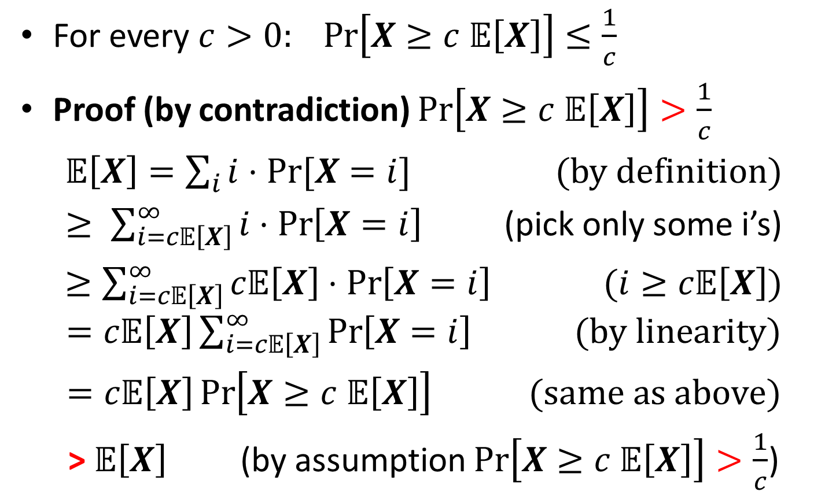
Markov’s Inequality
For every $c>0: Pr\left[X≥c 𝔼\left[X\right]\right]≤\frac{1}{c}$
Proof (by contradiction) $Pr\left[X≥c 𝔼\left[X\right]\right]>\frac{1}{c}$
$𝔼\left[X\right]=\sum_{i}{i⋅Pr⁡[X=i]}$ (by definition)
$≥ \sum_{i=c𝔼\left[X\right]}^{∞}{i⋅\operatorname{Pr}\left[X=i\right]}$ (pick only some i’s)
$≥\sum_{i=c𝔼\left[X\right]}^{∞}{c𝔼\left[X\right]⋅\operatorname{Pr}\left[X=i\right] }$ $(i≥c𝔼\left[X\right])$ $=c𝔼\left[X\right]\sum_{i=c𝔼\left[X\right]}^{∞}{\operatorname{Pr}\left[X=i\right] } (by linearity)$
$=c𝔼\left[X\right]\operatorname{Pr}\left[X≥c 𝔼\left[X\right]\right]$ $(same as above)$
> $𝔼\left[X\right]$ (by assumption $Pr\left[X≥c 𝔼\left[X\right]\right]>\frac{1}{c}$)

Slide 38
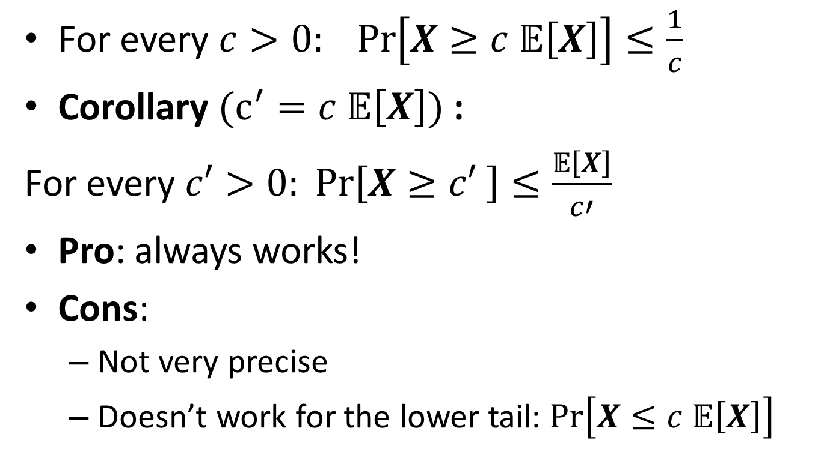
Markov’s Inequality
For every $c>0: Pr\left[X≥c 𝔼\left[X\right]\right]≤\frac{1}{c}$
Corollary $(c^{′}=c 𝔼\left[X\right])$:
For every $c′>0: Pr\left[X≥c′ \right]≤\frac{𝔼\left[X\right]}{c′}$
Pro: always works!
Cons:
Not very precise
Doesn’t work for the lower tail: $Pr\left[X≤c 𝔼\left[X\right]\right]$

Slide 39
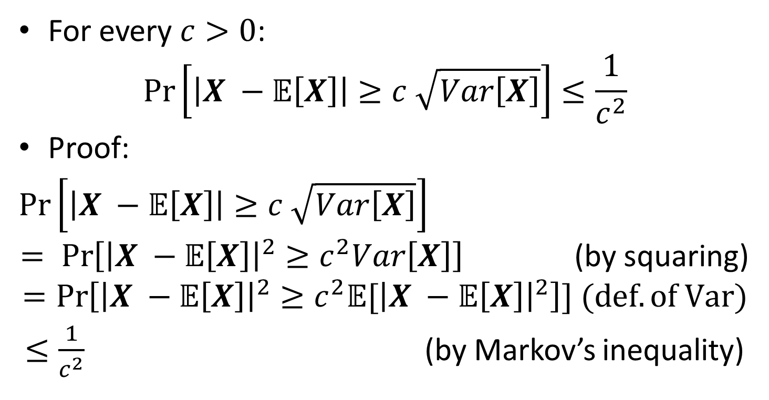
Chebyshev’s Inequality
For every $c>0$:
$$\operatorname{Pr}\left[\left|X −𝔼\left[X\right]\right|≥c \sqrt{Var\left[X\right]}\right]≤\frac{1}{c^{2}}$$
Proof:
$\operatorname{Pr}\left[\left|X −𝔼\left[X\right]\right|≥c \sqrt{Var\left[X\right]}\right]$
$= \operatorname{Pr}\left[{\left|X −𝔼\left[X\right]\right|}^{2}≥c^{2}Var\left[X\right]\right]$ (by squaring)
$$=\operatorname{Pr}\left[{\left|X −𝔼\left[X\right]\right|}^{2}≥c^{2}{𝔼[\left|X −𝔼\left[X\right]\right|}^{2}\right]] (def. of Var)$$
$≤\frac{1}{c^{2}}$ (by Markov’s inequality)

Slide 40
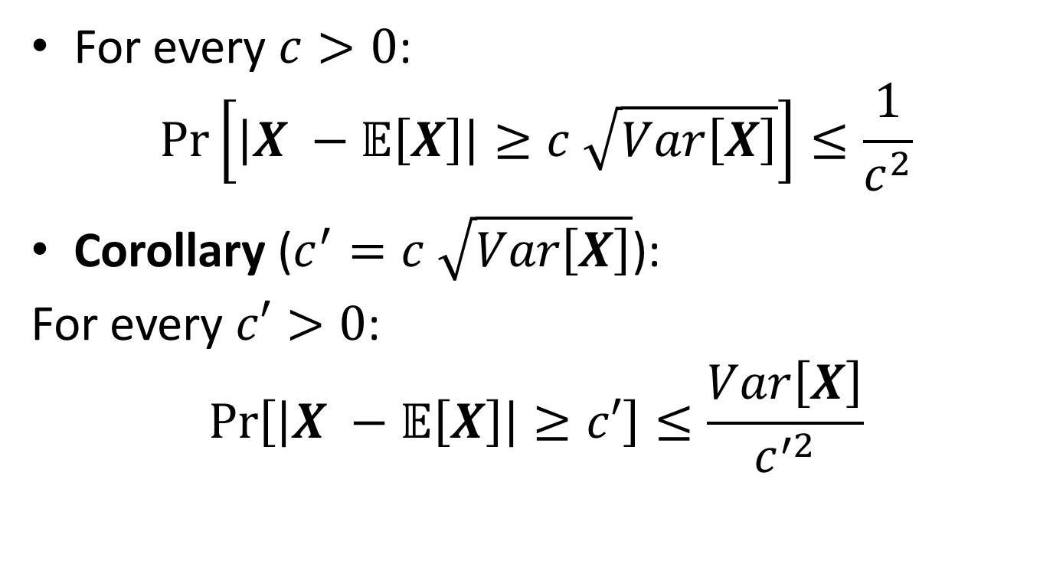
Chebyshev’s Inequality
For every $c>0$:
$$\operatorname{Pr}\left[\left|X −𝔼\left[X\right]\right|≥c \sqrt{Var\left[X\right]}\right]≤\frac{1}{c^{2}}$$
Corollary ($c^{′}=c \sqrt{Var\left[X\right]}$):
For every $c′>0$:
$$\operatorname{Pr}\left[\left|X −𝔼\left[X\right]\right|≥c′\right]≤\frac{Var\left[X\right]}{c^{′2}}$$

Slide 41
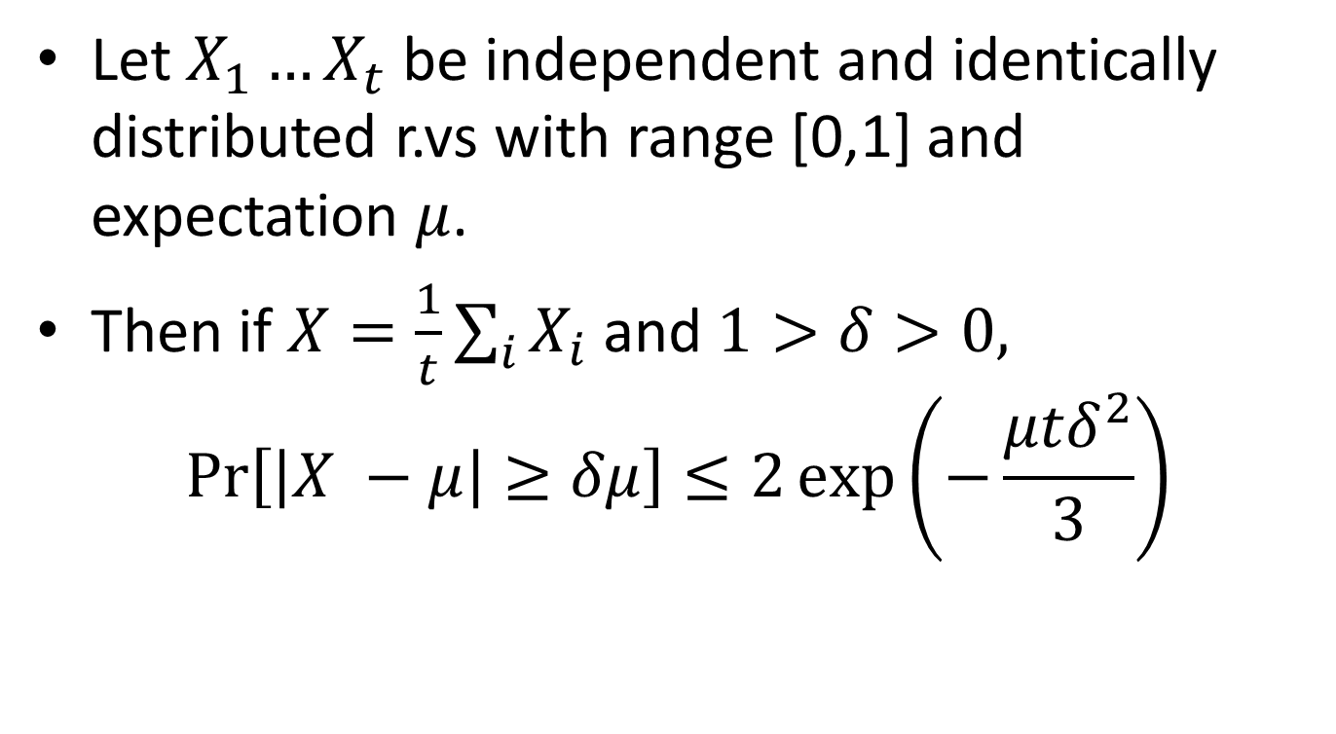
Chernoff bound
Let $X_{1}…X_{t}$ be independent and identically distributed r.vs with range [0,1] and expectation $μ$.
Then if $X=\frac{1}{t}\sum_{i}{X_{i}}$ and $1>δ>0,$
$$\operatorname{Pr}\left[\left|X −μ\right|≥δμ\right]≤2\exp\left(−\frac{μtδ^{2}}{3}\right)$$

Slide 42
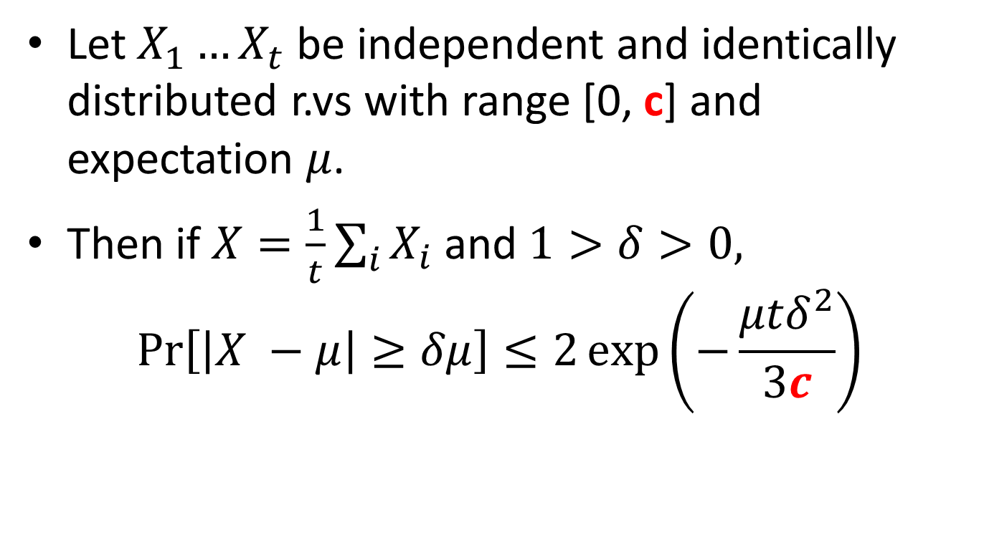
Chernoff bound (corollary)
Let $X_{1}…X_{t}$ be independent and identically distributed r.vs with range [0, c] and expectation $μ$.
Then if $X=\frac{1}{t}\sum_{i}{X_{i}}$ and $1>δ>0,$
$$\operatorname{Pr}\left[\left|X −μ\right|≥δμ\right]≤2\exp\left(−\frac{μtδ^{2}}{3c}\right)$$

Slide 43
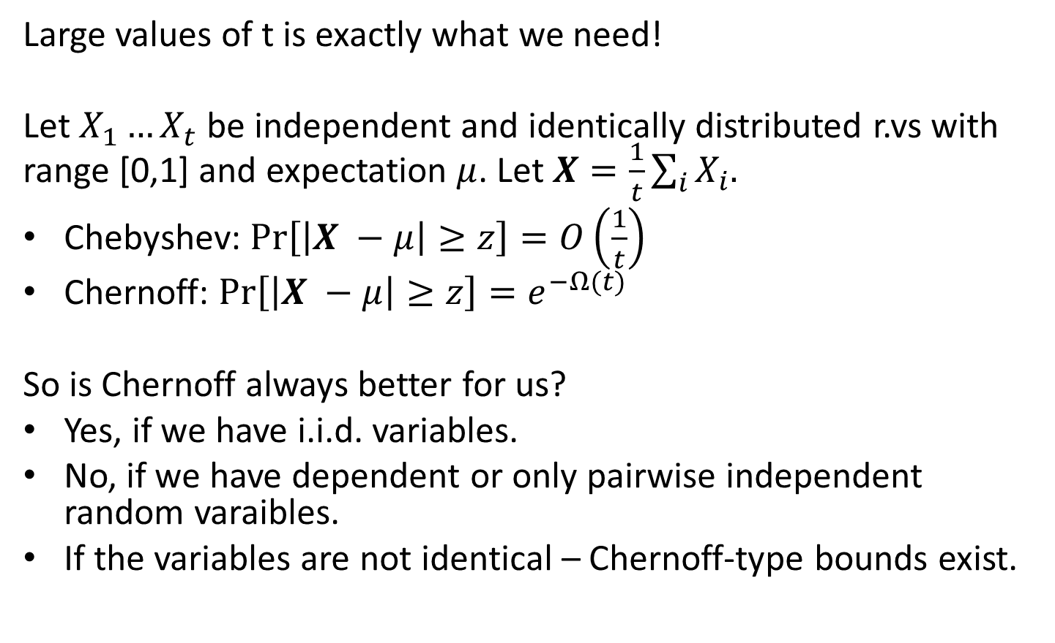
Chernoff v.s Chebyshev
Large values of t is exactly what we need!
Let $X_{1}…X_{t}$ be independent and identically distributed r.vs with range [0,1] and expectation $μ$. Let $X=\frac{1}{t}\sum_{i}{X_{i}.}$
Chebyshev: $\operatorname{Pr}\left[\left|X −μ\right|≥z\right]=O\left(\frac{1}{t}\right)$
Chernoff: $\operatorname{Pr}\left[\left|X −μ\right|≥z\right]=e^{−Ω(t)}$
So is Chernoff always better for us?
Yes, if we have i.i.d. variables.
No, if we have dependent or only pairwise independent random varaibles.
If the variables are not identical – Chernoff-type bounds exist.

Slide 44
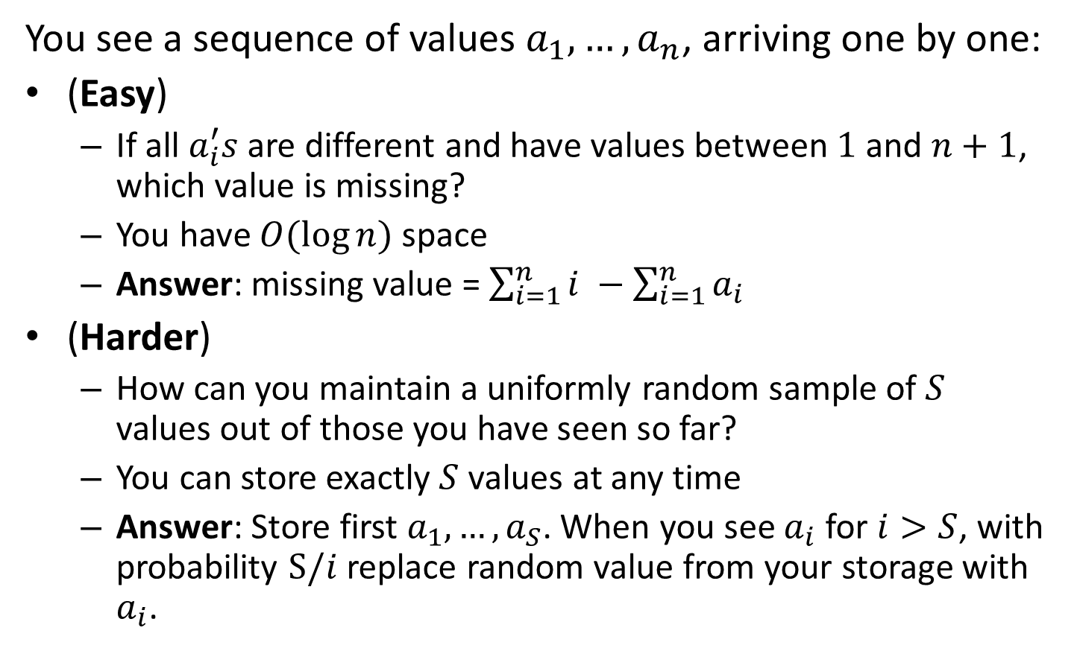
Answers to the puzzles
You see a sequence of values $a_{1}, …, a_{n}$, arriving one by one:
(Easy)
If all $a_{i}^{′}s$ are different and have values between $1$ and $n+1$, which value is missing?
You have $O(\log{n})$ space
Answer: missing value = $\sum_{i=1}^{n}{i} −\sum_{i=1}^{n}{a_{i}}$
(Harder)
How can you maintain a uniformly random sample of $S$ values out of those you have seen so far?
You can store exactly $S$ values at any time
Answer: Store first $a_{1},…, a_{S}$. When you see $a_{i}$ for $i>S$, with probability $S/i$ replace random value from your storage with $a_{i}$.

Slide 45
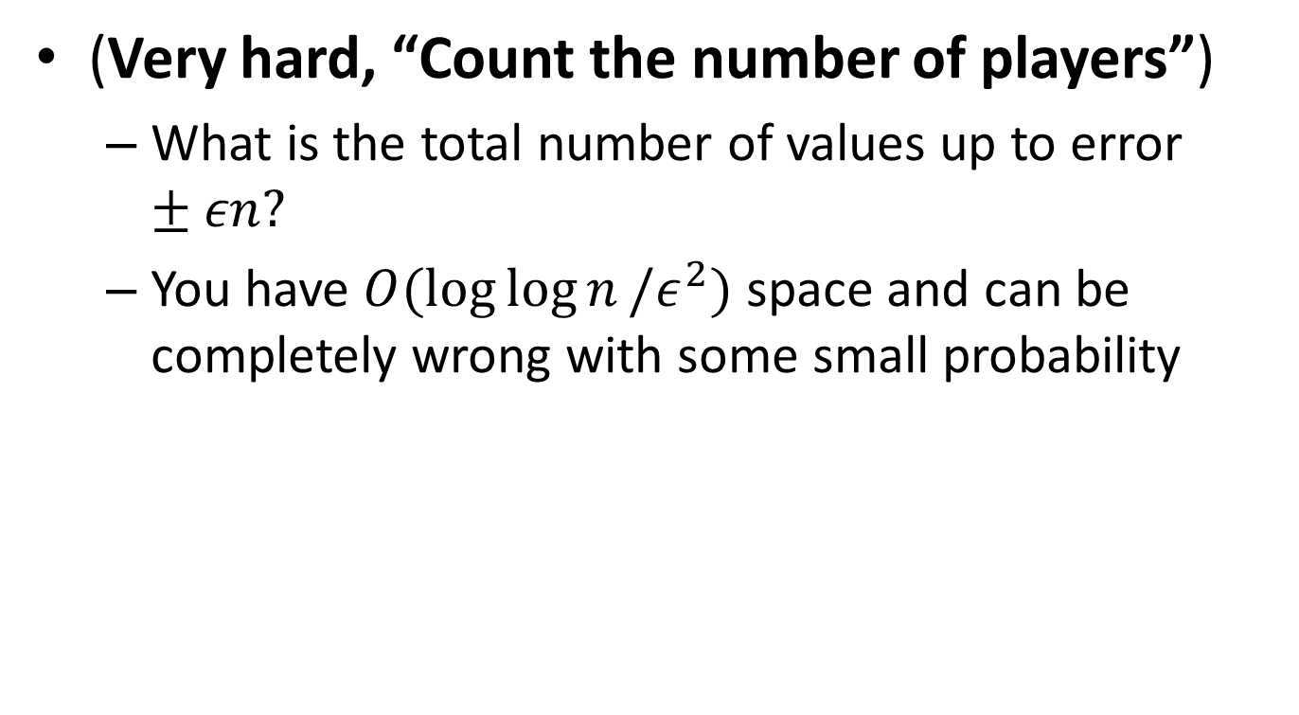
Part 3: Morris’s Algorithm
(Very hard, “Count the number of players”)
What is the total number of values up to error $±εn?$
You have $O(\log{\log{n}}/ε^{2})$ space and can be completely wrong with some small probability

Slide 46
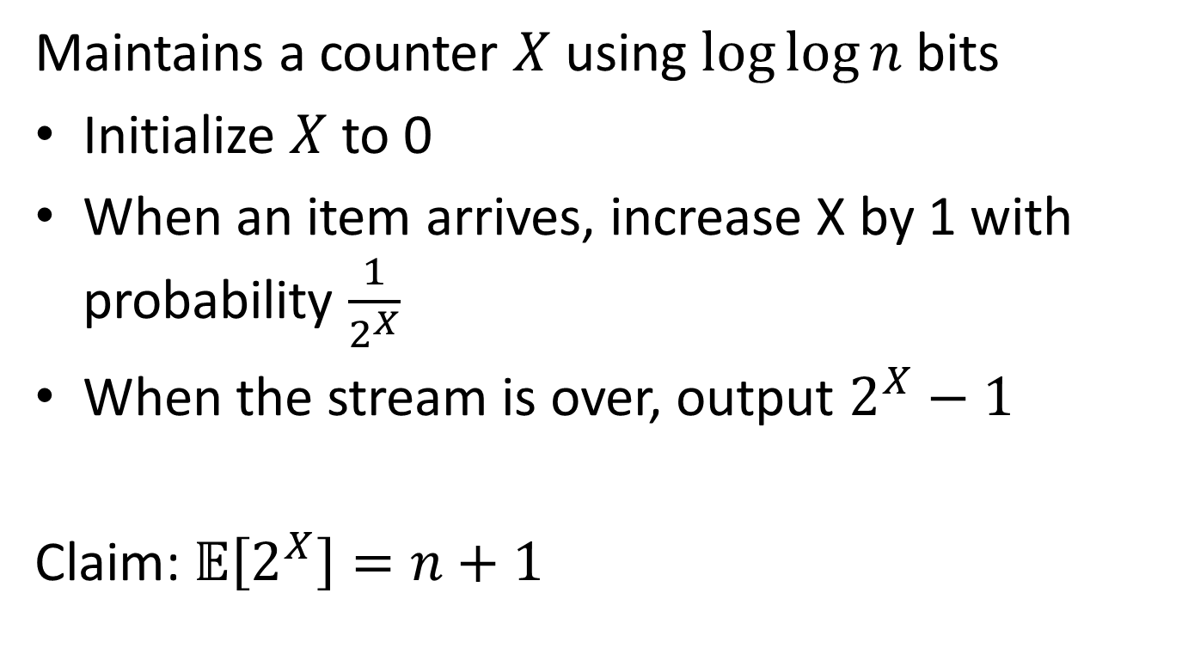
Morris’s Algorithm: Alpha-version
Maintains a counter $X$ using $log⁡log⁡n$ bits
Initialize $X$ to 0
When an item arrives, increase X by 1 with probability $\frac{1}{2^{X}}$
When the stream is over, output $2^{X}−1$
Claim: $𝔼\left[2^{X}\right]=n+1$

Slide 47
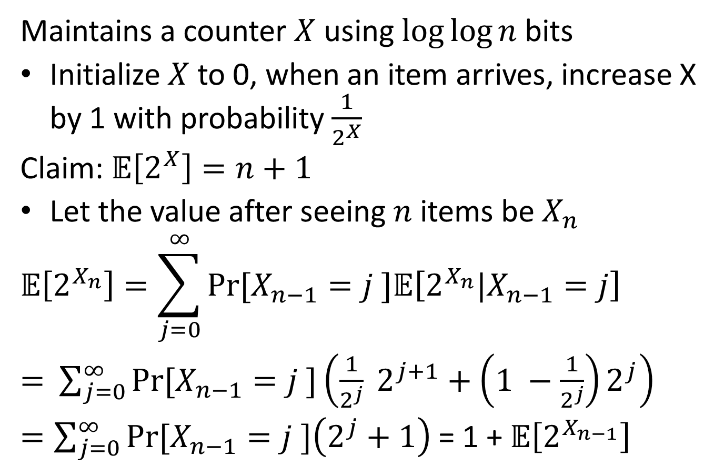
Morris’s Algorithm: Alpha-version
Maintains a counter $X$ using $log⁡log⁡n$ bits
Initialize $X$ to 0, when an item arrives, increase X by 1 with probability $\frac{1}{2^{X}}$
Claim: $𝔼\left[2^{X}\right]=n+1$
Let the value after seeing $n$ items be $X_{n}$
$$𝔼\left[2^{X_{n}}\right]=\sum_{j=0}^{∞}{Pr⁡[X_{n−1}=j ]𝔼\left[2^{X_{n}}|X_{n−1}=j\right]}$$
$=$ $\sum_{j=0}^{∞}{Pr⁡[X_{n−1}=j ]\left(\frac{1}{2^{j}} 2^{j+1}+\left(1 −\frac{1}{2^{j}}\right)2^{j}\right)}$
$=\sum_{j=0}^{∞}{Pr⁡[X_{n−1}=j ]\left(2^{j}+1\right) }$= 1 + $𝔼\left[2^{X_{n−1}}\right]$

Slide 48
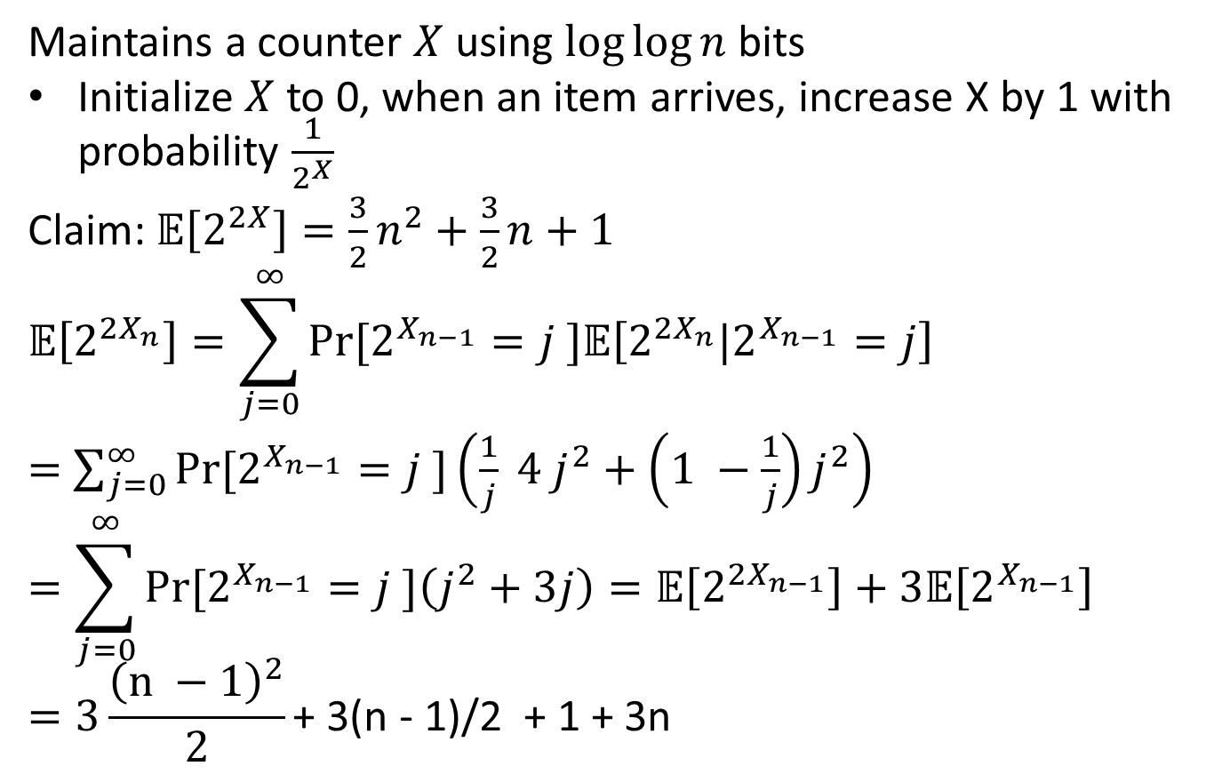
Morris’s Algorithm: Alpha-version
Maintains a counter $X$ using $log⁡log⁡n$ bits
Initialize $X$ to 0, when an item arrives, increase X by 1 with probability $\frac{1}{2^{X}}$
Claim: $𝔼\left[2^{2X}\right]=\frac{3}{2}n^{2}+\frac{3}{2}n+1$
$$𝔼\left[2^{{2X}_{n}}\right]=\sum_{j=0}^{∞}{Pr⁡[2^{X_{n−1}}=j ]𝔼\left[2^{2X_{n}}|2^{X_{n−1}}=j\right]}$$
$=$ $\sum_{j=0}^{∞}{Pr⁡[2^{X_{n−1}}=j ]\left(\frac{1}{j} 4 j^{2}+\left(1 −\frac{1}{j}\right)j^{2}\right)}$
$$=\sum_{j=0}^{∞}{Pr⁡[2^{X_{n−1}}=j ]\left(j^{2}+3j\right)=𝔼\left[2^{{2X}_{n−1}}\right]+3𝔼\left[2^{X_{n−1}}\right] }$$
$$=3\frac{{\left(n −1\right)}^{2}}{2}\text{+ 3(}\text{n}\text{ − 1)/2 + 1 + 3}\text{n}$$

Slide 49
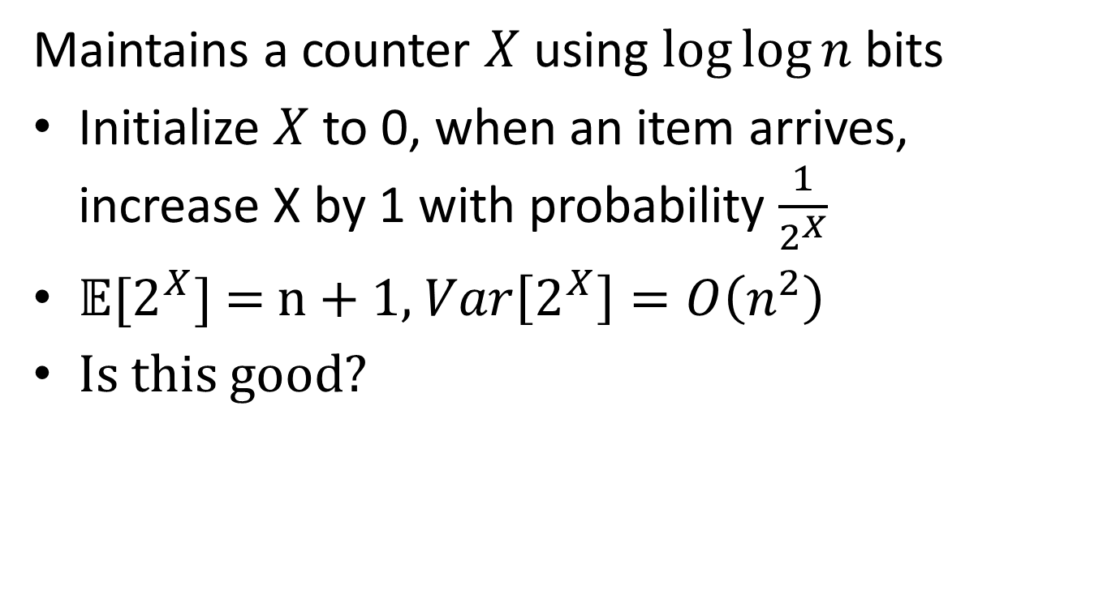
Morris’s Algorithm: Alpha-version
Maintains a counter $X$ using $log⁡log⁡n$ bits
Initialize $X$ to 0, when an item arrives, increase X by 1 with probability $\frac{1}{2^{X}}$
$𝔼[2^{X}]$ = n + 1, $Var\left[2^{X}\right]=O\left(n^{2}\right)$
Is this good?

Slide 50
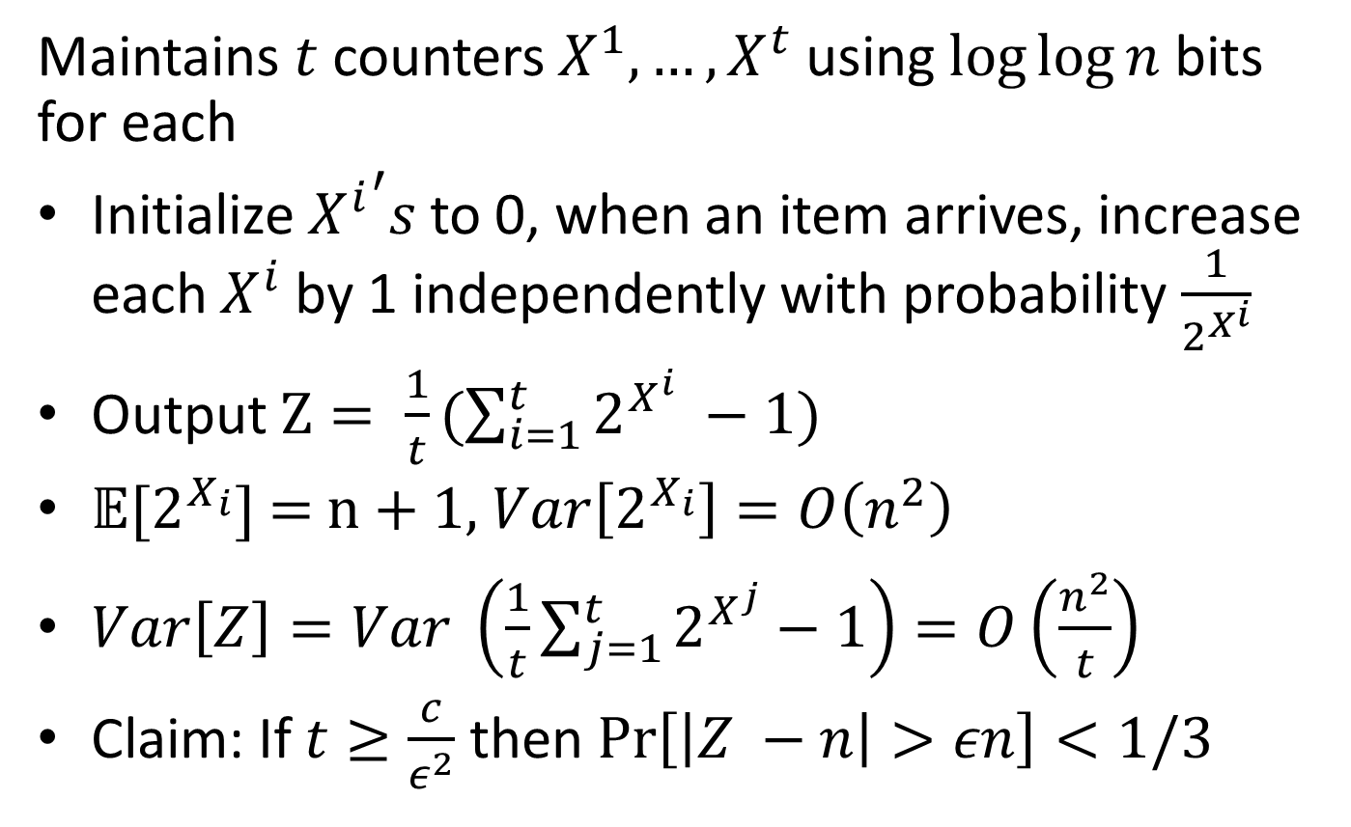
Morris’s Algorithm: Beta-version
Maintains $t$ counters $X^{1}, …,X^{t}$ using $log⁡log⁡n$ bits for each
Initialize ${X^{i}}^{′}s$ to 0, when an item arrives, increase each $X^{i}$ by 1 independently with probability $\frac{1}{2^{X^{i}}}$
Output $Z= \frac{1}{t}(\sum_{i=1}^{t}{2^{X^{i}} −1)}$
$𝔼[2^{X_{i}}]$ = n + 1, $Var\left[2^{X_{i}}\right]=O\left(n^{2}\right)$
$Var\left[Z\right]=Var \left(\frac{1}{t}\sum_{j=1}^{t}{2^{X^{j}}}−1\right)=O\left(\frac{n^{2}}{t}\right)$
Claim: If $t≥\frac{c}{ε^{2}}$ then $\operatorname{Pr}\left[\left|Z −n\right|>εn\right]<1/3$

Slide 51
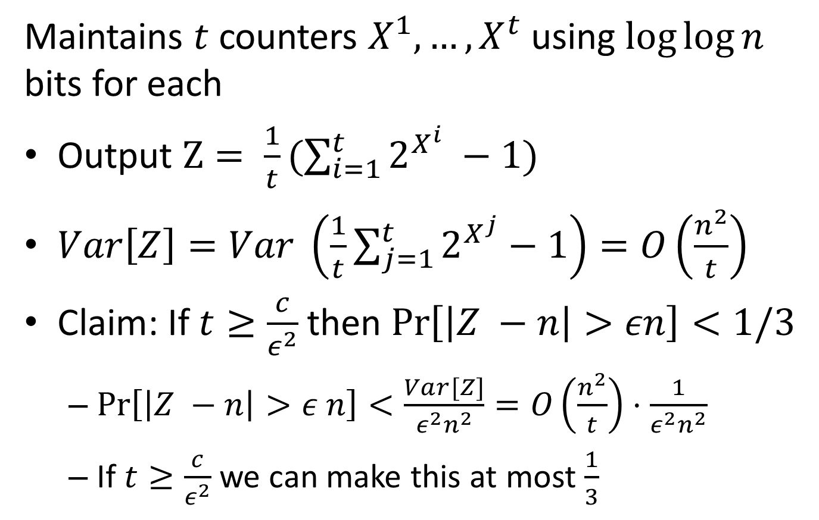
Morris’s Algorithm: Beta-version
Maintains $t$ counters $X^{1}, …,X^{t}$ using $log⁡log⁡n$ bits for each
Output $Z= \frac{1}{t}(\sum_{i=1}^{t}{2^{X^{i}} −1)}$
$Var\left[Z\right]=Var \left(\frac{1}{t}\sum_{j=1}^{t}{2^{X^{j}}}−1\right)=O\left(\frac{n^{2}}{t}\right)$
Claim: If $t≥\frac{c}{ε^{2}}$ then $\operatorname{Pr}\left[\left|Z −n\right|>εn\right]<1/3$
$\operatorname{Pr}\left[\left|Z −n\right|>ε n\right]<\frac{Var[Z]}{ε^{2}n^{2}}=O\left(\frac{n^{2}}{t}\right)⋅\frac{1}{ε^{2}n^{2}}$
If $t≥\frac{c}{ε^{2}}$ we can make this at most $\frac{1}{3}$

Slide 52
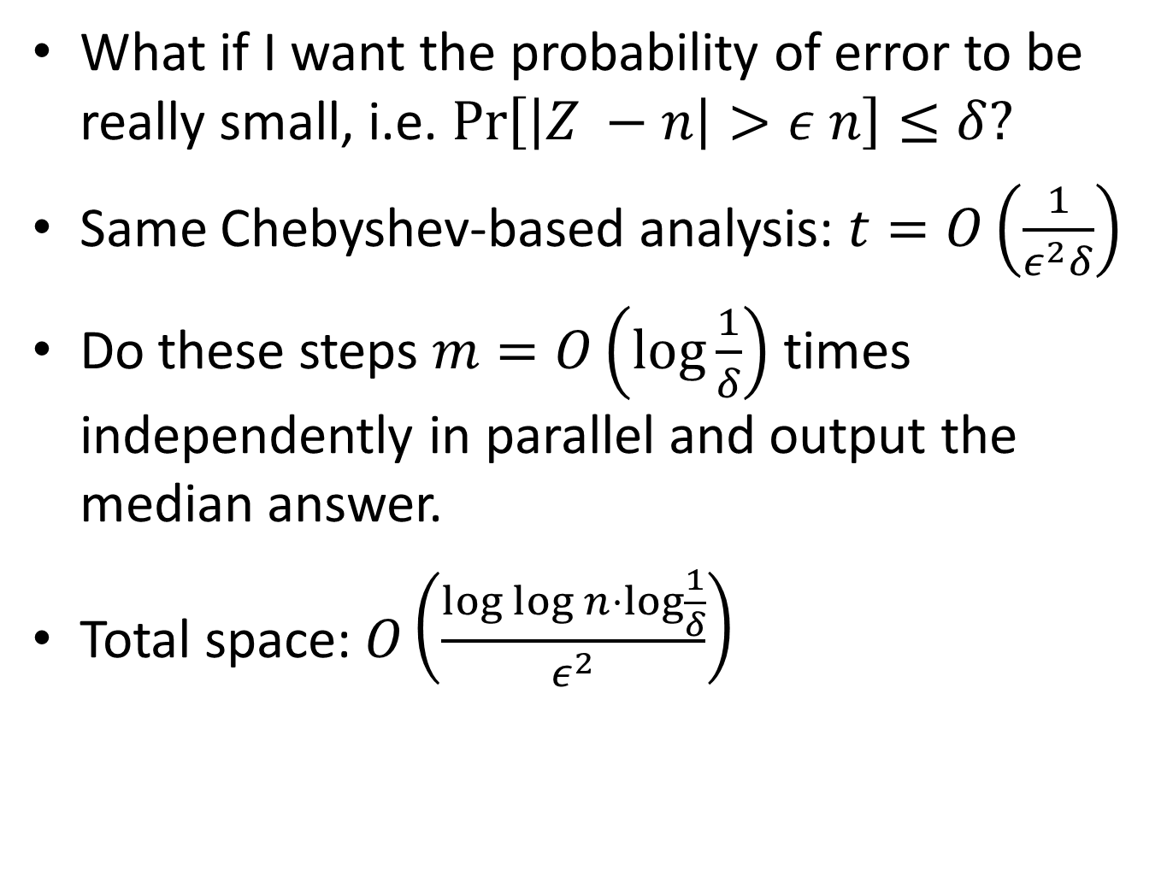
Morris’s Algorithm: Final
What if I want the probability of error to be really small, i.e. $\operatorname{Pr}\left[\left|Z −n\right|>ε n\right]≤δ?$
Same Chebyshev-based analysis: $t=O\left(\frac{1}{ε^{2}δ}\right)$
Do these steps $m=O\left(\log{\frac{1}{δ}}\right)$ times independently in parallel and output the median answer.
Total space: $O\left(\frac{\log{\log{n}}⋅\log{\frac{1}{δ}}}{ε^{2}}\right)$

Slide 53
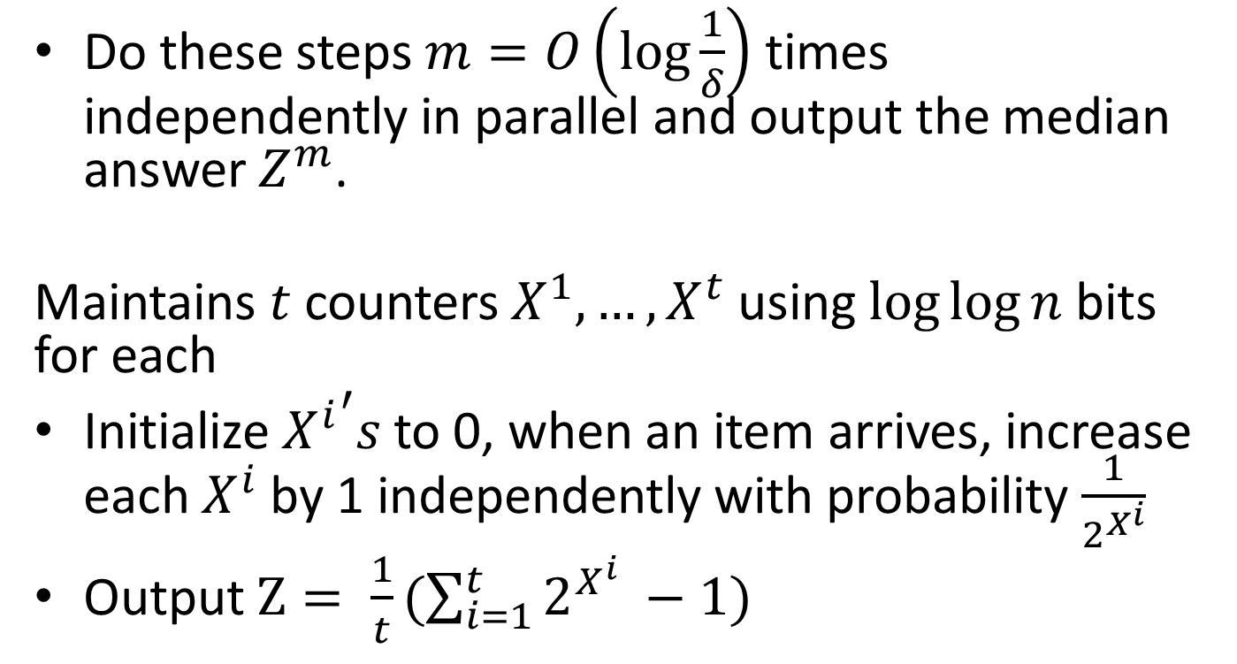
Morris’s Algorithm: Final
Do these steps $m=O\left(\log{\frac{1}{δ}}\right)$ times independently in parallel and output the median answer $Z^{m}$.
Maintains $t$ counters $X^{1}, …,X^{t}$ using $log⁡log⁡n$ bits for each
Initialize ${X^{i}}^{′}s$ to 0, when an item arrives, increase each $X^{i}$ by 1 independently with probability $\frac{1}{2^{X^{i}}}$
Output $Z= \frac{1}{t}(\sum_{i=1}^{t}{2^{X^{i}} −1)}$

Slide 54
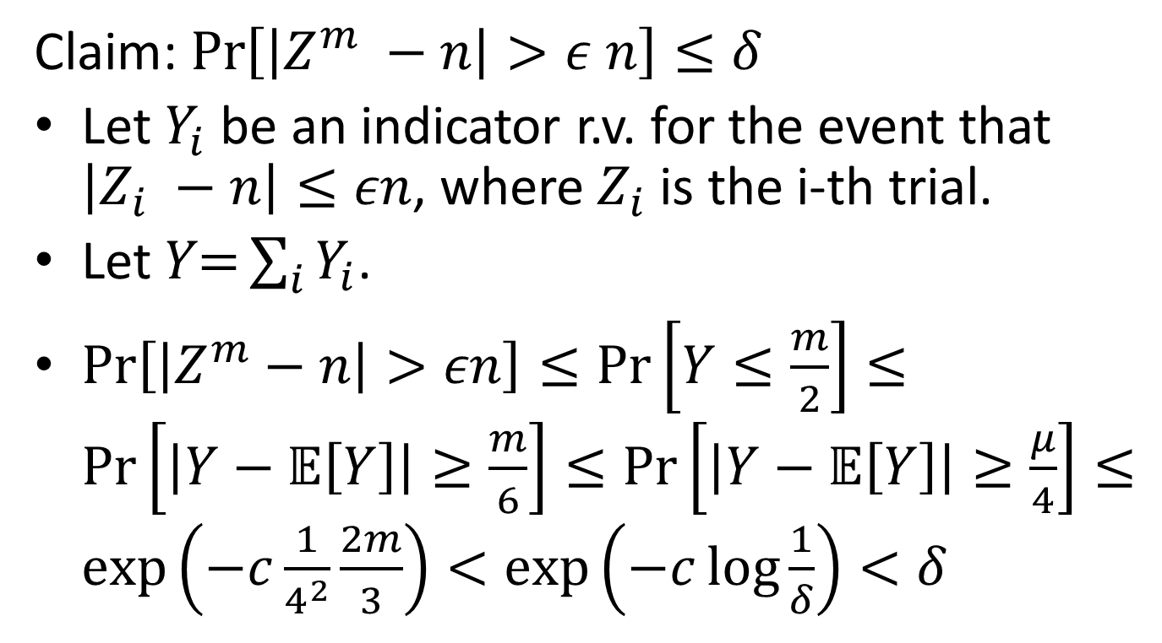
Morris’s Algorithm: Final Analysis
Claim: $\operatorname{Pr}\left[\left|Z^{m} −n\right|>ε n\right]≤δ$
Let $Y_{i}$ be an indicator r.v. for the event that $\left|Z_{i} −n\right|≤εn$, where $Z_{i}$ is the i-th trial.
Let $Y\text{=}\sum_{i}{Y_{i}}$.
$\operatorname{Pr}\left[\left|Z^{m}−n\right|>εn\right]≤\operatorname{Pr}\left[Y≤\frac{m}{2}\right]≤\operatorname{Pr}\left[\left|Y−𝔼\left[Y\right]\right|≥\frac{m}{6}\right]≤\operatorname{Pr}\left[\left|Y−𝔼\left[Y\right]\right|≥\frac{μ}{4}\right]≤\exp\left(−c\frac{1}{4^{2}}\frac{2m}{3}\right)<\exp\left(−c\log{\frac{1}{δ}}\right)<δ$

Slide 55
Thank you!
Questions?
Next time:
More streaming algorithms

