Slide 1

CIS 700: “algorithms for Big Data”
Lecture 5: Dimension Reduction
Slides at http://grigory.us/big-data-class.html
Grigory Yaroslavtsev
http://grigory.us

Slide 2
Today
Dimensionality reduction
AMS as dimensionality reduction
Johnson-Lindenstrauss transform

Slide 3
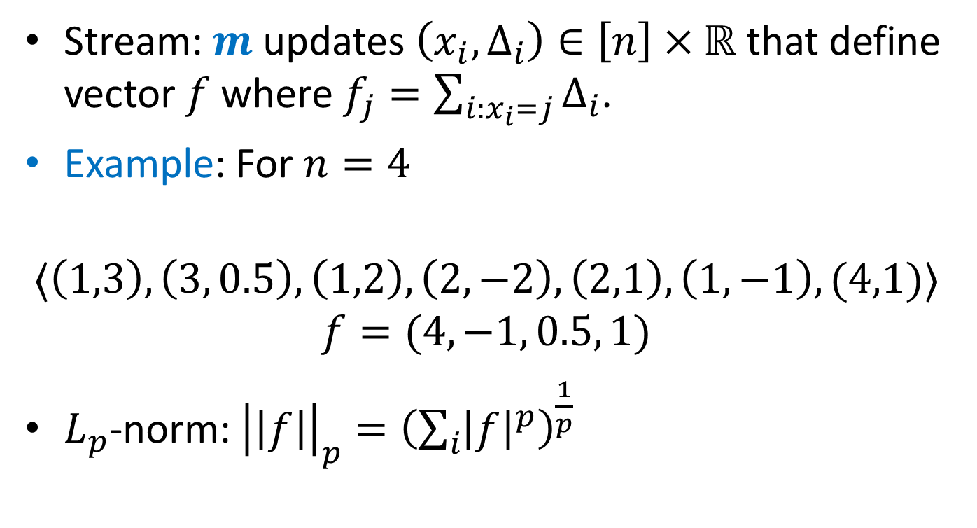

$L_{p}$-norm Estimation
Stream: $m$ updates $\left(x_{i}, Δ_{i}\right)∈\left[n\right]×ℝ$ that define vector $f$ where $f_{j}=\sum_{i:x_{i}=j}{Δ_{i}}$.
Example: For $n=4$
$$〈\left(1,3\right), \left(3, 0.5\right), \left(1,2\right), \left(2,−2\right),\left(2,1\right), \left(1,−1\right), (4,1)〉$$
$$f=(4, −1, 0.5, 1)$$
$L_{p}$-norm: ${\left|\left|f\right|\right|}_{p}={\left(\sum_{i}{{\left|f\right|}^{p}}\right)}^{\frac{1}{p}}$

Slide 4
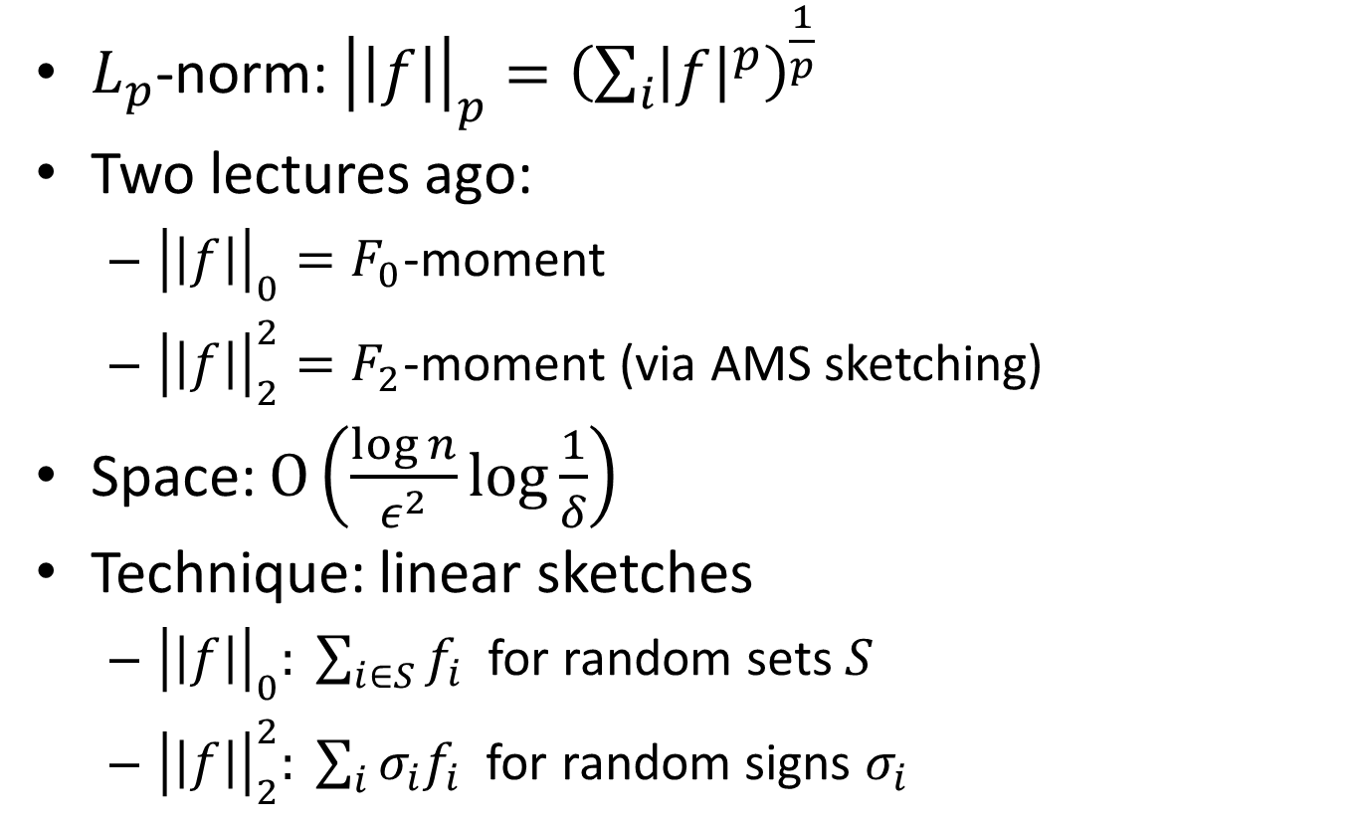
$L_{p}$-norm Estimation
$L_{p}$-norm: ${\left|\left|f\right|\right|}_{p}={\left(\sum_{i}{{\left|f\right|}^{p}}\right)}^{\frac{1}{p}}$
Two lectures ago:
${\left|\left|f\right|\right|}_{0}=F_{0}$-moment
${\left|\left|f\right|\right|}_{2}^{2}=F_{2}$-moment (via AMS sketching)
Space: $O\left(\frac{\log{n}}{ε^{2}}\log{\frac{1}{δ}}\right)$
Technique: linear sketches
${\left|\left|f\right|\right|}_{0}: \sum_{i∈S}{f_{i}}$ for random sets $S$
${\left|\left|f\right|\right|}_{2}^{2}: \sum_{i}{σ_{i}f_{i}}$ for random signs $σ_{i}$

Slide 5
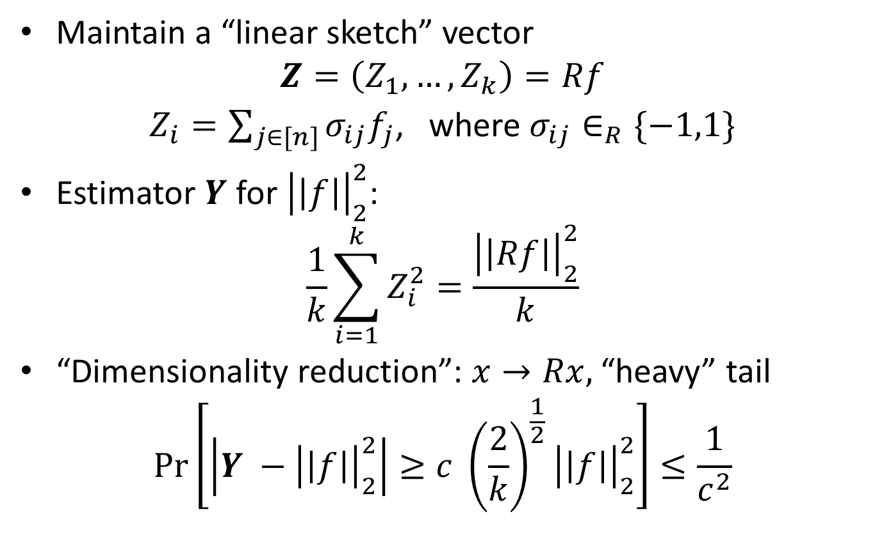
AMS as dimensionality reduction
Maintain a “linear sketch” vector
$$Z=\left(Z_{1}, …, Z_{k}\right)=Rf$$
$Z_{i}=\sum_{j∈[n]}{σ_{ij}f_{j}}$, where $σ_{ij}∈_{R}\{−1,1\}$
Estimator $Y$ for ${\left|\left|f\right|\right|}_{2}^{2}$:
$$\frac{1}{k}\sum_{i=1}^{k}{Z_{i}^{2}}=\frac{{\left|\left|Rf\right|\right|}_{2}^{2}}{k}$$
“Dimensionality reduction”: $x→Rx,$ “heavy” tail
$$\operatorname{Pr}\left[\left|Y −{\left|\left|f\right|\right|}_{2}^{2}\right|≥c {\left(\frac{2}{k}\right)}^{\frac{1}{2}}{\left|\left|f\right|\right|}_{2}^{2}\right]≤\frac{1}{c^{2}}$$

Slide 6
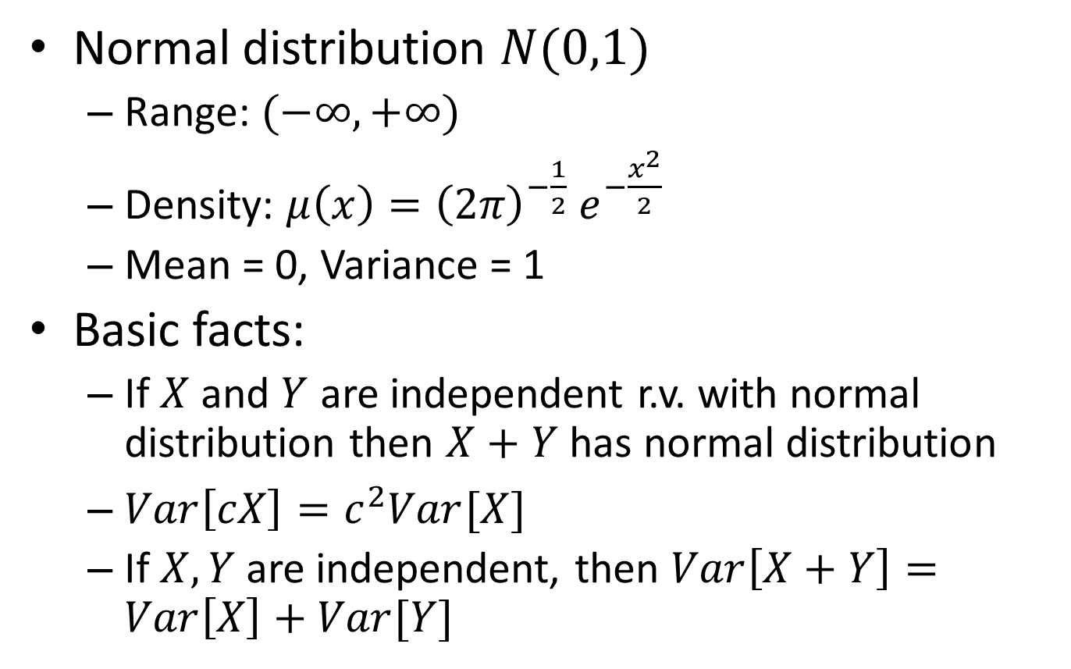
Normal Distribution
Normal distribution $N(0,1)$
Range: $(−∞, +∞)$
Density: $μ\left(x\right)={{\left(2π\right)}^{−\frac{1}{2}} e}^{−\frac{x^{2}}{2}}$
Mean = 0, Variance = 1
Basic facts:
If $X$ and $Y$ are independent r.v. with normal distribution then $X+Y$ has normal distribution
$Var\left[cX\right]=c^{2}Var[X]$
If $X, Y$ are independent, then $Var\left[X+Y\right]=Var\left[X\right]+Var[Y]$

Slide 7
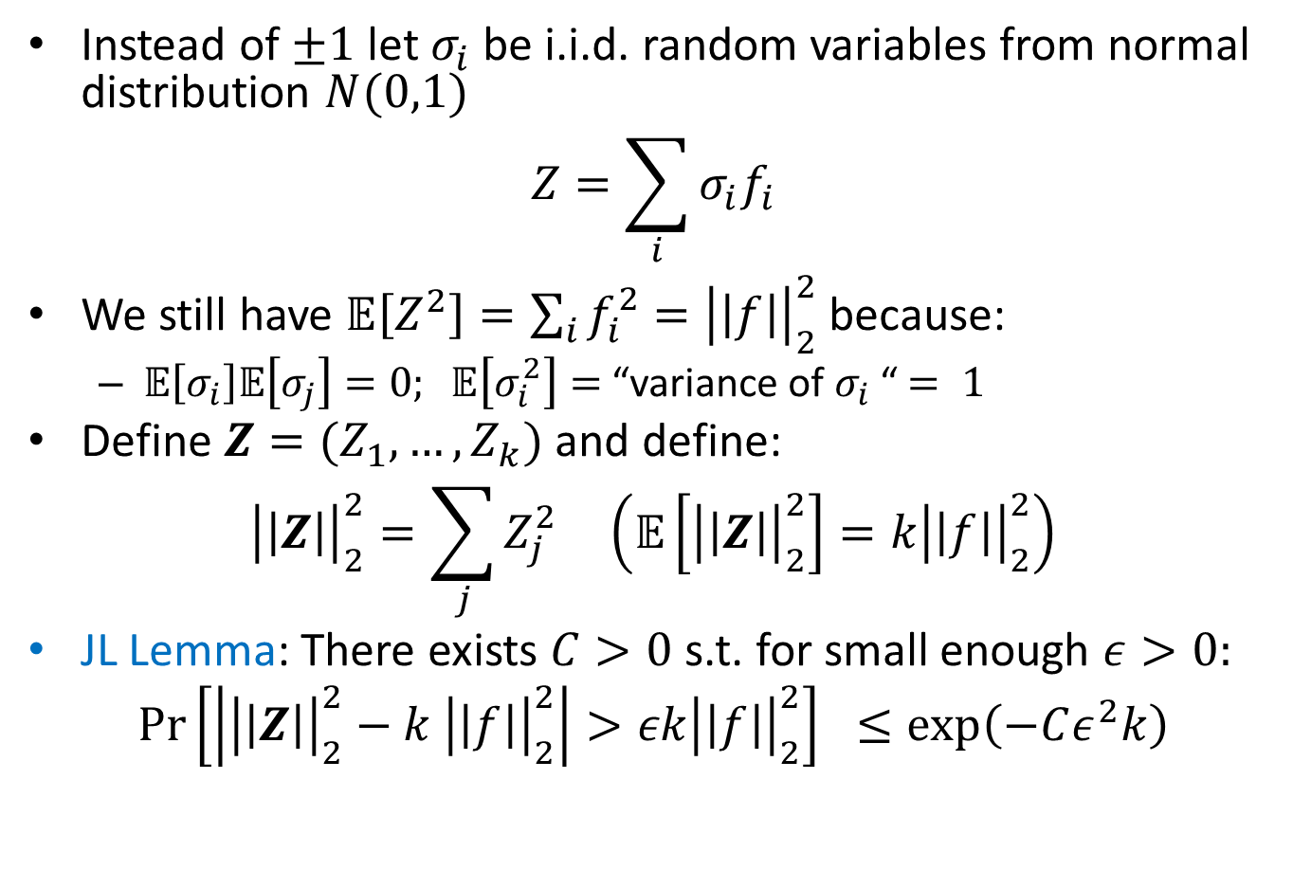
Johnson-Lindenstrauss Transform
Instead of $±1$ let $σ_{i}$ be i.i.d. random variables from normal distribution $N(0,1)$
$$Z=\sum_{i}{σ_{i}f_{i}}$$
We still have $𝔼\left[Z^{2}\right]=\sum_{i}{f_{i}^{2}}={\left|\left|f\right|\right|}_{2}^{2}$ because:
$𝔼\left[σ_{i}\right]𝔼\left[σ_{j}\right]=0; 𝔼\left[σ_{i}^{2}\right]=$ “variance of $σ_{i}$ “$= 1$
Define $Z=(Z_{1}, …, Z_{k})$ and define:
$${\left|\left|Z\right|\right|}_{2}^{2}=\sum_{j}{Z_{j}^{2}} \left(𝔼\left[{\left|\left|Z\right|\right|}_{2}^{2}\right]=k{\left|\left|f\right|\right|}_{2}^{2}\right)$$
JL Lemma: There exists $C>0$s.t. for small enough $ε>0:$
$$\operatorname{Pr}\left[\left|{\left|\left|Z\right|\right|}_{2}^{2}−k {\left|\left|f\right|\right|}_{2}^{2}\right|>εk{\left|\left|f\right|\right|}_{2}^{2}\right] ≤\exp\left(−Cε^{2}k\right)$$

Slide 8
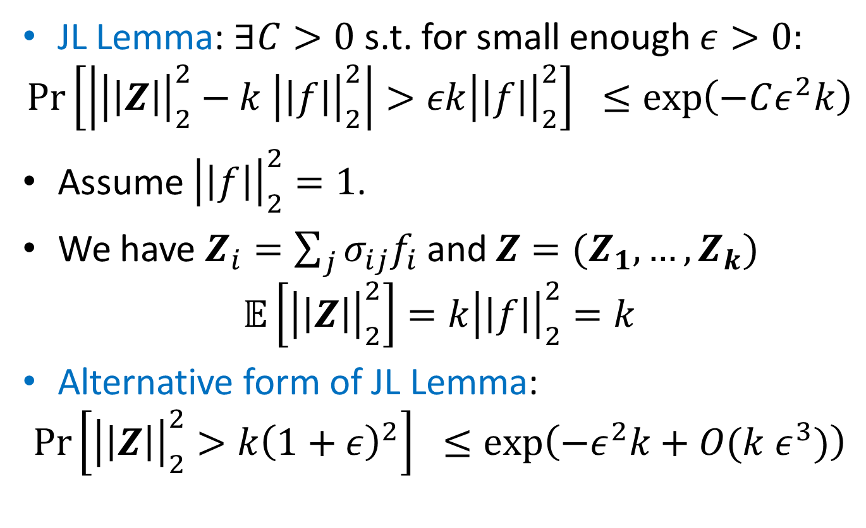
Proof of JL Lemma
JL Lemma: $∃C>0$s.t. for small enough $ε>0:$
$$\operatorname{Pr}\left[\left|{\left|\left|Z\right|\right|}_{2}^{2}−k {\left|\left|f\right|\right|}_{2}^{2}\right|>εk{\left|\left|f\right|\right|}_{2}^{2}\right] ≤\exp\left(−Cε^{2}k\right)$$
Assume ${\left|\left|f\right|\right|}_{2}^{2}=1$.
We have $Z_{i}=\sum_{j}{σ_{ij}f_{i}}$ and $Z=(Z_{1}, …,Z_{k})$
$$𝔼\left[{\left|\left|Z\right|\right|}_{2}^{2}\right]=k{\left|\left|f\right|\right|}_{2}^{2}=k$$
Alternative form of JL Lemma:
$$\operatorname{Pr}\left[{\left|\left|Z\right|\right|}_{2}^{2}>k{\left(1+ε\right)}^{2}\right] ≤\exp\left(−ε^{2}k+O(k ε^{3})\right)$$

Slide 9
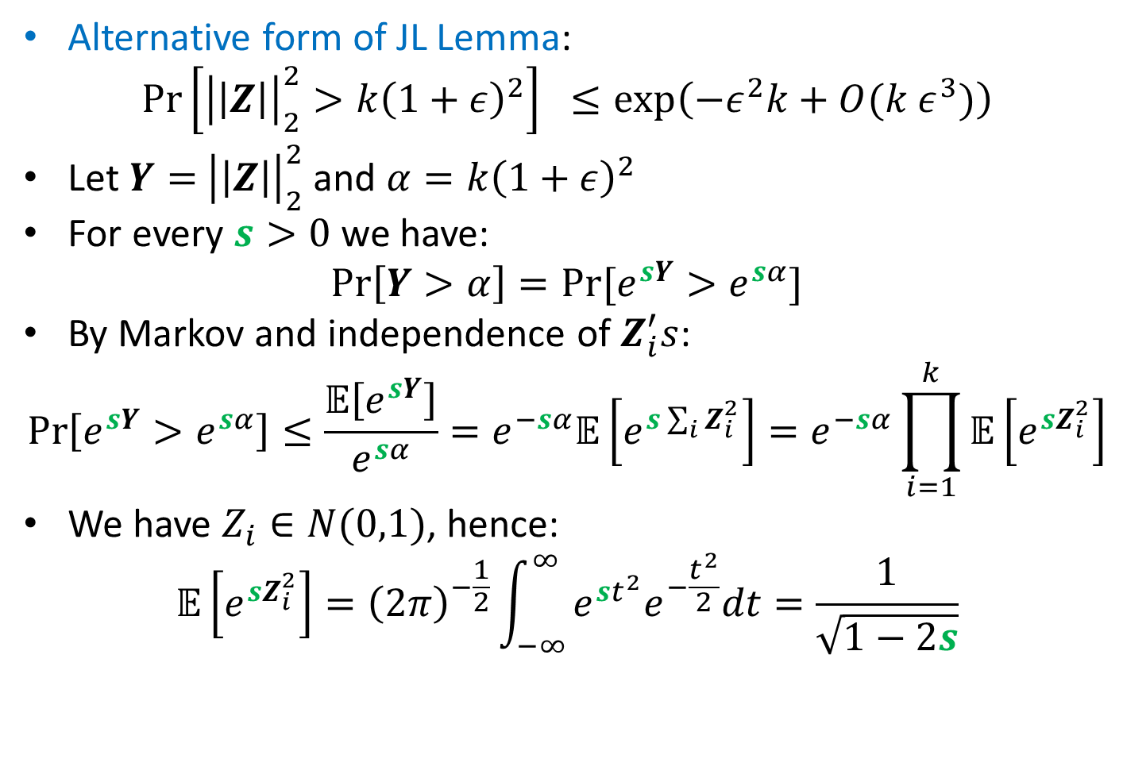
Proof of JL Lemma
Alternative form of JL Lemma:
$$\operatorname{Pr}\left[{\left|\left|Z\right|\right|}_{2}^{2}>k{\left(1+ε\right)}^{2}\right] ≤\exp\left(−ε^{2}k+O(k ε^{3})\right)$$
Let $Y=$ ${\left|\left|Z\right|\right|}_{2}^{2}$ and $α=k{\left(1+ε\right)}^{2}$
For every $s>0$ we have:
$$\operatorname{Pr}\left[Y>α\right]=Pr⁡[e^{sY}>e^{sα}]$$
By Markov and independence of $Z_{i}^{′}s$:
$$\operatorname{Pr}\left[e^{sY}>e^{sα}\right]≤\frac{𝔼\left[e^{sY}\right]}{e^{sα}}=e^{−sα}𝔼\left[e^{s\sum_{i}{Z_{i}^{2}}}\right]=e^{−sα}\prod_{i=1}^{k}{𝔼\left[e^{sZ_{i}^{2}}\right]}$$
We have $Z_{i}∈N(0,1)$, hence:
$$𝔼\left[e^{sZ_{i}^{2}}\right]={\left(2π\right)}^{−\frac{1}{2}}\int_{−∞}^{∞}{e^{st^{2}}e^{−\frac{t^{2}}{2}}dt}=\frac{1}{\sqrt{1−2s}}$$

Slide 10
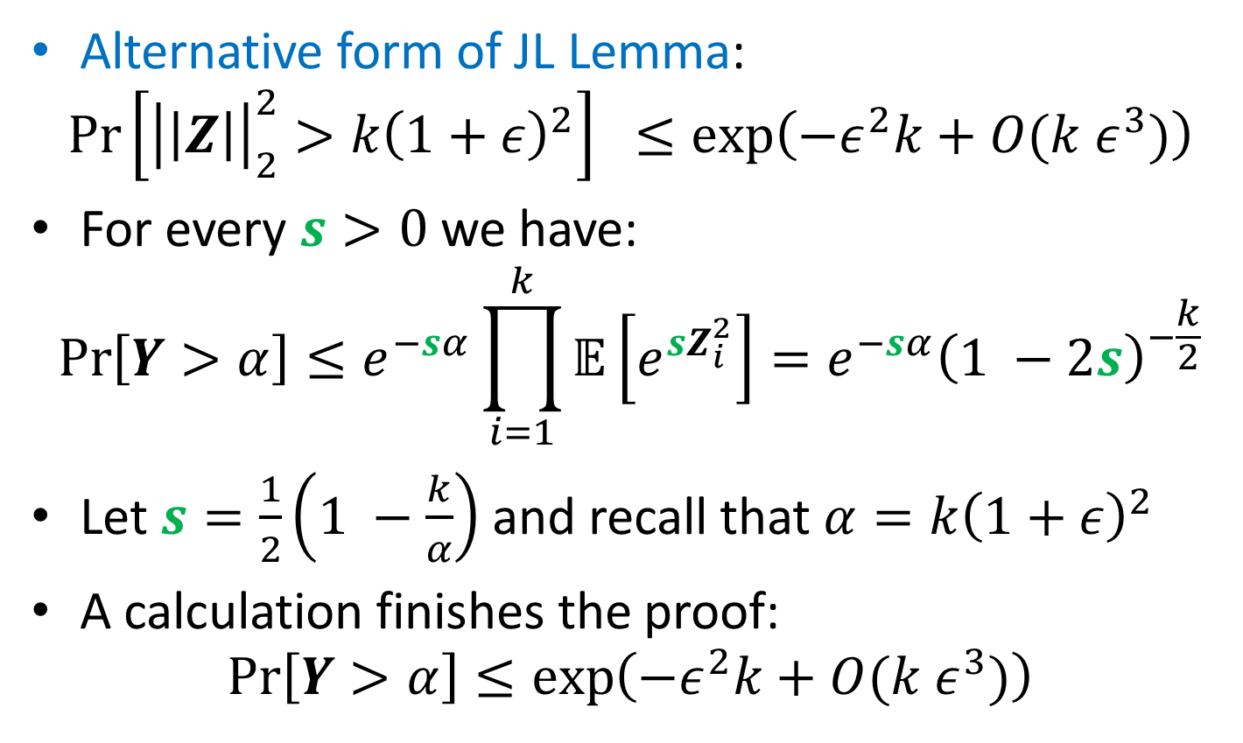
Proof of JL Lemma
Alternative form of JL Lemma:
$$\operatorname{Pr}\left[{\left|\left|Z\right|\right|}_{2}^{2}>k{\left(1+ε\right)}^{2}\right] ≤\exp\left(−ε^{2}k+O(k ε^{3})\right)$$
For every $s>0$ we have:
$$\operatorname{Pr}\left[Y>α\right]≤e^{−sα}\prod_{i=1}^{k}{𝔼\left[e^{sZ_{i}^{2}}\right]}=e^{−sα}{\left(1 −2s\right)}^{−\frac{k}{2}}$$
Let $s=\frac{1}{2}\left(1 −\frac{k}{α}\right)$ and recall that $α=k{\left(1+ε\right)}^{2}$
A calculation finishes the proof:
$$\operatorname{Pr}\left[Y>α\right]≤\exp\left(−ε^{2}k+O(k ε^{3})\right)$$

Slide 11
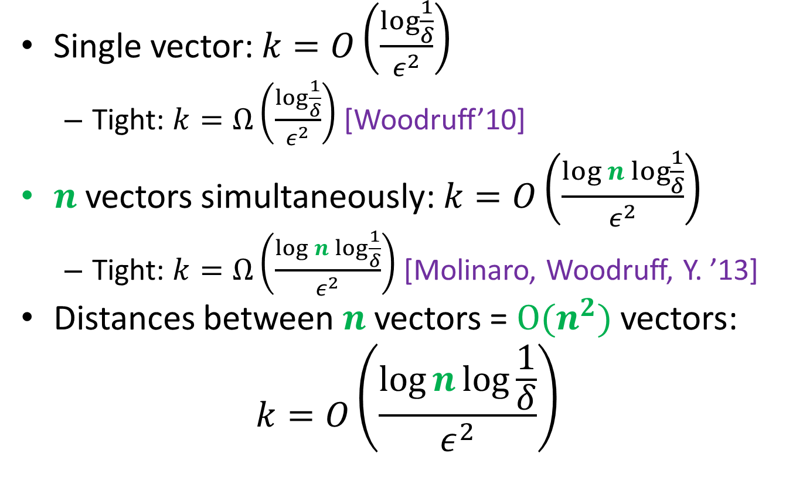
Johnson-Lindenstrauss Transform
Single vector: $k=O\left(\frac{\log{\frac{1}{δ}}}{ε^{2}}\right)$
Tight: $k=Ω\left(\frac{\log{\frac{1}{δ}}}{ε^{2}}\right)$ [Woodruff’10]
$n$ vectors simultaneously: $k=O\left(\frac{\log{n}\log{\frac{1}{δ}}}{ε^{2}}\right)$
Tight: $k=Ω\left(\frac{\log{n}\log{\frac{1}{δ}}}{ε^{2}}\right)$ [Molinaro, Woodruff, Y. ’13]
Distances between $n$ vectors = $O(n^{2})$ vectors:
$$k=O\left(\frac{\log{n}\log{\frac{1}{δ}}}{ε^{2}}\right)$$

Slide 12
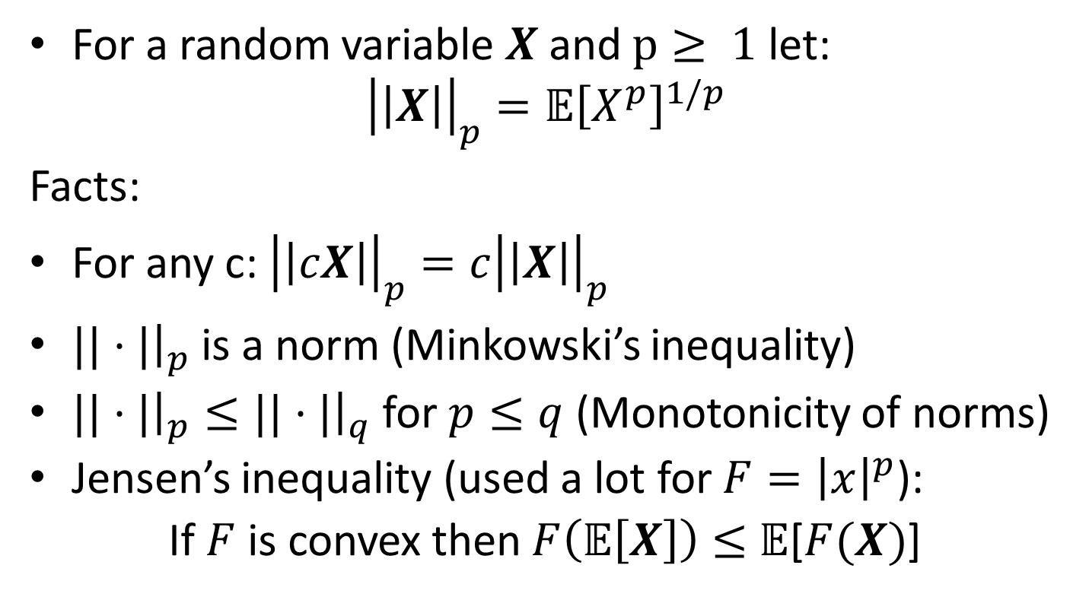
Random Variables and Norms
For a random variable $X$ and $p≥ 1$ let:
$${\left|\left|X\right|\right|}_{p}={𝔼\left[X^{p}\right]}^{1/p}$$
Facts:
For any c: ${\left|\left|cX\right|\right|}_{p}=c{\left|\left|X\right|\right|}_{p}$
$||⋅|{\left.​\right|}_{p}$ is a norm (Minkowski’s inequality)
$||⋅|{\left.​\right|}_{p}≤||⋅|{\left.​\right|}_{q}$ for $p≤q$(Monotonicity of norms)
Jensen’s inequality (used a lot for $F={\left|x\right|}^{p}$):
If $F$ is convex then $F\left(𝔼\left[X\right]\right)≤$ $𝔼$[$F(X)$]

Slide 13
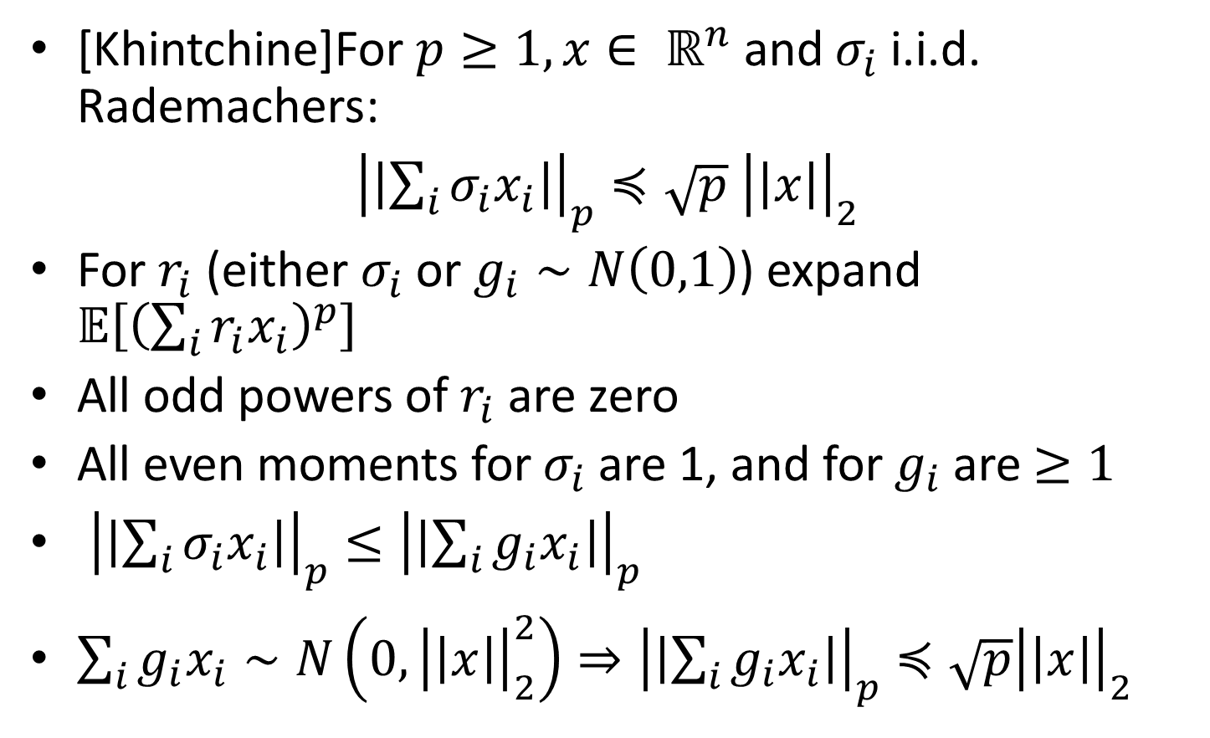
Khintchine Inequality
[Khintchine]For $p≥1, x∈ ℝ^{n}$ and $σ_{i}$ i.i.d. Rademachers:
${\left|\left|\sum_{i}{σ_{i}x_{i}}\right|\right|}_{p}≼\sqrt{p} {\left|\left|x\right|\right|}_{2}$
For $r_{i}$ (either $σ_{i}$ or $g_{i}∼N\left(0,1\right)$) expand $𝔼\left[{\left(\sum_{i}{r_{i}x_{i}}\right)}^{p}\right]$
All odd powers of $r_{i}$ are zero
All even moments for $σ_{i}$ are 1, and for $g_{i}$ are $≥1$
${\left|\left|\sum_{i}{σ_{i}x_{i}}\right|\right|}_{p}≤{\left|\left|\sum_{i}{g_{i}x_{i}}\right|\right|}_{p}$
$\sum_{i}{g_{i}x_{i}}∼N\left(0,{\left|\left|x\right|\right|}_{2}^{2}\right)⇒{\left|\left|\sum_{i}{g_{i}x_{i}}\right|\right|}_{p}≼\sqrt{p}{\left|\left|x\right|\right|}_{2}$

Slide 14
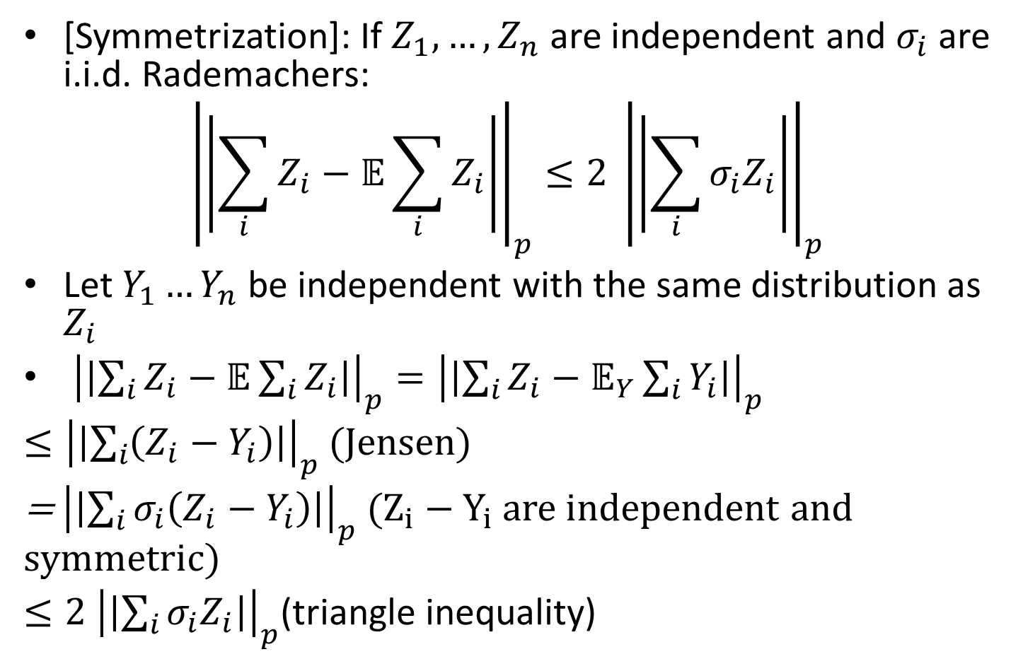
Symmetrization
[Symmetrization]: If $Z_{1}, …,Z_{n}$ are independent and $σ_{i}$ are i.i.d. Rademachers:
$${\left|\left|\sum_{i}{Z_{i}}−𝔼\sum_{i}{Z_{i}}\right|\right|}_{p}≤2 {\left|\left|\sum_{i}{σ_{i}Z_{i}}\right|\right|}_{p}$$
Let $Y_{1}…Y_{n}$ be independent with the same distribution as $Z_{i}$
${\left|\left|\sum_{i}{Z_{i}}−𝔼\sum_{i}{Z_{i}}\right|\right|}_{p}={\left|\left|\sum_{i}{Z_{i}}−𝔼_{Y}\sum_{i}{Y_{i}}\right|\right|}_{p}$
$≤{\left|\left|\sum_{i}{\left(Z_{i}−Y_{i}\right)}\right|\right|}_{p}$ (Jensen)
= ${\left|\left|\sum_{i}{σ_{i}\left(Z_{i}−Y_{i}\right)}\right|\right|}_{p}$ ($Z_{i}−Y_{i}$ are independent and symmetric)
$≤2 {\left|\left|\sum_{i}{σ_{i}Z_{i}}\right|\right|}_{p}$(triangle inequality)

Slide 15
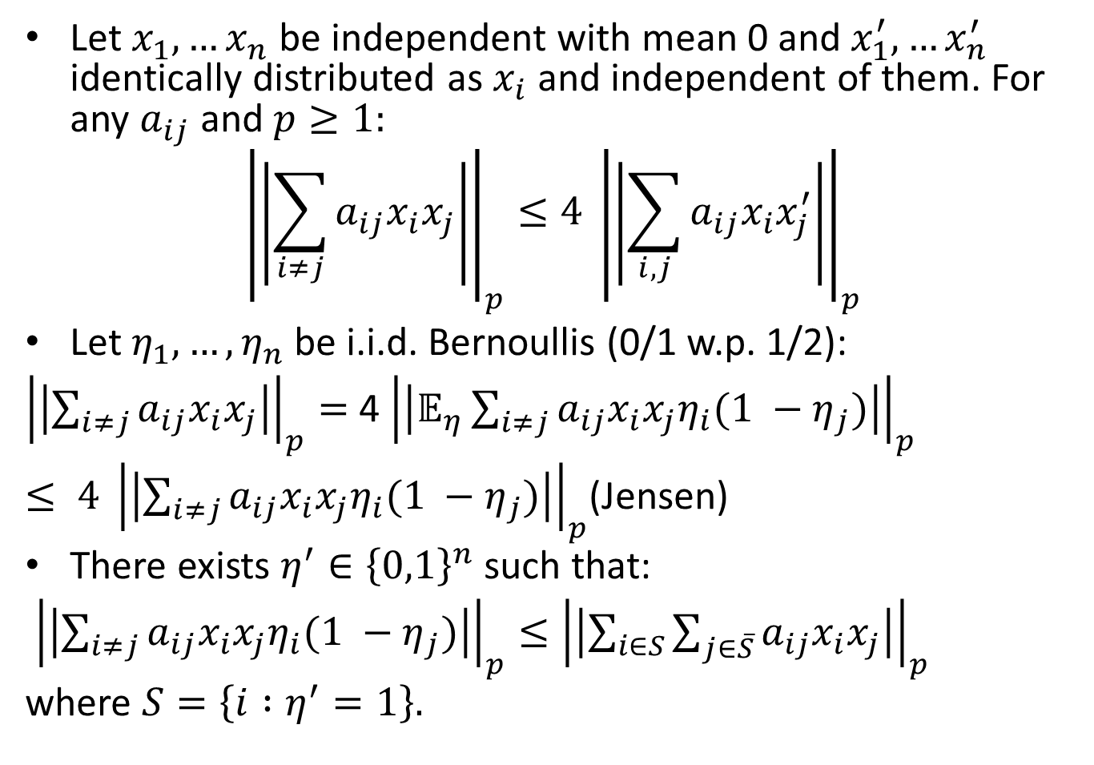
Decoupling
Let $x_{1},…x_{n}$ be independent with mean 0 and $x_{1}^{′},…x_{n}^{′}$ identically distributed as $x_{i}$ and independent of them. For any $a_{ij}$ and $p≥1:$
$${\left|\left|\sum_{i≠j}{a_{ij}x_{i}x_{j}}\right|\right|}_{p}≤4 {\left|\left|\sum_{i,j}{a_{ij}x_{i}x_{j}^{′}}\right|\right|}_{p}$$
Let $η_{1},…, η_{n}$be i.i.d. Bernoullis (0/1 w.p. 1/2):
${\left|\left|\sum_{i≠j}{a_{ij}x_{i}x_{j}}\right|\right|}_{p}=$ 4 ${\left|\left|𝔼_{η}\sum_{i≠j}{a_{ij}x_{i}x_{j}η_{i}(1 −η_{j})}\right|\right|}_{p}$
$≤ {4 \left|\left|\sum_{i≠j}{a_{ij}x_{i}x_{j}η_{i}(1 −η_{j})}\right|\right|}_{p}$(Jensen)
There exists $η^{′}∈{\left\{0,1\right\}}^{n}$ such that:
${\left|\left|\sum_{i≠j}{a_{ij}x_{i}x_{j}η_{i}(1 −η_{j})}\right|\right|}_{p}≤{\left|\left|\sum_{i∈S}{\sum_{j∈\overline{S}}{a_{ij}x_{i}x_{j}}}\right|\right|}_{p}$
where $S=\left\{i :η^{′}=1\right\}.$

Slide 16
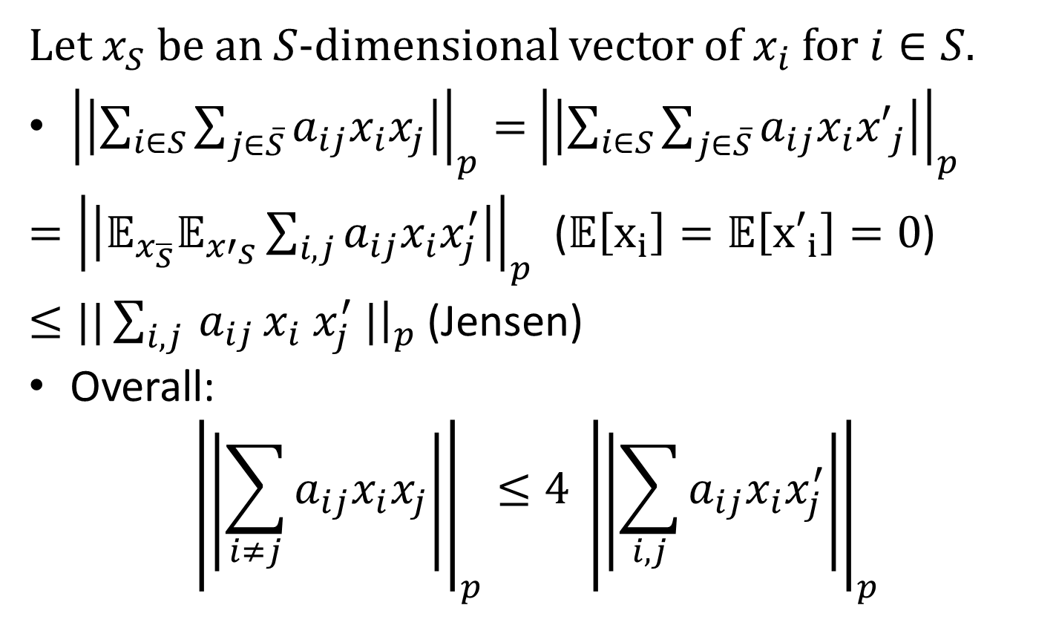
Decoupling (continued)
Let $x_{S}$ be an $S$-dimensional vector of $x_{i}$ for $i∈S.$
${\left|\left|\sum_{i∈S}{\sum_{j∈\overline{S}}{a_{ij}x_{i}x_{j}}}\right|\right|}_{p}=$ ${\left|\left|\sum_{i∈S}{\sum_{j∈\overline{S}}{a_{ij}x_{i}{x′}_{j}}}\right|\right|}_{p}$
$={\left|\left|𝔼_{x_{\overline{S}}}𝔼_{{x′}_{S}}\sum_{i,j}{a_{ij}x_{i}x_{j}^{′}}\right|\right|}_{p}$ ($𝔼\left[x_{i}\right]=𝔼\left[{x′}_{i}\right]=0$)
$≤||\sum_{i,j }{a_{ij}}x_{i} x_{j}^{′} |{\left.​\right|}_{p}$ (Jensen)
Overall:
$${\left|\left|\sum_{i≠j}{a_{ij}x_{i}x_{j}}\right|\right|}_{p}≤4 {\left|\left|\sum_{i,j}{a_{ij}x_{i}x_{j}^{′}}\right|\right|}_{p}$$

Slide 17
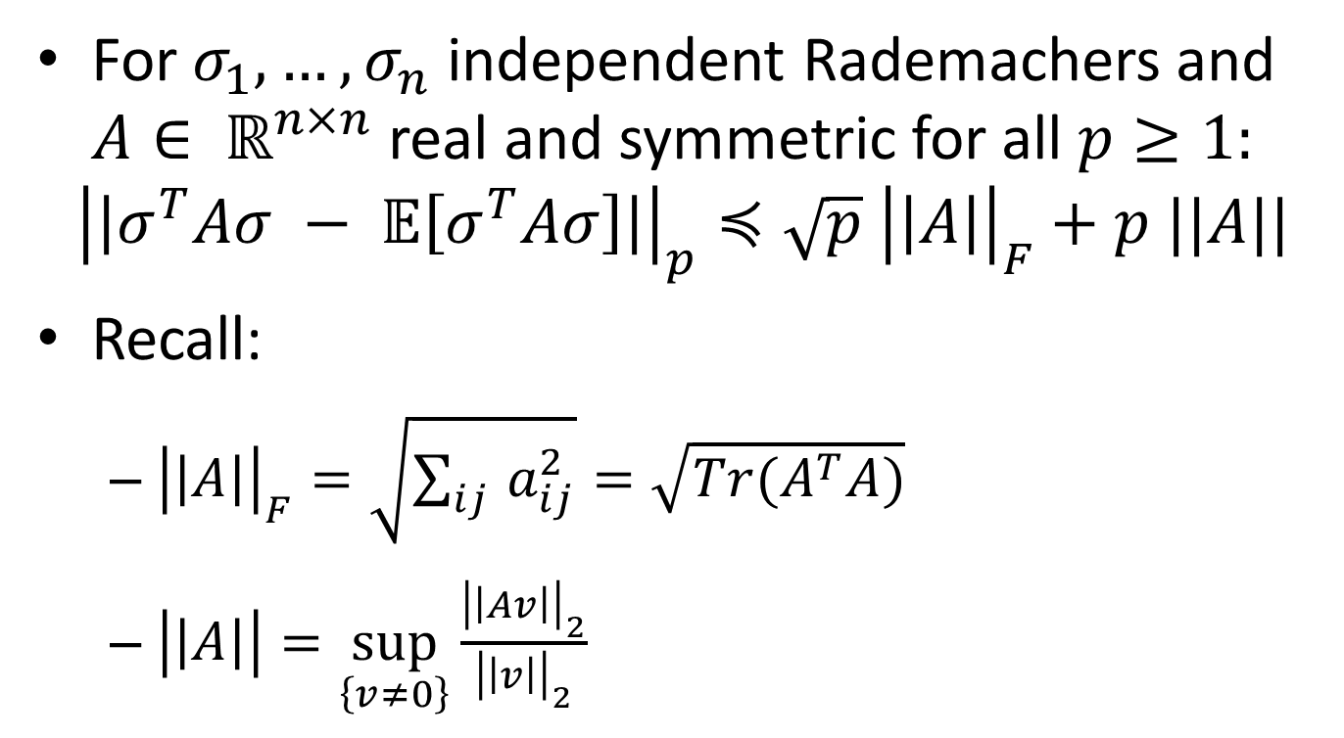
Hanson-Wright Inequality
For $σ_{1}, …, σ_{n}$ independent Rademachers and $A∈ ℝ^{n×n}$ real and symmetric for all $p≥1:$
$${\left|\left|σ^{T}Aσ − 𝔼\left[σ^{T}Aσ\right]\right|\right|}_{p}≼\sqrt{p} {\left|\left|A\right|\right|}_{F}+p ||A||$$
Recall:
${\left|\left|A\right|\right|}_{F}=\sqrt{\sum_{ij }{a_{ij}^{2}}}=\sqrt{Tr(A^{T}A)}$
$\left|\left|A\right|\right|=\sup_{\left\{v≠0\right\}}{\frac{{\left|\left|Av\right|\right|}_{2}}{{\left|\left|v\right|\right|}_{2}}}$

Slide 18
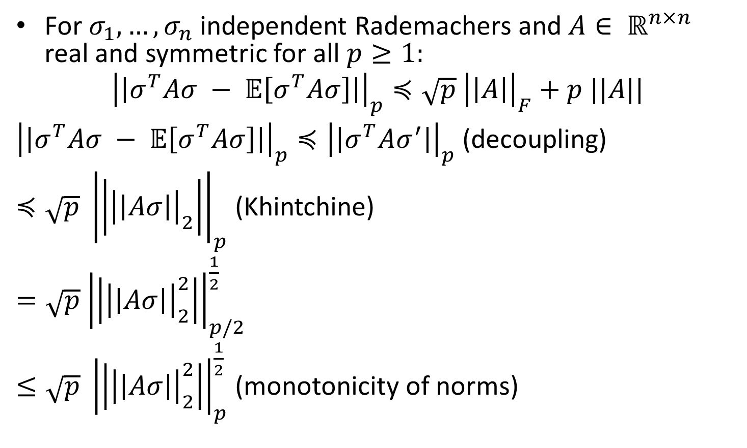
Hanson-Wright Inequality
For $σ_{1}, …, σ_{n}$ independent Rademachers and $A∈ ℝ^{n×n}$ real and symmetric for all $p≥1:$
$${\left|\left|σ^{T}Aσ − 𝔼\left[σ^{T}Aσ\right]\right|\right|}_{p}≼\sqrt{p} {\left|\left|A\right|\right|}_{F}+p ||A||$$
${\left|\left|σ^{T}Aσ − 𝔼\left[σ^{T}Aσ\right]\right|\right|}_{p}≼{\left|\left|σ^{T}Aσ^{′}\right|\right|}_{p}$ (decoupling)
$≼\sqrt{p} {\left|\left|{\left|\left|Aσ\right|\right|}_{2}\right|\right|}_{p}$ (Khintchine)
$=\sqrt{p}$ ${\left|\left|{\left|\left|Aσ\right|\right|}_{2}^{2}\right|\right|}_{p/2}^{\frac{1}{2}}$
$≤\sqrt{p} {\left|\left|{\left|\left|Aσ\right|\right|}_{2}^{2}\right|\right|}_{p}^{\frac{1}{2}}$ (monotonicity of norms)

Slide 19
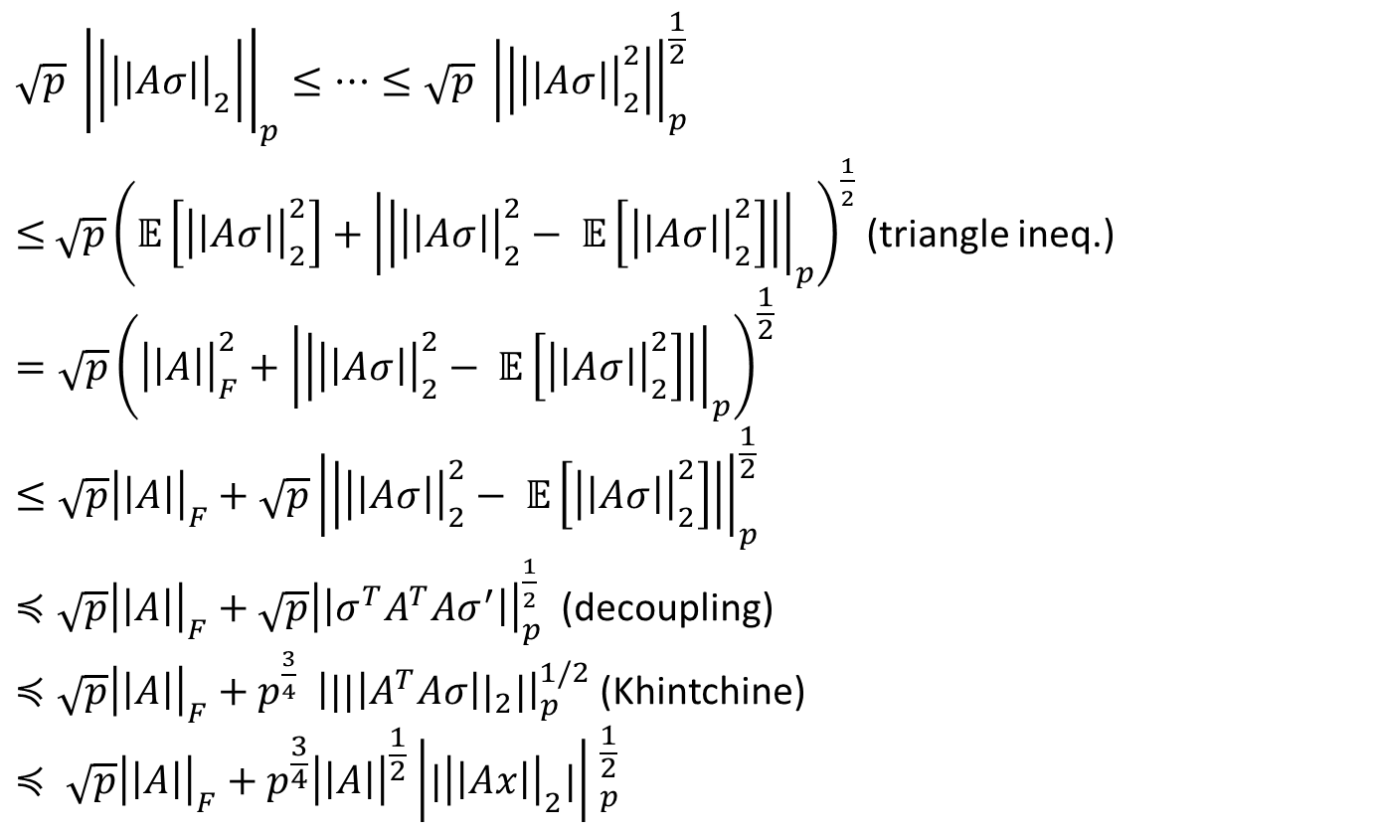
Hanson-Wright (continued)
$$\sqrt{p} {\left|\left|{\left|\left|Aσ\right|\right|}_{2}\right|\right|}_{p}≤…≤\sqrt{p} {\left|\left|{\left|\left|Aσ\right|\right|}_{2}^{2}\right|\right|}_{p}^{\frac{1}{2}}$$
$≤$ $\sqrt{p}{\left(𝔼\left[{\left|\left|Aσ\right|\right|}_{2}^{2}\right]+{\left|\left|{\left|\left|Aσ\right|\right|}_{2}^{2}− 𝔼\left[{\left|\left|Aσ\right|\right|}_{2}^{2}\right]\right|\right|}_{p}\right)}^{\frac{1}{2}}$ (triangle ineq.)
$$=\sqrt{p}{\left({\left|\left|A\right|\right|}_{F}^{2}+{\left|\left|{\left|\left|Aσ\right|\right|}_{2}^{2}− 𝔼\left[{\left|\left|Aσ\right|\right|}_{2}^{2}\right]\right|\right|}_{p}\right)}^{\frac{1}{2}}$$
$$≤\sqrt{p}{\left|\left|A\right|\right|}_{F}^{}+{\sqrt{p}\left|\left|{\left|\left|Aσ\right|\right|}_{2}^{2}− 𝔼\left[{\left|\left|Aσ\right|\right|}_{2}^{2}\right]\right|\right|}_{p}^{\frac{1}{2}}$$
$≼\sqrt{p}{\left|\left|A\right|\right|}_{F}^{}+\sqrt{p}{\left|\left|σ^{T}A^{T}Aσ^{′}\right|\right|}_{p}^{\frac{1}{2}}$ (decoupling)
$≼\sqrt{p}{\left|\left|A\right|\right|}_{F}^{}+p^{\frac{3}{4}} {\left|{||\left|A^{T}Aσ\right||}_{2}|\right|}_{p}^{1/2}$ (Khintchine)
$$≼ \sqrt{p}{\left|\left|A\right|\right|}_{F}^{}+p^{\frac{3}{4}}{\left|\left|A\right|\right|}^{\frac{1}{2}}{\left|{|\left|\left|Ax\right|\right|}_{2}|\right| }_{p}^{\frac{1}{2}}$$

Slide 20
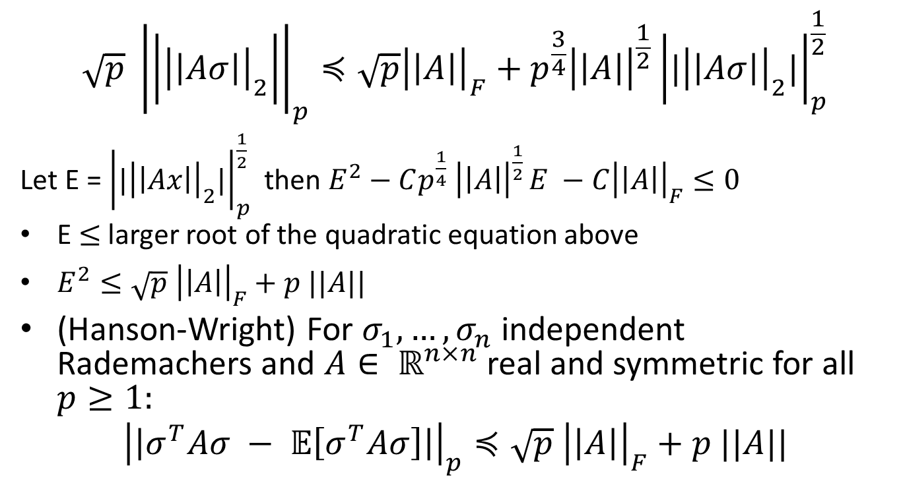
Hanson-Wright (continued)
$$\sqrt{p} {\left|\left|{\left|\left|Aσ\right|\right|}_{2}\right|\right|}_{p}≼\sqrt{p}{\left|\left|A\right|\right|}_{F}^{}+p^{\frac{3}{4}}{\left|\left|A\right|\right|}^{\frac{1}{2}}{\left|{|\left|\left|Aσ\right|\right|}_{2}|\right|}_{p}^{\frac{1}{2}}$$
Let E = ${\left|{|\left|\left|Ax\right|\right|}_{2}|\right|}_{p}^{\frac{1}{2}}$ then $E^{2}−Cp^{\frac{1}{4}} {\left|\left|A\right|\right|}^{\frac{1}{2} }E −C{\left|\left|A\right|\right|}_{F}≤0$
E $≤$ larger root of the quadratic equation above
$E^{2}≤\sqrt{p} {\left|\left|A\right|\right|}_{F}+p ||A||$
(Hanson-Wright) For $σ_{1}, …, σ_{n}$ independent Rademachers and $A∈ ℝ^{n×n}$ real and symmetric for all $p≥1:$
$${\left|\left|σ^{T}Aσ − 𝔼\left[σ^{T}Aσ\right]\right|\right|}_{p}≼\sqrt{p} {\left|\left|A\right|\right|}_{F}+p ||A||$$

Slide 21
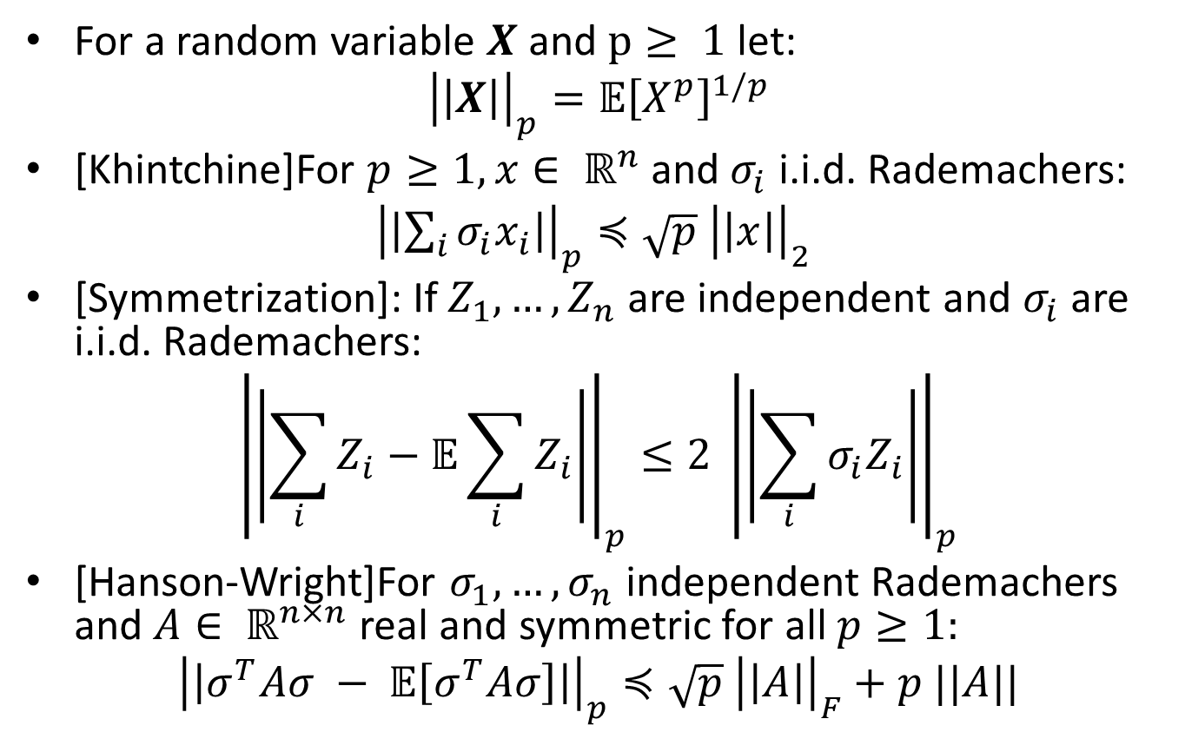
Recap
For a random variable $X$ and $p≥ 1$ let:
$${\left|\left|X\right|\right|}_{p}={𝔼\left[X^{p}\right]}^{1/p}$$
[Khintchine]For $p≥1, x∈ ℝ^{n}$ and $σ_{i}$ i.i.d. Rademachers:
${\left|\left|\sum_{i}{σ_{i}x_{i}}\right|\right|}_{p}≼\sqrt{p} {\left|\left|x\right|\right|}_{2}$
[Symmetrization]: If $Z_{1}, …,Z_{n}$ are independent and $σ_{i}$ are i.i.d. Rademachers:
$${\left|\left|\sum_{i}{Z_{i}}−𝔼\sum_{i}{Z_{i}}\right|\right|}_{p}≤2 {\left|\left|\sum_{i}{σ_{i}Z_{i}}\right|\right|}_{p}$$
[Hanson-Wright]For $σ_{1}, …, σ_{n}$ independent Rademachers and $A∈ ℝ^{n×n}$ real and symmetric for all $p≥1:$
$${\left|\left|σ^{T}Aσ − 𝔼\left[σ^{T}Aσ\right]\right|\right|}_{p}≼\sqrt{p} {\left|\left|A\right|\right|}_{F}+p ||A||$$

Slide 22
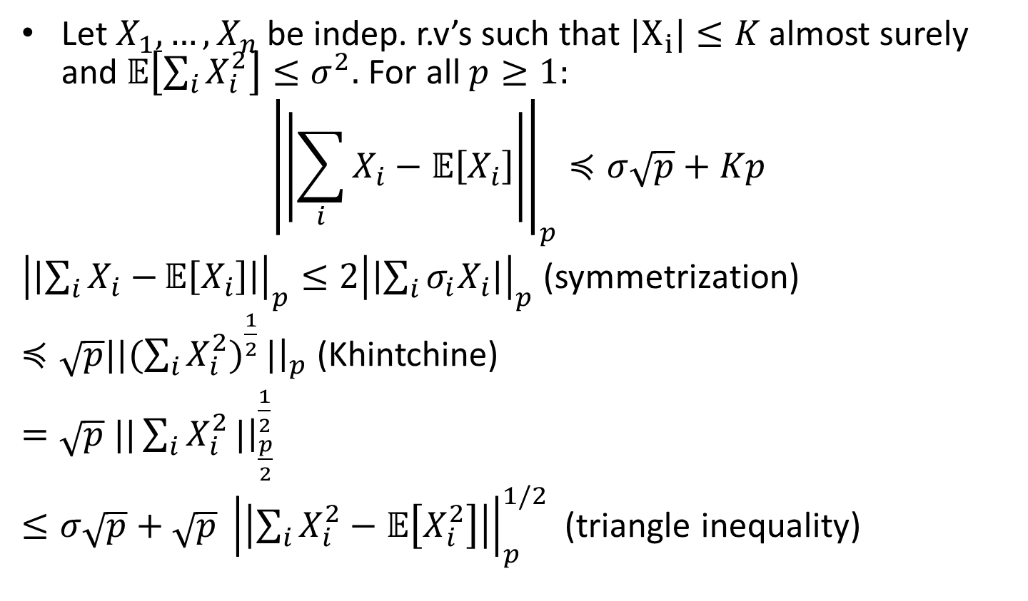
Bernstein Inequality
Let $X_{1},…, X_{n}$ be indep. r.v’s such that $|X_{i}|≤K$ almost surely and 𝔼$\left[\sum_{i}{X_{i}^{2}}\right]≤σ^{2}.$ For all $p≥1:$
$${\left|\left|\sum_{i}{X_{i}}−\text{𝔼}\left[X_{i}\right]\right|\right|}_{p}≼σ\sqrt{p}+Kp$$
${\left|\left|\sum_{i}{X_{i}−}\text{𝔼}\left[X_{i}\right]\right|\right|}_{p}≤2{\left|\left|\sum_{i}{σ_{i}X_{i}}\right|\right|}_{p}$ (symmetrization)
$≼\sqrt{p}||({\sum_{i}{X_{i}^{2})}}^{\frac{1}{2}}|{\left.​\right|}_{p}$ (Khintchine)
$=\sqrt{p}$ $||\sum_{i}{X_{i}^{2}}|{\left.​\right|}_{\frac{p}{2}}^{\frac{1}{2}}$
$≤σ\sqrt{p}+\sqrt{p} {\left|\left|\sum_{i}{X_{i}^{2}}−\text{𝔼}\left[X_{i}^{2}\right]\right|\right|}_{p}^{1/2}$ (triangle inequality)

Slide 23
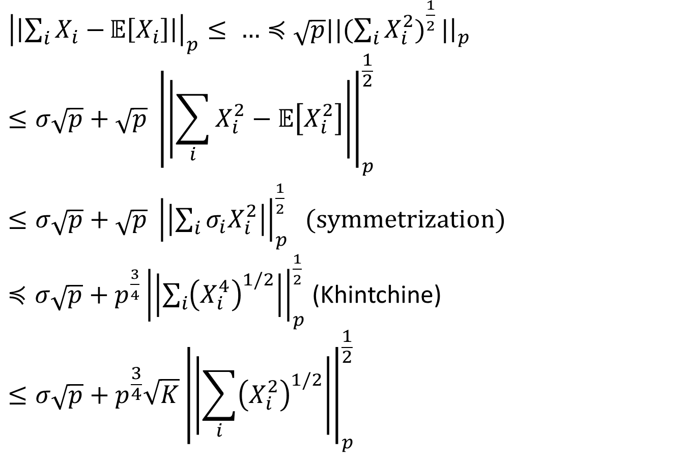
Bernstein Inequality (cont.)
${\left|\left|\sum_{i}{X_{i}−}\text{𝔼}\left[X_{i}\right]\right|\right|}_{p}≤ …≼$ $\sqrt{p}||({\sum_{i}{X_{i}^{2})}}^{\frac{1}{2}}|{\left.​\right|}_{p}$
$$≤σ\sqrt{p}+\sqrt{p} {\left|\left|\sum_{i}{X_{i}^{2}}−\text{𝔼}\left[X_{i}^{2}\right]\right|\right|}_{p}^{\frac{1}{2}}$$
$≤σ\sqrt{p}+\sqrt{p} {\left|\left|\sum_{i}{σ_{i}X_{i}^{2}}\right|\right|}_{p}^{\frac{1}{2}} (symmetrization)$
$≼σ\sqrt{p}+{p^{\frac{3}{4}}\left|\left|\sum_{i}{{\left(X_{i}^{4}\right)}^{1/2}}\right|\right|}_{p}^{\frac{1}{2}}$ (Khintchine)
$$≤σ\sqrt{p}+{p^{\frac{3}{4}}\sqrt{K}\left|\left|\sum_{i}{{\left(X_{i}^{2}\right)}^{1/2}}\right|\right|}_{p}^{\frac{1}{2}}$$

Slide 24
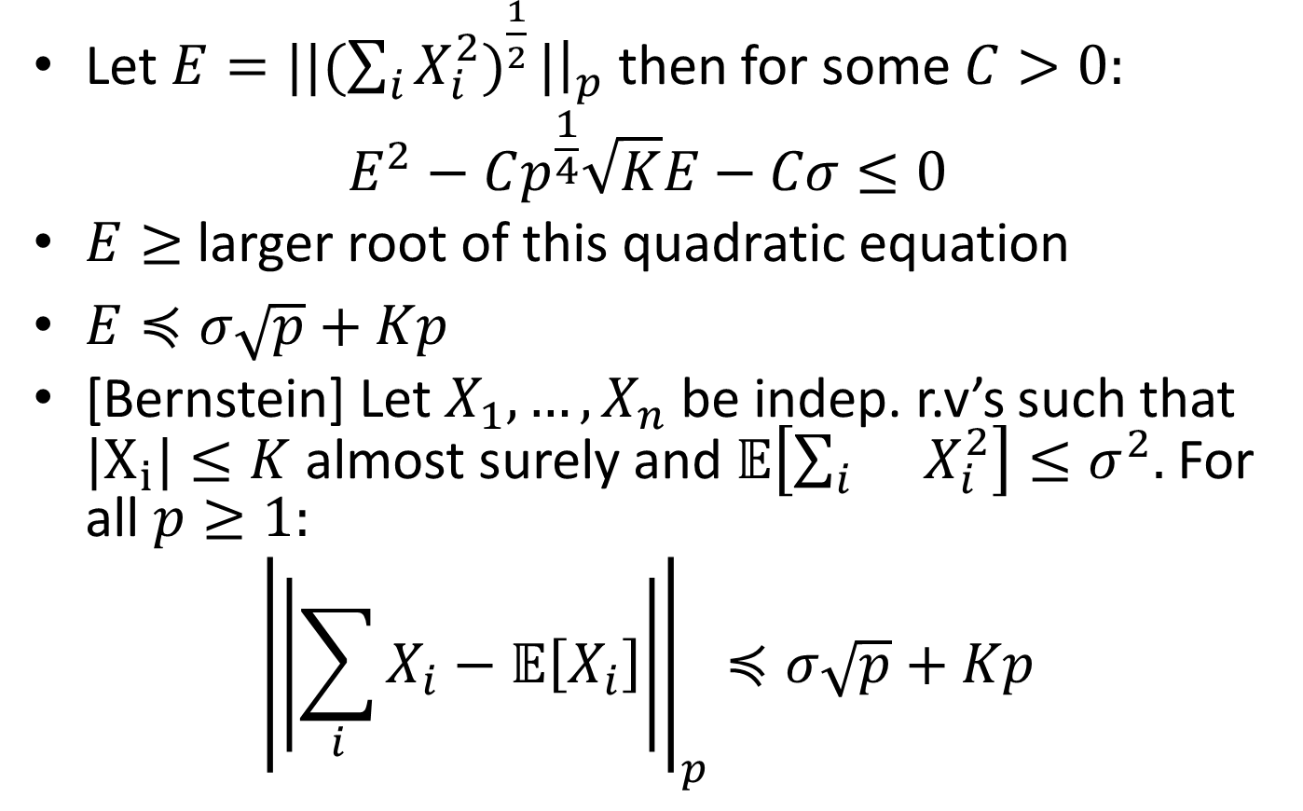
Bernstein Inequality (cont.)
Let $E=||({\sum_{i}{X_{i}^{2})}}^{\frac{1}{2}}|{\left.​\right|}_{p}$ then for some $C>0:$
$$E^{2}−Cp^{\frac{1}{4}}\sqrt{K}E−Cσ≤0$$
$E≥$ larger root of this quadratic equation
$E≼σ\sqrt{p}+Kp$
[Bernstein] Let $X_{1},…, X_{n}$ be indep. r.v’s such that $|X_{i}|≤K$ almost surely and 𝔼$\left[{\sum_{i}{}X}_{i}^{2}\right]≤σ^{2}.$ For all $p≥1:$
$${\left|\left|\sum_{i}{X_{i}}−\text{𝔼}\left[X_{i}\right]\right|\right|}_{p}≼σ\sqrt{p}+Kp$$

Slide 25
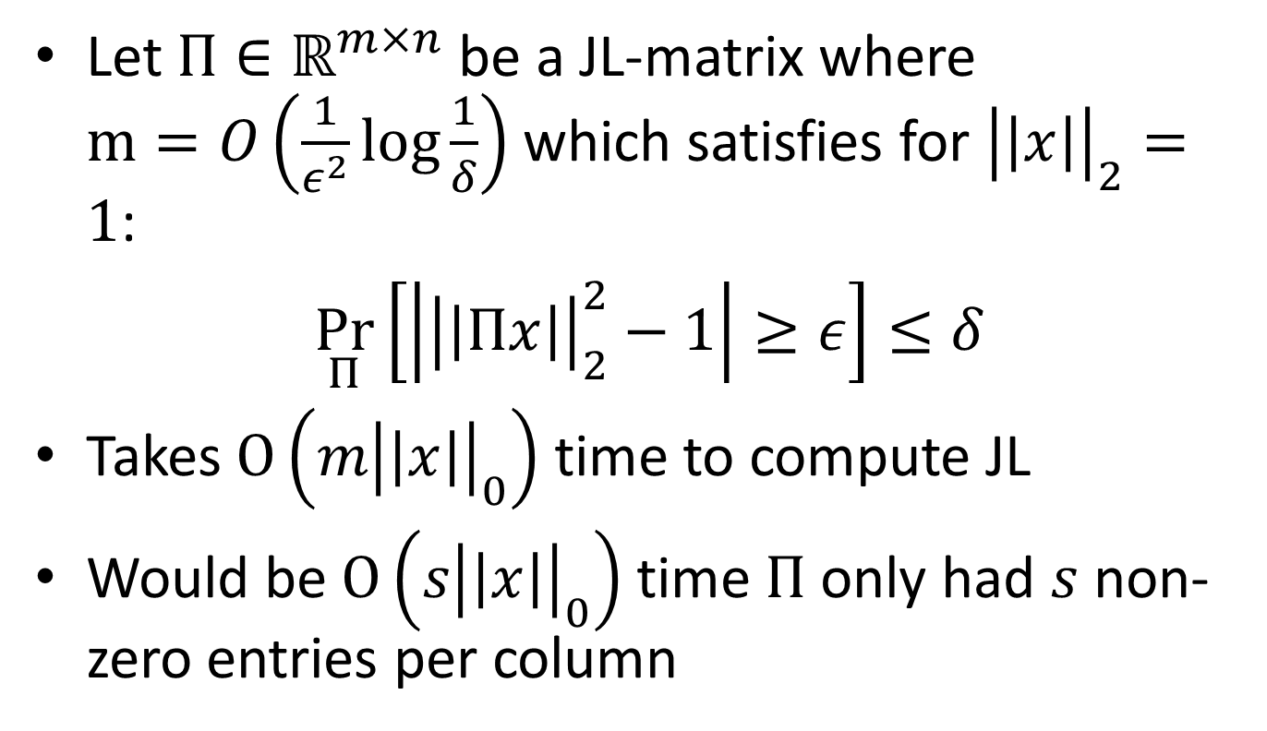
Sparse Johnson-Lindenstrauss Transform
Let $Π∈ℝ^{m×n}$ be a JL-matrix where $m=O\left(\frac{1}{ε^{2}}\log{\frac{1}{δ}}\right)$ which satisfies for ${\left|\left|x\right|\right|}_{2}=1$:
$\underset{Π}{Pr}\left[\left|{\left|\left|Πx\right|\right|}_{2}^{2}−1\right|≥ε\right]≤δ$
Takes $O\left(m{\left|\left|x\right|\right|}_{0}\right)$ time to compute JL
Would be $O\left(s{\left|\left|x\right|\right|}_{0}\right)$ time $Π$ only had $s$ non-zero entries per column

Slide 26
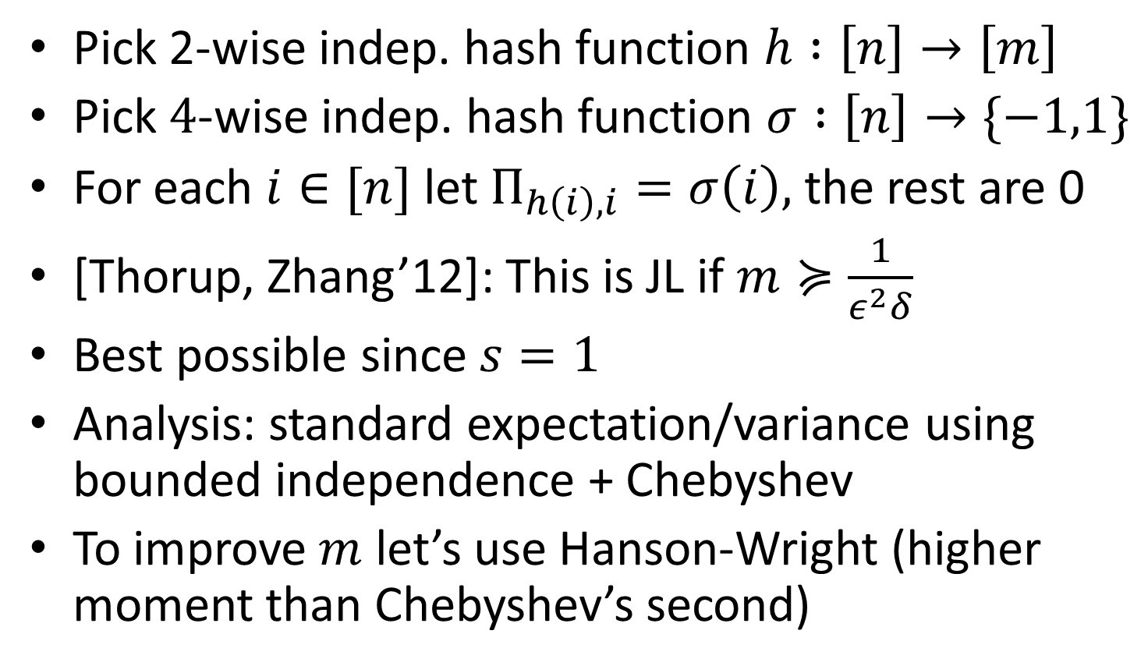
Basic Sparse JL Transform
Pick 2-wise indep. hash function $h :\left[n\right]→\left[m\right]$
Pick $4$-wise indep. hash function $σ :\left[n\right]→\{−1,1\}$
For each $i∈[n]$ let $Π_{h\left(i\right),i}=σ\left(i\right),$ the rest are 0
[Thorup, Zhang’12]: This is JL if $m≽\frac{1}{ε^{2}δ}$
Best possible since $s=1$
Analysis: standard expectation/variance using bounded independence + Chebyshev
To improve $m$ let’s use Hanson-Wright (higher moment than Chebyshev’s second)

Slide 27
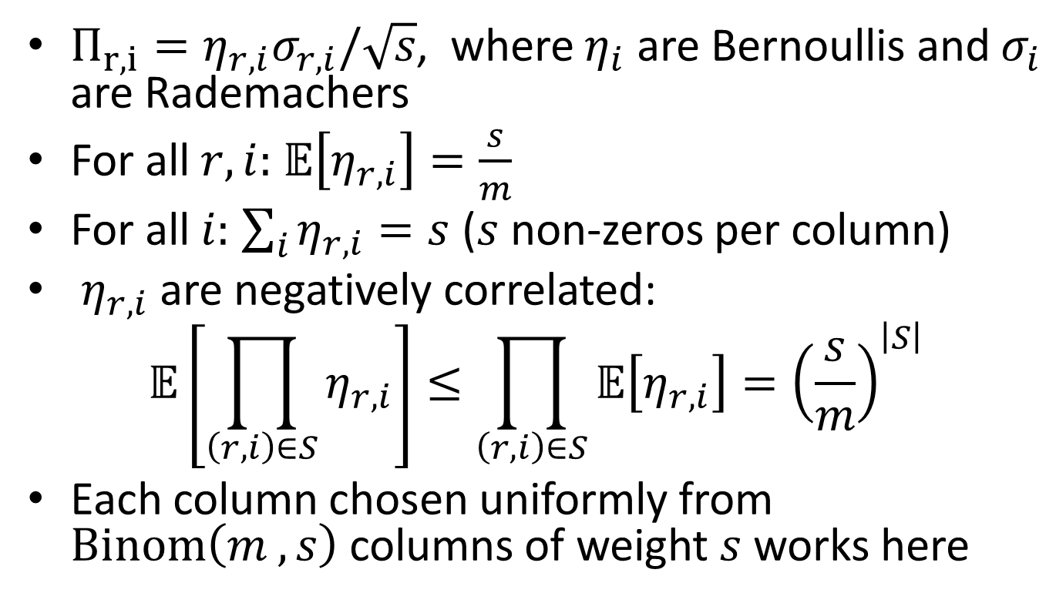
Sparse JL Transform: Construction
$Π_{r,i}=η_{r,i}σ_{r,i}/\sqrt{s}$, where $η_{i}$ are Bernoullis and $σ_{i}$ are Rademachers
For all $r,i:$ $𝔼\left[η_{r,i}\right]=\frac{s}{m}$
For all $i:$ $\sum_{i}{η_{r,i}=s}$ ($s$ non-zeros per column)
$η_{r,i}$ are negatively correlated:
$$𝔼\left[\prod_{\left(r,i\right)∈S}{η_{r,i}}\right]≤\prod_{\left(r,i\right)∈S}{𝔼\left[η_{r,i}\right]}={\left(\frac{s}{m}\right)}^{\left|S\right|}$$
Each column chosen uniformly from $Binom\left(m , s\right)$ columns of weight $s$ works here

Slide 28
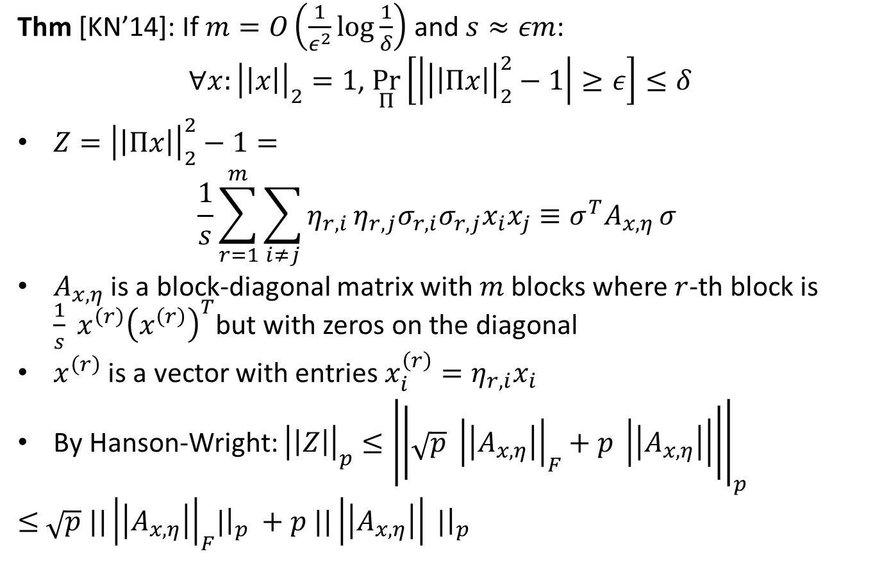
Sparse JL Transform: Analysis
Thm [KN’14]: If $m=O\left(\frac{1}{ε^{2}}\log{\frac{1}{δ}}\right)$ and $s≈εm$:
$∀x:{\left|\left|x\right|\right|}_{2}=1$, $\underset{Π}{Pr}\left[\left|{\left|\left|Πx\right|\right|}_{2}^{2}−1\right|≥ε\right]≤δ$
$Z={\left|\left|Πx\right|\right|}_{2}^{2}−1=$
$$\frac{1}{s}\sum_{r=1}^{m}{\sum_{i≠j}{η_{r,i}}η_{r,j}σ_{r,i}σ_{r,j}x_{i}x_{j}}≡σ^{T}A_{x,η }σ$$
$A_{x,η}$ is a block-diagonal matrix with $m$ blocks where $r$-th block is $\frac{1}{s} x^{\left(r\right)}{\left(x^{\left(r\right)}\right)}^{T}$but with zeros on the diagonal
$x^{\left(r\right)}$ is a vector with entries $x_{i}^{\left(r\right)}=η_{r,i}x_{i}$
By Hanson-Wright: ${\left|\left|Z\right|\right|}_{p}≤{\left|\left|\sqrt{p} {\left|\left|A_{x,η}\right|\right|}_{F}+p \left|\left|A_{x,η}\right|\right|\right|\right|}_{p}$
$≤$ $\sqrt{p} {||\left|\left|A_{x,η}\right|\right|}_{F}|{\left.​\right|}_{p} +p ||\left|\left|A_{x,η}\right|\right| |{\left.​\right|}_{p}$

Slide 29
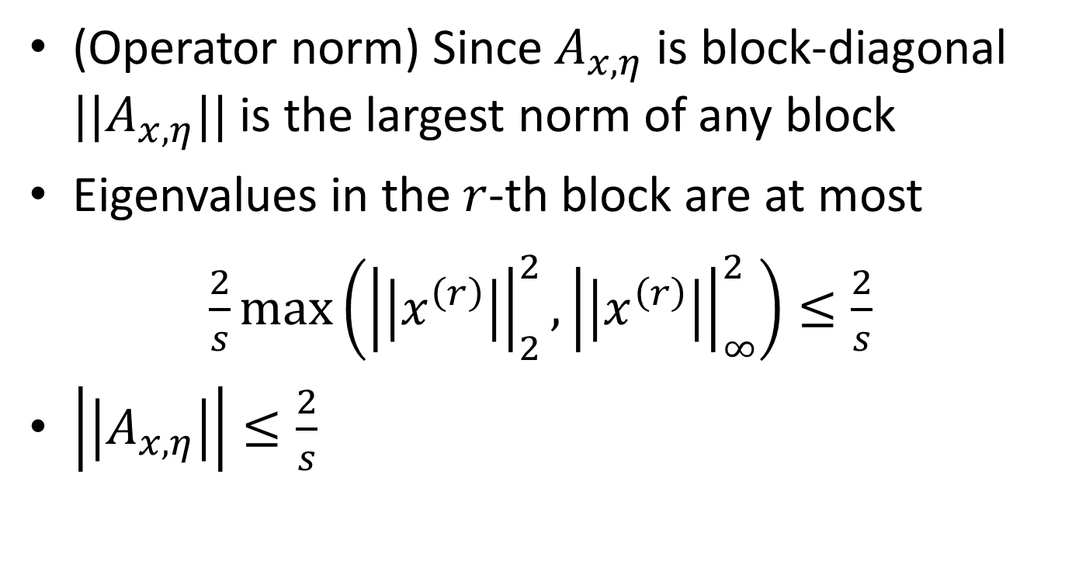
Sparse JL Transform: Analysis
(Operator norm) Since $A_{x,η}$ is block-diagonal $||A_{x,η}||$ is the largest norm of any block
Eigenvalues in the $r$-th block are at most
$\frac{2}{s}\max\left({\left|\left|x^{\left(r\right)}\right|\right|}_{2}^{2},{\left|\left|x^{\left(r\right)}\right|\right|}_{∞}^{2}\right)≤\frac{2}{s}$
$\left|\left|A_{x,η}\right|\right|≤\frac{2}{s}$

Slide 30
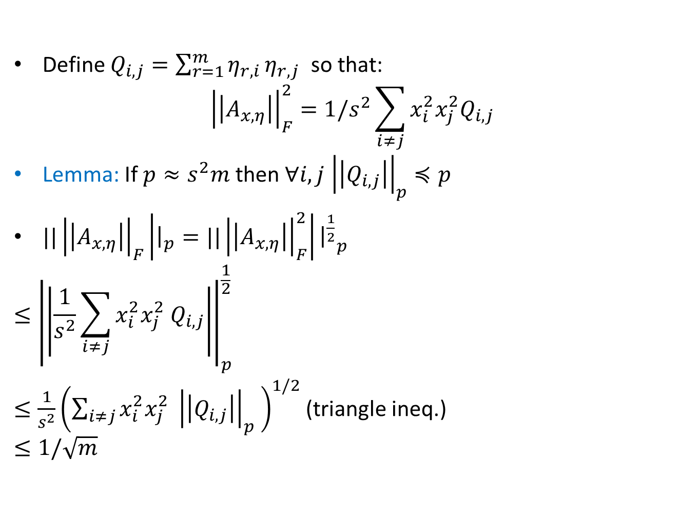
Sparse JL Transform: Analysis
Define $Q_{i,j}=\sum_{r=1}^{m}{η_{r,i}}η_{r,j}$ so that:
$${\left|\left|A_{x,η}\right|\right|}_{F}^{2}=1/s^{2}\sum_{i≠j}{x_{i}^{2}x_{j}^{2}Q_{i,j}}$$
Lemma: If $p≈s^{2}m$ then $∀i,j$ ${\left|\left|Q_{i,j}\right|\right|}_{p}≼p$
${||\left|\left|A_{x,η}\right|\right|}_{F}\left|{\left.​\right|}_{p}={||\left|\left|A_{x,η}\right|\right|}_{F}^{2}\right|{{\left.​\right|}^{\frac{1}{2}}}_{p}$
$$≤{\left|\left|\frac{1}{s^{2}}\sum_{i≠j}{x_{i}^{2}x_{j}^{2} Q_{i,j}}\right|\right|}_{p}^{\frac{1}{2}}$$
$≤\frac{1}{s^{2}}{\left(\sum_{i≠j}{x_{i}^{2}x_{j}^{2} {\left|\left|Q_{i,j}\right|\right|}_{p} }\right)}^{1/2}$ (triangle ineq.)
$$≤1/\sqrt{m}$$

Slide 31
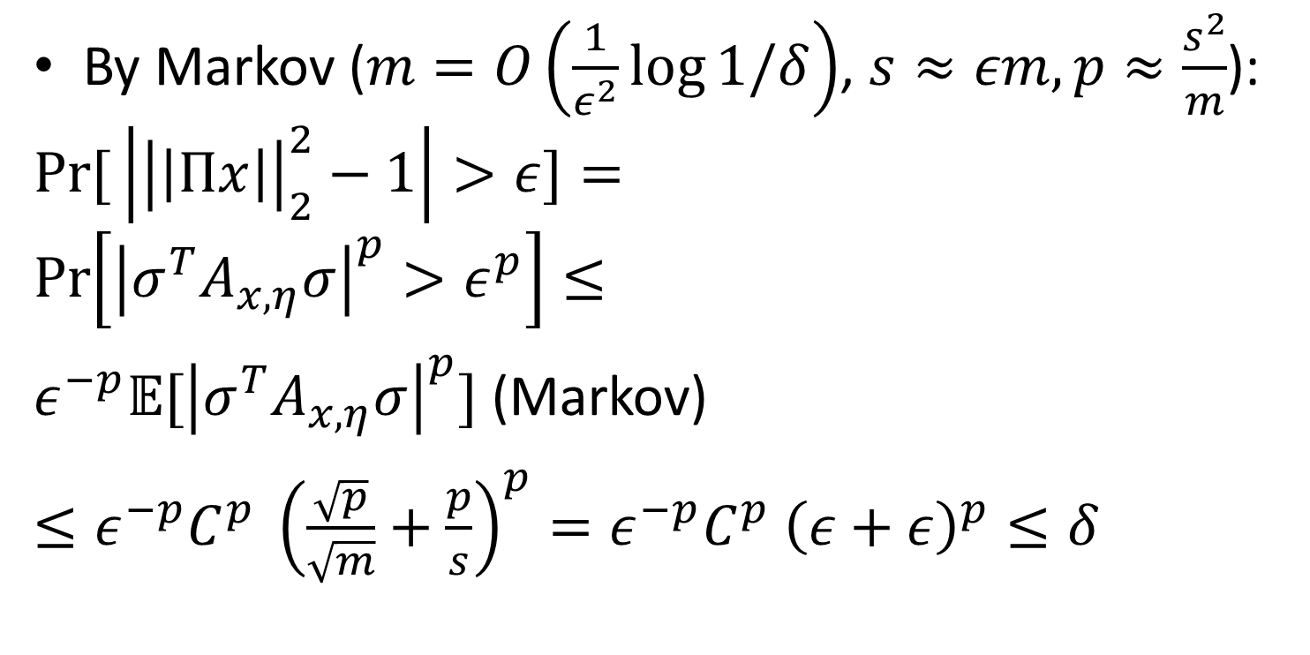
Sparse JL Transform: Analysis
By Markov ($m=O\left(\frac{1}{ε^{2}}\log{1/δ}\right)$, $s≈εm, p≈\frac{s^{2}}{m}$):
$$\operatorname{Pr}{[}\left|{\left|\left|Πx\right|\right|}_{2}^{2}−1\right|>ε]=$$
$$\operatorname{Pr}\left[{\left|σ^{T}A_{x,η}σ\right|}^{p}>ε^{p}\right]≤$$
$ε^{−p}{𝔼[\left|σ^{T}A_{x,η}σ\right|}^{p}]$ (Markov)
$≤ε^{−p}C^{p} {\left(\frac{\sqrt{p}}{\sqrt{m}}+\frac{p}{s}\right)}^{p}=ε^{−p}C^{p} {\left(ε+ε\right)}^{p}≤δ$

Slide 32
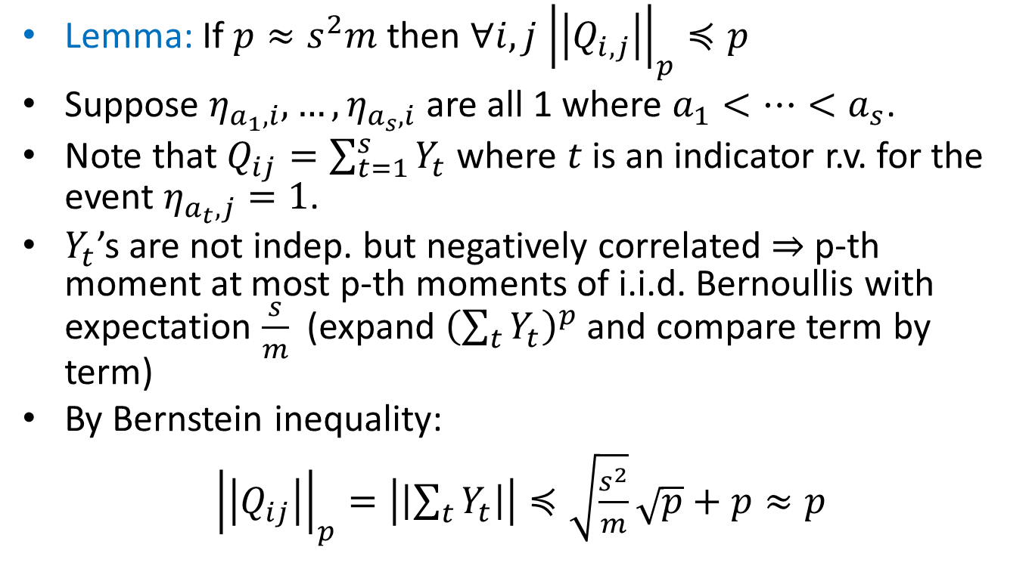
Sparse JL Transform: Analysis
Lemma: If $p≈s^{2}m$ then $∀i,j$ ${\left|\left|Q_{i,j}\right|\right|}_{p}≼p$
Suppose $η_{a_{1},i}, …,η_{a_{s},i}$ are all 1 where $a_{1}<…<a_{s}$.
Note that $Q_{ij}=\sum_{t=1}^{s}{Y_{t}}$ where $t$ is an indicator r.v. for the event $η_{a_{t},j}=1$.
$Y_{t}$’s are not indep. but negatively correlated $⇒$ p-th moment at most p-th moments of i.i.d. Bernoullis with expectation $\frac{s}{m}$ (expand ${\left(\sum_{t}{Y_{t}}\right)}^{p}$ and compare term by term)
By Bernstein inequality:
${\left|\left|Q_{ij}\right|\right|}_{p}=\left|\left|\sum_{t}{Y_{t}}\right|\right|≼\sqrt{\frac{s^{2}}{m}}\sqrt{p}+p≈p$

Slide 33
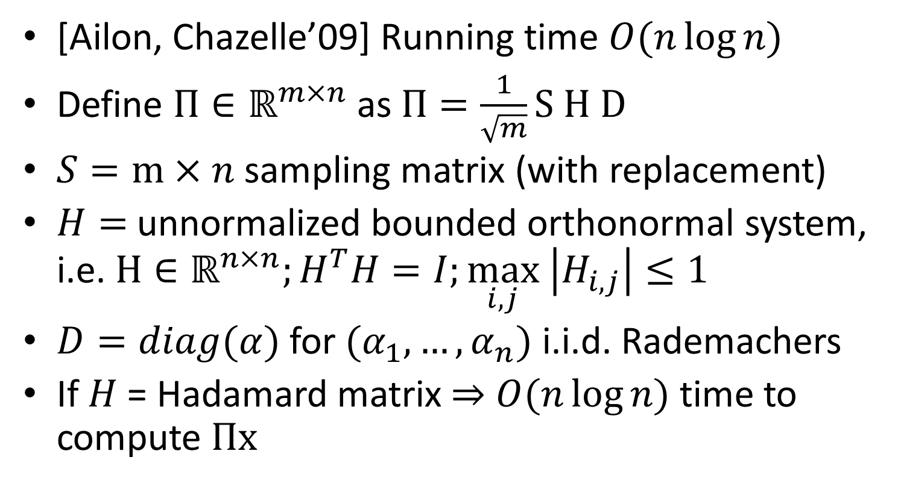
FFT-based Fast JL-Transform
[Ailon, Chazelle’09] Running time $O(n\log{n})$
Define $Π∈ℝ^{m×n}$ as $Π=\frac{1}{\sqrt{m}}S H D$
$S=m×n$ sampling matrix (with replacement)
$H=$unnormalized bounded orthonormal system, i.e. $H∈ℝ^{n×n};H^{T}H=I;\max_{i,j} \left|H_{i,j}\right|≤1$
$D=diag(α)$ for $(α_{1},…, α_{n})$ i.i.d. Rademachers
If $H$ = Hadamard matrix $⇒$ $O(n\log{n})$ time to compute $Πx$

Slide 34
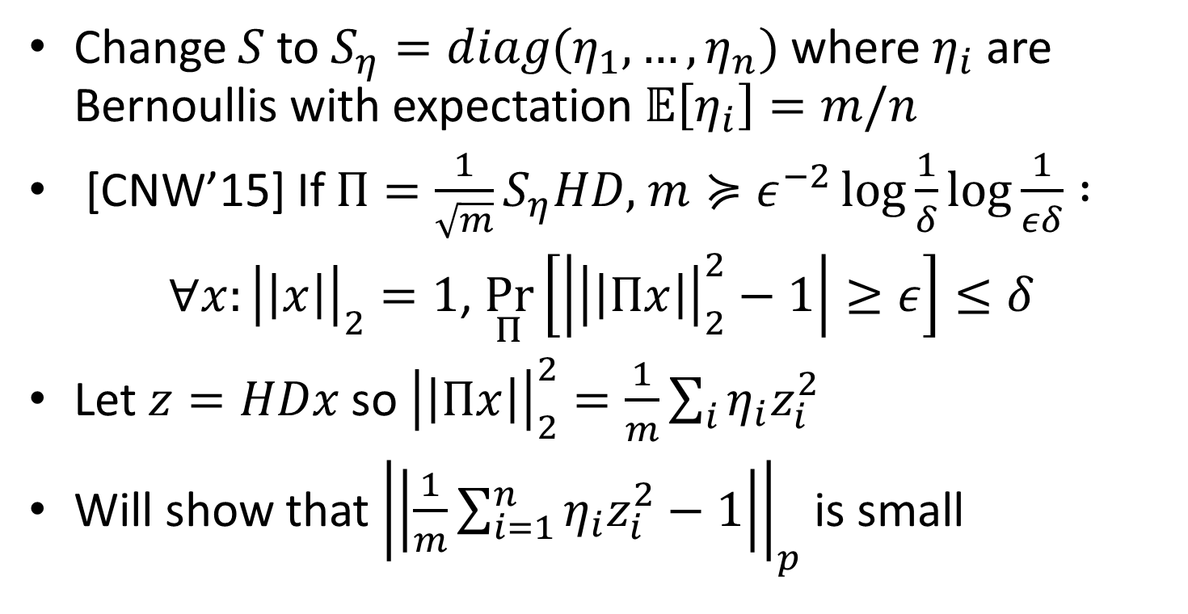
FFT-based Fast JL-Transform
Change $S$ to $S_{η}=diag(η_{1},…, η_{n})$ where $η_{i}$ are Bernoullis with expectation $𝔼\left[η_{i}\right]=m/n$
[CNW’15] If $Π={\frac{1}{\sqrt{m}}S}_{η}HD,$ $m≽ε^{−2}\log{\frac{1}{δ}}\log{\frac{1}{εδ}} :$
$∀x:{\left|\left|x\right|\right|}_{2}=1$, $\underset{Π}{Pr}\left[\left|{\left|\left|Πx\right|\right|}_{2}^{2}−1\right|≥ε\right]≤δ$
Let $z=HDx$ so ${\left|\left|Πx\right|\right|}_{2}^{2}=\frac{1}{m}\sum_{i}{η_{i}z_{i}^{2}}$
Will show that ${\left|\left|\frac{1}{m}\sum_{i=1}^{n}{η_{i}z_{i}^{2}}−1\right|\right|}_{p}$is small

Slide 35
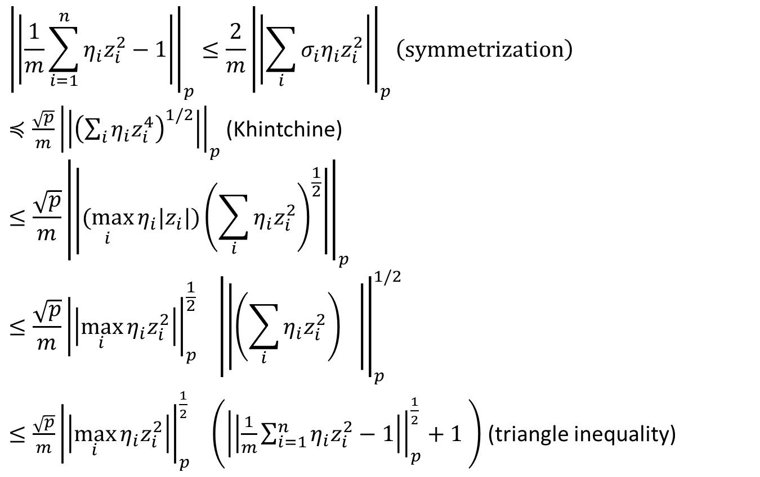
FFT-based Fast JL-Transform
$${\left|\left|\frac{1}{m}\sum_{i=1}^{n}{η_{i}z_{i}^{2}}−1\right|\right|}_{p}≤\frac{2}{m}{\left|\left|\sum_{i}{σ_{i}η_{i}z_{i}^{2}}\right|\right|}_{p}\left(symmetrization\right)$$
$≼\frac{\sqrt{p}}{m}{\left|\left|{\left(\sum_{i}{η_{i}z_{i}^{4}}\right)}^{1/2}\right|\right|}_{p}$ (Khintchine)
$$≤\frac{\sqrt{p}}{m}{\left|\left|\underset{i}{(max}{η_{i}{|z}_{i}|}){\left(\sum_{i}{η_{i}z_{i}^{2}}\right)}^{\frac{1}{2}}\right|\right|}_{p}$$
$$≤\frac{\sqrt{p}}{m}{{\left|\left|\max_{i}{η_{i}z_{i}^{2}}\right|\right|}_{p}^{\frac{1}{2}}}_{}{\left|\left|{\left(\sum_{i}{η_{i}z_{i}^{2}}\right)}^{}\right|\right|}_{p}^{1/2}$$
$≤\frac{\sqrt{p}}{m}{{\left|\left|\max_{i}{η_{i}z_{i}^{2}}\right|\right|}_{p}^{\frac{1}{2}}}_{}\left({\left|\left|\frac{1}{m}\sum_{i=1}^{n}{η_{i}z_{i}^{2}}−1\right|\right|}_{p}^{\frac{1}{2}}+1 \right)$ (triangle inequality)

Slide 36
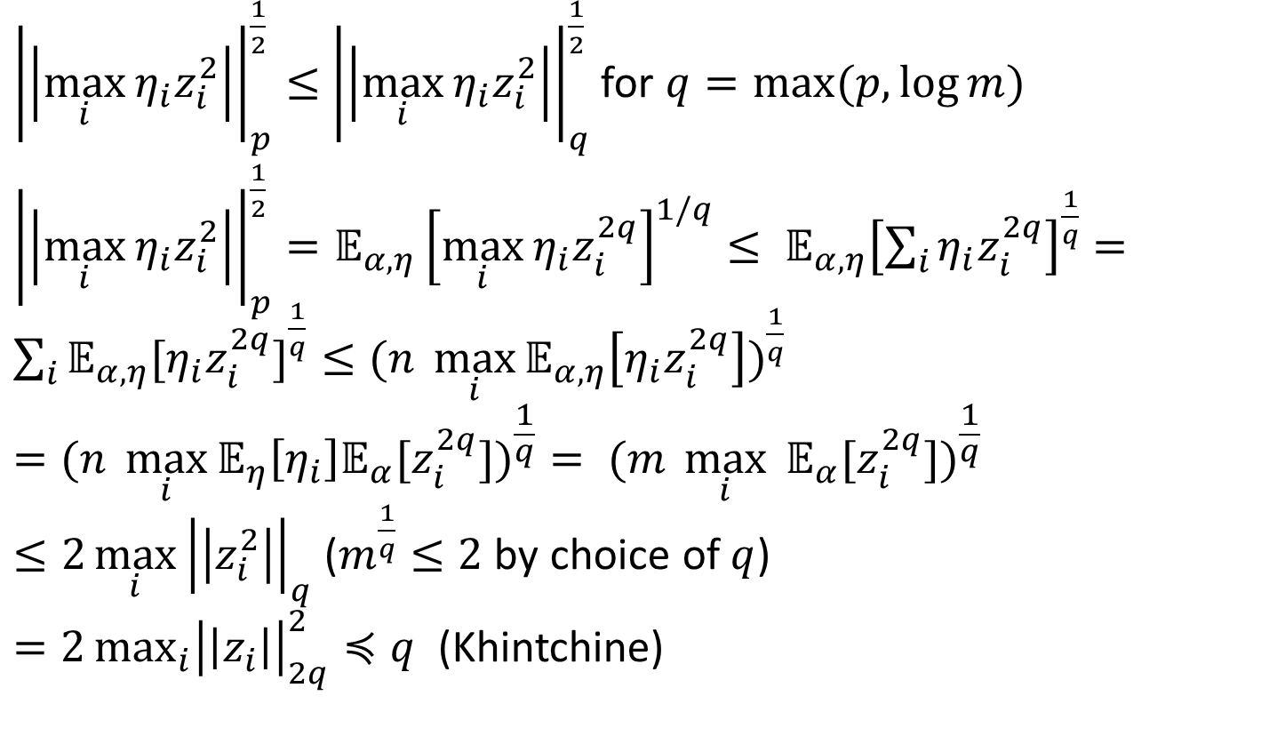
FFT-based Fast JL-Transform
${\left|\left|\max_{i}{η_{i}z_{i}^{2}}\right|\right|}_{p}^{\frac{1}{2}}≤$ ${\left|\left|\max_{i}{η_{i}z_{i}^{2}}\right|\right|}_{q}^{\frac{1}{2}}$ for $q=max⁡(p,\log{m})$
${\left|\left|\max_{i}{η_{i}z_{i}^{2}}\right|\right|}_{p}^{\frac{1}{2}}=𝔼_{α,η}{\left[\max_{i}{η_{i}z_{i}^{2q}}\right]}^{1/q}≤ 𝔼_{α,η}{\left[\sum_{i}{η_{i}z_{i}^{2q}}\right]}^{\frac{1}{q}}=$ ${\sum_{i}{𝔼_{α,η}[η_{i}z_{i}^{2q}]}}^{\frac{1}{q}}≤(n {\max_{i}{𝔼_{α,η}\left[η_{i}z_{i}^{2q}\right])}}^{\frac{1}{q}}$
$$=(n {\max_{i}{𝔼_{η}\left[η_{i}\right]{𝔼_{α}[z}_{i}^{2q}])}}^{\frac{1}{q}}= (m {\max_{i}{ {𝔼_{α}[z}_{i}^{2q}])}}^{\frac{1}{q}}$$
$≤2\max_{i}{{\left|\left|z_{i}^{2}\right|\right|}_{q}}$ ($m^{\frac{1}{q}}≤2$ by choice of $q$)
$=2\max_{i}{{\left|\left|z_{i}\right|\right|}_{2q}^{2}}≼q$ (Khintchine)

Slide 37
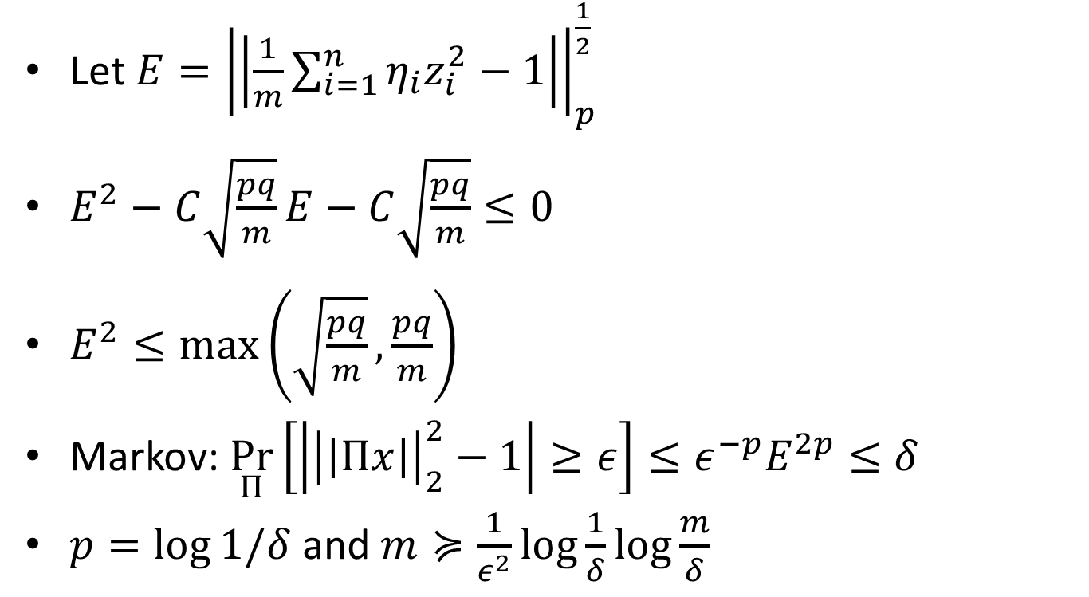
FFT-based Fast JL-Transform
Let $E={\left|\left|\frac{1}{m}\sum_{i=1}^{n}{η_{i}z_{i}^{2}}−1\right|\right|}_{p}^{\frac{1}{2}}$
$E^{2}−C\sqrt{\frac{pq}{m}}E−C\sqrt{\frac{pq}{m}}≤0$
$E^{2}≤\max\left(\sqrt{\frac{pq}{m}},\frac{pq}{m}\right)$
Markov: $\underset{Π}{Pr}\left[\left|{\left|\left|Πx\right|\right|}_{2}^{2}−1\right|≥ε\right]≤ε^{−p}E^{2p}≤δ$
$p=\log{1/δ}$ and $m≽\frac{1}{ε^{2}}\log{\frac{1}{δ}}\log{\frac{m}{δ}}$

