Slide 1

CIS 700: “algorithms for Big Data”
Lecture 8:
Gradient Descent
Slides at http://grigory.us/big-data-class.html
Grigory Yaroslavtsev
http://grigory.us

Slide 2
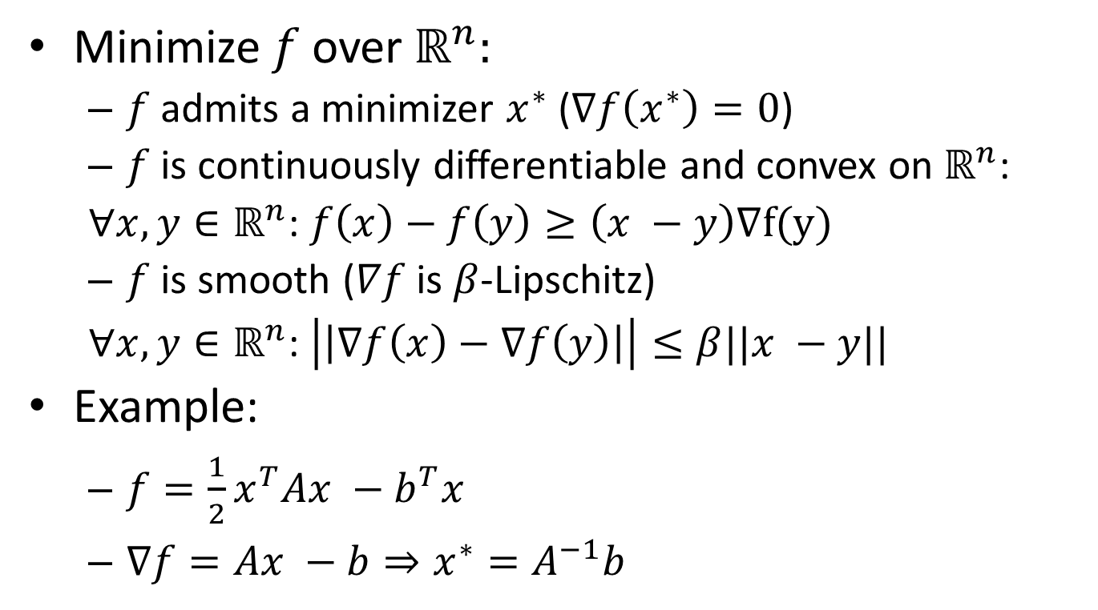
Smooth Convex Optimization
Minimize $f$ over $ℝ^{n}:$
$f$ admits a minimizer $x^{∗}$ ($∇f\left(x^{∗}\right)=0$)
$f$ is continuously differentiable and convex on $ℝ^{n}$:
$∀x,y∈ℝ^{n}$: $f\left(x\right)−f\left(y\right)≥\left(x −y\right)∇f(y)$
$f$ is smooth ($∇f$ is $β$-Lipschitz)
$∀x,y∈ℝ^{n}$: $\left|\left|∇f\left(x\right)−∇f\left(y\right)\right|\right|≤β||x −y||$
Example:
$f={\frac{1}{2}x}^{T}Ax −b^{T}x$
$∇f=Ax −b⇒x^{∗}=A^{−1}b$

Slide 3
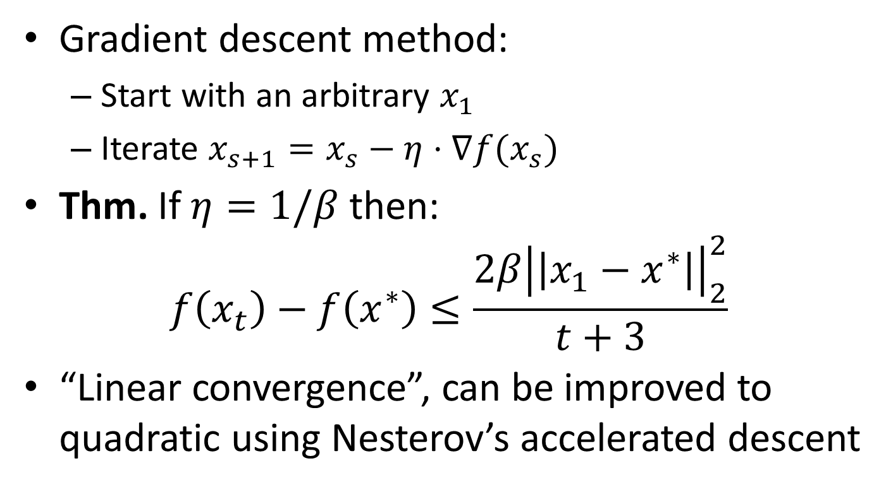
Gradient Descent Method
Gradient descent method:
Start with an arbitrary $x_{1}$
Iterate $x_{s+1}=x_{s}−η⋅∇f(x_{s})$
Thm. If $η=1/β$ then:
$$f\left(x_{t}\right)−f\left(x^{∗}\right)≤\frac{2β{\left|\left|x_{1}−x^{∗}\right|\right|}_{2}^{2}}{t+3}$$
“Linear convergence”, can be improved to quadratic using Nesterov’s accelerated descent

Slide 4
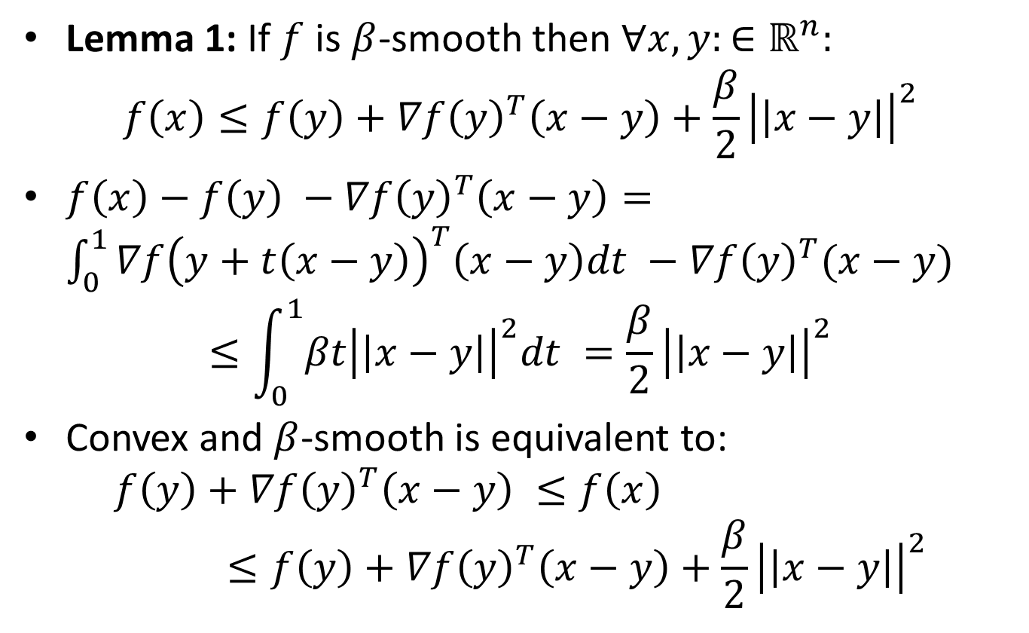
Gradient Descent: Analysis
Lemma 1: If $f$ is $β$-smooth then $∀x,y:∈ℝ^{n}:$
$$f\left(x\right)≤f\left(y\right)+∇f{\left(y\right)}^{T}\left(x−y\right)+\frac{β}{2}{\left|\left|x−y\right|\right|}^{2}$$
$f\left(x\right)−f\left(y\right) −∇f{\left(y\right)}^{T}\left(x−y\right)=\int_{0}^{1}{∇f{\left(y+t\left(x−y\right)\right)}^{T}\left(x−y\right)dt} −∇f{\left(y\right)}^{T}(x−y)$
$$≤\int_{0}^{1}{βt{\left|\left|x−y\right|\right|}^{2}dt }=\frac{β}{2}{\left|\left|x−y\right|\right|}^{2}$$
Convex and $β$-smooth is equivalent to:
$$f\left(y\right)+∇f{\left(y\right)}^{T}\left(x−y\right) ≤f\left(x\right)≤f\left(y\right)+∇f{\left(y\right)}^{T}\left(x−y\right)+\frac{β}{2}{\left|\left|x−y\right|\right|}^{2}$$

Slide 5
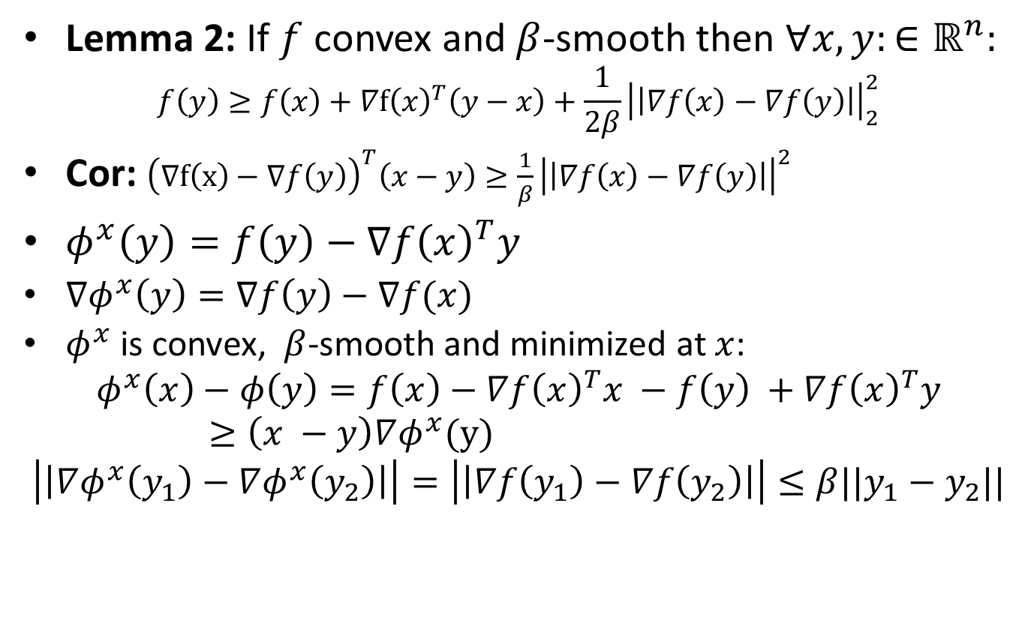
Gradient Descent: Analysis
Lemma 2: If $f$ convex and $β$-smooth then $∀x,y:∈ℝ^{n}:$
$$f\left(y\right)≥f\left(x\right)+∇f{\left(x\right)}^{T}\left(y−x\right)+\frac{1}{2β}{\left|\left|∇f\left(x\right)−∇f\left(y\right)\right|\right|}_{2}^{2}$$
Cor: ${\left(∇f\left(x\right)−∇f\left(y\right)\right)}^{T}\left(x−y\right)≥\frac{1}{β}{\left|\left|∇f\left(x\right)−∇f\left(y\right)\right|\right|}^{2}$
$φ^{x}\left(y\right)=f\left(y\right)−∇f{\left(x\right)}^{T}y$
$∇φ^{x}\left(y\right)=∇f\left(y\right)−∇f(x)$
$φ^{x}$ is convex, $β$-smooth and minimized at $x$:
$$φ^{x}\left(x\right)−φ\left(y\right)=f\left(x\right)−∇f{\left(x\right)}^{T}x −f\left(y\right) +∇f{\left(x\right)}^{T}y≥\left(x −y\right)∇φ^{x}(y)$$
$$\left|\left|∇φ^{x}\left(y_{1}\right)−∇φ^{x}\left(y_{2}\right)\right|\right|=\left|\left|∇f\left(y_{1}\right)−∇f\left(y_{2}\right)\right|\right|≤β||y_{1}−y_{2}||$$

Slide 6
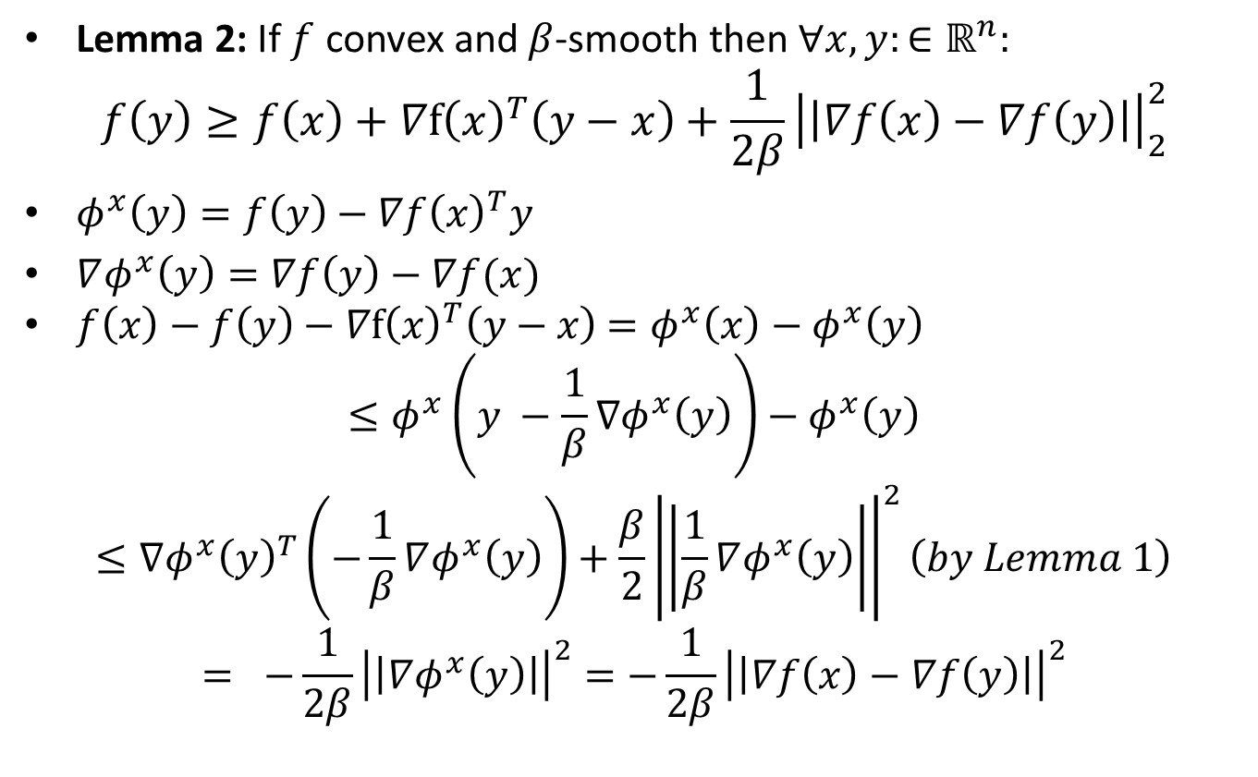
Gradient Descent: Analysis
Lemma 2: If $f$ convex and $β$-smooth then $∀x,y:∈ℝ^{n}:$
$$f\left(y\right)≥f\left(x\right)+∇f{\left(x\right)}^{T}\left(y−x\right)+\frac{1}{2β}{\left|\left|∇f\left(x\right)−∇f\left(y\right)\right|\right|}_{2}^{2}$$
$φ^{x}\left(y\right)=f\left(y\right)−∇f{\left(x\right)}^{T}y$
$∇φ^{x}\left(y\right)=∇f\left(y\right)−∇f(x)$
$f\left(x\right)−f\left(y\right)−∇f{\left(x\right)}^{T}\left(y−x\right)$ $=φ^{x}\left(x\right)−φ^{x}\left(y\right)$
$$≤φ^{x}\left(y −\frac{1}{β}∇φ^{x}\left(y\right)\right)−φ^{x}\left(y\right)$$
$$≤∇φ^{x}{\left(y\right)}^{T}\left(−\frac{1}{β}∇φ^{x}\left(y\right)\right)+\frac{β}{2}{\left|\left|\frac{1}{β}∇φ^{x}\left(y\right)\right|\right|}^{2}\left(by Lemma 1\right)$$
$$= −\frac{1}{2β}{\left|\left|∇φ^{x}\left(y\right)\right|\right|}^{2}=−\frac{1}{2β}{\left|\left|∇f\left(x\right)−∇f\left(y\right)\right|\right|}_{}^{2}$$

Slide 7
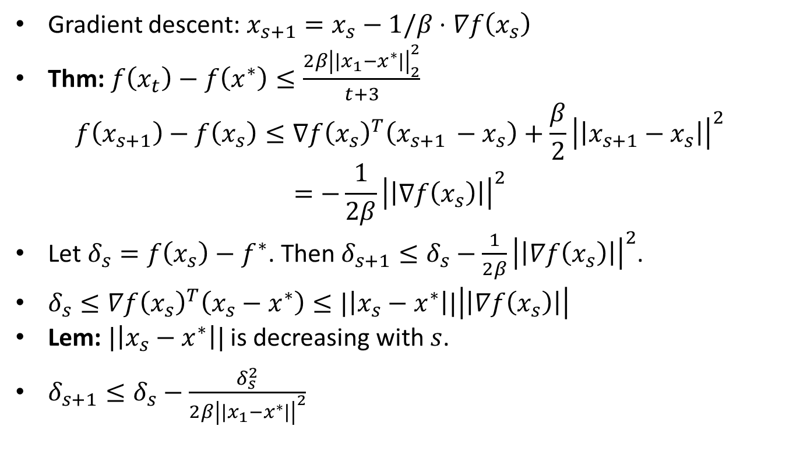
Gradient Descent: Analysis
Gradient descent: $x_{s+1}=x_{s}−1/β⋅∇f\left(x_{s}\right)$
Thm: $f\left(x_{t}\right)−f\left(x^{∗}\right)≤\frac{2β{\left|\left|x_{1}−x^{∗}\right|\right|}_{2}^{2}}{t+3}$
$$f\left(x_{s+1}\right)−f\left(x_{s}\right)≤∇f{\left(x_{s}\right)}^{T}\left(x_{s+1 }−x_{s}\right)+\frac{β}{2}{\left|\left|x_{s+1}−x_{s}\right|\right|}^{2}$$
$$=−\frac{1}{2β}{\left|\left|∇f\left(x_{s}\right)\right|\right|}^{2}$$
Let $δ_{s}=f\left(x_{s}\right)−f^{∗}$. Then $δ_{s+1}≤δ_{s}−\frac{1}{2β}{\left|\left|∇f\left(x_{s}\right)\right|\right|}^{2}$.
$δ_{s}≤∇f{\left(x_{s}\right)}^{T}\left(x_{s}−x^{∗}\right)≤|\left|x_{s}−x^{∗}\right||\left|\left|∇f\left(x_{s}\right)\right|\right|$
Lem: $|\left|x_{s}−x^{∗}\right||$ is decreasing with $s$.
$δ_{s+1}≤δ_{s}−\frac{δ_{s}^{2}}{2β{\left|\left|x_{1}−x^{∗}\right|\right|}^{2}}$

Slide 8
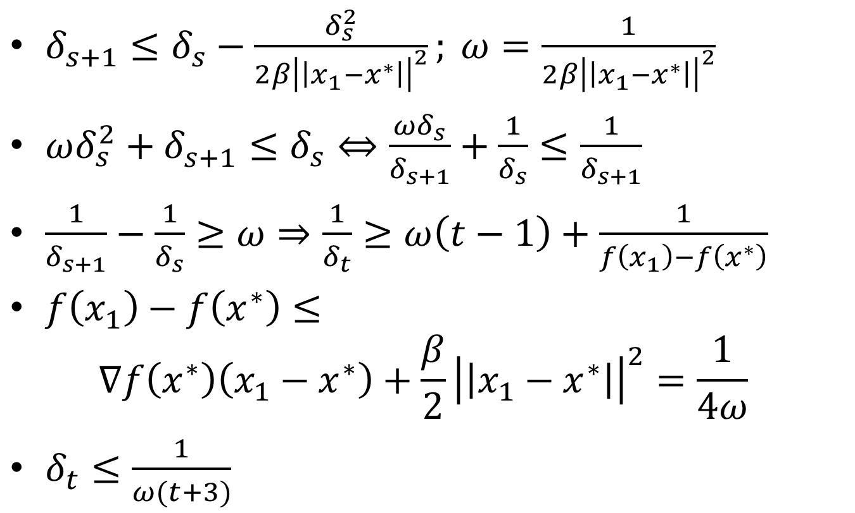
Gradient Descent: Analysis
$δ_{s+1}≤δ_{s}−\frac{δ_{s}^{2}}{2β{\left|\left|x_{1}−x^{∗}\right|\right|}^{2}}; ω=\frac{1}{2β{\left|\left|x_{1}−x^{∗}\right|\right|}^{2}}$
$ωδ_{s}^{2}+δ_{s+1}^{}≤δ_{s}⇔\frac{{ωδ}_{s}}{δ_{s+1}}+\frac{1}{δ_{s}}≤\frac{1}{δ_{s+1}}$
$\frac{1}{δ_{s+1}}−\frac{1}{δ_{s}}≥ω⇒\frac{1}{δ_{t}}≥ω\left(t−1\right)+\frac{1}{f\left(x_{1}\right)−f\left(x^{∗}\right)}$
$f\left(x_{1}\right)−f\left(x^{∗}\right)≤$
$$∇f\left(x^{∗}\right)\left(x_{1}−x^{∗}\right)+\frac{β}{2}{\left|\left|x_{1}−x^{∗}\right|\right|}^{2}=\frac{1}{4ω}$$
$δ_{t}≤\frac{1}{ω(t+3)}$

Slide 9
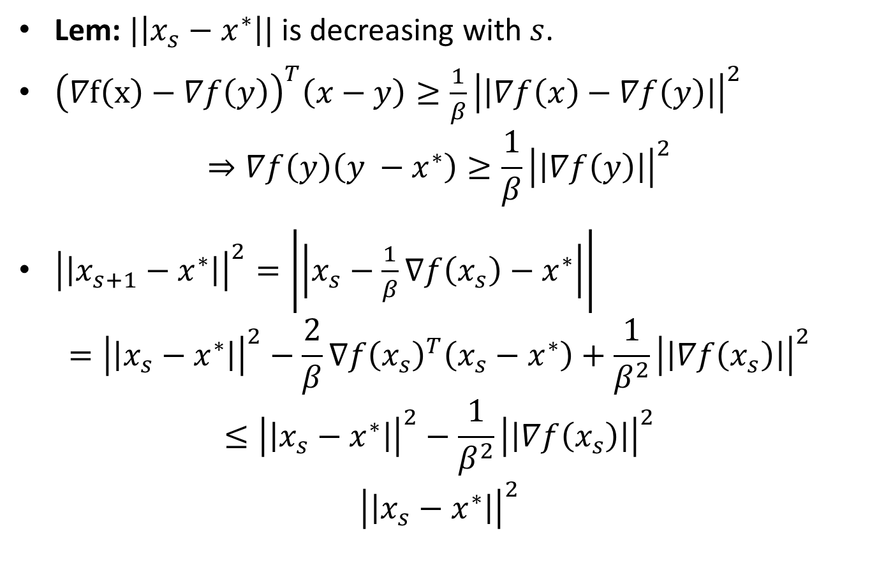
Gradient Descent: Analysis
Lem: $|\left|x_{s}−x^{∗}\right||$ is decreasing with $s$.
${\left(∇f\left(x\right)−∇f\left(y\right)\right)}^{T}\left(x−y\right)≥\frac{1}{β}{\left|\left|∇f\left(x\right)−∇f\left(y\right)\right|\right|}^{2}$
$$⇒∇f\left(y\right)\left({y −x}^{∗}\right)≥\frac{1}{β}{\left|\left|∇f\left(y\right)\right|\right|}^{2}$$
${\left|\left|x_{s+1}−x^{∗}\right|\right|}^{2}=\left|\left|x_{s}−\frac{1}{β}∇f\left(x_{s}\right)−x^{∗}\right|\right|$
$$={\left|\left|x_{s}−x^{∗}\right|\right|}^{2}−\frac{2}{β}∇f{\left(x_{s}\right)}^{T}\left(x_{s}−x^{∗}\right)+\frac{1}{β^{2}}{\left|\left|∇f\left(x_{s}\right)\right|\right|}^{2}$$
$$≤{\left|\left|x_{s}−x^{∗}\right|\right|}^{2}−\frac{1}{β^{2}}{\left|\left|∇f\left(x_{s}\right)\right|\right|}^{2}$$
$${\left|\left|x_{s}−x^{∗}\right|\right|}^{2}$$

Slide 10
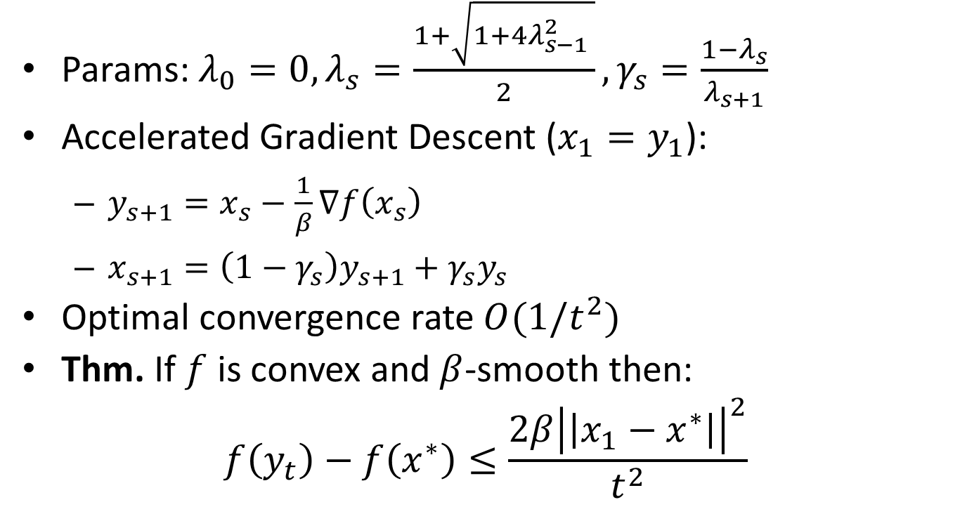
Nesterov’s Accelerated Gradient Descent
Params: $λ_{0}=0, λ_{s}=\frac{1+\sqrt{1+4λ_{s−1}^{2} }}{2}, γ_{s}=\frac{1−λ_{s}}{λ_{s+1}}$
Accelerated Gradient Descent ($x_{1}=y_{1}$):
$y_{s+1}=x_{s}−\frac{1}{β}∇f\left(x_{s}\right)$
$x_{s+1}=\left(1−γ_{s}\right)y_{s+1}+γ_{s}y_{s}$
Optimal convergence rate $O(1/t^{2})$
Thm. If $f$ is convex and $β$-smooth then:
$$f\left(y_{t}\right)−f\left(x^{∗}\right)≤\frac{2β{\left|\left|x_{1}−x^{∗}\right|\right|}^{2}}{t^{2}}$$

Slide 11
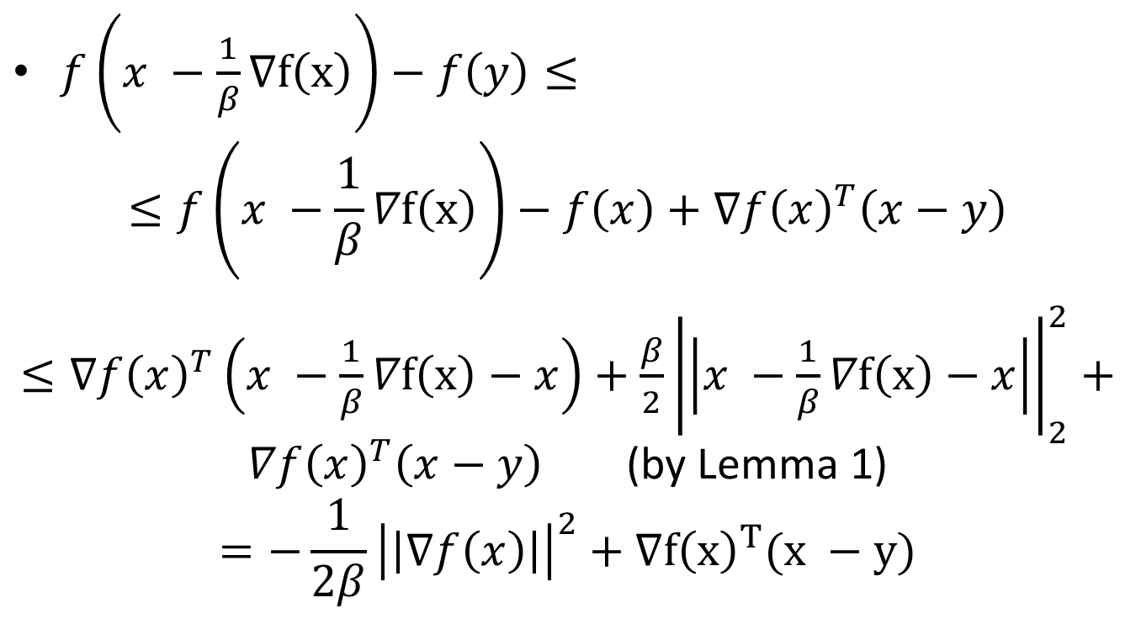
Accelerated Gradient Descent: Analysis
$f\left(x −\frac{1}{β}∇f\left(x\right)\right)−f\left(y\right)≤$
$$≤f\left(x −\frac{1}{β}∇f\left(x\right)\right)−f\left(x\right)+∇f{\left(x\right)}^{T}\left(x−y\right)$$
$≤∇{f\left(x\right)}^{T}\left(x −\frac{1}{β}∇f\left(x\right)−x\right)+\frac{β}{2}{\left|\left|x −\frac{1}{β}∇f\left(x\right)−x\right|\right|}_{2}^{2}+∇f{\left(x\right)}^{T}\left(x−y\right)$ (by Lemma 1)
$$=−\frac{1}{2β}{\left|\left|∇f\left(x\right)\right|\right|}^{2}+∇f{\left(x\right)}^{T}(x −y)$$

Slide 12
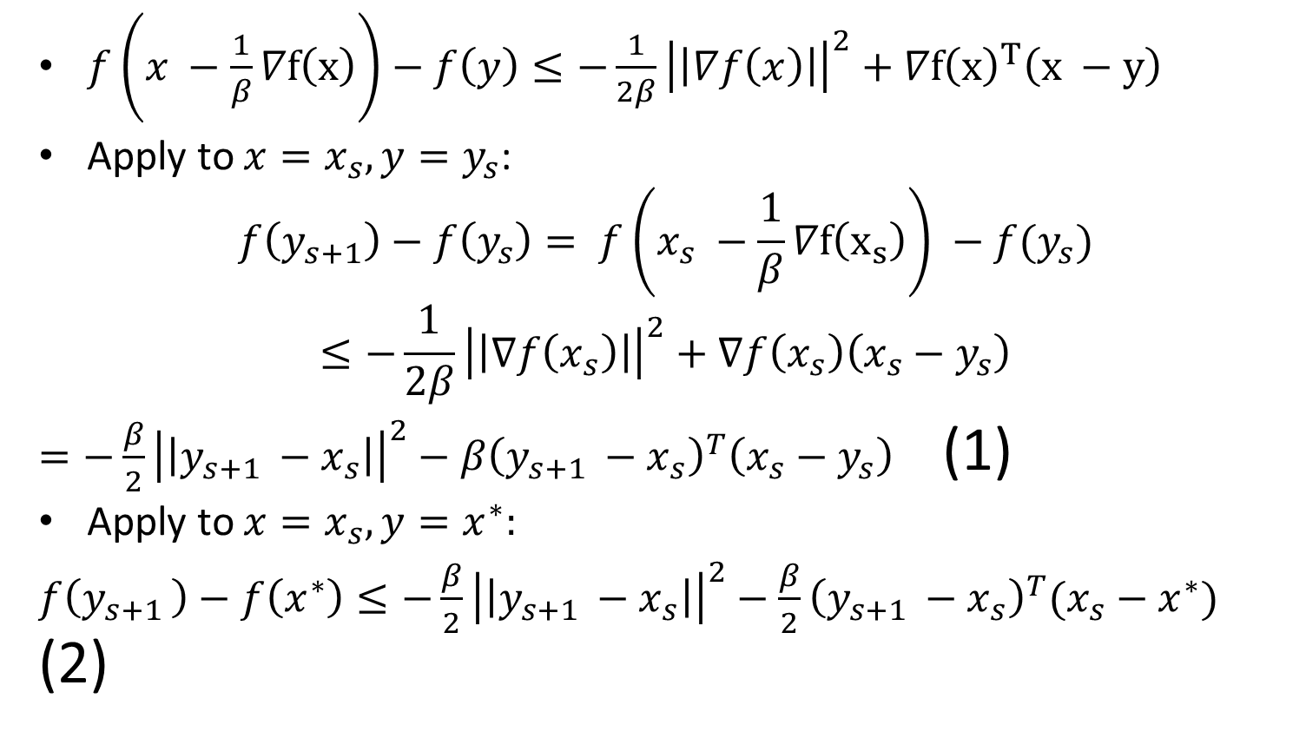
Accelerated Gradient Descent: Analysis
$f\left(x −\frac{1}{β}∇f\left(x\right)\right)−f\left(y\right)≤−\frac{1}{2β}{\left|\left|∇f\left(x\right)\right|\right|}^{2}+∇f{\left(x\right)}^{T}\left(x −y\right)$
Apply to $x=x_{s}, y=y_{s}$:
$$f\left(y_{s+1}\right)−f\left(y_{s}\right)= f\left(x_{s} −\frac{1}{β}∇f\left(x_{s}\right)\right) −f(y_{s})$$
$$≤−\frac{1}{2β}{\left|\left|∇f\left(x_{s}\right)\right|\right|}^{2}+∇f\left(x_{s}\right)\left(x_{s}−y_{s}\right)$$
$=−\frac{β}{2}{\left|\left|y_{s+1 }−x_{s}\right|\right|}_{}^{2}−β{\left(y_{s+1 }−x_{s}\right)}^{T}\left(x_{s}−y_{s}\right)$ (1)
Apply to $x=x_{s}, y=x^{∗}:$
$f\left(y_{s+1 }\right)−f\left(x^{∗}\right)≤−\frac{β}{2}{\left|\left|y_{s+1 }−x_{s}\right|\right|}^{2}−\frac{β}{2}{\left(y_{s+1 }−x_{s}\right)}^{T}(x_{s}−x^{∗})$ (2)

Slide 13
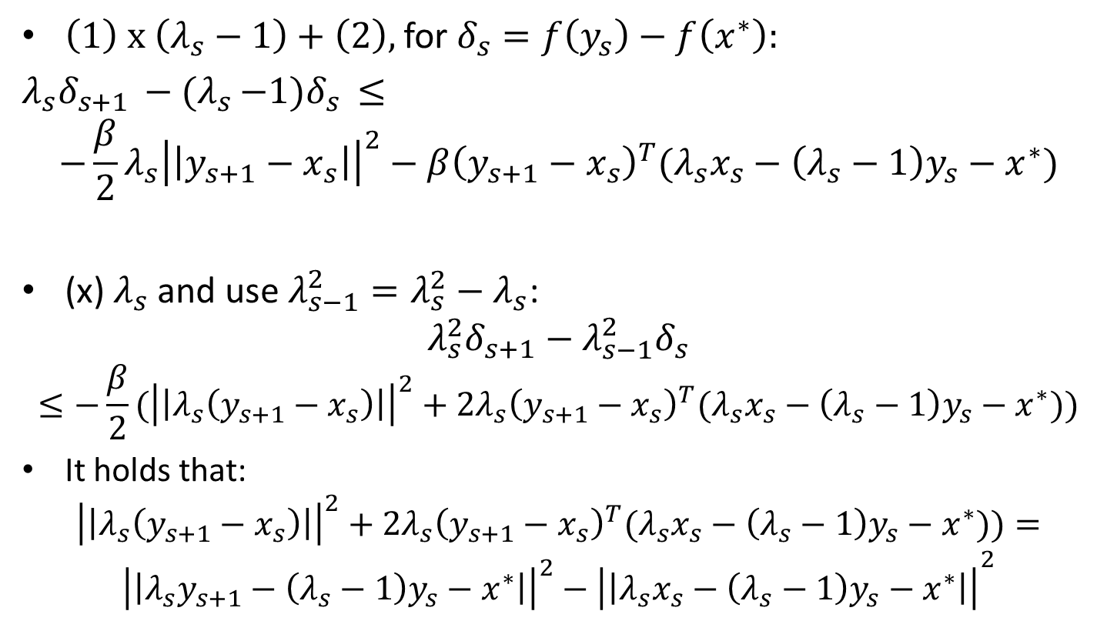
Accelerated Gradient Descent: Analysis
$\left(1\right) x \left(λ_{s}−1\right)+\left(2\right),$ for $δ_{s}=f\left(y_{s}\right)−f\left(x^{∗}\right):$
$λ_{s}δ_{s+1 }−{(λ}_{s }−1)δ_{s }≤$
$$−\frac{β}{2}λ_{s}{\left|\left|y_{s+1}−x_{s}\right|\right|}^{2}−β{\left(y_{s+1}−x_{s}\right)}^{T}(λ_{s}x_{s}−\left(λ_{s}−1\right)y_{s}−x^{∗})$$
(x) $λ_{s}$ and use $λ_{s−1}^{2}=λ_{s}^{2}−λ_{s}$:
$$λ_{s}^{2}δ_{s+1}−λ_{s−1}^{2}δ_{s}$$
$$≤−\frac{β}{2}({\left|\left|λ_{s}\left(y_{s+1}−x_{s}\right)\right|\right|}^{2}+2λ_{s}{\left(y_{s+1}−x_{s}\right)}^{T}(λ_{s}x_{s}−\left(λ_{s}−1\right)y_{s}−x^{∗}))$$
It holds that:
$${\left|\left|λ_{s}\left(y_{s+1}−x_{s}\right)\right|\right|}^{2}+2λ_{s}{\left(y_{s+1}−x_{s}\right)}^{T}(λ_{s}x_{s}−\left(λ_{s}−1\right)y_{s}−x^{∗}))=$$
$${{\left|\left|λ_{s}y_{s+1}−\left(λ_{s}−1\right)y_{s}−x^{∗}\right|\right|}^{2}−\left|\left|λ_{s}x_{s}−\left(λ_{s}−1\right)y_{s}−x^{∗}\right|\right|}^{2}$$

Slide 14
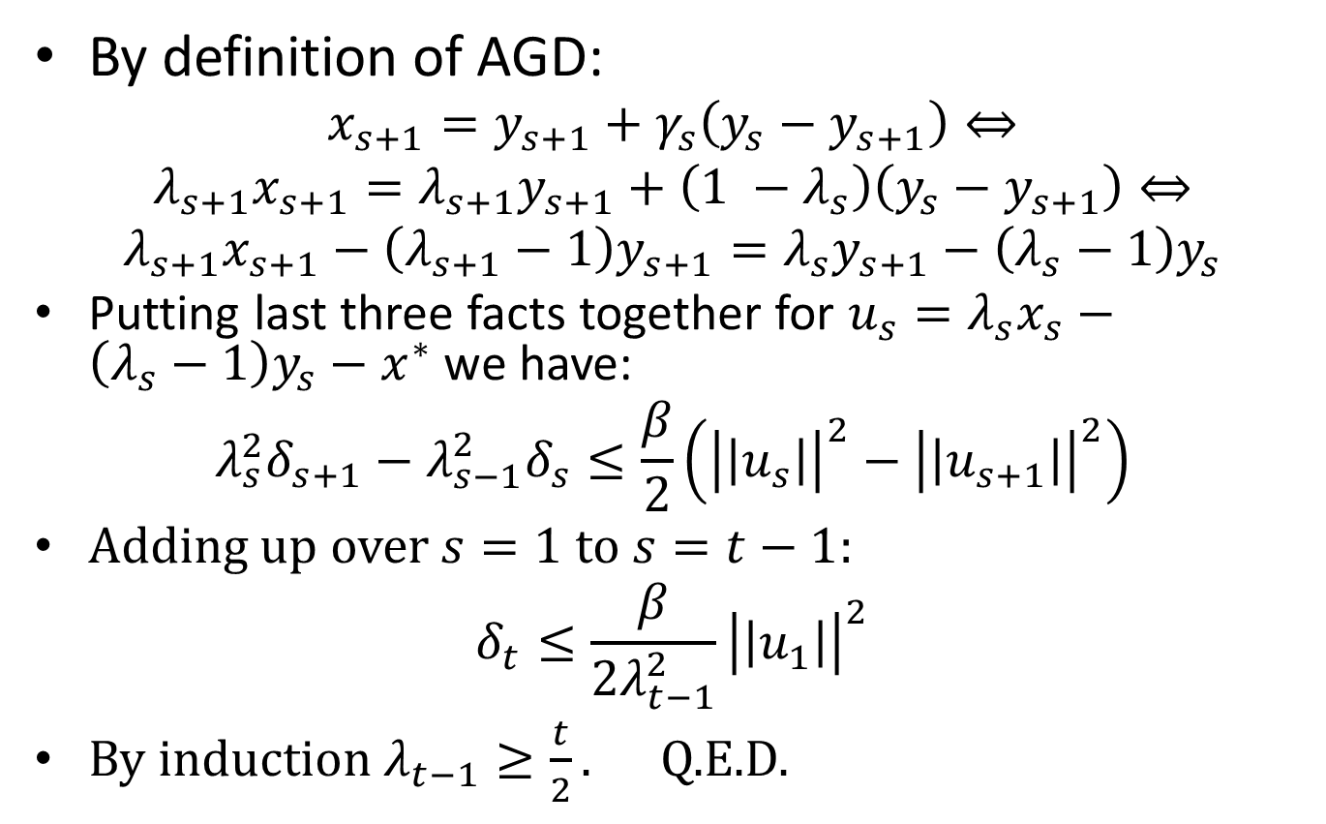
Accelerated Gradient Descent: Analysis
By definition of AGD:
$$x_{s+1}=y_{s+1}+γ_{s}\left(y_{s}−y_{s+1}\right)⇔$$
$λ_{s+1}x_{s+1}=λ_{s+1}y_{s+1}+\left(1 −λ_{s}\right)\left(y_{s}−y_{s+1}\right)⇔$
$$λ_{s+1}x_{s+1}−\left(λ_{s+1}−1\right)y_{s+1}=λ_{s}y_{s+1}−\left(λ_{s}−1\right)y_{s}$$
Putting last three facts together for $u_{s}=λ_{s}x_{s}−\left(λ_{s}−1\right)y_{s}−x^{∗}$ we have:
$$λ_{s}^{2}δ_{s+1}−λ_{s−1}^{2}δ_{s}≤\frac{β}{2}\left({\left|\left|u_{s}\right|\right|}^{2}−{\left|\left|u_{s+1}\right|\right|}^{2}\right)$$
Adding up over $s=1$ to $s=t−1$:
$$δ_{t}≤\frac{β}{2λ_{t−1}^{2}}{\left|\left|u_{1}\right|\right|}^{2}$$
By induction $λ_{t−1}≥\frac{t}{2}.$ Q.E.D.

Slide 15
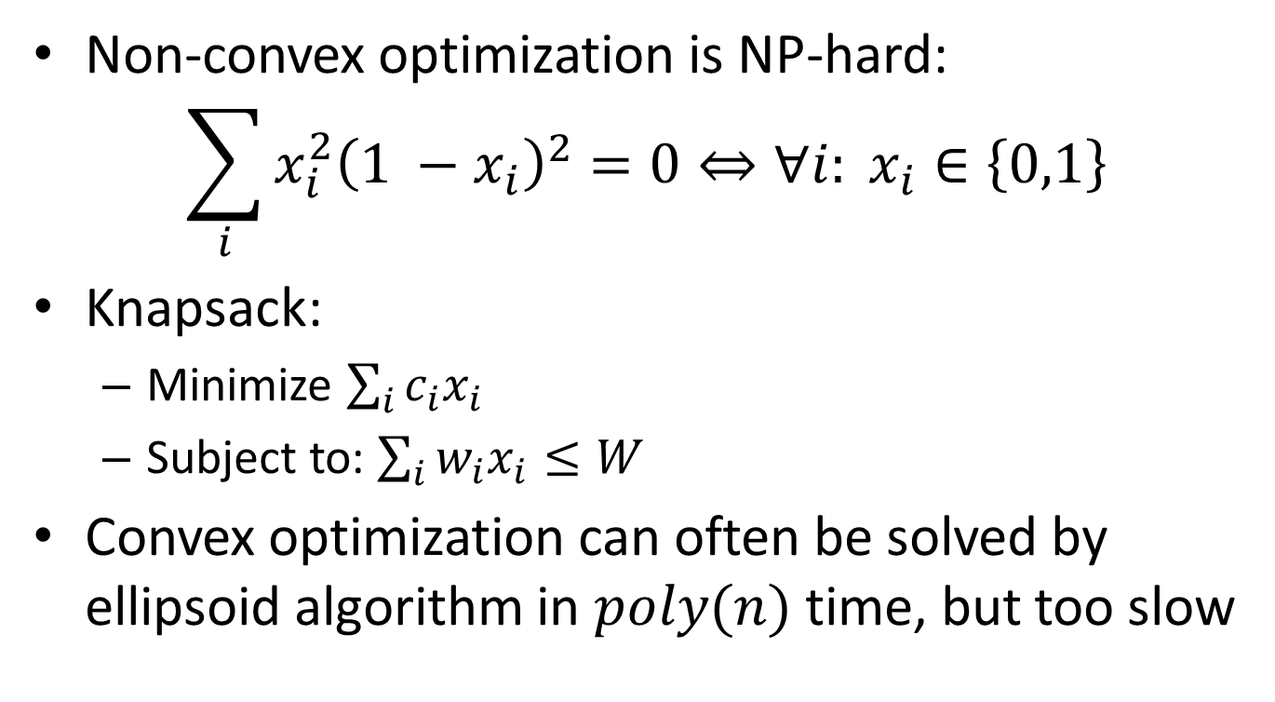
Constrained Convex Optimization
Non-convex optimization is NP-hard:
$$\sum_{i}{x_{i}^{2}{\left(1 −x_{i}\right)}^{2}=0}⇔∀i: x_{i}∈\left\{0,1\right\}$$
Knapsack:
Minimize $\sum_{i}{c_{i}x_{i}}$
Subject to: $\sum_{i}{w_{i}x_{i}≤W}$
Convex optimization can often be solved by ellipsoid algorithm in $poly(n)$ time, but too slow

Slide 16
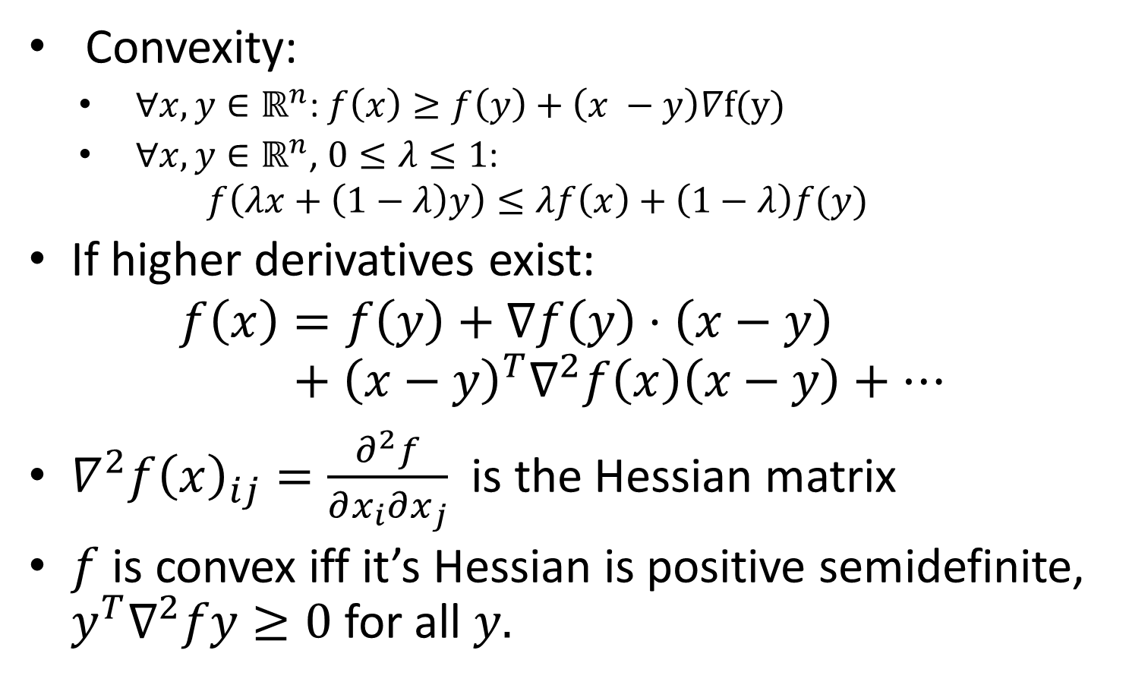
Convex multivariate functions
Convexity:
$∀x,y∈ℝ^{n}$: $f\left(x\right)≥f\left(y\right)+\left(x −y\right)∇f(y)$
$∀x,y∈ℝ^{n}$, $0≤λ≤1$:
$$f\left(λx+\left(1−λ\right)y\right)≤λf\left(x\right)+\left(1−λ\right)f(y)$$
If higher derivatives exist:
$$f\left(x\right)=f\left(y\right)+∇f\left(y\right)⋅\left(x−y\right)+{\left(x−y\right)}^{T}∇^{2}f\left(x\right)\left(x−y\right)+…$$
$∇^{2}f{\left(x\right)}_{ij}=\frac{∂^{2}f}{∂x_{i}∂x_{j}}$ is the Hessian matrix
$f$ is convex iff it’s Hessian is positive semidefinite, $y^{T}∇^{2}fy≥0$ for all $y.$

Slide 17
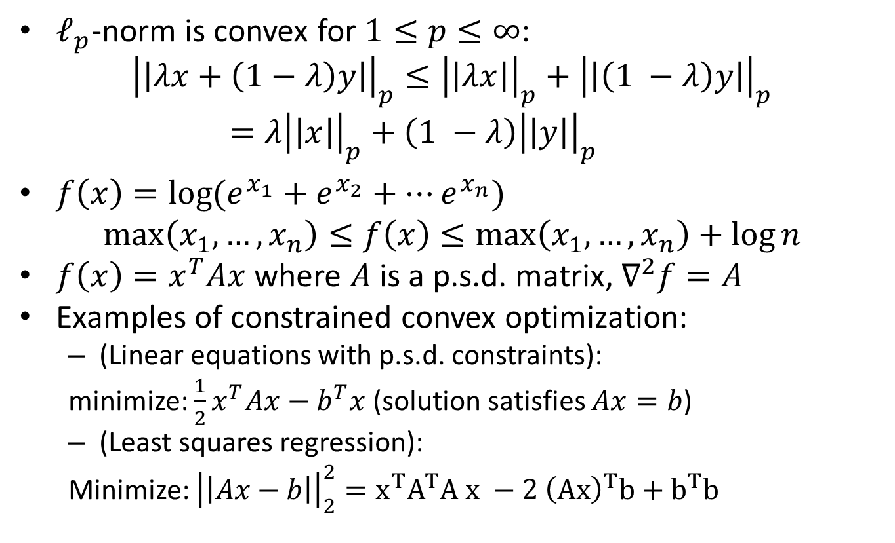
Examples of convex functions
$ℓ_{p}$-norm is convex for $1≤p≤∞$:
$${\left|\left|λx+\left(1−λ\right)y\right|\right|}_{p}≤{\left|\left|λx\right|\right|}_{p}+{\left|\left|\left(1 −λ\right)y\right|\right|}_{p}=λ{\left|\left|x\right|\right|}_{p}+\left(1 −λ\right){\left|\left|y\right|\right|}_{p}$$
$f\left(x\right)=\log{(e_{}^{x_{1}}+e_{}^{x_{2}}+⋯e_{}^{x_{n}})}$
$$\max\left(x_{1},…, x_{n}\right)≤f\left(x\right)≤\max\left(x_{1},…, x_{n}\right)+\log{n}$$
$f\left(x\right)=x^{T}Ax$ where $A$ is a p.s.d. matrix, $∇^{2}f=A$
Examples of constrained convex optimization:
(Linear equations with p.s.d. constraints):
minimize: $\frac{1}{2}x^{T}Ax−b^{T}x$ (solution satisfies $Ax=b$)
(Least squares regression):
Minimize: ${\left|\left|Ax−b\right|\right|}_{2}^{2}=x^{T}A^{T}A x −2 {\left(Ax\right)}^{T}b+b^{T}b$

Slide 18
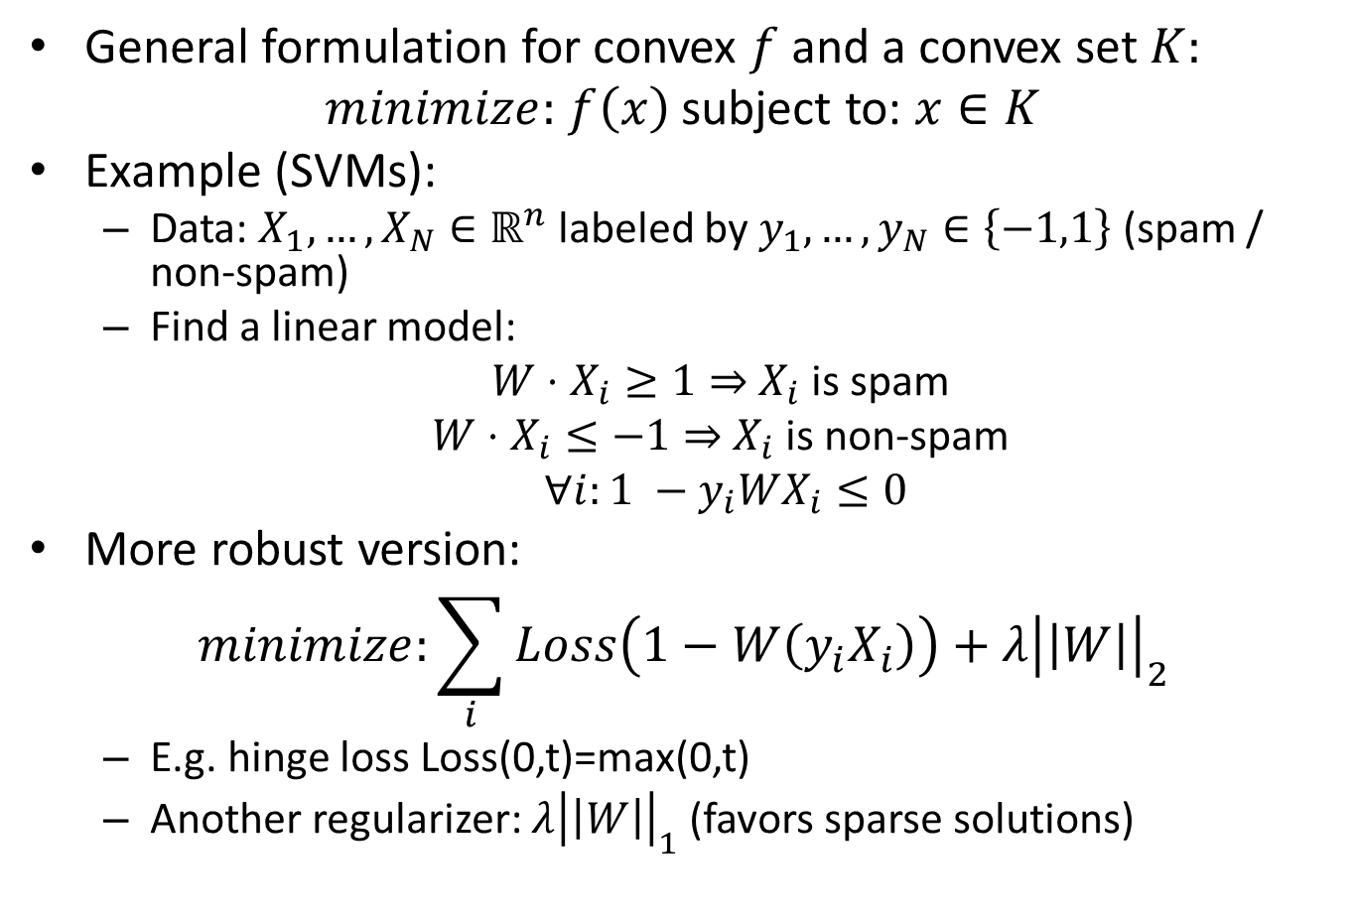
Constrained Convex Optimization
General formulation for convex $f$ and a convex set $K:$
$minimize:$ $f\left(x\right)$ subject to: $x∈K$
Example (SVMs):
Data: $X_{1},…,X_{N}∈ℝ^{n}$ labeled by $y_{1},…, y_{N}∈\left\{−1,1\right\}$ (spam / non-spam)
Find a linear model:
$W⋅X_{i}≥1⇒$ $X_{i}$ is spam
$W⋅X_{i}≤−1⇒$ $X_{i}$ is non-spam
$∀i:1 −y_{i}WX_{i}≤0$
More robust version:
$$minimize:\sum_{i}{Loss\left(1−W\left(y_{i}X_{i}\right)\right)+λ{\left|\left|W\right|\right|}_{2}^{}}$$
E.g. hinge loss Loss(0,t)=max(0,t)
Another regularizer: ${λ\left|\left|W\right|\right|}_{1}$ (favors sparse solutions)

Slide 19
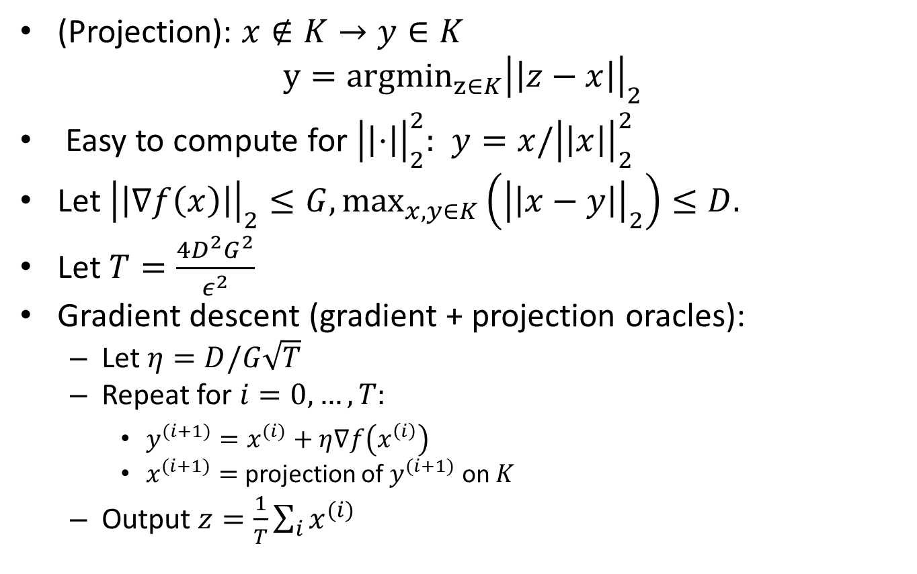
Gradient Descent for Constrained Convex Optimization
(Projection): $x∉K→y∈K$
$$y={argmin}_{z∈K}{\left|\left|z−x\right|\right|}_{2}$$
Easy to compute for ${\left|\left|⋅\right|\right|}_{2}^{2}:$ $y=x/{\left|\left|x\right|\right|}_{2}^{2}$
Let ${\left|\left|∇f\left(x\right)\right|\right|}_{2}≤G,\max_{x,y∈K}\left({\left|\left|x−y\right|\right|}_{2}\right)≤D.$
Let $T=\frac{4D^{2}G^{2}}{ε^{2}}$
Gradient descent (gradient + projection oracles):
Let $η=D/G\sqrt{T}$
Repeat for $i=0, …, T:$
$y^{(i+1)}=x^{(i)}+η∇f\left(x^{\left(i\right)}\right)$
$x^{(i+1)}=$ projection of $y^{(i+1)}$ on $K$
Output $z=\frac{1}{T}\sum_{i}{x^{(i)}}$

Slide 20
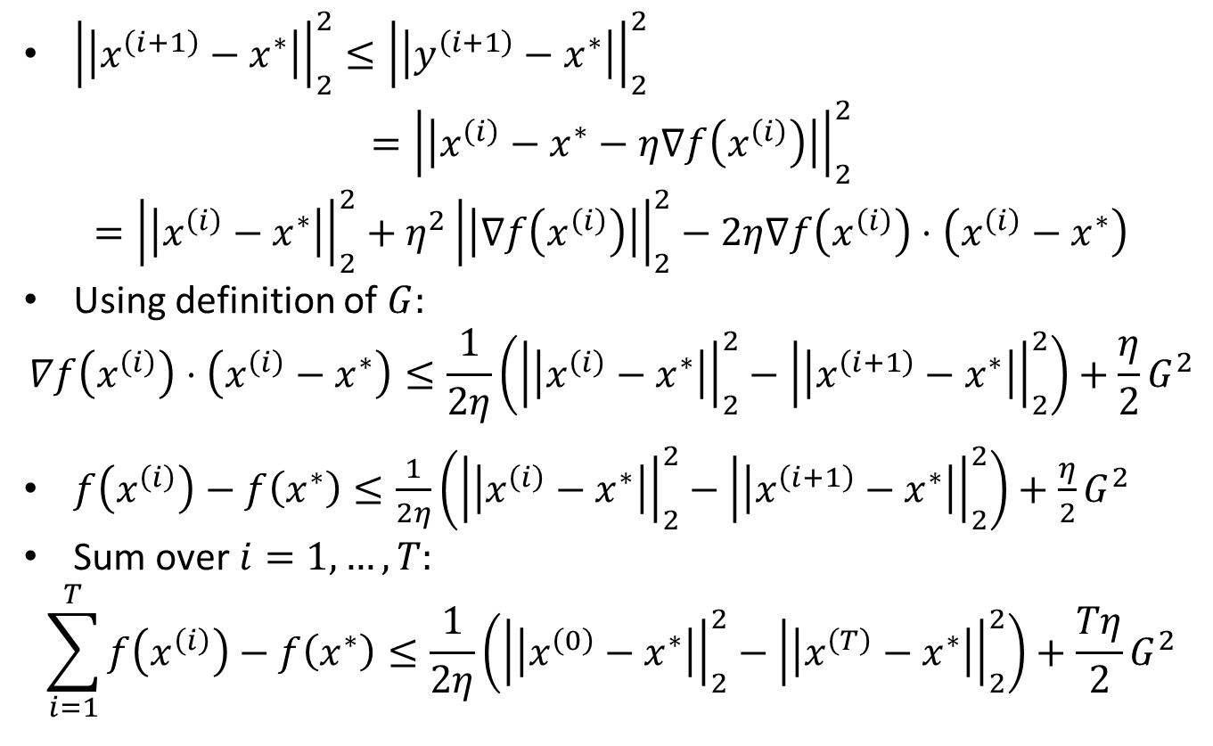
Gradient Descent for Constrained Convex Optimization
${\left|\left|x^{\left(i+1\right)}−x^{∗}\right|\right|}_{2}^{2}≤{\left|\left|y^{\left(i+1\right)}−x^{∗}\right|\right|}_{2}^{2}$
$$={\left|\left|x^{\left(i\right)}−x^{∗}−η∇f\left(x^{\left(i\right)}\right)\right|\right|}_{2}^{2}$$
$$={\left|\left|x^{\left(i\right)}−x^{∗}\right|\right|}_{2}^{2}+η^{2}{\left|\left|∇f\left(x^{\left(i\right)}\right)\right|\right|}_{2}^{2}−2η∇f\left(x^{\left(i\right)}\right)⋅\left(x^{\left(i\right)}−x^{∗}\right)$$
Using definition of $G:$
$$∇f\left(x^{\left(i\right)}\right)⋅\left(x^{\left(i\right)}−x^{∗}\right)≤\frac{1}{2η}\left({\left|\left|x^{\left(i\right)}−x^{∗}\right|\right|}_{2}^{2}−{\left|\left|x^{\left(i+1\right)}−x^{∗}\right|\right|}_{2}^{2}\right)+\frac{η}{2}G^{2}$$
$f\left(x^{\left(i\right)}\right)−f\left(x^{∗}\right)≤\frac{1}{2η}\left({\left|\left|x^{\left(i\right)}−x^{∗}\right|\right|}_{2}^{2}−{\left|\left|x^{\left(i+1\right)}−x^{∗}\right|\right|}_{2}^{2}\right)+\frac{η}{2}G^{2}$
Sum over $i=1,…, T:$
$$\sum_{i=1}^{T}{f\left(x^{\left(i\right)}\right)−f\left(x^{∗}\right)}≤\frac{1}{2η}\left({\left|\left|x^{\left(0\right)}−x^{∗}\right|\right|}_{2}^{2}−{\left|\left|x^{\left(T\right)}−x^{∗}\right|\right|}_{2}^{2}\right)+\frac{Tη}{2}G^{2}$$

Slide 21
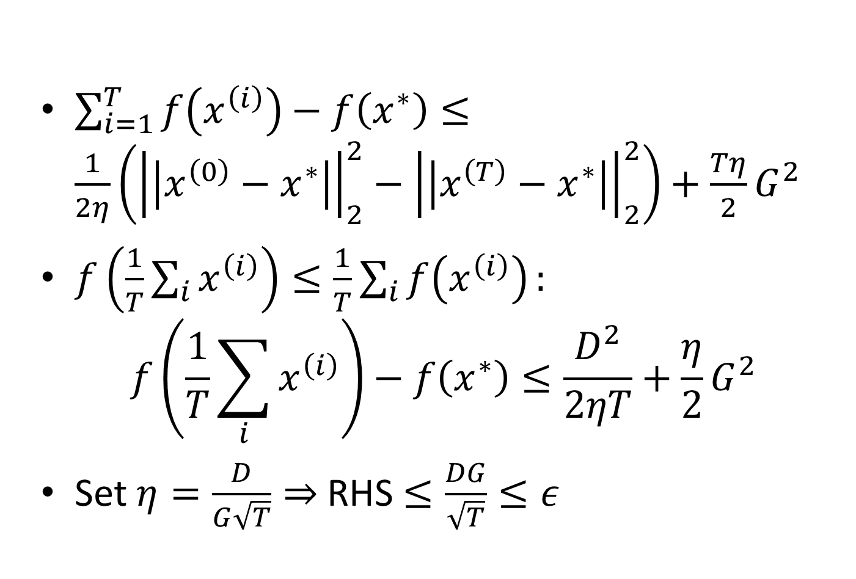
Gradient Descent for Constrained Convex Optimization
$\sum_{i=1}^{T}{f\left(x^{\left(i\right)}\right)−f\left(x^{∗}\right)}≤\frac{1}{2η}\left({\left|\left|x^{\left(0\right)}−x^{∗}\right|\right|}_{2}^{2}−{\left|\left|x^{\left(T\right)}−x^{∗}\right|\right|}_{2}^{2}\right)+\frac{Tη}{2}G^{2}$
$f\left(\frac{1}{T}\sum_{i}{x^{\left(i\right)}}\right)≤\frac{1}{T}\sum_{i}{f\left(x^{\left(i\right)}\right)}:$
$$f\left(\frac{1}{T}\sum_{i}{x^{\left(i\right)}}\right)−f\left(x^{∗}\right)≤\frac{D^{2}}{2ηT}+\frac{η}{2}G^{2}$$
Set $η=\frac{D}{G\sqrt{T}}⇒$ RHS $≤\frac{DG}{\sqrt{T}}≤ε$

Slide 22
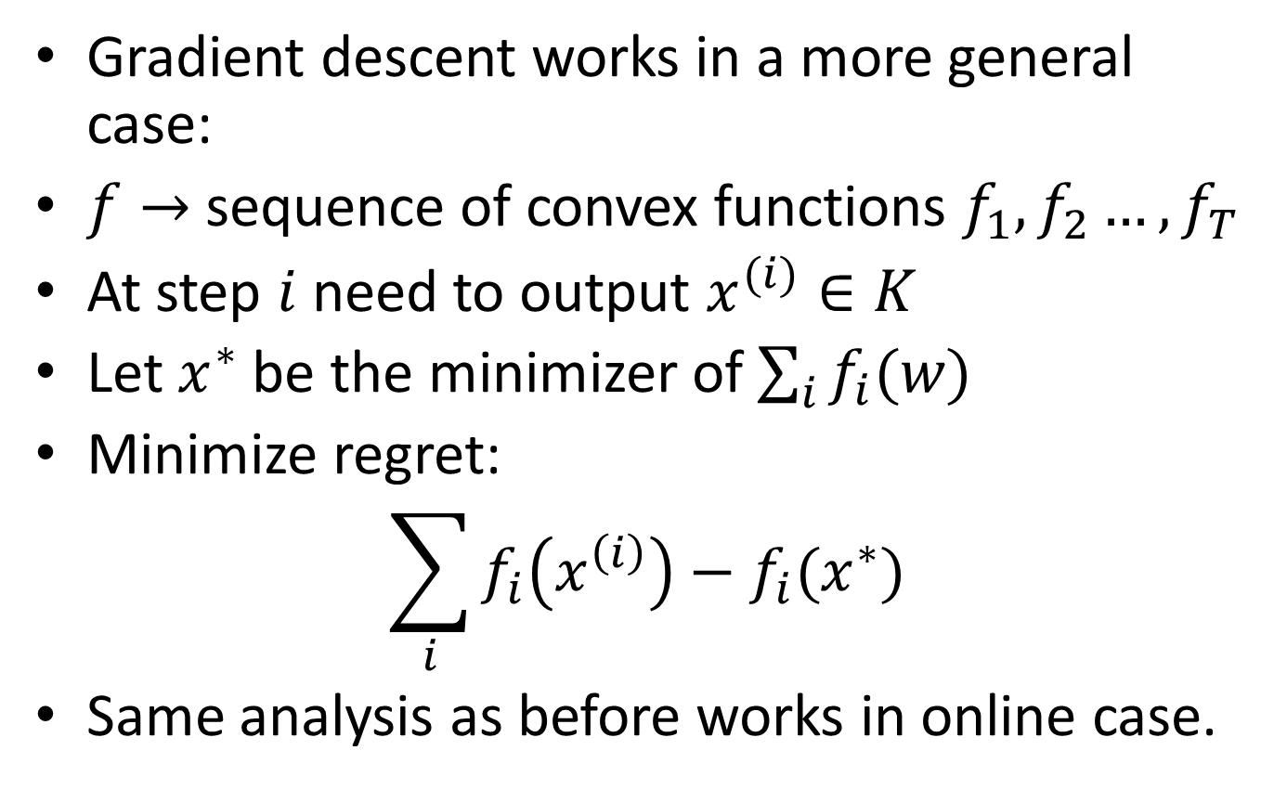
Online Gradient Descent
Gradient descent works in a more general case:
$f→$ sequence of convex functions $f_{1},f_{2}…, f_{T}$
At step $i$ need to output $x^{(i)}∈K$
Let $x^{∗}$ be the minimizer of $\sum_{i}{f_{i}(w)}$
Minimize regret:
$$\sum_{i}{f_{i}\left(x^{\left(i\right)}\right)−f_{i}(x^{∗})}$$
Same analysis as before works in online case.

Slide 23
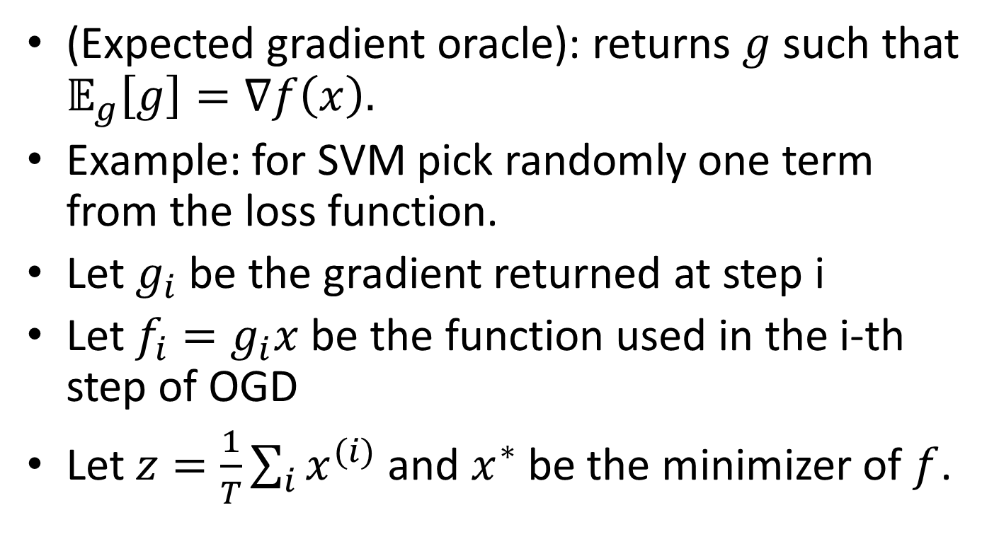
Stochastic Gradient Descent
(Expected gradient oracle): returns $g$such that $𝔼_{g}\left[g\right]=∇f\left(x\right).$
Example: for SVM pick randomly one term from the loss function.
Let $g_{i}$ be the gradient returned at step i
Let $f_{i}=g_{i}x$ be the function used in the i-th step of OGD
Let $z=\frac{1}{T}\sum_{i}{x^{(i)}}$ and $x^{∗}$ be the minimizer of $f$.

Slide 24
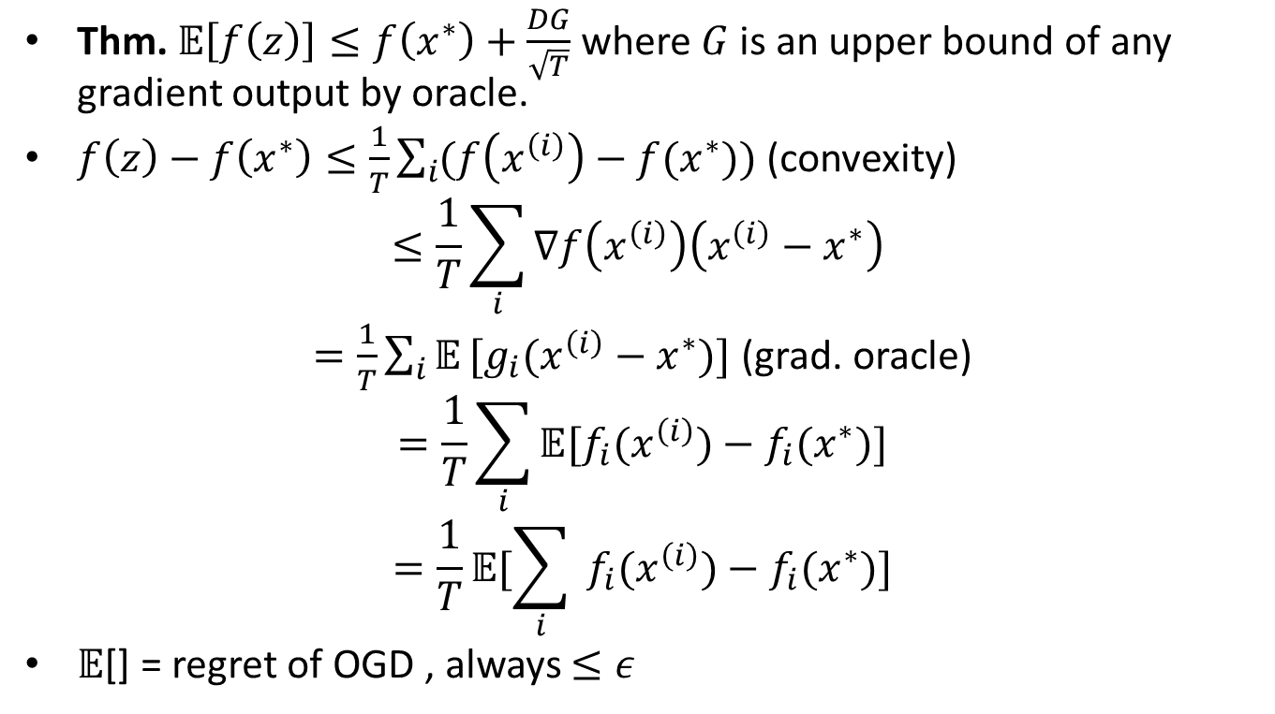
Stochastic Gradient Descent
Thm. 𝔼$\left[f\left(z\right)\right]≤f\left(x^{∗}\right)+\frac{DG}{\sqrt{T}}$ where $G$ is an upper bound of any gradient output by oracle.
$f\left(z\right)−f\left(x^{∗}\right)≤\frac{1}{T}\sum_{i}{(f\left(x^{\left(i\right)}\right)−f(x^{∗}))}$ (convexity)
$$≤\frac{1}{T}\sum_{i}{∇f\left(x^{\left(i\right)}\right)\left(x^{\left(i\right)}−x^{∗}\right)}$$
$=\frac{1}{T}\sum_{i}{𝔼}[g_{i}(x^{\left(i\right)}−x^{∗})]$ (grad. oracle)
$$=\frac{1}{T}\sum_{i}{𝔼[f_{i}(x^{\left(i\right)})−{f_{i}(x}^{∗})]}$$
$$=\frac{1}{T}𝔼[\sum_{i}{ f_{i}(x^{\left(i\right)})−{f_{i}(x}^{∗})]}$$
$𝔼$[] = regret of OGD , always $≤ε$

