Slide 1
Parallel Algorithms for Geometric Graph Problems
Grigory Yaroslavtsev
http://grigory.us + /blog/
STOC 2014, joint work with Alexandr Andoni, Krzysztof Onak and Aleksandar Nikolov.

Slide 2
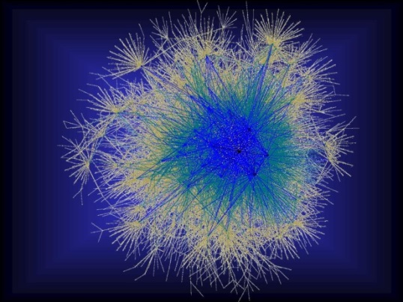
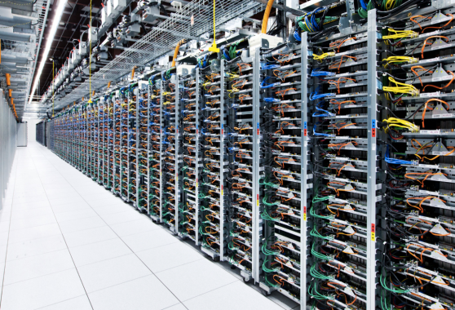
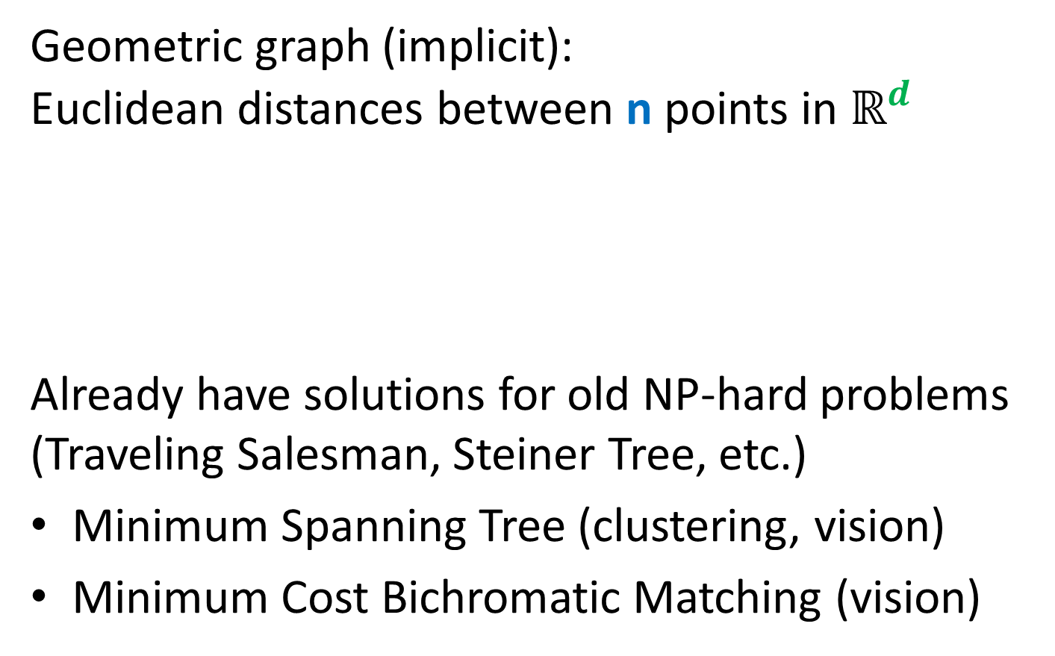
Approximating Geometric Problems in Parallel Models
Geometric graph (implicit): Euclidean distances between n points in $ℝ^{d}$
Already have solutions for old NP-hard problems (Traveling Salesman, Steiner Tree, etc.)
Minimum Spanning Tree (clustering, vision)
Minimum Cost Bichromatic Matching (vision)
Notes:
Question: do we really have an O(1)-round algorithm for TSP and Steiner Tree?

Slide 3
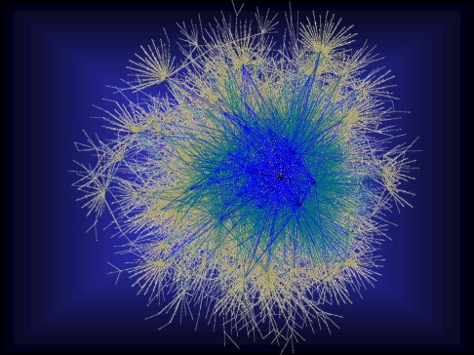



Geometric Graph Problems
Combinatorial problems on graphs in $ℝ^{d}$
Polynomial time (“easy”)
Minimum Spanning Tree
Earth-Mover Distance =
Min Weight Bi-chromatic Matching
NP-hard (“hard”)
Steiner Tree
Traveling Salesman
Clustering (k-medians, facility location, etc.)
Need new theory!
Arora-Mitchell-style “Divide and Conquer”, easy to implement in Massively Parallel Computational Models

Slide 4
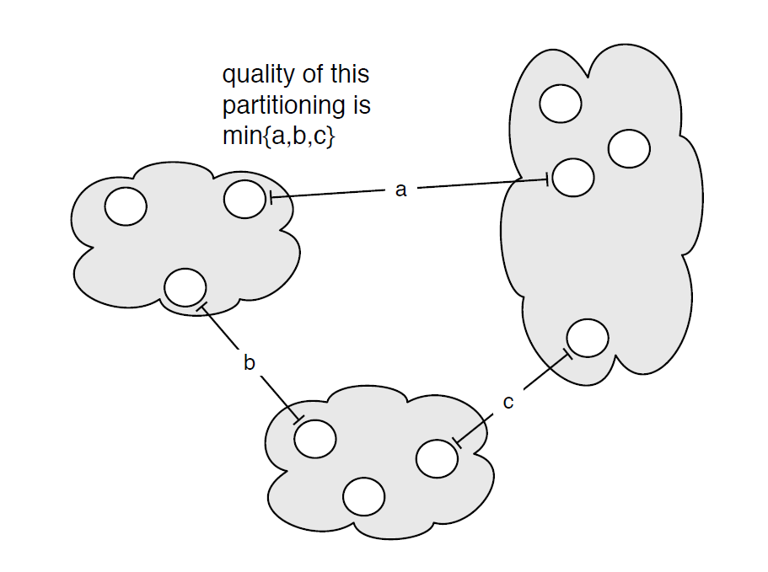

MST: Single Linkage Clustering
[Zahn’71] Clustering via MST (Single-linkage):
k clusters: remove $k−1$ longest edges from MST
Maximizes minimum intercluster distance
[Kleinberg, Tardos]
Notes:
“”

Slide 5
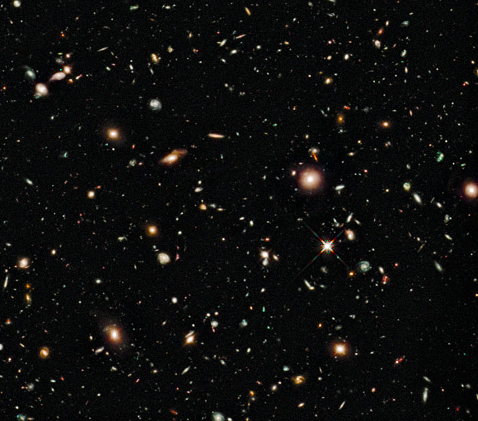
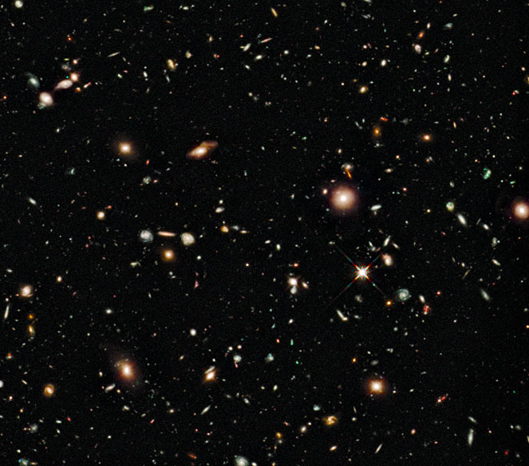
Earth-Mover Distance
Computer vision: compare two pictures of moving objects (stars, MRI scans)

Slide 6
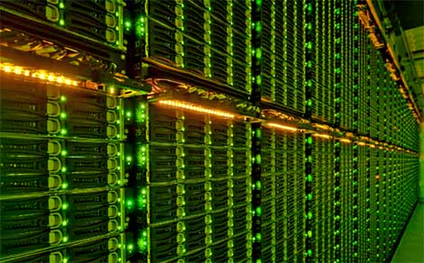
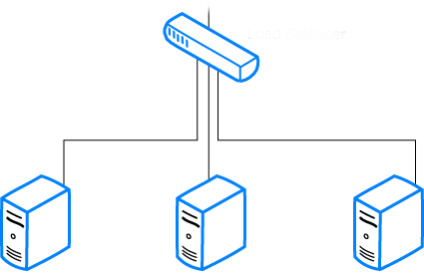

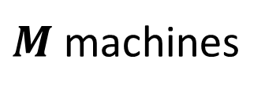
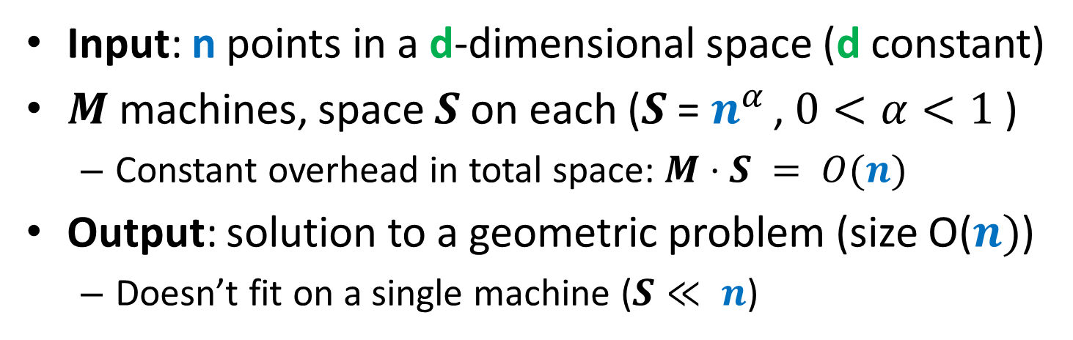

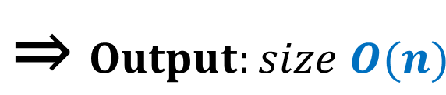

Computational Model
Input: n points in a d-dimensional space (d constant)
$M$ machines, space $S$ on each ($S$ = $n^{α }$, $0<α<1$ )
Constant overhead in total space: $M⋅S = O(n)$
Output: solution to a geometric problem (size O($n)$)
Doesn’t fit on a single machine ($S≪ n$)
$Input: n$ points ⇒
$$\text{⇒} Output:size O(n)$$
$M$machines
S space

Slide 7



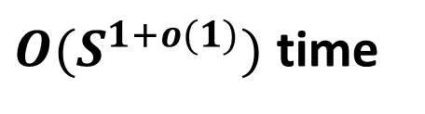
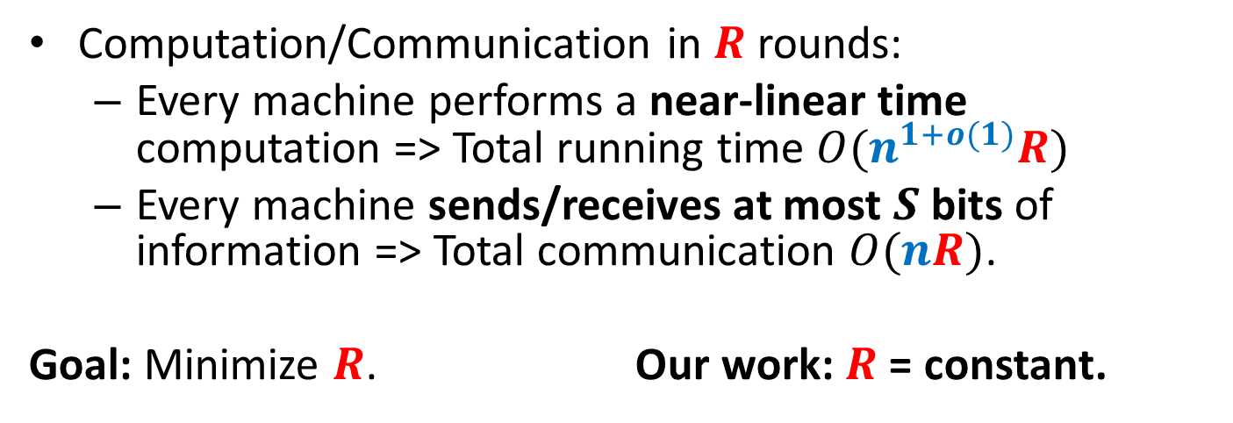
Computational Model
Computation/Communication in $R$ rounds:
Every machine performs a near-linear time computation => Total running time $O(n^{1+o(1)}R)$
Every machine sends/receives at most $S$ bits of information => Total communication $O(nR)$.
Goal: Minimize $R$. Our work: $R$ = constant.
$≤S$ bits
$M$machines
S space
$O(S^{1+o(1)})$ time

Slide 8

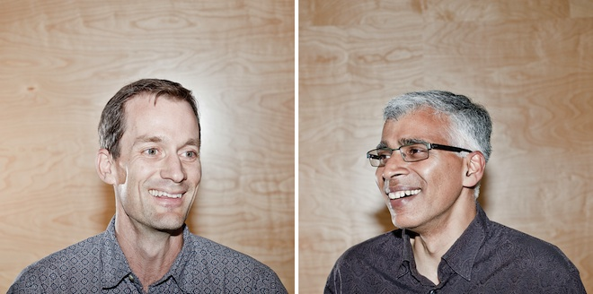


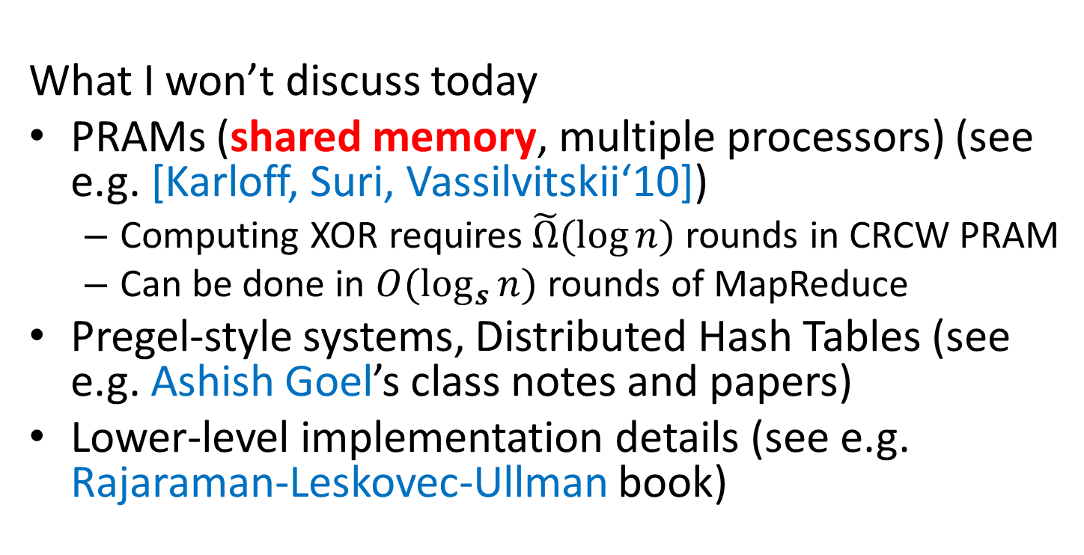
MapReduce-style computations
What I won’t discuss today
PRAMs (shared memory, multiple processors) (see e.g. [Karloff, Suri, Vassilvitskii‘10])
Computing XOR requires$\tilde{Ω}(\log{n})$ rounds in CRCW PRAM
Can be done in $O(\log_{s}{n})$ rounds of MapReduce
Pregel-style systems, Distributed Hash Tables (see e.g. Ashish Goel’s class notes and papers)
Lower-level implementation details (see e.g. Rajaraman-Leskovec-Ullman book)

Slide 9
Models of parallel computation
Bulk-Synchronous Parallel Model (BSP) [Valiant,90]
Pro: Most general, generalizes all other models
Con: Many parameters, hard to design algorithms
Massive Parallel Computation [Feldman-Muthukrishnan-Sidiropoulos-Stein-Svitkina’07, Karloff-Suri-Vassilvitskii’10, Goodrich-Sitchinava-Zhang’11, ..., Beame, Koutris, Suciu’13]
Pros:
Inspired by modern systems (Hadoop, MapReduce, Dryad, … )
Few parameters, simple to design algorithms
New algorithmic ideas, robust to the exact model specification
# Rounds is an information-theoretic measure => can prove unconditional lower bounds
Between linear sketching and streaming with sorting

Slide 10
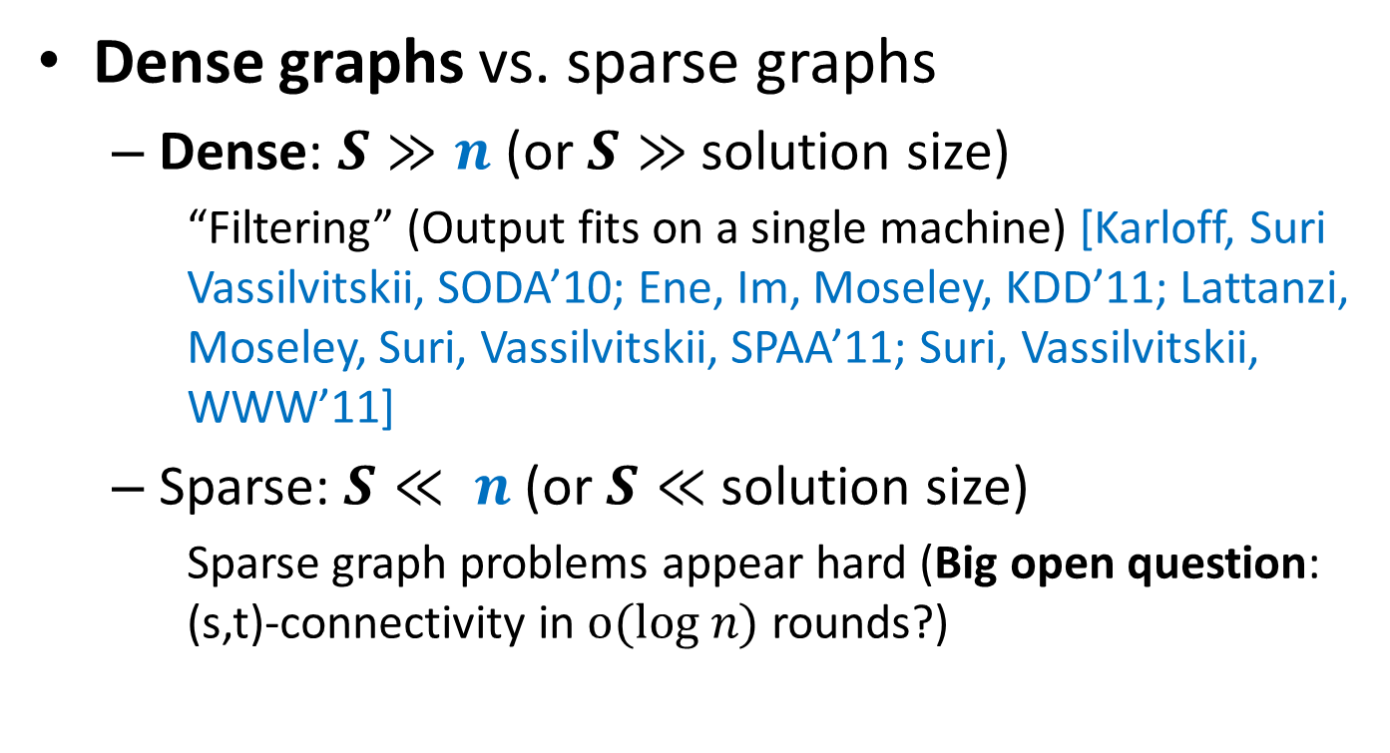
Previous work
Dense graphs vs. sparse graphs
Dense: $S≫n$ (or $S≫$ solution size)
“Filtering” (Output fits on a single machine) [Karloff, Suri Vassilvitskii, SODA’10; Ene, Im, Moseley, KDD’11; Lattanzi, Moseley, Suri, Vassilvitskii, SPAA’11; Suri, Vassilvitskii, WWW’11]
Sparse: $S≪ n$(or $S≪$ solution size)
Sparse graph problems appear hard (Big open question: (s,t)-connectivity in $o(log n)$ rounds?)
VS.

Slide 11

Large geometric graphs
Graph algorithms: Dense graphs vs. sparse graphs
Dense: $S≫n$.
Sparse: $S≪ n$.
Our setting:
Dense graphs, sparsely represented: O(n) space
Output doesn’t fit on one machine ($S≪ n$)
Today: $(1+ε)$-approximate MST
$d=2$ (easy to generalize)
$R=\log_{S}{n}\text{= }\text{O}\text{(1) }$rounds ($S=n^{Ω(1)}$)

Slide 12
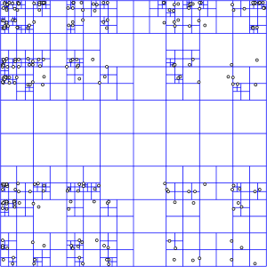
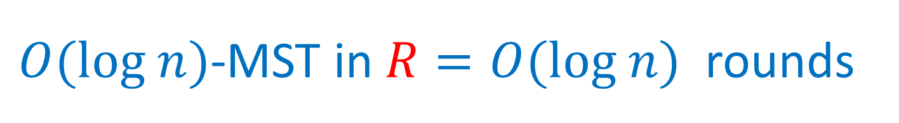

$O(log n)$-MST in $R=O(log n)$rounds
Assume points have integer coordinates $\left[0, …,Δ\right]$, where $Δ=O\left(n^{2}\right) .$
Impose an $O(log⁡n)$-depth quadtree
Bottom-up: For each cell in the quadtree
compute optimum MSTs in subcells
Use only one representative from each cell on the next level
Wrong representative:
O(1)-approximation per level

Slide 13





$εL$-nets
$εL$-net for a cell C with side length $L$:
Collection S of vertices in C, every vertex is at distance <= $εL$ from some vertex in S. (Fact: Can efficiently compute $ε$-net of size $O\left(\frac{1}{ε^{2}}\right))$
Bottom-up: For each cell in the quadtree
Compute optimum MSTs in subcells
Use $εL$-net from each cell on the next level
Idea: Pay only $O(εL$) for an edge cut by cell with side $L$
Randomly shift the quadtree: $\operatorname{Pr}\left[cut edge of length ℓ by L\right]∼ℓ/L$ – charge errors
Wrong representative:
O(1)-approximation per level
$$L$$
$$εL$$
$$L$$

Slide 14



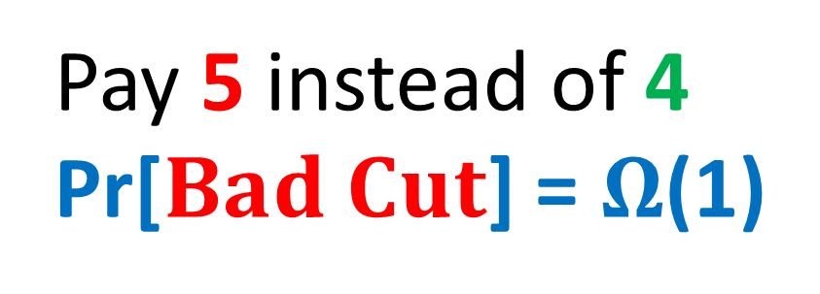
$$Randomly shifted quadtree$$
Top cell shifted by a random vector in ${\left[0,L\right]}^{2}$
Impose a randomly shifted quadtree (top cell length $2Δ$)
Bottom-up: For each cell in the quadtree
Compute optimum MSTs in subcells
Use $εL$-net from each cell on the next level
Pay 5 instead of 4
Pr[$Bad Cut$] = $Ω$(1)
2
$$Bad Cut$$
1

Slide 15

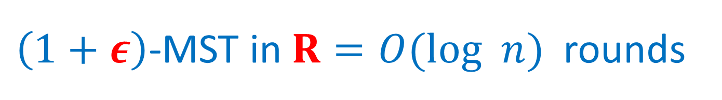
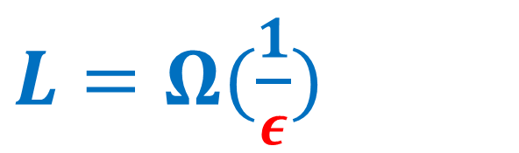
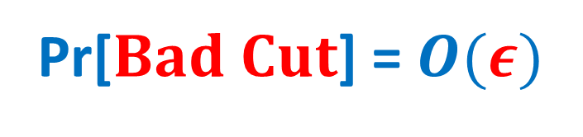
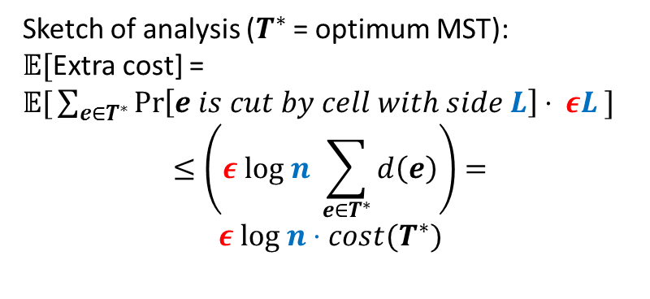
$\left(1+ε\right)$-MST in $R=O(log n)$rounds
Idea: Only use short edges inside the cells
Impose a randomly shifted quadtree (top cell length $\frac{2Δ}{ε }$ )
Bottom-up: For each node (cell) in the quadtree
compute optimum Minimum Spanning Forests in subcells, using edges of length $≤εL$
Use only $ε^{2}L$-net from each cell on the next level
Sketch of analysis ($T^{∗}$ = optimum MST):
𝔼[Extra cost] =
𝔼$\text{[}\sum_{e∈T^{∗}}{\operatorname{Pr}\left[e is cut by cell with side L\right]⋅ εL} ]$
$$≤\left(ε log n \sum_{e∈T^{∗}}{d\left(e\right)}\right)=$$
$$ε log n⋅cost(T^{∗})$$
$L=Ω(\frac{1}{ε})$
2
Pr[$Bad Cut$] = $O(ε)$
1

Slide 16

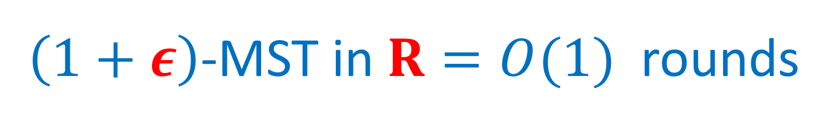


$\left(1+ε\right)$-MST in $R=O(1)$rounds
$O(log n)$ rounds => O($\log_{S}{n}$) = O(1) rounds
Flatten the tree: ($\sqrt{m}×\sqrt{m}$)-grids instead of (2x2) grids at each level.
Impose a randomly shifted ($\sqrt{m}×\sqrt{m}$)-tree
Bottom-up: For each node (cell) in the tree
compute optimum MSTs in subcells via edges of length $≤εL$
Use only $ε^{2}L$-net from each cell on the next level
$$\sqrt{m}=n^{Ω(1)}$$
⇒

Slide 17
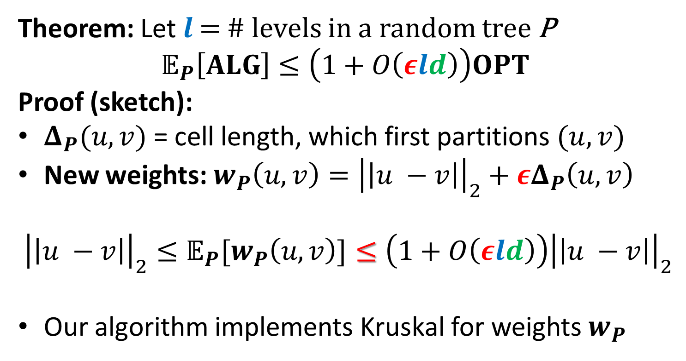



$\left(1+ε\right)$-MST in $R=O(1)$rounds
Theorem: Let $l$ = # levels in a random tree P
$$𝔼_{P}\left[ALG\right]≤\left(1+O\left(εld\right)\right)OPT$$
Proof (sketch):
$Δ_{P}(u,v)$ = cell length, which first partitions $(u, v)$
New weights: $w_{P}\left(u,v\right)={\left|\left|u −v\right|\right|}_{2}+εΔ_{P}\left(u,v\right)$
$${{\left|\left|u −v\right|\right|}_{2}≤𝔼_{P}[w}_{P}\left(u,v\right)]≤\left(1+O\left(εld\right)\right){\left|\left|u −v\right|\right|}_{2}$$
Our algorithm implements Kruskal for weights $w_{P}$
$$u$$
$$v$$
$$Δ_{P}\left(u,v\right)$$

Slide 18
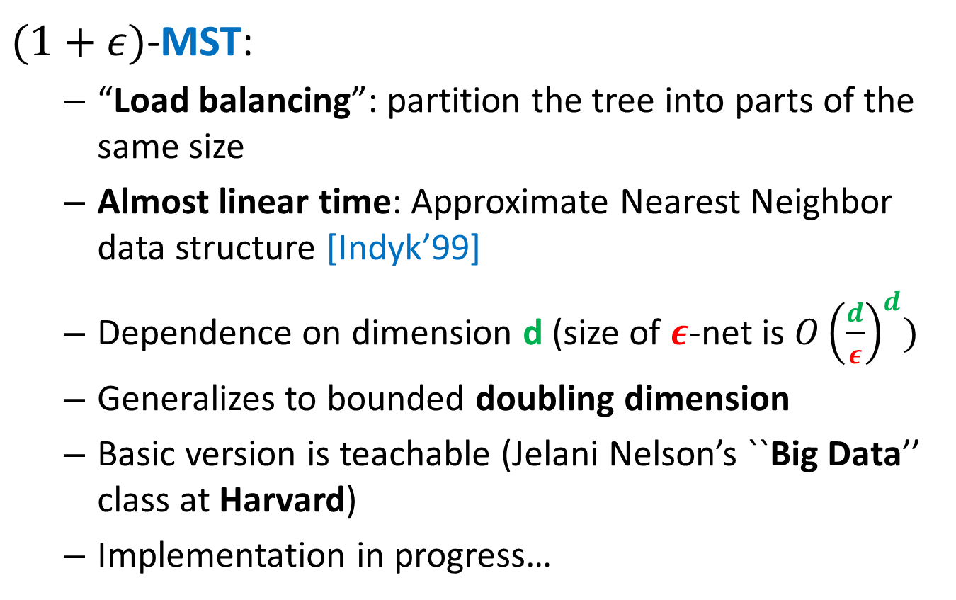
“Solve-And-Sketch” Framework
$(1+ε)$-MST:
“Load balancing”: partition the tree into parts of the same size
Almost linear time: Approximate Nearest Neighbor data structure [Indyk’99]
Dependence on dimension d (size of $ε$-net is ${O\left(\frac{d}{ε}\right)}^{d})$
Generalizes to bounded doubling dimension
Basic version is teachable (Jelani Nelson’s ``Big Data’’ class at Harvard)
Implementation in progress…

Slide 19
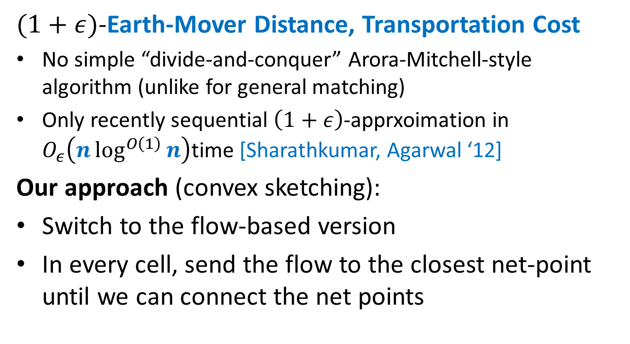
“Solve-And-Sketch” Framework
$(1+ε)$-Earth-Mover Distance, Transportation Cost
No simple “divide-and-conquer” Arora-Mitchell-style algorithm (unlike for general matching)
Only recently sequential $\left(1+ε\right)$-apprxoimation in $O_{ε}\left(n\log^{O\left(1\right)}{n}\right)$time [Sharathkumar, Agarwal ‘12]
Our approach (convex sketching):
Switch to the flow-based version
In every cell, send the flow to the closest net-point until we can connect the net points

Slide 20
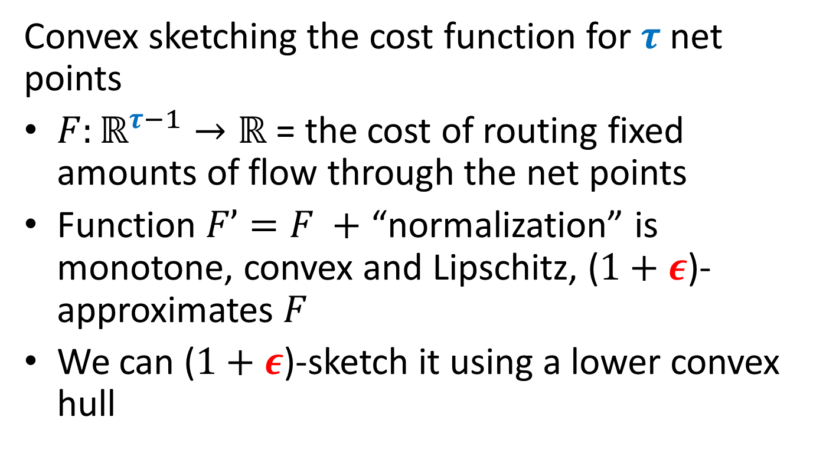
“Solve-And-Sketch” Framework
Convex sketching the cost function for $τ$ net points
$F:ℝ^{τ−1}→ℝ$ = the cost of routing fixed amounts of flow through the net points
Function $F’=F +$ “normalization” is monotone, convex and Lipschitz, ($1+ε$)-approximates $F$
We can ($1+ε$)-sketch it using a lower convex hull

Slide 21
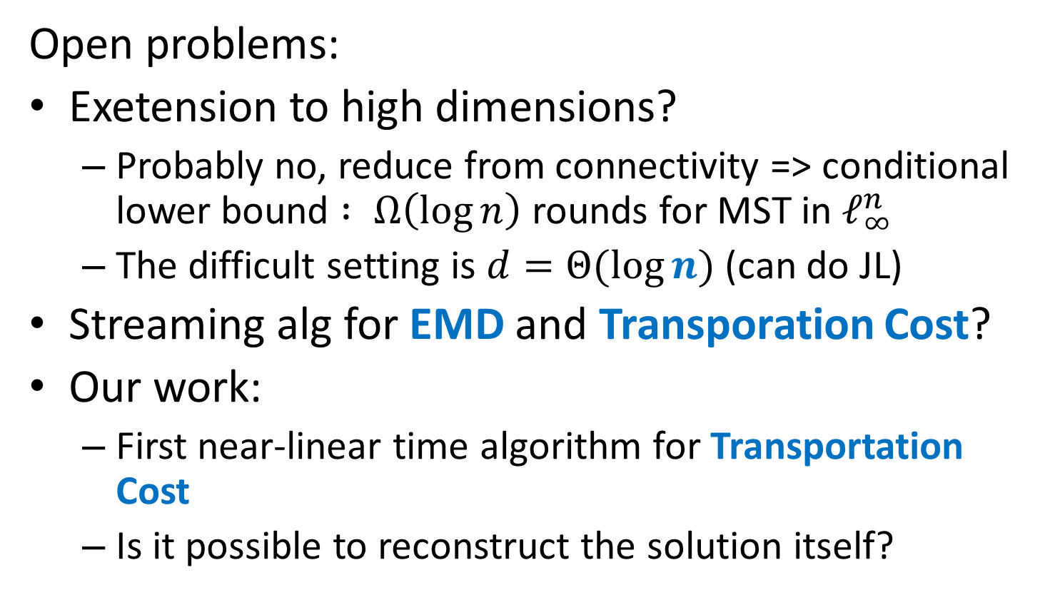
Thank you! http://grigory.us
Open problems:
Exetension to high dimensions?
Probably no, reduce from connectivity => conditional lower bound $: Ω\left(\log{n}\right)$ rounds for MST in $ℓ_{∞}^{n}$
The difficult setting is $d=Θ(\log{n})$ (can do JL)
Streaming alg for EMD and Transporation Cost?
Our work:
First near-linear time algorithm for Transportation Cost
Is it possible to reconstruct the solution itself?

