Slide 1
CSCI B609: “Foundations of Data Science”
Lecture 10/11: Random Walks and Markov Chains + ML Intro
Slides at http://grigory.us/data-science-class.html
Grigory Yaroslavtsev
http://grigory.us

Slide 2
Project Example: Gradient Descent in TensorFlow
Gradient Descent (will be covered in class)
Adagrad: http://www.magicbroom.info/Papers/DuchiHaSi10.pdf
Momentum (stochastic gradient descent + tweaks): http://www.cs.toronto.edu/~hinton/absps/naturebp.pdf
Adam (Adaptive + momentum): http://arxiv.org/pdf/1412.6980.pdf
FTRL: http://jmlr.org/proceedings/papers/v15/mcmahan11b/mcmahan11b.pdf
RMSProp: http://www.cs.toronto.edu/~tijmen/csc321/slides/lecture_slides_lec6.pdf

Slide 3







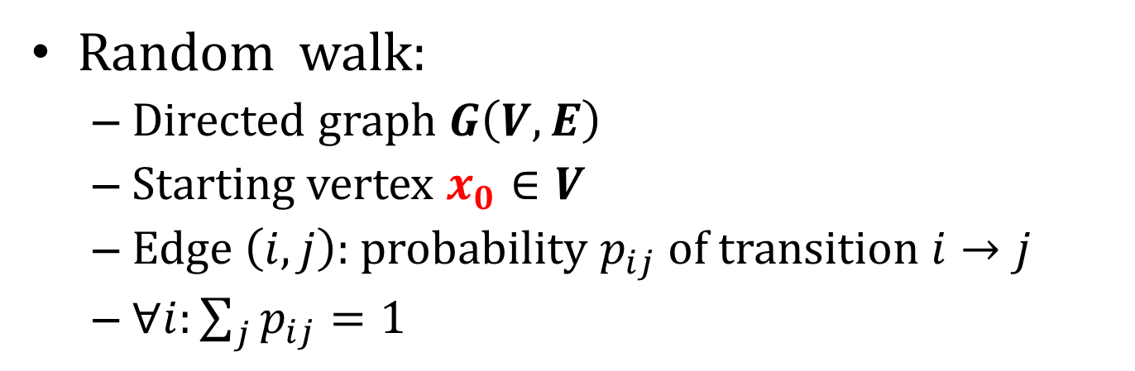










Random Walks and Markov Chains
Random walk:
Directed graph $G\left(V,E\right)$
Starting vertex $x_{0}∈V$
Edge $\left(i,j\right):$ probability $p_{ij}$ of transition $i→j$
$∀i:\sum_{j}{p_{ij}=1}$
$$0.5$$
$$0.5$$
$$x_{0}$$
$$0.5$$
$$1$$
$$0.4$$
$$0.5$$
$$0.5$$
$$0.9$$
$$0.5$$
$$0.5$$
$$0.1$$
$$0.5$$
$$0.5$$
$$1$$
$$1$$
$$0.1$$

Slide 4







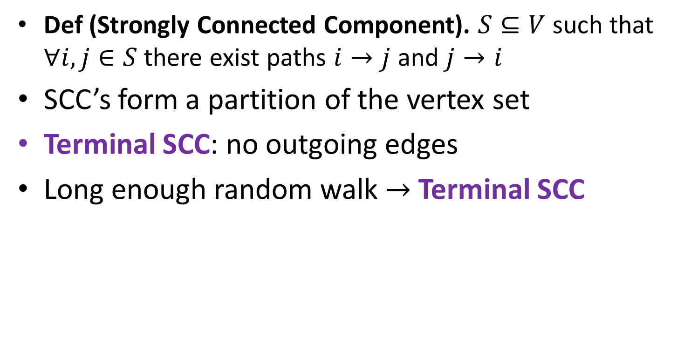










Strongly Connected Components
Def (Strongly Connected Component). $S⊆V$ such that $∀i,j∈S$ there exist paths $i→j$ and $j→i$
SCC’s form a partition of the vertex set
Terminal SCC: no outgoing edges
Long enough random walk $→$ Terminal SCC
$$0.5$$
$$0.5$$
$$x_{0}$$
$$0.5$$
$$1$$
$$0.4$$
$$0.5$$
$$0.5$$
$$0.9$$
$$0.5$$
$$0.5$$
$$0.1$$
$$0.5$$
$$0.5$$
$$1$$
$$1$$
$$0.1$$

Slide 5
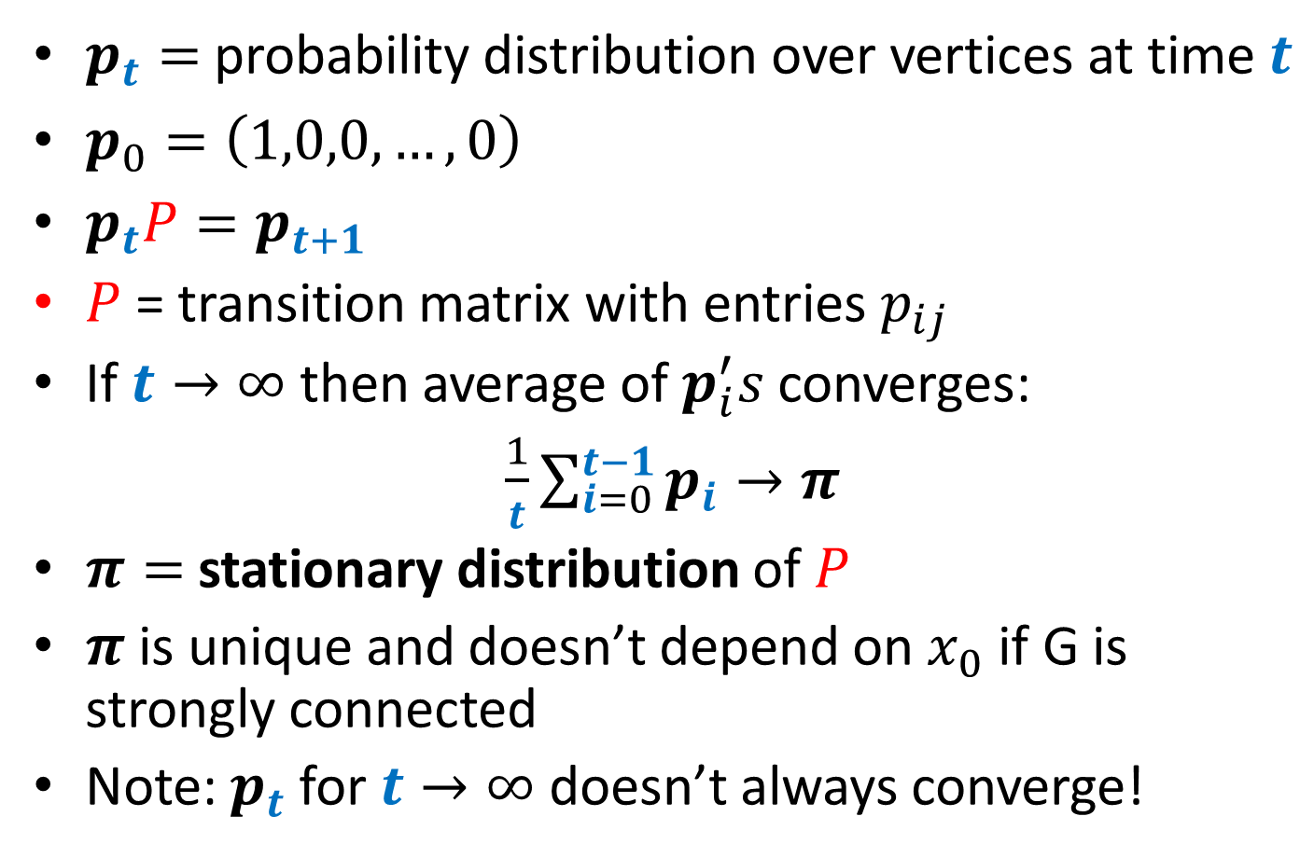
Matrix Form and Stationary Distribution
$p_{t}=$ probability distribution over vertices at time $t$
$p_{0}=\left(1,0,0,…,0\right)$
$p_{t}P=p_{t+1}$
$P$ = transition matrix with entries $p_{ij}$
If $t→∞$ then average of $p_{i}^{′}s$ converges:
$\frac{1}{t}\sum_{i=0}^{t−1}{p_{i}}→π$
$π=$ stationary distribution of $P$
$π$ is unique and doesn’t depend on $x_{0}$ if G is strongly connected
Note: $p_{t}$ for $t→∞$ doesn’t always converge!

Slide 6
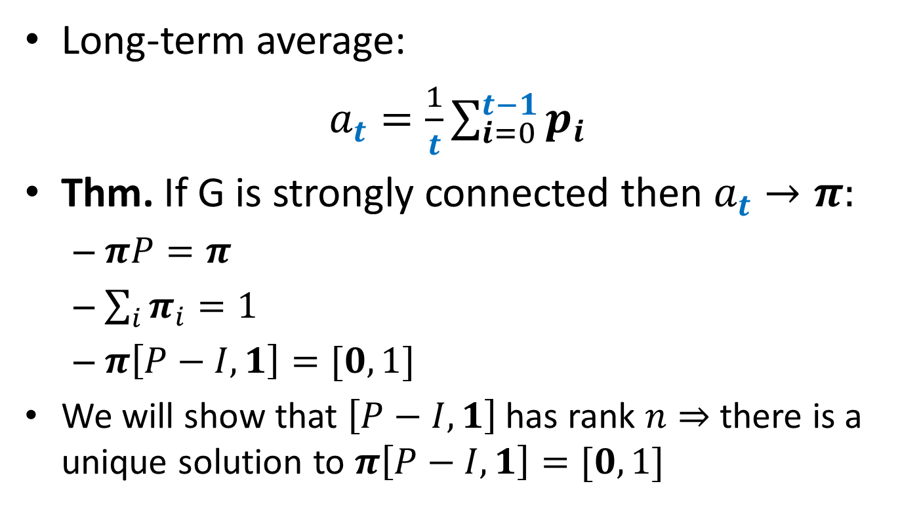
Stationary Distribution
Long-term average:
$a_{t}=\frac{1}{t}\sum_{i=0}^{t−1}{p_{i}}$
Thm. If G is strongly connected then $a_{t}→π:$
$πP=π$
$\sum_{i}{π_{i}=1}$
$π\left[P−I,1\right]=[0,1]$
We will show that $\left[P−I,1\right]$ has rank $n⇒$ there is a unique solution to $π\left[P−I,1\right]=[0,1]$

Slide 7
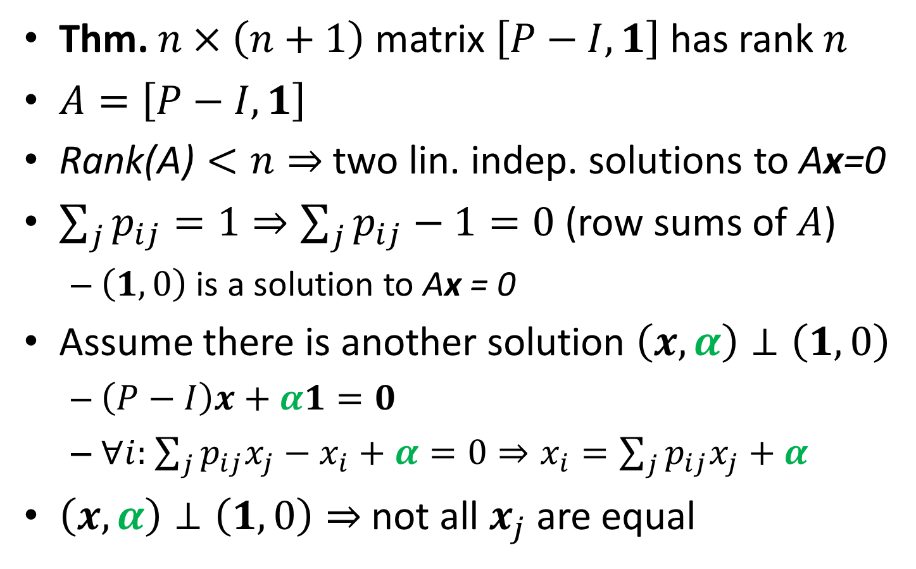
Stationary Distribution Theorem
Thm. $n×\left(n+1\right)$ matrix $\left[P−I,1\right]$ has rank $n$
$A=\left[P−I,1\right]$
$\text{Rank}\text{(}\text{A}\text{)}<n⇒$ two lin. indep. solutions to $\text{A}\text{x}\text{=0}$
$\sum_{j}{p_{ij}=1}⇒\sum_{j}{p_{ij}}−1=0$ (row sums of $A$)
$\left(1,0\right)$ is a solution to $\text{A}\text{x}\text{ = 0}$
Assume there is another solution $\left(x,α\right)⊥\left(1,0\right)$
$\left(P−I\right)x+α1=0$
$∀i:$ $\sum_{j}{p_{ij}x_{j}−x_{i}+α=0}⇒x_{i}=\sum_{j}{p_{ij}x_{j}+α}$
$\left(x,α\right)⊥\left(1,0\right)⇒$ not all $x_{j}$ are equal

Slide 8
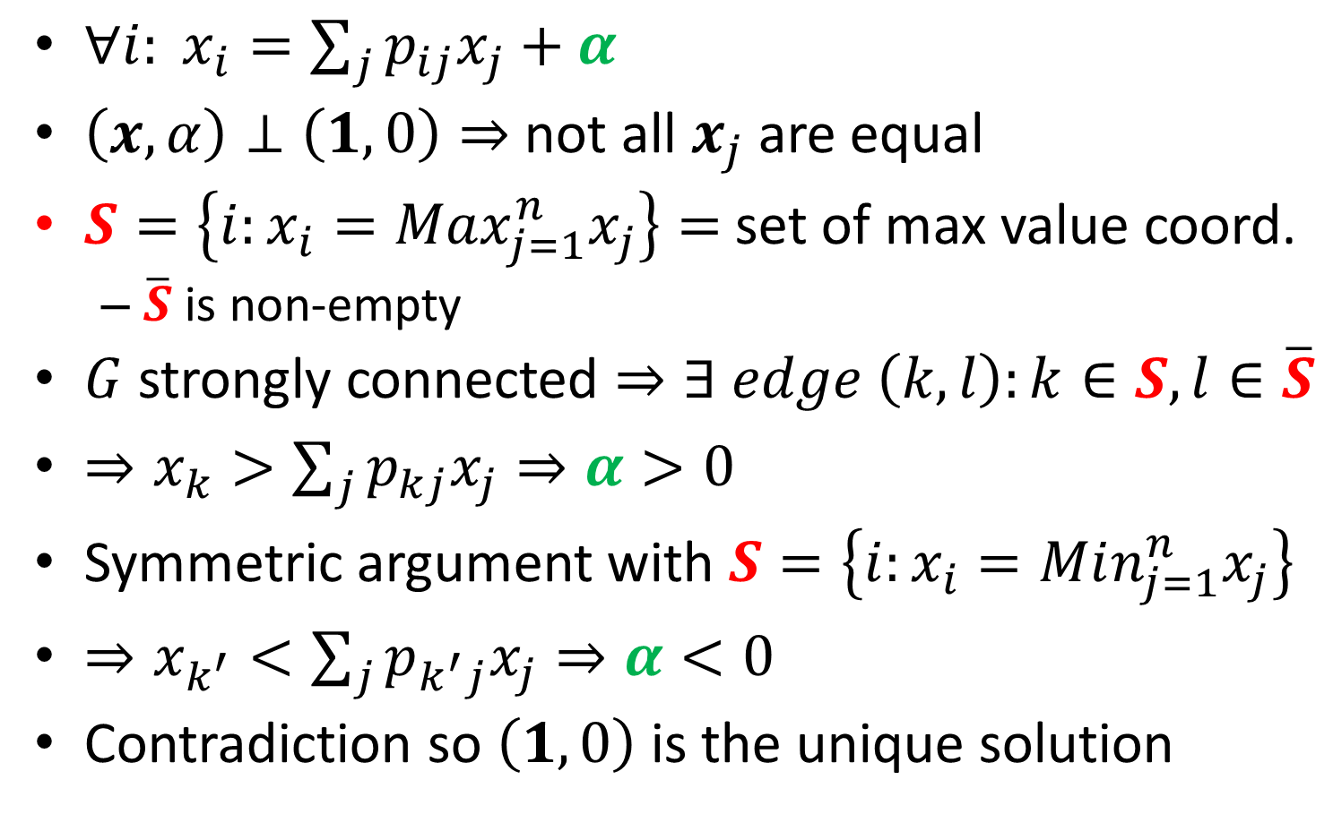
Stationary Distribution Theorem Cont.
$∀i: x_{i}=\sum_{j}{p_{ij}x_{j}+α}$
$\left(x,α\right)⊥\left(1,0\right)⇒$ not all $x_{j}$ are equal
$S=\left\{i:x_{i}=Max_{j=1}^{n}x_{j}\right\}=$ set of max value coord.
$\overline{S}$ is non-empty
$G$ strongly connected $⇒∃ edge \left(k,l\right):k∈S, l∈\overline{S}$
$⇒x_{k}>\sum_{j}{p_{kj}x_{j}}⇒α>0$
Symmetric argument with $S=\left\{i:x_{i}=Min_{j=1}^{n}x_{j}\right\}$
$⇒x_{k^{′}}<\sum_{j}{p_{k^{′}j}x_{j}}⇒α<0$
Contradiction so $\left(1,0\right)$ is the unique solution

Slide 9
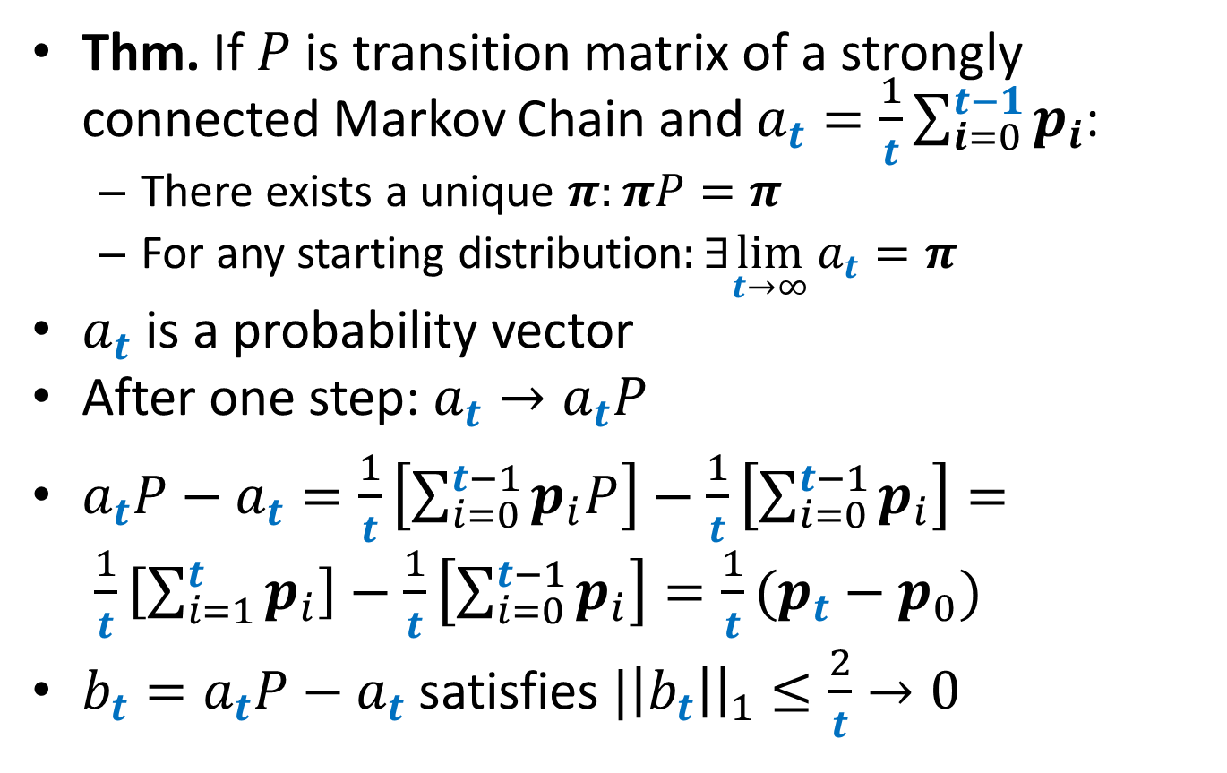
Fundamental Theorem of Markov Chains
Thm. If $P$ is transition matrix of a strongly connected Markov Chain and $a_{t}=\frac{1}{t}\sum_{i=0}^{t−1}{p_{i}}$:
There exists a unique $π:πP=π$
For any starting distribution$:∃\lim_{t→∞}a_{t}{=π}$
$a_{t}$ is a probability vector
After one step: $a_{t}→a_{t}P$
$a_{t}P−a_{t}=\frac{1}{t}\left[\sum_{i=0}^{t−1}{p_{i}P}\right]−\frac{1}{t}\left[\sum_{i=0}^{t−1}{p_{i}}\right]= \frac{1}{t}\left[\sum_{i=1}^{t}{p_{i}}\right]−\frac{1}{t}\left[\sum_{i=0}^{t−1}{p_{i}}\right]=\frac{1}{t}(p_{t}−p_{0})$
$b_{t}=a_{t}P−a_{t}$ satisfies $|\left|b_{t}\right|{\left.​\right|}_{1}≤\frac{2}{t}→0$

Slide 10
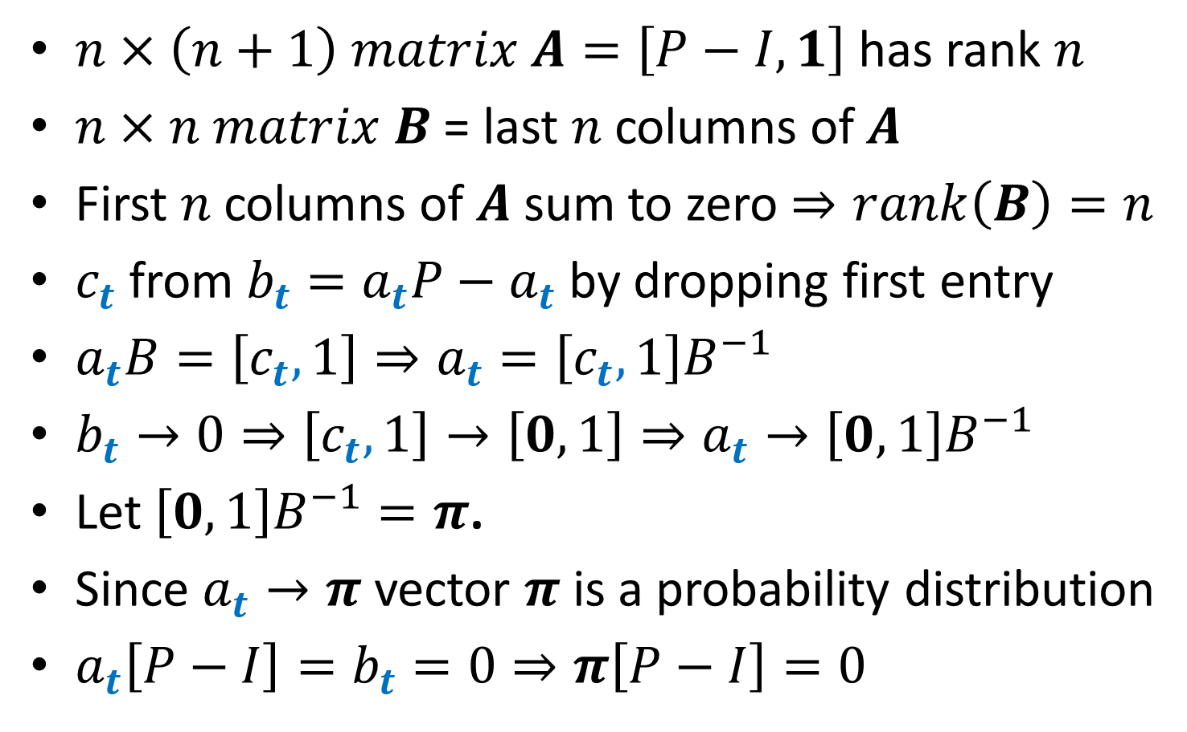
Fundamental Theorem of Markov Chains
$n×\left(n+1\right) matrix A=\left[P−I,1\right]$ has rank $n$
$n×n matrix B$ = last $n$ columns of $A$
First $n$ columns of $A$ sum to zero $⇒rank\left(B\right)=n$
$c_{t}$from$b_{t}=a_{t}P−a_{t}$ by dropping first entry
$a_{t}B=\left[c_{t},1\right]⇒a_{t}=\left[c_{t},1\right]B^{−1}$
$b_{t}→0⇒\left[c_{t},1\right]→\left[0,1\right]⇒a_{t}→\left[0,1\right]B^{−1}$
Let $\left[0,1\right]B^{−1}=π$.
Since $a_{t}→π$ vector $π$ is a probability distribution
$a_{t}\left[P−I\right]=b_{t}=0⇒π\left[P−I\right]=0$

Slide 11
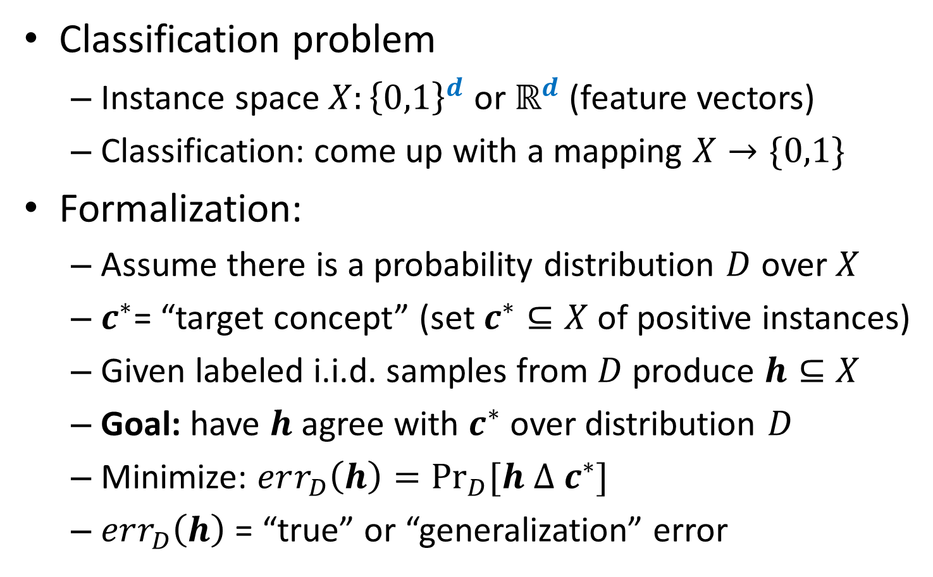
Intro to ML
Classification problem
Instance space $X:{\left\{0,1\right\}}^{d}$ or $ℝ^{d}$ (feature vectors)
Classification: come up with a mapping $X→\{0,1\}$
Formalization:
Assume there is a probability distribution $D$ over $X$
$c^{∗}$= “target concept” (set $c^{∗}⊆X$ of positive instances)
Given labeled i.i.d. samples from $D$ produce $h⊆X$
Goal: have $h$ agree with $c^{∗}$ over distribution $D$
Minimize: $err_{D}\left(h\right)=\underset{D}{Pr}{[h Δ c^{∗}]}$
$err_{D}\left(h\right)$ = “true” or “generalization” error

Slide 12
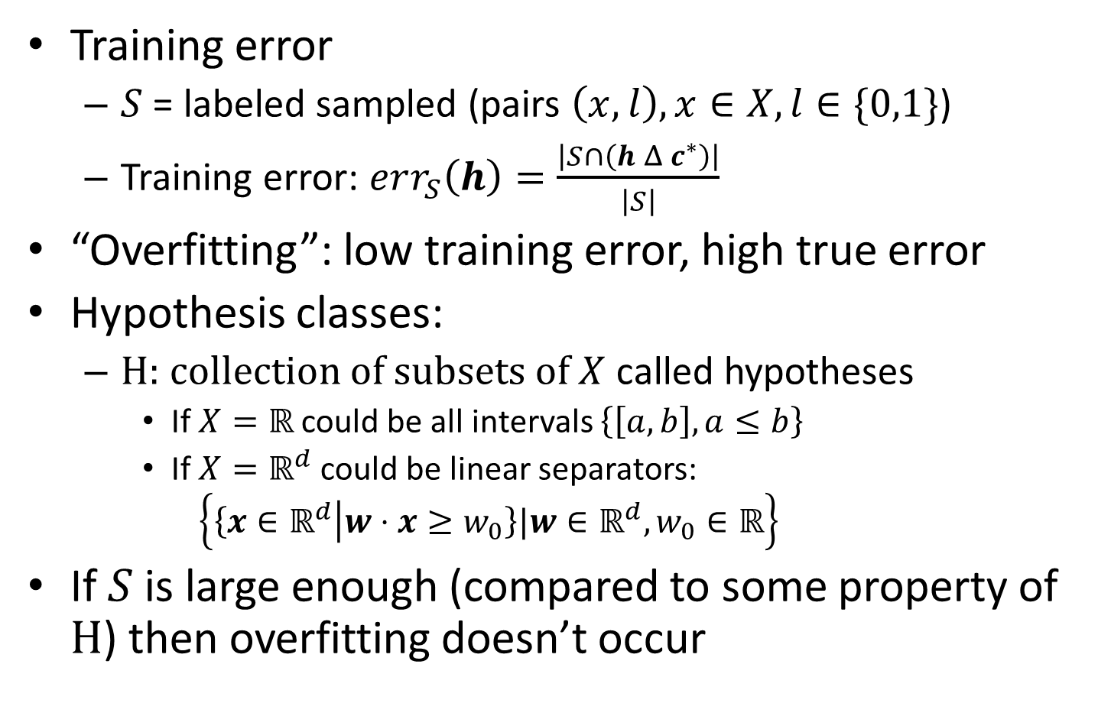
Intro to ML
Training error
$S$ = labeled sampled (pairs $\left(x,l\right), x∈X, l∈\{0,1\}$)
Training error: $err_{S}\left(h\right)=\frac{\left|S∩\left(h Δ c^{∗}\right)\right|}{\left|S\right|}$
“Overfitting”: low training error, high true error
Hypothesis classes:
H: collection of subsets of $X$ called hypotheses
If $X=ℝ$ could be all intervals $\left\{\left[a,b\right],a≤b\right\}$
If $X=ℝ^{d}$ could be linear separators:
$$\left\{\left\{x∈ℝ^{d} | w⋅x≥w_{0}\right\}|w∈ℝ^{d},w_{0}∈ℝ\right\}$$
If $S$ is large enough (compared to some property of H) then overfitting doesn’t occur

Slide 13

Overfitting and Uniform Convergence
PAC learning (agnostic): For $ε,δ>0$ if
$$\left|S\right|≥1/2ε^{2}(\ln\left|H\right|+\ln{2/δ})$$
then with probability $1−δ$:
$∀h∈H:$ $\left|err_{S}\left(h\right)−err_{D}\left(h\right)\right|≤ε$
$x_{j}=$ r.v. (=1 if $h$ has error on $j$-th sample in $S$)
${𝔼[x}_{j}]=$ $err_{D}\left(h\right)$ and$err_{S}\left(h\right)=\frac{1}{\left|S\right|}\sum_{j=1}^{\left|S\right|}{x_{j}}$
Chernoff bound:
$$\operatorname{Pr}\left[\left|err_{S}\left(h\right)−err_{D}\left(h\right)\right|>ε\right]≤2e^{−2\left|S\right|ε^{2}}$$
Union bound:
$\operatorname{Pr}\left[∃h∈H:\left|err_{S}\left(h\right)−err_{D}\left(h\right)\right|>ε\right]≤2\left|H\right|e^{−2\left|S\right|ε^{2}}≤$ $δ$

Slide 14
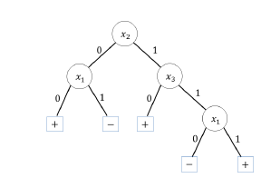
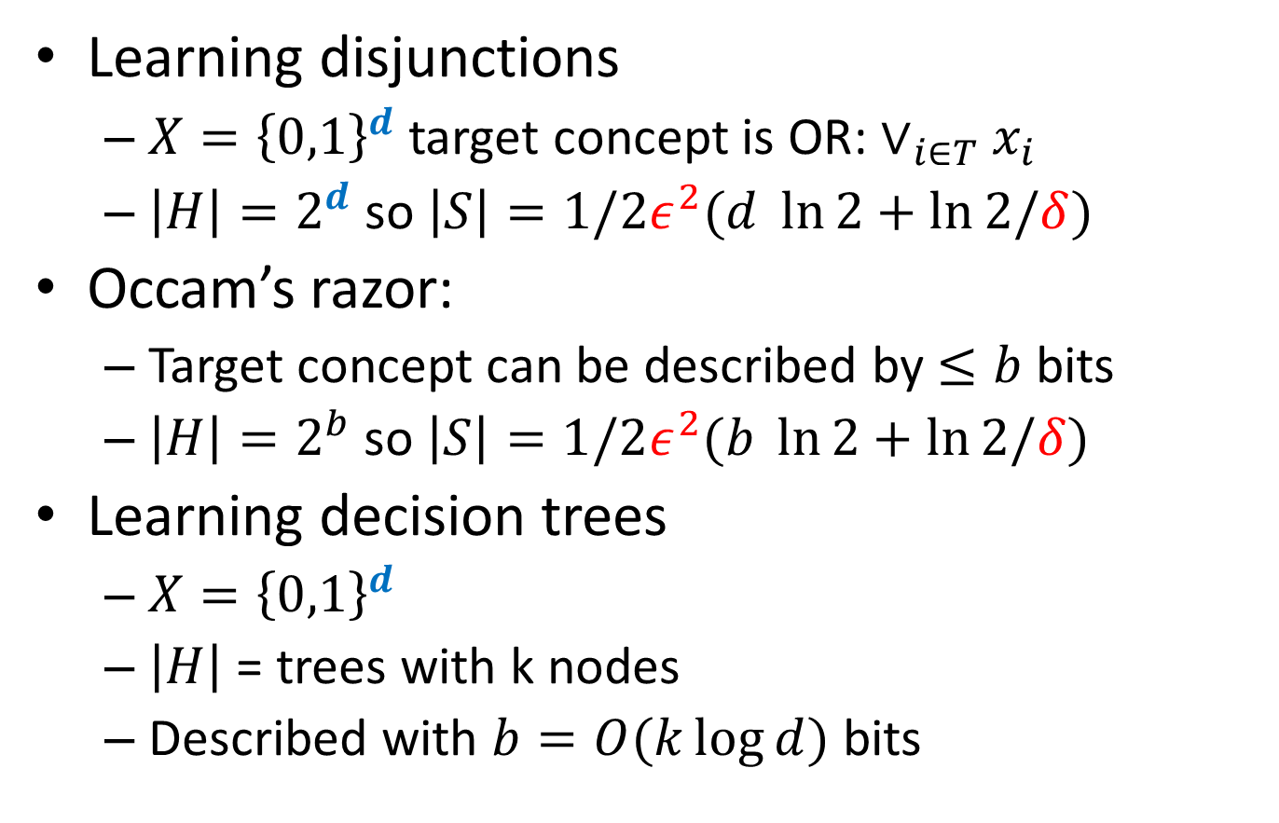
Examples
Learning disjunctions
$X={\left\{0,1\right\}}^{d}$ target concept is OR: $∨_{i∈T}x_{i}$
$\left|H\right|=2^{d}$ so $\left|S\right|=1/2ε^{2}(d \ln{2}+\ln{2/δ})$
Occam’s razor:
Target concept can be described by $≤b$ bits
$\left|H\right|=2^{b}$ so $\left|S\right|=1/2ε^{2}(b \ln{2}+\ln{2/δ})$
Learning decision trees
$X={\left\{0,1\right\}}^{d}$
$\left|H\right|$ = trees with k nodes
Described with $b=O(k\log{d})$ bits

Slide 15
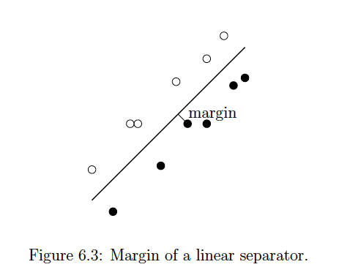
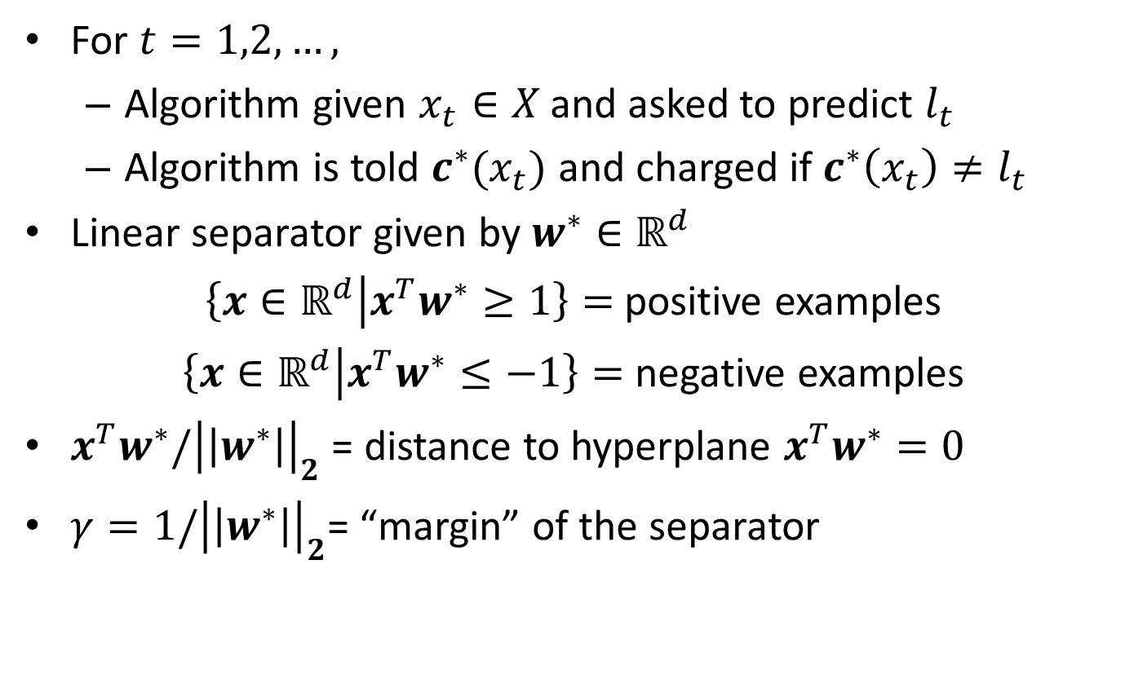
Online Learning + Perceptron Algorithm
For $t=1,2,…,$
Algorithm given $x_{t}∈X$ and asked to predict $l_{t}$
Algorithm is told $c^{∗}(x_{t})$ and charged if $c^{∗}\left(x_{t}\right)≠l_{t}$
Linear separator given by $w^{∗}∈ℝ^{d}$
$\left\{x∈ℝ^{d} | {x^{T}w}^{∗}≥1\right\}=$positive examples
$\left\{x∈ℝ^{d} | {x^{T}w}^{∗}≤−1\right\}=$negative examples
${x^{T}w}^{∗}/{\left|\left|w^{∗}\right|\right|}_{2}$ = distance to hyperplane ${x^{T}w}^{∗}=0$
$γ={1/\left|\left|w^{∗}\right|\right|}_{2}$= “margin” of the separator

Slide 16
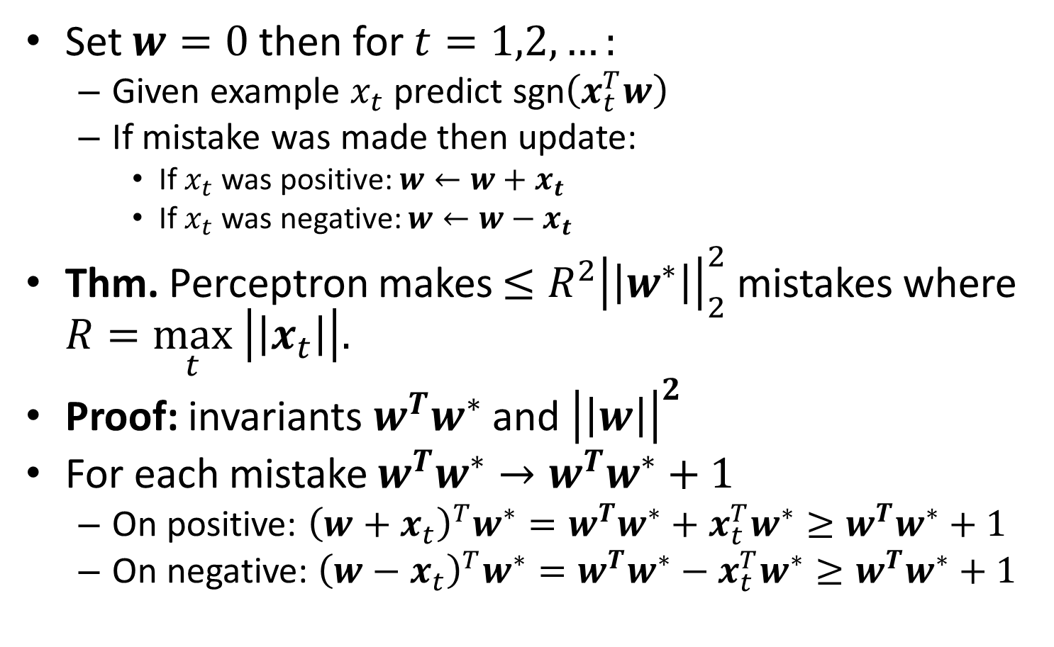
Perceptron Algorithm
Set $w=0$ then for $t=1,2,…:$
Given example $x_{t}$ predict sgn$\left(x_{t}^{T}w\right)$
If mistake was made then update:
If $x_{t}$ was positive: $w←w+x_{t}$
If $x_{t}$ was negative: $w←w−x_{t}$
Thm. Perceptron makes $≤R^{2}{\left|\left|w^{∗}\right|\right|}_{2}^{2}$ mistakes where $R=\max_{t} \left|\left|x_{t}\right|\right|.$
Proof: invariants $w^{T}w^{∗}$ and ${\left|\left|w\right|\right|}^{2}$
For each mistake $w^{T}w^{∗}→w^{T}w^{∗}+1$
On positive: ${\left(w+x_{t}\right)}^{T}w^{∗}=w^{T}w^{∗}+x_{t}^{T}w^{∗}≥w^{T}w^{∗}+1$
On negative: ${\left(w−x_{t}\right)}^{T}w^{∗}=w^{T}w^{∗}−x_{t}^{T}w^{∗}≥w^{T}w^{∗}+1$

Slide 17
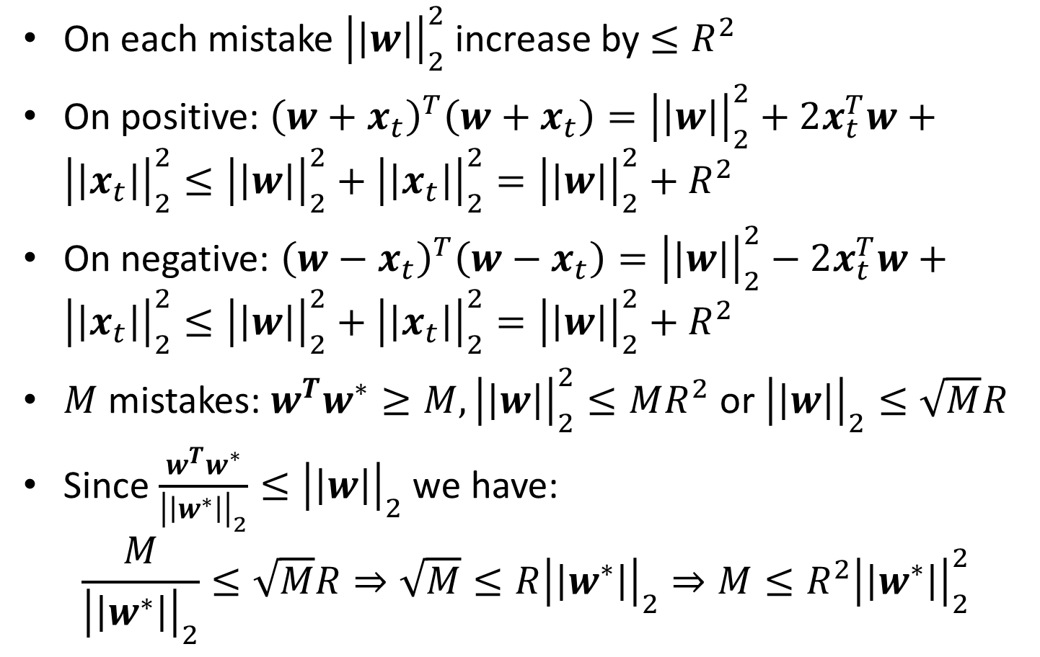
Perceptron Analysis cont.
On each mistake ${\left|\left|w\right|\right|}_{2}^{2}$ increase by $≤R^{2}$
On positive: ${\left(w+x_{t}\right)}^{T}\left(w+x_{t}\right)={\left|\left|w\right|\right|}_{2}^{2}+2x_{t}^{T}w+{\left|\left|x_{t}\right|\right|}_{2}^{2}≤{\left|\left|w\right|\right|}_{2}^{2}+{\left|\left|x_{t}\right|\right|}_{2}^{2}={\left|\left|w\right|\right|}_{2}^{2}+R^{2}$
On negative: ${\left(w−x_{t}\right)}^{T}\left(w−x_{t}\right)={\left|\left|w\right|\right|}_{2}^{2}−2x_{t}^{T}w+{\left|\left|x_{t}\right|\right|}_{2}^{2}≤{\left|\left|w\right|\right|}_{2}^{2}+{\left|\left|x_{t}\right|\right|}_{2}^{2}={\left|\left|w\right|\right|}_{2}^{2}+R^{2}$
$M$ mistakes: $w^{T}w^{∗}≥M, {\left|\left|w\right|\right|}_{2}^{2}≤MR^{2}$ or ${\left|\left|w\right|\right|}_{2}^{}≤\sqrt{M}R$
Since $\frac{w^{T}w^{∗}}{{\left|\left|w^{∗}\right|\right|}_{2}}≤{\left|\left|w\right|\right|}_{2}^{}$ we have:
$$\frac{M}{{\left|\left|w^{∗}\right|\right|}_{2}}≤\sqrt{M}R⇒\sqrt{M}≤R{\left|\left|w^{∗}\right|\right|}_{2}⇒M≤R^{2}{\left|\left|w^{∗}\right|\right|}_{2}^{2}$$

Slide 18
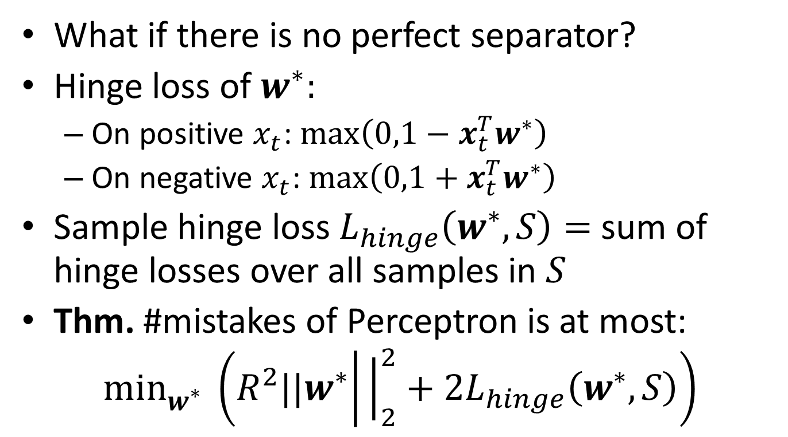
Perceptron with noisy data
What if there is no perfect separator?
Hinge loss of $w^{∗}:$
On positive $x_{t}$: $\max\left(0,1−x_{t}^{T}w^{∗}\right)$
On negative $x_{t}$: $\max\left(0,1+x_{t}^{T}w^{∗}\right)$
Sample hinge loss $L_{hinge}\left(w^{∗},S\right)=$ sum of hinge losses over all samples in $S$
Thm. #mistakes of Perceptron is at most:
$$\min_{w^{∗}}^{} \left(R^{2}{||w}^{∗} | {\left.​\right|}_{2}^{2}+2L_{hinge}\left(w^{∗},S\right)\right)$$

Slide 19
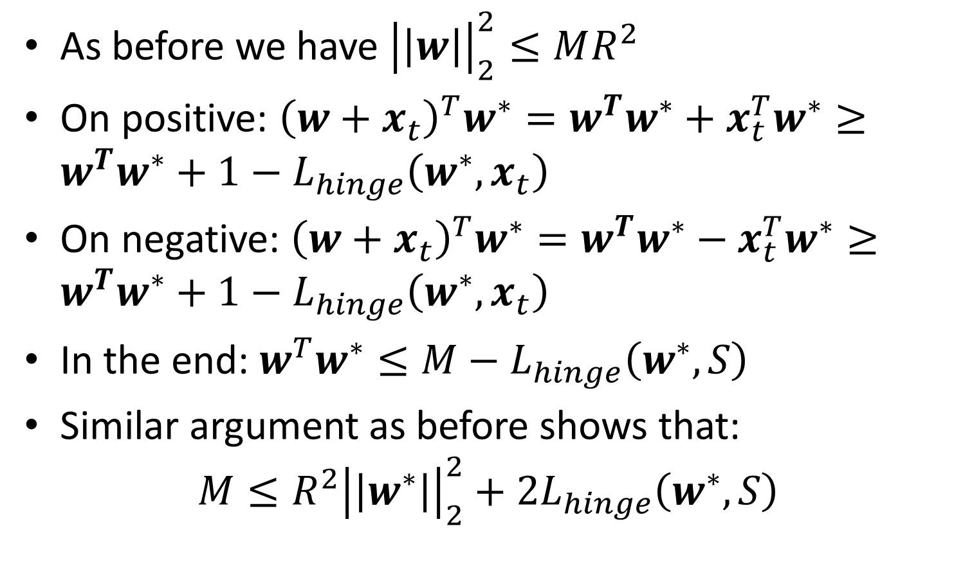
Proof of noisy perceptron
As before we have ${\left|\left|w\right|\right|}_{2}^{2}≤MR^{2}$
On positive: ${\left(w+x_{t}\right)}^{T}w^{∗}=w^{T}w^{∗}+x_{t}^{T}w^{∗}≥w^{T}w^{∗}+1−L_{hinge}\left(w^{∗},x_{t}\right)$
On negative: ${\left(w+x_{t}\right)}^{T}w^{∗}=w^{T}w^{∗}−x_{t}^{T}w^{∗}≥w^{T}w^{∗}+1−L_{hinge}\left(w^{∗},x_{t}\right)$
In the end: $w^{T}w^{∗}≤M−L_{hinge}\left(w^{∗},S\right)$
Similar argument as before shows that:
$$M≤R^{2}{\left|\left|w^{∗}\right|\right|}_{2}^{2}+2L_{hinge}\left(w^{∗},S\right)$$

