Slide 1
CSCI B609: “Foundations of Data Science”
Lecture 5: Dimension Reduction,
Separating and Fitting Gaussians
Slides at http://grigory.us/data-science-class.html
Grigory Yaroslavtsev
http://grigory.us

Slide 2
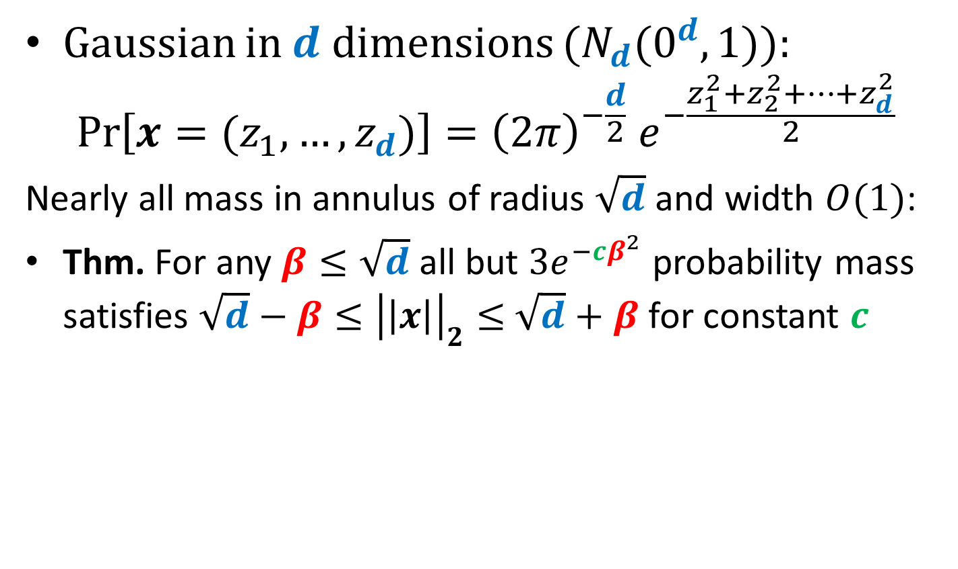
Gaussian Annulus Theorem
Gaussian in $d$ dimensions ($N_{d}(0^{d}, 1)$):
$$\operatorname{Pr}\left[x=(z_{1},…,z_{d})\right]={{\left(2π\right)}^{−\frac{d}{2}} e}^{−\frac{z_{1}^{2}+z_{2}^{2}+…+z_{d}^{2}}{2}}$$
Nearly all mass in annulus of radius $\sqrt{d}$ and width $O(1)$:
Thm. For any $β≤\sqrt{d}$ all but $3e^{−cβ^{2}}$ probability mass satisfies ${\sqrt{d}−β≤\left|\left|x\right|\right|}_{2}≤$ $\sqrt{d}+β$ for constant $c$

Slide 3
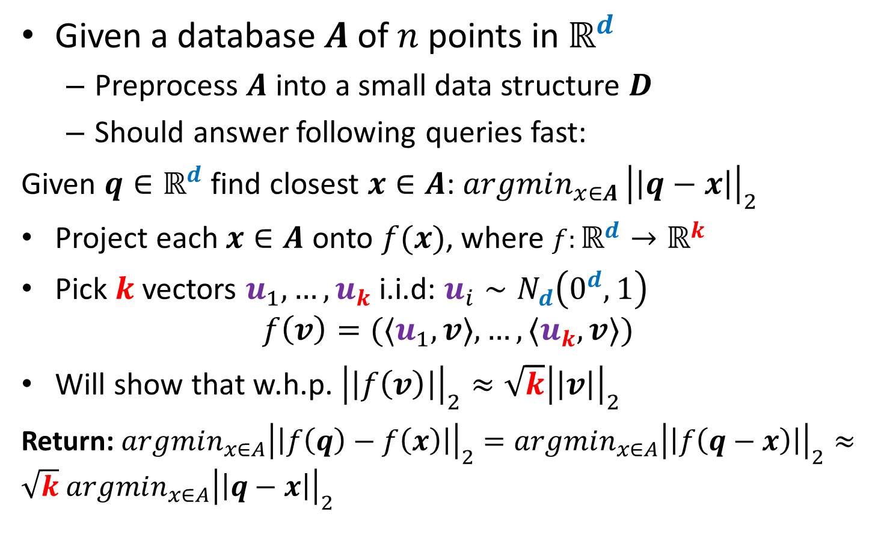
Nearest Neighbors and Random Projections
Given a database $A$ of $n$ points in $ℝ^{d}$
Preprocess $A$ into a small data structure $D$
Should answer following queries fast:
Given $q∈ℝ^{d}$ find closest $x∈A$: $argmin_{x∈A }{\left|\left|q−x\right|\right|}_{2}$
Project each $x∈A$ onto $f(x)$, where $f:ℝ^{d}→ℝ^{k}$
Pick $k$ vectors $u_{1},…, u_{k}$ i.i.d: $u_{i}∼N_{d}\left(0^{d},1\right)$
$$f\left(v\right)=(〈u_{1},v〉,…, {〈u}_{k},v〉)$$
Will show that w.h.p. ${\left|\left|f\left(v\right)\right|\right|}_{2}≈\sqrt{k}{\left|\left|v\right|\right|}_{2}$
Return: $argmin_{x∈A}{\left|\left|f\left(q\right)−f\left(x\right)\right|\right|}_{2}=argmin_{x∈A}{\left|\left|f\left(q−x\right)\right|\right|}_{2}≈\sqrt{k}$ $argmin_{x∈A}{\left|\left|q−x\right|\right|}_{2}$

Slide 4
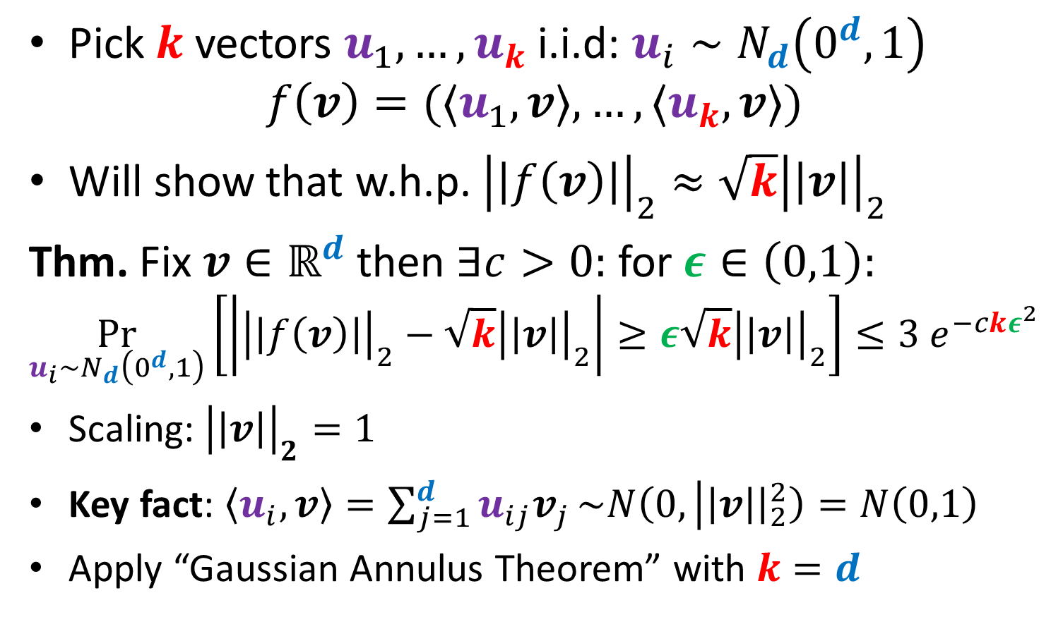
Random Projection Theorem
Pick $k$ vectors $u_{1},…, u_{k}$ i.i.d: $u_{i}∼N_{d}\left(0^{d},1\right)$
$$f\left(v\right)=(〈u_{1},v〉,…, {〈u}_{k},v〉)$$
Will show that w.h.p. ${\left|\left|f\left(v\right)\right|\right|}_{2}≈\sqrt{k}{\left|\left|v\right|\right|}_{2}$
Thm. Fix $v∈ℝ^{d}$ then $∃c>0:$ for $ε∈\left(0,1\right):$
$$\underset{u_{i}∼N_{d}\left(0^{d},1\right)}{Pr}\left[\left|{\left|\left|f\left(v\right)\right|\right|}_{2}−\sqrt{k}{\left|\left|v\right|\right|}_{2}\right|≥ε\sqrt{k}{\left|\left|v\right|\right|}_{2}\right]≤3 e^{−ckε^{2}}$$
Scaling: ${\left|\left|v\right|\right|}_{2}=1$
Key fact: $〈u_{i},v〉=\sum_{j=1}^{d}{u_{ij}v_{j}}\sim N\left(0, | \left|v\right|{\left.​\right|}_{2}^{2}\right)=N\left(0,1\right)$
Apply “Gaussian Annulus Theorem” with $k=d$

Slide 5

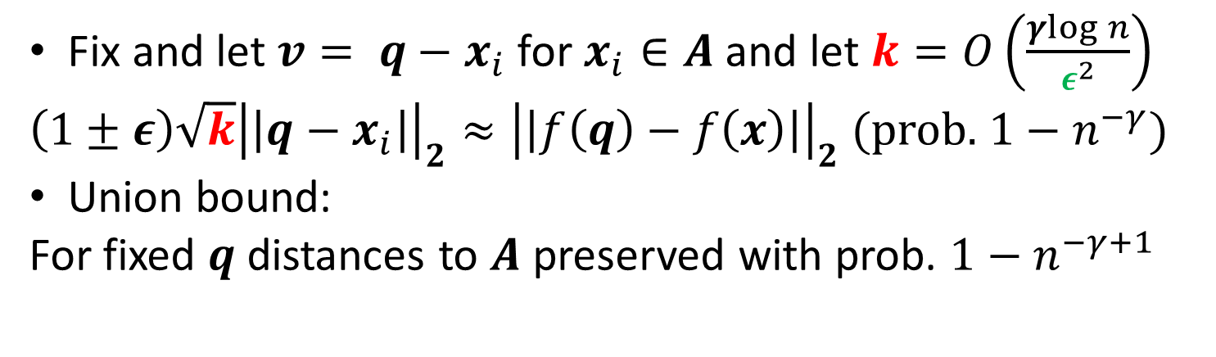
Nearest Neighbors and Random Projections
Thm. Fix $v∈ℝ^{d}$ then $∃c>0:$ for $ε∈\left(0,1\right):$
$$\underset{u_{i}∼N_{d}\left(0^{d},1\right)}{Pr}\left[\left|{\left|\left|f\left(v\right)\right|\right|}_{2}−\sqrt{k}{\left|\left|v\right|\right|}_{2}\right|≥ε\sqrt{k}{\left|\left|v\right|\right|}_{2}\right]≤3 e^{−ckε^{2}}$$
Return: $argmin_{x∈A}{\left|\left|f\left(q\right)−f\left(x\right)\right|\right|}_{2}≈\sqrt{k}$ $argmin_{x∈A}{\left|\left|q−x\right|\right|}_{2}$
Fix and let $v= q−x_{i}$ for $x_{i}∈A$ and let $k=O\left(\frac{γlog{n}}{ε^{2}}\right)$
$\left(1±ε\right){\sqrt{k}\left|\left|q−x_{i}\right|\right|}_{2}≈{\left|\left|f\left(q\right)−f\left(x\right)\right|\right|}_{2}$ (prob. $1−n^{−γ}$)
Union bound:
For fixed $q$ distances to $A$ preserved with prob. $1−n^{−γ+1}$

Slide 6
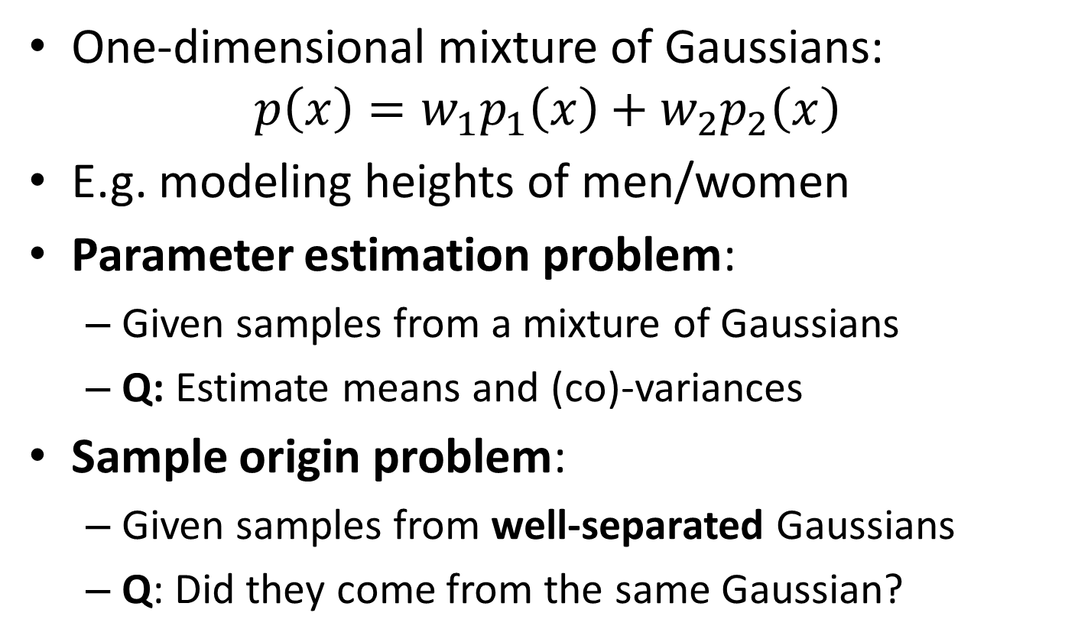
Separating Gaussians
One-dimensional mixture of Gaussians:
$$p\left(x\right)=w_{1}p_{1}\left(x\right)+w_{2}p_{2}\left(x\right)$$
E.g. modeling heights of men/women
Parameter estimation problem:
Given samples from a mixture of Gaussians
Q: Estimate means and (co)-variances
Sample origin problem:
Given samples from well-separated Gaussians
Q: Did they come from the same Gaussian?

Slide 7
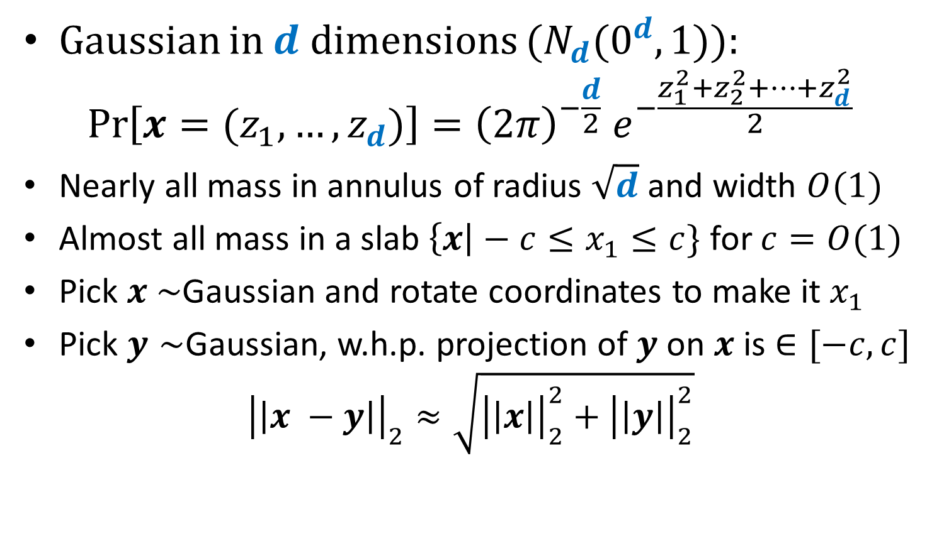
Separating Gaussians
Gaussian in $d$ dimensions ($N_{d}(0^{d}, 1)$):
$$\operatorname{Pr}\left[x=(z_{1},…,z_{d})\right]={{\left(2π\right)}^{−\frac{d}{2}} e}^{−\frac{z_{1}^{2}+z_{2}^{2}+…+z_{d}^{2}}{2}}$$
Nearly all mass in annulus of radius $\sqrt{d}$ and width $O(1)$
Almost all mass in a slab $\left\{x\right|−c≤x_{1}≤c\}$ for $c=O(1)$
Pick $x \sim$Gaussian and rotate coordinates to make it $x_{1}$
Pick $y∼$Gaussian, w.h.p. projection of $y$ on $x$ is $∈[−c,c]$
$${\left|\left|x −y\right|\right|}_{2}≈\sqrt{{\left|\left|x\right|\right|}_{2}^{2}+{\left|\left|y\right|\right|}_{2}^{2}}$$

Slide 8
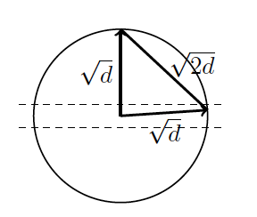
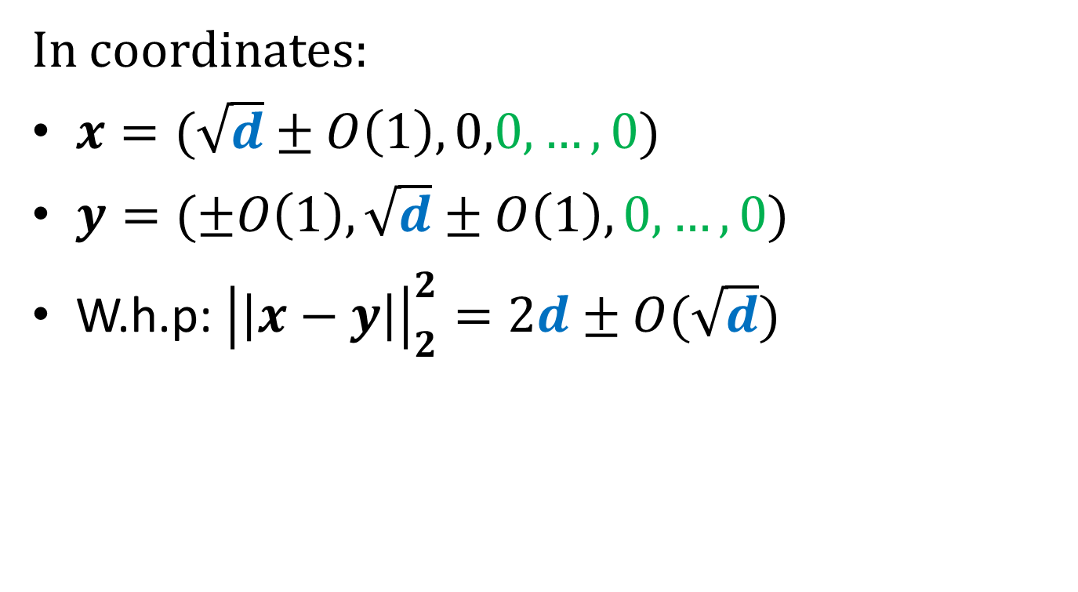
Separating Gaussians
In coordinates:
$x=(\sqrt{d}±O\left(1\right), 0,0,…, 0)$
$y=(±O\left(1\right), \sqrt{d}±O\left(1\right), 0,…, 0)$
W.h.p: ${\left|\left|x−y\right|\right|}_{2}^{2}=2d±O(\sqrt{d})$

Slide 9
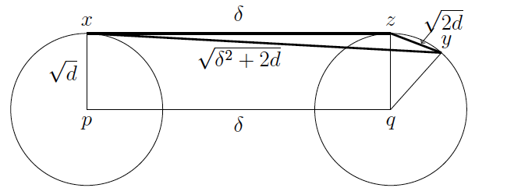
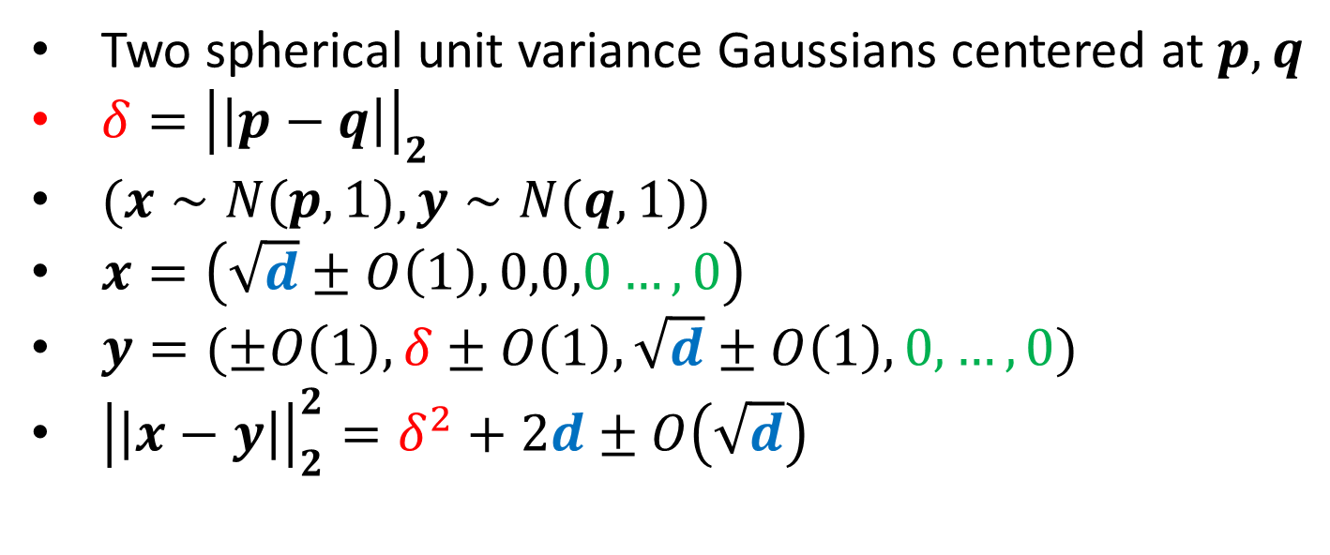
Separating Gaussians
Two spherical unit variance Gaussians centered at $p,q$
$δ={\left|\left|p−q\right|\right|}_{2}$
$(x∼N(p,1),y∼N(q,1))$
$x=\left(\sqrt{d}±O\left(1\right), 0,0,0…, 0\right)$
$y=(±O\left(1\right),δ±O\left(1\right), \sqrt{d}±O\left(1\right), 0,…, 0)$
${\left|\left|x−y\right|\right|}_{2}^{2}=δ^{2}+2d±O\left(\sqrt{d}\right)$

Slide 10
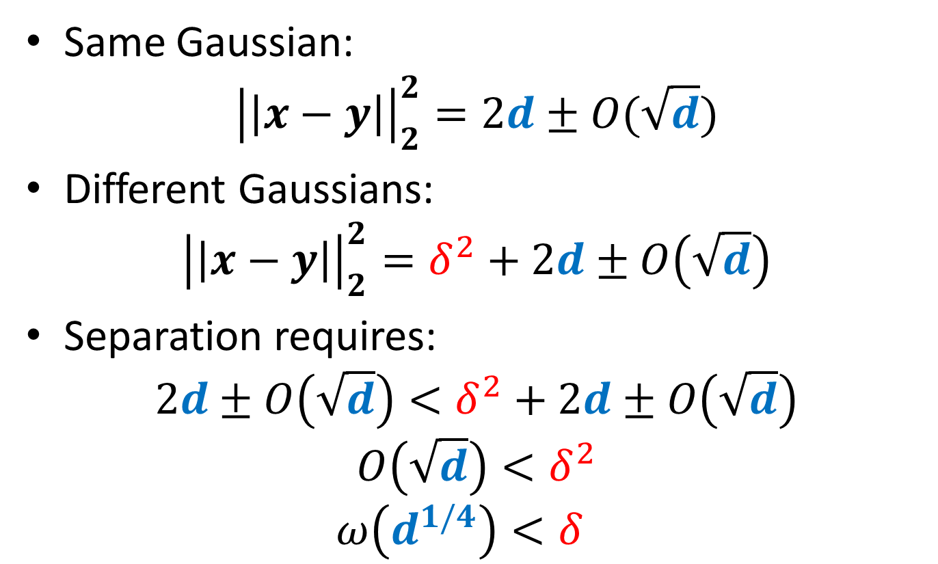
Separating Gaussians
Same Gaussian:
$${\left|\left|x−y\right|\right|}_{2}^{2}=2d±O(\sqrt{d})$$
Different Gaussians:
$${\left|\left|x−y\right|\right|}_{2}^{2}=δ^{2}+2d±O\left(\sqrt{d}\right)$$
Separation requires:
$$2d±O\left(\sqrt{d}\right)<δ^{2}+2d±O\left(\sqrt{d}\right)$$
$$O\left(\sqrt{d}\right)<δ^{2}$$
$$ω\left(d^{1/4}\right)<δ^{}$$

Slide 11
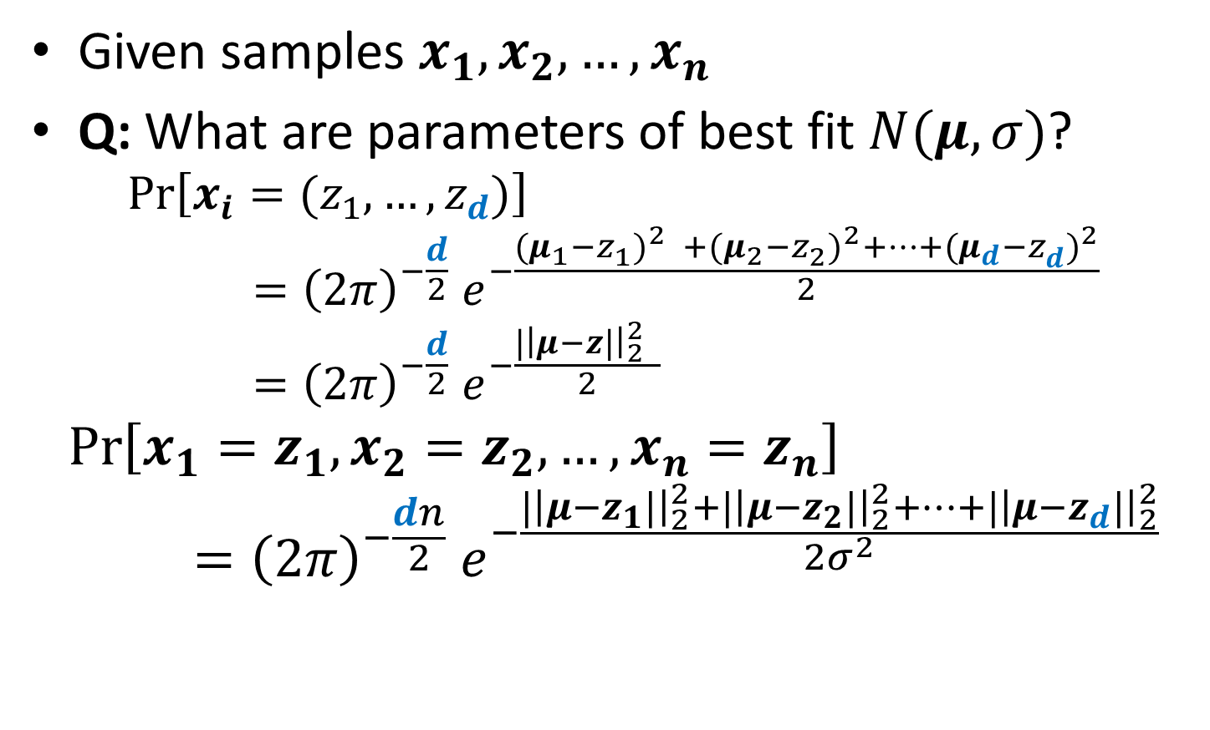
Fitting Spherical Gaussian to Data
Given samples $x_{1}, x_{2},…, x_{n}$
Q: What are parameters of best fit $N(μ,σ)$?
$$\operatorname{Pr}\left[x_{i}=(z_{1},…,z_{d})\right]={{\left(2π\right)}^{−\frac{d}{2}} e}^{−\frac{{{(μ_{1}−z}_{1}^{})}^{2} +{{(μ_{2}−z}_{2}^{})}^{2}+…+{{(μ_{d}−z}_{d}^{})}^{2}}{2}}={{\left(2π\right)}^{−\frac{d}{2}} e}^{−\frac{|{\left|μ−z|\right|}_{2}^{2} }{2}}$$
$$\operatorname{Pr}\left[x_{1}=z_{1},x_{2}=z_{2},…,x_{n}=z_{n}\right]={{\left(2π\right)}^{−\frac{dn}{2}} e}^{−\frac{|{\left|μ−z_{1}|\right|}_{2}^{2}+|{\left|μ−z_{2}|\right|}_{2}^{2}+…+|{\left|μ−z_{d}|\right|}_{2}^{2}}{2σ^{2}}}$$

Slide 12
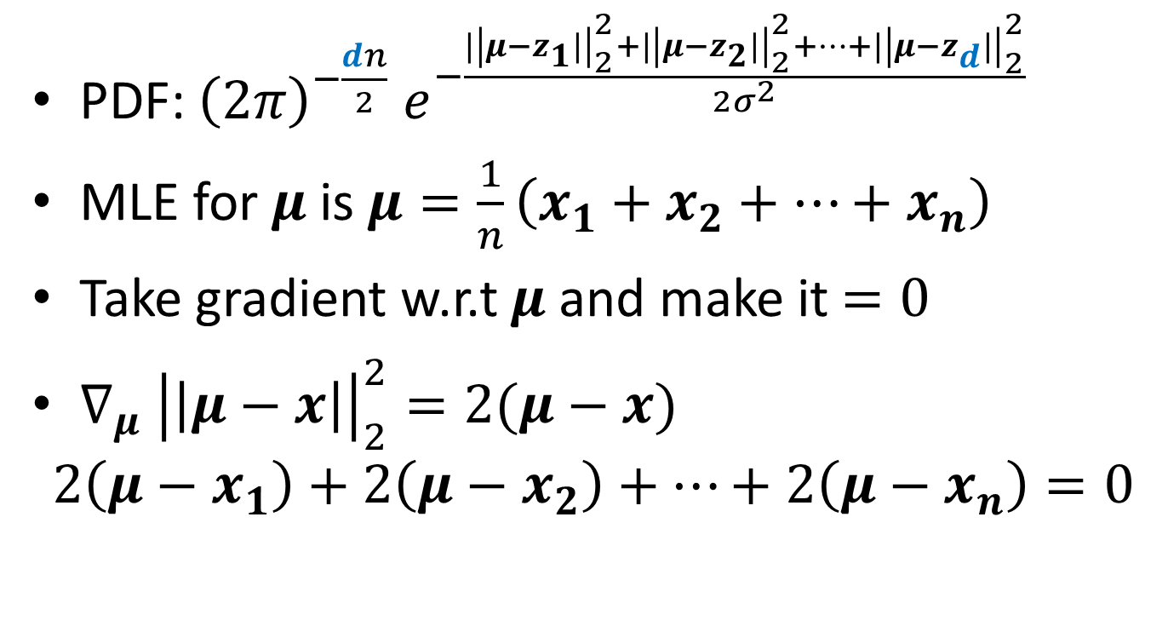
Maximum Likelihood Estimator
PDF: ${{\left(2π\right)}^{−\frac{dn}{2}} e}^{−\frac{|{\left|μ−z_{1}|\right|}_{2}^{2}+|{\left|μ−z_{2}|\right|}_{2}^{2}+…+|{\left|μ−z_{d}|\right|}_{2}^{2}}{2σ^{2}}}$
MLE for $μ$ is$μ=\frac{1}{n}\left(x_{1}+x_{2}+…+x_{n}\right)$
Take gradient w.r.t $μ$ and make it $=0$
$∇_{μ} {\left|\left|μ−x\right|\right|}_{2}^{2}=2(μ−x)$
$$2\left(μ−x_{1}\right)+2\left(μ−x_{2}\right)+…+2\left(μ−x_{n}\right)=0$$

Slide 13
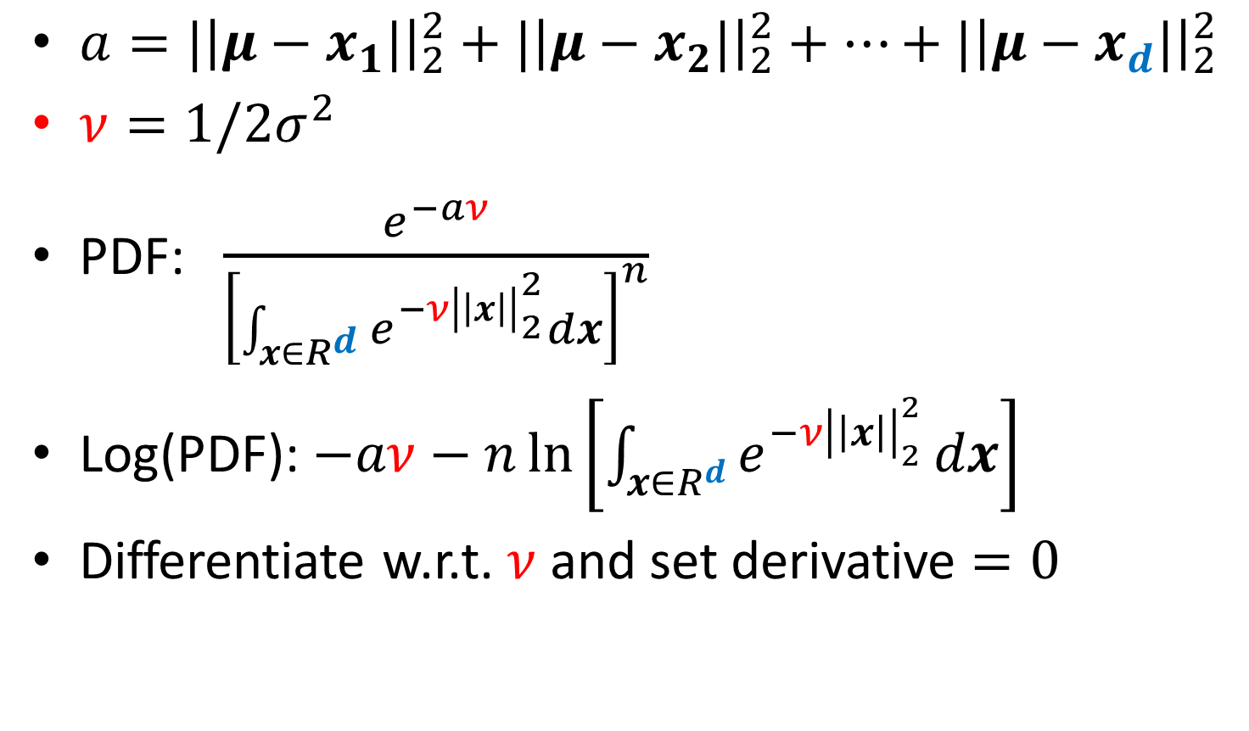
MLE for Variance
$a=|{\left|μ−x_{1}|\right|}_{2}^{2}+|{\left|μ−x_{2}|\right|}_{2}^{2}+…+|{\left|μ−x_{d}|\right|}_{2}^{2}$
$ν=1/2σ^{2}$
PDF: $\frac{e^{−aν}}{{\left[\int_{x∈R^{d}}{e^{−{ν\left|\left|x\right|\right|}_{2}^{2}}}dx\right]}^{n}}$
Log(PDF): $−aν−n\ln\left[\int_{x∈R^{d}}{e^{−{ν\left|\left|x\right|\right|}_{2}^{2}}}dx\right]$
Differentiate w.r.t. $ν$ and set derivative $=0$

Slide 14
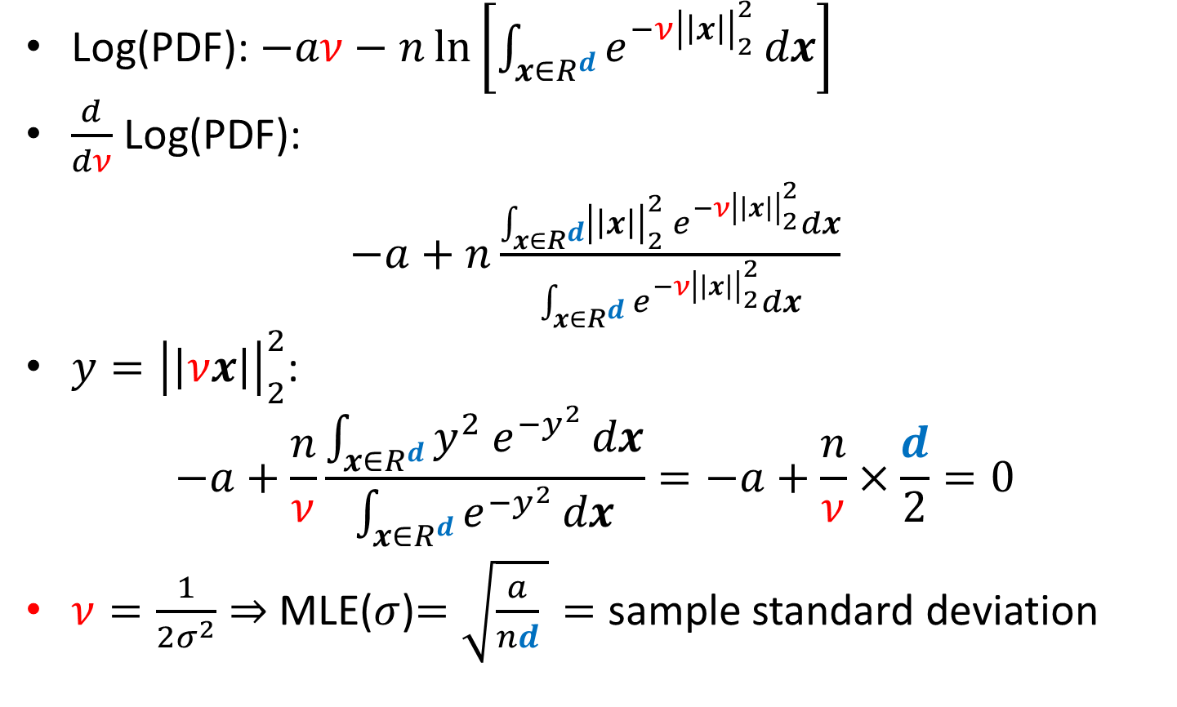
MLE for Variance
Log(PDF): $−aν−n\ln\left[\int_{x∈R^{d}}{e^{−{ν\left|\left|x\right|\right|}_{2}^{2}}}dx\right]$
$\frac{d}{dν}$ Log(PDF):
$−a+n\frac{\int_{x∈R^{d}}{{\left|\left|x\right|\right|}_{2}^{2}{ e}^{−{ν\left|\left|x\right|\right|}_{2}^{2}}}dx}{\int_{x∈R^{d}}{e^{−{ν\left|\left|x\right|\right|}_{2}^{2}}}dx}$
$y={\left|\left|νx\right|\right|}_{2}^{2}$:
$$−a+\frac{n}{ν}\frac{\int_{x∈R^{d}}{y^{2}{ e}^{−y^{2}}}dx}{\int_{x∈R^{d}}{e^{−y_{}^{2}}}dx}=−a+\frac{n}{ν}×\frac{d}{2}=0$$
$ν=\frac{1}{2σ^{2}}⇒$ MLE($σ$)$=\sqrt{\frac{a}{nd} }=$ sample standard deviation

