Slide 1

CIS 700: “algorithms for Big Data”
Lecture 3: Streaming
Slides at http://grigory.us/big-data-class.html
Grigory Yaroslavtsev
http://grigory.us

Slide 2
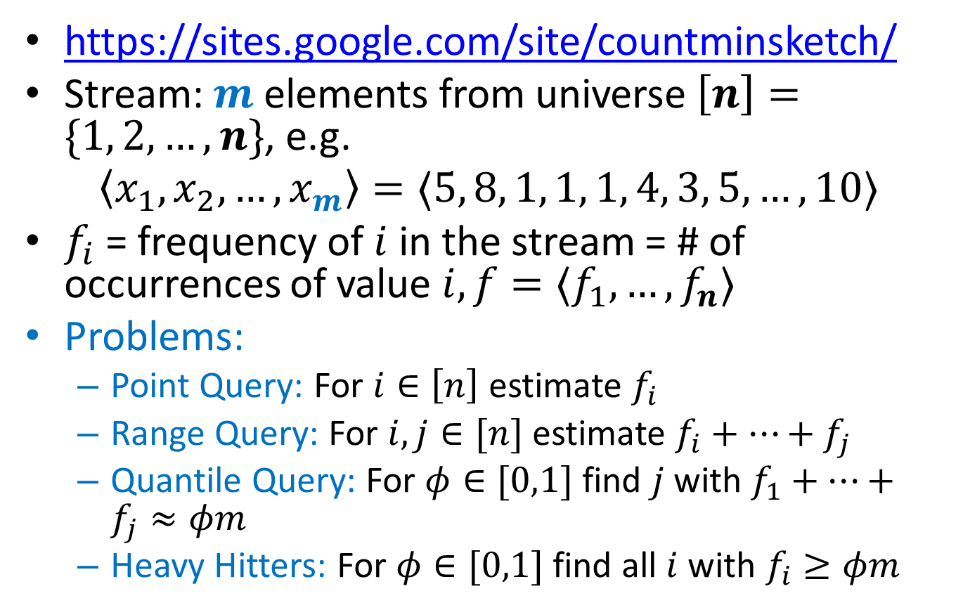
Count-Min Sketch
https://sites.google.com/site/countminsketch/
Stream: $m$ elements from universe $\left[n\right]=\{1, 2, …, n\}$, e.g.
$$〈x_{1},x_{2},…, x_{m}〉=〈5, 8, 1, 1, 1, 4, 3, 5, …, 10〉$$
$f_{i}$ = frequency of $i$ in the stream = # of occurrences of value $i, f=〈f_{1},…, f_{n}〉$
Problems:
Point Query: For $i∈\left[n\right]$ estimate $f_{i}$
Range Query: For $i,j∈[n]$ estimate $f_{i}+…+f_{j}$
Quantile Query: For $φ∈[0,1]$ find $j$ with $f_{1}+…+f_{j}≈φm$
Heavy Hitters: For $φ∈[0,1]$ find all $i$ with $f_{i}≥φm$

Slide 3
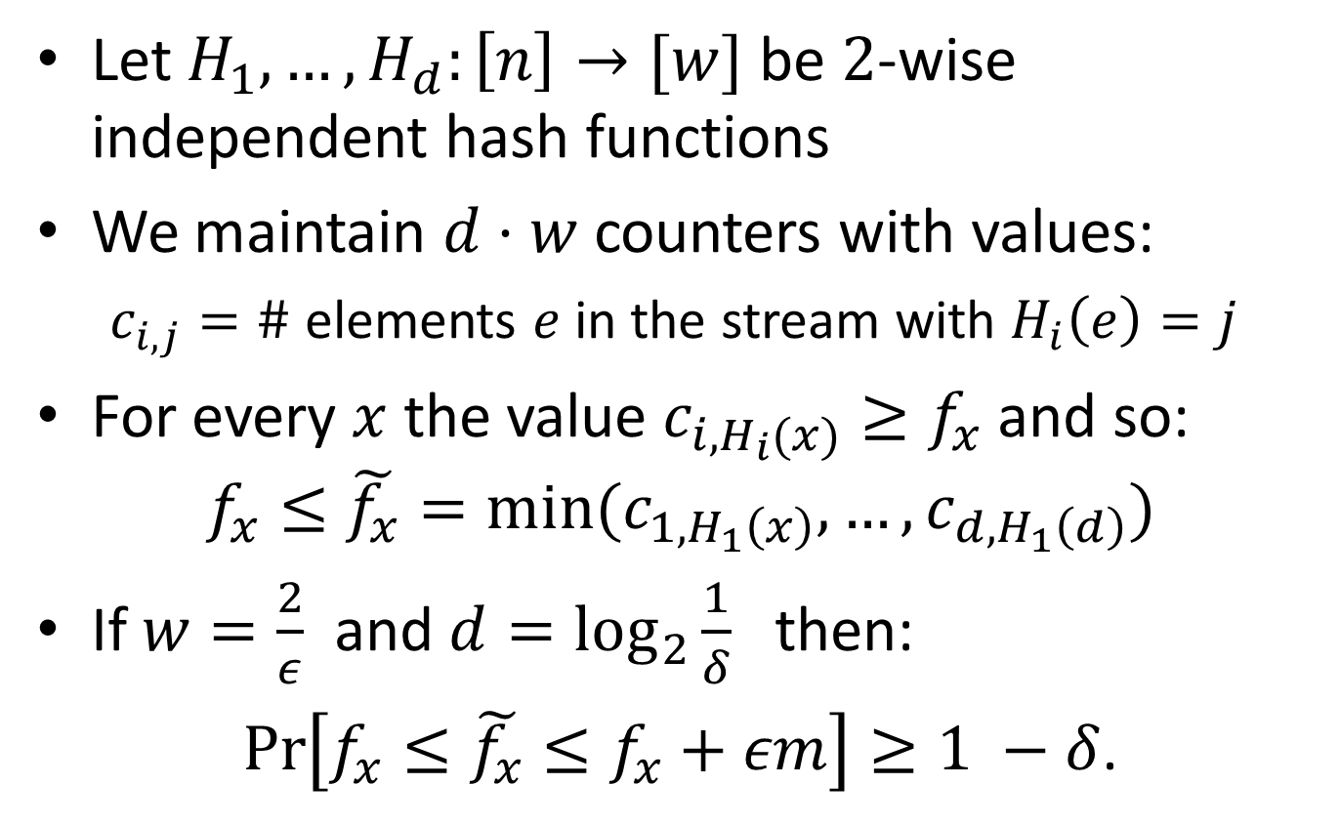
Count-Min Sketch: Construction
Let $H_{1},…,H_{d}:\left[n\right]→[w]$ be $2$-wise independent hash functions
We maintain $d⋅w$ counters with values:
$c_{i,j}=\#$ elements $e$ in the stream with $H_{i}\left(e\right)=j$
For every $x$ the value $c_{i,H_{i}(x)}≥f_{x}$ and so:
$$f_{x}≤\tilde{f_{x}}=min⁡(c_{1,H_{1}\left(x\right)}, …,c_{d,H_{1}\left(d\right)})$$
If $w=\frac{2}{ε}$ and $d=\log_{2}{\frac{1}{δ}}$ then:
$\operatorname{Pr}\left[f_{x}≤\tilde{f_{x}}≤f_{x}+εm\right]≥1 −δ$.

Slide 4
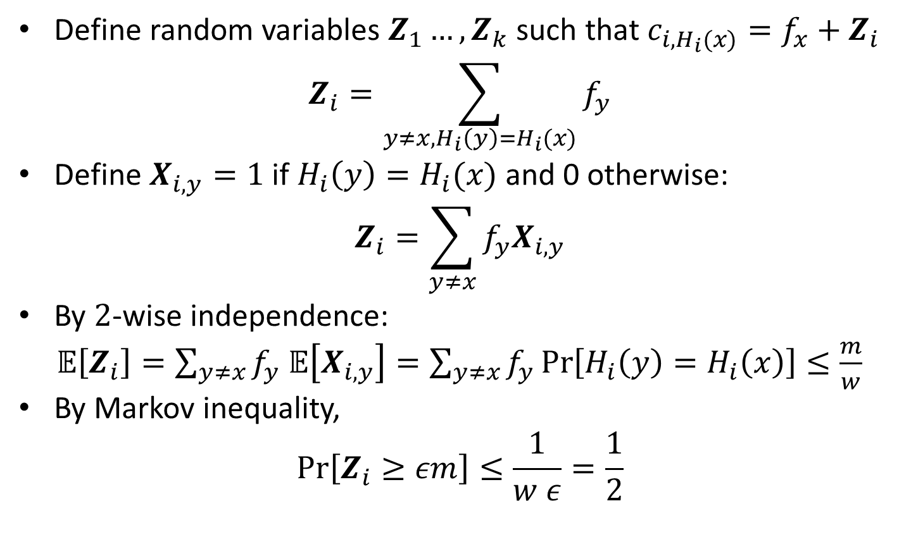
Count-Min Sketch: Analysis
Define random variables $Z_{1}…, Z_{k}$ such that $c_{i, H_{i}(x)}=f_{x}+Z_{i}$
$$Z_{i}=\sum_{y≠x, H_{i}\left(y\right)=H_{i}(x)}{f_{y}}$$
Define $X_{i, y}=1$ if $H_{i}\left(y\right)=H_{i}(x)$ and 0 otherwise:
$$Z_{i}=\sum_{y≠x}{f_{y}X_{i,y}}$$
By $2$-wise independence:
$𝔼\left[Z_{i}\right]=\sum_{y≠x}{f_{y}}$ $𝔼\left[X_{i,y}\right]=\sum_{y≠x}{f_{y}}\operatorname{Pr}\left[H_{i}\left(y\right)=H_{i}\left(x\right)\right]≤\frac{m}{w}$
By Markov inequality,
$$\operatorname{Pr}\left[Z_{i}≥εm\right]≤\frac{1}{w ε}=\frac{1}{2}$$

Slide 5
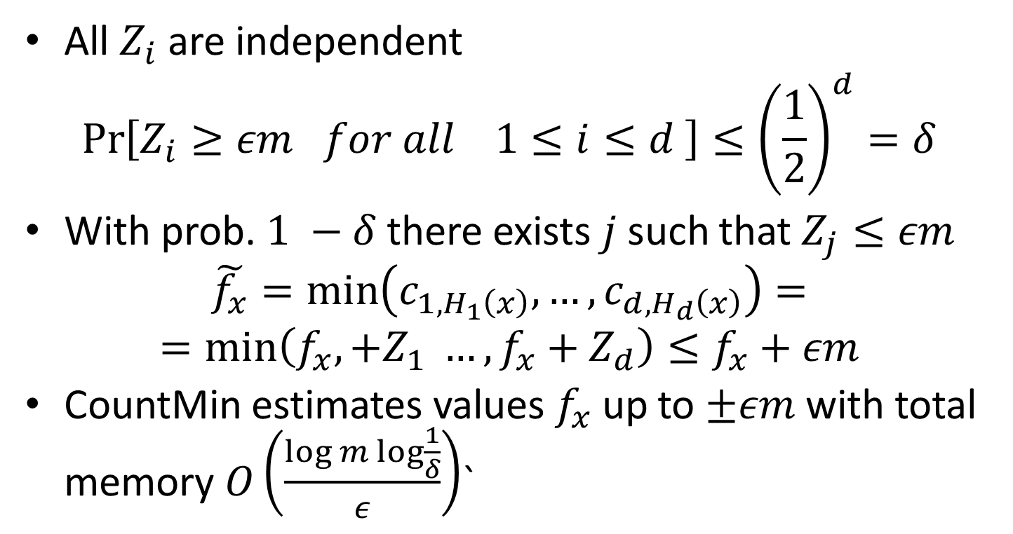
Count-Min Sketch: Analysis
All $Z_{i}$ are independent
$$\operatorname{Pr}\left[Z_{i}≥εm for all 1≤i≤d \right]≤{\left(\frac{1}{2}\right)}^{d}=δ$$
With prob.$1 −δ$ there exists $j$ such that $Z_{j}≤εm$
$$\tilde{f_{x}}=\min\left(c_{1, H_{1}\left(x\right)}, …,c_{d, H_{d}\left(x\right)}\right)=$$
$$=\min\left(f_{x},+Z_{1} …,f_{x}+Z_{d}\right)≤f_{x}+εm$$
CountMin estimates values $f_{x}$ up to $±εm$ with total memory $O\left(\frac{log m\log{\frac{1}{δ}}}{ε}\right)$`

Slide 6
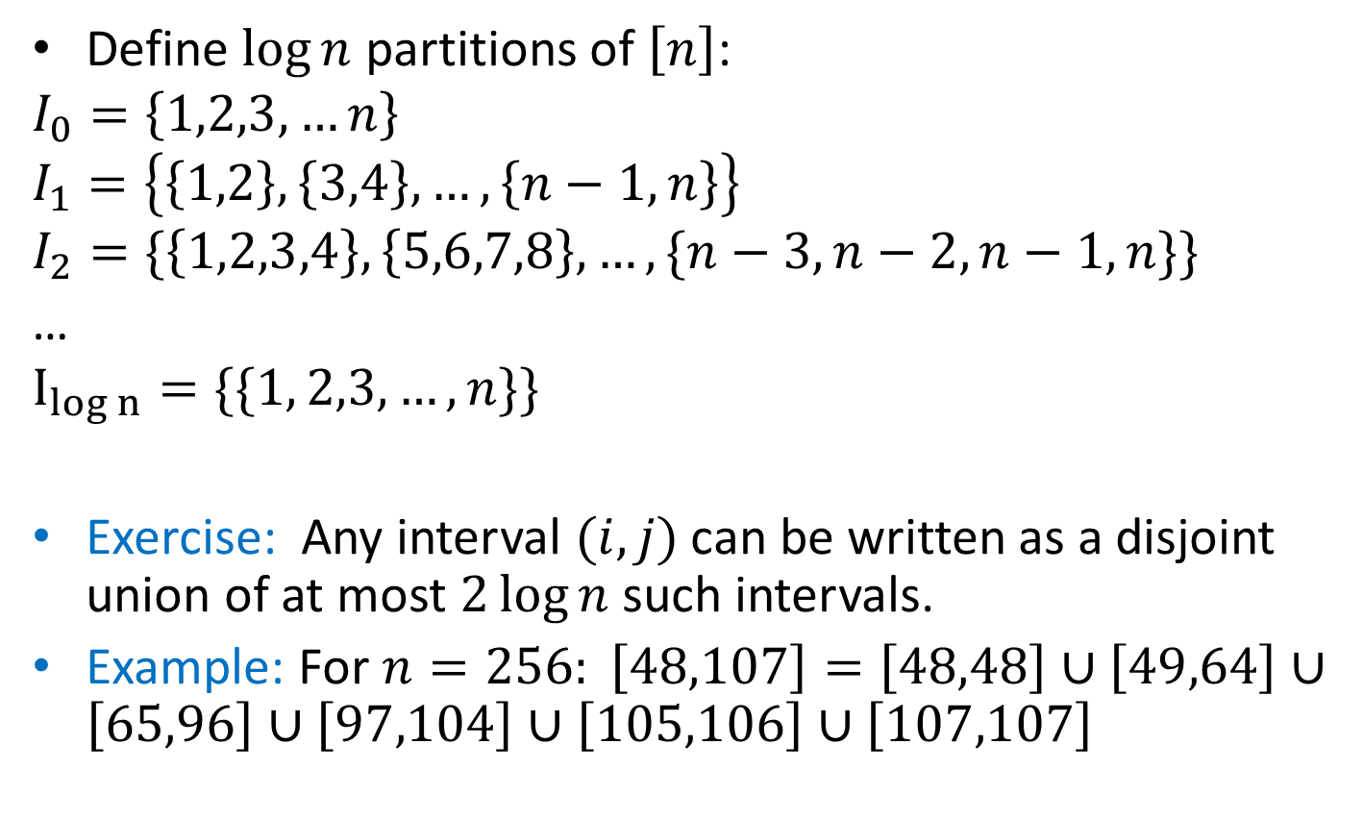
Dyadic Intervals
Define $\log{n}$ partitions of $\left[n\right]$:
$$I_{0}=\left\{1,2,3,…n\right\}$$
$$I_{1}=\left\{\left\{1,2\right\},\left\{3,4\right\},…,\left\{n−1,n\right\}\right\}$$
$$I_{2}=\{\left\{1,2,3,4\right\},\left\{5,6,7,8\right\}, …,\{n−3,n−2,n−1,n\}\}$$
…
$$I_{log n}=\{\{1, 2,3,…, n\}\}{}$$
Exercise: Any interval $(i,j)$ can be written as a disjoint union of at most $2\log{n }$such intervals.
Example: For $n=256: \left[48,107\right]=\left[48,48\right]∪\left[49,64\right]∪\left[65,96\right]∪\left[97,104\right]∪\left[105,106\right]∪\left[107,107\right]$

Slide 7
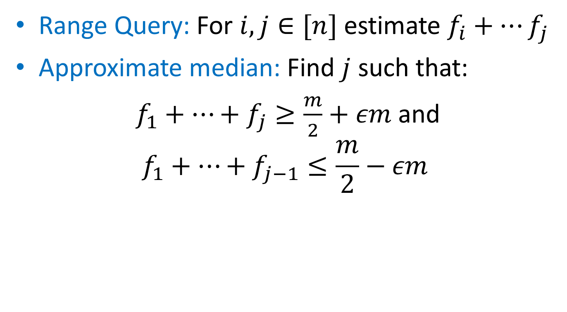
Count-Min: Range Queries and Quantiles
Range Query: For $i,j∈[n]$ estimate $f_{i}+…f_{j}$
Approximate median: Find $j$ such that:
$f_{1}+…+f_{j}≥\frac{m}{2}+εm$ and
$$f_{1}+…+f_{j−1}≤\frac{m}{2}−εm$$

Slide 8
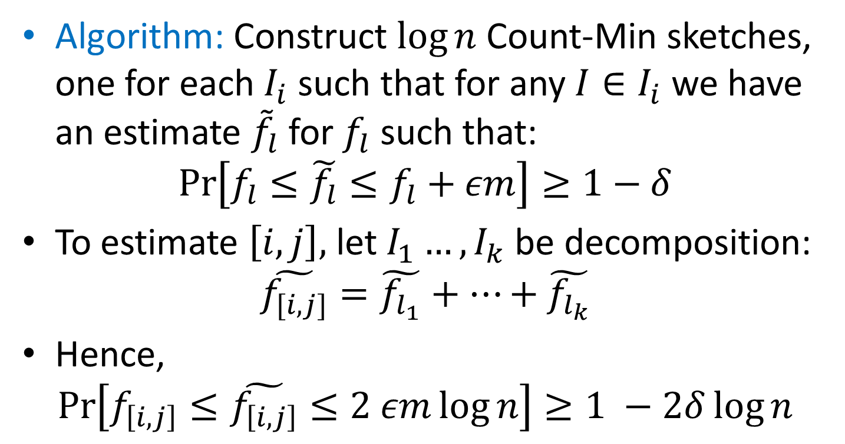
Count-Min: Range Queries and Quantiles
Algorithm: Construct $\log{n}$ Count-Min sketches, one for each $I_{i}$ such that for any $I∈I_{i}$ we have an estimate ${\tilde{f}}_{l}$for $f_{l}$ such that:
$$\operatorname{Pr}\left[f_{l}≤\tilde{f_{l}}≤f_{l}+εm\right]≥1−δ$$
To estimate $\left[i,j\right],$ let $I_{1}…, I_{k}$ be decomposition:
$$\tilde{f_{[i,j]}}=\tilde{f_{l_{1}}}+…+\tilde{f_{l_{k}}}$$
Hence,
$$\operatorname{Pr}\left[f_{\left[i,j\right]}≤\tilde{f_{\left[i,j\right]}}≤2 εm\log{n}\right]≥1 −2δ\log{n}$$

Slide 9
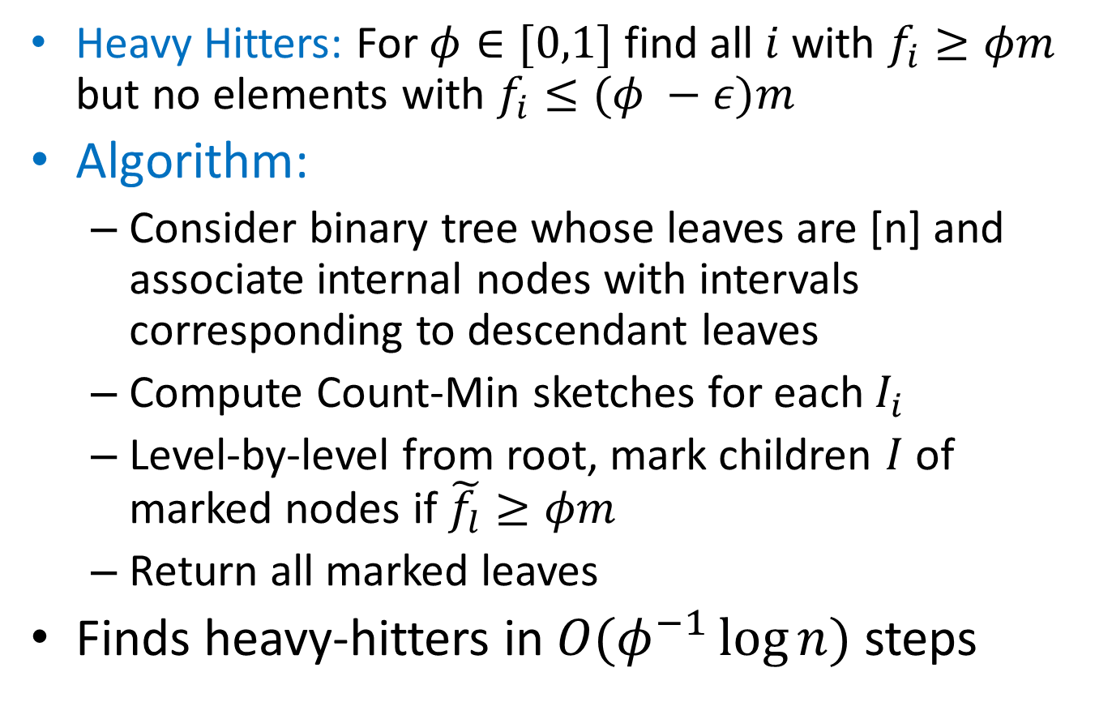
Count-Min: Heavy Hitters
Heavy Hitters: For $φ∈[0,1]$ find all $i$ with $f_{i}≥φm$ but no elements with $f_{i}≤(φ −ε)m$
Algorithm:
Consider binary tree whose leaves are [n] and associate internal nodes with intervals corresponding to descendant leaves
Compute Count-Min sketches for each $I_{i}$
Level-by-level from root, mark children $I$ of marked nodes if $\tilde{f_{l}}≥φm$
Return all marked leaves
Finds heavy-hitters in $O(φ^{−1}\log{n})$ steps

Slide 10
More about Count-Min
Authors: Graham Cormode, S. Muthukrishnan [LATIN’04]
Count-Min is linear:
Count-Min(S1 + S2) = Count-Min(S1) + Count-Min(S2)
Deterministic version: CR-Precis
Count-Min vs. Bloom filters
Allows to approximate values, not just 0/1 (set membership)
Doesn’t require mutual independence (only 2-wise)
FAQ and Applications:
https://sites.google.com/site/countminsketch/home/
https://sites.google.com/site/countminsketch/home/faq

Slide 11
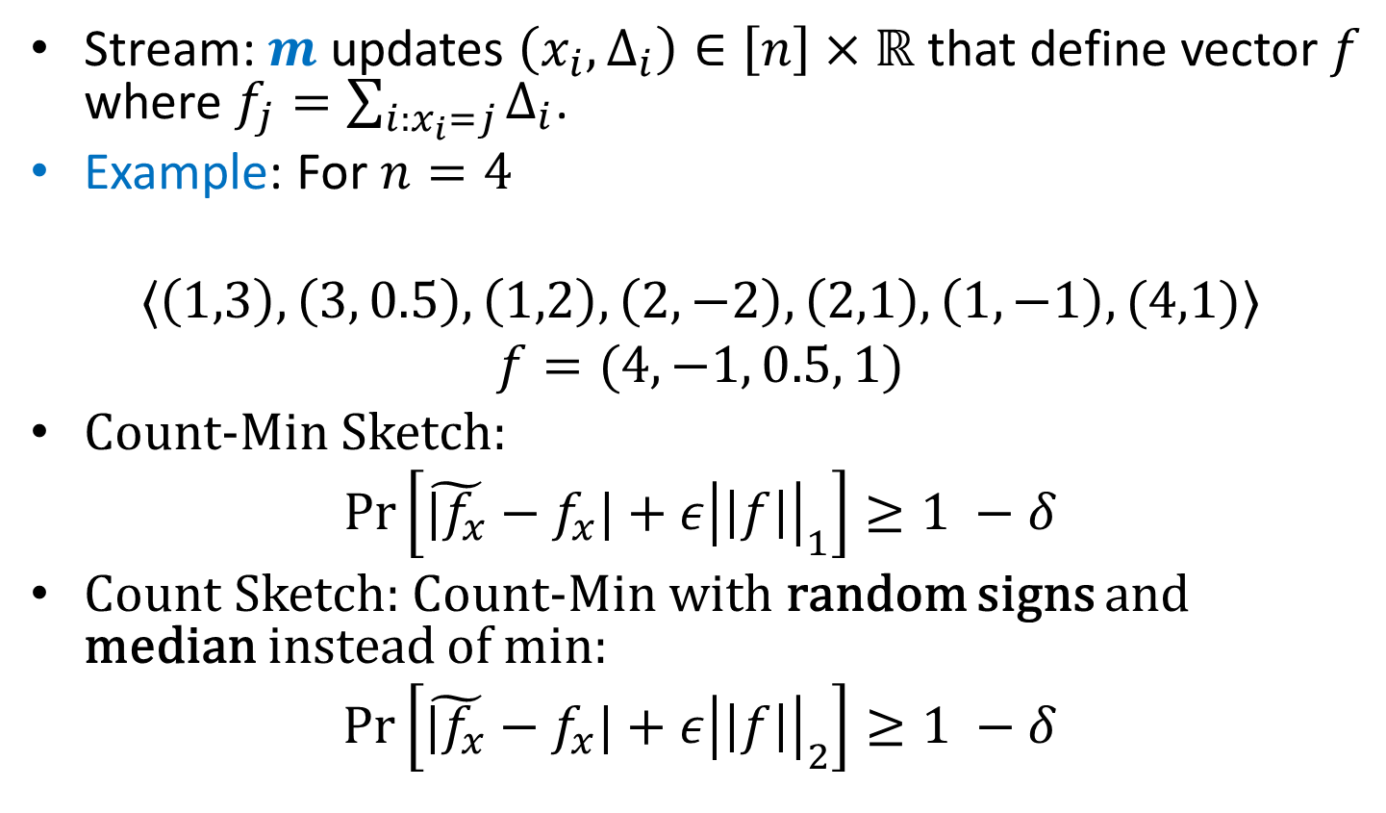
Fully Dynamic Streams
Stream: $m$ updates $\left(x_{i}, Δ_{i}\right)∈\left[n\right]×ℝ$ that define vector $f$ where $f_{j}=\sum_{i:x_{i}=j}{Δ_{i}}$.
Example: For $n=4$
$$〈\left(1,3\right), \left(3, 0.5\right), \left(1,2\right), \left(2,−2\right),\left(2,1\right), \left(1,−1\right), (4,1)〉$$
$$f=(4, −1, 0.5, 1)$$
Count-Min Sketch:
$$\operatorname{Pr}\left[\tilde{|f_{x}}−f_{x}|+ε{\left|\left|f\right|\right|}_{1}\right]≥1 −δ$$
Count Sketch: Count-Min with random signs and median instead of min:
$$\operatorname{Pr}\left[\tilde{|f_{x}}−f_{x}|+ε{\left|\left|f\right|\right|}_{2}\right]≥1 −δ$$

Slide 12
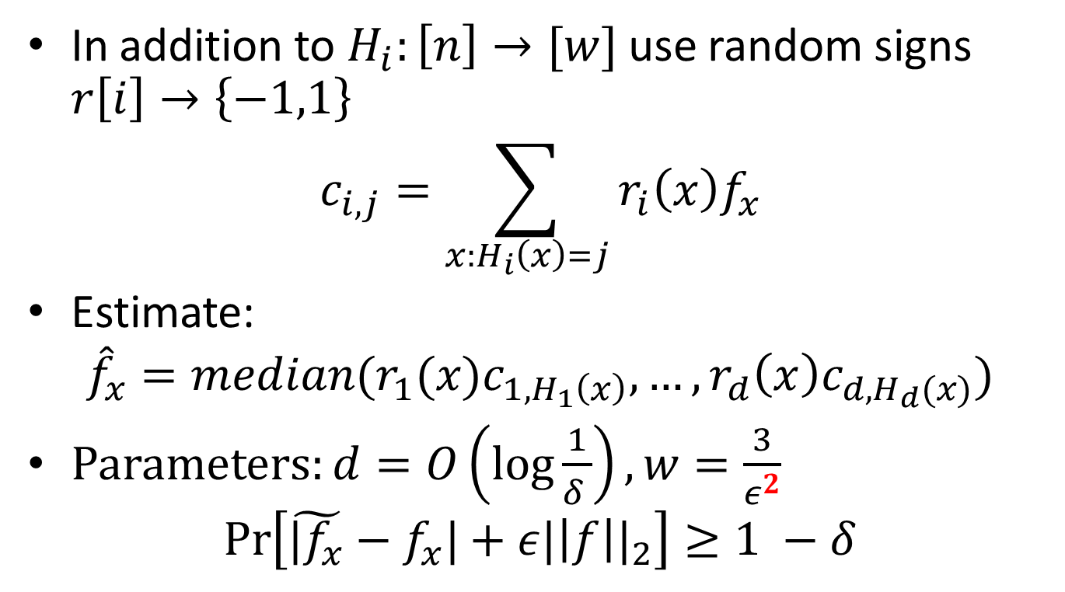
Count Sketch
In addition to $H_{i}:\left[n\right]→[w]$ use random signs $r\left[i\right]→\left\{−1,1\right\}$
$$c_{i,j}=\sum_{x:H_{i}\left(x\right)=j}{r_{i}\left(x\right)f_{x}}$$
Estimate:
$${\hat{f}}_{x}=median(r_{1}(x)c_{1,H_{1}\left(x\right)}, …,r_{d}\left(x\right)c_{d,H_{d}(x)})$$
Parameters: $d=O\left(\log{\frac{1}{δ }}\right), w=\frac{3}{ε^{2}}$
$$\operatorname{Pr}\left[\tilde{|f_{x}}−f_{x}|+ε{|\left|f\right||}_{2}\right]≥1 −δ$$

Slide 13
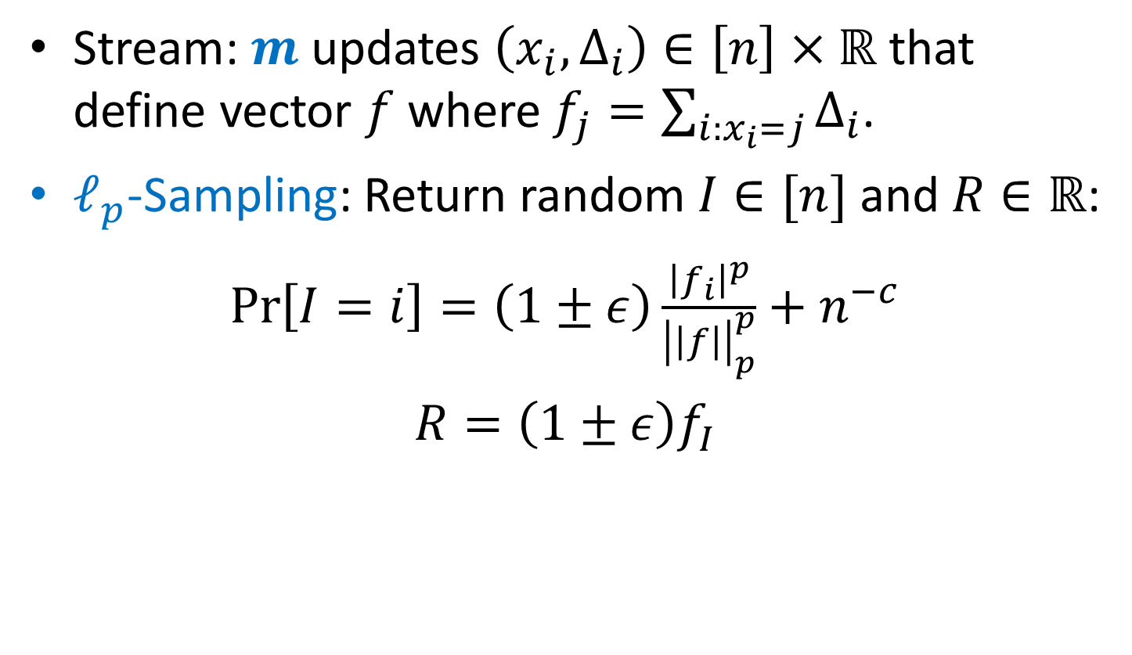

$ℓ_{p}$-Sampling
Stream: $m$ updates $\left(x_{i}, Δ_{i}\right)∈\left[n\right]×ℝ$ that define vector $f$ where $f_{j}=\sum_{i:x_{i}=j}{Δ_{i}}$.
$ℓ_{p}$-Sampling: Return random $I∈[n]$ and $R∈ℝ$:
$\operatorname{Pr}\left[I=i\right]=\left(1±ε\right)\frac{{\left|f_{i}\right|}^{p}}{{\left|\left|f\right|\right|}_{p}^{p}}+n^{−c}$
$R=\left(1±ε\right)f_{I}$

Slide 14
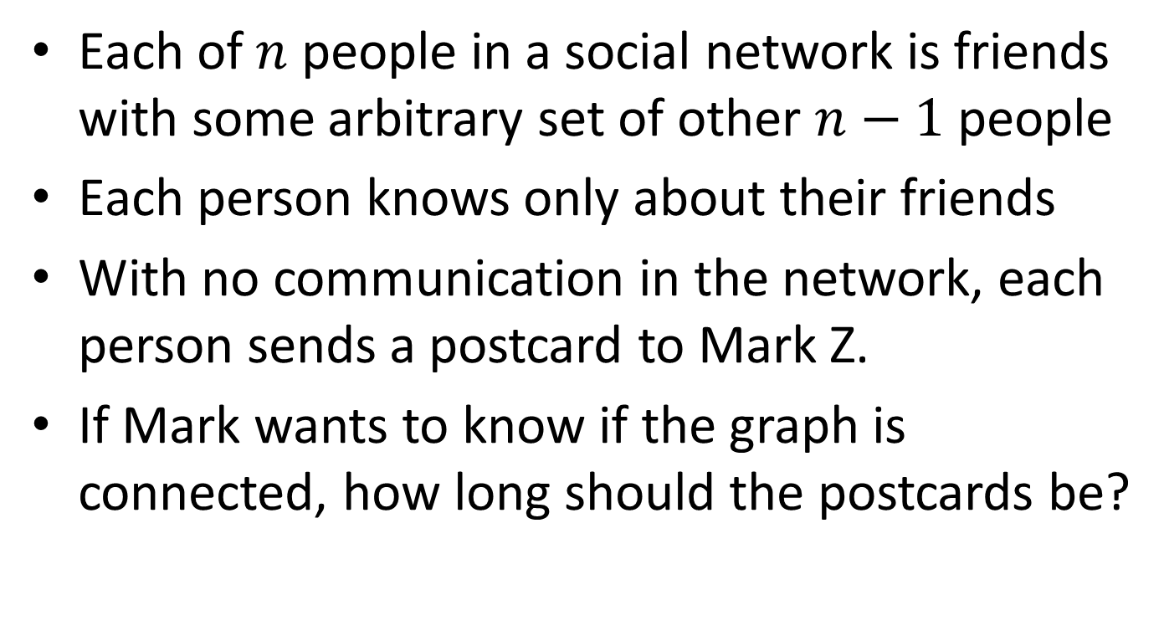
Application: Social Networks
Each of $n$ people in a social network is friends with some arbitrary set of other $n−1$ people
Each person knows only about their friends
With no communication in the network, each person sends a postcard to Mark Z.
If Mark wants to know if the graph is connected, how long should the postcards be?

Slide 15
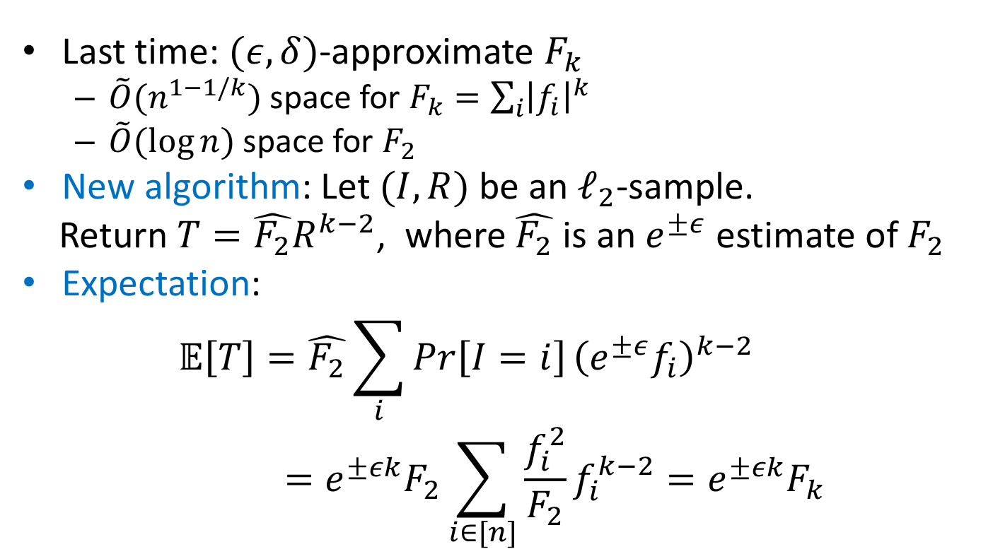

Optimal $F_{k}$ estimation
Last time: $(ε,δ)$-approximate $F_{k}$
$\tilde{O}(n^{1−1/k})$ space for $F_{k}=\sum_{i}{{\left|f_{i}\right|}^{k}}$
$\tilde{O}(\log{n})$ space for $F_{2}$
New algorithm: Let $(I,R)$ be an $ℓ_{2}$-sample.
Return $T=\hat{F_{2}}R^{k−2}$, where $\hat{F_{2}}$ is an $e^{±ε}$ estimate of $F_{2}$
Expectation:
$$𝔼\left[T\right]=\hat{F_{2}}\sum_{i}{Pr}\left[I=i\right]{\left(e^{±ε}f_{i}\right)}^{k−2}=e^{±εk}F_{2}\sum_{i∈[n]}{\frac{f_{i}^{2}}{F_{2}}f_{i}^{k−2}=e^{±εk}F_{k}}$$

Slide 16
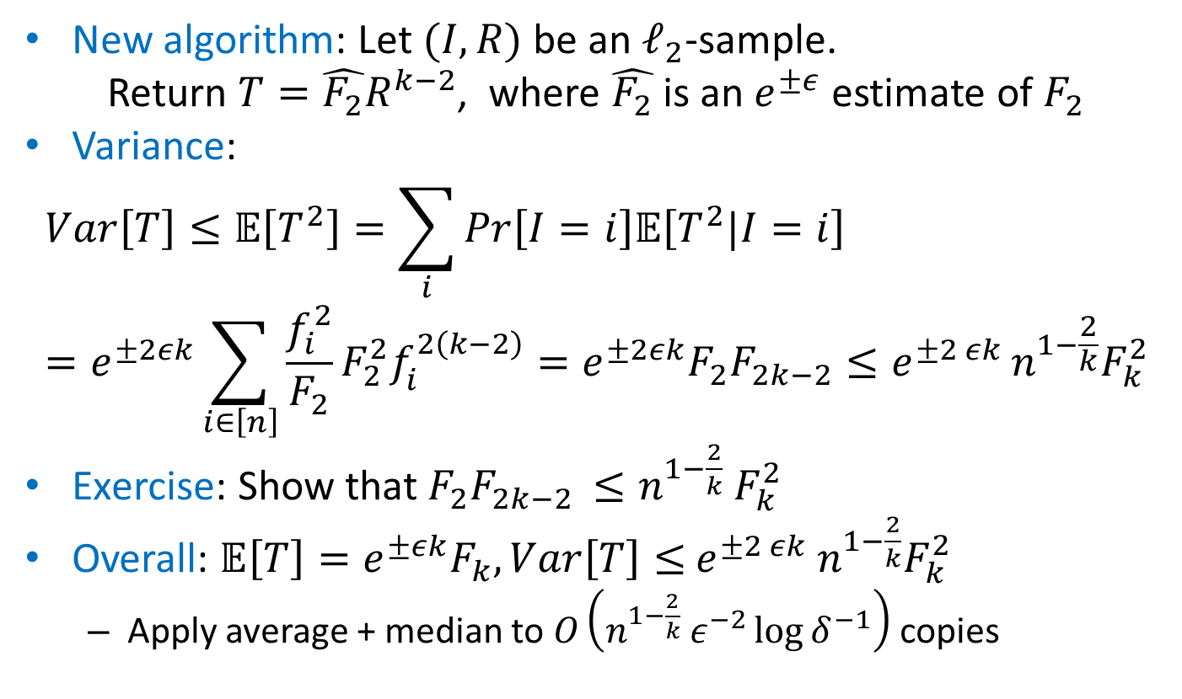
Optimal $F_{k}$ estimation
New algorithm: Let $(I,R)$ be an $ℓ_{2}$-sample.
Return $T=\hat{F_{2}}R^{k−2}$, where $\hat{F_{2}}$ is an $e^{±ε}$ estimate of $F_{2}$
Variance:
$$Var\left[T\right]≤𝔼\left[T^{2}\right]=\sum_{i}{Pr}\left[I=i\right]𝔼\left[T^{2}|I=i\right]=e^{±2εk}\sum_{i∈\left[n\right]}{\frac{f_{i}^{2}}{F_{2}}{F_{2}^{2}f}_{i}^{2\left(k−2\right)}=e^{±2εk}F_{2}F_{2k−2}≤e^{±2 εk}}n^{1−\frac{2}{k}}F_{k}^{2}$$
Exercise: Show that $F_{2}F_{2k−2 }≤n^{1−\frac{2}{k}} F_{k}^{2}$
Overall: ${𝔼\left[T\right]=e}^{±εk}F_{k}, Var\left[T\right]≤$ ${e^{±2 εk} n}^{1−\frac{2}{k}}F_{k}^{2}$
Apply average + median to $O\left(n^{1−\frac{2}{k}} ε^{−2}\log{δ^{−1}}\right)$ copies

Slide 17
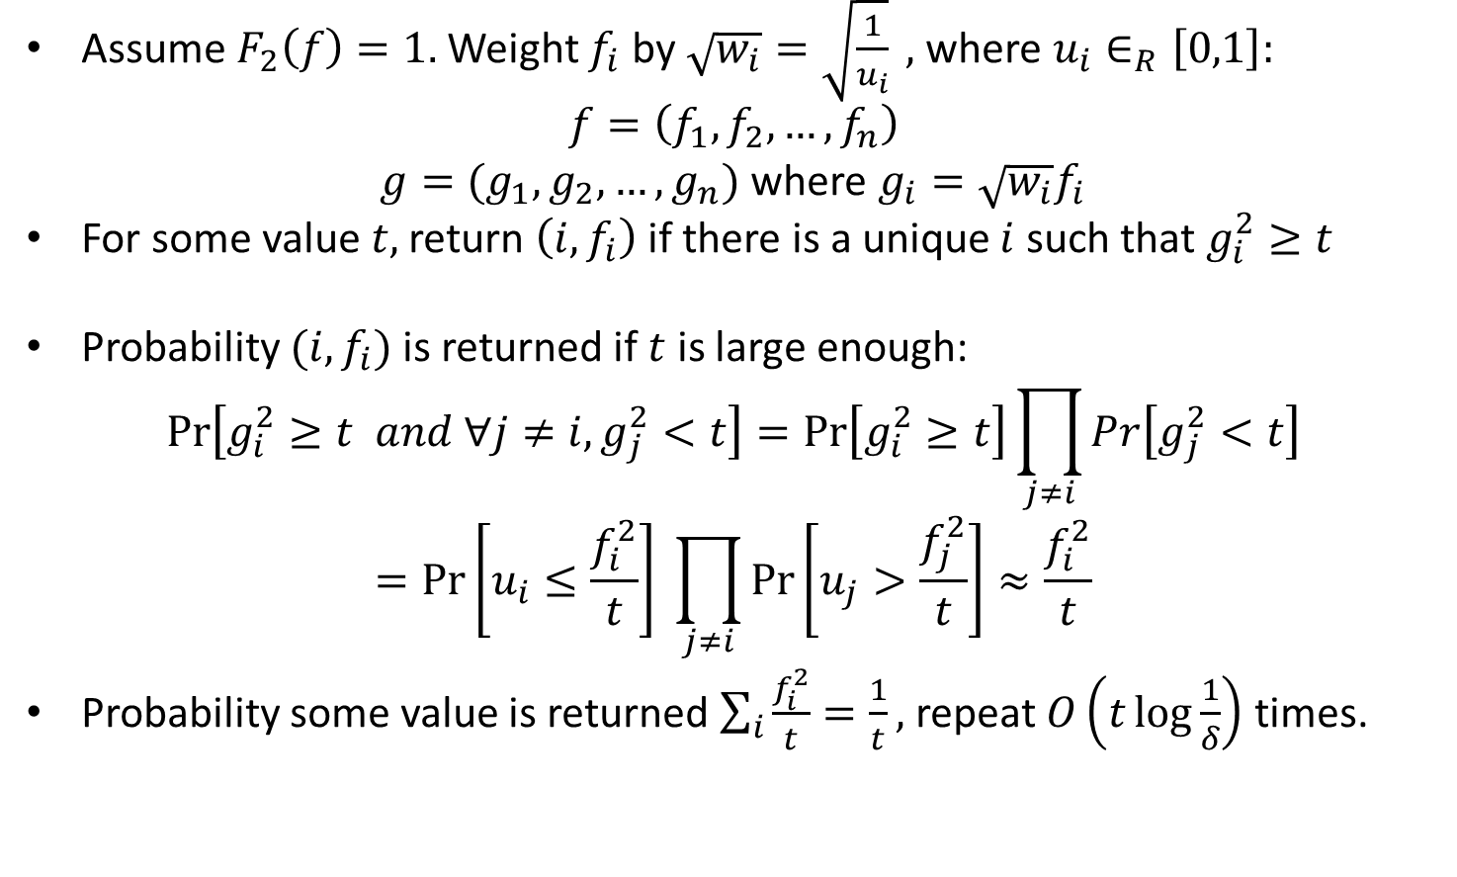

$ℓ_{2}$-Sampling: Basic Overview
Assume $F_{2}\left(f\right)=1.$ Weight $f_{i}$ by $\sqrt{w_{i}}=\sqrt{\frac{1}{u_{i}}} ,$ where $u_{i}∈_{R}\left[0,1\right]:$
$$f=\left(f_{1},f_{2},…, f_{n}\right)$$
$g=(g_{1},g_{2},…, g_{n})$ where $g_{i}=\sqrt{w_{i}}f_{i}$
For some value $t,$ return $\left(i,f_{i}\right)$ if there is a unique $i$ such that $g_{i}^{2}≥t$
Probability $(i,f_{i})$ is returned if $t$ is large enough:
$$\operatorname{Pr}\left[g_{i}^{2}≥t and ∀j≠i, g_{j}^{2}<t\right]=\operatorname{Pr}\left[g_{i}^{2}≥t\right]\prod_{j≠i}{Pr\left[g_{j}^{2}<t\right]}$$
$$=\operatorname{Pr}\left[u_{i}≤\frac{f_{i}^{2}}{t}\right] \prod_{j≠i}{\operatorname{Pr}\left[u_{j}>\frac{f_{j}^{2}}{t}\right]}≈\frac{f_{i}^{2}}{t}$$
Probability some value is returned $\sum_{i}{\frac{f_{i}^{2}}{t}}=\frac{1}{t},$ repeat $O\left(t\log{\frac{1}{δ}}\right)$ times.

Slide 18
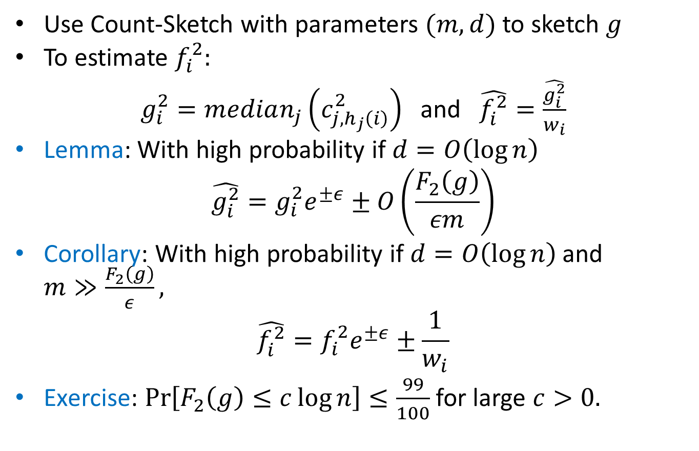

$ℓ_{2}$-Sampling: Part 1
Use Count-Sketch with parameters $(m,d)$ to sketch $g$
To estimate $f_{i}^{2}:$
$g_{i}^{2}=median_{j}\left(c_{j,h_{j}\left(i\right)}^{2}\right)$ and $\hat{f_{i}^{2}}=\frac{\hat{g_{i}^{2}}}{w_{i}}$
Lemma: With high probability if $d=O\left(\log{n}\right)$
$$\hat{g_{i}^{2}}=g_{i}^{2}e^{±ε}±O\left(\frac{F_{2}\left(g\right)}{εm}\right)$$
Corollary: With high probability if $d=O\left(\log{n}\right)$ and $m≫\frac{F_{2}\left(g\right)}{ε},$
$$\hat{f_{i}^{2}}=f_{i}^{2}e^{±ε}±\frac{1}{w_{i}}$$
Exercise: $\operatorname{Pr}\left[F_{2}\left(g\right)≤c\log{n}\right]≤\frac{99}{100}$ for large $c>0.$

Slide 19
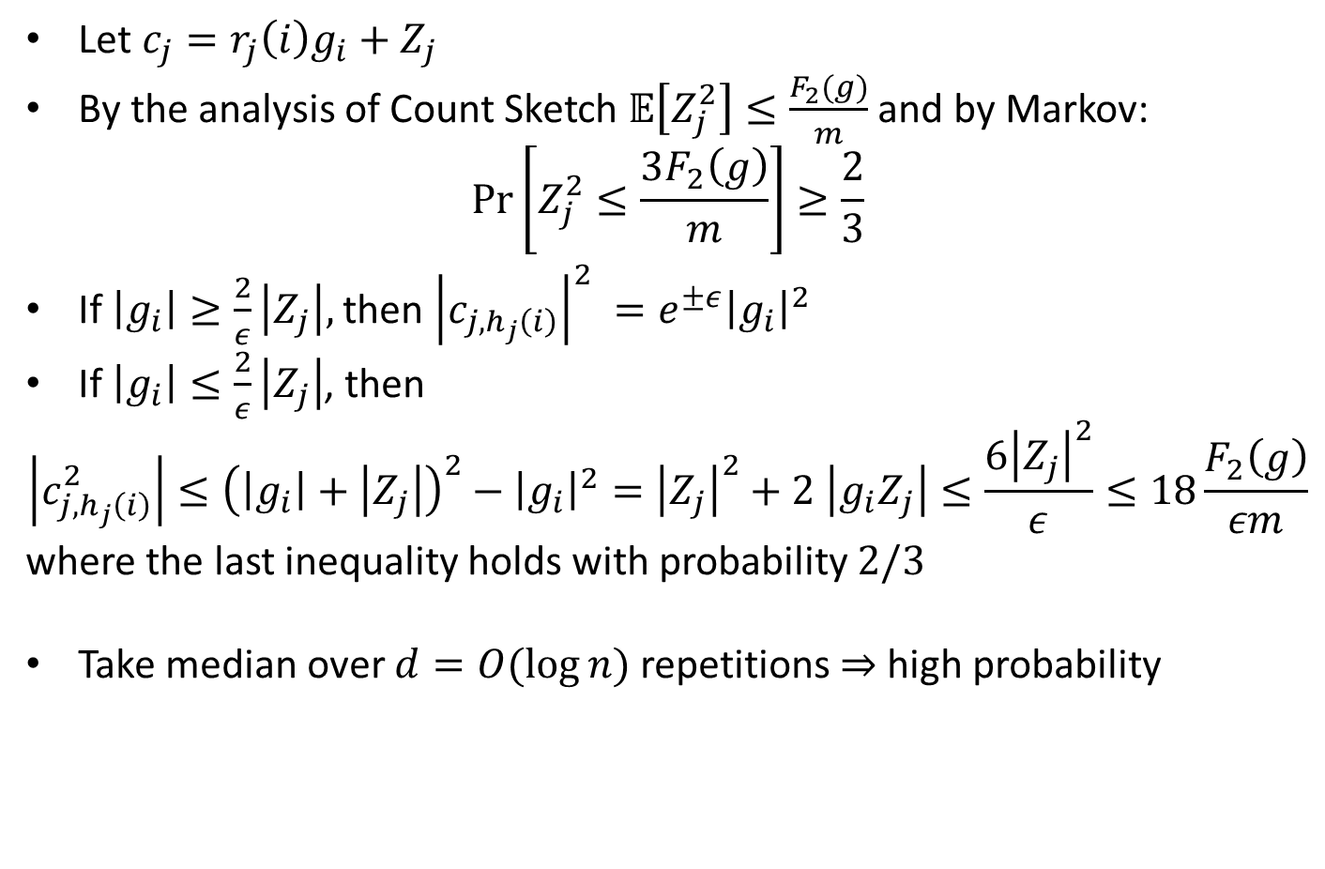
Proof of Lemma
Let $c_{j}=r_{j}\left(i\right)g_{i}+Z_{j}$
By the analysis of Count Sketch $𝔼\left[Z_{j}^{2}\right]≤\frac{F_{2}(g)}{m}$ and by Markov:
$$\operatorname{Pr}\left[Z_{j}^{2}≤\frac{3F_{2}\left(g\right)}{m}\right]≥\frac{2}{3}$$
If $\left|g_{i}\right|≥\frac{2}{ε}\left|Z_{j}\right|,$ then ${\left|c_{j, h_{j}\left(i\right)}\right|}^{2} =e^{±ε}{\left|g_{i}\right|}^{2}$
If $\left|g_{i}\right|≤\frac{2}{ε}\left|Z_{j}\right|$, then
$$\left|c_{j,h_{j}\left(i\right)}^{2}\right|≤{\left(\left|g_{i}\right|+\left|Z_{j}\right|\right)}^{2}−{\left|g_{i}\right|}^{2}={\left|Z_{j}\right|}^{2}+2 \left|g_{i}Z_{j}\right|≤\frac{6{\left|Z_{j}\right|}^{2}}{ε}≤18\frac{F_{2}\left(g\right)}{εm}$$
where the last inequality holds with probability $2/3$
Take median over $d=O(\log{n})$ repetitions $⇒$high probability

Slide 20
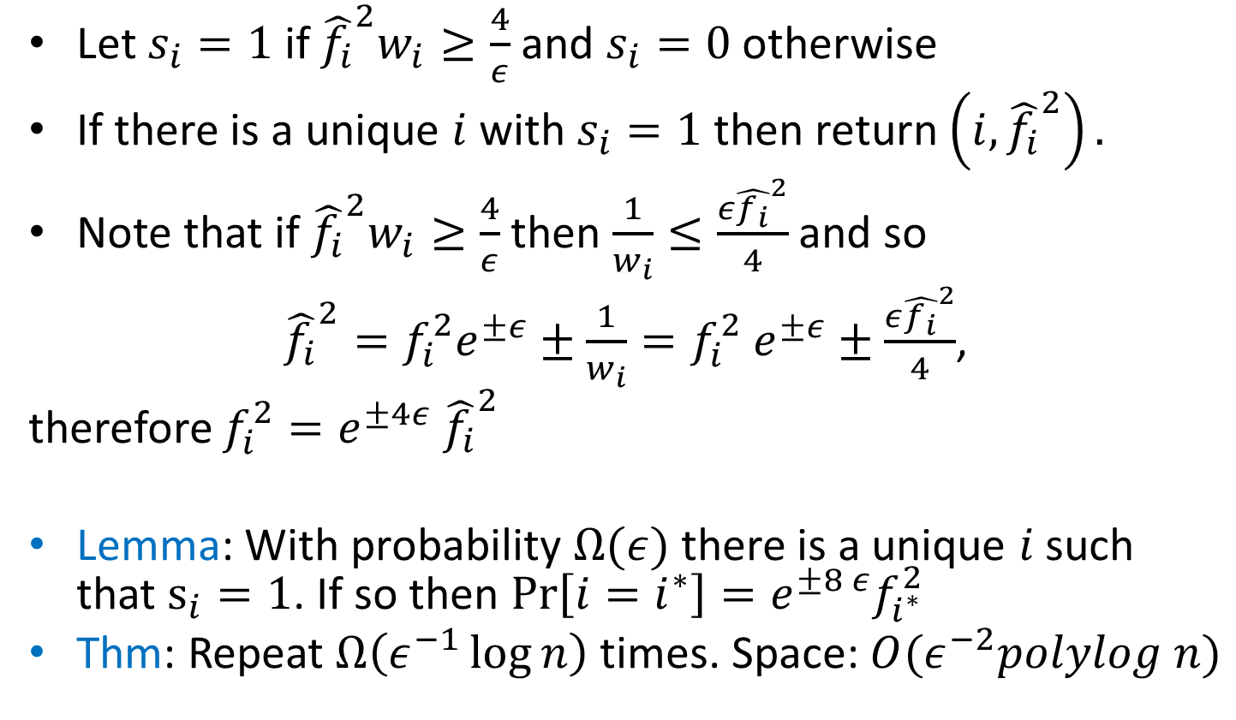

$ℓ_{2}$-Sampling: Part 2
Let $s_{i}=1$ if ${\hat{f_{i}}}^{2}w_{i}≥\frac{4}{ε}$ and $s_{i}=0$ otherwise
If there is a unique $i$ with $s_{i}=1$ then return $\left(i, {\hat{f_{i}}}^{2}\right).$
Note that if ${\hat{f_{i}}}^{2}w_{i}≥\frac{4}{ε}$ then $\frac{1}{w_{i}}≤\frac{ε{\hat{f_{i}}}^{2}}{4}$ and so
${\hat{f_{i}}}^{2}=f_{i}^{2}e^{±ε}±\frac{1}{w_{i}}=f_{i}^{2} e^{±ε}±\frac{ε{\hat{f_{i}}}^{2}}{4}$,
therefore $f_{i}^{2}=e^{±4ε} {\hat{f_{i}}}^{2}$
Lemma: With probability $Ω(ε)$ there is a unique $i$ such that $s_{i}=1$. If so then $\operatorname{Pr}\left[i=i^{∗}\right]=e^{±8 ε}f_{i^{∗}}^{2}$
Thm: Repeat $Ω\left(ε^{−1}\log{n}\right)$ times. Space: $O(ε^{−2}polylog n)$

Slide 21
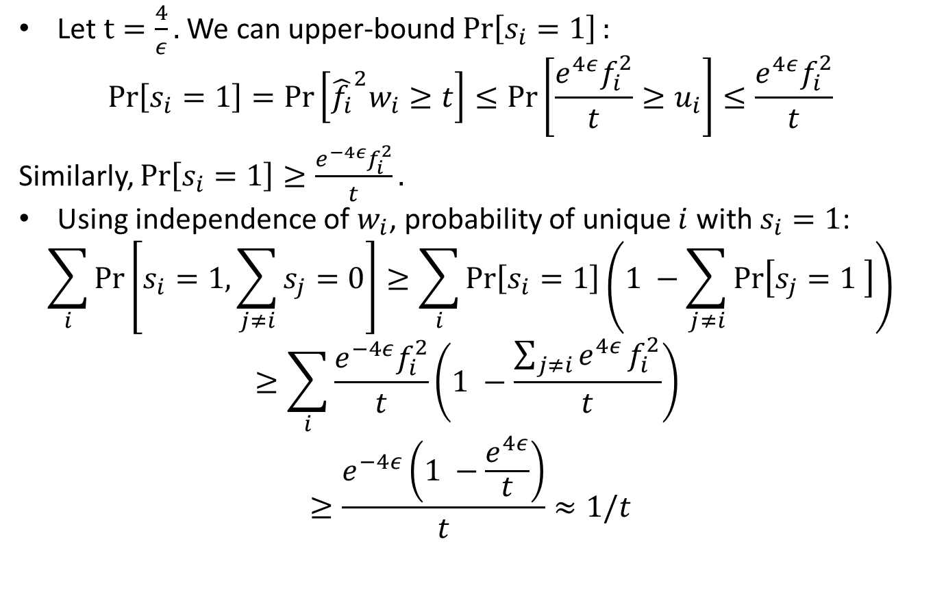
Proof of Lemma
Let $t=\frac{4}{ε}.$ We can upper-bound $\operatorname{Pr}\left[s_{i}=1\right]:$
$$\operatorname{Pr}\left[s_{i}=1\right]=\operatorname{Pr}\left[{\hat{f_{i}}}^{2}w_{i}≥t\right]≤\operatorname{Pr}\left[\frac{e^{4ε}f_{i}^{2}}{t}≥u_{i}\right]≤\frac{e^{4ε}f_{i}^{2}}{t}$$
Similarly, $\operatorname{Pr}\left[s_{i}=1\right]≥\frac{e^{−4ε}f_{i}^{2}}{t}.$
Using independence of $w_{i}$, probability of unique $i$ with $s_{i}=1$:
$$\sum_{i}{\operatorname{Pr}\left[s_{i}=1, \sum_{j≠i}{s_{j}=0}\right]≥\sum_{i}{\operatorname{Pr}\left[s_{i}=1\right]\left(1 −\sum_{j≠i}{\operatorname{Pr}\left[s_{j}=1 \right]}\right)}}$$
$$≥\sum_{i}{\frac{e^{−4ε}f_{i}^{2}}{t}}\left(1 −\frac{\sum_{j≠i}{e^{4ε}}f_{i}^{2}}{t}\right)$$
$$≥\frac{e^{−4ε}\left(1 −\frac{e^{4ε}}{t}\right)}{t}≈1/t$$

Slide 22
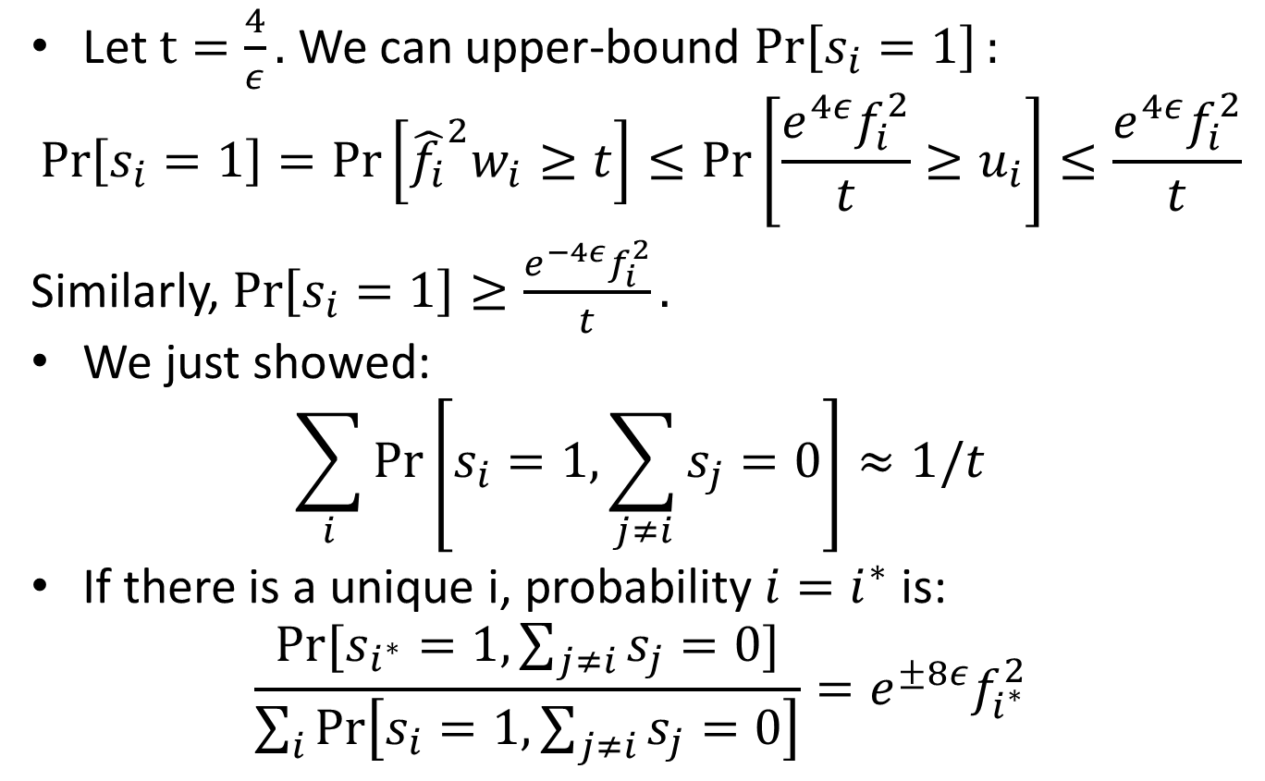
Proof of Lemma
Let $t=\frac{4}{ε}.$ We can upper-bound $\operatorname{Pr}\left[s_{i}=1\right]:$
$$\operatorname{Pr}\left[s_{i}=1\right]=\operatorname{Pr}\left[{\hat{f_{i}}}^{2}w_{i}≥t\right]≤\operatorname{Pr}\left[\frac{e^{4ε}f_{i}^{2}}{t}≥u_{i}\right]≤\frac{e^{4ε}f_{i}^{2}}{t}$$
Similarly, $\operatorname{Pr}\left[s_{i}=1\right]≥\frac{e^{−4ε}f_{i}^{2}}{t}.$
We just showed:
$$\sum_{i}{\operatorname{Pr}\left[s_{i}=1, \sum_{j≠i}{s_{j}=0}\right]}≈1/t$$
If there is a unique i, probability $i=i^{∗}$ is:
$$\frac{Pr⁡[s_{i^{∗}}=1, \sum_{j≠i}{s_{j}=0}]}{\sum_{i}{\operatorname{Pr}\left[s_{i}=1, \sum_{j≠i}{s_{j}=0}\right]}}=e^{±8ε}f_{i^{∗}}^{2}$$

Slide 23
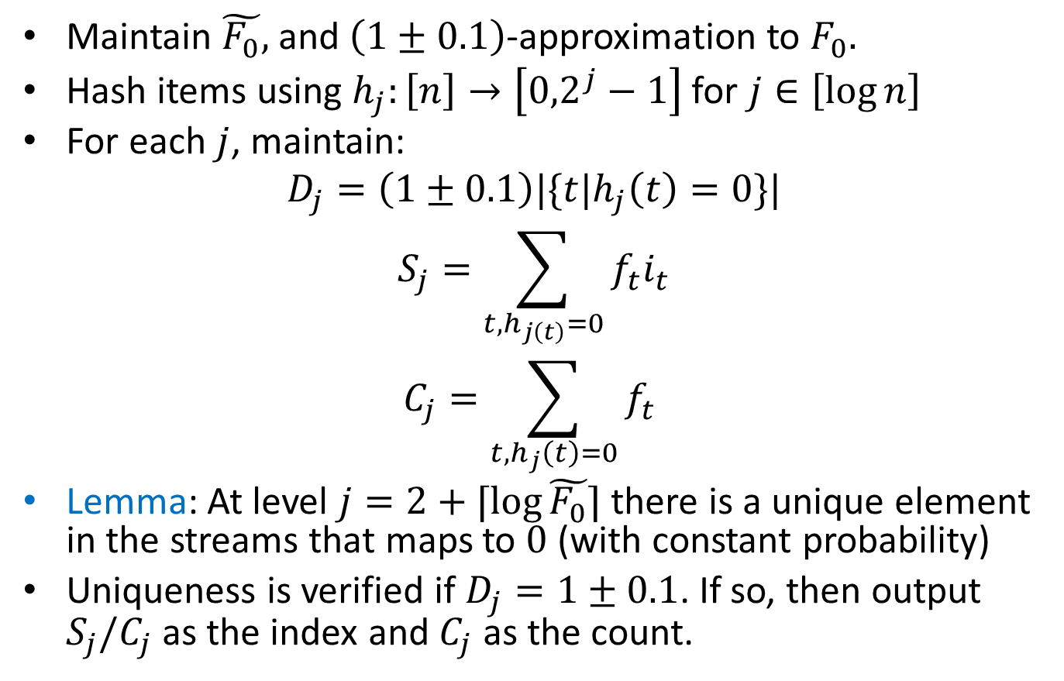

$ℓ_{0}$-sampling
Maintain $\tilde{F_{0}},$ and $\left(1±0.1\right)$-approximation to $F_{0}.$
Hash items using $h_{j}:\left[n\right]→\left[{0,2}^{j}−1\right]$ for $j∈\left[\log{n}\right]$
For each $j$, maintain:
$$D_{j}=\left(1±0.1\right)|\{t|h_{j}\left(t\right)=0\}|$$
$$S_{j}=\sum_{t, h_{j\left(t\right)}=0}{f_{t}i_{t}}$$
$$C_{j}=\sum_{t, h_{j}\left(t\right)=0}{f_{t}}$$
Lemma: At level $j=2+⌈\log{\tilde{F_{0}}}⌉$ there is a unique element in the streams that maps to $0$ (with constant probability)
Uniqueness is verified if $D_{j}=1±0.1$. If so, then output $S_{j}/C_{j}$ as the index and $C_{j}$ as the count.

Slide 24
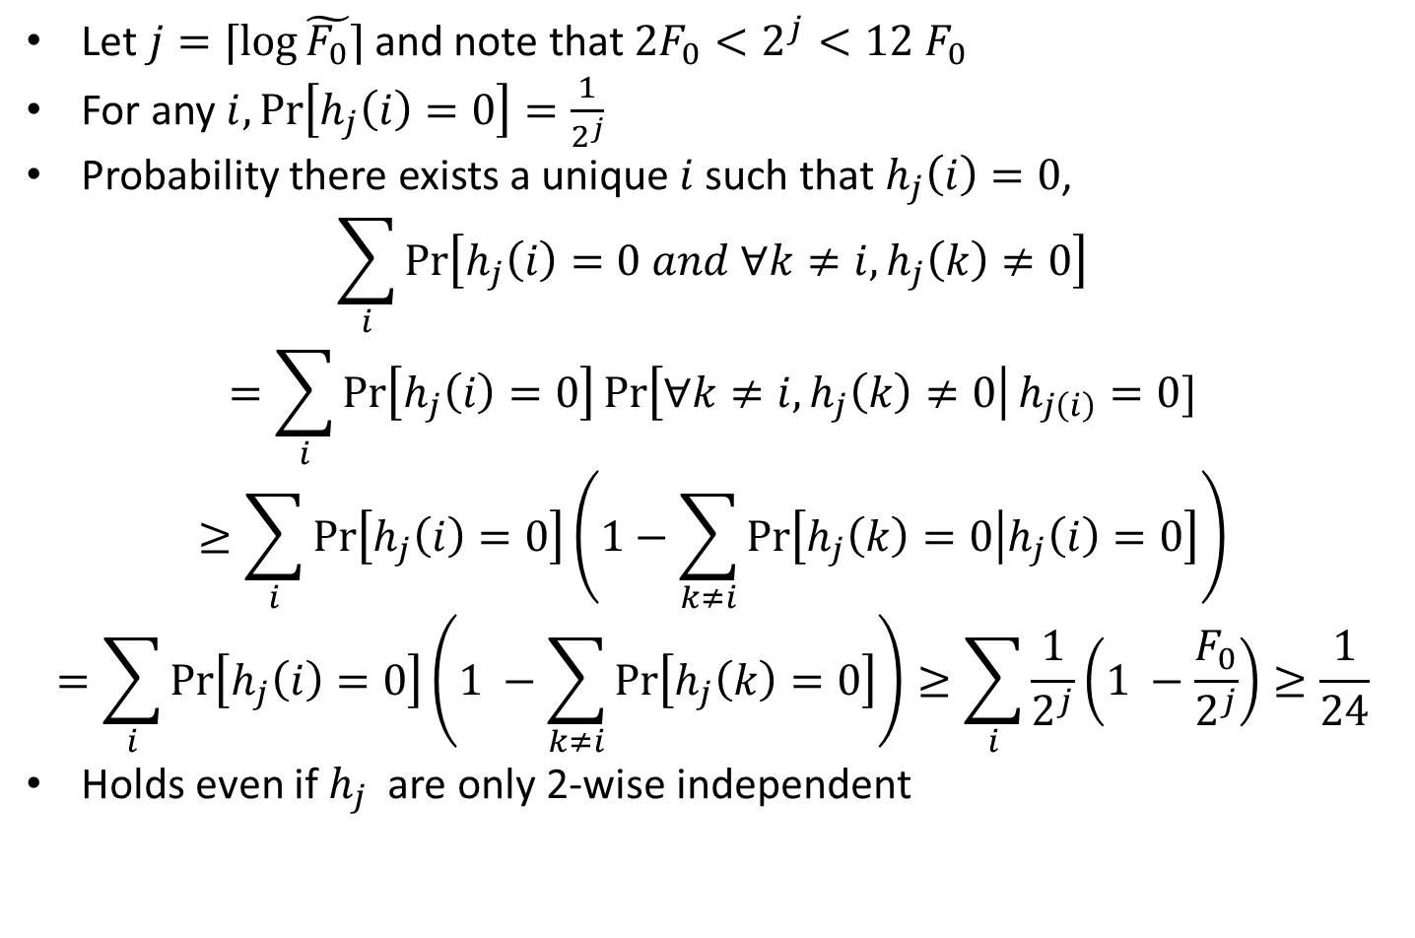
Proof of Lemma
Let $j=⌈\log{\tilde{F_{0}}}⌉$ and note that $2F_{0}<2^{j}<12 F_{0}$
For any $i,\operatorname{Pr}\left[h_{j}\left(i\right)=0\right]=\frac{1}{2^{j}}$
Probability there exists a unique $i$ such that $h_{j}\left(i\right)=0$,
$$\sum_{i}{\operatorname{Pr}\left[h_{j}\left(i\right)=0 and ∀k≠i, h_{j}\left(k\right)≠0\right]}$$
$$=\sum_{i}{\operatorname{Pr}\left[h_{j}\left(i\right)=0\right]\operatorname{Pr}\left[∀k≠i, h_{j}\left(k\right)≠0\right|h_{j\left(i\right)}=0]}$$
$$≥\sum_{i}{\operatorname{Pr}\left[h_{j}\left(i\right)=0\right]\left(1−\sum_{k≠i}{\operatorname{Pr}\left[h_{j}\left(k\right)=0 | h_{j}\left(i\right)=0\right]}\right)}$$
$$=\sum_{i}{\operatorname{Pr}\left[h_{j}\left(i\right)=0\right]\left(1 −\sum_{k≠i}{\operatorname{Pr}\left[h_{j}\left(k\right)=0\right]}\right)}≥\sum_{i}{\frac{1}{2^{j}}\left(1 −\frac{F_{0}}{2^{j}}\right)≥\frac{1}{24}}$$
Holds even if $h_{j}$ are only 2-wise independent

