Slide 1



Open Problems in $L_{p}$-Testing
See our joint work with P. Berman and S. Raskhodnikova (STOC’14).
Grigory Yaroslavtsev
Warren Center for Network and Data Sciences
http://grigory.us
Notes:
Plug in my job search and Warren Center.

Slide 2


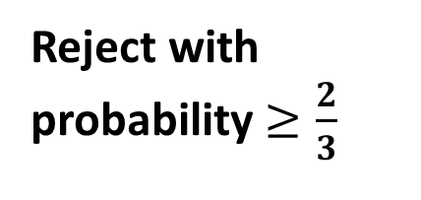
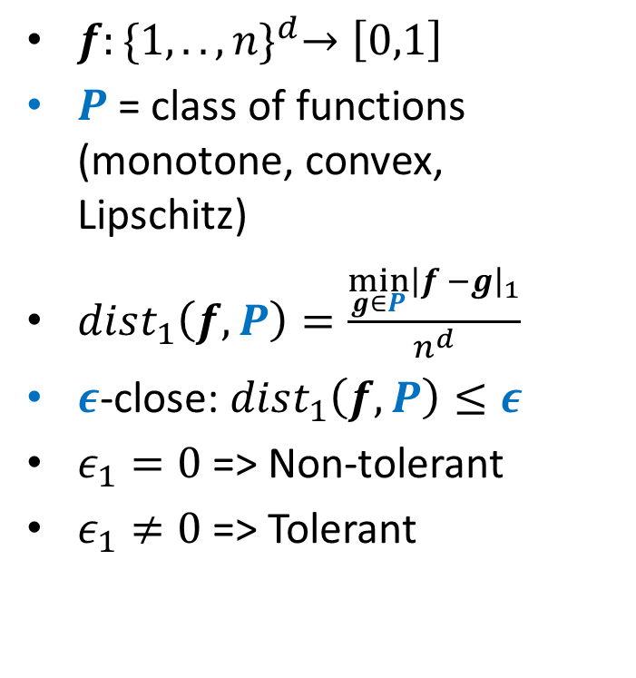
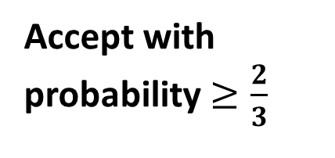





Tolerant “$L_{1}$Property Testing”
$f:{\{1,..,n\}}^{d}→\left[0,1\right]$
$P$ = class of functions (monotone, convex, Lipschitz)
$dist_{1}\left(f,P\right)=\frac{\min_{g∈P}{\left|f −g\right|}_{1}}{n^{d}}$
$ε$-close: $dist_{1}\left(f,P\right)≤ε$
$ε_{1}=0$ => Non-tolerant
$ε_{1}≠0$ => Tolerant
Tolerant “$L_{1}$ Property Tester”
YES
$$⇒$$
Accept with probability $≥\frac{2}{3}$
$ε_{1}$-close
$$⇒$$
$(ε_{1},ε_{2})$-close
Don’t care
NO
$$⇒$$
Reject with probability $≥\frac{2}{3}$

Slide 3
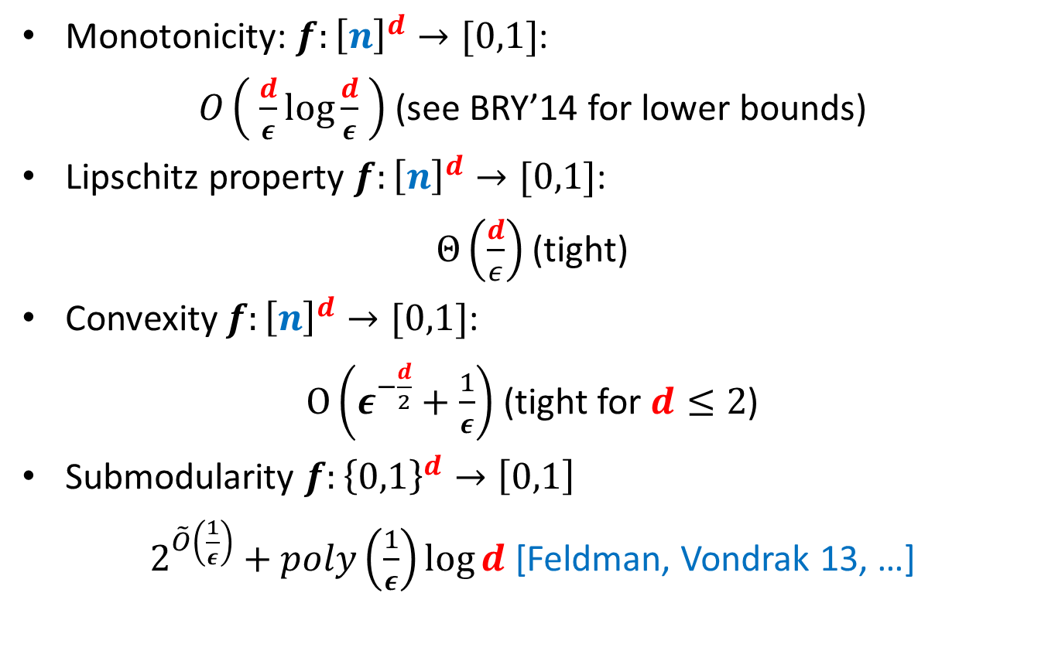

Known non-tolerant $L_{1}$-Testers
Monotonicity: $f:{\left[n\right]}^{d}→[0,1]$:
$O\left( \frac{d}{ε}\log{\frac{d}{ε} }\right)$ (see BRY’14 for lower bounds)
Lipschitz property $f:{\left[n\right]}^{d}→[0,1]$:
$Θ\left(\frac{d}{ε}\right)$ (tight)
Convexity $f:{\left[n\right]}^{d}→[0,1]$:
$O\left(ε^{−\frac{d}{2}}+\frac{1}{ε}\right)$ (tight for $d≤2$)
Submodularity $f:{\left\{0,1\right\}}^{d}→\left[0,1\right]$
$2^{\tilde{O}\left(\frac{1}{ε}\right)}+poly\left(\frac{1}{ε}\right)\log{d}$ [Feldman, Vondrak 13, …]

Slide 4
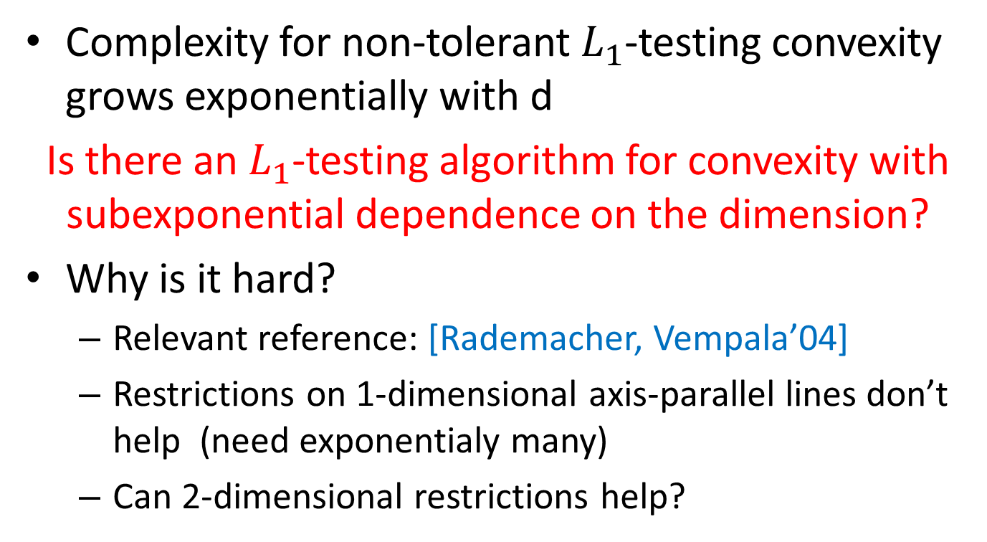
Open Problem #1
Complexity for non-tolerant $L_{1}$-testing convexity grows exponentially with d
Is there an $L_{1}$-testing algorithm for convexity with subexponential dependence on the dimension?
Why is it hard?
Relevant reference: [Rademacher, Vempala’04]
Restrictions on 1-dimensional axis-parallel lines don’t help (need exponentialy many)
Can 2-dimensional restrictions help?

Slide 5


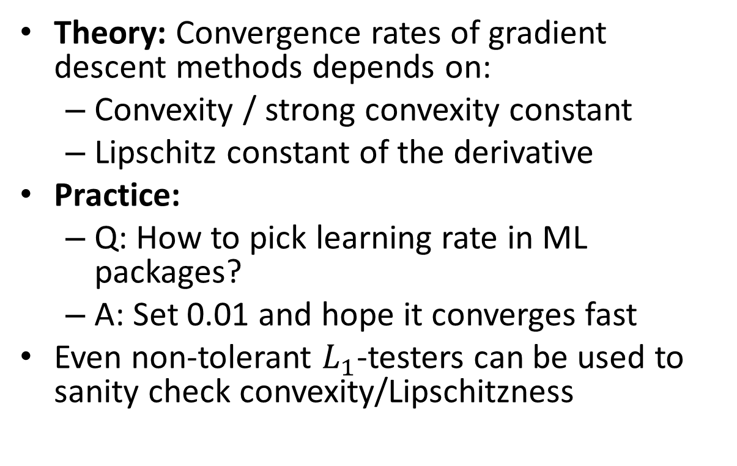
$L_{1}$-Testing for Convex Optimization
Theory: Convergence rates of gradient descent methods depends on:
Convexity / strong convexity constant
Lipschitz constant of the derivative
Practice:
Q: How to pick learning rate in ML packages?
A: Set 0.01 and hope it converges fast
Even non-tolerant $L_{1}$-testers can be used to sanity check convexity/Lipschitzness

Slide 6
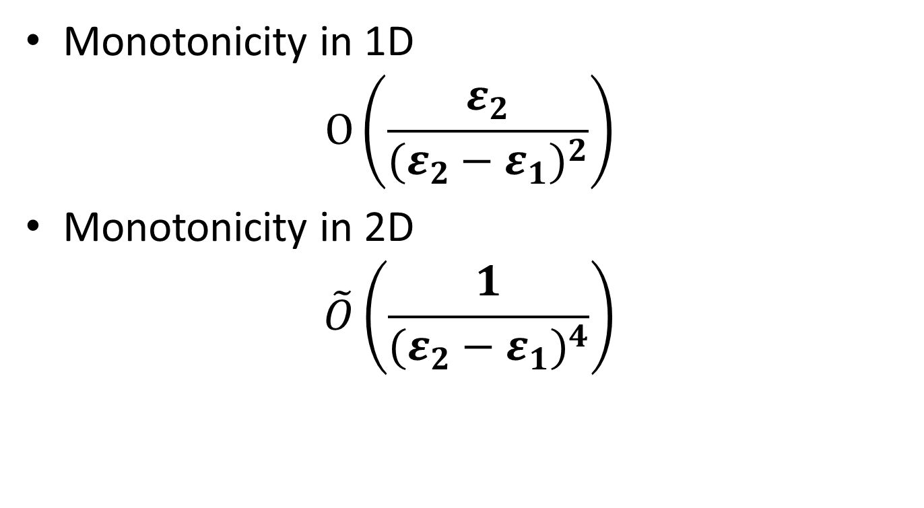

Known tolerant $L_{1}$-testers
Monotonicity in 1D
$$O\left(\frac{ε_{2}}{{(ε_{2}−ε_{1})}^{2}}\right)$$
Monotonicity in 2D
$$\tilde{O}\left(\frac{1}{{(ε_{2}−ε_{1})}^{4}}\right)$$

Slide 7

Open Problem #2
Only have tolerant monotonicity for $d=1,2$.
Tolerant testers for higher dimensions?

