Slide 1

CIS 700: “algorithms for Big Data”
Lecture 10:
Massively Parallel Algorithms
Slides at http://grigory.us/big-data-class.html
Grigory Yaroslavtsev
http://grigory.us

Slide 2
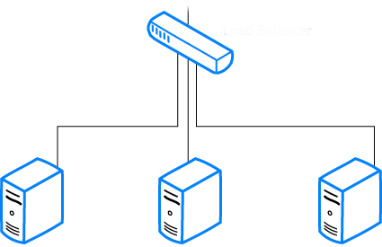

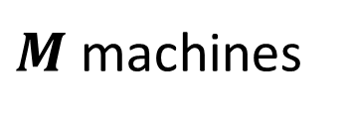
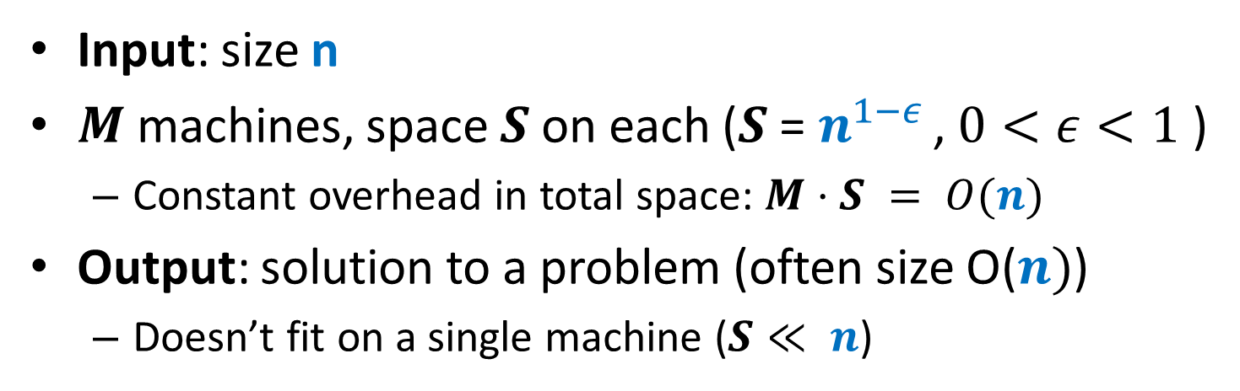

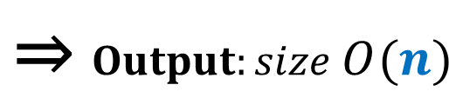

Computational Model
Input: size n
$M$ machines, space $S$ on each ($S$ = $n^{1−ε }$, $0<ε<1$ )
Constant overhead in total space: $M⋅S = O(n)$
Output: solution to a problem (often size O($n)$)
Doesn’t fit on a single machine ($S≪ n$)
$Input:size n$ ⇒
$$\text{⇒} Output:size O(n)$$
$M$machines
S space

Slide 3



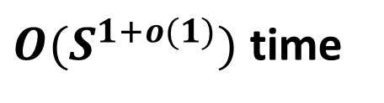
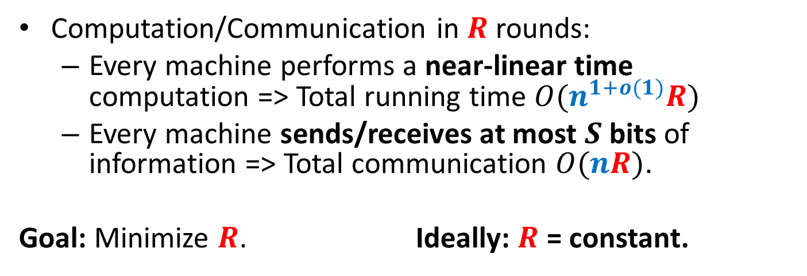
Computational Model
Computation/Communication in $R$ rounds:
Every machine performs a near-linear time computation => Total running time $O(n^{1+o(1)}R)$
Every machine sends/receives at most $S$ bits of information => Total communication $O(nR)$.
Goal: Minimize $R$. Ideally: $R$ = constant.
$≤S$ bits
$M$machines
S space
$O(S^{1+o(1)})$ time

Slide 4

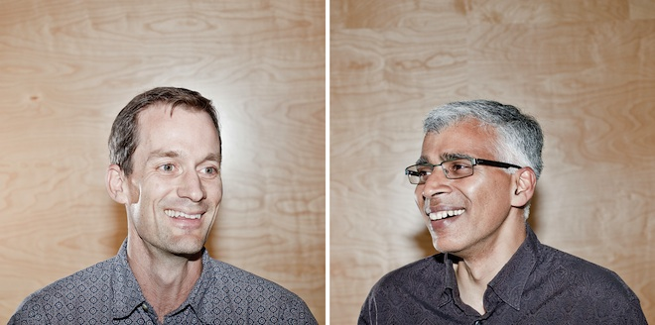


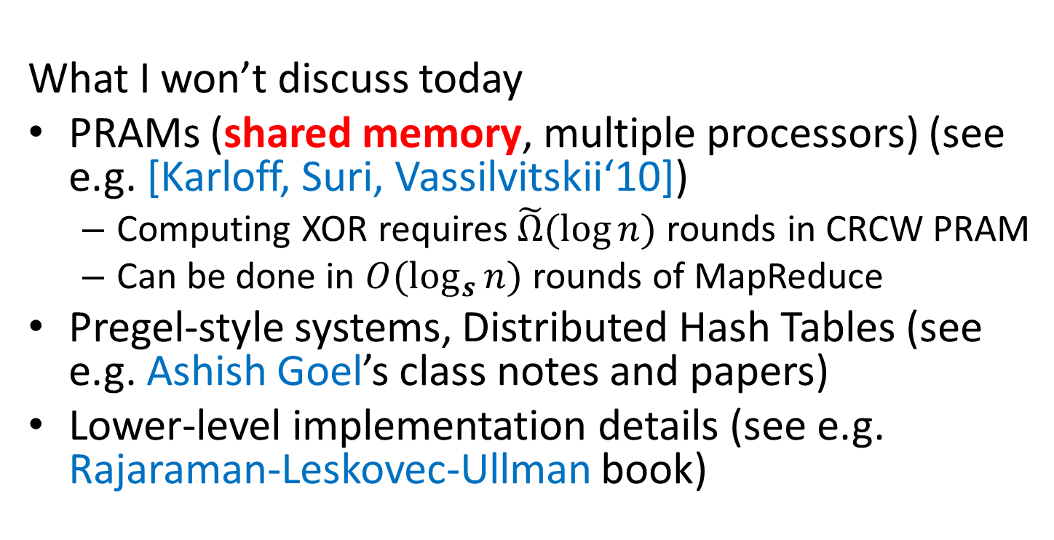
MapReduce-style computations
What I won’t discuss today
PRAMs (shared memory, multiple processors) (see e.g. [Karloff, Suri, Vassilvitskii‘10])
Computing XOR requires$\tilde{Ω}(\log{n})$ rounds in CRCW PRAM
Can be done in $O(\log_{s}{n})$ rounds of MapReduce
Pregel-style systems, Distributed Hash Tables (see e.g. Ashish Goel’s class notes and papers)
Lower-level implementation details (see e.g. Rajaraman-Leskovec-Ullman book)

Slide 5
Models of parallel computation
Bulk-Synchronous Parallel Model (BSP) [Valiant,90]
Pro: Most general, generalizes all other models
Con: Many parameters, hard to design algorithms
Massive Parallel Computation [Feldman-Muthukrishnan-Sidiropoulos-Stein-Svitkina’07, Karloff-Suri-Vassilvitskii’10, Goodrich-Sitchinava-Zhang’11, ..., Beame, Koutris, Suciu’13]
Pros:
Inspired by modern systems (Hadoop, MapReduce, Dryad, … )
Few parameters, simple to design algorithms
New algorithmic ideas, robust to the exact model specification
# Rounds is an information-theoretic measure => can prove unconditional lower bounds
Between linear sketching and streaming with sorting

Slide 6
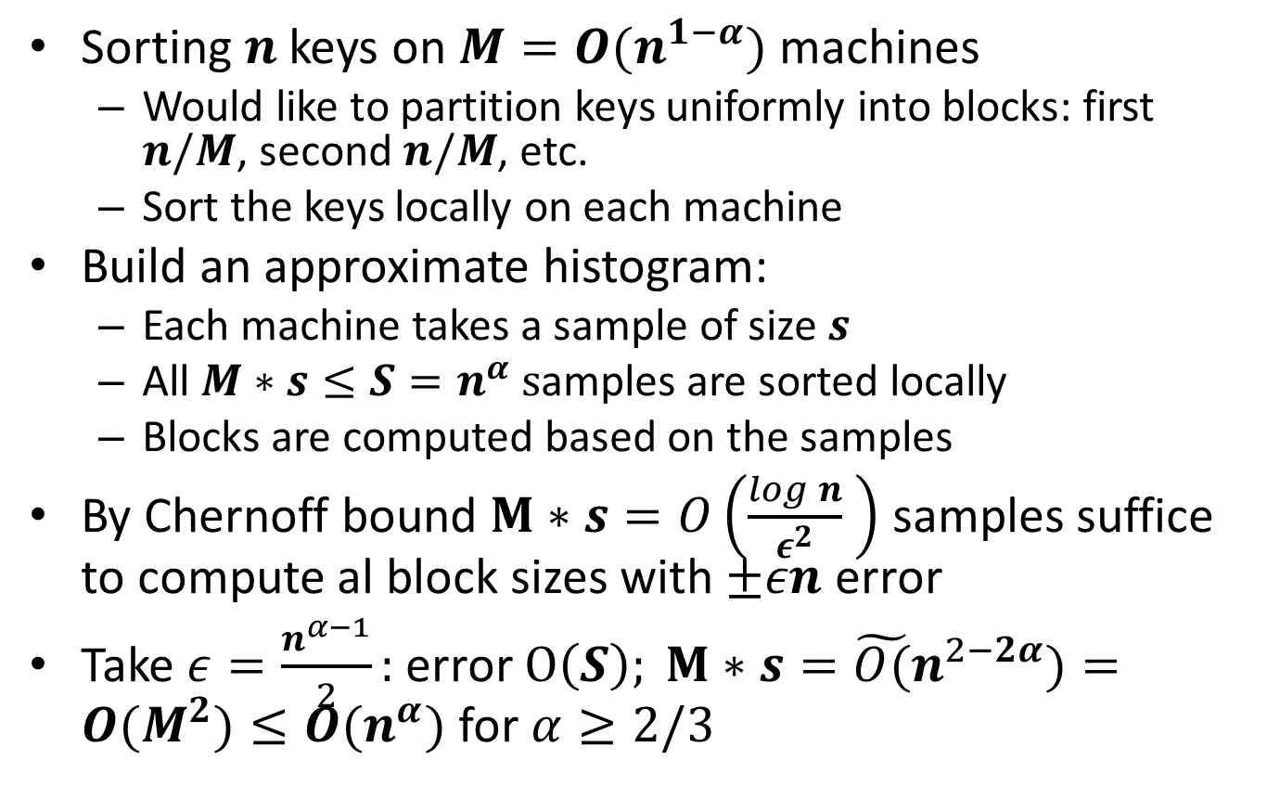
Sorting: Terasort
Sorting $n$ keys on $M=O(n^{1−α})$ machines
Would like to partition keys uniformly into blocks: first $n/M$, second $n/M$, etc.
Sort the keys locally on each machine
Build an approximate histogram:
Each machine takes a sample of size $s$
All $M∗s≤S=n^{α} s$amples are sorted locally
Blocks are computed based on the samples
By Chernoff bound $M∗s=O\left(\frac{log n}{ε^{2}} \right)$ samples suffice to compute al block sizes with $±εn$ error
Take $ε=\frac{n^{α−1}}{2}:$ error $O\left(S\right); M∗s={\tilde{O(}n}^{2−2α})=O(M^{2})≤O(n^{α})$ for $α≥2/3$

Slide 7
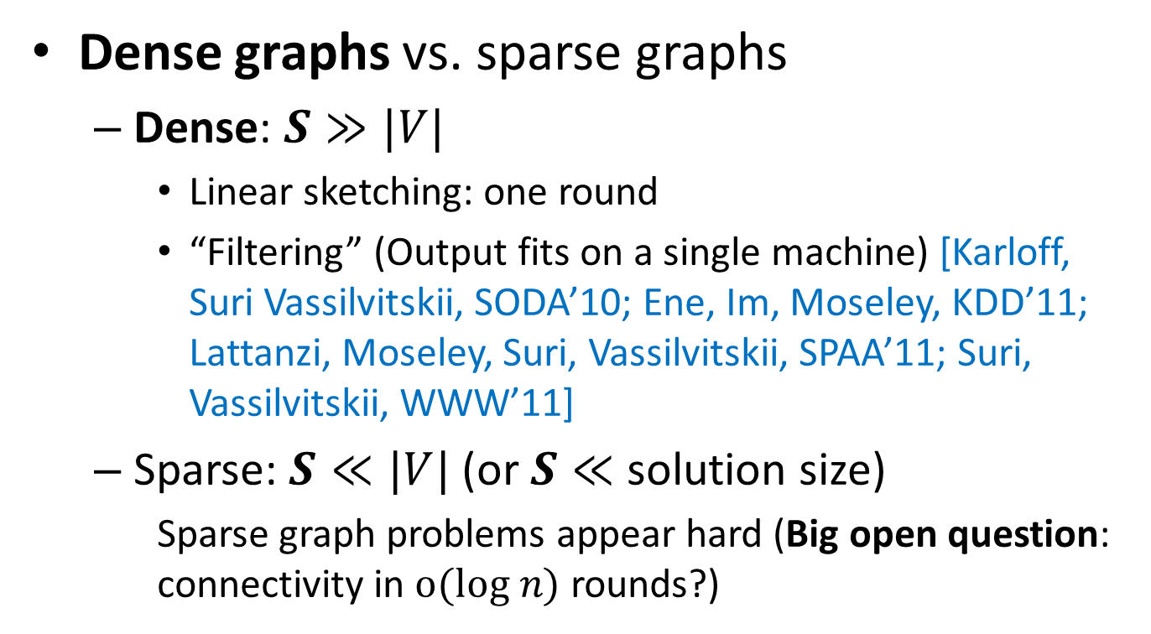
Algorithms for Graphs
Dense graphs vs. sparse graphs
Dense: $S≫|V|$
Linear sketching: one round
“Filtering” (Output fits on a single machine) [Karloff, Suri Vassilvitskii, SODA’10; Ene, Im, Moseley, KDD’11; Lattanzi, Moseley, Suri, Vassilvitskii, SPAA’11; Suri, Vassilvitskii, WWW’11]
Sparse: $S≪|V|$(or $S≪$ solution size)
Sparse graph problems appear hard (Big open question: connectivity in $o(log n)$ rounds?)
VS.

Slide 8
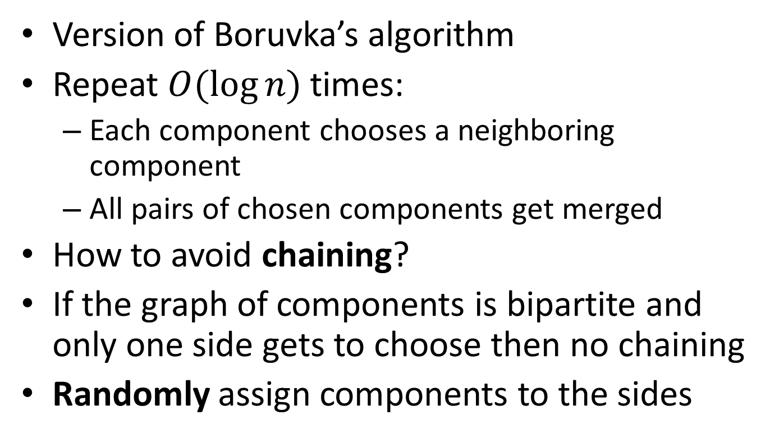
Algorithm for Connectivity
Version of Boruvka’s algorithm
Repeat $O(\log{n})$ times:
Each component chooses a neighboring component
All pairs of chosen components get merged
How to avoid chaining?
If the graph of components is bipartite and only one side gets to choose then no chaining
Randomly assign components to the sides

Slide 9
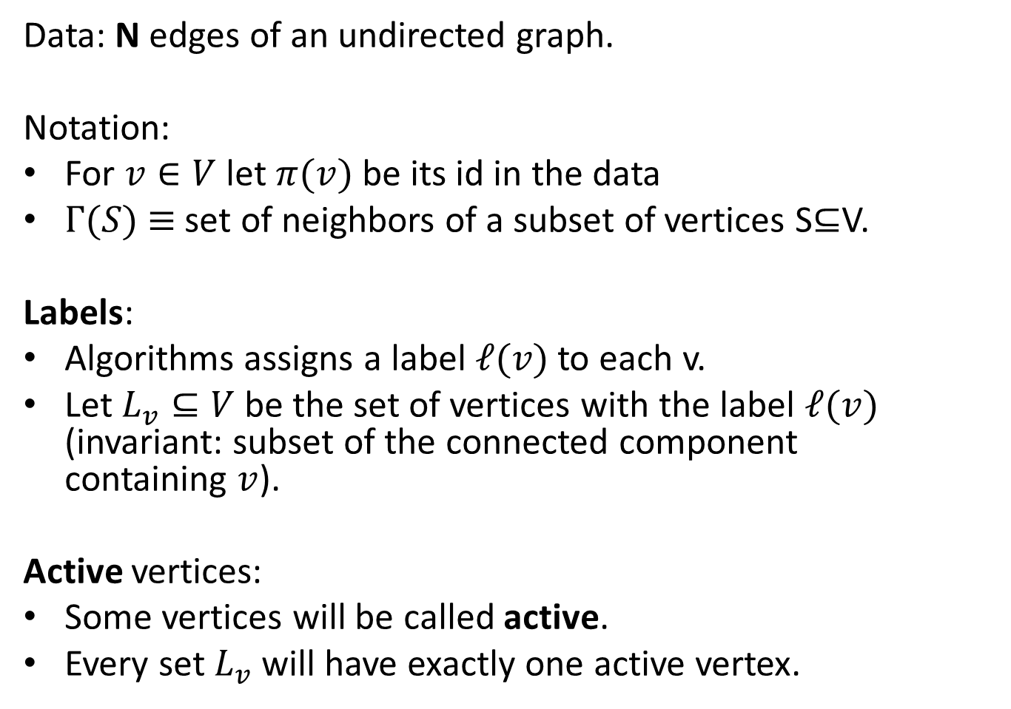
Algorithm for Connectivity: Setup
Data: N edges of an undirected graph.
Notation:
For $v∈V$ let $π(v)$ be its id in the data
$Γ(S)$ $≡$ set of neighbors of a subset of vertices S⊆V.
Labels:
Algorithms assigns a label $ℓ(v)$ to each v.
Let $L_{v}⊆V$ be the set of vertices with the label $ℓ(v)$ (invariant: subset of the connected component containing $v$).
Active vertices:
Some vertices will be called active.
Every set $L_{v}$ will have exactly one active vertex.

Slide 10
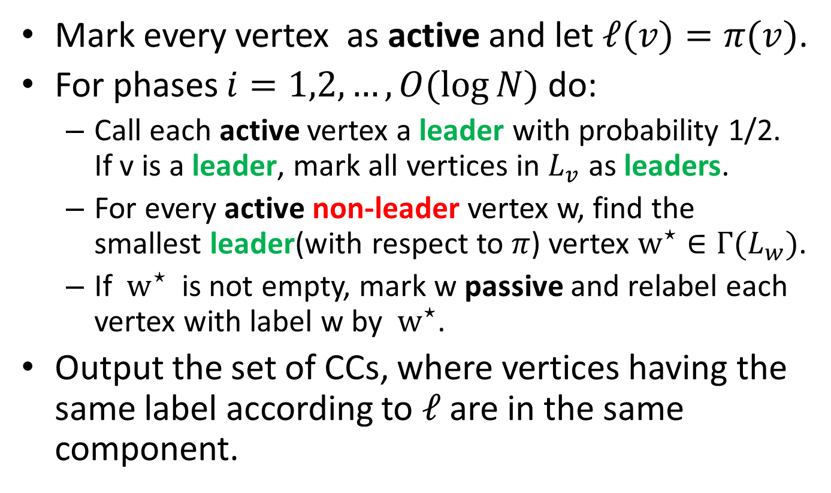
Algorithm for Connectivity
Mark every vertex as active and let $ℓ(v)=π(v)$.
For phases $i=1,2,…,O(log⁡N)$ do:
Call each active vertex a leader with probability 1/2. If v is a leader, mark all vertices in $L_{v}$ as leaders.
For every active non-leader vertex w, find the smallest leader(with respect to $π$) vertex $w^{⋆}∈Γ(L_{w})$.
If $w^{⋆}$ is not empty, mark w passive and relabel each vertex with label w by $w^{⋆}$.
Output the set of CCs, where vertices having the same label according to $ℓ$ are in the same component.

Slide 11
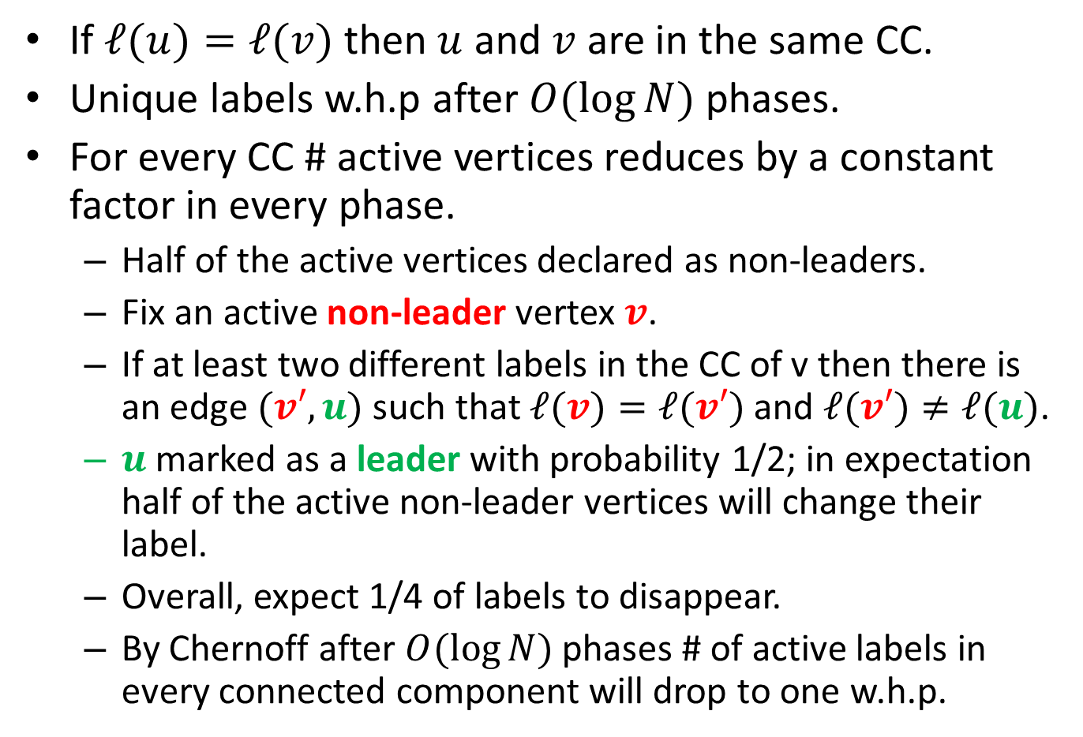
Algorithm for Connectivity: Analysis
If $ℓ(u)=ℓ(v)$ then $u$ and $v$ are in the same CC.
Unique labels w.h.p after $O(\log{N})$ phases.
For every CC # active vertices reduces by a constant factor in every phase.
Half of the active vertices declared as non-leaders.
Fix an active non-leader vertex $v$.
If at least two different labels in the CC of v then there is an edge $(v′,u)$ such that $ℓ(v)=ℓ(v′)$ and $ℓ(v′)≠ℓ(u)$.
$u$ marked as a leader with probability 1/2; in expectation half of the active non-leader vertices will change their label.
Overall, expect 1/4 of labels to disappear.
By Chernoff after $O(\log{N})$ phases # of active labels in every connected component will drop to one w.h.p.

Slide 12
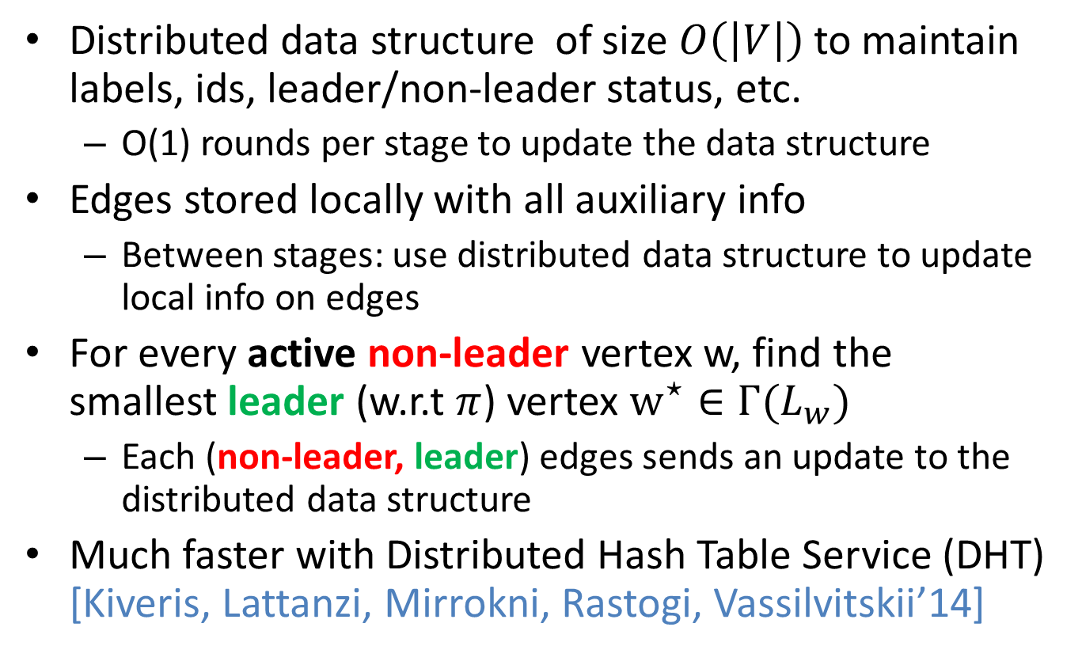
Algorithm for Connectivity: Implementation Details
Distributed data structure of size $O\left(\left|V\right|\right)$to maintain labels, ids, leader/non-leader status, etc.
O(1) rounds per stage to update the data structure
Edges stored locally with all auxiliary info
Between stages: use distributed data structure to update local info on edges
For every active non-leader vertex w, find the smallest leader (w.r.t $π$) vertex $w^{⋆}∈Γ(L_{w})$
Each (non-leader, leader) edges sends an update to the distributed data structure
Much faster with Distributed Hash Table Service (DHT) [Kiveris, Lattanzi, Mirrokni, Rastogi, Vassilvitskii’14]

Slide 13
Applications
Using same reductions as in streaming:
Bipartiteness
k-connectivity
Cut-sparsification

Slide 14
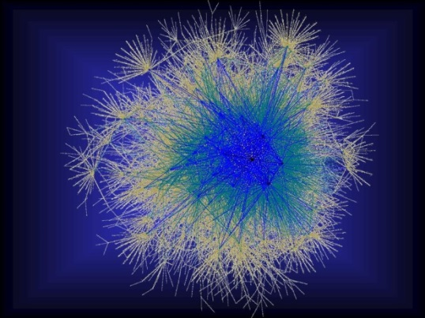
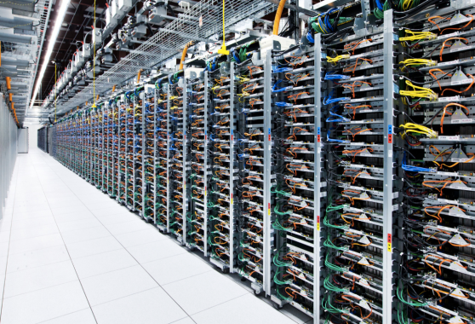
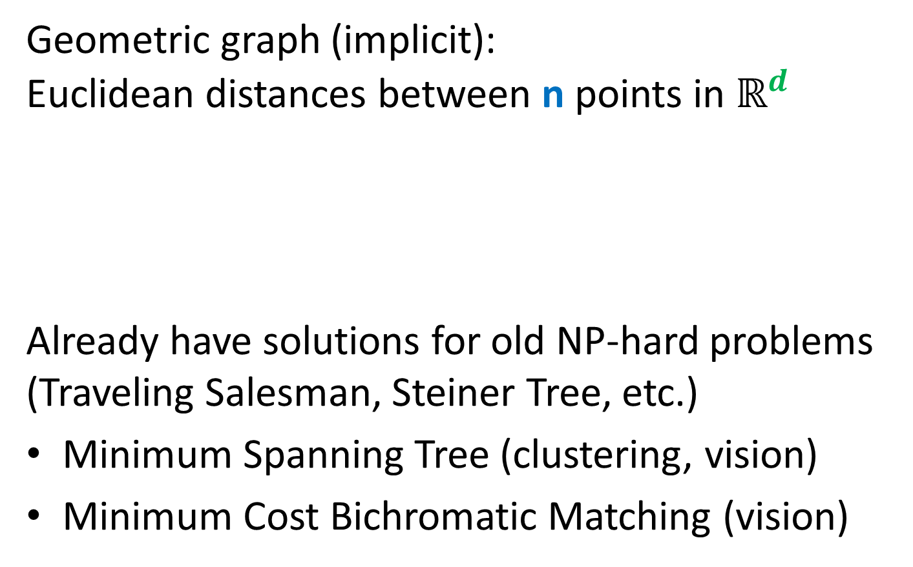
Approximating Geometric Problems in Parallel Models
Geometric graph (implicit): Euclidean distances between n points in $ℝ^{d}$
Already have solutions for old NP-hard problems (Traveling Salesman, Steiner Tree, etc.)
Minimum Spanning Tree (clustering, vision)
Minimum Cost Bichromatic Matching (vision)
Notes:
Question: do we really have an O(1)-round algorithm for TSP and Steiner Tree?

Slide 15
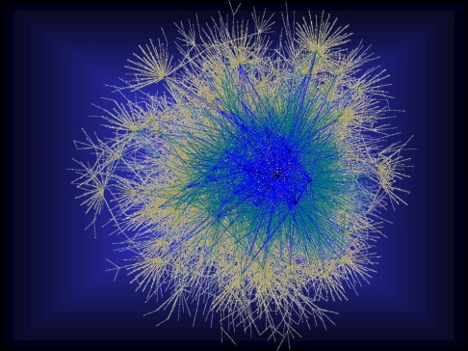



Geometric Graph Problems
Combinatorial problems on graphs in $ℝ^{d}$
Polynomial time (“easy”)
Minimum Spanning Tree
Earth-Mover Distance =
Min Weight Bi-chromatic Matching
NP-hard (“hard”)
Steiner Tree
Traveling Salesman
Clustering (k-medians, facility location, etc.)
Need new theory!
Arora-Mitchell-style “Divide and Conquer”, easy to implement in Massively Parallel Computational Models, but bad running time

Slide 16
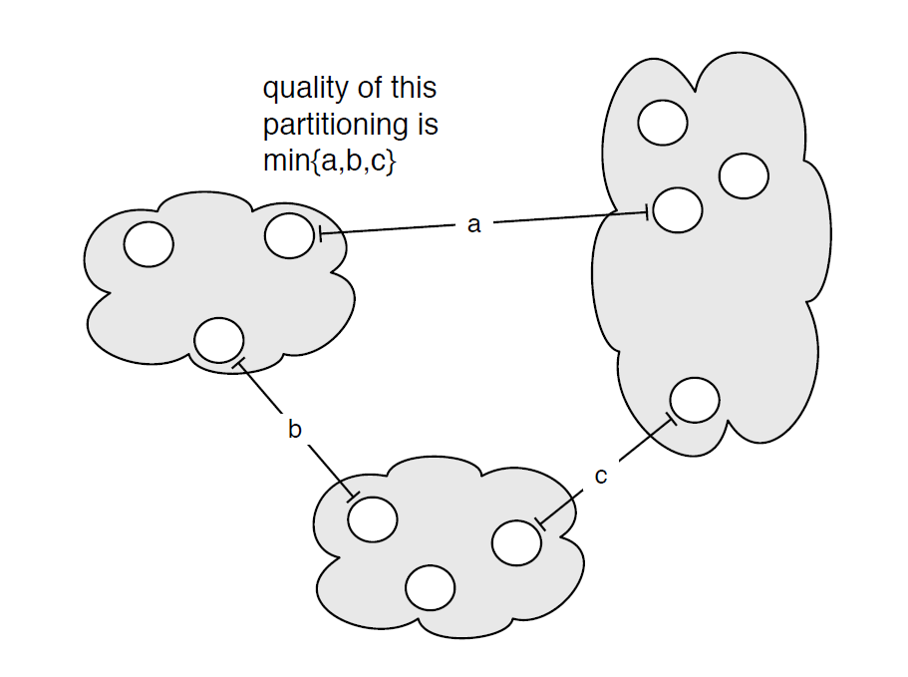

MST: Single Linkage Clustering
[Zahn’71] Clustering via MST (Single-linkage):
k clusters: remove $k−1$ longest edges from MST
Maximizes minimum intercluster distance
[Kleinberg, Tardos]
Notes:
“”

Slide 17
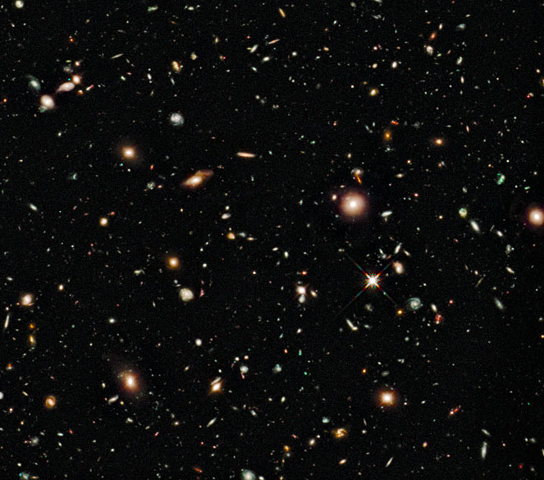
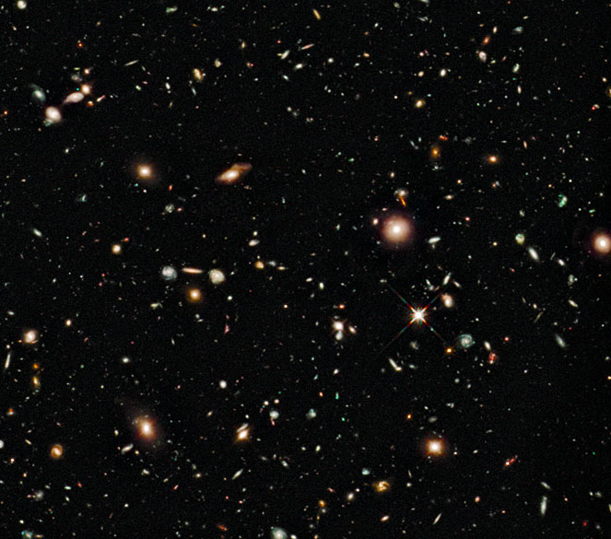
Earth-Mover Distance
Computer vision: compare two pictures of moving objects (stars, MRI scans)

Slide 18

Large geometric graphs
Graph algorithms: Dense graphs vs. sparse graphs
Dense: $S≫|V|$.
Sparse: $S≪|V|$.
Our setting:
Dense graphs, sparsely represented: O(n) space
Output doesn’t fit on one machine ($S≪ n$)
Today: $(1+ε)$-approximate MST
$d=2$ (easy to generalize)
$R=\log_{S}{n}\text{= }\text{O}\text{(}\text{1}\text{) }$rounds ($S=n^{Ω(1)}$)

Slide 19
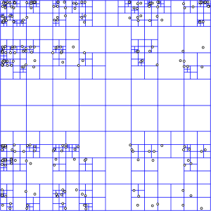
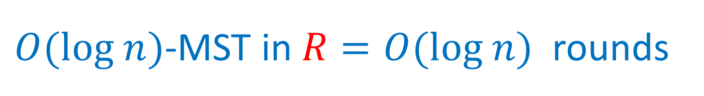

$O(log n)$-MST in $R=O(log n)$rounds
Assume points have integer coordinates $\left[0, …,Δ\right]$, where $Δ=O\left(n^{2}\right) .$
Impose an $O(log⁡n)$-depth quadtree
Bottom-up: For each cell in the quadtree
compute optimum MSTs in subcells
Use only one representative from each cell on the next level
Wrong representative:
O(1)-approximation per level

Slide 20





$εL$-nets
$εL$-net for a cell C with side length $L$:
Collection S of vertices in C, every vertex is at distance <= $εL$ from some vertex in S. (Fact: Can efficiently compute $ε$-net of size $O\left(\frac{1}{ε^{2}}\right))$
Bottom-up: For each cell in the quadtree
Compute optimum MSTs in subcells
Use $εL$-net from each cell on the next level
Idea: Pay only $O(εL$) for an edge cut by cell with side $L$
Randomly shift the quadtree: $\operatorname{Pr}\left[cut edge of length ℓ by L\right]∼ℓ/L$ – charge errors
Wrong representative:
O(1)-approximation per level
$$L$$
$$εL$$
$$L$$

Slide 21



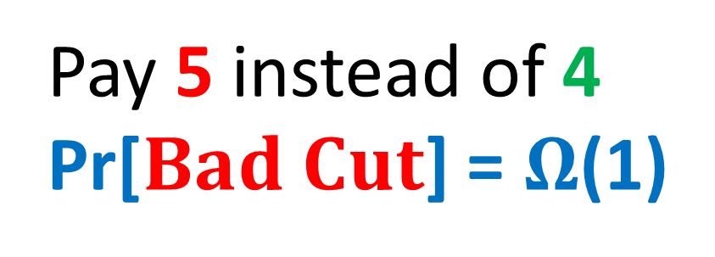
$$Randomly shifted quadtree$$
Top cell shifted by a random vector in ${\left[0,L\right]}^{2}$
Impose a randomly shifted quadtree (top cell length $2Δ$)
Bottom-up: For each cell in the quadtree
Compute optimum MSTs in subcells
Use $εL$-net from each cell on the next level
Pay 5 instead of 4
Pr[$Bad Cut$] = $Ω$(1)
2
$$Bad Cut$$
1

Slide 22

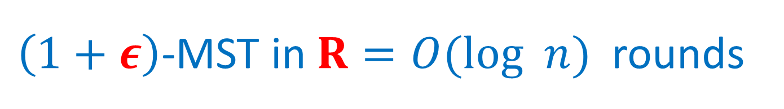
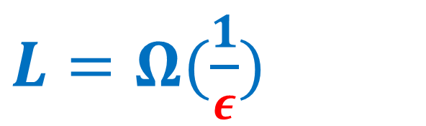
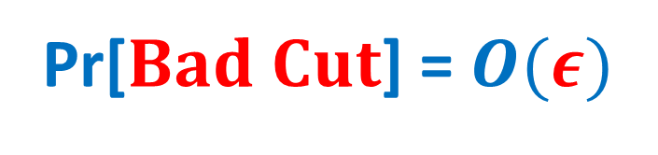
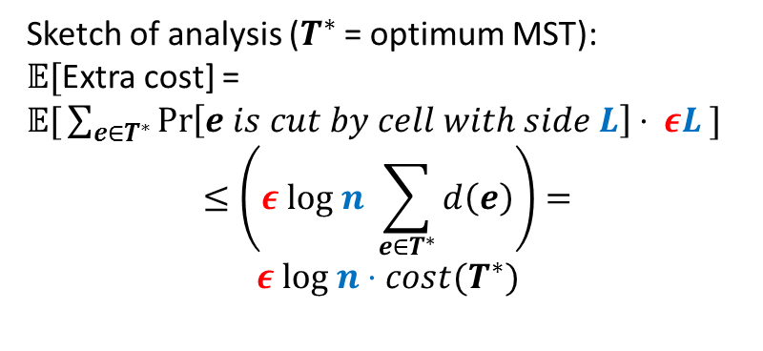
$\left(1+ε\right)$-MST in $R=O(log n)$rounds
Idea: Only use short edges inside the cells
Impose a randomly shifted quadtree (top cell length $\frac{2Δ}{ε }$ )
Bottom-up: For each node (cell) in the quadtree
compute optimum Minimum Spanning Forests in subcells, using edges of length $≤εL$
Use only $ε^{2}L$-net from each cell on the next level
Sketch of analysis ($T^{∗}$ = optimum MST):
𝔼[Extra cost] =
𝔼$\text{[}\sum_{e∈T^{∗}}{\operatorname{Pr}\left[e is cut by cell with side L\right]⋅ εL} ]$
$$≤\left(ε log n \sum_{e∈T^{∗}}{d\left(e\right)}\right)=$$
$$ε log n⋅cost(T^{∗})$$
$L=Ω(\frac{1}{ε})$
2
Pr[$Bad Cut$] = $O(ε)$
1

Slide 23

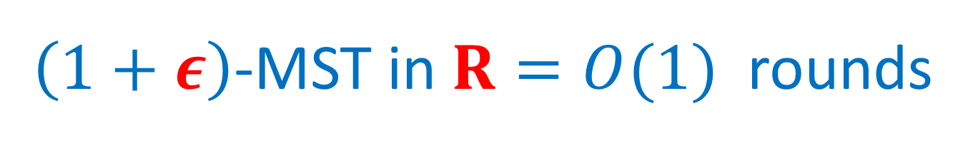


$\left(1+ε\right)$-MST in $R=O(1)$rounds
$O(log n)$ rounds => O($\log_{S}{n}$) = O(1) rounds
Flatten the tree: ($\sqrt{M}×\sqrt{M}$)-grids instead of (2x2) grids at each level.
Impose a randomly shifted ($\sqrt{M}×\sqrt{M}$)-tree
Bottom-up: For each node (cell) in the tree
compute optimum MSTs in subcells via edges of length $≤εL$
Use only $ε^{2}L$-net from each cell on the next level
$$\sqrt{M}=n^{Ω(1)}$$
⇒

Slide 24
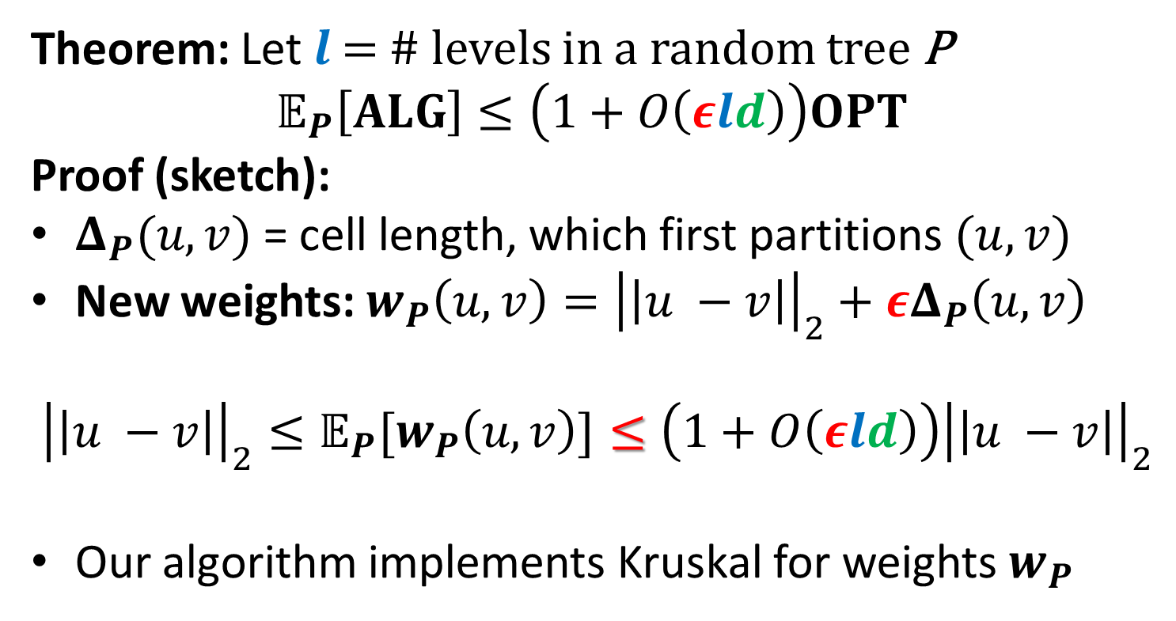



$\left(1+ε\right)$-MST in $R=O(1)$rounds
Theorem: Let $l$ = # levels in a random tree P
$$𝔼_{P}\left[ALG\right]≤\left(1+O\left(εld\right)\right)OPT$$
Proof (sketch):
$Δ_{P}(u,v)$ = cell length, which first partitions $(u, v)$
New weights: $w_{P}\left(u,v\right)={\left|\left|u −v\right|\right|}_{2}+εΔ_{P}\left(u,v\right)$
$${{\left|\left|u −v\right|\right|}_{2}≤𝔼_{P}[w}_{P}\left(u,v\right)]≤\left(1+O\left(εld\right)\right){\left|\left|u −v\right|\right|}_{2}$$
Our algorithm implements Kruskal for weights $w_{P}$
$$u$$
$$v$$
$$Δ_{P}\left(u,v\right)$$

Slide 25
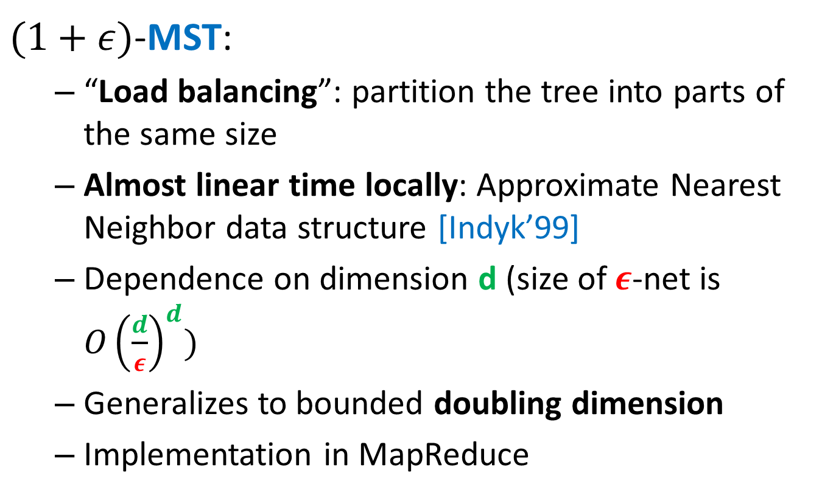
“Solve-And-Sketch” Framework
$(1+ε)$-MST:
“Load balancing”: partition the tree into parts of the same size
Almost linear time locally: Approximate Nearest Neighbor data structure [Indyk’99]
Dependence on dimension d (size of $ε$-net is ${O\left(\frac{d}{ε}\right)}^{d})$
Generalizes to bounded doubling dimension
Implementation in MapReduce

Slide 26
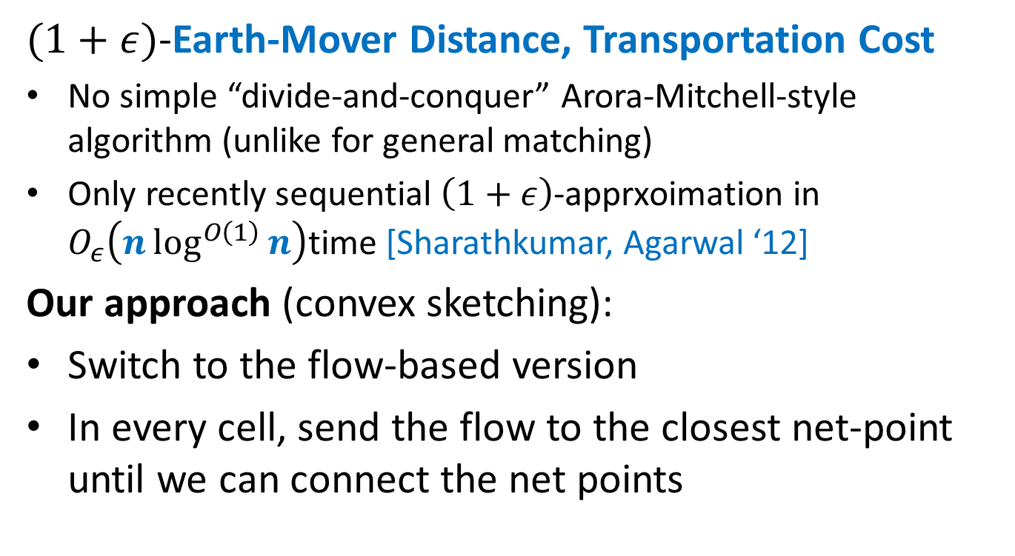
“Solve-And-Sketch” Framework
$(1+ε)$-Earth-Mover Distance, Transportation Cost
No simple “divide-and-conquer” Arora-Mitchell-style algorithm (unlike for general matching)
Only recently sequential $\left(1+ε\right)$-apprxoimation in $O_{ε}\left(n\log^{O\left(1\right)}{n}\right)$time [Sharathkumar, Agarwal ‘12]
Our approach (convex sketching):
Switch to the flow-based version
In every cell, send the flow to the closest net-point until we can connect the net points

Slide 27
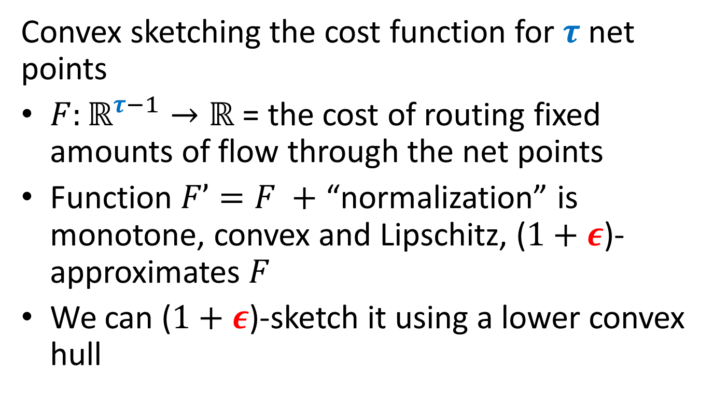
“Solve-And-Sketch” Framework
Convex sketching the cost function for $τ$ net points
$F:ℝ^{τ−1}→ℝ$ = the cost of routing fixed amounts of flow through the net points
Function $F’=F +$ “normalization” is monotone, convex and Lipschitz, ($1+ε$)-approximates $F$
We can ($1+ε$)-sketch it using a lower convex hull

Slide 28
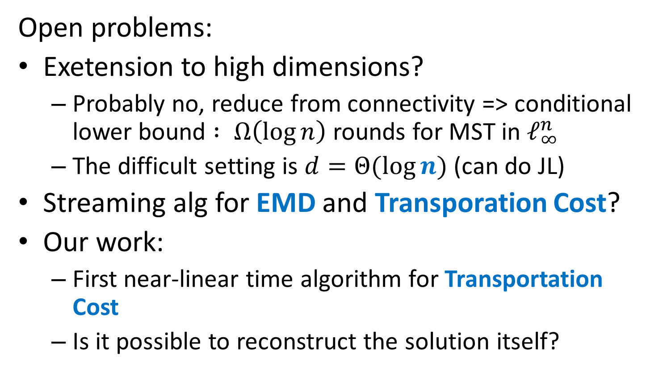
Thank you! http://grigory.us
Open problems:
Exetension to high dimensions?
Probably no, reduce from connectivity => conditional lower bound $: Ω\left(\log{n}\right)$ rounds for MST in $ℓ_{∞}^{n}$
The difficult setting is $d=Θ(\log{n})$ (can do JL)
Streaming alg for EMD and Transporation Cost?
Our work:
First near-linear time algorithm for Transportation Cost
Is it possible to reconstruct the solution itself?

Slide 29
Class Project
Survey of 3-5 research papers
Closely related to the topics of the class
Streaming
MapReduce
Convex Optmization
Sublinear Time Algorithms
Office hours if you need suggestions
Individual or groups of 2 people
Deadline: December 18, 2015 at 23:59 EST
Submission by e-mail grigory@grigory.us
Submission Email Title: Project + Space + “Your Name”
One submission per group listing participants
Submission format
PDF from LaTeX (best)
PDF

Slide 30
Example: Gradient Descent in TensorFlow
Gradient Descent (covered in class)
Adagrad: http://www.magicbroom.info/Papers/DuchiHaSi10.pdf
Momentum (stochastic gradient descent + tweaks): http://www.cs.toronto.edu/~hinton/absps/naturebp.pdf
Adam (Adaptive + momentum): http://arxiv.org/pdf/1412.6980.pdf
FTRL: http://jmlr.org/proceedings/papers/v15/mcmahan11b/mcmahan11b.pdf
RMSProp: http://www.cs.toronto.edu/~tijmen/csc321/slides/lecture_slides_lec6.pdf

