Slide 1
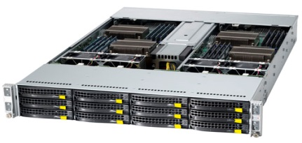



$≤S$ bits sent/received
}
$$M$$
Machines
}
$R$ Rounds

