Slide 1


Distributed Submodular Maximization in Massive Datasets
Rafael Barbosa, Alina Ene, Justin Ward (University of Warwick)
Huy L. Nguyen (Toyota Technological Institute)

Slide 2
Distributed Submodular Maximization in Massive Datasets
Alina Ene
Joint work with
Rafael Barbosa, Huy L. Nguyen, Justin Ward

Slide 3
Combinatorial Optimization
Given
A set of objects V
A function f on subsets of V
A collection of feasible subsets I
Find
A feasible subset of I that maximizes f
Goal
Abstract/general f and I
Capture many interesting problems
Allow for efficient algorithms

Slide 4
Submodularity
We say that a function is submodular if:
We say that is monotone if:
Alternatively, f is submodular if:
for all and
Submodularity captures diminishing returns.

Slide 5
Submodularity
Examples of submodular functions:
The number of elements covered by a collection of sets
Entropy of a set of random variables
The capacity of a cut in a directed or undirected graph
Rank of a set of columns of a matrix
Matroid rank functions
Log determinant of a submatrix

Slide 6
Example: Multimode Sensor Coverage
We have distinct locations where we can place sensors
Each sensor can operate in different modes, each with a distinct coverage profile
Find sensor locations, each with a single mode to maximize coverage

Slide 7

Example: Identifying Representatives In Massive Data

Slide 8
Example: Identifying Representative Images
We are given a huge set X of images.
Each image is stored multidimensional vector.
We have a function d giving the difference between two images.
We want to pick a set S of at most k images to minimize the loss function:
Suppose we choose a distinguished vector e₀ (e.g. 0 vector), and set:
The function f is submodular. Our problem is then equivalent to maximizing f under a single cardinality constraint.

Slide 9
Need for Parallelization
Datasets grow very large
TinyImages has 80M images
Kosarak has 990K sets
Need multiple machines to fit the dataset
Use parallel frameworks such as MapReduce

Slide 10
Problem Definition
Given set V and submodular function f
Hereditary constraint I (cardinality at most k, matroid constraint of rank k, … )
Find a subset that satisfies I and maximizes f
Parameters
n = |V|
k : max size of feasible solutions
m : number of machines

Slide 11
Greedy Algorithm
Initialize S = {}
While there is some element x that can be added to S:
Add to S the element x that maximizes the marginal gain
Return S

Slide 12
Greedy Algorithm
Approximation Guarantee:
1 - 1/e for a cardinality constraint
1/2 for a matroid constraint
Runtime: O(nk)
Need to recompute marginals each time an element is added
Not good for large data sets

Slide 13
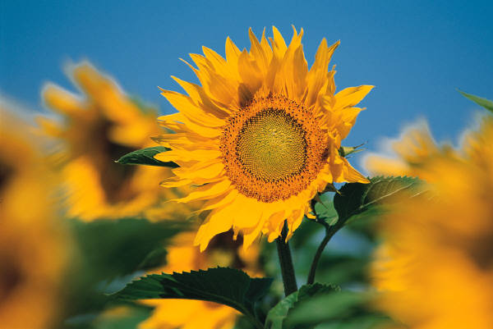
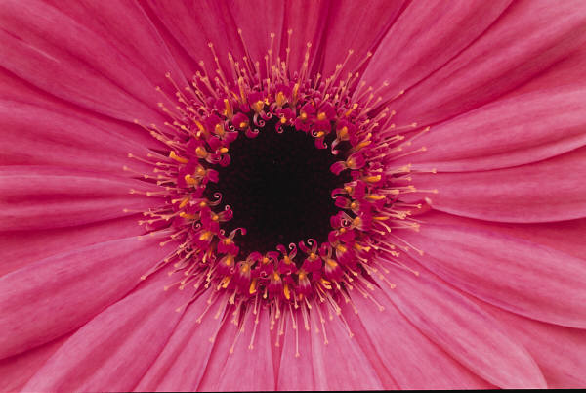
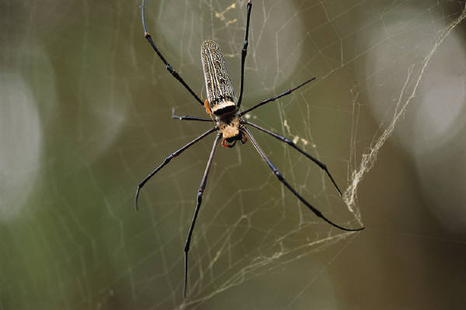

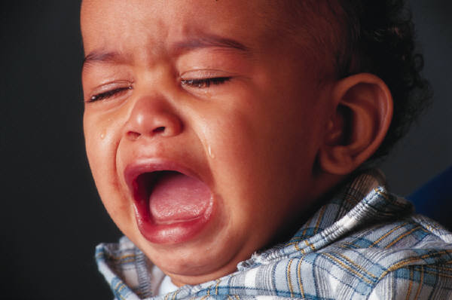


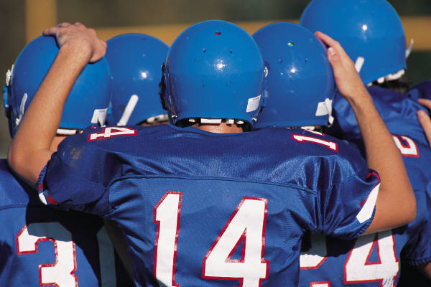

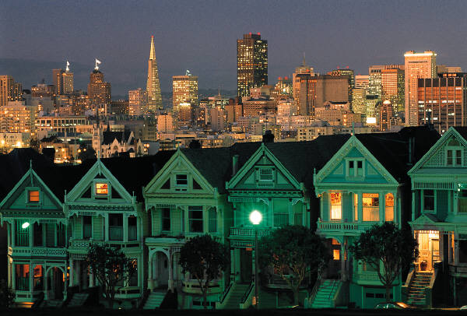

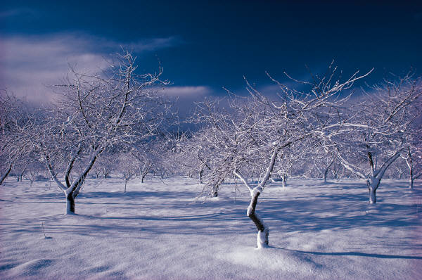


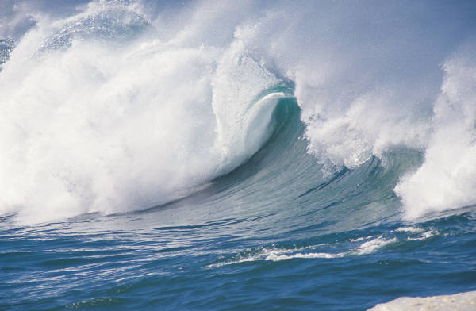
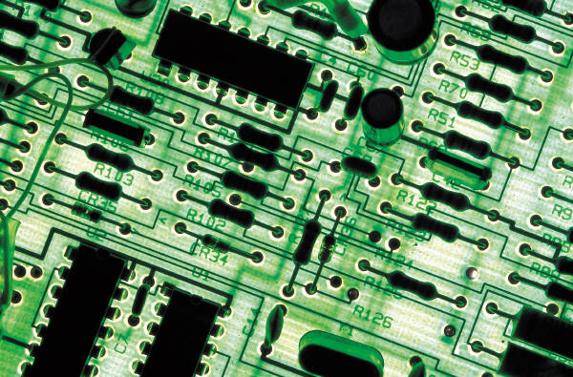

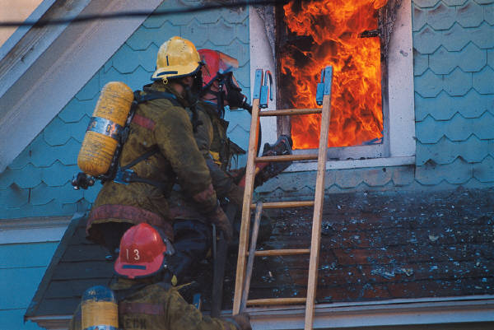
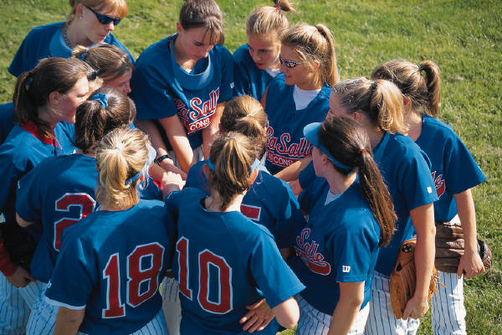
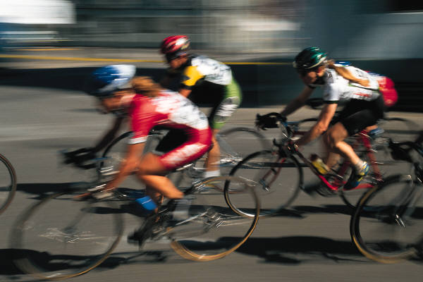

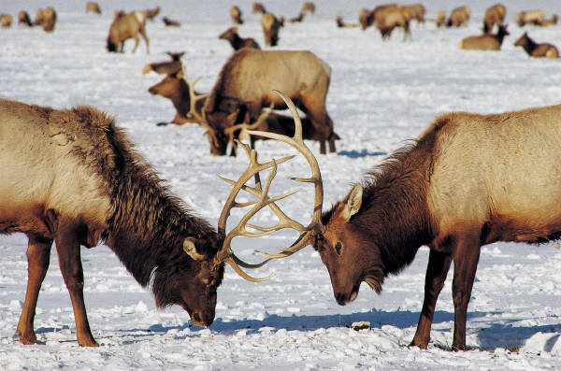

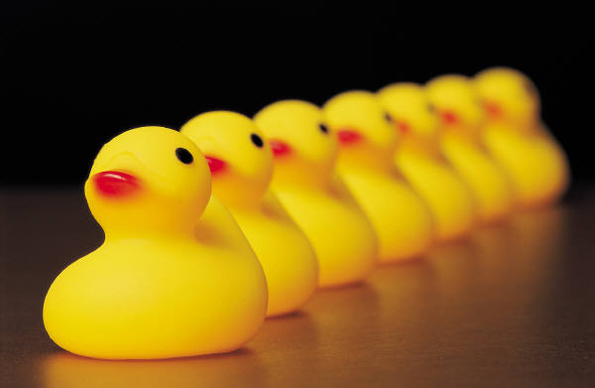

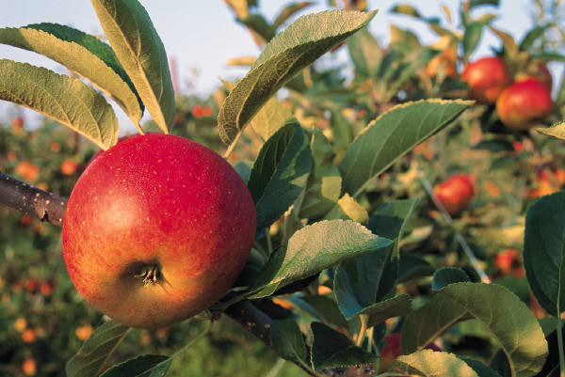





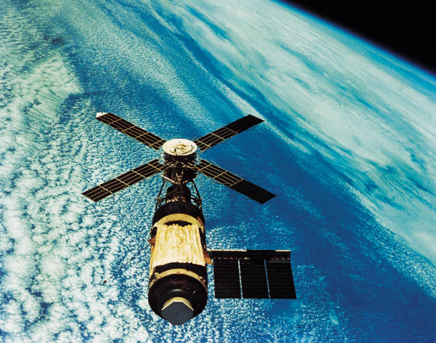

Distributed Greedy
Mirzasoleiman, Karbasi, Sarkar, Krause '13

Slide 14
Performance of Distributed Greedy
Mirzasoleiman, Karbasi, Sarkar, Krause '13
Only requires 2 rounds of communication
Approximation ratio is:
(where m is number of machines)
If we use the optimal algorithm on each machine in both phases, we can still only get:

Slide 15
Performance of Distributed Greedy
If we use the optimal algorithm on each machine in both phases, we can still only get:
In fact, we can show that using greedy gives:
Why?
The problem doesn't have optimal substructure.
Better to run greedy in round 1 instead of the optimal algorithm.

Slide 16

Revisiting the Analysis
Can construct bad examples for Greedy/optimal
Lower bound for any poly(k) coresets (Indyk et al. ’14)
Yet the distributed greedy algorithm works very well on real instances
Why?

Slide 17

Power of Randomness
Randomized distributed Greedy
Distribute the elements of V randomly in round 1
Select the best solution found in rounds 1 & 2
Theorem: If Greedy achieves a C approximation, randomized distributed Greedy achieves a C/2 approximation in expectation.

Slide 18
Intuition
If elements in OPT are selected in round 1 with high probability
Most of OPT is present in round 2 so solution in round 2 is good
If elements in OPT are selected in round 1 with low probability
OPT is not very different from typical solution so solution in round 1 is good

Slide 19
Analysis (Preliminaries)
Greedy Property:
Suppose:
x is not selected by greedy on S∪{x}
y is not selected by greedy on S∪{y}
Then:
x and y are not selected by greedy on S∪{x,y}
Lovasz extension : convex function on [0,1]^{V} that agrees with on integral vectors.

Slide 20
Analysis (Sketch)
Let X be a random 1/m sample of V
For e in OPT, let p_{e} be the probability (over choice of X) that e is selected by Greedy on X∪{e}
Then, expected value of elements of OPT on the final machine is
On the other hand, expected value of rejected elements is

Slide 21
Analysis (Sketch)
The best single machine solution S satisfies:
The final greedy solution T satisfies:
Altogether, we get an approximation in expectation of:

Slide 22
Analysis (Sketch)
The final greedy solution T satisfies:
The best single machine solution S satisfies:
Altogether, we get an approximation in expectation of:

Slide 23
Generality
What do we need for the proof?
Monotonicity and submodularity of f
Heredity of constraint
Greedy property
The result holds in general any time greedy is an -approximation for a hereditary, constrained submodular maximization problem.

Slide 24
Non-monotone Functions
In the first round, use Greedy on each machine
In the second round, use any algorithm on the last machine
We still obtain a constant factor approximation for most problems

Slide 25
Tiny Image Experiments
(n = 1M, m = 100)

Slide 26
Matroid Coverage Experiments
Matroid Coverage (n=900, r=5)
Matroid Coverage (n=100, r=100)
It's better to distribute ellipses from each location across several machines!

Slide 27
Future Directions
Can we relax the greedy property further?
What about non-greedy algorithms?
Can we speed up the final round, or reduce the number machines required?
Better approximation guarantees?

