Slide 1


CIS 700: “algorithms for Big Data”
Lecture 23:
$L_{p}$-testing and isotonic regression
Slides at http://grigory.us/big-data-class.html
Grigory Yaroslavtsev
http://grigory.us

Slide 2
Testing Big Data
Q: How to make sense of big data?
Q: How to understand properties looking only at a small sample?
Q: How to ignore noise and outliers?
Q: How to minimize assumptions about the sample generation process?
Q: How to optimize running time?
Notes:
The motivation for this work came from our desire to answer the following questions

Slide 3

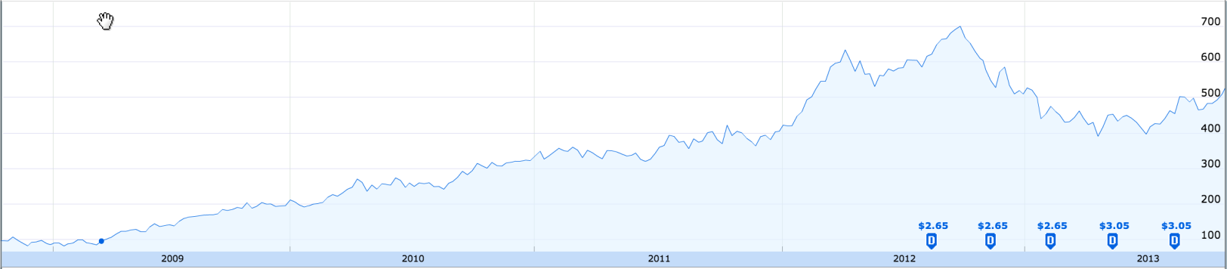
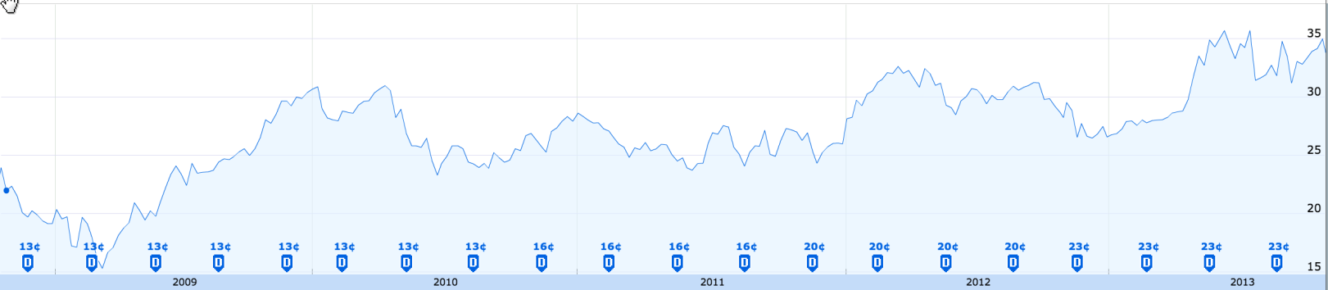

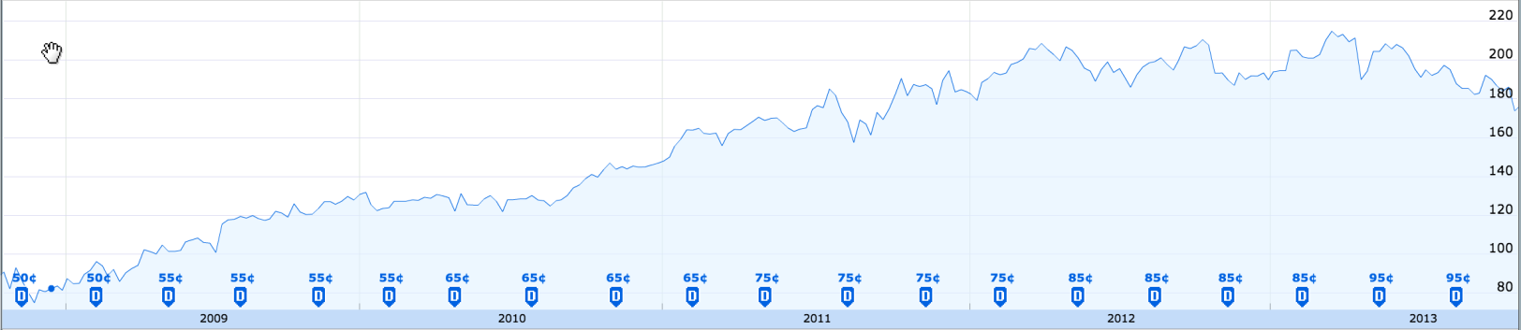

Which stocks were growing steadily?
Data from http://finance.google.com
Notes:
Given time-series data we can ask ourselves a question: does it follow a monotone trend?
Let’s look at the dynamics of stocks and see whether they have demonstrated robust growth.
We are looking at the data from Google Finance over the 5 years following recession.
Apple was growing steadily, but then

Slide 4
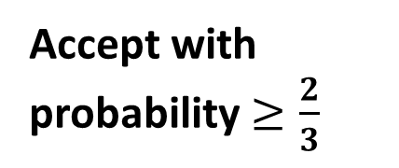
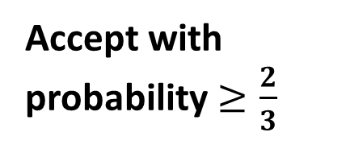





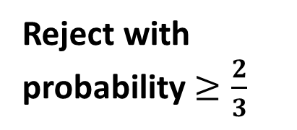

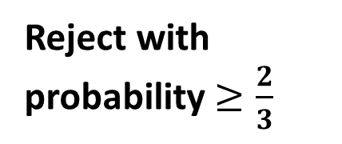
Property Testing [Goldreich, Goldwasser, Ron; Rubinfeld, Sudan]
Randomized Algorithm
Property Tester
YES
YES
$$⇒$$
Accept with probability $≥\frac{2}{3}$
$$⇒$$
Accept with probability $≥\frac{2}{3}$
$$⇒$$
NO
$ε$-close
Don’t care
NO
$$⇒$$
Reject with probability $≥\frac{2}{3}$
$$⇒$$
Reject with probability $≥\frac{2}{3}$
$ε$-close : $≤ε$fraction has to be changed to become YES
Notes:
A randomized algorithm distinguishes with some constant probability (e.g. 2/3) the two scenarios: monotone vs. not monotone.
The problem with a randomized algorithm is that in the worst case it has too look in the entire data, which is too big. So the running time of such algorithm would be at least linear.
In order to be able do design sublinear time algorithms one has to relax its definition.
The first such relaxation, called property testing, was introduced by bla-bla-bla.
A parameter \epsilon allows to specify approximation in the decision problem.
If the data is monotone a property testing algorithm still accepts.

Slide 5
Which stocks were growing steadily?
Data from http://finance.google.com
Notes:
Given time-series data we can ask ourselves a question: does it follow a monotone trend?
Let’s look at the dynamics of stocks and see whether they have demonstrated robust growth.
We are looking at the data from Google Finance over the 5 years following recession.
Apple was growing steadily, but then

Slide 6




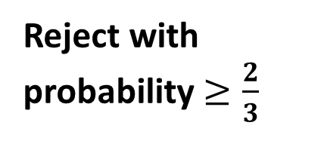
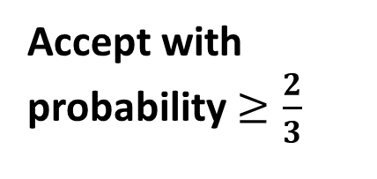


Tolerant Property Testing [Parnas, Ron, Rubinfeld]
Property Tester
Tolerant Property Tester
YES
$$⇒$$
Accept with probability $≥\frac{2}{3}$
YES
$$⇒$$
Accept with probability $≥\frac{2}{3}$
$$⇒$$
Don’t care
$ε$-close
$ε_{1}$-close
NO
$$⇒$$
Don’t care
$$⇒$$
Reject with probability $≥\frac{2}{3}$
$(ε_{1},ε_{2})$-close
NO
$$⇒$$
Reject with probability $≥\frac{2}{3}$
$ε$-close : $≤ε$fraction has to be changed to become YES

Slide 7
Which stocks were growing steadily?
Data from http://finance.google.com

Slide 8
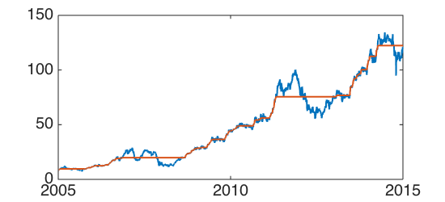


$L_{1}$-Isotonic Regression
Running time $O(n\log{n})$ [Ahuja, Orlin]

Slide 9


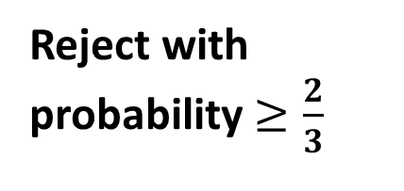
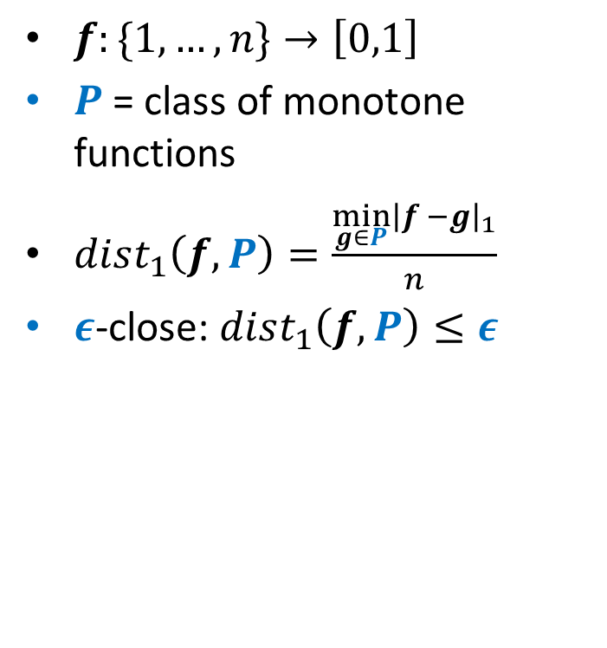
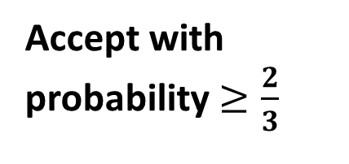





Tolerant “$L_{1}$Property Testing”
$f:\{1, …, n\}→\left[0,1\right]$
$P$ = class of monotone functions
$dist_{1}\left(f,P\right)=\frac{\min_{g∈P}{\left|f −g\right|}_{1}}{n}$
$ε$-close: $dist_{1}\left(f,P\right)≤ε$
Tolerant “$L_{1}$ Property Tester”
YES
$$⇒$$
Accept with probability $≥\frac{2}{3}$
$ε_{1}$-close
$$⇒$$
$(ε_{1},ε_{2})$-close
Don’t care
NO
$$⇒$$
Reject with probability $≥\frac{2}{3}$

Slide 10
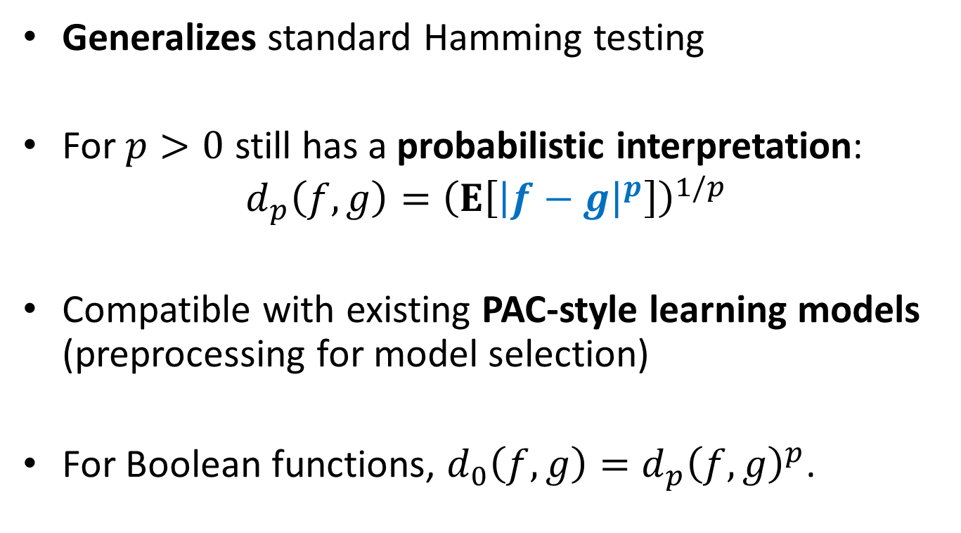

New $L_{p}$-Testing Model for Real-Valued Data
Generalizes standard Hamming testing
For $p>0$ still has a probabilistic interpretation:
$$d_{p}\left(f,g\right)={\left(E\left[{\left|f−g\right|}^{p}\right]\right)}^{1/p}$$
Compatible with existing PAC-style learning models (preprocessing for model selection)
For Boolean functions, $d_{0}\left(f,g\right)=d_{p}{\left(f,g\right)}^{p}$.

Slide 11
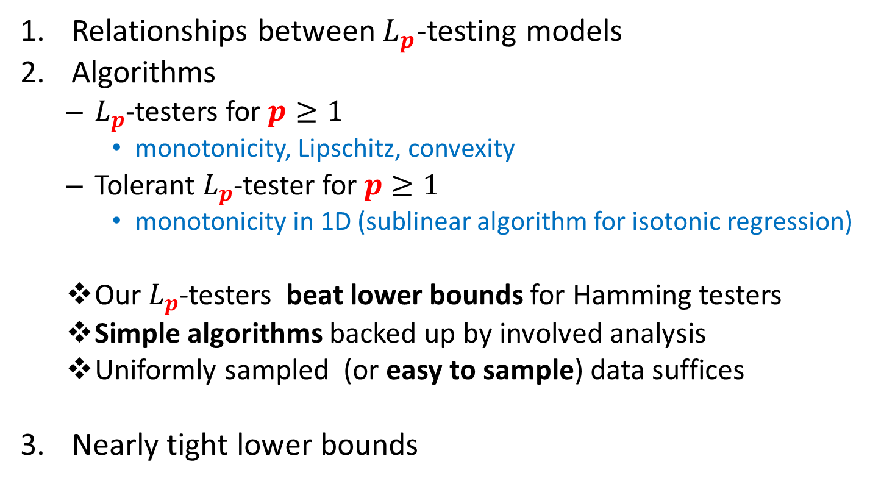
Our Contributions
Relationships between $L_{p}$-testing models
Algorithms
$L_{p}$-testers for $p≥1$
monotonicity, Lipschitz, convexity
Tolerant $L_{p}$-tester for $p≥1$
monotonicity in 1D (sublinear algorithm for isotonic regression)
Our $L_{p}$-testers beat lower bounds for Hamming testers
Simple algorithms backed up by involved analysis
Uniformly sampled (or easy to sample) data suffices
Nearly tight lower bounds

Slide 12
Implications for Hamming Testing
Some techniques/results carry over to Hamming testing
Improvement on Levin’s work investment strategy
Connectivity of bounded-degree graphs [Goldreich, Ron ‘02]
Properties of images [Raskhodnikova ‘03]
Multiple-input problems [Goldreich ‘13]
First example of monotonicity testing problem where adaptivity helps
Improvements to Hamming testers for Boolean functions

Slide 13
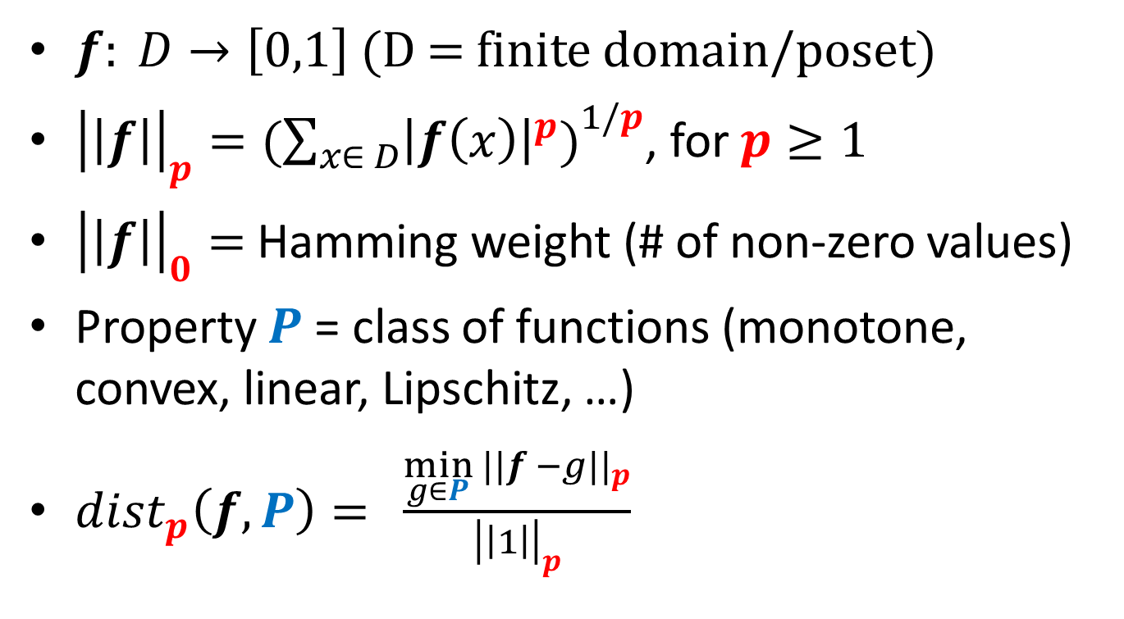
Definitions
$f: D→\left[0,1\right]$ (D = finite domain/poset)
${\left|\left|f\right|\right|}_{p}=({\sum_{x∈ D}{{\left|f\left(x\right)\right|}^{p})}}^{1/p}$, for $p≥1$
${\left|\left|f\right|\right|}_{0}=$ Hamming weight (# of non-zero values)
Property $P$ = class of functions (monotone, convex, linear, Lipschitz, …)
$dist_{p}\left(f,P\right)={\frac{{\min_{g∈P}{||f −g||}}_{p}}{{\left|\left|1\right|\right|}_{p}}}$

Slide 14

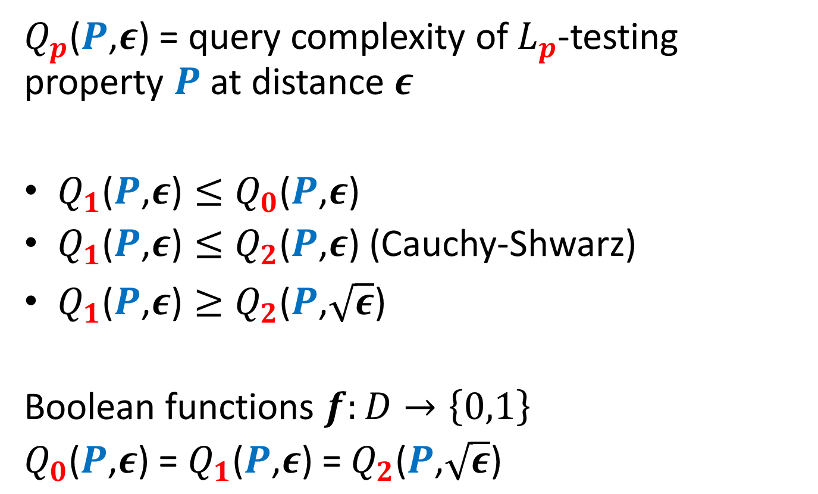
Relationships: $L_{p}$-Testing
$Q_{p}$($P$,$ε$) = query complexity of $L_{p}$-testing property $P$ at distance $ε$
$Q_{1}\text{(}P\text{,}ε\text{)}≤Q_{0}\text{(}P\text{,}ε\text{)}$
$Q_{1}\text{(}P\text{,}ε\text{)}≤Q_{2}\text{(}P\text{,}ε\text{)}$ (Cauchy-Shwarz)
$Q_{1}\text{(}P\text{,}ε\text{)}≥Q_{2}\text{(}P\text{,}\sqrt{ε}\text{)}$
Boolean functions $f:D→\left\{0,1\right\}$
$Q_{0}\text{(}P\text{,}ε\text{) =} Q_{1}\text{(}P\text{,}ε\text{)}\text{ =}{ Q}_{2}\text{(}P\text{,}\sqrt{ε}\text{)}$

Slide 15
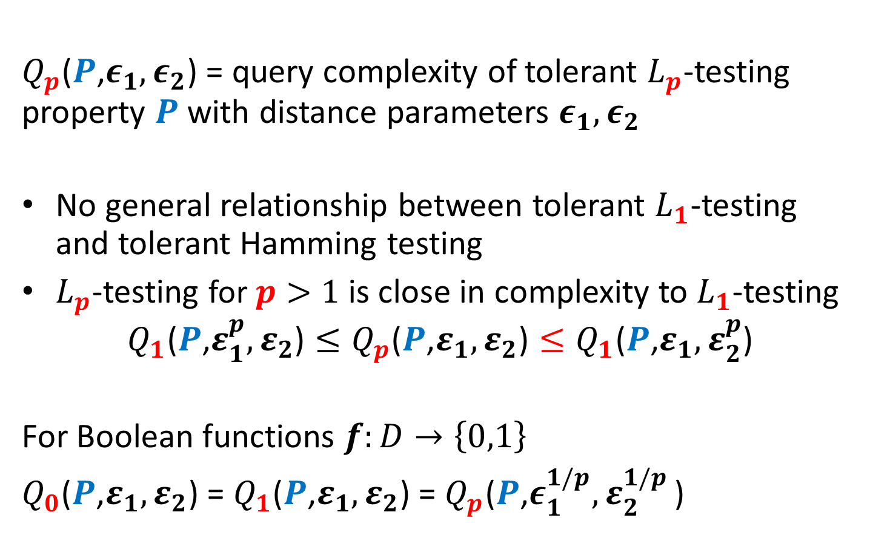

Relationships: Tolerant $L_{p}$-Testing
$Q_{p}$($P$,$ε_{1},ε_{2}$) = query complexity of tolerant $L_{p}$-testing property $P$ with distance parameters $ε_{1}, ε_{2}$
No general relationship between tolerant $L_{1}$-testing and tolerant Hamming testing
$L_{p}$-testing for $p>1$ is close in complexity to $L_{1}$-testing
$${Q_{1}\text{(}P\text{,}ε_{1}^{p},ε_{2}\text{)}≤Q}_{p}\text{(}P\text{,}ε_{1},ε_{2}\text{)}≤Q_{1}\text{(}P\text{,}ε_{1},ε_{2}^{p}\text{)}$$
For Boolean functions $f:D→\left\{0,1\right\}$
$Q_{0}\text{(}P\text{,}ε_{1},ε_{2}\text{)}\text{ = }Q_{1}\text{(}P\text{,}ε_{1},ε_{2}\text{)}$ = $Q_{p}\text{(}P\text{,}ε_{1}^{1/p}{,ε}_{2}^{1/p}\text{)}$

Slide 16
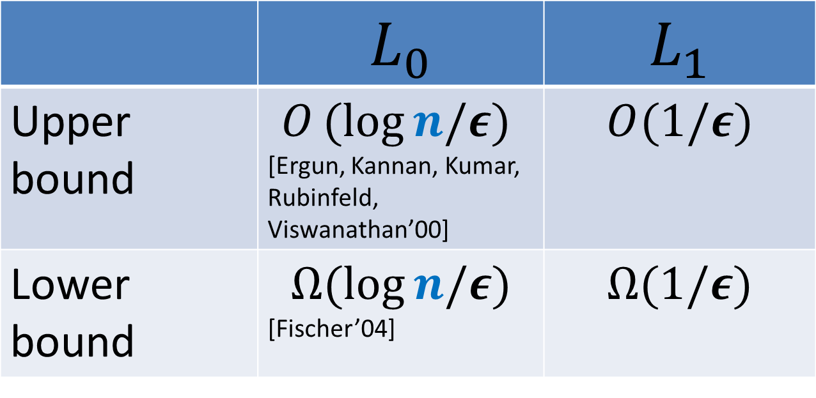

Testing Monotonicity
Line ($D=[n]$)
 | $L_{0}$ | $$L_{1}$$
Upper bound | $$O(log{n/ε})$$ [Ergun, Kannan, Kumar, Rubinfeld, Viswanathan’00] | $$O(1/ε)$$
Lower bound | $$Ω(log{n/ε})$$ [Fischer’04] | $$Ω(1/ε)$$

Slide 17
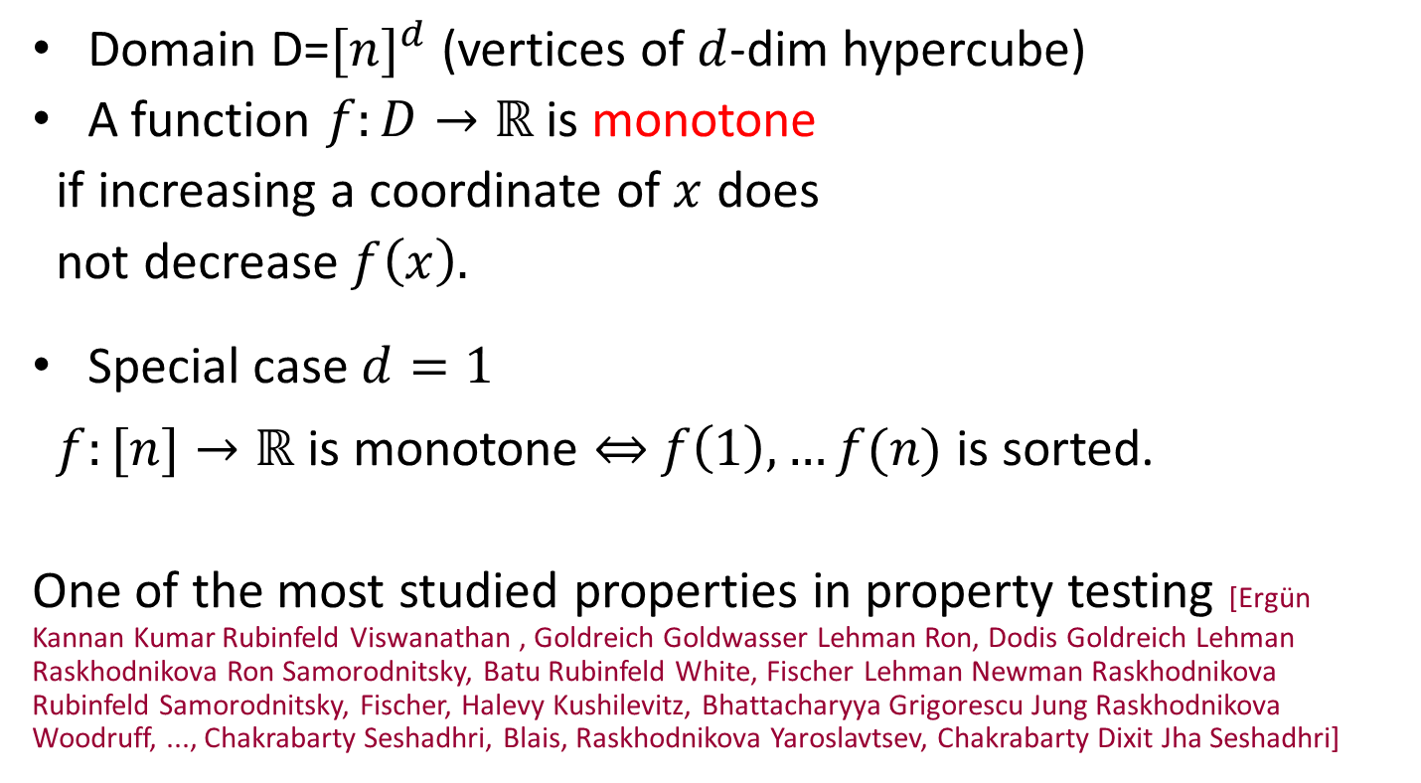
Monotonicity
$$(d,d,d)$$
Domain D=${[n]}^{d}$ (vertices of $d$-dim hypercube)
A function $f:D→ℝ$ is monotone
if increasing a coordinate of $x$ does
not decrease $f\left(x\right).$
Special case $d=1$
$f:[n]→ℝ$ is monotone $⇔$ $f\left(1\right),…f(n)$ is sorted.
One of the most studied properties in property testing [Ergün Kannan Kumar Rubinfeld Viswanathan , Goldreich Goldwasser Lehman Ron, Dodis Goldreich Lehman Raskhodnikova Ron Samorodnitsky, Batu Rubinfeld White, Fischer Lehman Newman Raskhodnikova Rubinfeld Samorodnitsky, Fischer, Halevy Kushilevitz, Bhattacharyya Grigorescu Jung Raskhodnikova Woodruff, ..., Chakrabarty Seshadhri, Blais, Raskhodnikova Yaroslavtsev, Chakrabarty Dixit Jha Seshadhri]
(1,1,1)

Slide 18
Monotonicity: Key Lemma
M = class of monotone functions
Boolean slicing operator $f_{y}:D→\{0,1\}$
$f_{y}\left(x\right)=1,$ if $f\left(x\right)≥ y,$
$f_{y}\left(x\right)=0,$ otherwise.
Theorem:
$$dist_{1}\left(f, M\right)=∫_{0}^{1}dist_{0}\left(f_{y}, M\right)dy$$

Slide 19
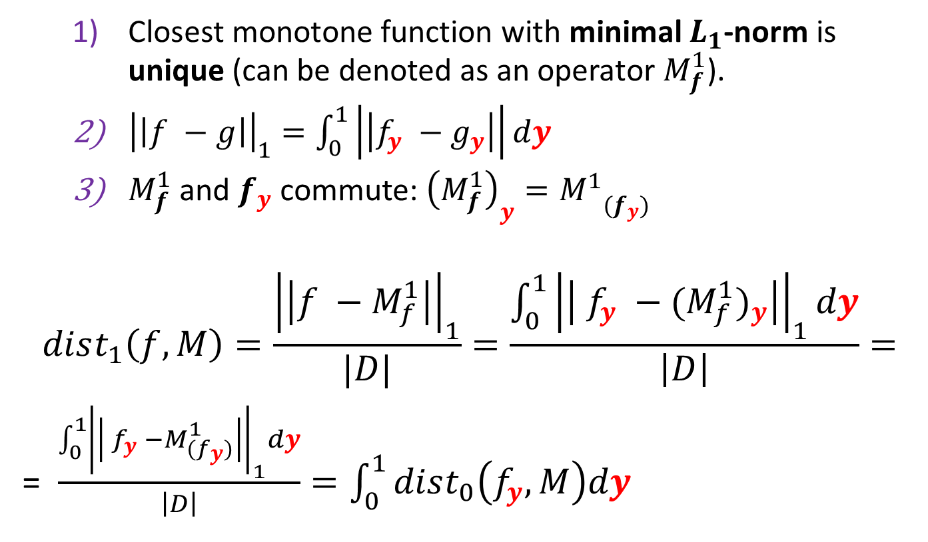
Proof sketch: slice and conquer
Closest monotone function with minimal $L_{1}$-norm is unique (can be denoted as an operator $M_{f}^{1}$).
${\left|\left|f −g\right|\right|}_{1}=\int_{0}^{1}{\left|\left|f_{y} −g_{y}\right|\right|dy}$
$M_{f}^{1}$ and $f_{y}$ commute: ${\left(M_{f}^{1}\right)}_{y}={M_{}^{1}}_{(f_{y})}$
$$dist_{1}\left(f,M\right)=\frac{{\left|\left|f −M_{f}^{1}\right|\right|}_{1}}{|D|}=\frac{\int_{0}^{1}{{\left|\left| f_{y} −{(M_{f}^{1})}_{y}\right|\right|}_{1}dy}}{\left|D\right|}=$$
= $\frac{\int_{0}^{1}{{\left|\left| f_{y} −M_{{(f}_{y})}^{1}\right|\right|}_{1}dy}}{\left|D\right|}=\int_{0}^{1}{dist_{0}\left(f_{y},M\right)dy}$
1)
2)
3)

Slide 20




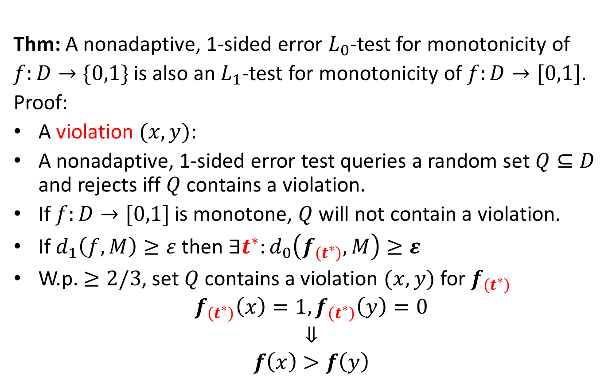
$L_{1}$-Testers from Boolean Testers
Thm: A nonadaptive, 1-sided error $L_{0}$-test for monotonicity of
$f:D→\{0,1\}$ is also an $L_{1}$-test for monotonicity of $f:D→[0,1]$.
Proof:
A violation $(x,y)$:
A nonadaptive, 1-sided error test queries a random set $Q⊆D$ and rejects iff $Q$ contains a violation.
If $f:D→[0,1]$ is monotone, $Q$ will not contain a violation.
If $d_{1}\left(f,M\right)≥ε$ then $∃t^{∗}:d_{0}\left(f_{{(t}^{∗})}, M\right)≥ε$
W.p.$≥2/3$, set $Q$ contains a violation $(x,y)$ for $f_{{(t}^{∗})}$
$$f_{(t^{∗})}\left(x\right)=1, f_{(t^{∗})}\left(y\right)=0$$
$$⇓$$
$$f\left(x\right)>f\left(y\right)$$
$$f(x)$$
$$>$$
$$f(y)$$

Slide 21
Our Results: Testing Monotonicity
Hypergrid ($D={\left[n\right]}^{d}$)
$2^{O\left(d\right)}/ε$ adaptive tester for Boolean functions
 | $L_{0}$ | $$L_{1}$$
Upper bound | $$O\left(\frac{d log n}{ε}\right)$$ [Dodis et al. ’99,…, Chakrabarti, Seshadhri ’13] | $$O\left( \frac{d}{ε}\log{\frac{d}{ε} }\right)$$
Lower bound | $$Ω\left(\frac{d log n}{ε}\right)$$ [Dodis et al.’99…, Chakrabarti, Seshadhri ’13] | $$Ω\left(\frac{1}{ε}\log{\frac{1}{ε}}\right)$$ Non-adaptive 1-sided error

Slide 22

Testing Monotonicity of ${\left[n\right]}^{d}→\{0,1\}$
$e^{i}=(0…1…0)$ = $i$-th unit vector.
For $i∈\left[d\right], α∈{\left[n\right]}^{d}$ where $α_{i}=0$ an axis-parallel line along dimension$i$ : $\left\{α +x_{i}e^{i}\right|x_{i}∈[n]\}$
$L_{n,d}$= set of all $dn^{d−1}$ axis-parallel lines
Dimension reduction for $f:{\left[n\right]}^{d}→\left\{0,1\right\}$[Dodis et al.’99]:
$$E_{ℓ∼L_{n,d}}\left[dist\left(f{\left.​\right|}_{ℓ},M\right)\right]≥\frac{dist\left(f,M\right)}{2d}$$
If $dist\left(f{\left.​\right|}_{ℓ},M\right)≥δ$ => $O\left(\frac{1}{δ}\right)$-sample detects a violation

Slide 23
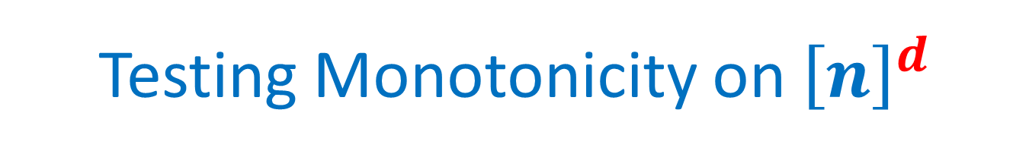
Testing Monotonicity on ${\left[n\right]}^{d}$
Dimension reduction for $f:{\left[n\right]}^{d}→\{0,1\}$[Dodis et al.’99]:
$$E_{ℓ∼L_{n,d}}\left[dist\left(f{\left.​\right|}_{ℓ},M\right)\right]≥\frac{dist\left(f,M\right)}{2d}$$
If $dist\left(f{\left.​\right|}_{ℓ},M\right)≥δ$ => $O\left(\frac{1}{δ}\right)$-sample can detect a violation
“Inverse Markov”: For $r.v. X∈\left[0,1\right]$ with $E\left[X\right]=μ$ and $c<1$
$$\operatorname{Pr}\left[X≤cμ\right]≤\frac{1 − μ}{1 −c μ}⇒\operatorname{Pr}\left[X≤\frac{μ}{2}\right]≤1 −\frac{μ}{2 −μ}≤1 −\frac{μ}{2}$$
$\operatorname{Pr}\left[dist\left(f{\left.​\right|}_{ℓ},M\right)≥\frac{dist\left(f,M\right)}{4d}\right]≥\frac{dist\left(f,M\right)}{4d}⇒O\left(\frac{d^{2}}{ε^{2}}\right)$-test
[Dodis et al.] $O\left(\frac{d}{ε}\log^{2}\frac{d}{ε}\right)$ via “Levin’s economical work investment strategy” (used in other papers for testing connectedness of a graph, properties of images, etc.)

Slide 24
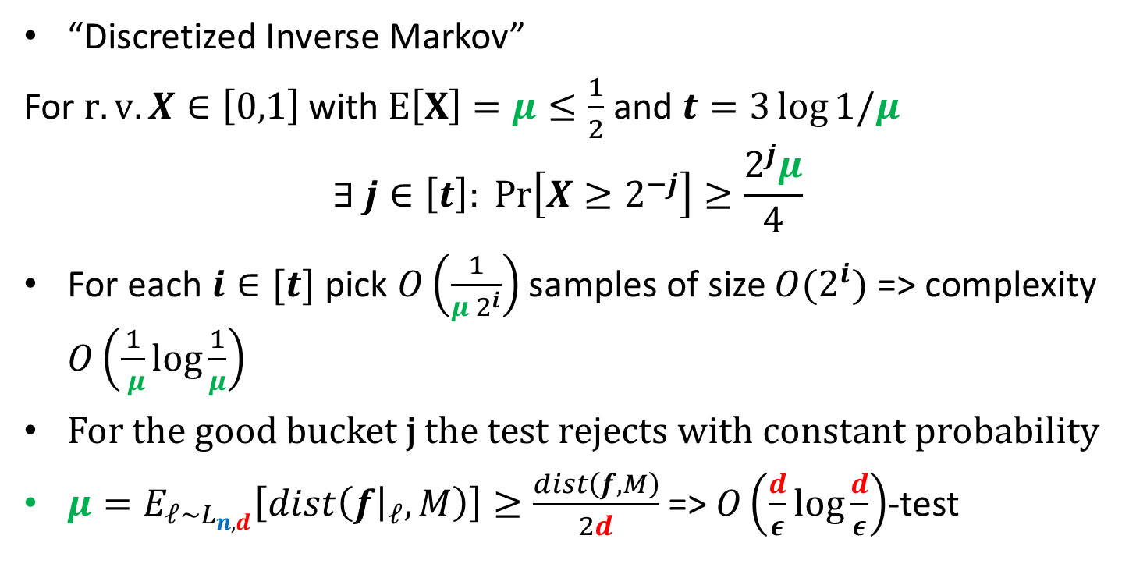
Testing Monotonicity on ${\left[n\right]}^{d}$
“Discretized Inverse Markov”
For $r.v. X∈\left[0,1\right]$ with $E\left[X\right]=μ≤\frac{1}{2}$ and $t=3\log{1/μ}$
$$∃ j∈\left[t\right]:\operatorname{Pr}\left[X≥2^{−j}\right]≥\frac{2^{j}μ}{4}$$
For each $i∈[t]$ pick $O\left(\frac{1}{μ{ 2}^{i}}\right)$ samples of size $O(2^{i})$ => complexity $O\left(\frac{1}{ μ}log\frac{1}{μ}\right)$
For the good bucket j the test rejects with constant probability
$μ=E_{ℓ∼L_{n,d}}\left[dist\left(f{\left.​\right|}_{ℓ},M\right)\right]≥\frac{dist\left(f,M\right)}{2d}$ => $O\left(\frac{d}{ε}\log{\frac{d}{ε}}\right)$-test

Slide 25
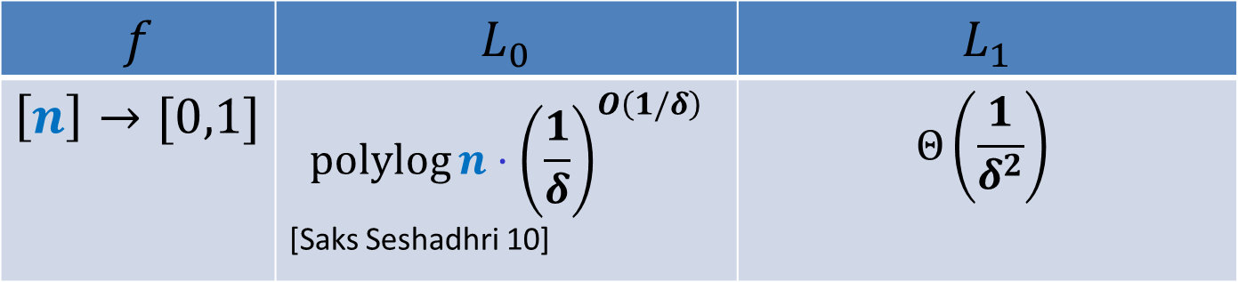
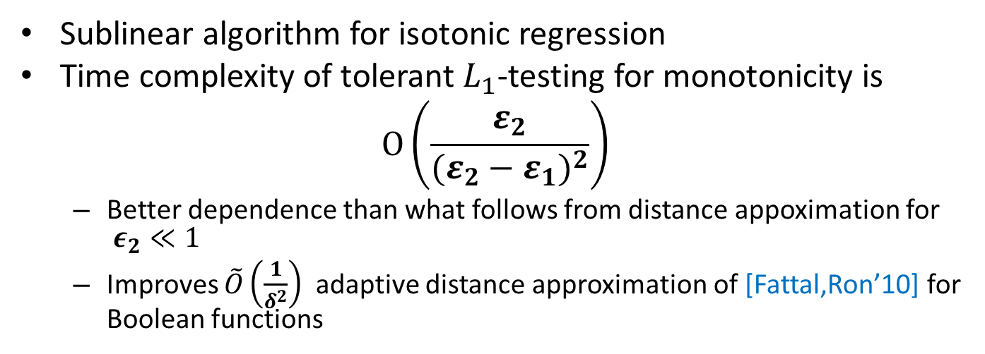
Distance Approximation and Tolerant Testing
Approximating $L_{1}$-distance to monotonicity $±δ w.p. ≥2/3$
$$f$$ | $L_{0}$ | $$L_{1}$$
$$\left[n\right]→[0,1]$$ | $$\operatorname{polylog}{n}⋅{\left(\frac{1}{δ}\right)}^{O\left(1/δ\right)}$$ [Saks Seshadhri 10] | $$Θ\left(\frac{1}{δ^{2}}\right)$$
Sublinear algorithm for isotonic regression
Time complexity of tolerant $L_{1}$-testing for monotonicity is
$$O\left(\frac{ε_{2}}{{(ε_{2}−ε_{1})}^{2}}\right)$$
Better dependence than what follows from distance appoximation for $ε_{2}≪1$
Improves $\tilde{O}\left(\frac{1}{δ^{2}}\right)$ adaptive distance approximation of [Fattal,Ron’10] for Boolean functions

Slide 26

Distance Approximation $f:\left[n\right]→\left[0,1\right]$
Theorem: with constant probability over the choice of a random sample S of size $O\left(\frac{1}{δ^{2}}\right):$
$\left|dist_{1}\left(f{\left.​\right|}_{S} ,M\right)−dist_{1}\left(f,M\right)\right| <δ$
Implies an $O\left(\frac{1}{{\left(ε_{2}−ε_{1} \right)}^{2}}\right)$tolerant tester by setting $δ=\frac{\left(ε_{2}−ε_{1}\right)}{3}$
$dist_{1}\left(f, M\right)=∫_{0}^{1}dist_{0}\left(f_{y}, M\right)dy$
Suffices: $∀y: \left|dist_{0}\left(f_{y}{\left.​\right|}_{S} ,M\right)−dist_{0}\left(f_{y},M\right)\right| <δ$
Improves previous $\tilde{O}(1/δ^{2})$ algorithm [Fattal, Ron’10]

Slide 27
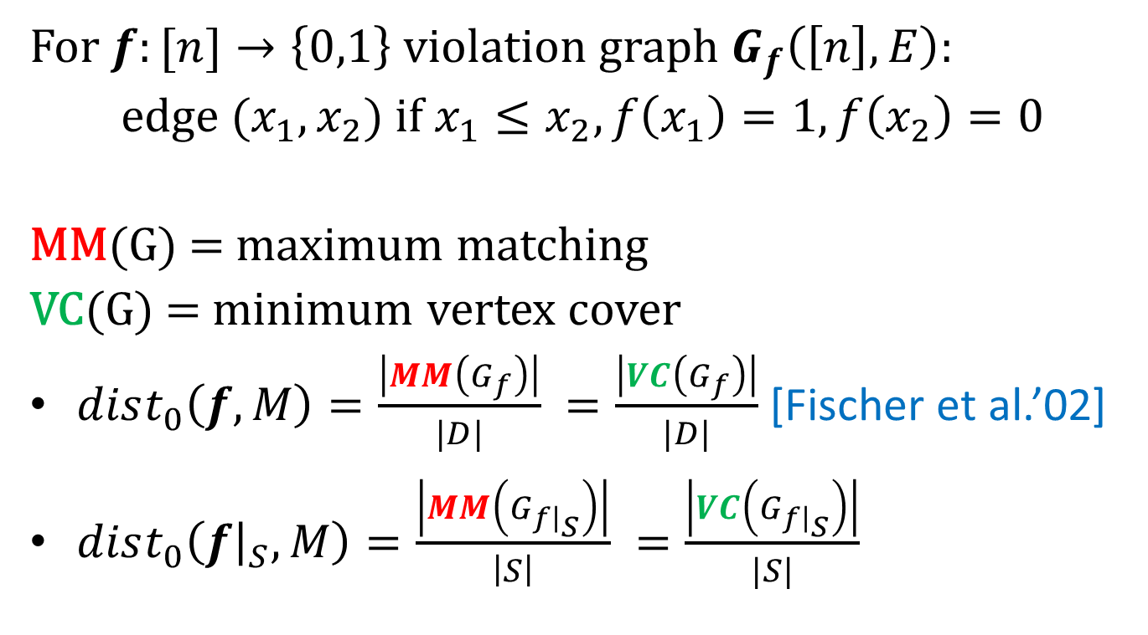
Distance Approximation
For $f:[n]→\left\{0,1\right\}$ violation graph $G_{f}\left(\left[n\right], E\right):$
edge $(x_{1},x_{2})$ if $x_{1}≤x_{2}, f\left(x_{1}\right)=1, f\left(x_{2}\right)=0$
MM(G) = maximum matching
VC(G) = minimum vertex cover
$dist_{0}\left(f,M\right)=\frac{\left|MM\left(G_{f}\right)\right|}{|D|} =\frac{\left|VC\left(G_{f}\right)\right|}{|D|}$ [Fischer et al.’02]
$dist_{0}\left(f{\left.​\right|}_{S},M\right)=\frac{\left|MM\left(G_{f{\left.​\right|}_{S}}\right)\right|}{\left|S\right|} =\frac{\left|VC\left(G_{f{\left.​\right|}_{S}}\right)\right|}{|S|}$

Slide 28
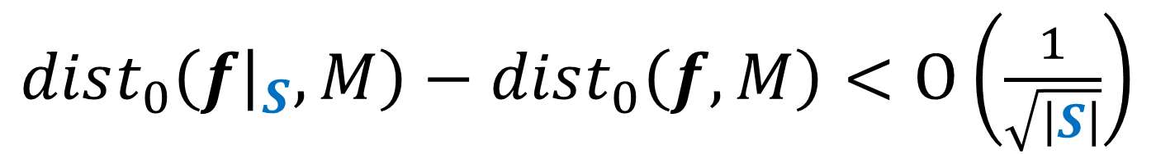
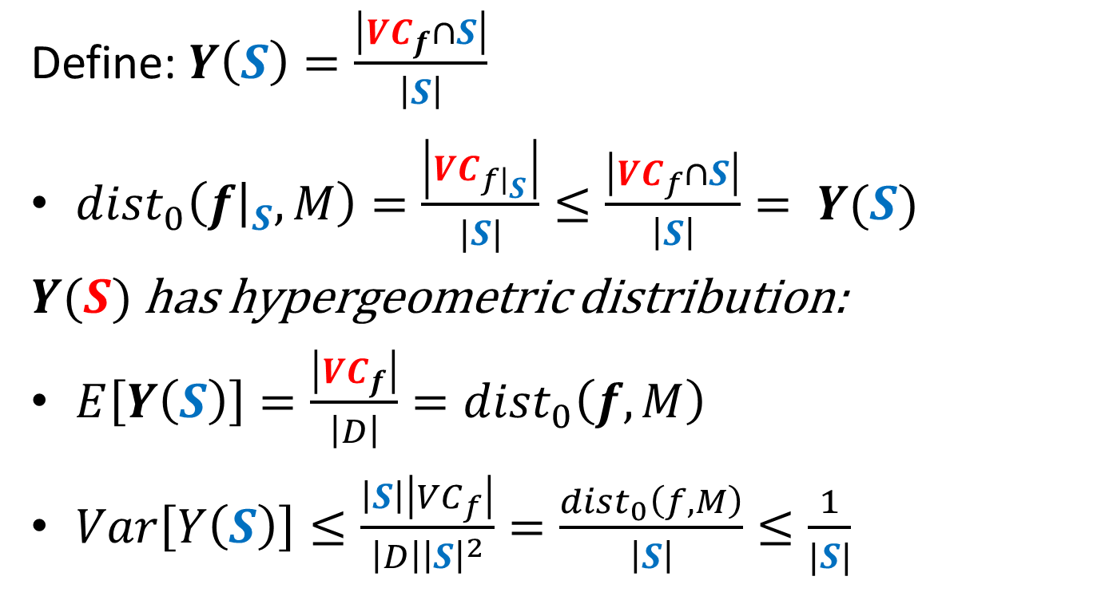
$dist_{0}\left(f{\left.​\right|}_{S},M\right)−dist_{0}\left(f,M\right)<O\left(\frac{1}{\sqrt{\left|S\right|}}\right)$
Define: $Y\left(S\right)=\frac{\left|{VC}_{f}∩S\right|}{\left|S\right|}$
$dist_{0}\left(f{\left.​\right|}_{S},M\right)=\frac{\left|{VC}_{f{\left.​\right|}_{S}}\right|}{|S|}≤\frac{\left|{VC}_{f}∩S\right|}{\left|S\right|}= Y(S)$
$Y(S)$ has hypergeometric distribution:
$E\left[Y\left(S\right)\right]=\frac{\left|{VC}_{f}\right|}{\left|D\right|}=dist_{0}\left(f,M\right)$
$Var\left[Y\left(S\right)\right]≤\frac{\left|S\right|\left|VC_{f}\right|}{\left|D\right|{\left|S\right|}^{2}}=\frac{dist_{0}\left(f,M\right)}{\left|S\right|}≤\frac{1}{|S|}$

Slide 29
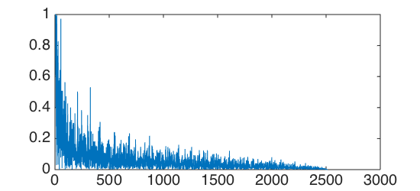
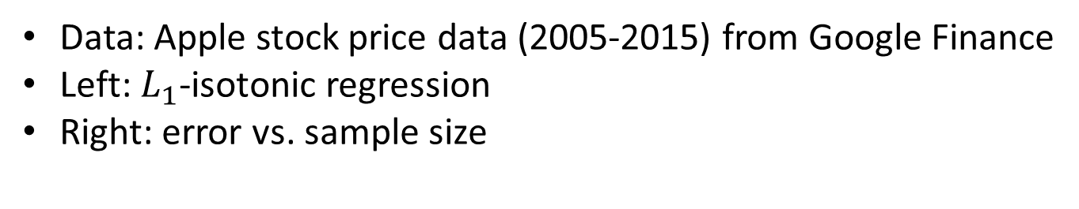
Experiments
Data: Apple stock price data (2005-2015) from Google Finance
Left: $L_{1}$-isotonic regression
Right: error vs. sample size

Slide 30
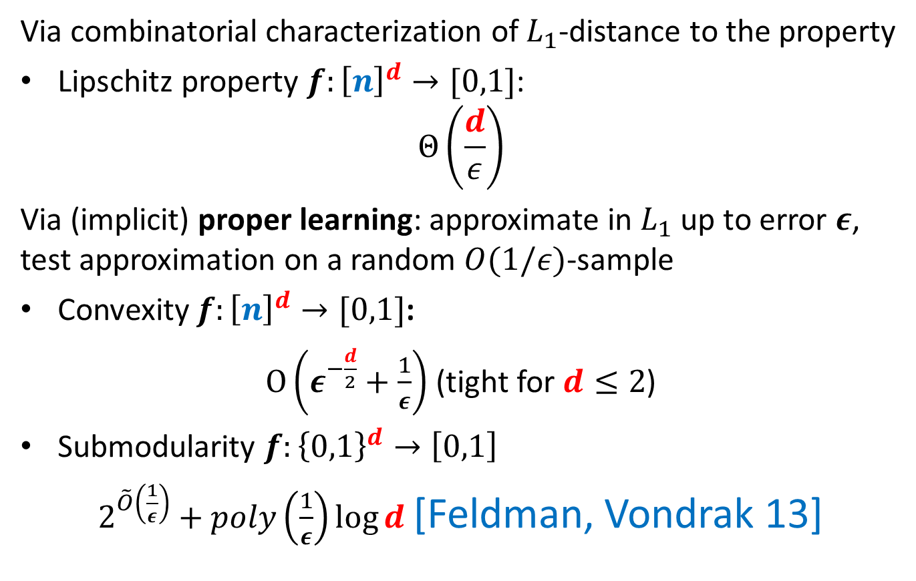

$L_{1}$-Testers for Other Properties
Via combinatorial characterization of $L_{1}$-distance to the property
Lipschitz property $f:{\left[n\right]}^{d}→[0,1]$:
$$Θ\left(\frac{d}{ε}\right)$$
Via (implicit) proper learning: approximate in $L_{1}$ up to error $ε$, test approximation on a random $O(1/ε)$-sample
Convexity $f:{\left[n\right]}^{d}→[0,1]$:
$O\left(ε^{−\frac{d}{2}}+\frac{1}{ε}\right)$ (tight for $d≤2$)
Submodularity $f:{\left\{0,1\right\}}^{d}→\left[0,1\right]$
$2^{\tilde{O}\left(\frac{1}{ε}\right)}+poly\left(\frac{1}{ε}\right)\log{d}$ [Feldman, Vondrak 13]

Slide 31
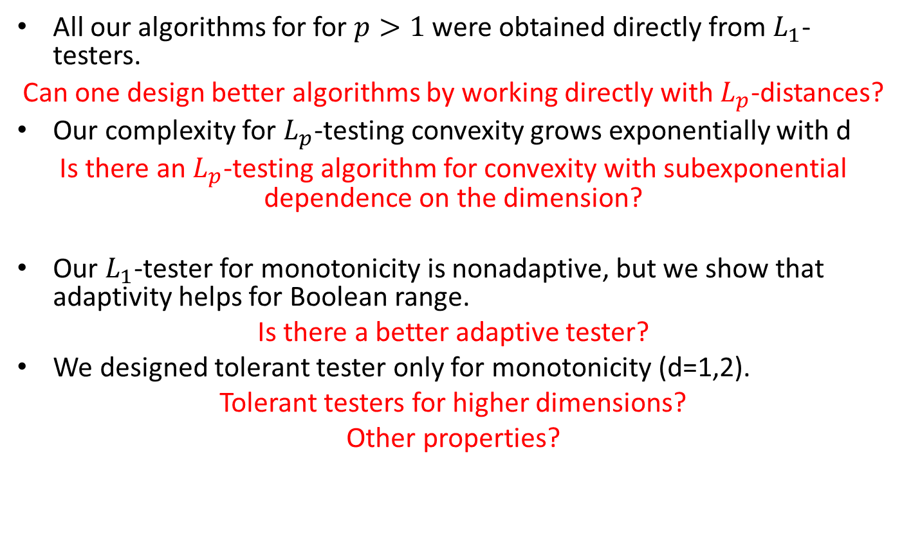
Open Problems
All our algorithms for for $p>1$ were obtained directly from $L_{1}$-testers.
Can one design better algorithms by working directly with $L_{p}$-distances?
Our complexity for $L_{p}$-testing convexity grows exponentially with d
Is there an $L_{p}$-testing algorithm for convexity with subexponential dependence on the dimension?
Our $L_{1}$-tester for monotonicity is nonadaptive, but we show that adaptivity helps for Boolean range.
Is there a better adaptive tester?
We designed tolerant tester only for monotonicity (d=1,2).
Tolerant testers for higher dimensions?
Other properties?

