Slide 1

Fast Fourier Sparsity Testing over the Boolean Hypercube
Grigory Yaroslavtsev
http://grigory.us
Joint with Andrew Arnold (Waterloo), Arturs Backurs (MIT), Eric Blais (Waterloo) and Krzysztof Onak (IBM).

Slide 2
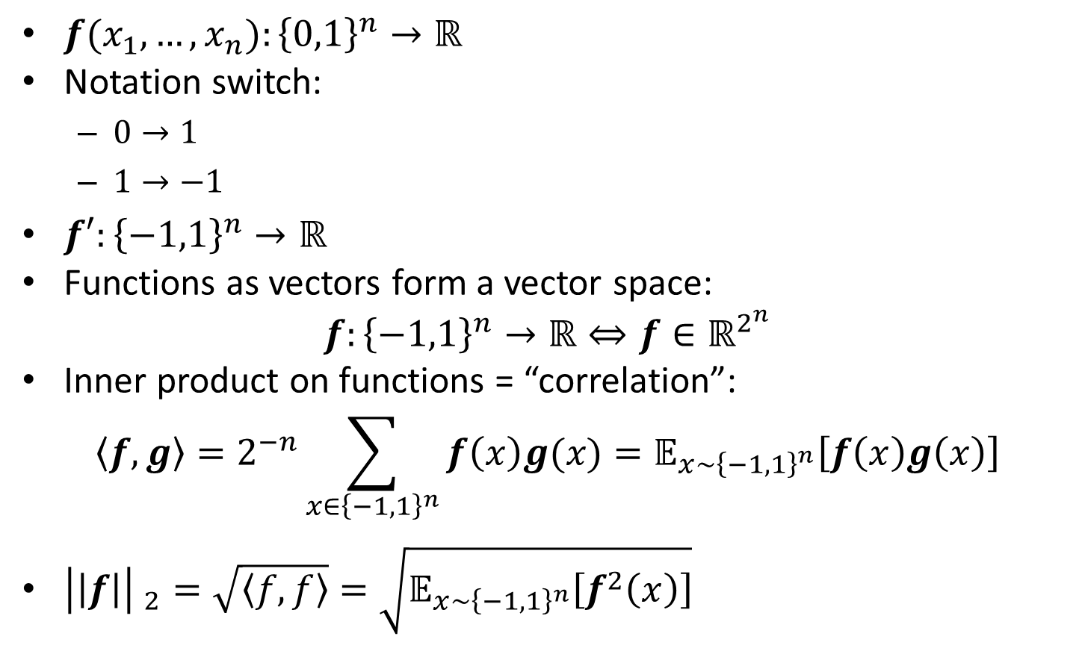
Fourier Analysis
$f(x_{1}, …, x_{n}):{\left\{0,1\right\}}^{n}→ℝ$
Notation switch:
$0→1$
$1→−1$
$f′:{\left\{−1,1\right\}}^{n}→ℝ$
Functions as vectors form a vector space:
$$f:{\left\{−1,1\right\}}^{n}→ℝ⇔f∈ℝ^{2^{n}}$$
Inner product on functions = “correlation”:
$$〈f,g〉=2^{−n}\sum_{x∈{\left\{−1,1\right\}}^{n}}{f\left(x\right)g(x)}=𝔼_{x∼{\left\{−1,1\right\}}^{n}}\left[f\left(x\right)g\left(x\right)\right]$$
${\left|\left|f\right|\right| }_{2}=\sqrt{〈f,f〉}=\sqrt{𝔼_{x∼{\left\{−1,1\right\}}^{n}}\left[f^{2}\left(x\right)\right]}$

Slide 3
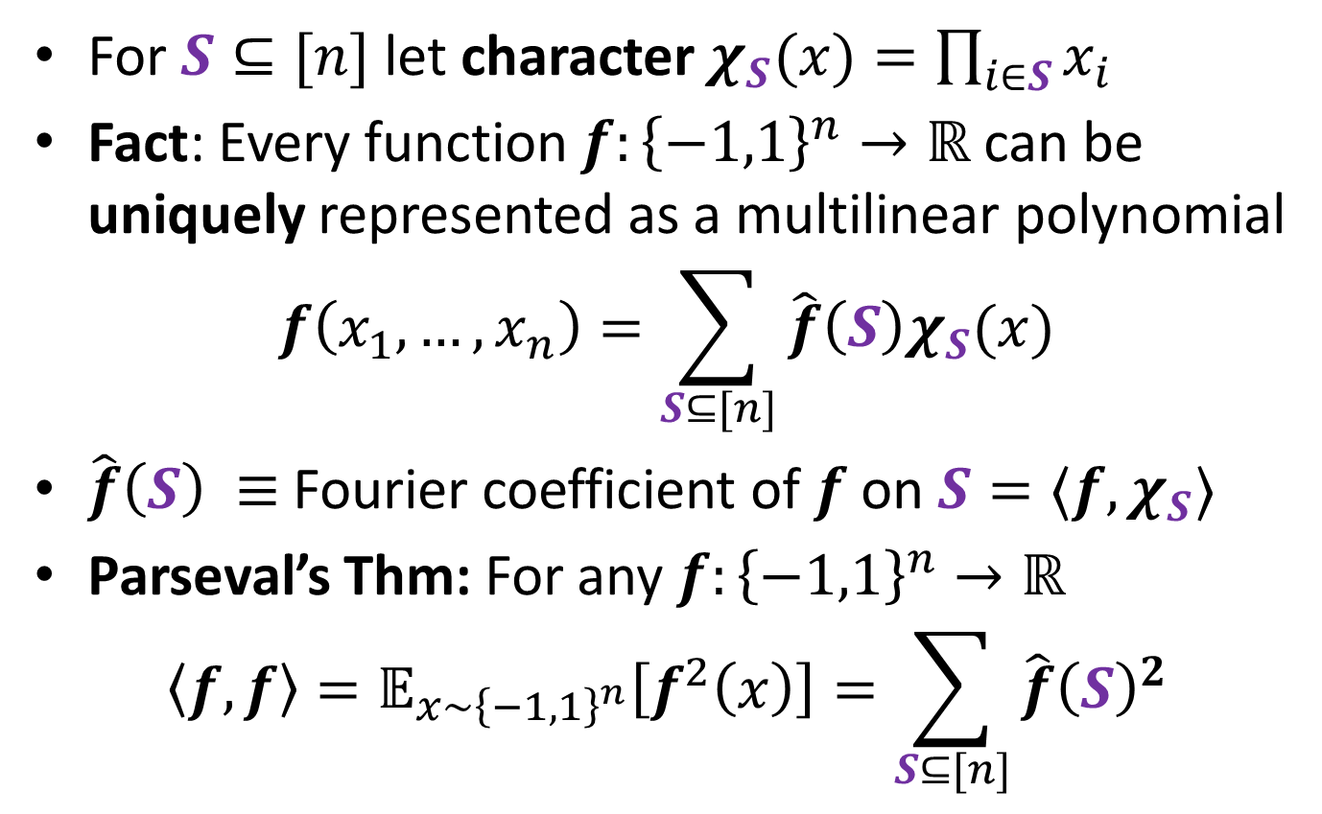
Fourier Analysis
For $S⊆[n]$ let character $χ_{S}(x)=\prod_{i∈S}{x_{i}}$
Fact: Every function $f:{\left\{−1,1\right\}}^{n}→ℝ$ can be uniquely represented as a multilinear polynomial
$$f\left(x_{1}, …, x_{n}\right)=\sum_{S⊆[n]}{\hat{f}\left(S\right)χ_{S}(x)}$$
$\hat{f}\left(S\right) ≡$ Fourier coefficient of $f$ on $S=〈f,χ_{S}〉$
Parseval’s Thm: For any $f:{\left\{−1,1\right\}}^{n}→ℝ$
$$〈f,f〉=𝔼_{x∼{\left\{−1,1\right\}}^{n}}\left[f^{2}\left(x\right)\right]=\sum_{S⊆[n]}{\hat{f}{\left(S\right)}^{2}}$$

Slide 4
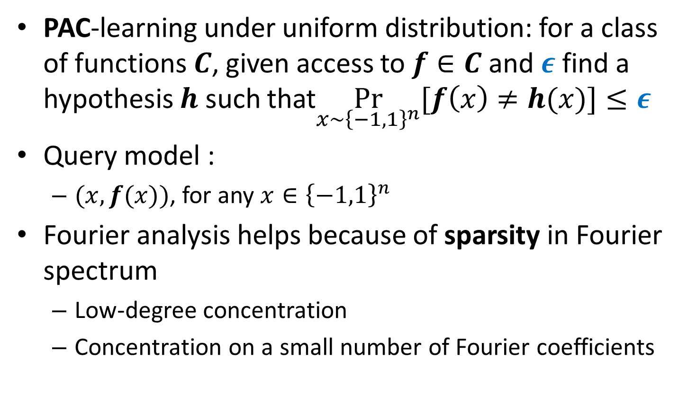
PAC-style learning
PAC-learning under uniform distribution: for a class of functions $C$, given access to $f∈C$ and $ε$ find a hypothesis $h$ such that$\underset{x∼{\left\{−1,1\right\}}^{n}}{Pr}{[f\left(x\right)≠h(x)]}≤ε$
Query model :
$(x, f(x))$, for any $x∈{\left\{−1,1\right\}}^{n}$
Fourier analysis helps because of sparsity in Fourier spectrum
Low-degree concentration
Concentration on a small number of Fourier coefficients

Slide 5
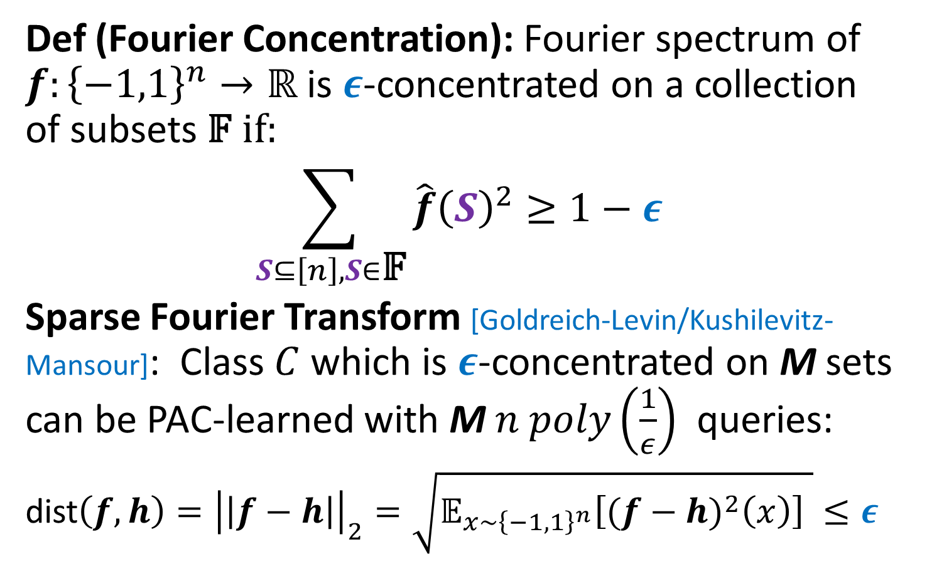
Fourier Analysis and Learning
Def (Fourier Concentration): Fourier spectrum of $f:{\left\{−1,1\right\}}^{n}→ℝ$ is $ε$-concentrated on a collection of subsets 𝔽 if:
$$\sum_{S⊆\left[n\right], S∈\text{𝔽}}{\hat{f}{\left(S\right)}^{2}≥1−ε}$$
Sparse Fourier Transform [Goldreich-Levin/Kushilevitz-Mansour]: Class $C$ which is $ε$-concentrated on M sets can be PAC-learned with $\text{M} n poly\left(\frac{1}{ε}\right)$ queries:
dist$\left(f,h\right)={\left|\left|f−h\right|\right|}_{2}=\sqrt{𝔼_{x∼{\left\{−1,1\right\}}^{n}}\left[{(f−h)}^{2}\left(x\right)\right] }≤ε$

Slide 6
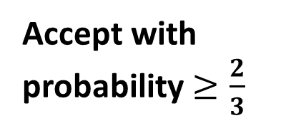







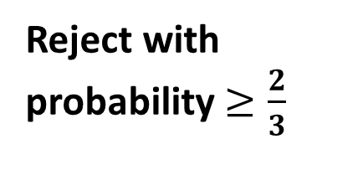
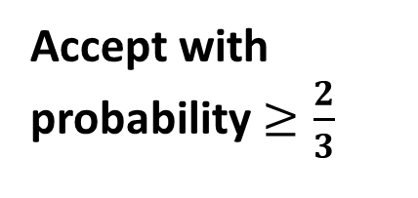

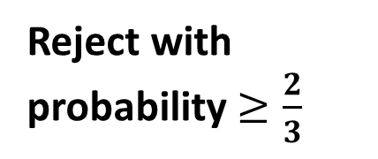


Testing Sparsity in $ℓ_{2}$
Property Tester
Tolerant Property Tester
k-sparse
$$⇒$$
Accept with probability $≥\frac{2}{3}$
k-sparse
$$⇒$$
Accept with probability $≥\frac{2}{3}$
$$⇒$$
Don’t care
$ε$-close
$ε_{1}$-close
NO
$$⇒$$
Don’t care
$$⇒$$
Reject with probability $≥\frac{2}{3}$
$(ε_{1},ε_{2})$-close
NO
$$⇒$$
Reject with probability $≥\frac{2}{3}$
$ε$-close : dist($f$,k-sparse)$=\inf_{g∈\text{k}\text{−}\text{sparse}}{dist(f,g)}≤ε$

Slide 7
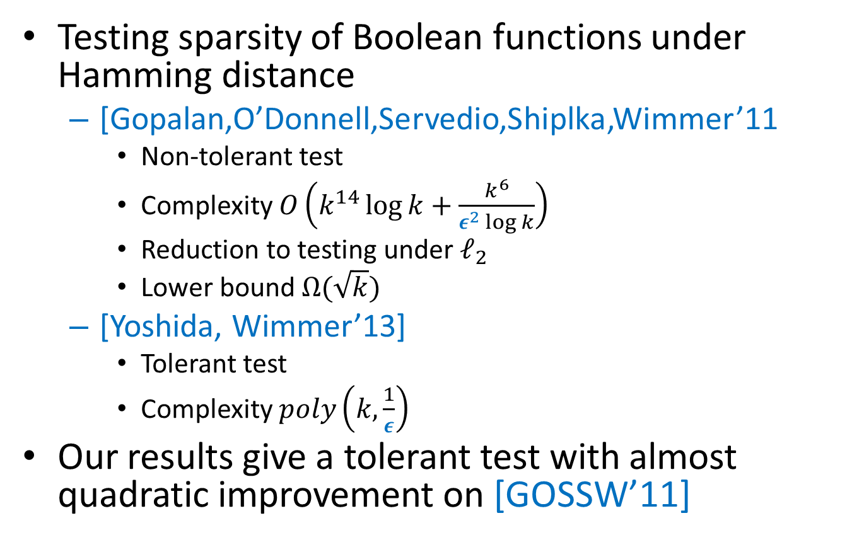
Previous work under Hamming
Testing sparsity of Boolean functions under Hamming distance
[Gopalan,O’Donnell,Servedio,Shiplka,Wimmer’11
Non-tolerant test
Complexity $O\left(k^{14}\log{k}+\frac{k^{6}}{ε^{2}\log{k}}\right)$
Reduction to testing under $ℓ_{2}$
Lower bound $Ω(\sqrt{k})$
[Yoshida, Wimmer’13]
Tolerant test
Complexity $poly\left(k,\frac{1}{ε}\right)$
Our results give a tolerant test with almost quadratic improvement on [GOSSW’11]

Slide 8


Pairwise Independent Hashing
$$∀ S, T\operatorname{Pr}\left[h\left(S\right)=a, h\left(T\right)=b\right]=\operatorname{Pr}\left[h\left(S\right)=a\right]Pr⁡[h\left(T\right)=b]$$

Slide 9


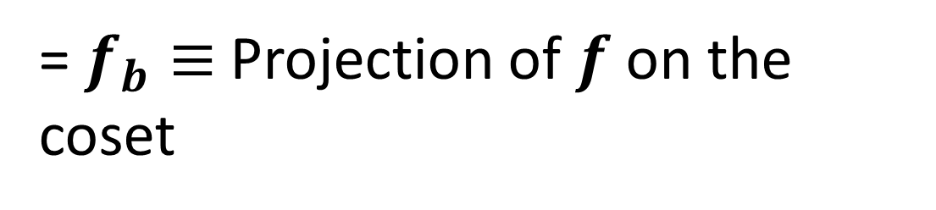
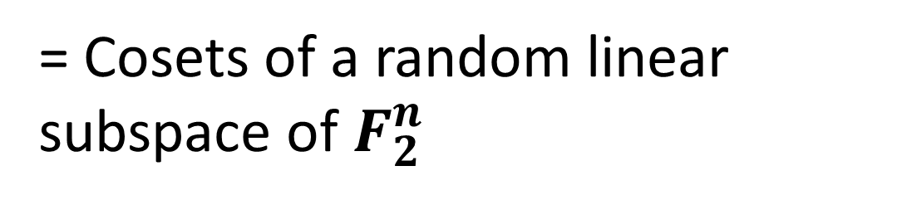
Pairwise Fourier Hashing [FGKP’09]
= Cosets of a random linear subspace of${ F}_{2}^{n}$
= $f_{b}≡$Projection of $f$ on the coset
$${\text{"}\text{Energy}\text{"}=\left|\left|f\right|\right|}_{2}^{2}=\sum_{b}{{\left|\left|f_{b}\right|\right|}_{2}^{2}}$$

Slide 10




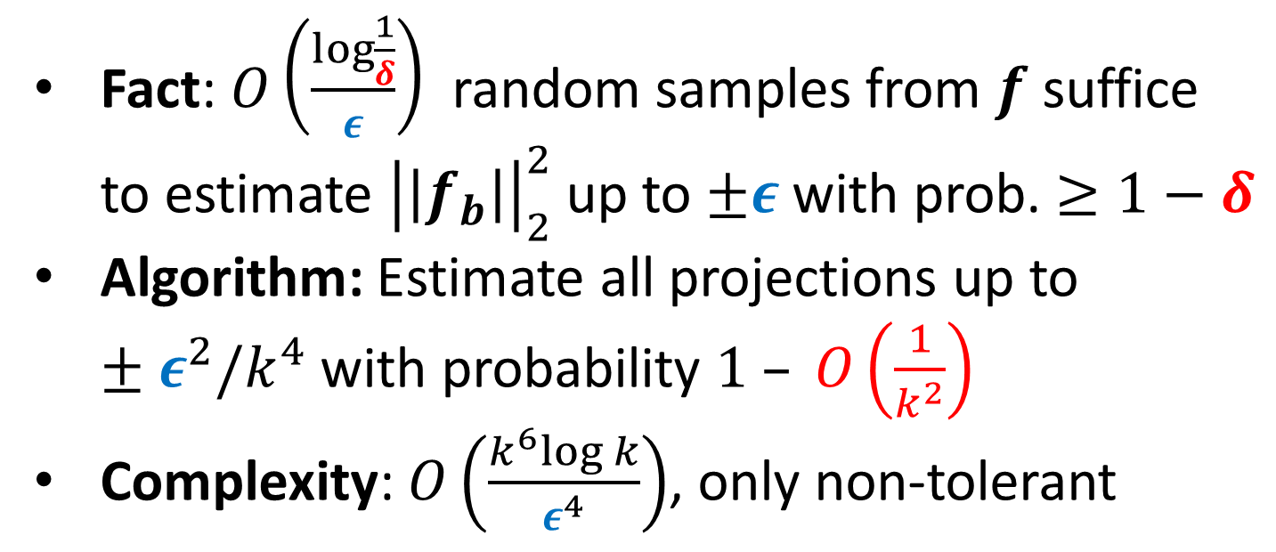
Testing k-sparsity [GOSSW’11]
#
$$= O\left(k^{2}\right)⇒$$
Fact: $O\left(\frac{\log{\frac{1}{δ}}}{ε}\right)$ random samples from $f$ suffice to estimate ${\left|\left|f_{b}\right|\right|}_{2}^{2}$ up to $±ε$with prob. $≥1−δ$
Algorithm: Estimate all projections up to $±ε^{2}/k^{4}$ with probability $1 – O\left(\frac{1}{k^{2}}\right)$
Complexity: $O\left(\frac{k^{6}log k}{ε^{4}}\right)$, only non-tolerant

Slide 11
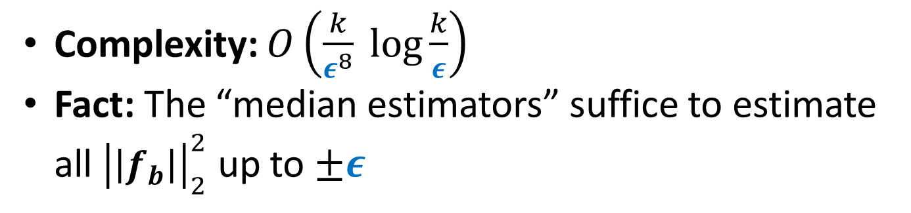
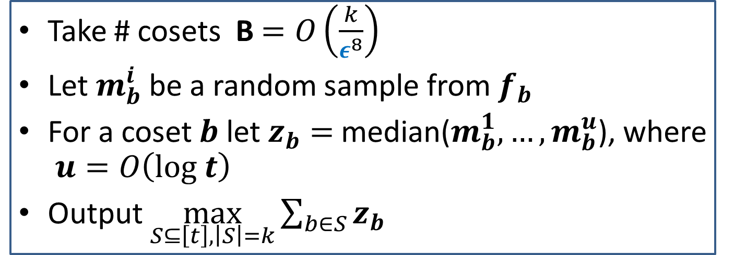
Our Algorithm
Take # cosets B $=O\left(\frac{k}{ε^{8}}\right)$
Let $m_{b}^{i}$ be a random sample from $f_{b}$
For a coset $b$ let $z_{b}=$ median($m_{b}^{1}, …,m_{b}^{u}$), where $u=O\left(log t\right)$
Output $\max_{S⊆\left[t\right], \left|S\right|=k}\sum_{b∈S}{z_{b}}$
Complexity: $O\left(\frac{k}{ε^{8}} log\frac{k}{ε}\right)$
Fact: The “median estimators” suffice to estimate all ${\left|\left|f_{b}\right|\right|}_{2}^{2}$ up to $±ε$

Slide 12

Analysis
Take # cosets B $=O\left(\frac{k}{ε^{8}}\right)$
Let $m_{b}^{i}$ be a random sample from $f_{b}$
For a coset $b$ let $z_{b}=$ median($m_{b}^{1}, …,m_{b}^{u}$), where $u=O\left(log t\right)$
Output $\max_{S⊆\left[t\right], \left|S\right|=k}\sum_{b∈S}{z_{b}}$
Two main challenges
Top-k coefficients may collide
Noise from non top-k coefficients

Slide 13
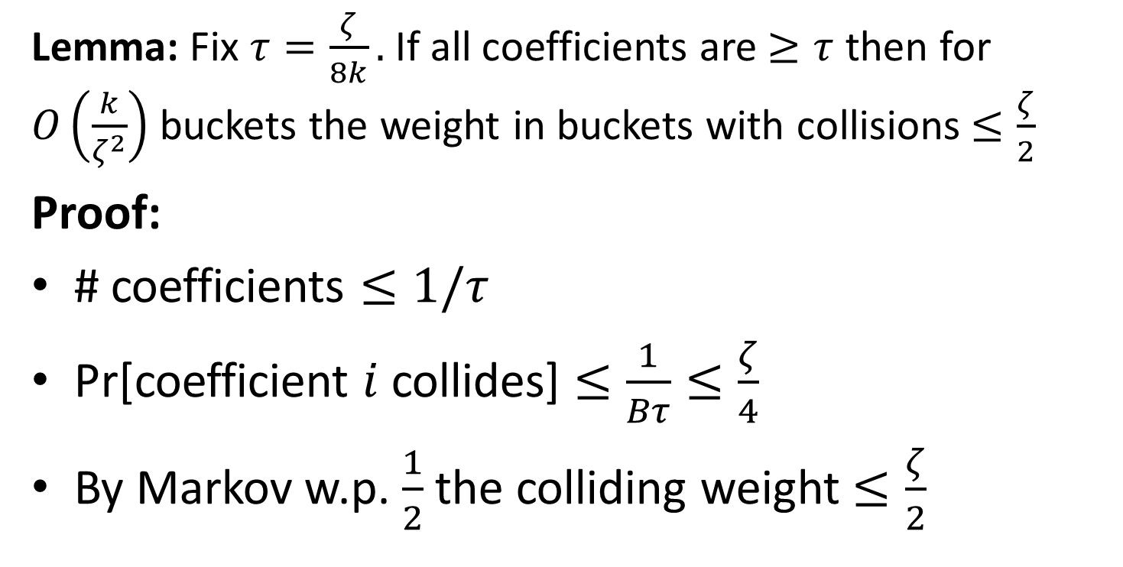
Analysis: Large coefficients
Lemma: Fix $τ=\frac{ζ}{8k}.$ If all coefficients are $≥τ$ then for $O\left(\frac{k}{ζ^{2}}\right)$ buckets the weight in buckets with collisions $≤\frac{ζ}{2}$
Proof:
# coefficients $≤1/τ$
Pr[coefficient $i$ collides] $≤\frac{1}{Bτ}≤\frac{ζ}{4}$
By Markov w.p. $\frac{1}{2}$ the colliding weight $≤\frac{ζ}{2}$

Slide 14
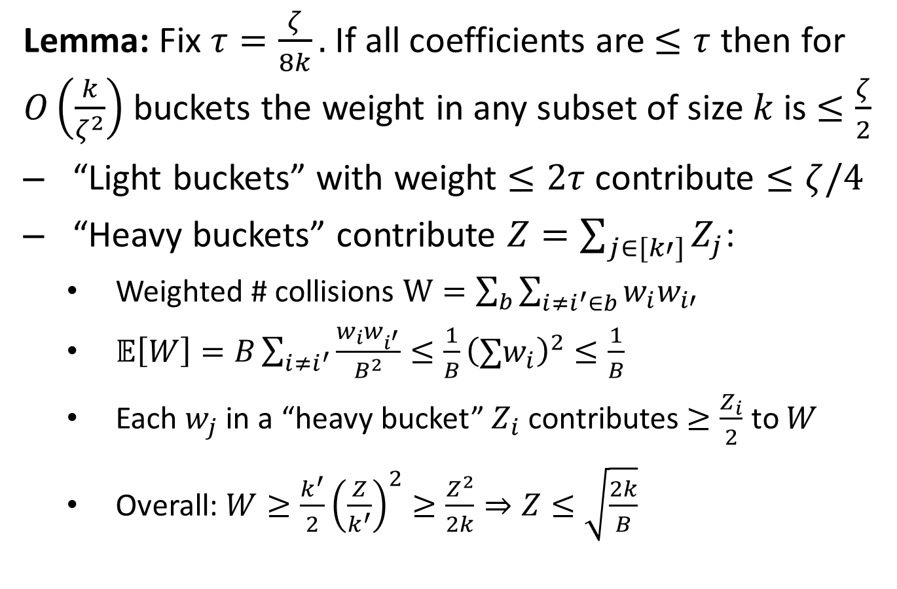
Analysis: Small coefficients
Lemma: Fix $τ=\frac{ζ}{8k}.$ If all coefficients are $≤τ$ then for $O\left(\frac{k}{ζ^{2}}\right)$ buckets the weight in any subset of size $k$ is $≤\frac{ζ}{2}$
“Light buckets” with weight $≤2τ$ contribute $≤ζ/4$
“Heavy buckets” contribute $Z=\sum_{j∈[k′]}{Z_{j}}$:
Weighted # collisions $W=\sum_{b}{\sum_{i≠i^{′}∈b}{w_{i}w_{i′}}}$
$𝔼\left[W\right]=B\sum_{i≠i^{′}}{\frac{w_{i}w_{i^{′}}}{B^{2}}≤\frac{1}{B}{\left(∑w_{i}\right)}^{2}≤\frac{1}{B}}$
Each $w_{j}$ in a “heavy bucket” $Z_{i}$ contributes $≥\frac{Z_{i}}{2}$ to $W$
Overall: $W≥\frac{k^{′}}{2}{\left(\frac{Z}{k^{′}}\right)}^{2}≥\frac{Z^{2}}{2k}⇒Z≤\sqrt{\frac{2k}{B}}$

Slide 15
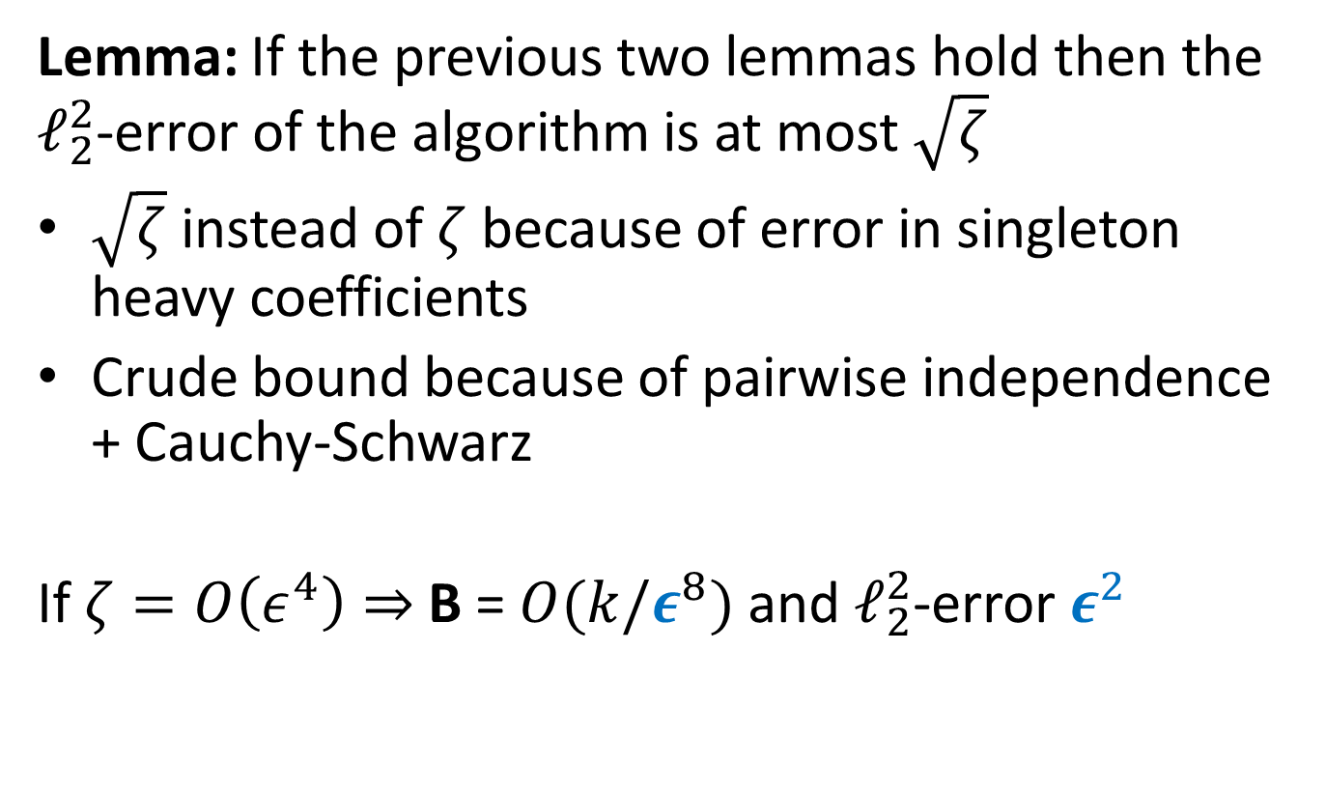
Analysis: Putting it together
Lemma: If the previous two lemmas hold then the $ℓ_{2}^{2}$-error of the algorithm is at most $\sqrt{ζ}$
$\sqrt{ζ}$ instead of $ζ$ because of error in singleton heavy coefficients
Crude bound because of pairwise independence + Cauchy-Schwarz
If $ζ=O\left(ε^{4}\right)⇒$B = $O(k/ε^{8})$ and $ℓ_{2}^{2}$-error $ε^{2}$

Slide 16
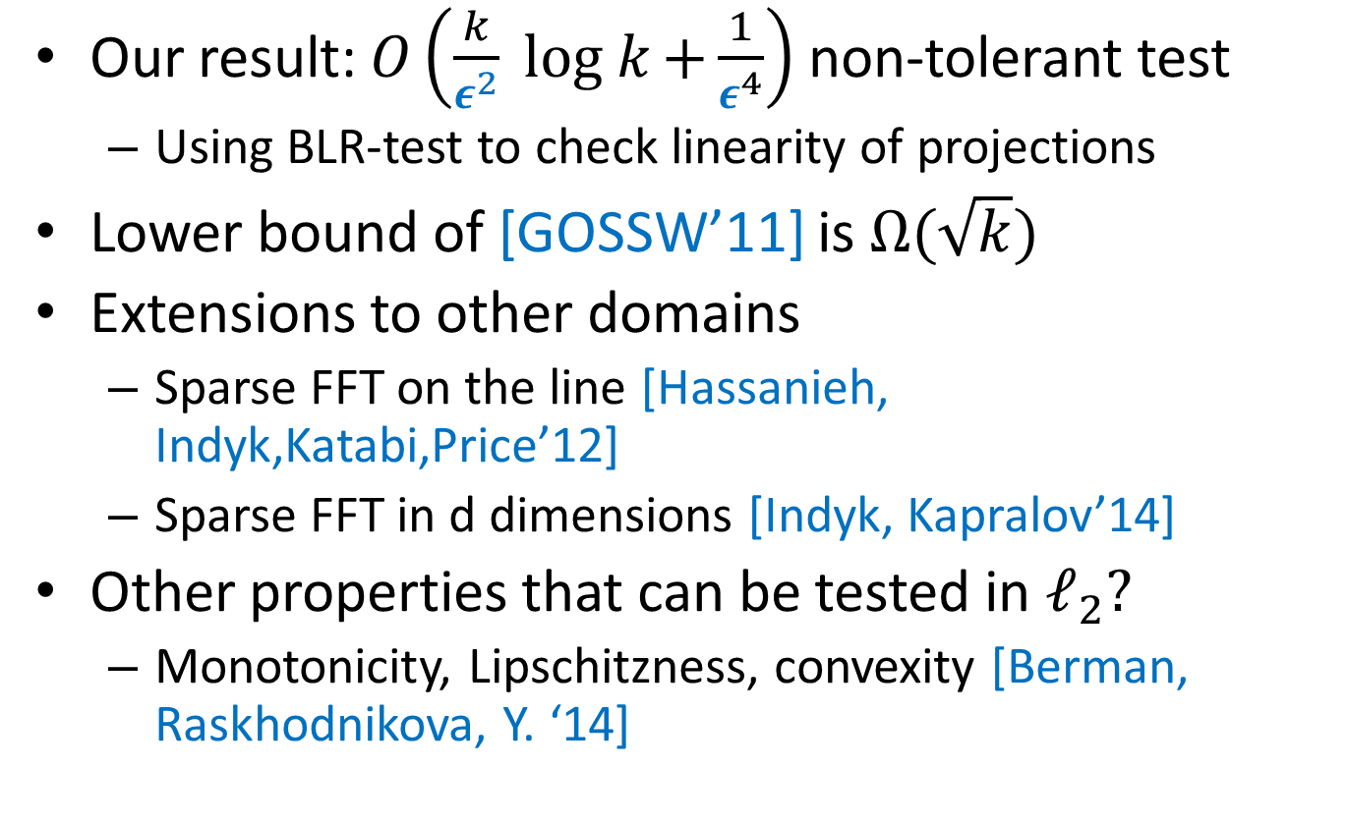
Other results + Open Problems
Our result: $O\left(\frac{k}{ε^{2}} log k{+\frac{1}{ε^{4}}}\right)$ non-tolerant test
Using BLR-test to check linearity of projections
Lower bound of [GOSSW’11] is $Ω(\sqrt{k})$
Extensions to other domains
Sparse FFT on the line [Hassanieh, Indyk,Katabi,Price’12]
Sparse FFT in d dimensions [Indyk, Kapralov’14]
Other properties that can be tested in $ℓ_{2}?$
Monotonicity, Lipschitzness, convexity [Berman, Raskhodnikova, Y. ‘14]
Notes:
Mention HIKIP

