Slide 1

Learning and Fourier Analysis
Grigory Yaroslavtsev
http://grigory.us
Slides at http://grigory.us/cis625/lecture2.pdf
CIS 625: Computational Learning Theory

Slide 2
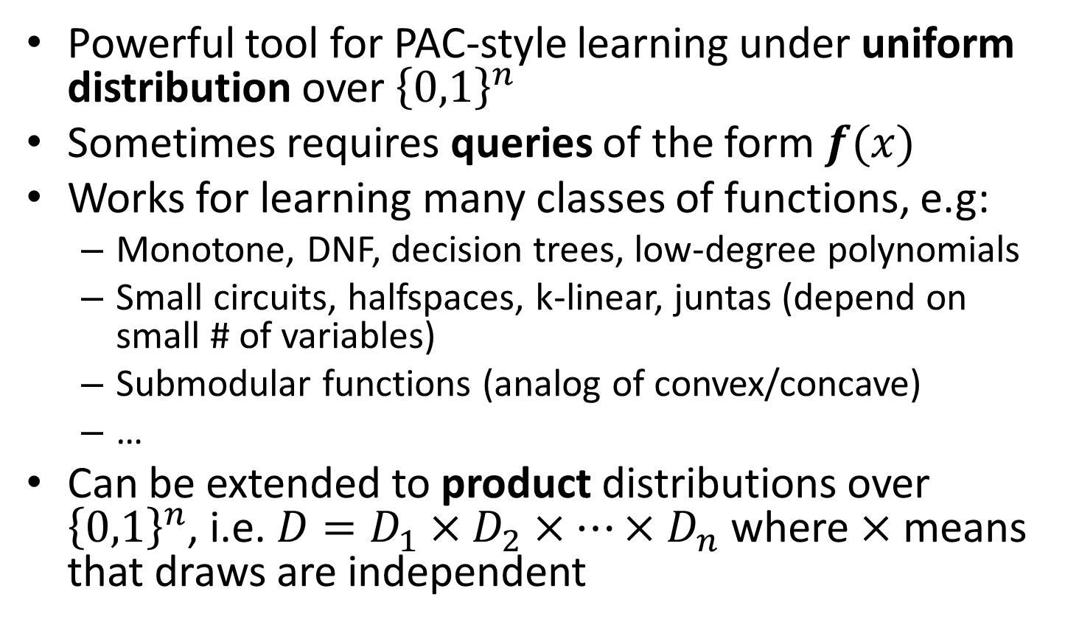
Fourier Analysis and Learning
Powerful tool for PAC-style learning under uniform distribution over ${\left\{0,1\right\}}^{n}$
Sometimes requires queries of the form $f(x)$
Works for learning many classes of functions, e.g:
Monotone, DNF, decision trees, low-degree polynomials
Small circuits, halfspaces, k-linear, juntas (depend on small # of variables)
Submodular functions (analog of convex/concave)
…
Can be extended to product distributions over ${\left\{0,1\right\}}^{n}$, i.e. $D=D_{1}×D_{2}×⋯×D_{n}$ where $×$ means that draws are independent

Slide 3
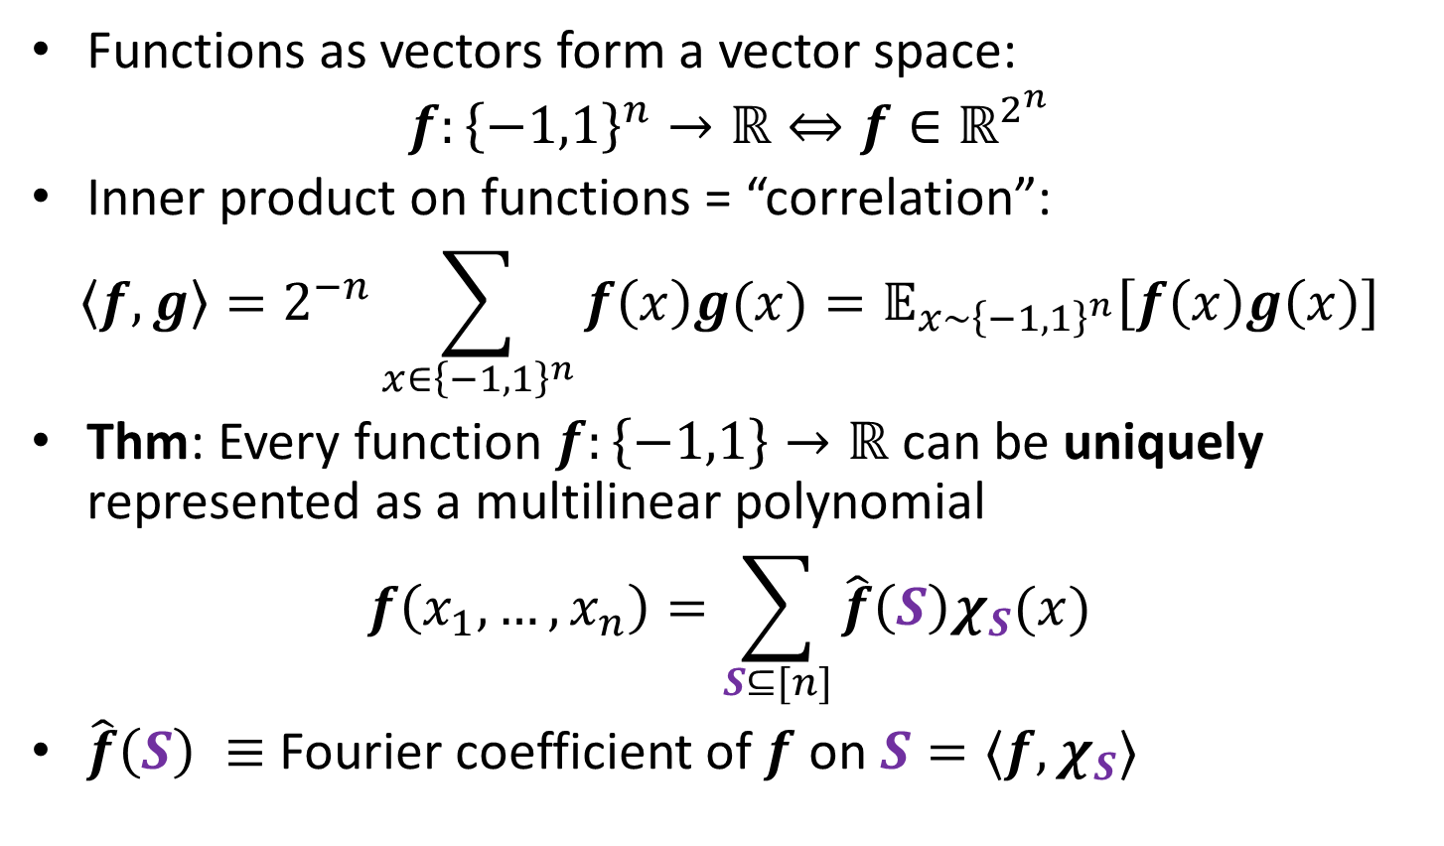
Recap: Fourier Analysis
Functions as vectors form a vector space:
$$f:{\left\{−1,1\right\}}^{n}→ℝ⇔f∈ℝ^{2^{n}}$$
Inner product on functions = “correlation”:
$$〈f,g〉=2^{−n}\sum_{x∈{\left\{−1,1\right\}}^{n}}{f\left(x\right)g(x)}=𝔼_{x∼{\left\{−1,1\right\}}^{n}}\left[f\left(x\right)g\left(x\right)\right]$$
Thm: Every function $f:\left\{−1,1\right\}→ℝ$ can be uniquely represented as a multilinear polynomial
$$f\left(x_{1}, …, x_{n}\right)=\sum_{S⊆[n]}{\hat{f}\left(S\right)χ_{S}(x)}$$
$\hat{f}\left(S\right) ≡$ Fourier coefficient of $f$ on $S=〈f,χ_{S}〉$

Slide 4
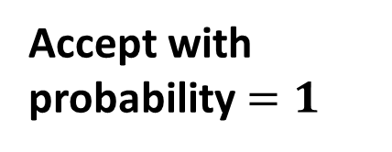





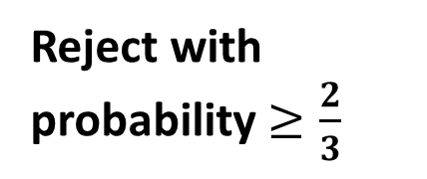
Linearity Testing
$f:{\left\{0,1\right\}}^{n}→\{0,1\}$
$P$ = class of linear functions
$dist\left(f,P\right)=\min_{g∈P} dist(f,g)$
$ε$-close: $dist\left(f,P\right)≤ε$
Linearity Tester
Linear
$$⇒$$
Accept with probability $=1$
$$⇒$$
$ε$-close
Don’t care
Non-linear
$$⇒$$
Reject with probability $≥\frac{2}{3}$

Slide 5
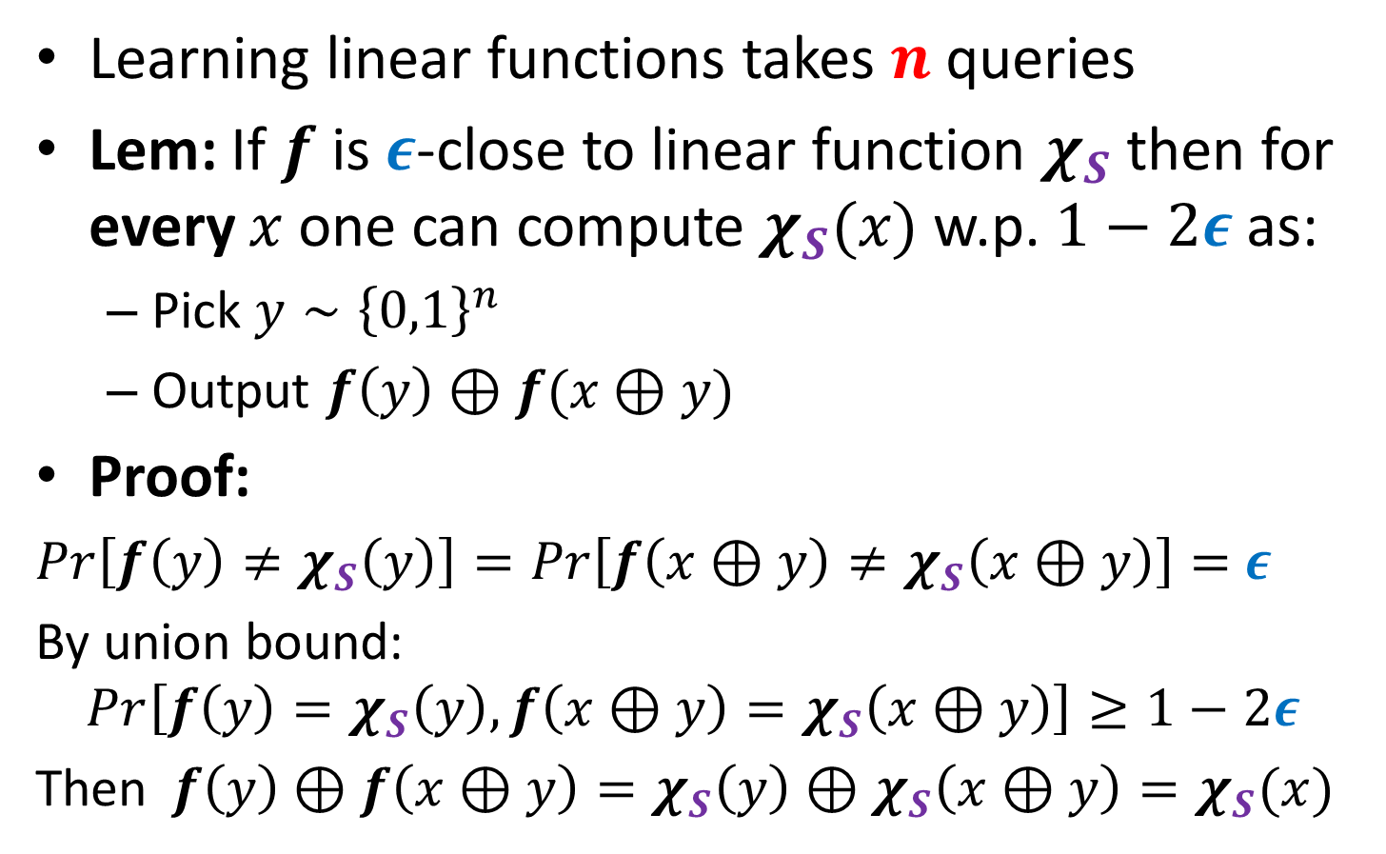
Local Correction
Learning linear functions takes $n$ queries
Lem: If $f$ is $ε$-close to linear function $χ_{S}$ then for every $x$ one can compute $χ_{S}(x)$ w.p. $1−2ε$as:
Pick $y∼{\left\{0,1\right\}}^{n}$
Output $f\left(y\right)⊕f(x⊕y)$
Proof:
$Pr\left[f\left(y\right)≠χ_{S}\left(y\right)\right]=Pr\left[f\left(x⊕y\right)≠χ_{S}\left(x⊕y\right)\right]=$ $ε$
By union bound:
$$Pr\left[f\left(y\right)=χ_{S}\left(y\right),f\left(x⊕y\right)=χ_{S}\left(x⊕y\right)\right]≥1−2ε$$
Then$f\left(y\right)⊕f\left(x⊕y\right)=χ_{S}\left(y\right)⊕χ_{S}\left(x⊕y\right)=χ_{S}(x)$

Slide 6
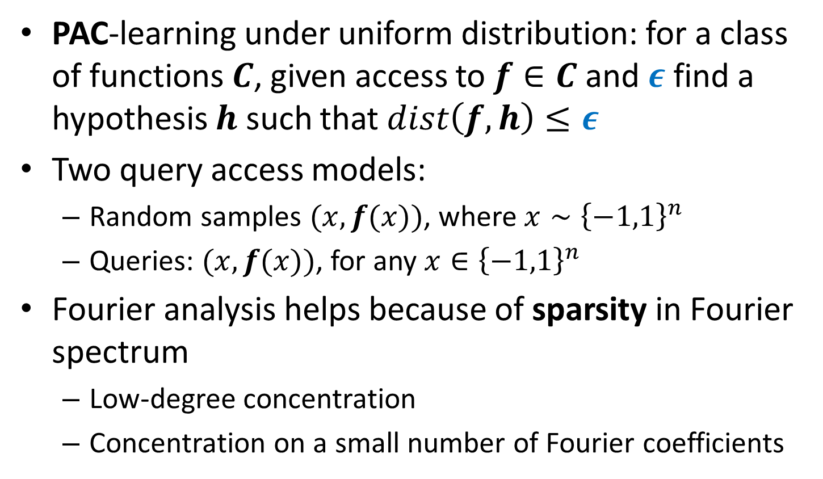
Recap: PAC-style learning
PAC-learning under uniform distribution: for a class of functions $C$, given access to $f∈C$ and $ε$ find a hypothesis $h$ such that $dist\left(f,h\right)≤ε$
Two query access models:
Random samples $(x, f(x))$, where $x∼{\left\{−1,1\right\}}^{n}$
Queries: $(x, f(x))$, for any $x∈{\left\{−1,1\right\}}^{n}$
Fourier analysis helps because of sparsity in Fourier spectrum
Low-degree concentration
Concentration on a small number of Fourier coefficients

Slide 7
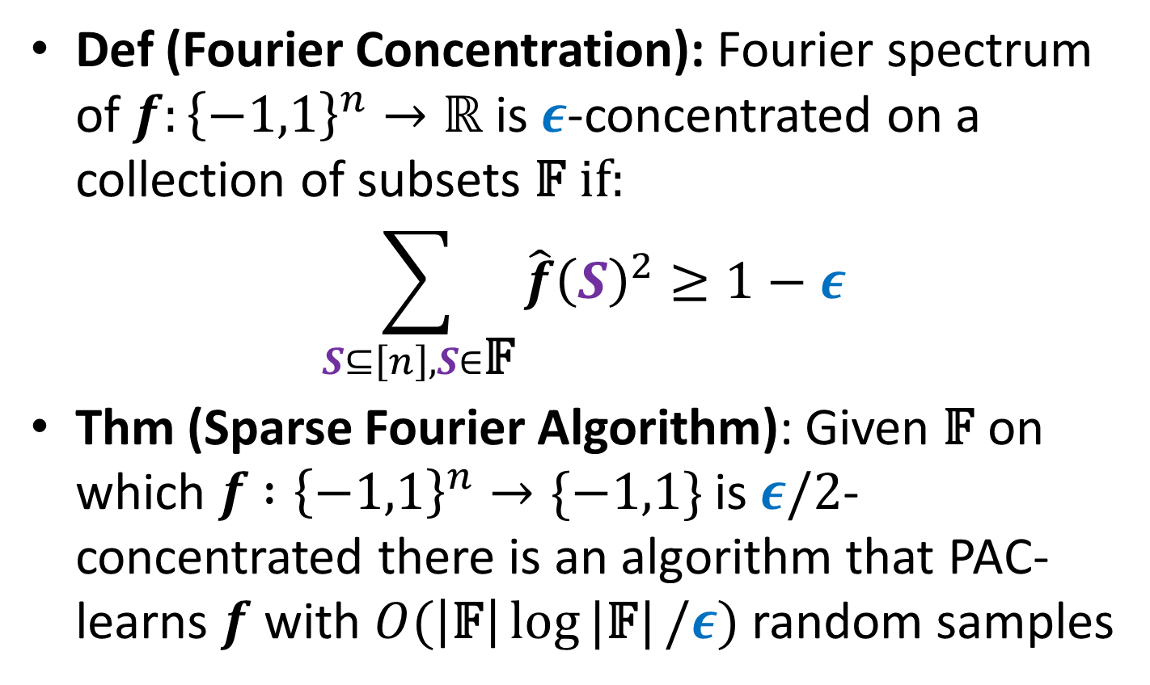
Fourier Analysis and Learning
Def (Fourier Concentration): Fourier spectrum of $f:{\left\{−1,1\right\}}^{n}→ℝ$ is $ε$-concentrated on a collection of subsets 𝔽 if:
$$\sum_{S⊆\left[n\right], S∈\text{𝔽}}{\hat{f}{\left(S\right)}^{2}≥1−ε}$$
Thm (Sparse Fourier Algorithm): Given 𝔽 on which $f$ $:{\left\{−1,1\right\}}^{n}→\{−1,1\}$ is $ε/2$-concentrated there is an algorithm that PAC-learns $f$ with $O(\left|\text{𝔽}\right|\log{|\text{𝔽}|}/ε)$ random samples

Slide 8
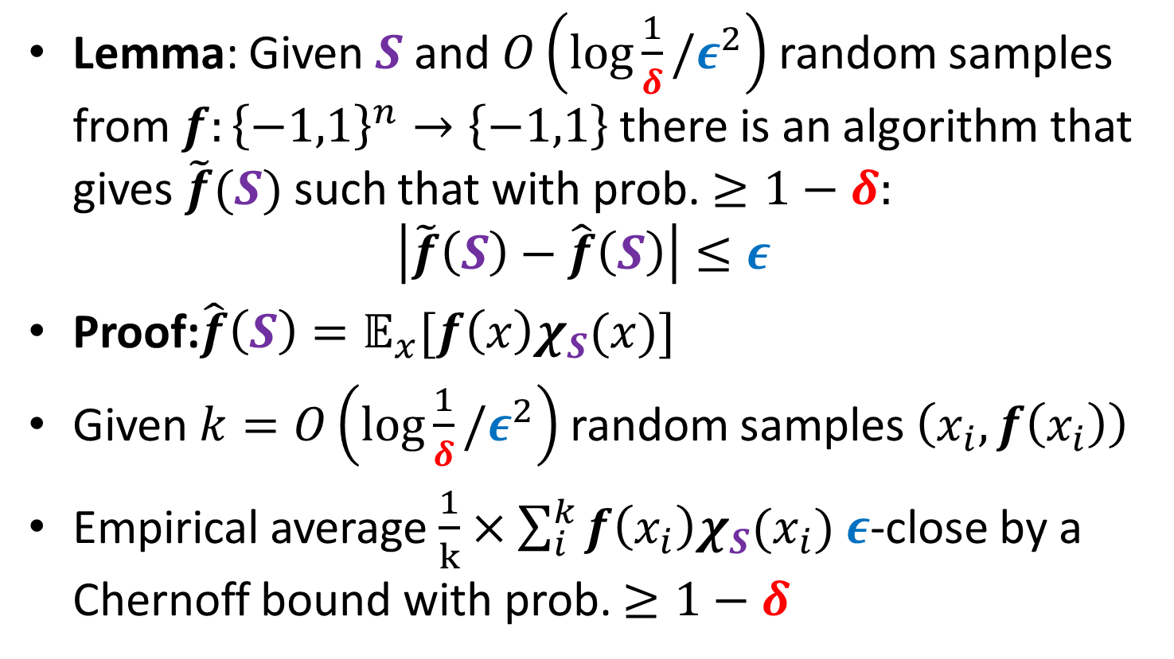
Estimating Fourier Coefficients
Lemma: Given $S$ and $O\left(\log{\frac{1}{δ}}/ε^{2}\right)$ random samples from $f:{\left\{−1,1\right\}}^{n}→\left\{−1,1\right\}$ there is an algorithm that gives $\tilde{f}(S)$ such that with prob. $≥1−δ:$
$$\left|\tilde{f}\left(S\right)−\hat{f}\left(S\right)\right|≤ε$$
Proof:$\hat{f}\left(S\right)=𝔼_{x}[f\left(x\right)χ_{S}(x)]$
Given $k=O\left(\log{\frac{1}{δ}}/ε^{2}\right)$ random samples $\left(x_{i},f\left(x_{i}\right)\right)$
Empirical average $\frac{1}{k}×\sum_{i}^{k}{f\left(x_{i}\right)χ_{S}(x_{i})}$ $ε$-close by a Chernoff bound with prob. $≥1−δ$

Slide 9
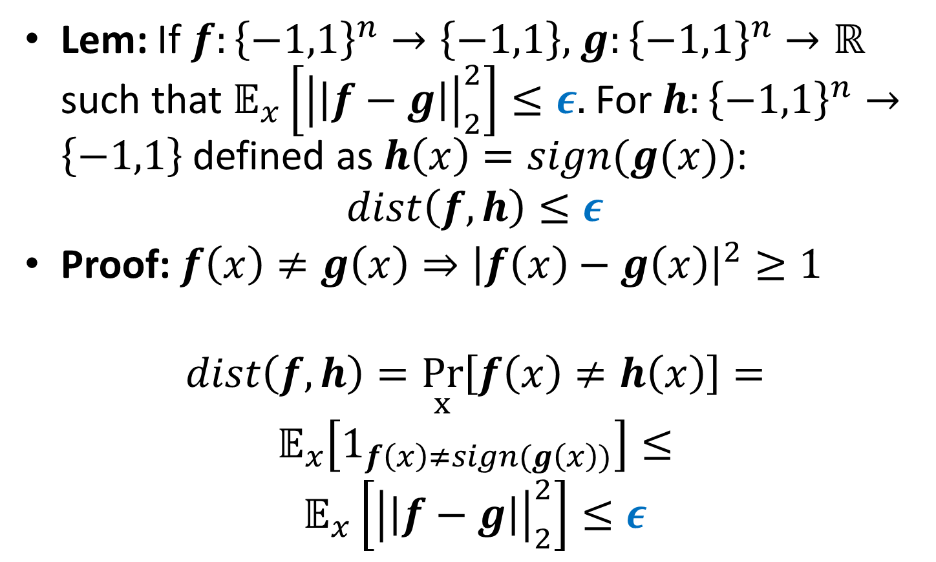
Rounding real-valued approximations
Lem: If $f:{\left\{−1,1\right\}}^{n}→\left\{−1,1\right\},$ $g:{\left\{−1,1\right\}}^{n}→ℝ$ such that $𝔼_{x}\left[{\left|\left|f−g\right|\right|}_{2}^{2}\right]≤ε.$ For $h:{\left\{−1,1\right\}}^{n}→\left\{−1,1\right\}$ defined as$h\left(x\right)=sign(g(x))$:
$$dist\left(f,h\right)≤ε$$
Proof: $f\left(x\right)≠g\left(x\right)⇒{\left|f\left(x\right)−g\left(x\right)\right|}^{2}≥1$
$$dist\left(f,h\right)=\underset{x}{Pr}\left[f\left(x\right)≠h\left(x\right)\right]=$$
$$𝔼_{x}\left[1_{f\left(x\right)≠sign(g\left(x\right))}\right]≤$$
$$𝔼_{x}\left[{\left|\left|f−g\right|\right|}_{2}^{2}\right]≤ε$$

Slide 10
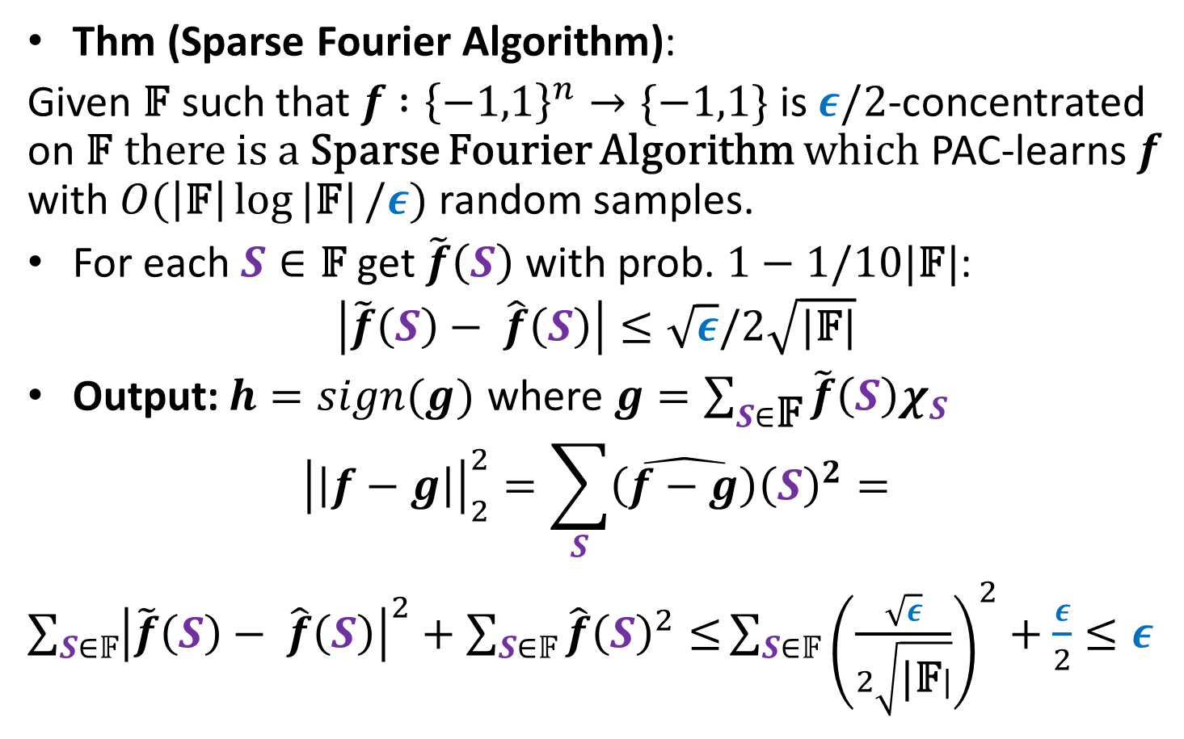
Sparse Fourier Algorithm
Thm (Sparse Fourier Algorithm):
Given 𝔽 such that $f$ $:{\left\{−1,1\right\}}^{n}→\{−1,1\}$ is $ε/2$-concentrated on 𝔽 there is a Sparse Fourier Algorithm which PAC-learns $f$ with $O(\left|\text{𝔽}\right|\log{|\text{𝔽}|}/ε)$ random samples.
For each $S∈\text{𝔽}$ get $\tilde{f}\left(S\right)$ with prob. $1−1/10\text{|}\text{𝔽}|$:
$$\left|\tilde{f}\left(S\right)− \hat{f}\left(S\right)\right|≤\sqrt{ε}/2\sqrt{\text{|}\text{𝔽}|}$$
Output:$h=sign(g)$ where $g=\sum_{S∈\text{𝔽}}{\tilde{f}\left(S\right)χ_{S}}$
$${\left|\left|f−g\right|\right|}_{2}^{2}=\sum_{S}{\hat{\left(f−g\right)}{\left(S\right)}^{2}}=$$
$\sum_{S∈𝔽}{{\left|\tilde{f}\left(S\right)− \hat{f}\left(S\right)\right|}^{2}+}$ $\sum_{S∈𝔽}{\hat{f}{\left(S\right)}^{2}≤}\sum_{S∈𝔽}{{\left(\frac{\sqrt{ε}}{2\sqrt{\text{|}\text{𝔽}|}}\right)}^{2}+\frac{ε}{2}}≤ε$

Slide 11
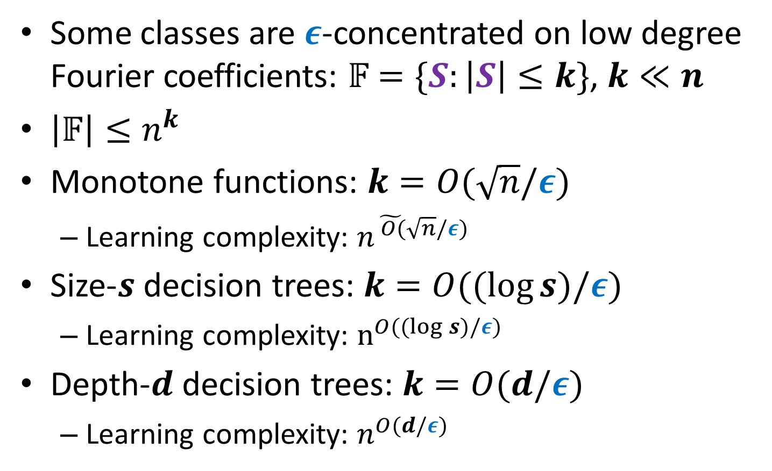
Low-Degree Algorithm
Some classes are $ε$-concentrated on low degree Fourier coefficients: 𝔽$=\{S:\left|S\right|≤k\}$, $k≪n$
$\left|𝔽\right|≤n^{k}$
Monotone functions: $k=O(\sqrt{n}/ε)$
Learning complexity: $n^{\tilde{ O(}\sqrt{n}/ε)}$
Size-$s$ decision trees: $k=O((log{s})/ε)$
Learning complexity: $n^{O((log{s})/ε)}$
Depth-$d$ decision trees: $k=O(d/ε)$
Learning complexity: $n^{O(d/ε)}$

Slide 12
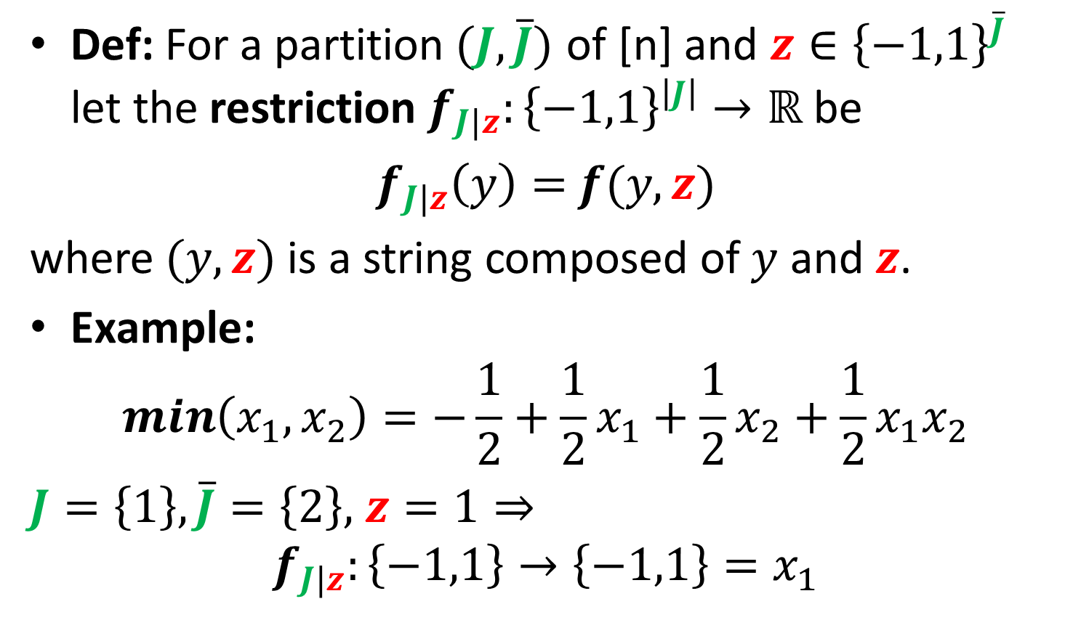
Restrictions
Def: For a partition$(J,\overline{J})$ of [n] and $z∈{\left\{−1,1\right\}}^{\overline{J}}$ let the restriction $f_{J|z}:{\left\{−1,1\right\}}^{\left|J\right|}→ℝ$be
$f_{J|z}\left(y\right)=$ $f(y,z)$
where $(y,z)$ is a string composed of $y$ and $z$.
Example:
$$\min\left(x_{1},x_{2}\right)=−\frac{1}{2}+\frac{1}{2}x_{1}+\frac{1}{2}x_{2}+\frac{1}{2}x_{1}x_{2}$$
$J=\left\{1\right\},\overline{J}=\left\{2\right\},$ $z=1⇒$
$$f_{J|z}:\left\{−1,1\right\}→\left\{−1,1\right\}=x_{1}$$

Slide 13
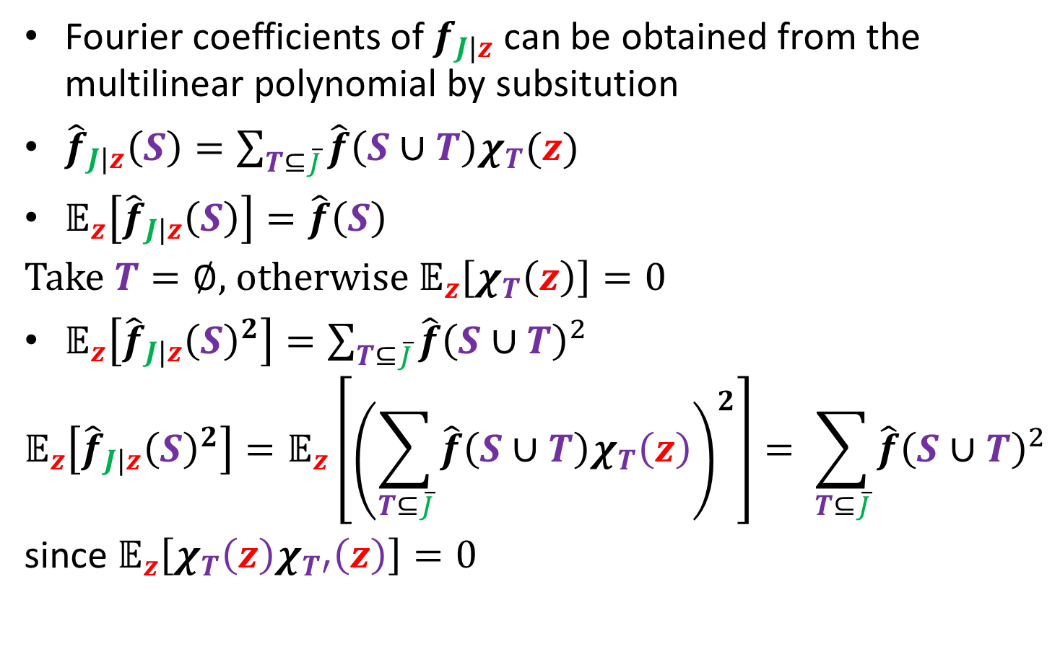
Fourier coefficients of restrictions
Fourier coefficients of $f_{J|z}$ can be obtained from the multilinear polynomial by subsitution
${\hat{f}}_{J|z}\left(S\right)=\sum_{T⊆\overline{J}}{\hat{f}\left(S∪T\right)χ_{T}(z)}$
$𝔼_{z}\left[{\hat{f}}_{J|z}\left(S\right)\right]=\hat{f}\left(S\right)$
Take $T=∅$, otherwise $𝔼_{z}\left[χ_{T}\left(z\right)\right]=0$
$𝔼_{z}\left[{\hat{f}}_{J|z}{\left(S\right)}^{2}\right]=\sum_{T⊆\overline{J}}{\hat{f}{\left(S∪T\right)}^{2}}$
$$𝔼_{z}\left[{\hat{f}}_{J|z}{\left(S\right)}^{2}\right]=𝔼_{z}\left[{\left(\sum_{T⊆\overline{J}}{\hat{f}\left(S∪T\right)χ_{T}\left(z\right)}\right)}^{2}\right]= \sum_{T⊆\overline{J}}{\hat{f}{\left(S∪T\right)}^{2}}$$
since $𝔼_{z}\left[χ_{T}\left(z\right)χ_{T′}\left(z\right)\right]=0$

Slide 14
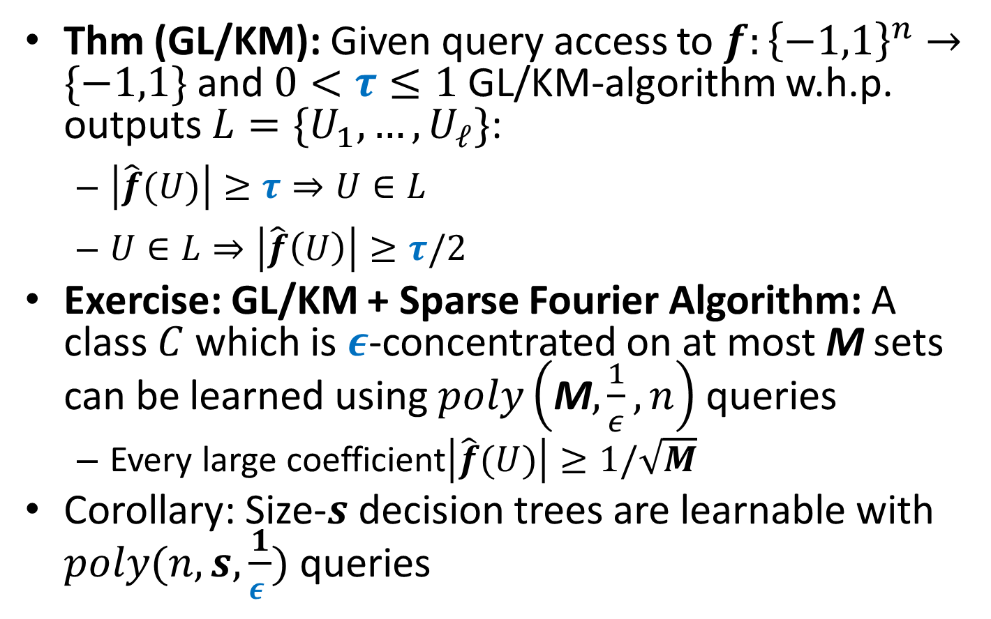
Goldreich-Levin/Kushilevitz-Mansour
Thm (GL/KM): Given query access to $f:{\left\{−1,1\right\}}^{n}→\{−1,1\}$ and $0<τ≤1$ GL/KM-algorithm w.h.p. outputs $L=\{U_{1},…,U_{ℓ}\}$:
$\left|\hat{f}(U)\right|≥τ⇒U∈L$
$U∈L⇒\left|\hat{f}\left(U\right)\right|≥τ/2$
Exercise: GL/KM + Sparse Fourier Algorithm: A class $C$ which is $ε$-concentrated on at most M sets can be learned using $poly\left(\text{M},\frac{1}{ε},n\right)$ queries
Every large coefficient$\left|\hat{f}(U)\right|≥1/\sqrt{M}$
Corollary: Size-$s$ decision trees are learnable with $poly(n,s,\frac{1}{ε })$ queries

Slide 15
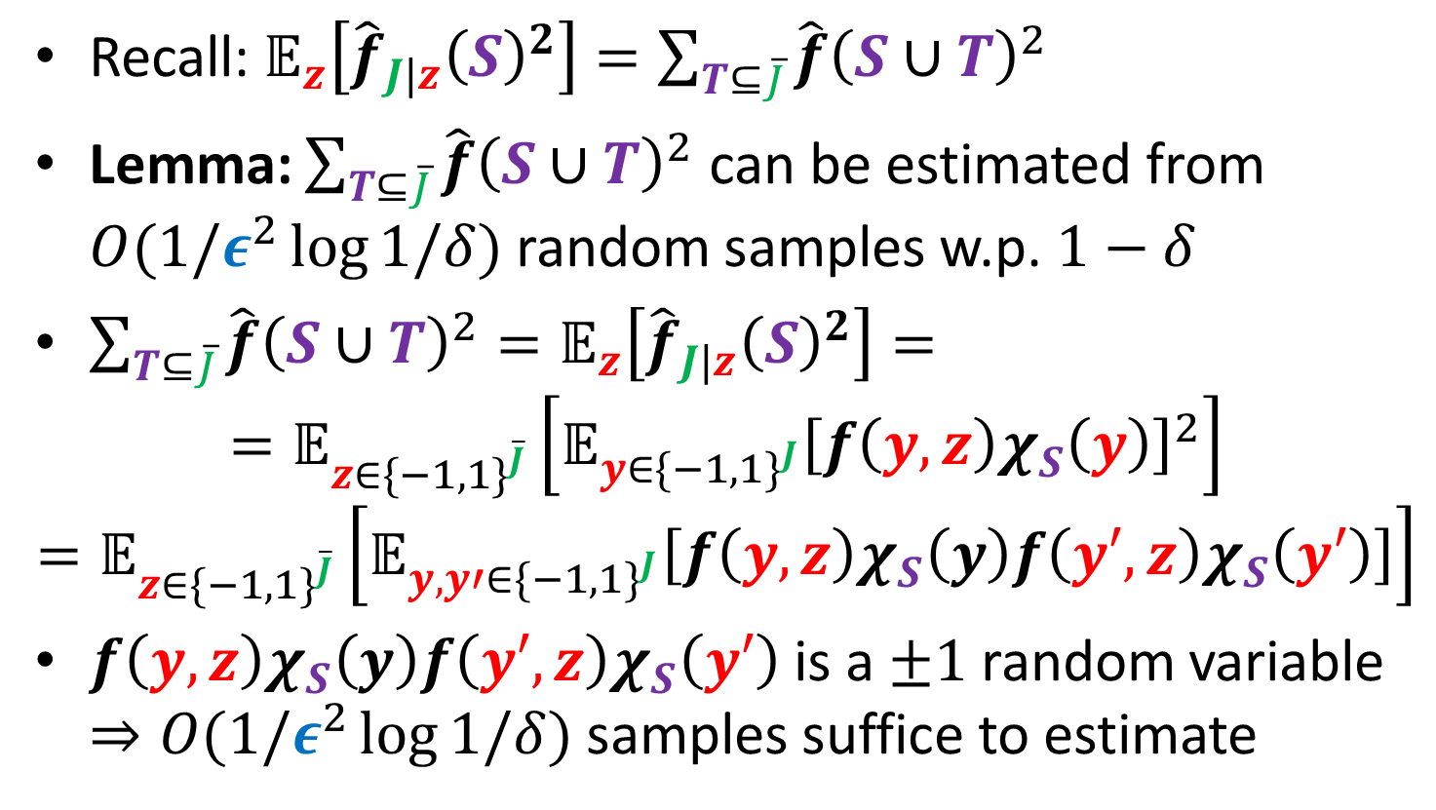
Estimating Fourier Weight via Restrictions
Recall: $𝔼_{z}\left[{\hat{f}}_{J|z}{\left(S\right)}^{2}\right]=\sum_{T⊆\overline{J}}{\hat{f}{\left(S∪T\right)}^{2}}$
Lemma: $\sum_{T⊆\overline{J}}{\hat{f}{\left(S∪T\right)}^{2}}$ can be estimated from $O(1/ε^{2}\log{1/δ})$ random samples w.p. $1−δ$
$\sum_{T⊆\overline{J}}{\hat{f}{\left(S∪T\right)}^{2}}=𝔼_{z}\left[{\hat{f}}_{J|z}{\left(S\right)}^{2}\right]=$
$$=𝔼_{z{∈\{−1,1\}}^{\overline{J}}}\left[𝔼_{y{∈\{−1,1\}}^{J}}{\left[f\left(y,z\right)χ_{S}\left(y\right)\right]}^{2}\right]$$
$$=𝔼_{z{∈\{−1,1\}}^{\overline{J}}}\left[𝔼_{y,y′{∈\{−1,1\}}^{J}}\left[f\left(y,z\right)χ_{S}\left(y\right)f\left(y′,z\right)χ_{S}\left(y′\right)\right]\right]$$
$f\left(y,z\right)χ_{S}\left(y\right)f\left(y′,z\right)χ_{S}\left(y′\right)$ is a $±1$ random variable $⇒O(1/ε^{2}\log{1/δ})$ samples suffice to estimate

Slide 16
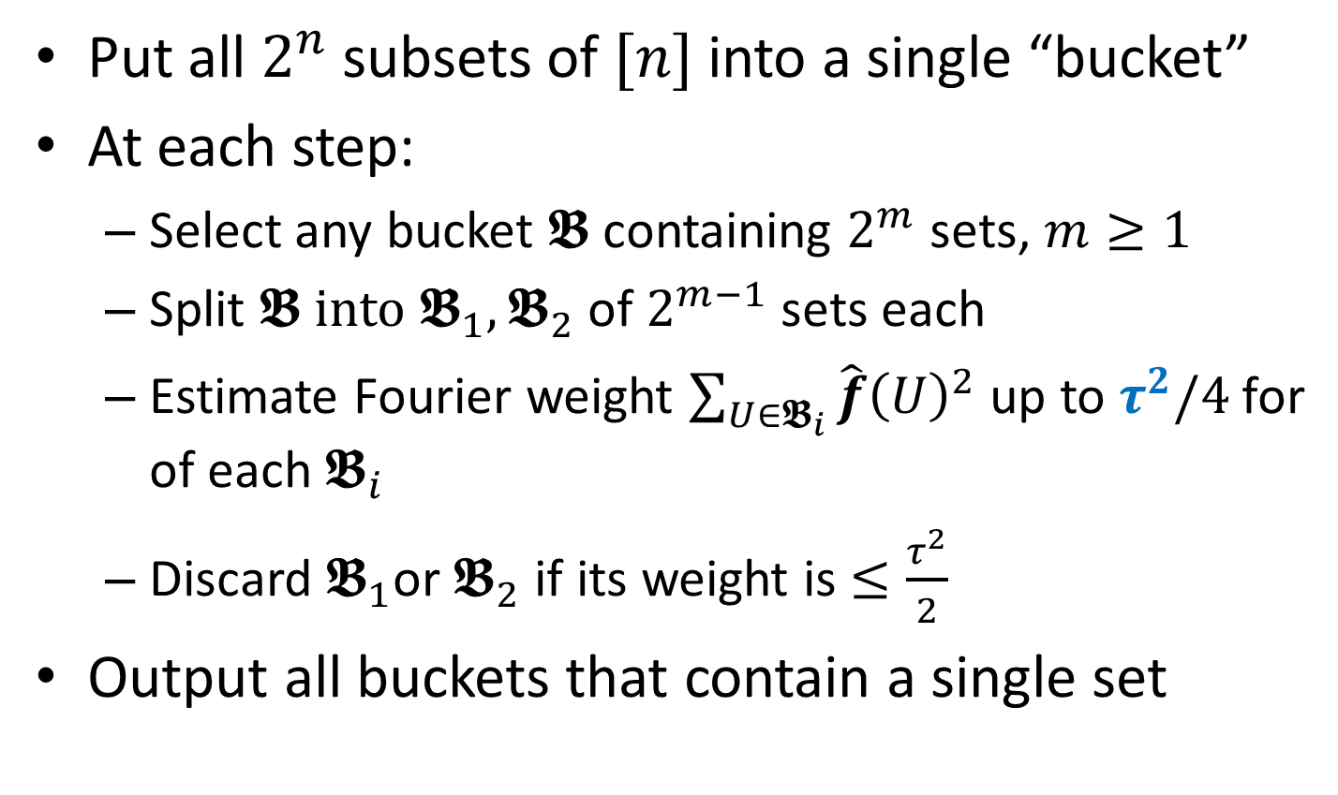
GL/KM-Algorithm
Put all $2^{n}$ subsets of $[n]$ into a single “bucket”
At each step:
Select any bucket 𝕭 containing $2^{m}$ sets, $m≥1$
Split 𝕭 into $𝕭_{1},𝕭_{2}$ of $2^{m−1}$ sets each
Estimate Fourier weight $\sum_{U∈𝕭_{i}}{\hat{f}{\left(U\right)}^{2}}$ up to $τ^{2}/4$for of each $𝕭_{i}$
Discard $𝕭_{1}$or $𝕭_{2}$ if its weight is $≤\frac{τ^{2}}{2}$
Output all buckets that contain a single set

Slide 17
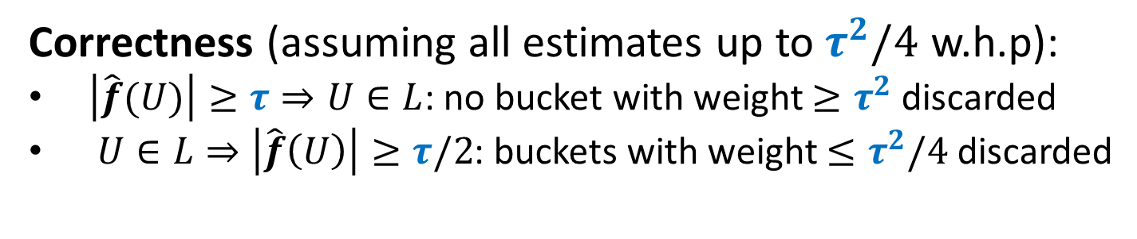
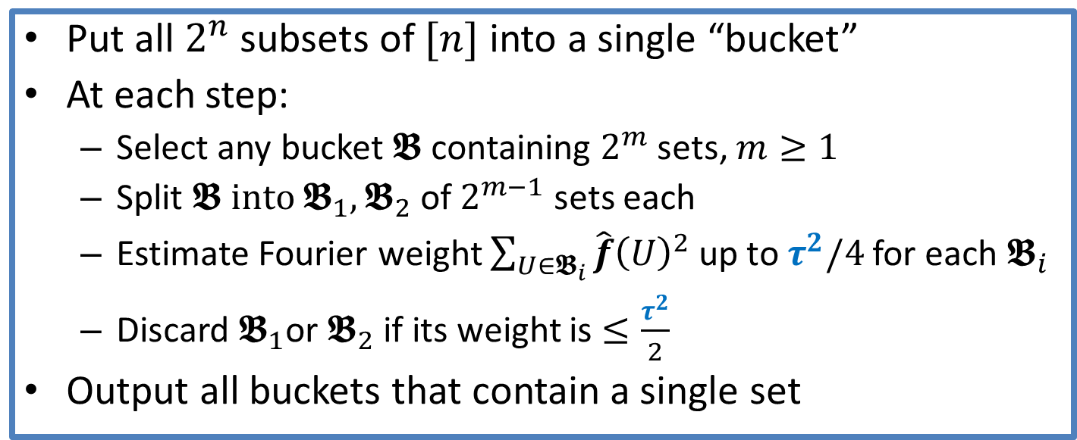
GL/KM-Algorithm: Correctness
Put all $2^{n}$ subsets of $[n]$ into a single “bucket”
At each step:
Select any bucket 𝕭 containing $2^{m}$ sets, $m≥1$
Split 𝕭 into $𝕭_{1},𝕭_{2}$ of $2^{m−1}$ sets each
Estimate Fourier weight $\sum_{U∈𝕭_{i}}{\hat{f}{\left(U\right)}^{2}}$ up to $τ^{2}/4$for each $𝕭_{i}$
Discard $𝕭_{1}$or $𝕭_{2}$ if its weight is $≤\frac{τ^{2}}{2}$
Output all buckets that contain a single set
Correctness (assuming all estimates up to $τ^{2}/4$ w.h.p):
$\left|\hat{f}(U)\right|≥τ⇒U∈L$: no bucket with weight $≥τ^{2}$ discarded
$U∈L⇒\left|\hat{f}\left(U\right)\right|≥τ/2$: buckets with weight $≤τ^{2}/4$ discarded

Slide 18
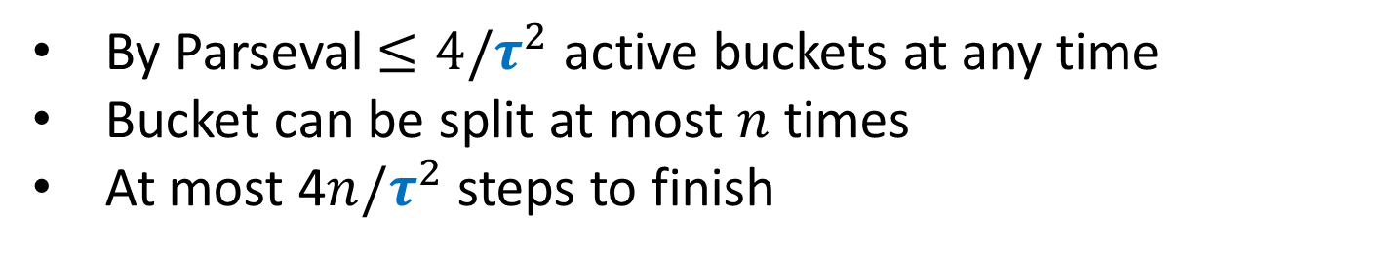
GL/KM-Algorithm: Complexity
Put all $2^{n}$ subsets of $[n]$ into a single “bucket”
At each step:
Select any bucket 𝕭 containing $2^{m}$ sets, $m≥1$
Split 𝕭 into $𝕭_{1},𝕭_{2}$ of $2^{m−1}$ sets each
Estimate Fourier weight $\sum_{U∈𝕭_{i}}{\hat{f}{\left(U\right)}^{2}}$ up to $τ^{2}/4$for each $𝕭_{i}$
Discard $𝕭_{1}$or $𝕭_{2}$ if its weight is $≤\frac{τ^{2}}{2}$
Output all buckets that contain a single set
By Parseval $≤4/τ^{2}$ active buckets at any time
Bucket can be split at most $n$ times
At most 4$n/τ^{2}$ steps to finish

Slide 19
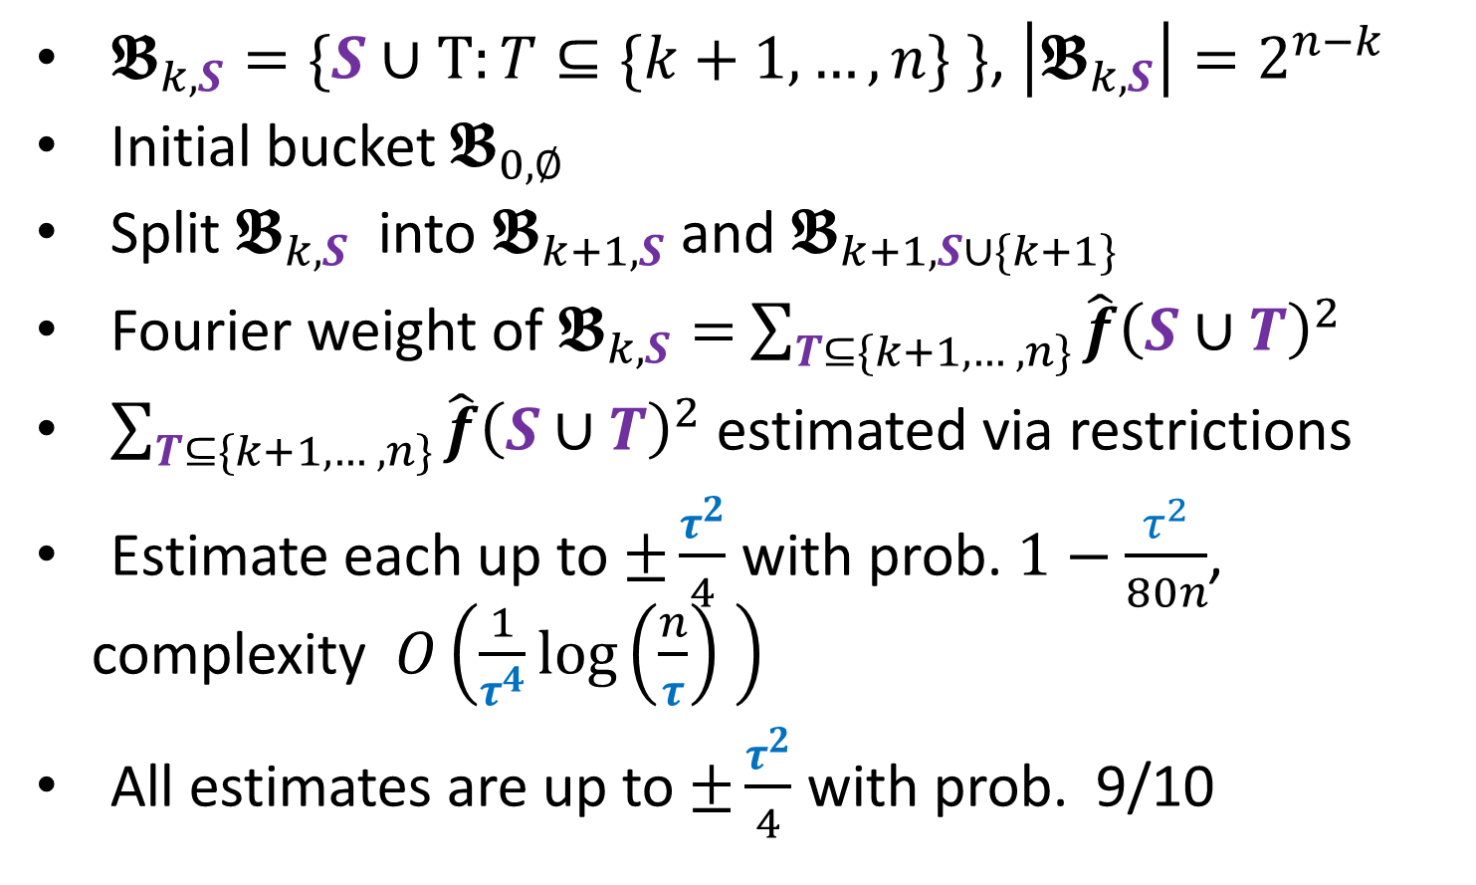
GL/KM-Algorithm: Bucketing
$𝕭_{k,S}=\{S∪T:T⊆\{k+1, …,n\} \}$, $\left|𝕭_{k,S}\right|=2^{n−k}$
Initial bucket $𝕭_{0,∅}$
Split $𝕭_{k,S}$ into $𝕭_{k+1,S}$ and $𝕭_{k+1,S∪\{k+1\}}$
Fourier weight of $𝕭_{k,S}=$ $\sum_{T⊆\{k+1, … ,n\}}{\hat{f}{\left(S∪T\right)}^{2}}$
$\sum_{T⊆\{k+1, … ,n\}}{\hat{f}{\left(S∪T\right)}^{2}}$ estimated via restrictions
Estimate each up to $±\frac{τ^{2}}{4}$ with prob. $1−\frac{τ^{2}}{80n}$, complexity $O\left(\frac{1}{τ^{4}}\log\left(\frac{n}{τ}\right) \right)$
All estimates are up to $±\frac{τ^{2}}{4}$ with prob. 9/10

Slide 20
Thanks!

