Slide 1

CIS 700: “algorithms for Big Data”
Lecture 9:
Compressed Sensing
Slides at http://grigory.us/big-data-class.html
Grigory Yaroslavtsev
http://grigory.us

Slide 2
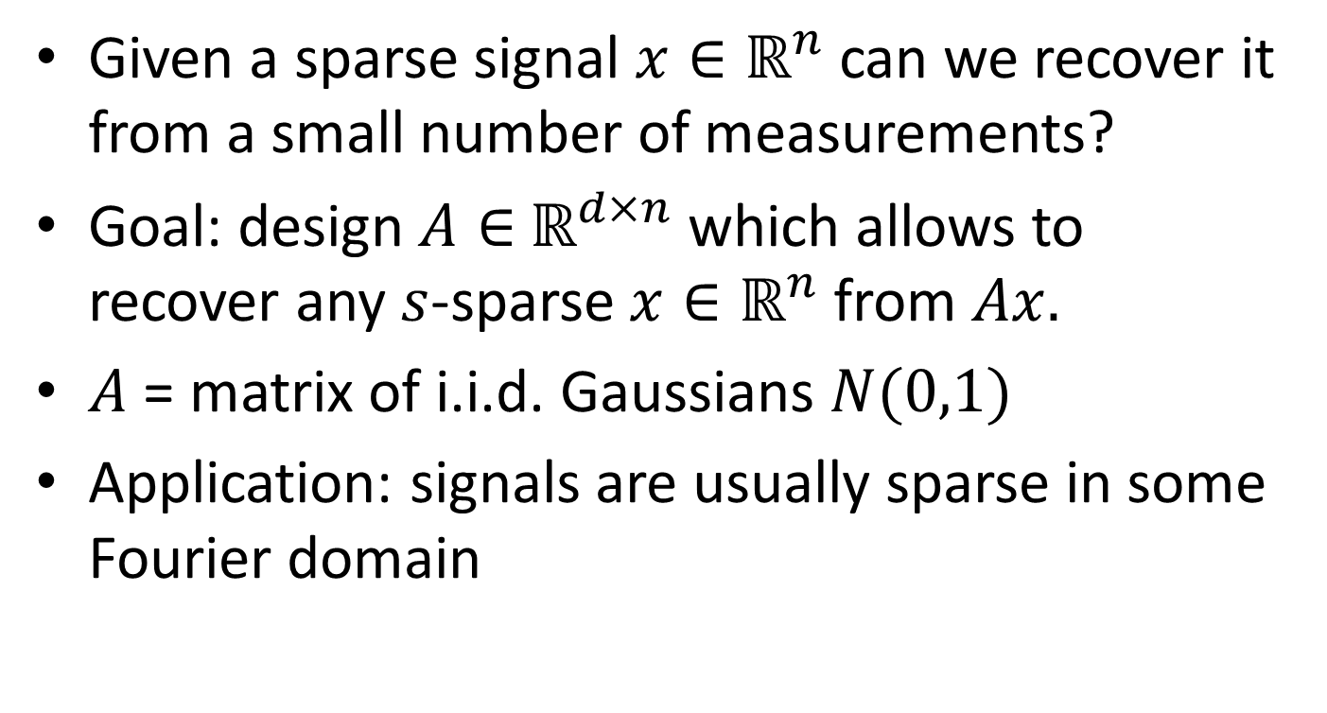
Compressed Sensing
Given a sparse signal $x∈ℝ^{n}$ can we recover it from a small number of measurements?
Goal: design $A∈$ $ℝ^{d×n}$ which allows to recover any $s$-sparse $x∈ℝ^{n}$ from $Ax.$
$A$ = matrix of i.i.d. Gaussians $N(0,1)$
Application: signals are usually sparse in some Fourier domain

Slide 3
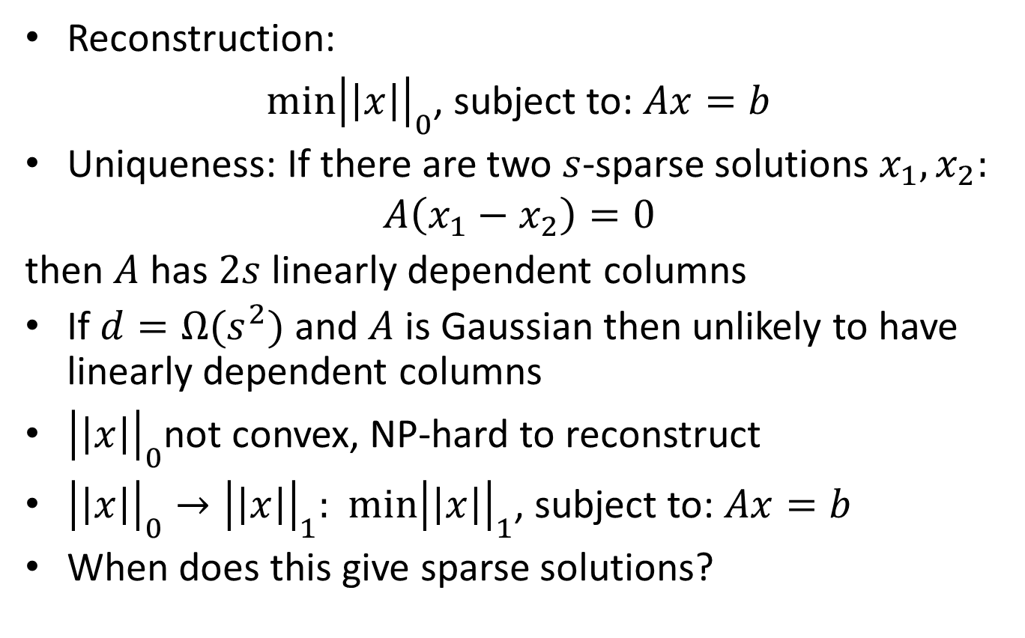
Reconstruction
Reconstruction:
$\min{{\left|\left|x\right|\right|}_{0}}$, subject to: $Ax=b$
Uniqueness: If there are two $s$-sparse solutions $x_{1}, x_{2}:$
$$A\left(x_{1}−x_{2}\right)=0$$
then $A$ has $2s$linearly dependent columns
If $d=Ω(s^{2})$ and $A$ is Gaussian then unlikely to have linearly dependent columns
${\left|\left|x\right|\right|}_{0}$not convex, NP-hard to reconstruct
${\left|\left|x\right|\right|}_{0}→{\left|\left|x\right|\right|}_{1}:$ $\min{{\left|\left|x\right|\right|}_{1}}$, subject to: $Ax=b$
When does this give sparse solutions?

Slide 4
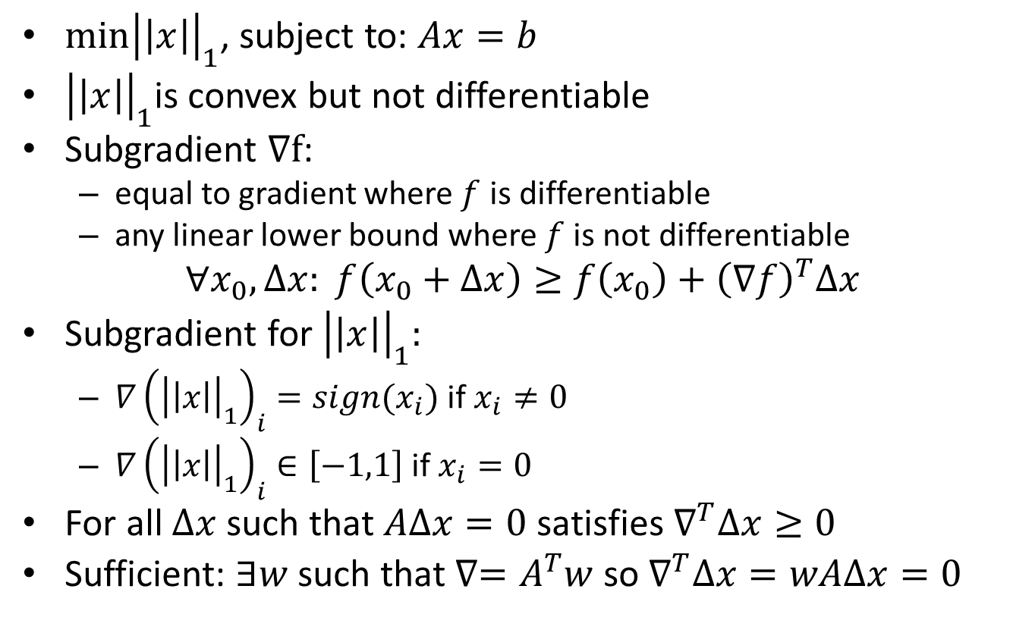
Subgradient
$\min{{\left|\left|x\right|\right|}_{1}}$, subject to: $Ax=b$
${\left|\left|x\right|\right|}_{1}$is convex but not differentiable
Subgradient $∇f$:
equal to gradient where $f$ is differentiable
any linear lower bound where $f$ is not differentiable
$$∀x_{0},Δx: f\left(x_{0}+Δx\right)≥f\left(x_{0}\right)+{\left(∇f\right)}^{T}Δx$$
Subgradient for ${\left|\left|x\right|\right|}_{1}:$
$∇{\left({\left|\left|x\right|\right|}_{1}\right)}_{i}=sign(x_{i})$ if $x_{i}≠0$
$∇{\left({\left|\left|x\right|\right|}_{1}\right)}_{i}∈\left[−1,1\right]$ if $x_{i}=0$
For all $Δx$ such that $AΔx=0$ satisfies $∇^{T}Δx≥0$
Sufficient: $∃w$such that $∇=A^{T}w$ so $∇^{T}Δx={wAΔx=0}^{}$

Slide 5
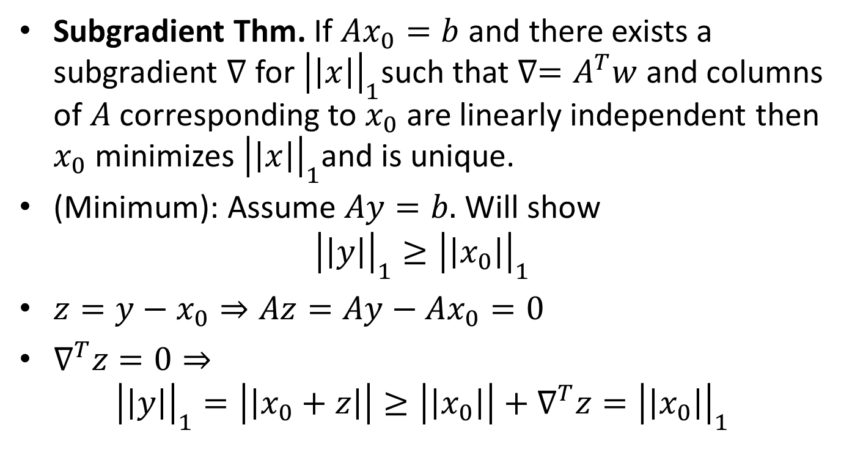
Exact Reconstruction Property
Subgradient Thm. If $Ax_{0}=b$ and there exists a subgradient $∇$ for ${\left|\left|x\right|\right|}_{1}$such that $∇=A^{T}w$ and columns of $A$ corresponding to $x_{0}$ are linearly independent then $x_{0}$ minimizes ${\left|\left|x\right|\right|}_{1}$and is unique.
(Minimum): Assume $Ay=b.$ Will show
$${\left|\left|y\right|\right|}_{1}≥{\left|\left|x_{0}\right|\right|}_{1}$$
$z=y−x_{0}⇒Az=Ay−Ax_{0}=0$
$∇^{T}z=0⇒$
$${\left|\left|y\right|\right|}_{1}=\left|\left|x_{0}+z\right|\right|≥\left|\left|x_{0}\right|\right|+∇^{T}z={\left|\left|x_{0}\right|\right|}_{1}$$

Slide 6
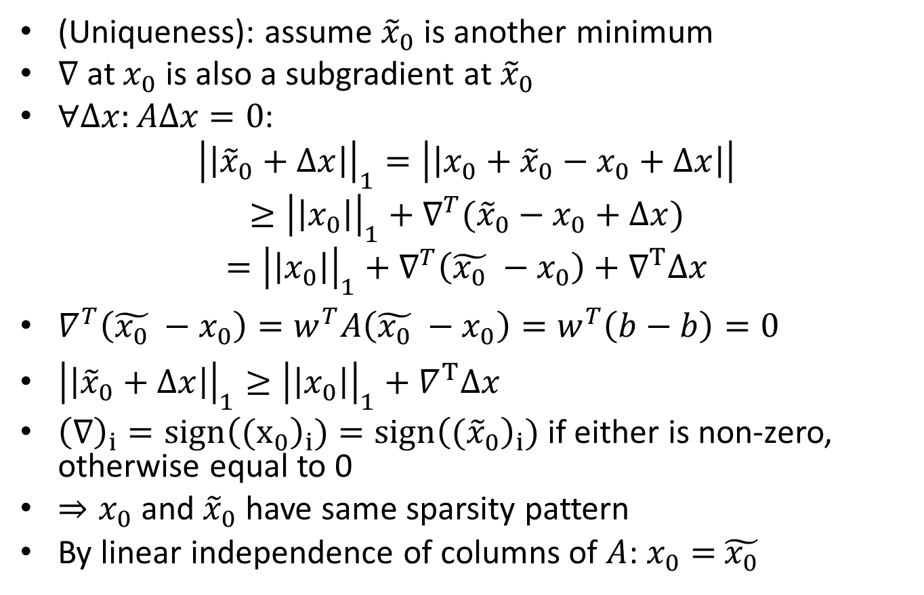
Exact Reconstruction Property
(Uniqueness): assume ${\tilde{x}}_{0}$ is another minimum
$∇$ at $x_{0}$ is also a subgradient at ${\tilde{x}}_{0}$
$∀Δx:AΔx=0$:
$${\left|\left|{\tilde{x}}_{0}+Δx\right|\right|}_{1}=\left|\left|x_{0}+{\tilde{x}}_{0}−x_{0}+Δx\right|\right|$$
$$≥{\left|\left|x_{0}\right|\right|}_{1}+∇^{T}({\tilde{x}}_{0}−x_{0}+Δx)$$
$$={\left|\left|x_{0}\right|\right|}_{1}+∇^{T}\left(\tilde{x_{0}} −x_{0}\right)+∇^{T}Δx$$
$∇^{T}\left(\tilde{x_{0}} −x_{0}\right)=w^{T}A\left(\tilde{x_{0}} −x_{0}\right)=w^{T}\left(b−b\right)=0$
${\left|\left|{\tilde{x}}_{0}+Δx\right|\right|}_{1}≥{\left|\left|x_{0}\right|\right|}_{1}+∇^{T}Δx$
${\left(∇\right)}_{i}=sign{\left({(x}_{0}\right)}_{i})=sign{\left({(\tilde{x}}_{0}\right)}_{i})$ if either is non-zero, otherwise equal to 0
$⇒x_{0}$ and ${\tilde{x}}_{0}$ have same sparsity pattern
By linear independence of columns of $A$: $x_{0}=$ ${\tilde{x_{0}}}_{}$

Slide 7
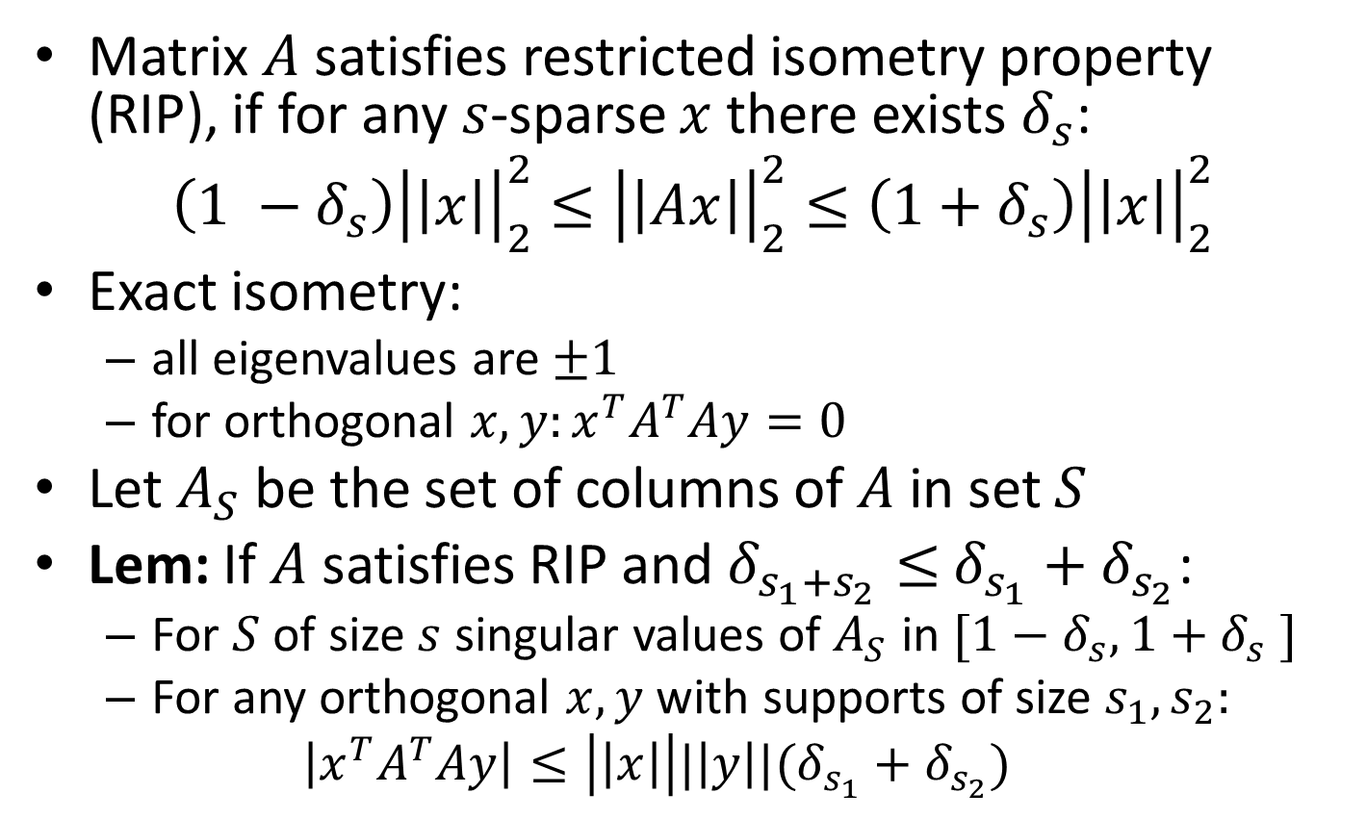
Restricted Isometry Property
Matrix $A$ satisfies restricted isometry property (RIP), if for any $s$-sparse $x$ there exists $δ_{s}$:
$$\left(1 −δ_{s}\right){\left|\left|x\right|\right|}_{2}^{2}≤{\left|\left|Ax\right|\right|}_{2}^{2}≤\left(1+δ_{s}\right){\left|\left|x\right|\right|}_{2}^{2}$$
Exact isometry:
all eigenvalues are $±1$
for orthogonal $x,y:x^{T}A^{T}Ay=0$
Let $A_{S}$ be the set of columns of $A$ in set $S$
Lem: If $A$ satisfies RIP and $δ_{s_{1}+s_{2}}≤$ $δ_{s_{1}}+δ_{s_{2}}$:
For $S$ of size $s$ singular values of $A_{S}$ in $[1−δ_{s},1+δ_{s} ]$
For any orthogonal $x,y$ with supports of size $s_{1},s_{2}:$
$$\left|x^{T}A^{T}Ay\right|≤\left|\left|x\right|\right||\left|y\right||(δ_{s_{1}}+δ_{s_{2}})$$

Slide 8
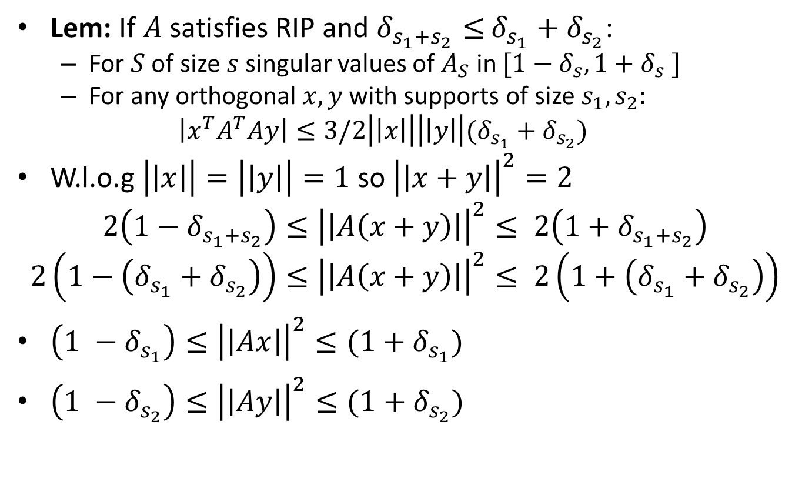
Restricted Isometry Property
Lem: If $A$ satisfies RIP and $δ_{s_{1}+s_{2}}≤$ $δ_{s_{1}}+δ_{s_{2}}$:
For $S$ of size $s$ singular values of $A_{S}$ in $[1−δ_{s},1+δ_{s} ]$
For any orthogonal $x,y$ with supports of size $s_{1},s_{2}:$
$$\left|x^{T}A^{T}Ay\right|≤3/2\left|\left|x\right|\right|\left|\left|y\right|\right|(δ_{s_{1}}+δ_{s_{2}})$$
W.l.o.g $\left|\left|x\right|\right|=\left|\left|y\right|\right|=1$ so ${\left|\left|x+y\right|\right|}^{2}=2$
$$2\left(1−δ_{s_{1}+s_{2}}\right)≤{\left|\left|A\left(x+y\right)\right|\right|}^{2}≤ 2\left(1+δ_{s_{1}+s_{2}}\right)$$
$$2\left(1−\left(δ_{s_{1}}+δ_{s_{2}}\right)\right)≤{\left|\left|A\left(x+y\right)\right|\right|}^{2}≤ 2\left(1+\left(δ_{s_{1}}+δ_{s_{2}}\right)\right)$$
$\left(1 −δ_{s_{1}}\right)≤{\left|\left|Ax\right|\right|}^{2}≤(1+δ_{s_{1}})$
$\left(1 −δ_{s_{2}}\right)≤{\left|\left|Ay\right|\right|}^{2}≤(1+δ_{s_{2}})$

Slide 9
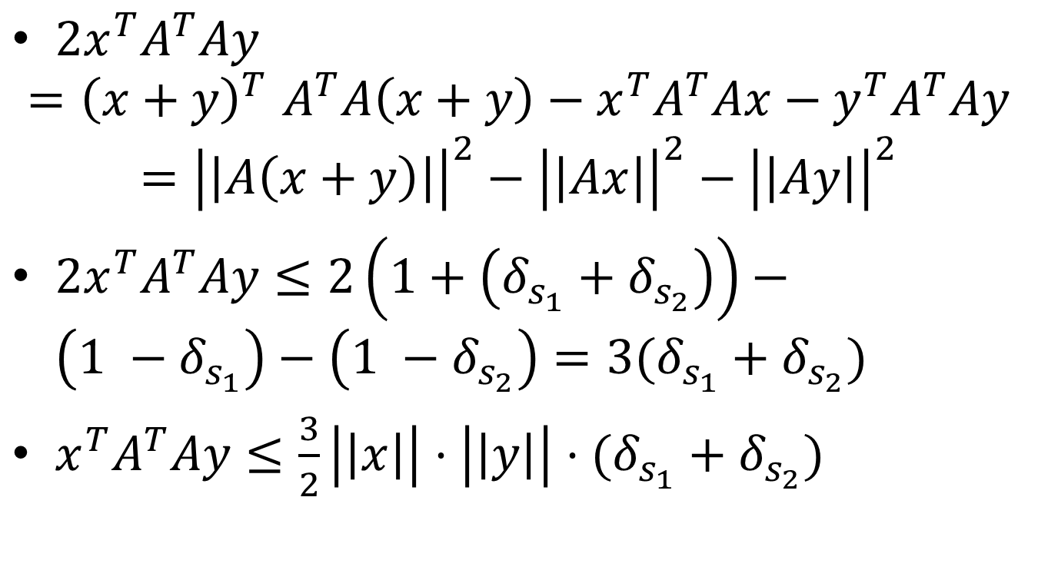
Restricted Isometry Property
$2x^{T}A^{T}Ay$
$${=\left(x+y\right)}^{T}A^{T}A\left(x+y\right)−x^{T}A^{T}Ax−y^{T}A^{T}Ay$$
$$={\left|\left|A\left(x+y\right)\right|\right|}^{2}−{\left|\left|Ax\right|\right|}^{2}−{\left|\left|Ay\right|\right|}^{2}$$
$2x^{T}A^{T}Ay≤2\left(1+\left(δ_{s_{1}}+δ_{s_{2}}\right)\right)−$ $\left(1 −δ_{s_{1}}\right)−\left(1 −δ_{s_{2}}\right)=3(δ_{s_{1}}+δ_{s_{2}})$
$x^{T}A^{T}Ay≤\frac{3}{2}\left|\left|x\right|\right|⋅\left|\left|y\right|\right|⋅(δ_{s_{1}}+δ_{s_{2}})$

Slide 10
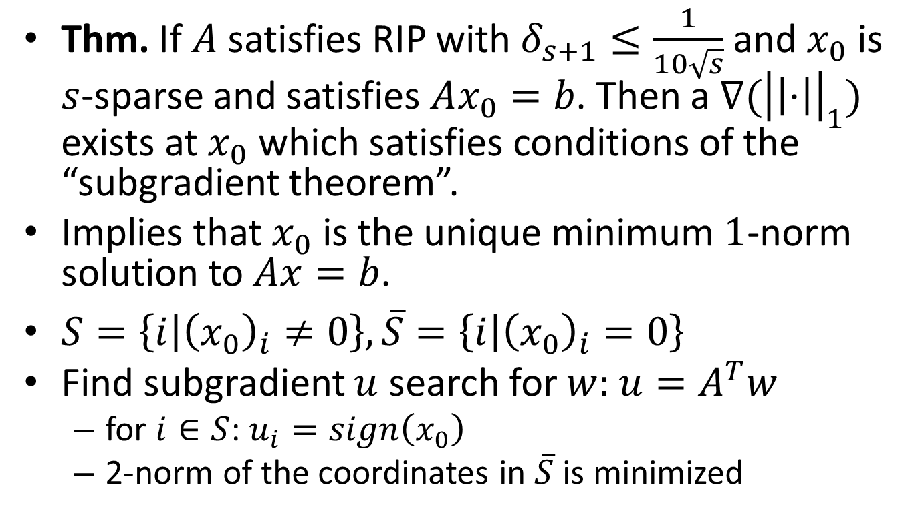
Reconstruction from RIP
Thm. If $A$ satisfies RIP with $δ_{s+1}≤\frac{1}{10\sqrt{s}}$ and $x_{0}$ is $s$-sparse and satisfies $Ax_{0}=b$. Then a $∇({\left|\left|⋅\right|\right|}_{1})$ exists at $x_{0}$ which satisfies conditions of the “subgradient theorem”.
Implies that $x_{0}$ is the unique minimum $1$-norm solution to $Ax=b$.
$S=\left\{i | {\left(x_{0}\right)}_{i}≠0\right\},\overline{S}=\left\{i | {\left(x_{0}\right)}_{i}=0\right\}$
Find subgradient $u$ search for $w:$ $u=A^{T}w$
for $i∈S$: $u_{i}=sign\left(x_{0}\right)$
2-norm of the coordinates in $\overline{S}$ is minimized

Slide 11
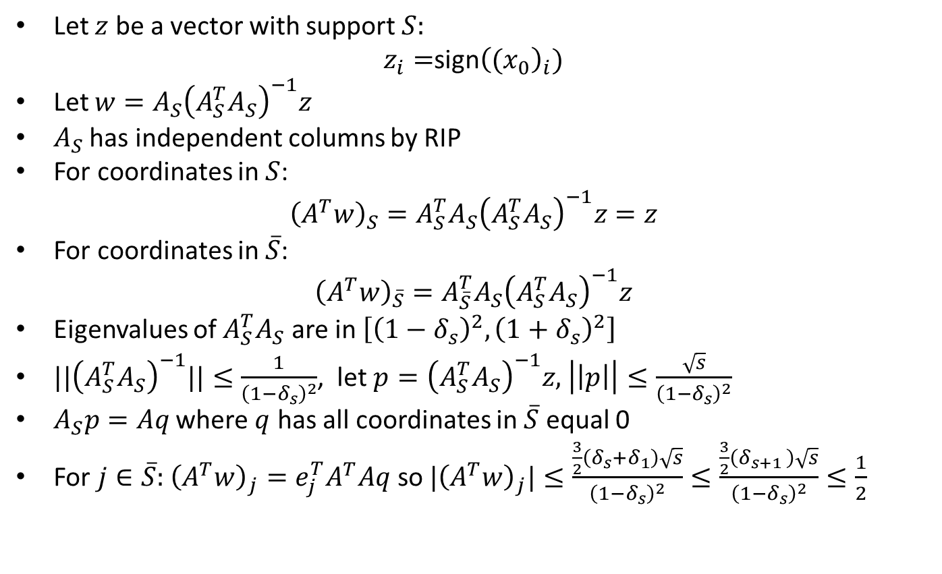
Reconstruction from RIP
Let $z$ be a vector with support $S:$
$z_{i}=$sign${\left({(x}_{0}\right)}_{i})$
Let $w=A_{S}{\left(A_{S}^{T}A_{S}\right)}^{−1}z$
$A_{S}$ has independent columns by RIP
For coordinates in $S$:
$${\left(A^{T}w\right)}_{S}=A_{S}^{T}A_{S}{\left(A_{S}^{T}A_{S}\right)}^{−1}z=z$$
For coordinates in $\overline{S}$:
$${\left(A^{T}w\right)}_{\overline{S}}=A_{\overline{S}}^{T}A_{S}{\left(A_{S}^{T}A_{S}\right)}^{−1}z$$
Eigenvalues of $A_{S}^{T}A_{S}$ are in $\left[{\left(1−δ_{s}\right)}^{2},{\left(1+δ_{s}\right)}^{2}\right]$
${||\left(A_{S}^{T}A_{S}\right)}^{−1}||≤\frac{1}{{\left(1−δ_{s}\right)}^{2}}$, let $p={\left(A_{S}^{T}A_{S}\right)}^{−1}z,$ $\left|\left|p\right|\right|≤\frac{\sqrt{s}}{{\left(1−δ_{s}\right)}^{2}}$
$A_{S}p=Aq$ where $q$ has all coordinates in $\overline{S}$ equal 0
For $j∈\overline{S}:$ ${\left(A^{T}w\right)}_{j}=e_{j}^{T}A^{T}Aq$ so ${|\left(A^{T}w\right)}_{j}|≤\frac{\frac{3}{2}\left(δ_{s}+δ_{1}\right)\sqrt{s}}{{\left(1−δ_{s}\right)}^{2}}≤\frac{\frac{3}{2}\left(δ_{s+1 }\right)\sqrt{s}}{{\left(1−δ_{s}\right)}^{2}}≤\frac{1}{2}$

